Slide 1
Line Fitting
Line fitting is key to investigating experimental data and calibrating instruments for analysis
Common assessment of how well a line ‘fits’ is the R² value – 1 is perfect, 0 is no correlation

Slide 2
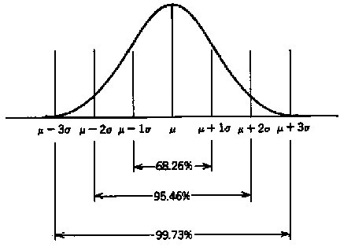
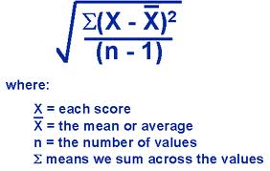
Data Quality
“Error” – how well do we know any number? What would replicate measurements tell us?
Standard Deviation, σ
Notes:
Standard error is the way to estimate standard deviation – not to get into it too much, but they are the same of the estimator is unbiased…. The diagram above is the standard error of the mean…

Slide 3
Error Accumulation
Any step of an analysis contains potential ‘error’:
Diluting a sample for analysis has error – type B volumetric flask for example is 250ml ± 0.25 ml for example (1 σ)
Weighing a salt to make a standard also has “error” 1.245 g ± 0.001 for example
Addition of error:

Slide 4
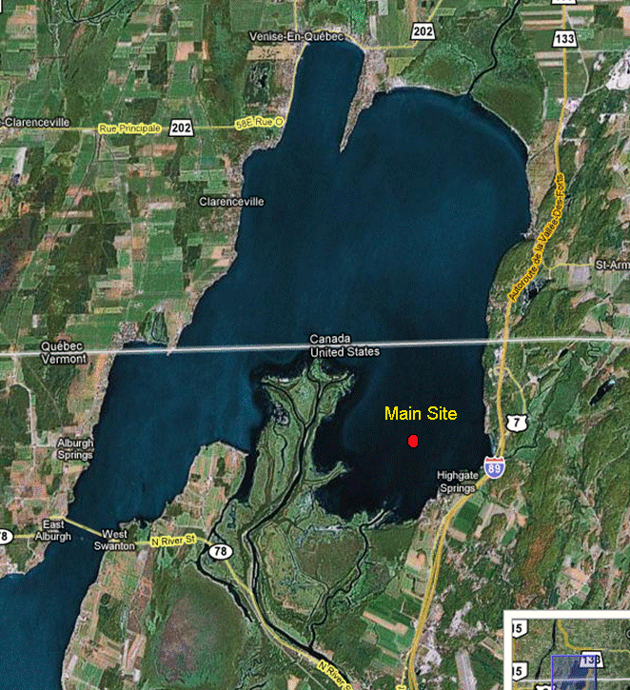
Where does “error” come from?

Slide 5
Units review
Mole = 6.02214x10²³ ‘units’ make up 1 mole, 1 mole of H+= 6.02214x10²³ H⁺ ions, 10 mol FeOOH = 6.02214x10²⁴ moles Fe, 6.02214x10²⁴ moles O, 6.02214x10²⁴ moles OH. A mole of something is related to it’s mass by the gram formula weight → Molecular weight of S = 32.04 g, so 32.04 grams S has 6.02214x10²³ S atoms.
Molarity = moles / liter solution
Molality = moles / kg solvent
ppm = 1 part in 1,000,000 (10⁶) parts by mass or volume
Conversion of these units is a critical skill!!

Slide 6
Let’s practice!
10 mg/l K+ = ____ μM K
16 μg/l Fe = ____ μM Fe
10 μg/l PO₄³⁻ = _____ μM P
50 μm H₂S = _____ μg/l H₂S
270 mg/l CaCO₃ = _____ M Ca²⁺
FeS₂ + 2H⁺ → Fe²⁺ + H₂S
75 μM H₂S = ____ mg/l FeS₂
GFW of Na₂S*9H₂O = _____ g/mol
how do I make a 100ml solution of 5 mM Na₂S??

Slide 7
Scientific Notation
4.517E-06 = 4.517x10⁻⁶ = 0.000004517
Another way to represent this: take the log = 10^{-5.345}
M | k |  | d | c | m | μ | n | p
1E+6 | 1000 | 1 | 0.1 | 0.01 | 1E-3 | 1E-6 | 1E-9 | 1E-12

Slide 8
Significant Figures
Precision vs. Accuracy
Significant figures – number of digits believed to be precise → LAST digit is always assumed to be an estimate
Using numbers from 2 sources of differing precision → must use lowest # of digits
  Mass = 2.05546 g, volume= 100.0 ml = 0.2055 g/l

Slide 9
Logarithm review
10³ = 1000
ln = 2.303 log x
pH = -log [H⁺] → 0.015 M H+ is what pH?
Antilogarithms: 10^{x} or e^{x} (anti-natural log)
pH = -log [H⁺] → how much H⁺ for pH 2?

Slide 10
Logarithmic transforms
Log xy = log x + log y
Log x/y = log x – log y
Log x^{y} = y log x
Log x^{1/y} = (1/y) log x
ln transforms are the same

Slide 11
Review of calculus principles
Process (function) y driving changes in x: y=y(x), the derivative of this is dy/dx (or y’(x)), is the slope of y with x
By definition, if y changes an infinitesimally small amount, x will essentially not change: dy/dk=
This derivative describes how the function y(x) changes in response to a variable, at any very small change in points it is analogous to the tangent to the curve at a point – measures rate of change of a function
Notes:
Graphical example – draw a curve with 2 variables – taking 2 points in x-y (x0,y0 and x1,y1) that are VERY close describe the slpoe

Slide 12
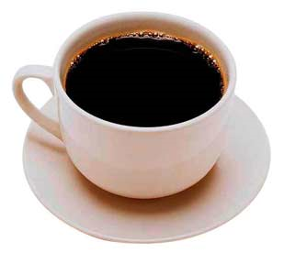
Differential
Is a deterministic (quantitative) relation between the rate of change (derivative) and a function that may be continually changing
In a simplified version of heat transfer, think about heat (q) flowing from the coffee to the cup – bigger T difference means faster transfer, when the two become equal, the reaction stops
Notes:
Heat exchange → q, heat, moves as a function of the material’s conductivity (k) and the temperature gradient. As heat is transferred to the vessel, the gradient is less and the heat transfer is less → Until the heat transfer slows to a point where the rate of change is zero (EQUILIBRIUM!! Yeah!!!)

Slide 13
Partial differentials
Most models are a little more complex, reflecting the fact that functions (processes) are often controlled by more than 1 variable
How fast Fe²⁺ oxidizes to Fe³⁺ is a process that is affected by temperature, pH, how much O₂ is around, and how much Fe²⁺ is present at any one time
what does this function look like, how do we figure it out???

Slide 14
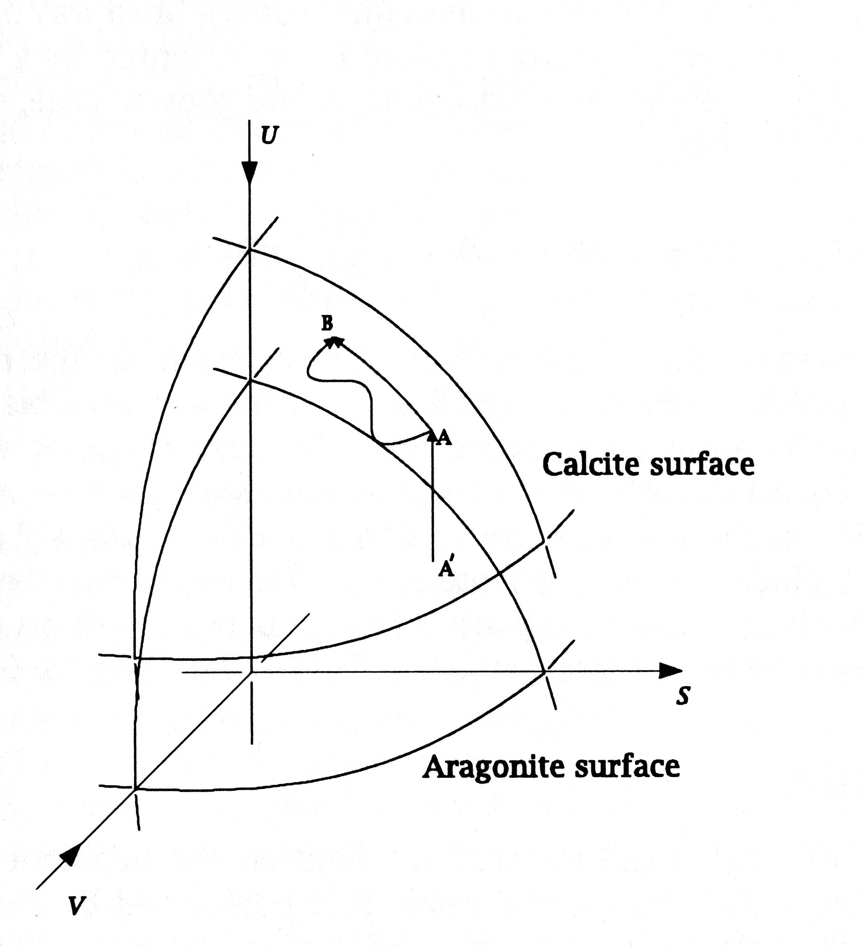
Total differential, dy, describing changes in y affected by changes in all variables (more than one, none held constant)
Notes:
Partial differential at any one point (the derivative) would be a plane tangent to the curved surface…

Slide 15
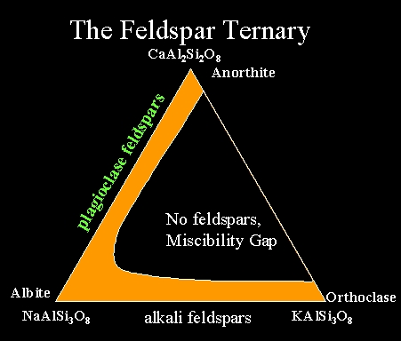
‘Pictures’ of variable changes
2 variables that affect a process: 2-axis x-y plot
3 variables that affect a process: 3 axis ternary plot (when only 2 variables are independent; know 2, automatically have #3)
monalbite
anorthoclase
1100
Temperature (ºC)
high albite
900
sanidine
intermediate albite
700
orthoclase
500
microcline
low albite
Miscibility Gap
300
10
30
50
70
90
Orthoclase
KAlSi₃O₈
% NaAlSi₃O₈
Albite
NaAlSi₃O₈

