Slide 1
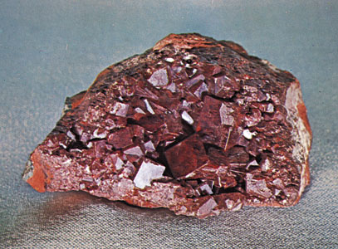
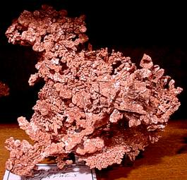
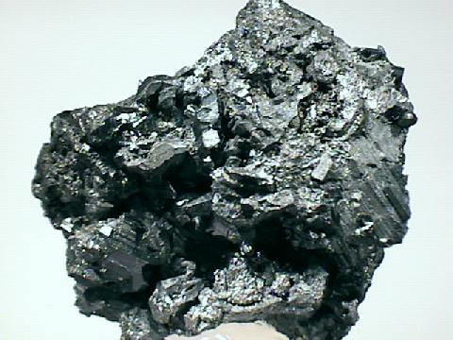
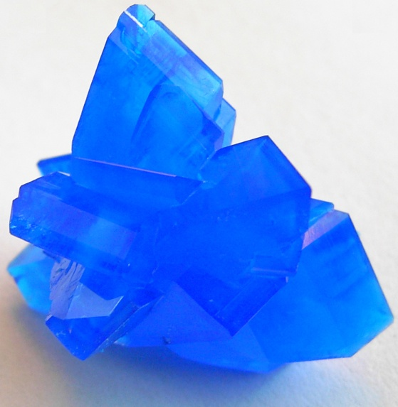
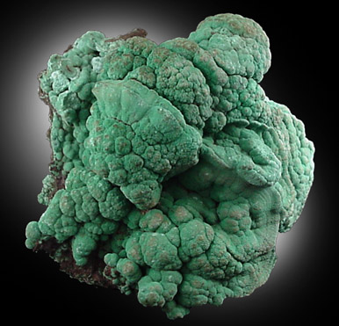
Minerals associated with economically recoverable metals
Elemental forms
Sulfides
Oxides
Carbonates
Sulfate salt
Cuprite, Cu₂O
Elemental copper
Chalcocite, Cu₂S
Chalcanthite, CuSO₄*5H₂O
Malachite, Cu₂CO₃(OH)₂

Slide 2
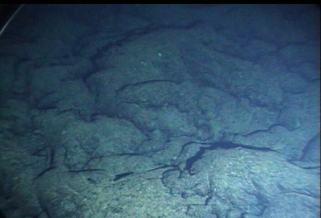

Slide 3
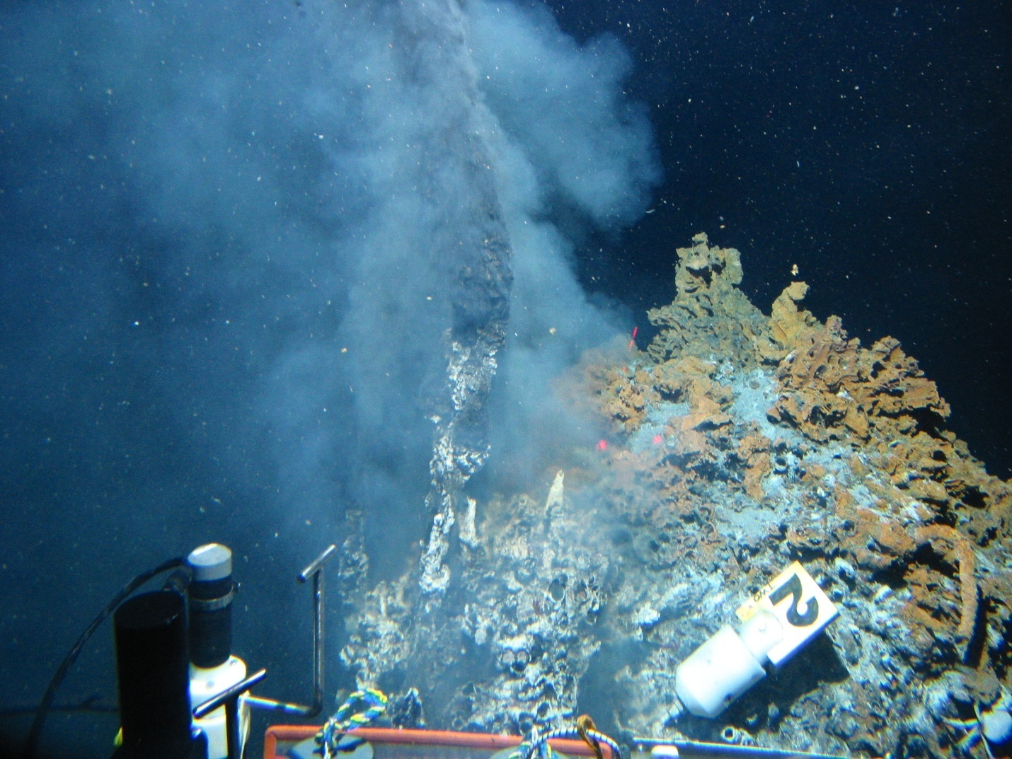
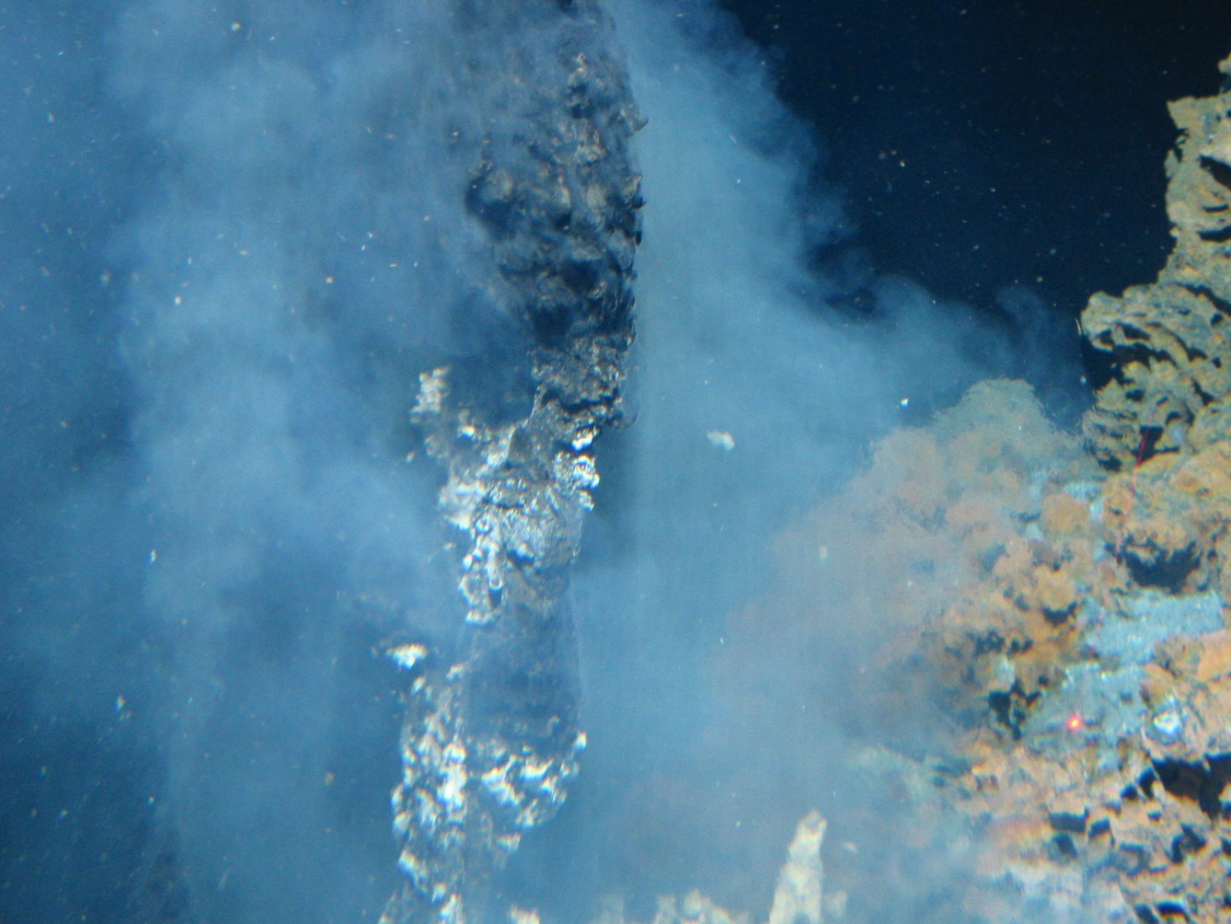

Slide 4
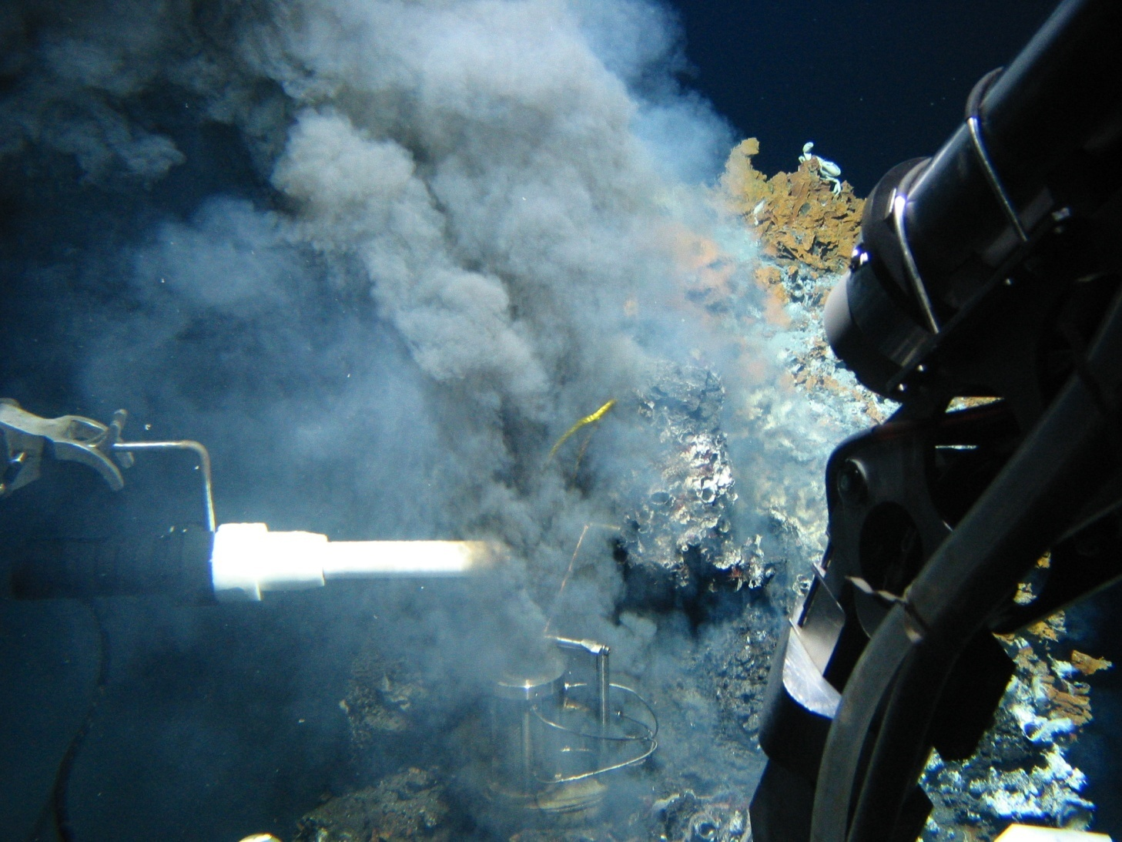
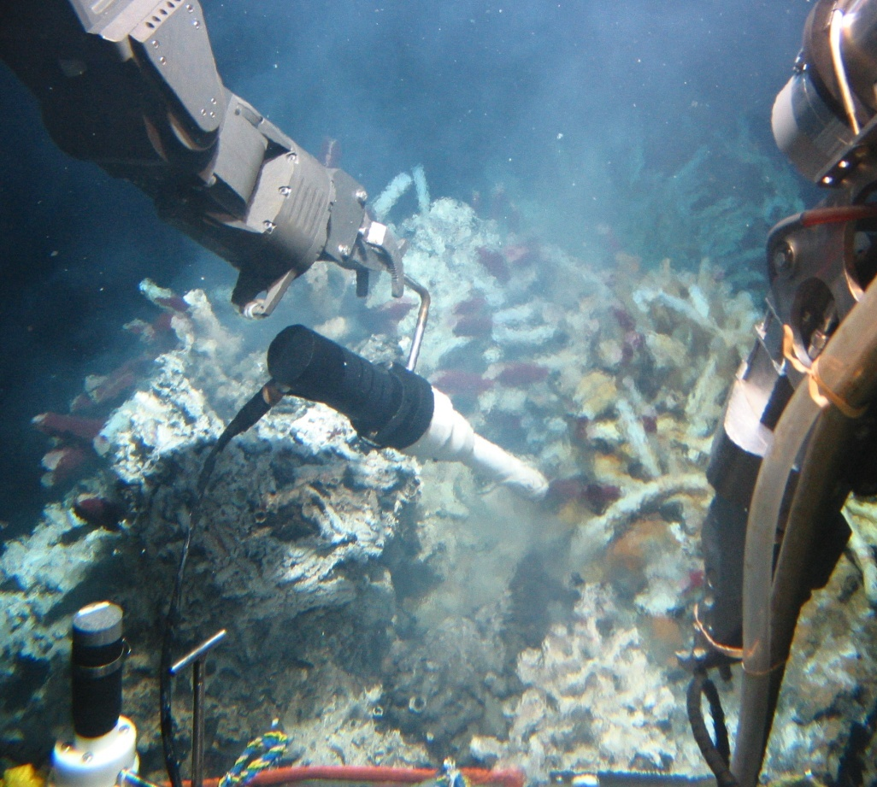
Wand, nicknamed ‘Fat Albert’ contains 2 electrodes and a thermistor

Slide 5
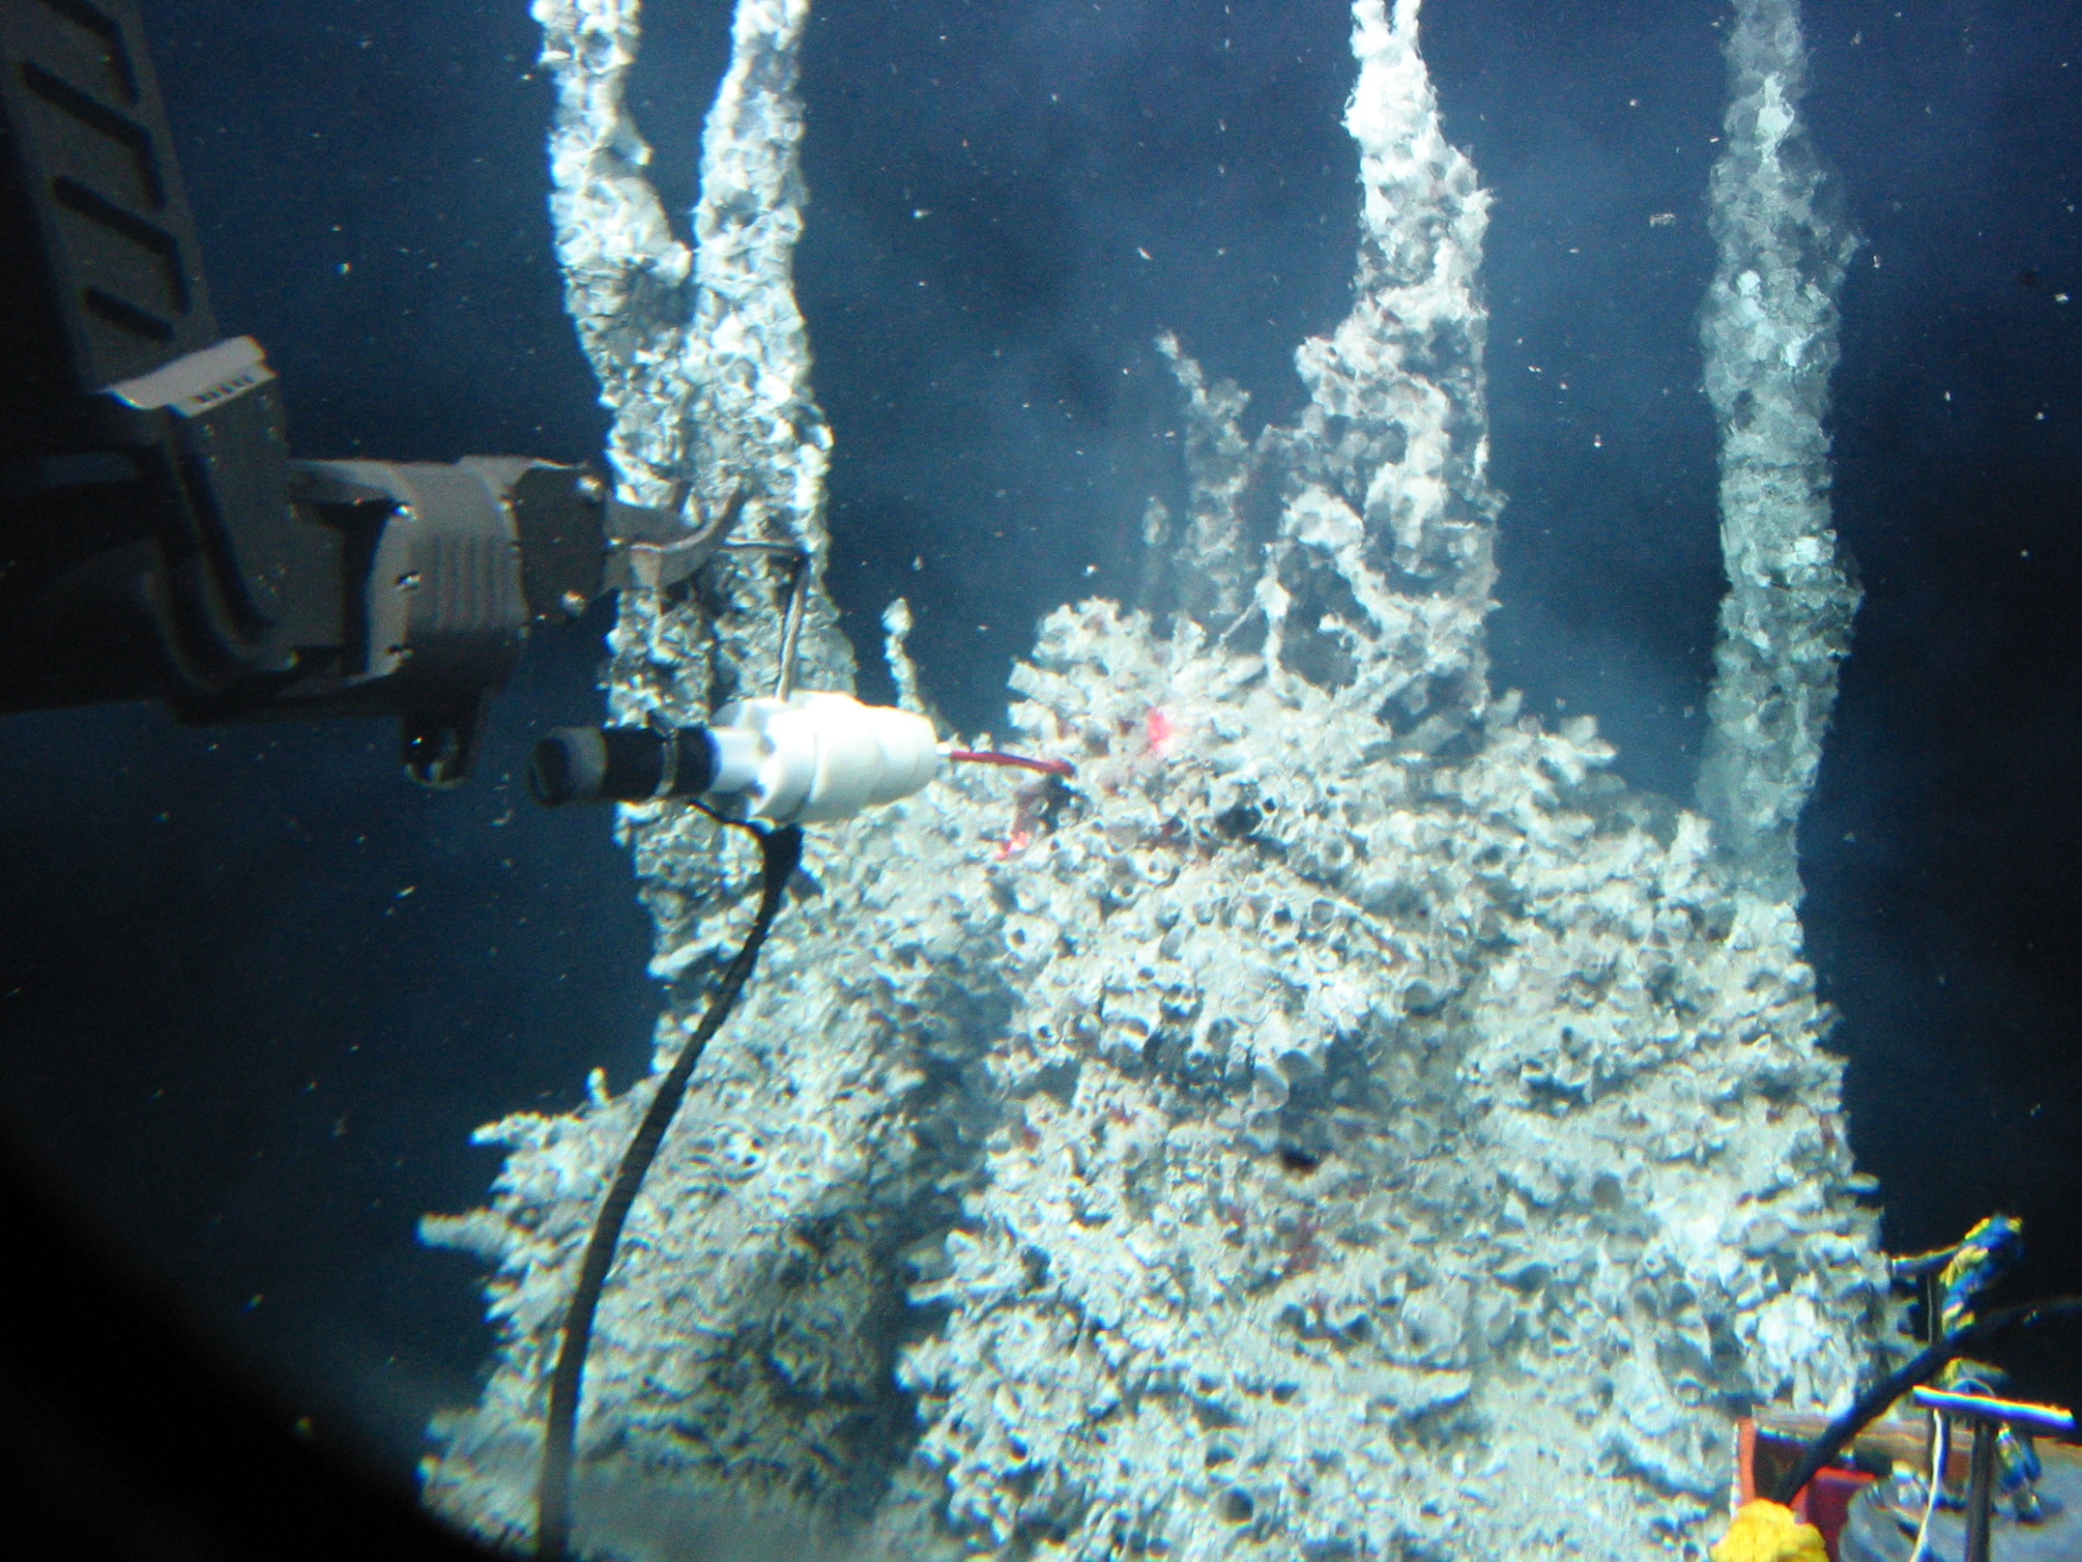

Slide 6
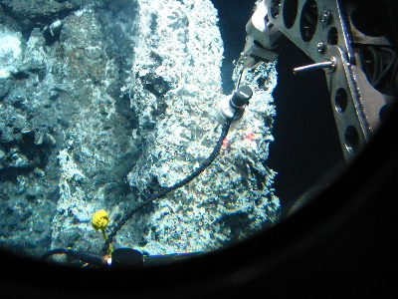
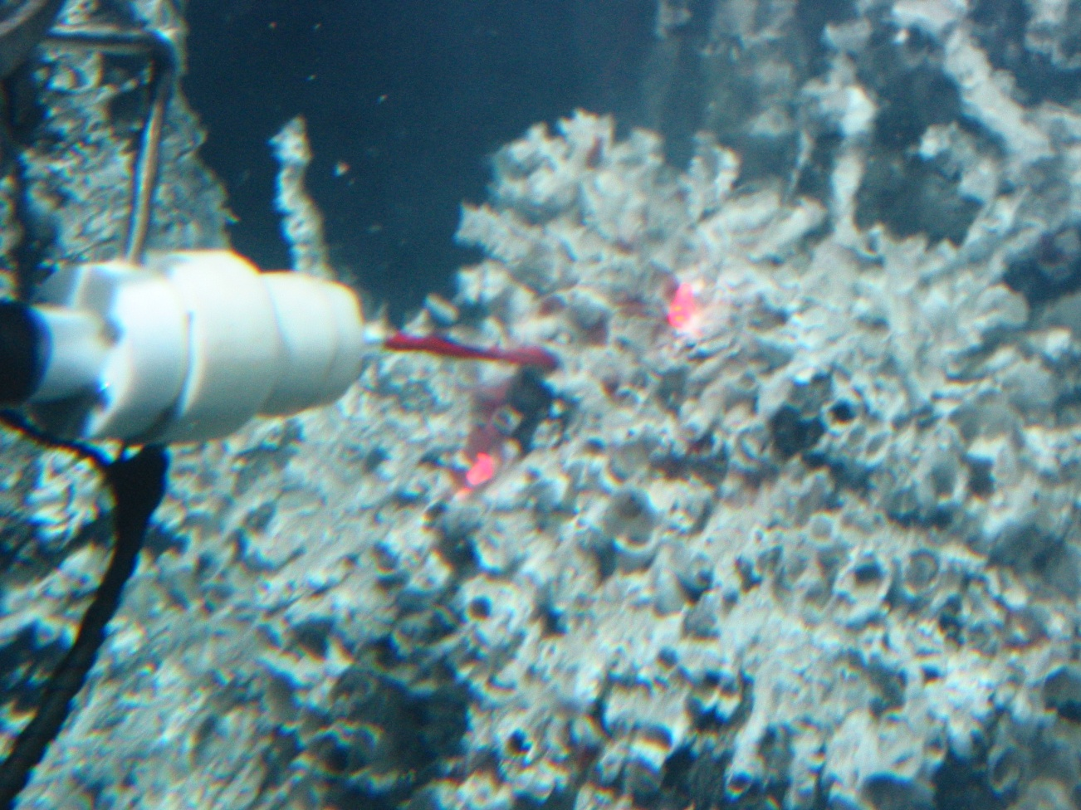

Slide 7
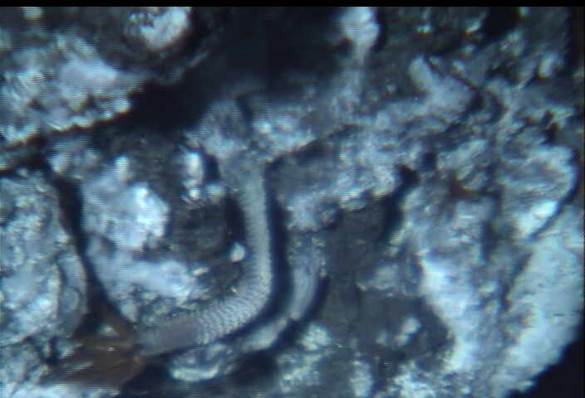

Slide 8
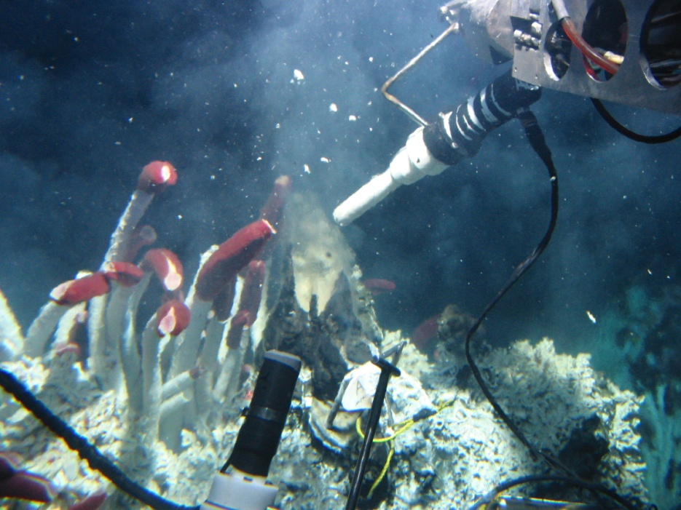
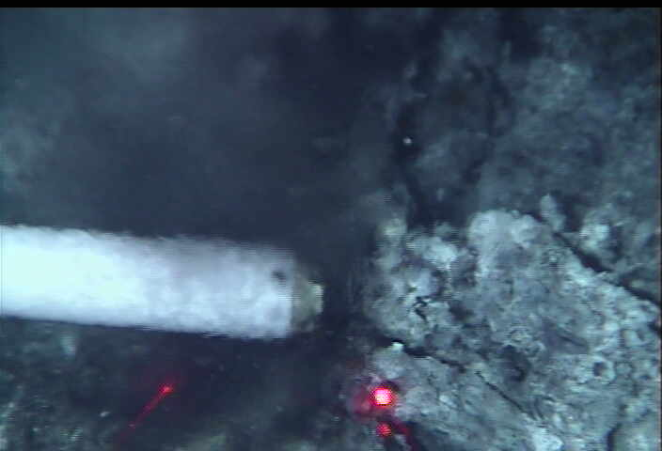
Voltammetry at 7,500 ft depth
Riftia field chemistry – Scans up to 20º C → little/no Fe²⁺, FeS_{(aq)}, few mM HS⁻,
Black Smoker chemistry – Scans up to 220º C → lots of Fe²⁺, HS⁻, FeS_{(aq)}, tens to hundreds of millimolar Fe and S

Slide 9
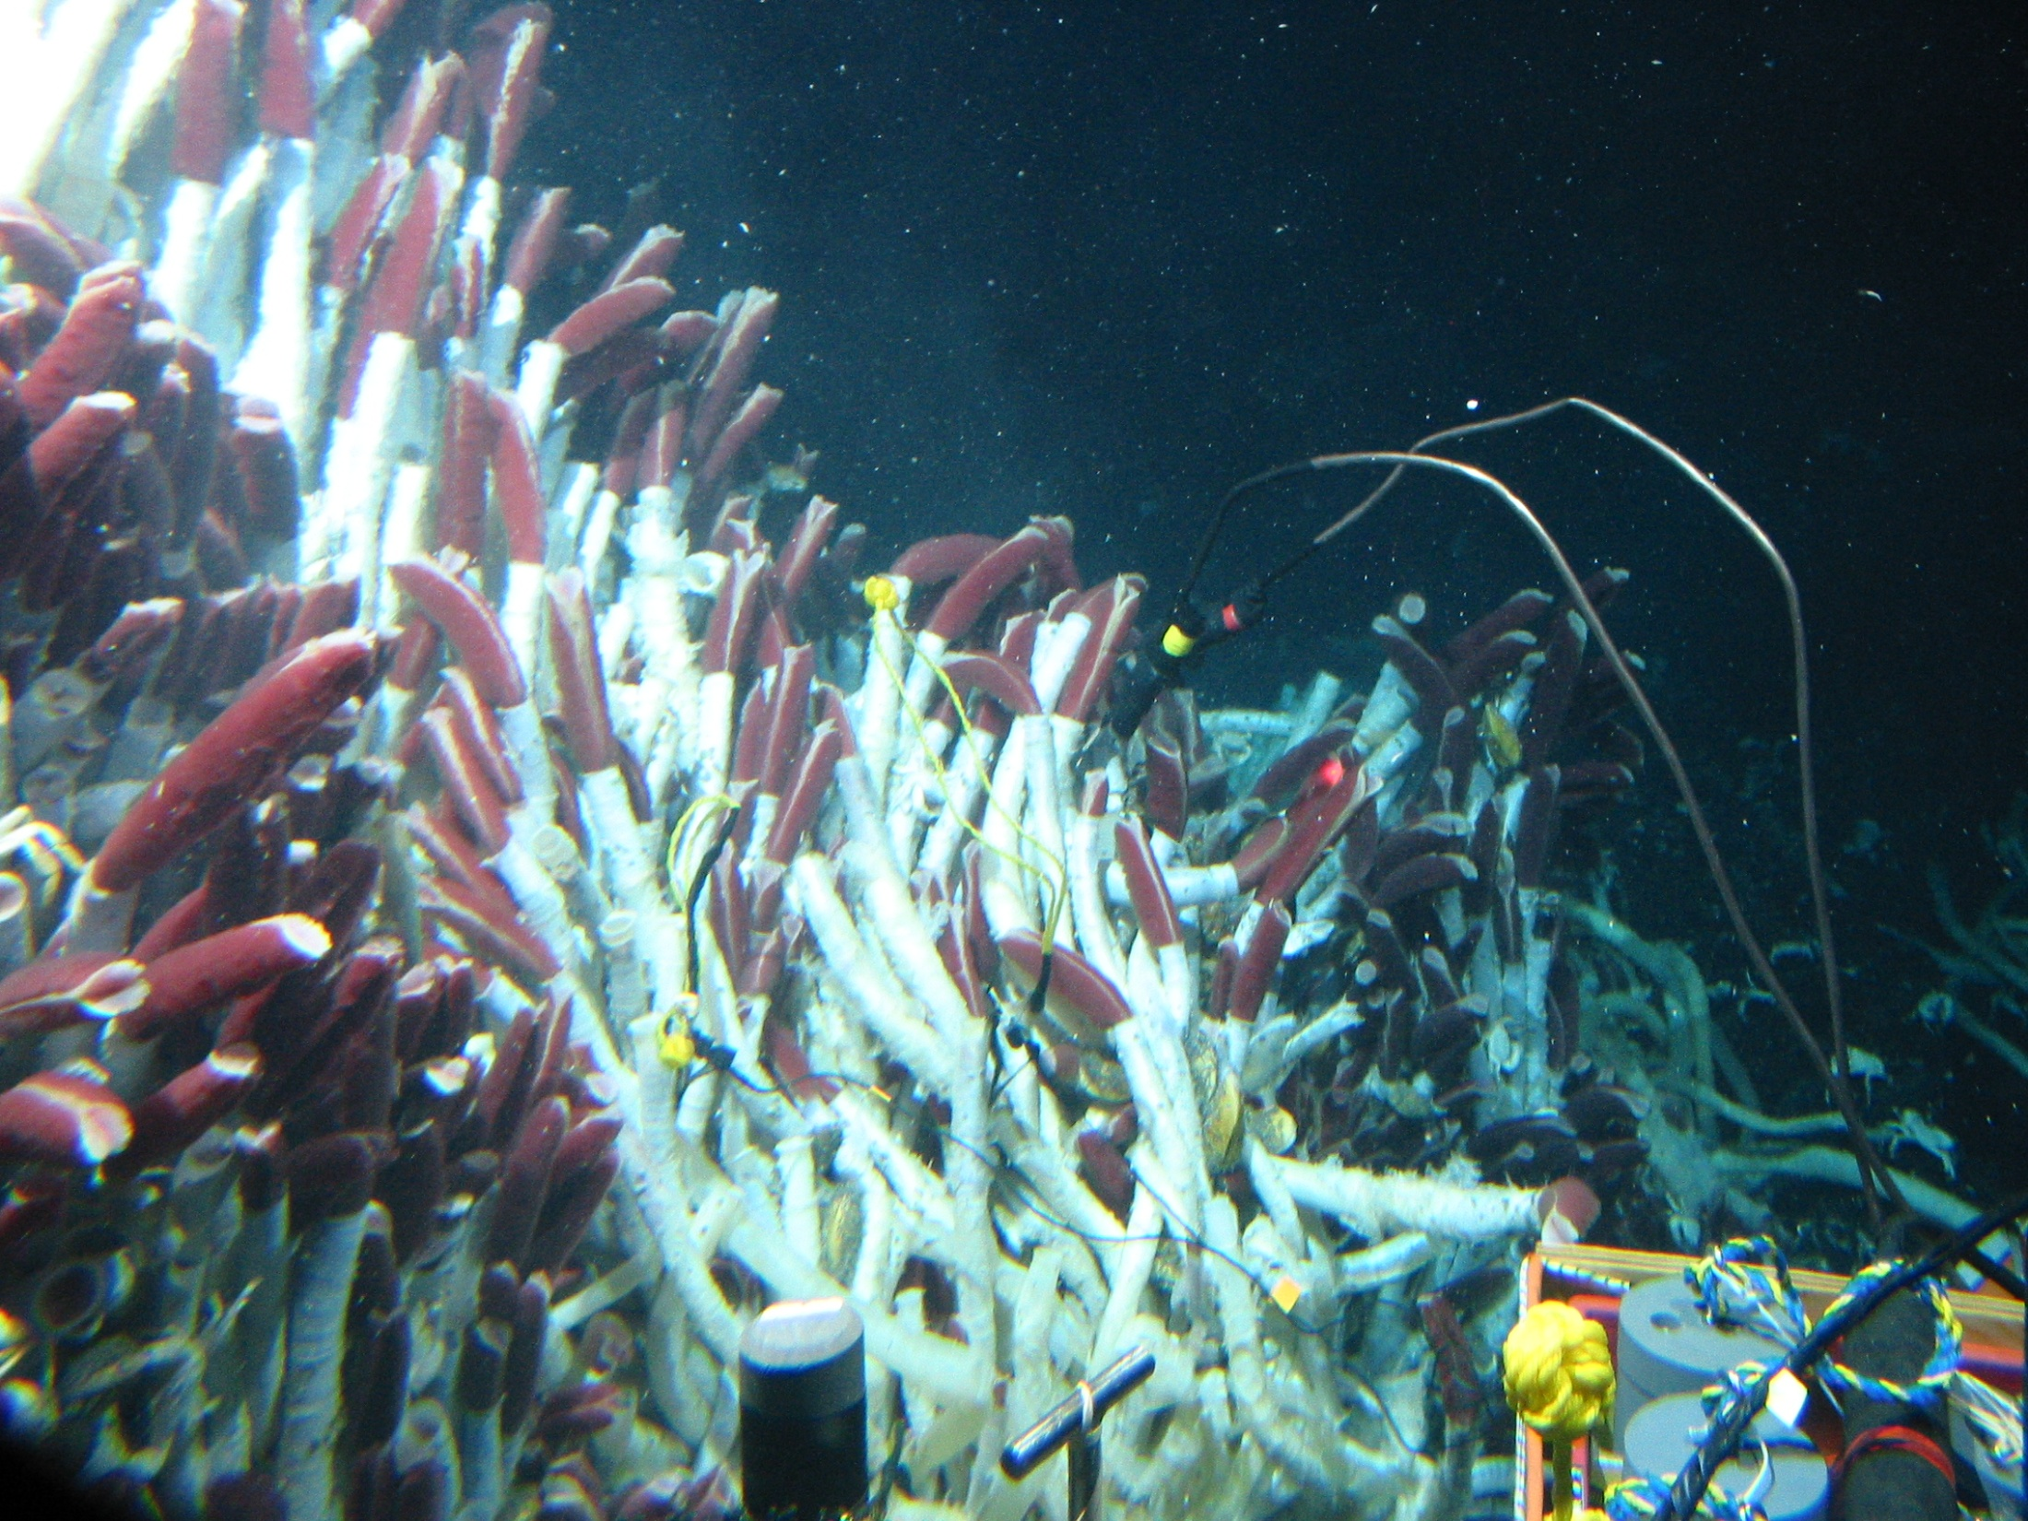

Slide 10
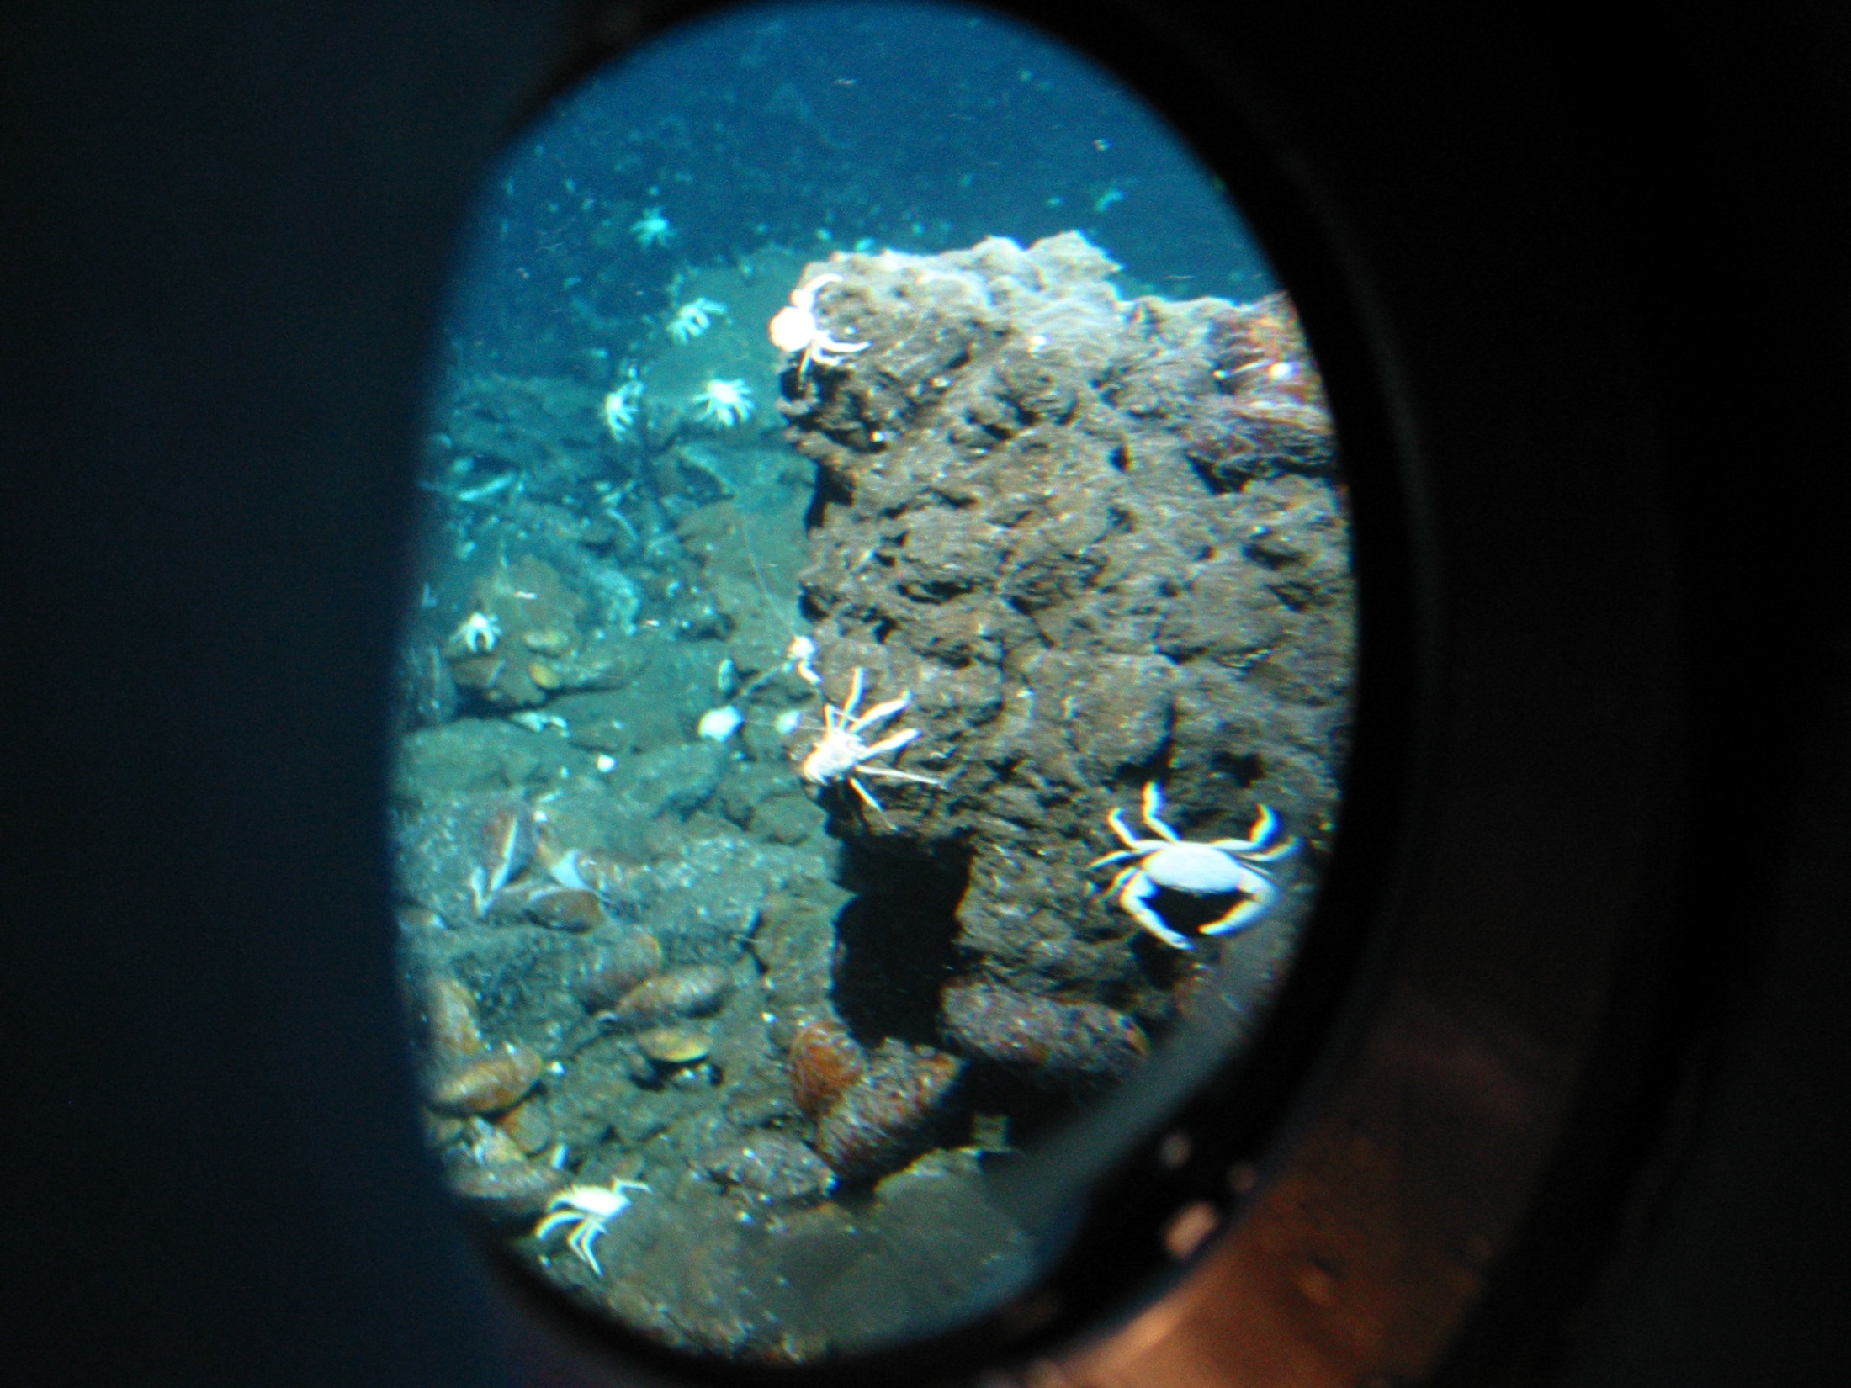

Slide 11
Sulfides Part 1
Substitution into sulfides is very common
As and Se substitute for S very easily
Au can substitute in cation sites (auriferrous minerals)
Different metals swap in and out pretty easily → Cu and Fe for instance have a wide range of solid solution materials

Slide 12
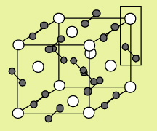
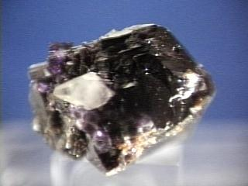
Sulfide Minerals
Minerals with S⁻ or S²⁻ (monosulfides) or S₂²⁻ (disulfides) as anionic group
Transition metals bonded with sulfide anion groups

Slide 13
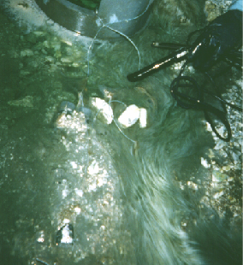
Iron Sulfides
Mackinawite – FeS
Greigite – Fe_{x}S_{y}
Pyrite – FeS₂ (cubic)
Marcasite – FeS₂ (orthorhombic)
Troilite – FeS end member
Pyrrhotite – Fe_{1-x}S (slightly deficient in iron)
Arsenopyrite – FeAsS
Chalcopyrite – CuFeS₂

Slide 14
Other important sulfides
Galena – PbS
Sphalerite/wurtzite – ZnS
Cinnabar – HgS
Molybdenite – MoS
Covellite – CuS
Chalcocite – Cu₂S
Acanthite or Argenite – AgS
Stibnite – Sb₂S₃
Orpiment – As₂S₃ ; Realgar – AsS

Slide 15
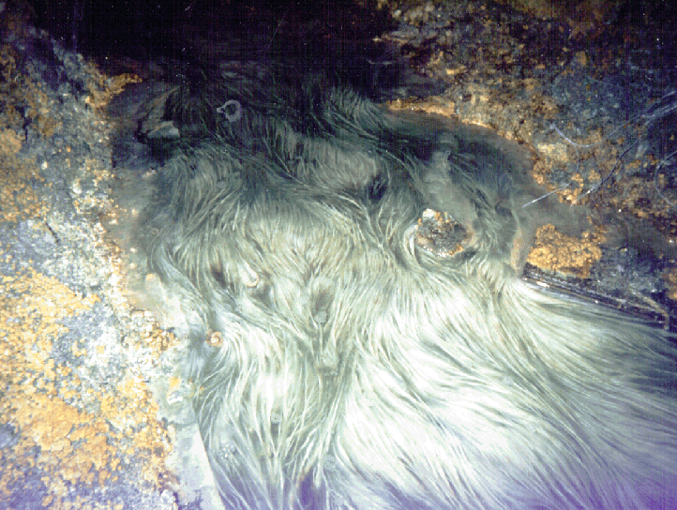
Sulfides are reduced minerals → what happens when they contact O₂?
This is the basis for supergene enrichment and acidic mine drainage

Slide 16
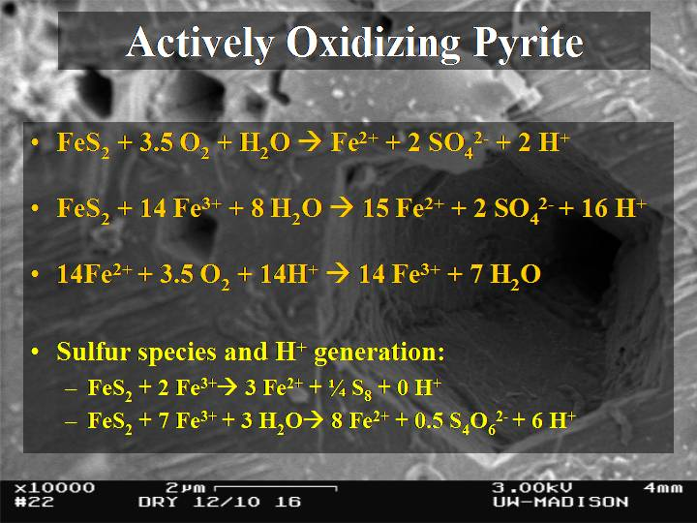
Actively Oxidizing Pyrite
FeS₂ + 3.5 O₂ + H₂O → Fe²⁺ + 2 SO₄²⁻ + 2 H⁺
FeS₂ + 14 Fe³⁺ + 8 H₂O → 15 Fe²⁺ + 2 SO₄²⁻ + 16 H⁺
14Fe²⁺ + 3.5 O₂ + 14H⁺ → 14 Fe³⁺ + 7 H₂O
Sulfur species and H⁺ generation:
  FeS₂ + 2 Fe³⁺à 3 Fe²⁺ + ¼ S₈ + 0 H⁺
  FeS₂ + 7 Fe³⁺ + 3 H₂Oà 8 Fe²⁺ + 0.5 S₄O₆²⁻ + 6 H⁺
Notes:
Iron Mountain effluent so acidic due to pyrite oxidation
See actively oxidizing pyrite (point out SEM in background) and Fe2+ microbes all over…
General reaction of pyrite oxidation, with O2 as TEAP is:
The oxidation of pyrite with Fe3+ is faster, making re-oxidation of Fe2+ rate limiting, and the basis for the original idea that microbes must be very important in these environments
Why are we concerned with intermediate S-species? If an intermediate achieves a significant steady-state concentration, that may affect the local pH significantly

Slide 17
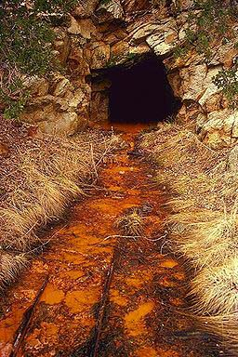
AMD neutralization
Metals are soluble in low pH solutions – can get 100’s of grams of metal into a liter of very acidic solution
HOWEVER – eventually that solution will get neutralized (reaction with other rocks, CO₂ in the atmosphere, etc.) and the metals are not so soluble → but oxidized S (sulfate, SO₄²⁻) is very soluble
A different kind of mineral is formed!

Slide 18
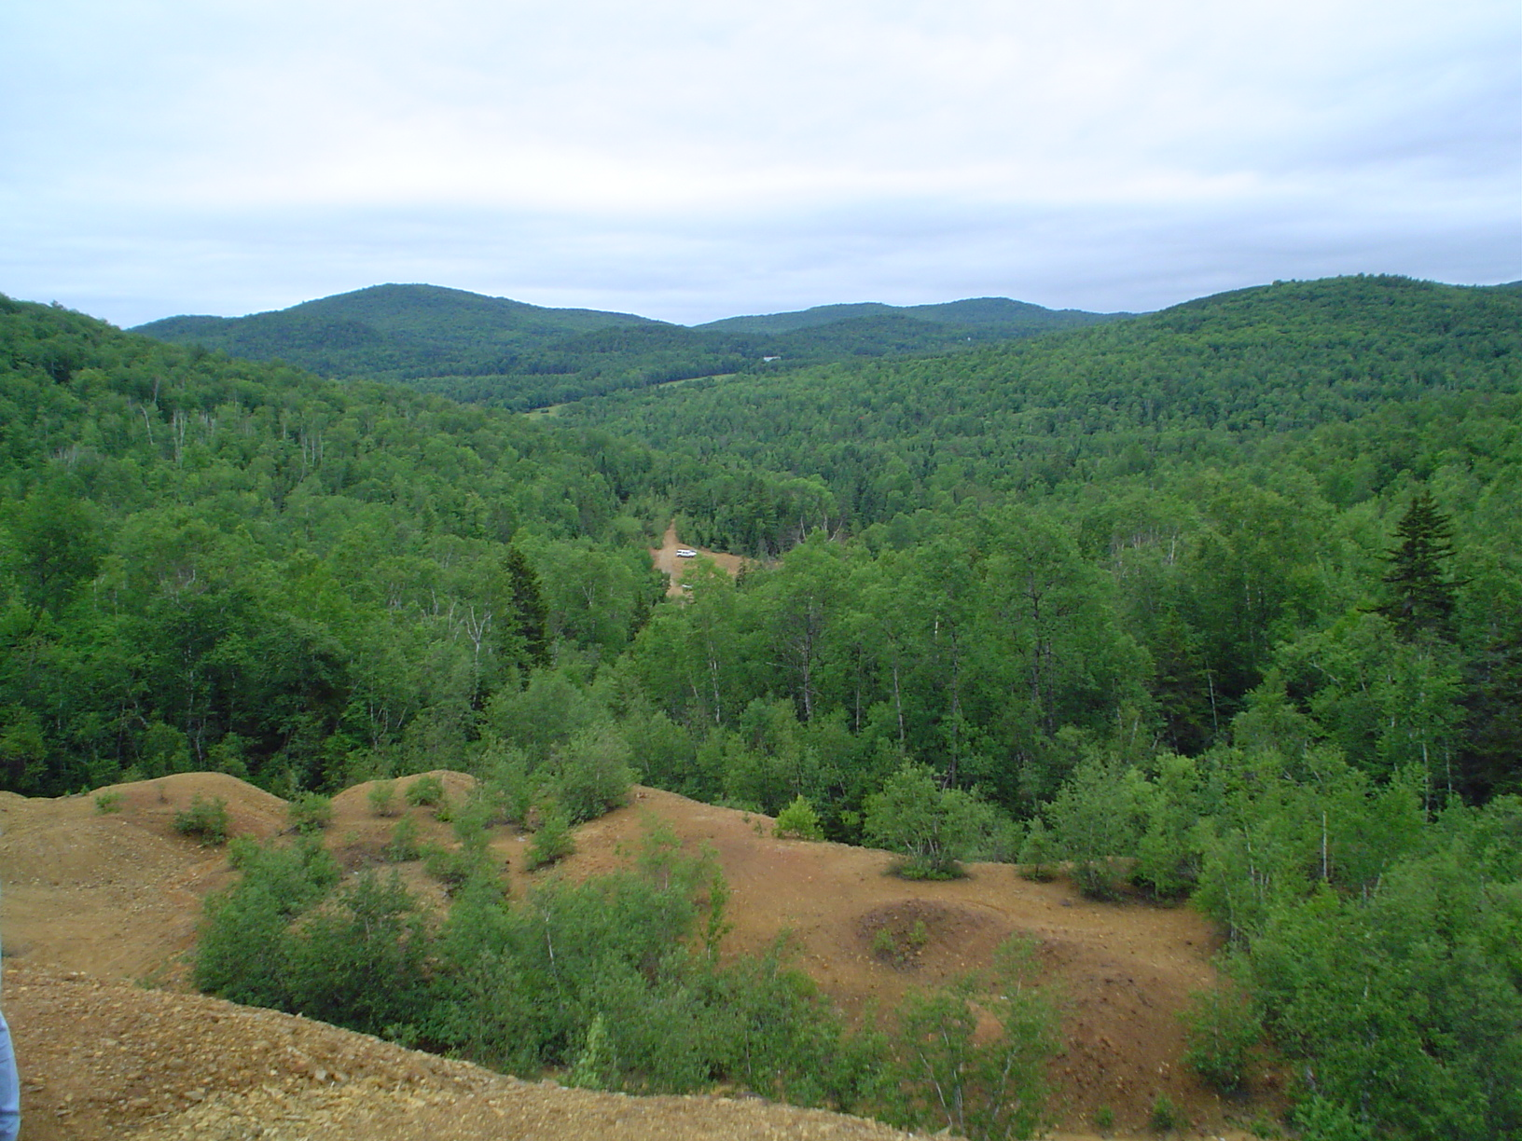
Ely Mine

Slide 19
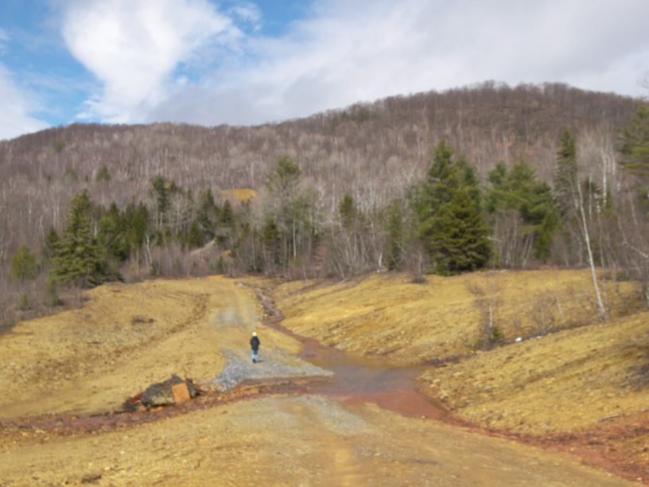

Slide 20
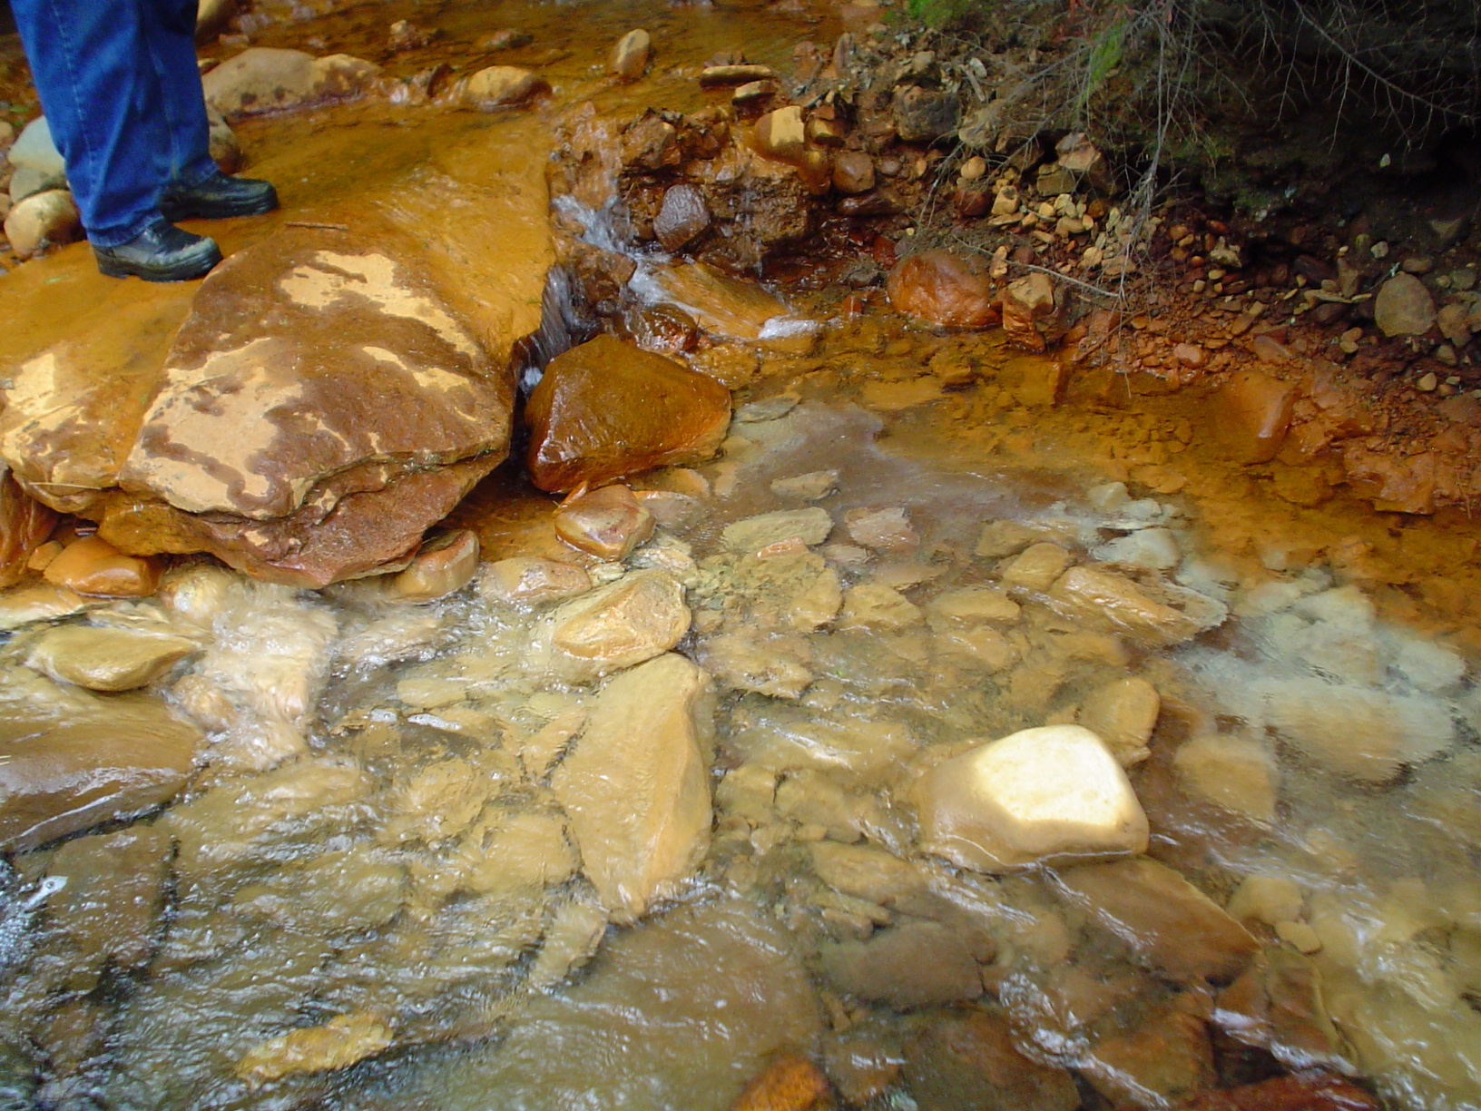

Slide 21
Oxides - Oxyhydroxides
FeOOH minerals → Goethite or Limonite (FeOOH) → important alteration products of weathering Fe-bearing minerals
Hematite (Fe₂O₃) → primary iron oxide in Banded Iron Formations
Boehmite (AlOOH) → primary mineral in bauxite ores (principle Al ore) which forms in tropical soils
Gibbsite (Al(OH)₃) – common Al oxide forming in aqueous sysems
Mn oxides → form Mn nodules in the oceans (estimated they cover 10-30% of the deep Pacific floor)
Many other oxides important in metamorphic rocks…

Slide 22
Al oxides
Aluminum occurs in economic deposits principally as bauxite
Bauxite is a mixture of Al oxides and oxyhydroxides:
  Diaspore - AlO(OH)
  Gibbsite - Al(OH)3
  Böhmite - AlO(OH)
Al is a residual phase and bauxite occurs where weathering is extreme and thick layers of aluminum oxyhydroxide are left over

Slide 23
Mn oxides - oxyhydroxides
Mn exists as 2+, 3+, and 4+; oxide minerals are varied, complex, and hard to ID
  ‘Wad’ → soft (i.e. blackens your fingers), brown-black fine-grained Mn oxides
  ‘Psilomelane’ → hard (does not blacked fingers) gray-black botroyoidal, massive Mn oxides
XRD analyses do not easily distinguish different minerals, must combine with TEM, SEM, IR spectroscopy, and microprobe work

Slide 24
Mn Oxide minerals (not all…)
Romanechite Ba_{.66}(Mn⁴⁺,Mn³⁺)₅O₁₀*1.34H₂O → Psilomelane
Pyrolusite MnO2
Ramsdellite MnO2
Nsutite Mn(O,OH)2
Hollandite Bax(Mn4+,Mn3+)8O16
Cryptomelane Kx(Mn4+,Mn3+)8O16
Manjiroite Nax(Mn4+,Mn3+)8O16
Coronadite Pbx(Mn4+,Mn3+)8O16
Todorokite (Ca,Na,K)X(Mn4+,Mn3+)6O12*3.5H2O
Lithiophorite LiAl2(Mn2+Mn3+)O6(OH)6
Chalcophanite ZnMn3O7*3H2O
Birnessite (Na,Ca)Mn7O14*2.8H2O
Vernadite MnO2*nH2O
Manganite MnOOH
Groutite MnOOH
Feitknechtite MnOOH
Hausmannite Mn²⁺Mn₂³⁺O4
Bixbyite Mn2O3
Pyrochroite Mn(OH)2
Manganosite MnO
Wad

Slide 25
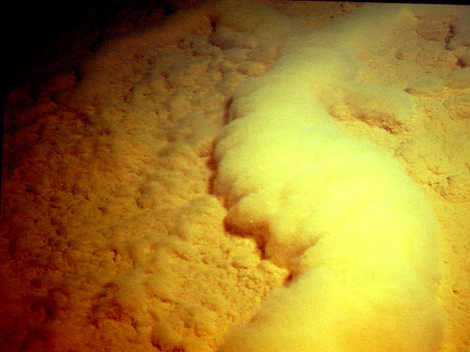
Iron Oxides
Interaction of dissolved iron with oxygen yields iron oxide and iron oxyhyroxide minerals
1st thing precipitated → amorphous or extremely fine grained (nanocrystaliine) iron oxides called ferrihydrite
O₂
Fe²⁺

Slide 26
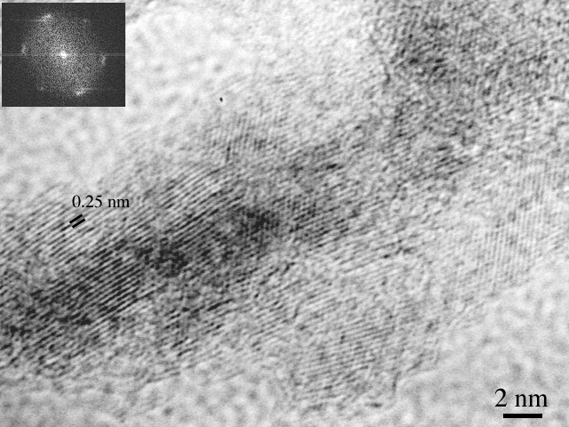
Ferrihydrite
Ferrihydrite (Fe₅O₇OH*H₂O; Fe₁₀O₁₅*9H₂O → some argument about exact formula) – a mixed valence iron oxide with OH and water

Slide 27
Goethite
Ferrihydrite recrystallizes into Goethite (α-FeOOH)
There are other polymorphs of iron oxyhydroxides:
  Lepidocrocite γ-FeOOH
  Akaganeite β-FeOOH

Slide 28
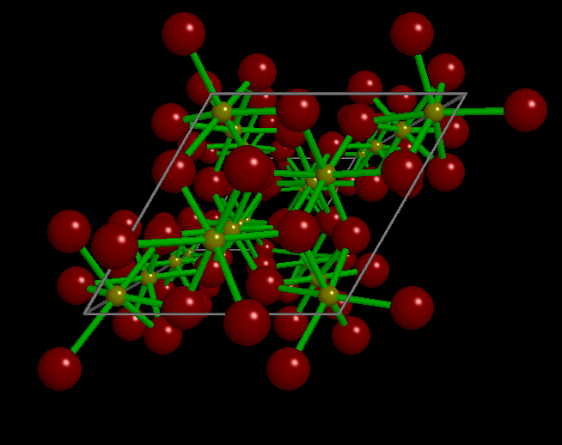
Iron Oxides
Hematite (Fe₂O₃) – can form directly or via ferrihydrite → goethite → hematite
Red-brown mineral is very common in soils and weathering iron-bearing rocks

Slide 29
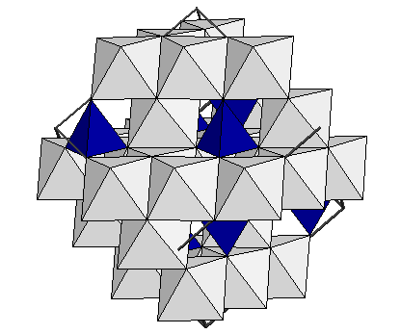
Magnetite (Fe₃O₄) – Magnetic mineral of mixed valence → must contain both Fe²⁺ and Fe³⁺ → how many of each??
‘Spinel’ structure – 2/3 of the cation sites are octahedral, 1/3 are tetrahedral

Slide 30
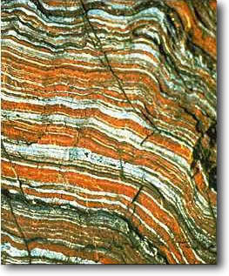
Banded Iron Formations (BIFs)
HUGE PreCambrian formations composed of hematite-jasper-chalcedony bands
Account for ~90% of the world’s iron supply
Occur only between 1.9 and 3.8 Ga → many sites around the world → Hammersley in Australia, Ishpeming in Michigan, Isua in Greenland, Carajas in Brazil, many other sites around the world…

Slide 31
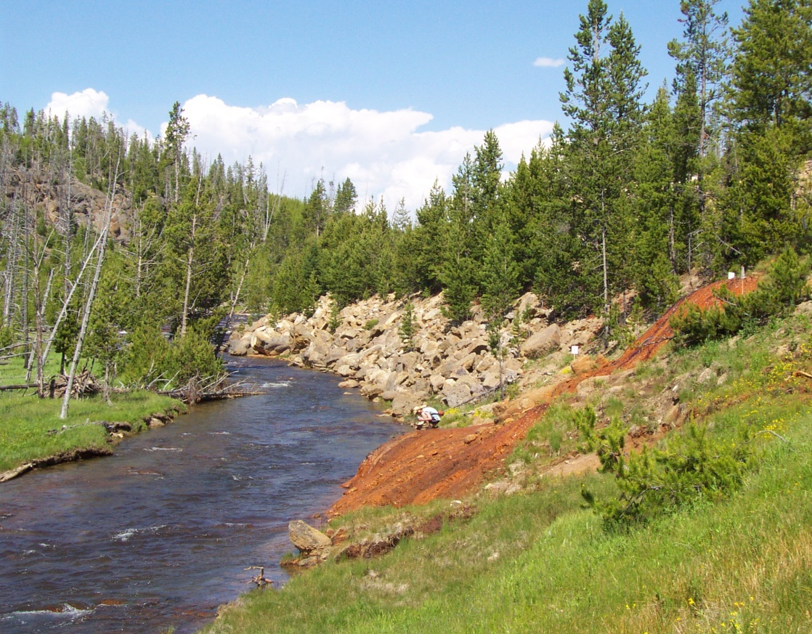
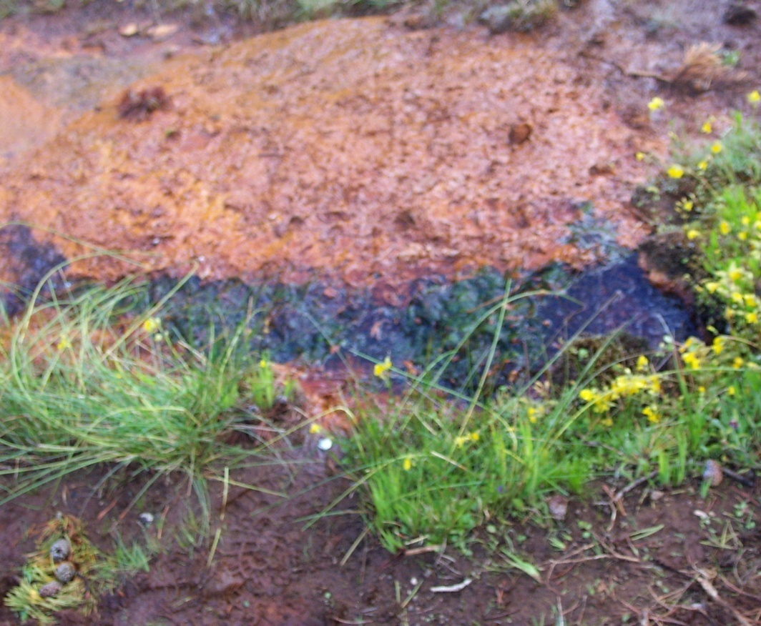
BIFs and bacteria
Early earth did not have free O₂, as microbial activity became widespread and photosynthetic organisms started generating O₂, the reduced species previously stable (without the O₂) oxidized – for Fe this results in formation of iron oxide minerals

Slide 32
Other important oxides
Periclase, MgO – Met. mineral from dolomite
Brucite, Mg(OH)₂ – weathering product
Rutile, Anatase, brooksite- TiO₂ polymorphs
Corundum, Al₂O₃ – sapphire and ruby
Ilmenite, FeTiO₃ – common in igneous/met. rx
Cuprite, Malachite, Azurite – copper oxides
Uraninite, UO₂ – important U ore
Spinel, MgAl₂O₄ – High-P met. mineral

