Slide 3
Bridging oxygen
Apical oxygen
Non-bridging oxygen

Slide 4
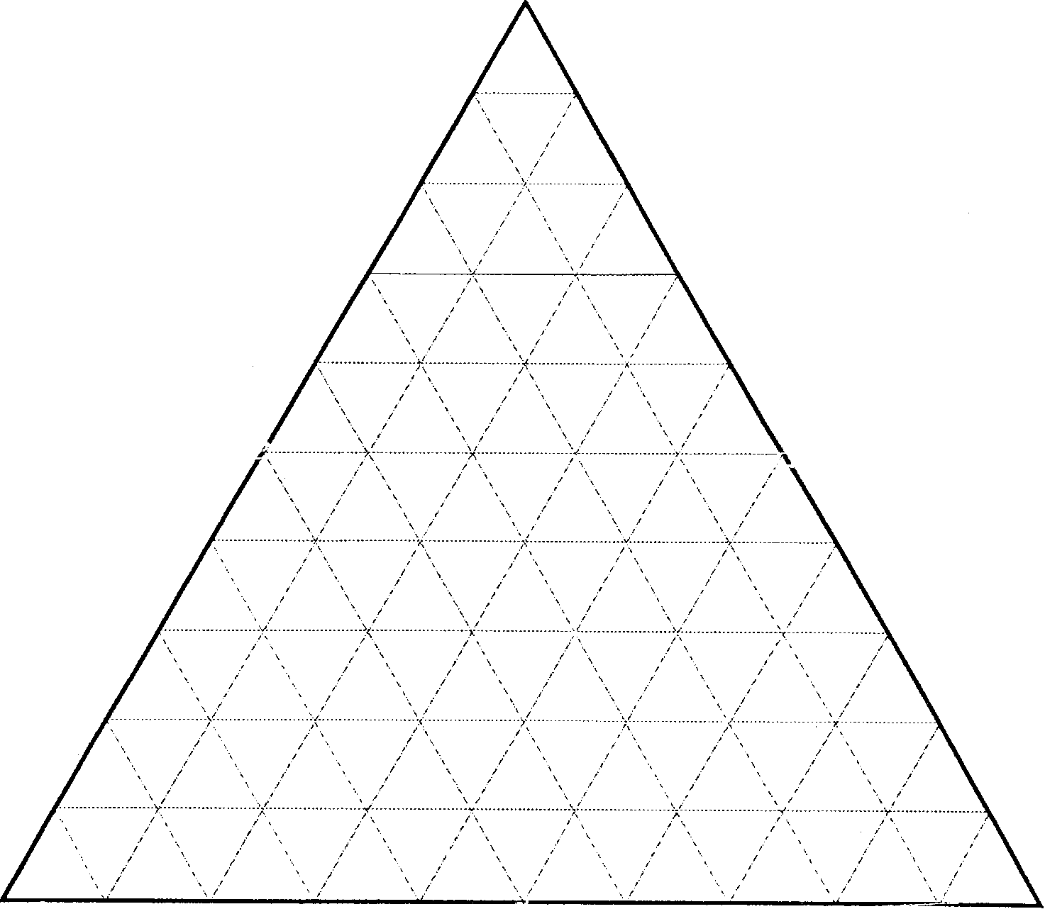
Ca₂Si₂O₆
Fe₂Si₂O₆
Mg₂Si₂O₆

Slide 5
Ca
Mg
Fe

Slide 6
Quad Pyroxenes
Ca
Mg
Fe

Slide 7
Quad Pyroxenes
Ca
Pyroxenoids
Mg
Fe

Slide 8
Wollastonite
Ca
Mg
Fe
Enstatite
Ferrosilite

Slide 9

Ca
Diopside
Hedenburgite
Mg
Fe
Ferrosilite

Slide 10
Ca
Diopside
Hedenburgite
Pigeonite
Mg
Fe
Ferrosilite

Slide 11
Ca
Diopside
Hedenburgite
Augite
Pigeonite
Mg
Fe
Enstatite
Ferrosilite

Slide 12
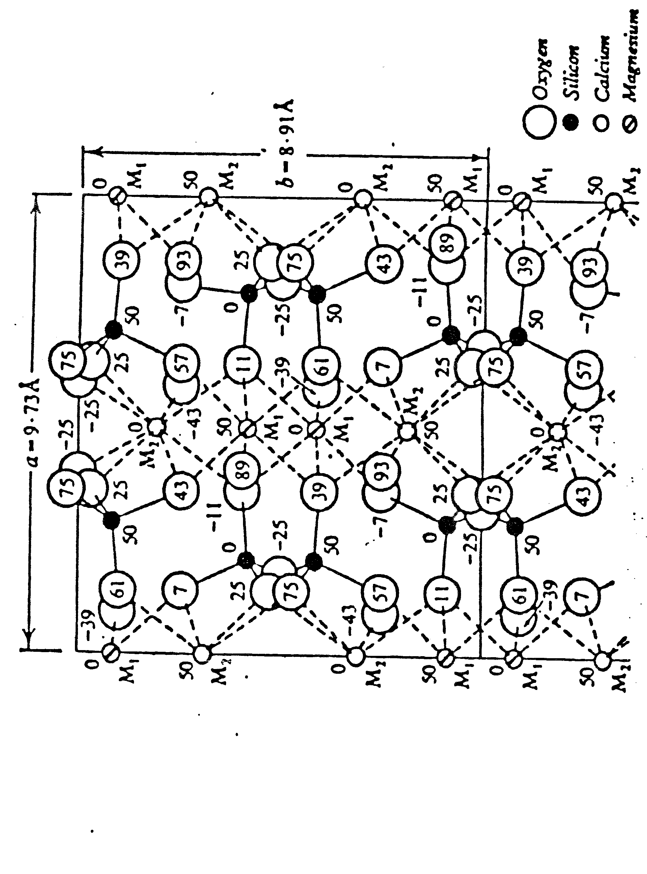

Slide 14
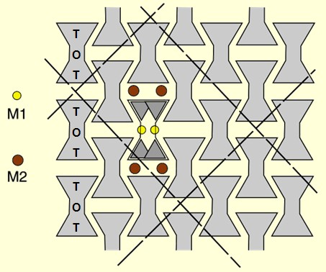

Slide 19
Ca
Diopside
Hedenburgite
Augite
Pigeonite
Mg
Fe
Enstatite
Ferrosilite

Slide 20
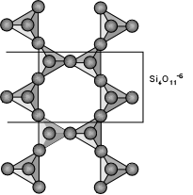

Slide 21
Amphibole Site Nomenclature
W₀₋₁ X₂ Y₅ Z₈O₂₂ (OH,F)₂
W = ions in A site, 10-12 coordinated (Na, K)
X = ions in 2 M4 sites, 6-8 coordinated (Mg, Fe²⁺, Ca, Na)
Y = ions in 5 octahedral M2, M1, M3 sites
(Mg, Fe²⁺, Fe³⁺, Al, Ti)
Z = Si or Al in tetrahedral sites

Slide 25
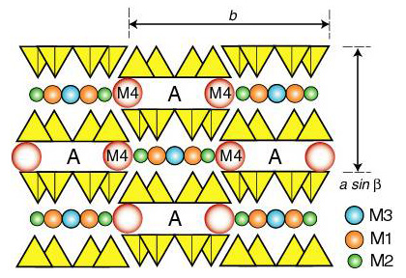

Slide 26
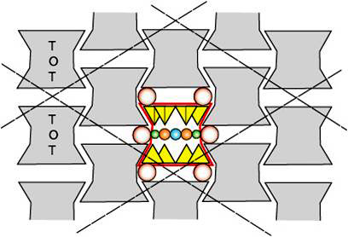

Slide 27
