Slide 1
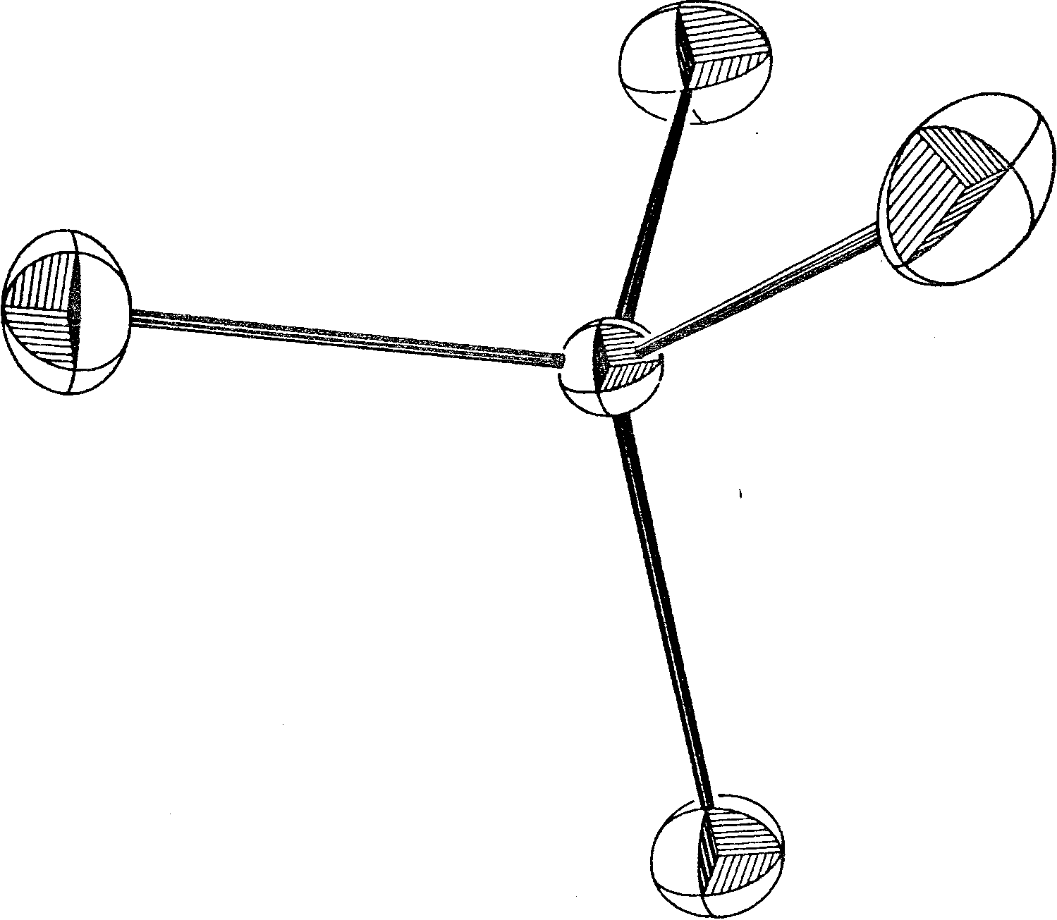

Slide 5
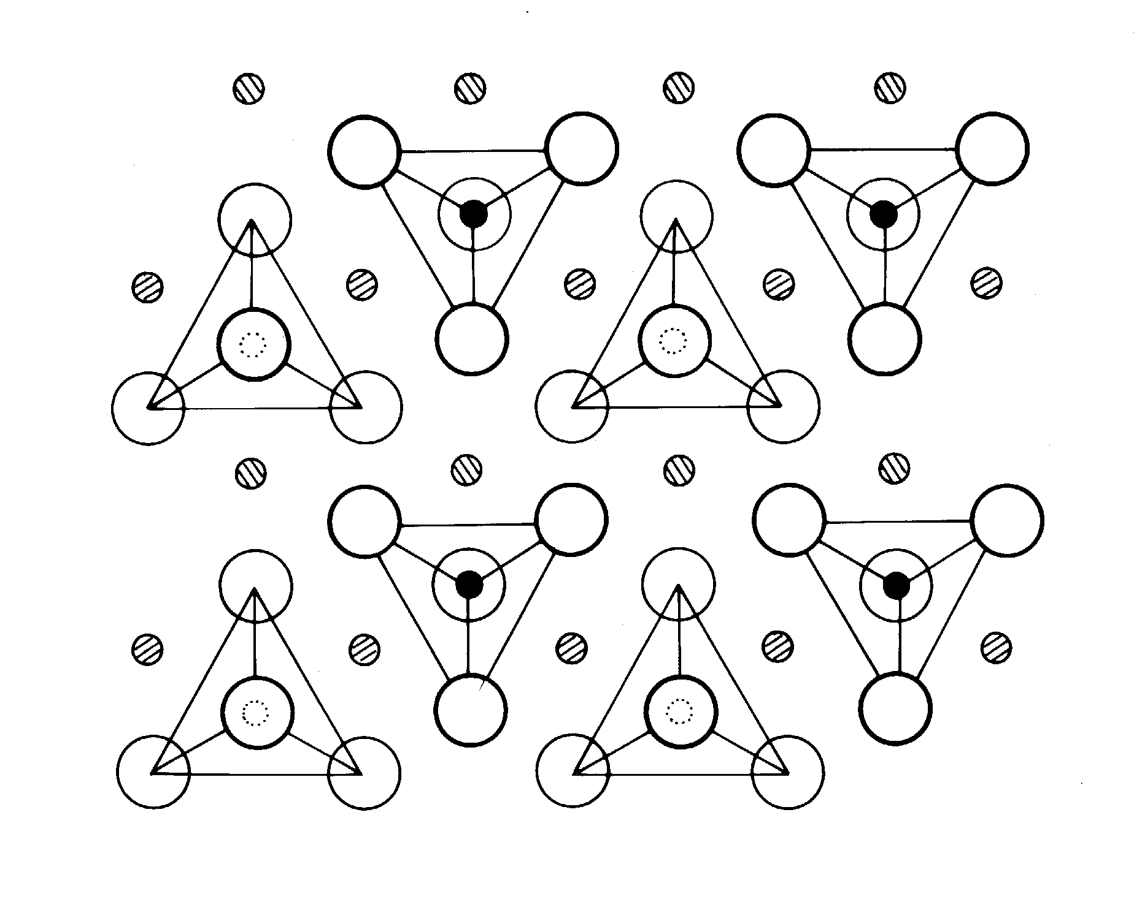

Slide 9
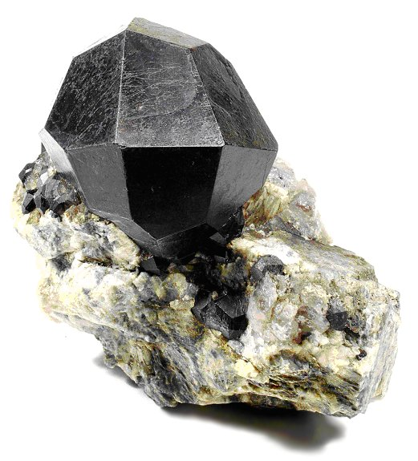

Slide 10
Garnets
A₃²⁺ B₂³⁺ (SiO₄)₃
B = Al: Pyralspite garnets
Mg₃ Al₂ (SiO₄)₃: Pyrope
Fe₃ Al₂ (SiO₄)₃: Almandine
Mn₃ Al₂ (SiO₄)₃: Spessartite
A = Ca: Ugrandite garnets
Ca₃ Cr₂ (SiO₄)₃: Uvarovite
Ca₃ Al₂ (SiO₄)₃: Grossularite
Ca₃ Fe₂ (SiO₄)₃: Andradite

Slide 11
