Slide 1
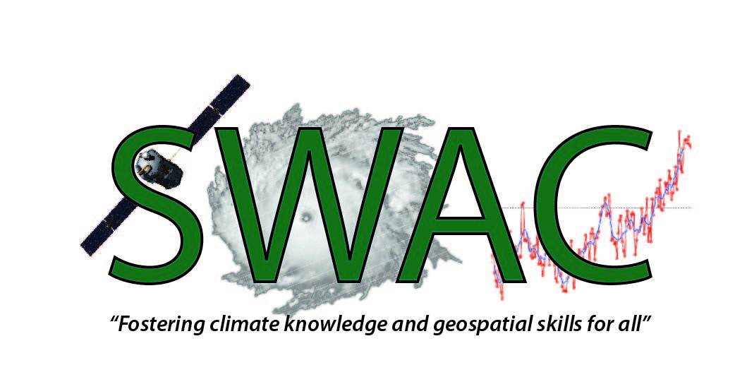



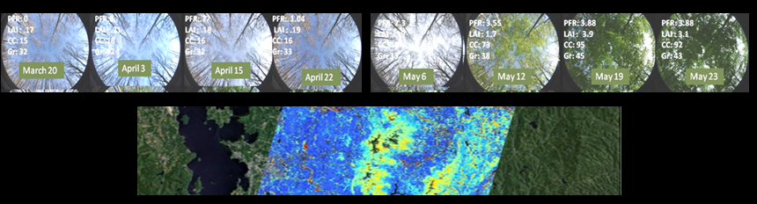
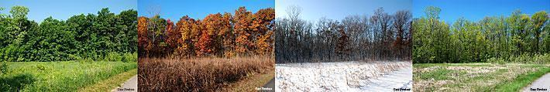
Vegetation Phenology
Quantifying climate impacts on ecosystems: Field and Satellite Assessments

Slide 2
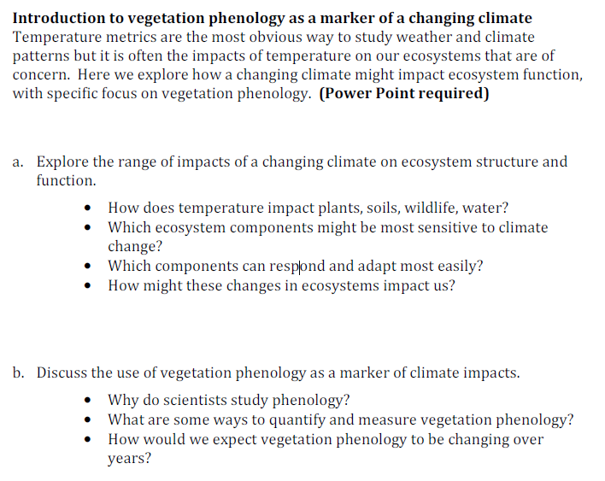
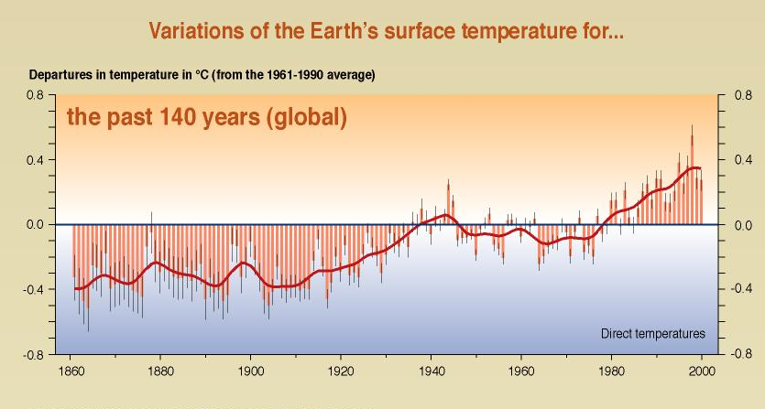
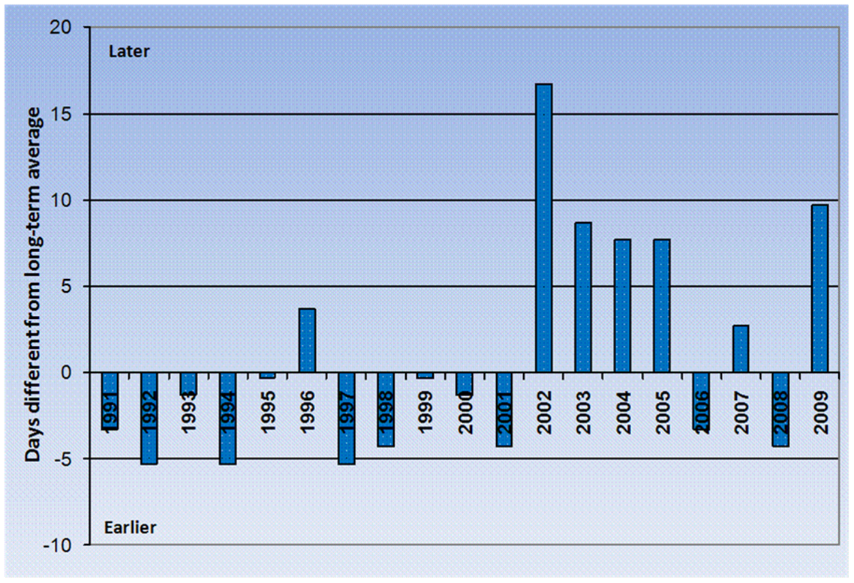

Plants can tell us a story about climate.
Timing of sugar maple leaf drop
  (Ollinger, S.V. “Potential effects of climate change and rising CO2 on ecosystem process in northeastern U.S. forests)

Slide 3
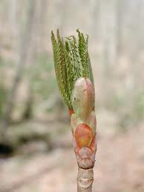
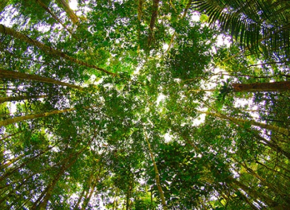
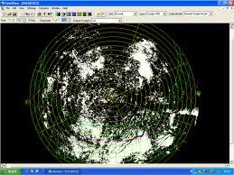
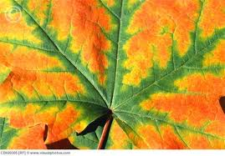
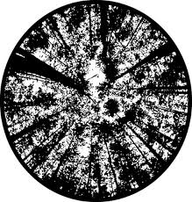
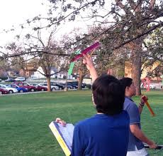
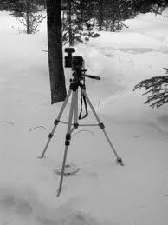
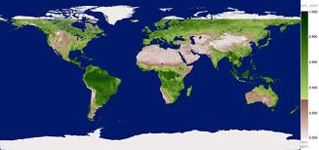
Phenology (the timing of leaf out and leaf off) is a common metric of climate impacts.
This is typically quantified in two ways:
Field assessments Satellite Observations

Slide 4
Really a combination of field and satellite observations are best
Tier 1
Intensive
Sites
AmeriFlux
Field Based
NWS Coop
NPS Inv. & Mon.
State Ag. Exp. Sta.
Tier 2
Spatially Extensive
Science Networks
Increasing Process Knowledge Data Quality
# of Measurements
Decreasing Spatial Coverage
Tier 3
Nature
Preserves,
Campuses
Spatially Extensive
Volunteer & Education Networks
Satellite Based
Tier 4
NASA
USGS
NOAA
Remote Sensing and
Synoptic (wall-to-wall) Data
George R. Kish U.S. Geological Survey
Notes:
The USA National Phenology Network brings together citizen scientists, government agencies, non-profit groups, educators and students of all ages to monitor the impacts of climate change on plants and animals in the United States. The network harnesses the power of people and the Internet to collect and share information, providing researchers with far more data than they could collect alone.

Slide 5
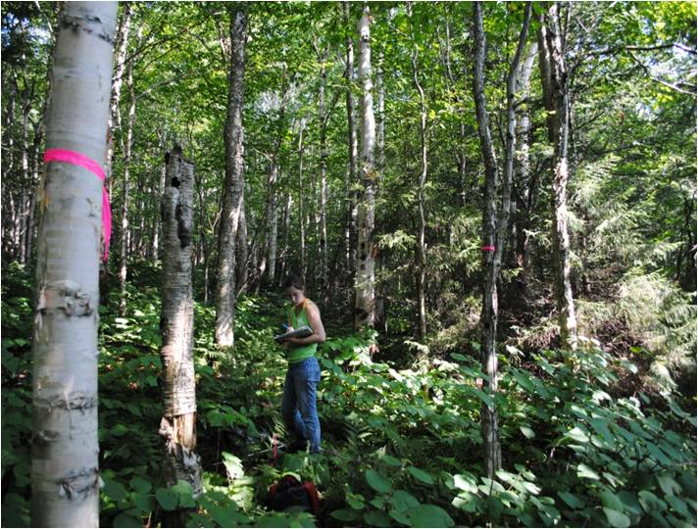

The goal of this module is to introduce students to these concepts by linking ground and satellite measurements at their own intensive research site.
Notes:
Didn’t get my hint already, largely two different approaches to measuring phenology. Large landscape. Plot tree scale – PMRC 5 trees. One start of Spring whole contiental US.
Many RS studies have struggled with linking ground measures to satellite data (deBeurs and Henebry 2010); (Cleland, Chuine et al. 2007).
Benefits of RS instruments- broad landscapes, without tedious field work go back in time since archived, but what good is it if doesn’t match what is happening on the ground
Different instruments and methods have been used to monitor phenology, but conclusions stress the need for ground metrics that are consistently recognized and interpreted in satellite data

Slide 6
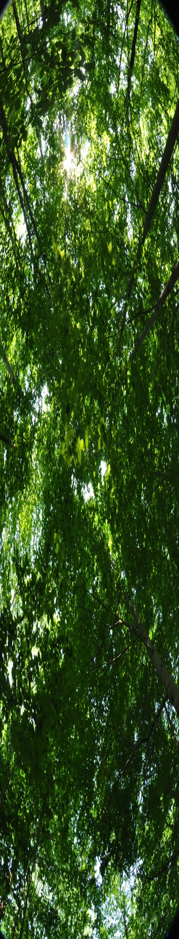
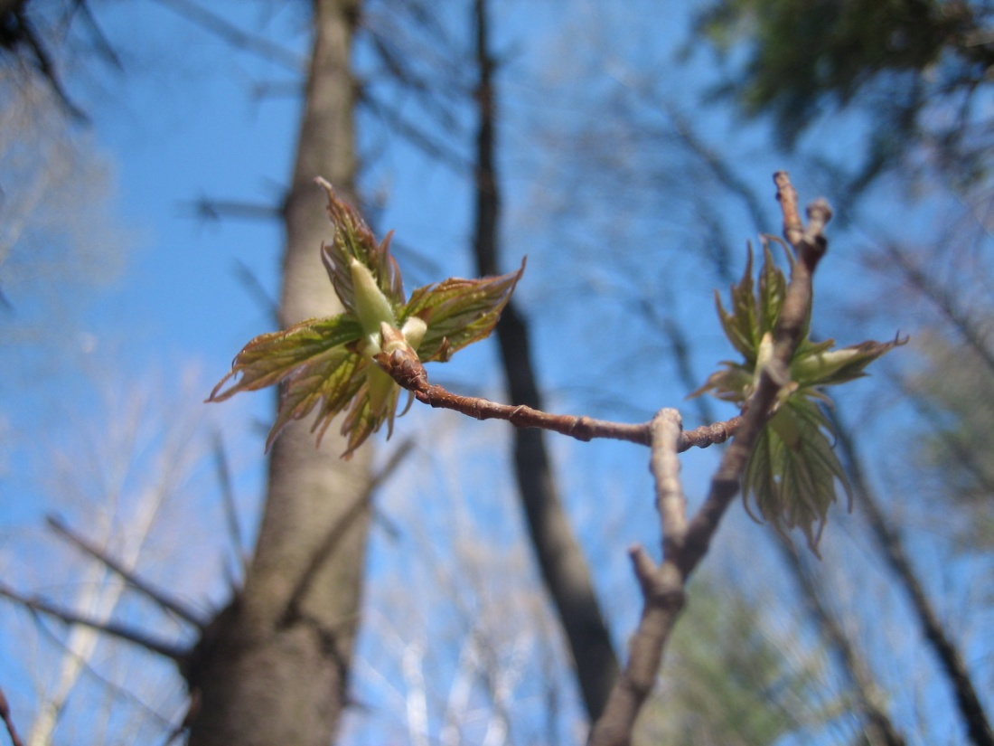
Getting Started
Establish a site
  You should have a location nearby that students can visit frequently during times of rapid change.
  (ideally this would be weekly in early spring and then 3-5 day returns as buds burst and expand)
  Look for a dense forest canopy
  Mark plot center for accurate returns
  Determine geographic coordinates for plot center
Notes:
On the ground
Site selection
Under canopy
Easy enough to get to
Ideally with similar forest/at least not parking lot within 1km

Slide 7
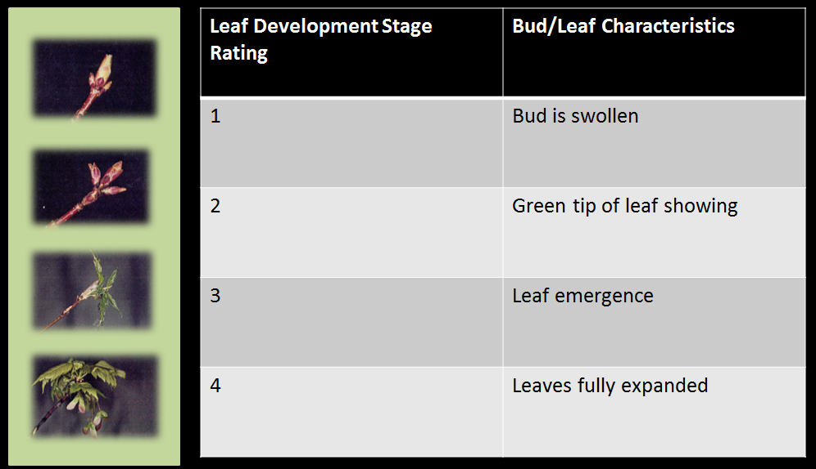
Collecting Data– Field Metrics
There are many different ways to quantify phenology.
We suggest including both visual assessments and digital measurements
Field Phenology Ranks
For each tree on the “plot” determine the dominant bud stage. This means that a value of 1,2,3 or 4 will be recorded for each tree.
Average all of these values to come up with one summary field phenology rank for the plot.
Notes:
On the ground
Site selection
Under canopy
Easy enough to get to
Ideally with similar forest/at least not parking lot within 1km

Slide 8
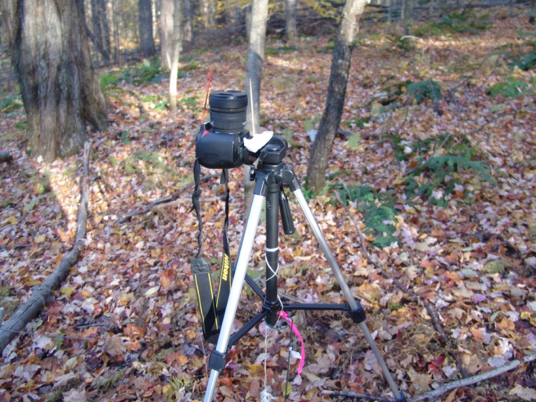
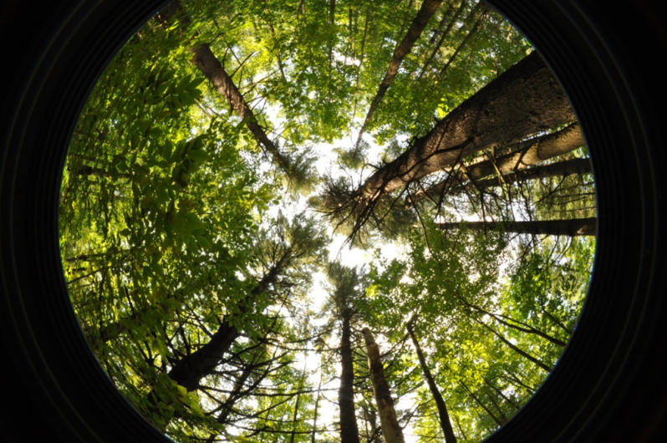
Collecting Data– Field Metrics
There are many different ways to quantify phenology.
We suggest including both visual assessments and digital measurements
Digital Canopy Metrics
At the center of each plot take a digital photograph looking strait up at the canopy.
Automatic settings should ensure consistent lighting over time.
Be sure to always orient the camera strait up, with the top facing the same direction and with no obstructions in the field of view.
Notes:
On the ground
Site selection
Under canopy
Easy enough to get to
Ideally with similar forest/at least not parking lot within 1km

Slide 9
Collecting Data – Field Metrics
There are many different ways to quantify phenology.
We suggest including both visual assessments and digital measurements
Digital Canopy Metrics
These digital metrics help us to “see” the canopy as a satellite might see it.
While most scientists use a hemispherical camera, any digital camera will work.
From these images we can use specialized software to calculate lots of different canopy characteristics:
“greeness”, canopy closure, gap fraction, leaf area index, etc.
Notes:
On the ground
Site selection
Under canopy
Easy enough to get to
Ideally with similar forest/at least not parking lot within 1km

Slide 10
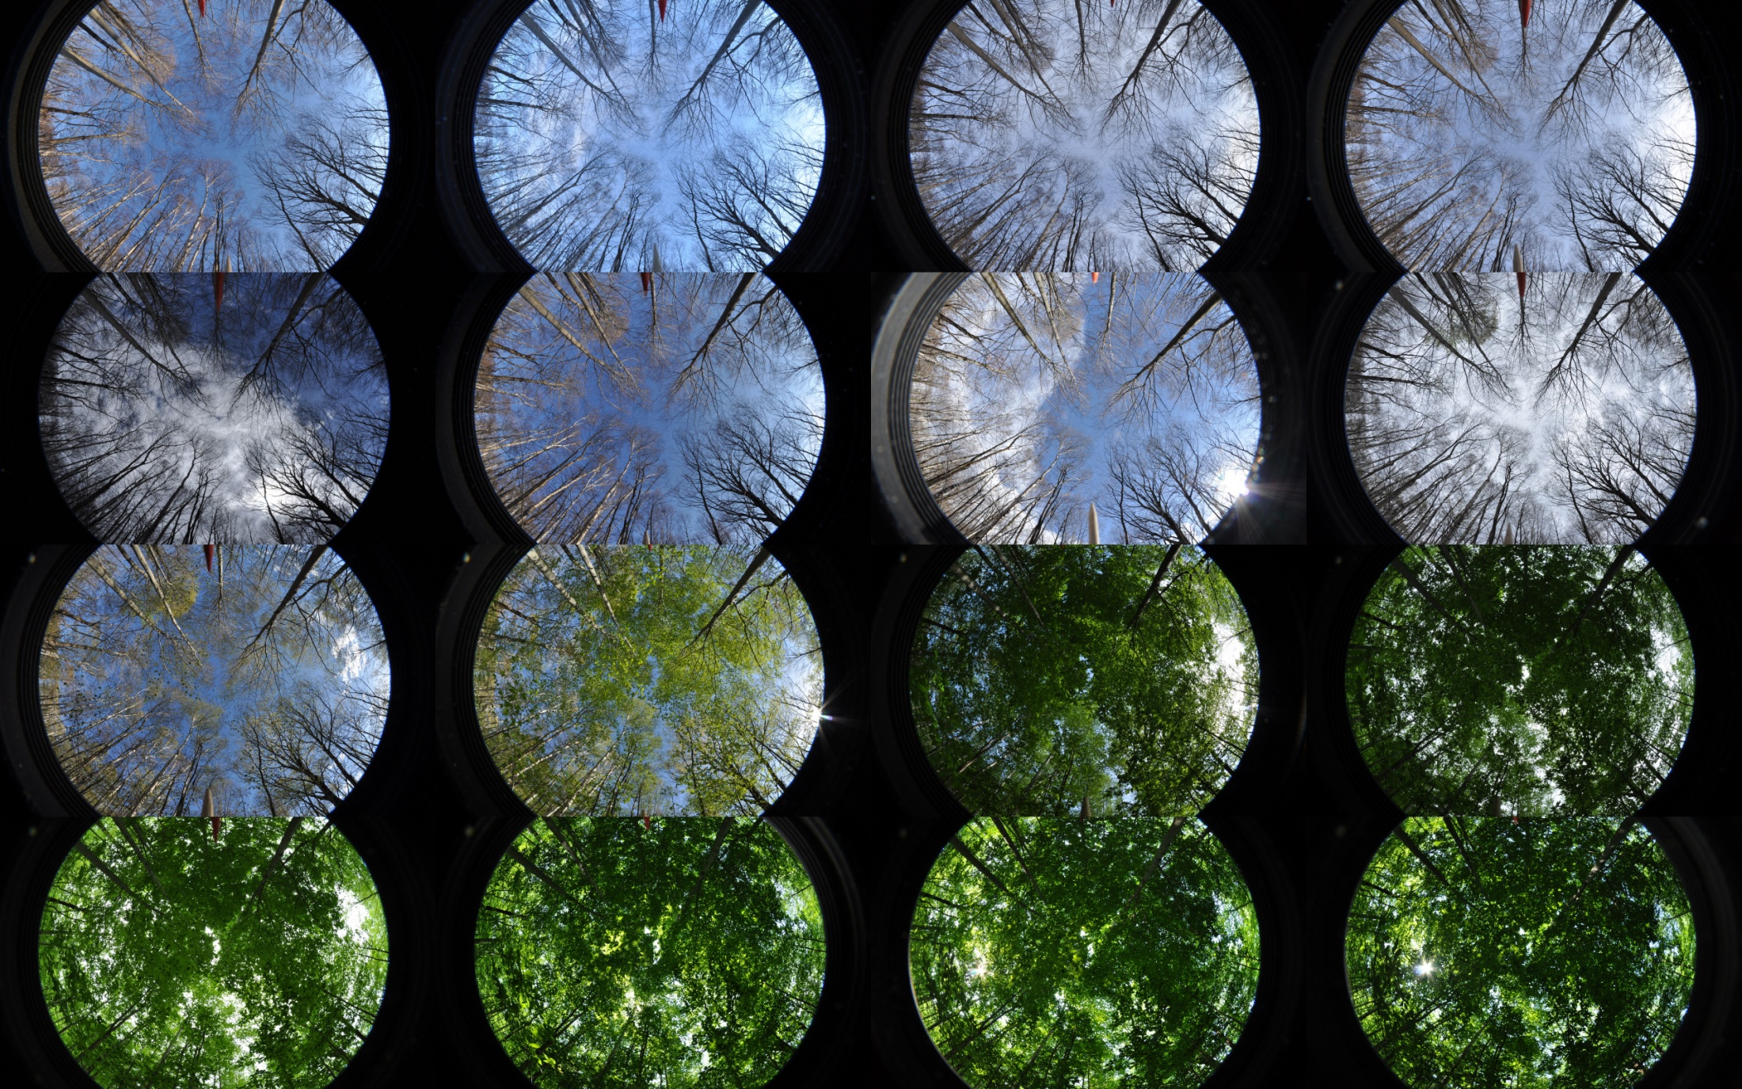
Over time you can quantify changes in canopy characteristics, compare rates of change and timing of changes.
March 20
June 15
Notes:
From hemispherical photos canopy openness, effective leaf area index and percentage of greenness in the photo were calculated.

Slide 11
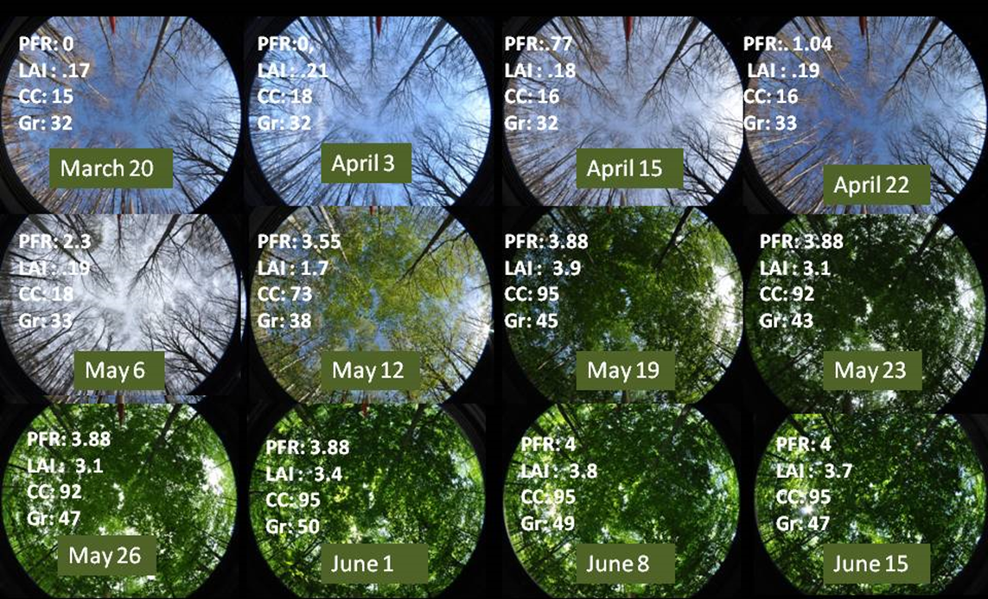
Specialized software can quickly calculate a suite of different canopy metrics we can use.
Notes:
(greenness, canopy closure, and leaf area index)

Slide 12
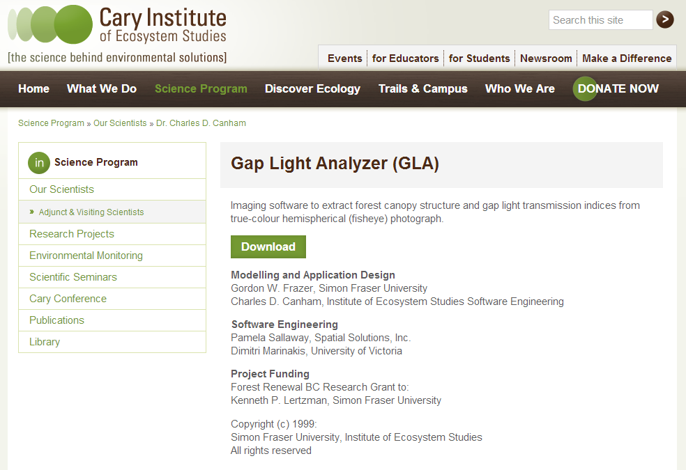
Gap Light Analyzer (GLA)
http://www.caryinstitute.org/science-program/our-scientists/dr-charles-d-canham/gap-light-analyzer-gla
Download
Unzip
Double click “setup.exe to install
Here is the catch:
It only runs on 32-bit versions of windows (so use an older machine if possible)
Notes:
Work around…download virula PC and windows XP modes from http://windows.microsoft.com/en-US/windows7/install-and-use-windows-xp-mode-in-windows-7

Slide 13
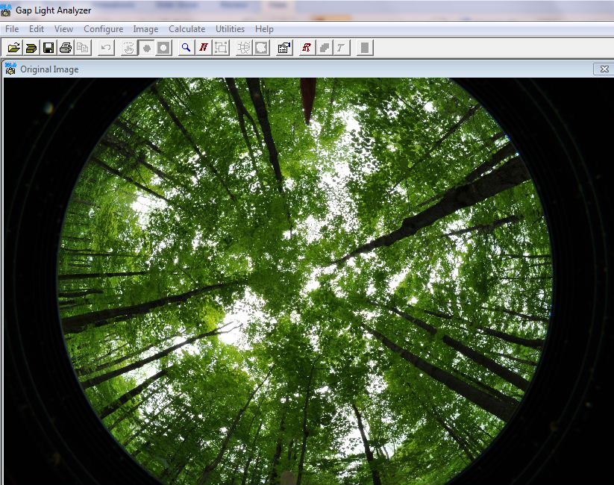
Working Gap Light Analyzer
Open your digital image

Slide 14
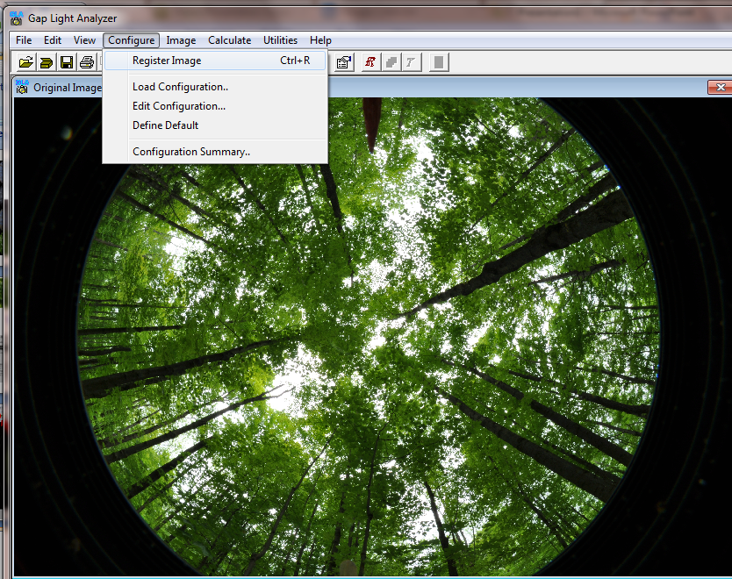
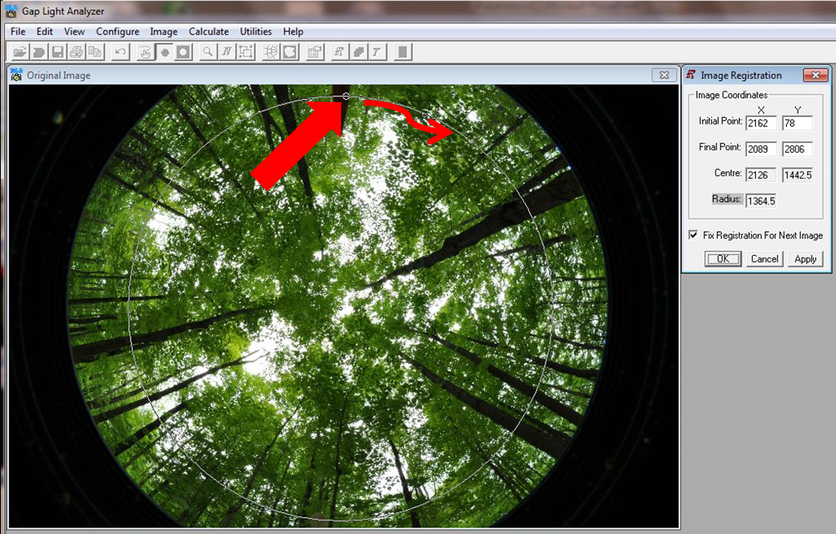
Working Gap Light Analyzer
Open your digital image
Register your image

Slide 15
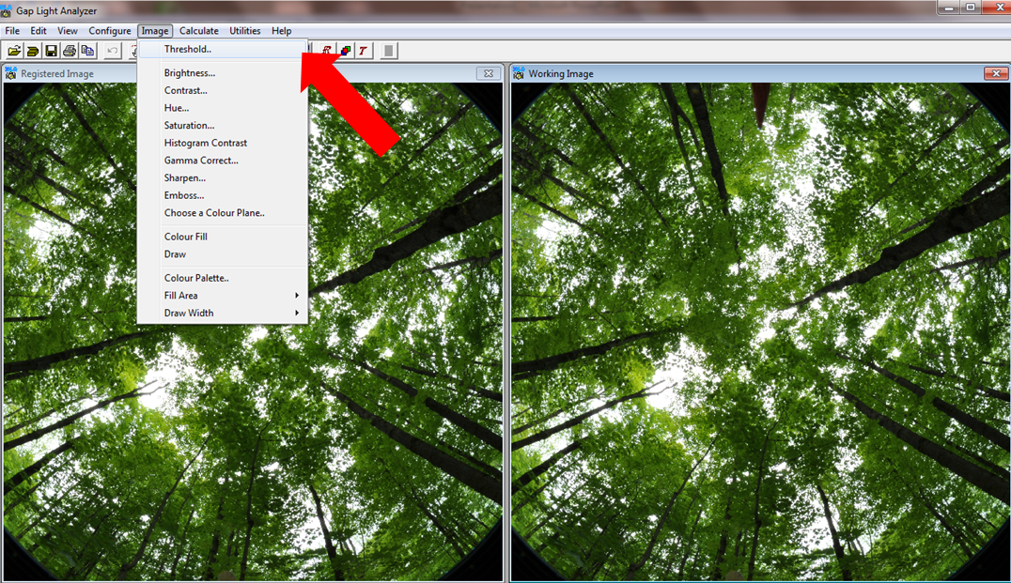
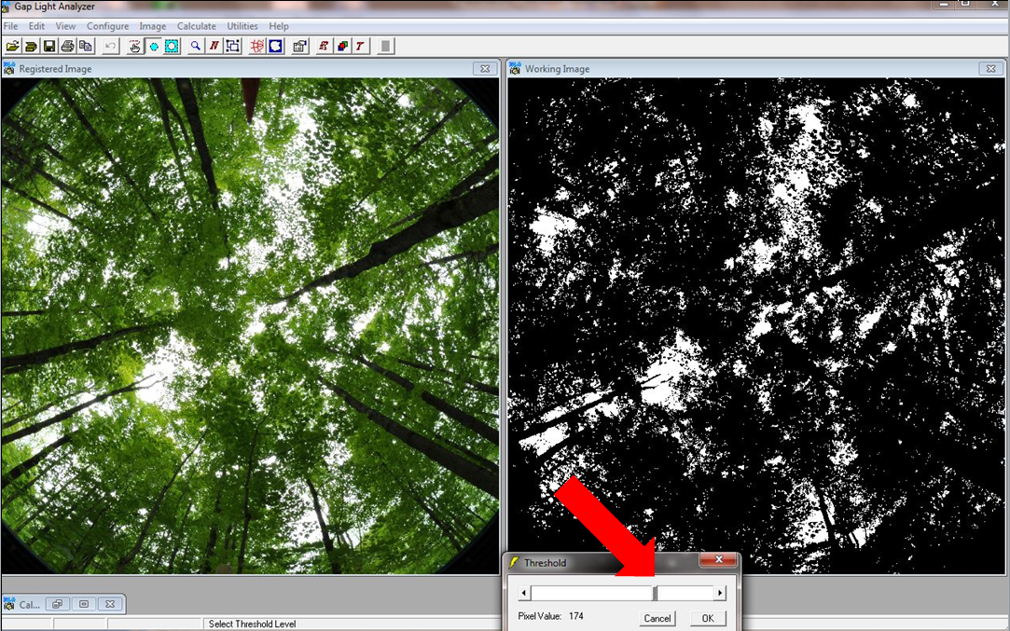
Working Gap Light Analyzer
Open your digital image
Register your image
Set the light/dark threshold

Slide 16
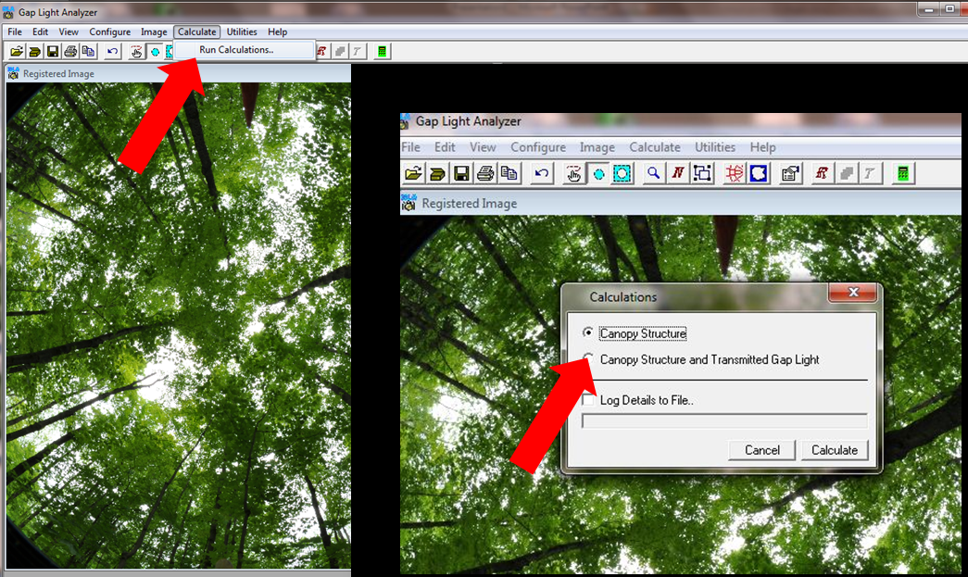
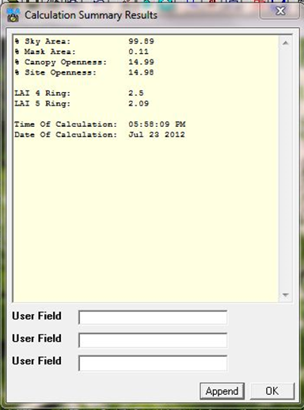
Working Gap Light Analyzer
Open your digital image
Register your image
Set the light/dark threshold
Run calculations

Slide 17
Working Gap Light Analyzer
Open your digital image
Register your image
Set the light/dark threshold
Run calculations

Slide 18
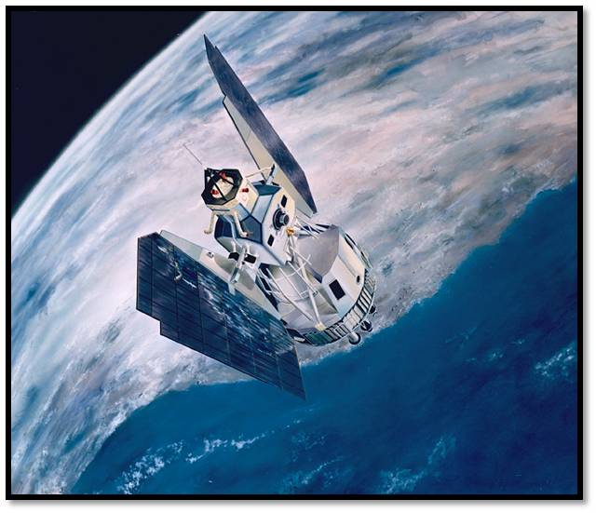
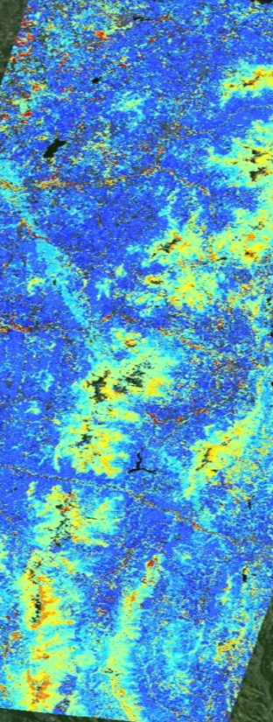
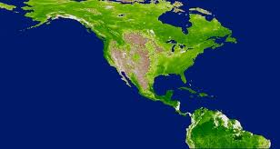
Collecting Data – Satellite Metrics
There are many different ways to quantify phenology.
We suggest including both visual assessments and digital measurements
Satellite Assessments
Satellites cover a large geographic area, making them useful for regional, continental or global assessments.
You sacrifice spatial detail and accuracy, but gain a larger perspective
Notes:
On the ground
Site selection
Under canopy
Easy enough to get to
Ideally with similar forest/at least not parking lot within 1km

Slide 19
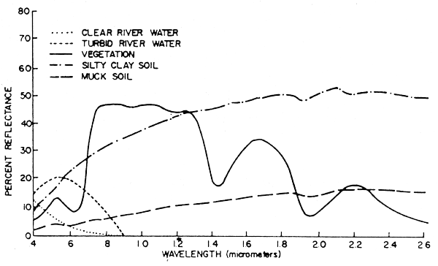

How do you see phenology from space?
Chlorophyll, strongly absorbs visible light for photosynthesis.
Leaf cell structure reflects near-infrared light.
NDVI exploits these characteristics of vegetation reflectance to quantify how much, how dense and how productive vegetation is.
http://www.fao.org/docrep/003/T0446E/T0446E04.htm
Notes:
Plants appear green to us because of the blue and red wavelengths absorbed for photosynthesis leave only green wavelengths in the visible spectrum for us to see.
But plants have another common reflectance signature in the near infrared portion of the electromagnetic spectrum. How high this plateau is, compared to how low the trough is at the chlorophyll absorption well in the red wavelengths can give you a measure of how “green” a pixel is.
The most common formula to summarize these key spectral values is called the Normalized Difference Vegetation Index.
The NDVI is calculated from these individual measurements as follows:
where VIS and NIR stand for the spectral reflectance measurements acquired in the visible (red) and near-infrared regions, respectively (http://earthobservatory.nasa.gov/Features/MeasuringVegetation/measuring_vegetation_2.php).
These spectral reflectances are themselves ratios of the reflected over the incoming radiation in each spectral band individually, hence they take on values between 0.0 and 1.0. By design, the NDVI itself thus varies between -1.0 and +1.0.

Slide 20
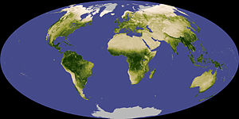
Normalized Difference Vegetation Index
NDVI
Negative values of NDVI correspond to water.
Values close to zero correspond to barren areas of rock, sand, or snow.
low, positive values represent shrub and grassland
high values indicate temperate and tropical rainforests.
Notes:
It can be seen from its mathematical definition that the NDVI of an area containing a dense vegetation canopy will tend to positive values (say 0.3 to 0.8) while clouds and snow fields will be characterized by negative values of this index. Other targets on Earth visible from space include
free standing water (e.g., oceans, seas, lakes and rivers) which have a rather low reflectance in both spectral bands (at least away from shores) and thus result in very low positive or even slightly negative NDVI values,
soils which generally exhibit a near-infrared spectral reflectance somewhat larger than the red, and thus tend to also generate rather small positive NDVI values (say 0.1 to 0.2).

Slide 21
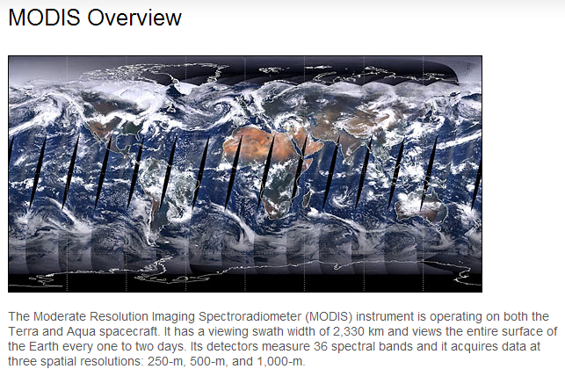
Global Agricultural Monitoring Project
Test Interactive Products
http://pekko.geog.umd.edu/usda/test/
Notes:
To meet its objectives, FAS/IPAD uses satellite data and data products to monitor agriculture worldwide and to locate and keep track of natural disasters such as short and long term droughts, floods and persistent snow cover which impair agricultural productivity. FAS is the largest user of satellite imagery in the non-military sector of the U.S. government. For the last 20 years FAS has used a combination of Landsat and NOAA-AVHRR satellite data to monitor crop condition and report on episodic events.
FAS is upgrading and enhancing the satellite component of its IPAD decision support system through an information delivery system for MODIS data and derived products. NASA's Moderate Resolution Imaging Spectroradiometer (MODIS) on board two platforms of the Earth Observing System (EOS), was designed in part to monitor subtle vegetation responses to stress, vegetation production and land cover with regional-to-global coverage. Hence, integration of MODIS data and derived products into the IPAD FAS DSS provides FAS with better characterization of land surface conditions at the regional scale and enables monitoring of changes in the key agricultural areas of FAS focus regions in a more timely fashion and at a higher resolution than previously possible with NOAA-AVHRR data.
MODIS: An Operational Prototype
Although MODIS is a NASA experimental mission, the instrument's capabilities will be extended by the launch of the Visible Infrared Imager Radiometer Suite (VIIRS) in 2008, part of the National Polar Orbiting Environmental Satellite System (NPOESS), which will become fully operational in 2009. Thus the methods and system developed through this research project can be transitioned into a fully operational domain.
Long Term Database of MODIS Composite Vegetation Index Time Series
In monitoring crop conditions for a specific region, remotely sensed vegetation index data are used to track the evolution of the growing season compared to reference long-term mean conditions. A global normalized difference vegetation index (NDVI) is produced from MODIS data, and is referred to as the "continuity index" similar to the existing archive of NOAA-AVHRR derived NDVI.
A global NDVI time-series database, with a spatial resolution of 250 meters has been assembled using a 16-day compositing period, allowing for interannual comparisons of growing season dynamics. This MODIS NDVI dataset is automatically reprojected and mosaicked to suit the FAS regions of interest.
The time-series data are accessible to FAS analysts through a powerful web interface and analysis tool. From this stand-alone interface the analysts can query these data by pre-defined sub-regions, by interactive regional subsetting, and by implementing crop/water masks to:
- plot time-series graphs over the crop growing seasons to quickly assess crop conditions and anomalies.
- monitor current conditions.
- view spatially, NDVI anomalies comparing current conditions to previous year, or historical mean.
- plot histograms of current and historical NDVI data.
These data and utilities are fundamental for crop yield forecasts and can serve as an early warning system for regions suffering from crop loss and food shortages.

Slide 22
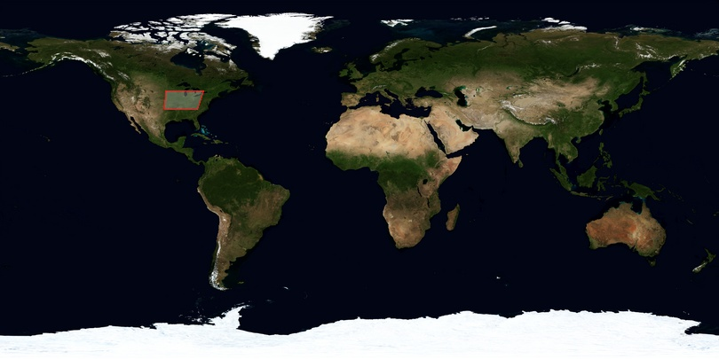
Global Agricultural Monitoring Project
Test Interactive Products
http://pekko.geog.umd.edu/usda/test/
Notes:
To meet its objectives, FAS/IPAD uses satellite data and data products to monitor agriculture worldwide and to locate and keep track of natural disasters such as short and long term droughts, floods and persistent snow cover which impair agricultural productivity. FAS is the largest user of satellite imagery in the non-military sector of the U.S. government. For the last 20 years FAS has used a combination of Landsat and NOAA-AVHRR satellite data to monitor crop condition and report on episodic events.
FAS is upgrading and enhancing the satellite component of its IPAD decision support system through an information delivery system for MODIS data and derived products. NASA's Moderate Resolution Imaging Spectroradiometer (MODIS) on board two platforms of the Earth Observing System (EOS), was designed in part to monitor subtle vegetation responses to stress, vegetation production and land cover with regional-to-global coverage. Hence, integration of MODIS data and derived products into the IPAD FAS DSS provides FAS with better characterization of land surface conditions at the regional scale and enables monitoring of changes in the key agricultural areas of FAS focus regions in a more timely fashion and at a higher resolution than previously possible with NOAA-AVHRR data.
MODIS: An Operational Prototype
Although MODIS is a NASA experimental mission, the instrument's capabilities will be extended by the launch of the Visible Infrared Imager Radiometer Suite (VIIRS) in 2008, part of the National Polar Orbiting Environmental Satellite System (NPOESS), which will become fully operational in 2009. Thus the methods and system developed through this research project can be transitioned into a fully operational domain.
Long Term Database of MODIS Composite Vegetation Index Time Series
In monitoring crop conditions for a specific region, remotely sensed vegetation index data are used to track the evolution of the growing season compared to reference long-term mean conditions. A global normalized difference vegetation index (NDVI) is produced from MODIS data, and is referred to as the "continuity index" similar to the existing archive of NOAA-AVHRR derived NDVI.
A global NDVI time-series database, with a spatial resolution of 250 meters has been assembled using a 16-day compositing period, allowing for interannual comparisons of growing season dynamics. This MODIS NDVI dataset is automatically reprojected and mosaicked to suit the FAS regions of interest.
The time-series data are accessible to FAS analysts through a powerful web interface and analysis tool. From this stand-alone interface the analysts can query these data by pre-defined sub-regions, by interactive regional subsetting, and by implementing crop/water masks to:
- plot time-series graphs over the crop growing seasons to quickly assess crop conditions and anomalies.
- monitor current conditions.
- view spatially, NDVI anomalies comparing current conditions to previous year, or historical mean.
- plot histograms of current and historical NDVI data.
These data and utilities are fundamental for crop yield forecasts and can serve as an early warning system for regions suffering from crop loss and food shortages.

Slide 23
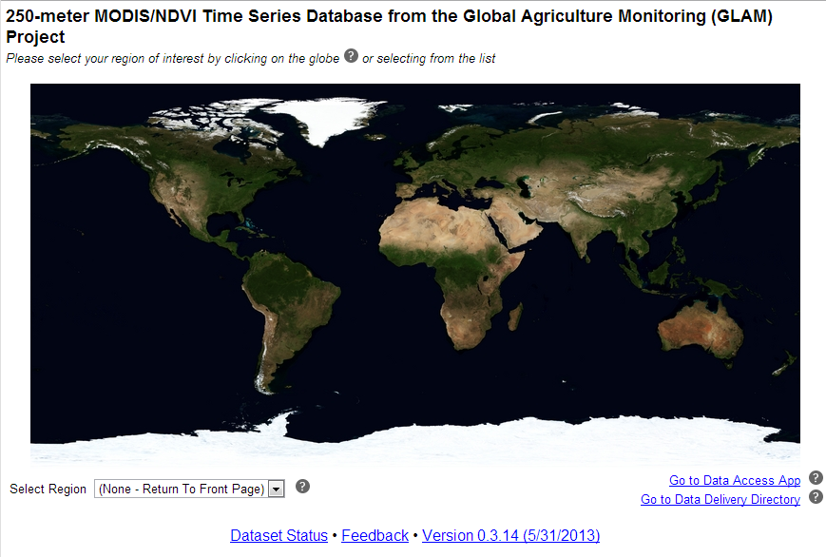
Getting NDVI Data for your location
Select US- Northeast from the drop down list to zoom to our region

Slide 24
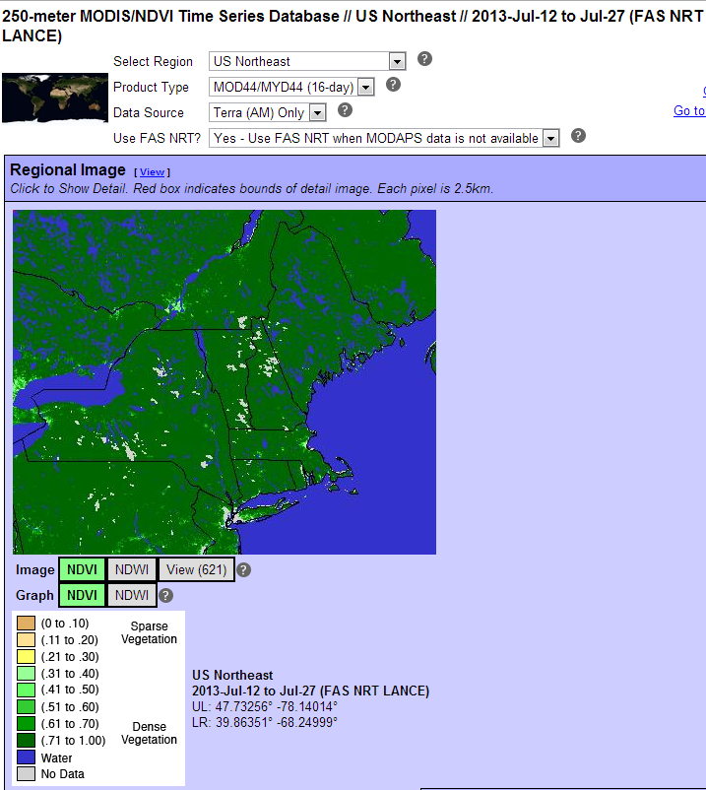
Getting NDVI Data for your location
The full region is shown by default but you can click over an area of interest to see a zoomed image for more accurate data extraction.

Slide 25
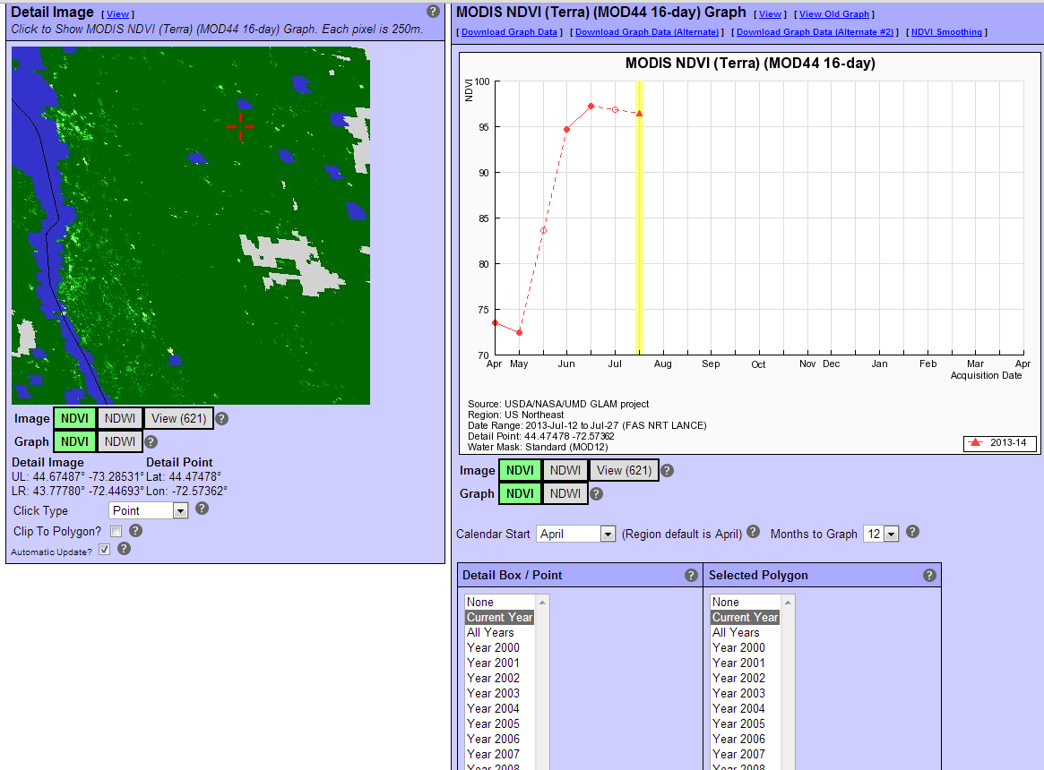
Getting NDVI Data for your location
Once you zoom in you will see other options to select different time periods or graph values from a given point or polygon.
Click on a location in the map on the left, select a time period on the right, and your data will be graphed for you.
Hover over a point and the data value will appear.

Slide 26
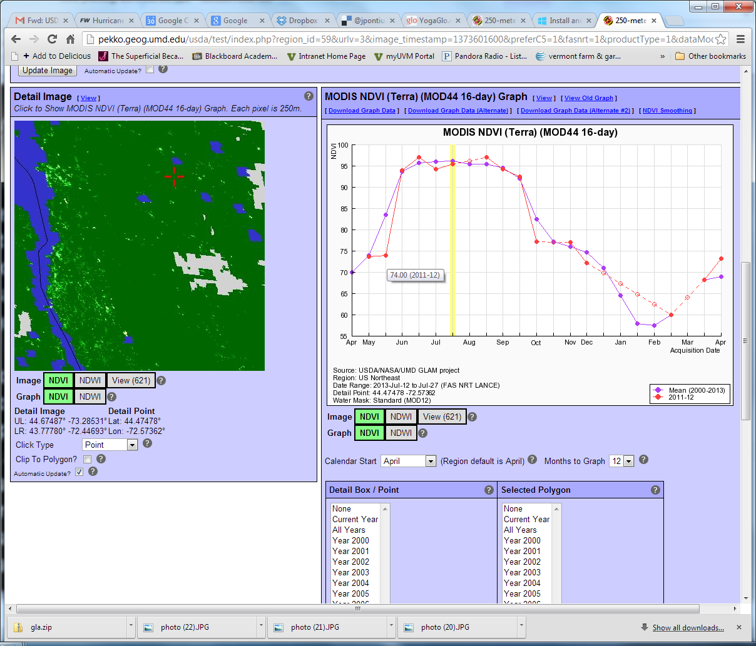
Getting NDVI Data for your location
You can move your point of interest around until you have a geolocation close to your field plot.
You can select any year to visualize from the lists here.
You can also overlay the mean values to see how anomalous a given year is.
Hover over a point and the data value will appear.

Slide 27
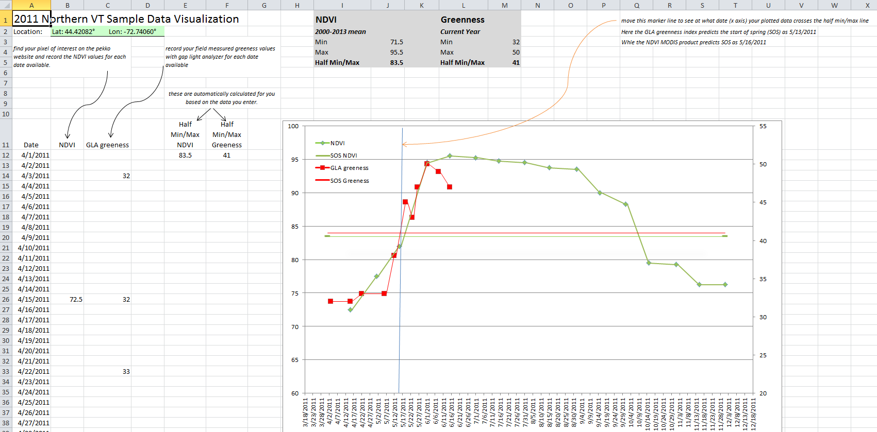
Visualizing your complete data set
The excel template provided allows you to quickly visualize your time series data, and identify a start of spring date based on both satellite and field measurements.

Slide 28
Potential explorations for this data set:
Aside from the basics (identify SOS date, quantify duration of greenup) other questions to be answered from this data set could include:
  How do our field metrics compare to the satellite metrics for our location?
      What might account for differences between the measurements?
      What are the strengths and weaknesses of both field and satellite metrics?
  How does phenology at our location differ from the average phenology response (compare to pekko mean data)?
      Did spring start earlier or later than usual at our location?
  How does phenology at our location compare to other nearby locations (examine NDVI for the date closest to determined SOS at nearby locations)?
      Why might phenology timing differ across the landscape?
      How does the general shape of the phenology curve differ across different eco-zones (tropical, tundra, southern temperate, etc)

Slide 29
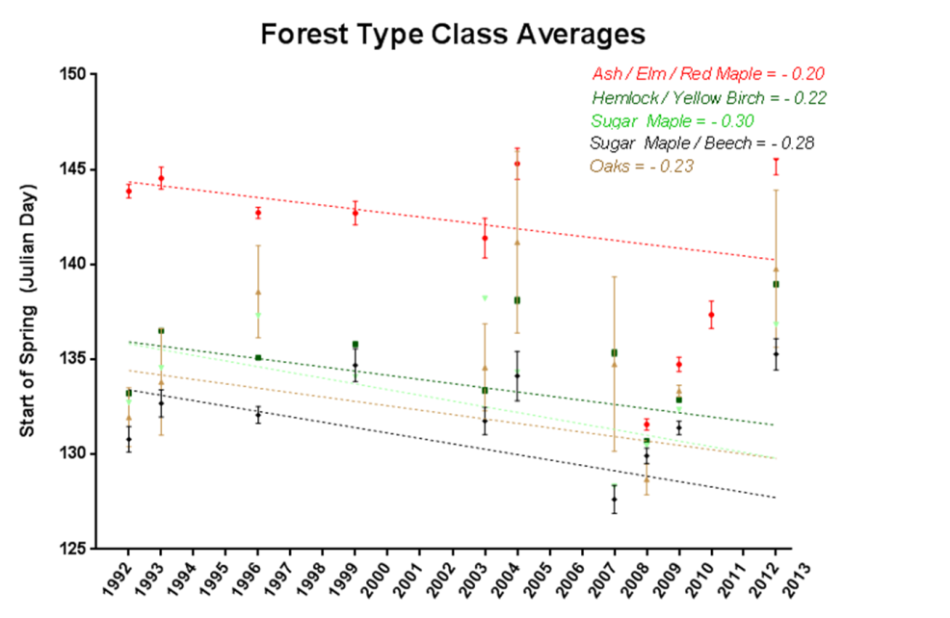
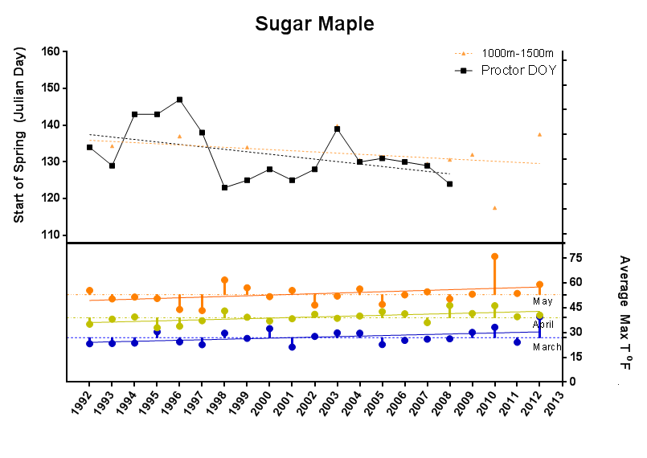
More advanced inquiries:
How is the SOS data changing over time (NDVI time series could be used until sufficient years of field measurements are obtained).
  Is there a consistent trend in this change?
  How much variability occurs from year to year that is not related to long-term trends?
How does weather influence the rate of green up or SOS timing?
  Is minimum, maximum or mean temperature more important in the timing of budburst?

Slide 30

Questions?

