Slide 1
Water and Gases
Pure water (evaporation generally purifies water) interacts with gases in air:
Equilibrium between air and gases:
H₂O + CO₂ → H₂CO_{3(aq)}
How do we determine conc. H₂CO_{3(aq)}??

Slide 2
Henry’s Law
A description of gas solubility of gases in solution
gas_{(g)} ↔ gas_{(aq)} O_{2(g)} ↔ O_{2(aq)}

Slide 3
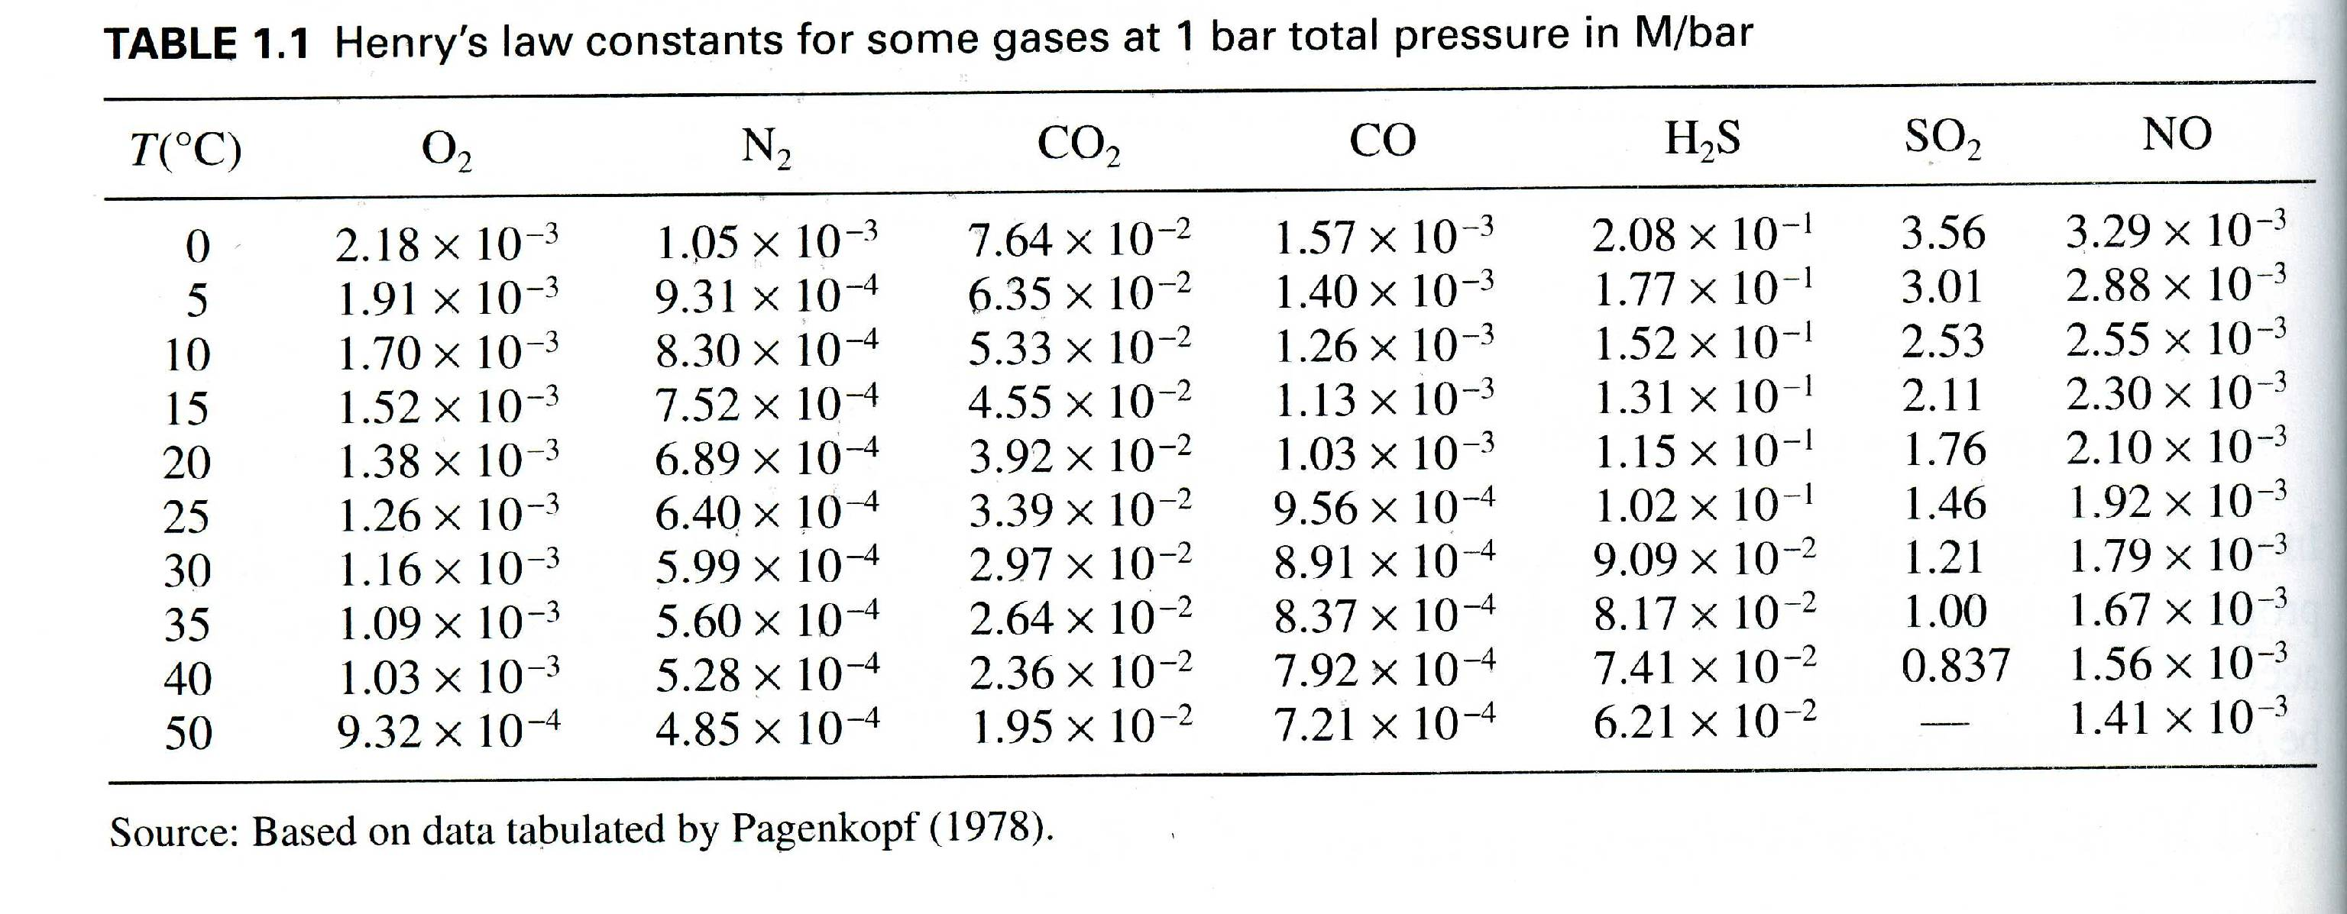
What is the difference in O₂ at equilibrium with 5ºC water vs. 35ºC water??
Compare that with SO₂…

Slide 4
Gas production?
What processes produce gases?
Degassing from melts
Formation and degassing from metamorphic reactions and hydrothermal systems
Diagenetic reactions, petroleum genesis
Biological production

Slide 5
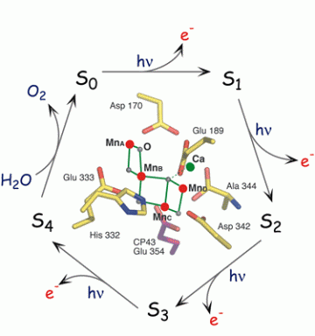
Oxygenic Photosynthesis
Chlorphyll a (P680) is very oxidized (E⁰=+1.1V), enough to oxidize H₂O. BUT e- excitation takes it to E⁰=-0.7V, not enough to reduce NADP+ to NADPH. Thus a need for 2 photosystems….
Water-oxidizing complex is key – Mn4Ca-complex that oxidizes H₂O to O₂ in 4 steps (S₀ through S₄)

Slide 6
Diffusion, Fickian
Diffusion from high to low levels..
Where D is the diffusion coefficient, dc/dx is the gradient, and J is the flux of material

Slide 7
Groundwater
Precipitation that does not run-off into rivers percolates into soils, sediments, and into basement rock fractures to become groundwater
Water always flows down-hill
Darcy’s Law describes the rate of flow
where, Q = volumetric flow rate (m³/s or ft³/s), A = flow area perpendicular to L (m² or ft²), K = hydraulic conductivity (m/s or ft/s), l = flow path length (m or ft), H = hydraulic head (m or ft), and d = denotes the change in h over the path L.

Slide 8
Groundwater Chemistry
Just like other waters, encounters minerals, gases, etc.
Some key differences from other waters:
P_{CO2} variable – respiration!
Segregation of flowpaths in different units

