Slide 1
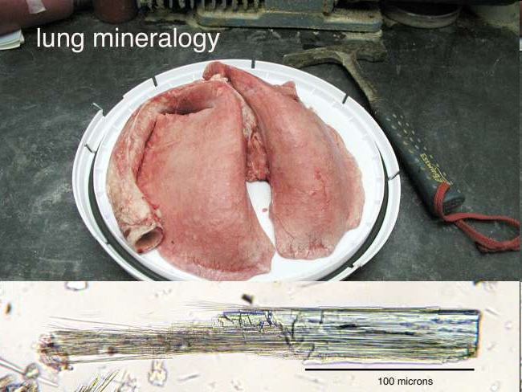
Geochemistry and mineralogy applied to problems in human health
Greg Druschel
University of Vermont

Slide 2
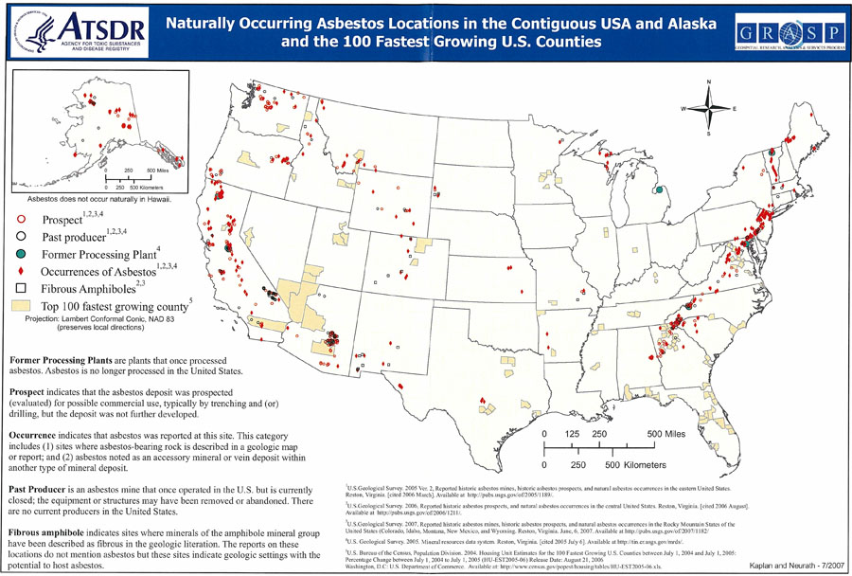
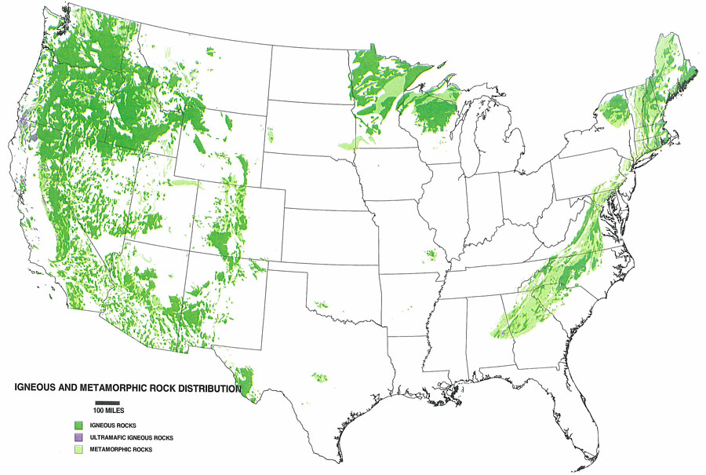
Asbestos & geology

Slide 3
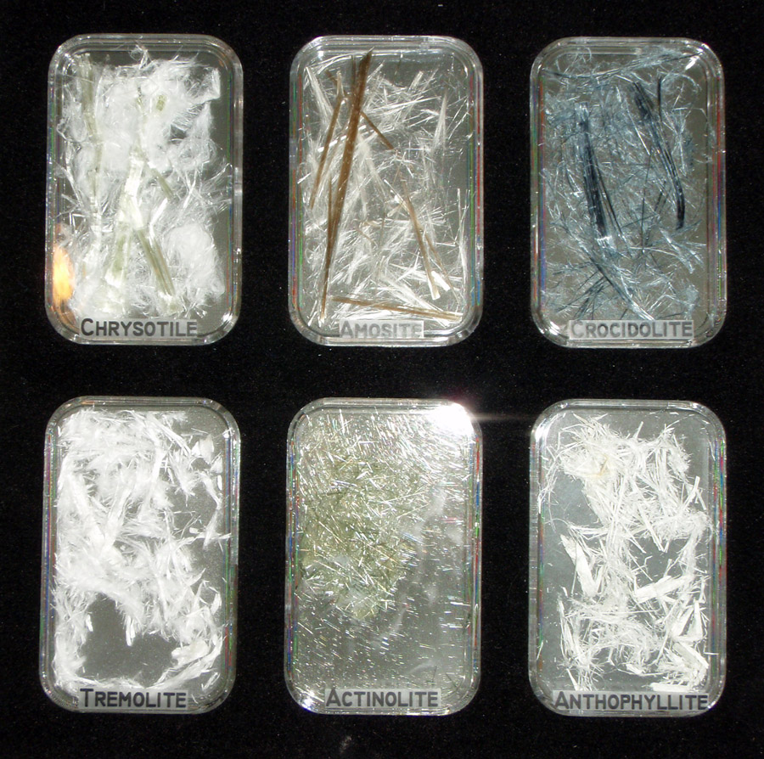
What’s asbestos?
Fibrous mineral, a commercial term
Typically six regulated
chrysotile (white asbestos)
crocidolite (blue asbestos)
amosite (brown asbestos)
tremolite, actinolite & anthophyllite (if asbestiform)

Slide 4
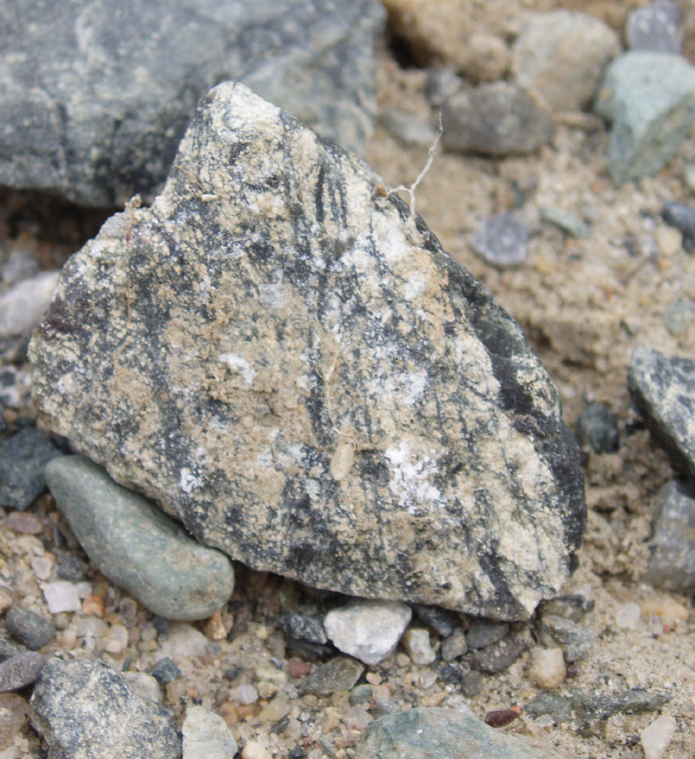
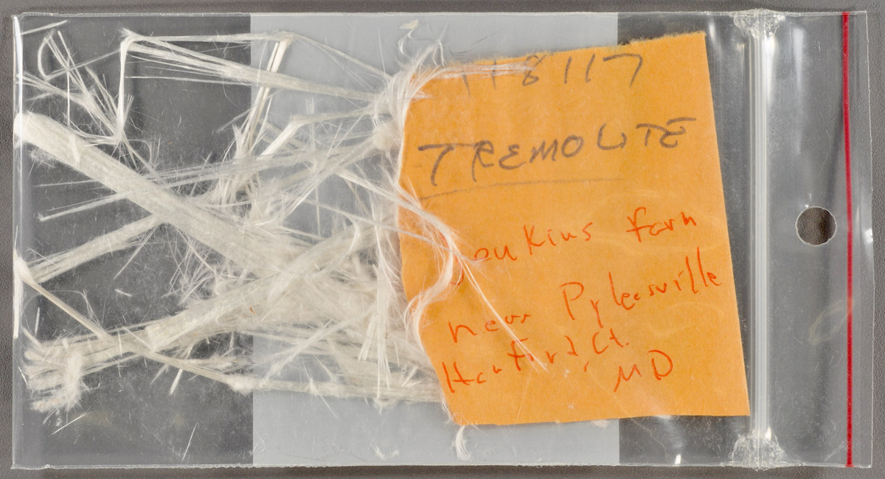
What’s asbestiform?
Separable fibers
= ‘elongated’ minerals??

Slide 5
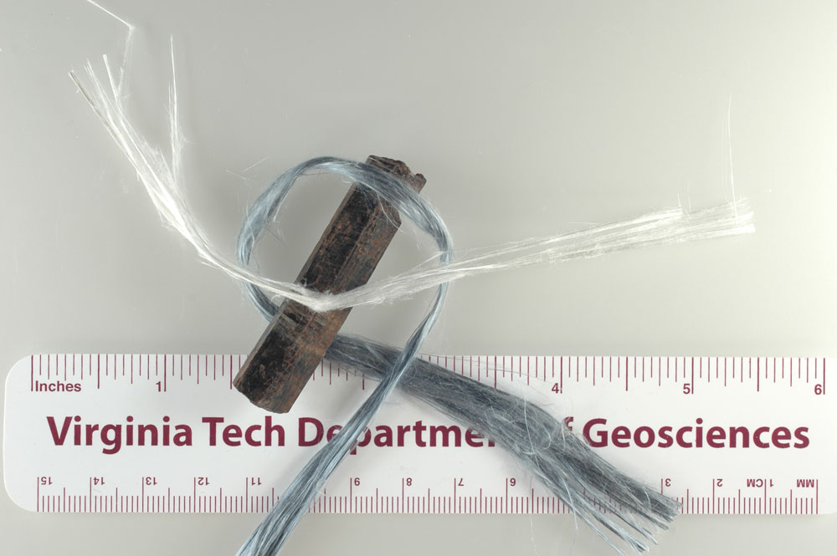
Morphology - seeing is knowing
asbestos vs non-asbestos
Gunter et al. (2007)

Slide 6
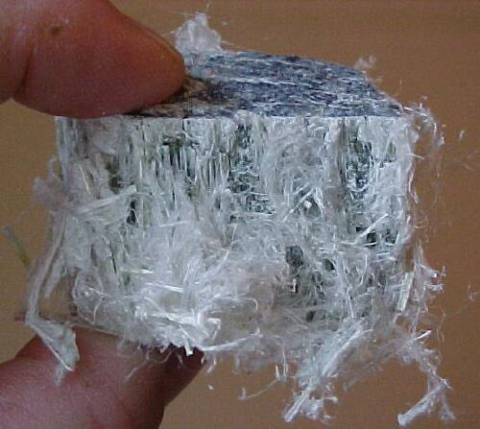
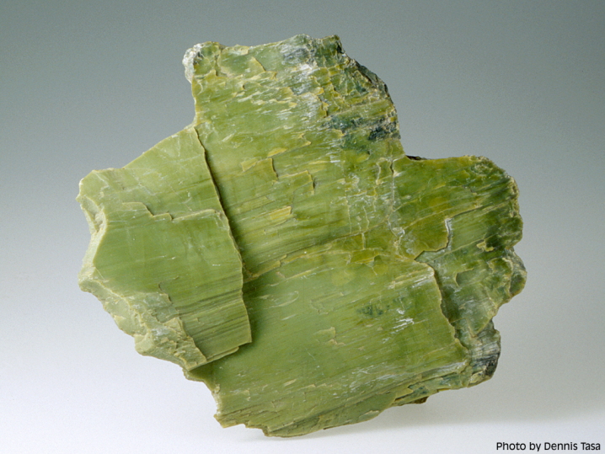
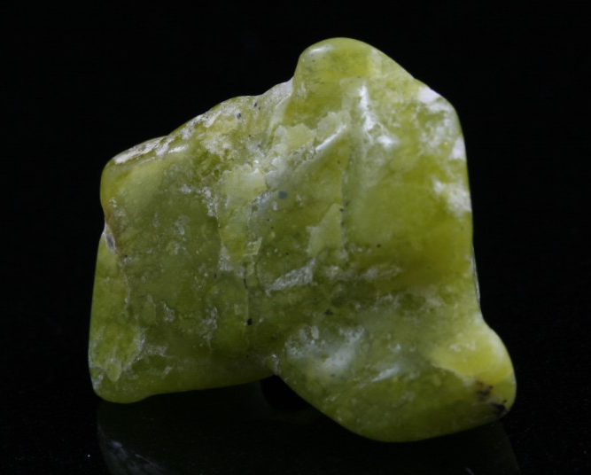
Serpentine Group
3 polymorphs: hydrated Magnesium silsicate - Mg₃Si₂O₅(OH)₄ - (Space group – use XRD)
Antigorite (Cm) – effectively a platy mineral
Lizardite (P1-bar) – effectively a platy mineral
Chrysotile – Clinochrysotile (C2/m), Orthochrysotile (Unk) – Mg-O and Si-O layer mismatch – effectively a fiber

Slide 7
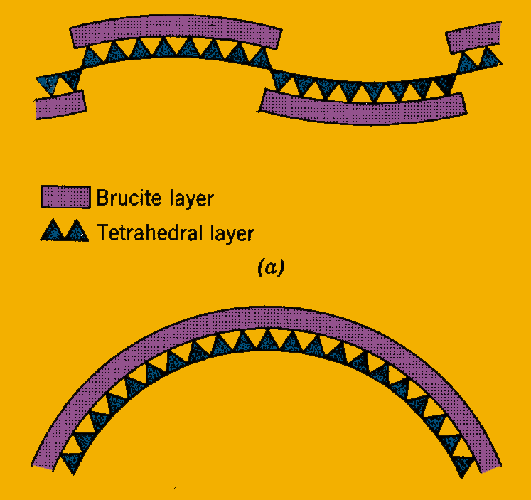
Serpentine
Antigorite maintains a sheet-like form by alternating segments of opposite curvature
Chrysotile does not do this and tends to roll into tubes
Octahedra are a bit larger than tetrahedral match, so they cause bending of the T-O layers (after Klein and Hurlbut, 1999).

Slide 8
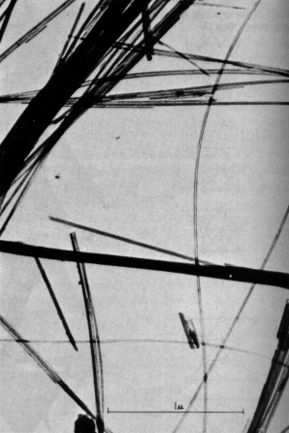
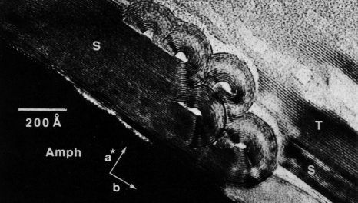
Serpentine
Veblen and Busek, 1979, Science 206, 1398-1400.
S = serpentine T = talc
Nagby and Faust (1956) Am. Mineralogist 41, 817-836.
The rolled tubes in chrysotile resolves the apparent paradox of asbestosform sheet silicates

Slide 9
Asbestiform Amphiboles
‘Regulated’ amphiboles – Crocidolite, Amosite, Tremolite, Anthophyllite, Actinolite
W₀₋₁ X₂ Y₅ [Z₈O₂₂] (OH, F, Cl)₂
Tremolite
Ferroactinolite
Ca₂Mg₅Si₈O₂₂(OH)₂
Actinolite
Ca₂Fe₅Si₈O₂₂(OH)₂
Anthophyllite
Cummingtonite-grunerite
Grunerite
Mg₇Si₈O₂₂(OH)₂
Fe₇Si₈O₂₂(OH)₂
Also couple Na substitution to create sodic amphiboles
Reibickite is Na₂Fe²⁺₃Fe³⁺₂Si₈O₂₂(OH)₂.

Slide 10
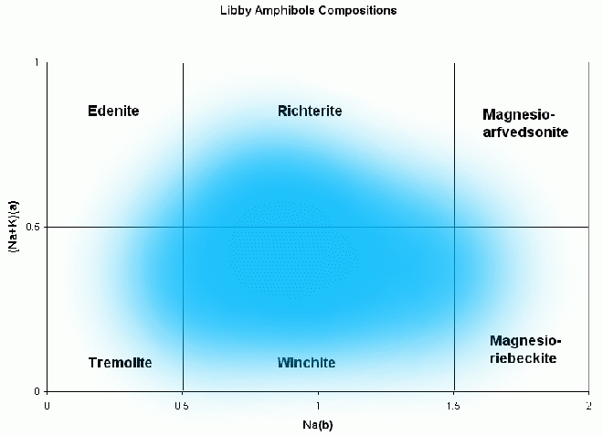
Chemical Varability
Chemical Variability of these minerals creates some interesting definition problems (for lawyers):
In a 2006 pretrial order, the district court ruled that “asbestos” for purposes of the Clean Air Act criminal provision means only those six compounds. U.S. v. W.R. Grace, 455 F. Supp.2d 1122, 1132 (D. Mont. 2006).
“fibrous, non-combustible compound that can be composed of several substances, typically including magnesium.” -9th circuit court decision, 2007

Slide 11
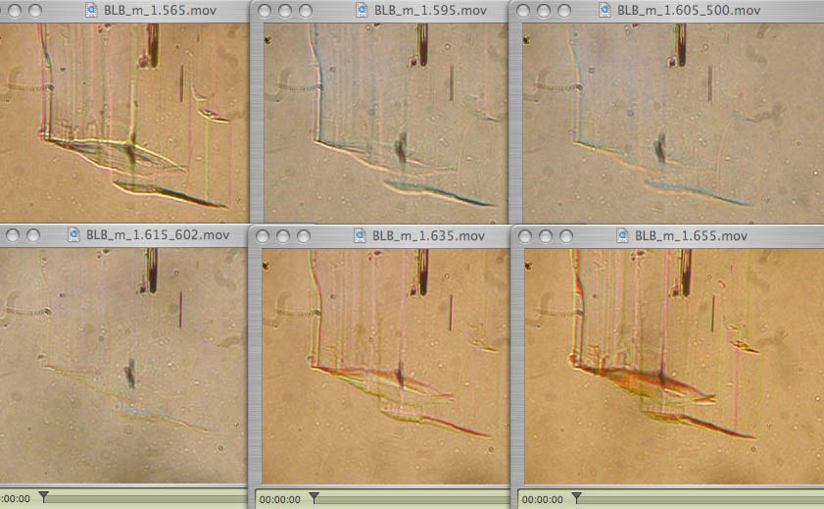
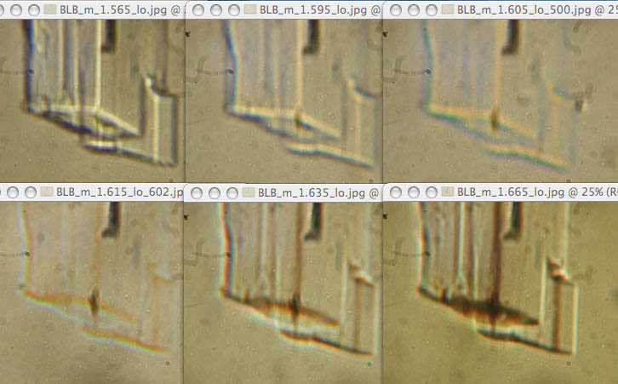
tremolite example
+0.050
+0.020
match at 500 nm
match at 600 nm
-0.020
-0.050
Dyar and Gunter (2008)

Slide 12
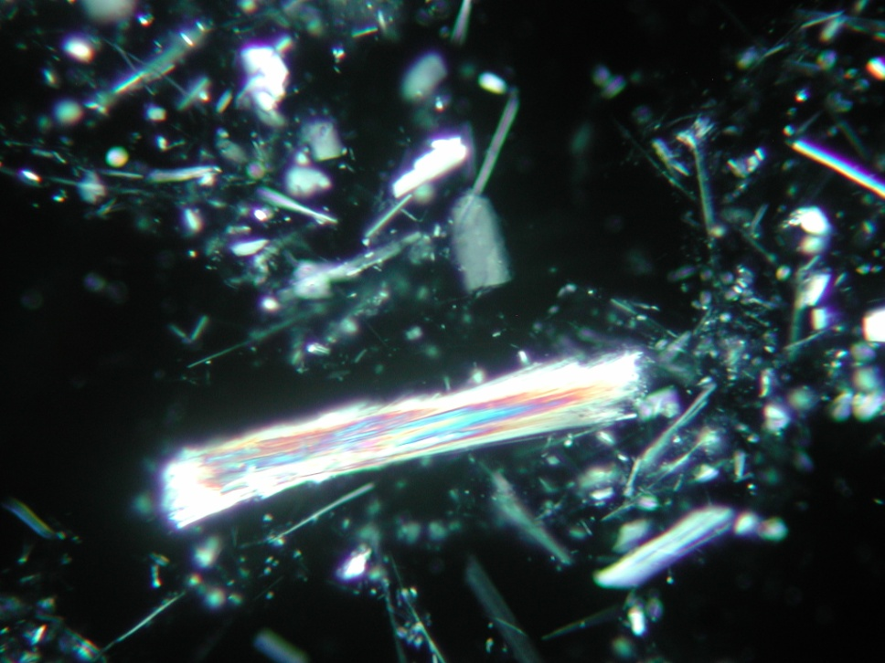
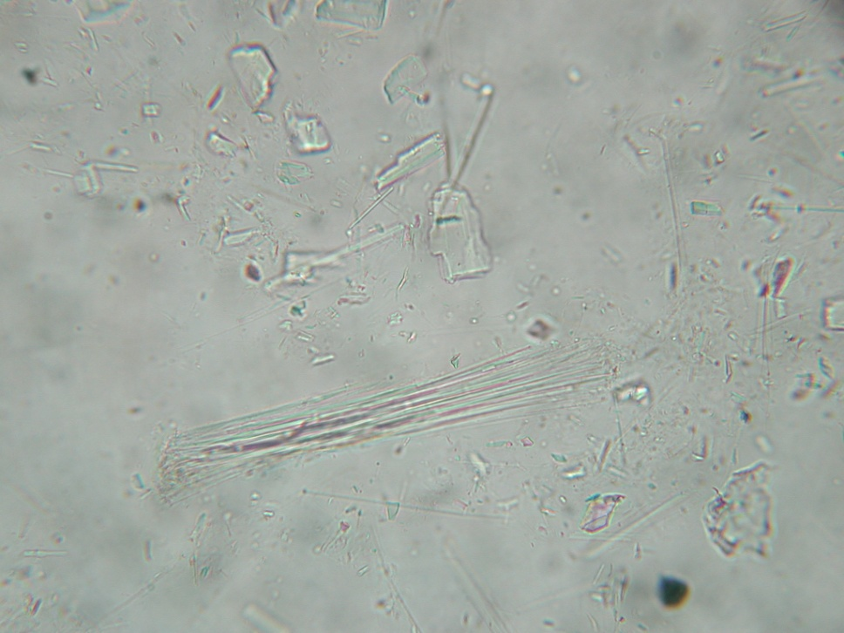
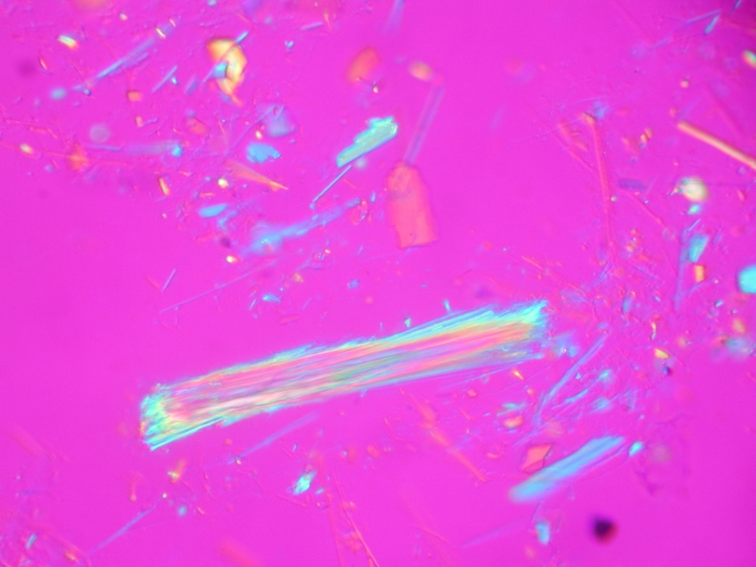
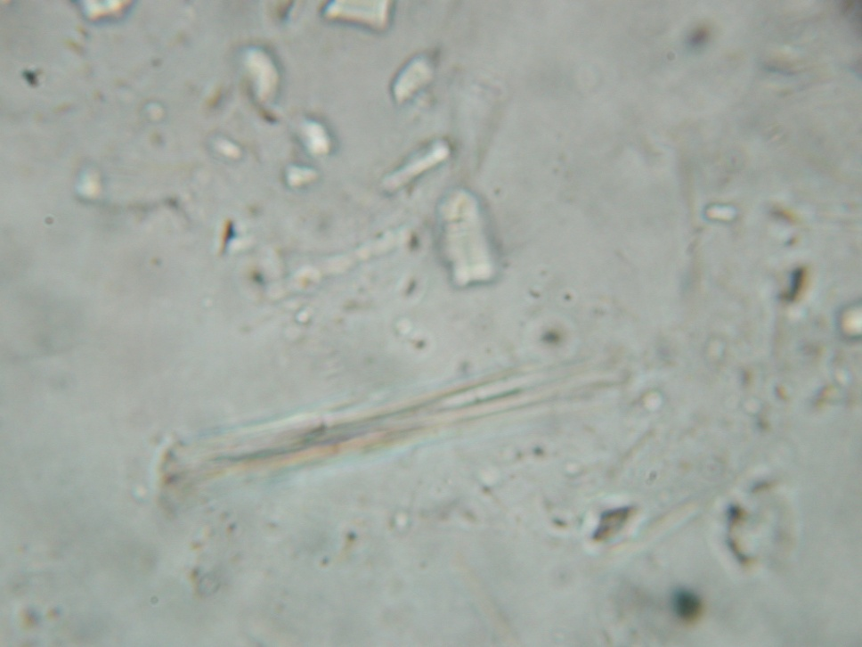
PLM photos in matching liquid (1.576) for talc (FOV = 0.5 mm)
a.
c.
tremolite
talc
b.
d.

Slide 13
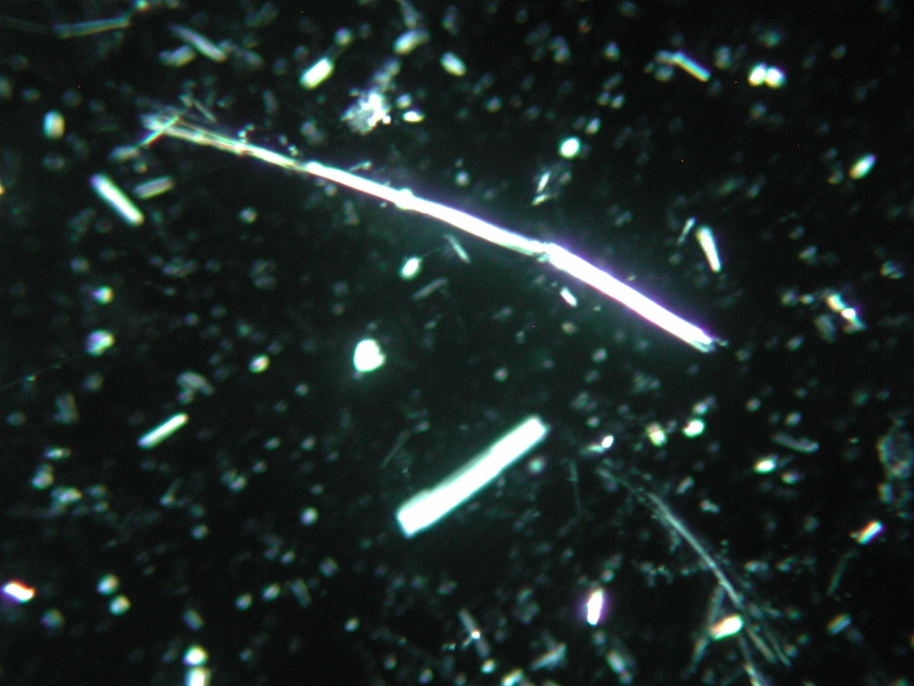
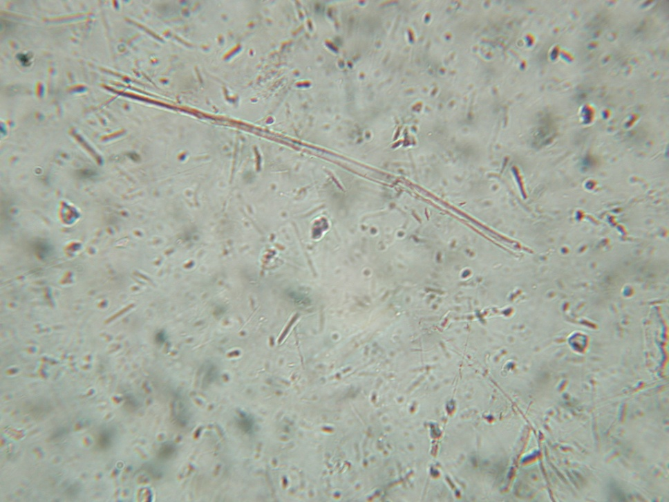
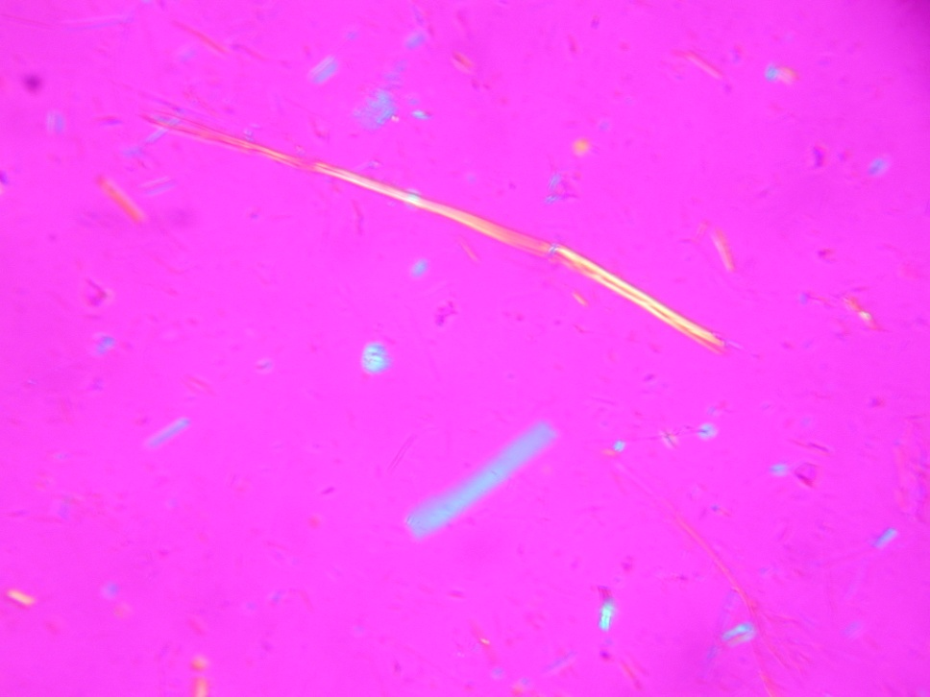
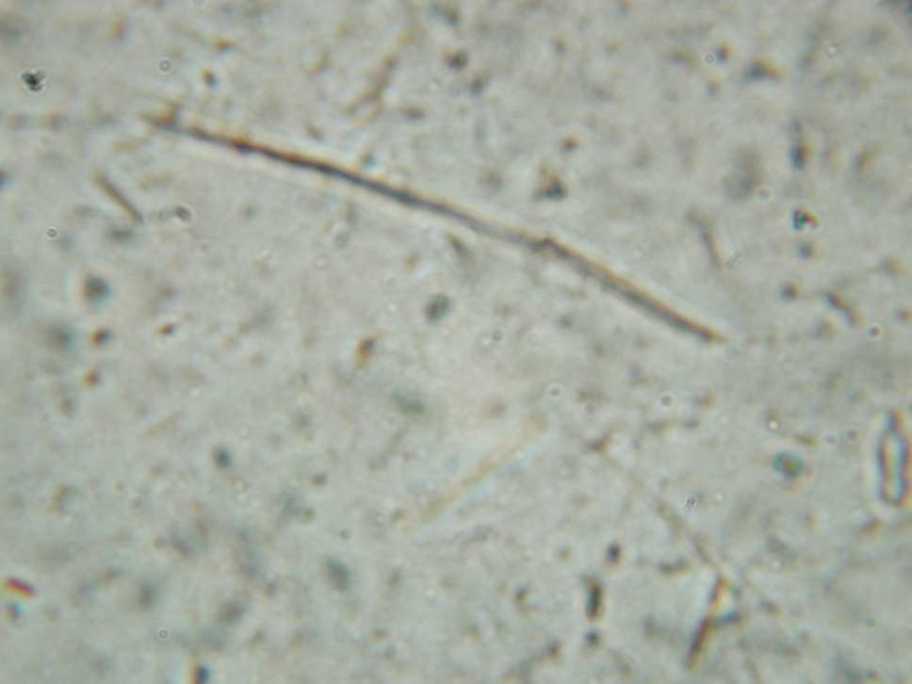
PLM photos in matching liquid (1.628) for tremolite (FOV = 0.5 mm)
a.
c.
talc
tremolite
b.
d.

Slide 14
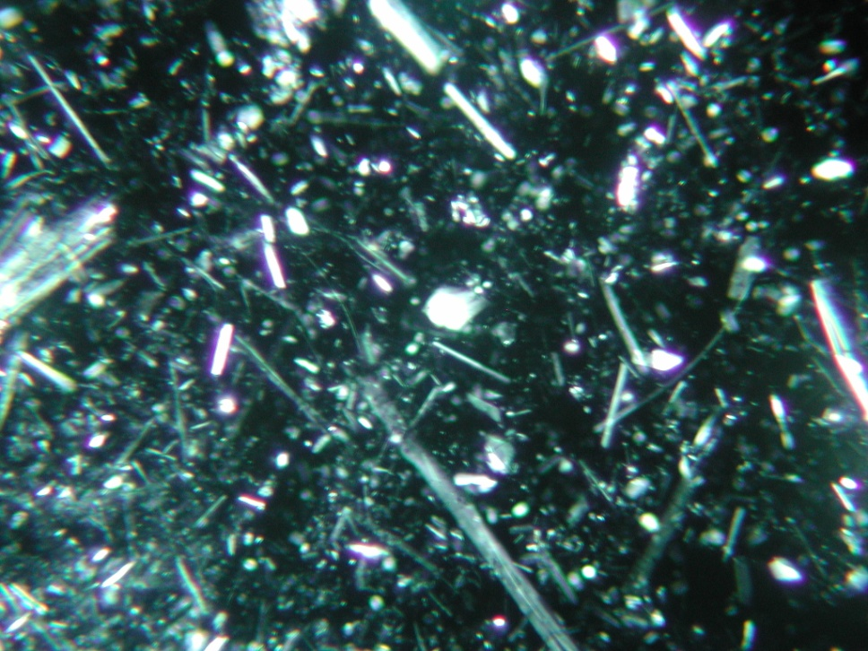
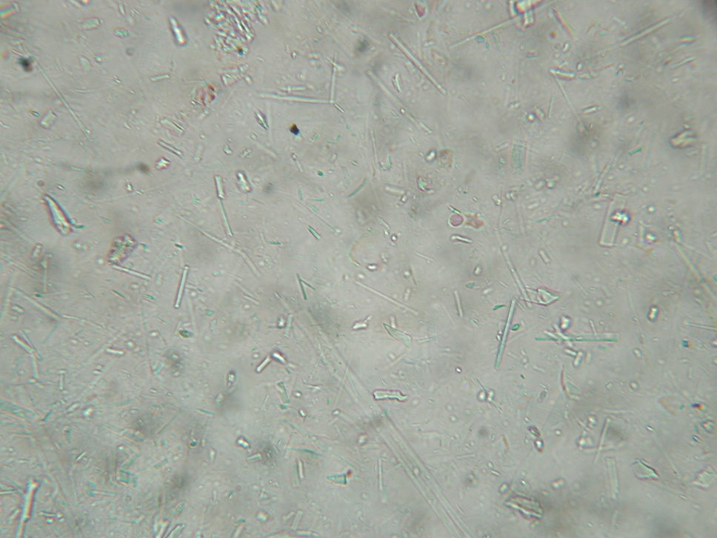
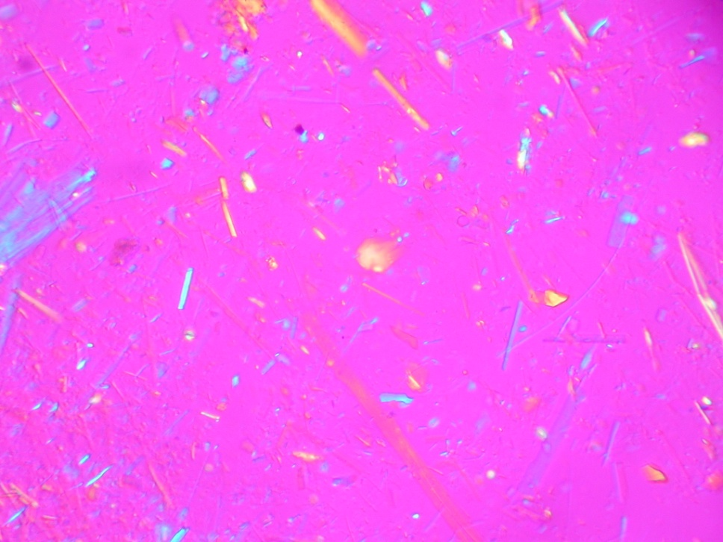
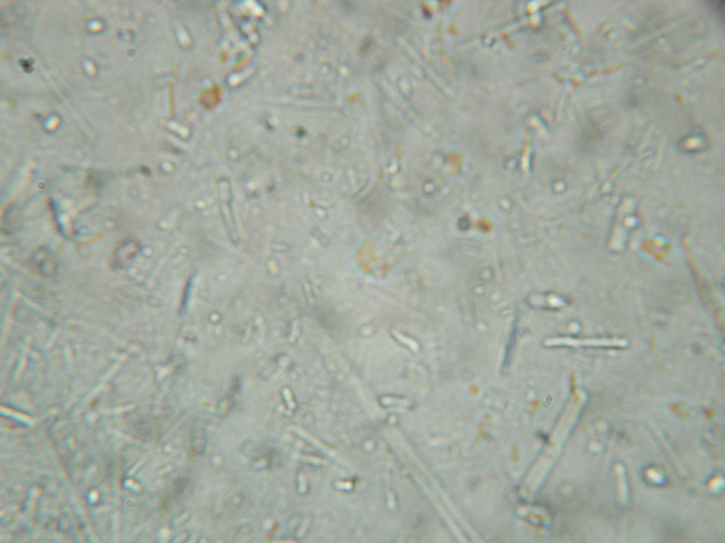
PLM photos in matching liquid (1.550) for serpentine (FOV = 0.5 mm)
a.
c.
serpentine
talc
tremolite
b.
d.

Slide 15
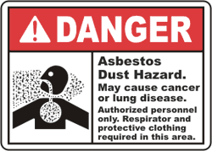
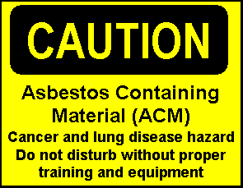
ASBESTOS

Slide 16
Fireproof = Asbestos
How did we know asbestos would be useful as a fireproofing material?
Known to antiquity – first reference as a fireproof fabric made in 300 B.C. (Theophrastus discussed asbestinon fabric), also referred to in ancient Chinese, Indian references
Roman descriptions of valuable asbestos napkins – thrown in the fire they come out brilliant white and clean (Pliny the elder)

Slide 17
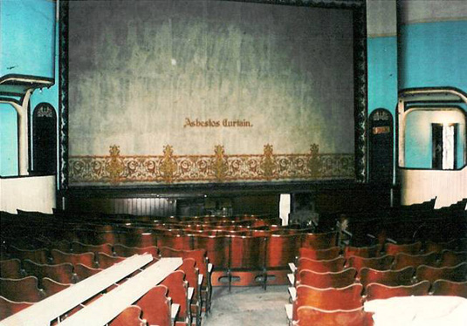
Why Asbesotos
Notes:
Best material, by far, available to contain fire available until the late 20th century

Slide 18
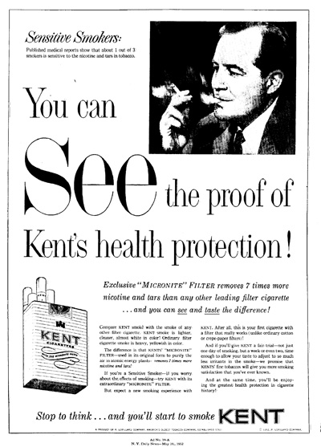
Notes:
Go back to the late 1800s through mid 1900s and many products were advertised as being made of asbestos – fire protection and filtering were the primary uses

Slide 19
Evolution of asbestos health issues
Dangers of asbestos recognized in antiquity – Greeks and Romans recognized slave health issues
Cases for mine workers in the 1900’s-1950’s known in U.S. and Britain but with substantial company cover-ups.
Use as fire & friction products (1960, 10lbs/person)
Health issues became public really starting in 1964 – New York Academy of Sciences meeting convened and a group of doctors began to alert the public to the dangers of asbestos dusts
Asbestosis, lung cancer, mesothelioma
Asbestos Hazard Emergency Response Act (AHERA), enacted in 1986, established strict asbestos regulations

Slide 20
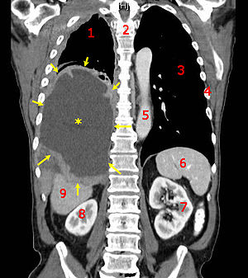
Health Effects
Asbestosis (type of pulmonary fibrosis) where air sacs in the lung become scarred, inflamed, and the tissue hardens
Pleural Mesothelioma – a cancer that affects the lining around the lungs (Pleura) – can have a 30 year latency before presenting.
Lung Cancer – difficult to tie this one specifically to asbestiform minerals

Slide 21
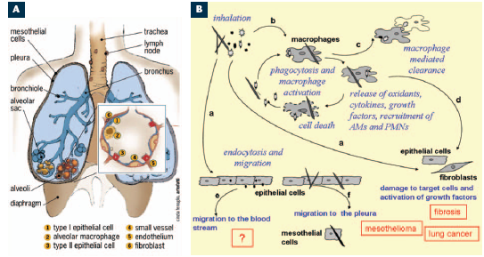
Inhaled mineral particles

Slide 22
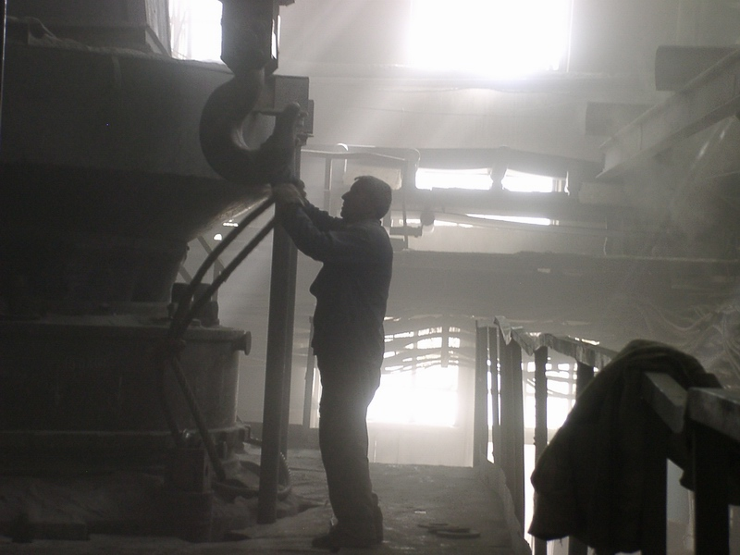
Background levels of dust
In air:
- 0.0004 to 0.01 fibers / cc -> breathe 4,000 to 100,000 fibers / day
(Mossman et al. 1990, Klein 1993)
- 10μg / m³ (of 5μm sized particles) -> breathe 2,500,000 particles / day
(Norton & Gunter 1999)
In lungs (at death):
- 80,000,000 “fibers” with 50% asbestos
general population Vancouver, BC (Chrug 1983)
- white-asbestos = 50,000,000 and tremolite-asbestos = 6,000,000
general population San Francisco (Chrug & Warnock 1980)

Slide 23
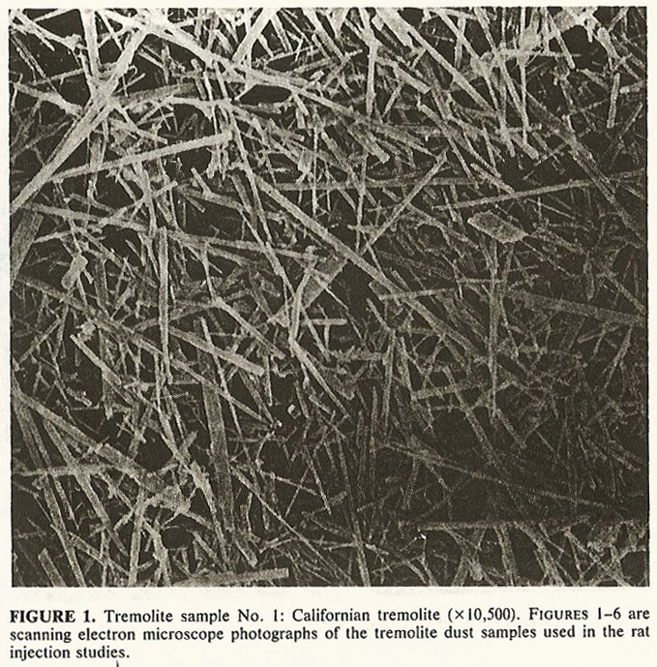
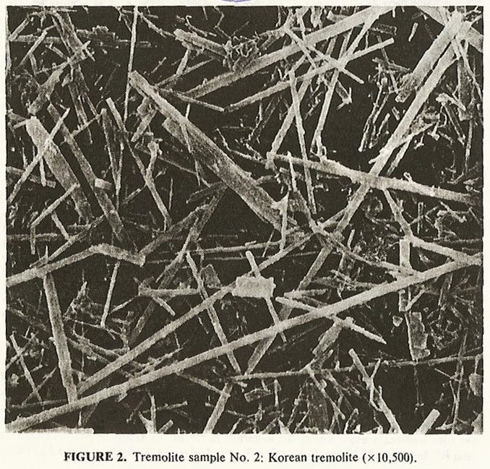
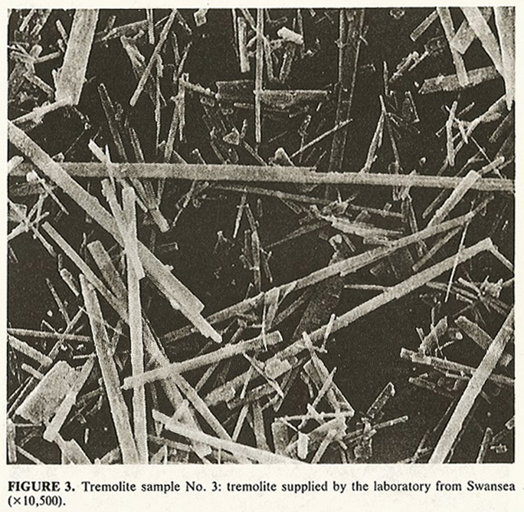
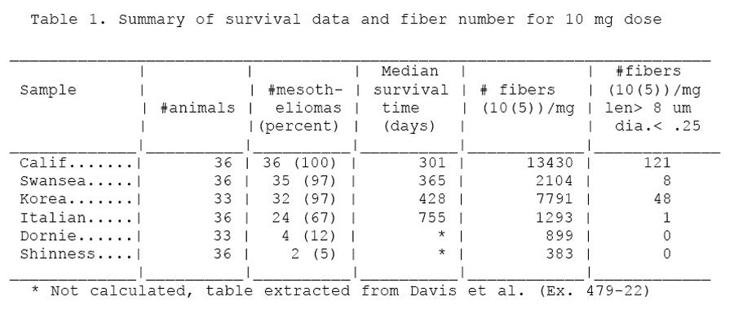
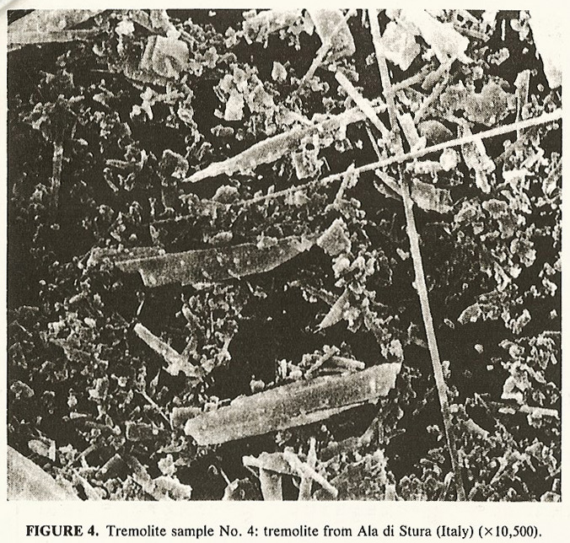
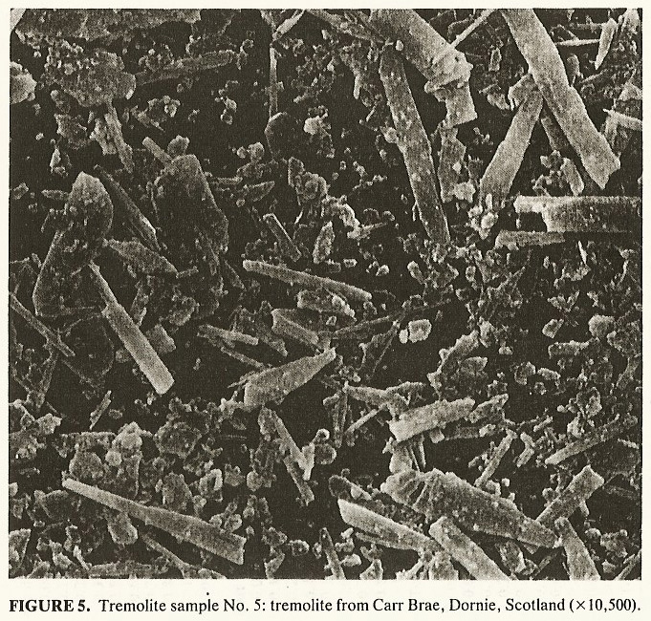
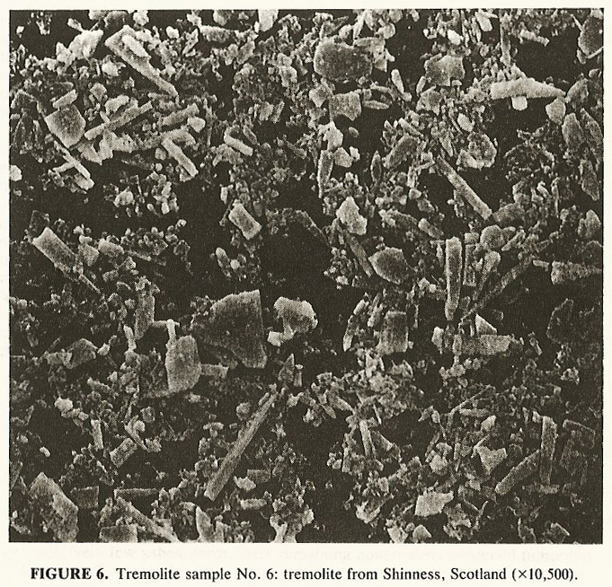
All ‘tremolite’…
Davis et al. 1991 & OSHA 1992…

Slide 24
Dose
“Alle Ding' sind Gift, und nichts ohn' Gift; allein die Dosis macht, daß ein Ding kein Gift ist.” "All things are poison, and nothing is without poison; only the dose permits something not to be poisonous.“ Paracelsus
SO… How much asbestos dose it take?

Slide 25
Asbestos Exposure
Significant epidemiological evidence exists to suggest occupational exposures have demonstrable negative health effects – workers in mines, shipyards, brake factories, etc.
OSHA limits 0.1 fiber/cc per 8 hour day - typical human breathes 12-20 times/minute, 500cc each, over an 8 hour day that means, on average the dose limit is around 400,000 fibers per day
“typical” airborne exposures – 0.001 to 0.0001 f/cc – 400-4000 asbestos fibers per 8-hour day

Slide 26
What causes health effects?
Several ideas exist about how specific minerals may cause asbestosis/mesothelioma/lung cancers:
Physical length of fibers screws up alveolar macrophage (cell that engulfs and dissolves foreign substances) – resulting in the macrophage being lysed (explodes)
Mineral fibers are sites of reactivity – generating reactive oxygen species (O₂⁻, OH*, H₂O₂), interacting with iron (Haber-Weiss cycling)
Interacting with key organic compounds associated with cell signaling (sorption, direct oxidation, catalysis)
Surface groups buffer pH, redox chemistry to upset fluid balance
Little agreement on what the causes are, and even more unclear how causes are linked to some mineral types being more toxic than others

Slide 27
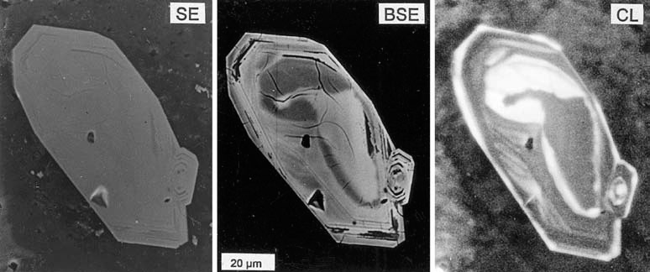
Mineral Reactivity
How can 6 different kinds of tremolite have such different levels of toxicity?
Same mineral name - may still have differences in chemical and structural imperfections!
From Gotze et al., 2002, zircon grains

Slide 28
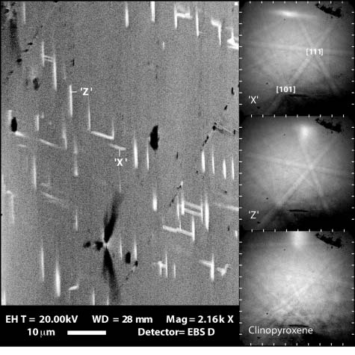
EBSD and defects
Electron Backscatter Diffaction (EBSD) is a tool to look at orientation of elements into a lattice at individual small points
Mismatches crystallographically are defects
Defects can be highly reactive – generating radicals on interaction with water, oxygen, iron, nitrogen, etc.
Feinberg et al., 2004 EBSD of clinopyroxene
Garnet by FESEM-EBSD – colors indicate crystallographically distinct orientations; Puelles et al., 2009

Slide 29
Minerals surfaces
Key signaling molecules (for example extracellular signal-regulated kinases, ERKs) may be an early part of the cellular reactions involved in fibrotic diseases like asbestosis.
Question now is – how can minerals affect these signaling molecules?
Atomic force microscopy using single crystals as the tip can be used to measure interactive force between specific minerals and key signaling molecules (Steve Lower, OSU)
Water-rock experiments can quantify degree of sorption, reversibility, and investigate role of radical generation at surface along with sorption processes

Slide 30
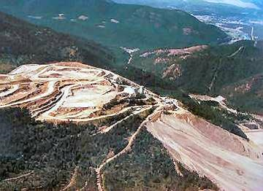
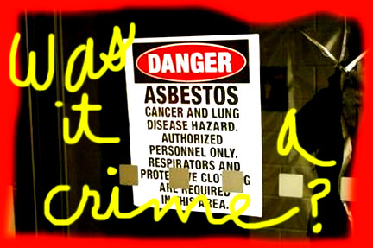
Libby
Trial of 5 former mine executives for violation of the Clean Air Act and Conspiracy

Slide 31
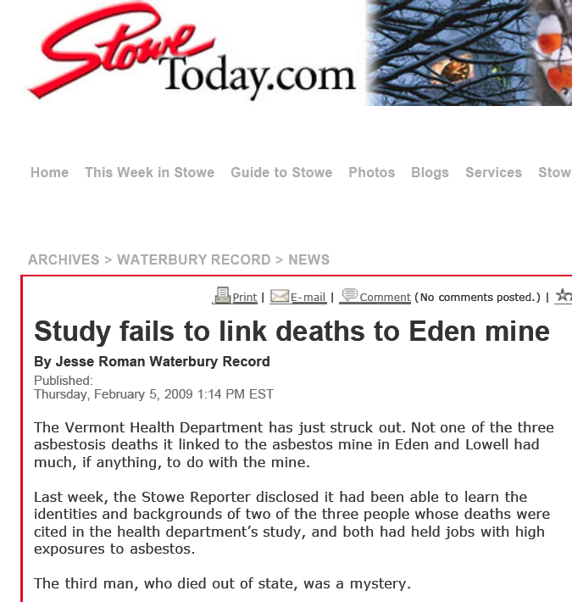
Recent VAG “issues”
VT Department of Health released a statistical study of risk analysis in Nov 2008 indicating residents in a 10 mile radius had a statistical risk increase for asbestos-related disease from environmental exposure
Study based on 3 cases where residents (not miners) had died of asbestos-linked asbestosis/mesothelioma

Slide 33
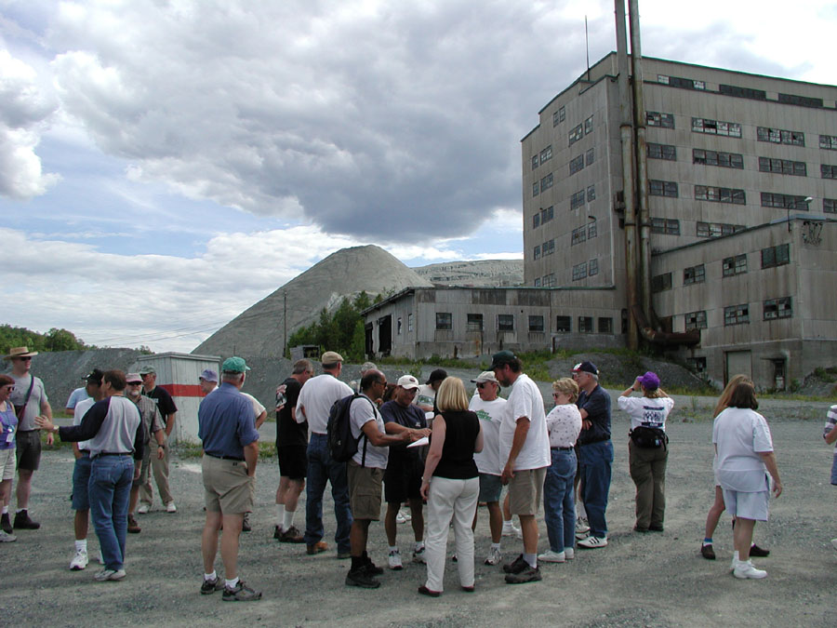
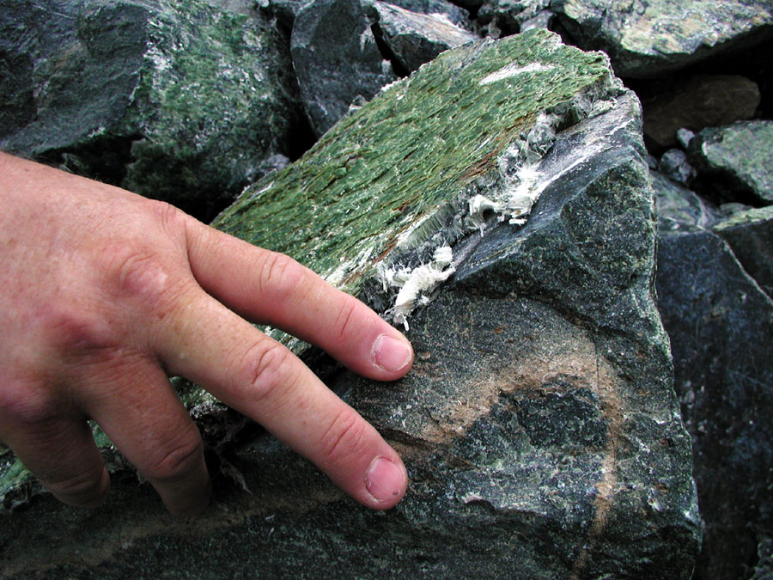
VAG mine (2002): Chrysotile deposit

Slide 34
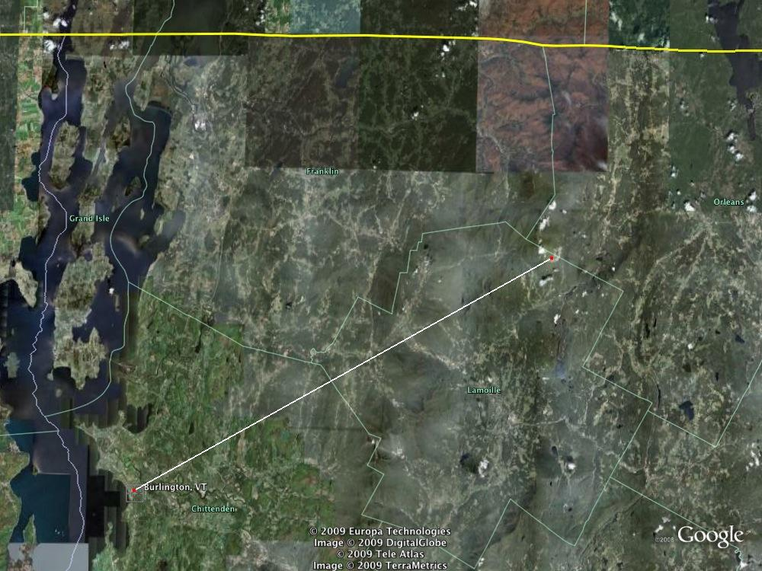
VAG location

Slide 36
samples (cont)
Images and data courtesy Mickey Gunter, University of Idaho

Slide 37
results
Images and data courtesy Mickey Gunter, University of Idaho

