Slide 1
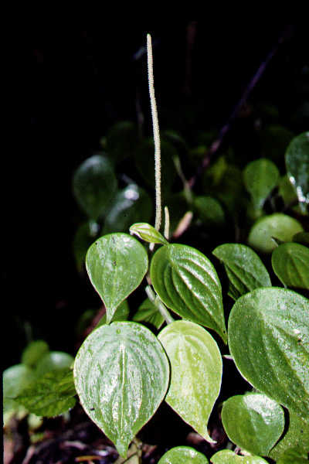
PIPERACEAE

Slide 2
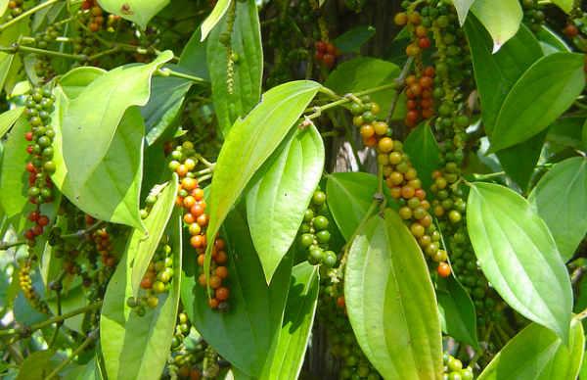
Key Characters for Piperaceae
Swollen nodes
Arcuate veins
Crushed-leaf odor of the magnoliids
Thick spikes
No perianth

Slide 3
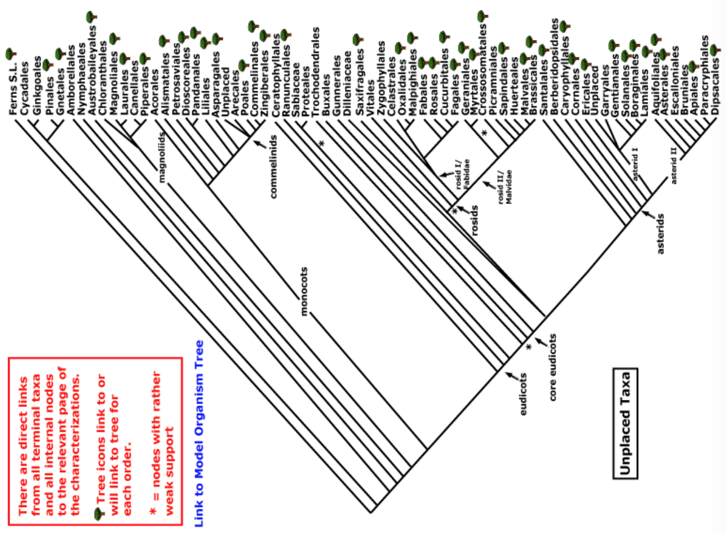
magnoliids
monocots
Current Angiosperm Phylogeny Group Tree for Flowering Plants
2016

Slide 4
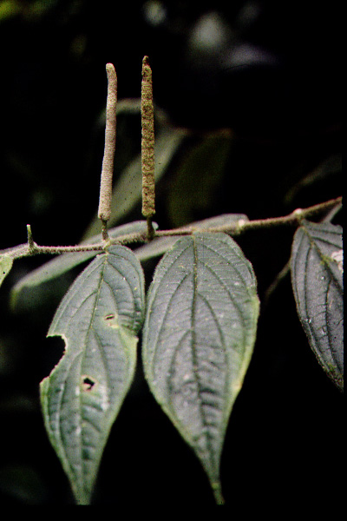
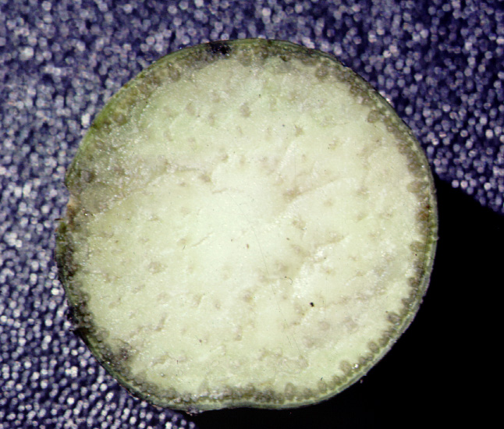
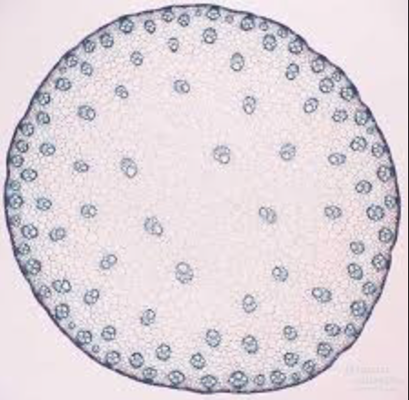
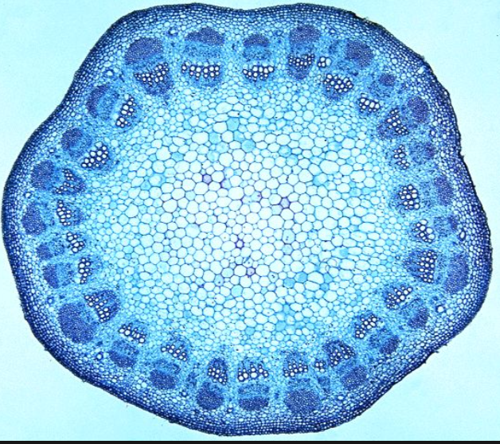
stem section of Piper showing monocot-like stem anatomy
Monocot Eudicot

Slide 5
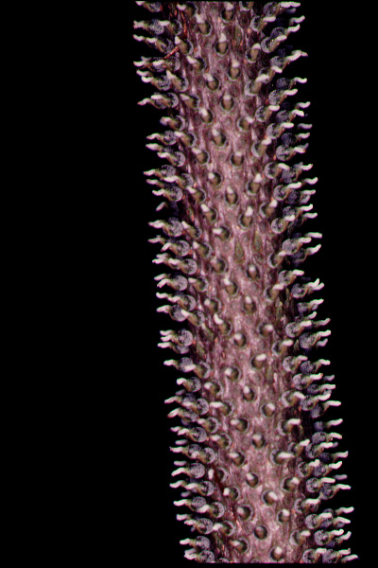
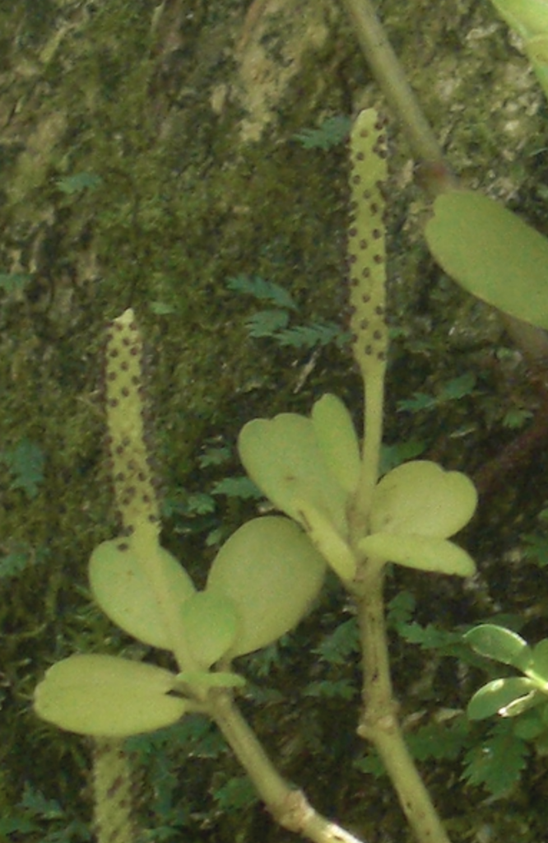
spikes of flowers without perianth

Slide 6
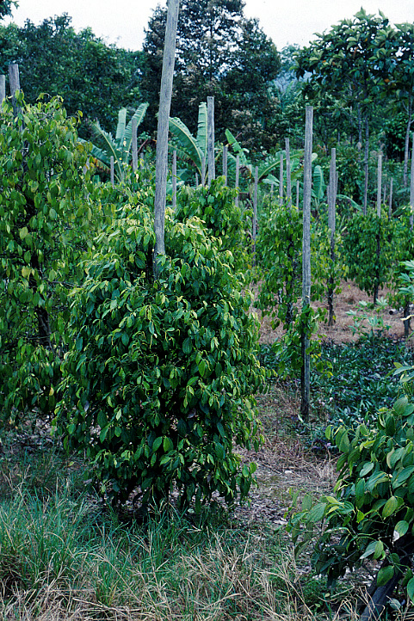
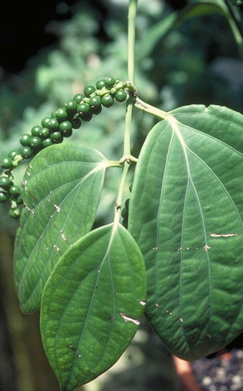
Piper nigrum in cultivation:

Slide 7
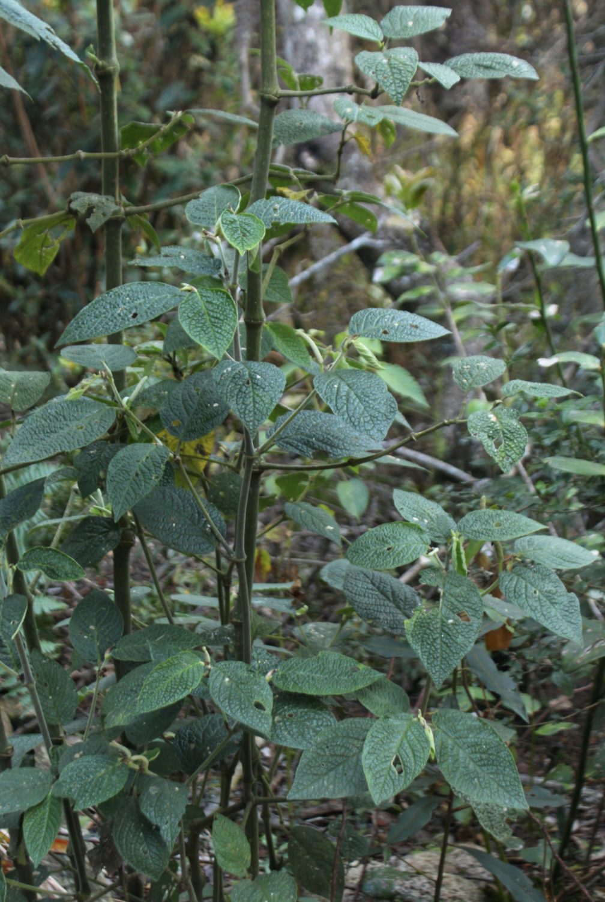
Piper: mostly reelets and shrubs in wet forests

Slide 8
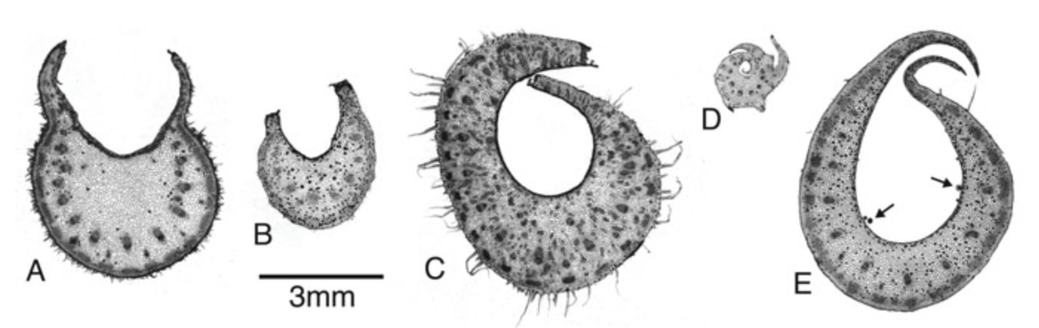
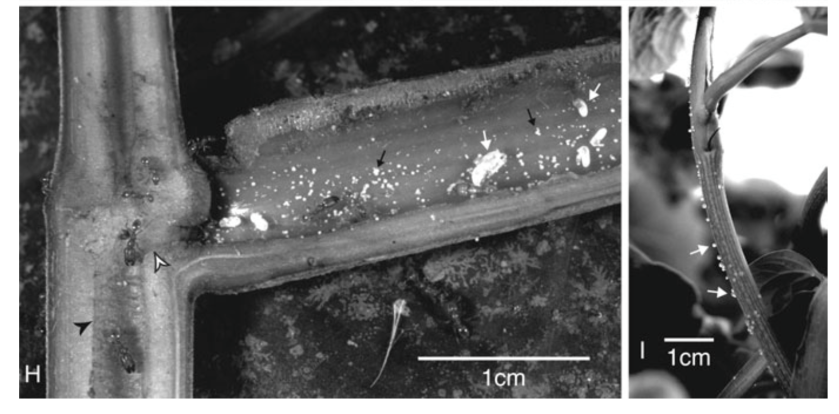
Petiolar domatia in Piper, Tepe et al., 2007

Slide 9
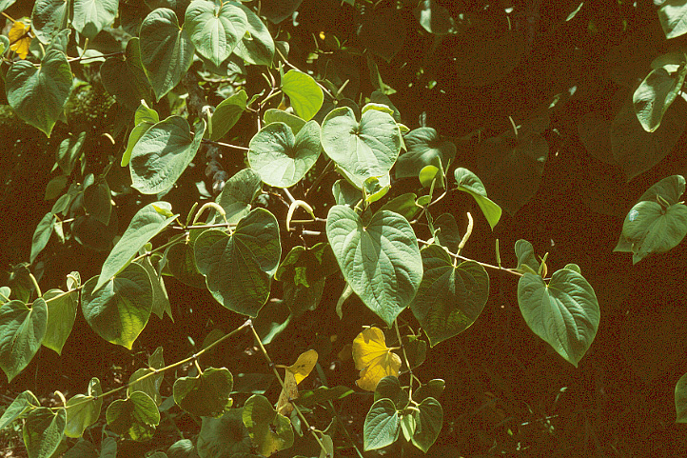
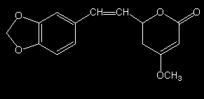
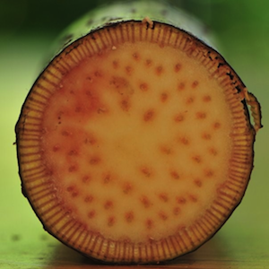
Piper methysticum - the source of kava
Methysticin, a kavalactone
Notes:
Kavalactones (produced in roots) have been shown to be allelopathic to plants such as lettuce, radish, and barnyard grass (Xuan et. al 2006). They act as pre-emergent herbicides, inhibiting seed germination.
Xuan, T. D., et al. "Herbicidal and fungicidal activities of lactones in kava (Piper methysticum)." Journal of agricultural and food chemistry 54.3 (2006): 720-725.
the beverage produced from its roots. Kava is a tranquilizer primarily consumed to relax without disrupting mental clarity. Its active ingredients are called kavalactones.
The sensations, in order of appearance, are slight tongue and lip numbing (the lips and skin surrounding may appear unusually pale); mildly talkative and sociable behavior; clear thinking; anxiolytic (calming) effects; relaxed muscles; and a very euphoric sense of well-being. The numbing of the mouth is caused by the two kavalactones kavain and dihydrokavain which cause the contraction of the blood vessels in these areas acting as a local topical anesthetic. These anesthetics can also make one's stomach feel numb. Sometimes this feeling has been mistaken for nausea. Some report that caffeine, consumed in moderation in conjunction with kava can significantly increase mental alertness.
A potent drink results in a faster onset with a lack of stimulation, the user's eyes become sensitive to light, they soon become somnolent and then have deep, dreamless sleep within 30 minutes. Sleep is often restful and there are pronounced periods of sleepiness correlating to the amount and potency of kava consumed. Unlike alcohol-induced sleep, after wakening the drinker does not experience any mental or physical after effects. However, this sleep has been reported as extremely restful and the user often wakes up more stimulated than he or she normally would. Although excessive consumption of exceptionally potent brew has been known to cause pronounced sleepiness into the next day. Although heavy doses can cause deep dreamless sleep, it is reported that many people experience lighter sleep and rather vivid dreams after drinking moderate amounts of kava. [2]
After thousands of years of use by the Polynesians and decades of research in Europe and the U.S., the traditional use of kava root has never been found to have any addictive or permanent adverse effects

Slide 10
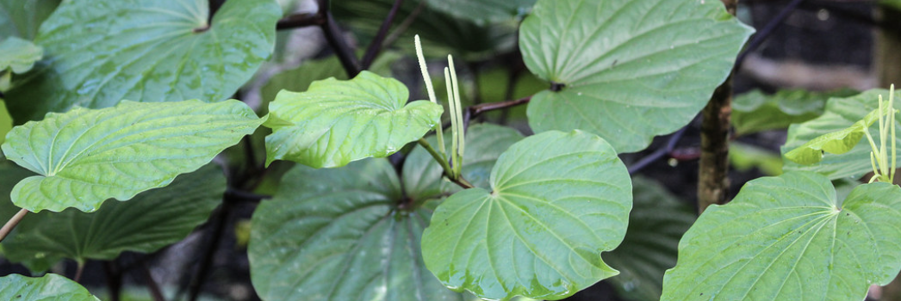
Piper methysticum - the source of kava
ECOLOGICALLY
MEDICINALLY
Kavalactones have been shown to be allelopathic to plants such as lettuce, radish, and barnyard grass (Xuan et. al 2006). They act as pre-emergent herbicides, inhibiting seed germination.
The sensations, in order of appearance, are slight tongue and lip numbing (the lips and skin surrounding may appear unusually pale); mildly talkative and sociable behavior; clear thinking; anxiolytic (calming) effects; relaxed muscles; and a very euphoric sense of well-being.
Notes:
Xuan, T. D., et al. "Herbicidal and fungicidal activities of lactones in kava (Piper methysticum)." Journal of agricultural and food chemistry 54.3 (2006): 720-725.

Slide 11
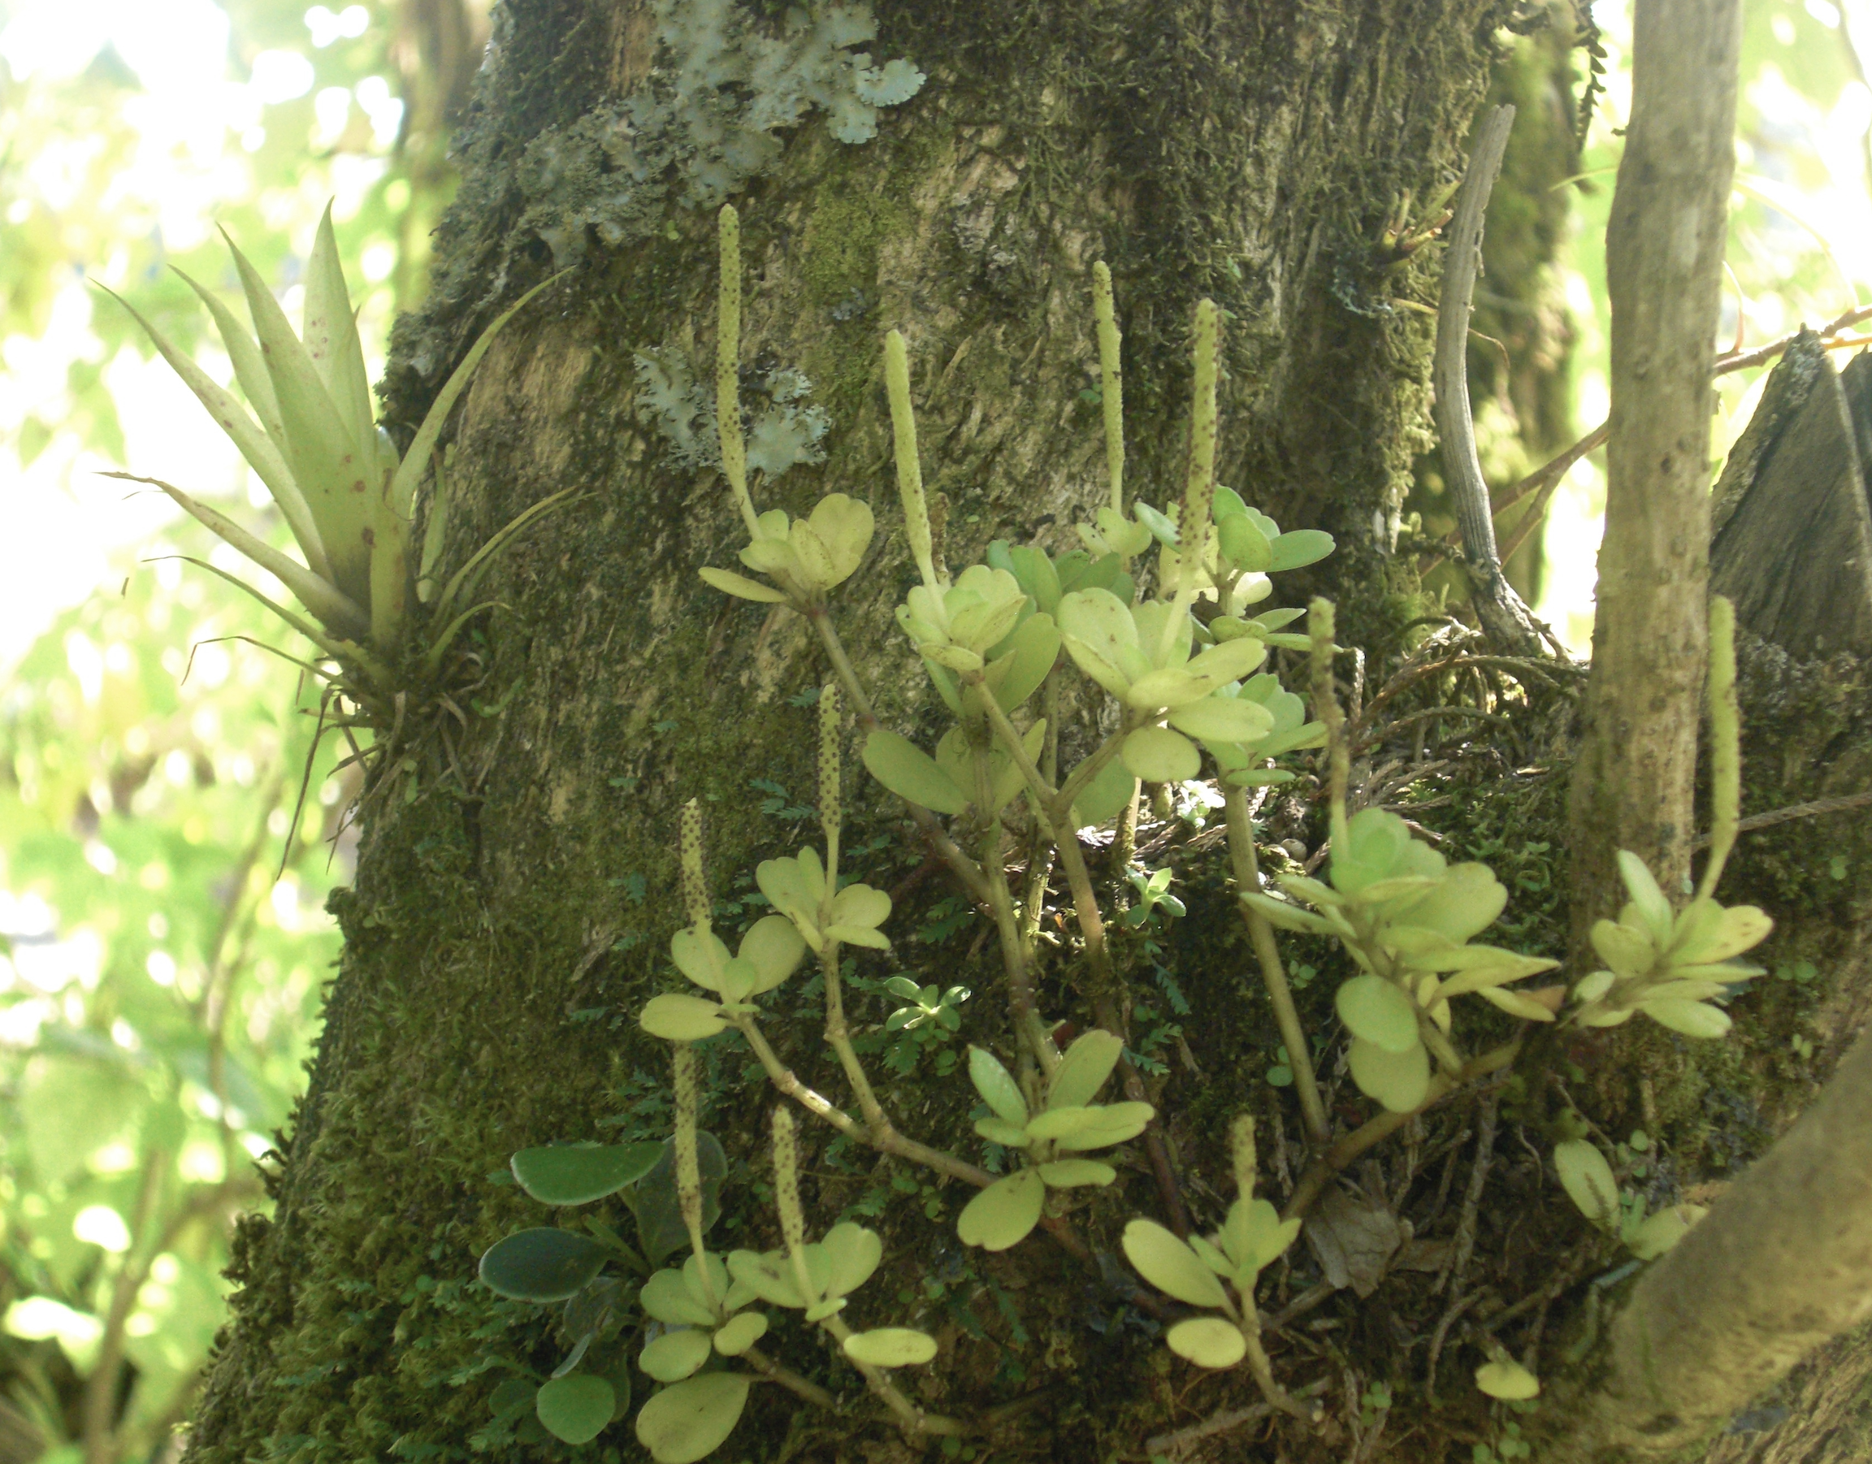
Peperomia

Slide 12
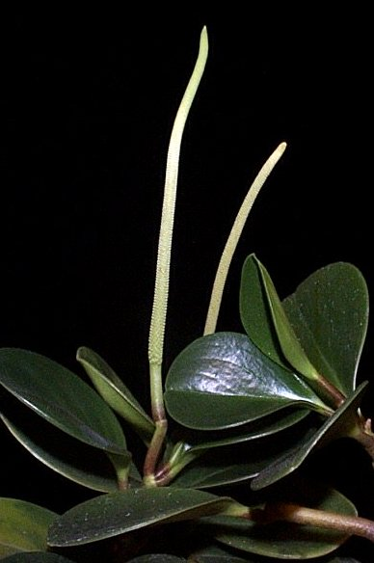
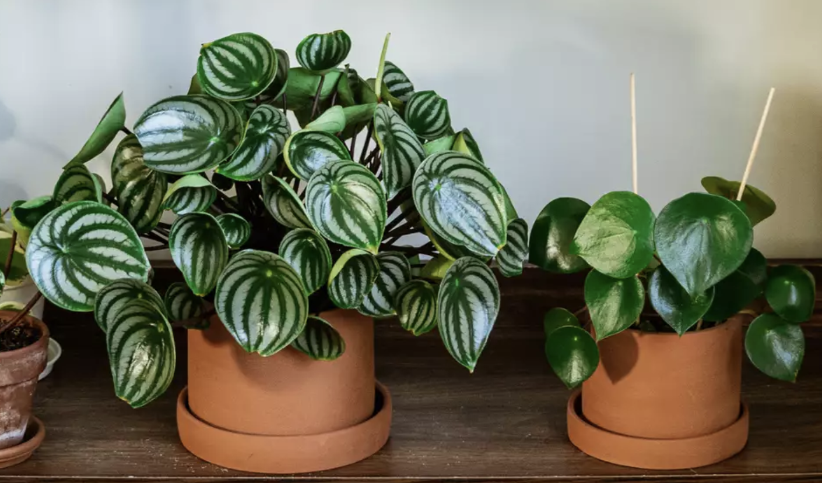
Peperomia

Slide 13
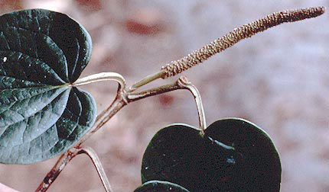
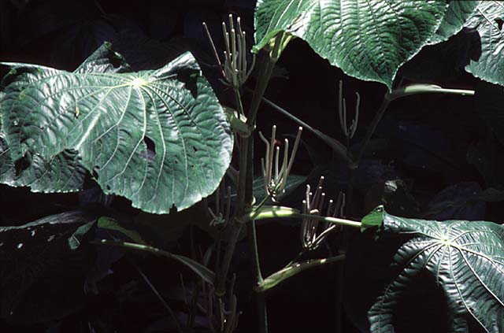
Sarcorhachis sydowii -
http://mobot.mobot.org/cgi-bin/search_vast?w3till=MOA-03621_001.jpg
Lepianthes (Pothomorphe)
http://botit.botany.wisc.edu/images/401/Magnoliophyta/Magnoliopsida/Magnoliidae/Piperaceae/Lepianthes(Pothomorphe)/

Slide 14
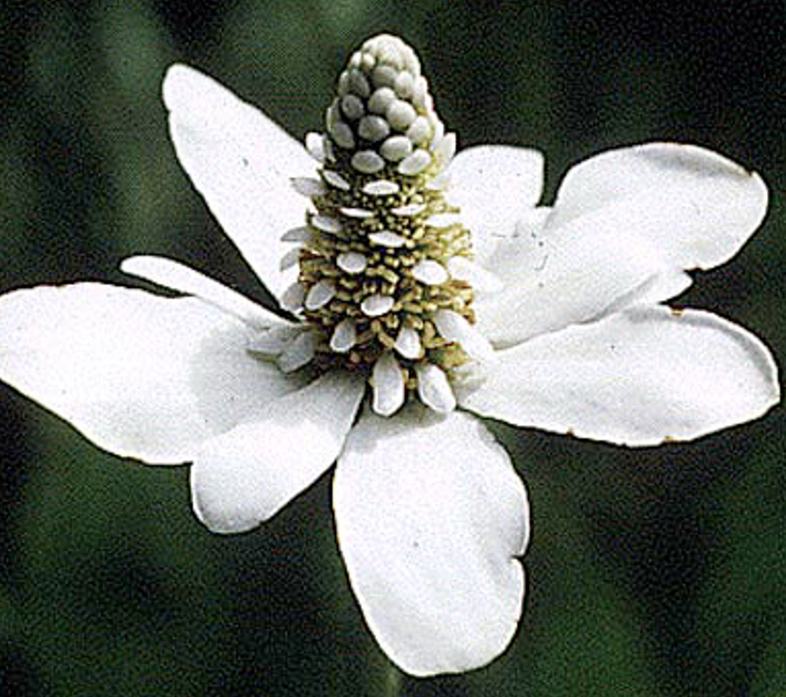
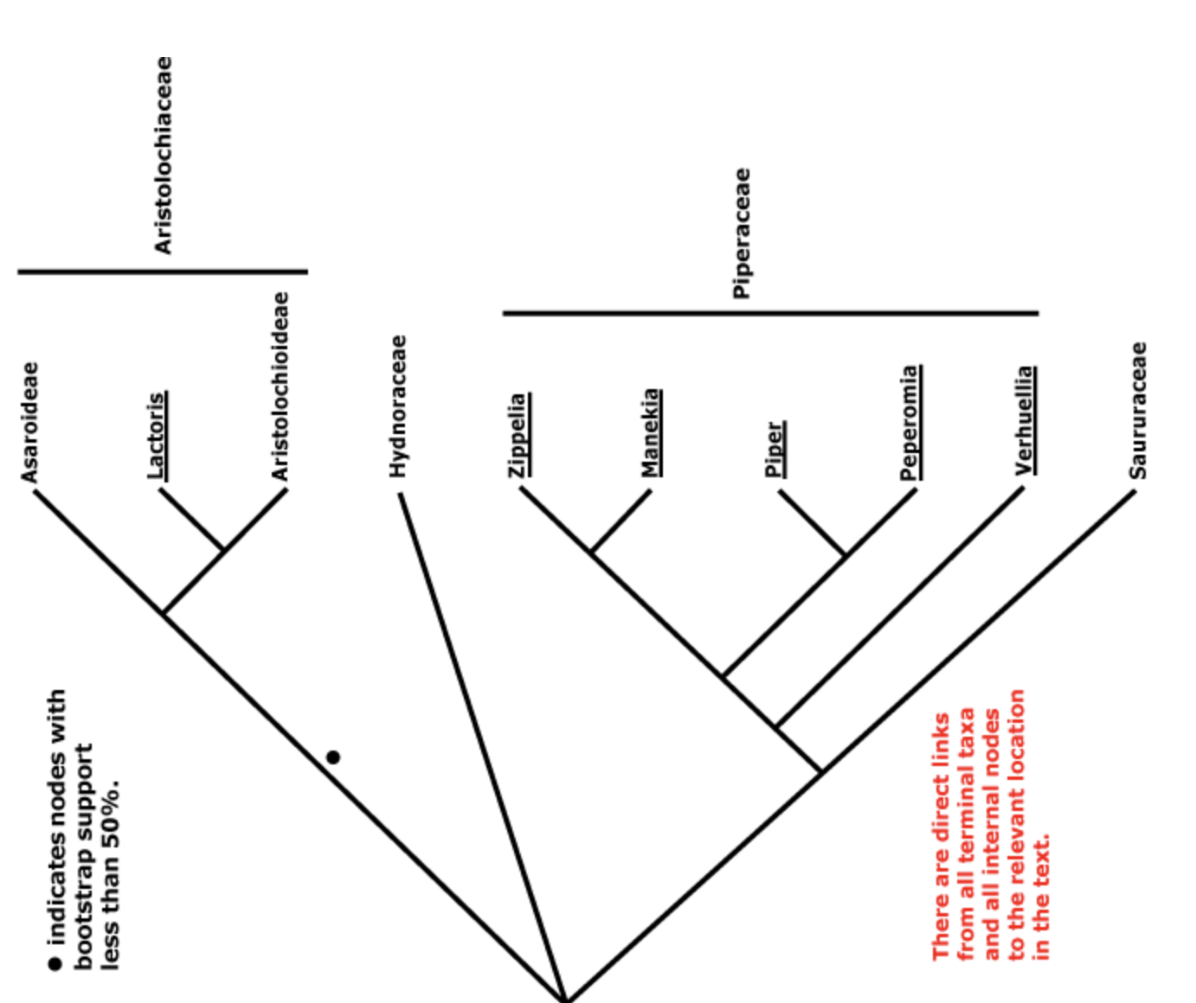
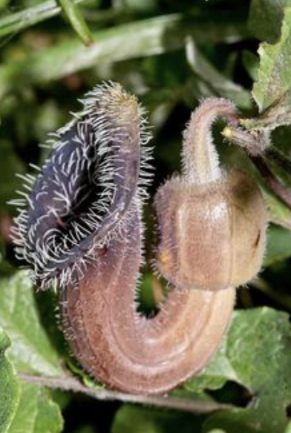
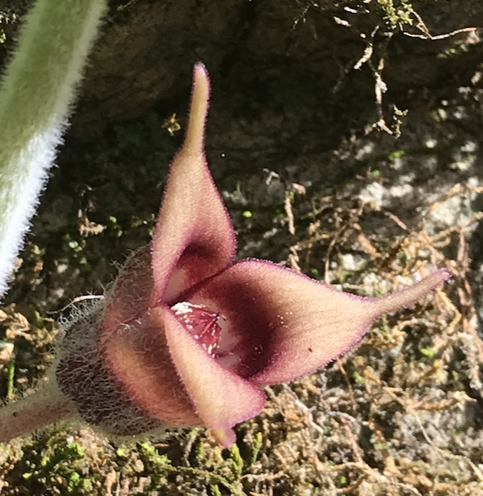
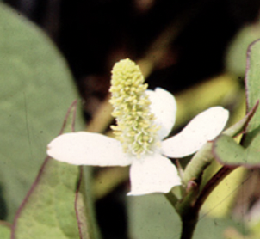
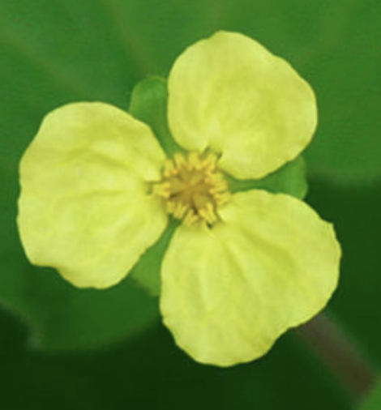
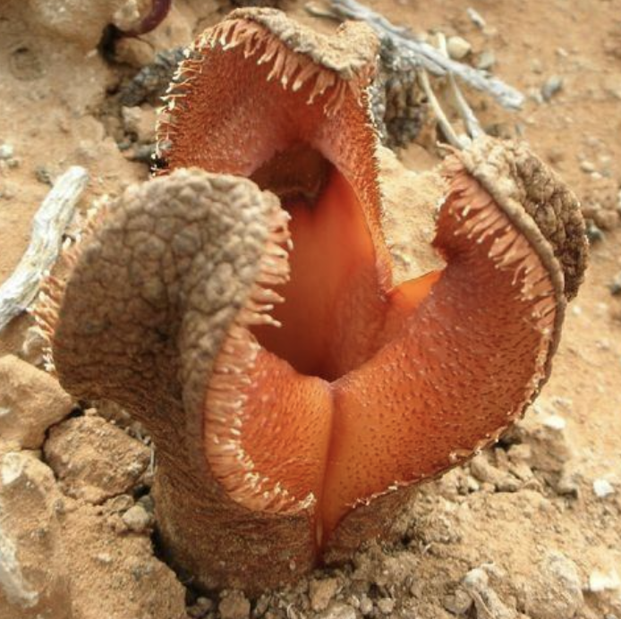

Slide 15
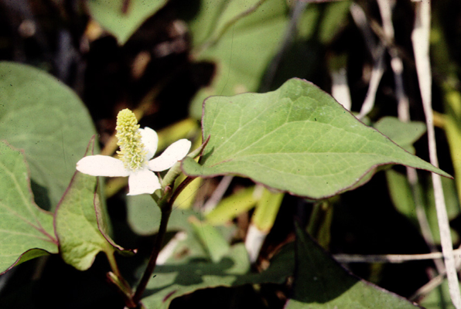
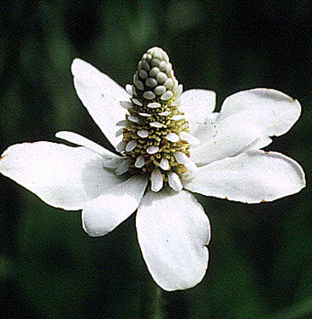
Saururaceae have a diversity of showy inflorescences that suggest flowers
Houttuynia
Houttuynia
Anemopsis

Slide 16
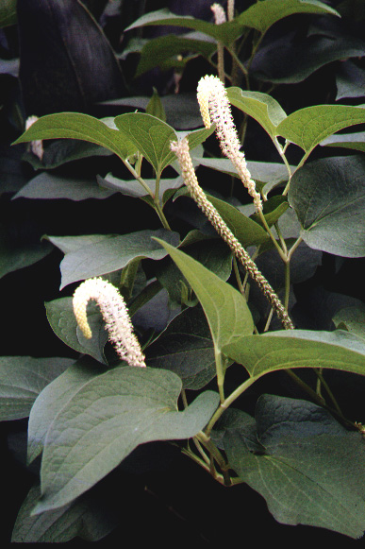
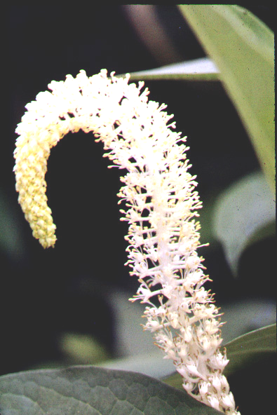
Saururus
Saururaceae have a diversity of showy inflorescences that suggest flowers
Houttuynia
Houttuynia
Anemopsis

Slide 17
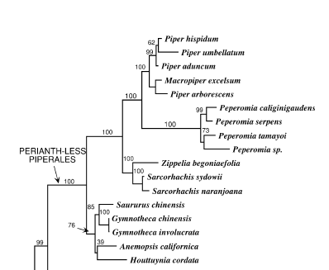
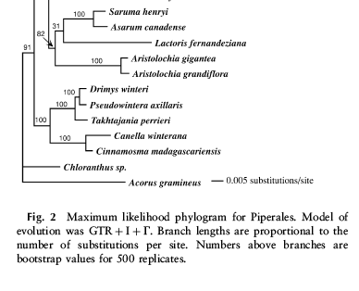
Piperales: molecular phylogeny
Piperaceae
Saururaceae
Aristolochiaceae

Slide 18
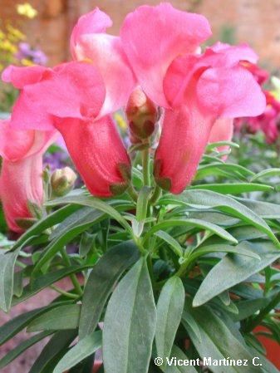
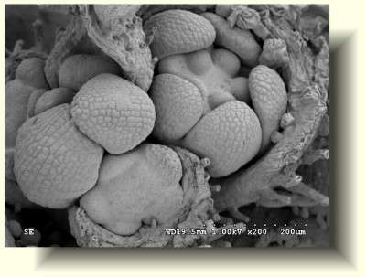
Flowers and Primordia of Snapdragon
petal
stamens
sepals

Slide 19
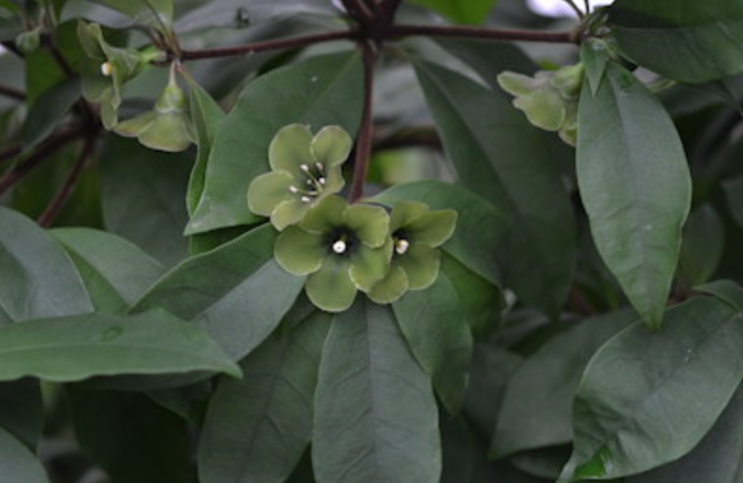
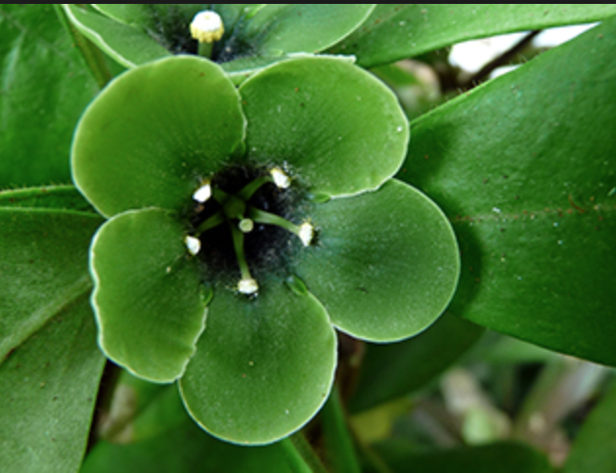
Introduction to floral meristems and floral primordia.
Deherainia smaragdina, Theophrastaceae
Notes:
caris2004.pdf Floral development in Deherainia smaragdina, Theophrastaceae. (A) Inception of the first sepal at the abaxial side of the flower primordium. (B) Sepal one to four are removed so that the unidirectional calyx development can clearly be observed. (C) The floral apex becomes separated from the calyx and forms a pentagonal shape. (D, E) Unidirectional development of separate petal, stamen, and staminode primordia; at the center a ring primordium becomes visible. (F) Further development with formation of the ovary. (G) Young ovary: lateral view. (H–K) Differentiation of stamens and staminodes. (L) Further differentiation of the gynoecium.

Slide 20
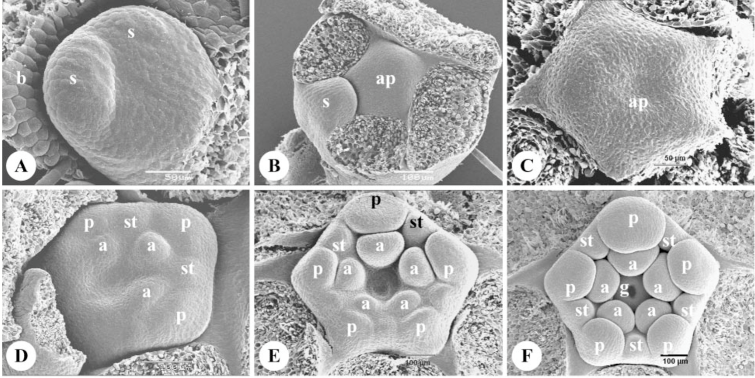
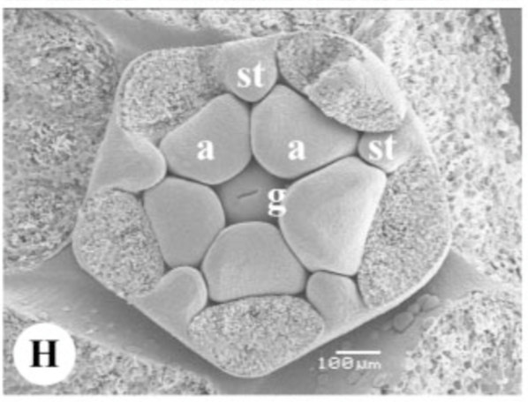
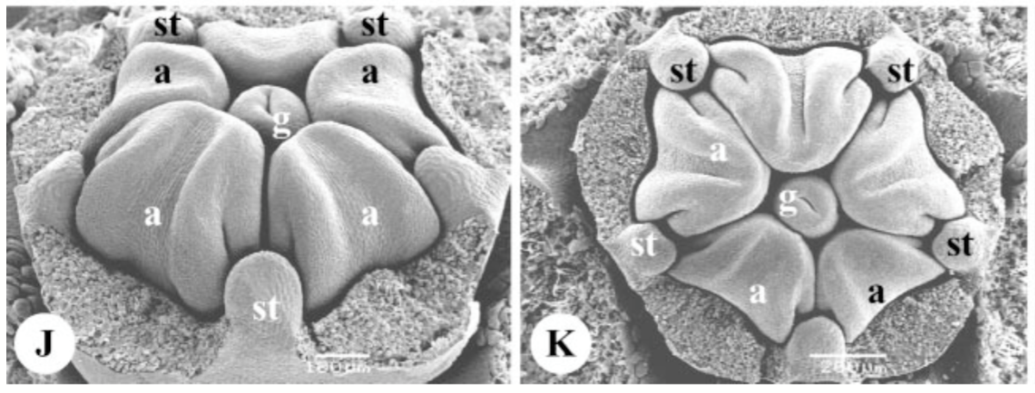
Introduction to floral meristems and floral primordia.
Deherainia smaragdina, Theophrastaceae
Notes:
caris2004.pdf Floral development in Deherainia smaragdina, Theophrastaceae. (A) Inception of the first sepal at the abaxial side of the flower primordium. (B) Sepal one to four are removed so that the unidirectional calyx development can clearly be observed. (C) The floral apex becomes separated from the calyx and forms a pentagonal shape. (D, E) Unidirectional development of separate petal, stamen, and staminode primordia; at the center a ring primordium becomes visible. (F) Further development with formation of the ovary. (G) Young ovary: lateral view. (H–K) Differentiation of stamens and staminodes. (L) Further differentiation of the gynoecium.

Slide 21
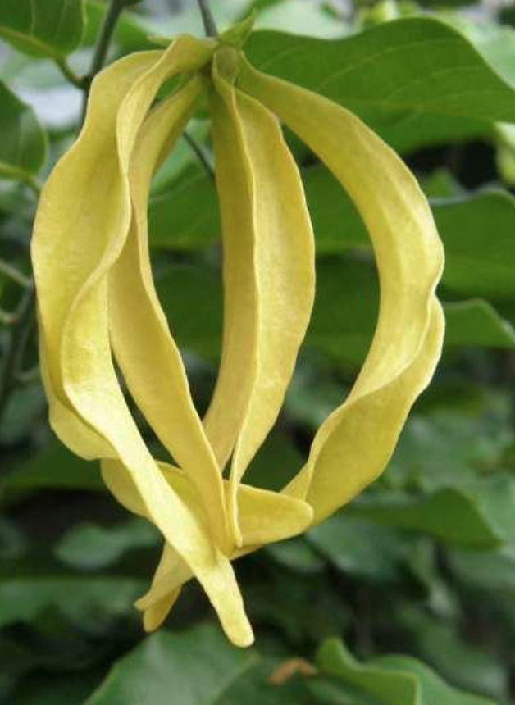
Floral meristem and floral primordia in a magnoliid
Desmos sinensis, Annonaceae
Notes:
xu2010.pdf FIG. 3. Floral development of Desmos chinensis: (A, B) initiation of the middle (asterisks in A) and inner perianth whorl (asterisks in B); (C) four perianth members in the inner whorl make the floral apex quadrangular – note two perianth members in double position (asterisks); (D) distal view of the perianth, hairs on the back of the second whorl members (asterisks); (E) initiation of first stamen primordia (stars) in three pairs on both sides of the inner perianth member; (F) further stamens initiated along the sides of the floral apex (arrowheads), and hairs appear on the back of the second whorl members (asterisks); (G) floral apex is more or less hexagonal, stamens appearing centripetally in rapid succession; (H) young carpels, showing no difference with the stamen pri- mordia; (I) nearly mature bud, with incomplete parastichies and orthostichies; (J) distal view of the floral bud before anthesis. Abbreviations: f, floral apex; c, carpel; ip, inner perianth whorl; mp, middle perianth whorl. Scale bars: (A, B, D) 1⁄4 200 mm; (C, E–I) 1⁄4 500 mm; (J) 1⁄4 1 mm.

Slide 22
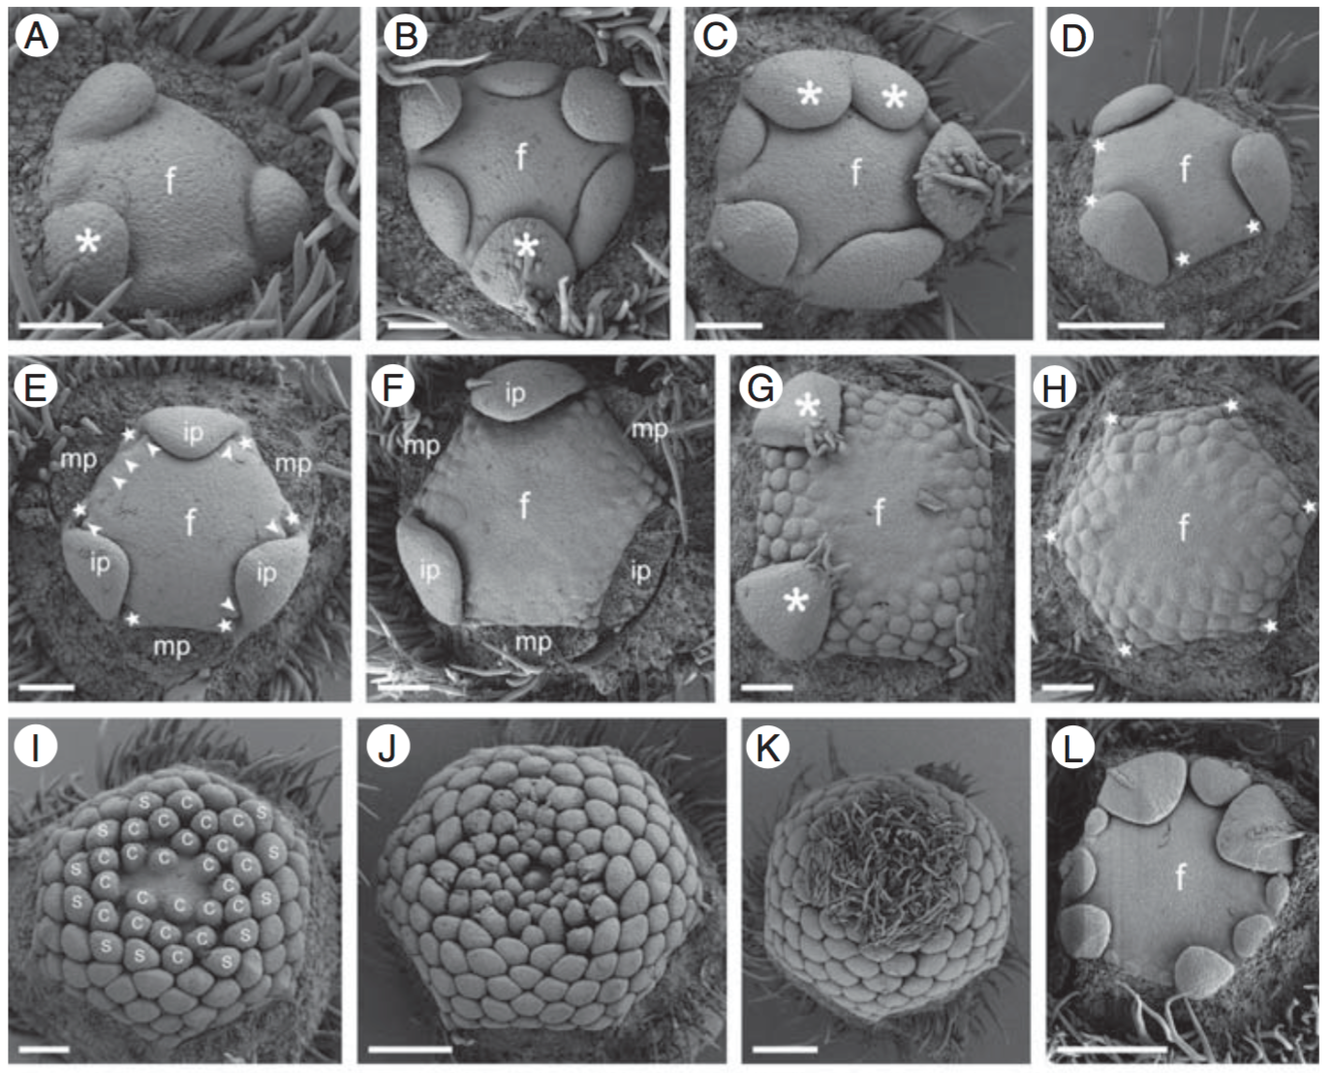
Floral meristem and floral primordia in a magnoliid
Desmos sinensis, Annonaceae
Notes:
xu2010.pdf FIG. 3. Floral development of Desmos chinensis: (A, B) initiation of the middle (asterisks in A) and inner perianth whorl (asterisks in B); (C) four perianth members in the inner whorl make the floral apex quadrangular – note two perianth members in double position (asterisks); (D) distal view of the perianth, hairs on the back of the second whorl members (asterisks); (E) initiation of first stamen primordia (stars) in three pairs on both sides of the inner perianth member; (F) further stamens initiated along the sides of the floral apex (arrowheads), and hairs appear on the back of the second whorl members (asterisks); (G) floral apex is more or less hexagonal, stamens appearing centripetally in rapid succession; (H) young carpels, showing no difference with the stamen pri- mordia; (I) nearly mature bud, with incomplete parastichies and orthostichies; (J) distal view of the floral bud before anthesis. Abbreviations: f, floral apex; c, carpel; ip, inner perianth whorl; mp, middle perianth whorl. Scale bars: (A, B, D) 1⁄4 200 mm; (C, E–I) 1⁄4 500 mm; (J) 1⁄4 1 mm.

Slide 23
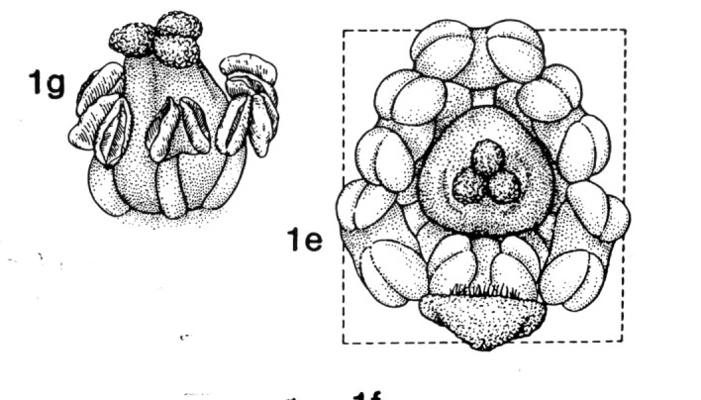
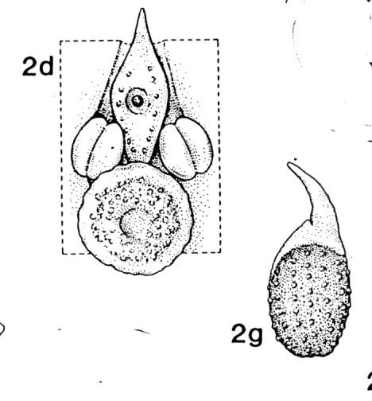
How is it possible that these two flowers are both in the same family, and that they are magnoliids?
PIPER PEPEROMIA

Slide 24
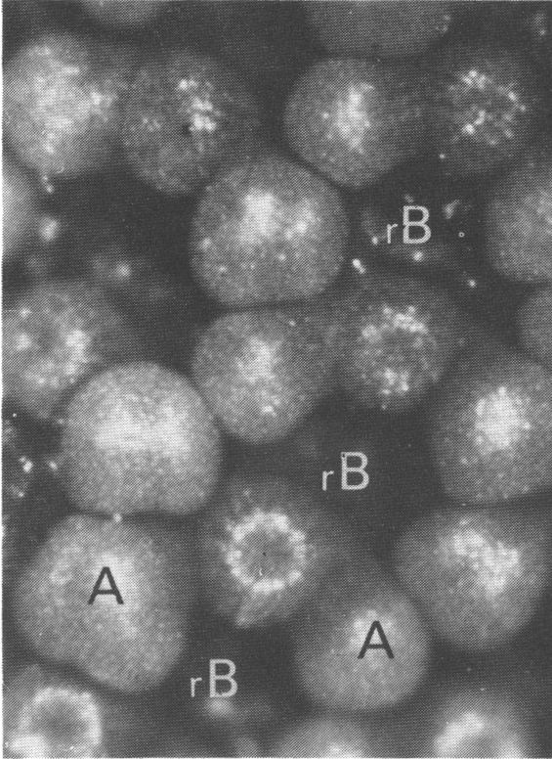
Rolf Sattler’s light microscope picture of Peperomia,
A = stamen
rB = Bract
G = Gynoecium
G
G
A
A
rB

Slide 25
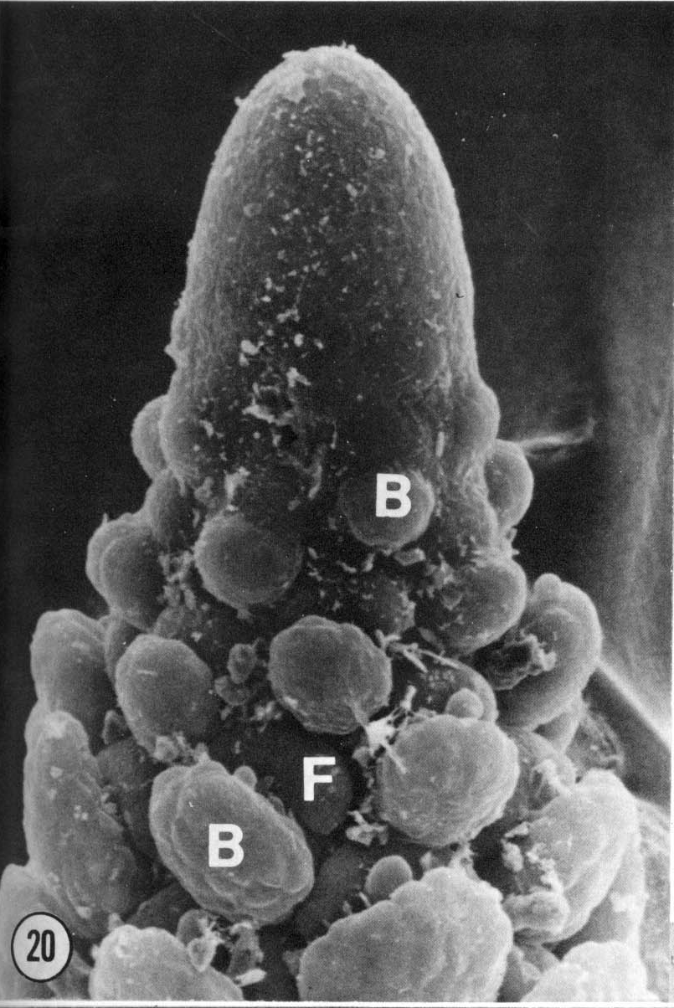
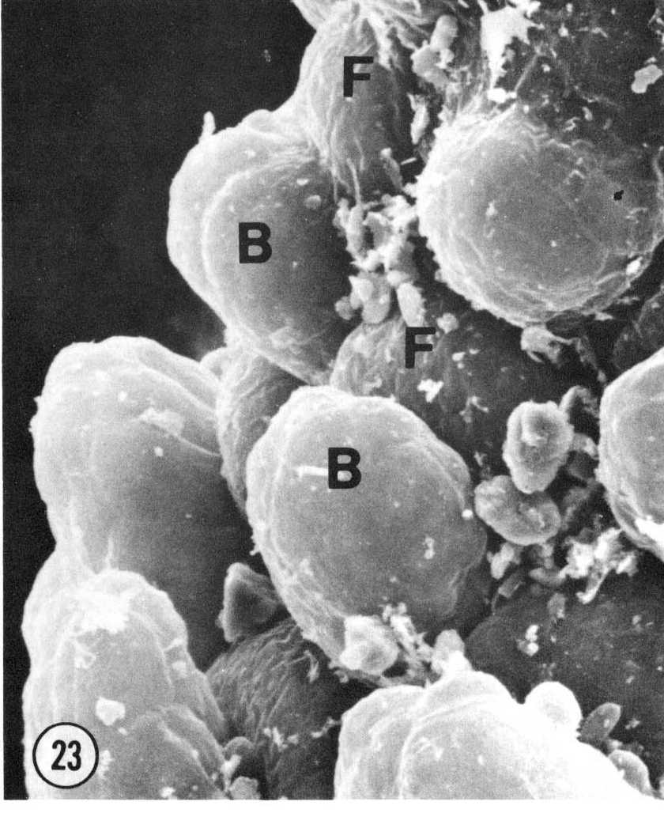
Shirley Tucker: Peperomia inflorescence in early development.
B = bract
F = flower

Slide 26

Older floral meristem of Peperomia
ynoecium
tamen
tamen
Bract removed from here

Slide 27

Piper amalago:
Stamens:
AM anterior median
PM posterior median
PL posterior lateral
AL anterior lateral
The four-carpellate gynoecium
is in the middle.
Notes:
tucker1982.pdf

Slide 28

Piperales: gynoecium structure overlain on the phylogeny

Slide 29

Piperales: gynoecium development overlain on the phylogeny
Jaramillo, M.A., Manos, P.S. and Zimmer, E.A., 2004. Phylogenetic relationships of the perianthless Piperales: reconstructing the evolution of floral development. International Journal of Plant Sciences, 165(3), pp.403-416.
Notes:
jaramillo2004.pdf

Slide 30
Key Characters for Piperaceae
Swollen nodes
Arcuate veins
Crushed-leaf odoer of the magnoliids
Thick spikes
No perianth

Slide 31
Monosulcate Pollen
( while in transition to monocots …

Slide 32




MONOSULCATE POLLEN
Cycas (Cycadaceae)
Anaxagorea (Annonaceae)
Ginkgo (Ginkgoaceae)
Lilium (Liliaceae)
Notes:
From maas1984.pdf

Slide 33


Notes:
doyle_ja2005.pdf Fig, 4

Slide 34
Set Aside

Slide 35


Unisulcate pollen with a granular exine
Notes:
From maas1984.pdf

Slide 36

Notes:
doyle_ja2005.pdf Fig, 1 THIS IS A tree reproduced from Doyle and Donoghue 1989

Slide 37


Slide 38



Time (developmental history)
TOP OF
INLORESCENCE

Slide 39
Piperales: gynoecium development overlain on the phylogeny
Notes:
jaramillo2004.pdf

Slide 40


Slide 41

Piperales: androecium development overlain on the phylogeny

Slide 42


Slide 43


Slide 44


Slide 45


Slide 46


When Arabidopsis flowers are first initiated no floral organs are visible, however floral organ primordia begin to develop shortly thereafter, beginning with the outer (sepal) primordia, and ending with the inner (carpel) primordia. http://www.botany.ubc.ca/haughn/overview.htm
LEFT - Scanning Electron Micrograph of very young floral buds emerging from the flanks of the apical meristem. The apical meristem is labelled (a) and one of the young flowers is labelled (f).
RIGHT- A slightly older flower in which primordia for a petal (2), a stamen (3), and gynoecium (4) are labelled. Sepals (1) have been removed to reveal the inner floral organ primordia.
1

