Slide 1
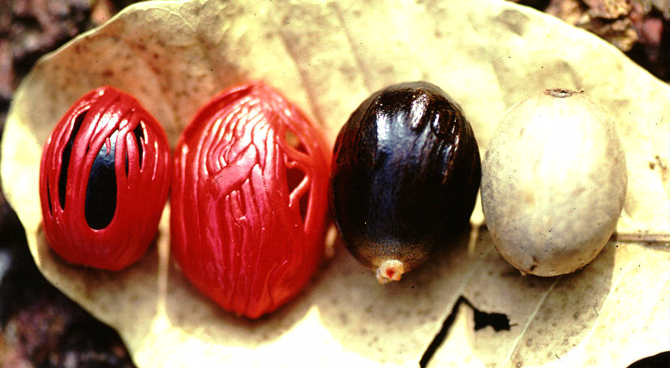
MYRISTICACEAE

Slide 2
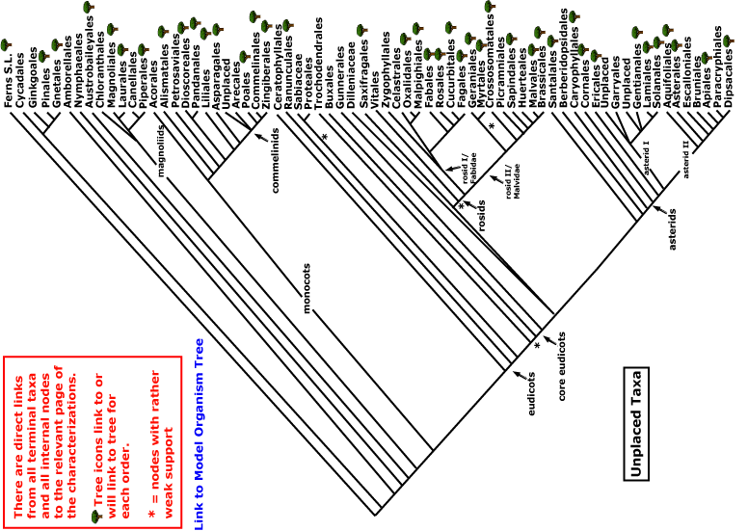
magnoliids
monocots
Current Angiosperm Phylogeny Group Tree for Flowering Plants
2010

Slide 3
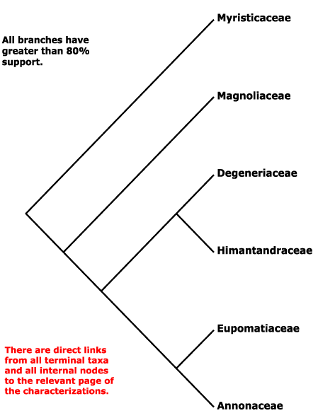
Magnoliales and the relations
of the Myristicaceae (APG)

Slide 4
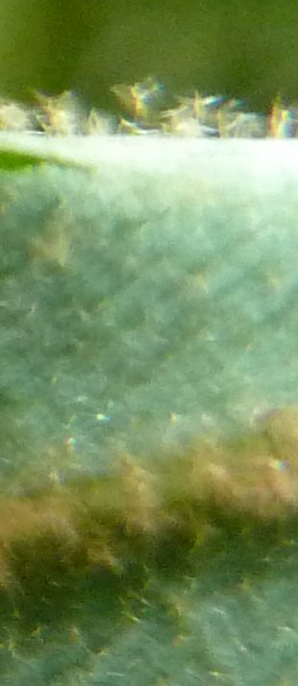
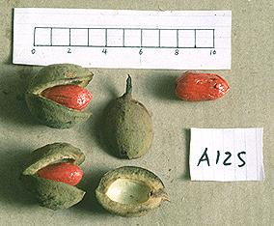
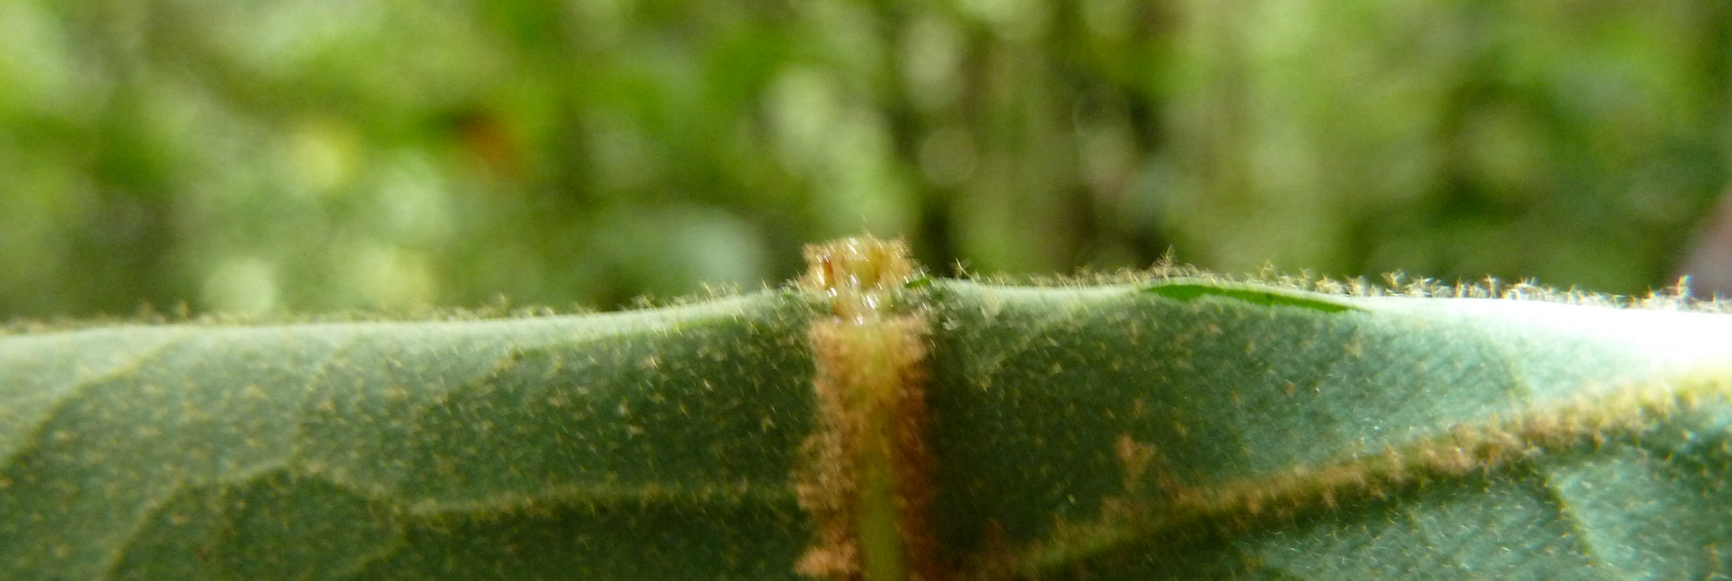
Key characters for the Myristicaceae
branches in whorls of four
branched hairs
reddish resin in bark
reduced, fused perianth
one-seeded dehiscent berry with aril

Slide 5
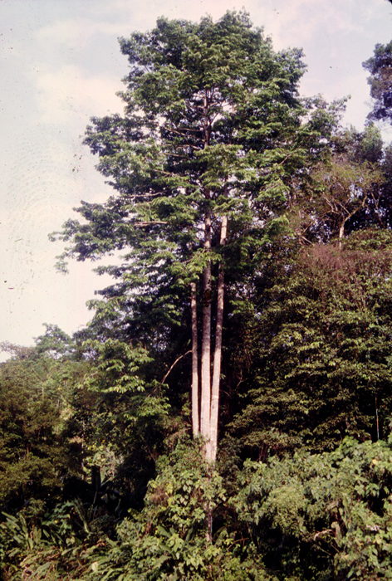
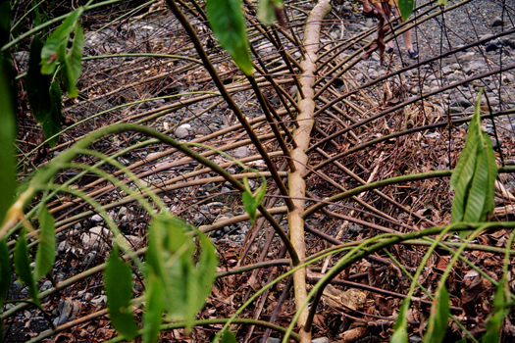
Virola – four-branch whorls

Slide 6
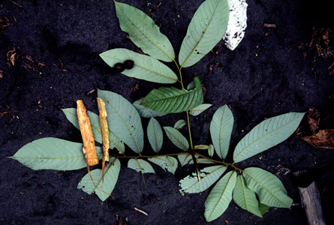
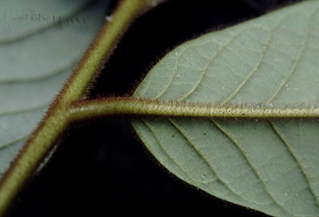
Virola –neotropical; glaucous below and covered with branched hairs, fruits typical of the family

Slide 7
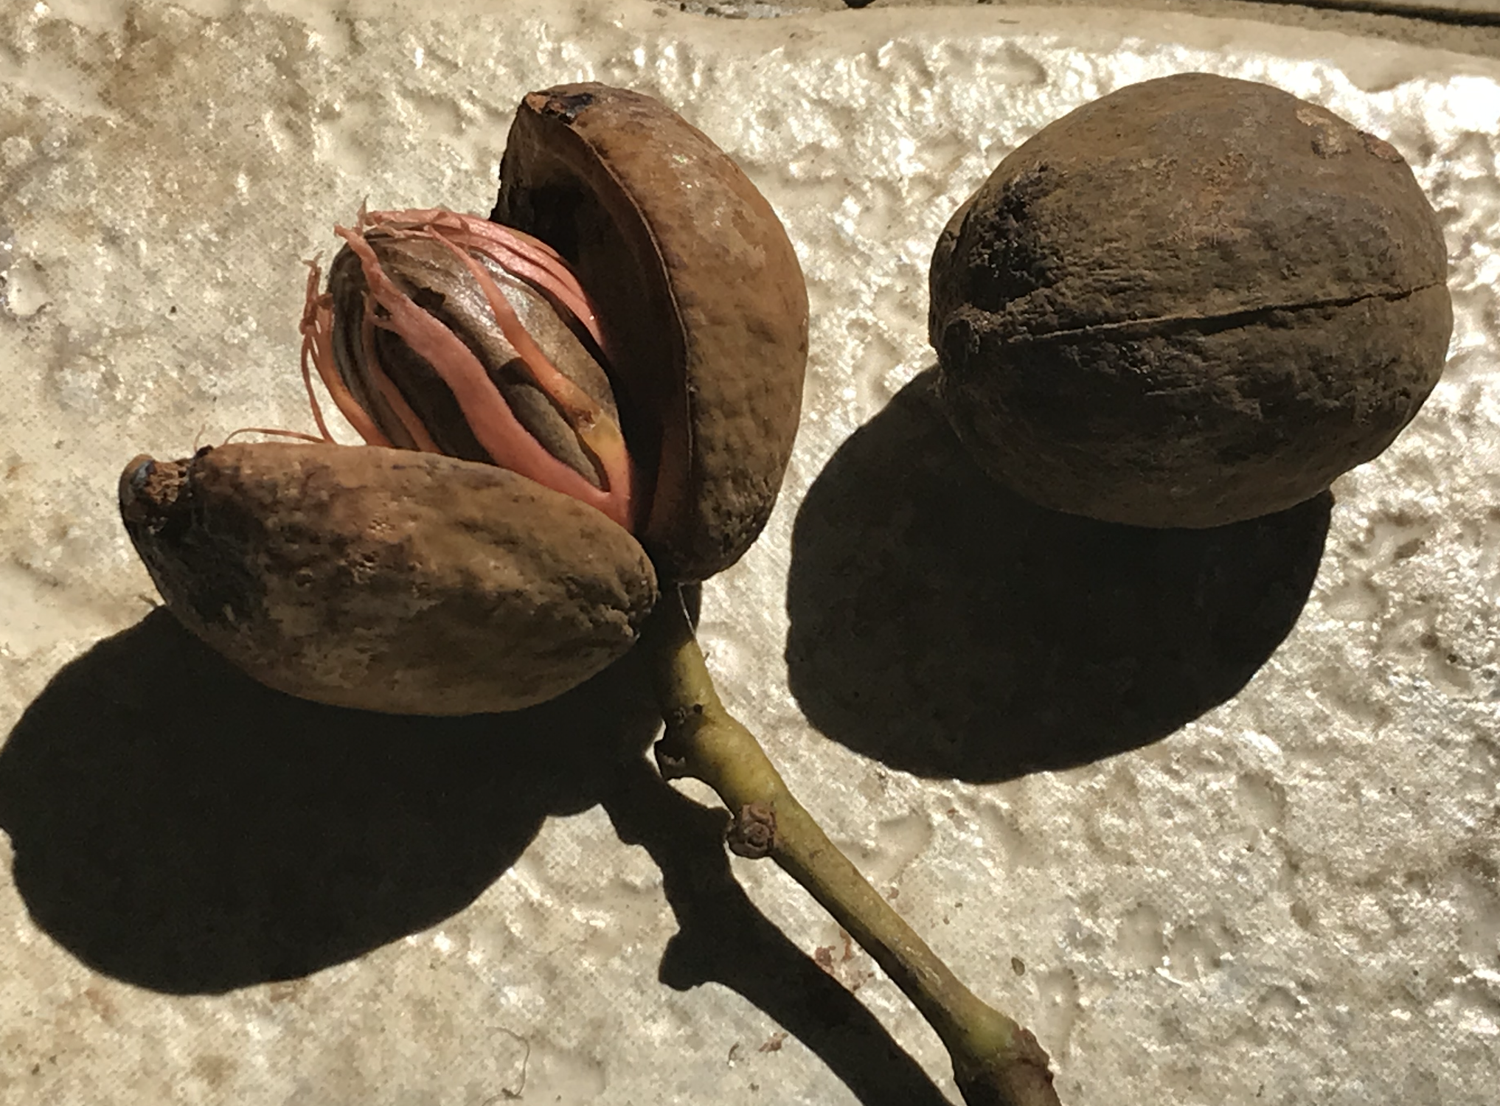

Slide 8
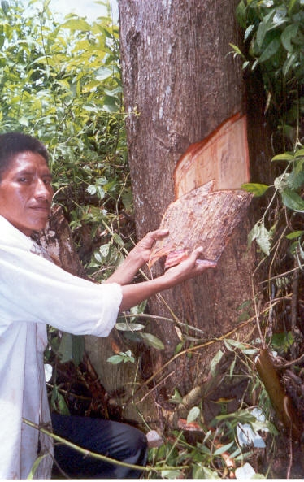
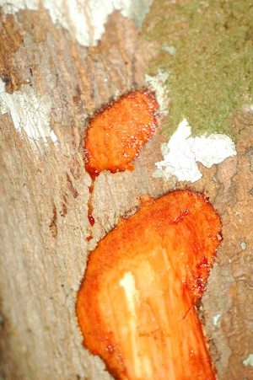
The red “sap” of the Myristicaceae
Is a water-soluble flow from wounds that includes an ethanol-soluble resin…
Notes:
processing: collect resin from bark, sun-dry, grind to a powder, inhale.

Slide 9
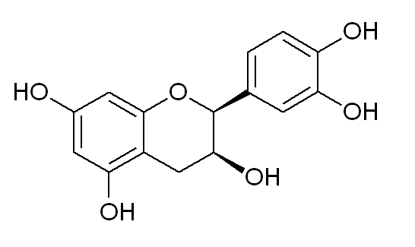
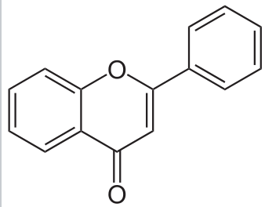
Epicatechin (an antioxidant flavonoid) is one of two key components of Virola resin
Flavonoid backbone:

Slide 10
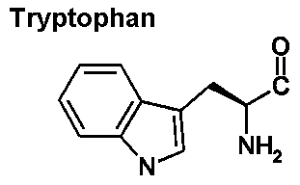
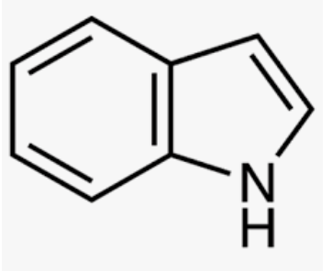
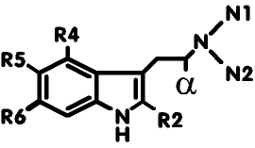
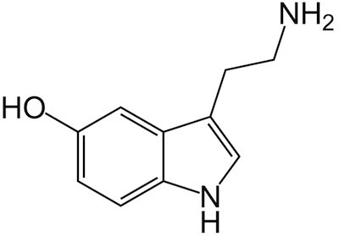
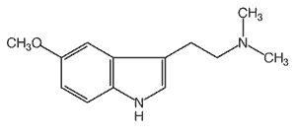
DMT is the other.
Tryptophan
Indole
tryptamine alkaloid backbone
serotonin, the neurotransmitter
5-MeO-DMT a tryptamine alkaloid from Virola
Notes:
The bark resin of these trees is used to prepare hallucinogenic snuffs in northwestern Brazil by boiling, drying and pulverizing it. Sometimes leaves of a Justicia are added. The snuff acts rapidly and violently, "effects include excitement, numbness of the limbs, twitching of facial muscles, nausea, hallucinations, and finally a deep sleep; macroscopia is frequent and enters into Waika beliefs about the spirits resident in the drug." Snuffs made from V. theiodora bark contain up to 11% 5-MeO-DMT and DMT. Also leaves, roots and flowers contain DMT.
Wink, M., 1993. Allelochemical properties or the raison d'etre of alkaloids. In The alkaloids: chemistry and pharmacology (Vol. 43, pp. 1-118). Academic press.

Slide 11
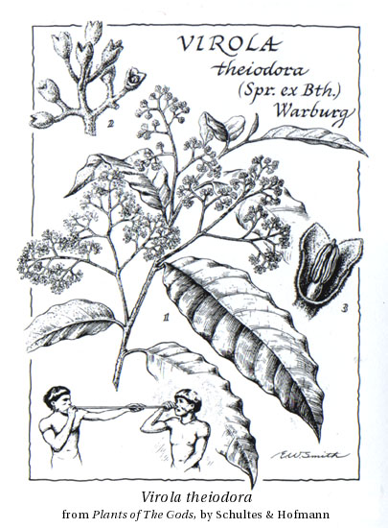

Richard Evans Schultes

Slide 12
EFFECTS OF VIROLA SNUFF are felt within minutes from the time of initial use. First there is a feeling of increasing excitability. This is followed by a numbness of the limbs, a twitching of the face, a lack of muscular coordination, nasal discharges, nausea, and, frequently, vomiting. Macropsia - the sensation of seeing things greatly enlarged - is characteristic and enters into Waika beliefs about the spirits resident in the drug
Richard Evans Schultes

Slide 13
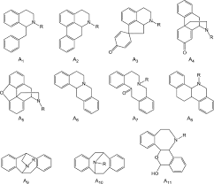
Alkaloids are a class of basic, naturally occurring organic compounds that contain at least one nitrogen atom. Commonly, there is a ring in the molecule including the nitrogen (and otherwise made of carbon atoms).
The boundary between alkaloids and other nitrogen-containing natural compounds is not clear-cut.^{[16]}
Compounds like amino acid peptides, proteins, nucleotides, nucleic acid, amines, and antibiotics are usually not called alkaloids.^{[2]}
Natural compounds containing nitrogen in the exocyclic position (mescaline, serotonin, dopamine, etc.) are usually classified as amines rather than as alkaloids.^{[17]} Some authors, however, consider alkaloids a special case of amines.

Slide 14
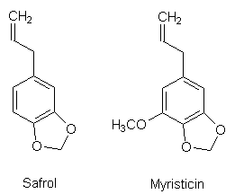
essential oils in Myristica, the nutmeg

Slide 15
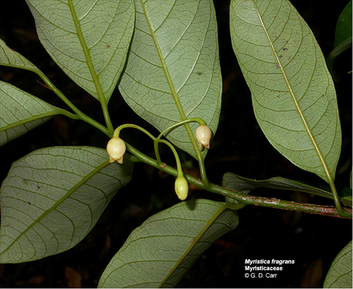
Myristica- the nutmeg --- imperfect, incomplete flowers with fusion

Slide 16
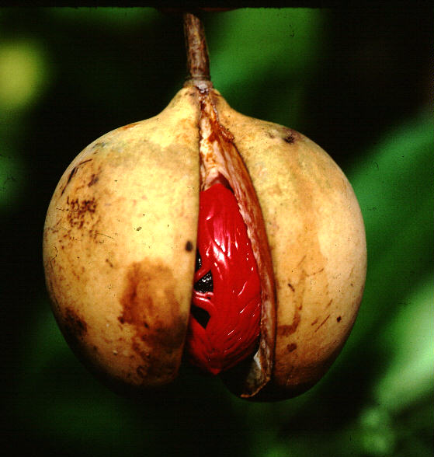
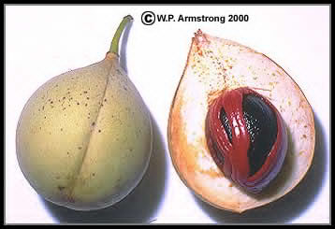
Myristica fragrans - nutmeg and mace

Slide 17
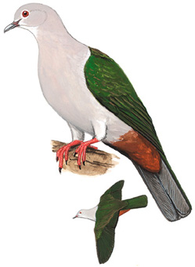
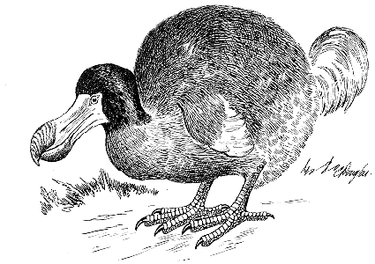
Myristica (nutmeg) is dispersed by pigeons in the genus Ducula - and in the past by dodos.
Notes:
In sum: nutmegs were dispersed by dodo-like birds - that is there are a diversity of large extinct flightless pigeons on old-world islands that were important fruit dispersers. Smaller but still large flighted pigeons now disperse the fruits of Myristica.
in lit. as meehan2002.pdf
Potential disruptions to seed dispersal mutualisms in Tonga, Western PolynesiaHayley J. Meehan¹, Kim R. McConkey¹ & Donald R. Drake² in lit. as worthy2001.pdf
© Journal of The Royal Society of New Zealand
Volume 31 Number 4 December 2001 pp 763 794
A giant flightless pigeon gen. et sp. nov. and a new species
of Ducula (Aves: Columbidae), from Quaternary deposits
in FIJI
T. H. Worthy*

Slide 18
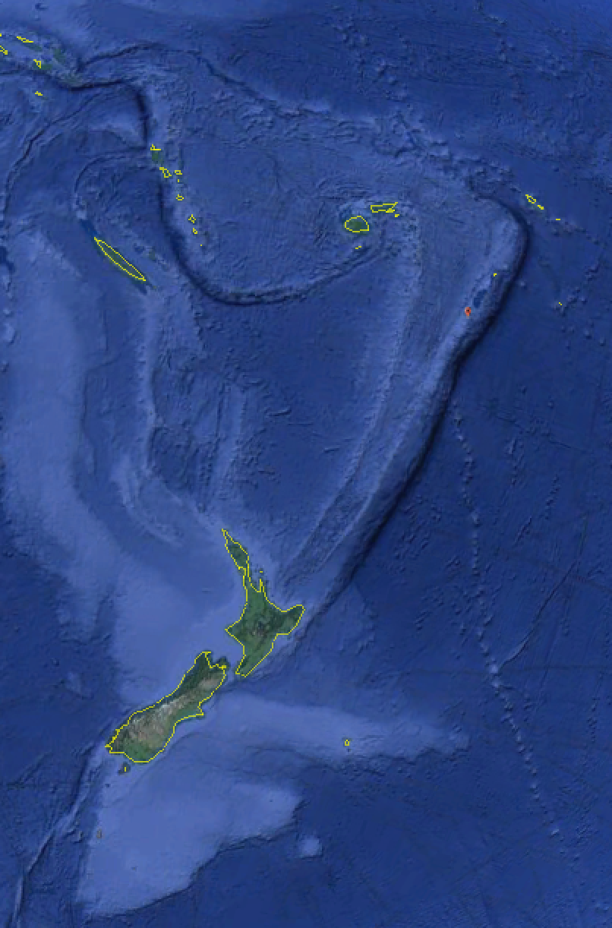
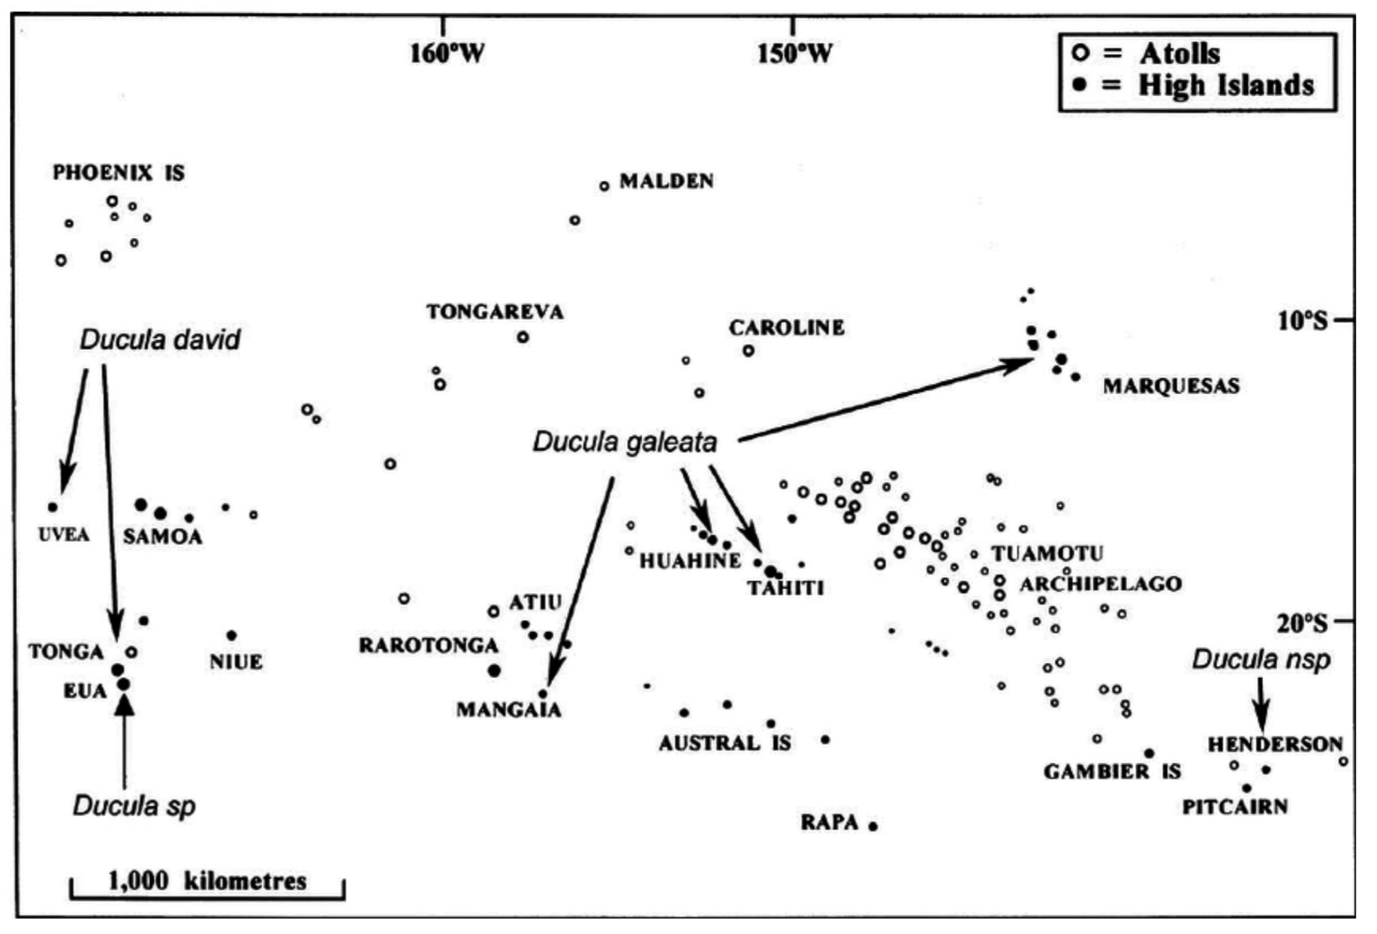

Slide 19
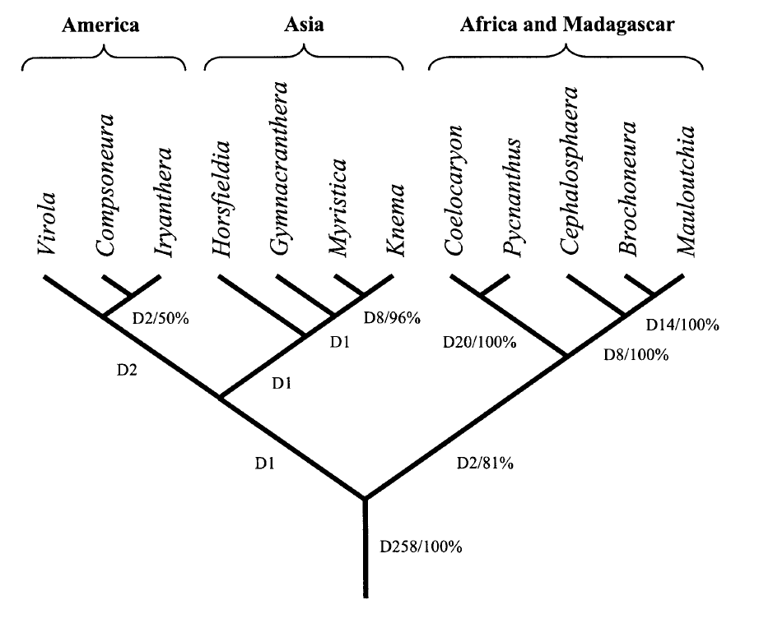
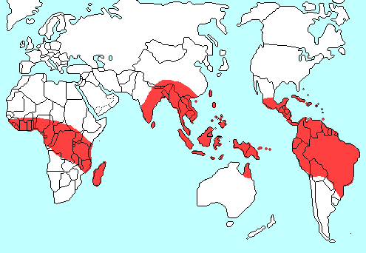
Biogeography of Myristicaceae

Slide 20
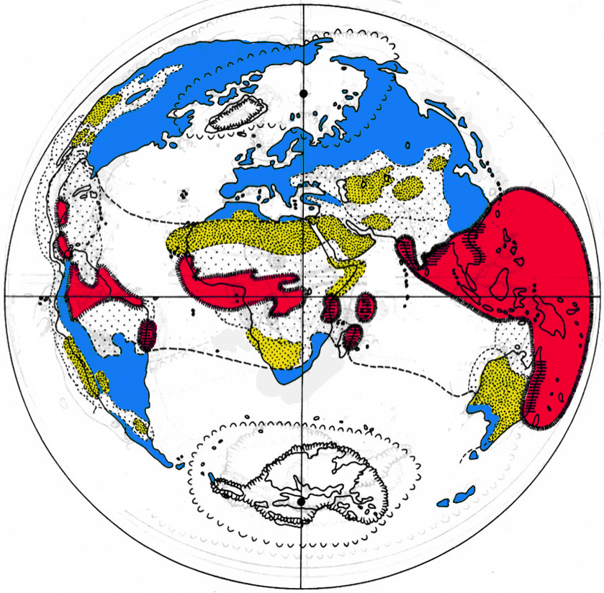
Kubitzki & Krutzsch on E. Asian Vegetation History:
Present-day------
Today
Humid
Equatorial
Forest
Semi-arid
tropical
Arid
Warm
Temperate

Slide 21
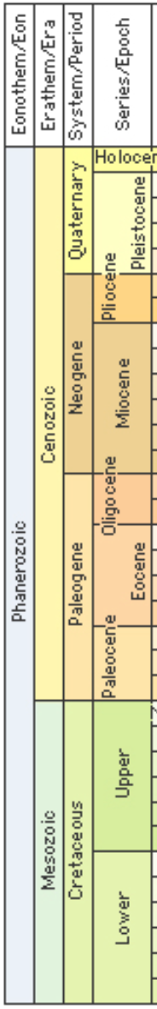

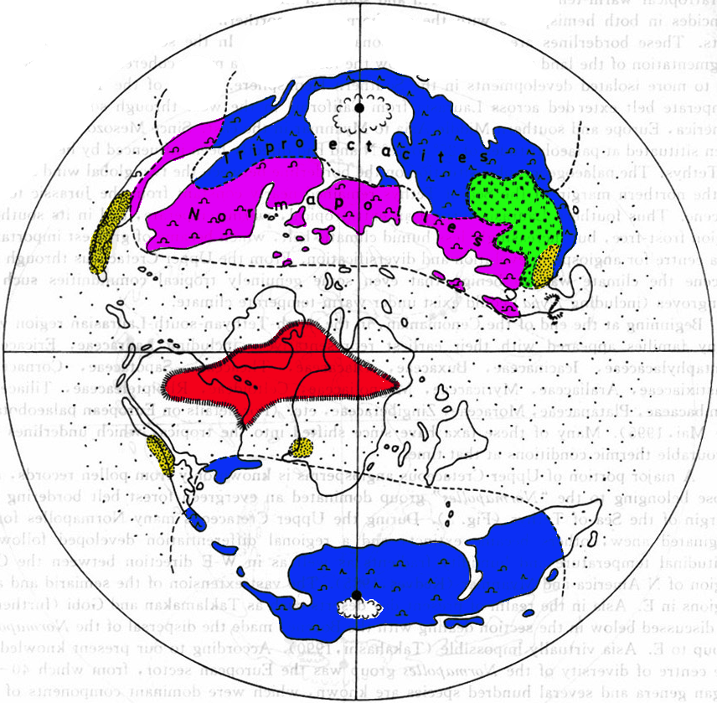
Upper Cretaceous
Humid
Equatorial
Forest
Semi-arid
tropical
Arid
Semi-arid
Temperate
Warm
Temperate
Warmer
Temperate

Slide 22
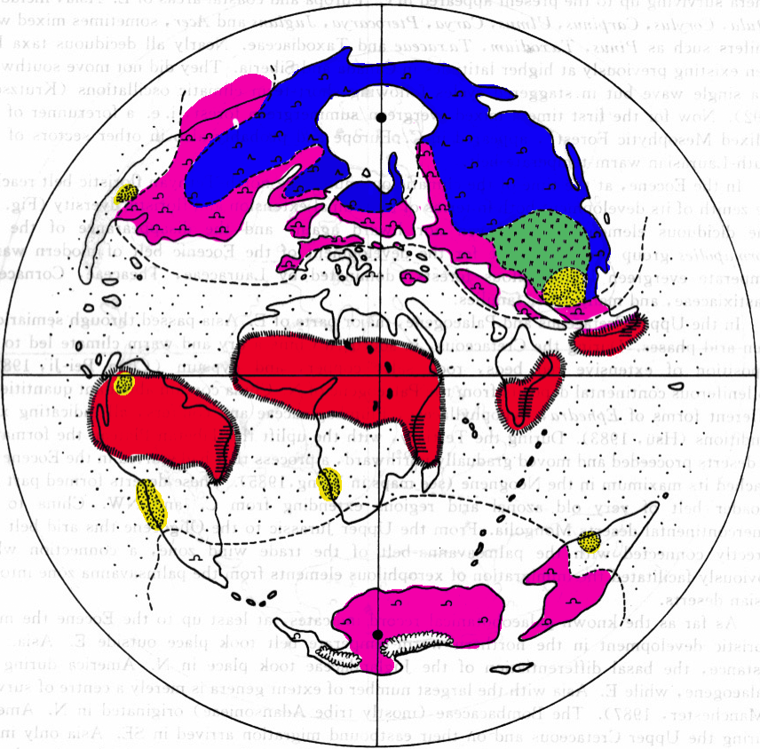
Mid Eocene
Humid
Equatorial
Forest
Semi-arid
tropical
Arid
Semi-arid
Temperate
Warm
Temperate
Warmer
Temperate

Slide 23
Another representation of the Eocene tropical wet forest

Slide 24
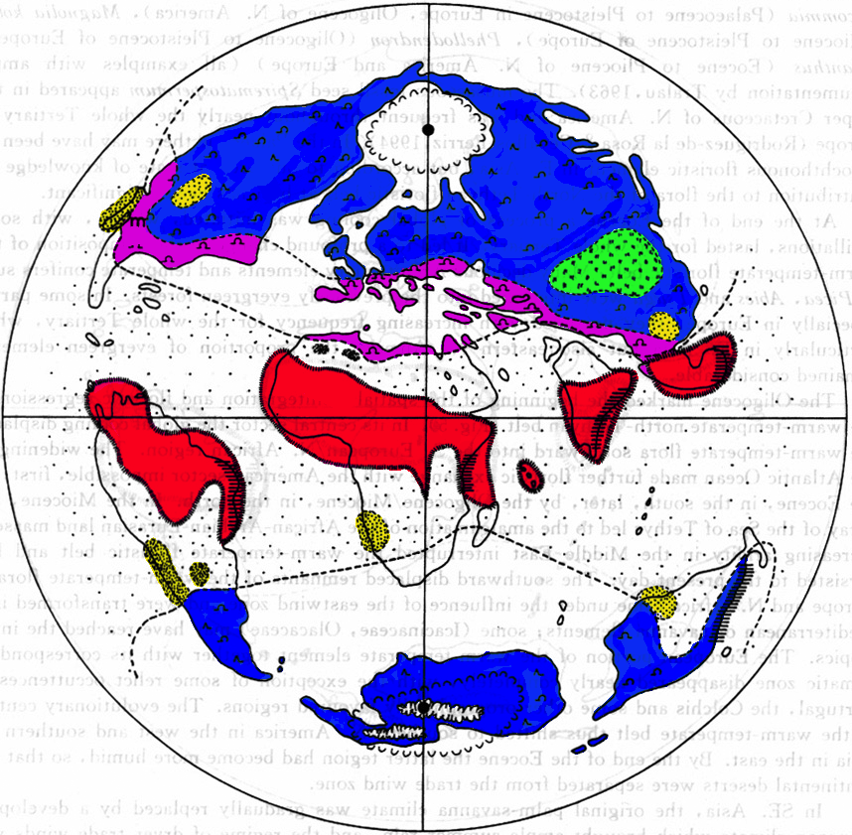
Oligocene
Humid
Equatorial
Forest
Semi-arid
tropical
Arid
Semi-arid
Temperate
Warm
Temperate
Warmer
Temperate

Slide 25
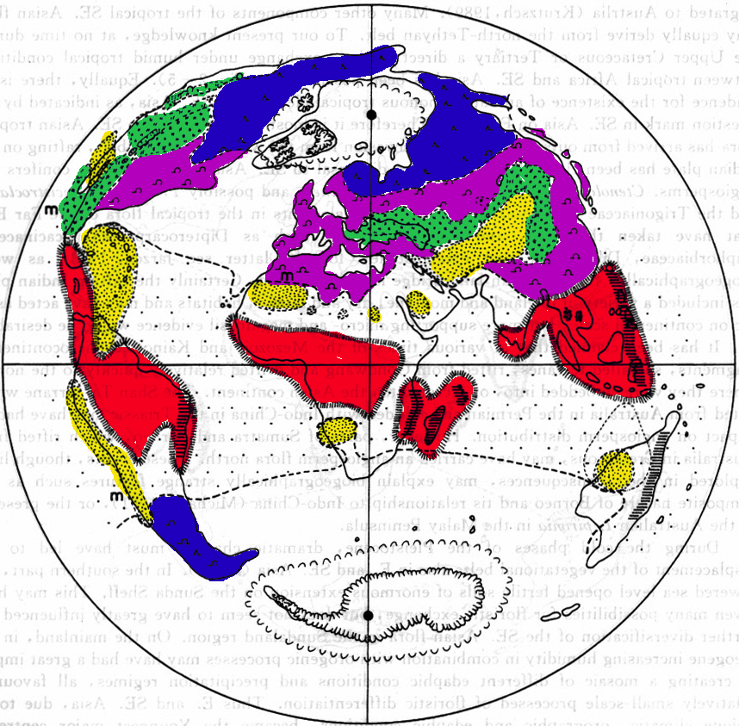
End of Miocene
Humid
Equatorial
Forest
Semi-arid
tropical
Arid
Semi-arid
Temperate
Warm
Temperate
Warmer
Temperate

Slide 26
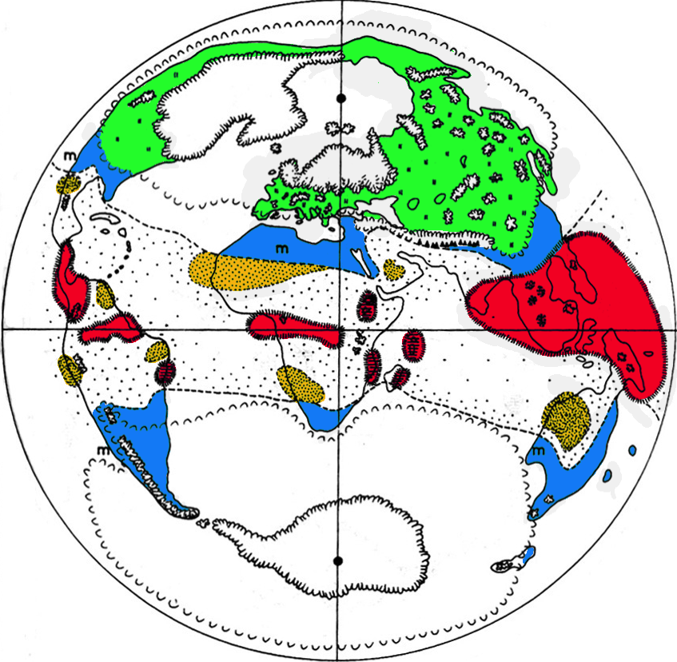
Pleistocene
Humid
Equatorial
Forest
Semi-arid
tropical
Arid
Semi-arid
Temperate
Warm
Temperate
Warmer
Temperate

Slide 27
Recent
Humid
Equatorial
Forest
Semi-arid
tropical
Arid
Semi-arid
Temperate
Warm
Temperate
Warmer
Temperate

Slide 28
Key characters for the Myristicaceae
branches in whorls of four
branched hairs
reddish resin in bark
reduced, fused perianth
one-seeded dehiscent berry with aril

Slide 29
EXTRA SLIDES

Slide 30
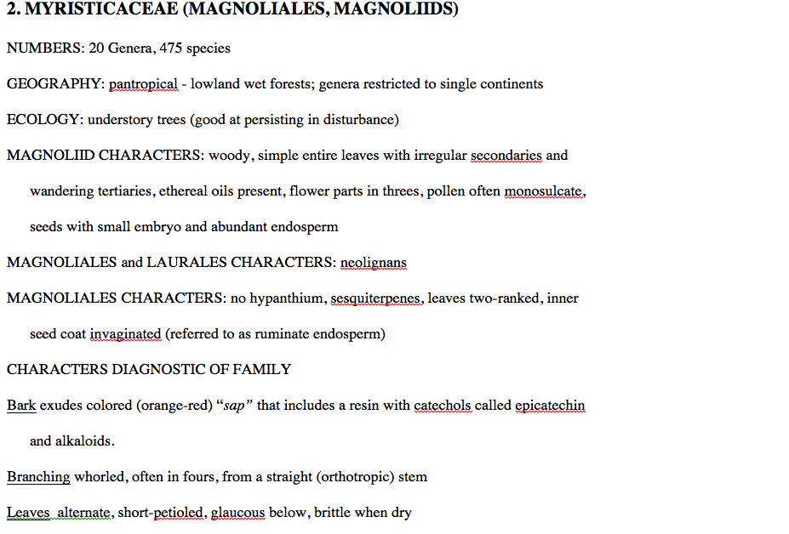

Slide 31
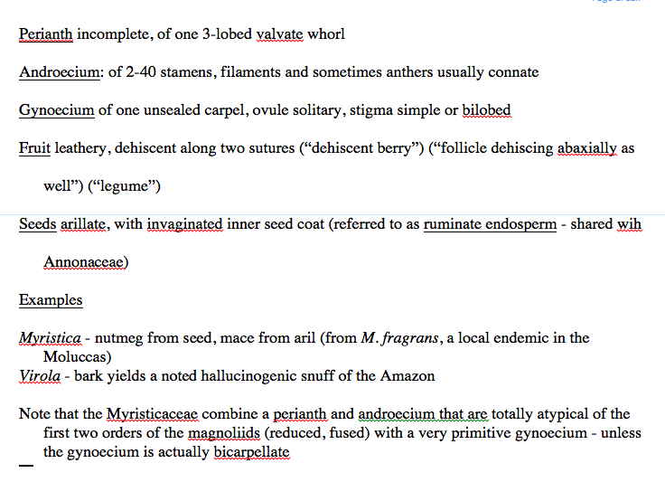

Slide 32
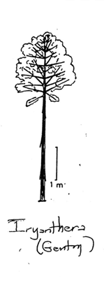
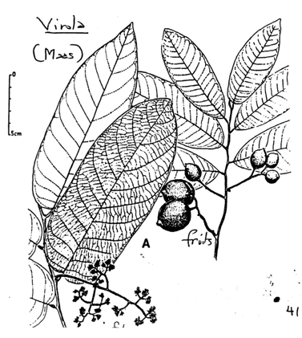
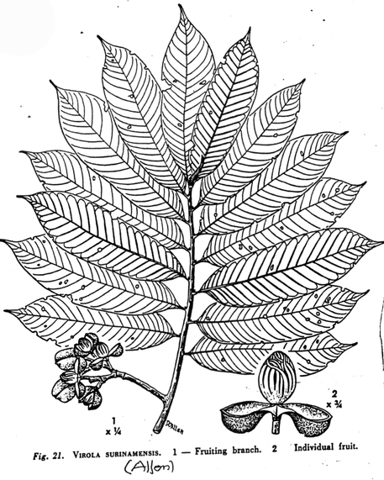
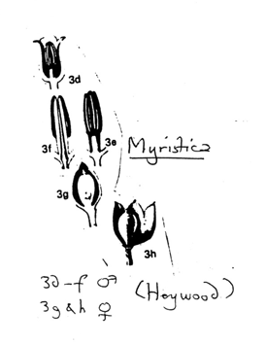

Slide 33
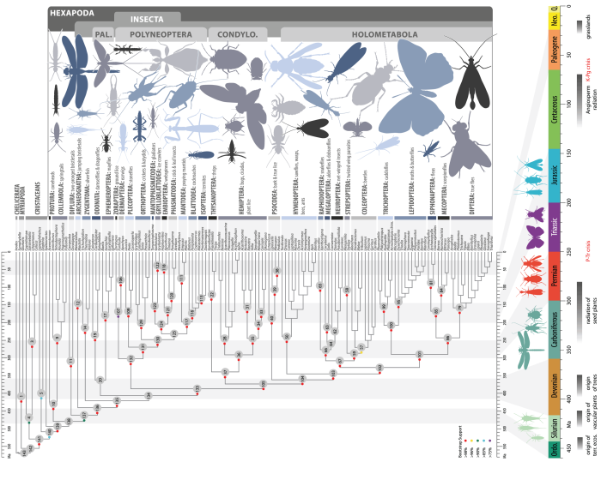
Notes:
Dated phylogenetic tree of insect relationships. The tree was inferred through a maximum-likelihood analysis of 413,459 amino acid sites divided into 479 metapartitions. Branch lengths were optimized and node ages estimated from 1,050,000 trees sampled from trees separately generated for 105 partitions that included all taxa. All nodes up to orders are labeled with numbers (gray circles). Colored circles indicate bootstrap support (left key). The time line at the bottom of the tree relates the geological origin of insect clades to major geological and biological events. CONDYLO, Condylognatha; PAL, Palaeoptera.
Misof, B., Liu, S., Meusemann, K., Peters, R.S., Donath, A., Mayer, C., Frandsen, P.B., Ware, J., Flouri, T., Beutel, R.G. and Niehuis, O., 2014. Phylogenomics resolves the timing and pattern of insect evolution. Science, 346(6210), pp.763-767.

Slide 34
Virola --- branched hairs (again)

Slide 35
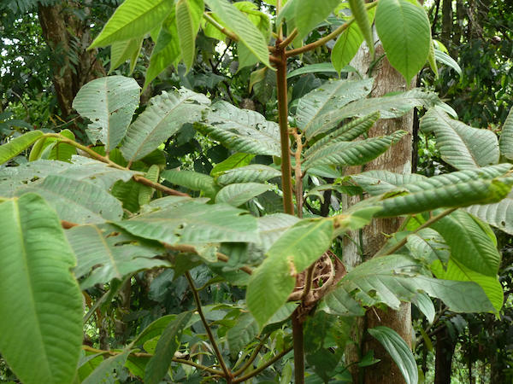
Virola – four-branch whorls

