Slide 1
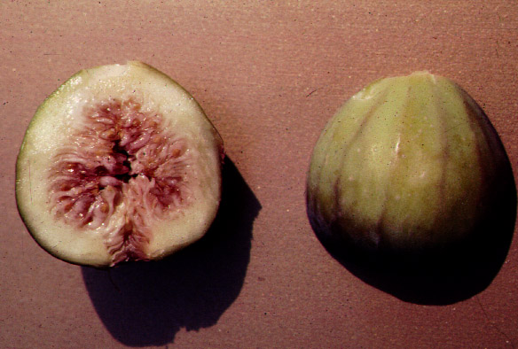
MORACEAE

Slide 2
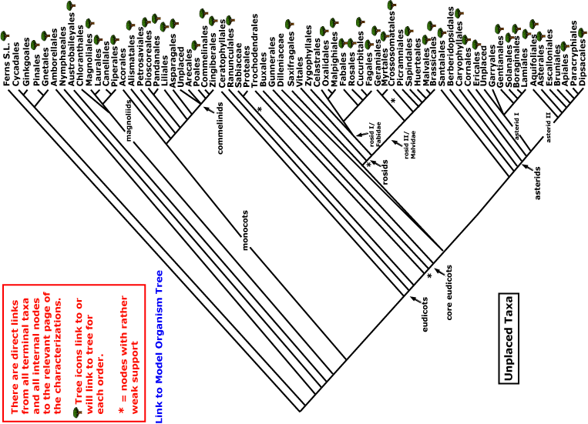


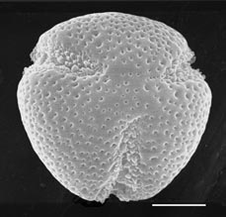
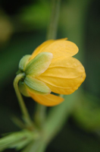
MORACEAE
magnoliids
rosids
Current Angiosperm Phylogeny Group Tree for Flowering Plants
2018
monocots
asterids
core eudicots
eudicots

Slide 3
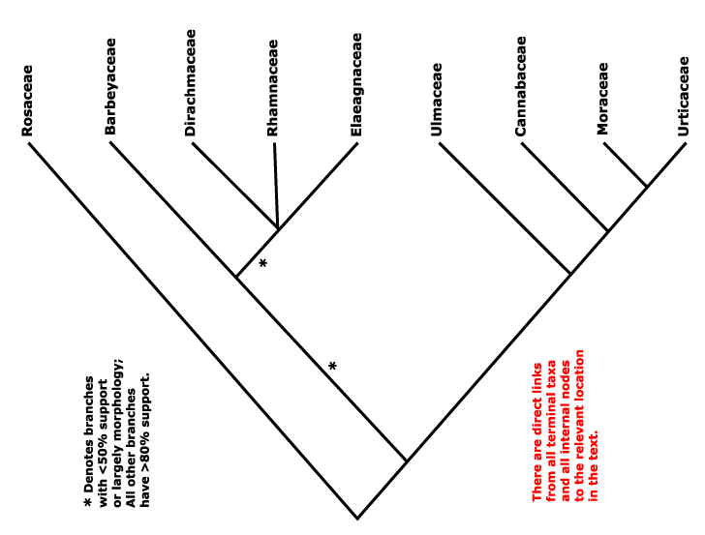
Rosales (Eurosids I)
Ulmaceae
group
Cecropia
is here!

Slide 4
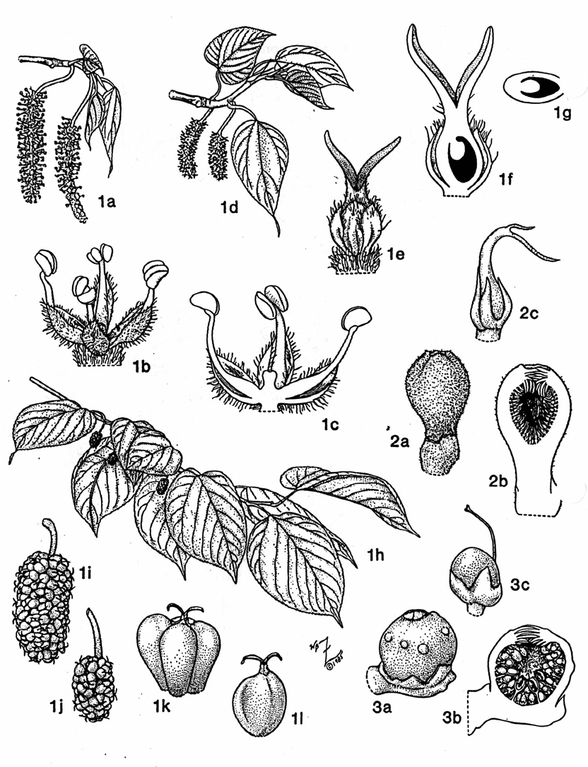
Key Characters for the Moraceae
Milky latex
Sheathing stipule
Wide-set secondaries
Small flowers united into a multiple fruit

Slide 5
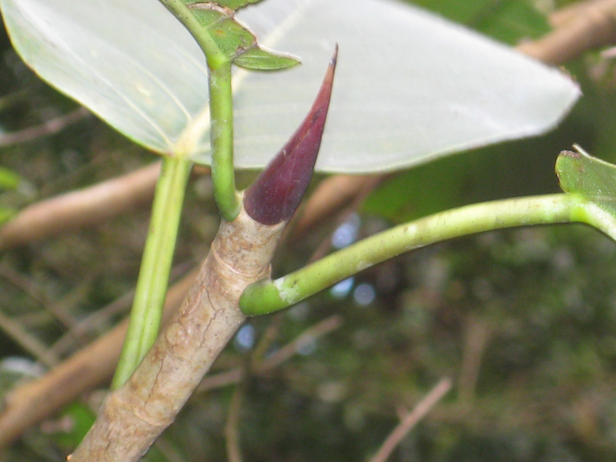
Moraceae: alternate simple leaves, latex, and pointed-wrap-around stipules

Slide 6
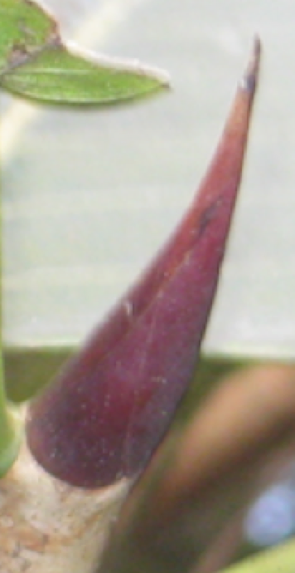
A TOUR with
Themes:
Inflorescence design
Venation

Slide 7

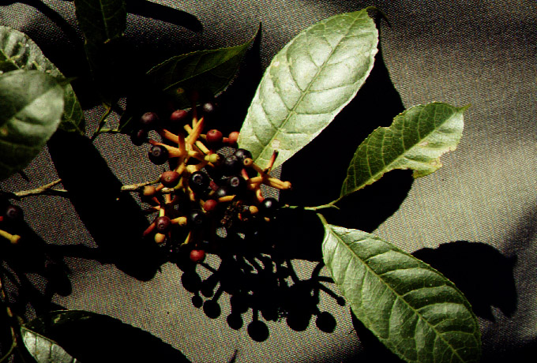
Sorocea - open inflorescence

Slide 8
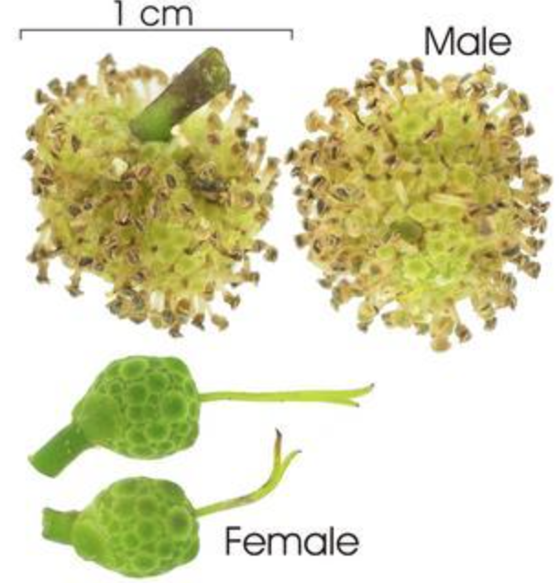
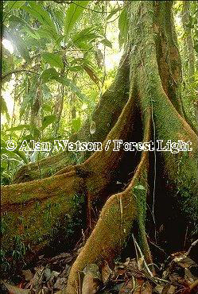
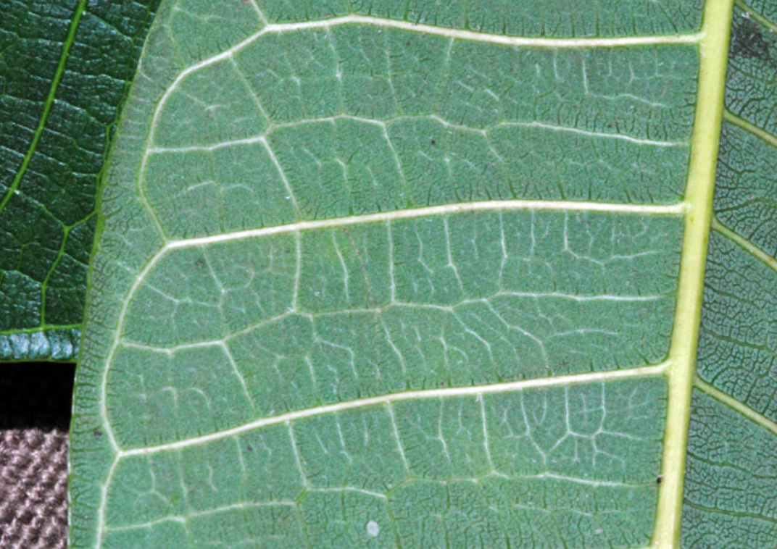
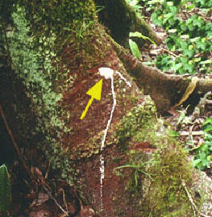
Brosimum (lechero) - colonizer,
canopy tree, edible latex
Notes:
scan my own drawing?

Slide 9
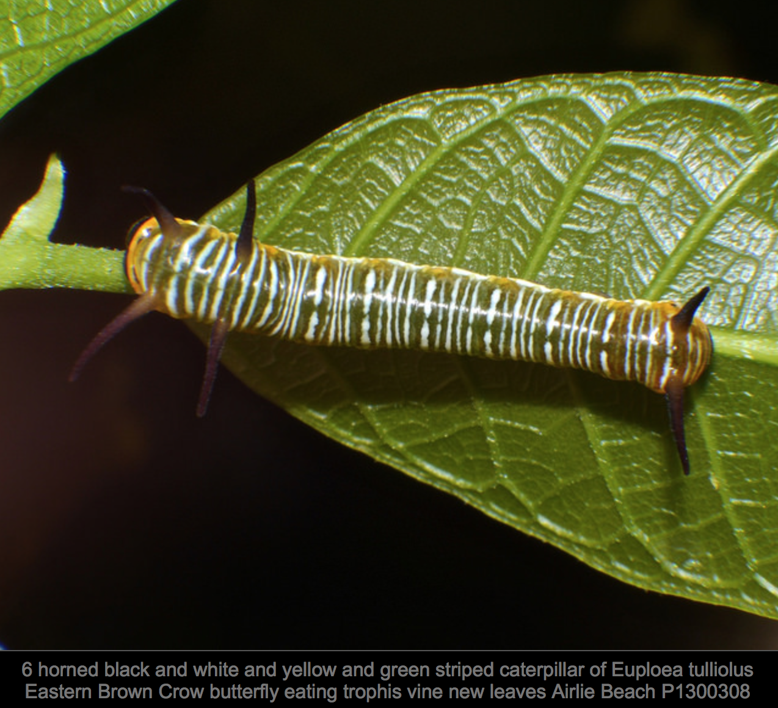
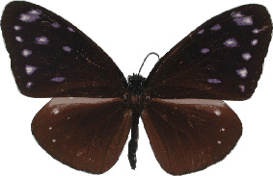
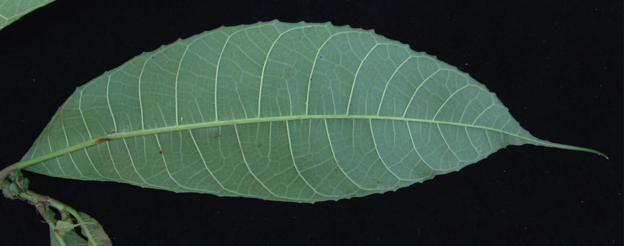
Trophis – worldwide liana
Euploea tulliolus
Nymphalidae
Notes:
Edgar, J.A., 1982. Pyrrolizidine alkaloids sequestered by Solomon Island danaine butterflies. The feeding preferences of the Danainae and Ithomiinae. Journal of Zoology, 196(3), pp.385-399.

Slide 10
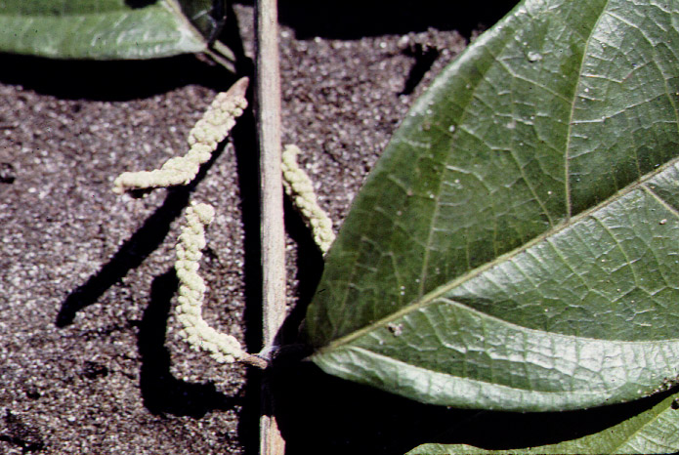
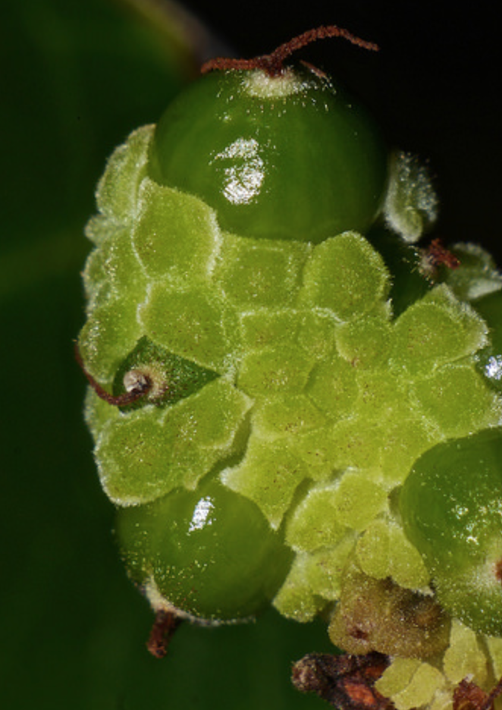
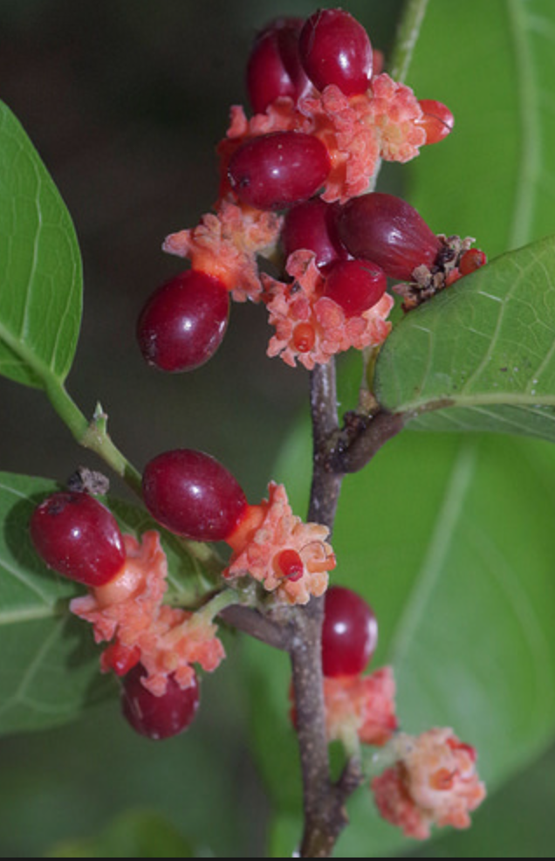
Trophis – worldwide liana

Slide 11
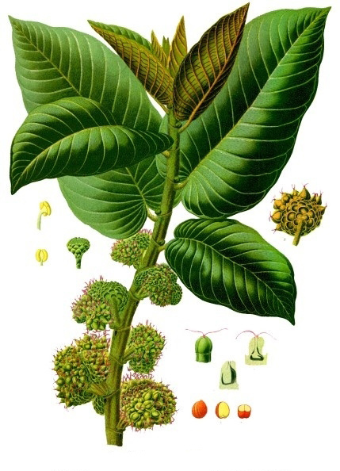
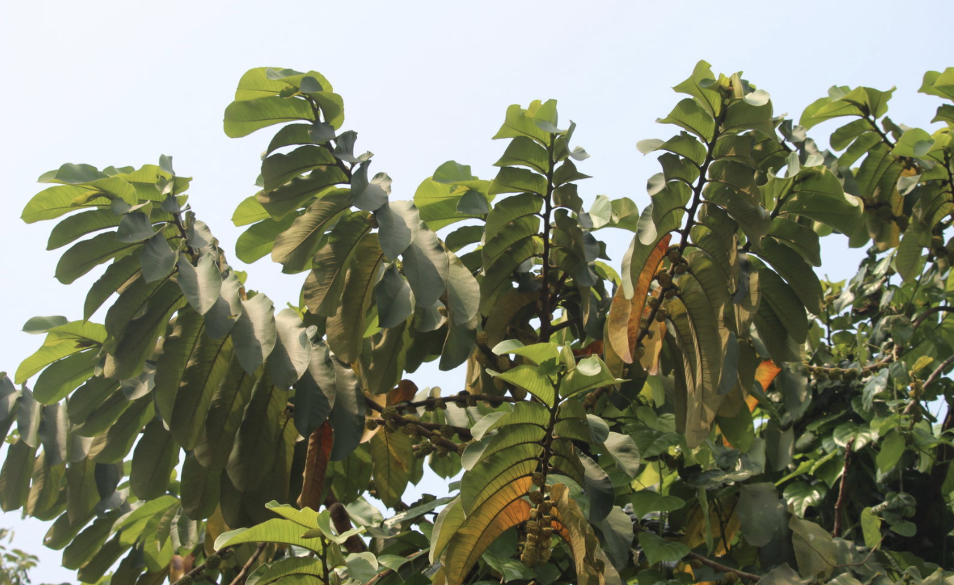
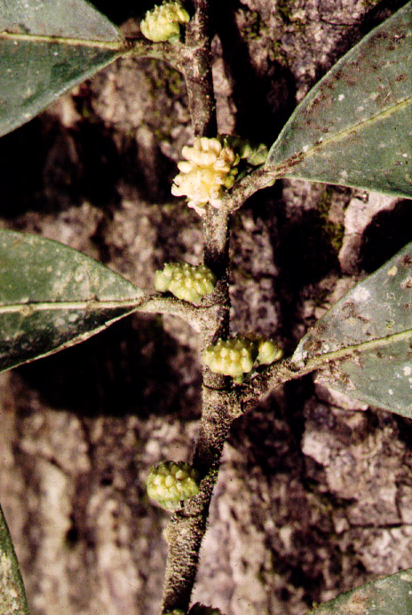
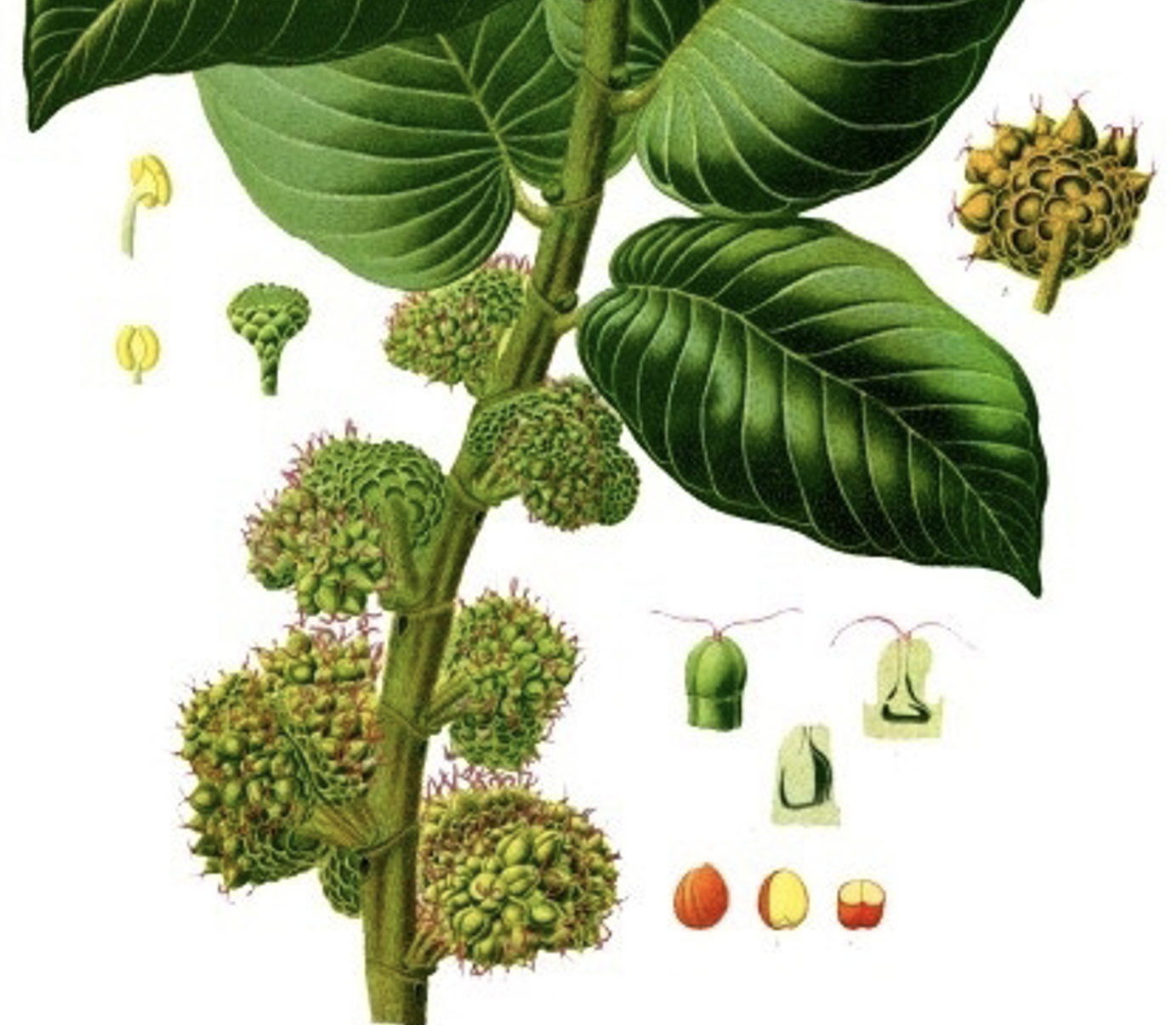
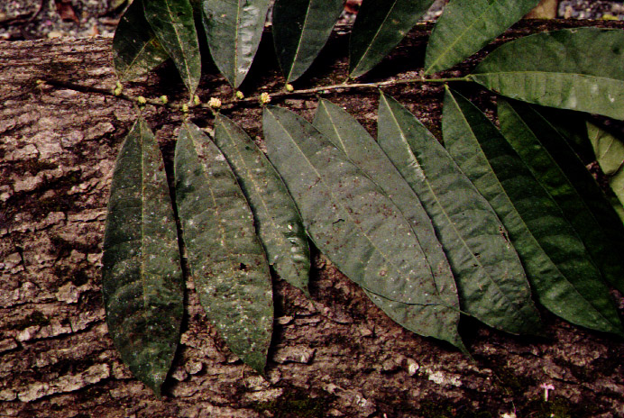
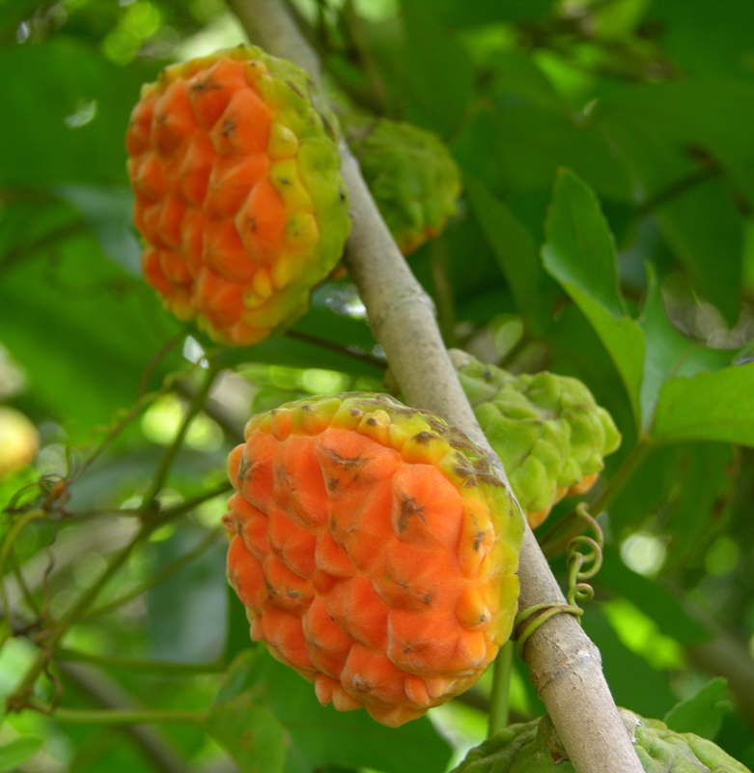
Castilla

Slide 12
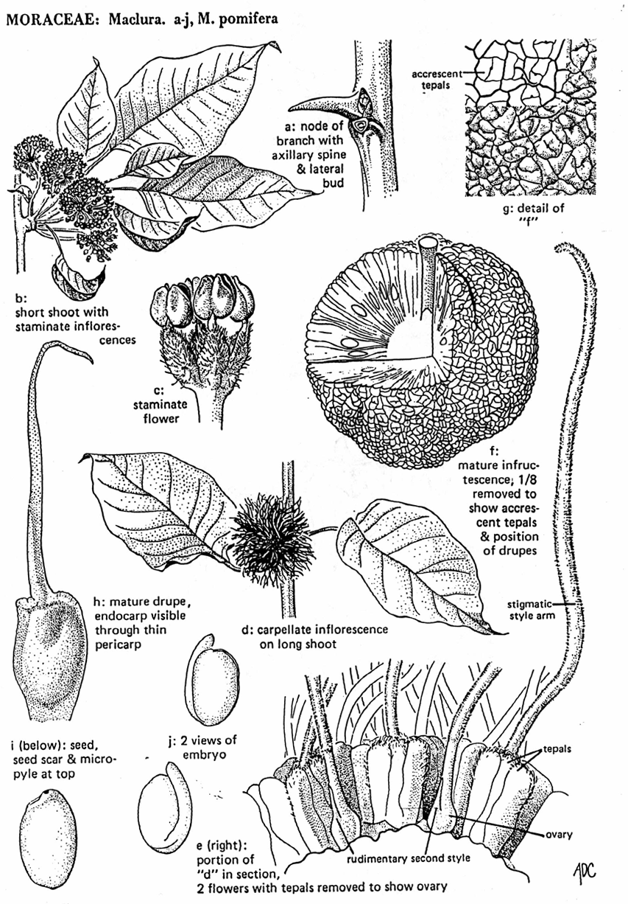
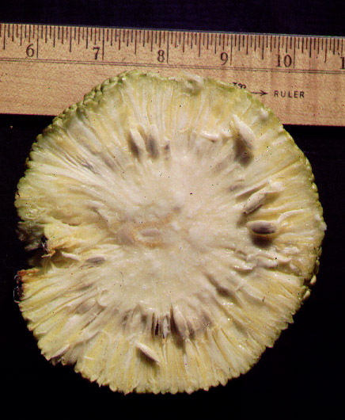
Maclura (osage orange) fruiting inflorescence in section

Slide 13
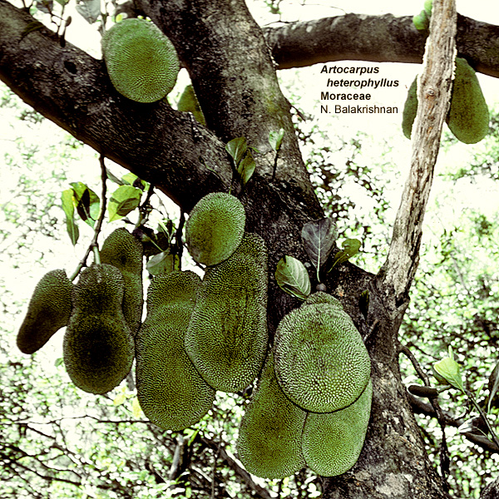
Artocarpus --- the breadfruit

Slide 14
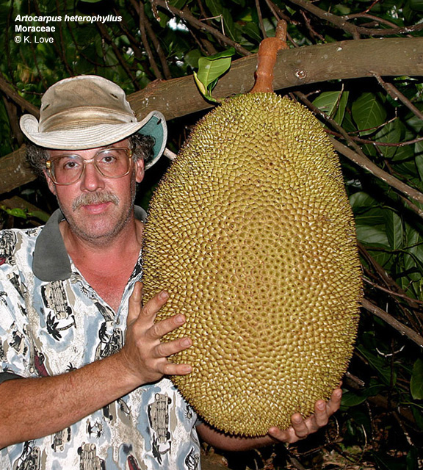

Slide 15
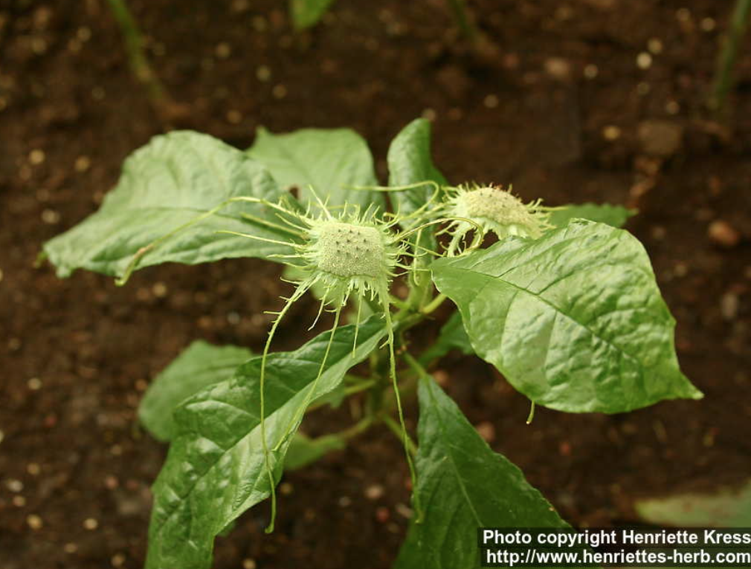
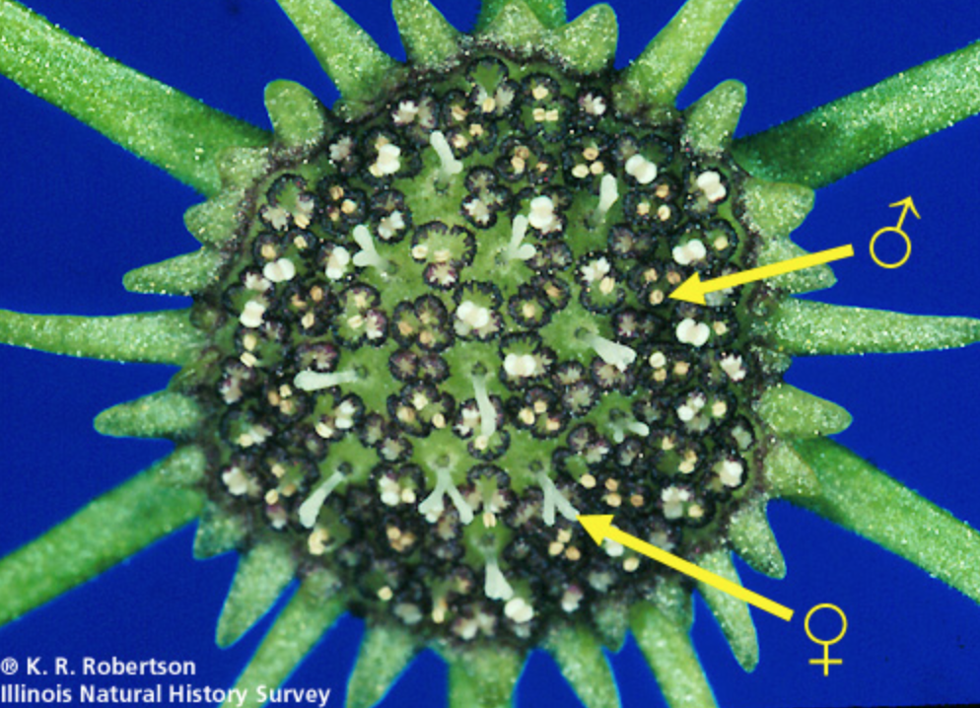
Dorstenia — herb, flat inflorescence

Slide 16
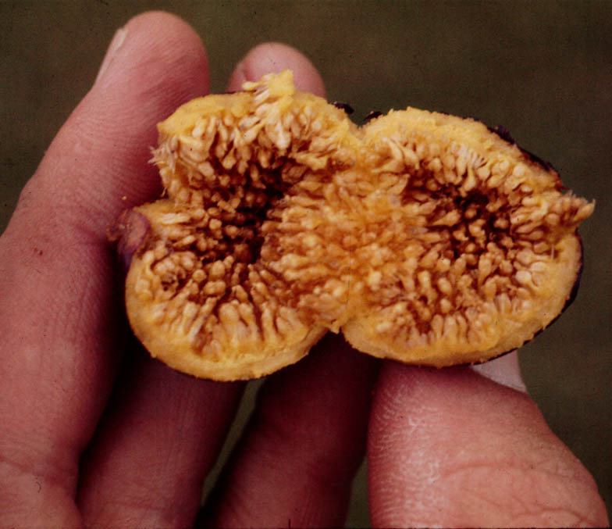
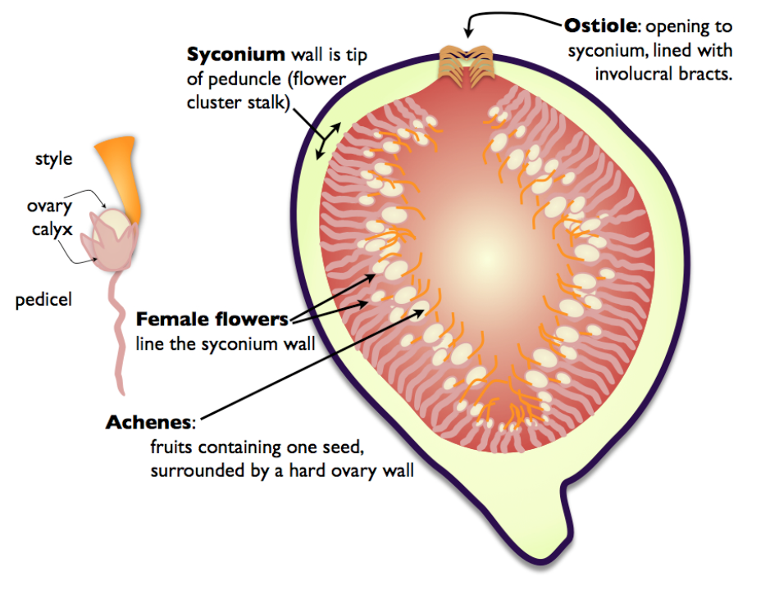
syconium
syconium - a hollow inflorescence with the flowers inside

Slide 17
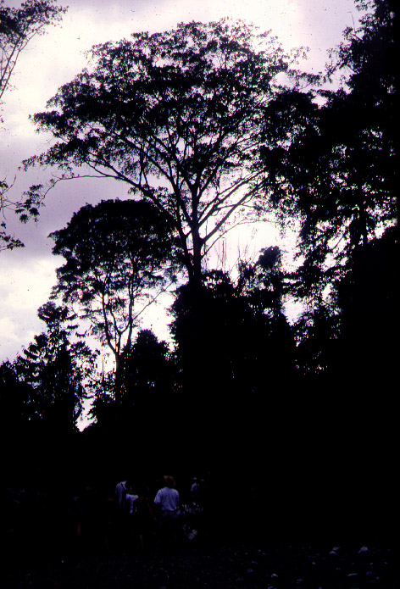
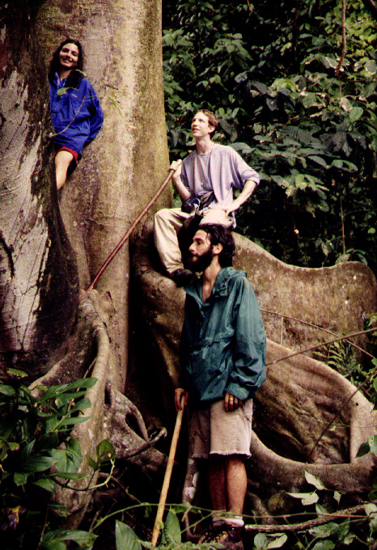
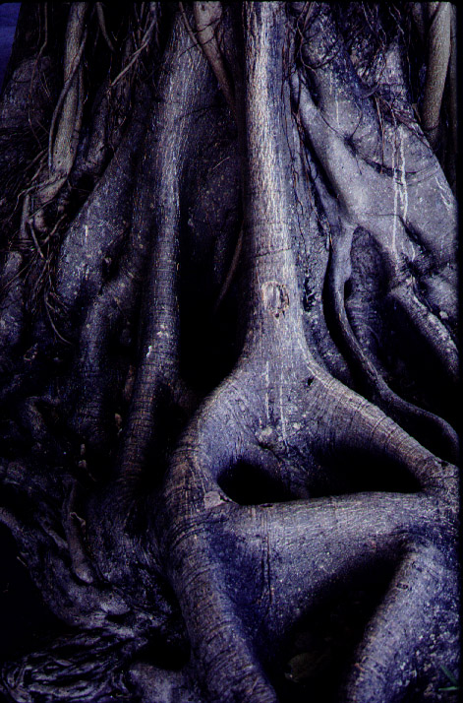
Ficus – canopy trees, distinctive roots
Osa Peninsula, 1997
Notes:
Arrigoni: https://www.ctaudubon.org/2018/06/deer-pond-farm-welcomes-jim-arrigoni-conservation-biologist-for-the-connecticut-audubon-society/

Slide 18
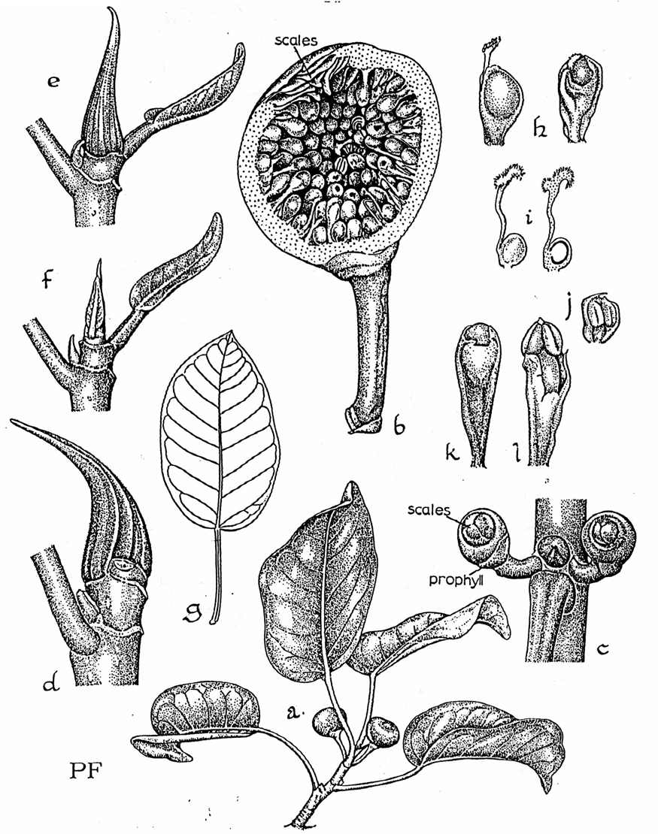
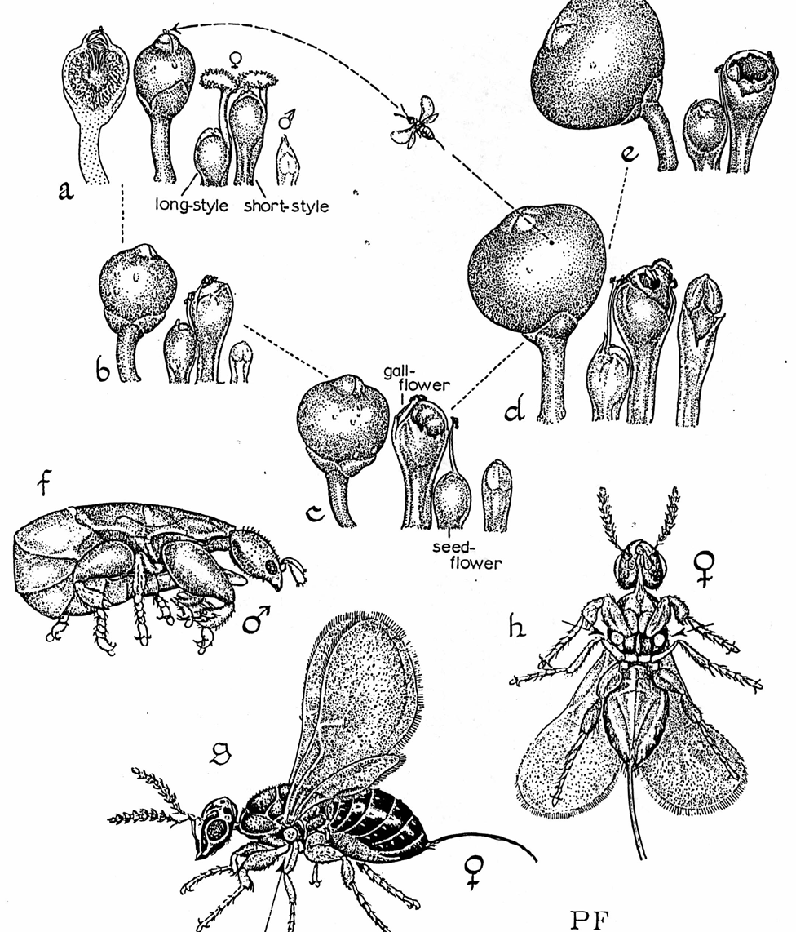
Ficus and the wasp Blastophaga
Notes:
pollination biology:
figs are monoecious (like the family) ---- both sexes are found inside each syconium (inside-out inflorescence). Female flowers of two types, 1) long-styled and short-pedicelled or 2) short-styled and long-pedicelled. Male flowers consist of a single stamen. Female flowers function first. Arriving pregnant female wasps with fig pollen ovipovit and pollinate both kinds of female flowers – the short styles yield wasps, the long-styled yield seeds. These wasps emerge as male flowers open, and the male wasp fertilizes the female wasp and the impregnated female is assisted in leaving the fig by the male after she gathers a pollen load. (Tomlinson, 1980, pp 260-51

Slide 19
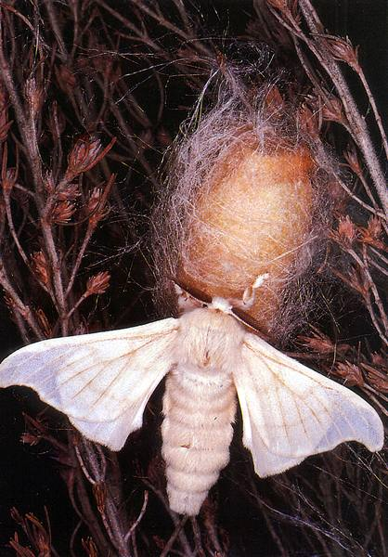
Bombyx mori (the silkworm) caterpillars can eat quite widely within Moraceae, but not on most other members of the Ulmaceae group.

Slide 20
Cecropia

Slide 21
Rosales (Eurosids I)
Lump or
split?
Ulmaceae
group
Cecropia
is here!

Slide 22
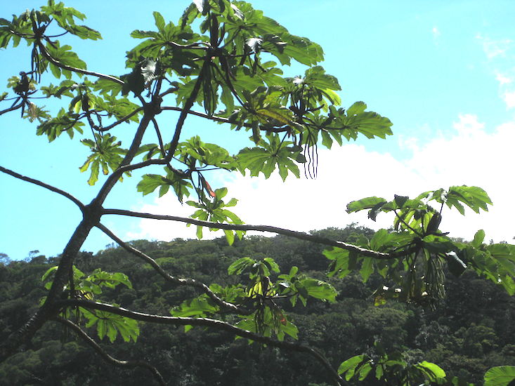
Cecropia -
disturbance
colonizer
Notes:
Aztec ants establish colonies inside the hollow stems of Cecropia trees. The ants feed on the sugary solution excreted by small plant-sucking insects which the ants introduce and maintain. The fierce ants protect the tree from other foragers and climbing vines which could cover the plant. They collect small nutritious outgrowths from the base of the Cecropia leaves which they use as food for themselves and their young. -- http://www.mobot.org/education/tropics/page5.html

Slide 23
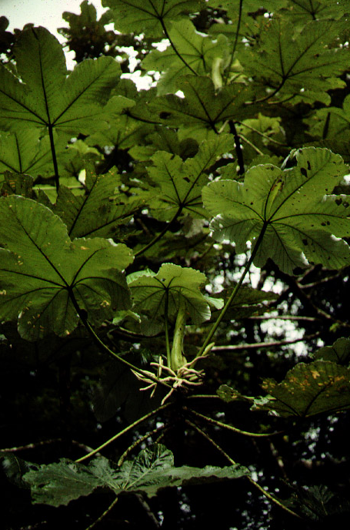
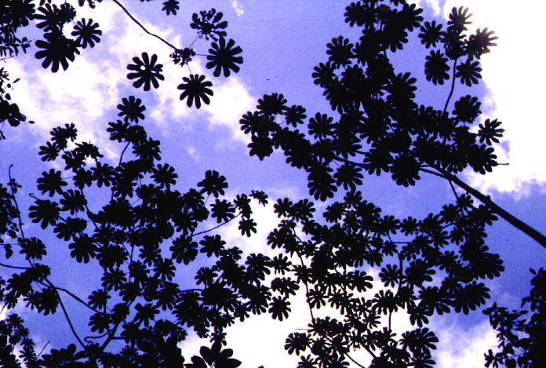
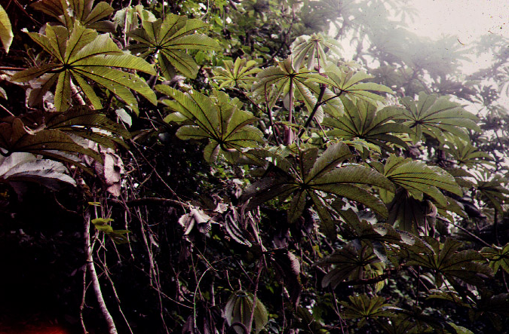
Cecropia – Moraceae or Urticaceae

Slide 24
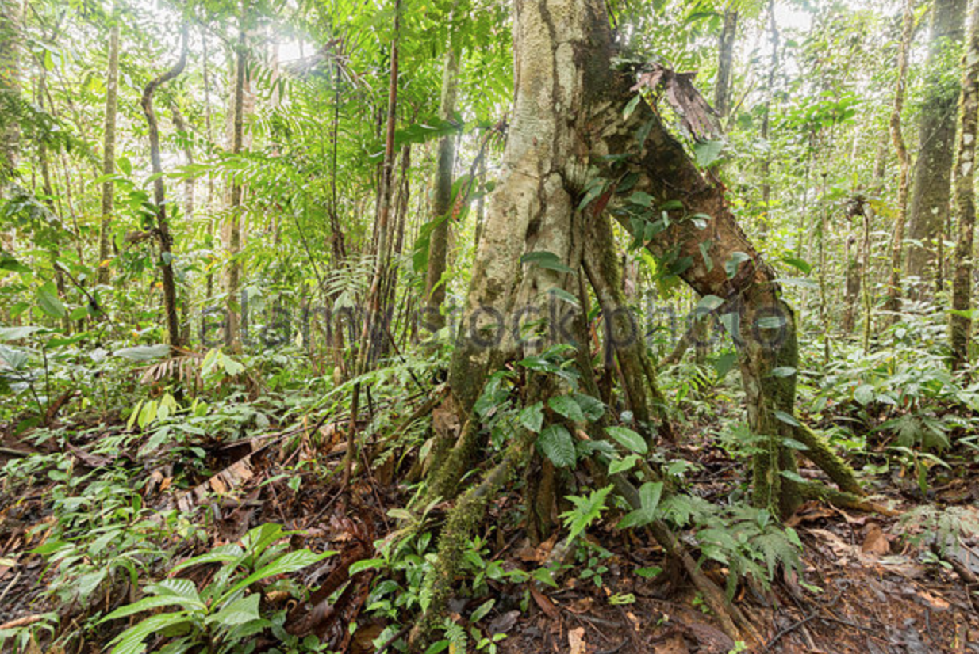
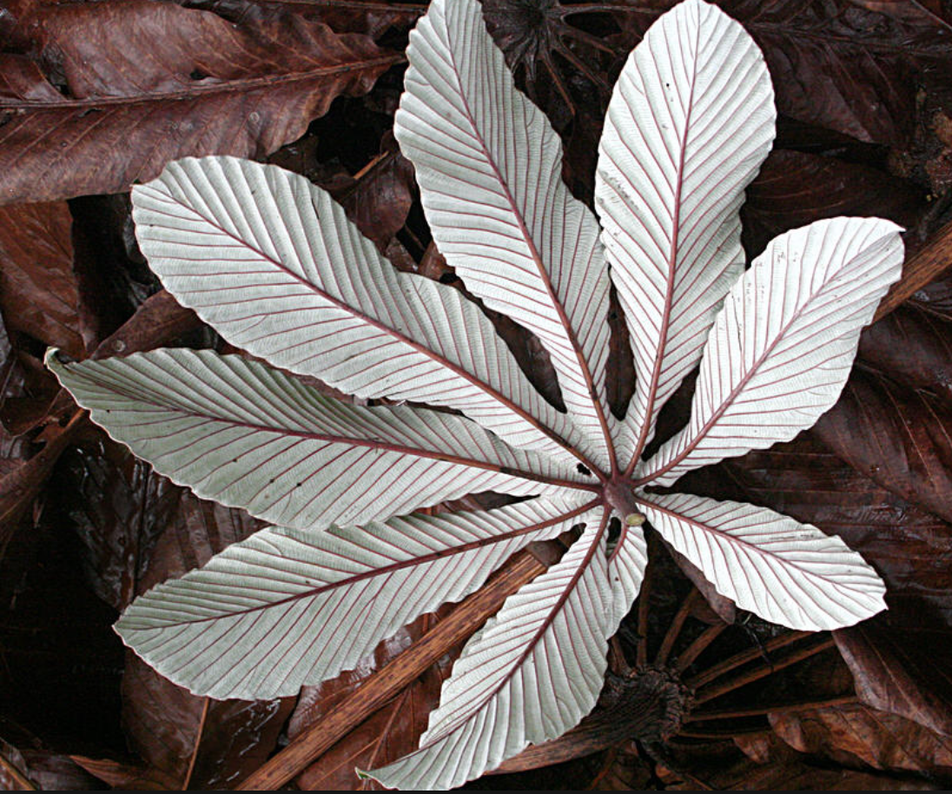
Cecropia – classic leaves, unique buttresses

Slide 25
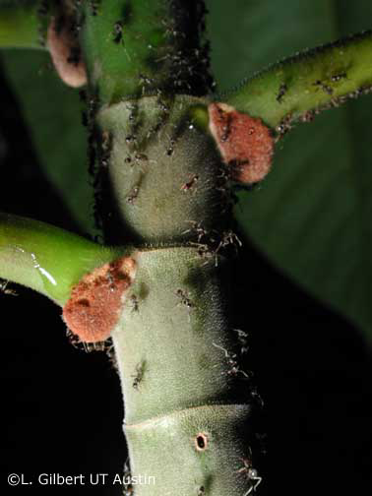
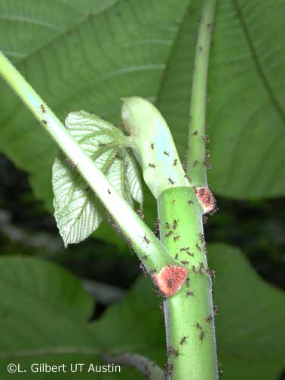
Cecropia defended by Azteca ants
Notes:
Aztec ants establish colonies inside the hollow stems of Cecropia trees. The ants feed on the sugary solution excreted by small plant-sucking insects which the ants introduce and maintain. The fierce ants protect the tree from other foragers and climbing vines which could cover the plant. They collect small nutritious outgrowths from the base of the Cecropia leaves which they use as food for themselves and their young. -- http://www.mobot.org/education/tropics/page5.html

Slide 26
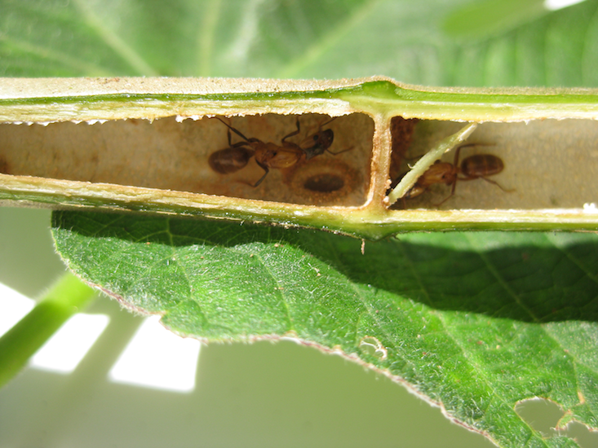
Cecropia stem interior
Notes:
Aztec ants establish colonies inside the hollow stems of Cecropia trees. The ants feed on the sugary solution excreted by small plant-sucking insects which the ants introduce and maintain. The fierce ants protect the tree from other foragers and climbing vines which could cover the plant. They collect small nutritious outgrowths from the base of the Cecropia leaves which they use as food for themselves and their young. -- http://www.mobot.org/education/tropics/page5.html

Slide 27
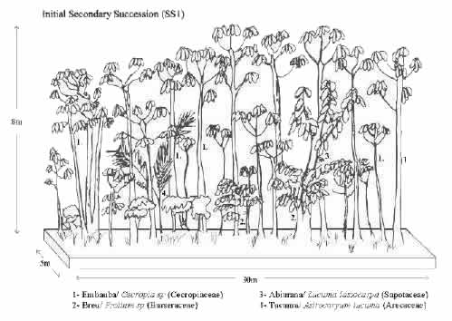
Notes:
based on a succession analysis from Brazil. See http://www.ecoro.cnpm.embrapa.br/341.html

Slide 28
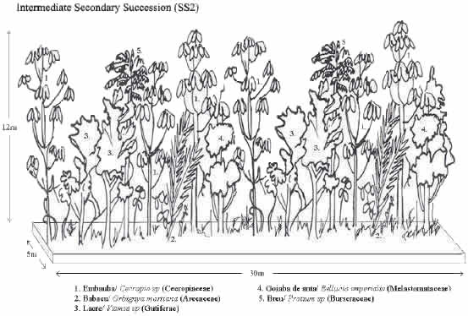

Slide 29


Slide 30


Slide 31
SET ASIDE

Slide 32


Slide 33


