Slide 1
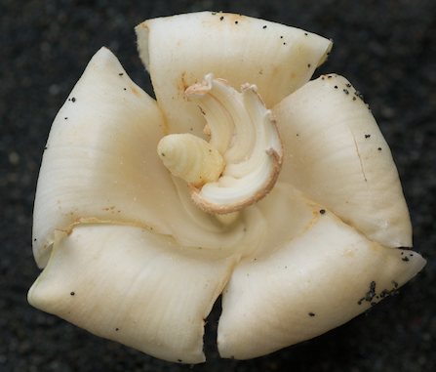
MALVACEAE

Slide 2
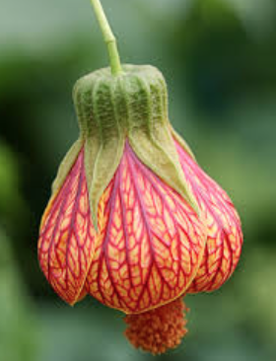
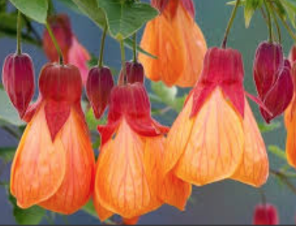

Slide 3
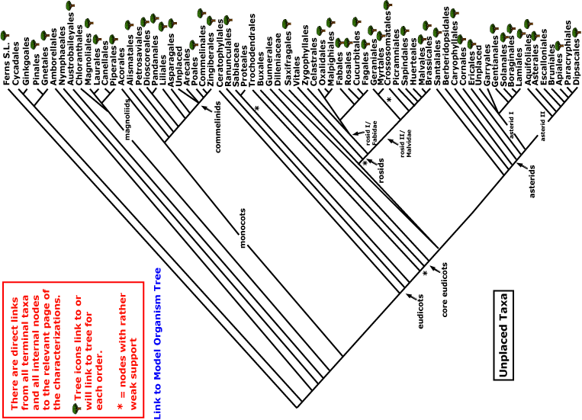

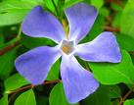
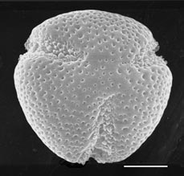
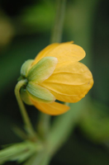
MALVACEAE
magnoliids
rosids
Current Angiosperm Phylogeny Group Tree for Flowering Plants
2018
monocots
asterids
core eudicots
eudicots

Slide 4
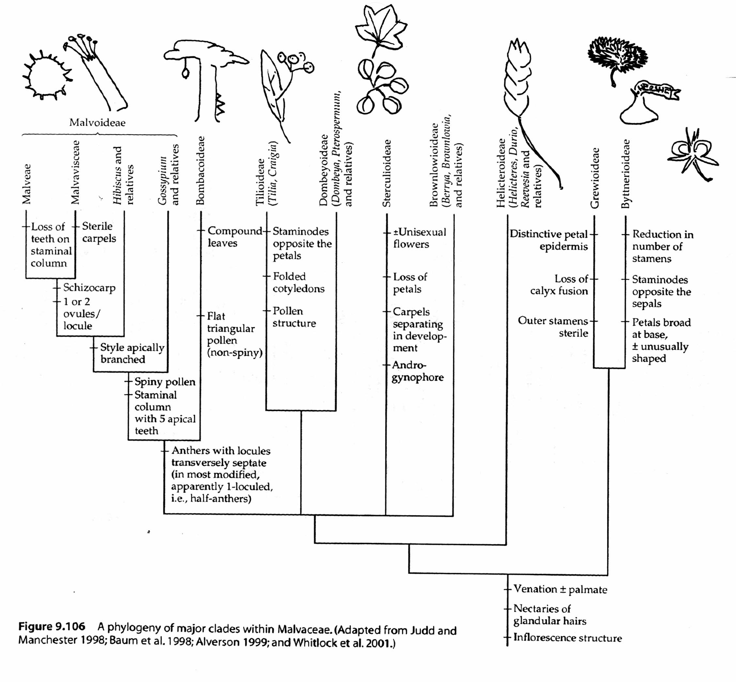
Malvaceae groups from molecular data

Slide 5
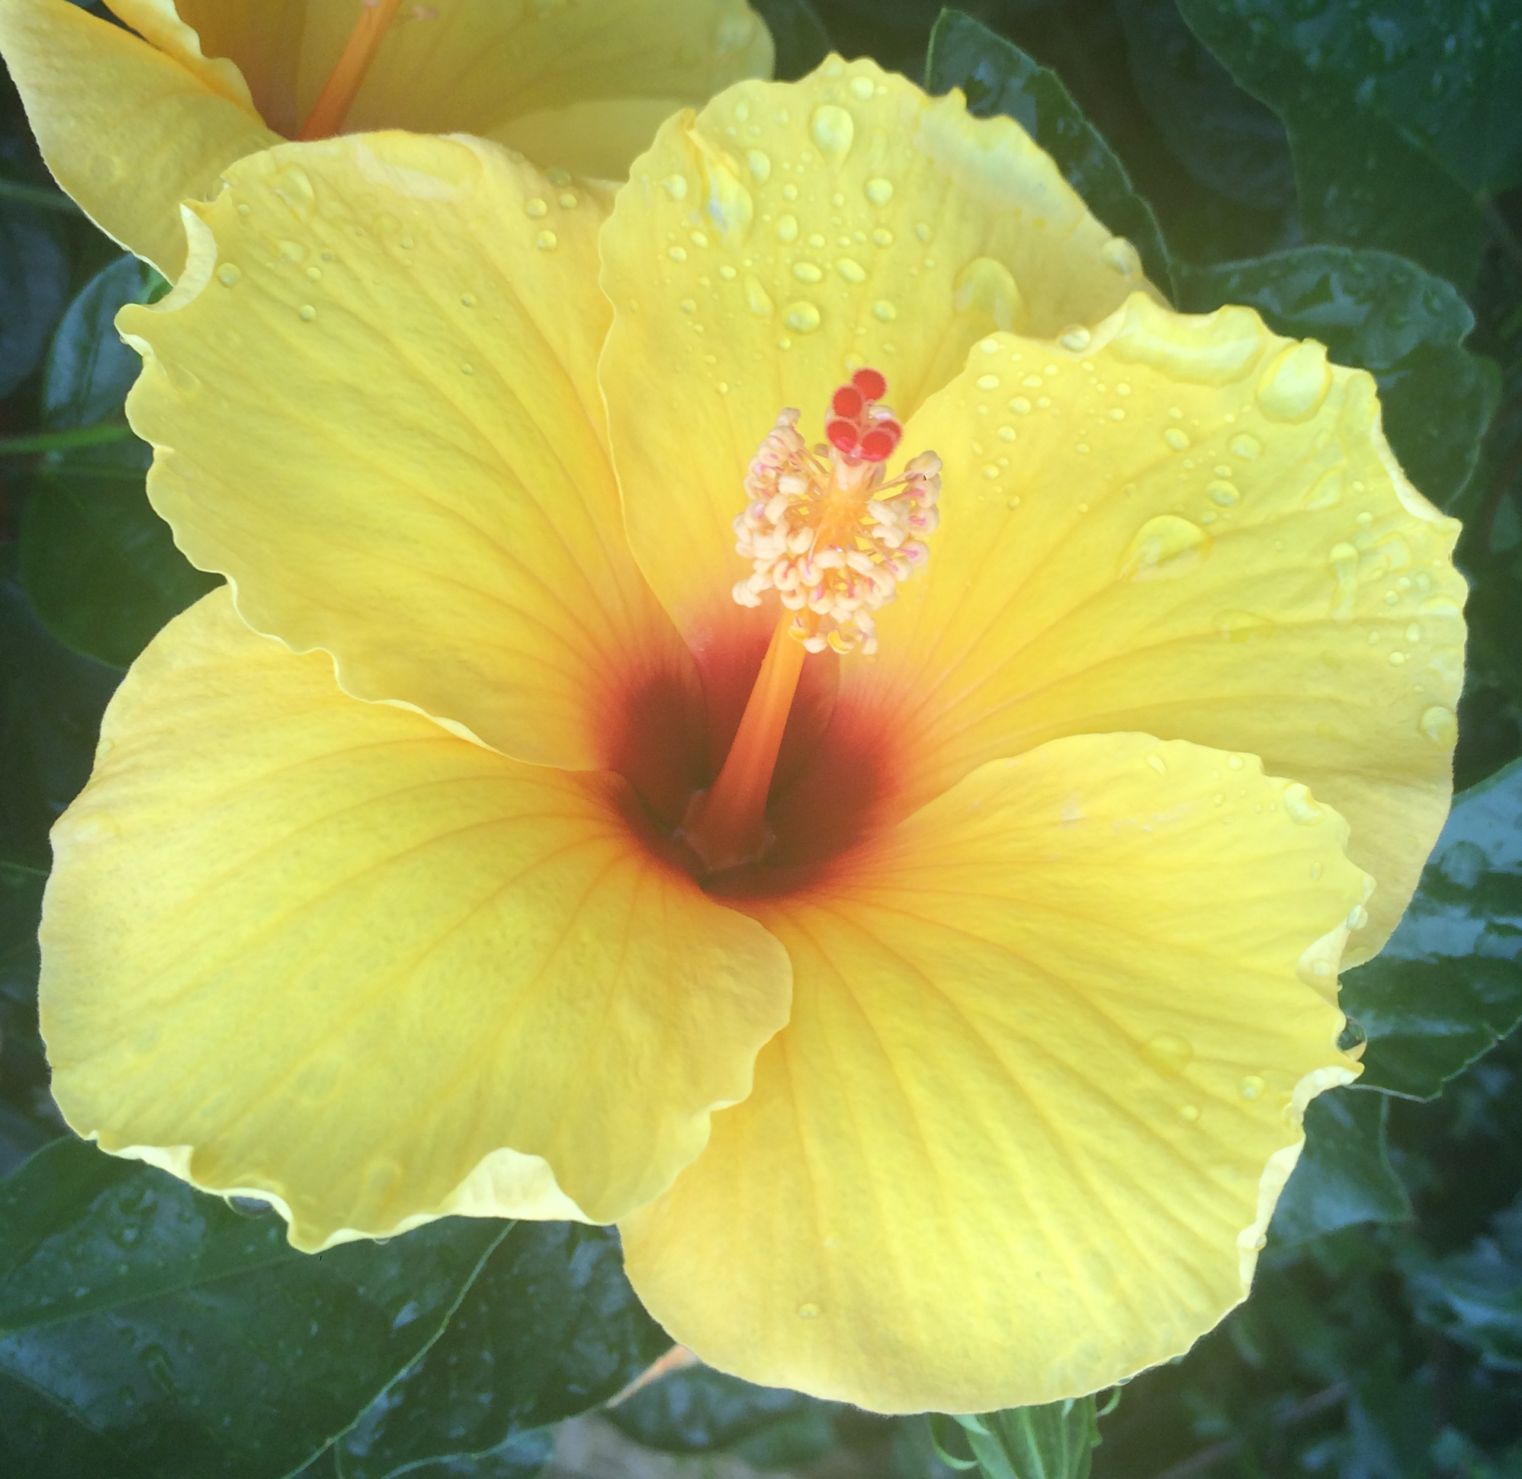
Early-divergent groups
Byttnerioideae, Grewioideae, Helicteridoideae

Slide 6
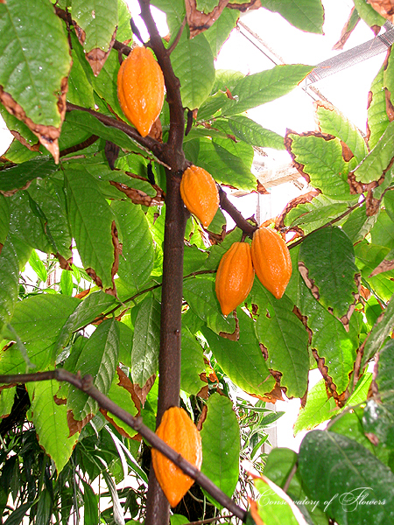
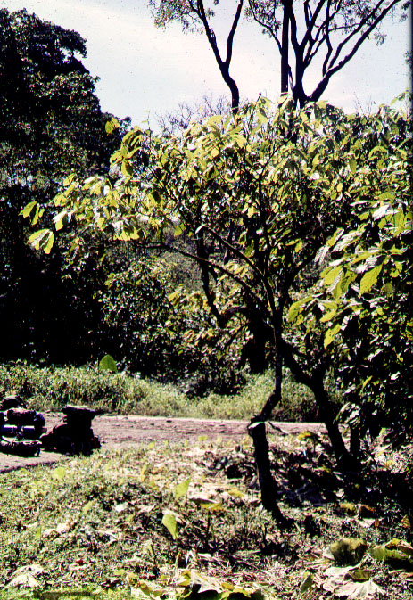
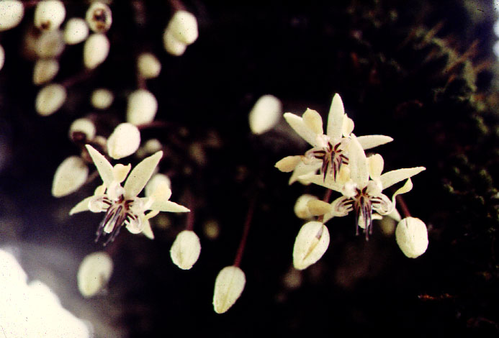
Theobroma cacao - byttnerioid

Slide 7
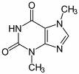
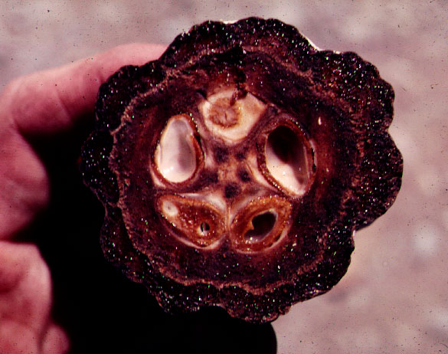
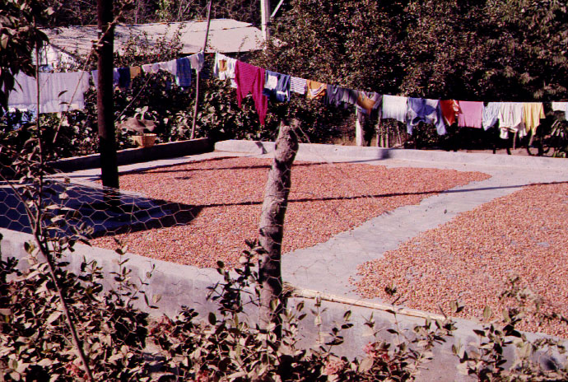
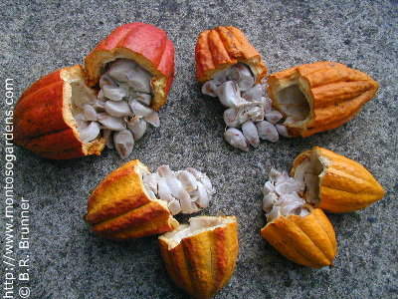
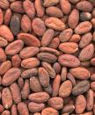
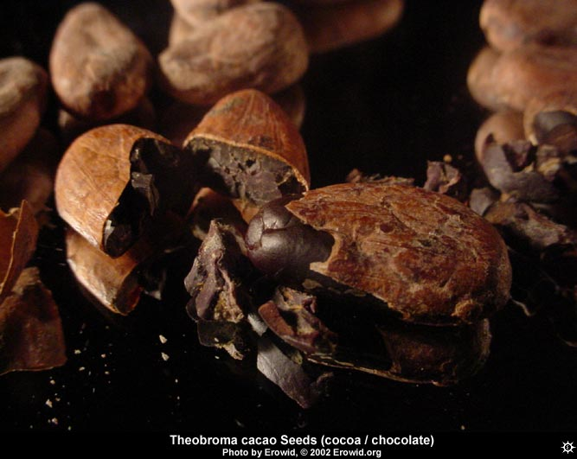

theobromine
caffeine

Slide 8
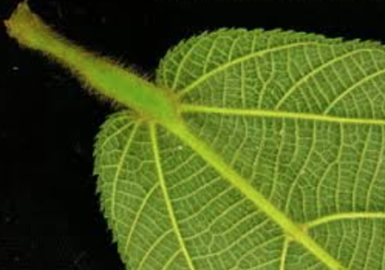
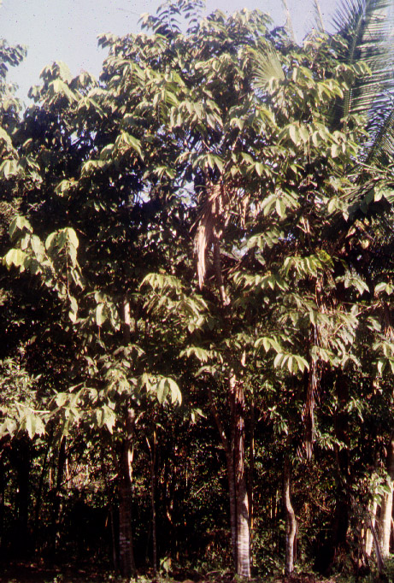
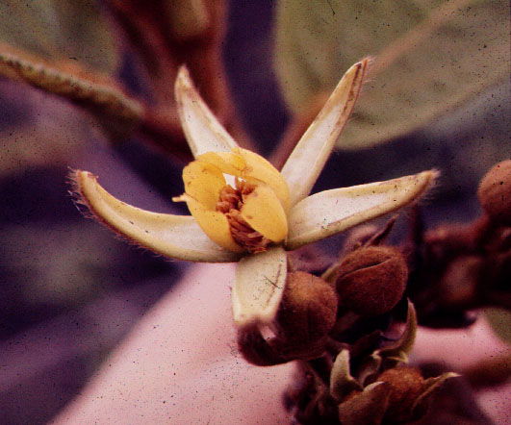
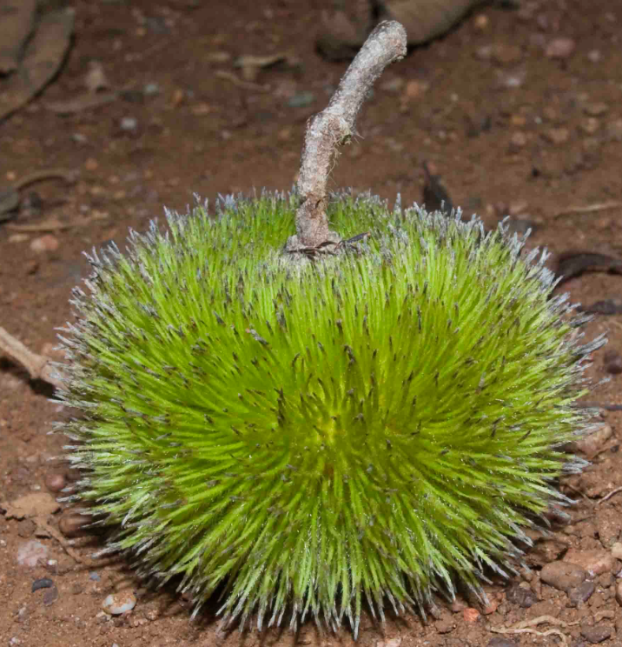
Apeiba
grewioid with sea-urchin fruits

Slide 9
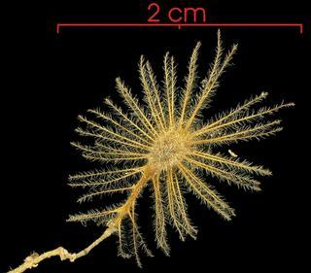
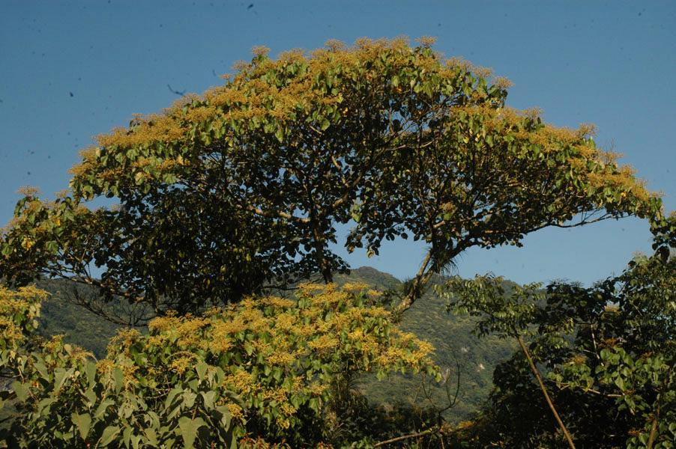
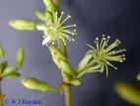
Heliocarpus – grewioid weed tree of the cloud forest

Slide 10
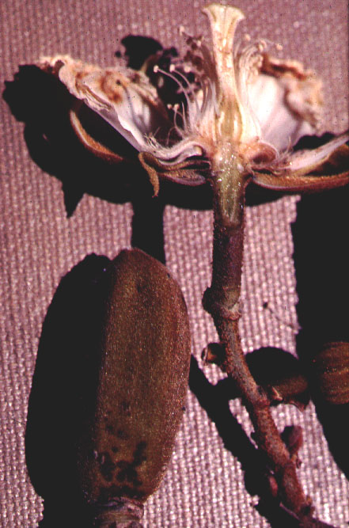
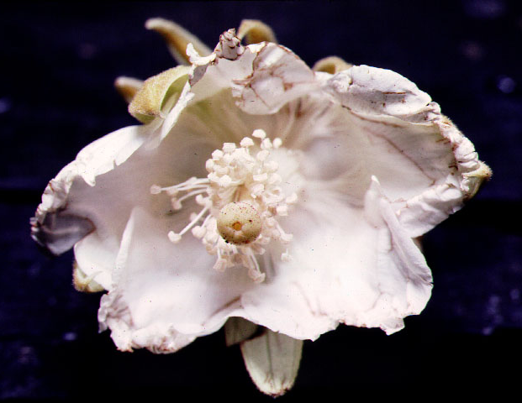
Luehea – grewioid dry-forest tree

Slide 11
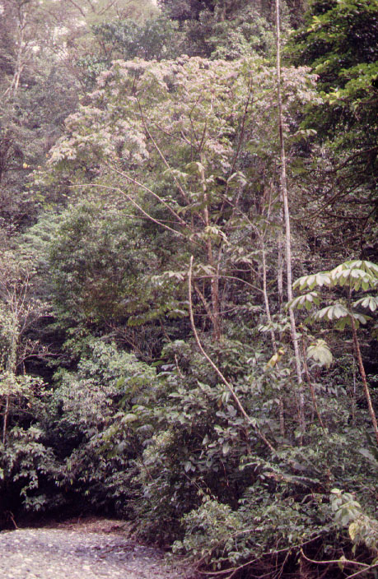
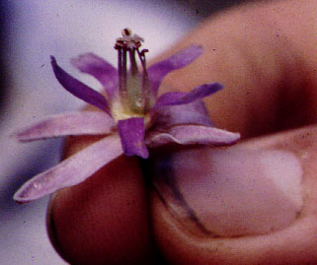
Trichospermum - grewioid tropical rainforest weed tree

Slide 12
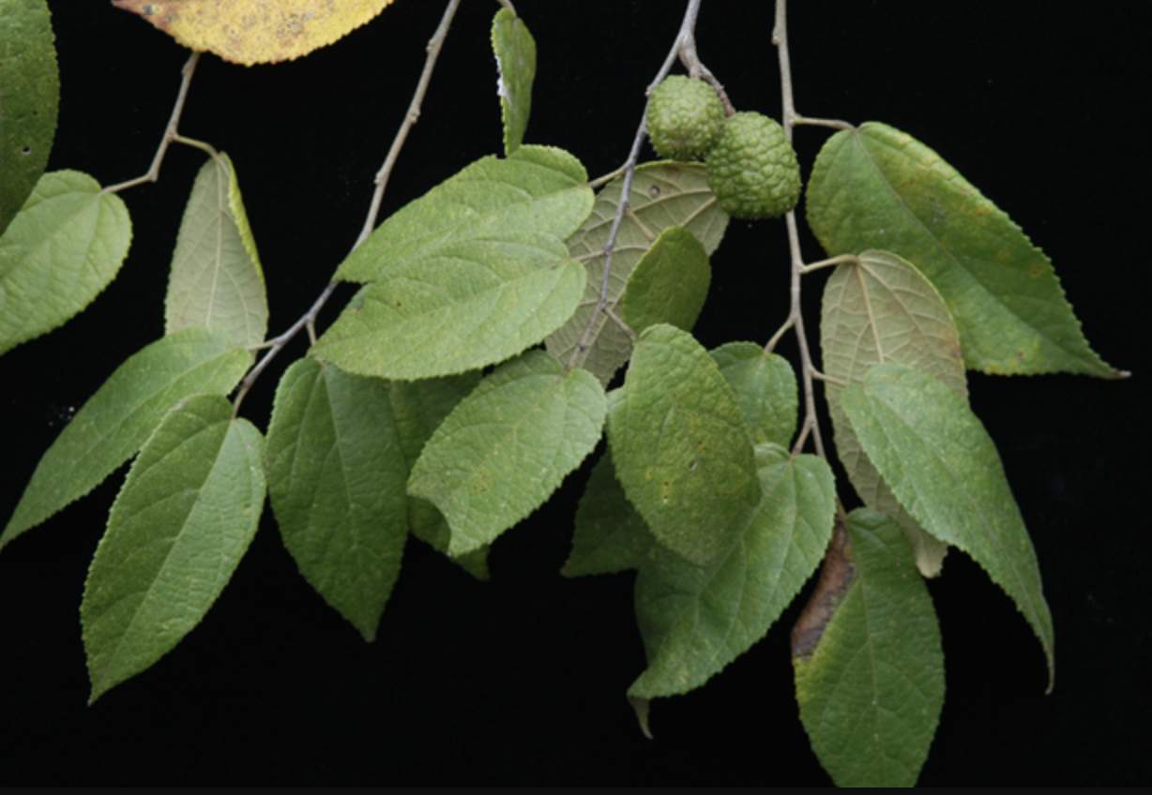
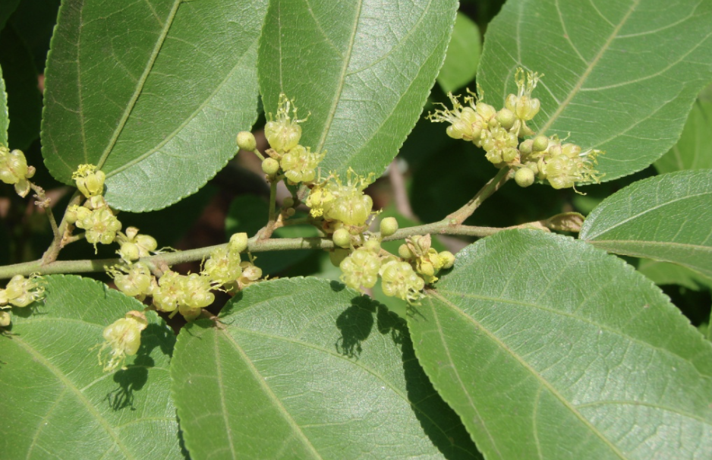
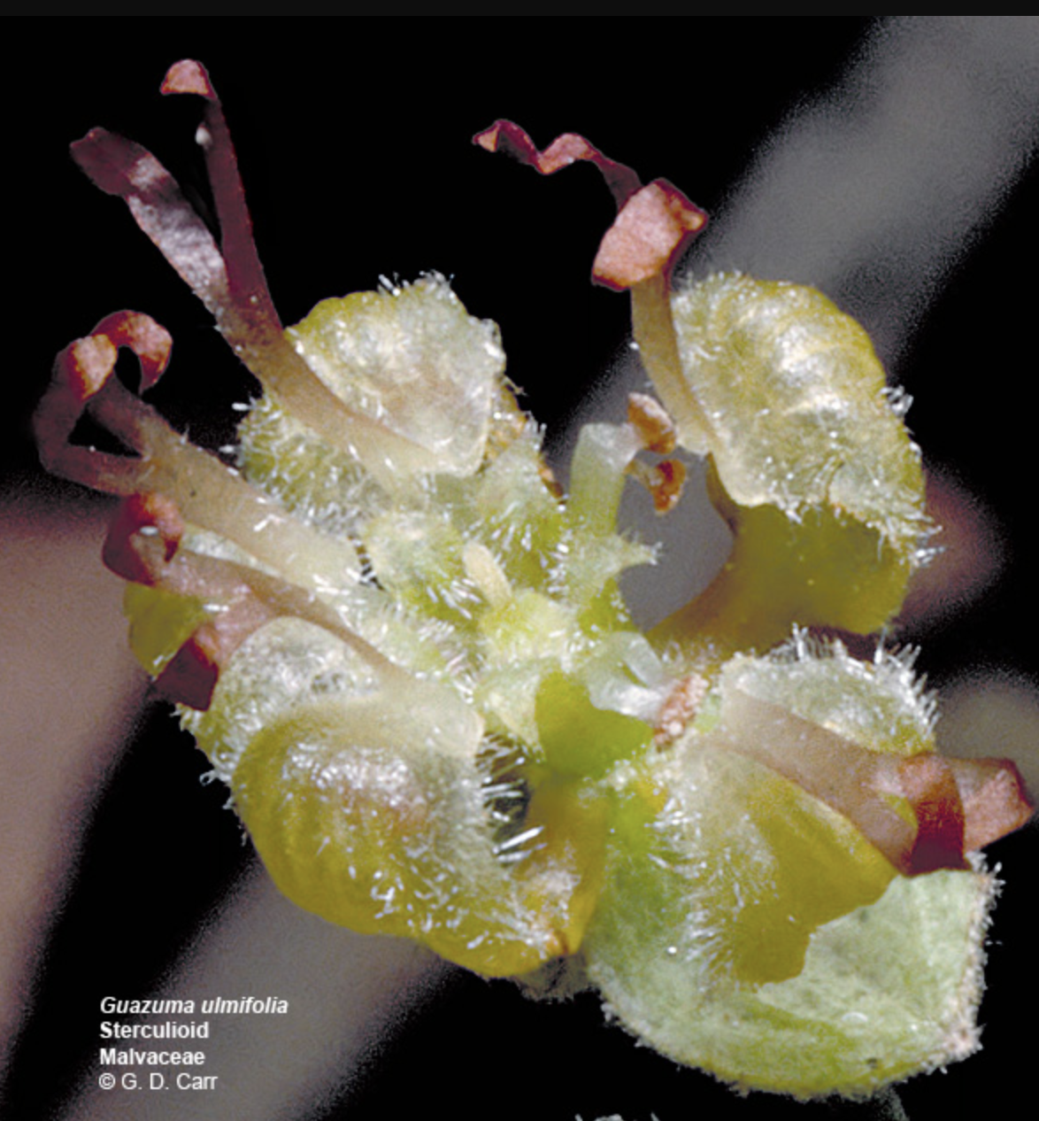
Guazuma - byttnerioid

Slide 13
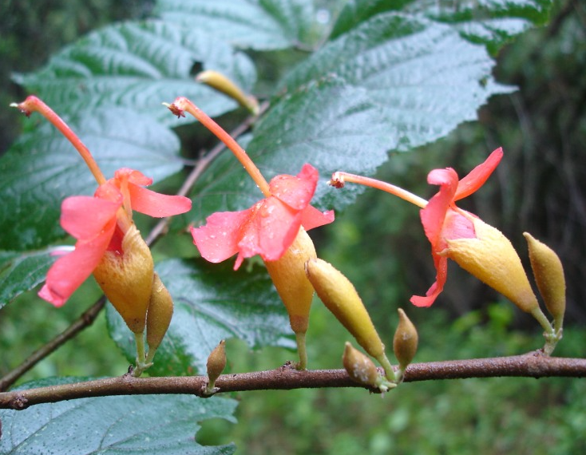
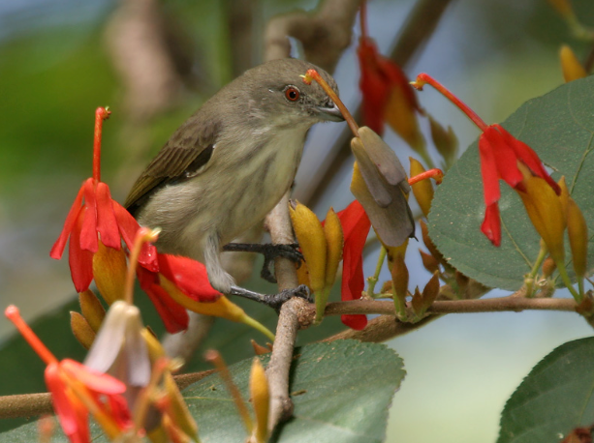
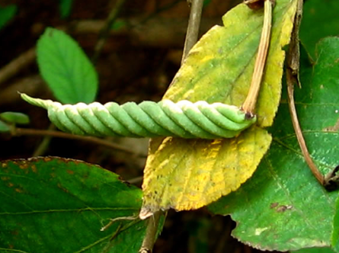
Helicteres – (helicteroid): complex pollination
Helicteres isora
Notes:
Bluish-grey day one flowers bee pollinated, selfed as bees remain on plant
Pinkish (day 2) and red (day 3) flowers are perching-bird pollinated, outcrossed as birds move between plants
Atluri, J. B., Rao, S. P., & Reddi, C. S. (2000). Pollination ecology of Helicteres isora Linn.(Sterculiaceae). CURRENT SCIENCE-BANGALORE-, 78(6), 713-718.

Slide 14
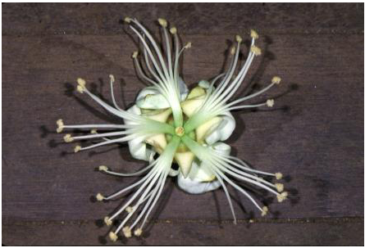
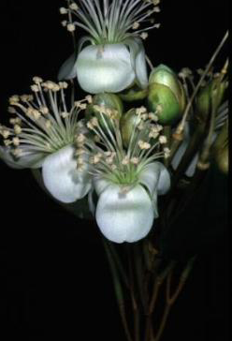
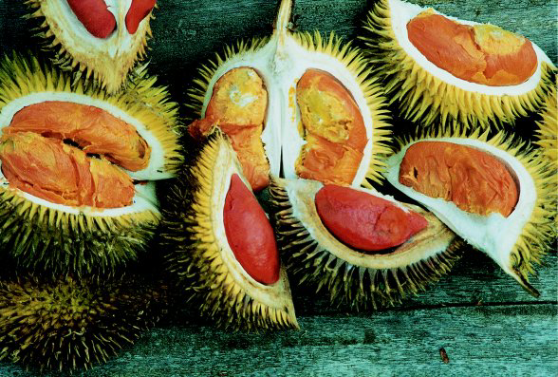
Durio - the legendary orangutan-dispersed old-world
tropical tree:
a helicteroid

Slide 15
Sterculioideae

Slide 16
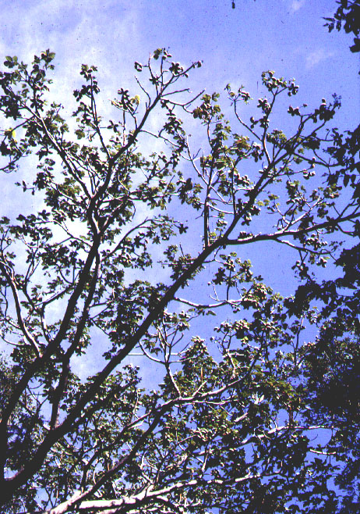
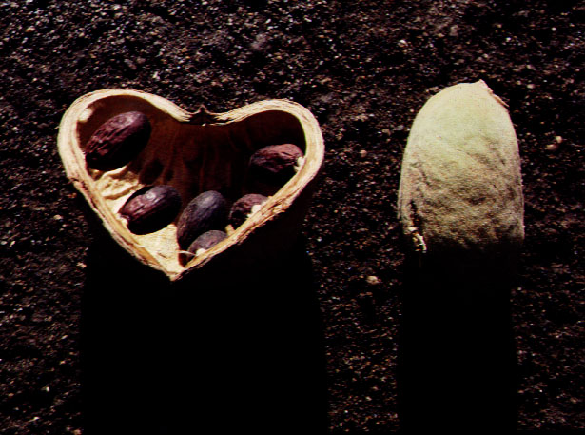
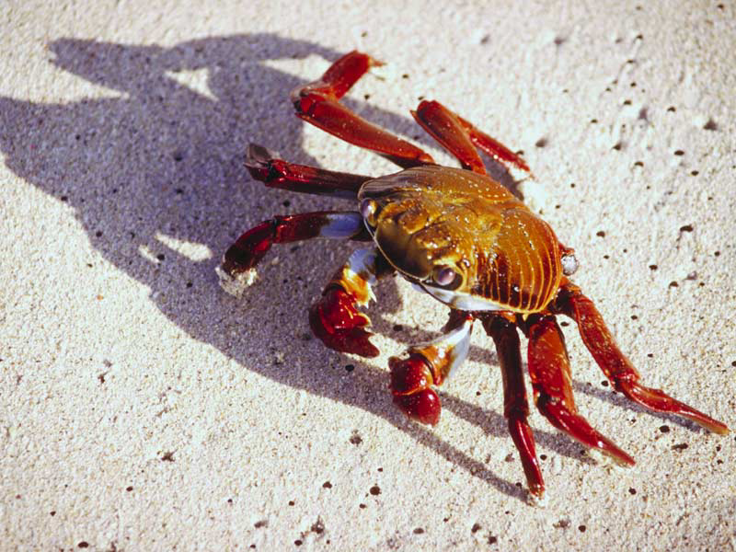
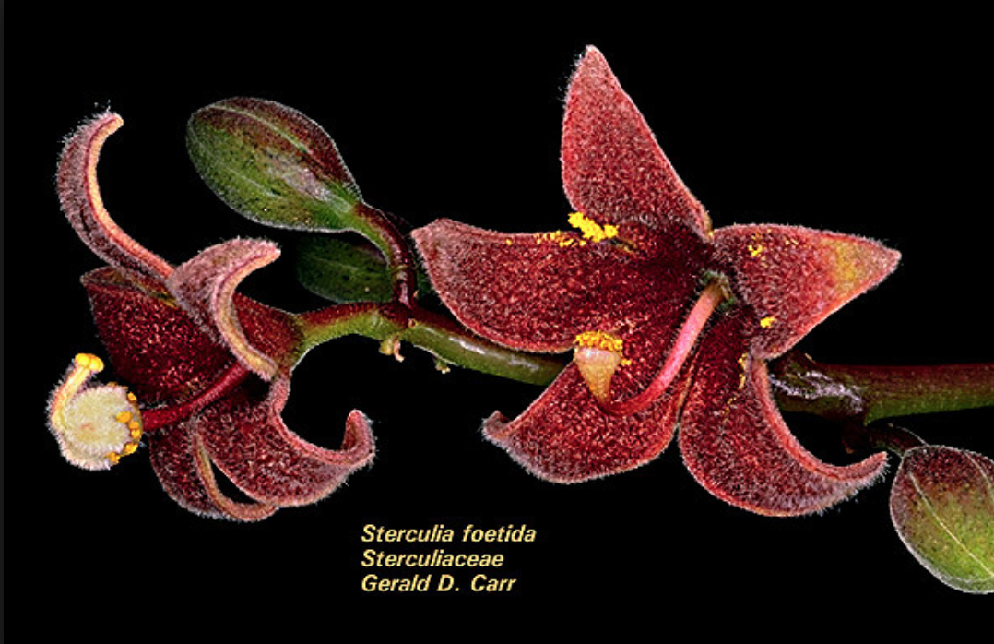
Sterculia – (sterculioid): tall tree of forests touched by storm tides, seeds dispersed by land crabs

Slide 17
Malvales groups from molecular data

Slide 18
Bombacoideae

Slide 19
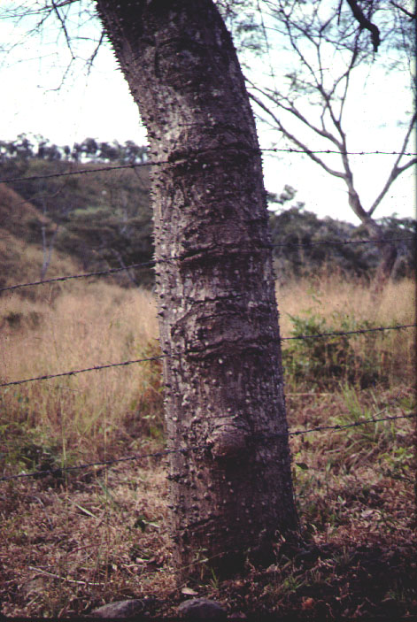
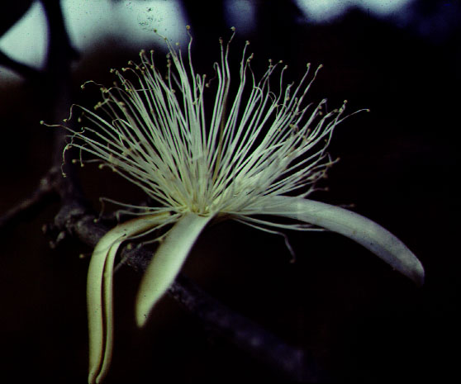
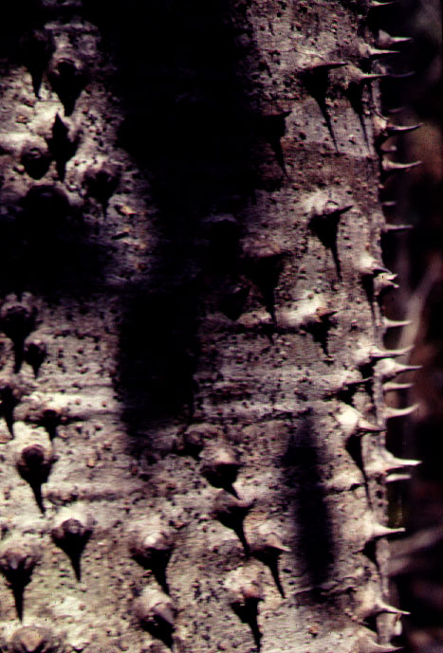
Bombacopsis – bombacoid: living fencepost,
with protection

Slide 20
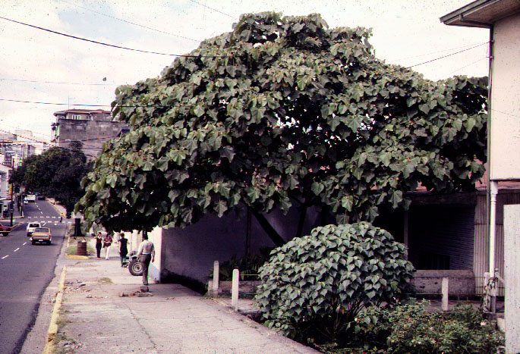
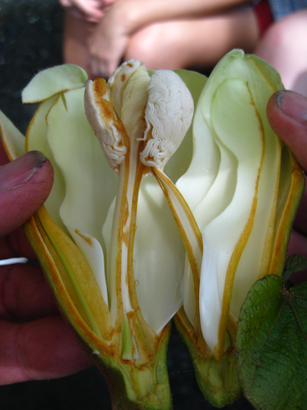
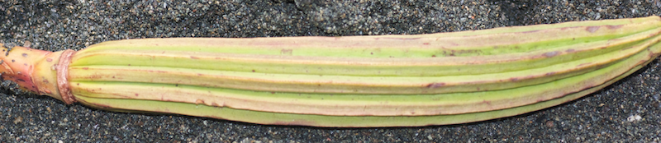
Ochroma – bombacoid: balsa

Slide 21
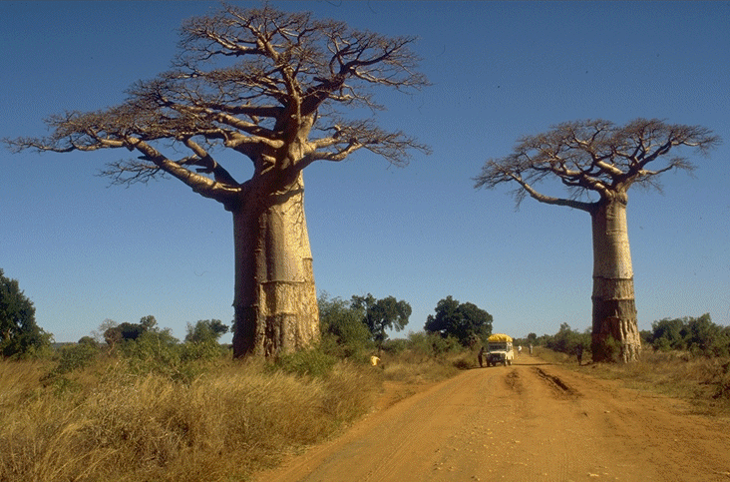
the baobab…Adansonia – a bombacoid:

Slide 22
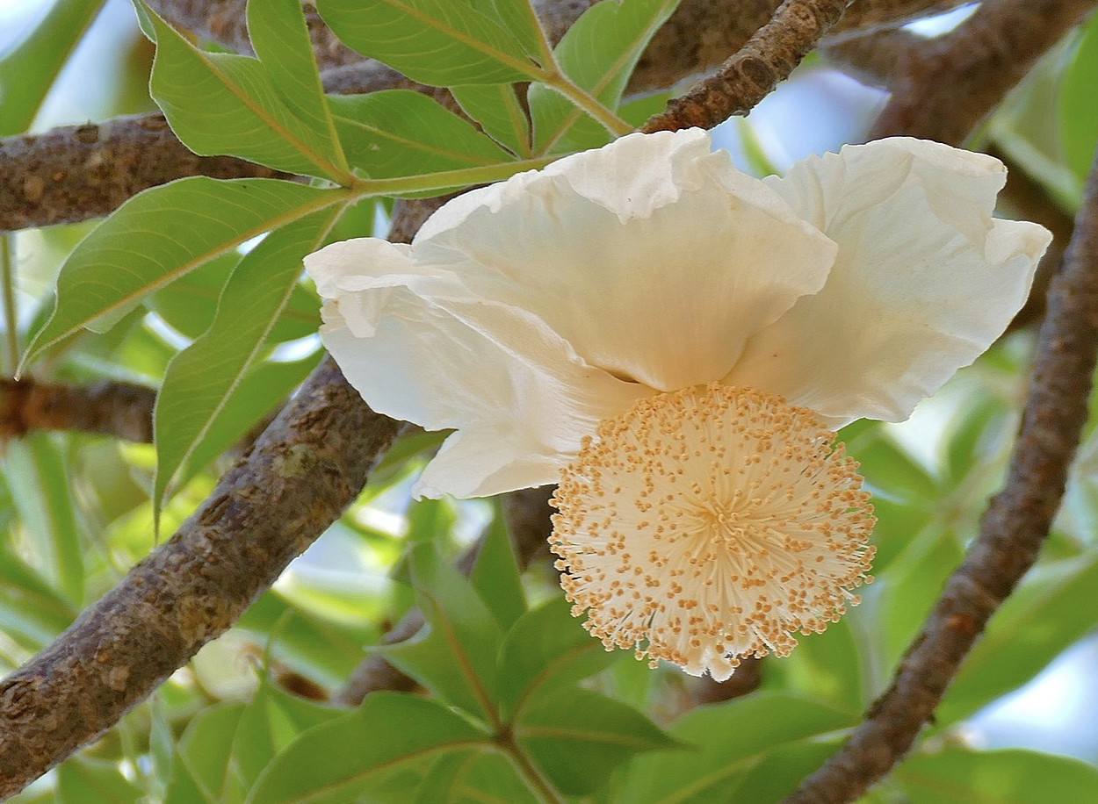
the baobab…Adansonia – a bombacoid:

Slide 23

the baobab…Adansonia – a bombacoid:

Slide 24


Ceiba – the commonest
bombacoid

Slide 25





Pachira aquatica– bombacoid: a sea-side canopy tree

Slide 26
Malvales groups from molecular data

Slide 27
Malvoideae

Slide 28


Quararibea – malvoid: cloud forest tree

Slide 29

Malvaviscus – malvoid: hummingbird flowers

Slide 30
Hibiscus – malvoid

Slide 31

Hibiscus – malvoid: hummingbird pollination, with enforcement

Slide 32



Cheiranthodendron– malvoid
Notes:
See toledo1975.pdf on perching bird syndrome.

Slide 33

Hibiscus pollen

Slide 34


Gossypium– ocean-dispersed malvoid

Slide 35


Slide 36



Dipterocarp trees in a mast flowering event, 2010, Malaysia
Notes:
http://borneobirds.blogspot.com/2010/04/2010-mass-flowering-of-dipterocarps-in.html

Slide 37
Additional Material

Slide 38


Slide 39

Bombax ceiba – bombacoid:

