Slide 1
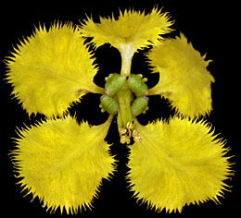
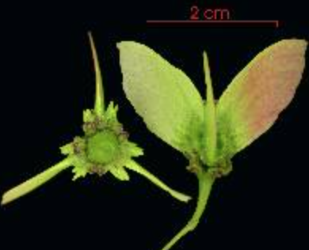
MALPIGHIACEAE
http://herbarium.lsa.umich.edu/malpigh/
Notes:
APG 2010: Evolution. An origin of the family in South America during the Late Cretaceous (ca 68 million years before present) has been suggested, with several - seven or so - subsequent dispersal events to the Old World followed by the loss of oil secretion by the sepals (Davis et al. 2002a, b, 2004). Malpighiaceae are known fossil from the Northern Hemisphere, e.g. from the Eocene Claiborne Formation in Tennessee, U.S.A. ca. 34 million years ago (Taylor & Crepet 1987).

Slide 2
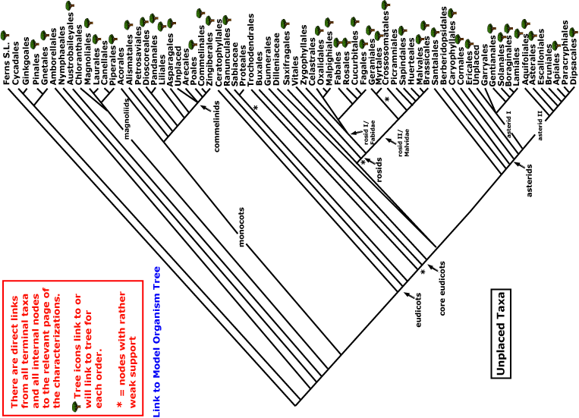


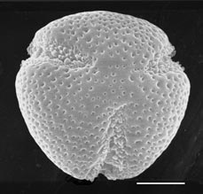
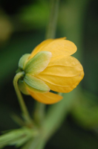
MALPIGHIACEAE
magnoliids
rosids
Current Angiosperm Phylogeny Group Tree for Flowering Plants
2018
monocots
asterids
core eudicots
eudicots

Slide 3
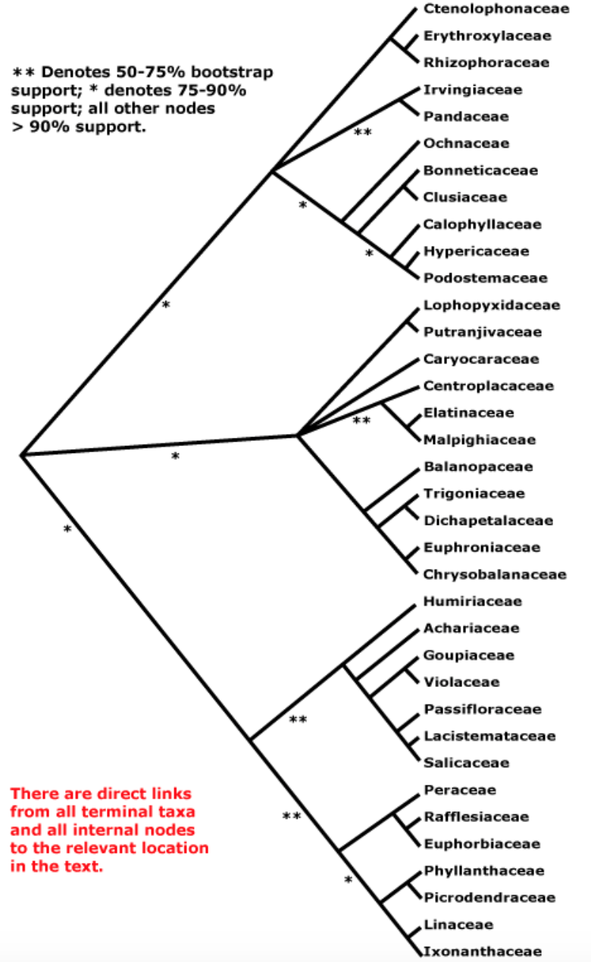
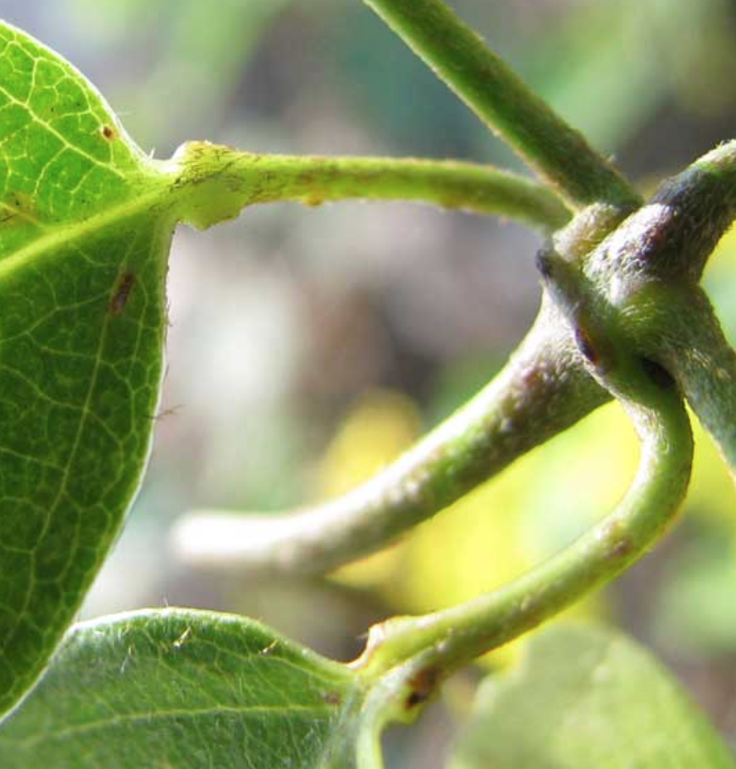
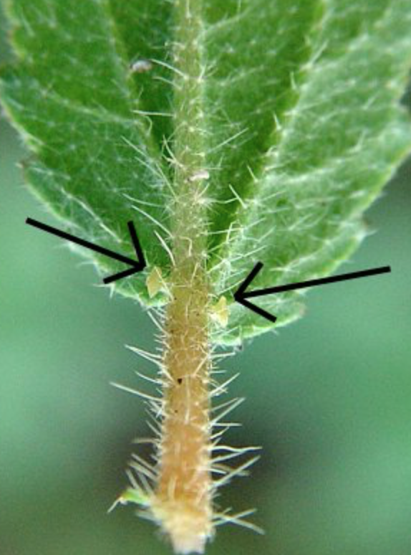
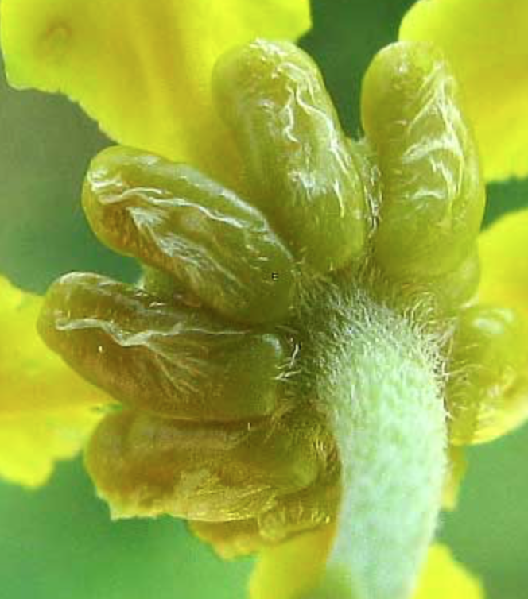
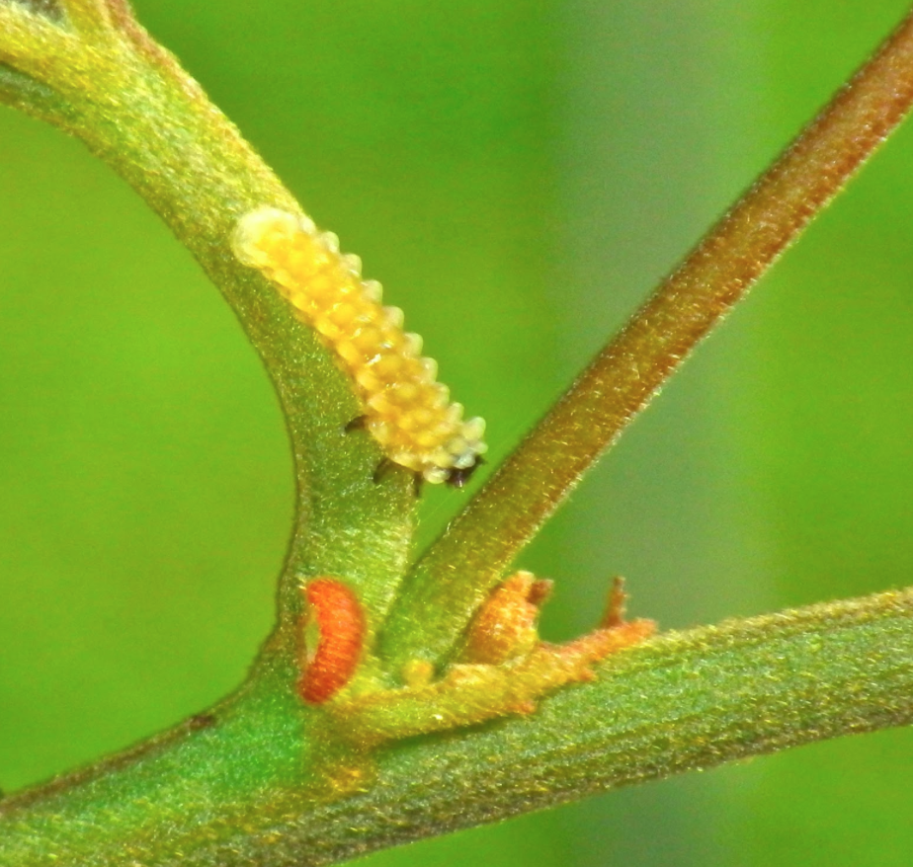
MALPIGHIACEAE,
Malpighiales (the leaf-gland order)
Notes:
Cymothoë likes Malpighiales: its allies are all Rosid specialists and mostly eurosids I specialists.

Slide 4
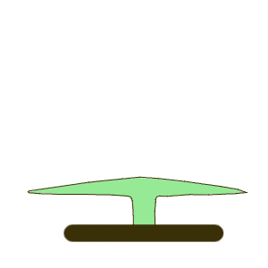
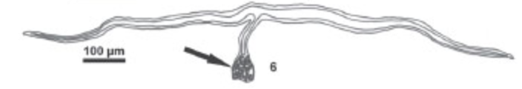
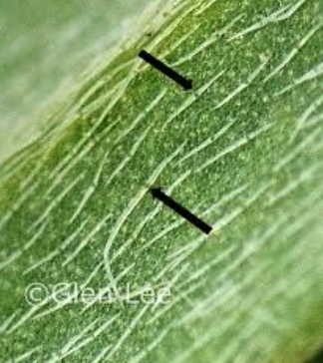
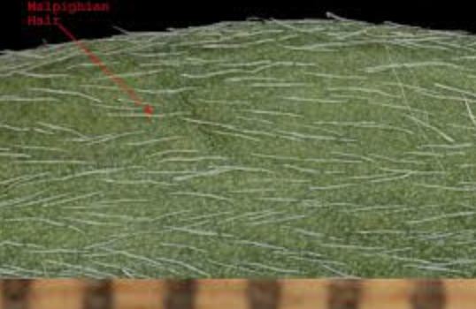
Key Characters for the Malpighiaceae
Rosids with
Opposite, simple leaves
No stipules or stipules 2 per leaf
Malpighian hairs
Notes:
http://www.amjbot.org/cgi/content/full/88/10/1847/F5
Cameron et al. 2001. Molecular systematics of Malpighiaceae: evidence from plastid rbcL and matK sequences. AJB. Stamen reduction and modification is widespread in the malpighs.

Slide 5
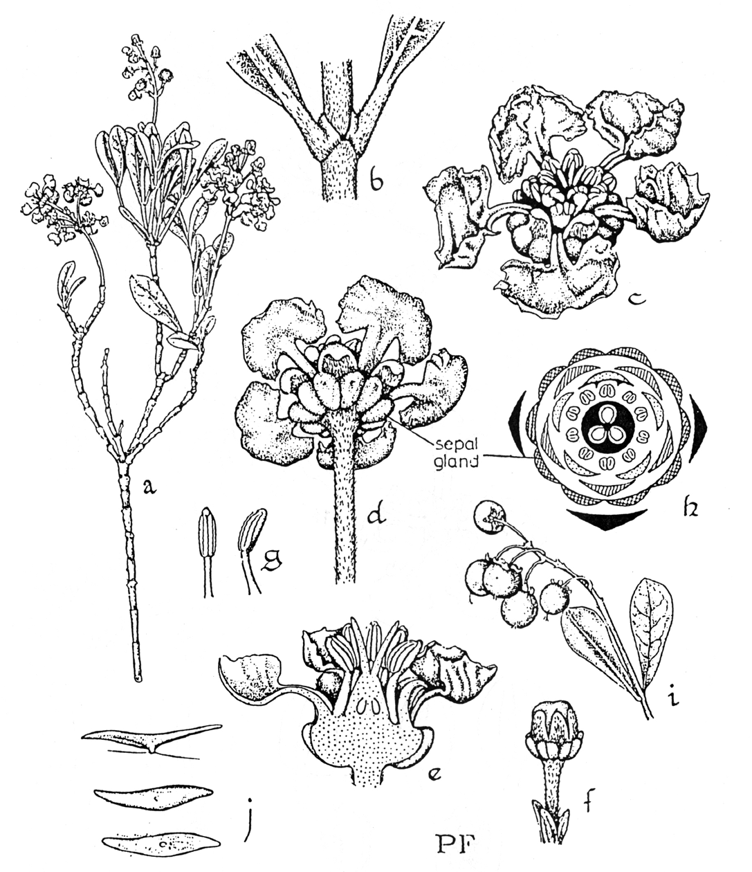
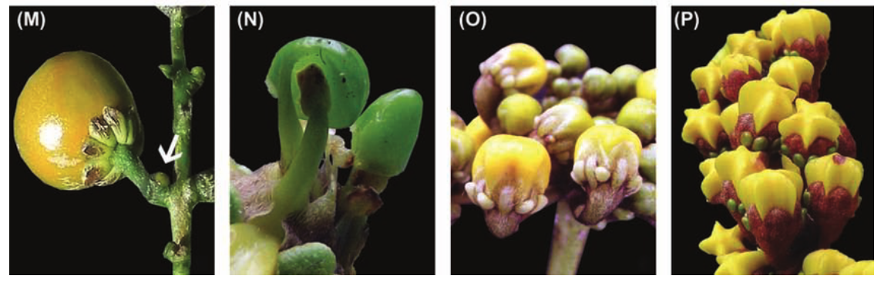
Byrsonima
A HIERARCHY OF FAMILY CHARACTERS
5 sepals, 5 petals
Petals separate
Stamens twice the petals
Glands common on sepals and petioles

Slide 6
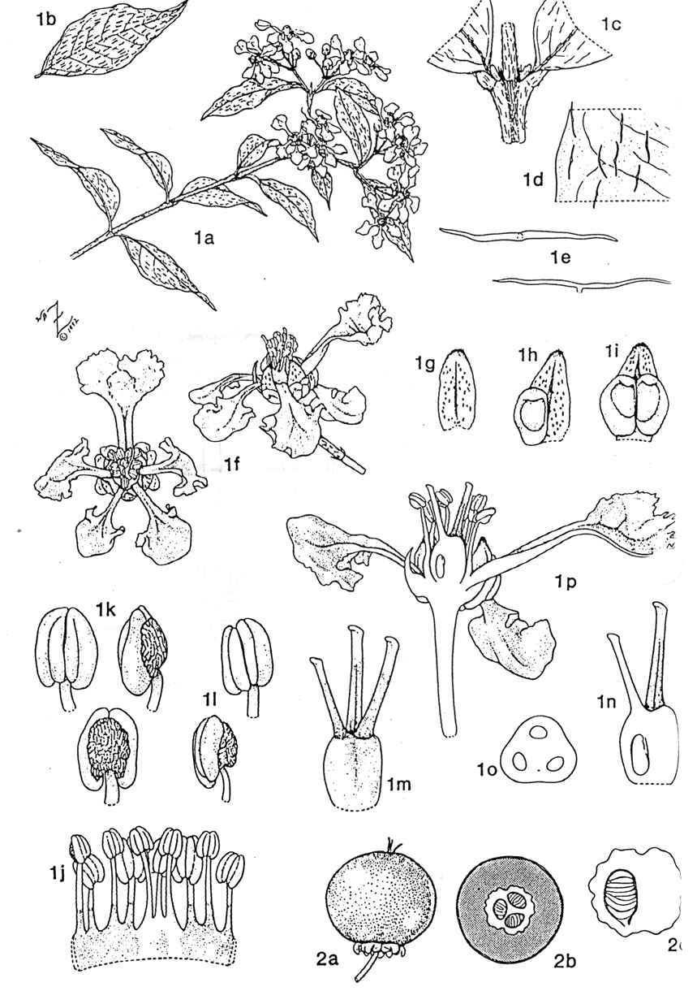
Malpighia

Slide 7
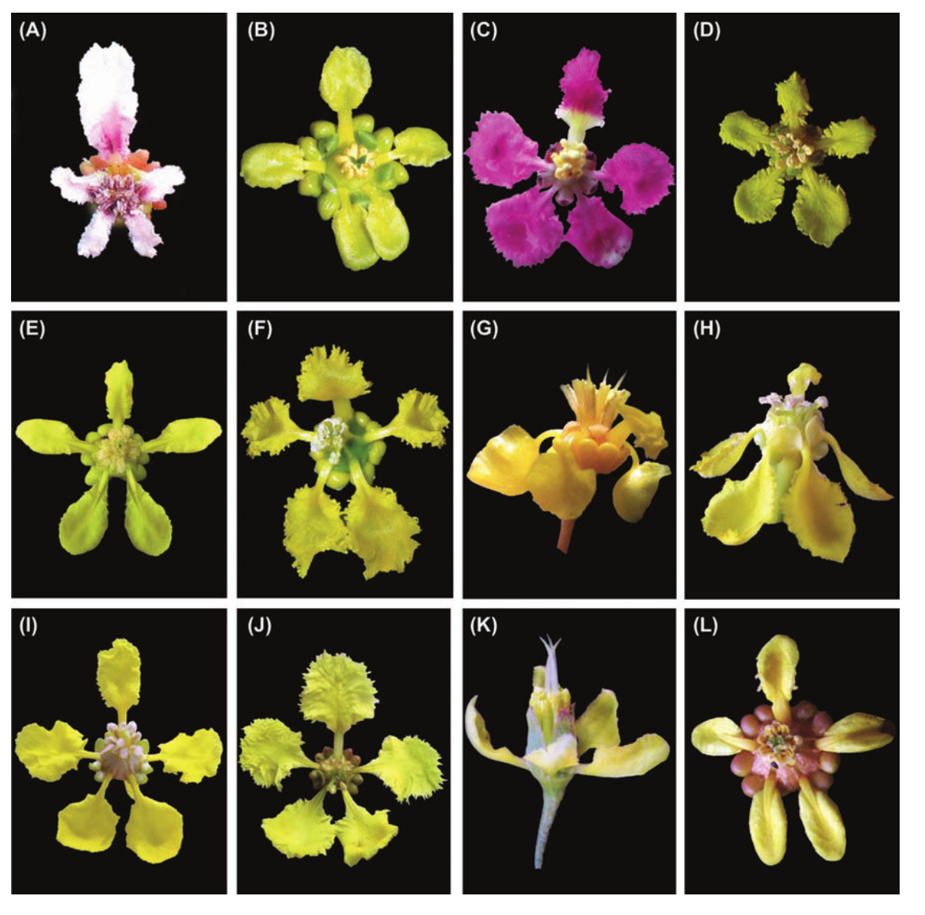
Clawed petals, common in the family (New World members)
(note variation in symmetry and gland number)

Slide 8
ON POLLINATION

Slide 9
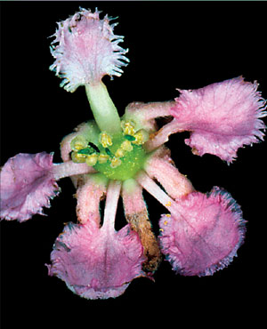
Jubelina (aka Diplopterys)
Notes:
Jubelina rosea (Malpighiaceae) from French Guiana

Slide 10
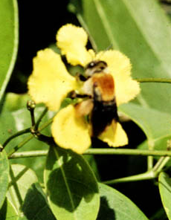
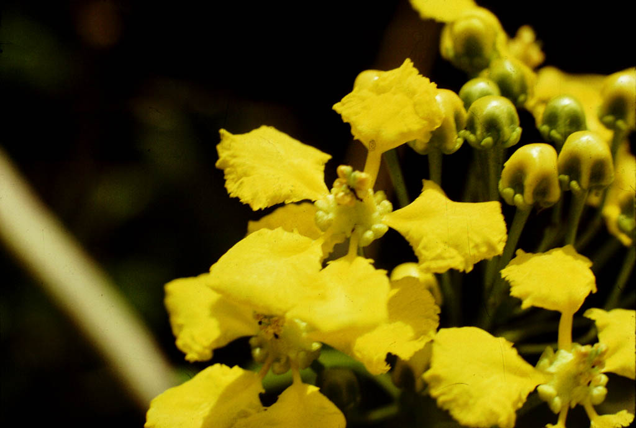
Notes:
MARIA ROSÂNGELA SIGRIST^{*,1} and MARLIES SAZIMA² 2004. Pollination and Reproductive Biology of Twelve Species of Neotropical Malpighiaceae: Stigma Morphology and its Implications for the Breeding System Annals of Botany 94: 33-41,
Flowers of the studied species were visited by female bees of the family Apidae (Table 2). Species of Centris, Epicharis (Centridini) and Monoeca (Tapinotaspidini) pollinated the flowers, collecting mainly oil (98 % of visits) (Fig. 3A). During the visits these bees behaved as described by Vogel (1974), and as further confirmed by other studies (Rêgo and Albuquerque, 1989; Sazima and Sazima, 1989; Gaglianone, 2000). The oil-collecting behaviour favours the rupture of the stigmatic cuticle and the exposure of the stigmatic surface or cavity, promoting the deposition of a large load of pollen on or inside the stigmas (Fig. 2D).

Slide 11
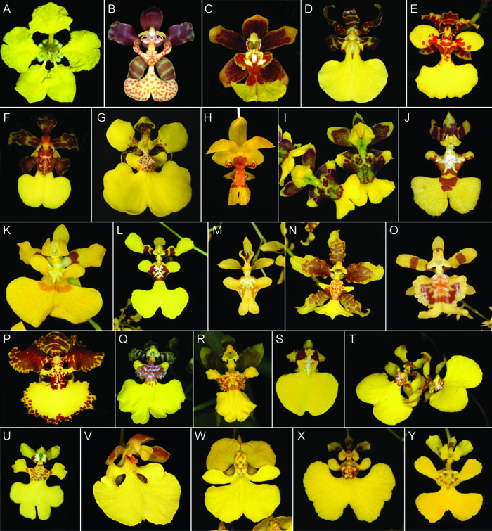
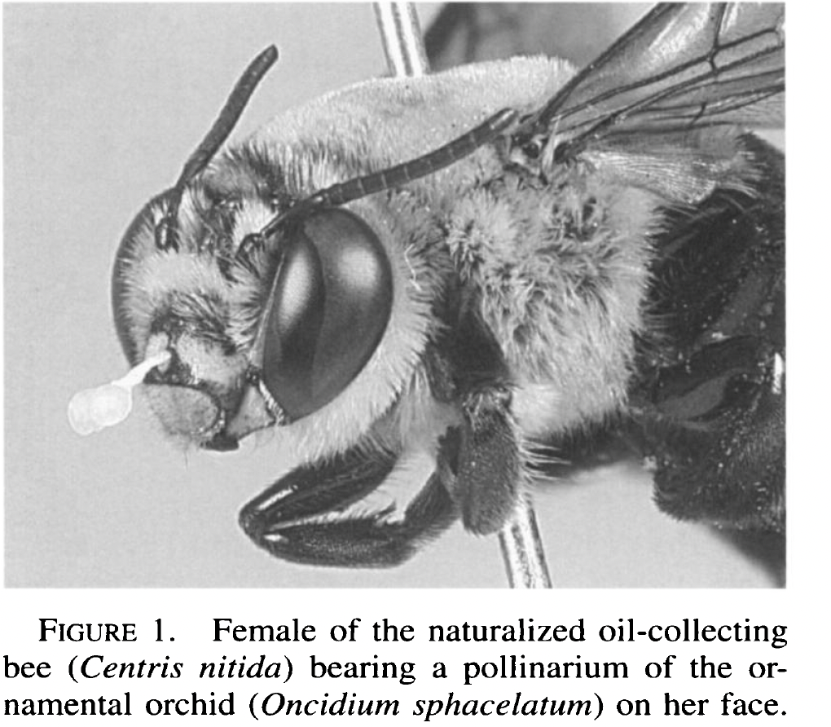
Banisteriopsis
Oncidium, Orchidaceae, convergent on malpighs and deceptive
see pemberton2008.pdf
Notes:
http://www.flmnh.ufl.edu/herbarium/oncids/home/
See stpiczynska2008.pdf

Slide 12
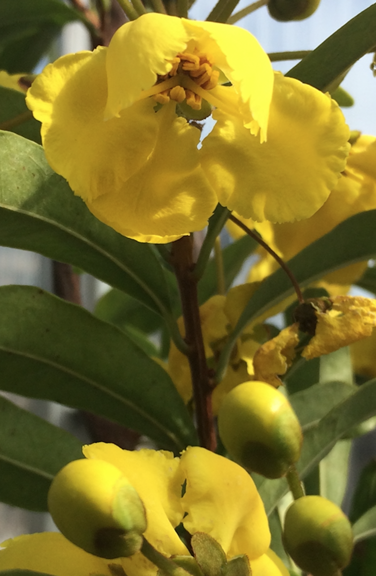
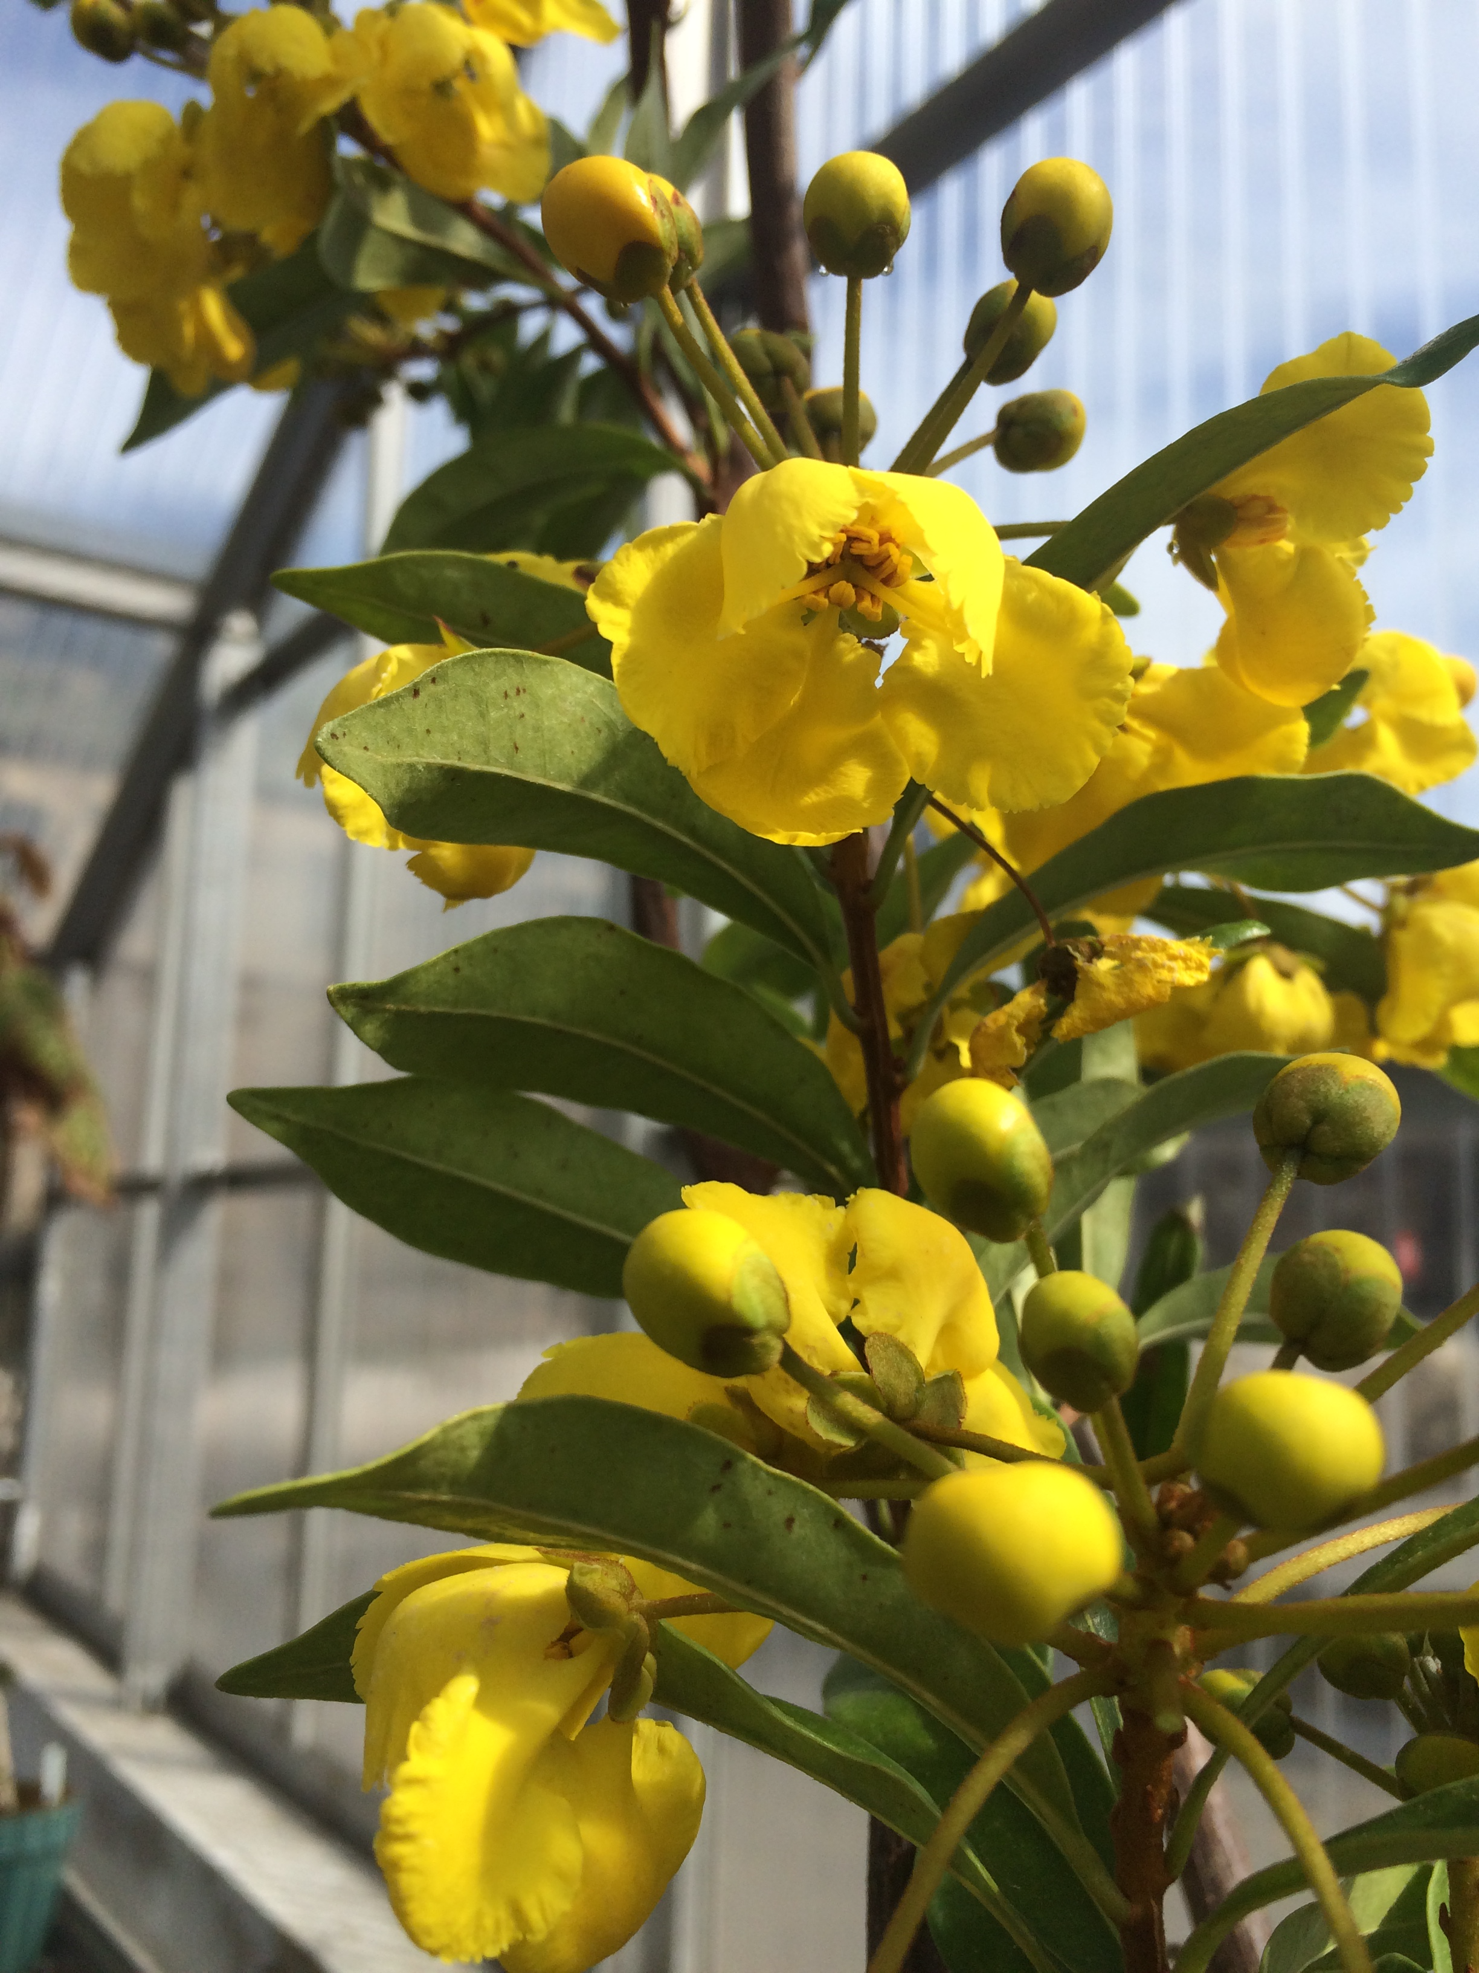
African Malpighiaceae, without the co-evolved flower morphology of the New World plants.

Slide 13
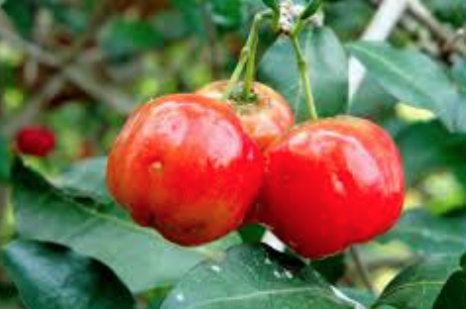
SMALL TREES AND LIANAS

Slide 14
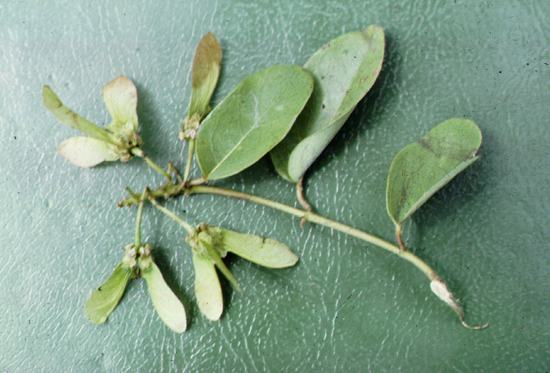
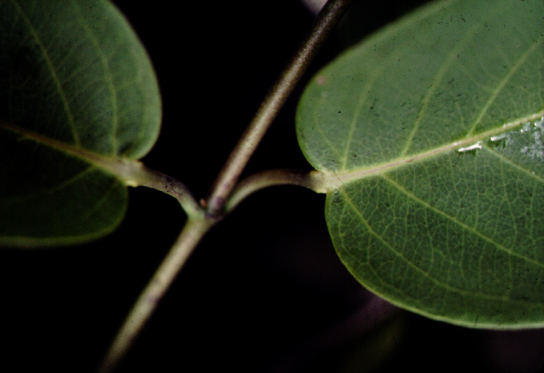
Stigmaphyllon, a typical malpighiaceous liana

Slide 15
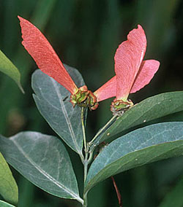
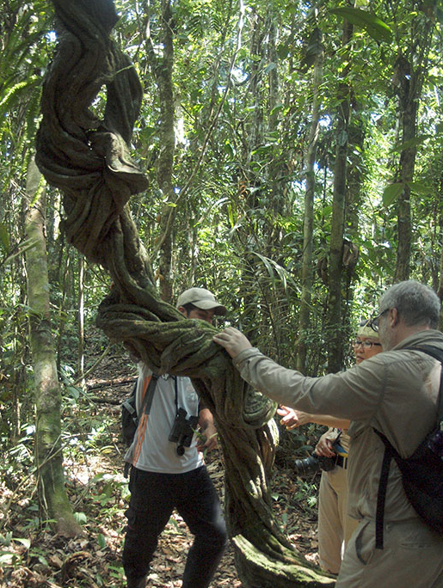
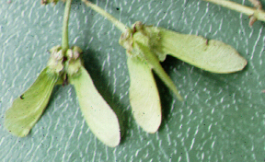
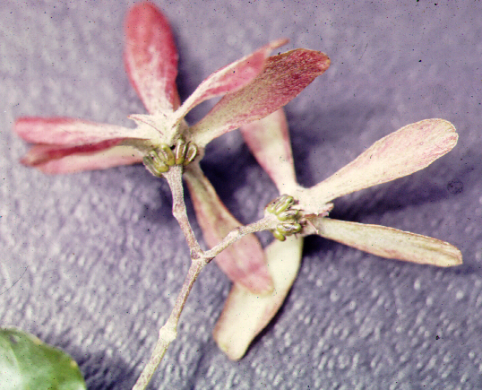
The malpighiaceous lianas have winged schizocarps
Banisteriopsis
Stigmatophyllon
Tetrapteris
Notes:
banistr. shoot: http://141.211.176.200:591/malpigh/images/BanPubFrt250w.jpg

Slide 16
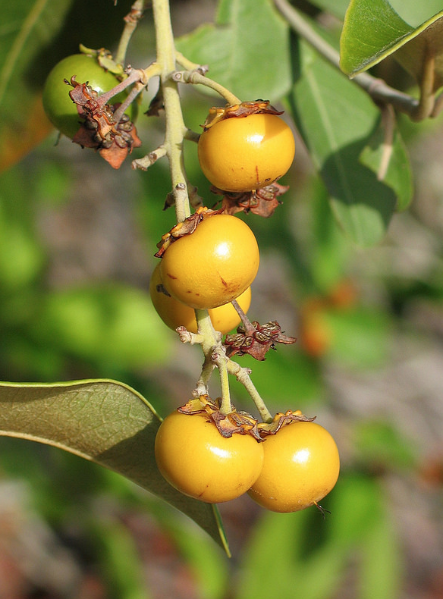
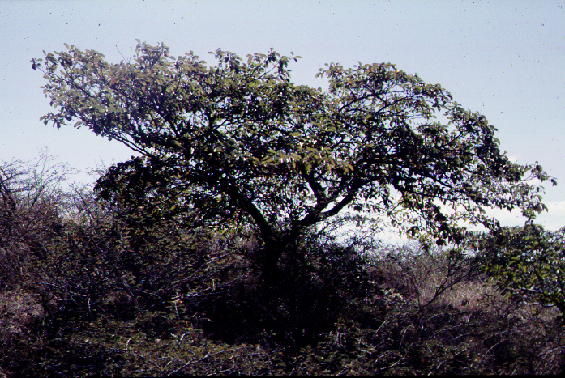
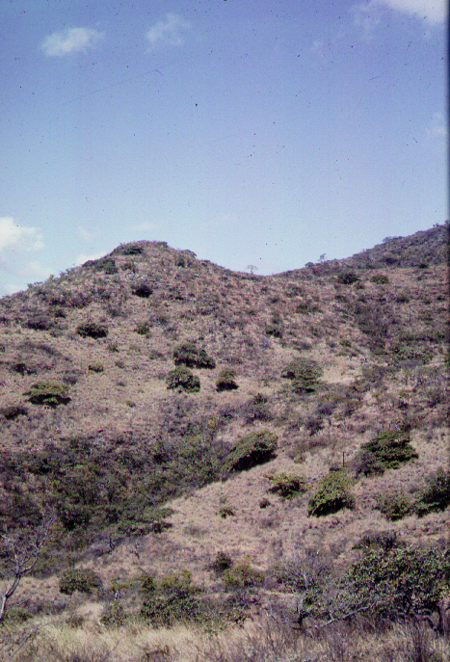
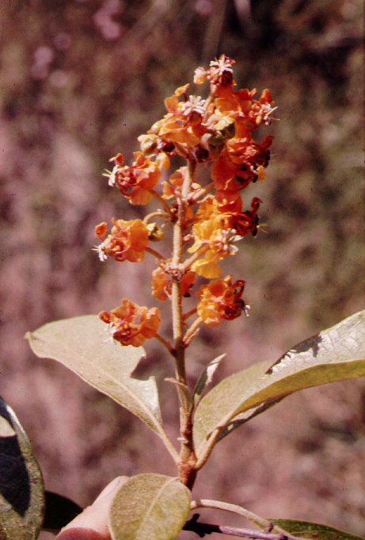
Malpighiaceous trees have 3-seeded red berries
Byrsonima

Slide 17
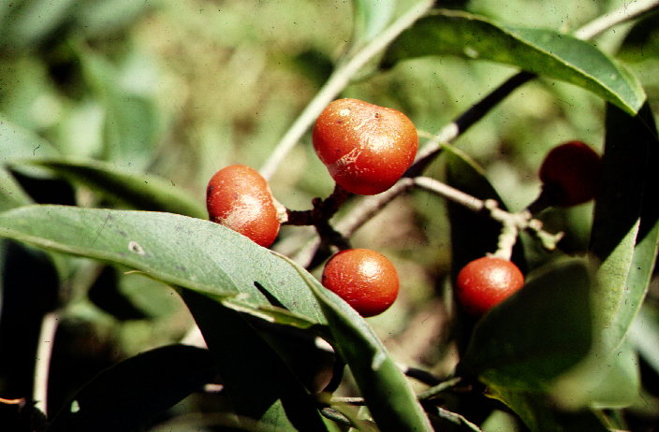
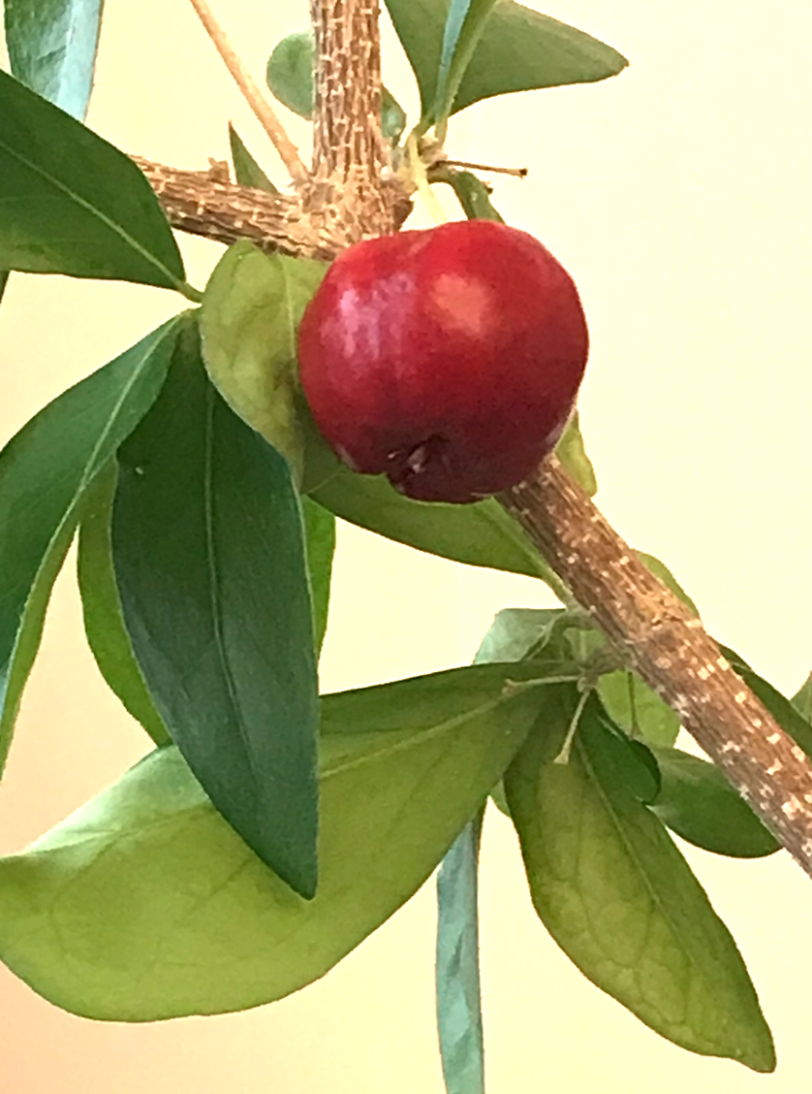
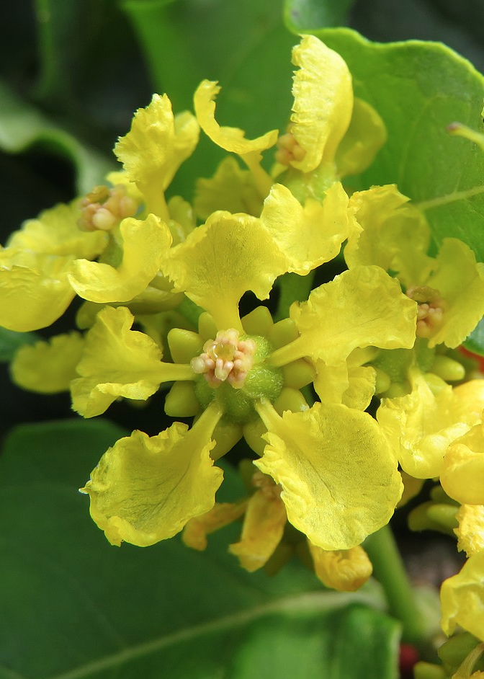
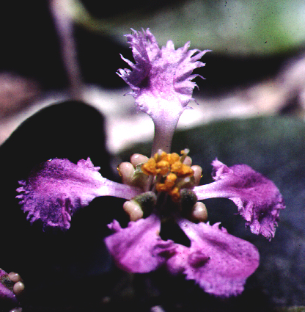
Malpighiaceous trees have 3-seeded red berries
Bunchosia
Malpighia

Slide 18
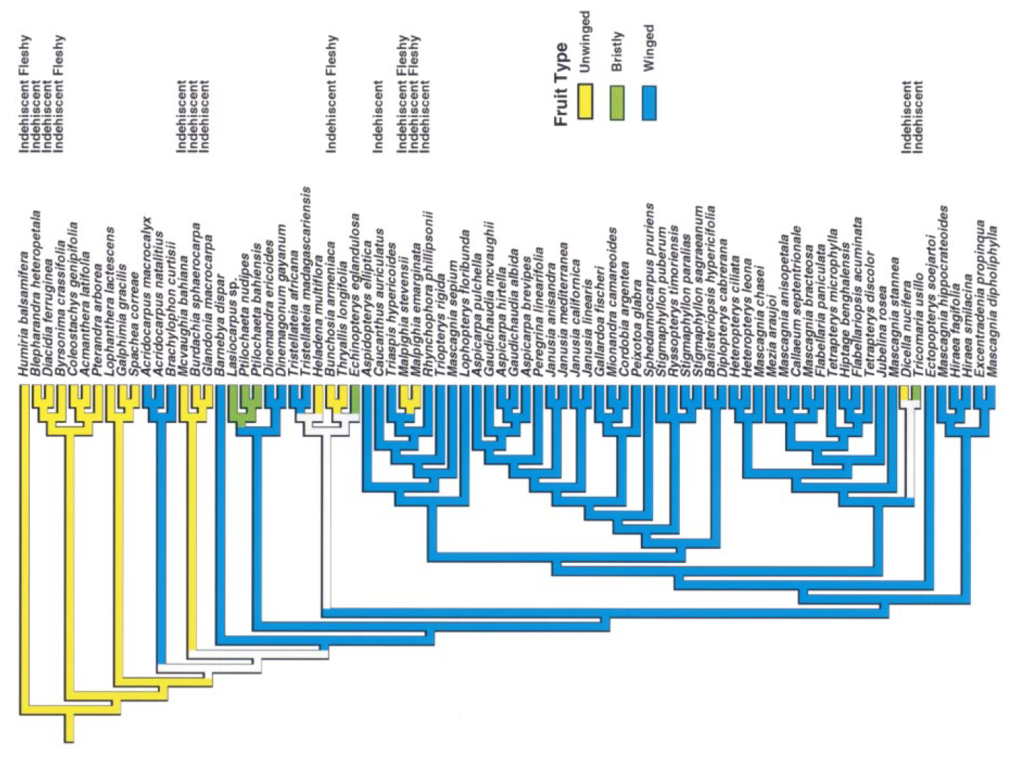
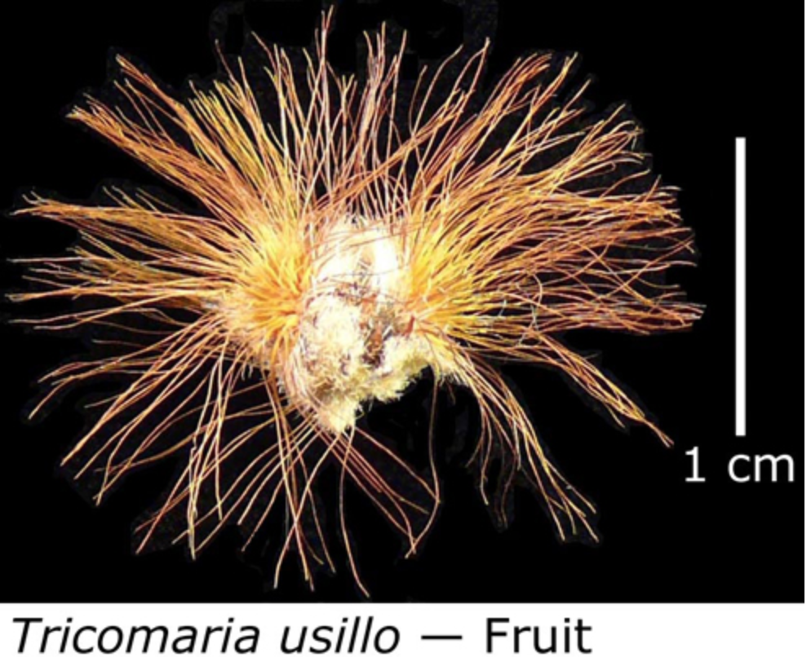
Fruit types optimized on the molecular phylogeny

Slide 19
ECOLOGY, ETHNOBOTANY, PHYTOCHEMISTRY

Slide 20
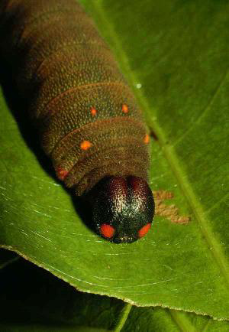
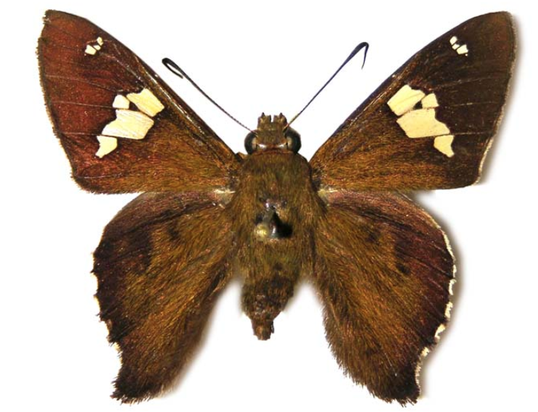
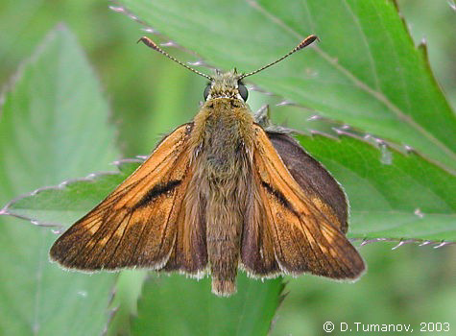
Cephise nuspesez. a skipper butterfly (Hesperiidae)
Cephise larva and adult
Janzen food-plant list
Banisteriopsis muricata 25 Banisteriopsis muricata 1 Banisteriopsis muricata 2 Bunchosia biocellata 1 Bunchosia cornifolia 119 Bunchosia odorata 12 Heteropterys laurifolia 28 Heteropterys macrostachya 77 Heteropterys obovata 186 Heteropterys obovata 1 Heteropterys obovata 4
Hiraea sp. 1 111
Hiraea sp. 2 2
Hiraea fagifolia 20
Hiraea reclinata 118
Mascagnia sinemariensis 27 Tetrapterys tinifolia 17
(also several Combretaceae)
a typical New England skipper
Notes:
http://janzen.sas.upenn.edu/Wadults/resultsfoodsumry2.lasso?herbivore%20species=Cephise%20nuspesez
Wink, M., 1993. Allelochemical properties or the raison d'etre of alkaloids. In The alkaloids: chemistry and pharmacology (Vol. 43, pp. 1-118). Academic press.
adult hesp from http://tinea.narod.ru/gallery/lep-hes004-ochlodes_faunus.jpg

Slide 21
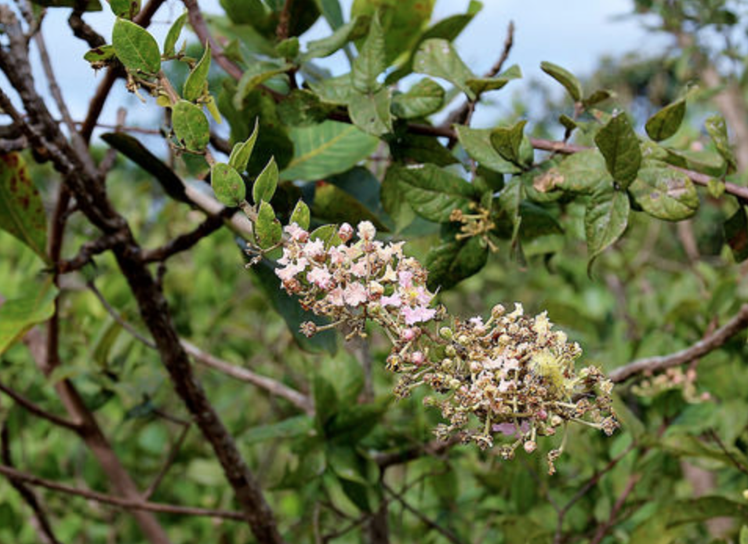
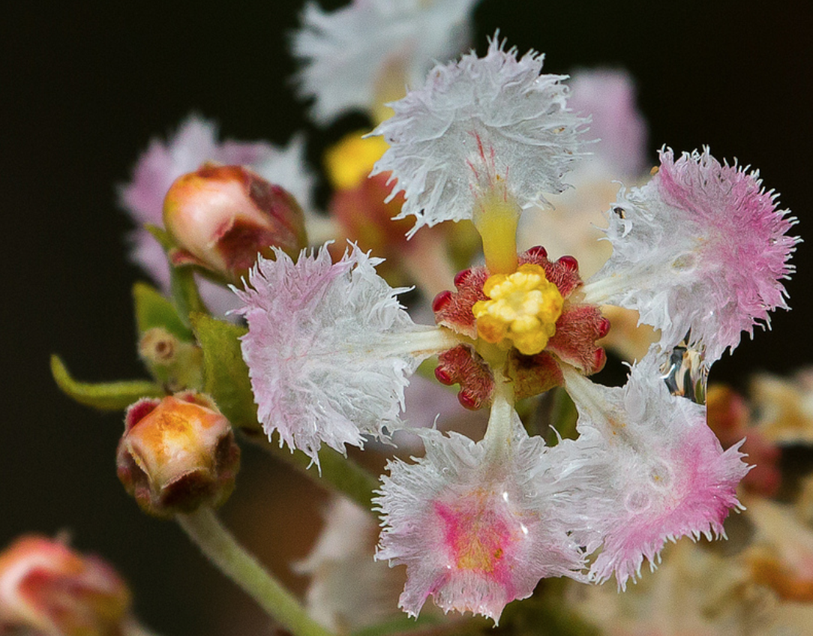
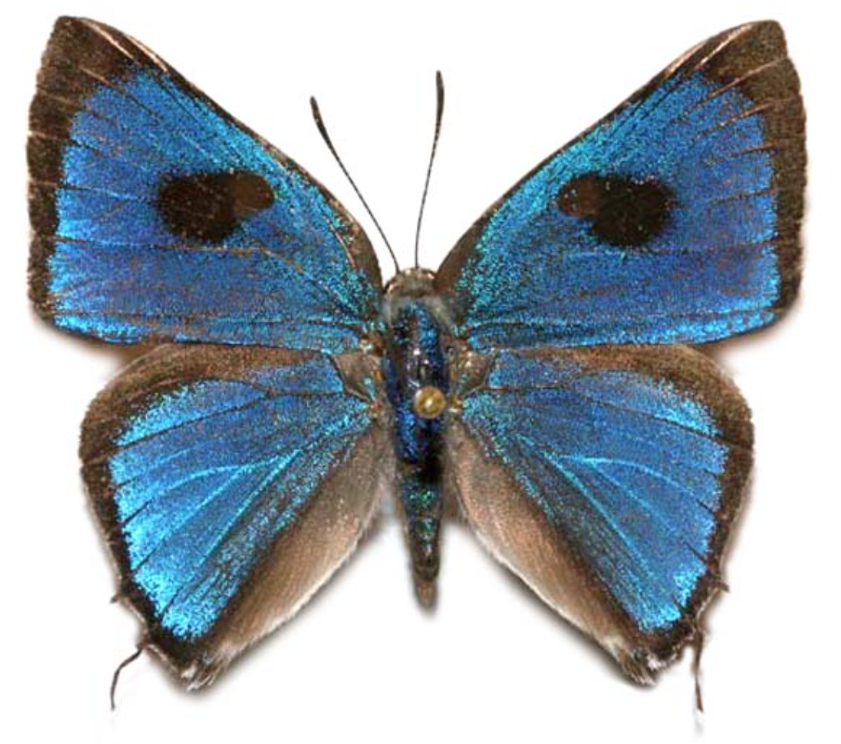
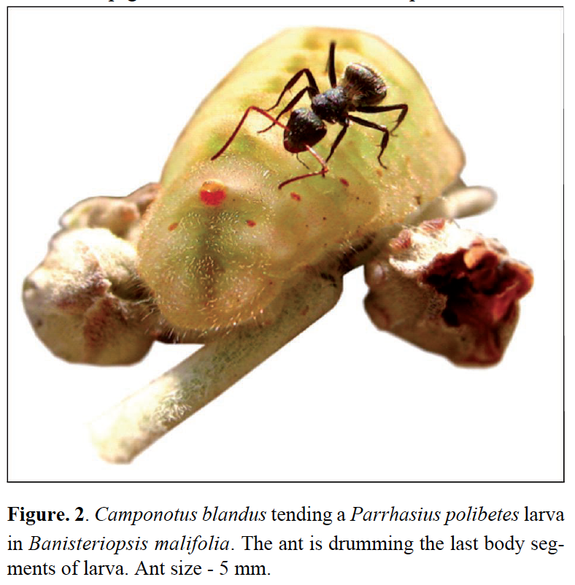
Banisteriopsis malifolia
Larvae have dorsal nectary organs (DNOs) and perforated cupolas organs (PCOs) (Fiedler, 1991). The former releases a sugared substance while the
latter pacifies the aggressive behavior of tending ants (Malicky,1970)
Parrhasius polibetes
Notes:
From alves-silva2013.pdf
Larvae have dorsal nectary organs
(DNOs) and perforated cupolas organs (PCOs) (Fiedler,
1991). The former releases a sugared substance while the
latter pacifies the aggressive behavior of tending ants (Malicky,
1970).
Alves-Silva, E., Bächtold, A., Barônio, G.J. and Del-Claro, K., 2013. Influence of Camponotus blandus (Formicinae) and flower buds on the occurrence of Parrhasius polibetes (Lepidoptera: Lycaenidae) in Banisteriopsis malifolia (Malpighiaceae). Sociobiology, 60(1), pp.30-34.

Slide 22
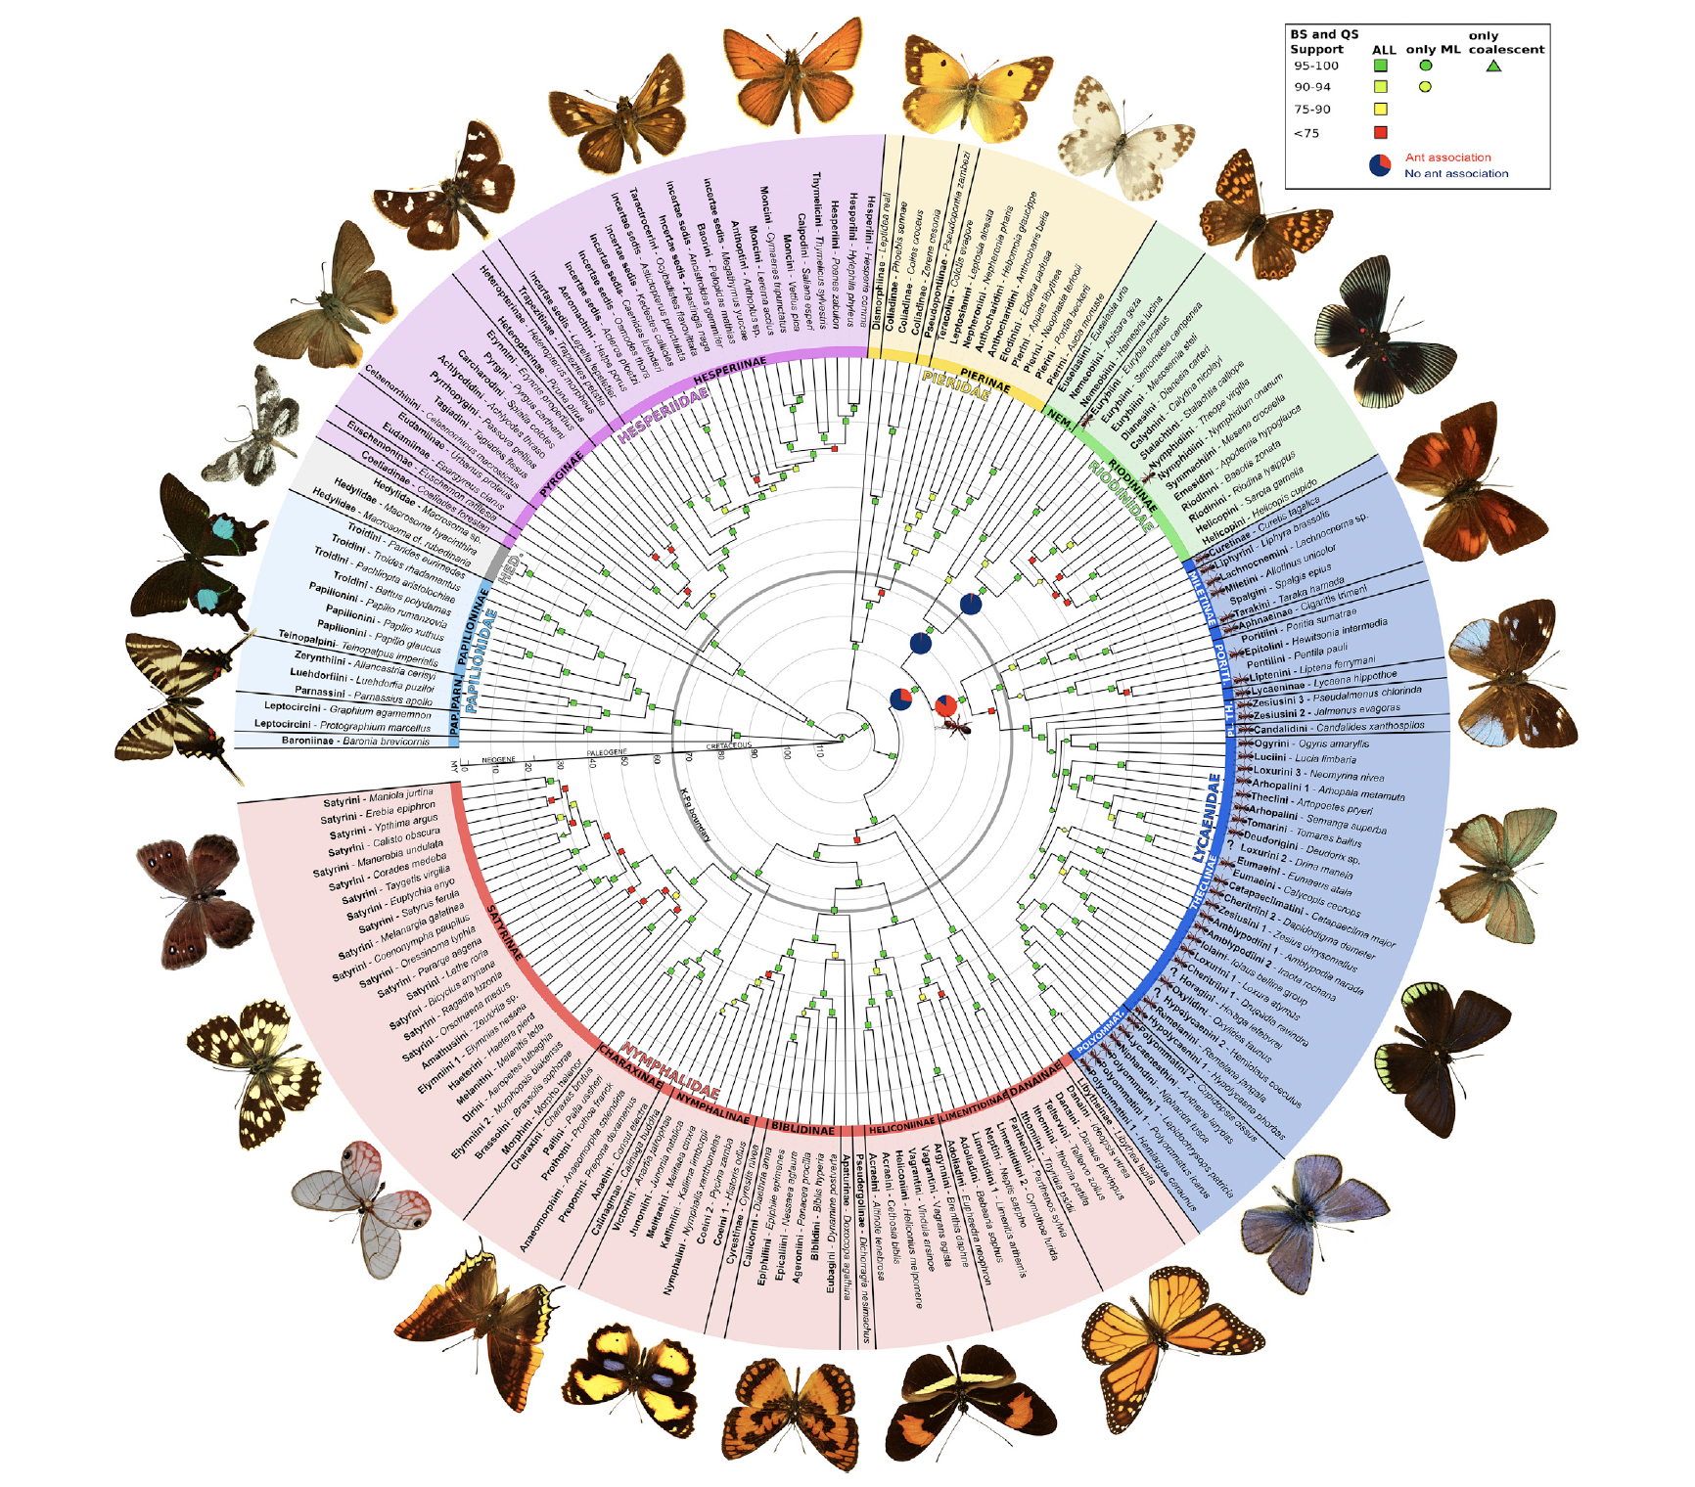
Notes:
espeland2018.pdf
Espeland, M., Breinholt, J., Willmott, K.R., Warren, A.D., Vila, R., Toussaint, E.F., Maunsell, S.C., Aduse-Poku, K., Talavera, G., Eastwood, R. and Jarzyna, M.A., 2018. A comprehensive and dated phylogenomic analysis of butterflies. Current Biology, 28(5), pp.770-778.

Slide 23

Notes:
espeland2018.pdf
Espeland, M., Breinholt, J., Willmott, K.R., Warren, A.D., Vila, R., Toussaint, E.F., Maunsell, S.C., Aduse-Poku, K., Talavera, G., Eastwood, R. and Jarzyna, M.A., 2018. A comprehensive and dated phylogenomic analysis of butterflies. Current Biology, 28(5), pp.770-778.

Slide 24

Notes:
Kawahara, A.Y., Plotkin, D., Espeland, M., Meusemann, K., Toussaint, E.F., Donath, A., Gimnich, F., Frandsen, P.B., Zwick, A., dos Reis, M. and Barber, J.R., 2019. Phylogenomics reveals the evolutionary timing and pattern of butterflies and moths. Proceedings of the National Academy of Sciences, 116(45), pp.22657-22663.

Slide 25
magnoliids
Monocots
butterflies
rosids
asterids
Notes:
Kawahara, A.Y., Plotkin, D., Espeland, M., Meusemann, K., Toussaint, E.F., Donath, A., Gimnich, F., Frandsen, P.B., Zwick, A., dos Reis, M. and Barber, J.R., 2019. Phylogenomics reveals the evolutionary timing and pattern of butterflies and moths. Proceedings of the National Academy of Sciences, 116(45), pp.22657-22663.

Slide 26




Banisteriopsis caapi: active principle is harmine, an indole alkaloid
harmine
serotonin
the amino acid tryptophan
DMT, from Tetrapteris, Psychotria, or Justicia, is combined with caapi to allow oral absorption
DMT, from Tetrapteris, Psychotria, or Justicia, is combined with caapi to allow oral absorption
Notes:
Ayahuasca: "Vine of the Dead" (Traditional mixture of DMT & MAOI's) This brew, commonly called yage, or yaje, in Colombia, ayahuasca in Ecuador and Peru (Inca "vine of the dead, vine of the souls," aya means in Quechua "spirit," "ancestor," "dead person," while huasca means "vine," "rope") caapi in Brazil, is prepared from segments of a species of the vine Banisteriopsis, a genus belonging to the Malpighiaceae from which an alkaloid called "telepathine" was isolated in the 1920s (later found to be the already known harmine).
Sections of vine are boiled with leaves from any of a large number of potential admixture plants resulting in a tea that contains the powerful hallucinogenic alkaloids the MAOIs; harmaline, harmine, d-tetrahydroharmine, and often dimethyltryptamine (DMT). Dimethyltryptamine closely resembles serotonin and has been discovered to be a component of normal mammallian metabolism, an endogenous hallucinogen. This medicine has been used for millenia in order to enter the sacred supernatural world, to heal, divine, and worship.
"With Ayahuasca, an interior sound is commonly heard, which quite often triggers a spontaneous burst of imitative vocalizings, markedly unlike any conventional human speech or facial contortions. The tryptamines can apparently trigger a kind of rippling of facial muscles, which results in the production of a vocally modulated pressure wave. What is more startling is that the sound, which gains in energy the longer it is sustained, can actually become visible - as if the vibrational wave patterns were shifting into the visible spectrum or inducing a vibrational excitation of the air in such a way as to affect light diffraction. These observations suggest that although the wave is produced with sound, it may possess an electromagnetic component. This peculiar wave phenomenon will continue to be generated out of the mouth and nostrils and will be visible in the surrounding air as long as the vocalizations are continued." Terence McKenna--- http://peyote.com/jonstef/maois.htm#ayahuasca
----------
Ayahuasca is made by brewing the stems of a vine called Banisteriopsis with parts of at least one other variety of plant. The spirit of the banisteriopsis plant is supposed to act as a guide for the spirits of the additive plants and potentiate their effects.
Different additive plants are used for different purposes: soul travel, telepathy, healing, communicating with spirits, visions, divination, or learning spirit songs (something in which I am particularly interested - I occasionally hear music in dreams and write it down or play it after I wake up), etc.
Some of the main additive plants are Psychotria, Justicia, and Tetrapteris. Strangely enough, all three of these plants contain DMT. The guide plant itself contains a drug called Harmaline.
Normally DMT is not active when taken orally - it has to be smoked (and there are several other snuffs and smoking mixtures in jungle sorcery that do contain only DMT).
But it's been found that harmaline prevents the breakdown of DMT by the digestive system and allows it to enter the bloodstream when one drinks Ayahuasca. Harmaline also extends DMT's visionary effects for up to 6 hours.
So it turns out that DMT, which I had always considered to be an exotic laboratory drug, has actually been used by sorcerers in the Amazon for thousands of years.
----------
Banisteriopsis active ingredient is HARMINE 7-methoxy-1-methyl-9H-pyrido (3,4-b) indole.
Material: Indole-based alkaloid found in several plants including Banisteriopsis caapi (from which the South American hallucinogenic brew yage is prepared),
Effects: Harmine and related alkaloids are serotonin antagonists, hallucinogens, CNS stimulants, and short)term MAO inhibitors (100 x MAO inhibition of iproniazid but lasting only several hours). Small doses (25-50mg) act as mild and therapeutic cerebral stimulant, sometimes producing drowsy or dreamy state for 1-2 hours. Larger doses up to 750mg may have hallucinogenic effects, the intensity of which varies widely with the individual.
----------
The active constituents of the plant are mostly alkaloids: Beta-carboline alkaloids harmine and harmaline act as MAO inhibitors blocking the activity of monoamine oxidase, thereby inhibiting the breakdown of neurotransmitters (Callaway 1998).
Callaway James C and Grob Charles S 1998 Ayahuasca Preparations and Serotonon Reuptake Inhibitors: A Potential Combination for Severe Adverse Interactions. Journal of Psychoactive Drugs 30 367-370
------
Midgut microsomes prepared from larvae of the fall armyworm, Spodoptera frugiperda (J.E. Smith), contain three enzyme systems which metabolize juvenile hormome III, namely, epoxide hydrolase, oxidase and esterase. Feeding the allelochemicals, indole-3-carbinol and ß-naphthoflavone, to the larvae caused 188% and 105% increases, respectively, in the JH III oxidase activity. …
Among many plant biochemicals that stimulated ecdysone 20-monooxygenase activity in the larvae from 28 to 234% as compared with the controls, harmine was the most potent inducer among those tested.
------
1. azadiractin (somewhat systemic); ecdysteriod, prevents peaks in ecdysone that prevent successful molting.
--------
In sum, harmine probably alters ecdysone concentrations in the herbivore body, which disrupts normal development--as ecdysone levels determine when the animals molt and what the next stage will be (in relation to juvenile hormone).

Slide 27
With Ayahuasca, an interior sound is commonly heard, which quite
often triggers a spontaneous burst of imitative vocalizings, markedly
unlike any conventional human speech or facial contortions.
The tryptamines can apparently trigger a kind of rippling of
facial muscles, which results in the production of a vocally
modulated pressure wave. What is more startling is that the sound,
which gains in energy the longer it is sustained, can actually become
visible - as if the vibrational wave patterns were shifting into
the visible spectrum or inducing a vibrational excitation of the air
in such a way as to affect light diffraction.
These observations suggest that although the wave is produced
with sound, it may possess an electromagnetic component.
This peculiar wave phenomenon will continue to be generated out
of the mouth and nostrils and will be visible in the surrounding
as long as the vocalizations are continued. Terence McKenna

Slide 28
Key Characters for the Malpighiaceae
Rosids with
Opposite, simple leaves
No stipules or stipules 2 per leaf
Malpighian hairs
Notes:
http://www.amjbot.org/cgi/content/full/88/10/1847/F5
Cameron et al. 2001. Molecular systematics of Malpighiaceae: evidence from plastid rbcL and matK sequences. AJB. Stamen reduction and modification is widespread in the malpighs.

Slide 29
SET ASIDE

Slide 30
Notes:
http://www.amjbot.org/cgi/content/full/88/10/1847/F5
Cameron et al. 2001. Molecular systematics of Malpighiaceae: evidence from plastid rbcL and matK sequences. AJB. Stamen reduction and modification is widespread in the malpighs.

Slide 31

The malpighiaceous lianas have winged schizocarps
Banisteriopsis
Notes:
banistr. shoot: http://141.211.176.200:591/malpigh/images/BanPubFrt250w.jpg

