Slide 1
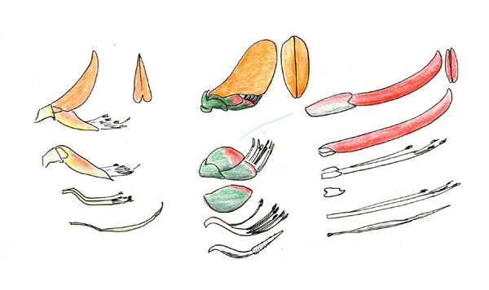
LEGUMINOSAE

Slide 2
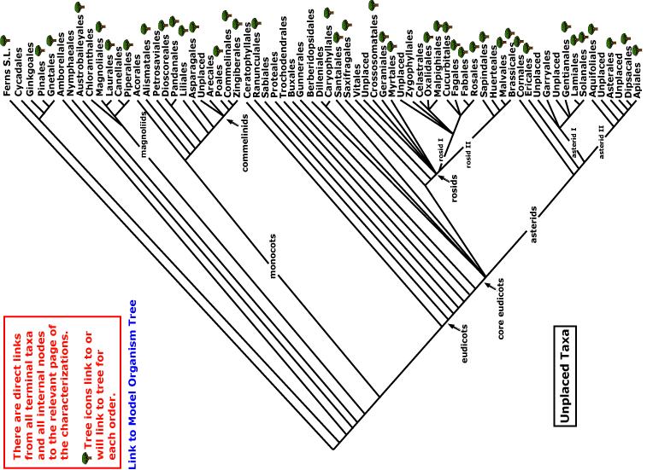
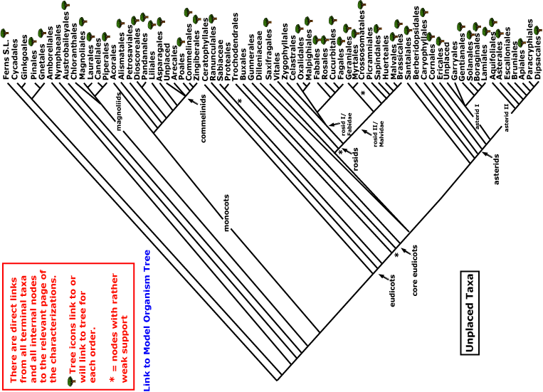

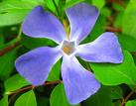
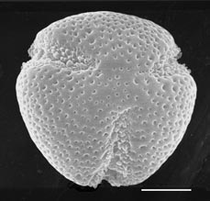
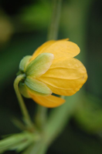
LEGUMINOSAE
magnoliids
rosids
Current Angiosperm Phylogeny Group Tree for Flowering Plants
2016
monocots
asterids
core eudicots
eudicots

Slide 3
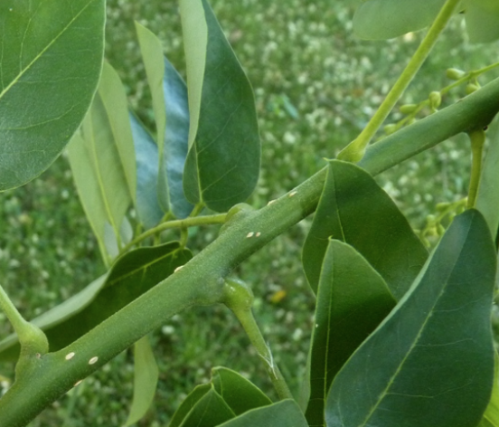
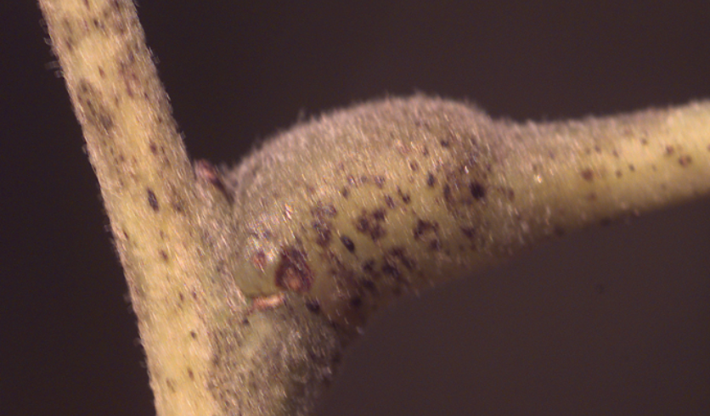
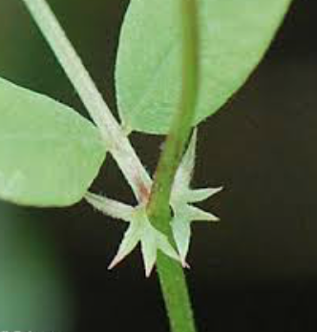
LEGUMINOSAE = FABACEAE
NUMBERS: 642 Genera, 18,000 species (ca 9.4% of eudicots) in three distinctive groups
ROSID CHARACTERS: petals separate, androecium diplostemonous and/or not fused to petals
KEY CHARACTERS:
leaves alternate,
compound, stipulate,
with a pulvinus
fruit a legume

Slide 4
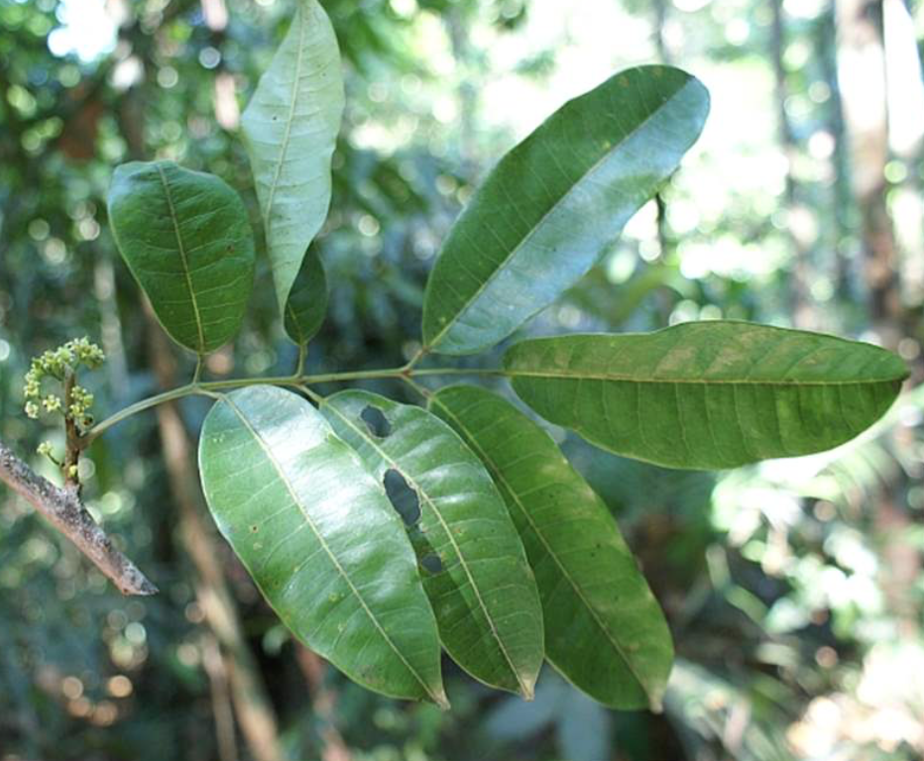
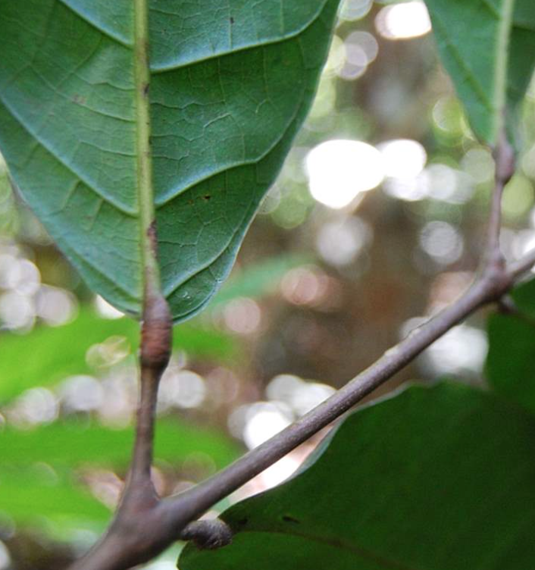
Beware the Sapindales ….also with alternate compound leaves and pulvini
Protium, Burseraceae

Slide 5
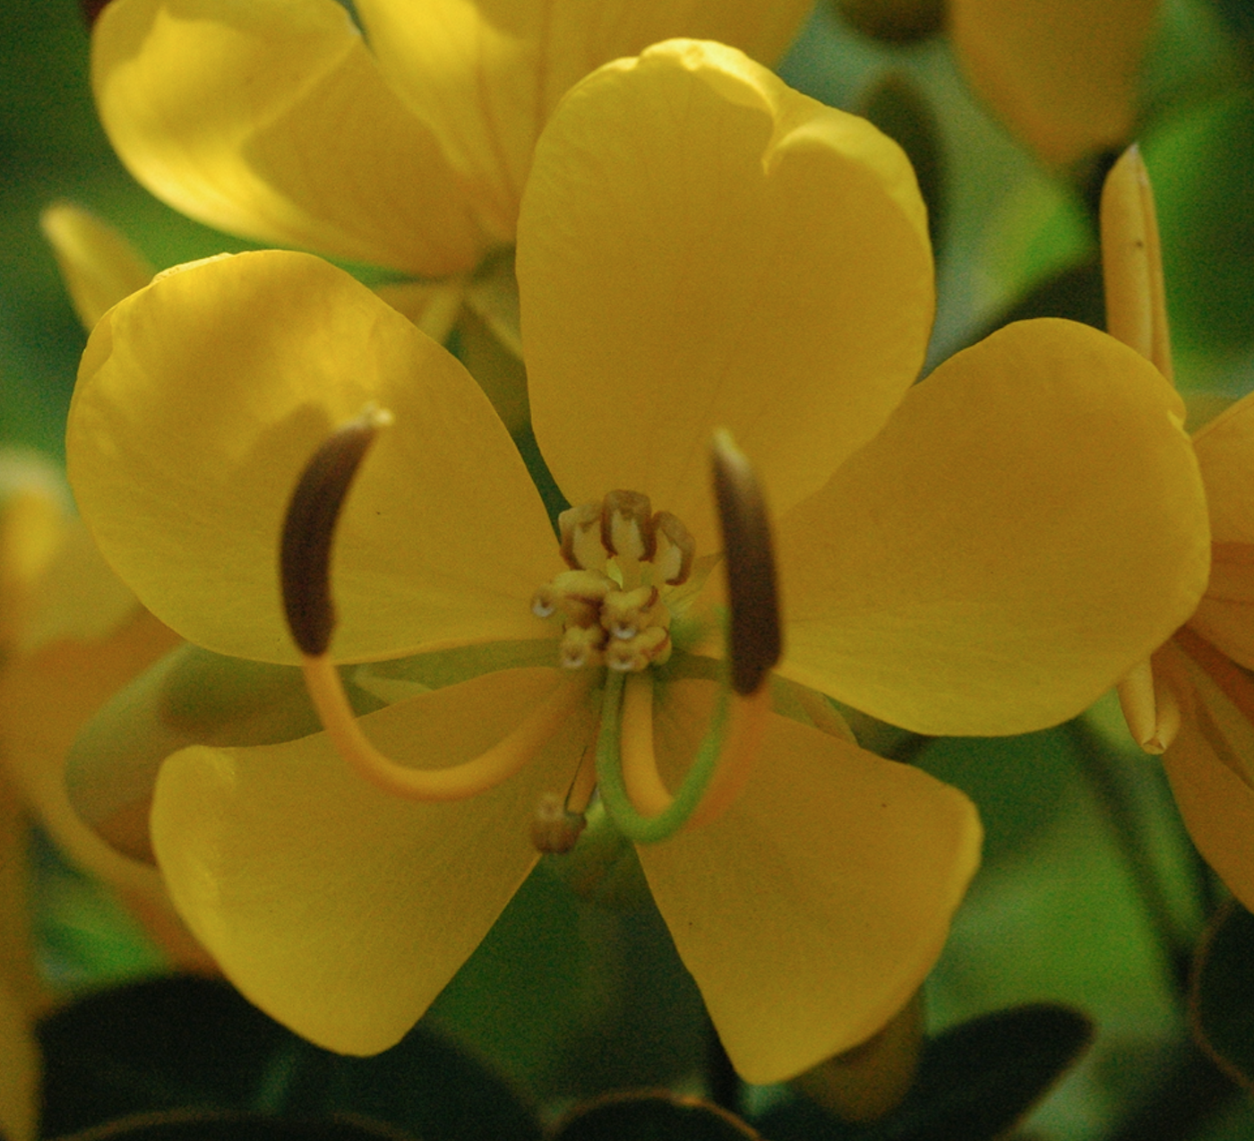
ECOLOGY

Slide 6
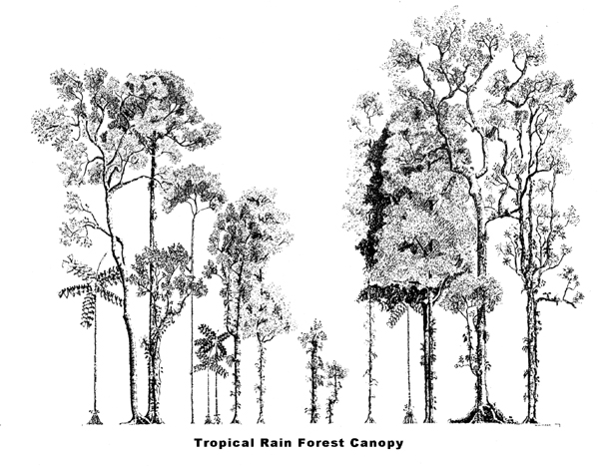

Slide 7
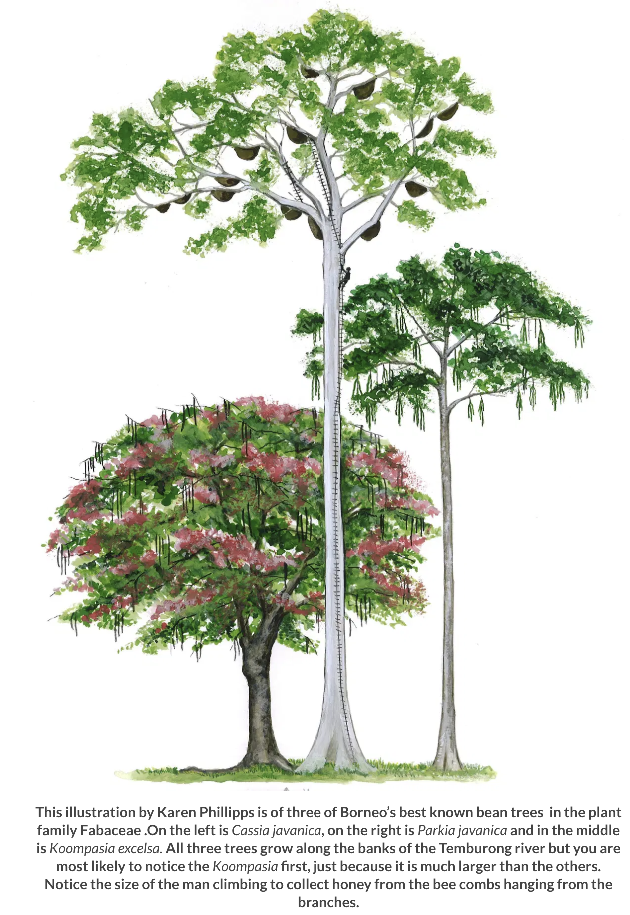
Koompassia excelsa
to 290’ tall (faboid)
Parkia javanica
(mimosoid)
Cassia javanica
(mimosoid)
Notes:
The genus Koompassia comprises three known species, one of which is Koompassia excelsa. It is known as Tualang in the Malay dialect, which refers to ‘the tree of swarming bees’. It is most often found growing naturally as an emergent tree in the tropical moist forest, and sometimes on cultivated areas in its native range from southern Thailand to Peninsular Malaysia, north‐eastern Sumatra, Borneo and the Palawan. The Tualang tree is a large evergreen tree with a buttressed columnar bole, frequently unbranched for up to 30 m in height. The tree has a smooth and shiny bark, a dome‐like crown made up of many small sub‐crowns with gnarly branches, and imparipinnate or pinnately compound leaves. It was recorded as the tallest broadleaf rain forest tree growing up to 85 m in height and reaching up to 3 m in diameter at breast height. The tree is protected from felling in Borneo because of its significance in the local culture and mythical belief, and its value in sustaining the local honeybees which produce the Tualang honey which is appreciated for its therapeutic benefits.
https://onlinelibrary.wiley.com/doi/abs/10.1002/9783527678518.ehg2012015
Apis dorsata builds open nests that hang from under thick tree branches or under cliffs (Figure 6). They build a single large comb up to 150 cm in length and 70 cm tall. The comb is permanently covered by a curtain of up to 100,000 worker bees (Figure 7). This curtain is several layers of bees thick and forms a protective barrier separating the vulnerable brood from the environment. This curtain is sufficient to protect the nest during storms with heavy wind and rain.
Itioka, T., Inoue, T., Kaliang, H., Kato, M., Nagamitsu, T., Momose, K., Sakai, S., Yumoto, T., Mohamad, S.U., Hamid, A.A. and Yamane, S., 2001. Six-year population fluctuation of the giant honey bee Apis dorsata (Hymenoptera: Apidae) in a tropical lowland dipterocarp forest in Sarawak. Annals of the Entomological Society of America, 94(4), pp.545-549. tioka, T., Inoue, T., Kaliang, H., Kato, M., Nagamitsu, T., Momose, K., Sakai, S., Yumoto, T., Mohamad, S.U., Hamid, A.A. and Yamane, S., 2001. Six-year population fluctuation of the giant honey bee Apis dorsata (Hymenoptera: Apidae) in a tropical lowland dipterocarp forest in Sarawak. Annals of the Entomological Society of America, 94(4), pp.545-549.

Slide 8
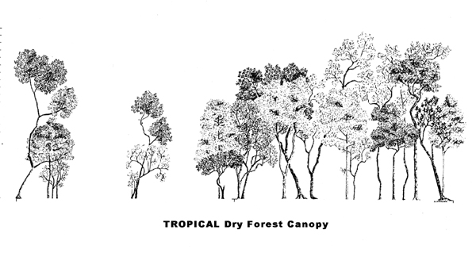

Slide 9
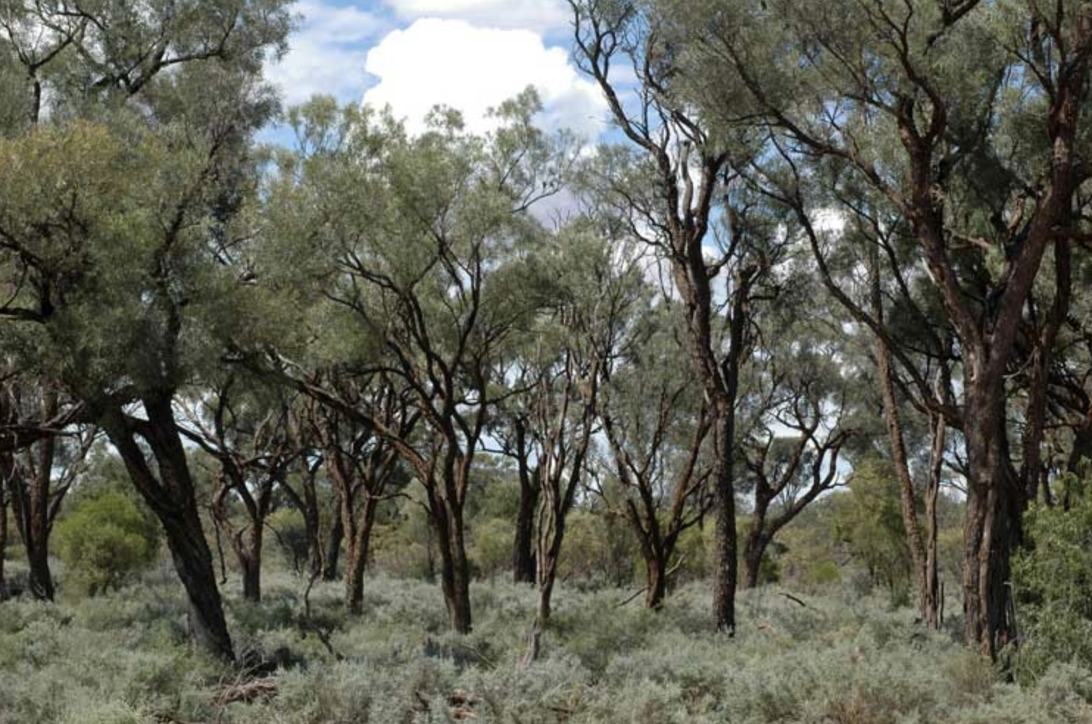
Acacia woodland dominated by Acacia cambagei, Australia

Slide 10
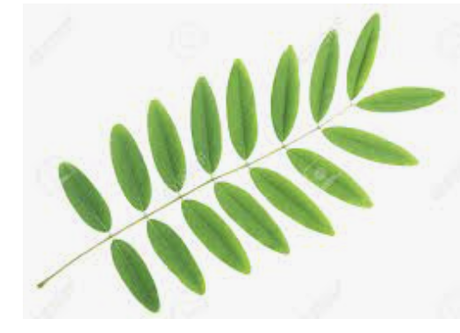
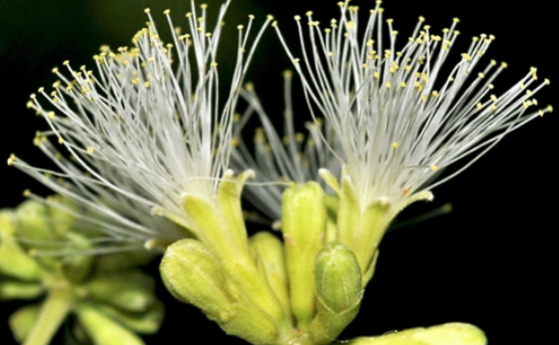
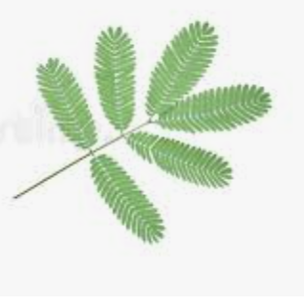
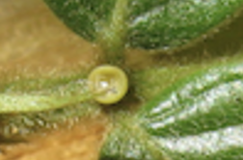
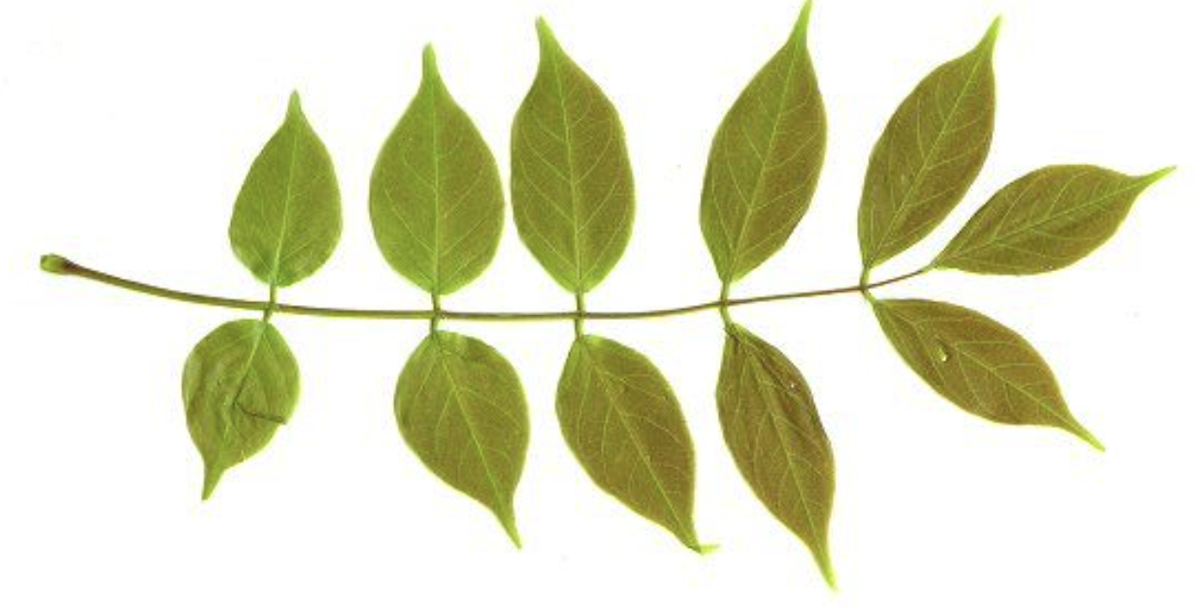
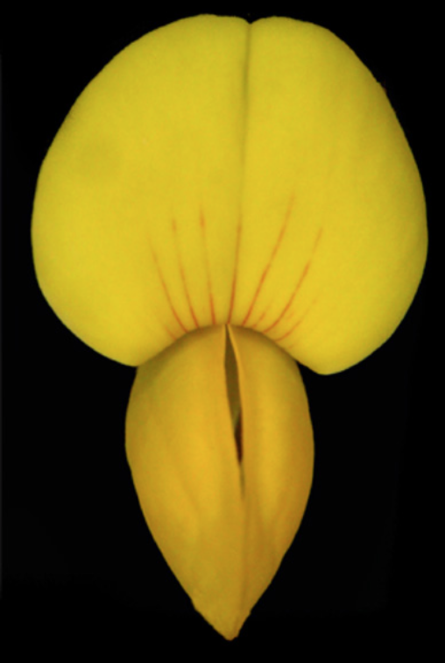
TRADITIONAL SUBFAMILIES
Caesalpinioideae: even-pinnate, no glands, barely bilateral flowers with hypanthia
Mimosoideae: even-pinnate, glands, radial
flowers with hypanthia, in
heads
Faboideae: odd-pinnate, no glands,
strongly bilateral flowers
without hypanthia
Notes:
Miosoid: Enterolobium

Slide 11
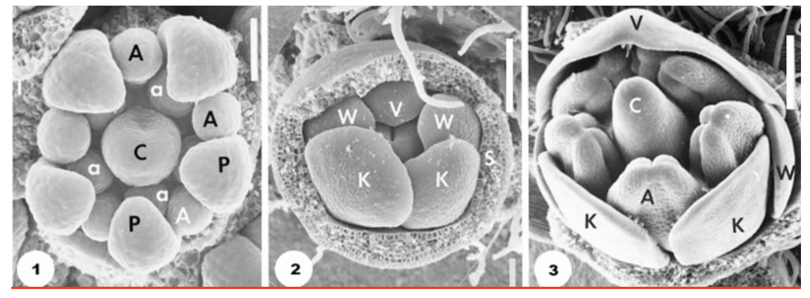
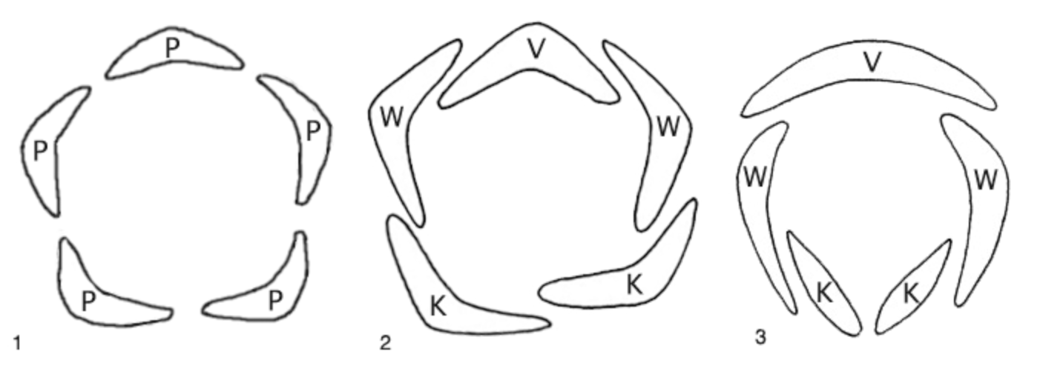
Estivation in the Fabaceae
Mimosoid Caesalpinioid Faboid
A,a stamens; C carpel; P petals; V banner; W wing; K keel
Notes:
Floral organ initiation illustrating patterns of petal aestivation (the arrangement of petals in the flower bud) in Fabaceae, as viewed in scanning electron micrographs of representative species from each subfamily. Abaxial side (away from stem) of flower bud is at bottom of figures. Image 1 (from Fig. 4; Tucker 2003), Neptunia pubescens (Mimosoideae) with 'valvate' corolla aestivation of petals: A and a, outer and inner whorl of stamens, P, petals, C, carpel. Scale bar = 50 μm. Image 2 (from Fig. 2; Tucker 2003), Cercis canadensis (Caesalpinioideae) with ascending 'imbricate' (or 'cochleate') aestivation: V, vexillum or banner petal, W, wing petals, K, keel petals, s, sepal. Scale bar = 100 μm. Image 3 (from Fig. 5; Tucker 2003), Genista tinctoria (Papilionoideae), with sepals removed to show descending 'imbricate' aestivation: V, vexillum or banner petal, W, wing petals, K, keel petals, A, outer whorl stamen, C, carpel. Scale bar = 200 μm. © 2003 Shirley C. Tucker.

Slide 12
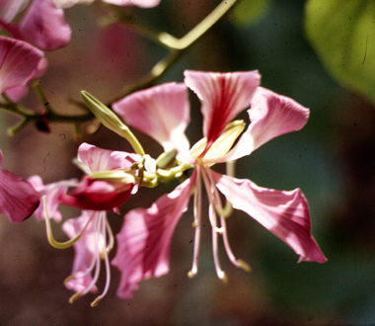
caesalpinioids

Slide 13
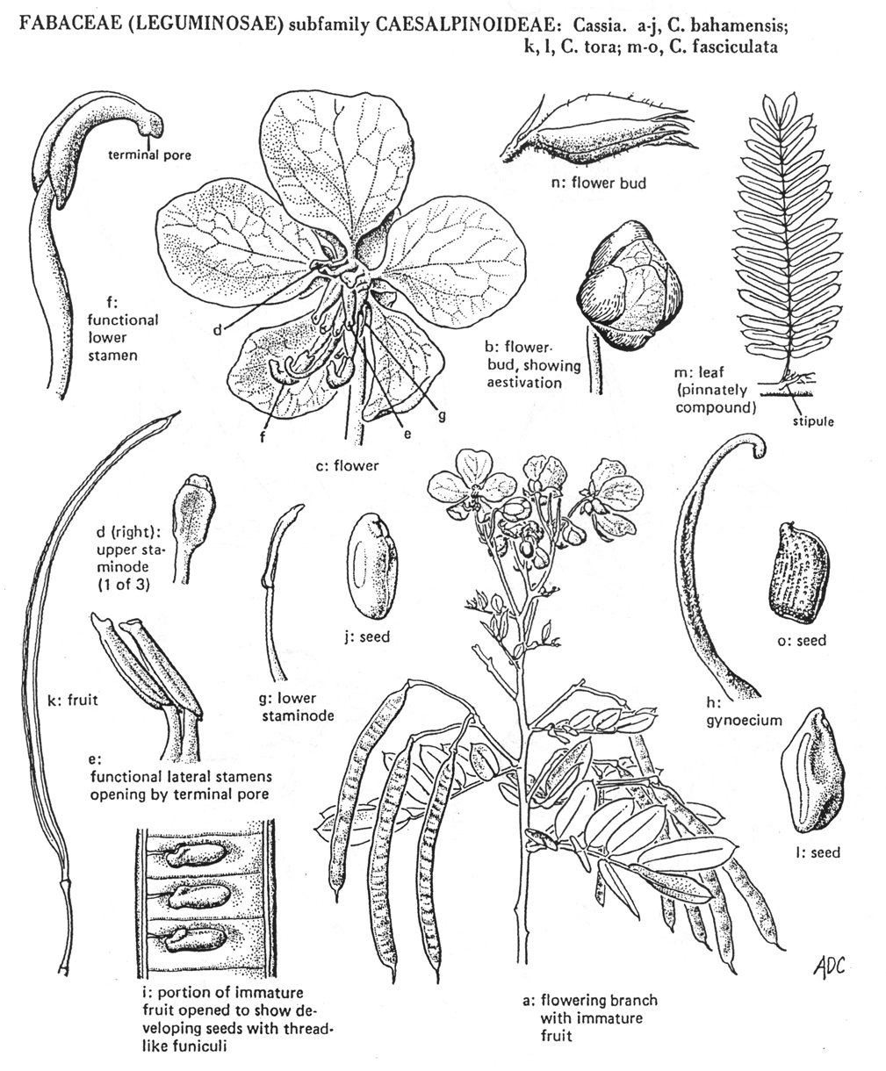
caesalpinioids:
even-pinnate leaves
barely bilateral flowers
hypanthium

Slide 14
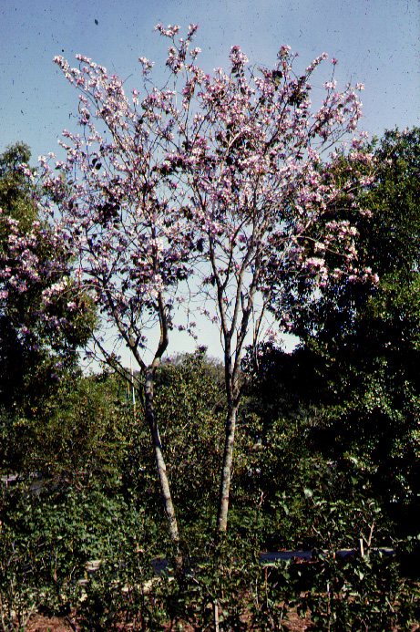
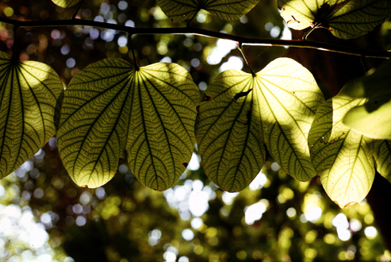
Bauhinia

Slide 15
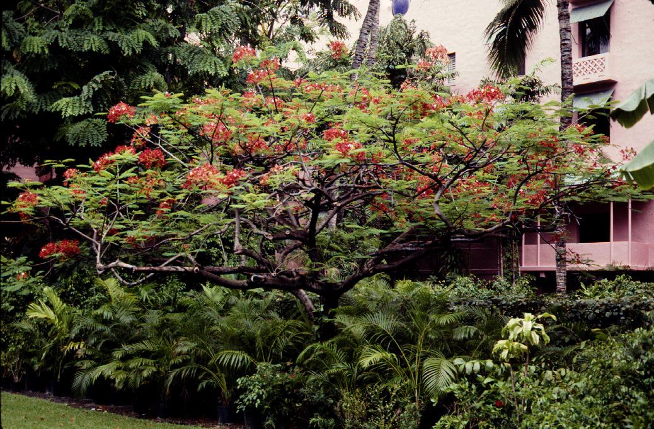
Delonix regia - Madagascar

Slide 16
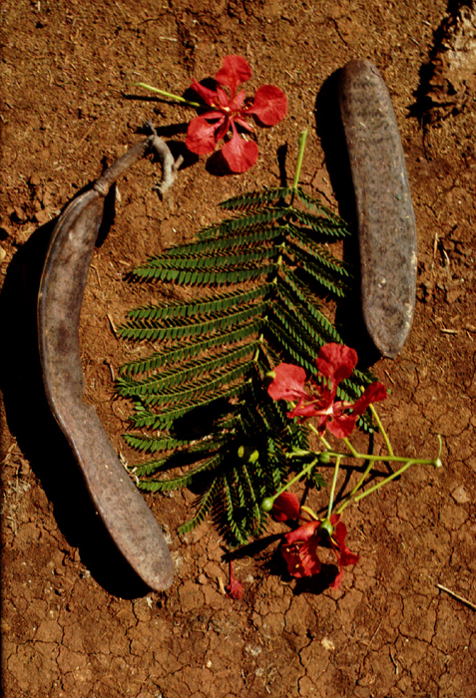
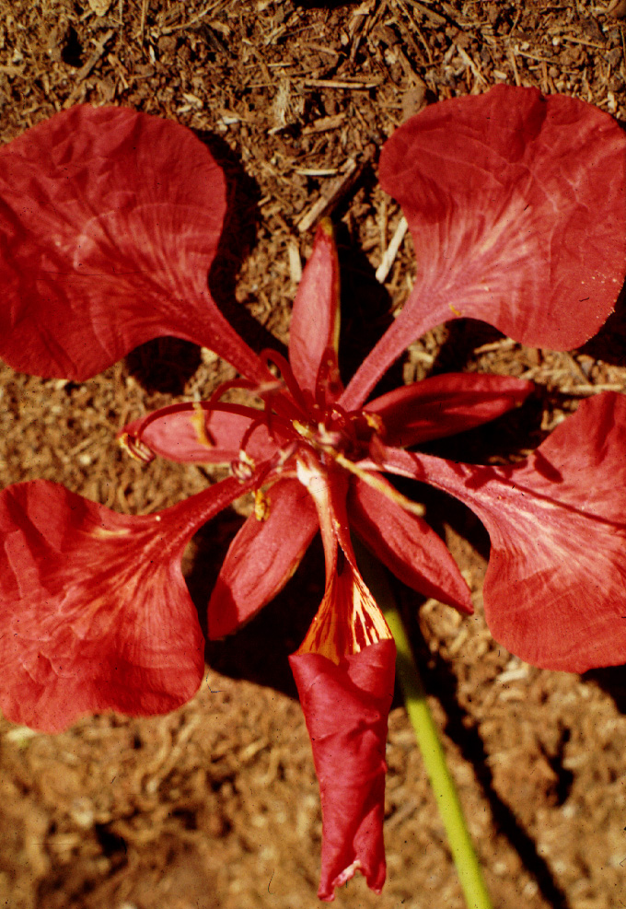

Slide 17
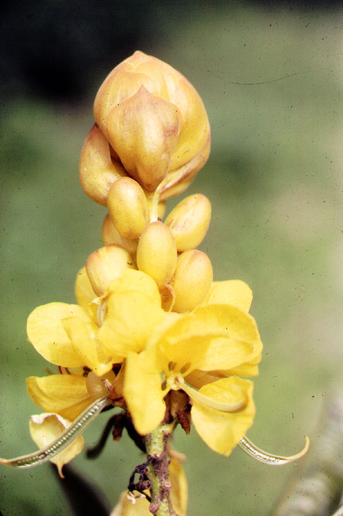
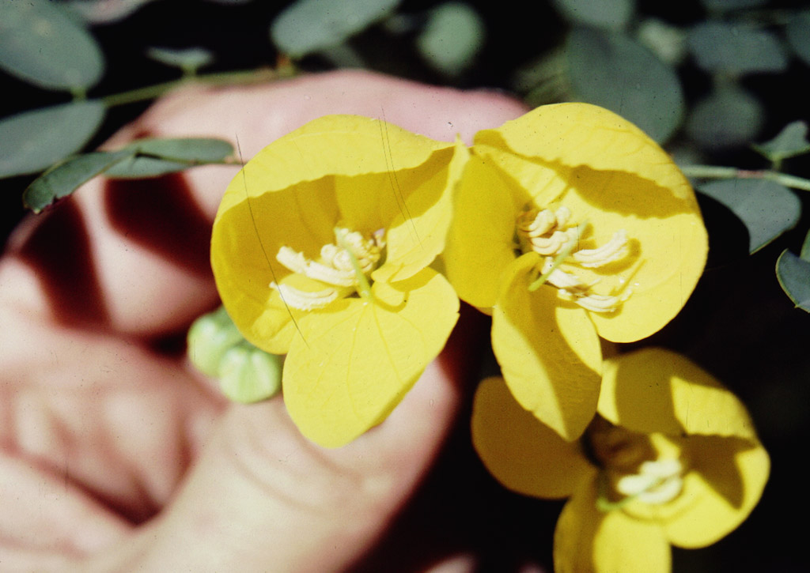
Cassia reticulata
Cassia biflora - a mirror-image flower pair

Slide 18
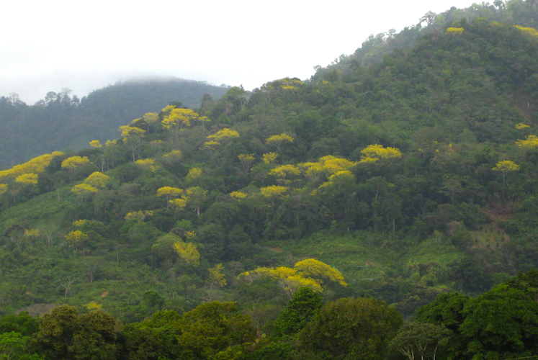
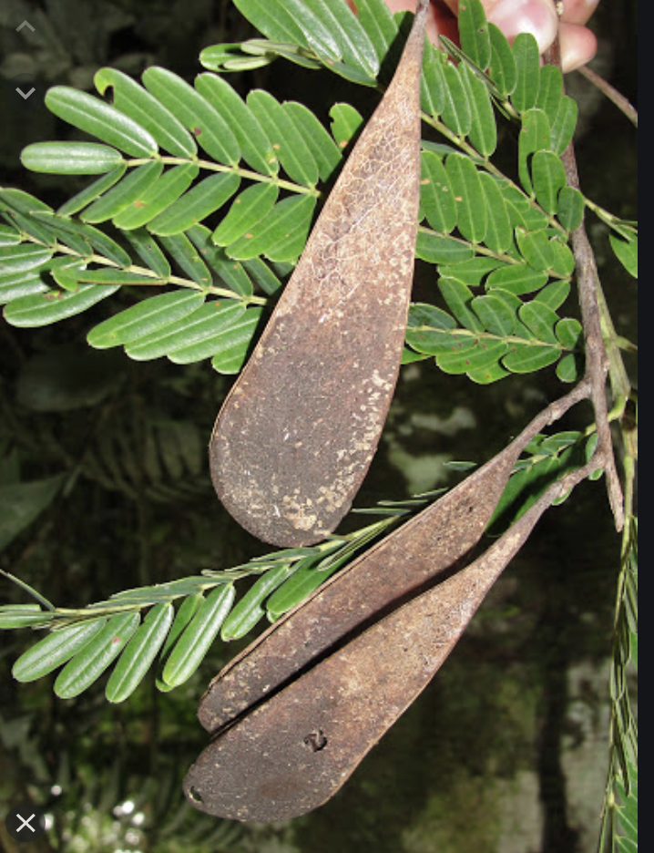
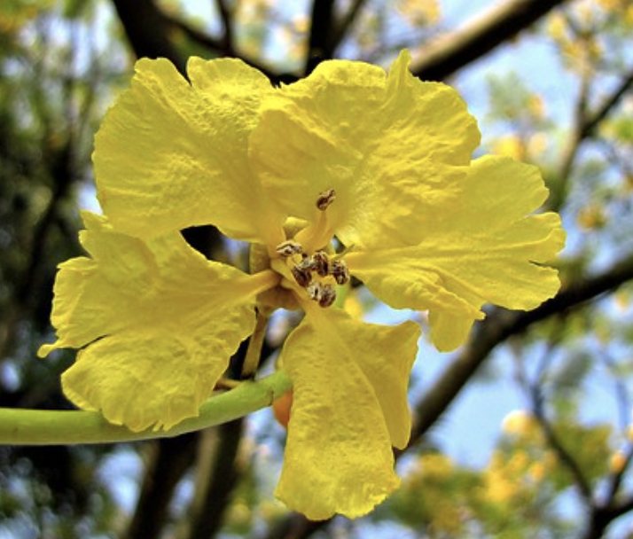
Schizolobium in bloom

Slide 19
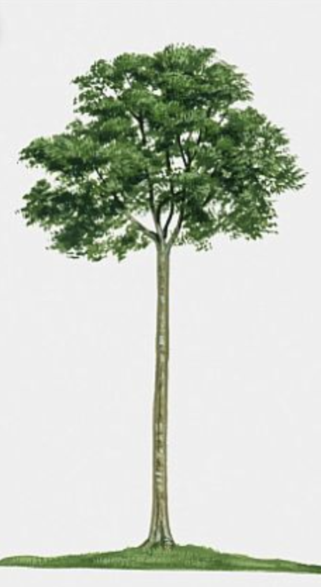
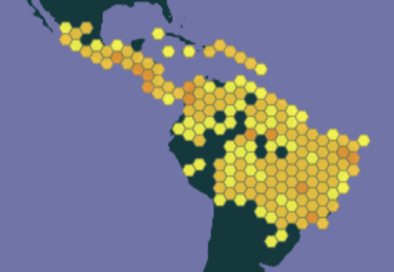
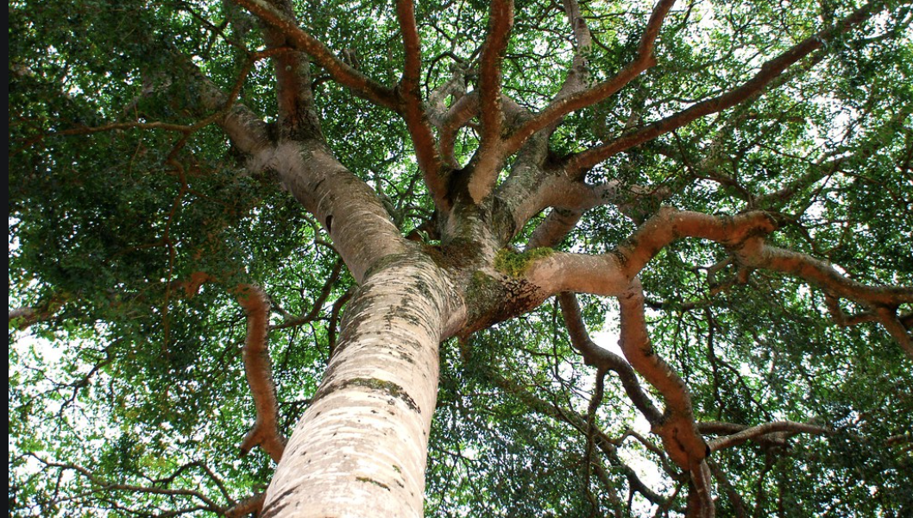
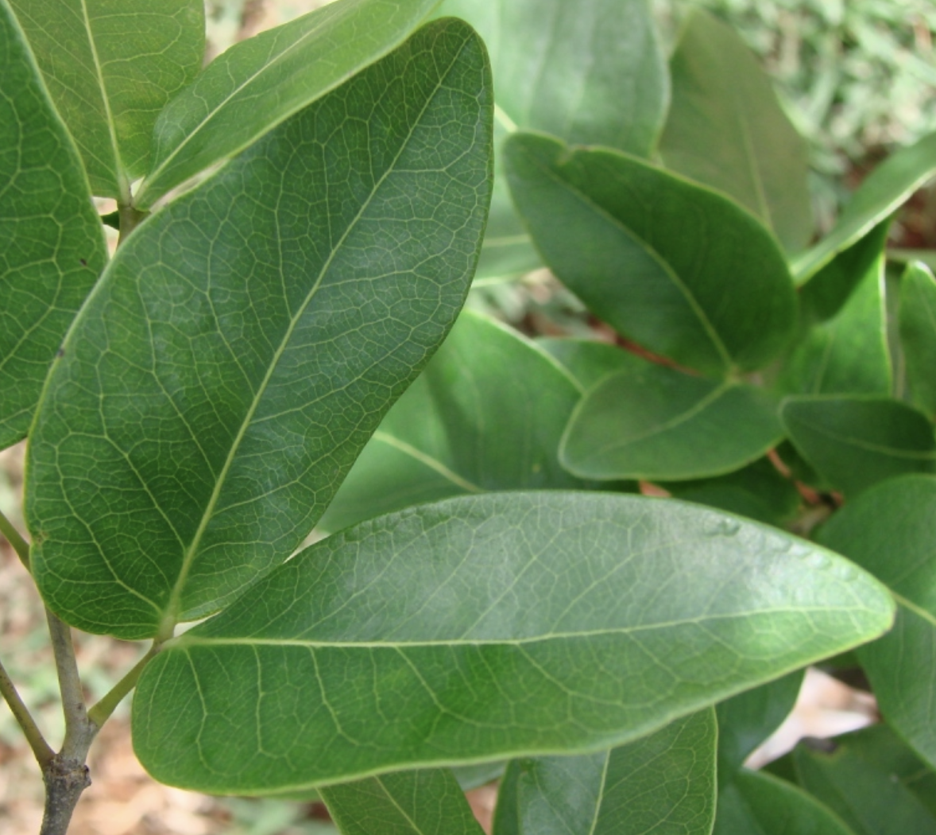
Hymenaea courbaril

Slide 20
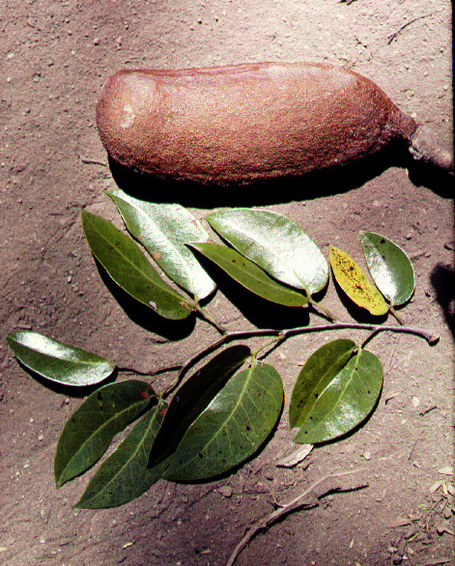
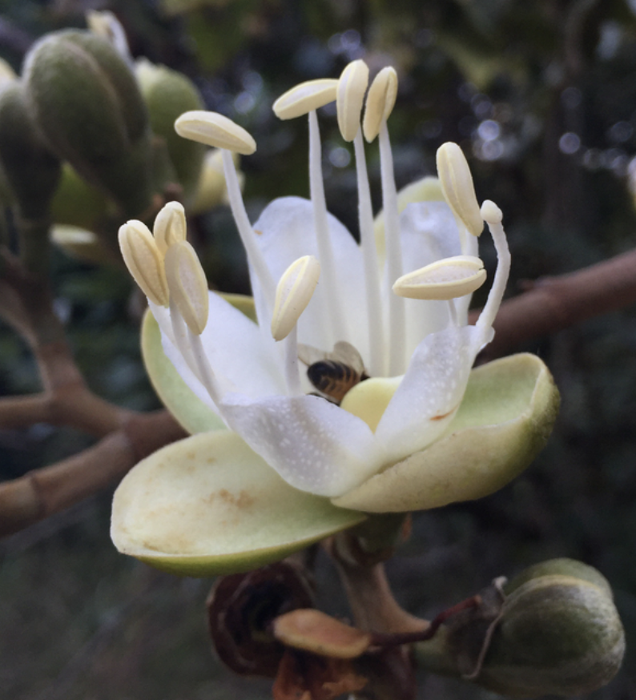
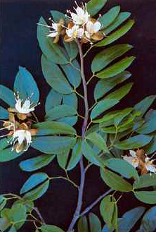
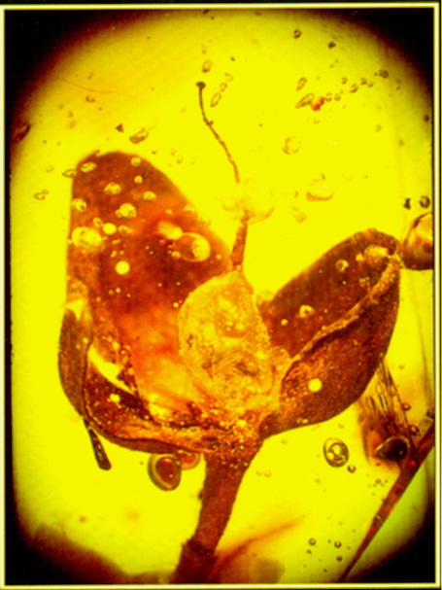
Hymenaea courbaril
Harri Lorenzi

Slide 21
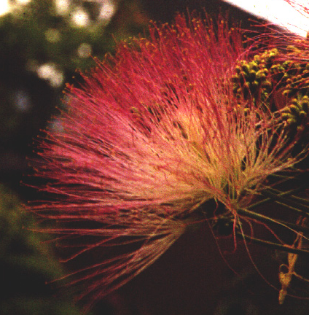
mimosoids
Notes:
See Luckow 2003 for phylogeny of mimosoids

Slide 22
Koompassia excelsa
to 290’ tall (faboid)
Parkia javanica
(mimosoid)
Cassia javanica
(mimosoid)
Notes:
The genus Koompassia comprises three known species, one of which is Koompassia excelsa. It is known as Tualang in the Malay dialect, which refers to ‘the tree of swarming bees’. It is most often found growing naturally as an emergent tree in the tropical moist forest, and sometimes on cultivated areas in its native range from southern Thailand to Peninsular Malaysia, north‐eastern Sumatra, Borneo and the Palawan. The Tualang tree is a large evergreen tree with a buttressed columnar bole, frequently unbranched for up to 30 m in height. The tree has a smooth and shiny bark, a dome‐like crown made up of many small sub‐crowns with gnarly branches, and imparipinnate or pinnately compound leaves. It was recorded as the tallest broadleaf rain forest tree growing up to 85 m in height and reaching up to 3 m in diameter at breast height. The tree is protected from felling in Borneo because of its significance in the local culture and mythical belief, and its value in sustaining the local honeybees which produce the Tualang honey which is appreciated for its therapeutic benefits.
https://onlinelibrary.wiley.com/doi/abs/10.1002/9783527678518.ehg2012015
Apis dorsata builds open nests that hang from under thick tree branches or under cliffs (Figure 6). They build a single large comb up to 150 cm in length and 70 cm tall. The comb is permanently covered by a curtain of up to 100,000 worker bees (Figure 7). This curtain is several layers of bees thick and forms a protective barrier separating the vulnerable brood from the environment. This curtain is sufficient to protect the nest during storms with heavy wind and rain.
Itioka, T., Inoue, T., Kaliang, H., Kato, M., Nagamitsu, T., Momose, K., Sakai, S., Yumoto, T., Mohamad, S.U., Hamid, A.A. and Yamane, S., 2001. Six-year population fluctuation of the giant honey bee Apis dorsata (Hymenoptera: Apidae) in a tropical lowland dipterocarp forest in Sarawak. Annals of the Entomological Society of America, 94(4), pp.545-549. tioka, T., Inoue, T., Kaliang, H., Kato, M., Nagamitsu, T., Momose, K., Sakai, S., Yumoto, T., Mohamad, S.U., Hamid, A.A. and Yamane, S., 2001. Six-year population fluctuation of the giant honey bee Apis dorsata (Hymenoptera: Apidae) in a tropical lowland dipterocarp forest in Sarawak. Annals of the Entomological Society of America, 94(4), pp.545-549.

Slide 23
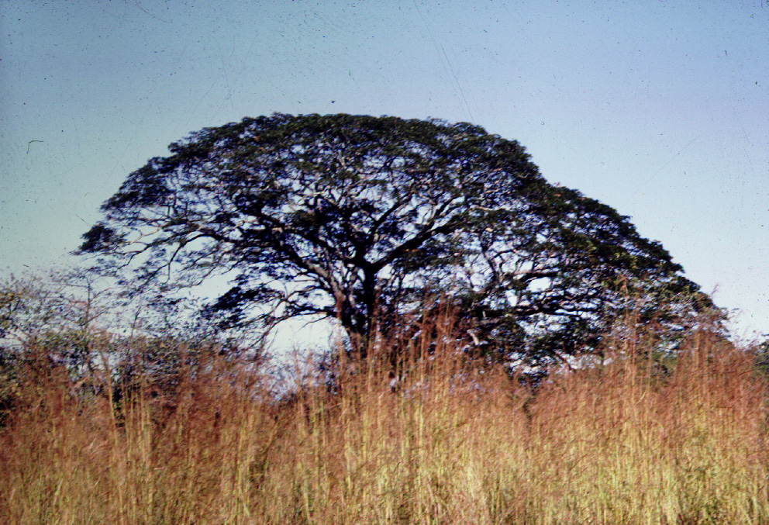
Pithecellobium - parasol form

Slide 24
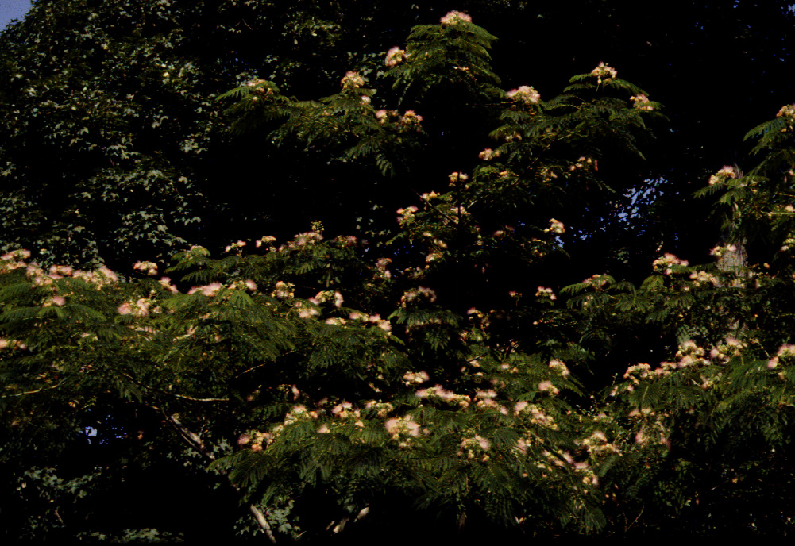
Albizia - mimosoid

Slide 25
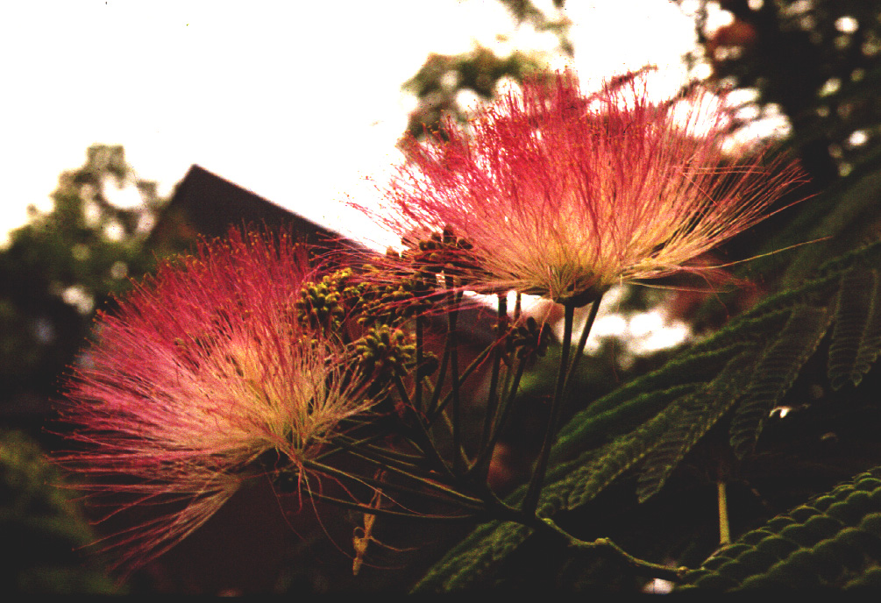

Slide 26
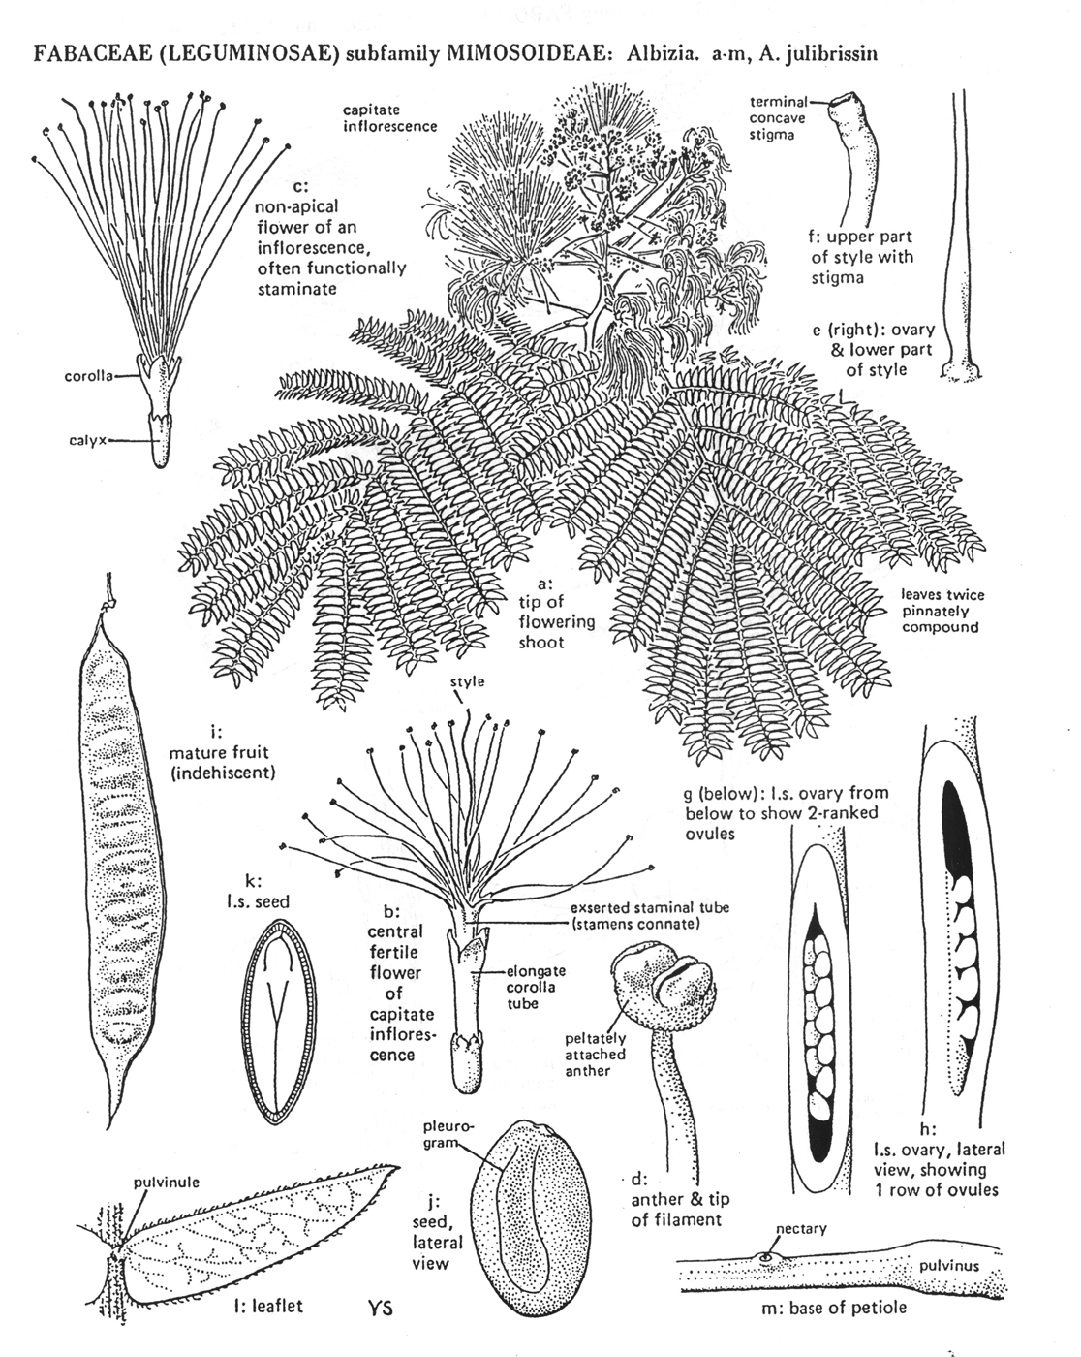
mimosoids:
bipinnate leaves with
glands
head inflorescences
hypanthium
prominent stamens
pollen in polyads
radial symmetry

Slide 27
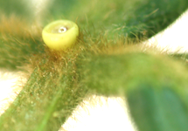



Inga -- the common coffee shade tree

Slide 28





Pollen polyads in Inga species

Slide 29



Calliandra

Slide 30


Parkia
Notes:
See Luckow 1995 on Parkia

Slide 31
Koompassia excelsa
to 290’ tall (faboid)
Parkia javanica
(mimosoid)
Cassia javanica
(mimosoid)
Notes:
The genus Koompassia comprises three known species, one of which is Koompassia excelsa. It is known as Tualang in the Malay dialect, which refers to ‘the tree of swarming bees’. It is most often found growing naturally as an emergent tree in the tropical moist forest, and sometimes on cultivated areas in its native range from southern Thailand to Peninsular Malaysia, north‐eastern Sumatra, Borneo and the Palawan. The Tualang tree is a large evergreen tree with a buttressed columnar bole, frequently unbranched for up to 30 m in height. The tree has a smooth and shiny bark, a dome‐like crown made up of many small sub‐crowns with gnarly branches, and imparipinnate or pinnately compound leaves. It was recorded as the tallest broadleaf rain forest tree growing up to 85 m in height and reaching up to 3 m in diameter at breast height. The tree is protected from felling in Borneo because of its significance in the local culture and mythical belief, and its value in sustaining the local honeybees which produce the Tualang honey which is appreciated for its therapeutic benefits.
https://onlinelibrary.wiley.com/doi/abs/10.1002/9783527678518.ehg2012015
Apis dorsata builds open nests that hang from under thick tree branches or under cliffs (Figure 6). They build a single large comb up to 150 cm in length and 70 cm tall. The comb is permanently covered by a curtain of up to 100,000 worker bees (Figure 7). This curtain is several layers of bees thick and forms a protective barrier separating the vulnerable brood from the environment. This curtain is sufficient to protect the nest during storms with heavy wind and rain.
Itioka, T., Inoue, T., Kaliang, H., Kato, M., Nagamitsu, T., Momose, K., Sakai, S., Yumoto, T., Mohamad, S.U., Hamid, A.A. and Yamane, S., 2001. Six-year population fluctuation of the giant honey bee Apis dorsata (Hymenoptera: Apidae) in a tropical lowland dipterocarp forest in Sarawak. Annals of the Entomological Society of America, 94(4), pp.545-549. tioka, T., Inoue, T., Kaliang, H., Kato, M., Nagamitsu, T., Momose, K., Sakai, S., Yumoto, T., Mohamad, S.U., Hamid, A.A. and Yamane, S., 2001. Six-year population fluctuation of the giant honey bee Apis dorsata (Hymenoptera: Apidae) in a tropical lowland dipterocarp forest in Sarawak. Annals of the Entomological Society of America, 94(4), pp.545-549.

Slide 32



Slide 33




Parkia biogeography
Dichrostachys, the sister genus
Parkia
Notes:
Gondwana vicariance versus south american origin and dispersal to old world tested by Luckow, 1995, A cladistic analysis of Parkia. American Journal of Botany.

Slide 34

Notes:
from conceicao oliveria 2020.pdf

Slide 35

Notes:
from conceicao oliveria 2020.pdf

Slide 36

Notes:
from conceicao oliveria 2020.pdf

Slide 37





the ant acacias

Slide 38



the ant acacias

Slide 39
faboids

Slide 40

faboids:
many herbs
odd-pinnate leaves
strong bilateral symmetry
hypanthium present only in primitive members

Slide 41


Glyricidia sepium
Notes:
no obvious toxicity evidenced in the literature 081030

Slide 42




Erythrina

Slide 43


Abrus
Notes:
Abrin works by penetrating the cells of the body and inhibiting cell protein synthesis. By attaching to a carbohydrate chain on the cell surface, the abrin molecule anchors itself to the cell, is subsequently engulfed and enters the inner parts of the cell where it reacts with a ribosomal subunit and interferes with the normal protein synthesis process of the cell. Without these proteins, cells cannot survive. This is harmful to the human body and death may occur. The severity of the effects of Abrin poisoning vary on the means of exposure to the substance (whether inhaled, ingested, or injected).
see Olsnes 2004 for escellent general accounts of lectins, esp. abrin and ricin. Some extracts follow:
Paul Ehrlich (1891) was convinced that the toxins had to be
fixed in the tissue to act. He proposed that the active toxins
consist of a binding part, a haptophore, and a toxin part, a
toxophore. He concluded that the haptophore bound almost
immediately to cells even at low temperature, whereas the
toxophore acted more slowly and was inhibited at low
temperature.
Fractionation of the reticulocyte lysate into ribosomes
and soluble factors demonstrated that the toxin A-chains act
on the ribosomes (Olsnes et al., 1973; Montanaro et al.,
1973). It was subsequently found that the large, 60 S subunit
of the ribosomes is the target (Sperti et al., 1973) and that the
effect of the toxins interferes with the interaction of
elongation factors with the ribosomes (Montanaro et al.,
1973; Olsnes et al., 1975). It was found that one A-chain
molecule is able to inactivate 2000 ribosomes per minute
and that the Km of the reaction is 0.1–0.2 mM (Olsnes et al.,
1975).
In elegant studies, Endo and co-workers (Endo et al.,
1987; Endo and Tsurugi, 1987) found that the A-chain is a
glycosidase that removes an adenine residue from an
exposed loop of 28 S ribosomal RNA (A4324 in rat 28 S
RNA) This loop is involved in the binding of elongation
factors and the modified ribosomes are, therefore, unable to
support protein synthesis (Endo et al., 1991).
The toxin does not by itself break the RNA chain, but the
depurinated RNA is susceptible to hydrolysis at alkaline pH,
and at acidic pH in the presence of anilin. Endo’s group
(Ogasawara et al., 1999) more recently identified a specific
lyase in various plants that cleaves the RNA at the
apurinated site.

Slide 44


Mucuna

Slide 45



Mucuna

Slide 46








Current Molecular Phylogeny for the Legumes
100
300
1
14000
2000
3300
Notes:
Bauhinia
Duparquetia, a S. Afr. Shrub with 1-imparapinnate lvs. And faboid estimvation. See Prenner 2008.
Gleditsia – See Herendeen et al, 2003 on Umtiza lineage

