Slide 1
Elevation, space and host plant species structure Ericaceae root associated fungal communities in Papua New Guinea
P. Kohout, M. Bahram , S. Pōlme, L. Tedersoo (2017)
Kyle Amerantes

Slide 2
Purpose of Study
Identify predictors of endomycorrhizae & ericoid mycorrhizae community structure in Ericaceae
Factors examined
  Spatial distance
  Elevation
  Host plant taxonomy

Slide 3
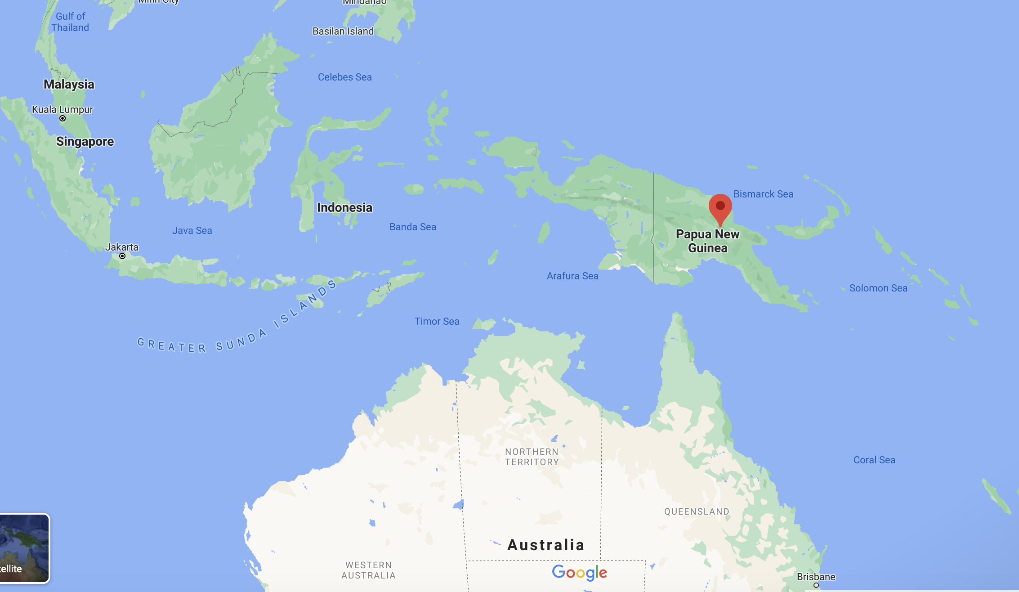
Region - Mt. Wilhelm, Papua New Guinea
Notes:
Mt. Wilhelm Image- https://s3.amazonaws.com/heli-production/package/e64e9419-4ad7-499e-837c-25d08851bb7e_1209_aa573ff2bd140ec51746d1ebc8ae02e0_pkg_ngl.jpg

Slide 4
Mycorrhizae Types
Ericoid Mycorrhizae
Notes:
Illustration from: Egerton-Warburton, Querejeta,Allen, Finkelman (2005) https://doi.org/10.1016/B0-12-348530-4/00455-0
Cell Image: http://www.mycorrhiza-research.de/Pages/01_04Erica.html

Slide 5
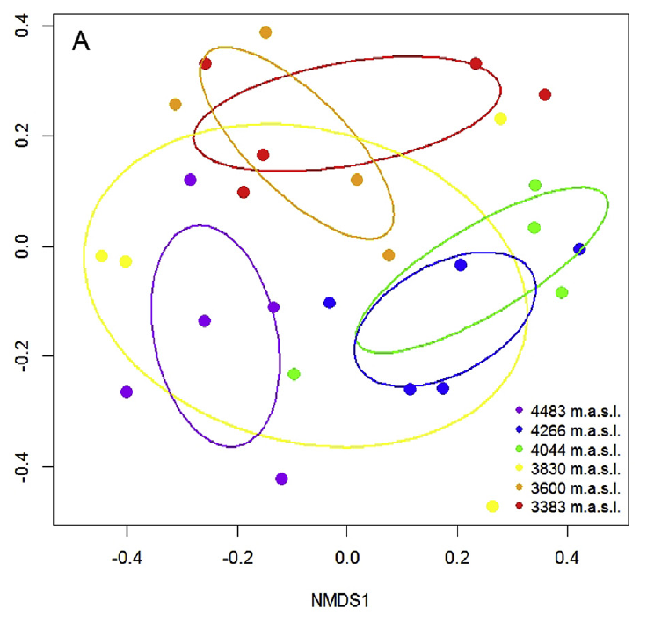
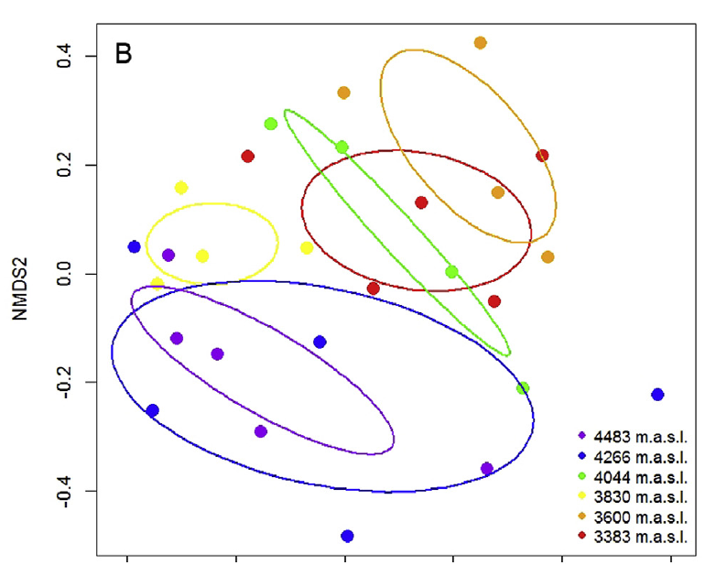

Dissimilarity by Elevation
Ericoid Mycorrhizal Fungi
Endophytic Fungi
Transect ranging from 3383 m - 4483 m
Cooler colors represent higher elevation
Notes:
Warm colors = lower elevation
Cool colors = Higher elevation

Slide 6
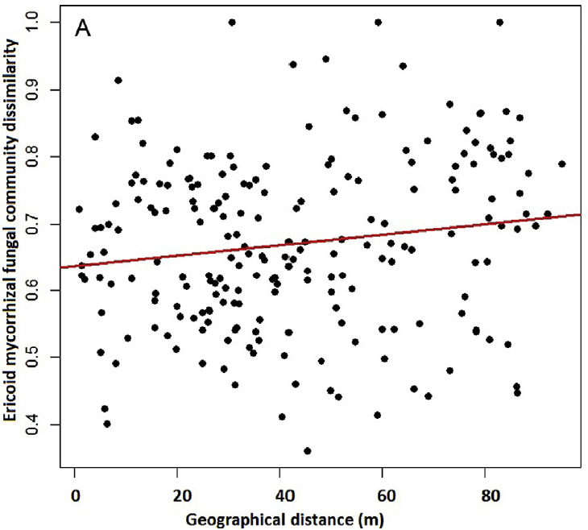
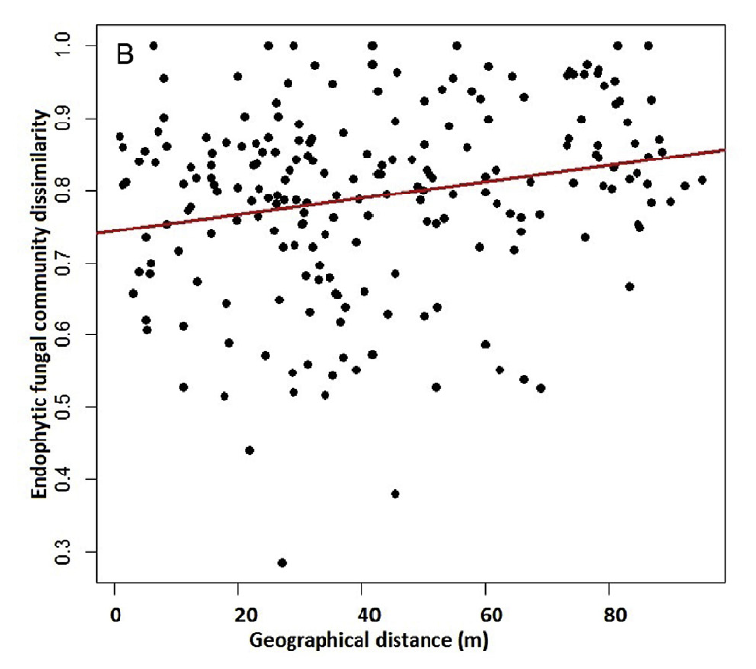

Dissimilarity vs. Distance
Ericoid Mycorrhizal Fungi
Endophytic Fungi
R_{Mantel} =. 0.18, P = . 0.007
R_{Mantel} = 0.26, P =0.002
R² = 0.02; P = 0.027;
R² =0.04; P = 0.001;
Notes:
Recorded at 3600 m section (most Ericaceae present)
The results of a Partial Mantel test showed significant spatial
autocorrelation of putative ErMF (RMantel . 0.18, P . 0.007) as well
as ENDF (RMantel . 0.26, P . 0.002) communities even when host
plant phylogenetic distances were taken into account. In accordance
with the results of the Partial Mantel test, the distance decay
analysis showed a positive correlation between spatial distance and
putative ErMF (R2 . 0.02; P . 0.027; Fig. 4A) as well as ENDF
(R2 . 0.04; P . 0.001; Fig. 4B) community dissimilarities.

Slide 7
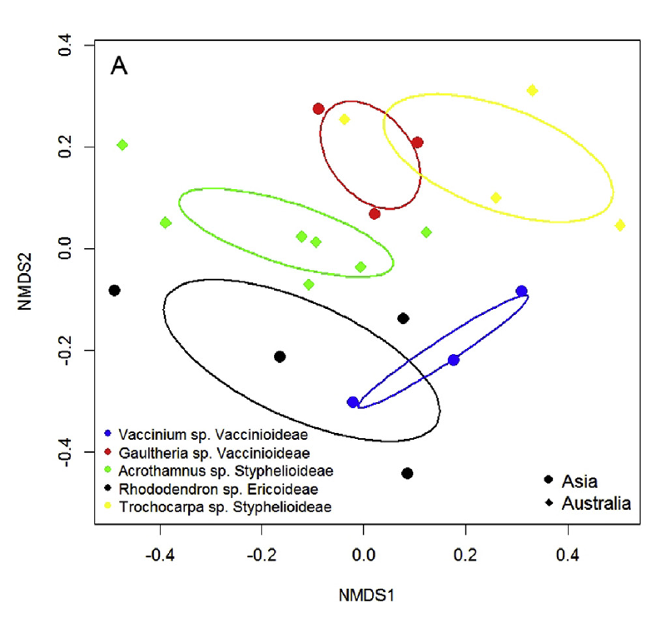
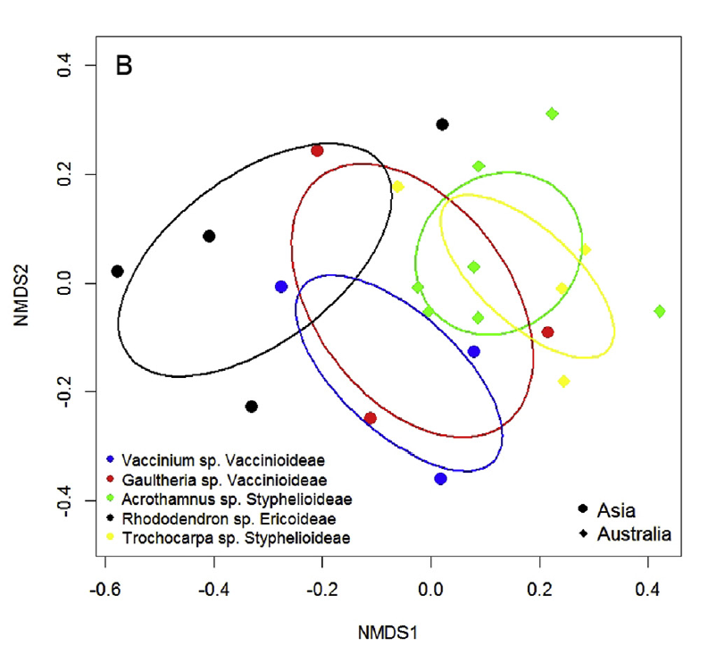
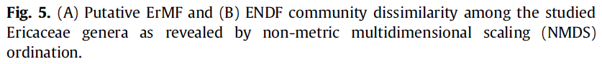
Dissimilarity According to Host Plant
Ericoid Mycorrhizal Fungi
Endophytic Fungi
Notes:
Recorded at 3600 m section (most Ericaceae present)
Different shapes represent different biogeographic origins
“NMDS analysis also revealed an effect of host plant genera on structuring putative ErMF (Fig. 5A) but not on ENDF communities (Fig. 5B).“

Slide 8
Conclusions
Elevation, host plant, and spatial distances impact both ericoid mycorrhizal fungi and endophytic mycorrhizal fungi community structure
Impacts are variable among the three factors examined

Slide 9
Thank You

