Slide 1
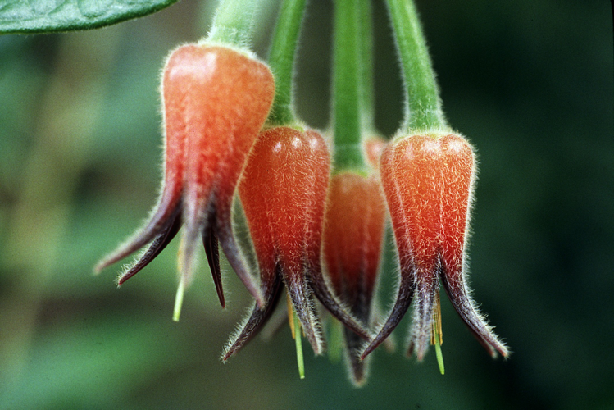
ERICACEAE
Notes:
Ceratostema lanigerum

Slide 2
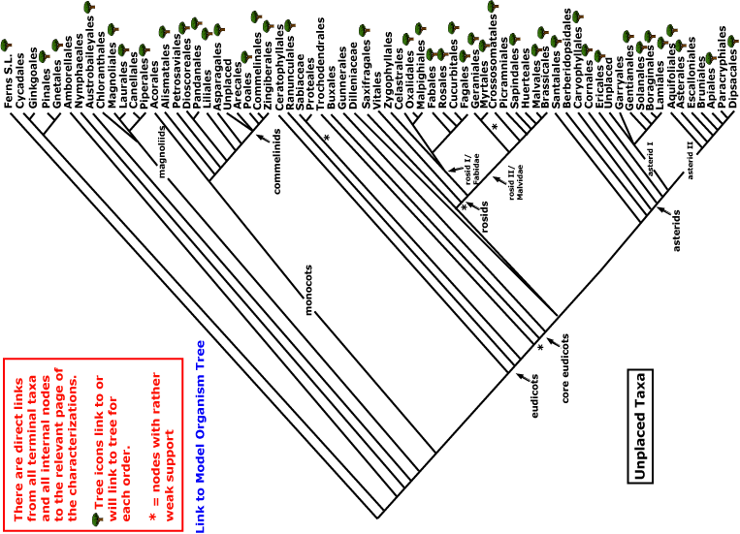

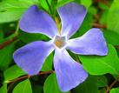
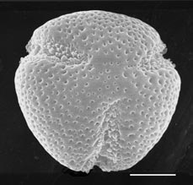
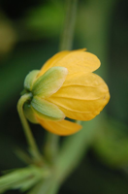
ERICACEAE
magnoliids
asterids
rosids
Current Angiosperm Phylogeny Group Tree for Flowering Plants
2018
monocots
core eudicots
eudicots

Slide 3
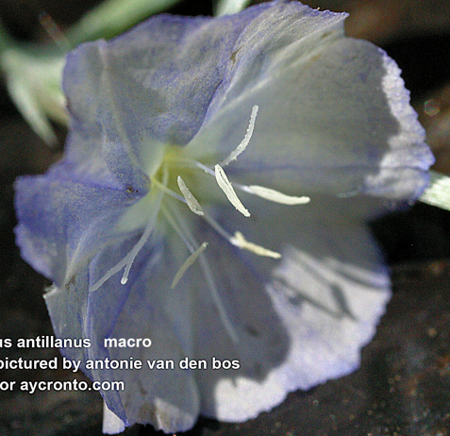
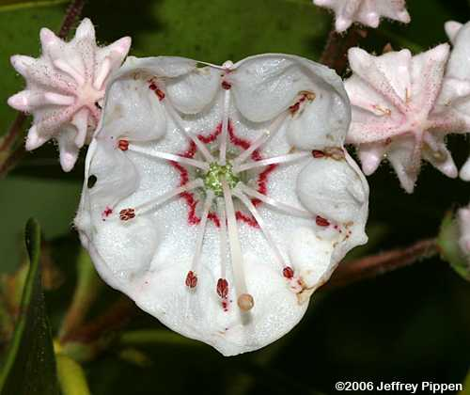
general Asterid Characters
fused corolla
stamens adnate to corolla
stamens equal to or fewer
than perianth lobes
gynoecium 2-carpellate
iridoid glycosides
Ericaceae make it on only the first two and the last.

Slide 4
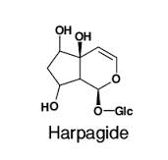
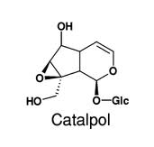
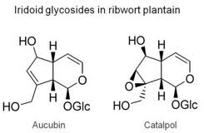
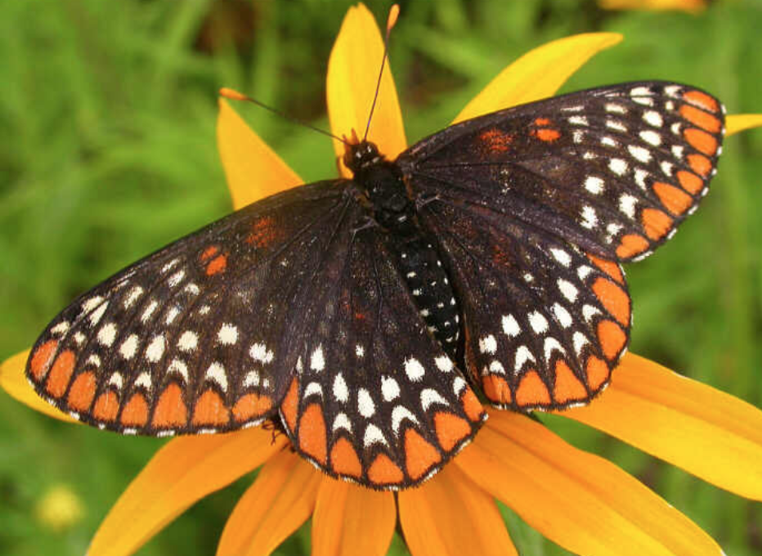
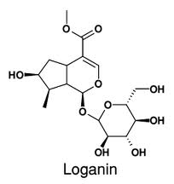
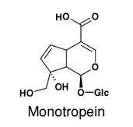
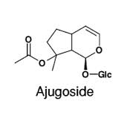
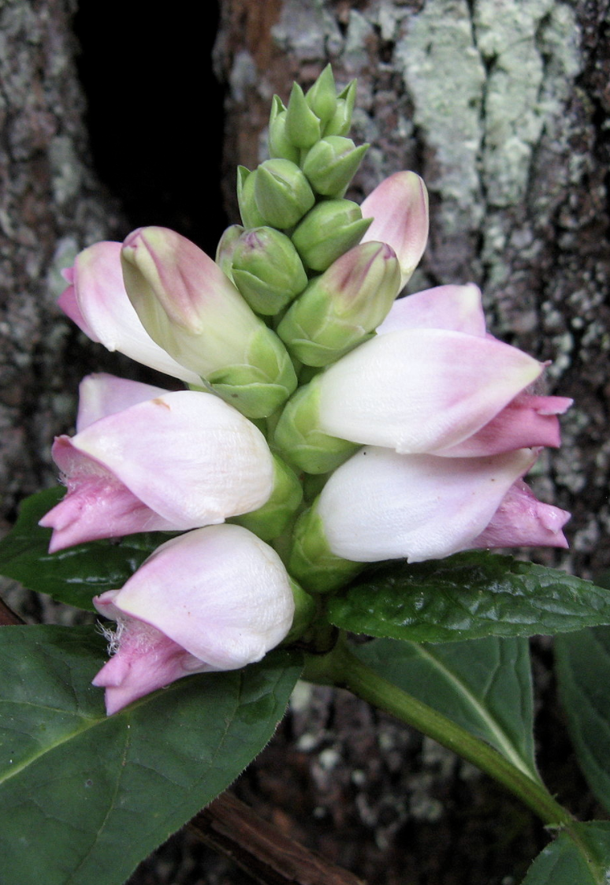
Iridoid Glycosides, a Signature Asterid Herbivore Deterrant
Baltimore checkerspot (Euphydryas phaeton)
snd Chelone glauca
Notes:
Iridoids are found in many medicinal plants and may be responsible for some of their pharmaceutical activities. Isolated and purified, iridoids exhibit a wide range of bioactivities including cardiovascular, antihepatotoxic, choleretic, hypoglycemic, analgesic, anti-inflammatory, antimutagenic, antispasmodic, antitumor, antiviral, immunomodulator, and purgative activities.[1][2]
The iridoids are produced by plants primarily as a defense against herbivores or against infection by microorganisms. The Variable Checkerspot butterfly also uses iridoids obtained through its diet as a defense against avian predators.[3] To humans and other mammals, iridoids are often characterized by a deterrent bitter taste.
Aucubin and catalpol are two of the most common iridoids in the plant kingdom. Iridoids are prevalent in the plant subclass Asteridae, such as Ericaceae, Loganiaceae, Gentianaceae, Rubiaceae, Verbenaceae, Lamiaceae, Oleaceae, Plantaginaceae, Scrophulariaceae, Valerianaceae, and Menyanthaceae.

Slide 5
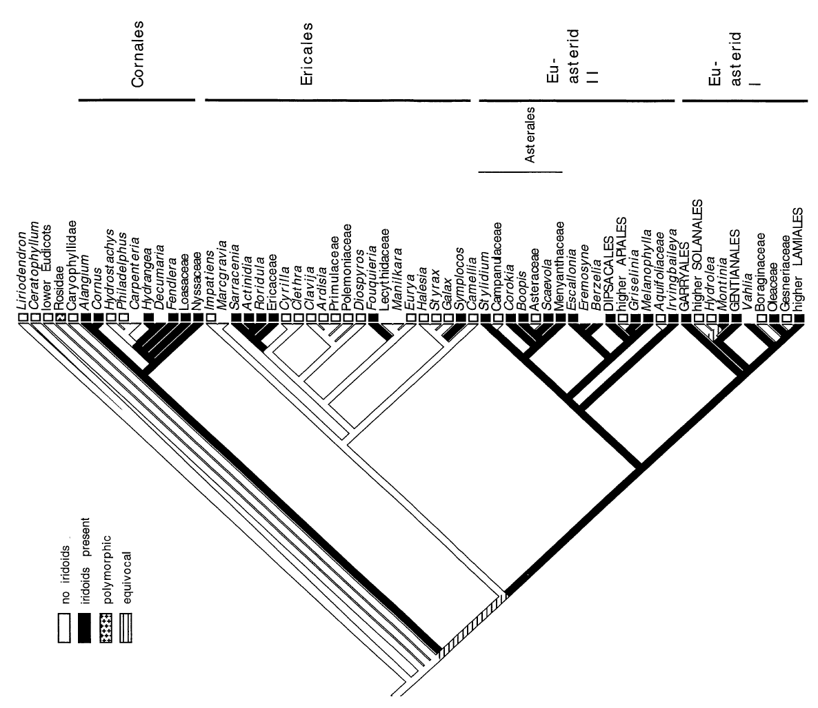
Distribution of Iridoid Glycosides

Slide 6
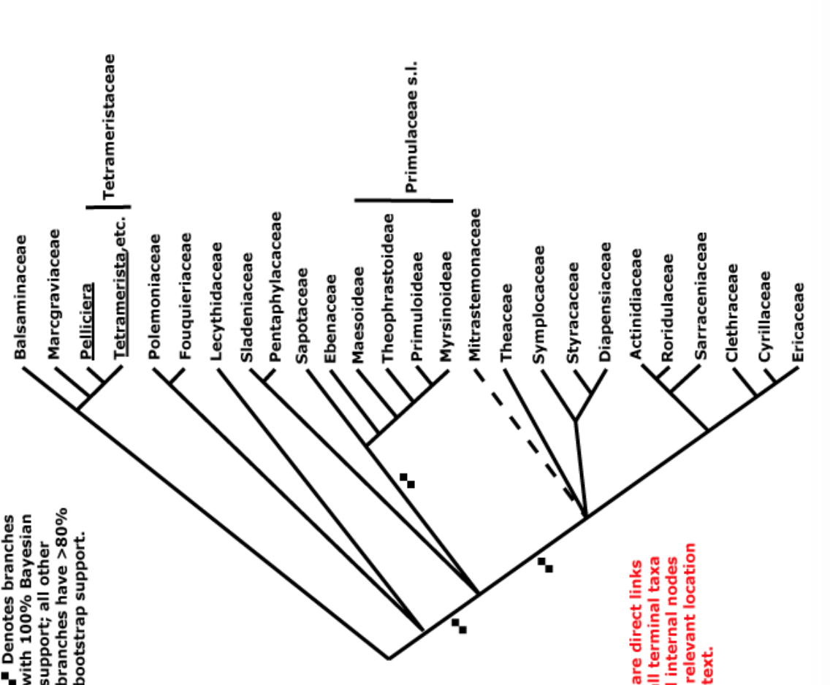
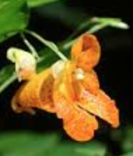
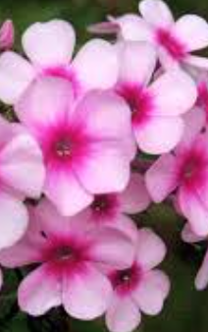
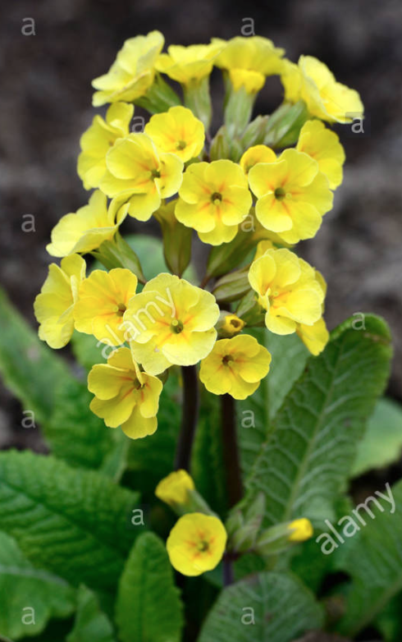
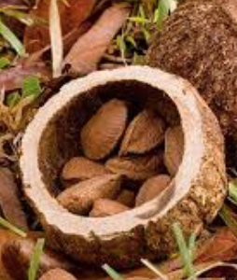

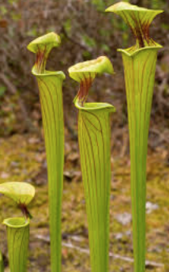
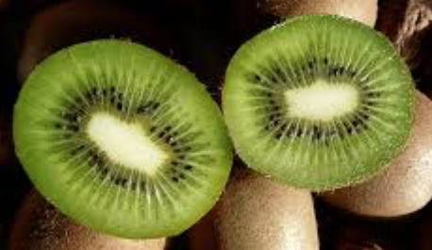
ERICALES

Slide 7
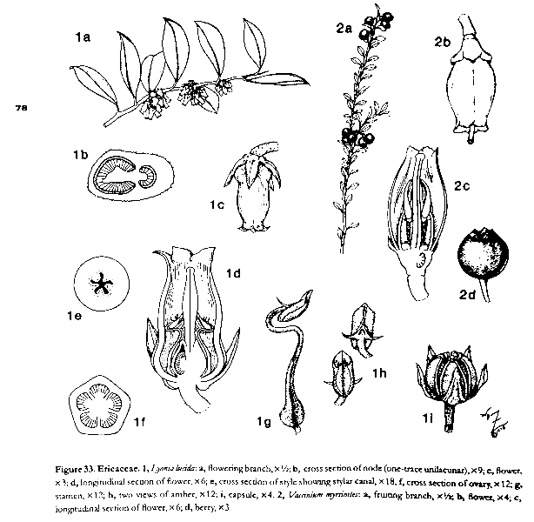
ERICACEAE
alternate, simple leaves with arcuate veins
stamens 2x petals
inverted stamens
poricidal anthers
5-carpellate, many seeds

Slide 8
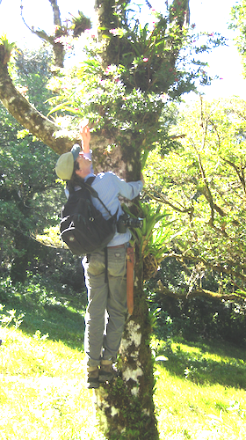
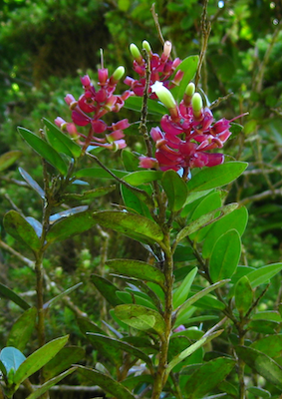
Tropical Ericaceae are mostly epiphytes.

Slide 9
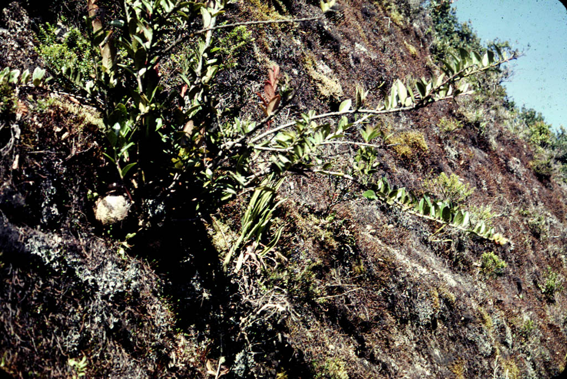
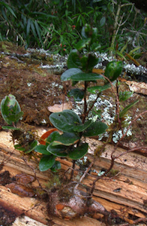
Cavendishia

Slide 10
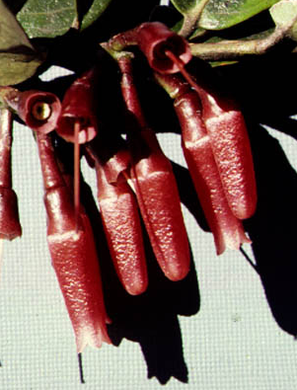
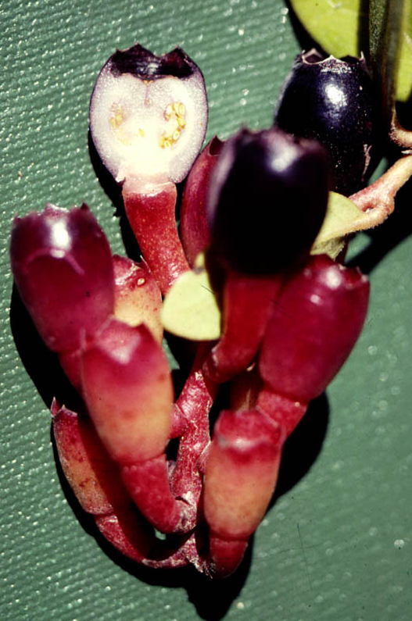
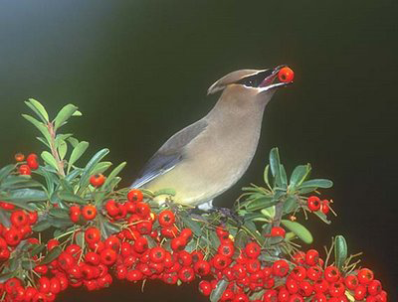
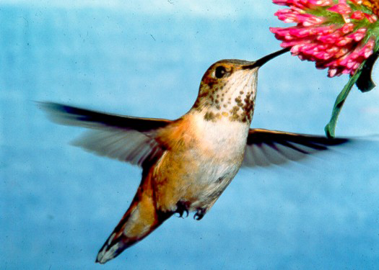
Cavendishia – bird-pollinated bird-dispersed

Slide 11
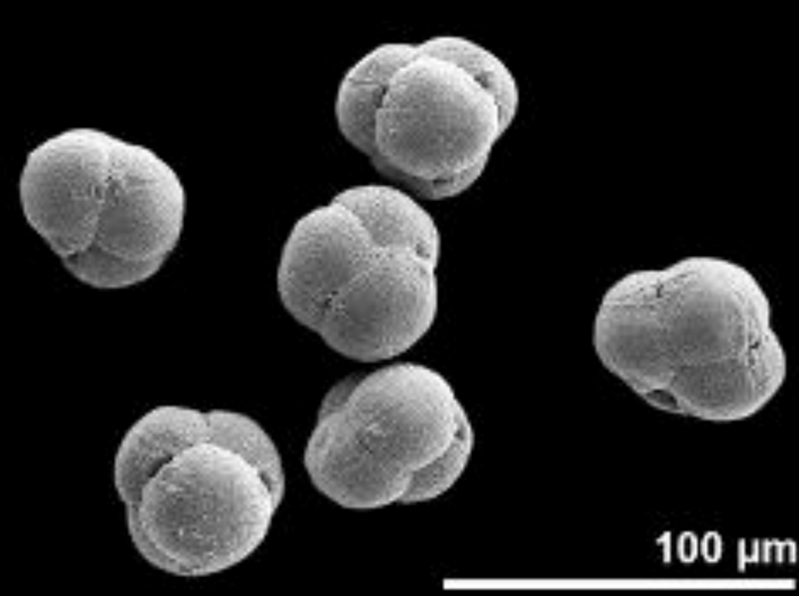
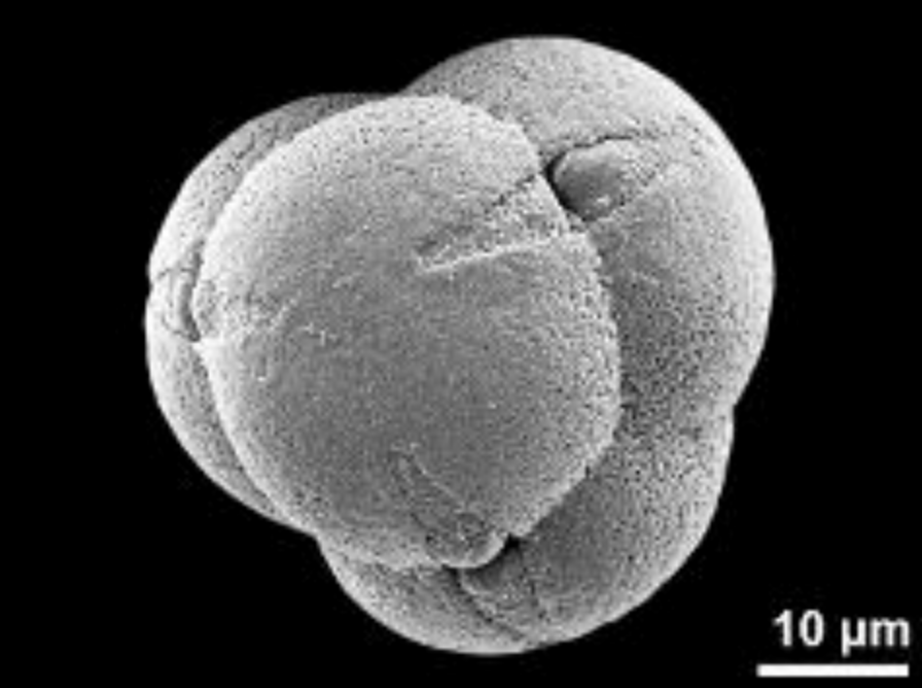
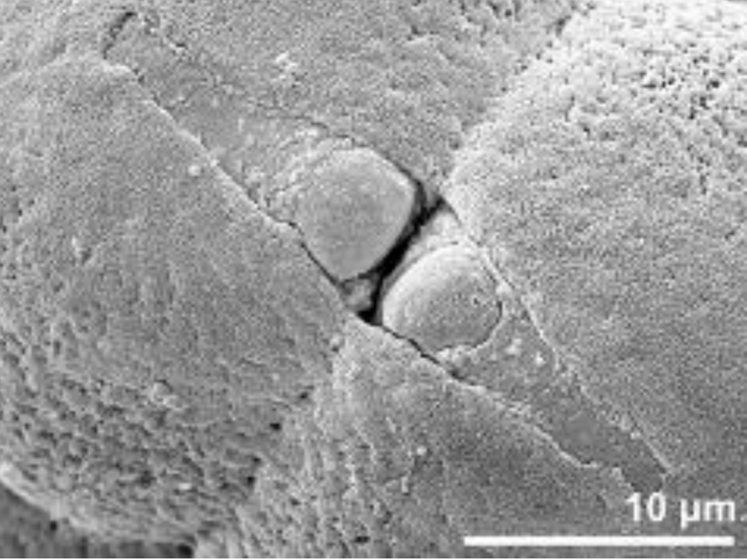
pollen tetrads from
Vaccinium myrtillus
a family character
Notes:
jordan2010.pdf

Slide 12
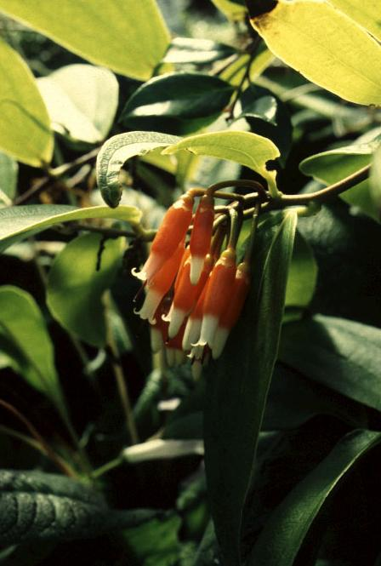
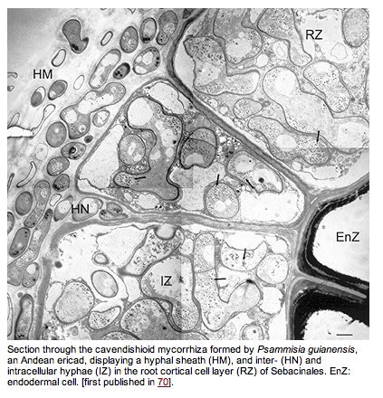
Specialist ectendo-mycorrhizae are key to the success of Ericaceae, tropical and temperate
Psammisia guianensis
Notes:
http://www.mycorrhiza-research.de/Pages/01_04Erica.html

Slide 13
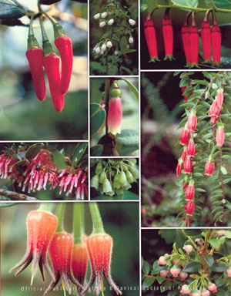
Paphia Vaccinium Macleania
Dimorphanthera
Agapetes
Satyria
Vaccinium
Vaccinium
Ceratostema Vaccinium
Notes:
Floral diversity in the blueberries (Vaccinieae, Ericaceae). Top row from left: Paphia meiniana, Queensland, Australia (photo: K. A. Kron); Vaccinium corymbosum, eastern United States (photo: K. A. Kron); Macleania stricta, Ecuador (photo: J. L. Luteyn). Second row from left: Satyria warszewiczii, Panama (photo: E. A. Powell), upper—Dimorphanthera anchorifera, New Guinea (photo: K. A. Kron), lower—Vaccinium poasanum, Central America (photo: E. A. Powell), Agapetes serpens, Thailand (photo: K. A. Kron). Bottom row from left: Ceratostema lanigerum, Ecuador (photo: K. A. Kron), Vaccinium myrtoides, China (photo: K. A. Kron).

Slide 14
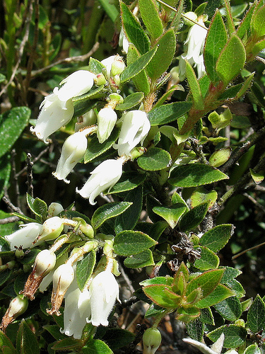
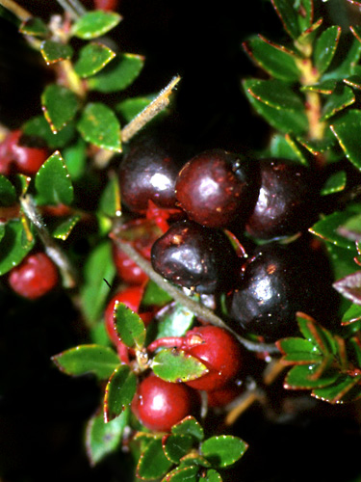
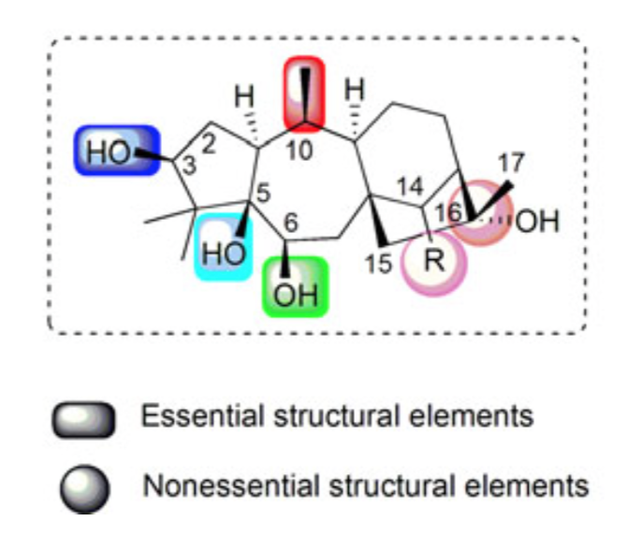
Pernettya
Grayanotoxin
Notes:
Grayanotoxins are toxic compounds contained in the leaves, flowers, pollen and nectar of some plants of the Rhododendron genus (Ericaceae) and in the toxic honey produced from the nectar of these plants.
”toxic effects have been proved to be initiated by binding to sodium channels in cell membranes, thereby increasing the permeability of sodium ions and inhibiting inactivation of sodium channels. The symptoms of grayanoid intoxication includes dizziness, weakness, excessive perspiration, hypersalivation, vomiting, paraesthesia, hypotension and atrial-ventricular block” from ***Li, Y., Liu, Y.B. and Yu, S.S., 2013. Grayanoids from the Ericaceae family: structures, biological activities and mechanism of action. Phytochemistry reviews, 12(2), pp.305-325. li_y2013
Also: Besides their high toxicities, grayanoids were reported to possess various significant bioactivities, such as sodium channel modulating,
[NOTE BOTH ECOLOGICAL AND PHARMACEUTICAL DIMENSIONS FOLLOWING HERE] analgesic, sedative,
insecticidal and antifeeding activities.
Cortés Casas, J.Y., 2009. Estudio químico de frutos de Pernettya prostrata (Cavan) Sleumer y su evaluación en la producción de hipercalcemia [on line] En la fraccion cloroformo del extracto etanólico se obtuvo un terpeno posiblemente del tipo grayanotoxina al ser comparado con el patrón diterpeno, y al dar positivo la prueba de Godin.
El consumo de fruto de Pernettya prostrata produjo aumento de calcio en suero sanguíneo en las ratas utilizadas, pensándose que es producto de la posible grayanotoxina presente en el fruto.

Slide 15
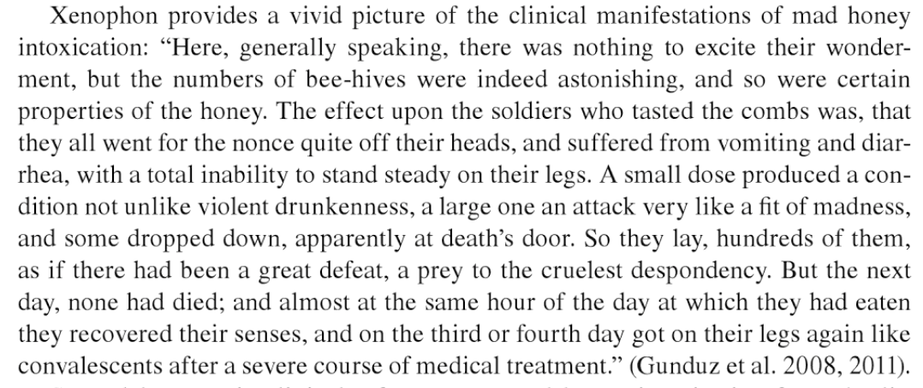
Grayanoids, foundexclusively in Ericaceae plants, are well-known highly toxic compounds. In 1960s, the term ‘‘grayanotoxin’’ was bestowed on this family of diterpenes after Leucothoe grayana, which has a wide array of these compounds.
Toxic effects of grayanotoxins have been proved to be initiated by binding to sodium channels in cell membranes, thereby increasing the permeability of sodium ions and inhibiting inactivation of sodium channels. The symptoms of grayanoid intoxication includes dizziness, weakness, excessive perspiration, hypersalivation, vomiting, paraesthesia, hypotension and atrial-ventricular block.
Notes:
Gunduz, A. and Ayaz, F.A., 2013. 16 Mad Honey. Honey in Traditional and Modern Medicine, p.359.

Slide 16
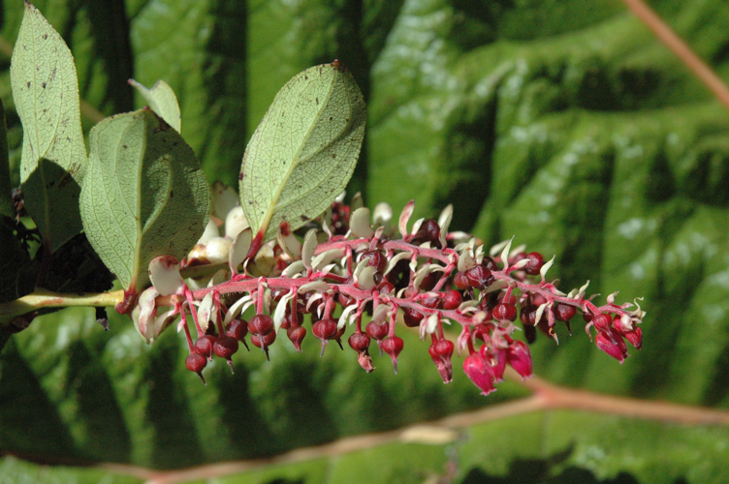
Gaultheria

Slide 17
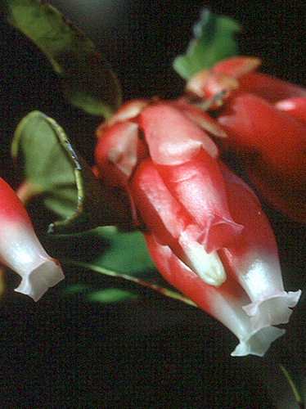
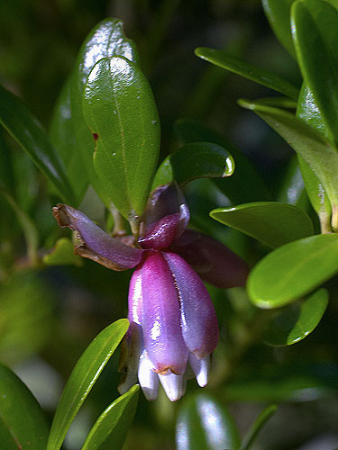
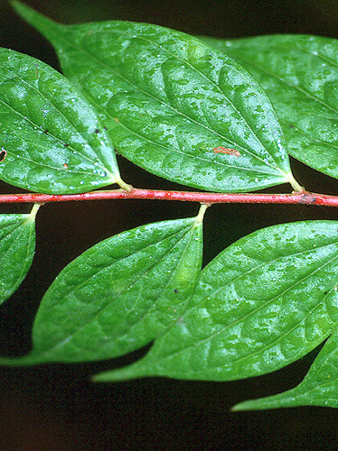
Cavendishia
Note arcuate veins, common
In the family
Notes:
red: Cavendishia bracteata
FAMILY: ERICACEAE
Country: Panamá
Photo ID. Code: guerra
© Photo: Marcos Guerra
det. J. L. Luteyn
purple:
Cavendishia capitulata
FAMILY: ERICACEAE
Country: Costa Rica
Photo ID. Code: shol9807
© Photo: Sune Holt

Slide 18
Ceratostema

Slide 19
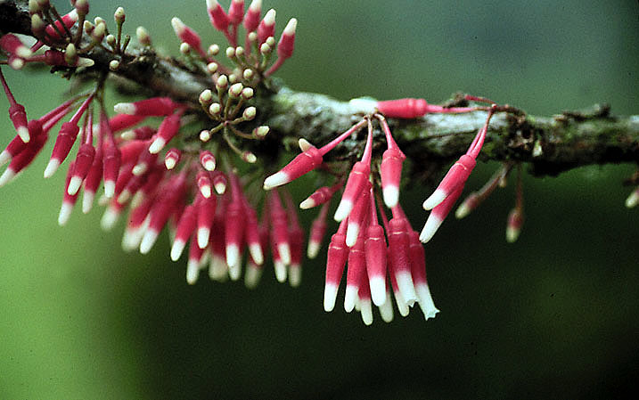
Satyria

Slide 20
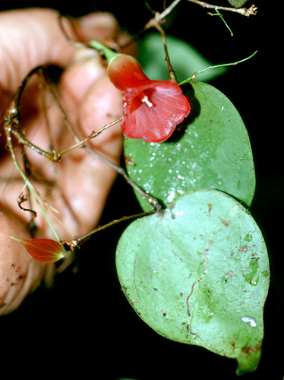
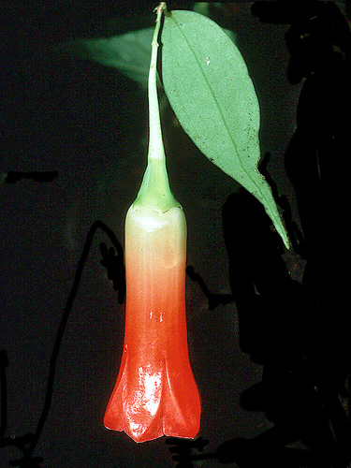
Semiramisia
Notes:
Semiramisia –sp. nov.
FAMILY: ERICACEAE
Country: Ecuador
Photo ID. Code: 21707
© Photo: Robin Foster
det. J. L. Luteyn
single flower:
Semiramisia speciosa
FAMILY: ERICACEAE
Country: Perú
Photo ID. Code: 8693
© Photo: Barbara L. Clauson
det. J. L. Luteyn

Slide 21
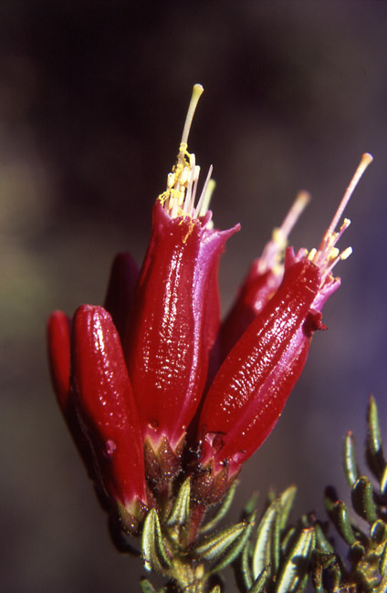
Befaria
Notes:
Befaria resinosa (Ericaceae), Pegamosco - Parque Distrital Entrenubes, Bogota DC, Colombia - Catalina Giraldo 2003 ©

Slide 22

Anthopterus
Notes:
Anthopterus wardii
FAMILY: ERICACEAE
Country: Colombia
Photo ID. Code: 3605
© Photo: Robin Foster

Slide 23

Luteyn, 2002: diversity of the family Ericaceae in the Andes

Slide 24





Dracophyllum-type pollen (Ericipites longisulcatus), remaining in a tetrad as is typical of the Ericaceae, with the colpae matched up.
Vaccinium myrtillus
Cyathodes map
from Newvale Mine, NZ (Late Oligocene to Early Miocene). Jordan et al. 2010
from living Ericaceae
Oligocene-Early Miocene Cyathodophyllum novae-zelandiae
living Cyathodes glauca
Notes:
Jordan, G.J., Bannister, J.M., Mildenhall, D.C., Zetter, R. and Lee, D.E., 2010. Fossil Ericaceae from New Zealand: deconstructing the use of fossil evidence in historical biogeography. American Journal of Botany, 97(1), pp.59-70.
Wagstaff, S.J., Dawson, M.I., Venter, S., Munzinger, J., Crayn, D.M., Steane, D.A. and Lemson, K.L., 2010. Origin, diversification, and classification of the Australasian genus Dracophyllum (Richeeae, Ericaceae) 1. Annals of the Missouri Botanical Garden, 97(2), pp.235-258.

Slide 25



Dracophyllum
Richea
Sphenotoma
Notes:
Jordan, G.J., Bannister, J.M., Mildenhall, D.C., Zetter, R. and Lee, D.E., 2010. Fossil Ericaceae from New Zealand: deconstructing the use of fossil evidence in historical biogeography. American Journal of Botany, 97(1), pp.59-70.
Wagstaff, S.J., Dawson, M.I., Venter, S., Munzinger, J., Crayn, D.M., Steane, D.A. and Lemson, K.L., 2010. Origin, diversification, and classification of the Australasian genus Dracophyllum (Richeeae, Ericaceae) 1. Annals of the Missouri Botanical Garden, 97(2), pp.235-258.

Slide 26
Late Oligocene to Early Miocene
These fossils emphasize the fact that at least some of the fossil pollen of Ericaceae
may have been derived from extinct lineages and therefore should not be used as evidence for the antiquity of any modern
New Zealand clade of Ericaceae.
Notes:
Jordan, G.J., Bannister, J.M., Mildenhall, D.C., Zetter, R. and Lee, D.E., 2010. Fossil Ericaceae from New Zealand: deconstructing the use of fossil evidence in historical biogeography. American Journal of Botany, 97(1), pp.59-70.
Wagstaff, S.J., Dawson, M.I., Venter, S., Munzinger, J., Crayn, D.M., Steane, D.A. and Lemson, K.L., 2010. Origin, diversification, and classification of the Australasian genus Dracophyllum (Richeeae, Ericaceae) 1. Annals of the Missouri Botanical Garden, 97(2), pp.235-258.

Slide 27
ERICACEAE
alternate, simple leaves with arcuate veins
stamens 2x petals
inverted stamens
poricidal anthers
5-carpellate, many seeds

Slide 28
Set aside

Slide 29

These last two slide are drafts of phylogeny within the family for future development.

Slide 30
Monotropoideae
Staphyleoideae
Pyroloideae
Vaccinioideae
Ericoideae
Includes all Ericaceae with inferior ovaries
As well as Pernettya, nested within Gaultheria; may be sister to the inferior-ovary group
Includes Rhododendron, Empetraceae, Epigaea, Calluna, Erica, Kalmia
After Kron et al. 2002

