Slide 1
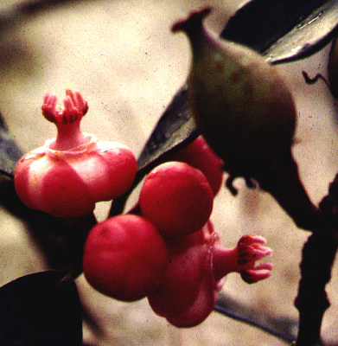
CLUSIACEAE

Slide 2
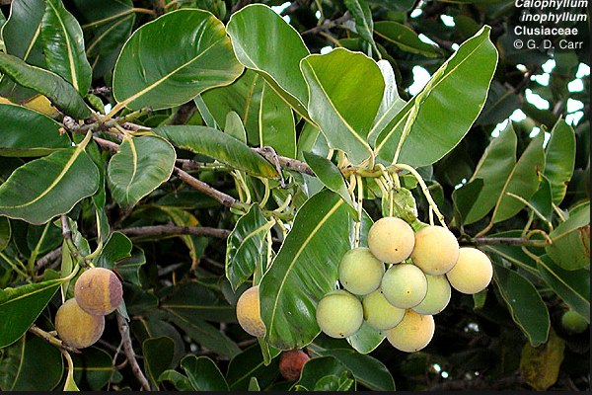
KEY CHARACTERS for the CLUSIACEAE
Opposite simple leaves
Latex, often yellow
Petioles hide shoot apex
Numerous stamens
Styles absent
Calophyllum

Slide 3
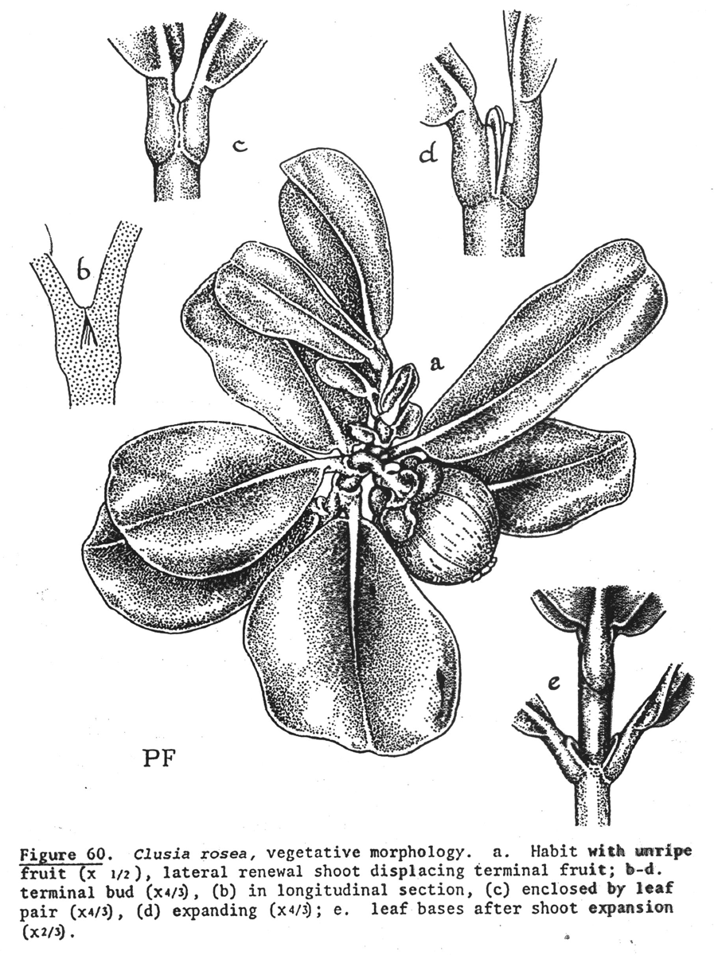
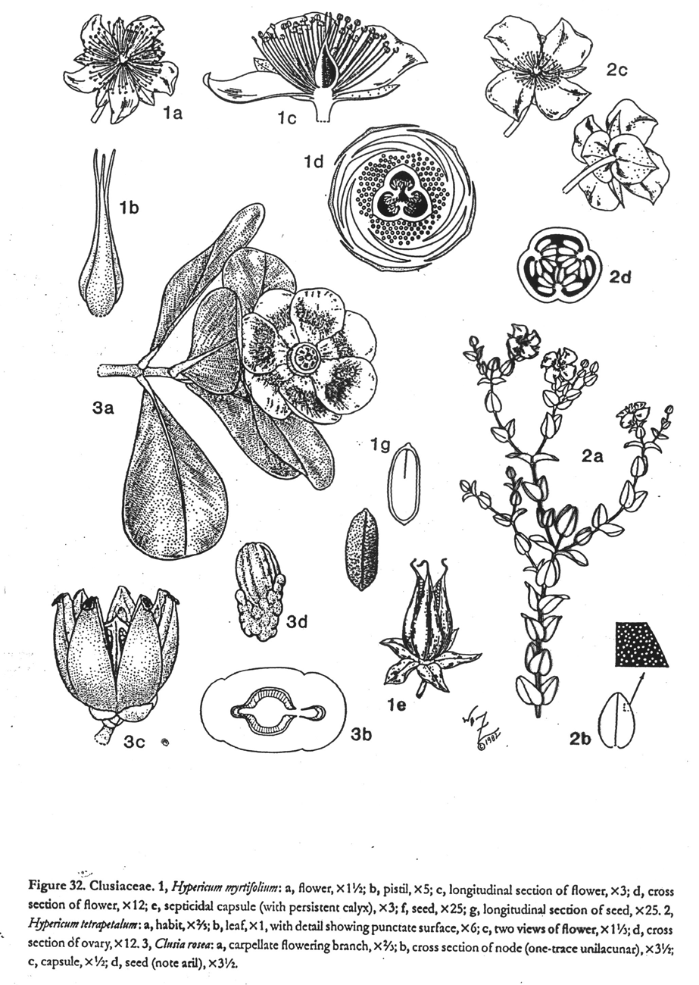
Opposite simple leaves, latex (often yellow), petioles hide shoot apex, numerous stamens, styles absent

Slide 4
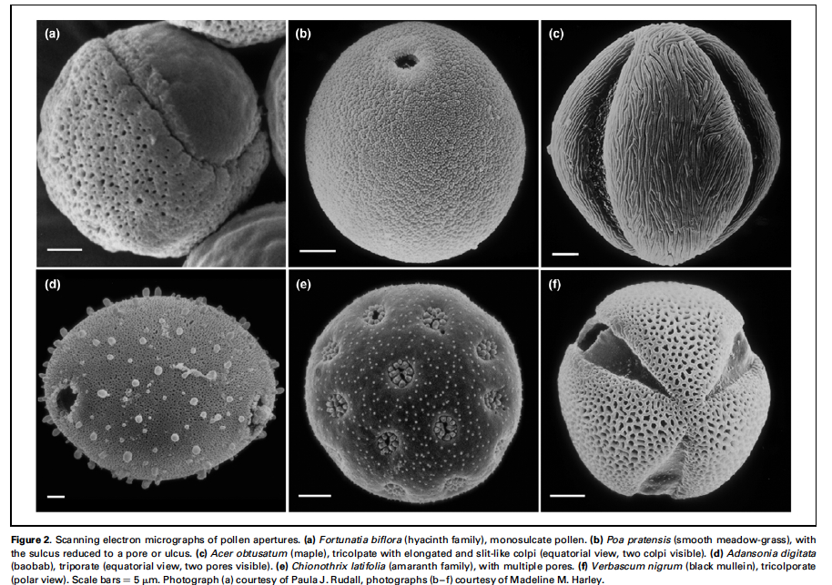
EUDICOTS,
CORE EUDICOTS

Slide 5
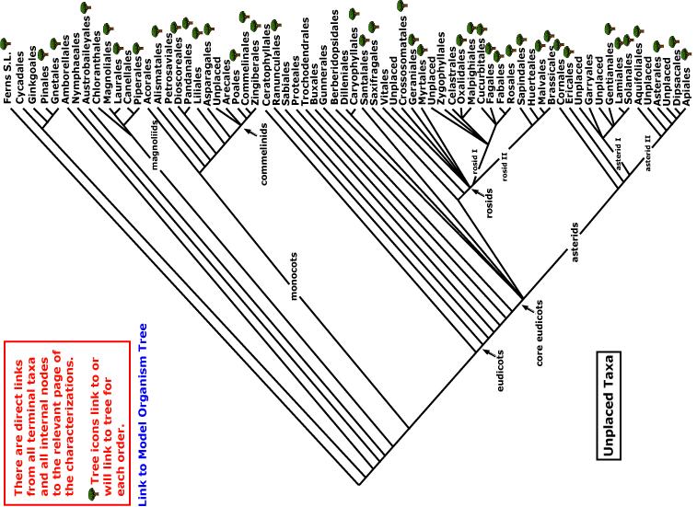
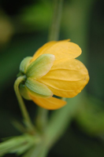
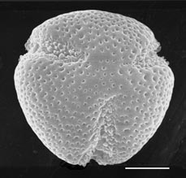
Current Angiosperm Phylogeny Group Tree for Flowering Plants

Slide 6
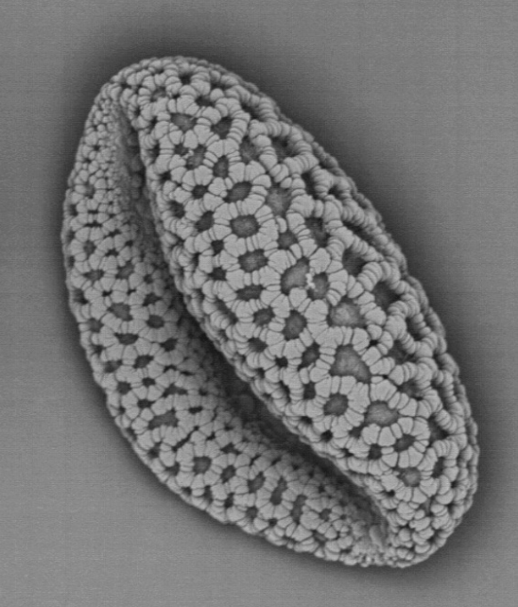
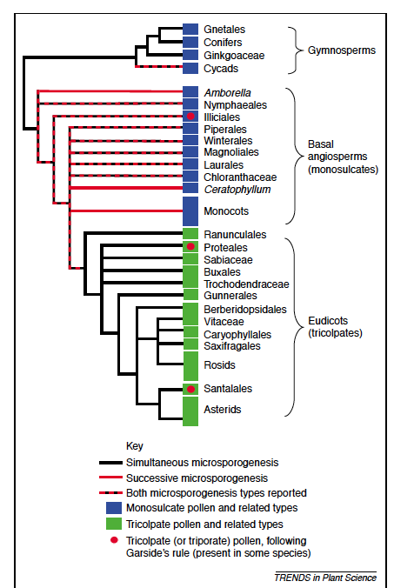
The pattern of pollen types in angiosperms
monosulcate
trisulcate etc.
Furness & Rudall, 2004
Notes:
In Viola, pollen with few apertures has a better survival rate, whereas pollen with more apertures germinates faster. More apertures, more flexibility.
Dajoz, I., Till-Bottraud, I. and Gouyon, P.-H. 1993. Pollen aperture polymorphism and
gametophyte performance in Viola diversifolia. Evolution, 47: 1080–1093.

Slide 7
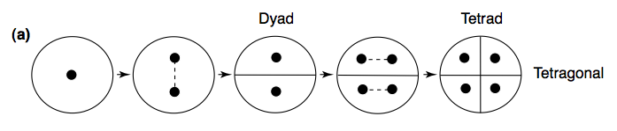
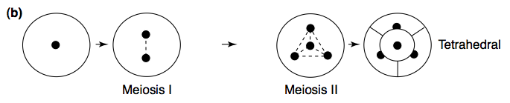
Successive sporogenesis, yielding monosulcate pollen
Simultaneous sporogenesis, yielding tricolpate pollen
Furness & Rudall, 2004
Notes:
furness2004.pdf

Slide 8
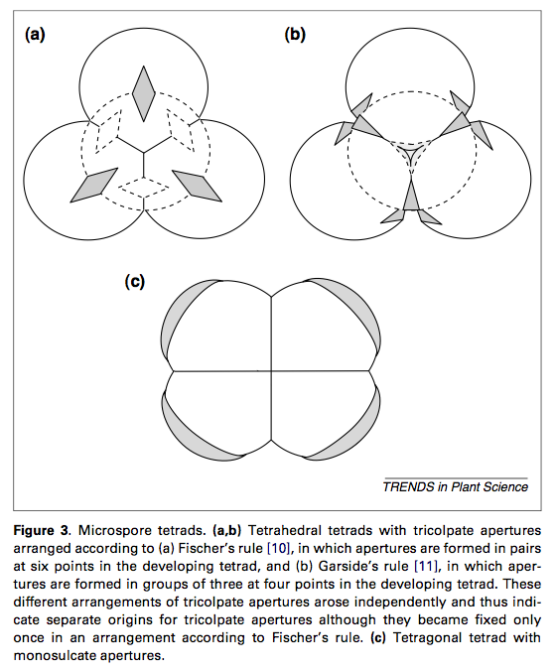
In Viola, pollen with few apertures has a better survival rate, whereas pollen with more apertures germinates faster. More apertures, more flexibility.
Dajoz
Fischer’s rule tricolpates Garside’s-rule tricolpates
Monosulcates
Furness & Rudall, 2004
Notes:
In Viola, pollen with few apertures has a better survival rate, whereas pollen with more apertures germinates faster. More apertures, more flexibility.
Dajoz, I., Till-Bottraud, I. and Gouyon, P.-H. 1993. Pollen aperture polymorphism and
gametophyte performance in Viola diversifolia. Evolution, 47: 1080–1093.

Slide 9
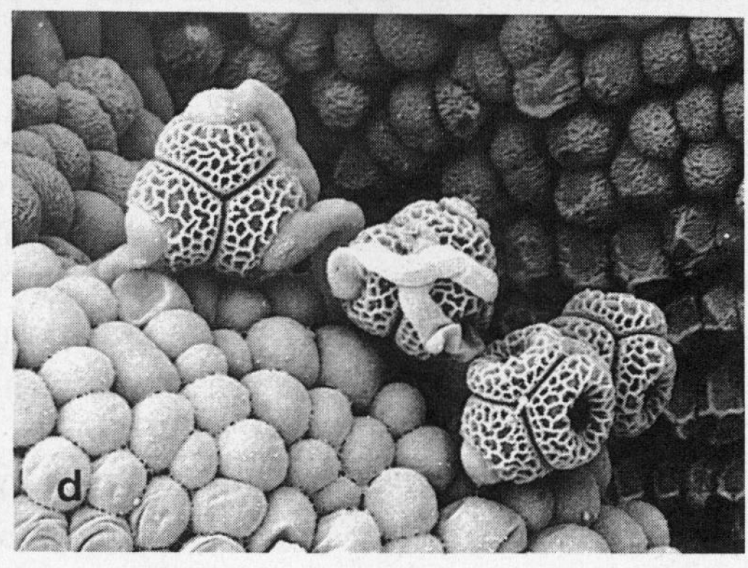
Monosulcate pollen, still in tetrads, germinating on a stigma.
Pseudowintera, Winteraceae
Notes:
lloyd1992.pdf
n.wikipedia.org/wiki/Pseudowintera_colorata

Slide 10
In Viola, pollen with few apertures has a better survival rate, whereas pollen with more apertures germinates faster. More apertures, more flexibility. (Dajoz et al., 1993)
Notes:
Dajoz, I., Till-Bottraud, I. and Gouyon, P.-H. 1993. Pollen aperture polymorphism and
gametophyte performance in Viola diversifolia. Evolution, 47: 1080–1093.

Slide 11
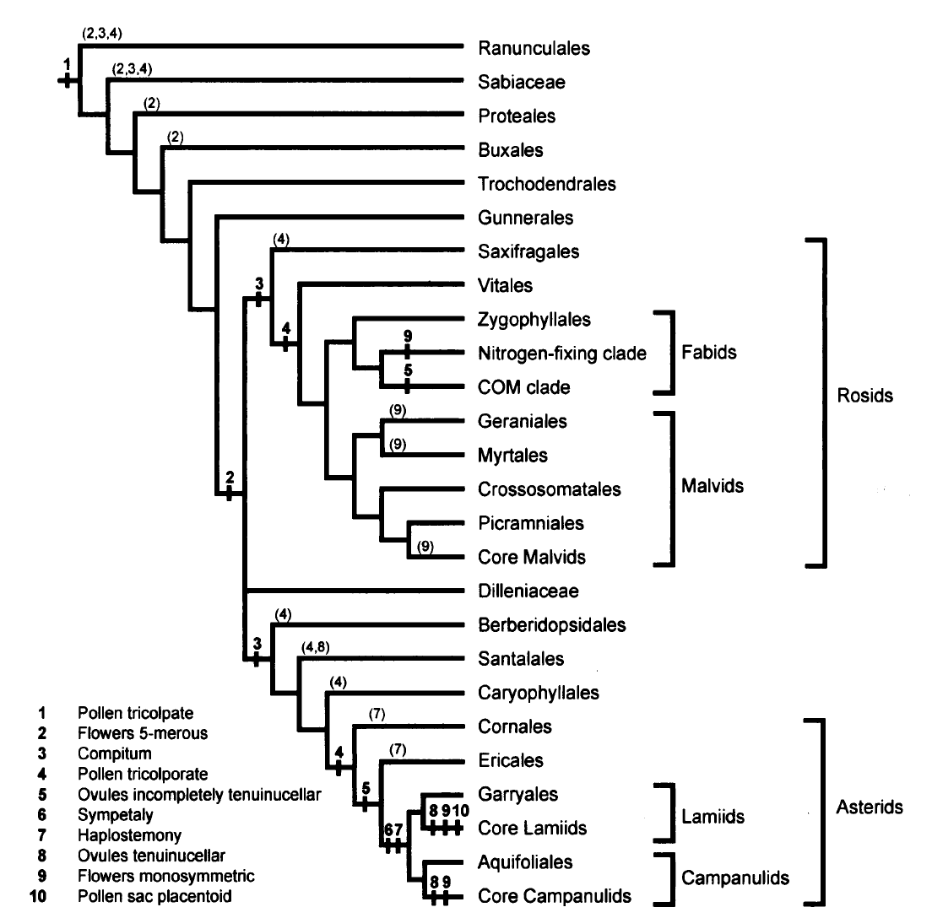
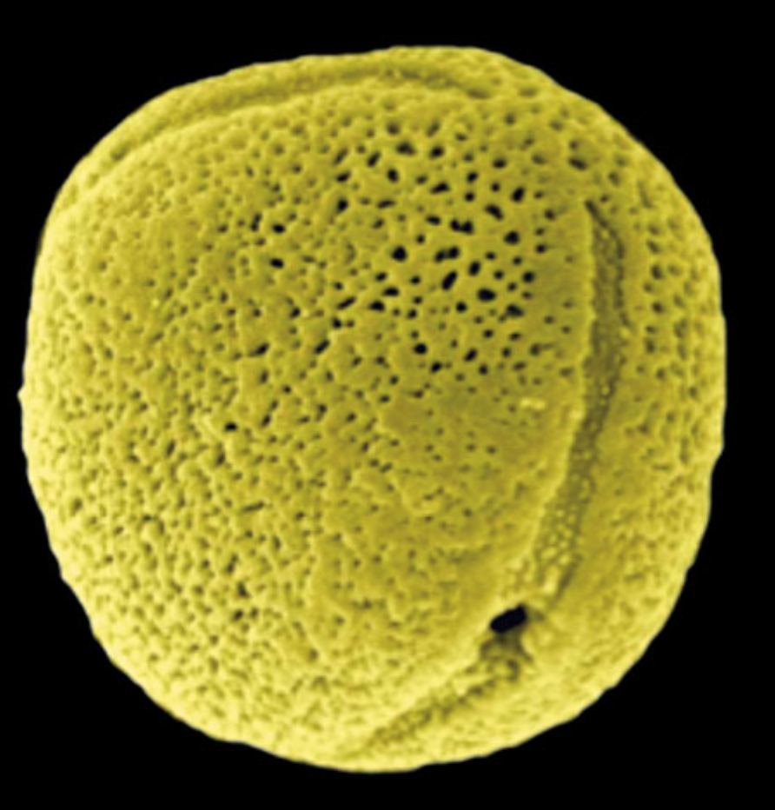
Endress’s Key Innovations in Eudicots
Endress, 2010
key innocations: numbers in bold
occurrence but not as key innovations: numbers in parentheses
Notes:
Endress, P.K., 2010. Flower Structure and Trends of Evolution in Eudicots and Their Major Subclades 1. Annals of the Missouri Botanical Garden, 97(4), pp.541-583.

Slide 12
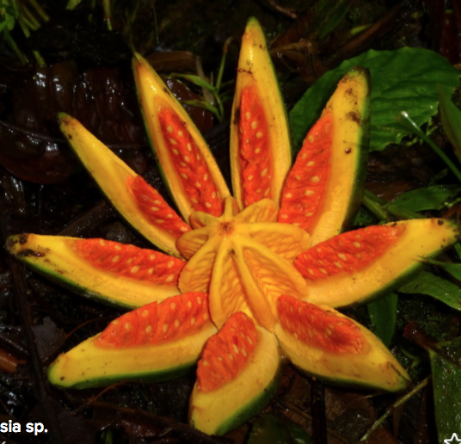
PHYLOGENY

Slide 13
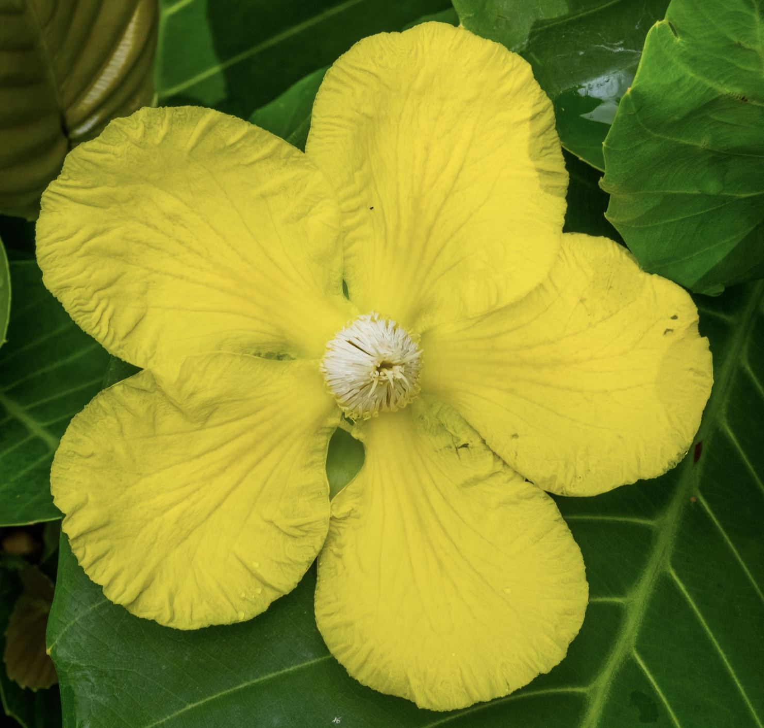

rosids
core eudicots
eudicots
magnoliids
asterids
pentamerae
monocots
Basic Landmarks in Navigating the eudicots
CLUSIACEAE

Slide 14

eurosids I
rosids
core eudicots
eudicots
magnoliids
monocots
And zeroing in on the Clusiaceae
CLUSIACEAE

Slide 15
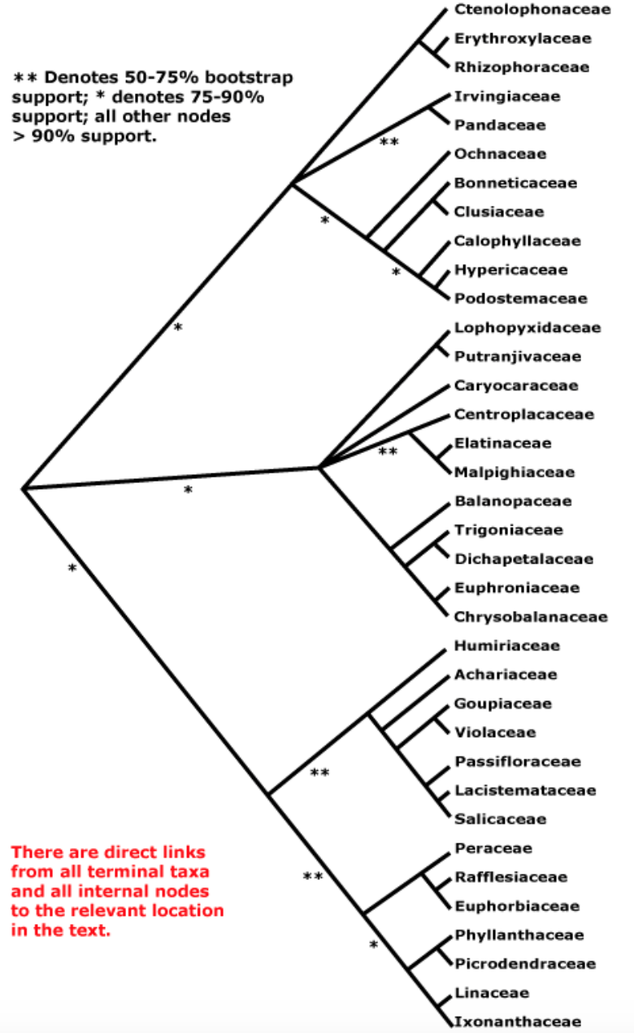
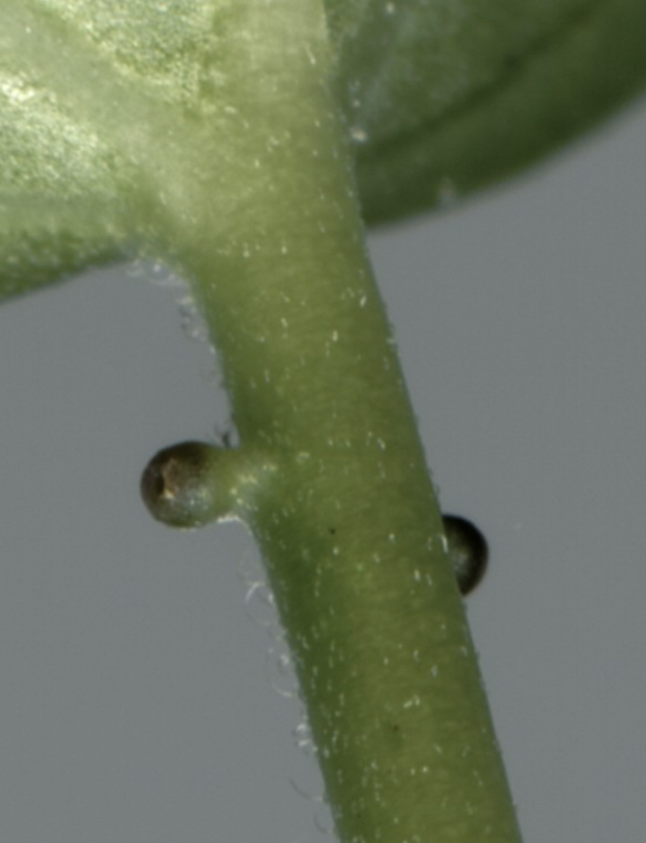
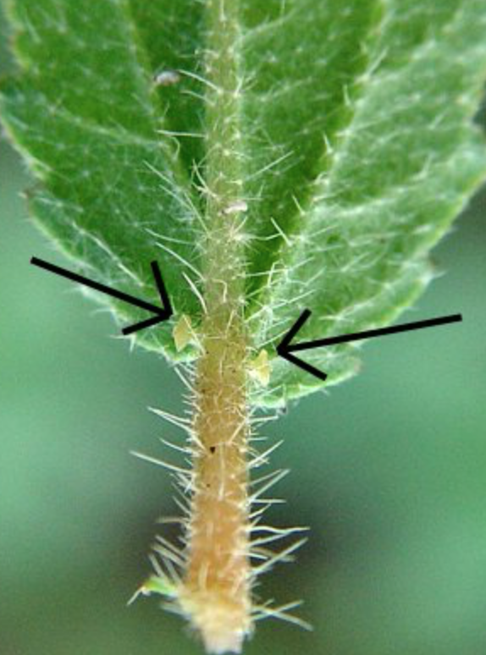
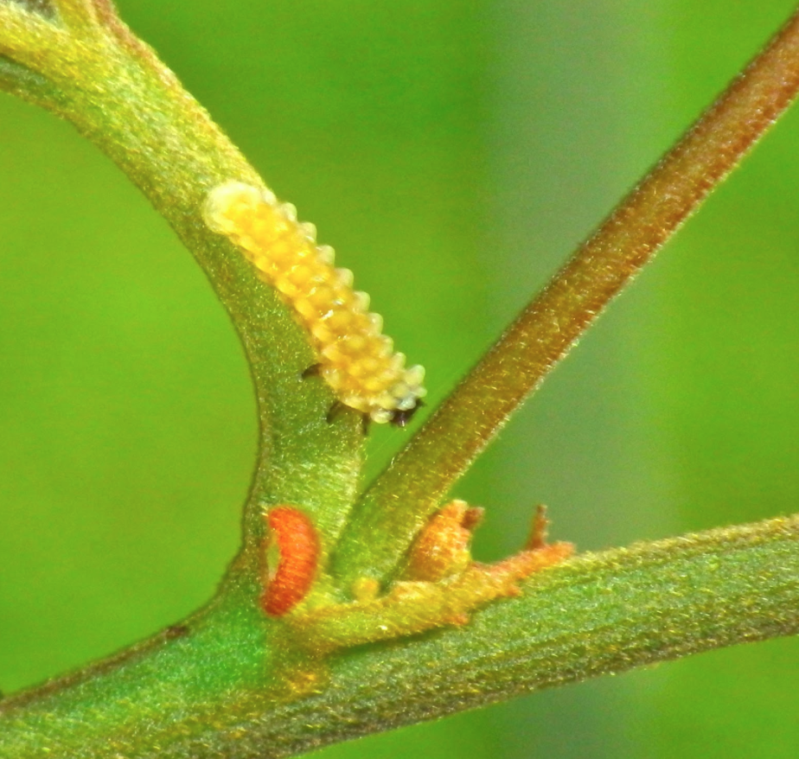
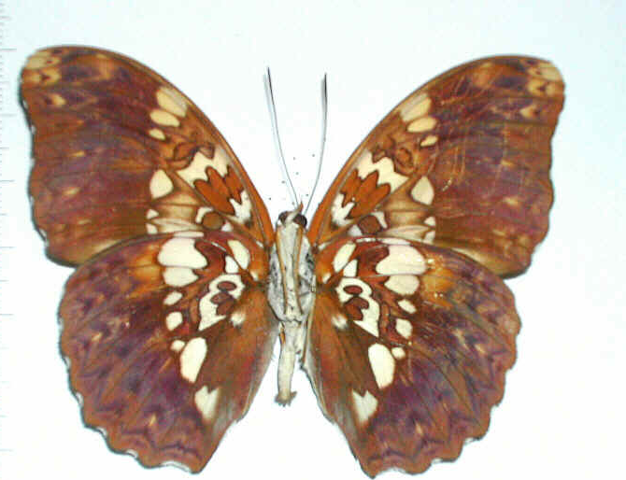
CLUSIACEAE,
Malpighiales (the home of leaf glands)
Cymothoë likes Malpighiales: its allies are all Rosid specialists and mostly eurosids I specialists.
Notes:
Cymothoë likes Malpighiales: its allies are all Rosid specialists and mostly eurosids I specialists.

Slide 16
ECOLOGY

Slide 17
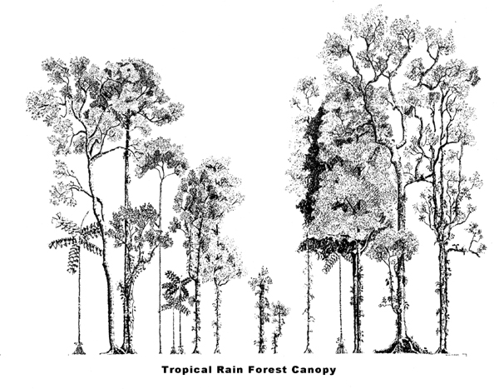
CLUSIACEAE - treelets and stranglers

Slide 18
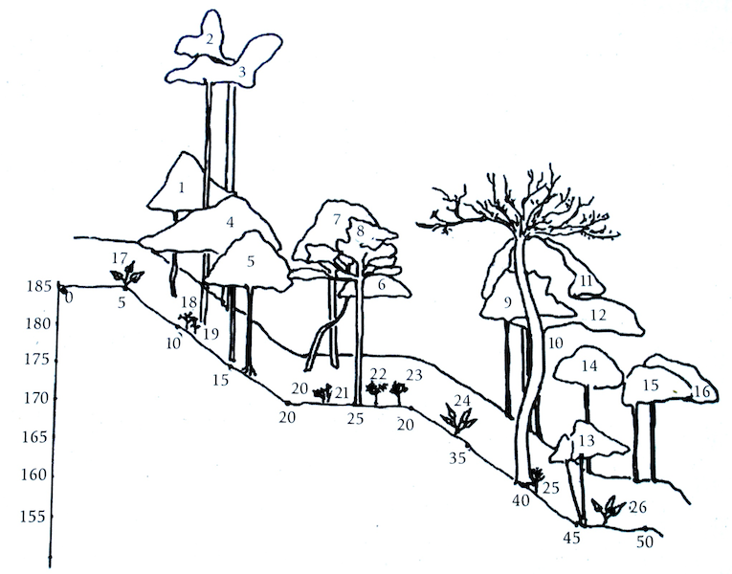
Clusiaceae in a Golfito profile:
2, 5, 20, 24
Notes:
Apocynaceae Lacmellea
Clusiaceae Callophyllum
Mimosoid legume: Inga
Myristicaceae Compsoneura
Clusiaceae Symphonia
Moraceae Brosimum
Legume
Anacardiaceae Spondias
Rubiaceae
Caesalpiniod legumee Schizolobium
Anacardiaceae Spondias
Rutaceae Zanthoxylum
Moraceae Sorocea
Salicaceae Tetrathylacium
Salicaceae Tetrathylacium
Olacaceae Heisteria
Heliconiaceae Heliconia
Annonaceae
Marantaceae Calathea
Clusiaceae Callophyllum
Arecaceae Chamaedoria
Piperacea Piper
Cycadaceae Zamia
Arecaceae Chamaedoria
Clusiaceae Garcinia
Araceae Anthurium

Slide 19
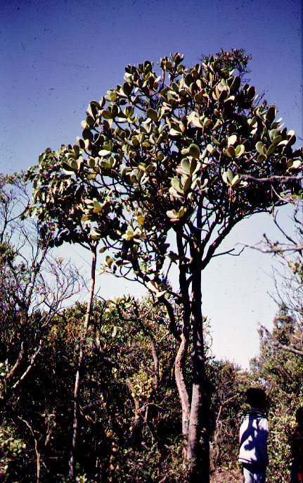
Clusia as a treelet (in montane rain forest near treeline - dwarf or elfin forest
Notes:
Anti-bacterial function in the sexually dimorphic pollinator rewards of Clusia grandiflora (Clusiaceae)Auteur(s) / Author(s)LOKVAM J. ⁽¹⁾ ; BRADDOCK J. F. ⁽¹⁾ ;Affiliation(s) du ou des auteurs / Author(s) Affiliation(s)⁽¹⁾ Institute of Arctic Biology, University of Alaska Fairbanks, Fairbanks, AK 99775, ETATS-UNISRésumé / AbstractMany species of the dioecious, neo-tropical plant genus Clusia secrete a viscous, hydrophobic resin from glandular tissues in both male and female flowers. This substance is readily gathered by meliponine and euglossine bees for whom it most often serves as the sole pollinator reward. Bees use Clusia resin as a nest-building material. As such, resin clearly serves an indispensable mechanical function. However, resins with antimicrobial properties may also serve to reduce the risk of pathogenesis in the nest. If resin-gathering apids benefit from antimicrobial properties in nesting materials and are able to discern these characteristics in the forage they gather, one might predict that the resin reward presented in Clusia could have evolved under selection for both mechanical and antimicrobial properties. In dioecious species, where females and males each present a resin reward, selection regimes may differ between the sexes with the result that resin form and function diverge. We investigated both the form and function of the male and female pollinator reward resins of Clusia grandiflora. Using thin-layer chromatography (TLC), we compared the chemical compositions of floral resins from five widely separated populations of this species growing in southeastern Venezuela. We found that male and female resins exhibited a marked chemical dimorphism, with females having two major TLC-resolvable fractions and males having seven. This dimorphism was stable: there were no component differences between populations in either sex. Using a disk-diffusion technique, we surveyed the same resins for antimicrobial activity using assay microorganisms isolated from eusocial meliponine bees. Both male and female Clusia grandiflora resins had pronounced but relatively directed antimicrobial activity: both were toxic to 10 of 11 Gram-positive bacteria, 7 of 15 Gram-negative or variably-staining bacteria, 0 of 3 yeasts, and 0 of 3 filamentous fungi. Again with the disk-diffusion technique, we performed more detailed tests of resin bioactivity using two Gram-positive honeybee associates, Paenibacillus larvae and P. alvei, as model pathogens. Both male and female C. grandiflora resins were highly toxic to these honeybee pathogens. Female resin, however, produced zones of inhibition with more than twice the mean diameter of those produced by the male resin. This divergence in form and function of the C. grandiflora pollinator reward resins could be in response to different selective regimes as mediated by the pollinating insects.Revue / Journal TitleOecologia (Oecologia) ISSN 0029-8549 CODEN OECOBXSource / Source1999, vol. 119, nº4, pp. 534-540 (24 ref.)

Slide 20
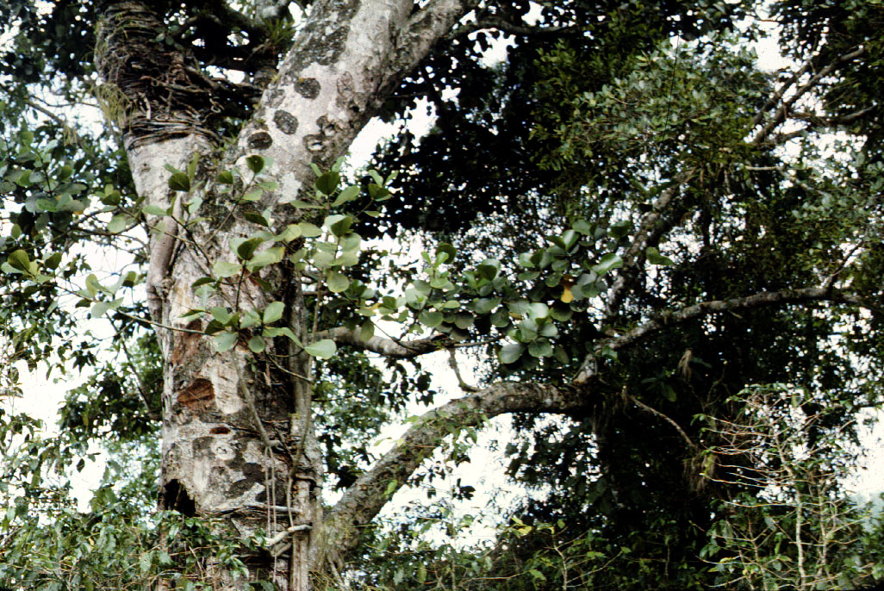
Clusia as a strangler

Slide 21
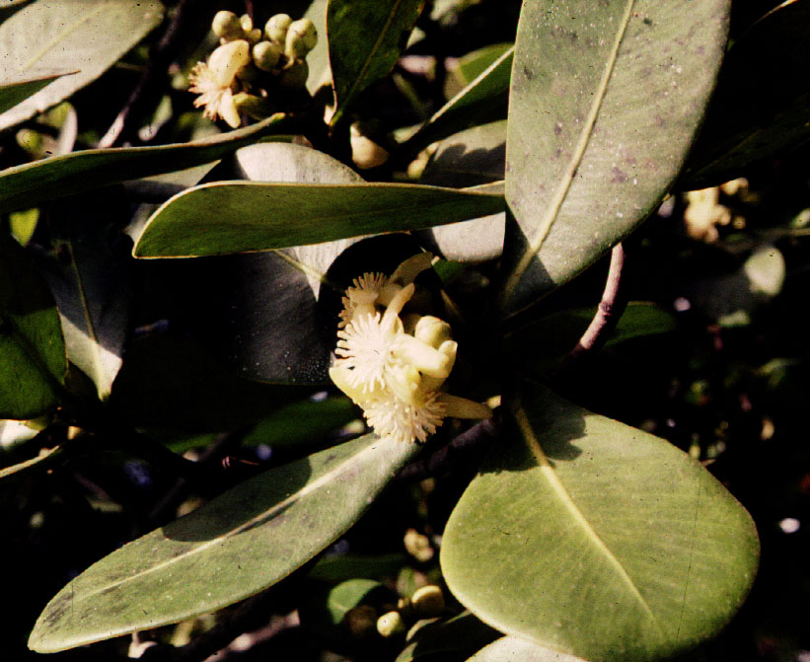
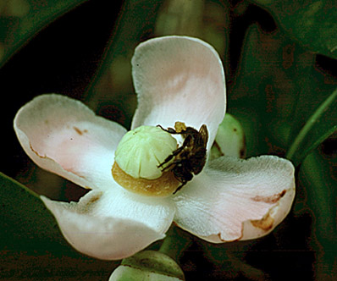
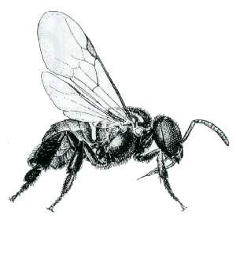
Clusia - dioecious, offers resin rewards for stingless bees.
Trigona - a meliponine bee
Notes:
SILMARY DE JESUS GONÇALVES-ALVIM (2001), Resin-collecting bees (Apidae) on Clusia palmicida (Clusiaceae) in a riparian forest in Brazil Journal of Tropical Ecology 17: 149-153.
Primary flower resources to bees, i.e. those that satisfy basic needs, such as feeding and reproduction (Faegri & van der Pijl 1979), include pollen, nectar, oil, resin and gums. Resins are used in nest construction as a waterproof and structural material (Simpson & Neff 1981). It is also excellent antimicrobial compound, and a sticky defence against ant attacks (Armbruster 1984, Dressler 1982, Lokvam & Braddock 1999, Michener 1990, Roubik 1989, Sakagami et al. 1989). Plant species with flowers which produce terpenoid resins are rare (Armbruster & Webster 1979). Clusia L. (Clusiaceae), Clusiella Planch. & Triana (Clusiaceae), and Dalechampia L. (Euphorbiaceae) are the only known plants that secrete resins from floral structures (Armbruster 1984, Armbruster & Webster 1979, Bittrich & Amaral 1996). Although resin-producing plants provide an essential resource for a large number of bees in tropical communities, there are few studies about resin-collecting bees on Clusia spp. Skutch (1971) was the first to report visits on Clusia by stingless bees to collect floral resin. Other reports include observations on C. odorata Seem. (Croat 1978, Ramirez & Gomez 1978), C. alata Pl. & Tr. (Ramirez & Gomez 1978), and C. nemorosa G. F. W. Meyer (Armbruster 1984, Bittrich & Amaral 1996, Lopes & Machado 1998, Mesquita & Fransciscon 1995). Recently, Bittrich & Amaral (1996, 1997) have described the flower morphology and pollination biology of other Clusia species from Central America and Venezuela.

Slide 22
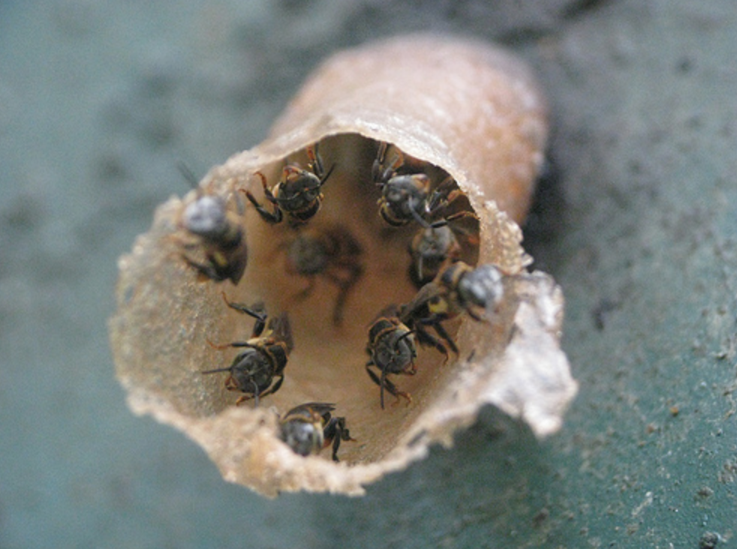

Slide 23
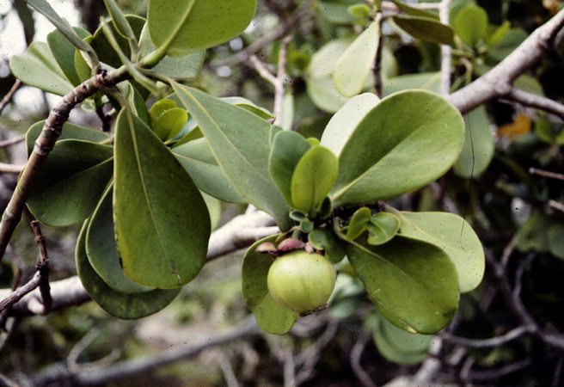
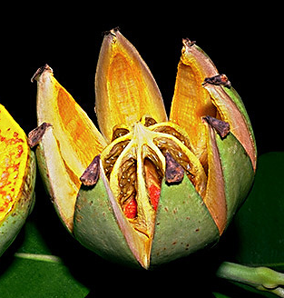
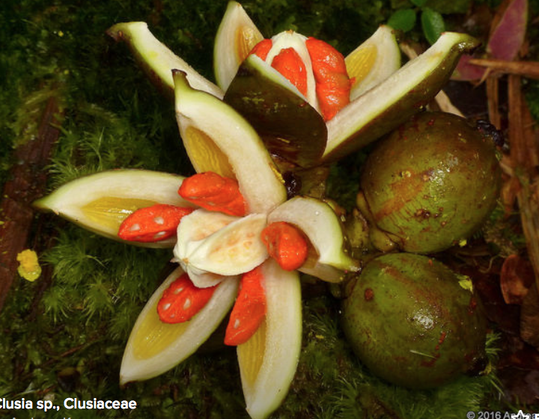
Clusia, bird-dispersed with arils as attractants.
Notes:
SILMARY DE JESUS GONÇALVES-ALVIM (2001), Resin-collecting bees (Apidae) on Clusia palmicida (Clusiaceae) in a riparian forest in Brazil Journal of Tropical Ecology 17: 149-153.
Primary flower resources to bees, i.e. those that satisfy basic needs, such as feeding and reproduction (Faegri & van der Pijl 1979), include pollen, nectar, oil, resin and gums. Resins are used in nest construction as a waterproof and structural material (Simpson & Neff 1981). It is also excellent antimicrobial compound, and a sticky defence against ant attacks (Armbruster 1984, Dressler 1982, Lokvam & Braddock 1999, Michener 1990, Roubik 1989, Sakagami et al. 1989). Plant species with flowers which produce terpenoid resins are rare (Armbruster & Webster 1979). Clusia L. (Clusiaceae), Clusiella Planch. & Triana (Clusiaceae), and Dalechampia L. (Euphorbiaceae) are the only known plants that secrete resins from floral structures (Armbruster 1984, Armbruster & Webster 1979, Bittrich & Amaral 1996). Although resin-producing plants provide an essential resource for a large number of bees in tropical communities, there are few studies about resin-collecting bees on Clusia spp. Skutch (1971) was the first to report visits on Clusia by stingless bees to collect floral resin. Other reports include observations on C. odorata Seem. (Croat 1978, Ramirez & Gomez 1978), C. alata Pl. & Tr. (Ramirez & Gomez 1978), and C. nemorosa G. F. W. Meyer (Armbruster 1984, Bittrich & Amaral 1996, Lopes & Machado 1998, Mesquita & Fransciscon 1995). Recently, Bittrich & Amaral (1996, 1997) have described the flower morphology and pollination biology of other Clusia species from Central America and Venezuela.

Slide 24
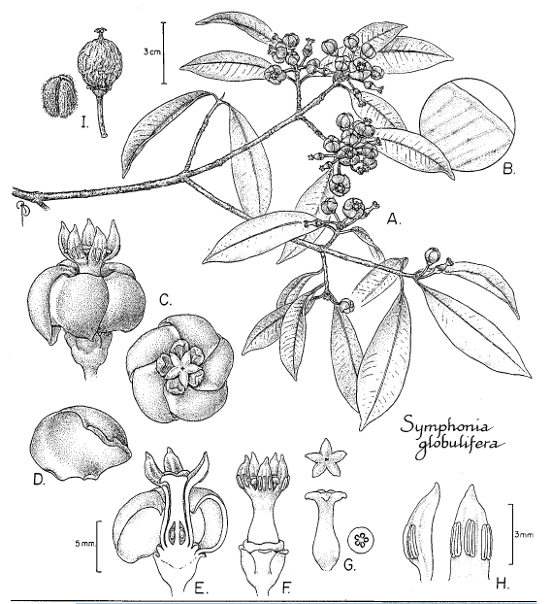
Notes:
From Gill et al 1998

Slide 25
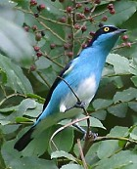
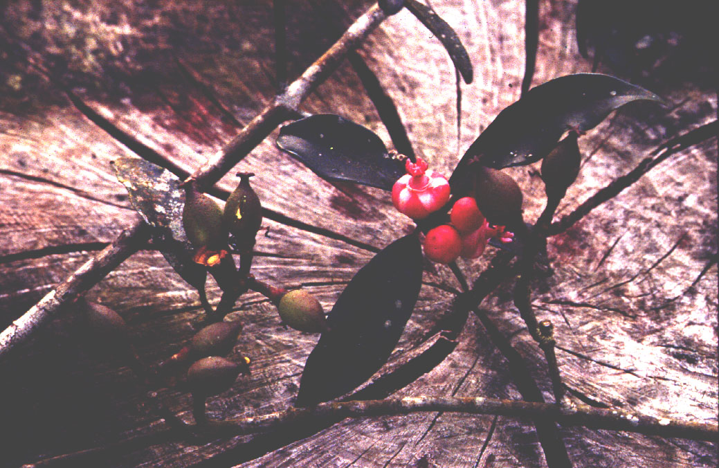
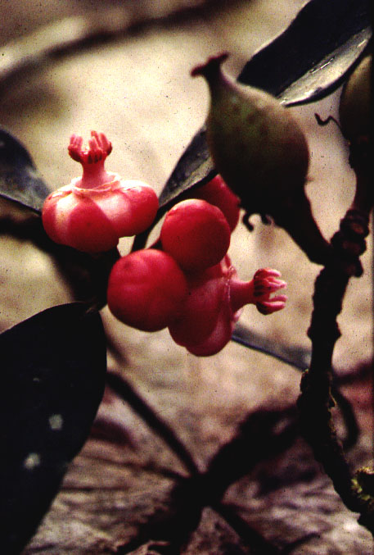
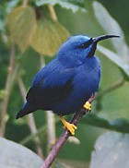
black-faced dacnis
Symphonia - the peppermint candy flower
blue honeycreeper
Notes:
Gill et al. 1998. Biotropica Recent reports on the pollination of Symphonia globulifera L. f. (Clusiaceae) have not clearly established the relative importance of hummingbirds and perching birds in the pollination of this species. Pascarella (1992) observed that hummingbirds visit the flowers of S. globulifera in Costa Rica, but he concluded that hummingbirds are probably nectar robbers and not pollinators. He suggested that other visitors, particularly Lepidoptera, may be the pollinators. In contrast, Bittrich and Amaral (1996) suggested, with some reservation, that in central Amazonian Brazil S. globulifera is pollinated mainly by hummingbirds. The purpose of this note is to demonstrate that perching birds play an important role in the pollination of S. globulifera, at least in central French Guiana.

Slide 26
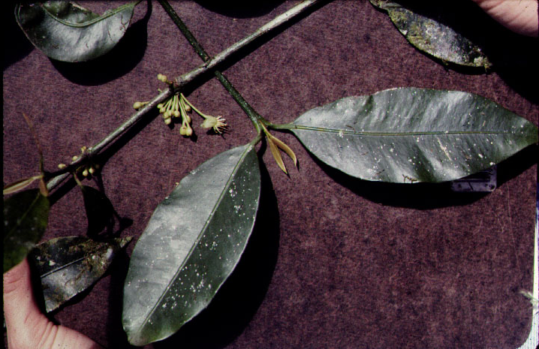
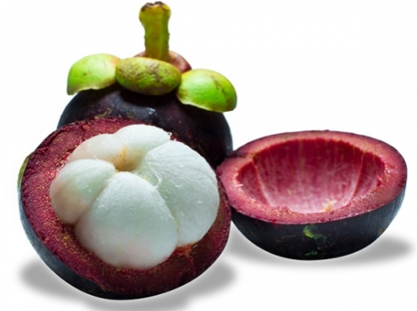
Garcinia - largely Old World, including the mangosteen

Slide 27
KEY CHARACTERS for the CLUSIACEAE
Opposite simple leaves
Latex, often yellow
Petioles hide shoot apex
Numerous stamens
Styles absent
Calophyllum

Slide 28
Notes:
For herbivore data see Ackery 1988 Hostplants and classification: a review of
nymphalid butterflies. Biological Journal ofthe Linnean Society (1988). 33: 95-203 .

Slide 29
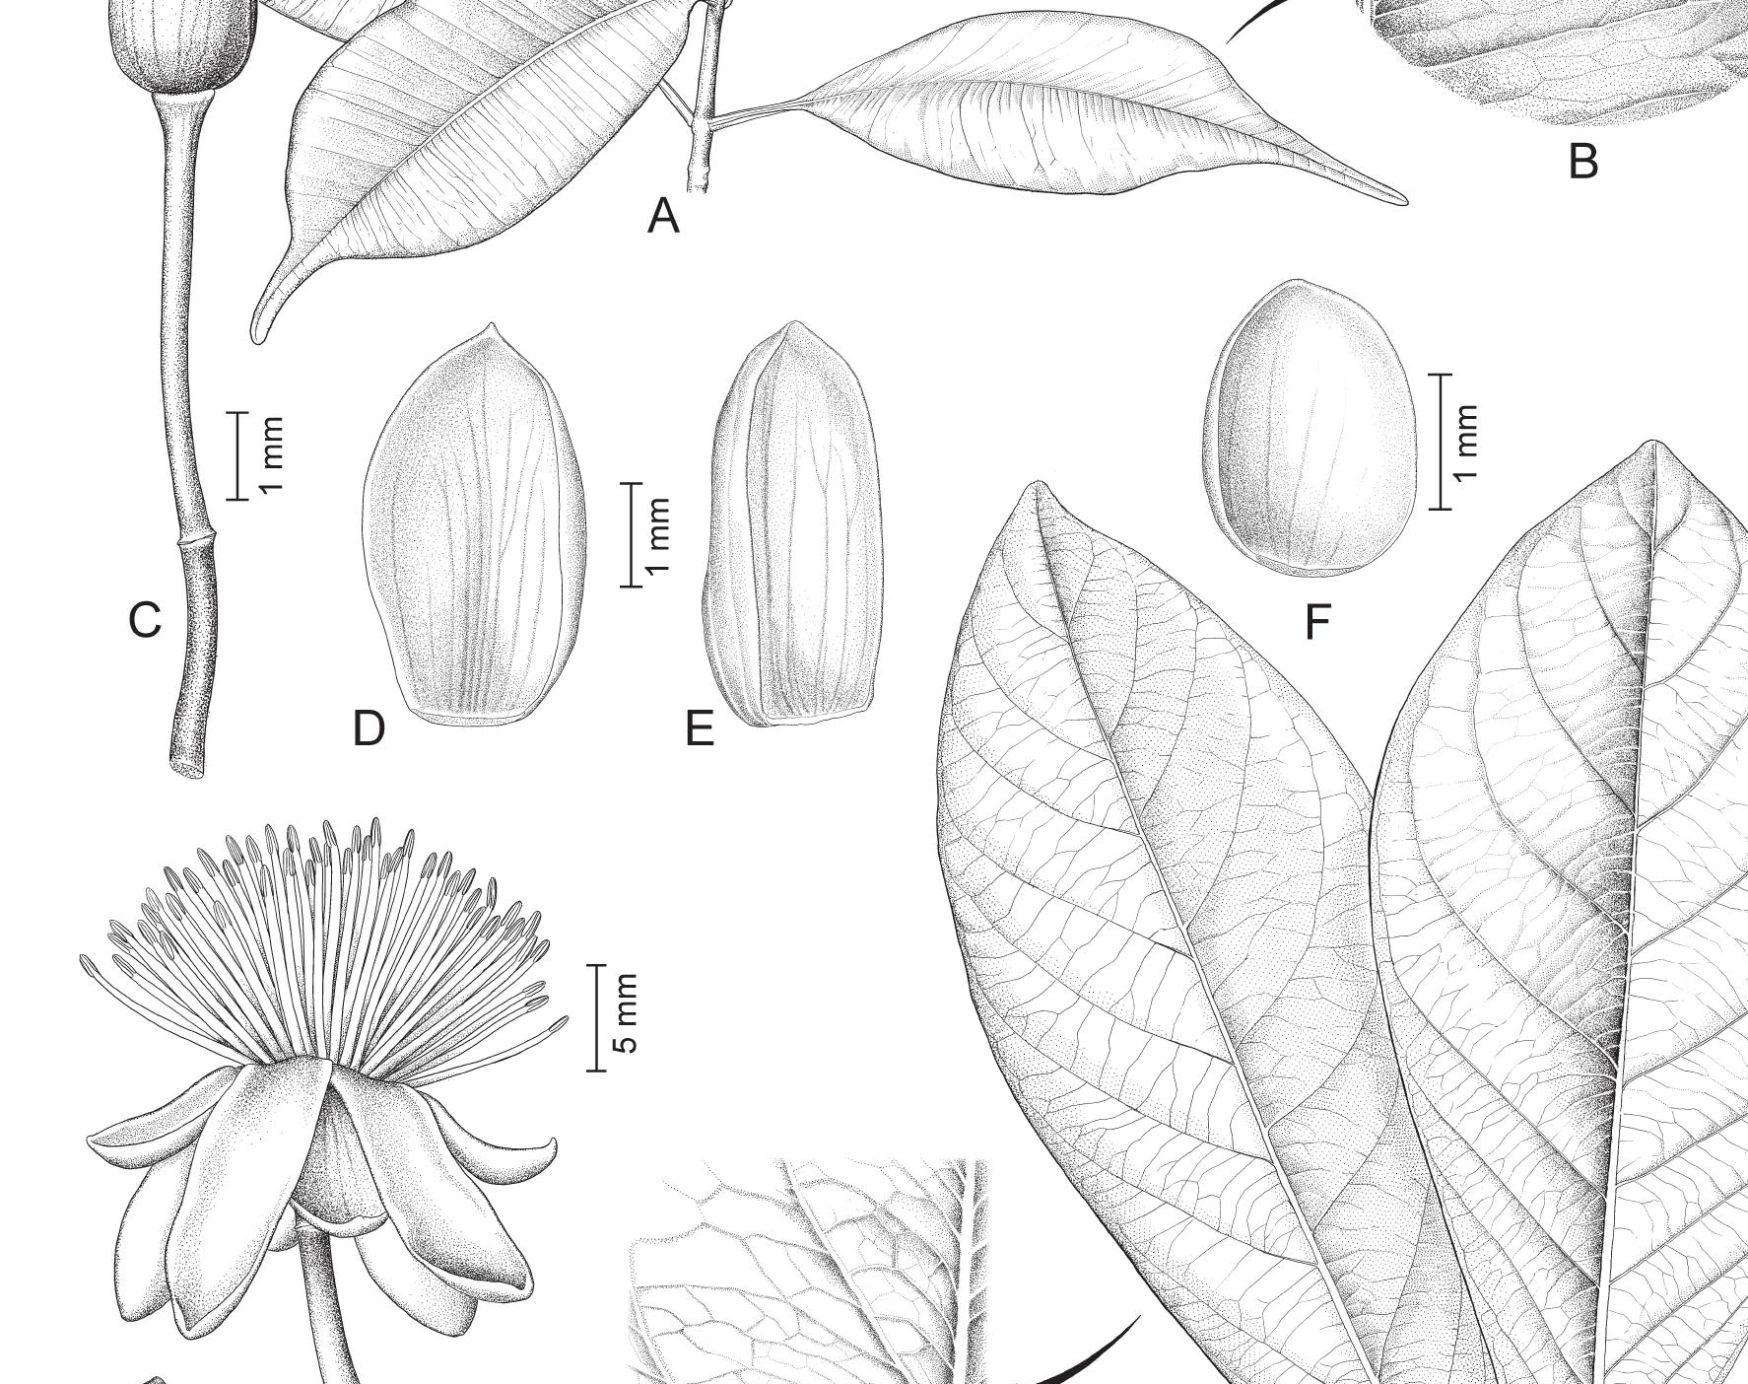
Clusiaceae: Investigating Classification Methods within the genus Tovomita
Presenter: Kat O’Neill
Based on Marinho et al. (2021)

Slide 30
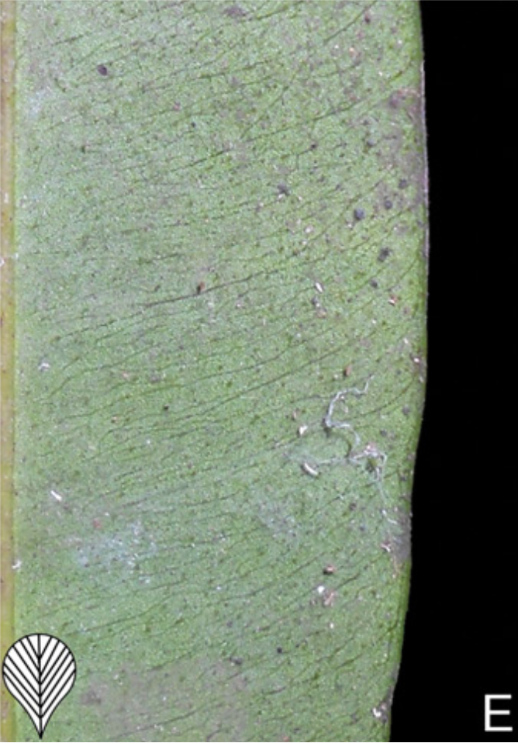
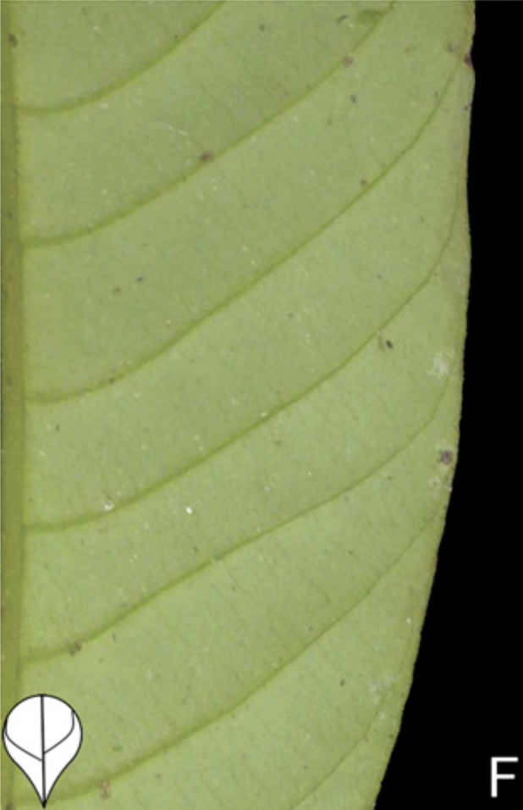
Abstract & Background
Takeaways:
The current method of infrageneric classification for members of the genus Tovomita is based on the abundance of secondary veins near the leaf margin, and whether or not the veins are arcuate.
Classification based on leaf venation is not supported by the phylogeny of Tovomita based on molecular data.
Based on the authors’ findings, the taxonomic character of carpel number appears to be more phylogenetically significant than that of leaf venation.
The correlation between geographic distribution and clade affiliation suggests some groups within Tovomita are confined to one of two habitats: Amazon or Atlantic forests.

Slide 31
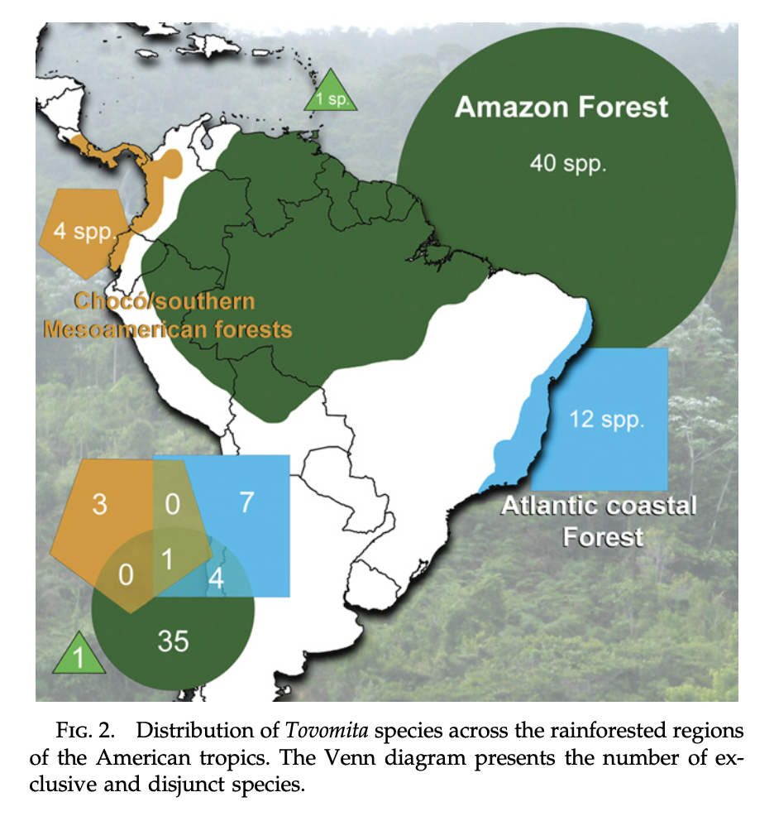
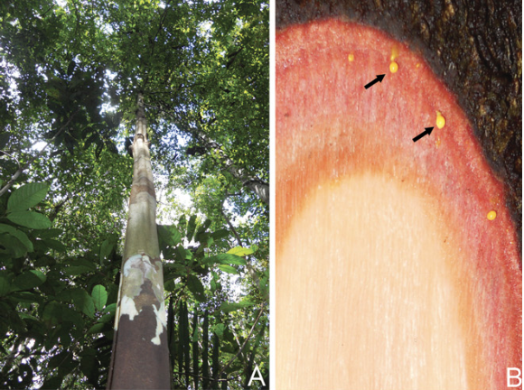
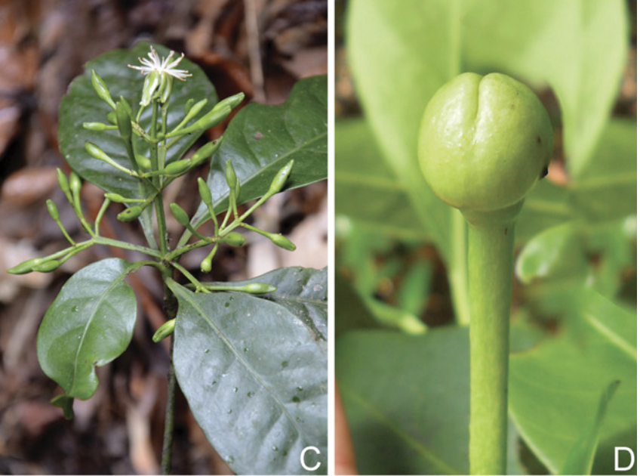
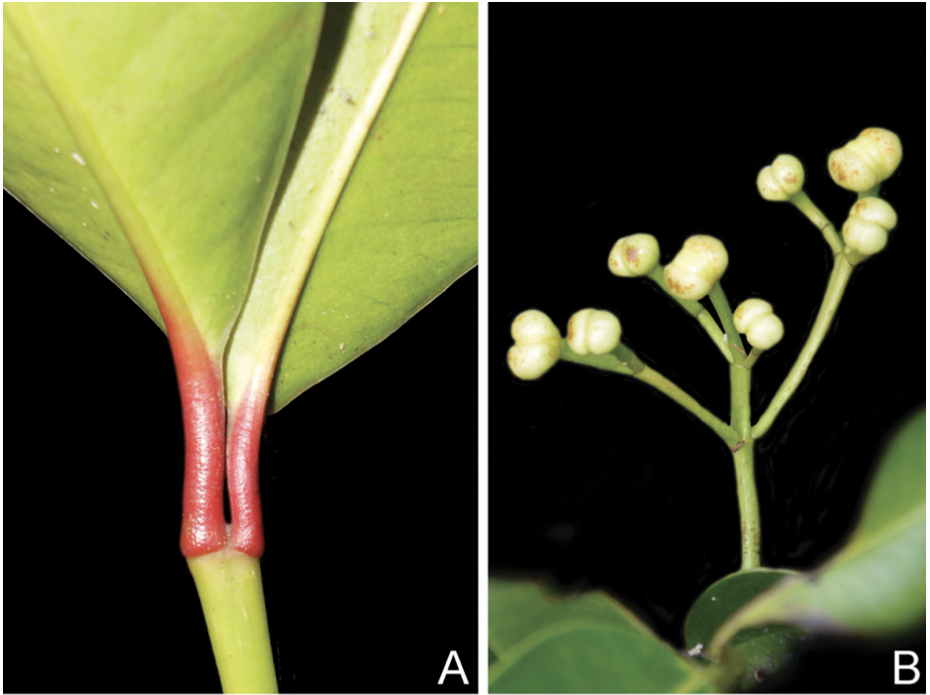
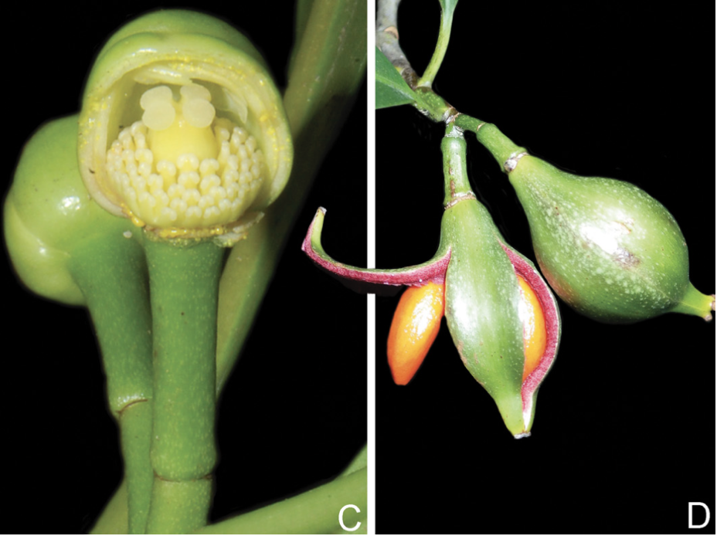
Tovomita genus features:
Tree life form (may also be a shrub)
Reddish cortex with yellow latex secretions
Terminal inflorescence
Sepals enclosing floral buds
Features unique to the Atlantic forest clade:
Reddish petiole of young leaves
Inflorescence is a dichasial cyme
Stigmas are sessile or nearly sessile
Fruits with smooth epicarps

Slide 32
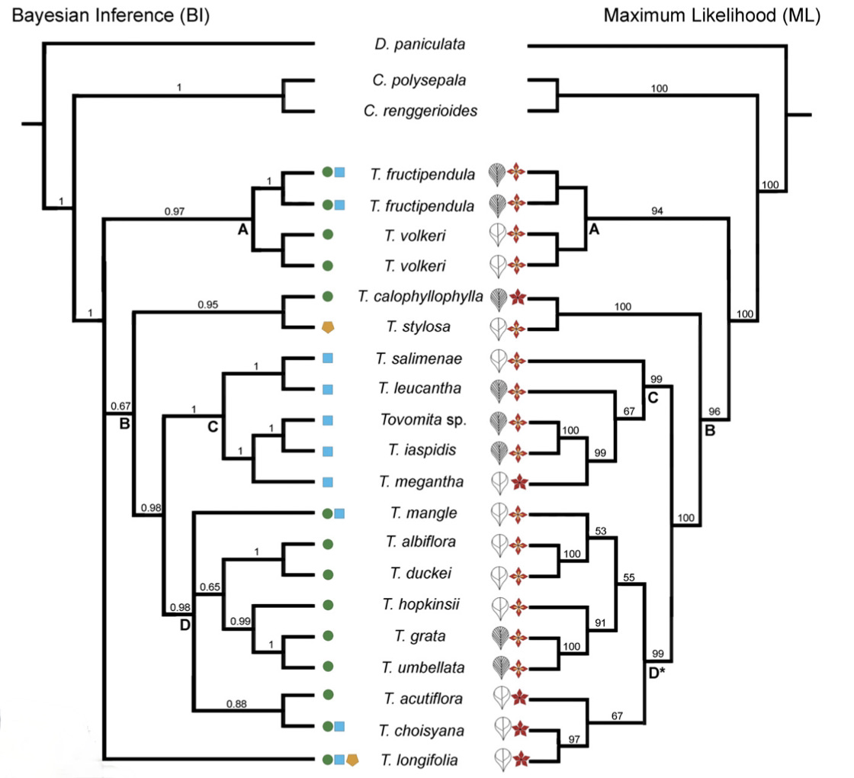

Fig. 3. Plastid genome trees of species of Tovomita. Support values are indicated above branches as follows: BI posterior probabilities (PP) and ML bootstrap percentage (BP). Branches with support values below 50% BP and 0.50 PP are collapsed. Clades A–D are discussed in the text. The asterisk in clade D of ML analysis indicates that clades D of ML and BI are not composed of the same species due to the absence of Tovomita longifolia in clade D of ML.

Slide 33

Both the Bayesian Inference and Maximum Likelihood analyses suggest the genus Tovomita is monophyletic and splits into two main clades, A and B. Included in Clade B are the subclades Clade C and Clade D.
Clade A is composed of one Amazon endemic species and one Amazon-Atlantic Disjunct species. All members are 4-carpellate.
Clade B encompasses species of various geographic distribution. The majority of the clade is 4-carpellate, with several instances of 5-7 carpellate species evolving independently.

Slide 34
Clade D encompasses species mostly endemic to Amazonian forests, as well as a few Amazonian-Atlantic disjunct species. The BI analysis revealed a polytomy with Clade A, Clade B, and T. longifolia; unlike the ML analysis that recovered T. longifolia as belonging in clade D.

Slide 35
Clade C includes endemic Atlantic forest species with unique features. This clade is situated within a group mostly restricted to Amazonian forest.
Several Amazonian-Atlantic disjunct species are situated within predominantly Amazonian clades.
This suggests Atlantic forest populations may have risen from Amazonian forest source populations.

Slide 36
OLD FAMILY SYNOPSIS

Slide 37
Notes:
37

