Slide 1
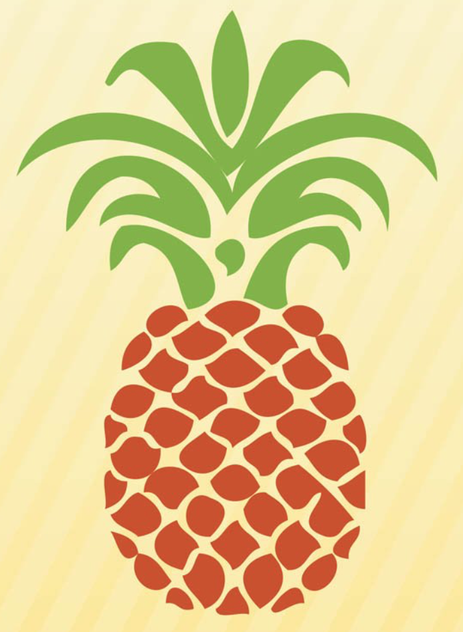
BROMELIACEAE

Slide 2
BROMELIACEAE
Key Characters
often epiphytic
rosette of helically arranged leaves
short, erect axis
silica bodies
terminal spike or panicle
brightly coloured bracts
inner tepal appendages

Slide 3
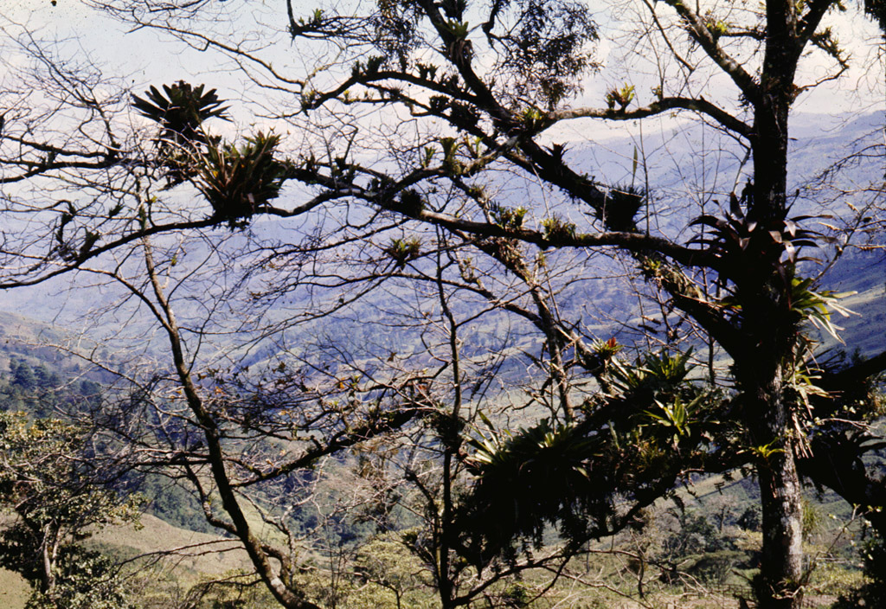
Epiphyte life form of the bromeliads - Mexico

Slide 4
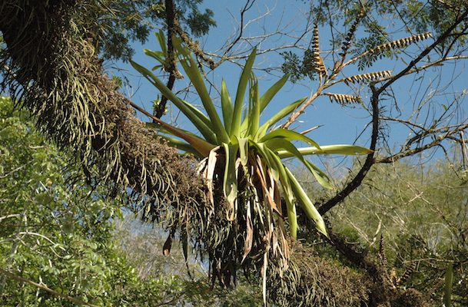
Epiphyte life form of the bromeliads

Slide 5
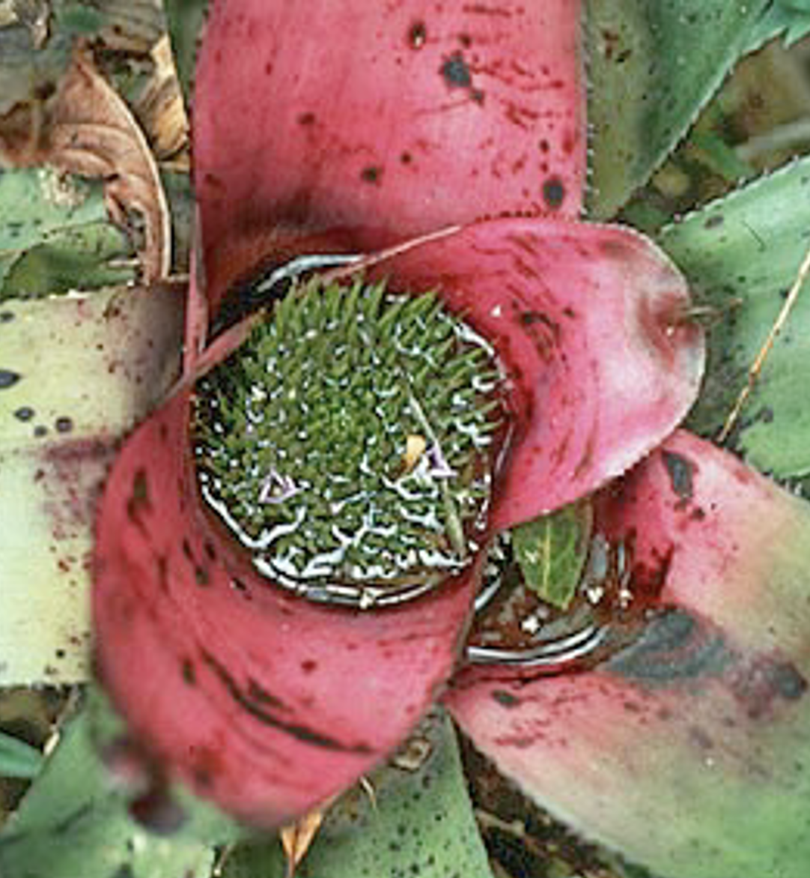
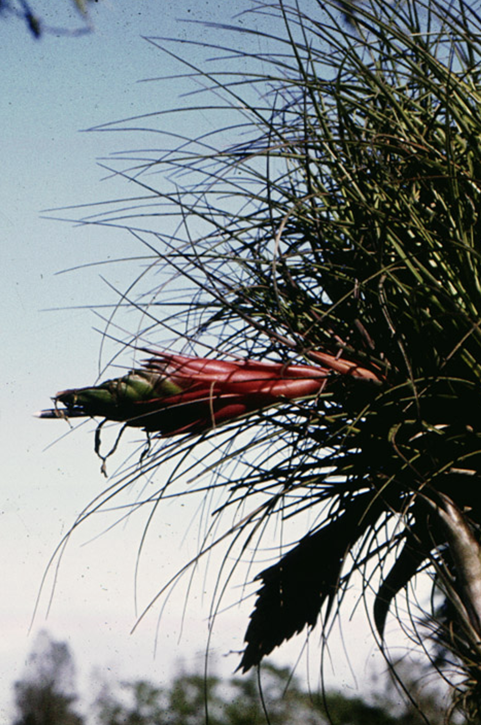
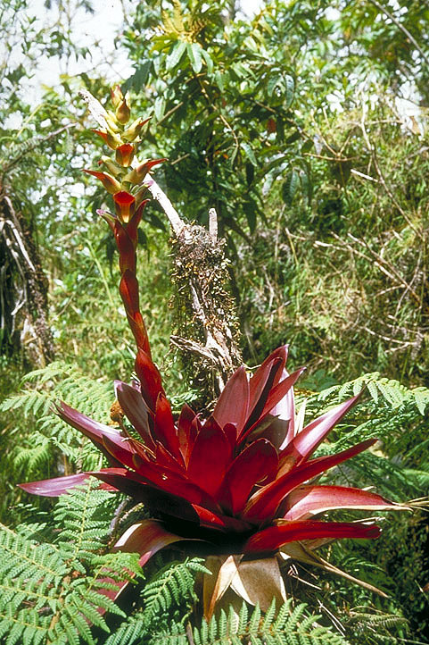
Bright inflorescence bracts

Slide 6
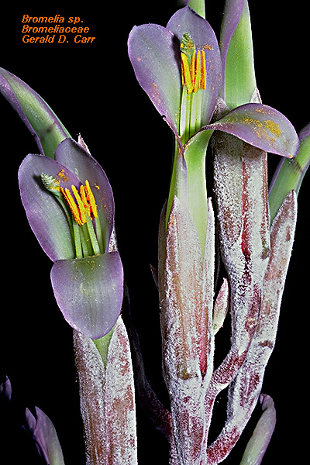
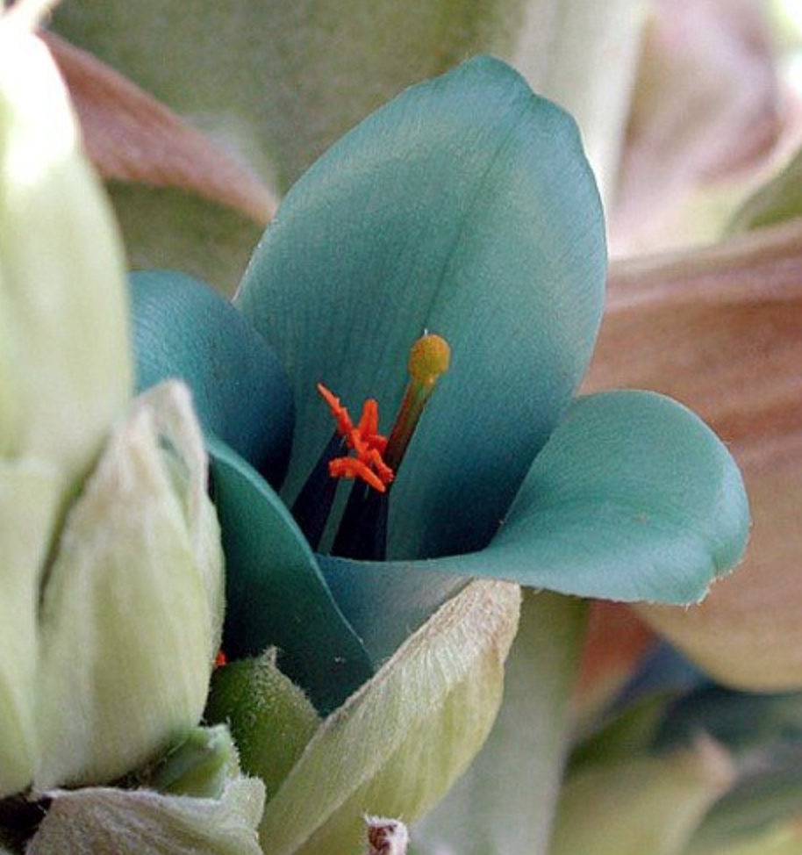
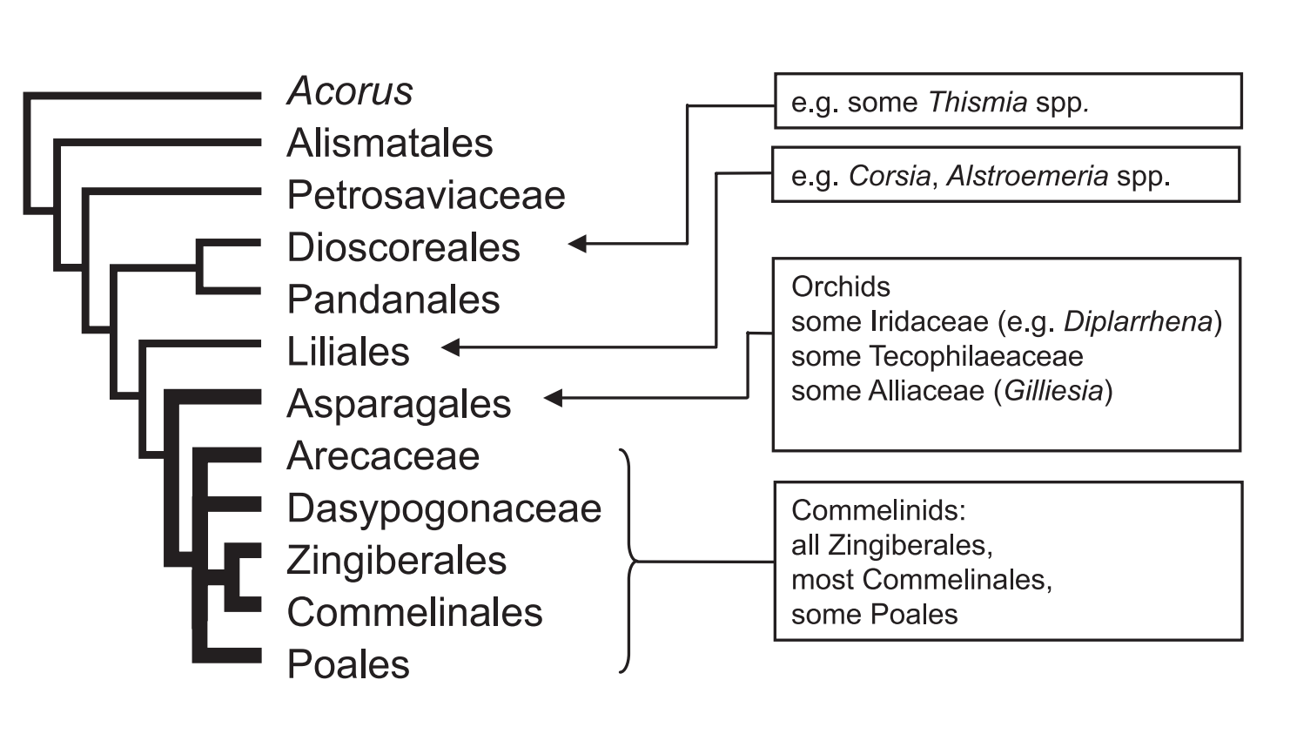
Bromelia perianth
--bilateral
Monocots with bilateral symmetry

Slide 7
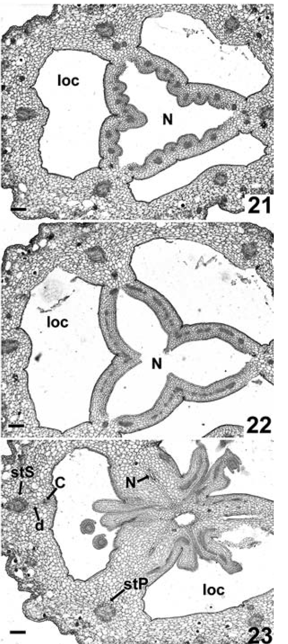
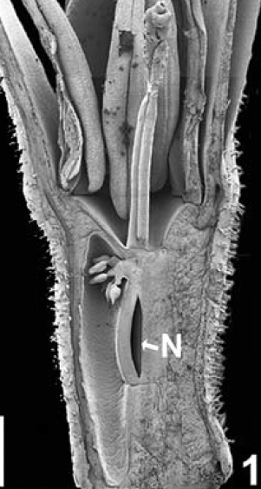
Floral anatomy of Bromeliaceae: septal nectaries
Notes:
Sajo2004.pdf
Sajo, M. G., Rudall, P. J., & Prychid, C. J. (2004). Floral anatomy of Bromeliaceae, with particular reference to the evolution of epigyny and septal nectaries in commelinid monocots. Plant Systematics and Evolution, 247(3-4), 215-231.

Slide 8
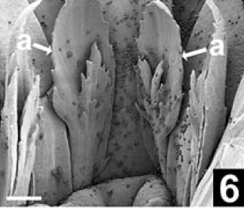
Floral anatomy of Bromeliaceae: inner tepal appendages
Notes:
Sajo2004.pdf
Sajo, M. G., Rudall, P. J., & Prychid, C. J. (2004). Floral anatomy of Bromeliaceae, with particular reference to the evolution of epigyny and septal nectaries in commelinid monocots. Plant Systematics and Evolution, 247(3-4), 215-231.

Slide 9
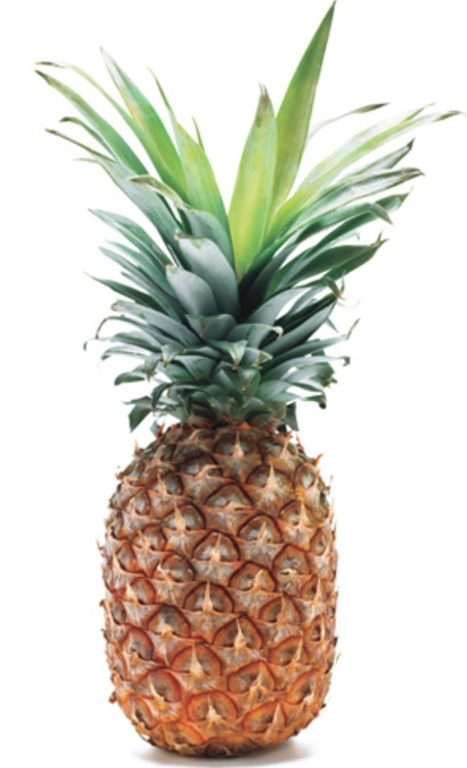
PHYLOGENY

Slide 10
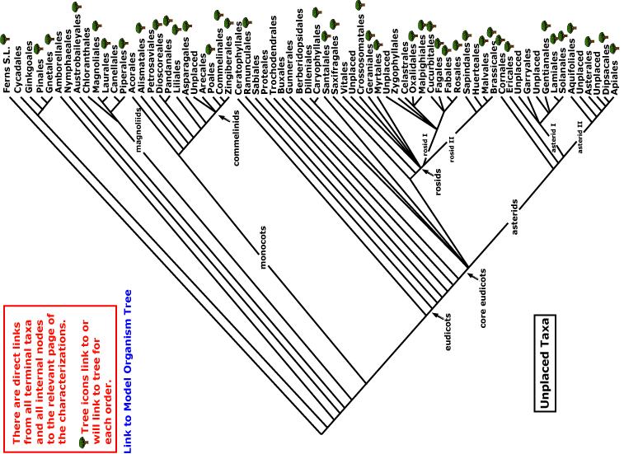
Bromeliaceae
monocots
Current Angiosperm Phylogeny Group Tree for Flowering Plants

Slide 11
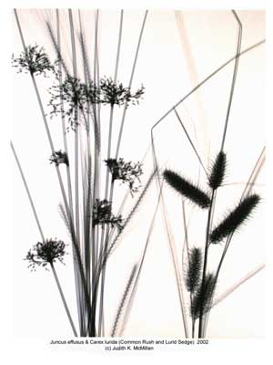
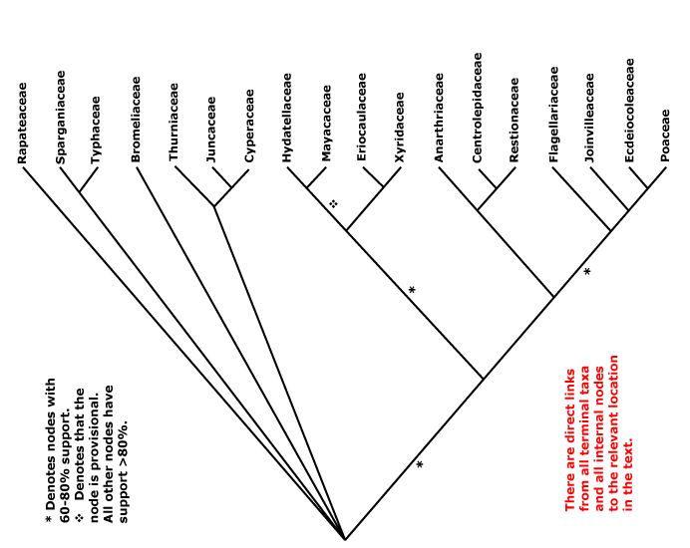


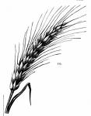
Poales

Slide 12
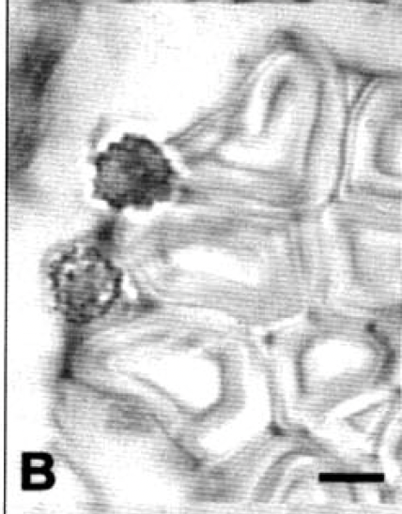
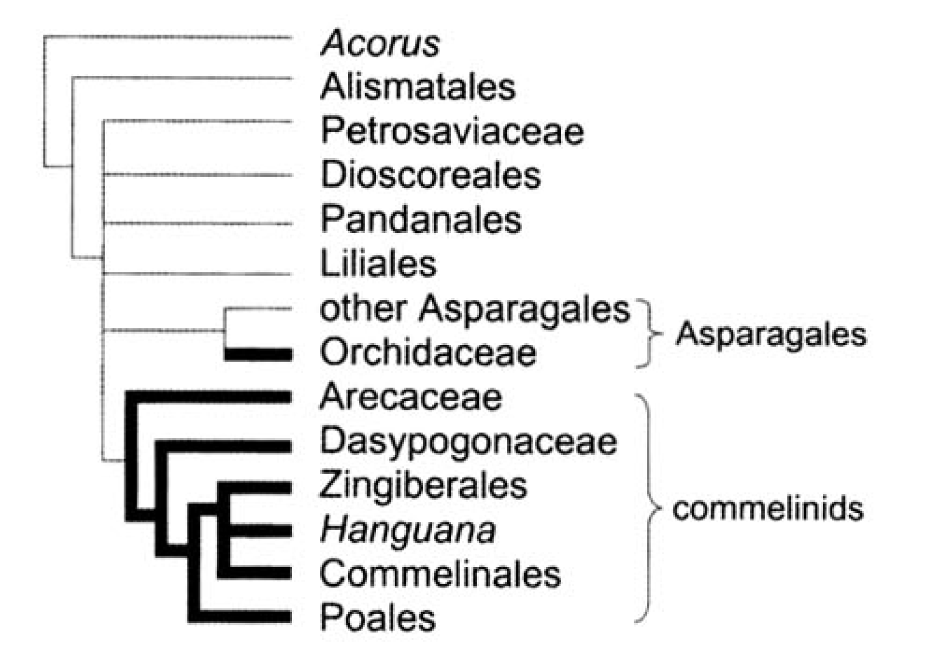
Distribution of raphides (red boxes) and silica bodies (bold) in the Monocots
Notes:
Prychid1999(oxalate),2004(silica)

Slide 13
DIVERSITY IN THE
FAMILY
Pitcairnioideae
Tillandsioideae
Bromelioideae

Slide 14
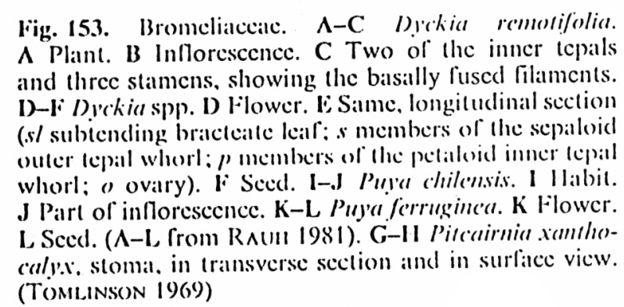
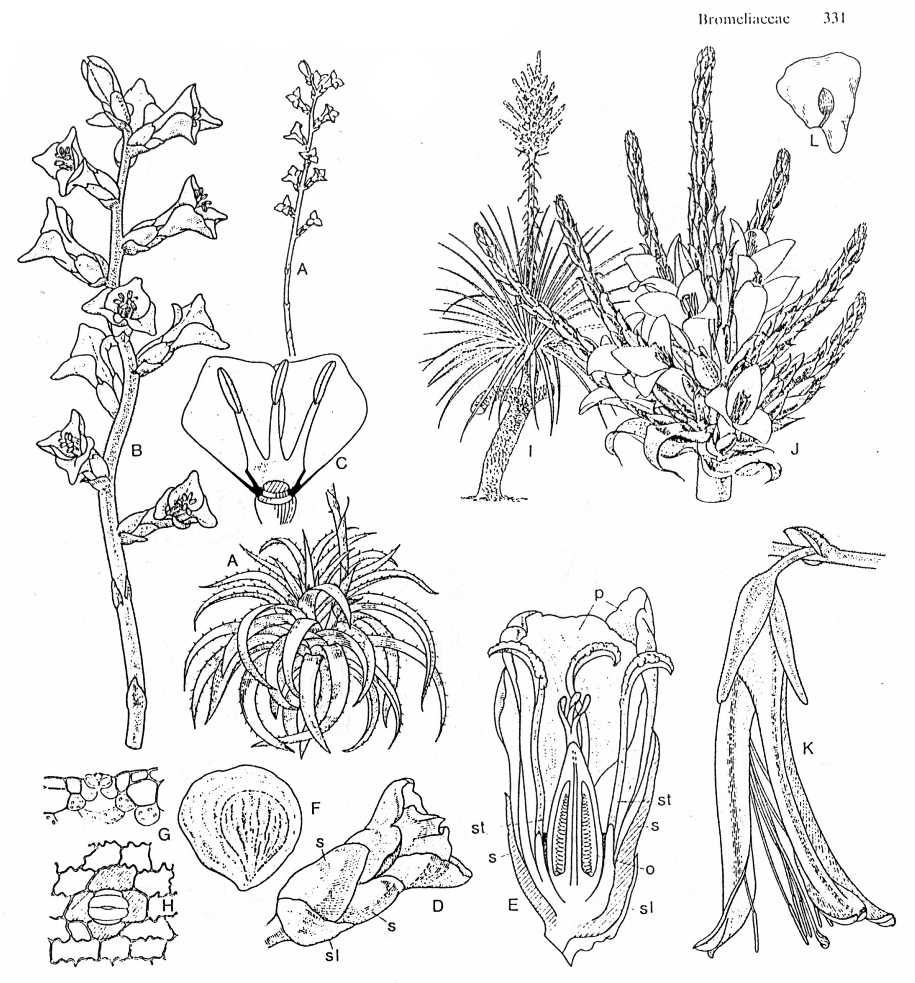
Pitcairnioideae
(capsules, seeds without hairs)

Slide 15
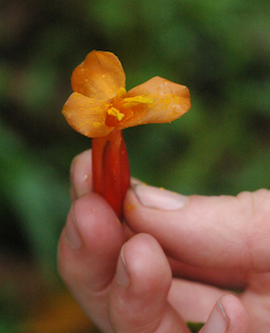
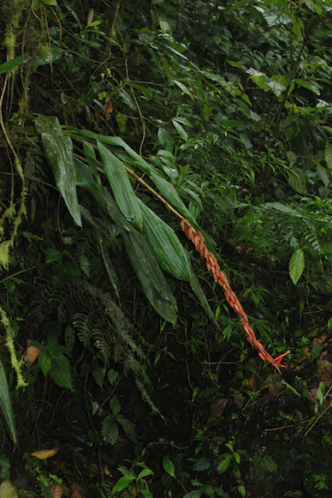
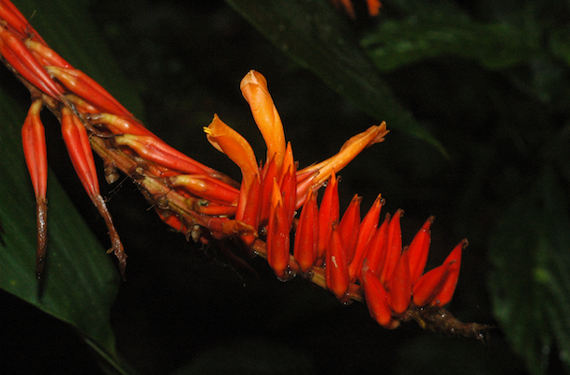
Pitcairnia

Slide 16
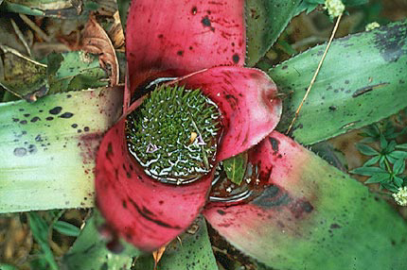
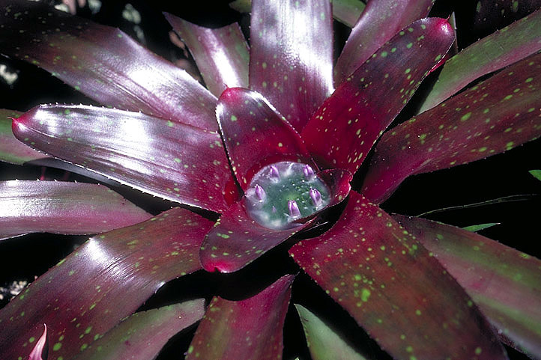
Neoregelia - flowers sessile in center
Al Gentry photo
Walter Judd photo

Slide 17
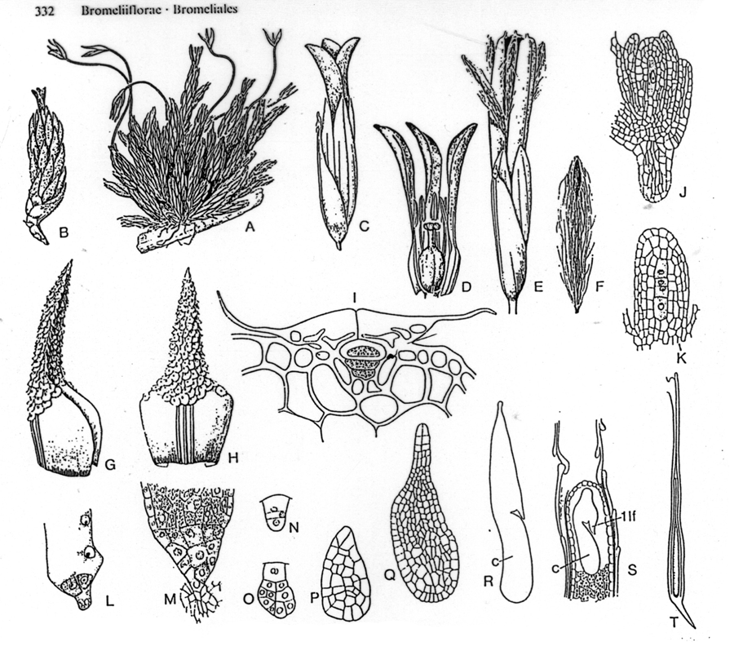
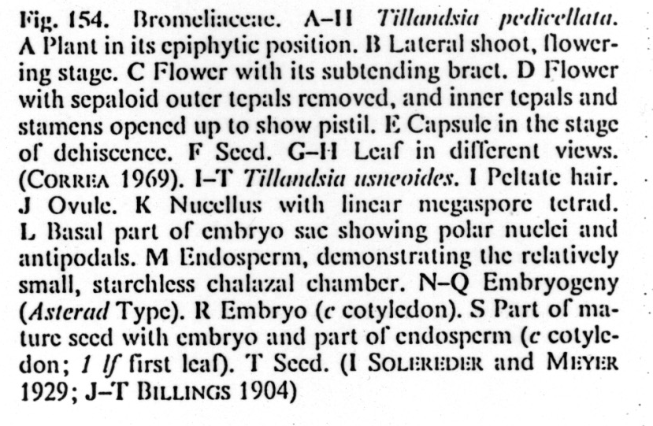
Tillandsioideae
(capsules, seeds with hairs)

Slide 18
Vriesia sintenisii
Walter Judd photo

Slide 19
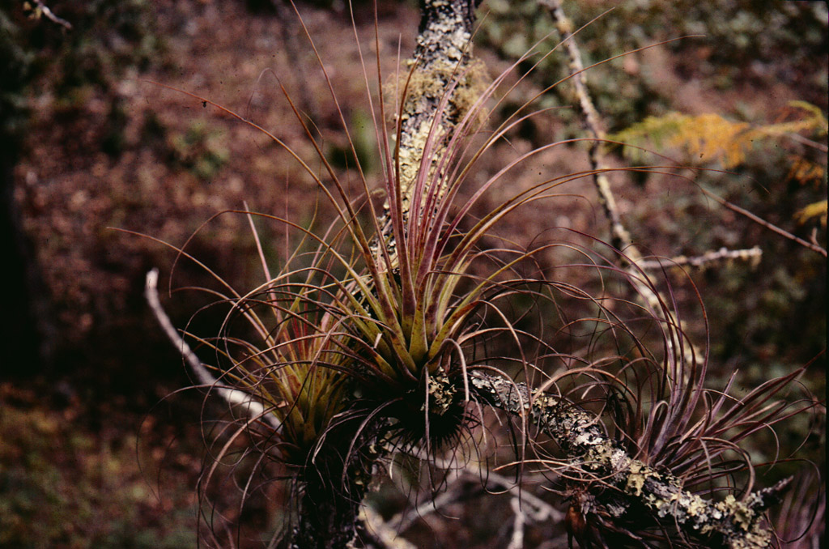
Tillandsia - typical habit (Chiapas, Mexico)

Slide 20
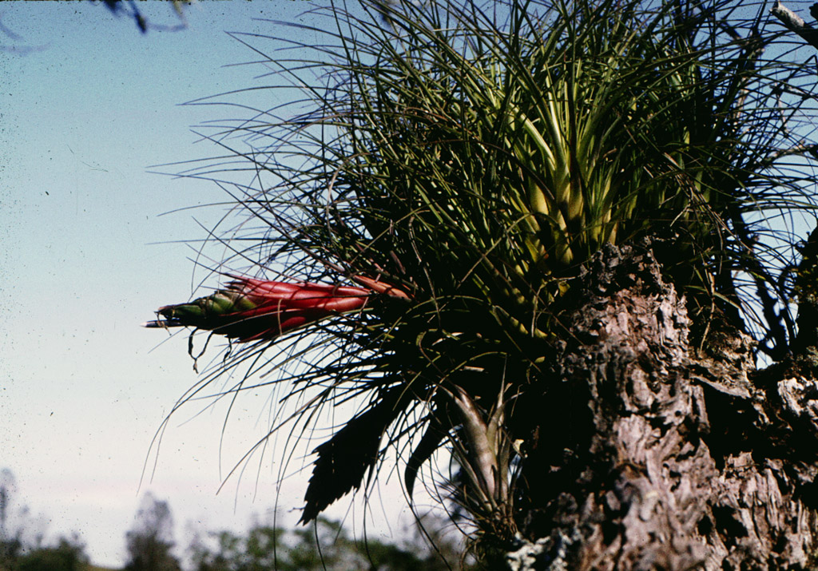
Tillandsia with inflorescence

Slide 21
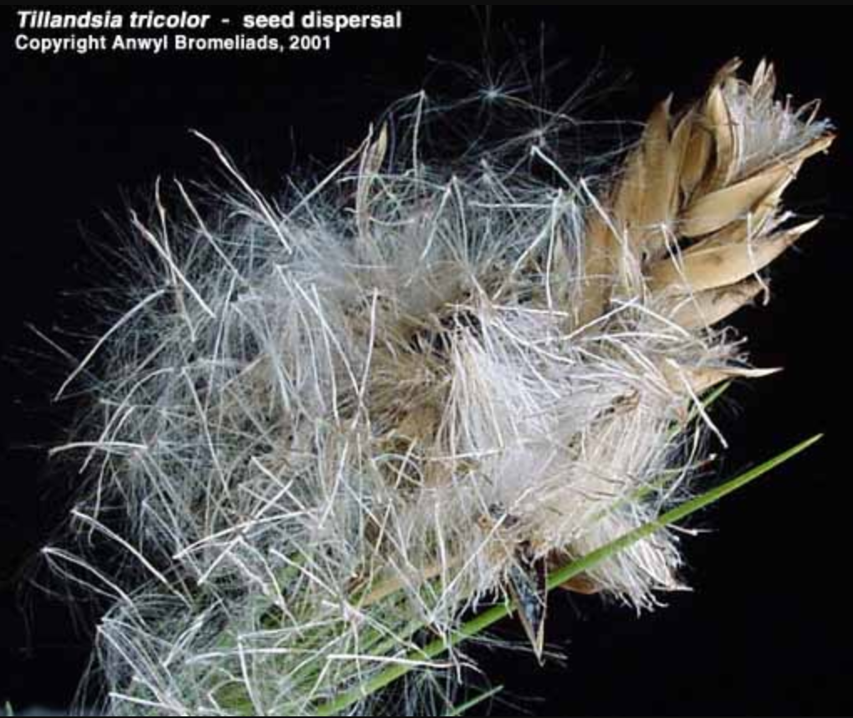
Tillandsia seeds with hairs, dispersing

Slide 22
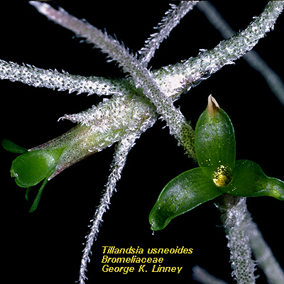
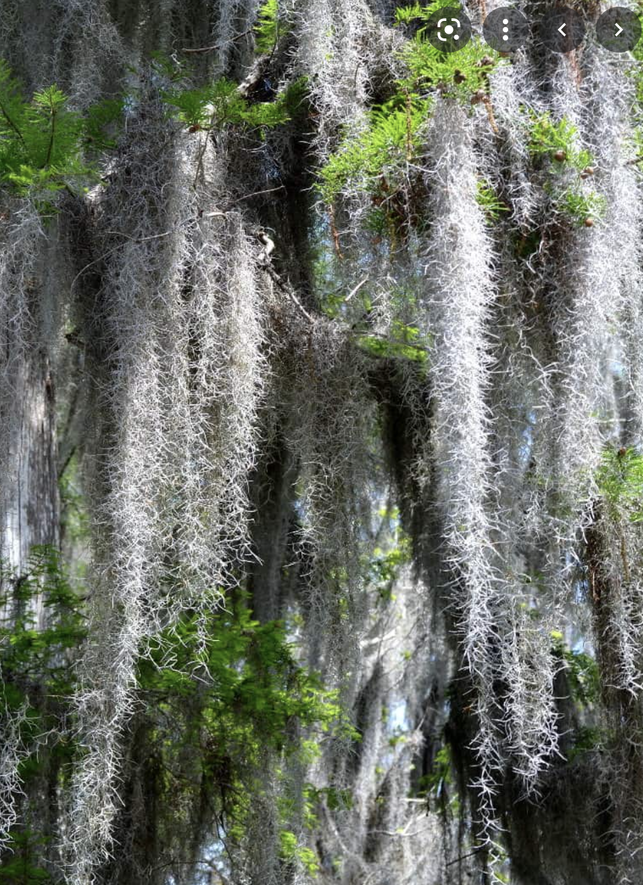
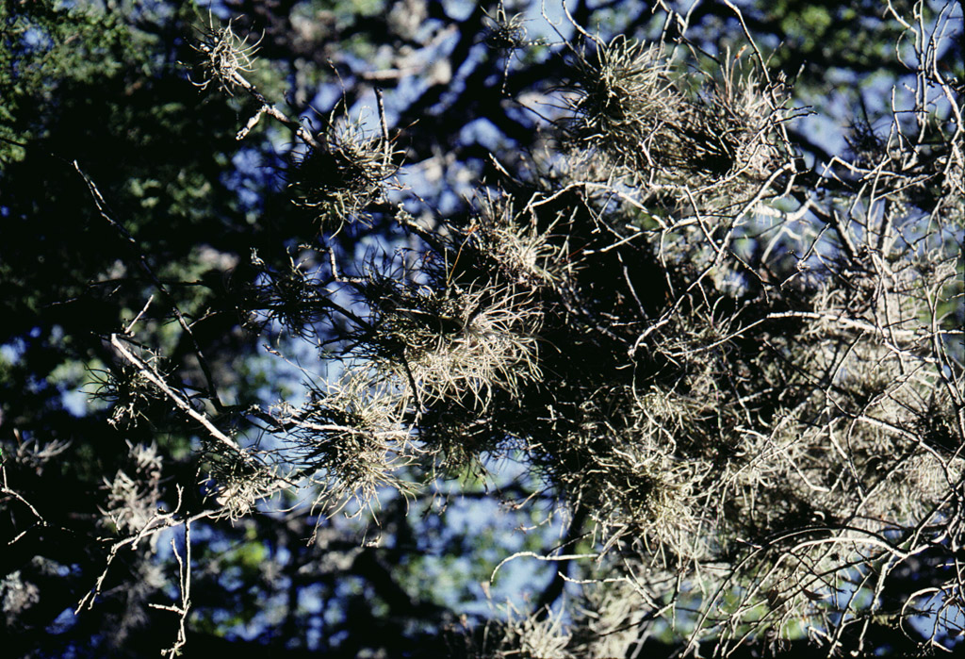
Tillandsia usneoides

Slide 23
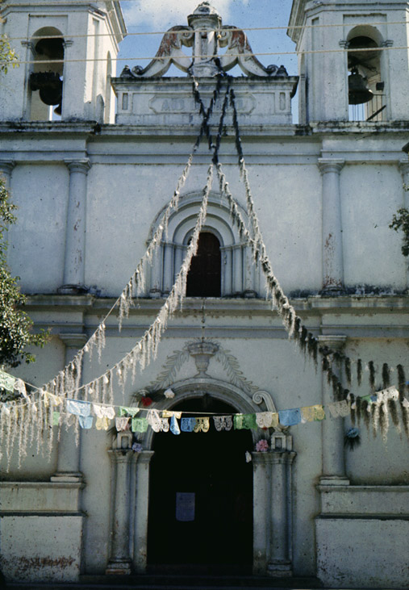
Tillandsia as decoration, Chiapas, Mexico

Slide 24
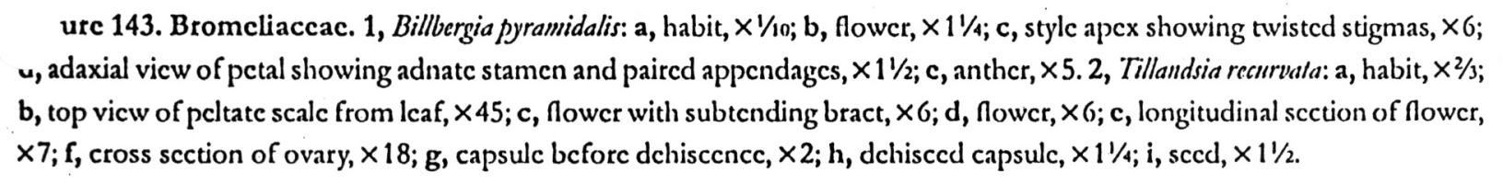
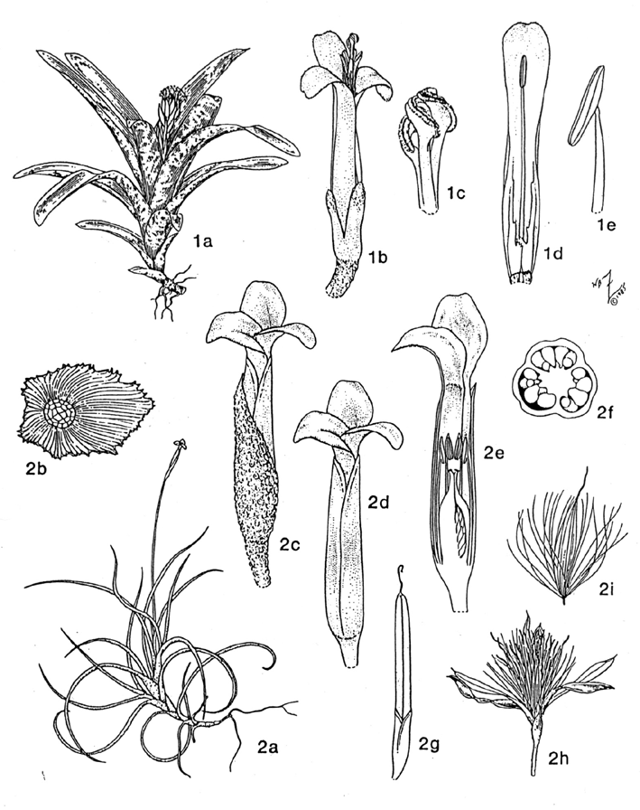
Bromelioideae
(berries) Fig 1
(more Tillandsoideae, Fig. 2)

Slide 25
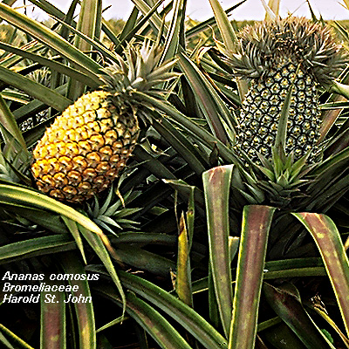
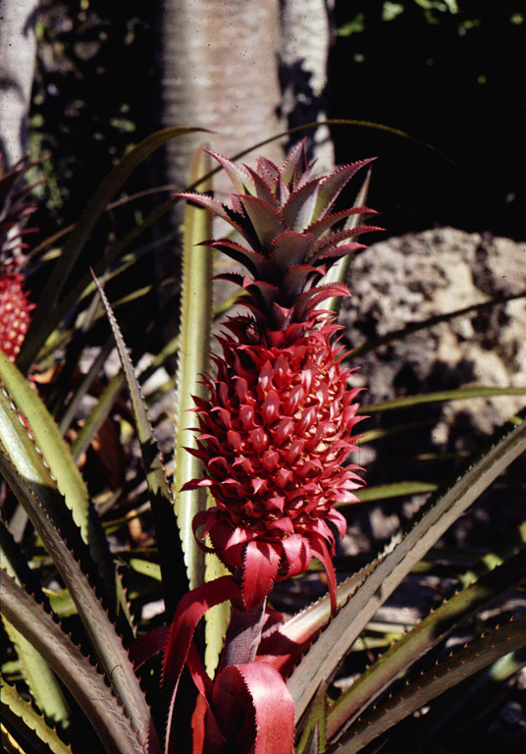
The pineapple - terrestrial, leaves with spines, fleshy fruits, inferior ovary, and delicious.
Ananas bracteatus, an ornamental

Slide 26
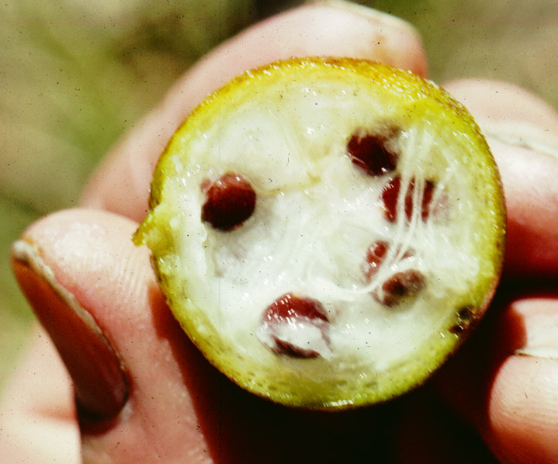
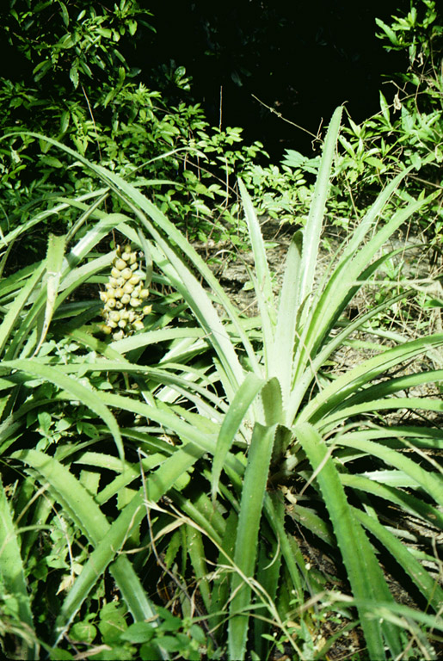
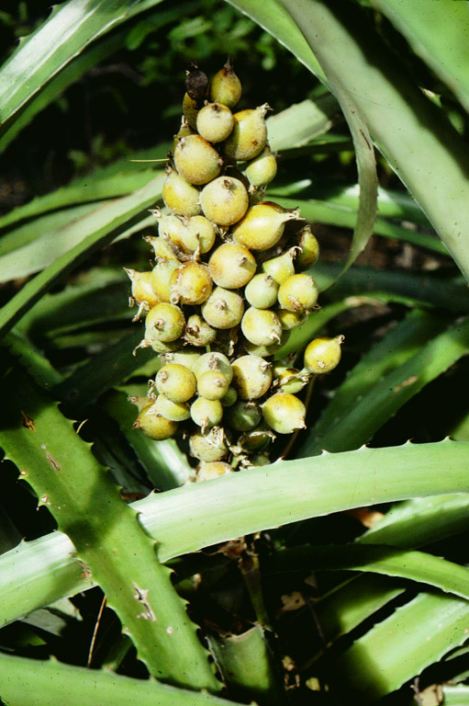
Bromelia - habit and fruiting axis
Santa Rosa, Costa Rica

Slide 27
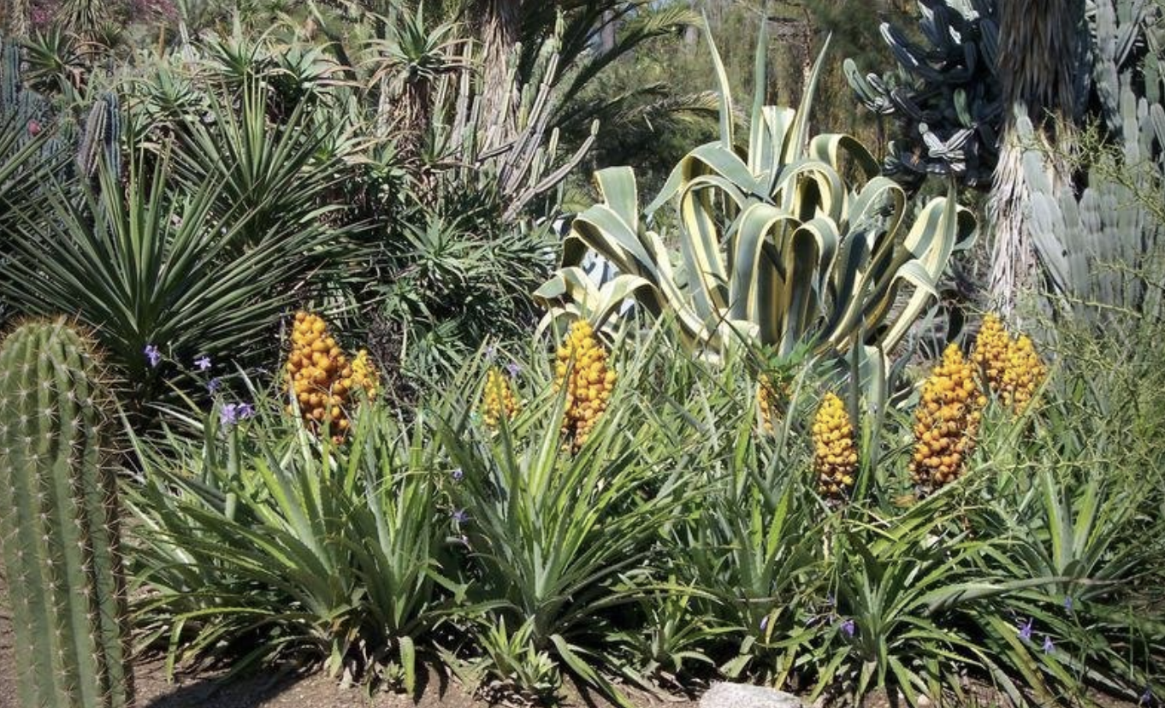
Bromelia balansae

Slide 28
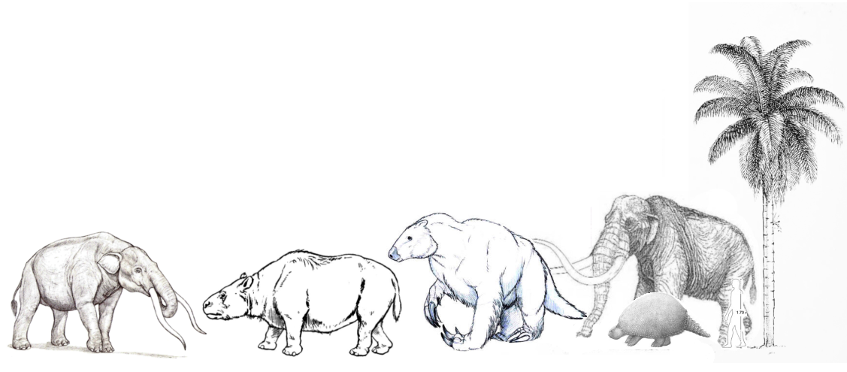
Acrocomia
Mammuthus
Cuvieronius
Toxodon
Megatherium
Glyptodon
Notes:
From photooshop composite

Slide 29
MORPHOLOGY, MOLECULES, and BIOGEOGRAPHY

Slide 30
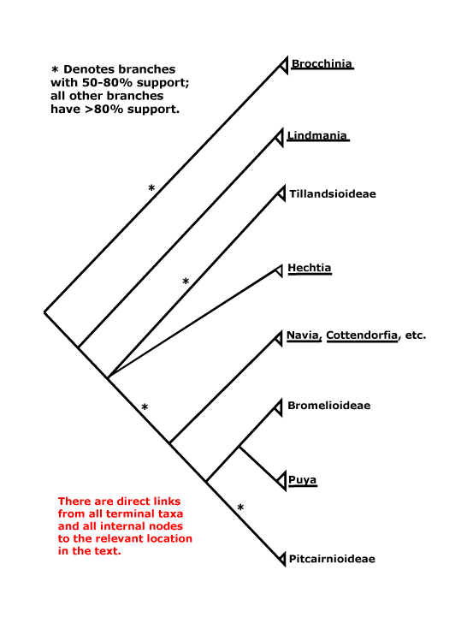
1 -superior ovary , fruits dry, seeds tailed
2 - superior ovary, fruits dry, seeds comose
3 - inferior ovary, fruits fleshy, seeds without
appendages
1 1 2 1 1 3 1 1

Slide 31
Bromeliaceae: Neotropical, with the ealiest-diverging species in the Guayana Highlands
Guayana Highlands
Guayana Highlands

Slide 32
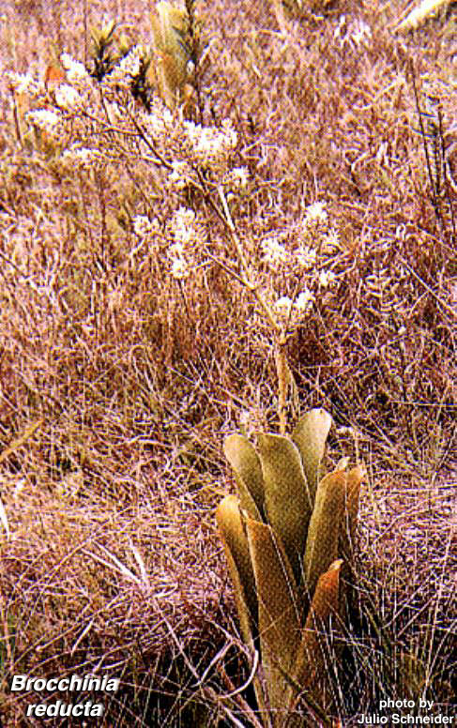
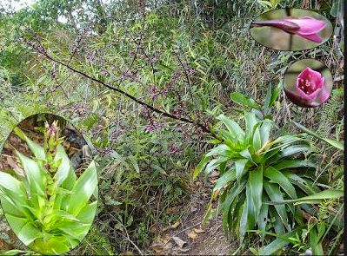
Brocchinia and Lindmania from the Guayana Highlands – the most primitive bromeliads

Slide 33
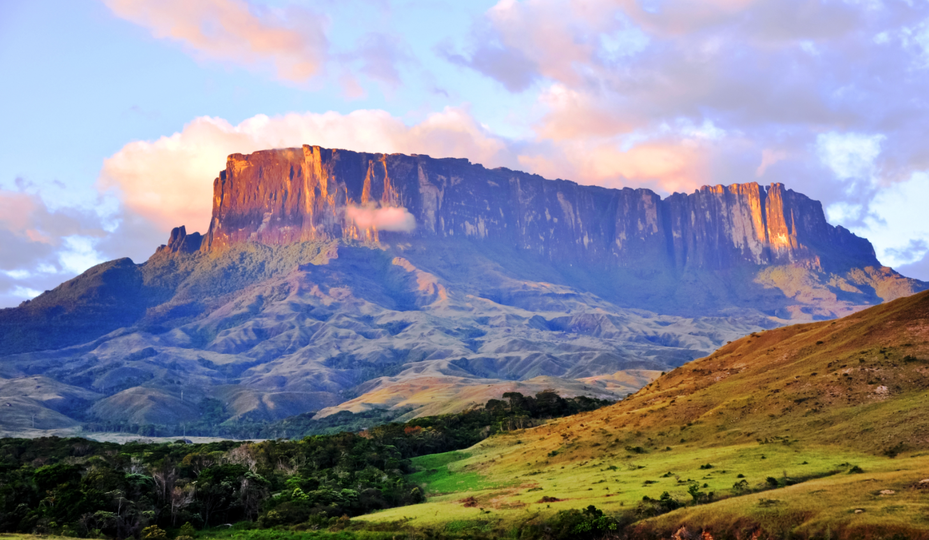
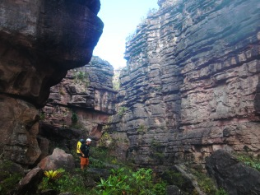
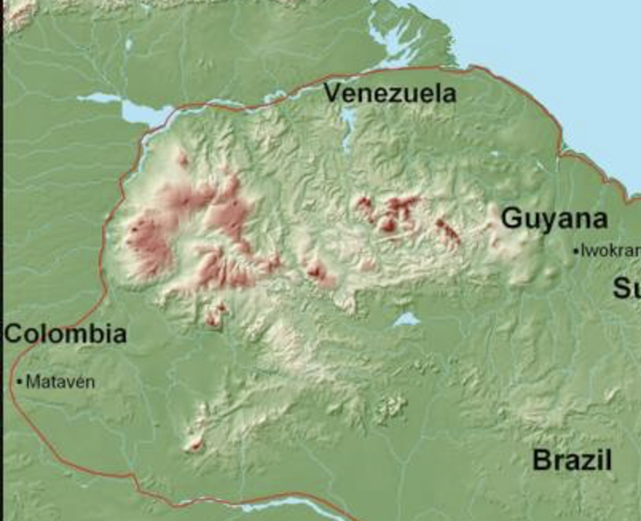

Guiana Highlands - singularly ancient, singularly isolated
Alex Kubacki on the cliffs.
Notes:
age of the Roraima Sandstone: 1.7 gY (santos2003.pdf)

Slide 34

Bromeliaceae: Neotropical except for one species.
sole African species here
Guayana Highlands
Guayana Highlands

Slide 35

Pitcairnia feliciana from West Africa – the only Old World bromeliad

Slide 36
Morphological changes within the subfamily Bromelioideae

Slide 37


Puya
páramo bromeliad
Costa Rica

Slide 38


Puya
Andes-
Costa Rica

Slide 39

Terrestrial to epiphyte transition in the bromelioids: early events

Slide 40

Terrestrial to epiphyte transition in the bromelioids: tank and sepal changes
Notes:
From K. Schulte et al. 2009

Slide 41

Aechmaea- beautiful, artificial

Slide 42


Benzing et al., 1985

Slide 43
BROMELIACEAE
Key Characters
often epiphytic
rosette of spirally arranged leaves
short, erect axis
silica bodies
terminal spike or panicle
brightly coloured bracts
inner tepal appendages

Slide 44

Bromeliads provide shelter against fire to mutualistic spiders in a fire-prone landscape
Omena et al. 2018

Slide 45


Bromelia balansae
Psecas chapoda
Notes:
Spider lives exclusively in the sheltered central rosette of this species of bromeliad. Live in the Brazilian cerrado, a savanna-like shrubby region where fires are frequent during the dry period.

Slide 46
Spiders benefit bromeliads by…
Protecting them from herbivorous insects
Providing them with nutrients (specifically N) from their debris (prey carcasses, feces, etc.)
  Bromeliad has specialized trichomes in the rosette for nutrient absorption
  Bromeliads with spiders produce leaves 15% longer than plants from which spiders have been excluded! Romero et al. 2006. Bromeliad-living spiders improve host plant nutrition and growth. Ecology 87(4), 803-808.

Slide 47

Before fire
1-day post-fire
5 months post-fire

Slide 48


Slide 49
Conclusions
Bromeliad-associating spiders took ~5 months to return to pre-fire abundances (vs. 12 months for spiders that do not associate with bromeliads) (Podgaiski et al. 2013. Spider Trait Assembly Patterns and Resilience under Fire-Induced Vegetation Change in South Brazilian Grasslands. PLoS ONE 8(3): e60207.)
Bromeliad rosettes act as refugia for spiders living in fire-prone landscapes, improving their resilience

Slide 50

How else might spiders benefit?
When they detect predators, female Cupiennius salei (Ctenidae) dive into the bromeliad’s water tank with their egg sac.
Henaut et al. 2018. An arboreal spider protects its offspring by diving into the water of tank bromeliads. Comptus Rendus Biologies 341, 196-199.

Slide 51
THE END

Slide 52

fffff
Bromeliaceae – key characters
Rosette architecture
Short internodes
Broad leaf-bases
Peltate scales
Unspecialized monocot flowers

Slide 53

Multiple origins of crassulacean acid metabolism in the Bromeliaceae
Notes:
Crayn2004.pdfCrayn, D.M., Winter, K. and Smith, J.A.C., 2004. Multiple origins of crassulacean acid metabolism and the epiphytic habit in the Neotropical family Bromeliaceae. Proceedings of the National Academy of Sciences of the United States of America, 101(10), pp.3703-3708.

Slide 56


