Slide 1
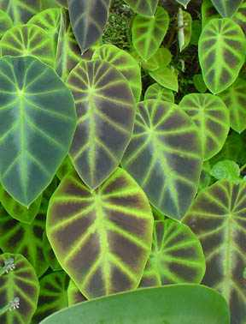
ARACEAE

Slide 2
CHARACTERS DIAGNOSTIC OF MONOCOTS:
branching sympodial
vascular bundles in stem scattered, closed
herbaceous, no interfascicular cambium developing
cotyledon 1
tertiary veins without free endings
pollen monosulcate
leaf base sheathing
gynoecium three-parted
primary root present but unbranched, not persisting
expanded to begin with
covered in Araceae

Slide 3
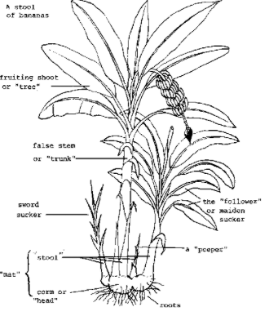
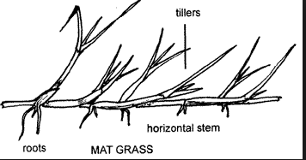
CHARACTERS DIAGNOSTIC OF MONOCOTS:
branching sympodial

Slide 4
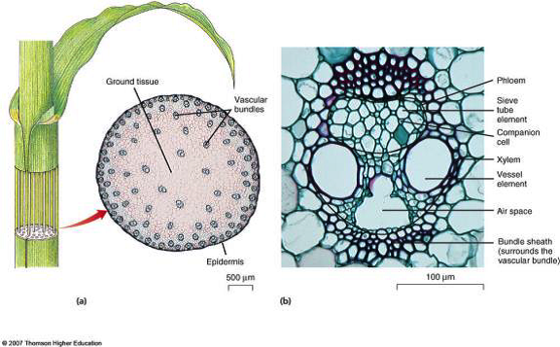
CHARACTERS DIAGNOSTIC OF MONOCOTS:
vascular bundles in stem scattered

Slide 5
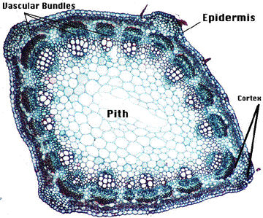
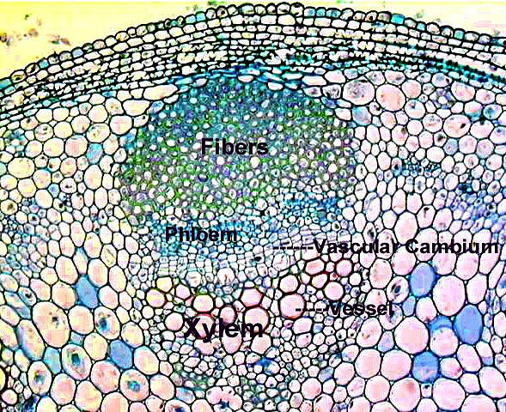
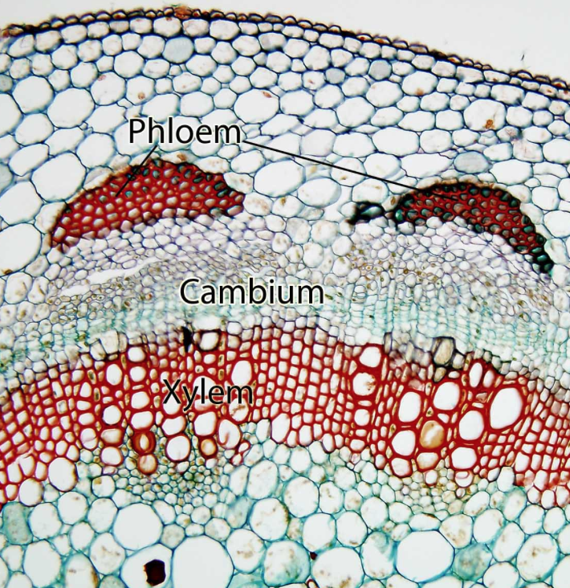
CHARACTERS DIAGNOSTIC OF MONOCOTS:
no interfascicular cambium developing
In the early-divergent groups and eudicots—but not in monocots—a cambium develops between the xylem and phloem of the original (primary) vascular bundles, i.e. there is no interfascicular cambium.

Slide 6
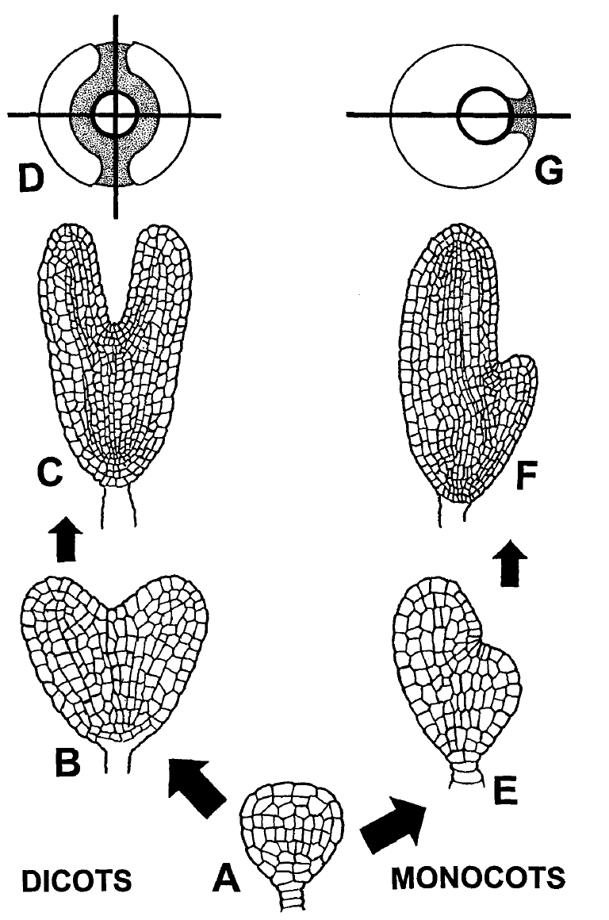
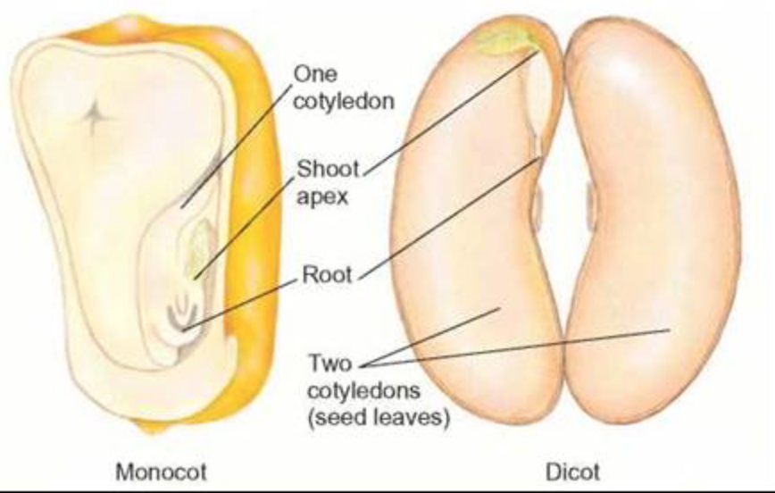
CHARACTERS DIAGNOSTIC OF MONOCOTS:
One cotyledon
Two planes of symmetry
One plane of symmetry
Notes:
burger1998.pdf: A fourth criterion of homology is the logical assumption that the two contrasting homologous
states can not co-occur in the same organism at the same developmental stage (Patterson, 1982).
we can conclude that the dicotyledonous character state was simply lost or became suppressed
in the early origin of monocots.

Slide 7
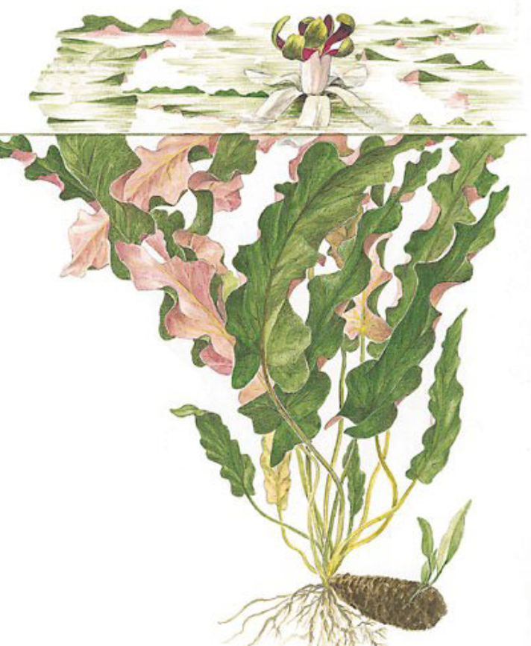
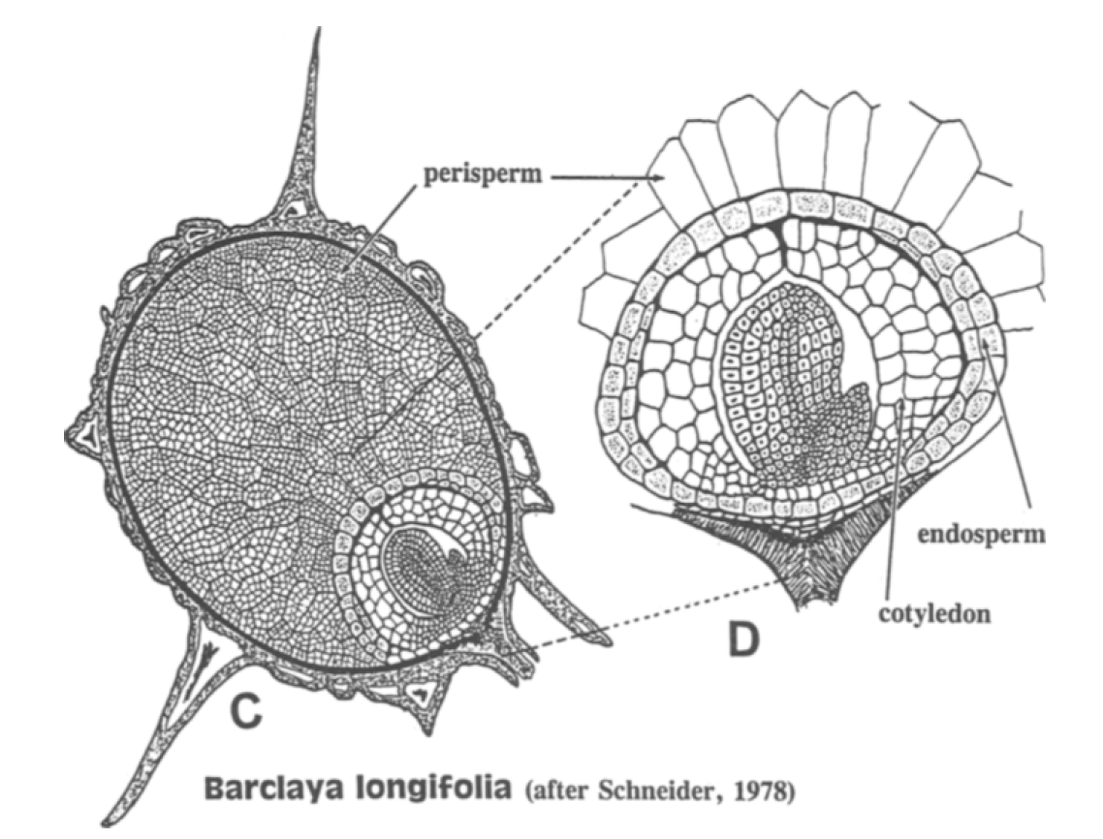
William Burger on the monocot “cotyledon”: not homologous with those of dicots; Barclaya has both.
Barclaya, Nymphaeaceae
Notes:
burger1998.pdf “a monocot-like embryo flanked by two large overarching cotyledons. All these
studies lend credence to the interpretation that all three "cotyledons" co-occur within the embryo
of Nymphaeales. Such a co-occurrence violates a fourth criterion of homology, and I believe
we must conclude that the cotyledons of monocots and dicots are fundamentally
different structures that do not share a common phylogenetic origin.”

Slide 8
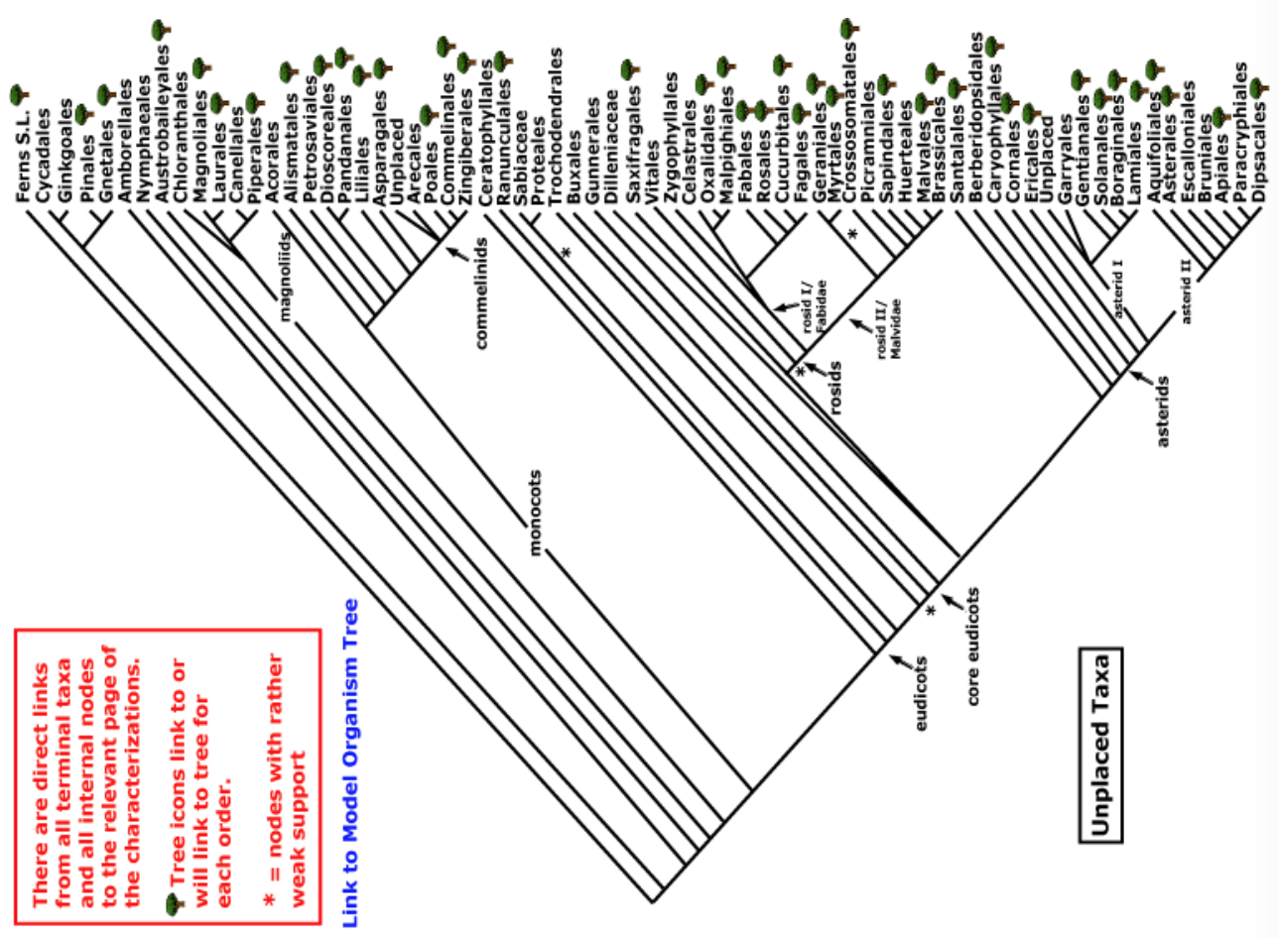
ANITAS
magnoliids
monocots
Current Angiosperm Phylogeny Group Tree for Flowering Plants
2016

Slide 9
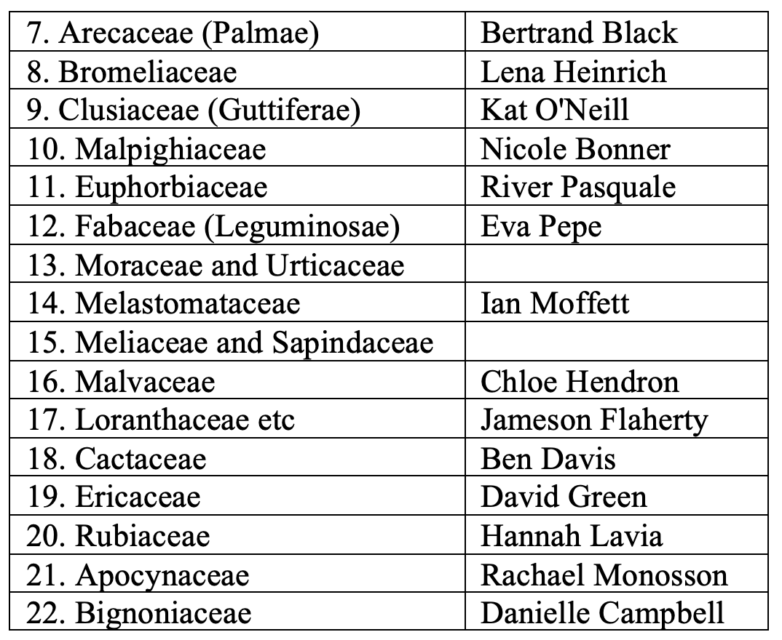
Presentations as of Today, Sept. 23

Slide 10
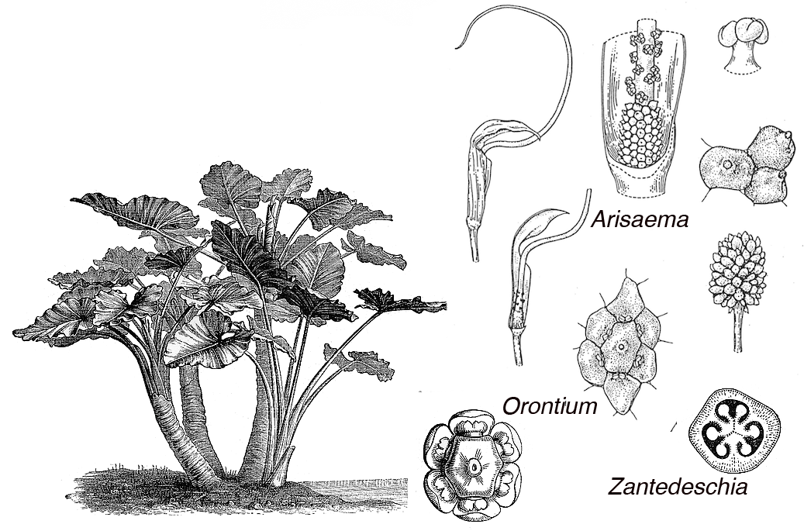
ARACEAE
Key Characters
net venation, no dead-end veins
raphides
spathe (inflorescence bract)
spadix (thick spike)
monocot numbers in flowers

Slide 11
MORPHOLOGY
KEY CHARACTERS – GENERAL MONOCOT

Slide 12
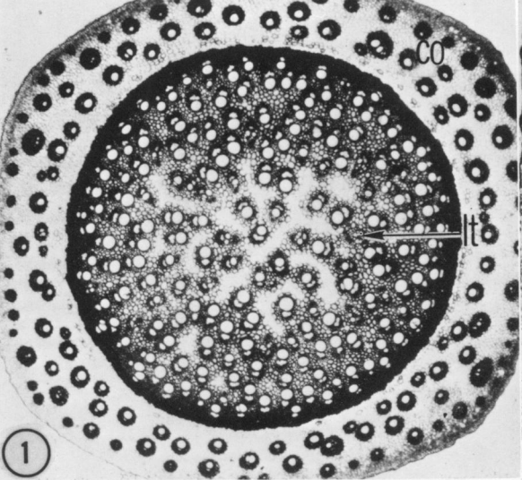
vascular bundles in stem scattered, closed
herbaceous, no interfascicular cambium developing
Pothos, Araceae
French and Tomlinson, 1981.

Slide 13
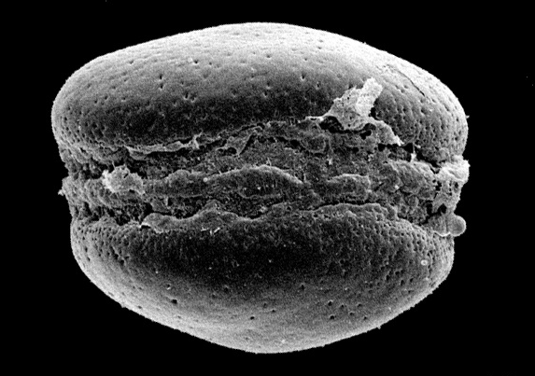
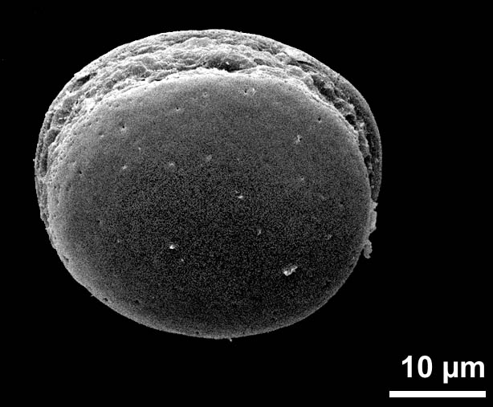
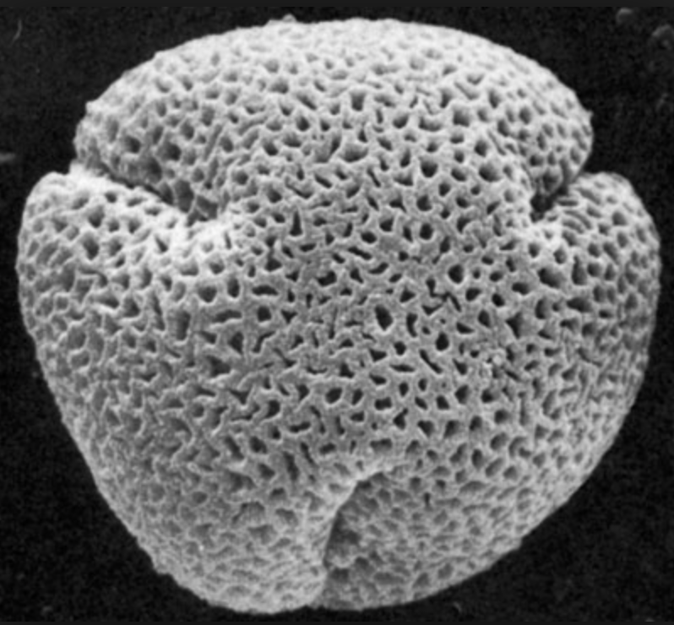
monosulcate pollen
Monstera
As opposed to trisulcate …

Slide 14
magnoliids
monocots
Current Angiosperm Phylogeny Group Tree for Flowering Plants
2016

Slide 15
MORPHOLOGY
KEY CHARACTERS – ARACEAE

Slide 16
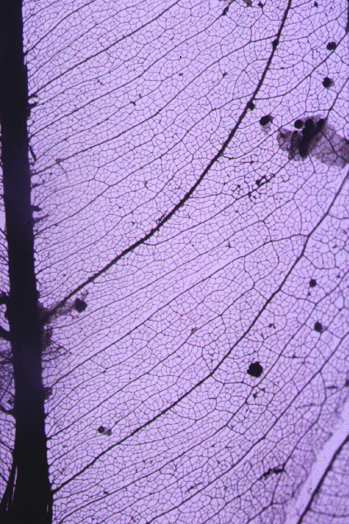

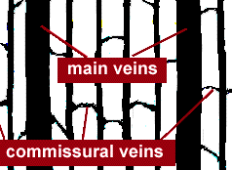
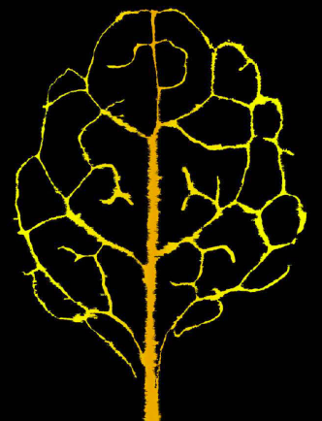
dicot-like secondary and tertiary veins in Anthurium, Araceae
textbook monocot veins
dicot
Notes:
Croat lexicon for Anthuirum: http://www.aroid.org/TAP/Articles/standanthdesc.php

Slide 17
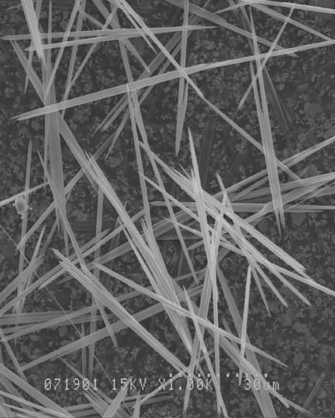
taro (Colocasia esculenta) calcium oxalate raphides 500x:
photo by Tina Weatherby Carvalho

Slide 18
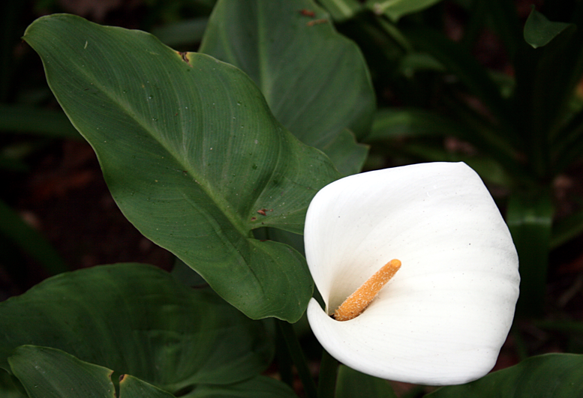
Spathe and spadix: Zantedischia, the "cally lily"

Slide 19
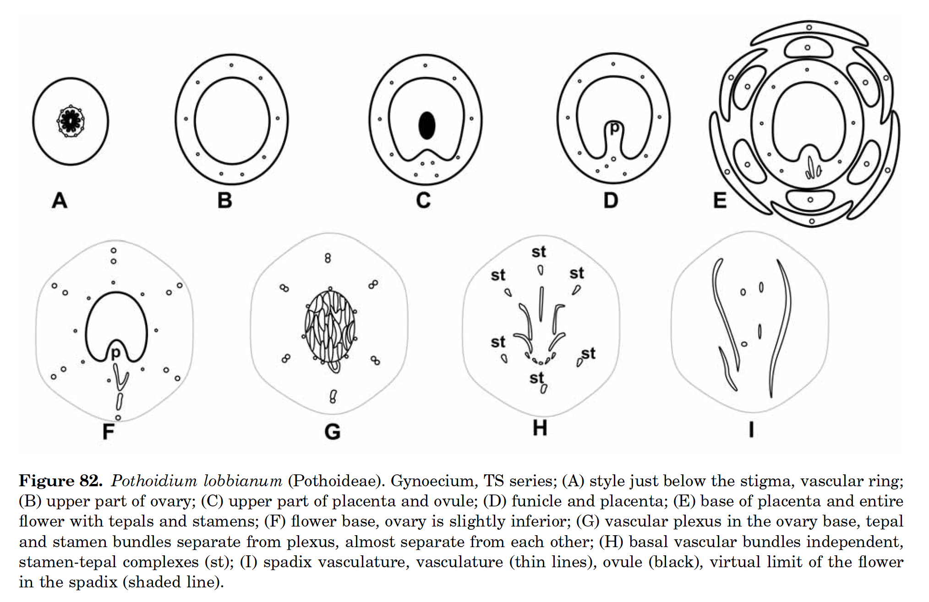
The gynoecium of the Araceae – one simple pistil
Notes:
Buzgo, M., 2001. Flower structure and development of Araceae compared with alismatids and Acoraceae. Botanical Journal of the Linnean Society, 136(4), pp.393-425.

Slide 20
LIFE FORM

Slide 21
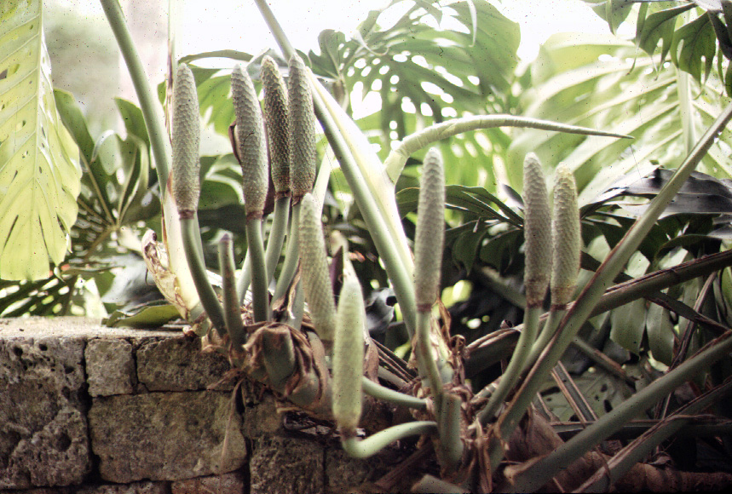
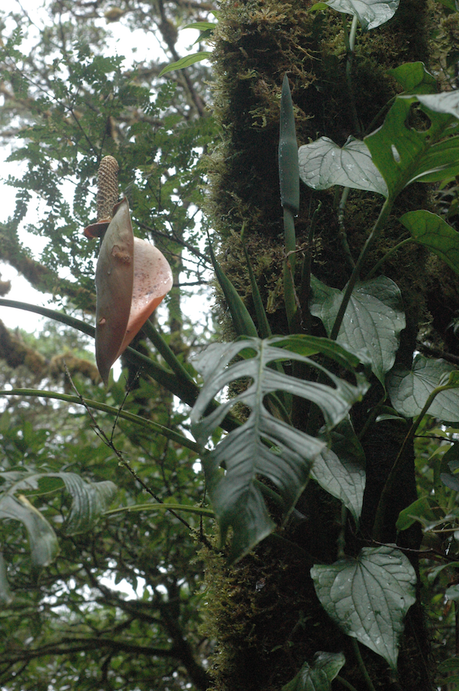
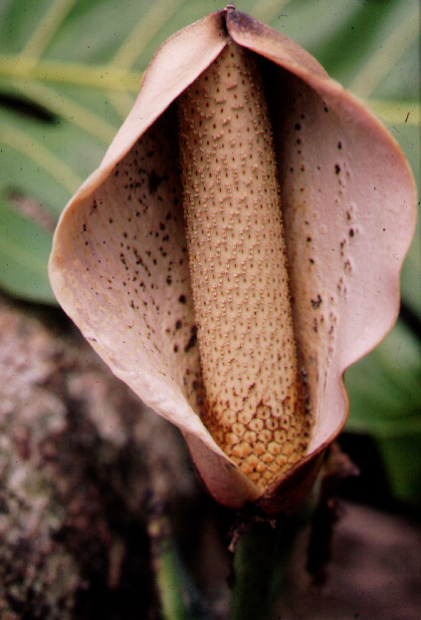
Monstera - hemiepiphyte with holes in leaves

Slide 23
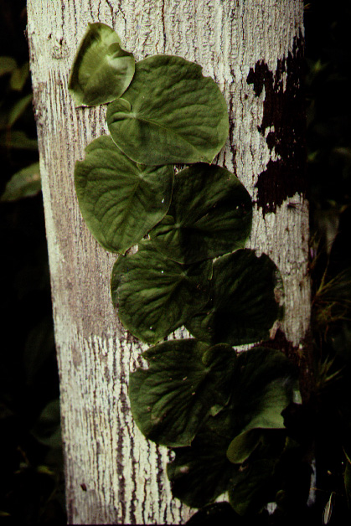
Philodendron - juvenile stem ascending trunk of a balsa tree

Slide 24
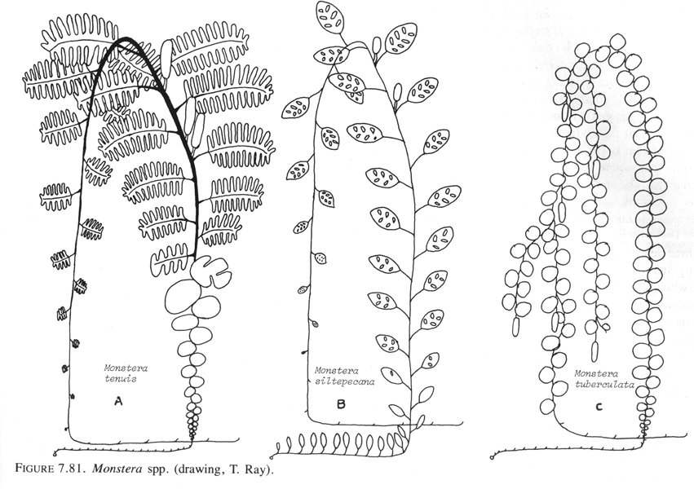

Slide 25
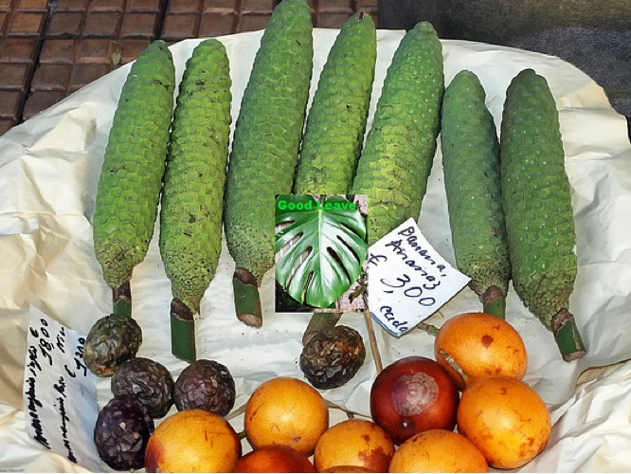
Monstera inflorescences as fruit in the market (active animal dispersal)

Slide 26
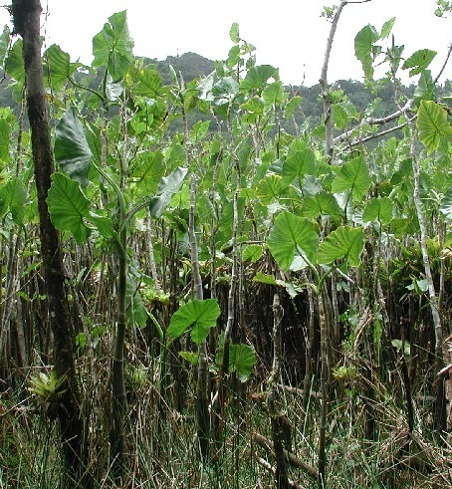
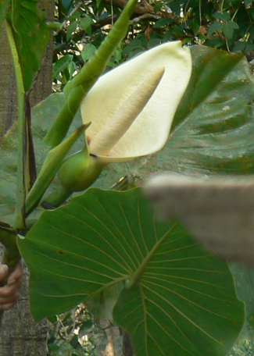
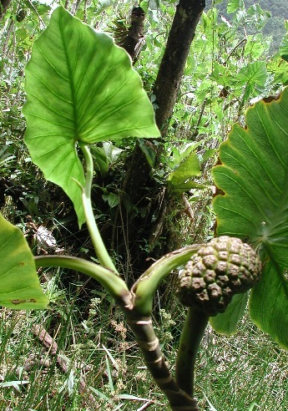
Montrichardia - monopodial, coastal swamp forests, a treelet without wood.
Notes:
infl picture: http://lh6.ggpht.com/_l--br1jG3MI/RsdzBiU0kCI/AAAAAAAACIU/qYzMIJONnqM/2007.8.1.Badajos+Rio.042.JPG
Known in some countries as Moco-Moco, the leaves are said to be the favourite food of manatees. The non-green parts, especially fruits in the fruiting head (spadix) are edible - the seeds can be roasted. Commonly eaten where they occur along the Orinoco delta Brucher (1989) . In Surinam a milky juice in the stem is used to treat deep cuts (external) and against nose bleeds.

Slide 27
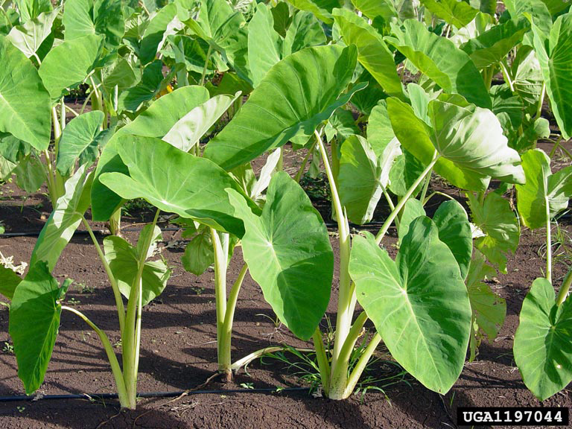
Emergent aquatics include Colocasia esculenta -- TARO
Colocasia affinis

Slide 28
FLOATING AQUATICS

Slide 29
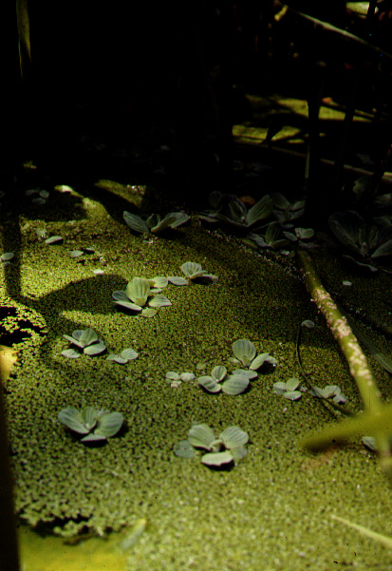
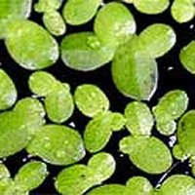
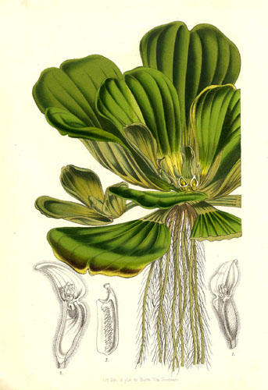
Pistia and Lemna – floating aquatics in the Araceae, but separate origins
Lemna

Slide 30
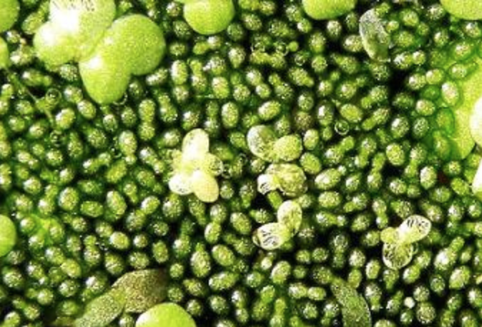
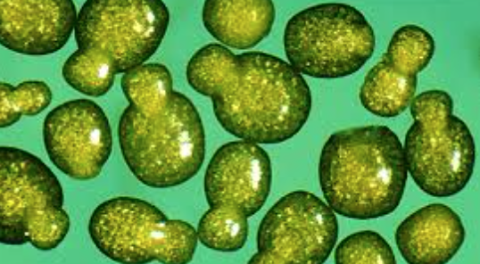
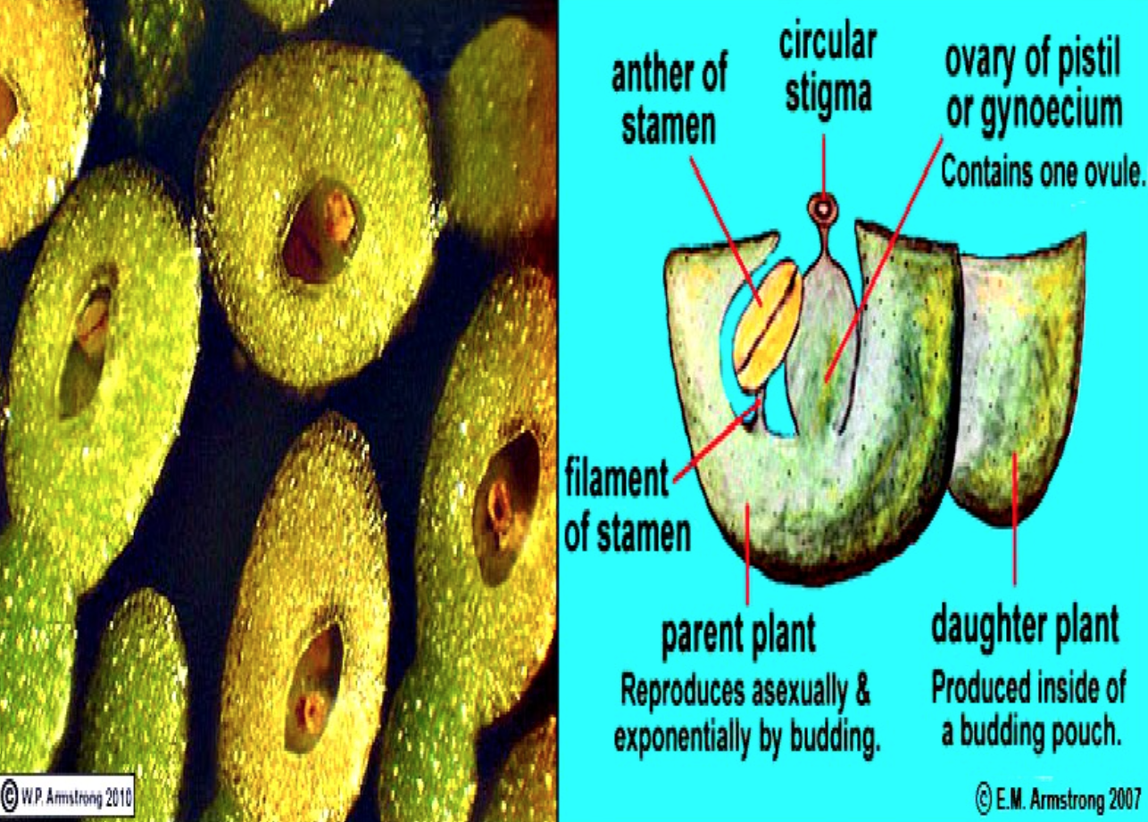
Wolffia
1 mm

Slide 31
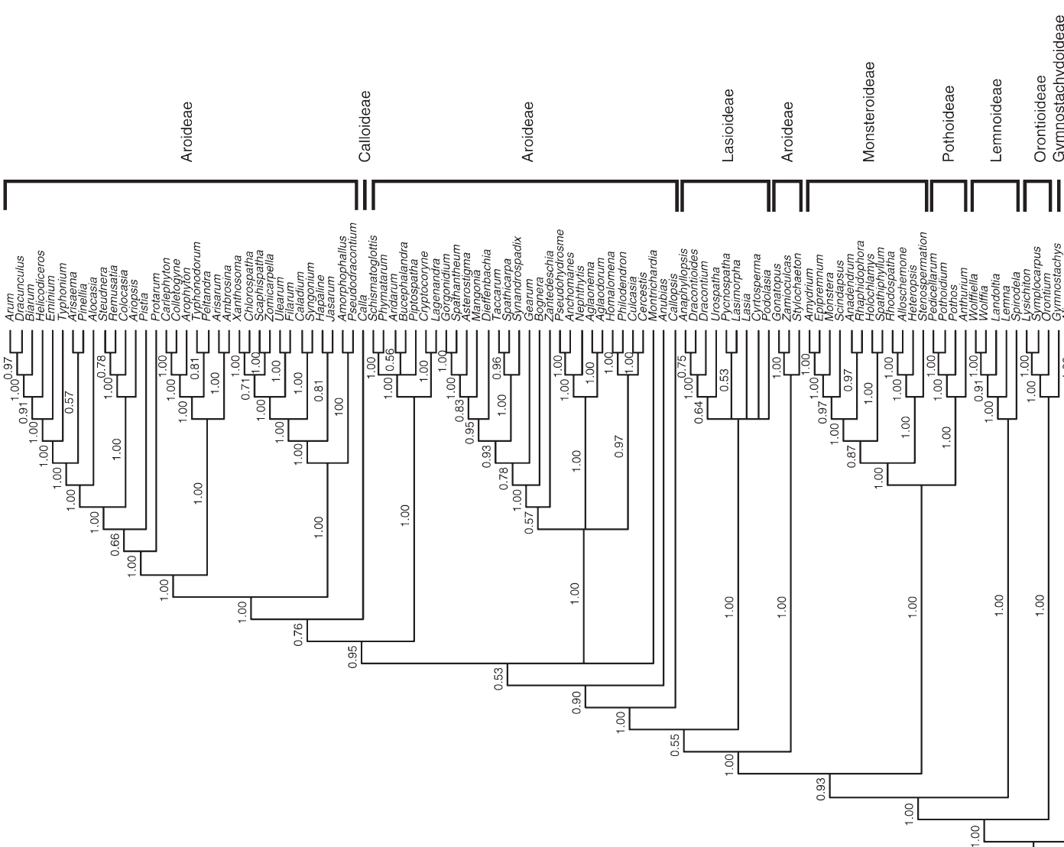
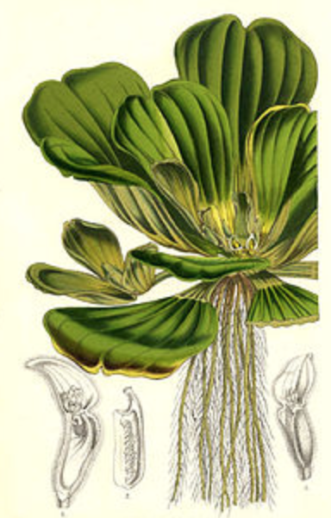
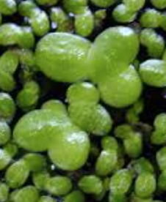
The floating aquatic life form originated twice.

Slide 32
POLLINATION

Slide 33
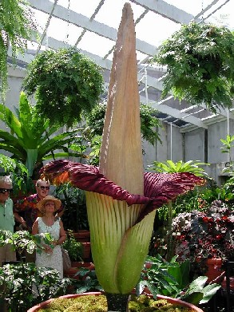
Amorphophallus titanum — originally from Sumatra

Slide 34
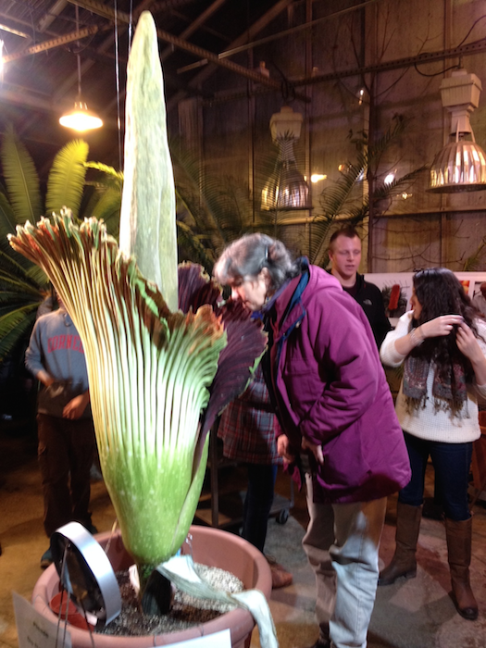
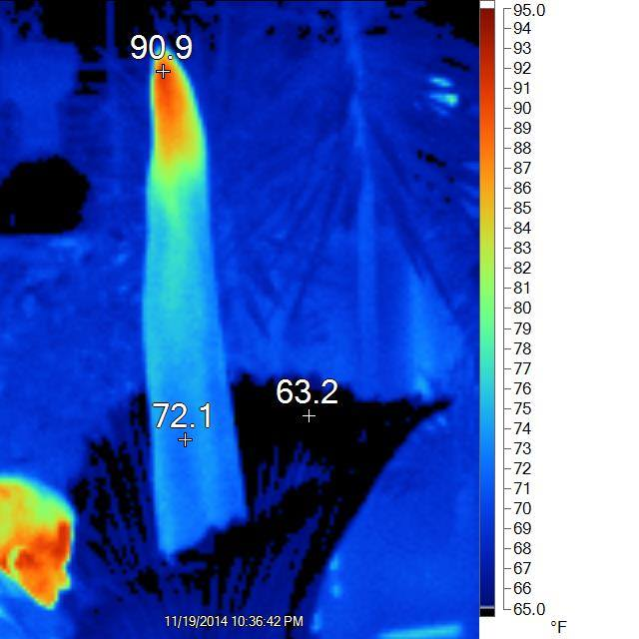
Amorphophallus titanum — Sumatra
The Cornell bloom, 2014, with heat map by Karl Niklas

Slide 35
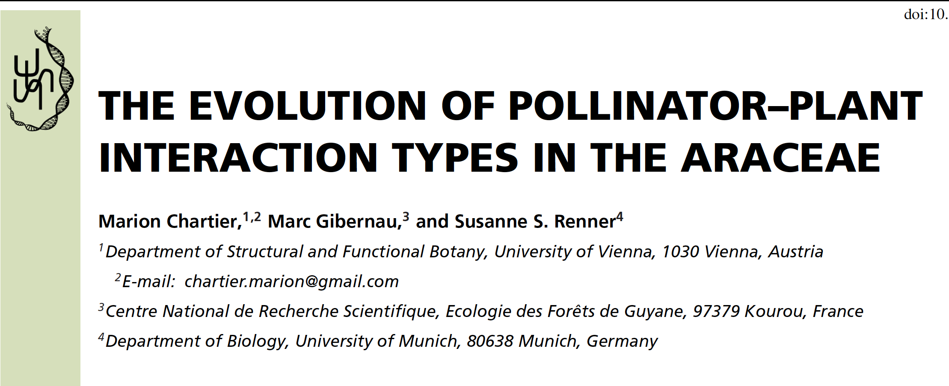

Slide 36

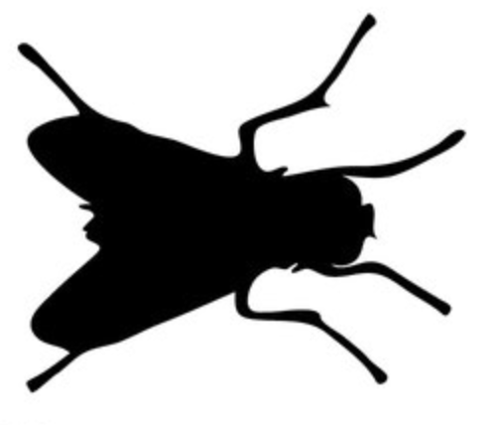

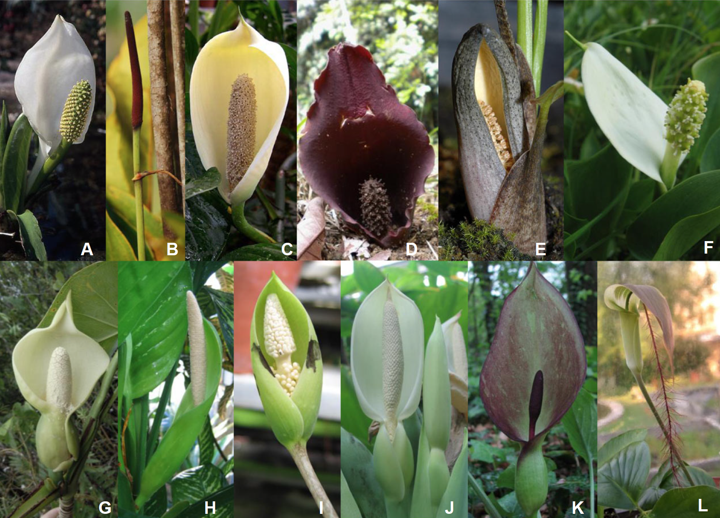
R Reward
D Deception
M Mating
O Ovipositing
A Lysichiton
B Anthurium
C Monstera
D Dracontium
E Stylochaeton
F Calla
G Montricharda
H Dieffenbachia
I Amorphophallus
J Colocasia
K Arum
L Arisaema
R
R
R
?
D
R?
M
M
D
O
D
D
Chartier et al., 2014
Notes:
A Lysichiton—rewarding mutualism, bees, flies
B Anthurium—rewarding mutualism, bees, beetles
C Monstera—rewarding mutualism, bees, beetles
D Dracontium—unknown type of interaction involving flies
E Stylochaeton—deceptive system involving beetles
F Calla—suspected rewarding mutualism involving flies and beetles
G Montrichardia—mating mutualism, beetles
H Dieffenbachia—mating mutualism, beetles
I Amorphophallus—deceptive system involving beetles
J Colocasia—oviposition mutualism, flies
K Arum—deceptive system involving flies
L Arisaema — deceptive system involving flies

Slide 37
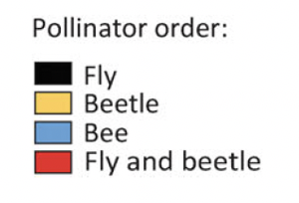



Slide 38


Slide 39



2 nd day hideout
Where does Philodendron fit in?
1st-day pistillate
2 nd eve exit
2 nd eve staminate
Notes:
Fig. 2. Philodendron selloum (length of inflorescence ca. 25 cm). A. One individual of pollinating beetles (Erioscelis emarginata) is approaching a first-evening, pistillate stage inflorescence . After collision with the spathe the beetle will fall into the kettle where the pistillate flowers are in the receptive stage. B. During the second day, the accumulated beetles try to protect themselves against daylight at the base of the kettle. C. On the second evening , the distal staminate flowers of the spadix press out pollen grain chains. The spathe is closing and the beetles are obliged to move upwards and to pass the pollen-producing region. D. Pollen-covered beetles arriving at the top of the spadix, shortly before flying off.
https://www.researchgate.net/publication/299566255_Generalist_and_specialist_pollination_in_basal_angiosperms_ANITA_grade_basal_monocots_magnoliids_Chloranthaceae_and_Ceratophyllaceae_what_we_know_now/figures?lo=1

Slide 40
PHYLOGENETIC CONTEXT

Slide 41

monocots
Current Angiosperm Phylogeny Group Tree for Flowering Plants

Slide 42
ACORACEAE – PRIMITIVE, MAGNOLIID-LIKE

Slide 43


Acorus (sweetflag) – currently the most primitive monocot
ethereal oils, absence of raphides suggest Magnoliids
Notes:
SEE buzgo2000.pdf on Acorus flora l development --- good on primitive carpel.
Many unusual characteristics of Acorus seem at home in the dicot order Piperales: presence of ethereal oil cells, absence of raphides, orthotropous ovules, secretory anther tapetum, cellular endosperm, perisperm and a base chromosome number of x = 11 or 12. Piperales differ, however, in having advanced vessel elements in the stem, apical anther dehiscence, simultaneous pollen mother-cell cytokinesis and (at least in Piper) a very
different type of embryogeny (Dahlgren and Clifford, 1982). They also have S-type sieve- tube plastids, which are unknown in monocots-though Acorus has not been investigated in this regard (Behnke, 1981 ) grayum, 1987, Taxon 36:723ff

Slide 44

monocots
Current Angiosperm Phylogeny Group Tree for Flowering Plants

Slide 45
SET ASIDE

Slide 46
The genera in the preceding figure:
A Lysichiton—rewarding mutualism, bees, flies
B Anthurium—rewarding mutualism, bees, beetles
C Monstera—rewarding mutualism, bees, beetles
D Dracontium—unknown type of interaction involving flies
E Stylochaeton—deceptive system involving beetles
F Calla—suspected rewarding mutualism involving flies and beetles
G Montrichardia—mating mutualism, beetles
H Dieffenbachia—mating mutualism, beetles
I Amorphophallus—deceptive system involving beetles
J Colocasia—oviposition mutualism, flies
K Arum—deceptive system involving flies
L Arisaema — deceptive system involving flies

Slide 47
Chartier et al., Evolution of pollinator–plant interaction types
The specific questions we wanted to answer with these data were
what is the phylogenetic distribution of mutualistic and deceptive pollination systems in the Araceae?
(ii) are there inflorescence traits that are correlated with interaction types, for example, unisexual flowers, spadix appendages, or constricted spathes?

Slide 48
Chartier et al., Evolution of pollinator–plant interaction types
The specific questions we wanted to answer with these data were
what is the phylogenetic distribution of mutualistic and deceptive pollination systems in the Araceae?
(ii) are there inflorescence traits that are correlated with interaction types, for example, unisexual flowers, spadix appendages, or constricted spathes?
Bayesian stochastic trait mapping showed that
1. spadix zonation,
2. presence of an appendix
3. flower sexuality (transition from bisexual to unisexual) were correlated with pollination interaction type.
Having unisexual flowers appears to have provided the morphological precondition for the evolution of traps.

Slide 49
monocots
Current Angiosperm Phylogeny Group Tree for Flowering Plants

Slide 50
Chartier et al., Evolution of pollinator–plant interaction types
The specific questions we wanted to answer with these data were
what is the phylogenetic distribution of mutualistic and deceptive pollination systems in the Araceae?
(ii) are there inflorescence traits that are correlated with interaction types, for example, unisexual flowers, spadix appendages, or constricted spathes?

Slide 51
POLLINATION TYPES
1. food rewards, such as stigmatic exudates, small amounts of nectar (Vogel and Martens 2000; Diaz and Kite 2006), or liquid
floral perfume for male euglossine bees (Hentrich et al. 2007,
2010).
2. Mating/oviposition site mutualisms involve flies or beetles
that mate or oviposit in the inflorescences (Gibernau et al. 1999;
Sakai 2002; Urru et al. 2010; our Table S2).
3. Antagonistic [deceptive] interactions involve the attraction and trapping of pollinators without either a food reward or a suitable site for larval development (Urru et al. 2011).

Slide 52


Slide 53


Slide 54

General Angiosperm Relations --- Soltis et al. 2008
No monosulcate pollen in descendants of this ancestor.
Mostly monosulcate pollen in early flowers and gymnosperms.

Slide 55


Slide 56


Slide 57


