Slide 1
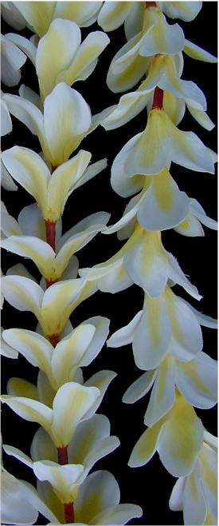
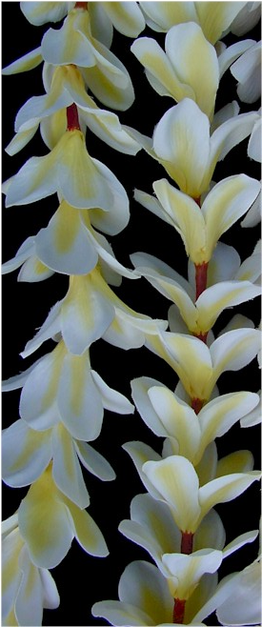

APOCYNACEAE (including Asclepiaceae)

Slide 2
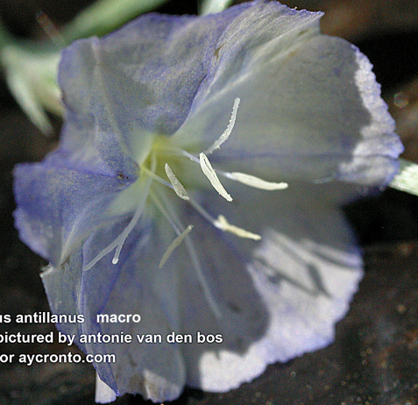
general Asterid Characters
fused corolla
stamens adnate to corolla
stamens equal to or fewer
than perianth lobes
gynoecium 2-carpellate

Slide 3
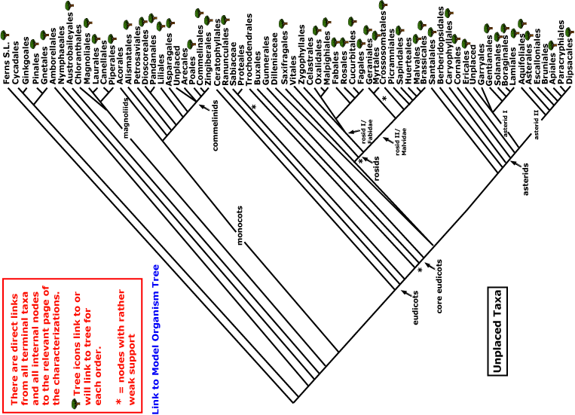

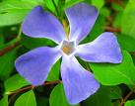
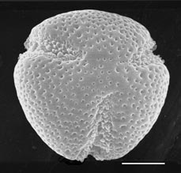
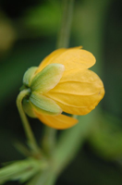
APOCYNACEAE
magnoliids
rosids
Current Angiosperm Phylogeny Group Tree for Flowering Plants
2016
monocots
asterids
core eudicots
eudicots

Slide 4
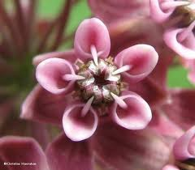
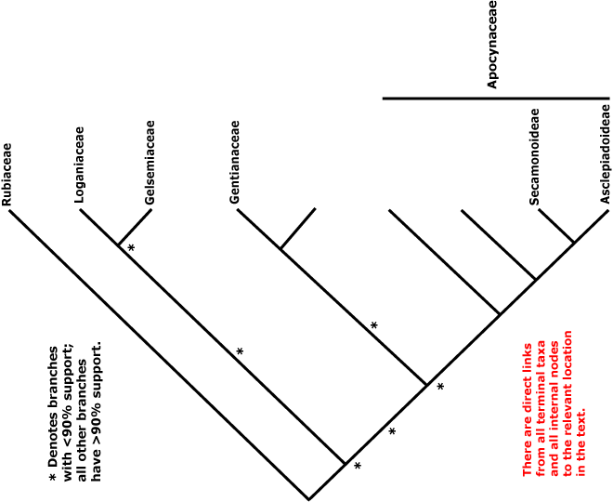

GENTIANALES
Asterids with
opposite leaves
radial symmetry
contorted petals

Slide 5
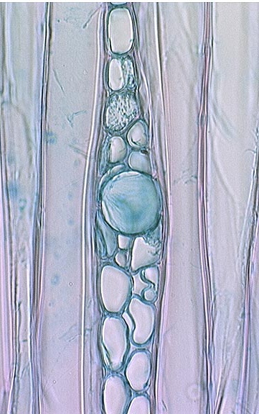
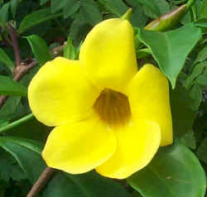
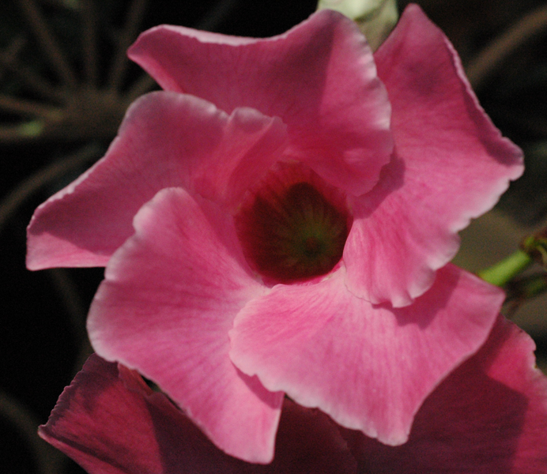
Allamanda and Dipladenia
APOCYNACEAE
laticifer in
Alstonia
milky latex
short filaments
superior ovary

Slide 6
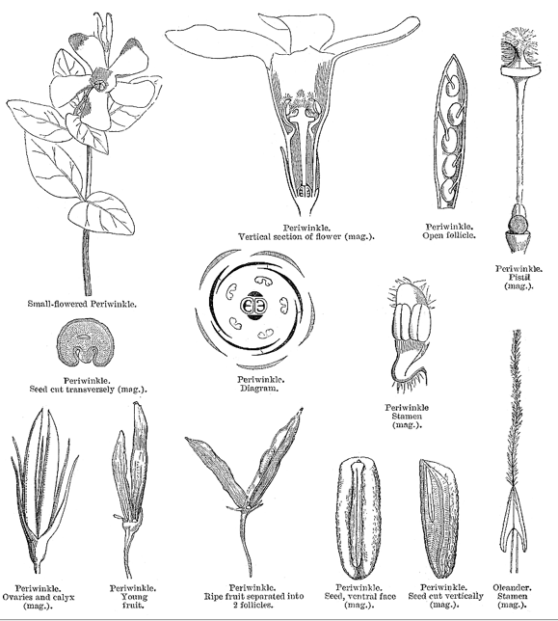
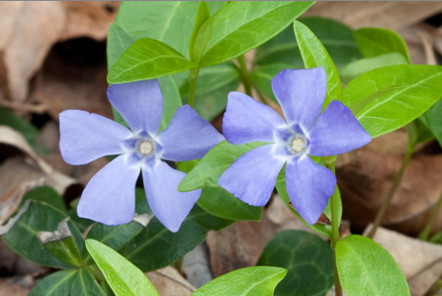
Vinca (periwinkle) local and typical Apocynaceae

Slide 7
Common Tropical American Apocynaceae

Slide 8
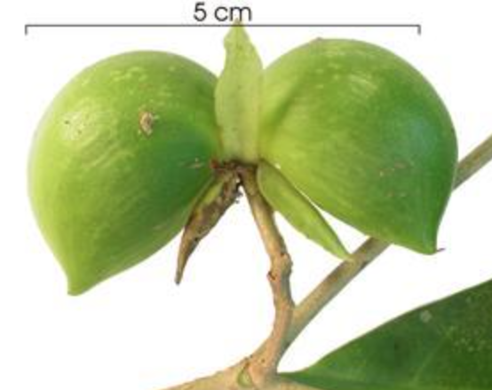
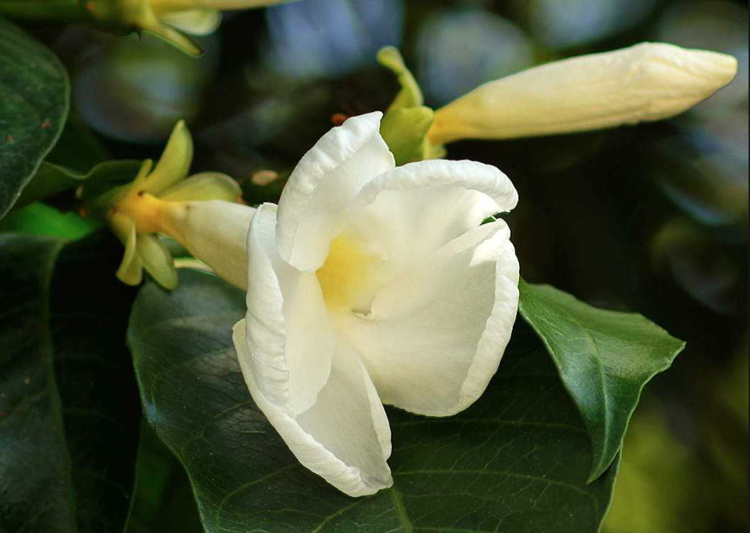
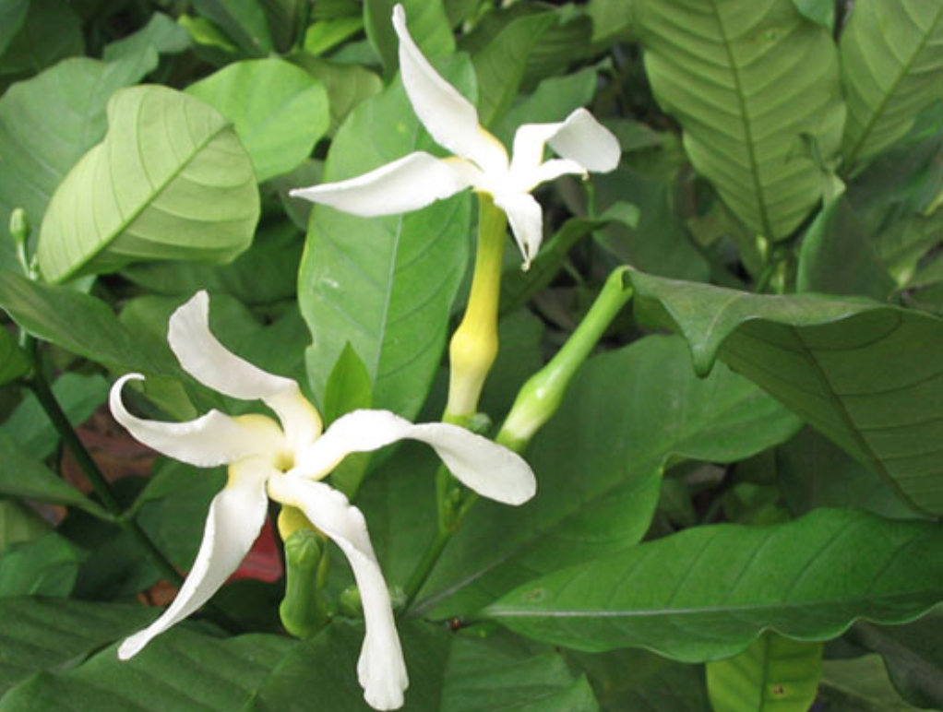
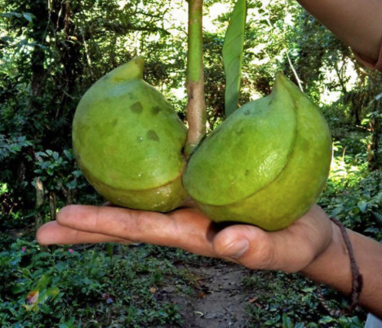
Stemmadenia and Tabernaemontana – American treelets of moist and dry forests
Notes:
Open fruits: http://www.projectnoah.org/spottings/6409324
McDiarmid, R.W., Ricklefs, R.E. and Foster, M.S., 1977. Dispersal of Stemmadenia donnell-smithii (Apocynaceae) by birds. Biotropica, pp.9-25.

Slide 9
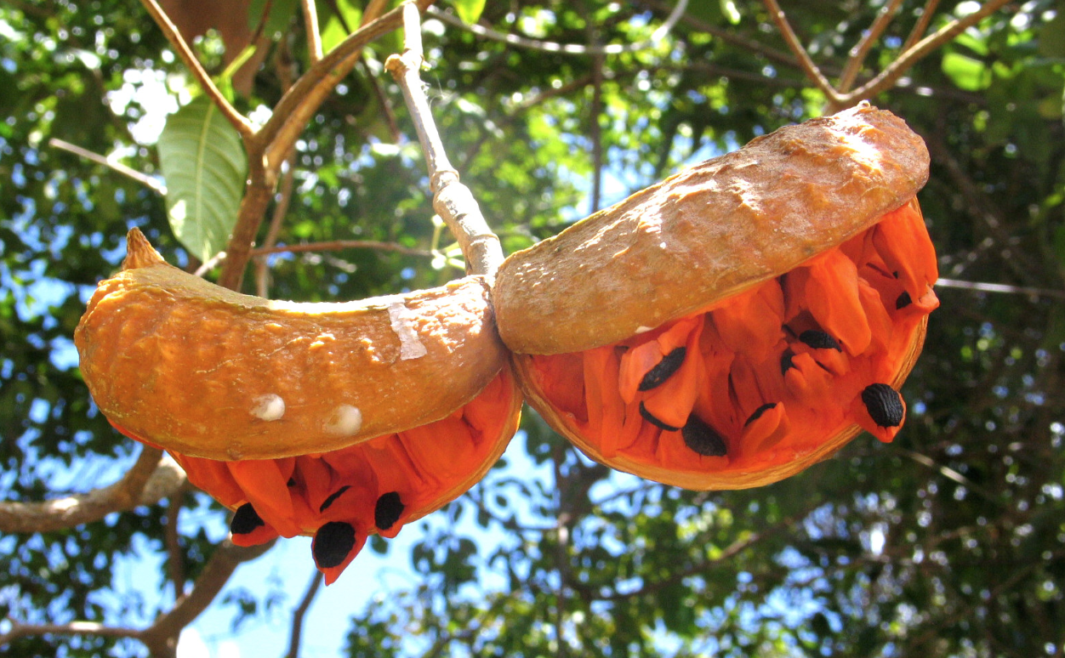
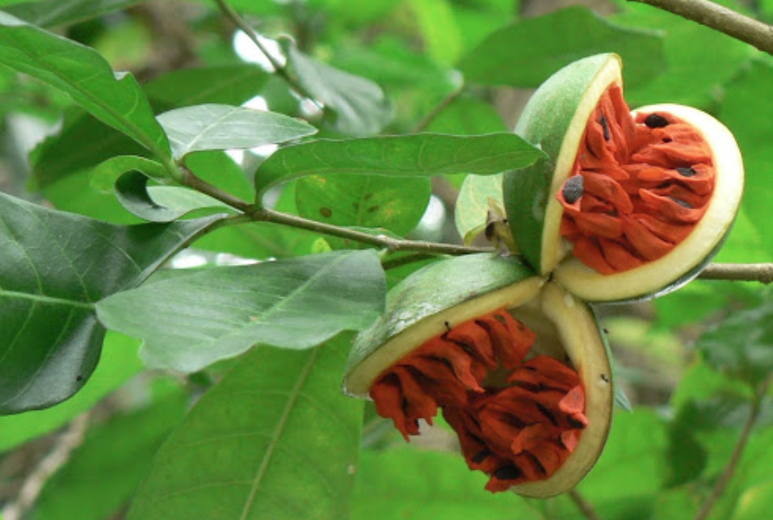
Bird-dispersal of fruits:
Characteristics of Stemmadenia that enhance dispersal include peak fruit availability in dry season, slow rate of opening, seed protection until maturation by husk, bright color of arils, relative accessibility and ease of separation of seed from husk and aril from seed, and high nutritive value of the aril.
McDiarmid, R.W., Ricklefs, R.E. and Foster, M.S., 1977. Dispersal of Stemmadenia donnell-smithii (Apocynaceae) by birds. Biotropica, pp.9-25.

Slide 10
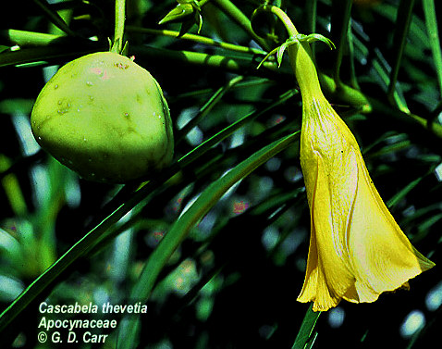
Thevetia

Slide 11
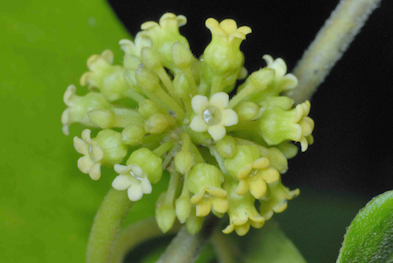
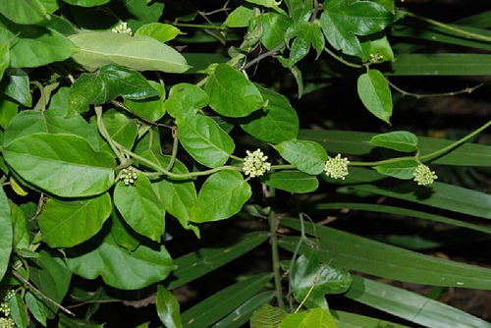
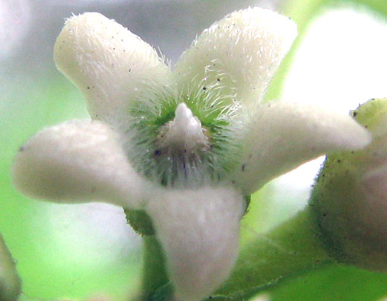
Climbers:
Marsdenia

Slide 12
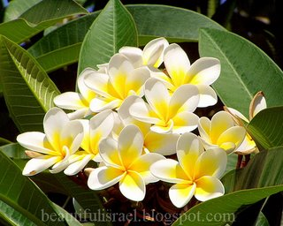
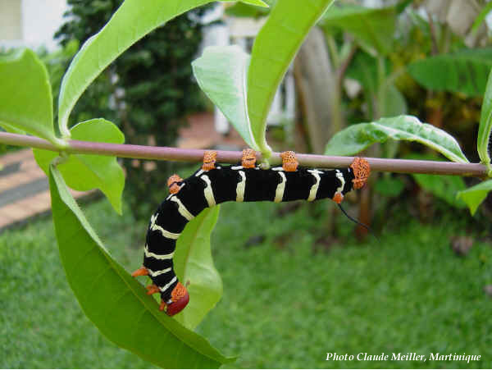
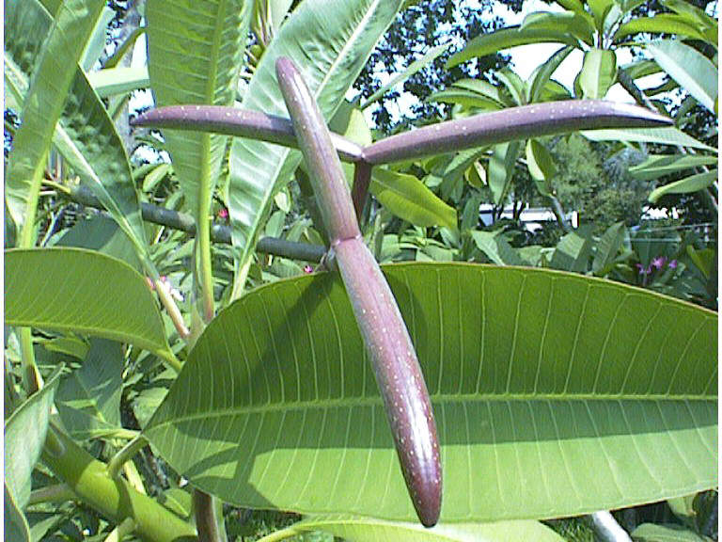
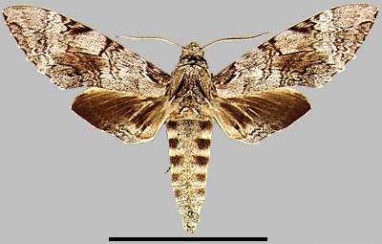
Plumeria and Pseudosphinx tetrio
Notes:
See Sloan2006.pdf
Pseudosphinx tetrio
http://images.google.com/imgres?imgurl=http://www.inra.fr/papillon/sphingid/images/ptetriol.jpg&imgrefurl=http://www.inra.fr/papillon/sphingid/texteng/p_tetrio.htm&usg=__R3IoxVJsNIWz3AQeogRjN-R6w80=&h=451&w=600&sz=65&hl=en&start=103&tbnid=GFX4beexh6qBIM:&tbnh=101&tbnw=135&prev=/images%3Fq%3Dapocynaceae%26start%3D100%26gbv%3D2%26ndsp%3D20%26hl%3Den%26sa%3DN

Slide 13
On Plumeria, herbivore damage by caterpillars of the sphinx moth Pseudosphinx tetrio is restricted primarily to the wettest season, consistent with the hypothesis that early leaf flush and reproduction has been selected to avoid herbivory.
Notes:
Phenology of Plumeria alba and its Herbivores in a Tropical Dry Forest
Steven A. Sloan 2,1 Jess K. Zimmerman 3 Alberto M. Sabat 4
2 Department of Biology, University of Puerto Rico, Rio Piedras Campus, San Juan, Puerto Rico 00931-3360, U.S.A.
3 Institute for Tropical Ecosystem Studies, PO Box 23341, San Juan, Puerto Rico 00931-3341, U.S.A.
and 4 Department of Biology, University of Puerto Rico, Rio Piedras Campus, San Juan, Puerto Rico 00931-3360, U.S.A.
1 Corresponding author; Current Address: Department of Biology, University of Puerto Rico, Bayamón Campus, Parque Industrial Minillas #170, Carr. 174, Bayamón, Puerto Rico 00959 U.S.A.; e-mail: stevenasloan@hotmail.com
Copyright 2007 The Author(s) Journal compilation © 2007 by The Association for Tropical Biology and Conservation
KEYWORDS
Apocynaceae • Guánica • herbivory • photoperiod • plant–insect interaction • Pseudosphinx tetrio • Puerto Rico • Sphingidae
ABSTRACT
Understanding phenology in plant populations requires distinction between proximate mechanisms and ultimate (evolutionary) causation. Leaf production and abscission, flower production, and herbivory were monitored for 2 yr in a population of the stem succulent tree, Plumeria alba L. in the Guánica State Forest in southwest Puerto Rico. Dependence of phenological events on abiotic (rainfall and day length) and biotic factors (herbivore abundance/damage) was quantified to discern potential relationships. Leaf flush and flowering were not associated with periods of highest rainfall as might be expected in a dry tropical forest. Rather, these events were highly correlated with day length. We observed that most leaf flush began in March and April, which was several months before the wettest period of the year (August to November). This result is consistent with other studies that show that leaf flush in Plumeria is under photoperiodic control and that the plants initiate growth and reproduction when cloudiness is low and seasonal light availability is greatest. Herbivore damage by caterpillars of the sphinx moth Pseudosphinx tetrio is restricted primarily to the wettest season, consistent with the hypothesis that early leaf flush and reproduction has been selected to avoid herbivory. It is not clear whether photoperiodic control of leaf flush and reproduction serves to maximize seasonal light availability, minimize the impact of herbivores, or both. However, it is clear that peak rainfall is not likely to have been the sole selective factor determining leaf flush and flowering in P. alba.

Slide 14
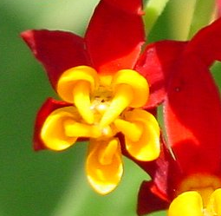
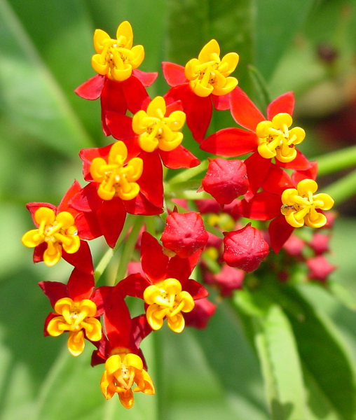
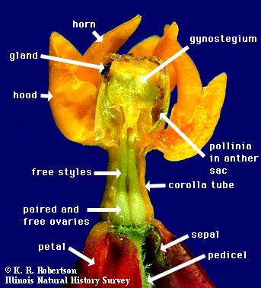
Asclepias

Slide 15
The African xerophytes

Slide 16
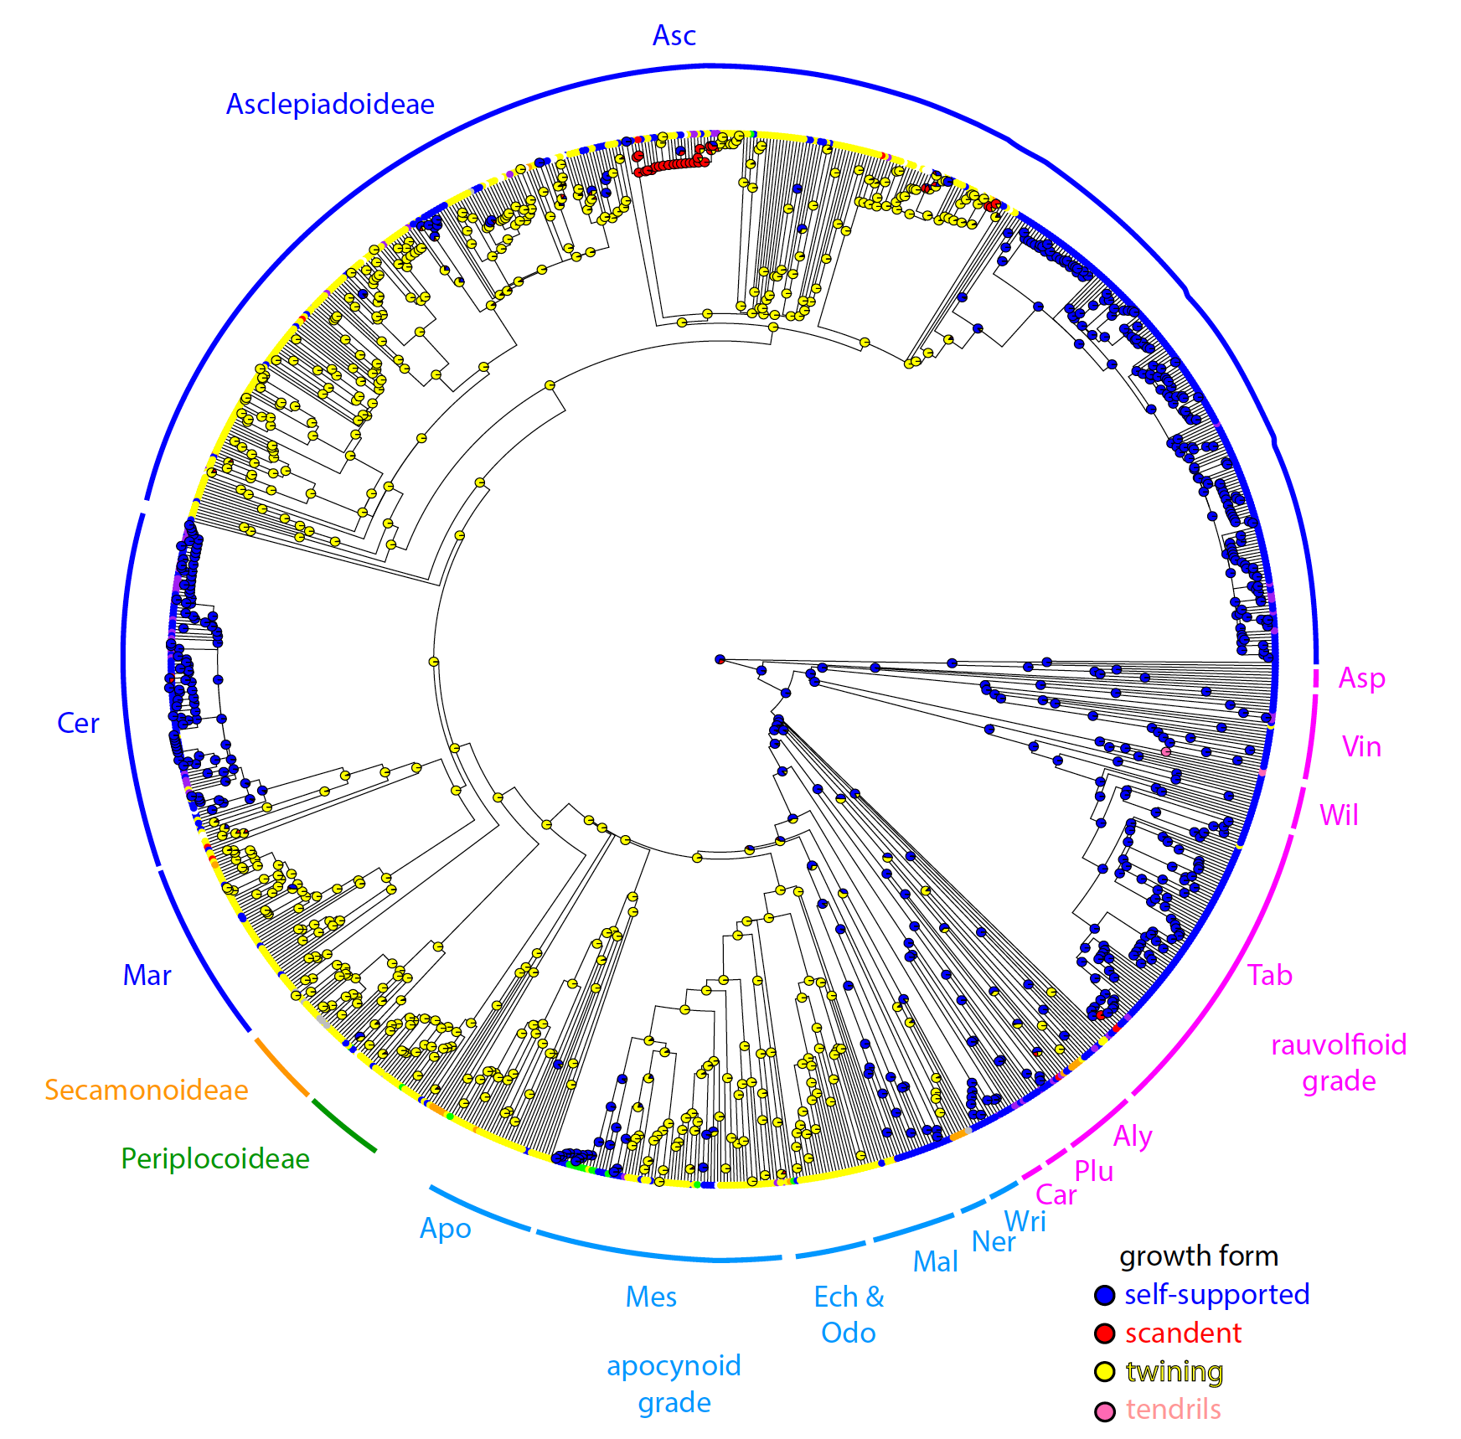
Notes:
Fishbein, M., Livshultz, T., Straub, S.C., Simões, A.O., Boutte, J., McDonnell, A. and Foote, A., 2018. Evolution on the backbone: Apocynaceae phylogenomics and new perspectives on growth forms, flowers, and fruits. American Journal of Botany, 105(3), pp.495-513.

Slide 17
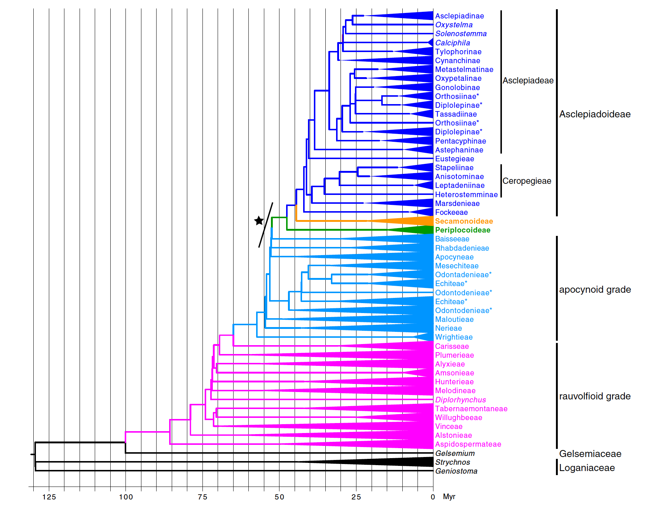
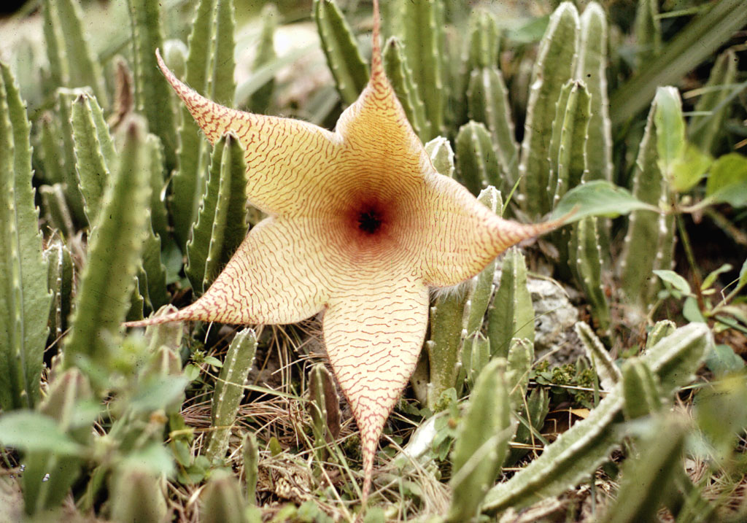
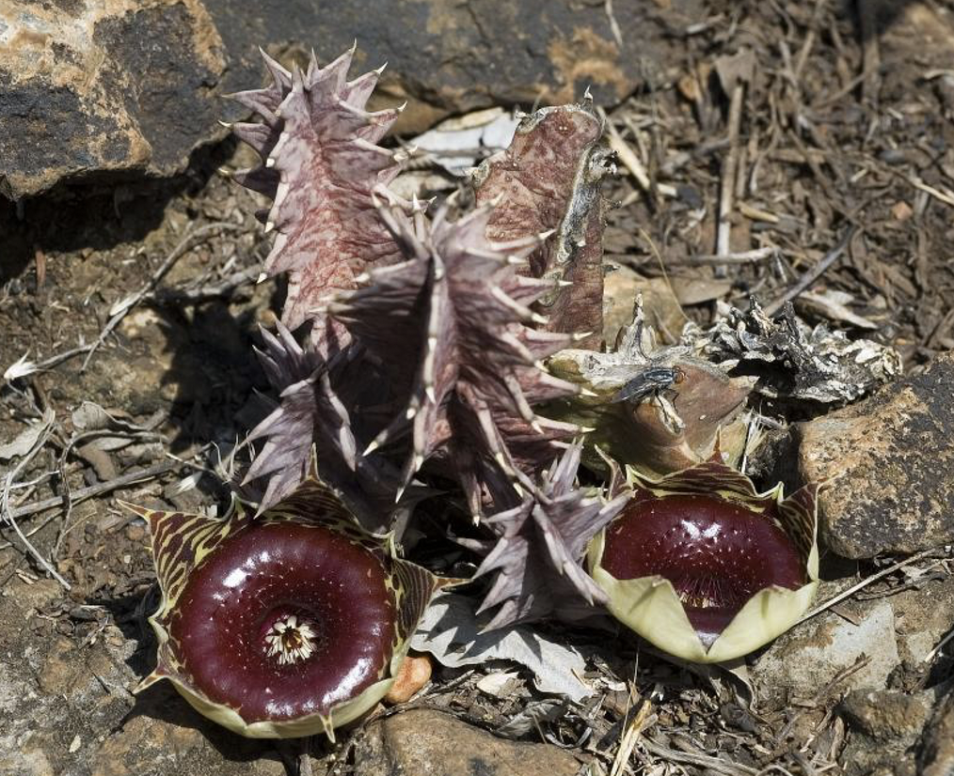
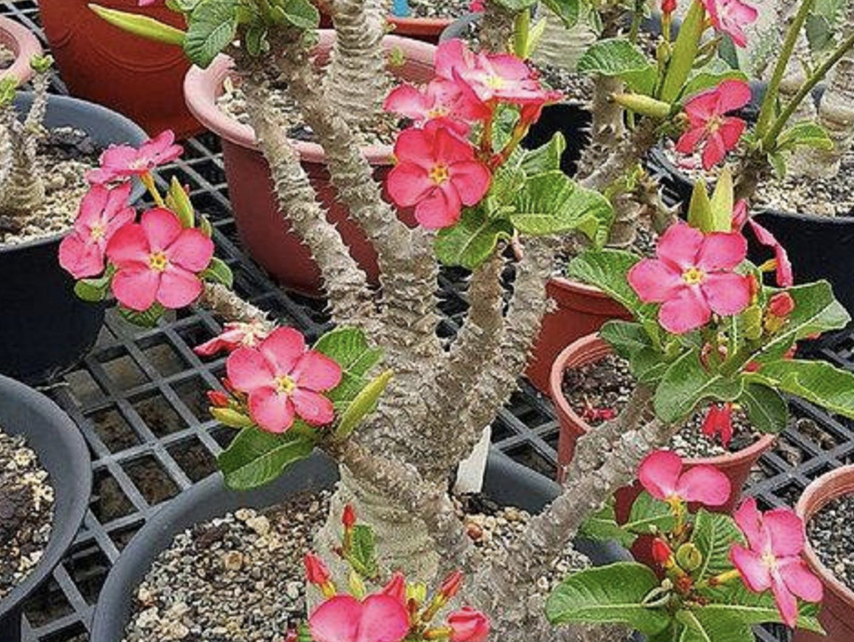
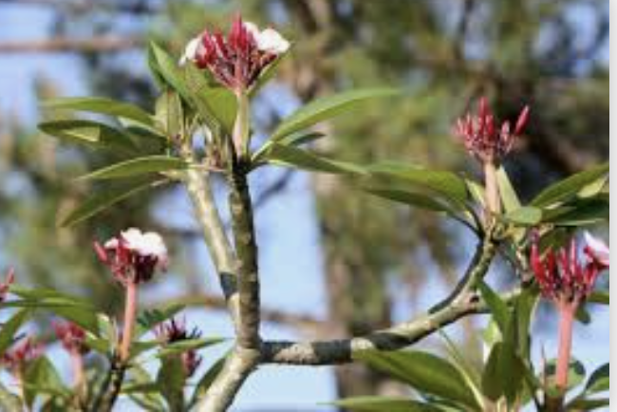
Notes:
chronogram: Fishbein, M., Livshultz, T., Straub, S.C., Simões, A.O., Boutte, J., McDonnell, A. and Foote, A., 2018. Evolution on the backbone: Apocynaceae phylogenomics and new perspectives on growth forms, flowers, and fruits. American Journal of Botany, 105(3), pp.495-513.

Slide 18
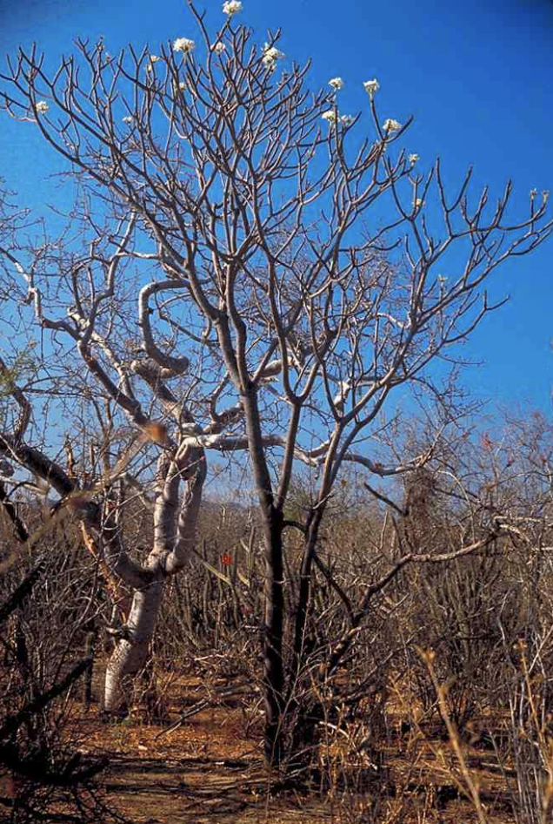
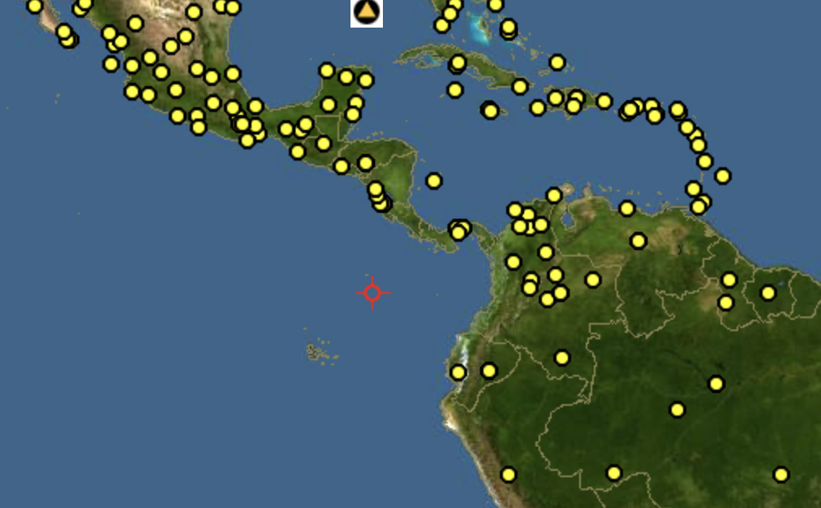
Plumeria

Slide 19
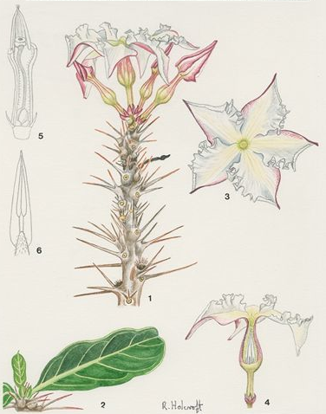
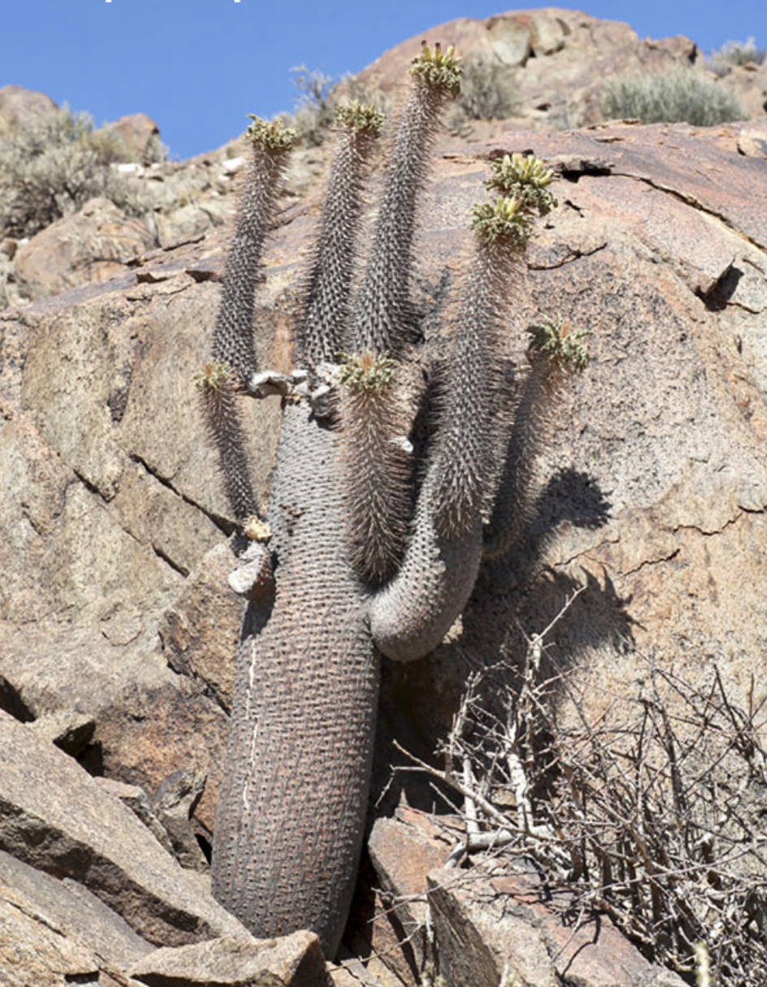
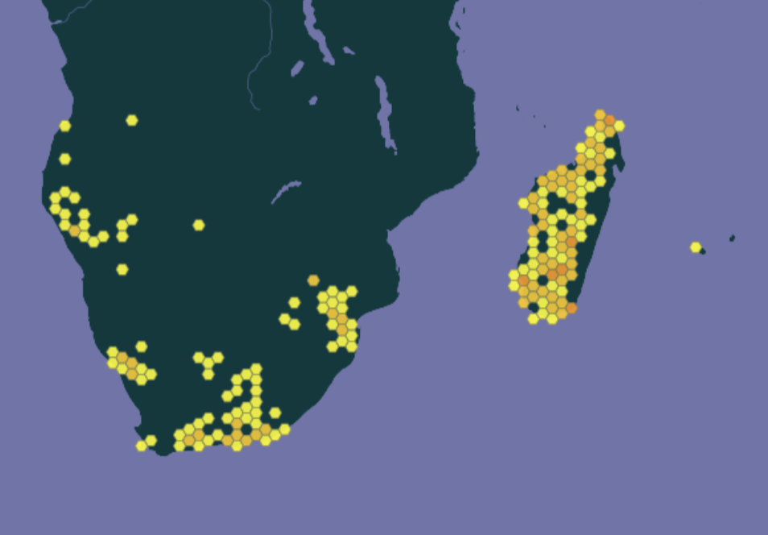
Pachypodium
African succulent

Slide 20
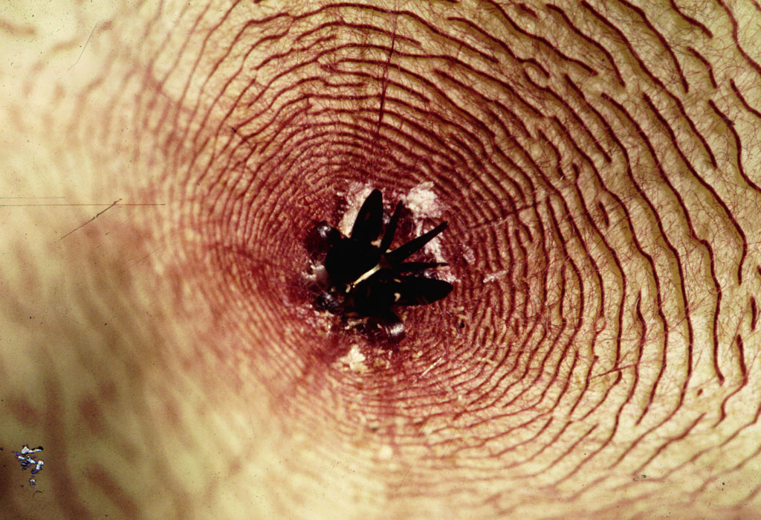
Stapelia - African carrion-insect dispersed flower

Slide 21
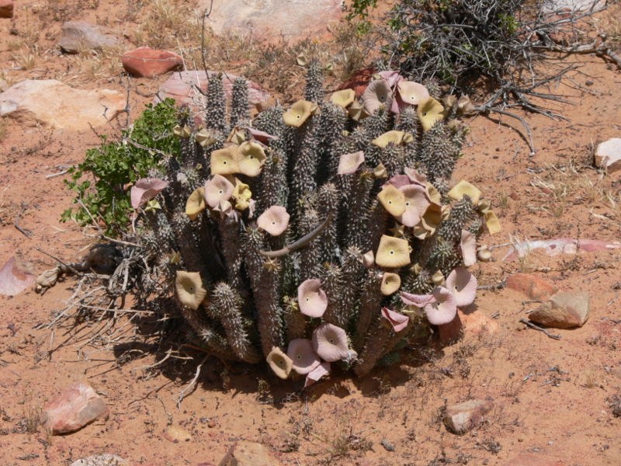
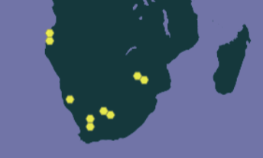
Hoodia
Notes:
wikipedia: Hoodia gordonii, is being investigated for use as an appetite suppressant.[2] "In the last few years, hoodia has been heavily marketed for weight loss and has become immensely popular.”
Hoodia is currently listed in Appendix II to the Convention on International Trade in Endangered Species of Wild Fauna and Flora (CITES), which includes species not currently considered endangered but are at risk if trade is not controlled.[4]

Slide 22
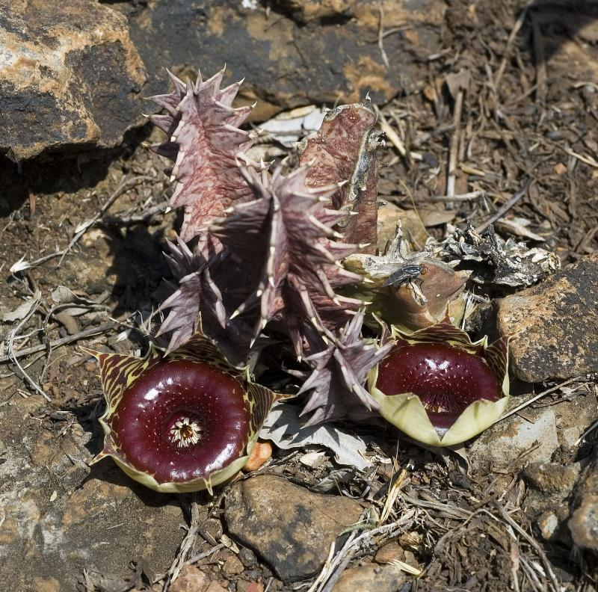
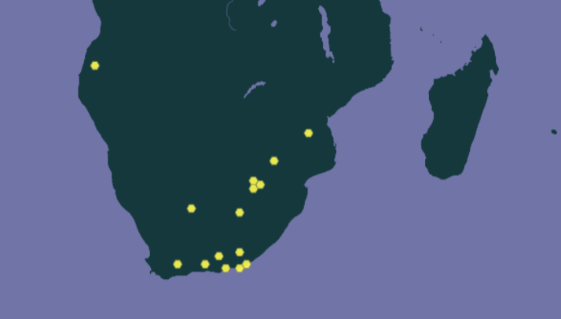
Huernia
South Africa
Notes:
http://images.google.com/imgres?imgurl=http://k41.pbase.com/v3/26/576926/2/46514666.Huernia_transvaalensis.jpg&imgrefurl=http://www.pbase.com/dorff/image/46514666&usg=__V8G5pXxGMog-a2l6C7_aWTnGwVA=&h=792&w=800&sz=167&hl=en&start=81&tbnid=R4aCf3-54opZyM:&tbnh=142&tbnw=143&prev=/images%3Fq%3Dapocynaceae%26start%3D80%26gbv%3D2%26ndsp%3D20%26hl%3Den%26sa%3DN

Slide 23
Medicinal and Toxic Apocynaceae

Slide 24
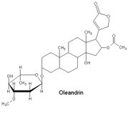
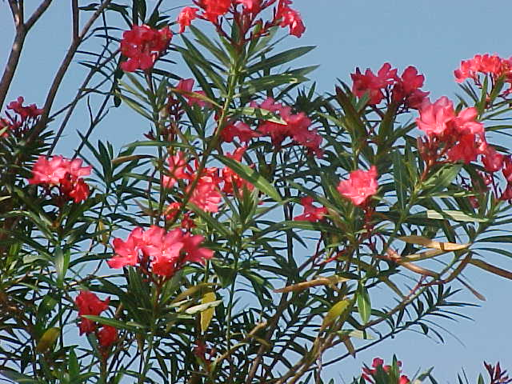
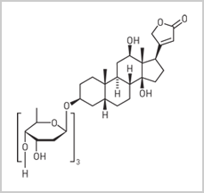

Nereum oleander: cardiac glycoside poisoning
DIGITOXIN from Digitalis
Notes:
Cardiac glycosides inhibit this pump by stabilizing it in the E2-P transition state, so that sodium cannot be extruded: intracellular sodium concentration therefore increases. A second membrane ion pump, NCX, is responsible for pumping calcium ions out of the cell and sodium ions in (3Na/Ca); raised intracellular sodium levels inhibit this pump, so calcium ions are not extruded and will also begin to build up inside the cell.

Slide 25



How a bluejay avoids Asclepias cardiac glycoside poisoning.
Bird images copyright Lincoln Brower, Sweet Briar College

Slide 26



Catharanthus – leukemia medicine
vinblastine
vincristine
Notes:
alkaloids are itotic inhibitors used to impede cancers BY STABILIZING MCIRTUBULES TO INHIBIT THE SEPARATION OF SISTER CHROMATIS, INHIBITING CELL DIVISION OF THE CANCER CELLS BECAUSE THE COMPOUND ACCUMULATES IN THE CELLS WITH ACTIVE MICROTUBULE ACTIVITY.

Slide 27


Rauwolfia, antihypertensive
reserpine
in herbal form rather than the form of isolated active ingredients, it is a safe and effective resource for hypertensive patients.
Notes:
Rauvolfia (also spelled Rauwolfia) is a genus of evergreen trees and shrubs in the Apocynaceae family. The approximately 85 species in the genus can mainly be found in tropical regions. Rauvolfia caffra is the South African quinine tree. Rauvolfia serpentina, or Indian Snakeroot or Sarpagandha, contains a number of bioactive chemicals, including ajmaline, deserpidine, rescinnamine, serpentinine, and yohimbine. Reserpine is an alkaloid first isolated from R. serpentina which was widely used as an antihypertensive drug. It had drastic psychological side effects and has been now replaced by blood-pressure-lowering drugs that lack such adverse effects. But in herbal form rather than the form of isolated active ingredients, it is a safe and effective resource for hypertensive patients. The pharmaceutical companies have stopped producing this drug as reserpine or deserpedine, or any other form. It is only available currently in the U.S. via herbal medicine ordering, over the Internet.

Slide 28

The Gentianales signature: monoterpene (i.e. 10 carbons) indole alkaloids
Rubiaceae
Apocynaceae
Apocynaceae
vinblastine
vinblastine
reserpine
vincristine
Notes:
[these] alkaloids are mitotic inhibitors used to impede cancers

Slide 29
Allamanda and Dipladenia
APOCYNACEAE
laticifer in
Alstonia
milky latex
short filaments
superior ovary

