Slide 1
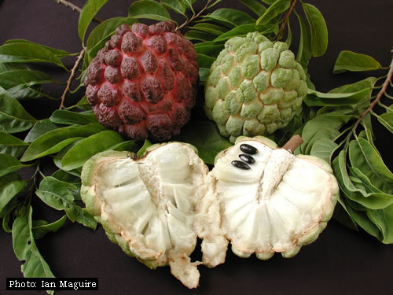
ANNONACEAE

Slide 2
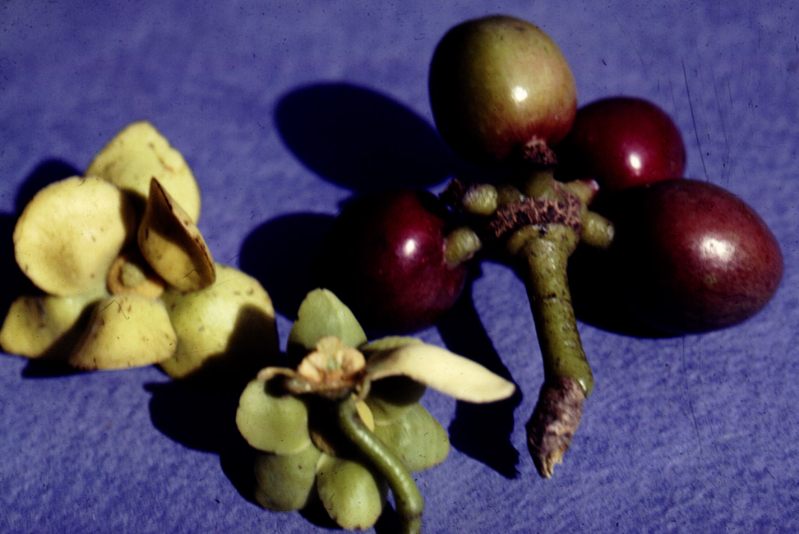
Guatteria - Costa Rica

Slide 3
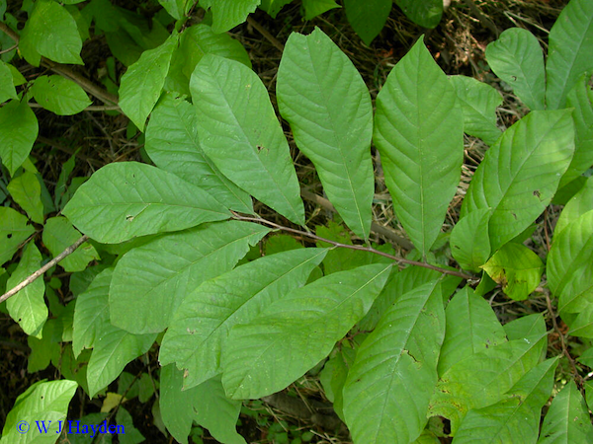
Key Family Characters - Annonaceae
Alternate simple, distichous leaves
Magnoliid tertiary veins
Unappealing magnoliid essential oils
Big flowers with 3 whorls of 3 tepals
Many stamens that have appendages

Slide 4
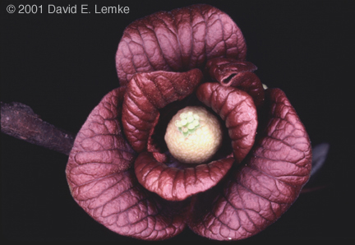
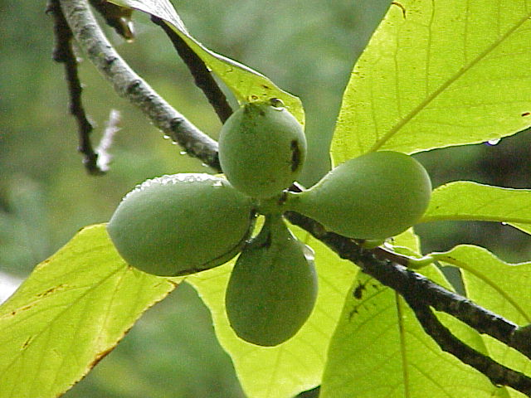
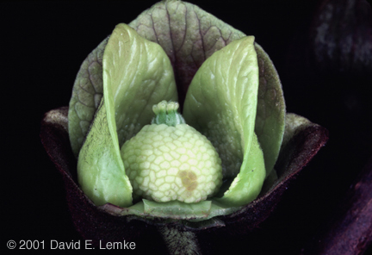
Asimina, the pawpaw of eastern North America
Notes:
The medicinal value of Pawpaw seed extracts has been documented since 1884. An alkaloid anti-cancer drug named asimicin was isolated from the Pawpaw in 1991. It is commercially available as the herbal medicine Pawpaw Cell-Reg. It is also an effective pesticide and has been used to treat head lice
Structure of asimicin.

Slide 6
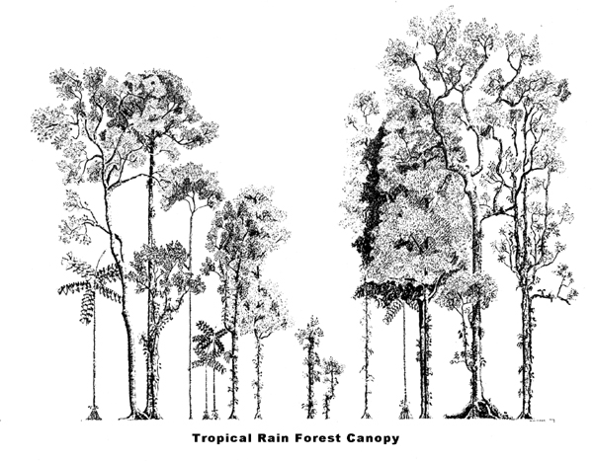
Annonaceae - lower understory trees
and treelets

Slide 7
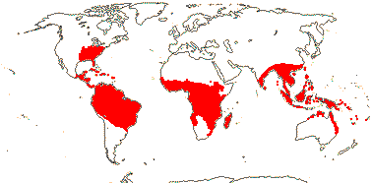
Annonaceae – World Distribution

Slide 8
Key Family Characters - Annonaceae
Alternate simple, distichous leaves
Magnoliid tertiary veins
Unappealing magnoliid essential oils
Big flowers with 2-3 whorls of 3 tepals
Many stamens that have appendages

Slide 9
Morphology

Slide 10
Malvaceae
Many families
Anacardiaceae
Piperaceae
magnoliids
Aquifoliaceae
Melastomataceae
Myrtaceae,
Primulaceae

Slide 11
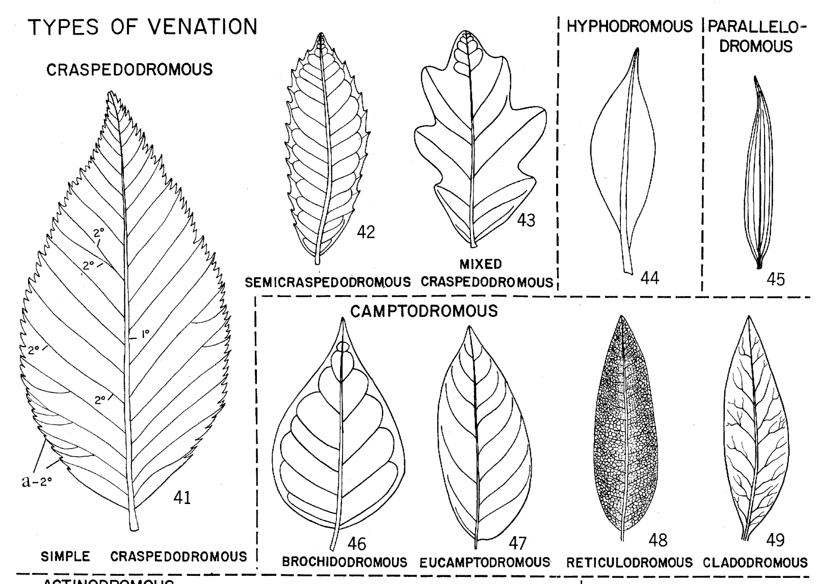
Secondary Vein patterns
Hickey, L.J., 1973. Classification of the architecture of dicotyledonous leaves. American journal of botany, pp.17-33.

Slide 12
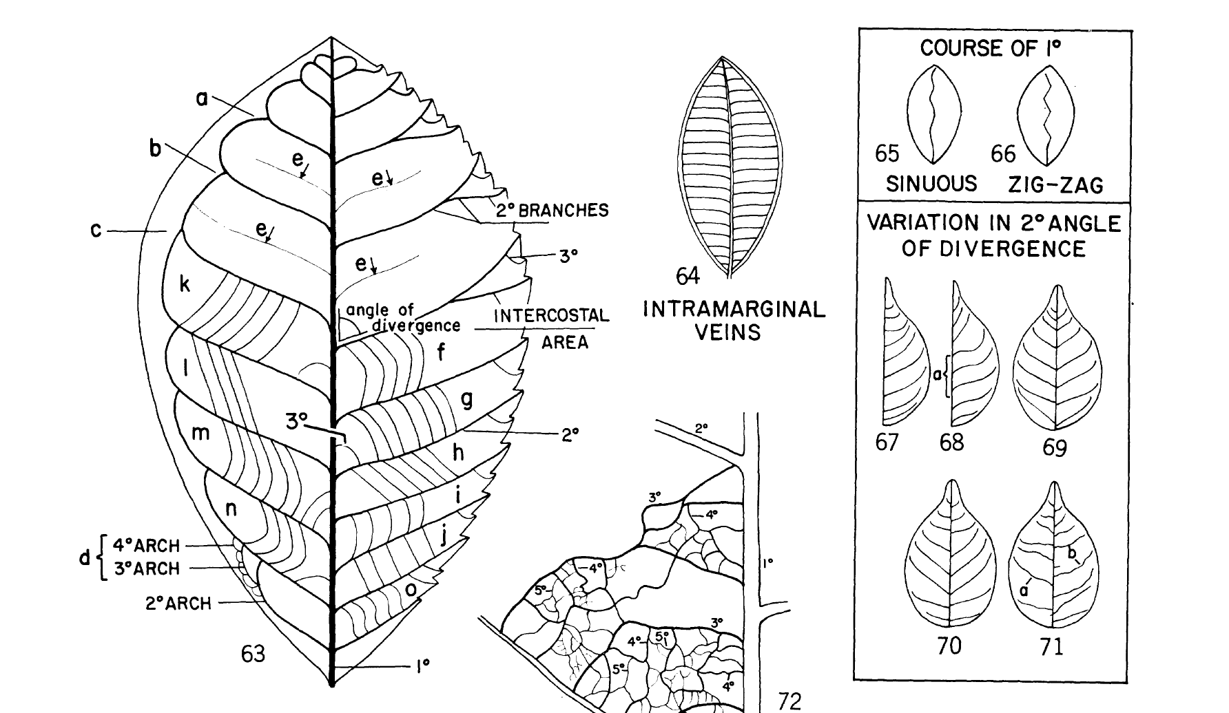
Tertiary vein patterns

Slide 13
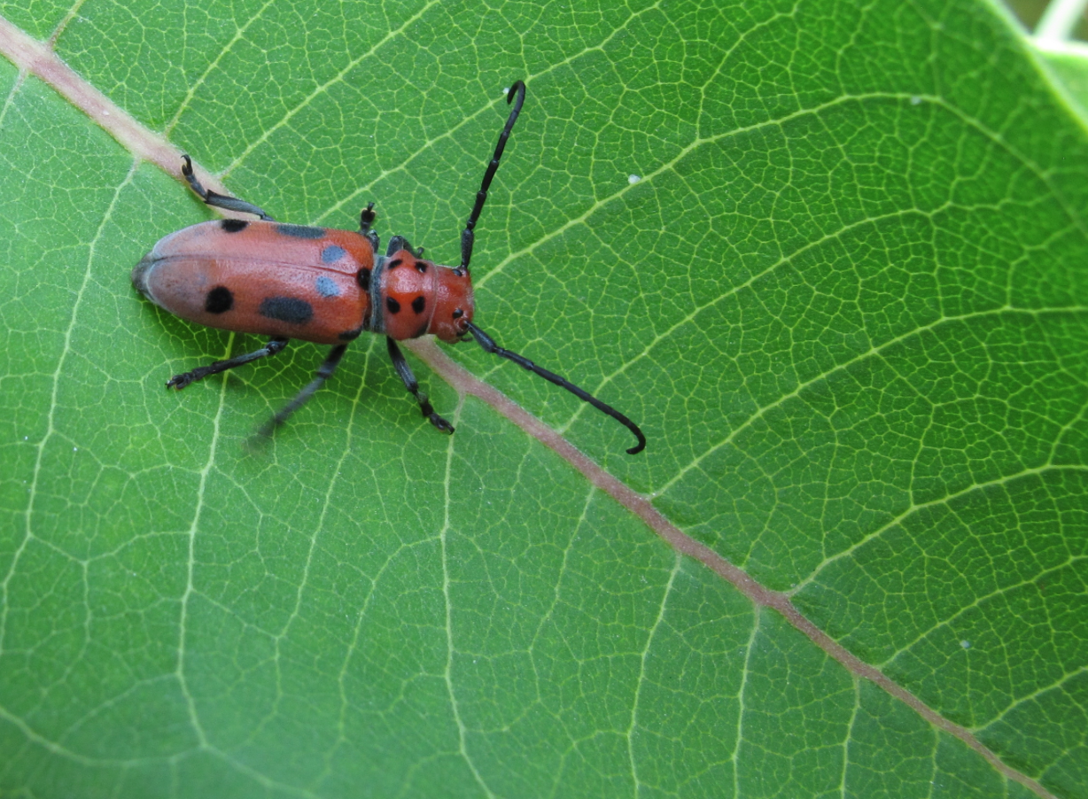
Magnoliid venation
Notes:
CERAMBYCID ON ASIMINA

Slide 14
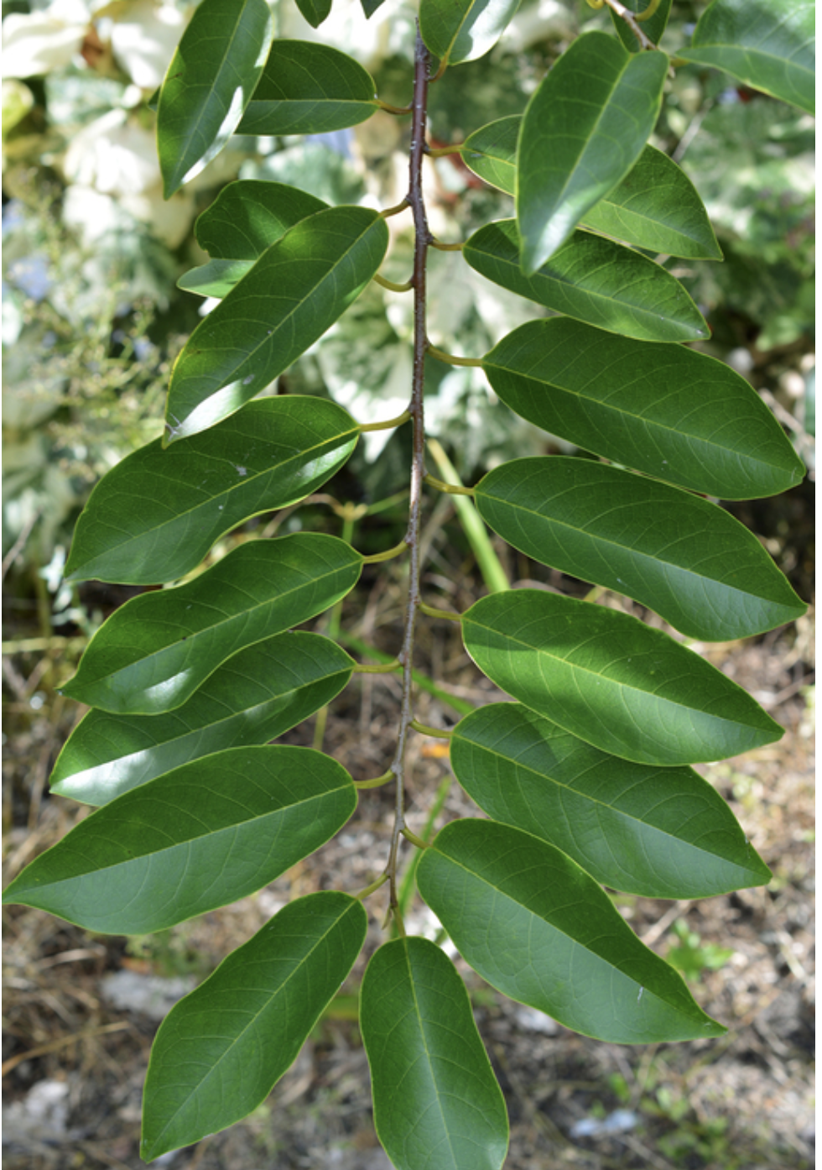
Go Outside
https://www.invasive.org/browse/detail.cfm?imgnum=5562534

Slide 15
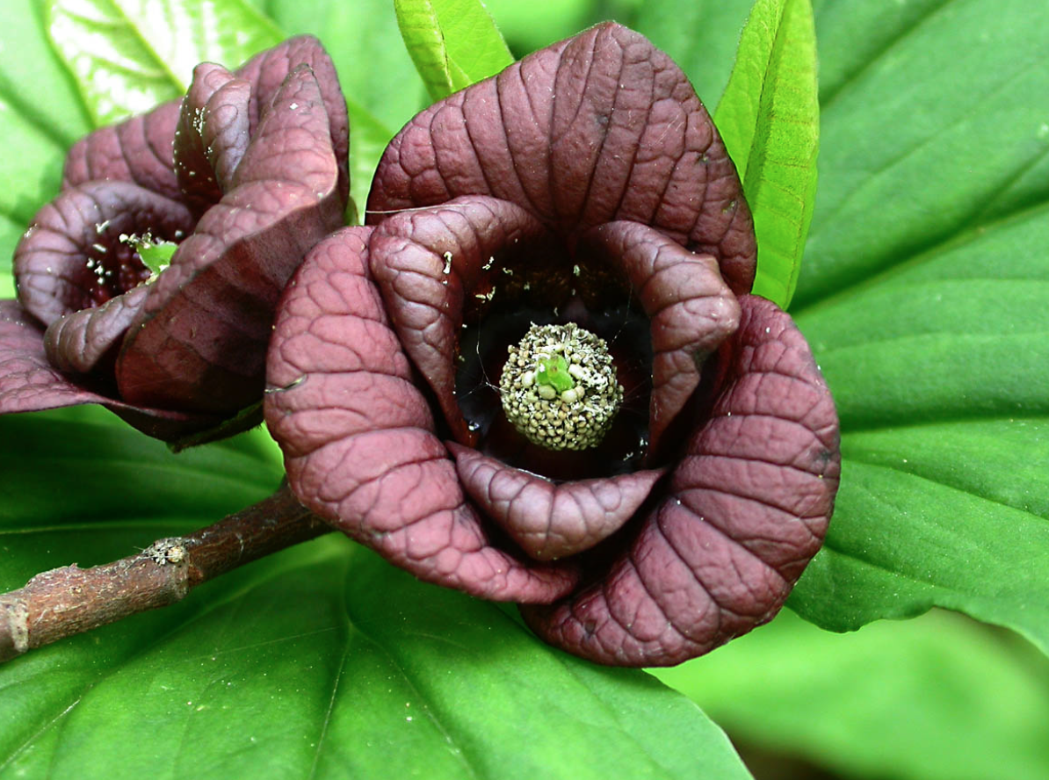
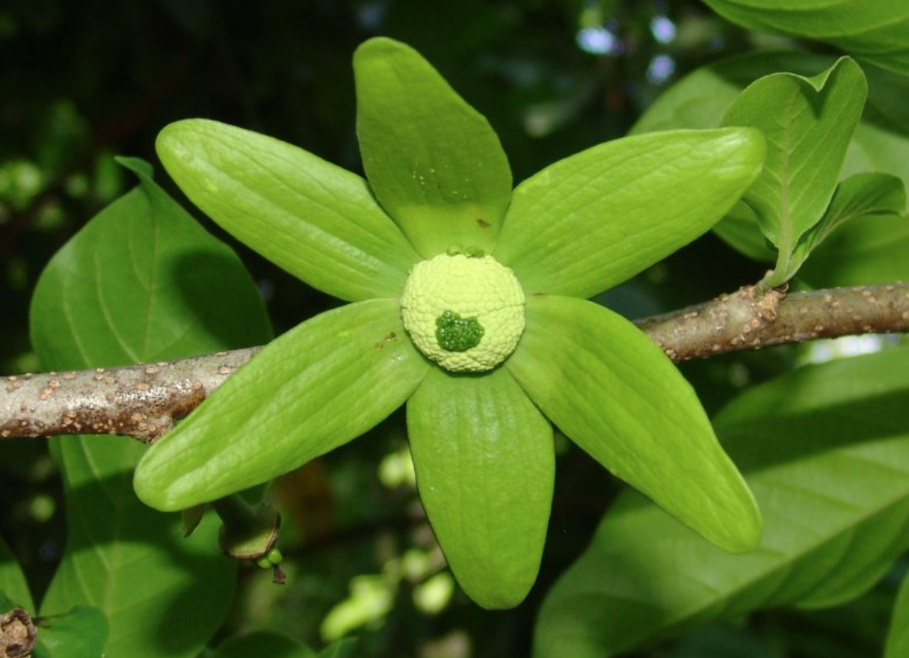
Big flowers with two whorls of three tepals (with a third smaller whorl below)
Lettowianthus stellatus
Asimina triloba

Slide 16
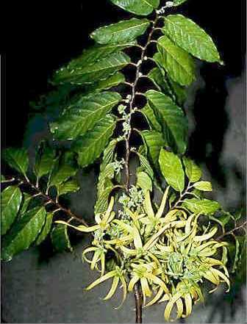
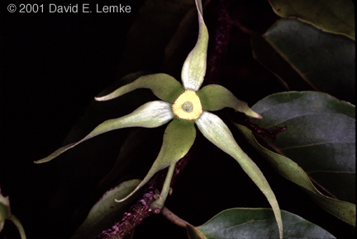
Cananga, the Old-World tree source of the Old-World tree source of ylang-ylang

Slide 17
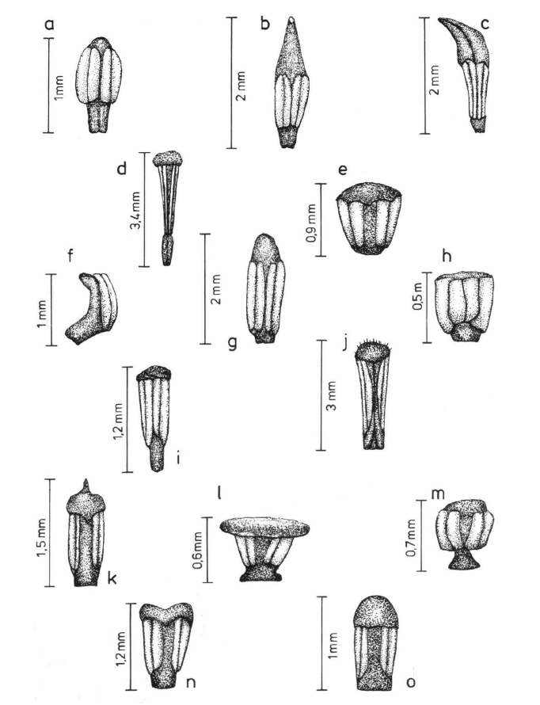
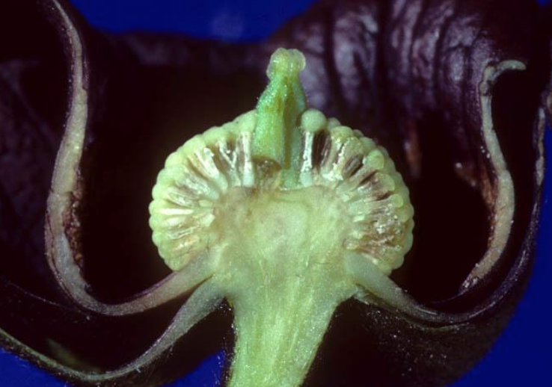
Many stamens that have appendages

Slide 18
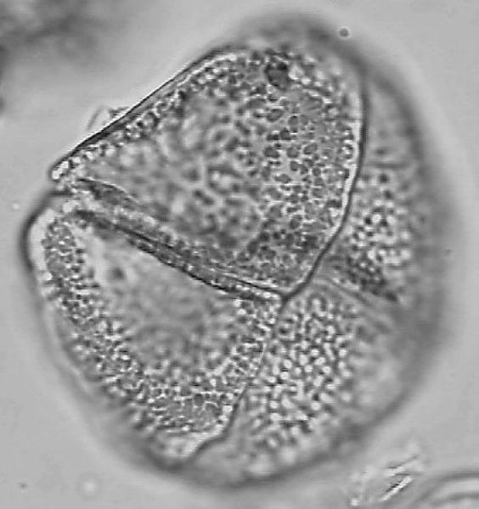
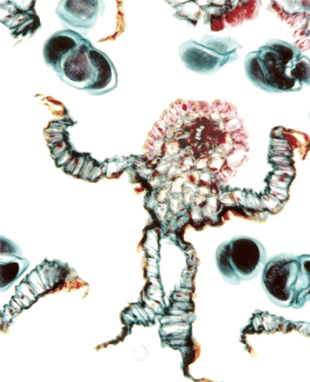
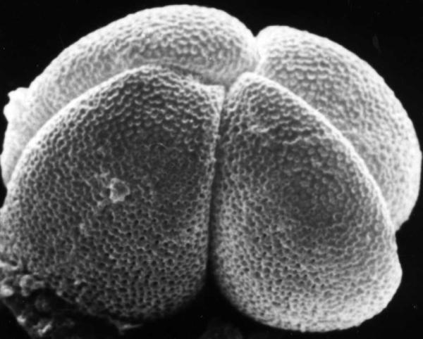
Pollen in groups of 4 (up to 32)
Xylopia
Notes:
Cross section through the dehisced anther of Xylopia collina of the pawpaw family (Annonaceae). Species of the genus Xylopia, as well as other members of this family, produce large pollen that is shed in units of four or sometimes even 32 grains (some tetrads visible in illustration). Associated with these compound pollen units in most genera are layers of sterile tissue, called septa, that separate the grains into chambers within each anther. Tsou and Johnson investigated the variation and development of the septa of Annonaceae, and found that despite variability in appearance, the septal tissues of all species were formed by the same developmental pathway. They propose that these tissues may have evolved in Annonaceae in response to a requirement for extra nutrients and support tissues for large pollen units. AJB V90.7

Slide 19
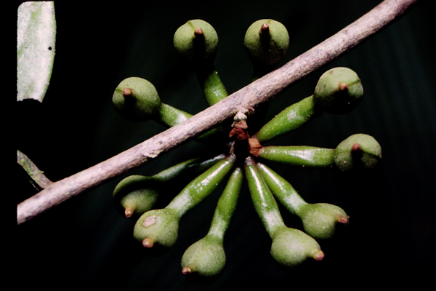
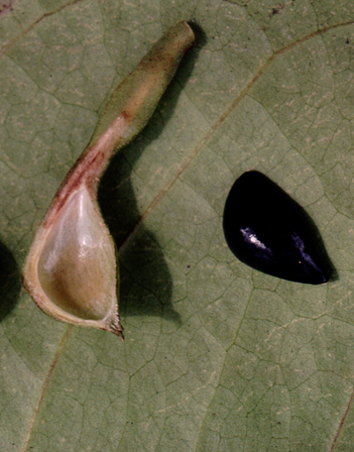
Anaxagorea - explosive dispersal of seeds
Notes:
Fournier, G. ; Hadjiakhoondi, A. ; Charles, B. ; Leboeuf, M. ; Cave, A.
Title: Volatile components of Anaxagorea dolichocarpa fruit.
Source: Biochemical systematics and ecology. 22, no. 6 (Sept 1994): p. 605-608.
Additional Info: Oxford, U.K. : Elsevier Science Ltd. Publishing Agencies: Non-US Imprint, not FAO
Standard No: ISSN: 0305-1978
Language: English
Abstract: The main volatile components of the oil extracted from the fruits of Anaxagorea dolichocarpa Sprag. and Sandw., Annonaceae, are delta-cadinol, caryophyllene oxide, delta-cadinene, alpha-copaene and gamma-muurolene. These sesquiterpene compounds were identified previously in several other Annonaceae oils, particularly from some Xylopia species. Chemotaxonomic connections are considered between Anaxagorea and Xylopia.

Slide 20
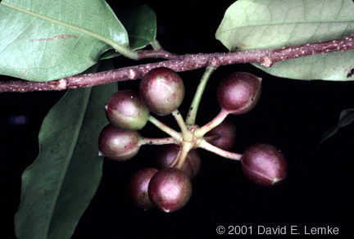
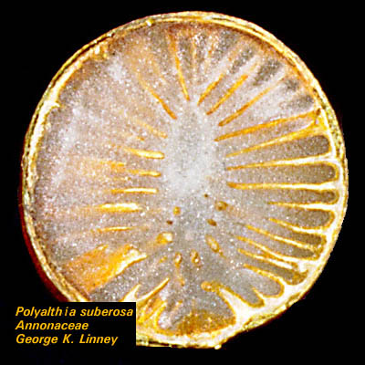
Polyalthia

Slide 21
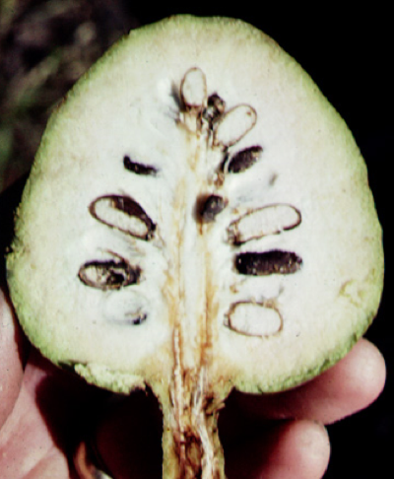
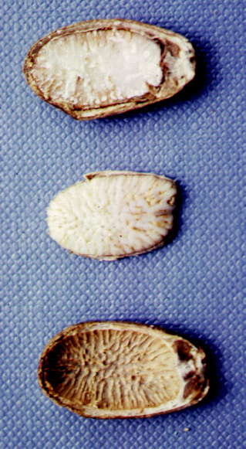
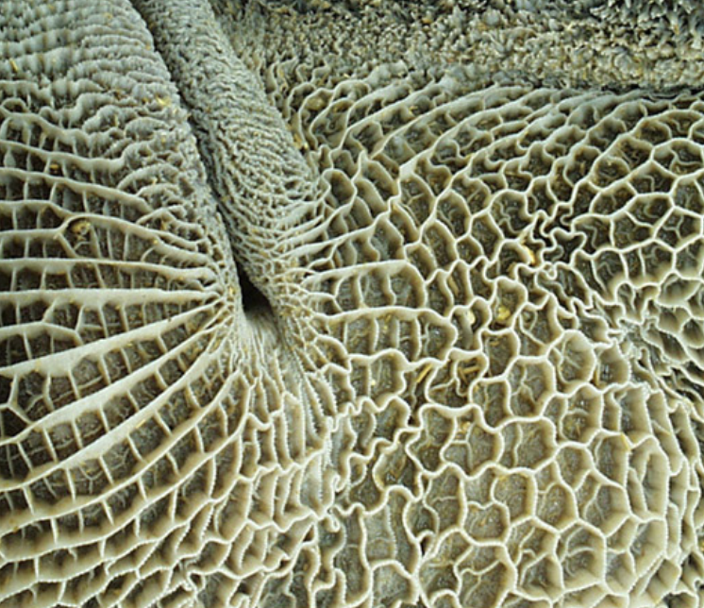
Annona
rumen (of a cow) ruminate endosperm

Slide 22
Key Family Characters - Annonaceae
Alternate simple, distichous leaves
Magnoliid tertiary veins
Unappealing magnoliid essential oils
Big flowers with 2-3 whorls of 3 tepals
Many stamens that have appendages

Slide 23
Magnoliids, Magnoliales

Slide 24
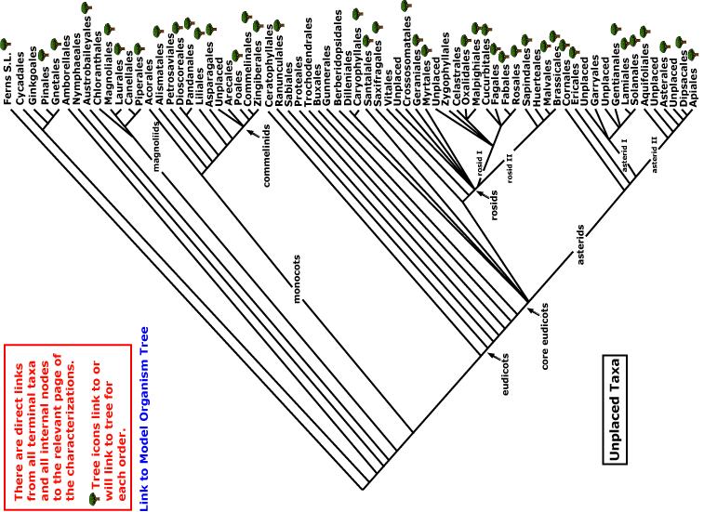
magnoliids
Current Angiosperm Phylogeny Group Tree for Flowering Plants
2008
monocots

Slide 25
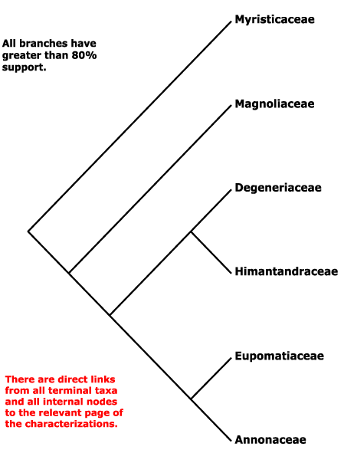
Magnoliales and the relations
of the Annonaceae

Slide 26
Herbivory

Slide 27
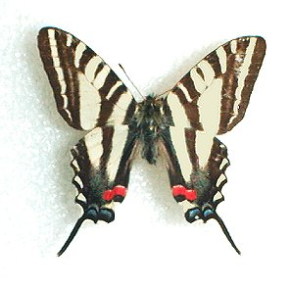
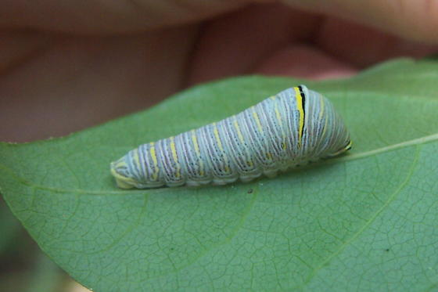
Caterpillars of Eurytides marcellus, the zebra swallowtail,
eat pawpaw
Notes:
The medicinal value of Pawpaw seed extracts has been documented since 1884. An alkaloid anti-cancer drug named asimicin was isolated from the Pawpaw in 1991. It is commercially available as the herbal medicine Pawpaw Cell-Reg. It is also an effective pesticide and has been used to treat head lice
Structure of asimicin.

Slide 28
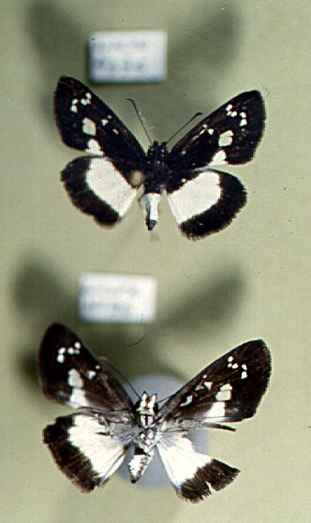
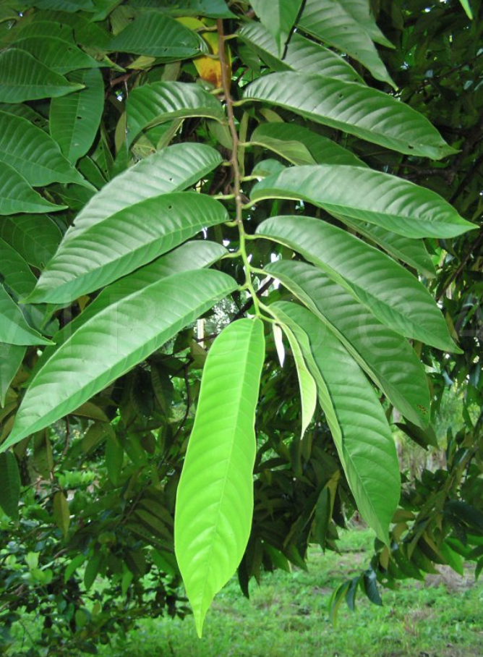
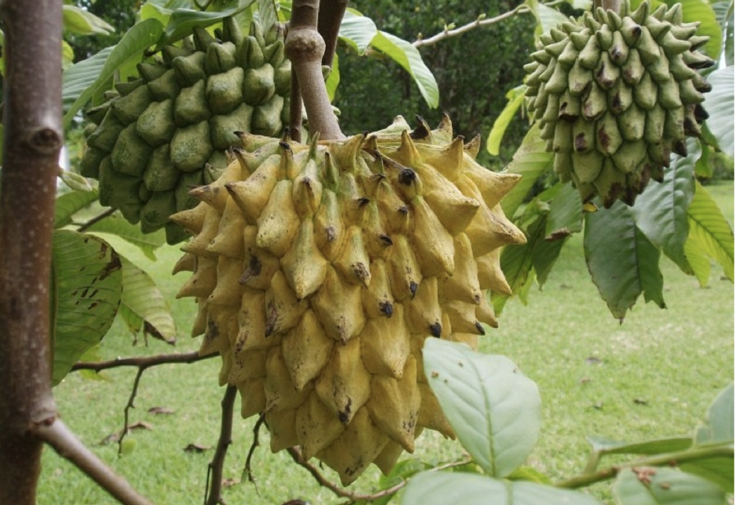
Larvae of Milanion (Hesperidae) eat Rollinia, (Annonaceae)
Notes:
Also Unonopsis pittieri.

Slide 29
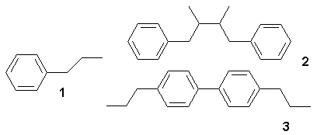
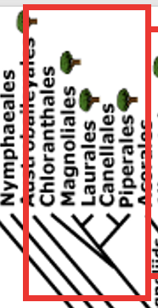
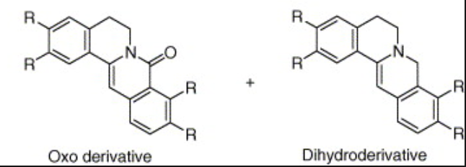
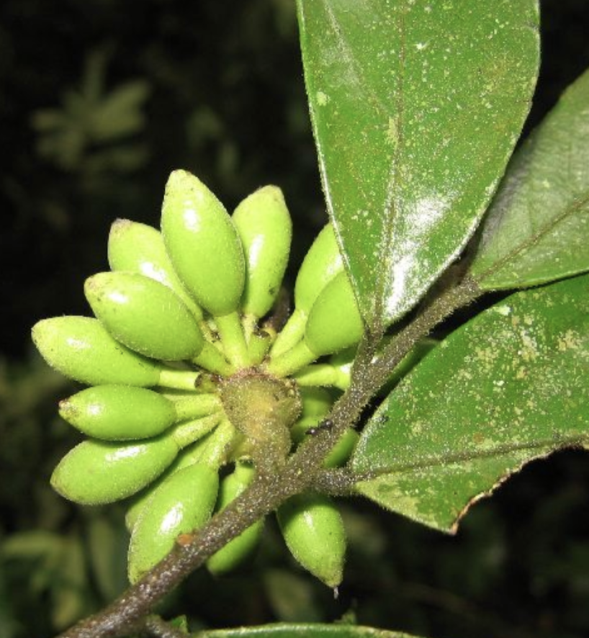
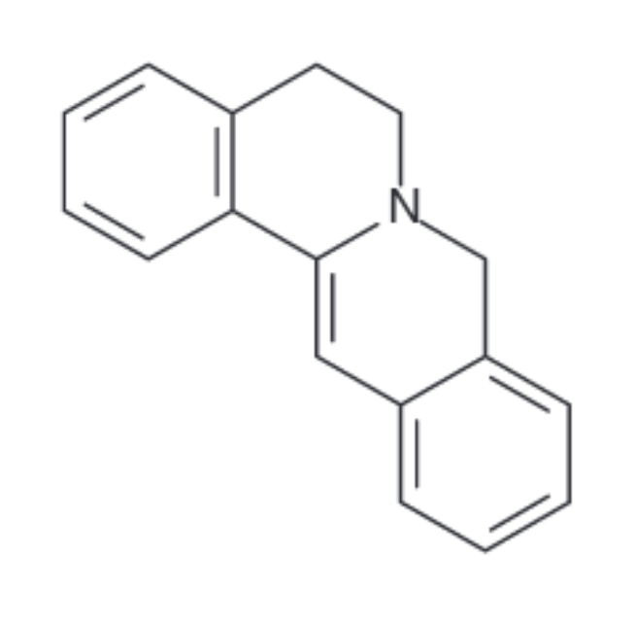
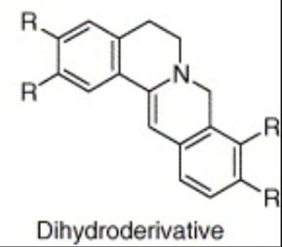
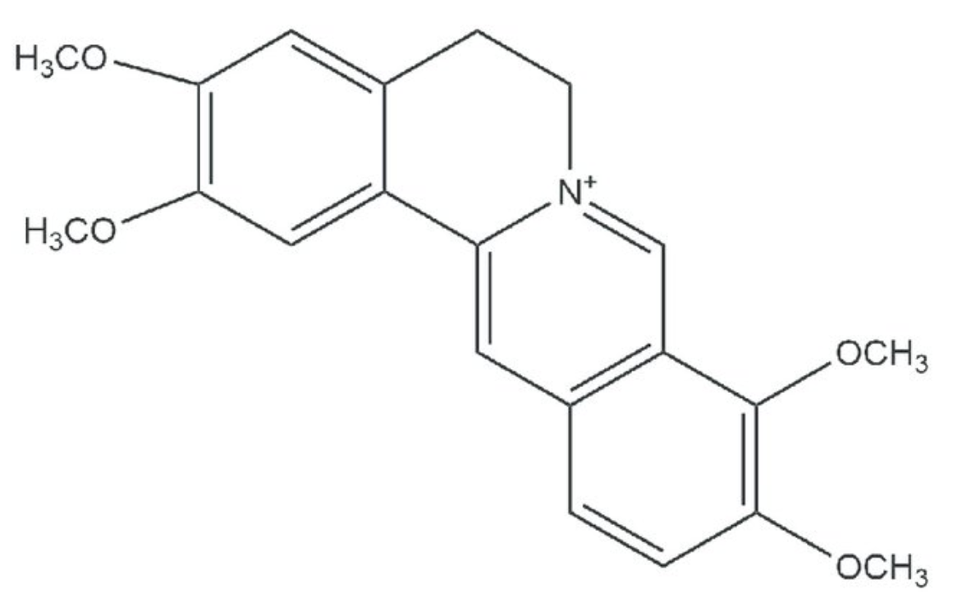
Neolignans in the Magnoliales and Laurales
Many natural products are built up of C6C3 units (a propylbenzene skeleton, 1) derived from cinnamyl units. Structure 3 is a neolignan.
Palmatine, a protoberberine alkaloid in the Annonaceae; protoberberines also found throughout the Magnoliales and Laurales
tetracycic ring
typical of protoberberines
palmatine, in Enantia chloranthia (Annonaceae) , a SE Asian traditional antimalarial
Notes:
lignan is a chemical compound found in plants. Lignans are one of the two major classes of phytoestrogens, which are antioxidants found in a variety of plants which includes flax seeds, pumpkin seeds, sesame seeds, rye, soybeans, broccoli, beans, and some berries. The other class of phytoestrogens is the isoflavones. Plant lignans are polyphenolic substances derived from phenylalanine via dimerization of substituted cinnamic alcohols (see cinnamic acid) to a dibenzylbutane skeleton 2. This reaction is catalysed by oxidative enzymes and is often controlled by dirigent proteins.
Many natural products are built up of C6C3 units (a propylbenzene skeleton 1) derived from cinnamyl units just as terpene chemistry builds on isoprene units. Structure 3 is a neolignan.
James K. Nitao1 Contact Information, Kelly S. Johnson1, J. Mark Scriber1 and Muraleedharan G. Nair2
1992
Abstract The role of toxins and deterrents in preventingtroilus group species (Lepidoptera, Papilionidae) from feeding on magnoliaceous hosts was investigated using bioassay-directed isolation ofMagnolia virginiana allelochemicals. A fraction consisting of three neolignan compounds significantly reduced survival of first instarP. palamedes, atroilus group member. Two of these compounds, magnolol and a biphenyl ether, were tested individually and were both toxic toP. palamedes. The larval survival ofP. troilus, anothertroilus group species, was also significantly reduced by magnolol but not by the biphenyl ether. In contrast,P. glaucus, a polyphagousglaucus group species that feeds on magnoliaceous hosts, was not affected by either compound. The effect of these compounds against a. polyphagous nonpapilionid was examined using the fall webworm (Hyphantria cunea, Lepidoptera: Arctiidae). The biphenyl ether but not magnolol significantly lowered webworm first-instar survival, demonstrating that polyphagy does not preadapt lepidopterans to feeding on this neolignan. These results demonstrate that although phagostimulants play a role in the specialization of thetroilus group on the Lauraceae, the presence of toxins and/or deterrents in nonhosts is also important in determining food plant patterns in these species.

Slide 30
Pollination

Slide 31
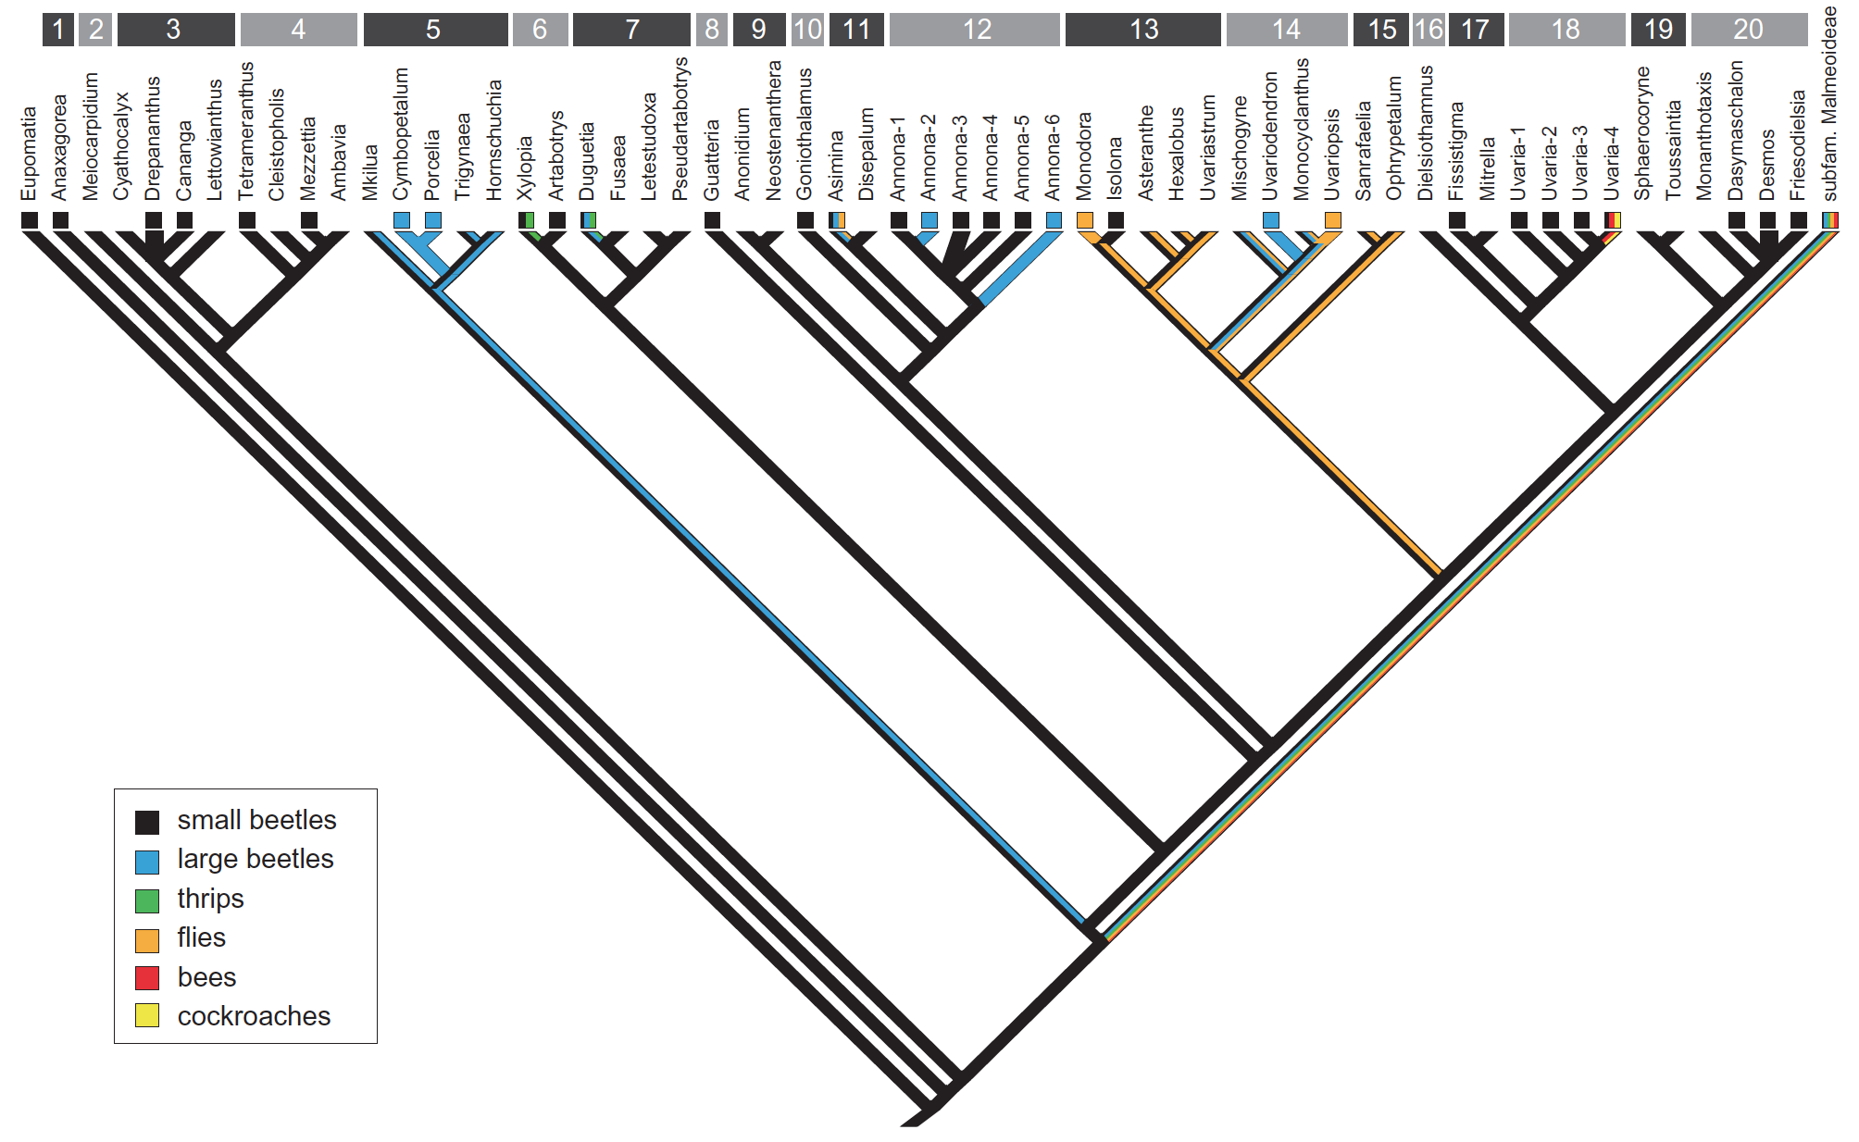

Slide 32
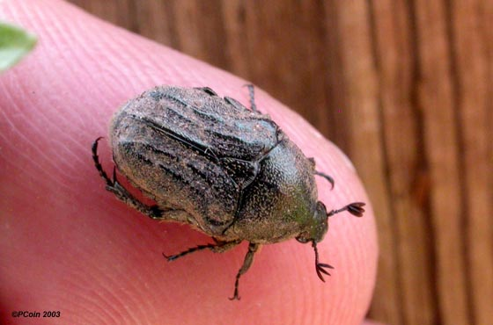
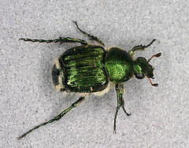
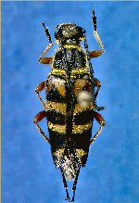
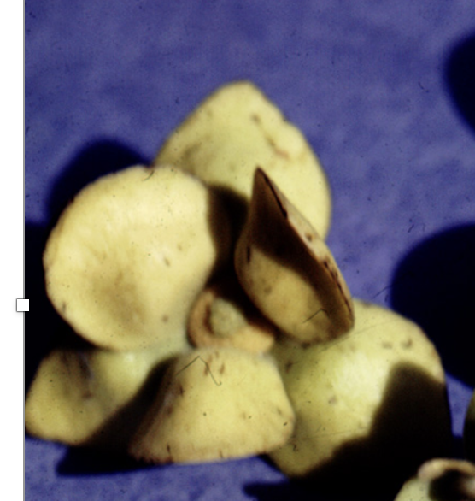
The beetle pollination syndrome - nuptial-chamber variant
Many stamens often with appendages
Chamber to accommodate several animals
Night-flowering
Without markings
Scent attractant for beetles
Notes:
Pollinators found by Norman et al, (1986) in Ocala National Forest, Volusia, and Marion counties were: Typocerus zebra (Oliv.)(Cerambycidae), Trichiotinus rufobrunneus (Csy.), T. Lunulatus (Fab.), and Euphoria sepulcralis (Fab.) (Scarabaeidae).

Slide 33
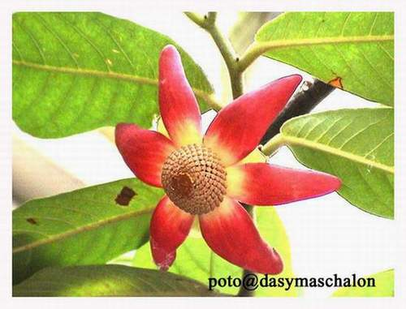
Uvaria - Thailand: cockroach-pollinated

Slide 34
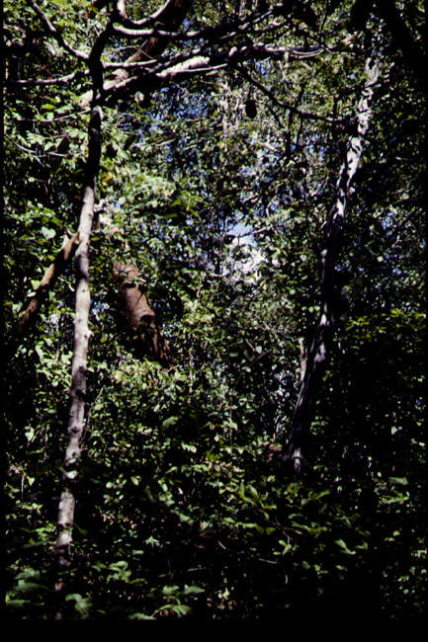
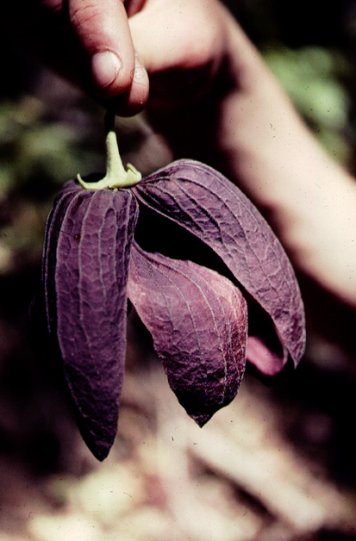
Sapranthus - a carrion flower in the Annonaceae

Slide 35

Sapranthus

Slide 36


pawpaw: pollinated by fruitflies
Notes:
Chemistry: Goodrich, K. R., Zjhra, M. L., Ley, C. A., & Raguso, R. A. (2006). When flowers smell fermented: the chemistry and ontogeny of yeasty floral scent in pawpaw (Asimina triloba: Annonaceae). International Journal of Plant Sciences, 167(1), 33-46.
Phenology and fruit-fly visitors: Norman, E. M., Rice, K., & Cochran, S. (1992). Reproductive biology of Asimina parviflora (Annonaceae). Bulletin of the Torrey Botanical Club, 1-5.

Slide 37


thrips?
Bocageopsis
Notes:
Gottsberger, G., 2012. How diverse are Annonaceae with regard to pollination?. Botanical Journal of the Linnean Society, 169(1), pp.245-261.

Slide 38
Fruits and Dispersal

Slide 39

Guatteria - Brazil

Slide 40



Xylopia
seeds with arils

Slide 41




variation in commercial Annona fruits
guanabaná
sweetsop
custard apple
cherimoya

Slide 42



Cherimoya (Annona cherimola)
http://www.hort.purdue.edu/newcrop/tropical/lecture_34/lec_34.html

Slide 43


Duguetia lepidota - upper Orinoco River

Slide 44


Duguetia
Cross-section of fruit of Duguetia stelechantha (Annonaceae).
Pygocentrus nattereri - the red-bellied piranha

Slide 45
Key Family Characters - Annonaceae
Alternate simple, distichous leaves
Magnoliid tertiary veins
Unappealing magnoliid essential oils
Big flowers with 2-3 whorls of 3 tepals
Many stamens that have appendages

Slide 46
EXTRA SLIDES

Slide 47



Desmos chinensis

Slide 48


Slide 49


Slide 50
Economic Plants in the Tropics

Slide 51
References for the Annonaceae
Author(s): Andrade, B.M. ; Oliveira-Filho, A.T. ; Soares, A.R.
Title: Pollination and breeding system of Xylopia brasiliensis sprengel (Annonaceae) in south-eastern Brazil.
Source: Journal of tropical ecology. 12, no. pt.2 (Mar 1996): p. 313-320.
Author(s): Armstrong, J.E. ; Marsh, D.
Title: Floral herbivory, floral phenology, visitation rate, and fruit set in Anaxagorea crassipetala (Annonaceae), a lowland rain forest tree of Costa Rica.
Source: The journal of the Torrey Botanical Society. 124, no. 3 (July/Sept 1997. ): p. 228-235.
Authors: James A. Doyle, Hervé Sauquet, Tanya Scharaschkin, and Annick Le Thomas
Title: Phylogeny, Molecular and Fossil Dating, and Biogeographic History of Annonaceae and Myristicaceae (Magnoliales)
Source: International Journal of Plant Sciences, volume 165 (2004), pages S55–S67
Fournier, G. ; Hadjiakhoondi, A. ; Charles, B. ; Leboeuf, M. ; Cave, A.
Title: Volatile components of Anaxagorea dolichocarpa fruit.
Source: Biochemical systematics and ecology. 22, no. 6 (Sept 1994): p. 605-608.
Additional Info: Oxford, U.K. : Elsevier Science Ltd. Publishing Agencies: Non-US Imprint, not FAO
Gottsberger, G. 1978. Seed dispersal by fish in the inundated regions of Humaita, Amazonia. Biotropica 10(3): 170-183.

Slide 52
Author(s): Gottsberger, G.
Title: Beetle pollination and flowering rhythm of Annona spp. (Annonaceae) in Brazil.
Source: Plant systematics and evolution. 167, no. 3/4 (1989): p. 165-187.
Author(s): Magamitsu, T. ; Inoue, T.
Title: Cockroach pollination and breeding system of Uvaria elmeri (Annonaceae) in a lowland mixed-dipterocarp forest in Sarawak.
Source: American journal of botany. 84, no. 2 (Feb 1997): p. 208-213.
Olesen, J.M. Title: Flower mining by moth larvae vs. pollination by beetles and bees in the Cauliflorous Sapranthus palanga (Annonaceae) in Costa Rica. Source: Flora : Morphologie, Geobotanik, Okologie. 187, no. 1/2 (Aug 1992): p. 9-15.
Rogstad, S.H.
Title: The biosystematics and evolution of the Polyalthia hypoleuca species complex (Annonaceae) of Malesia. III. Floral ontogeny and breeding systems.
Source: American journal of botany. 81, no. 2 (Feb 1994): p. 145-154.
Annona website - http://www.botanik.univie.ac.at/~rainer/annona.htm

Slide 54
synapomorphies of Archaeanthus
and Magnoliaceae
1. sheathing leaf
2. bilobed stipules
3. elongate receptacle. Other
features that support a position in this part of the tree
1. more than one whorl or series of plicate [conduplicate] carpels (a synapomorphy of Magnoliales and Laurales)
2. solitary flower
(a synapomorphy of either Magnoliales plus Laurales, or of Magnoliales other than Myristicaceae
3. calyptra (a synapomorphy of Magnoliaceae or of Magnoliales other
than Myristicaceae),
4. plicate carpels (a synapomorphy of mesangiosperms other than Chloranthaceae and Ceratophyllum).
The presence of more than two whorls (or series) of three tepals may be retained from the first angiosperms (Endress & Doyle,
2009).

