Slide 1
Plant Biology 241 in the time of COVID, Fall Semester 2020

Slide 2
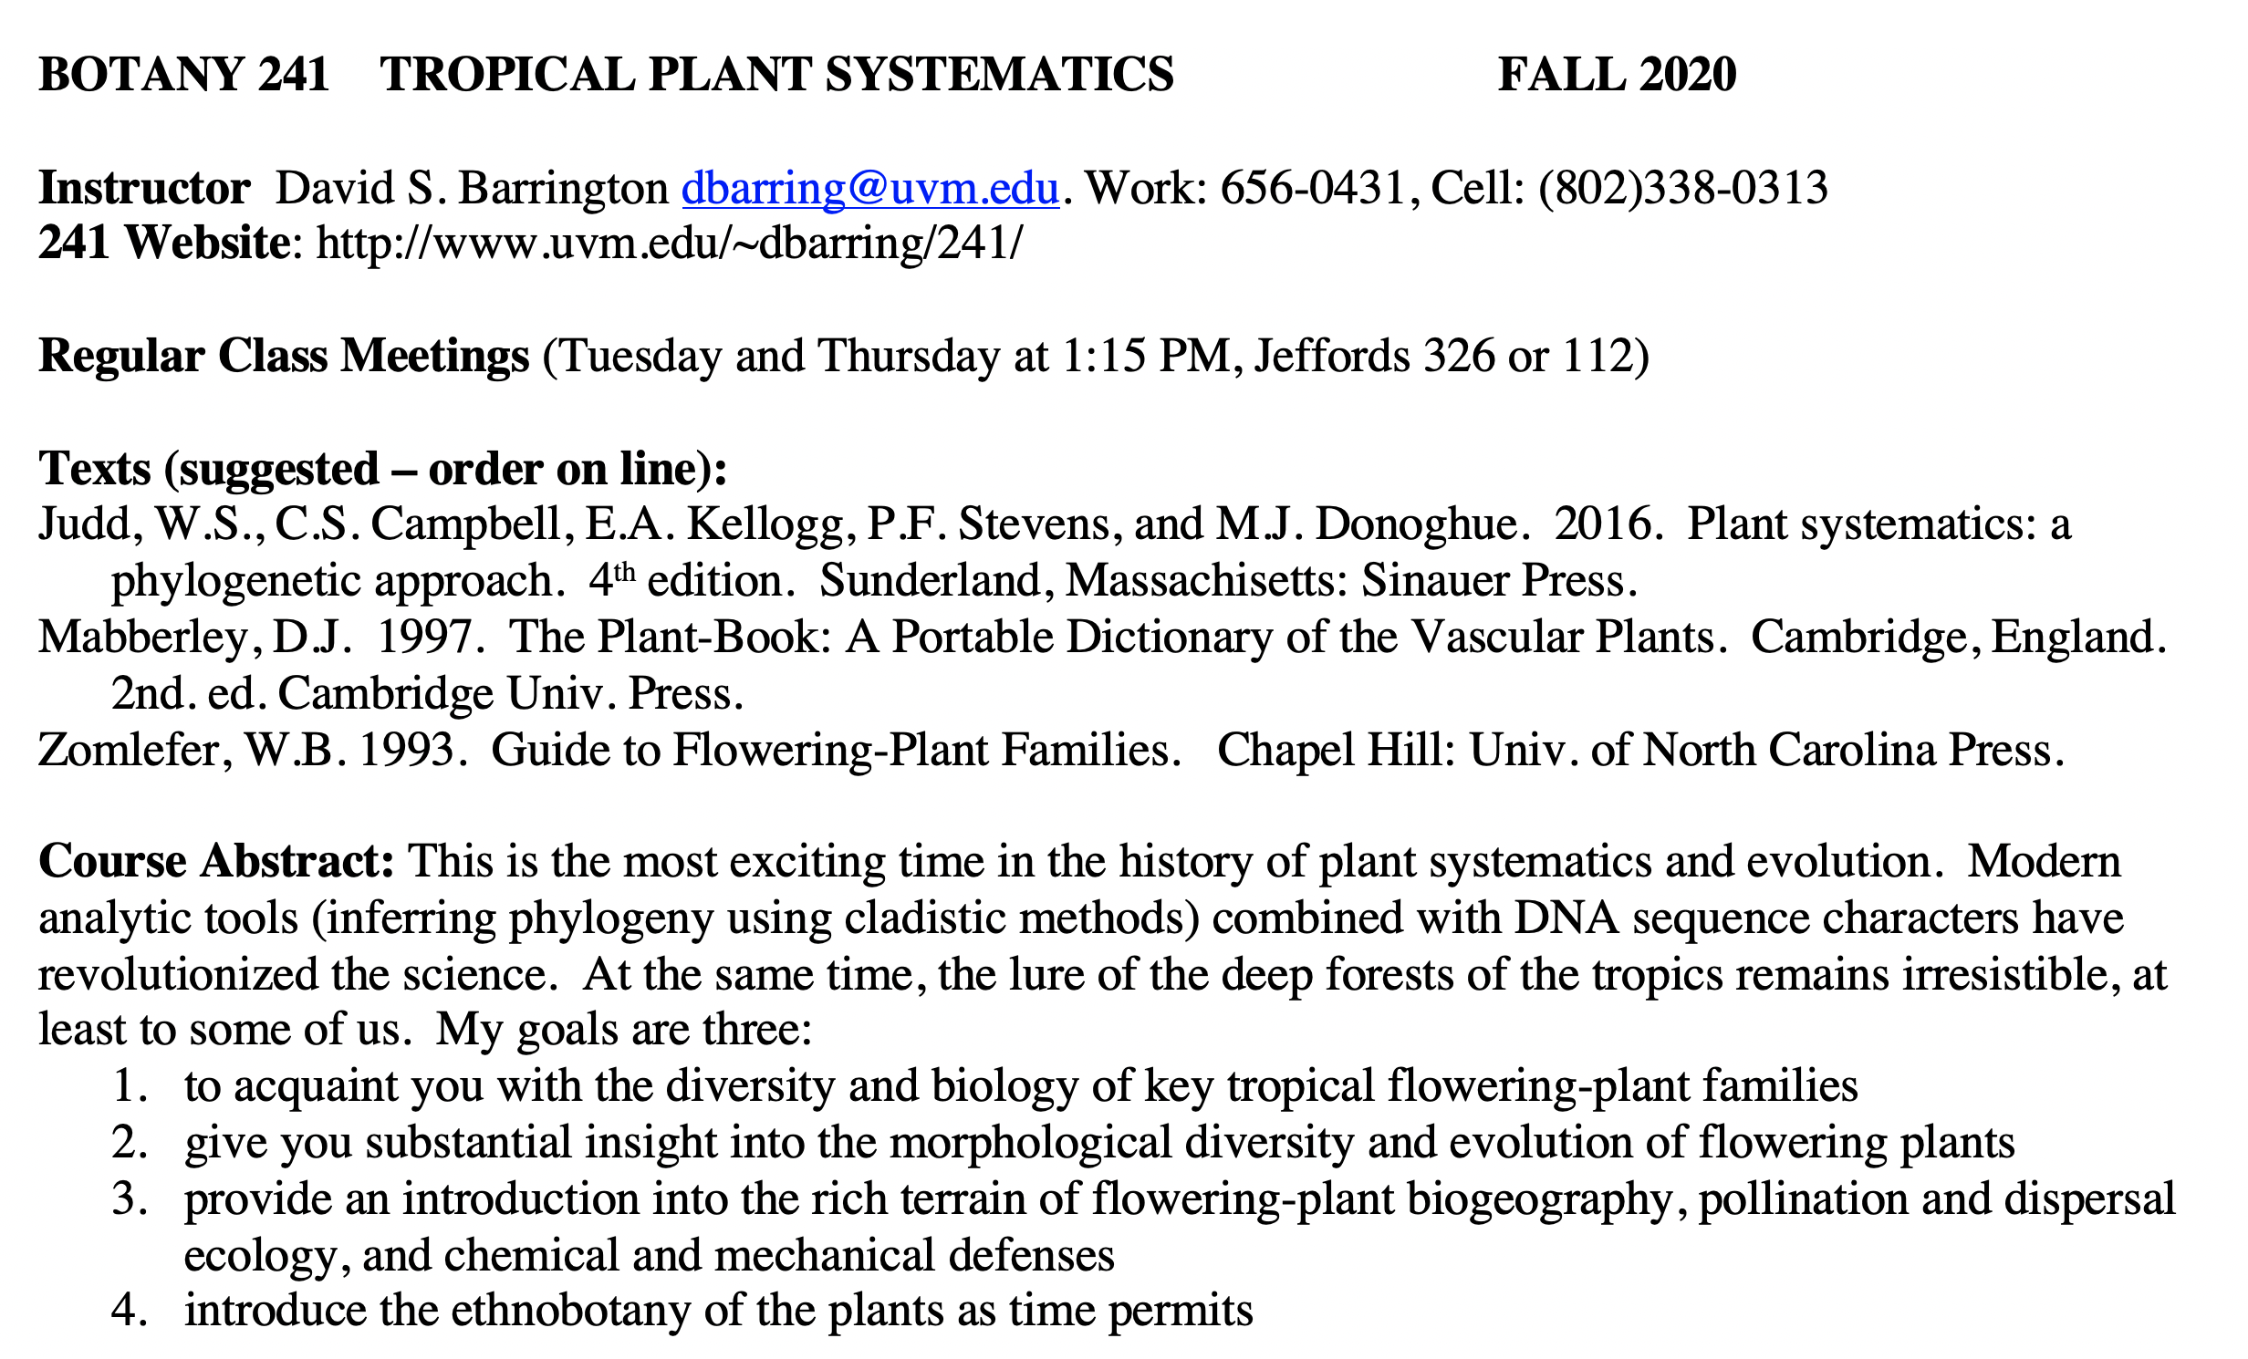

Slide 3
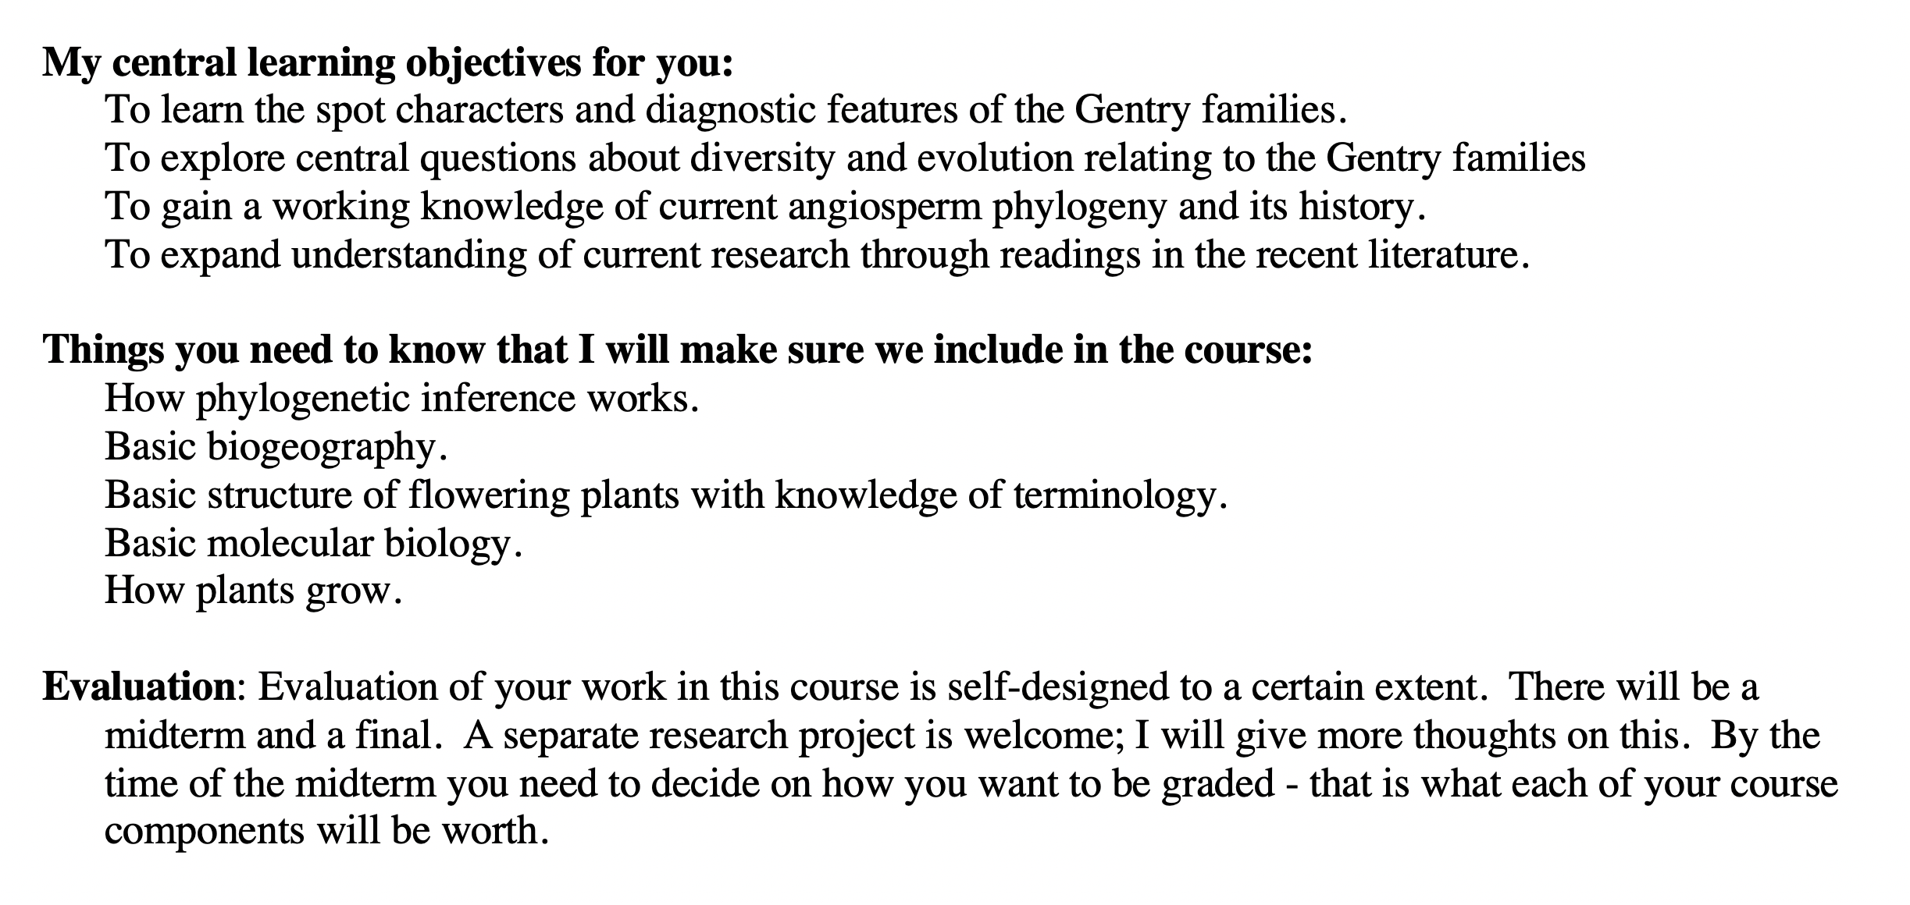

Slide 4
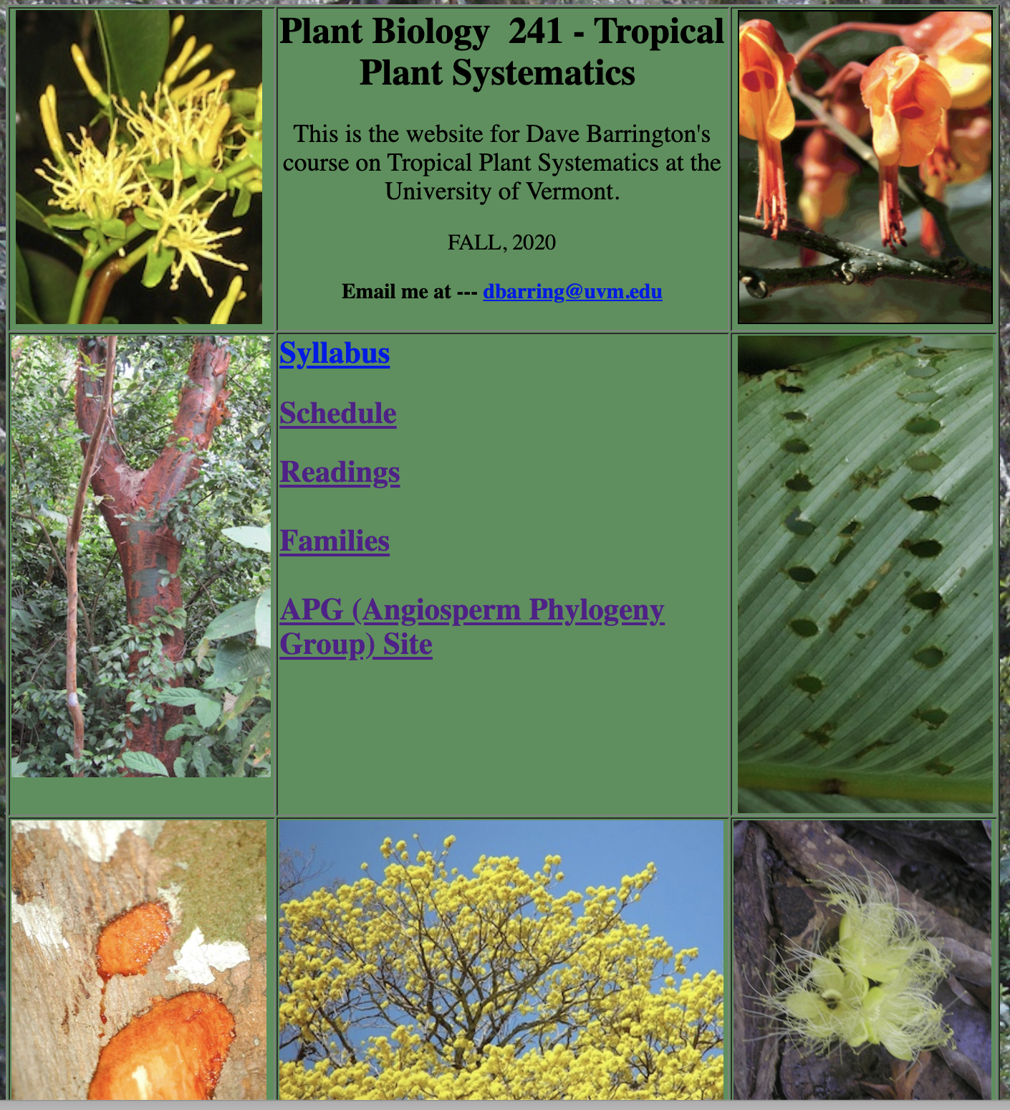
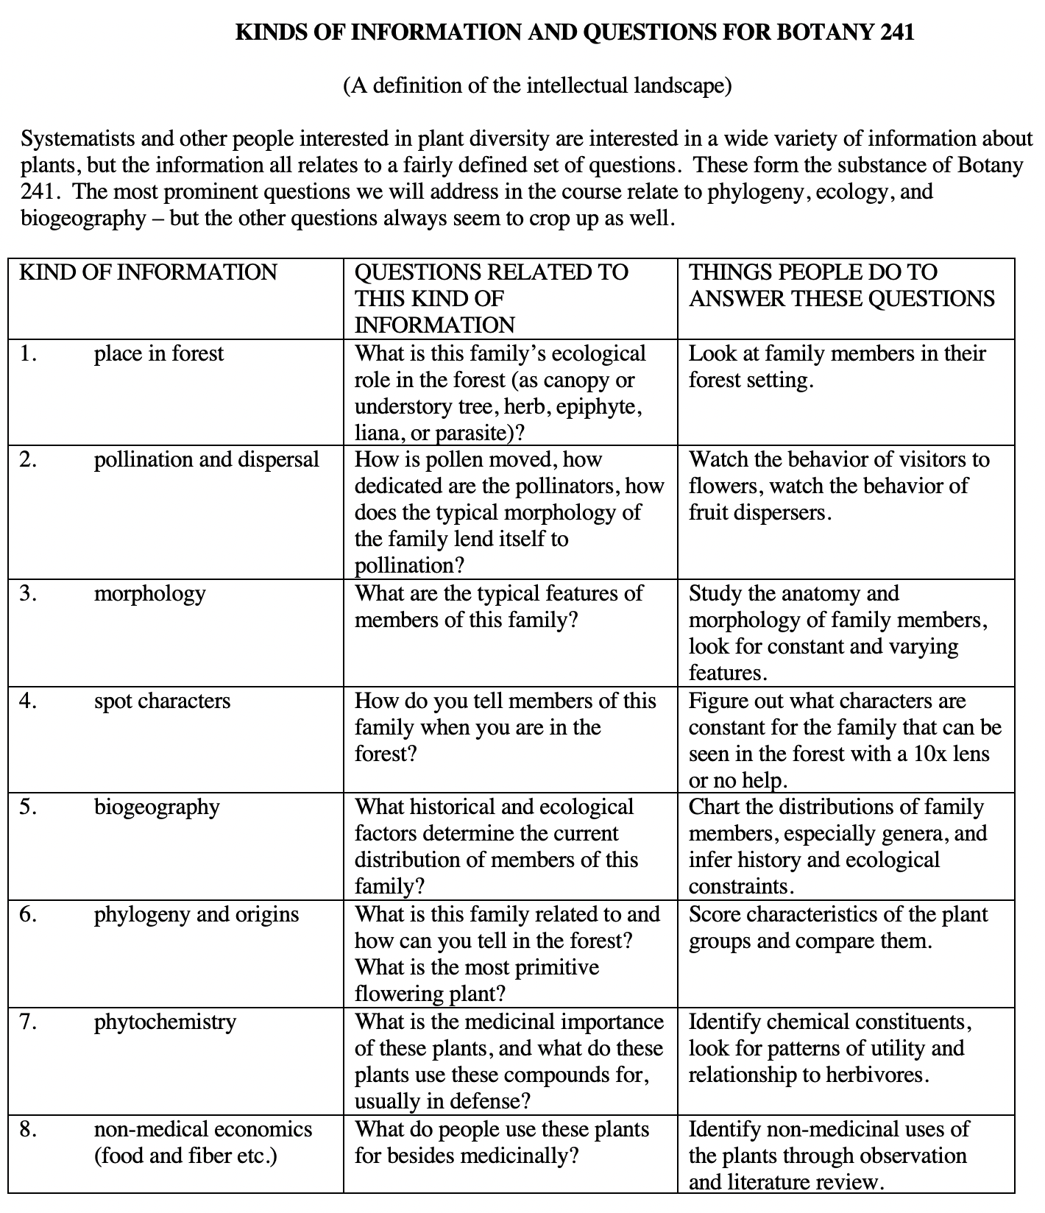

Slide 5
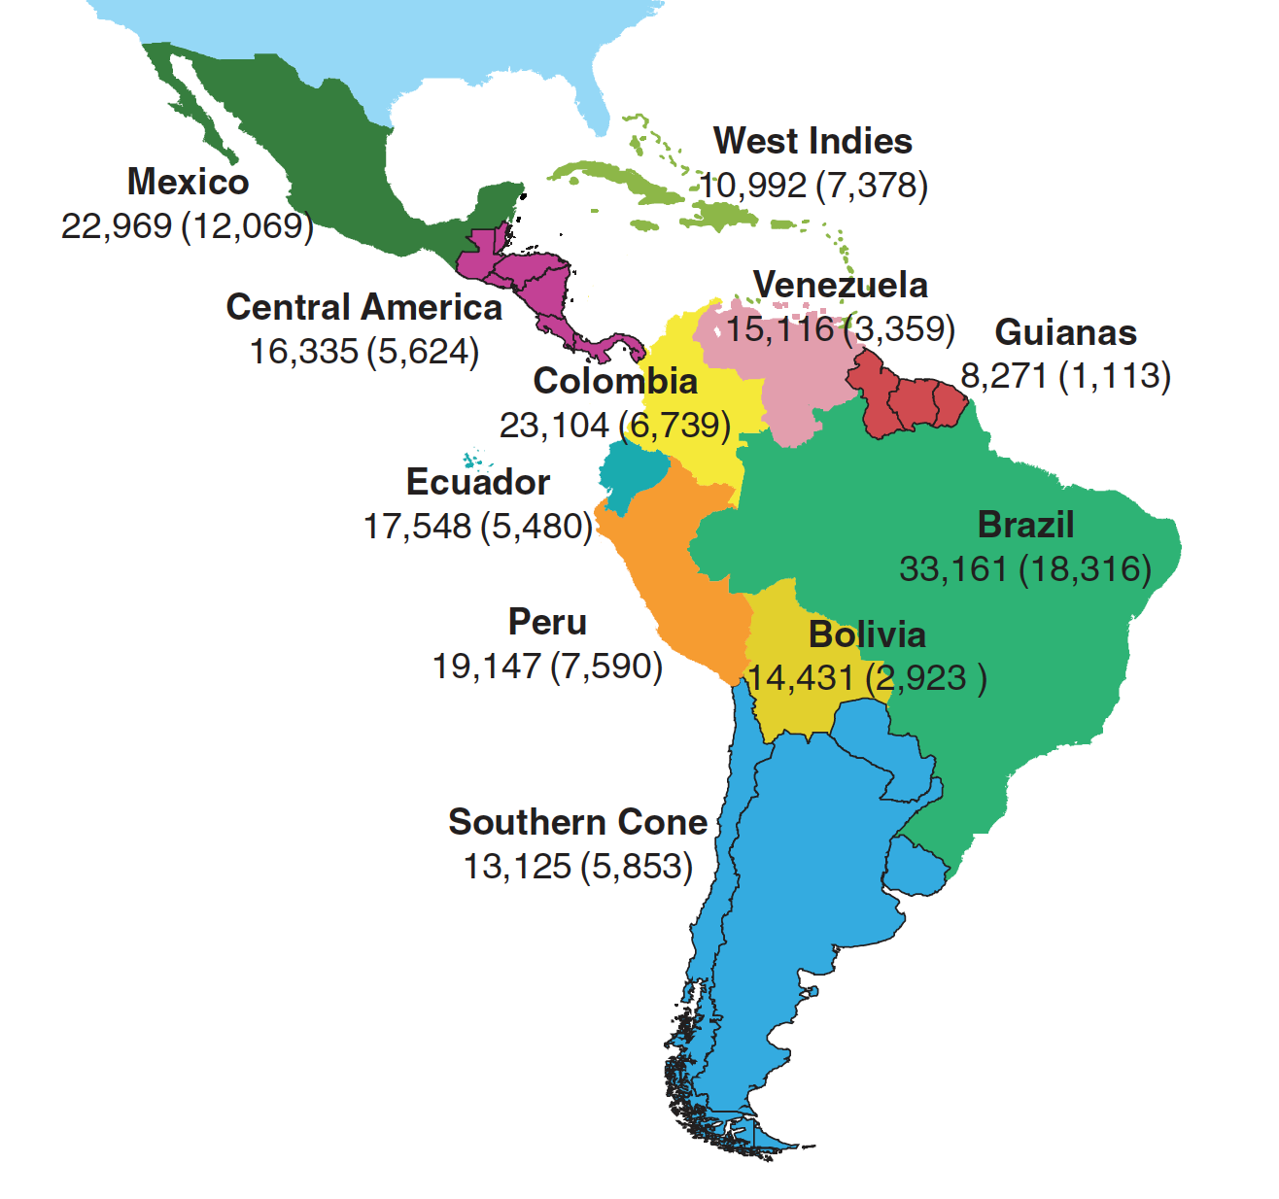
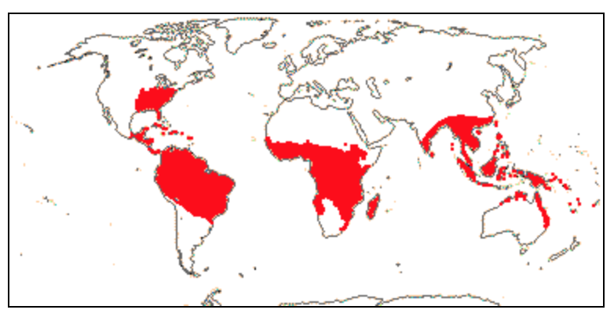

Slide 6
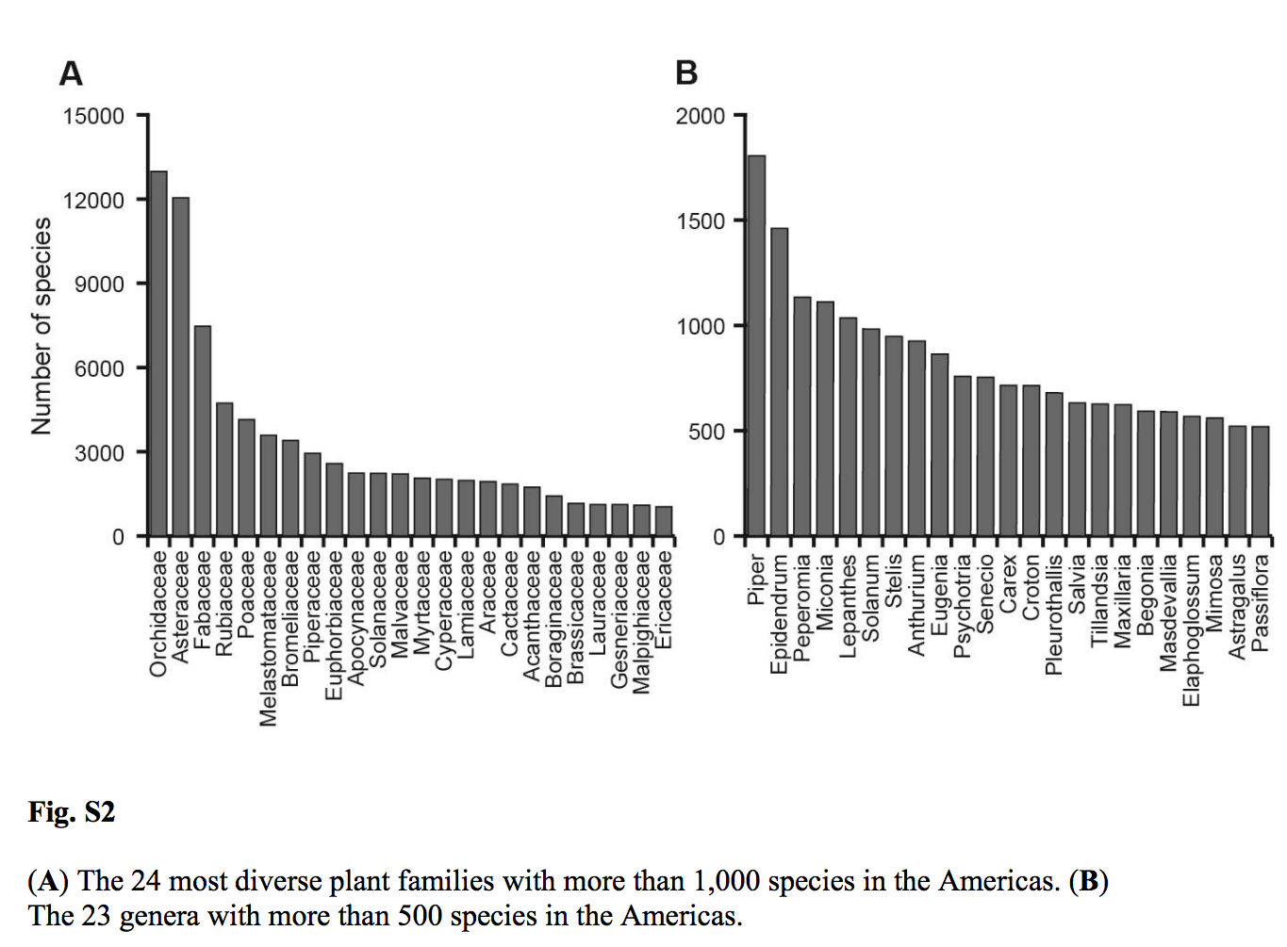
from ulloa2017.pdf

Slide 7
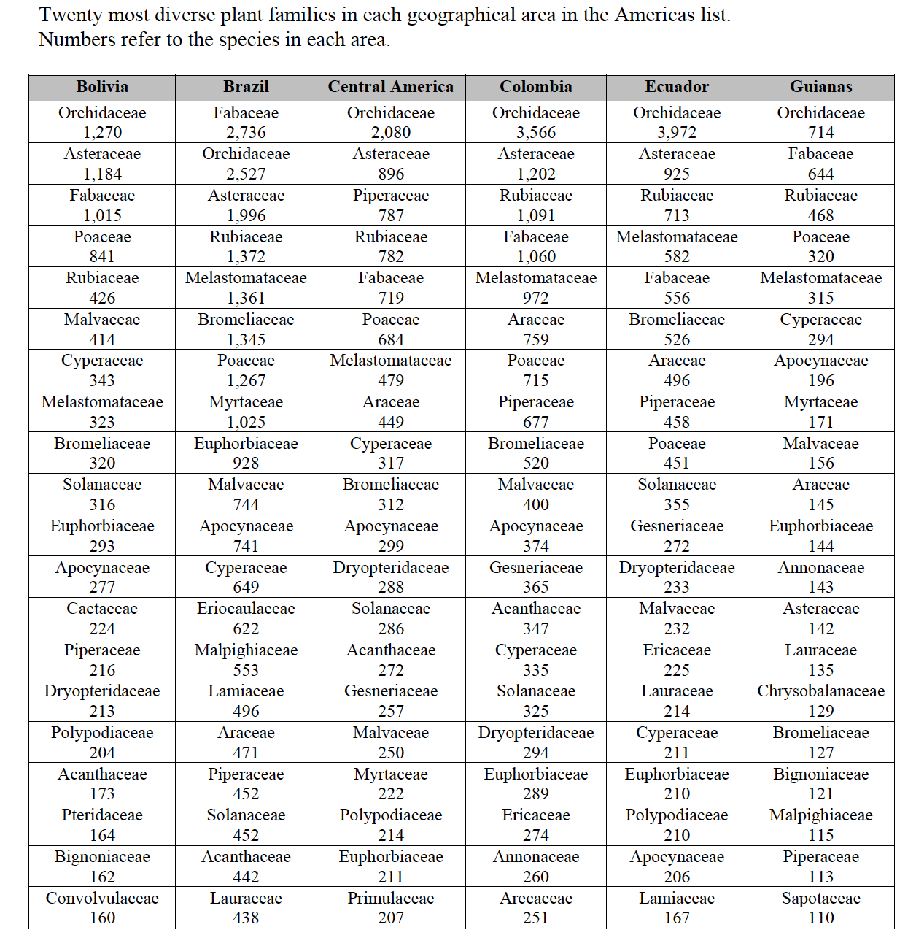

Slide 8
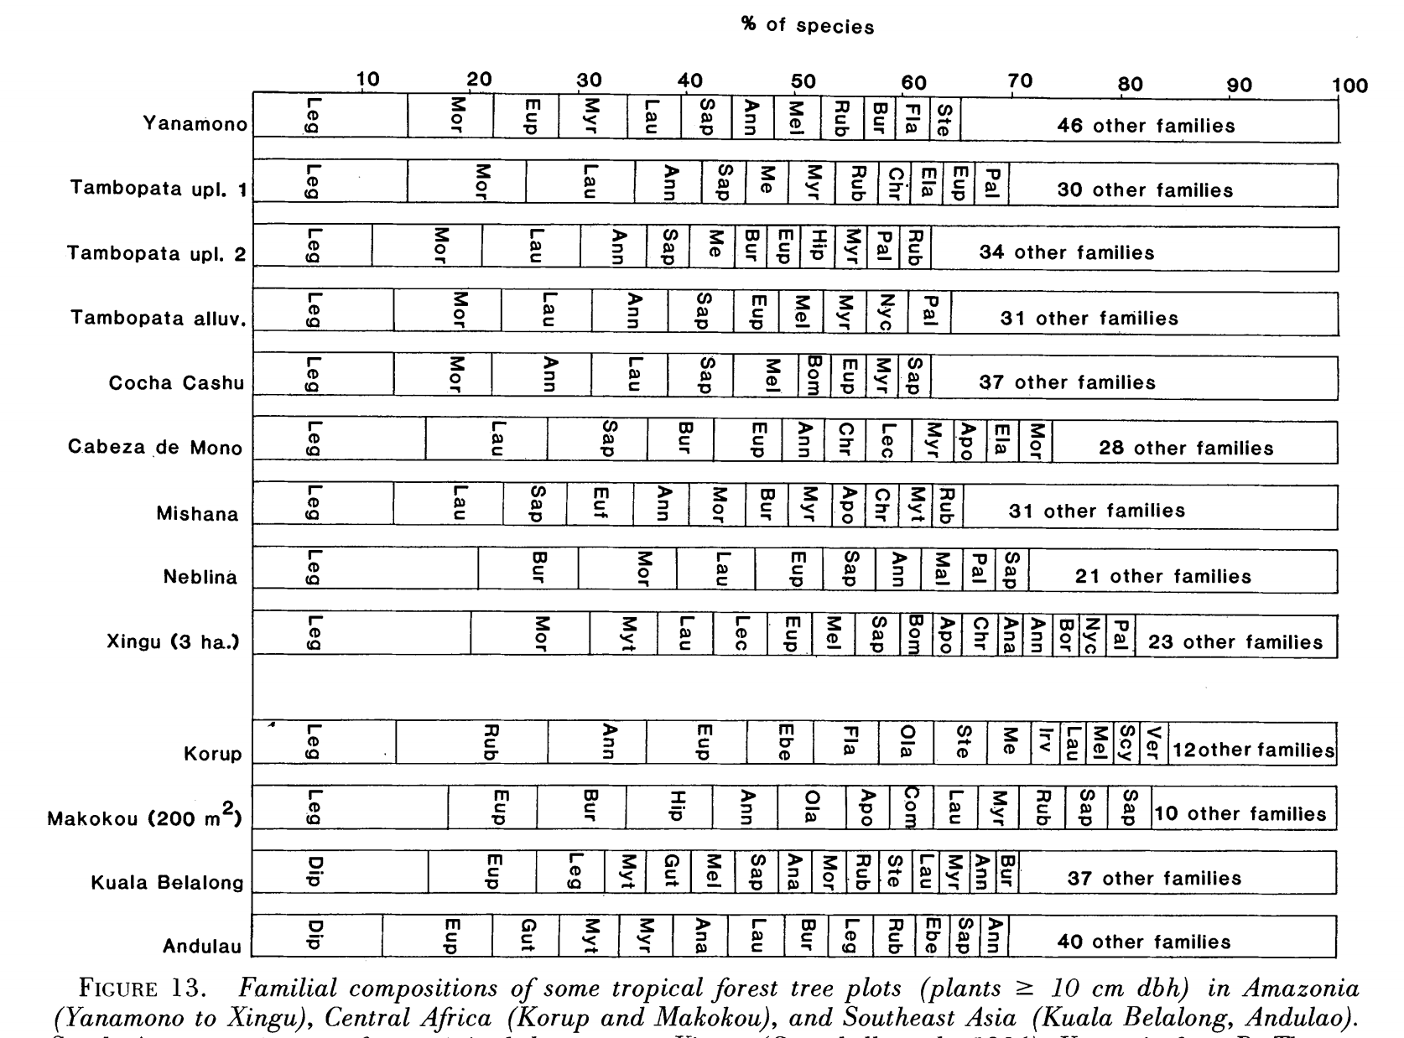
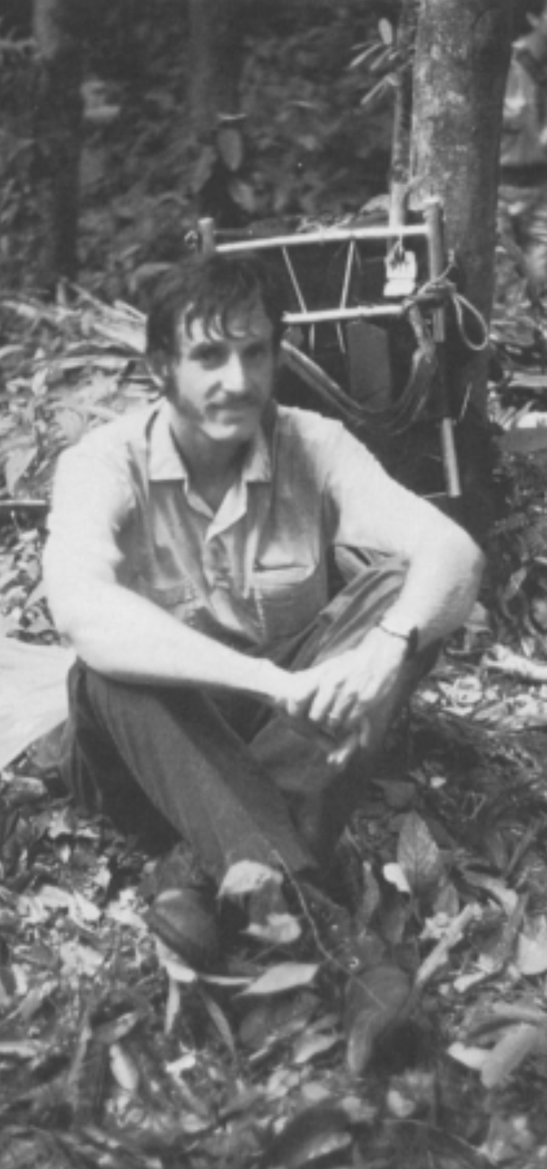
Gentry, 1988. Changes in Plant Community Diversity and Floristic Composition on Environmental and Geographical Gradients
AMAZON
AFRICA
ASIA

Slide 9
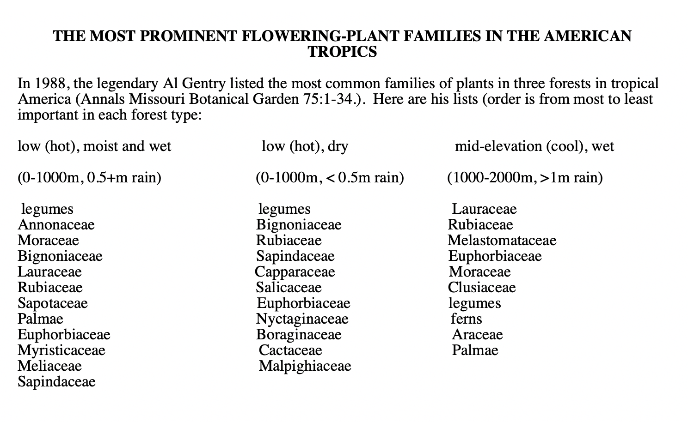

Slide 10
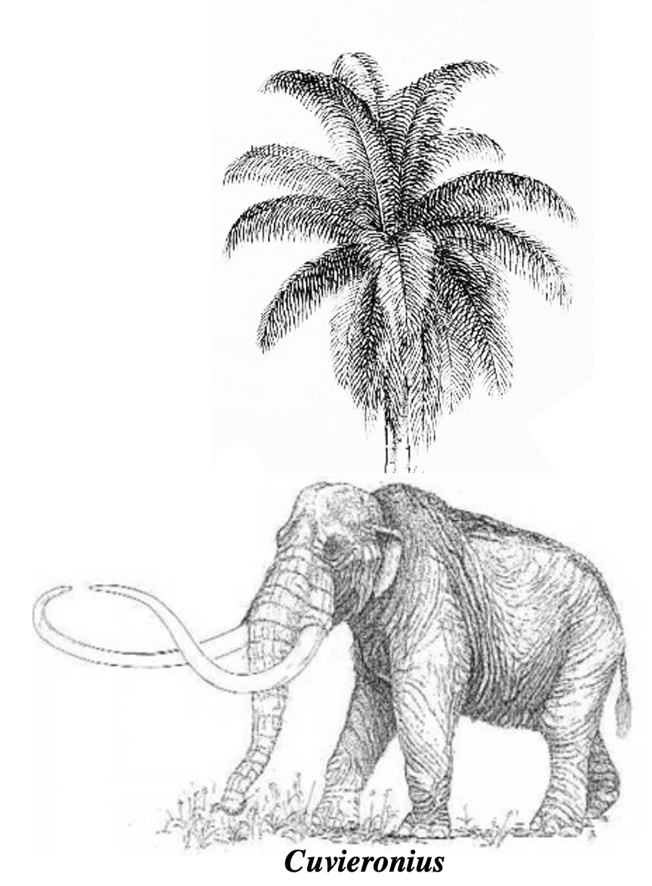
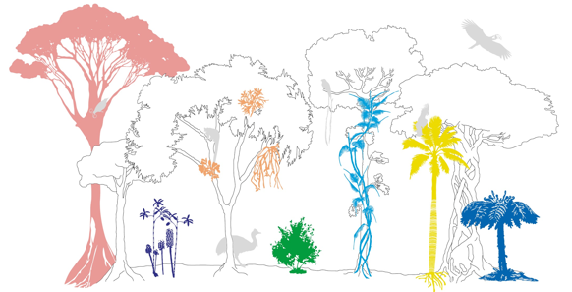

Slide 11
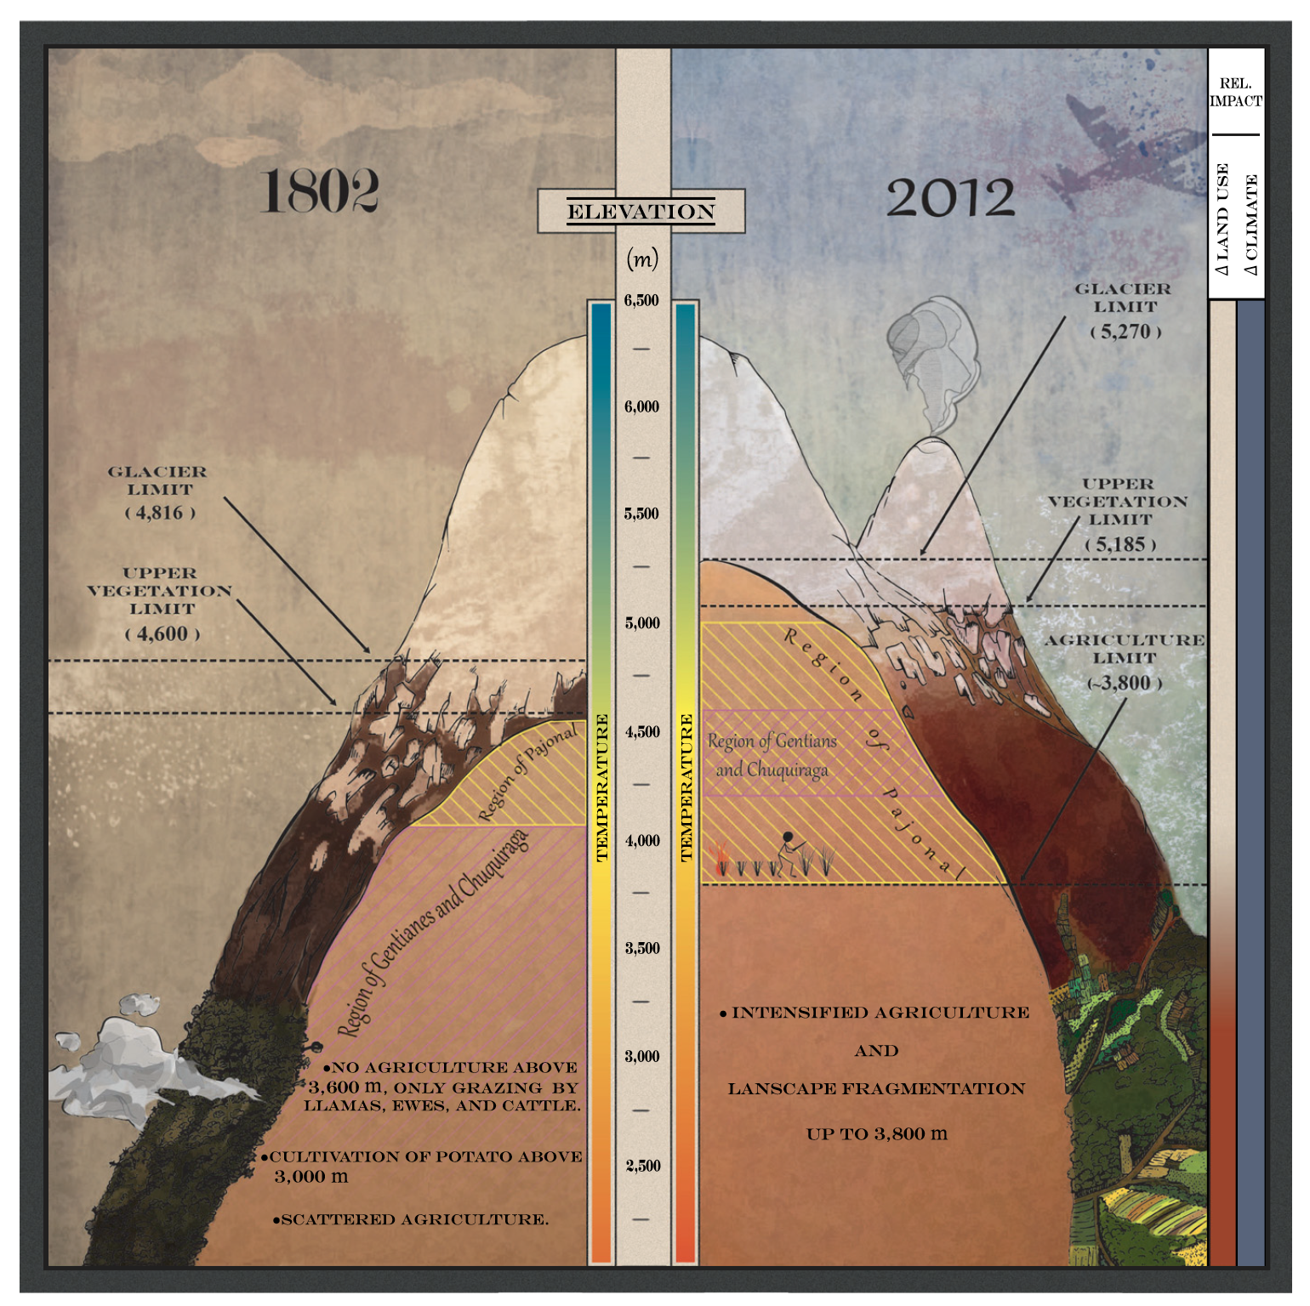
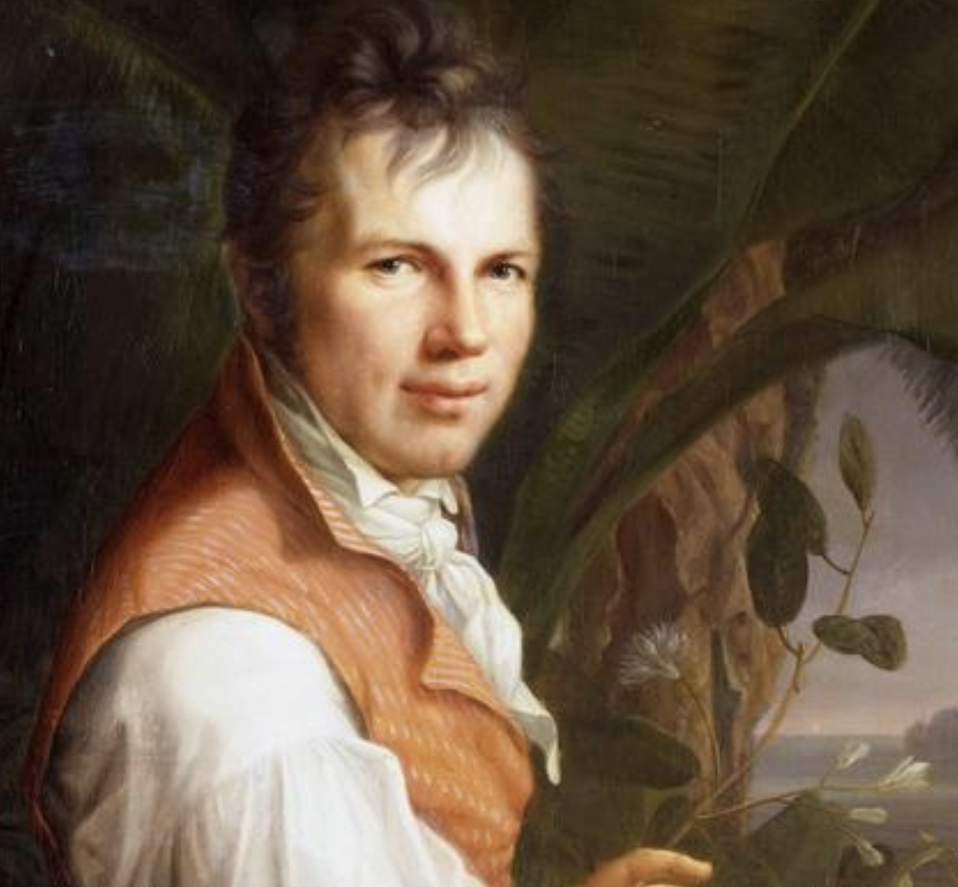
Morueta-Holme, N., Engemann, K., Sandoval-Acuña, P., Jonas, J.D., Segnitz, R.M. and Svenning, J.C., 2015.
Strong upslope shifts in Chimborazo's vegetation over two centuries since Humboldt.
Proceedings of the National Academy of Sciences, 112:12741-12745.
Chimborazo

