Slide 1
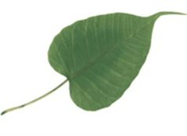
DRIP TIPS
A set of ideas on function
Drip tips are commoner on smaller trees in wetter forests. The stronger the drip tip, the more water is shed, and the less developed is the fungal community on the leaf surface. Drip tips do not impact epiphyll communities (i.e. communities of things like leafy liverworts that grow on leaves.

Slide 2
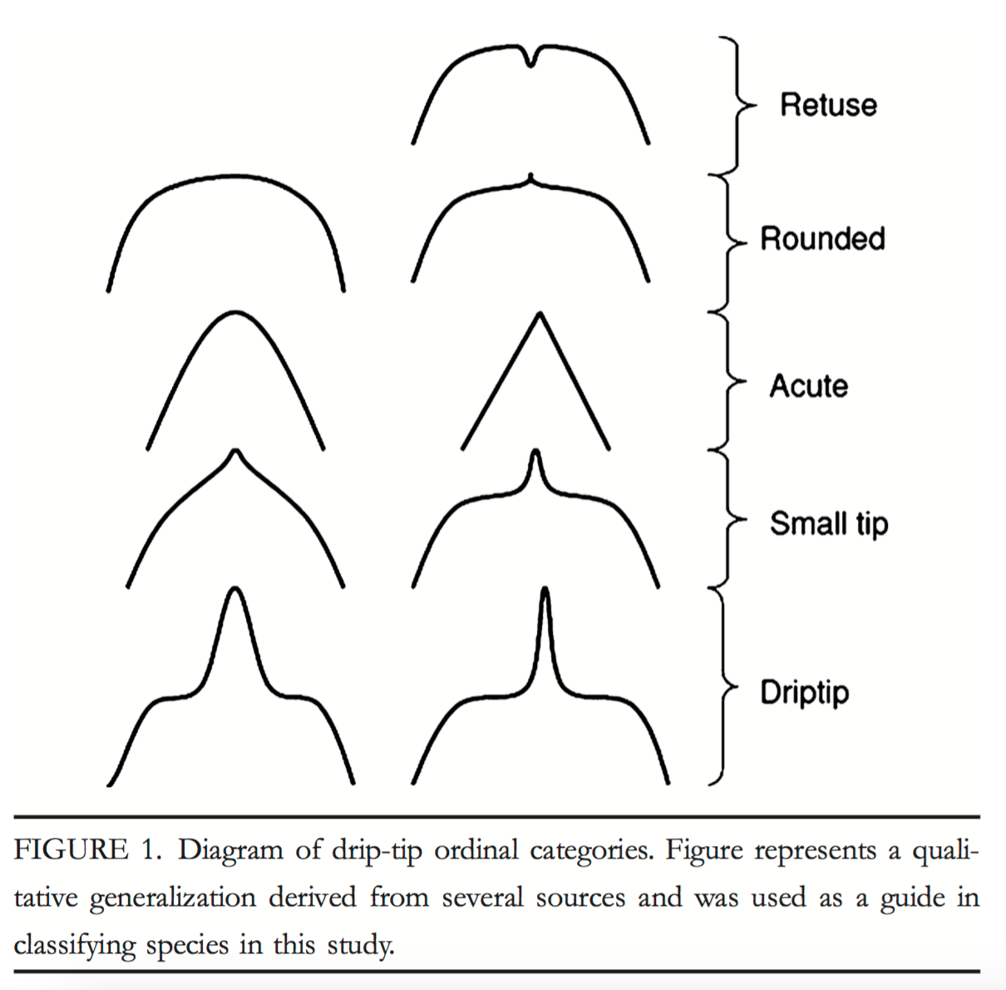
Trees and species with drip-tips were significantly more prevalent in the Central-East Amazon than the other regions.
Drip-tips were also associated with tree species that have smaller maximum heights and with trees with smaller trunk diameters.
The proportion of species and individuals with drip-tips was more strongly correlated with precipitation of the wettest trimester than with total annual precipitation or length of the dry season.
Malhado, A., Malhi, Y., Whittaker, R.J., Ladle, R.J., Ter Steege, H., Fabré, N.N., Phillips, O., Laurance, W.F., Aragao, L.E., Pitman, N.C. and Ramírez‐Angulo, H., 2012. Drip‐tips are Associated with Intensity of Precipitation in the Amazon Rain Forest. Biotropica, 44(6), pp.728-737.

Slide 3
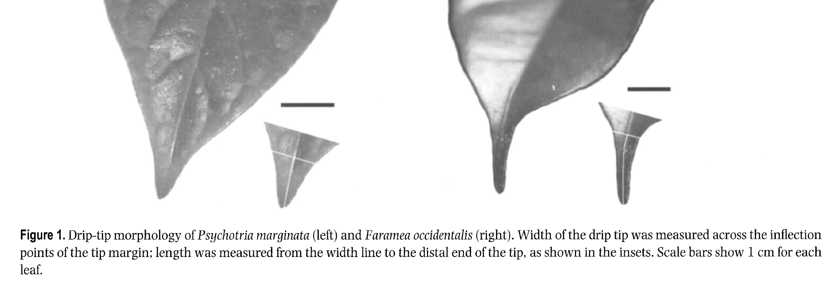
Drip tips do improve water flow, but not to reducing epiphyll cover:
“.... drip tips improve the drainage of water from leaf surfaces ... the effect was much more pronounced for Faraniea occidentalis than for Psychotria marginata”
Note that the latter has a better-developed drip tip.
Burd, M., 2007. Adaptive function of drip tips: a test of the epiphyll hypothesis in Psychotria marginata and Faramea occidentalis (Rubiaceae). Journal of Tropical Ecology, 23(04), pp.449-455.

Slide 4
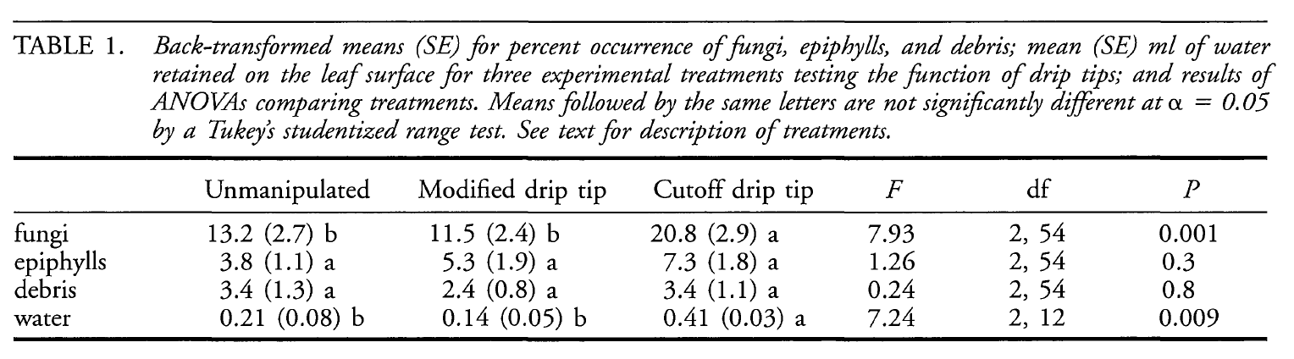
Perhaps the most persistent hypothesis for the function of drip tips is that they facilitate the rapid channeling of water from leaves, which decreases the drying time for the leaf surface (Stahl 1893, Lightbody 1985).
i.e. less water is retained, which is correlated with less fungal growth, but not less epiphylls and debris.
“Interestingly, we observed that epiphylls occurred most frequently on the drier regions of the leaves (away from the midveins, bases, and tips of the leaves), which may indicate that humidity is less of a limiting factor for the establishment of epiphylls than for fungi. “
Ivey, C.T. and DeSilva, N., 2001. A Test of the Function of Drip Tips1. Biotropica, 33(1), pp.188-191.

