Slide 1
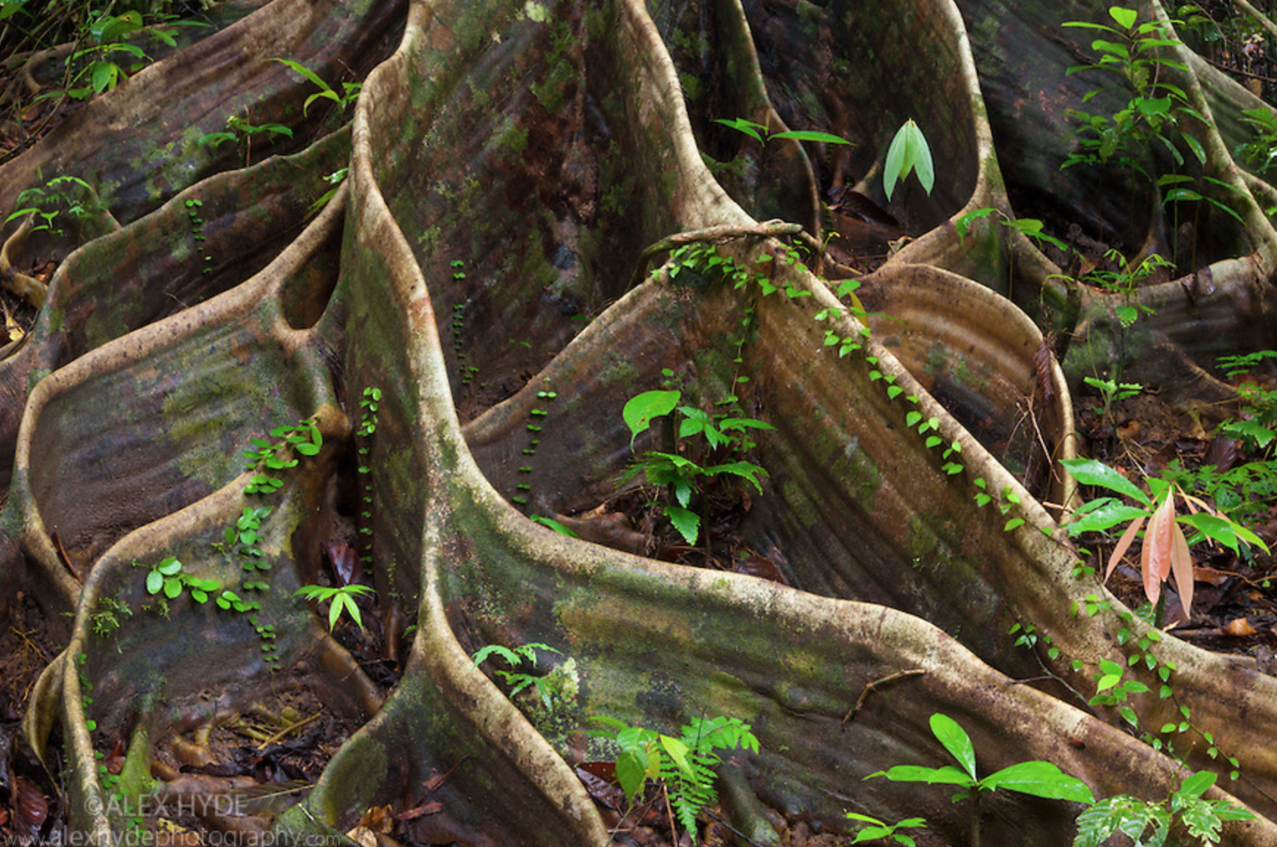
Buttress Roots --- a little side trip
Notes:
Borneo Shorea

Slide 2
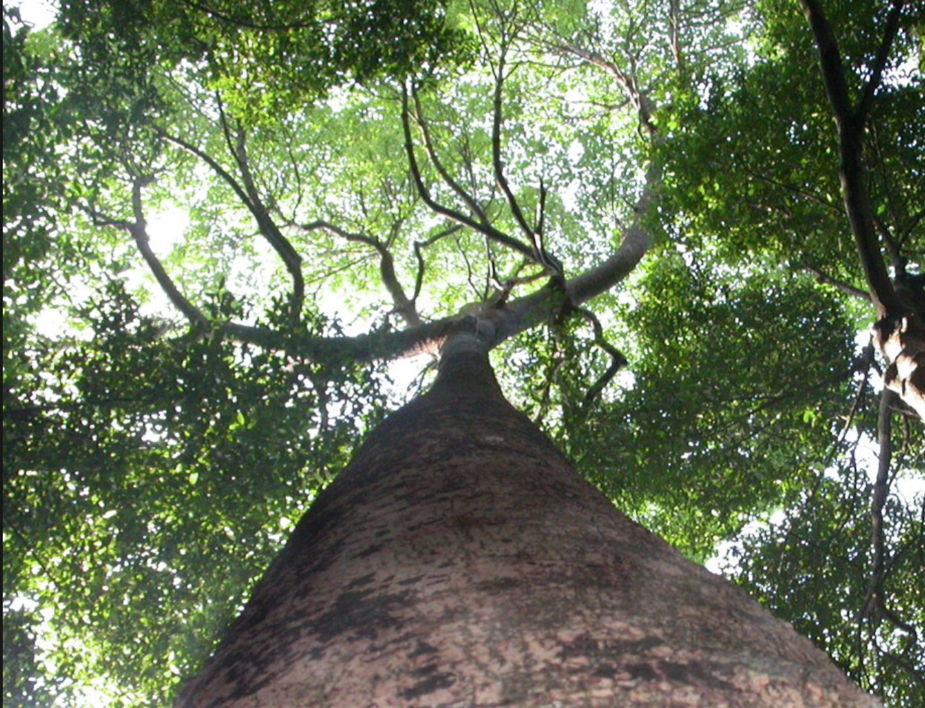
Notes:
Shorea gratissima, Sumber: Singapore Botanical Garden

Slide 3
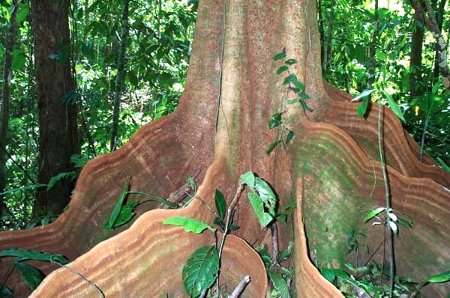
Buttress roots of Schizolobium parahyba [Caesalpinioid]

Slide 4
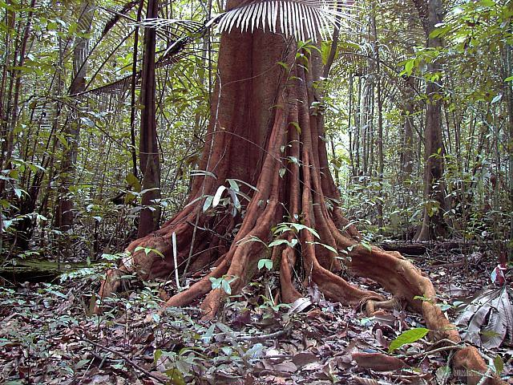
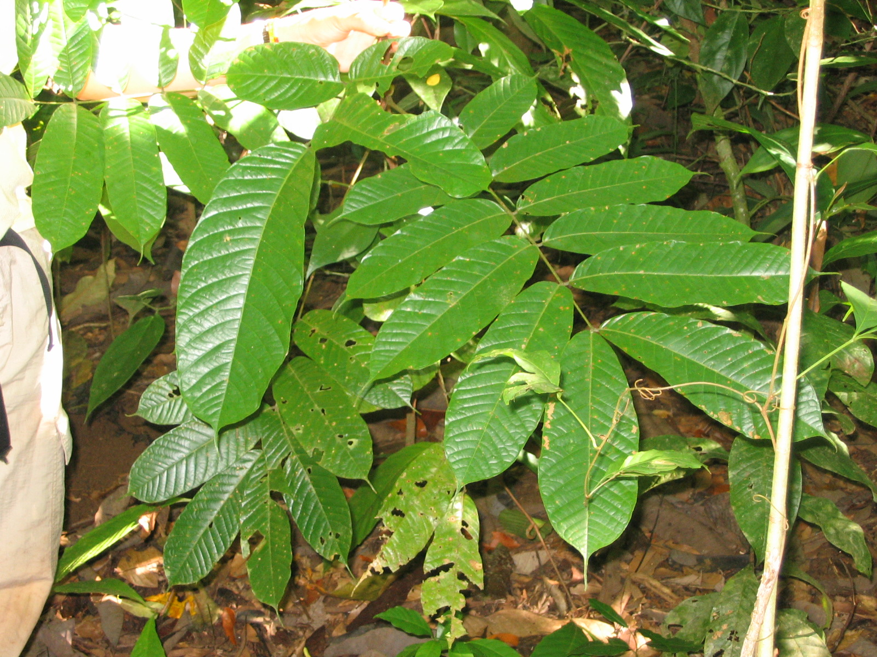
Tachigali [Caesalpinioid]

Slide 5
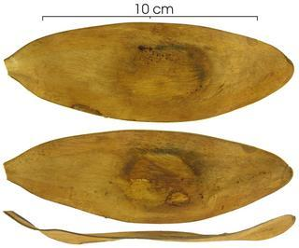
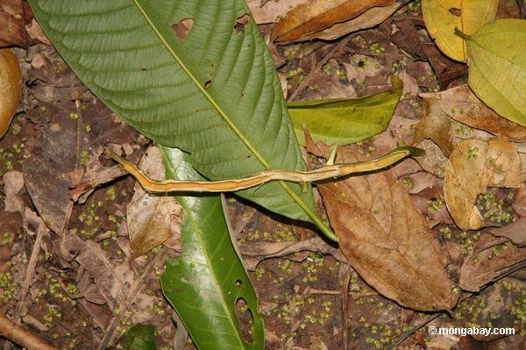
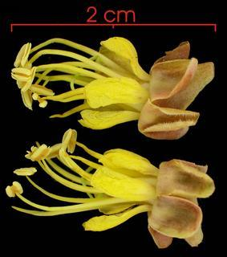
Tachigali
Ant passages in stem
Notes:
Loveless, M. D., Hamrick, J. L., & Foster, R. B. (1998). Population structure and mating system in Tachigali versicolor, a monocarpic neotropical tree. Heredity, 81(2), 134-143.

Slide 6
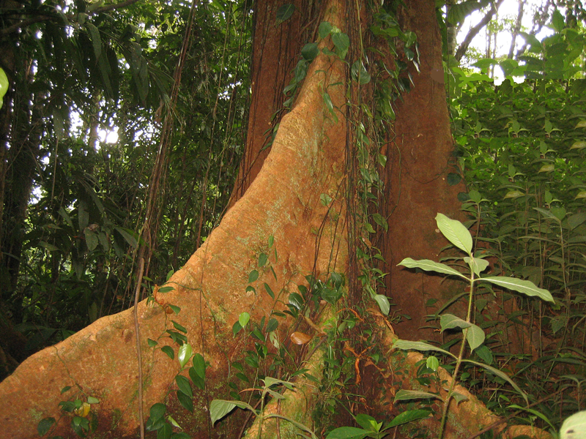
Parkia [mimosoid] , Osa

Slide 7
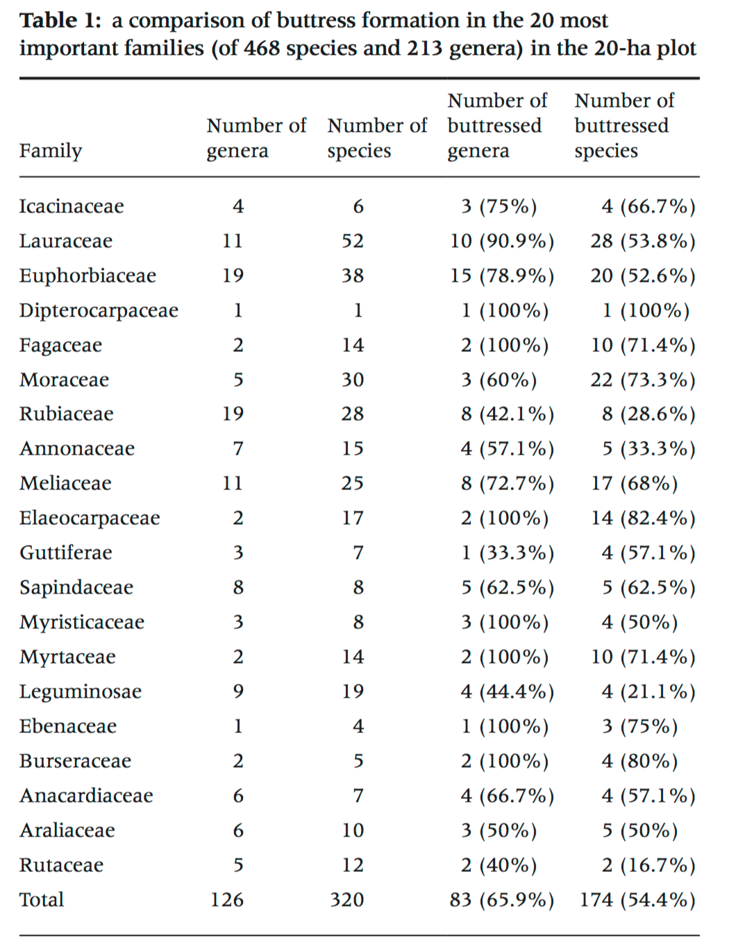
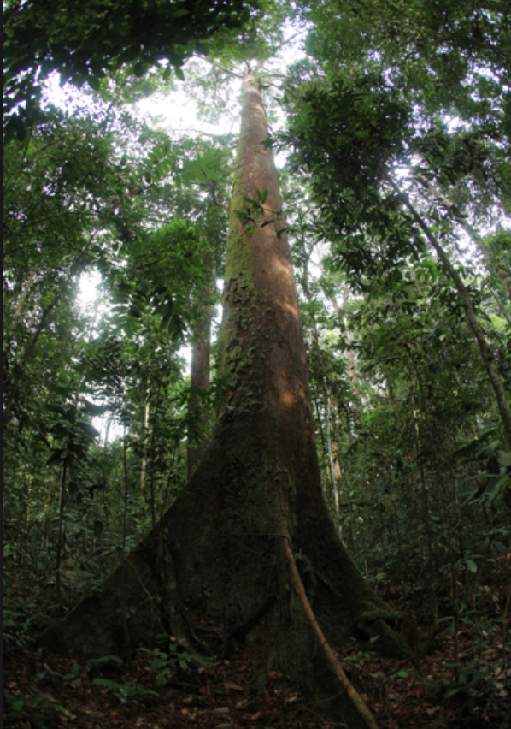
Buttress trees in a 20-hectare tropical dipterocarp rainforest in southwest China
Notes:
Zhiyuan, H., Yong, T., Xiaobao, D. and Min, C., 2012. Buttress trees in a 20-hectare tropical dipterocarp rainforest in Xishuangbanna, SW China. Journal of Plant Ecology, p.rts031.
BIG TREES HAVE BUTTRESSES, LITTLE ONES DON’T ACROSS PHYOLOGENETIC LINEAGES.

Slide 8
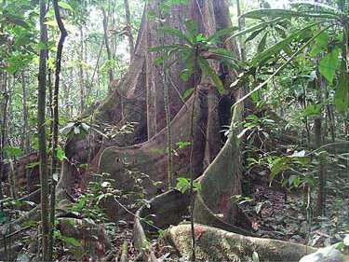
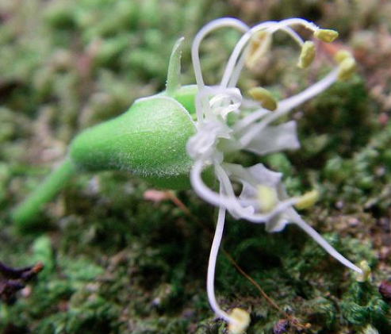
Microberlinia bisulcata [a Caesalpiniod legume]
For sites across the tropics in general, the degree of
shallowness and spatial extension of buttresses of the
dominant species is hypothesized to increase with
decreasing nutrient availability: Newbery et al. 2009.
Notes:
David M. Newbery Æ Sarah Schwan Æ
George B. Chuyong Æ Xander M. van der Burgt. 2009.
Buttress form of the central African rain forest tree Microberlinia
Bisulcata, and its possible role in nutrient acquisition.
Trees 23:219–234

Slide 9
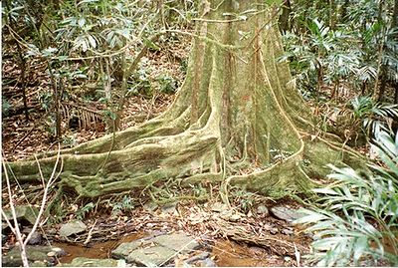
Elaeocarpus angustifolius [Elaeocarpaceae] of eastern Australia and New Caledonia
The trees have buttresses arranged uniformly around the circumference and exhibit no difference in values of wood specific gravity on the windward and leeward sides in spite of their location in the trade wind belt.Woodcock et al., 2000
Notes:
Annals of Botany 85: 1–6, 2000 Article No. anbo.1999.0985, available online at http:www.idealibrary.com on
The Buttressed Blue Marble Tree: Wood and Growth Characteristics of Elaeocarpus angustifolius (Elaeocarpaceae)
D. W. WOODCOCK*, G. DOS SANTOS and D. TAYLOR

Slide 10
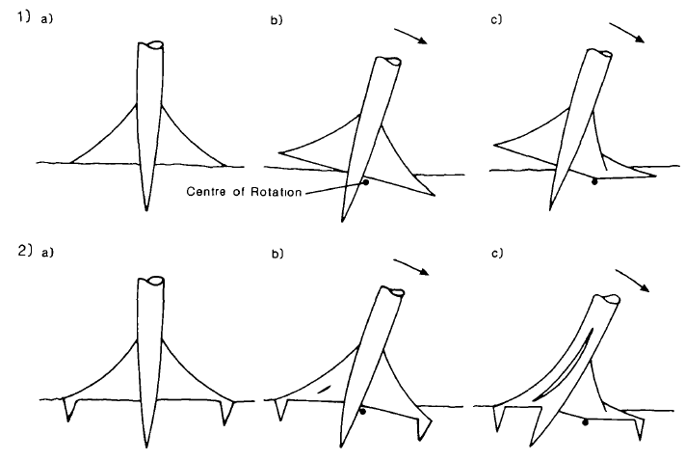
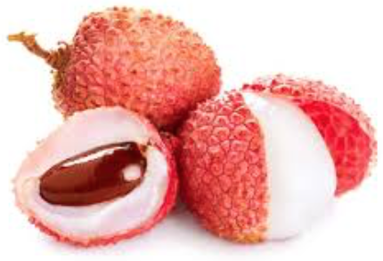
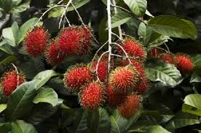
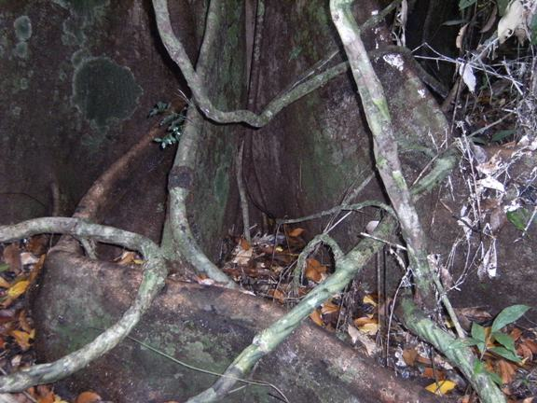
Crook et al., 1997, working on Nephelium (Sapindaceae), the litchi tree:
Buttresses contribute around 60% of the anchorage of buttressed trees, producing around six times more anchorage than the thin laterals of unbuttressed trees.
Notes:
M.J. Crook, A.R. Ennos and J.R. Banks, 1997
The function of buttress roots: a comparative study of the anchorage systems of buttressed (Aglaia and Nephelium ramboutan species) and non-buttressed (Mallotus wrayi) tropical trees. Journal of Experimental Botany, 48: 1703-1716, .

Slide 11
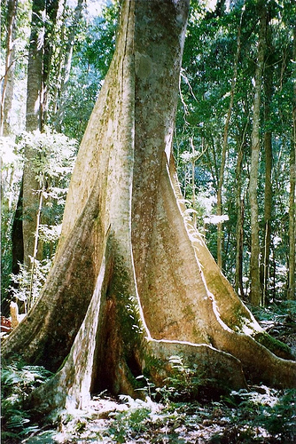
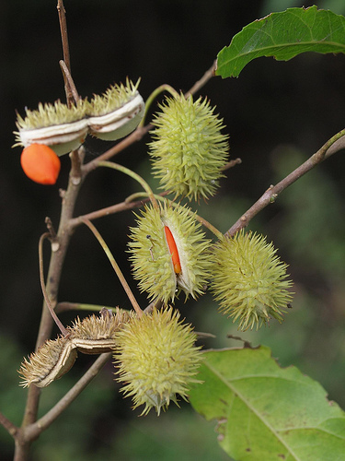
Sloanea woolsii, Elaeocarpaceae
Northeastern New South Wales and Queensland
Notes:
American Journal of Botany 90(9): 1349–1356. 2003.
BIOMECHANICS OF BUTTRESSED TREES: BENDING STRAINS AND STRESSES
Clair, B., Fournier, M., Prevost, M.F., Beauchene, J. and Bardet, S., 2003. Biomechanics of buttressed trees: bending strains and stresses. American journal of Botany, 90(9), pp.1349-1356.

Slide 12
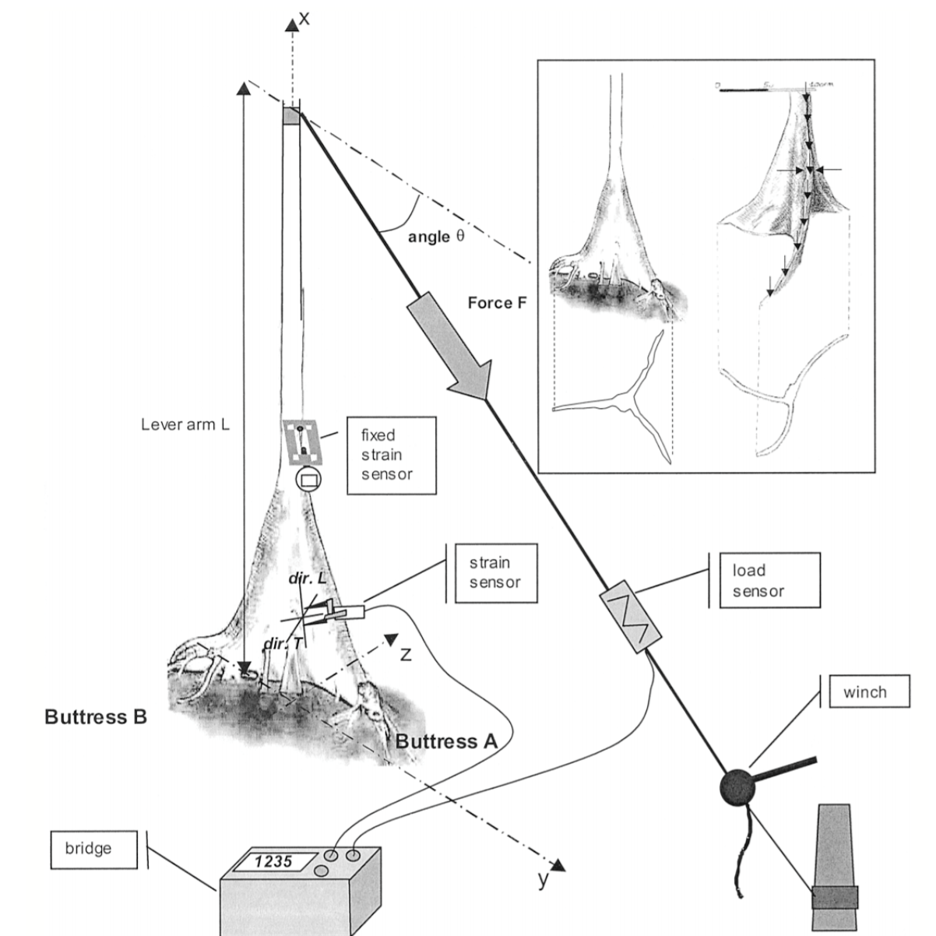
Sloanea buttress strains:
Risks of failure were greater on the buttress sides, where shear and tangential stresses are greater, not on the ridges, where longitudinal stresses are greater.
Without chronological data during the development of the tree, it cannot be proved that buttress formation is activated by stress or strain.
Notes:
Design of the bending tests and buttress forms of trees of Sloanea spp. Inset: left, first tree, with flat buttresses; right, second tree, with curved
buttresses. On the first tree, measurements were made in every part of the buttressed zone. On the second tree, the locations of the measurements are indicated
by arrows.
The mechanism of strain perception that controls growth locally
is still a puzzling question. Nevertheless, regardless of
adaptive theories, the different buttress shapes (plate or shell)
of the two trees can explain the different observed patterns of
strains, because in the second tree, the buttress base is almost
perpendicular to the bending plane.

Slide 13
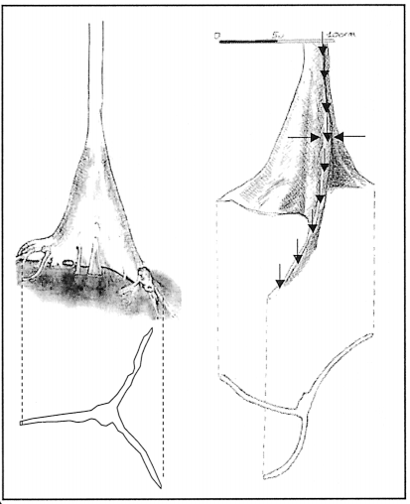
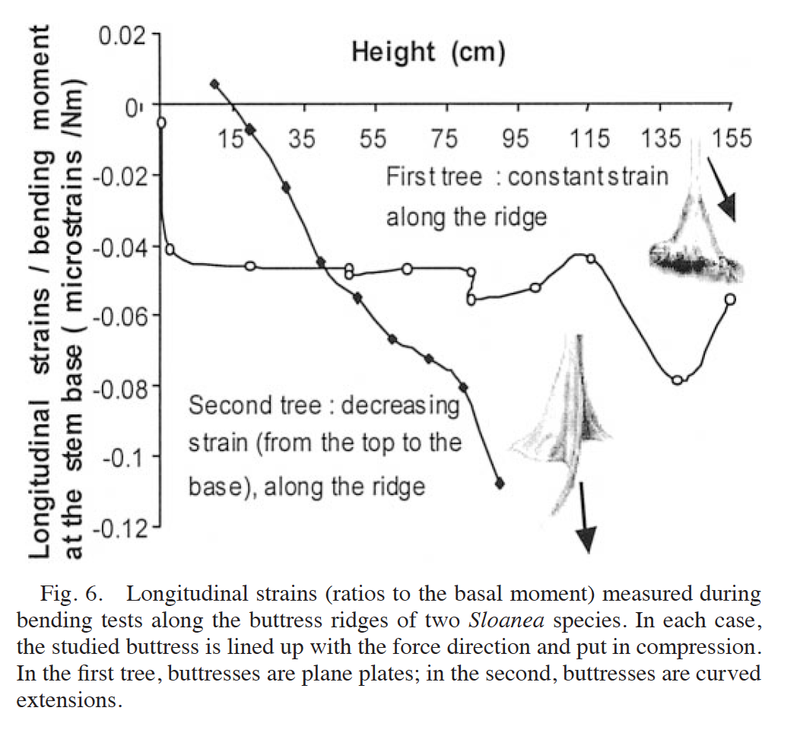
Buttress shape matters: first tree, with flat (plate) buttresses; right, second tree, left, with curved buttresses.
Still, the mechanism of strain perception that controls growth locally is still a puzzling question.

