Slide 1
On Apomixis …
Original Discovery
Our Vermont apomictic species:
Pellaea atropurpurea and Pellaea glabella var. glabella
Mechanics of the Döpp-Manton scheme
Altered Sporophyte Production: Farlow and Alice Tryon
Altered Spore Production: Manton on Cyrtomium
Gastony on the origins of Pellaea glabella var. glabella
Amanda Grusz on Apomixis, the Braithwaite scheme
Two Case Histories
Grusz on apomixis and polyploidy in Cheilanthes
Origin of apomixis – an example from Japan.
Notes:
acrostichoides

Slide 2
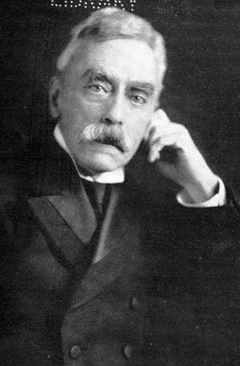
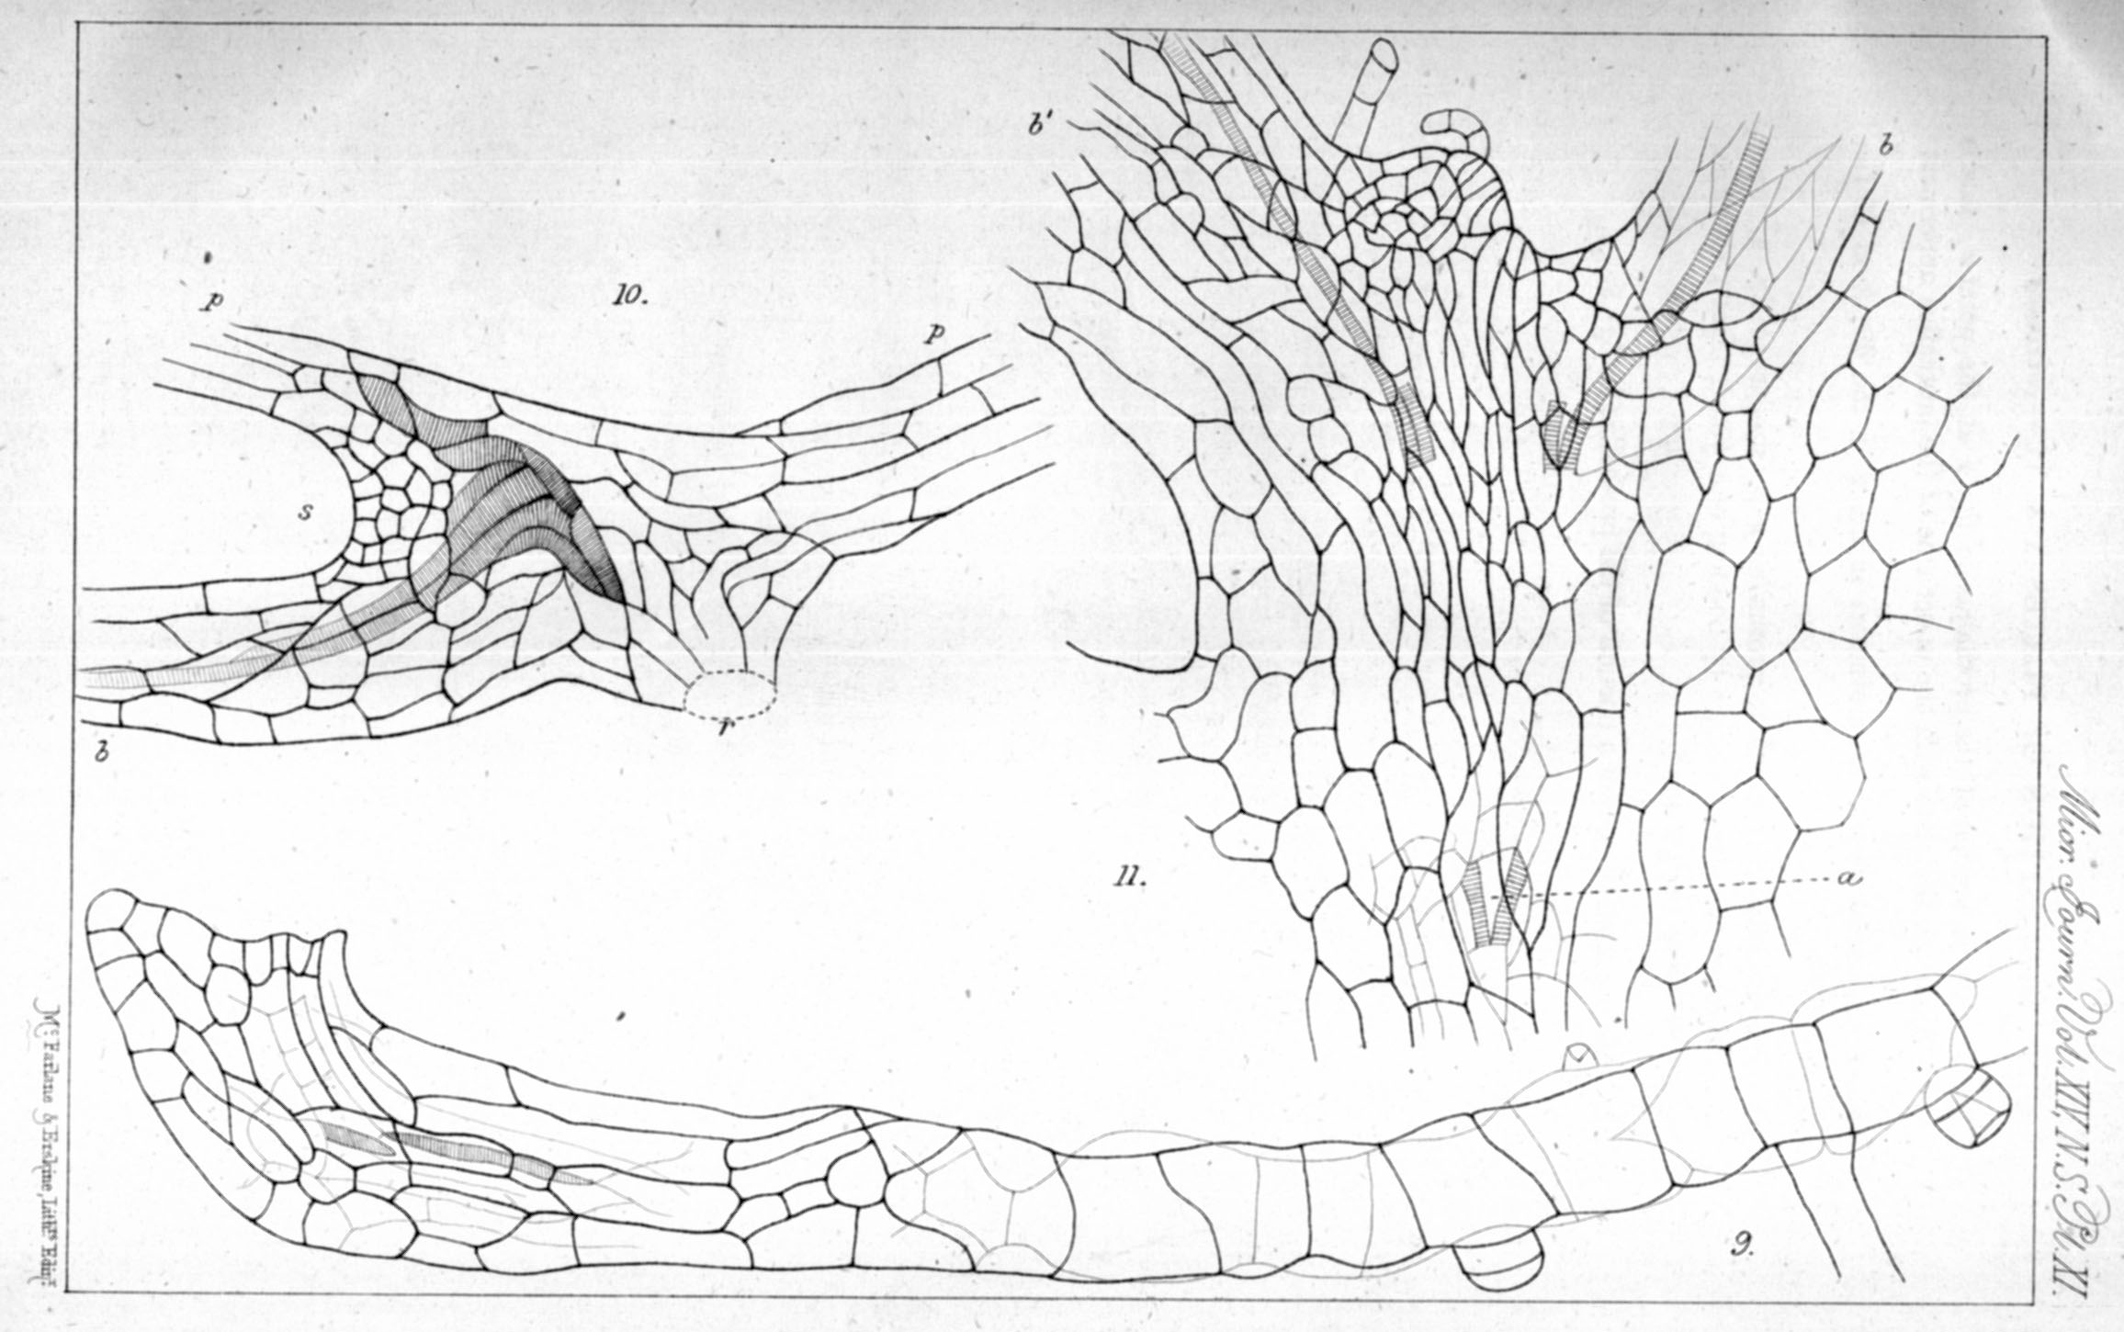
Farlow’s demonstration of apomixis, working in Strasbourg, 1872

Slide 3
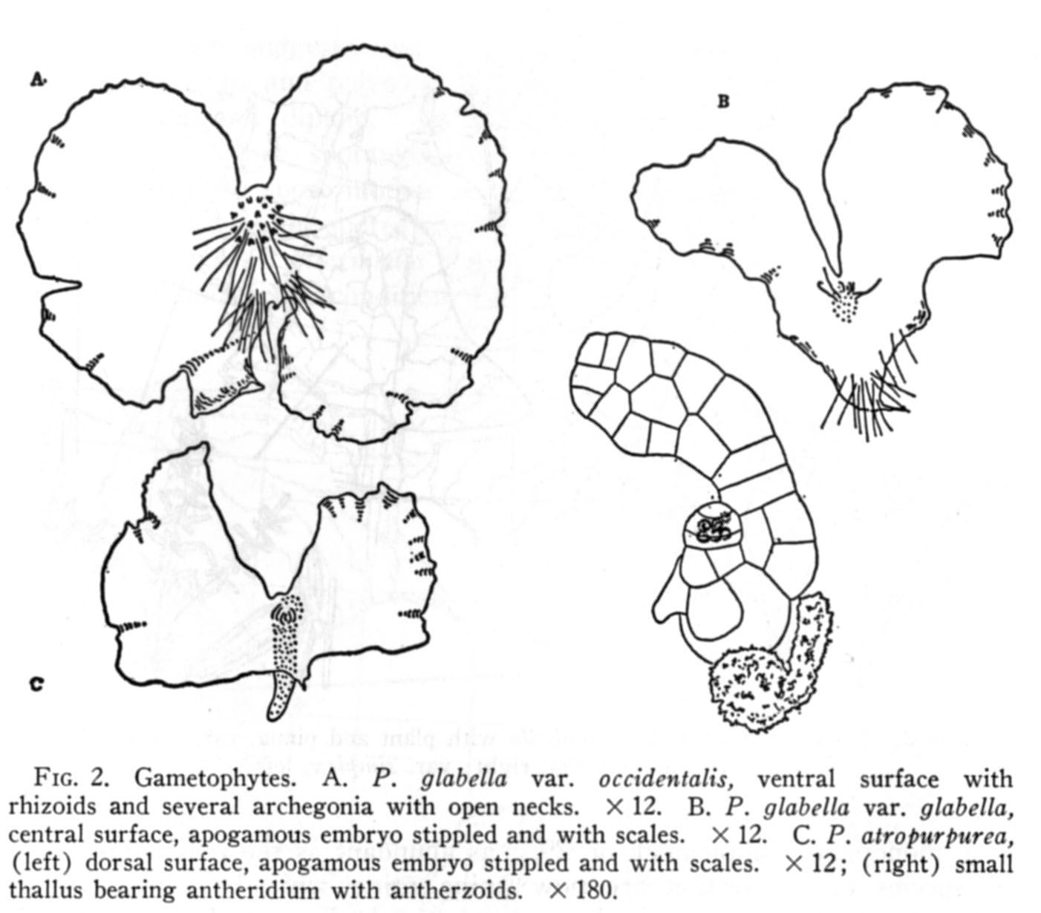

Slide 4
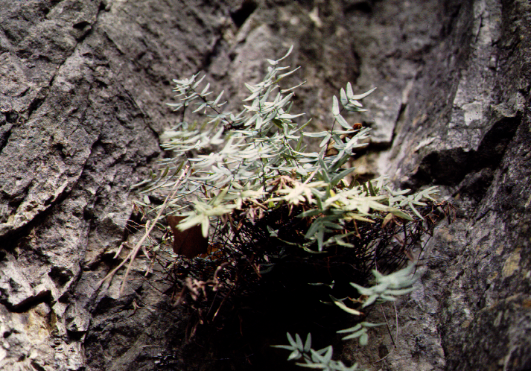
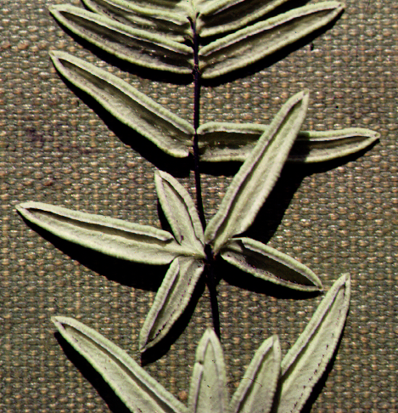
Pellaea glabella var. glabella

Slide 5
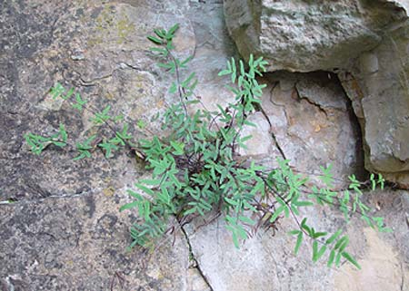
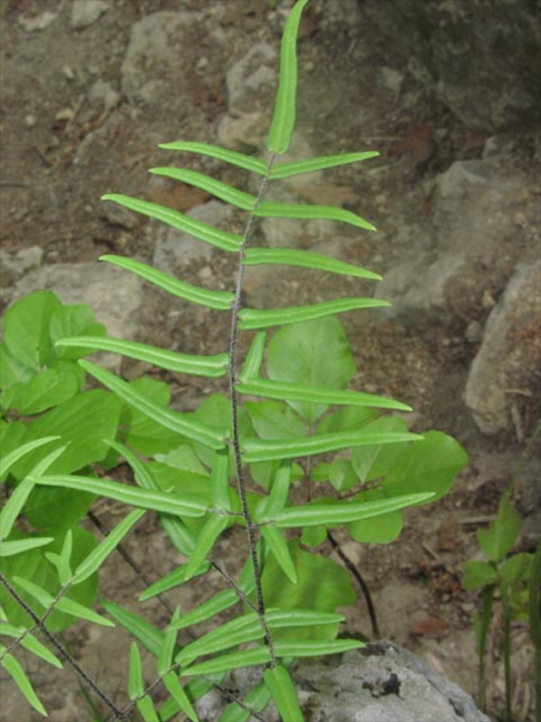
Pellaea atropurpurea

Slide 6
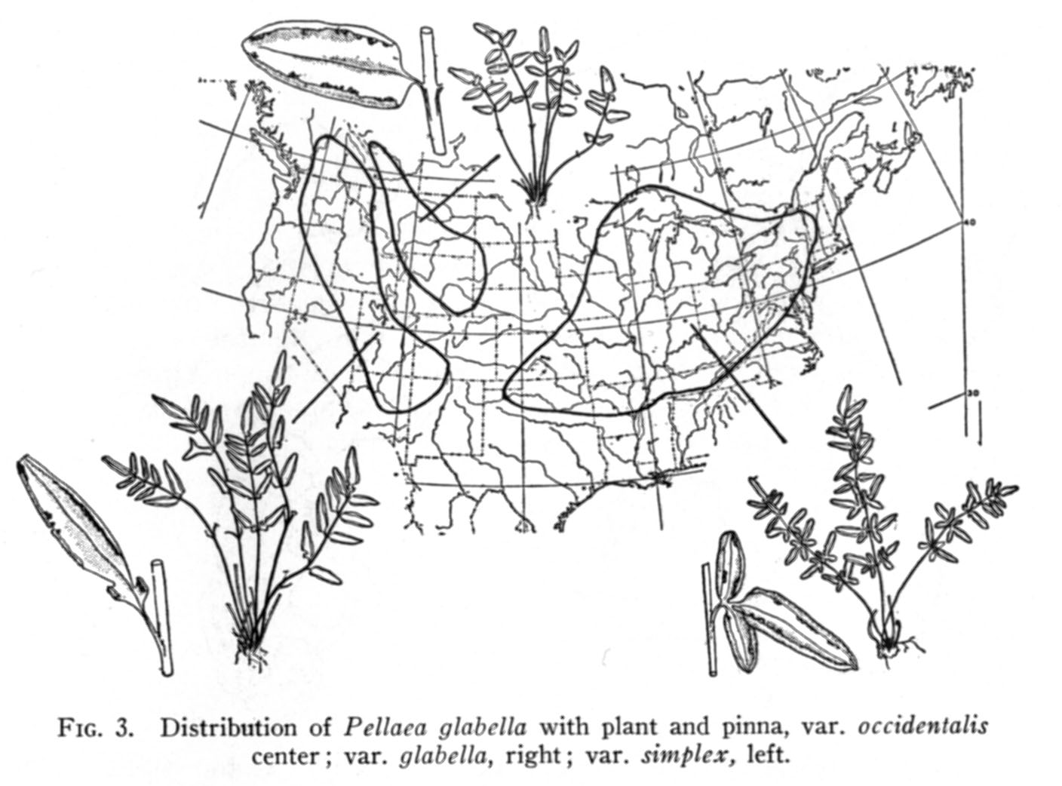
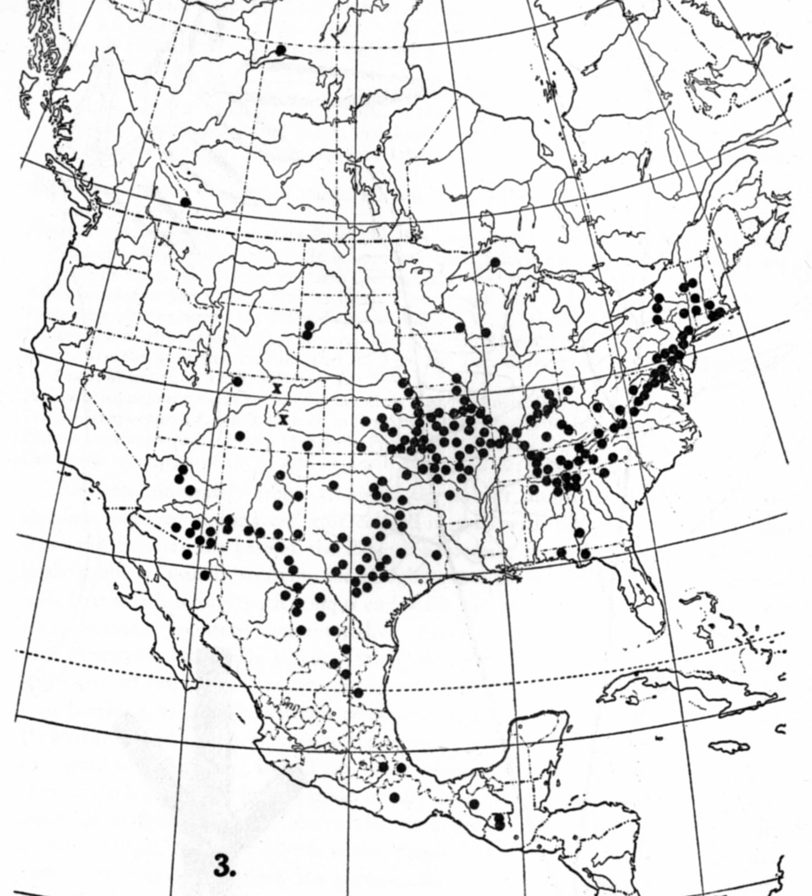
Geography of the Vermont pellaeas
glabella
atropurpurea
var. occidentalis
var. simplex
var. glabella

Slide 7

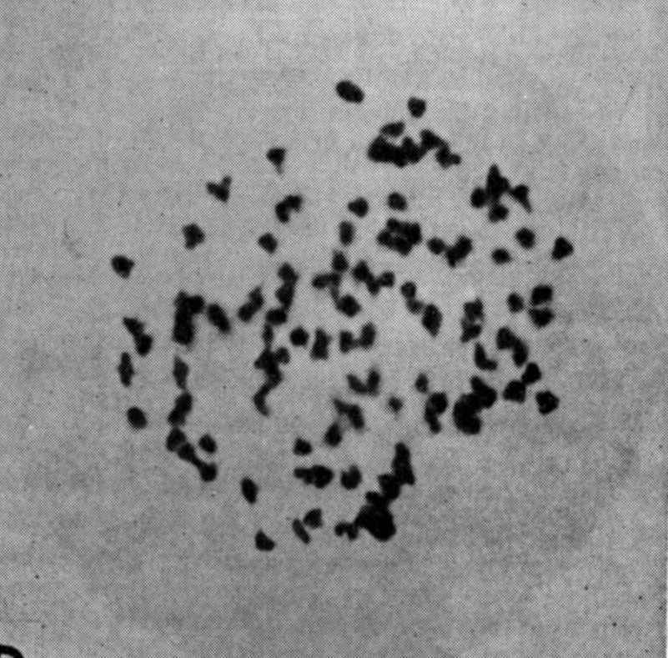
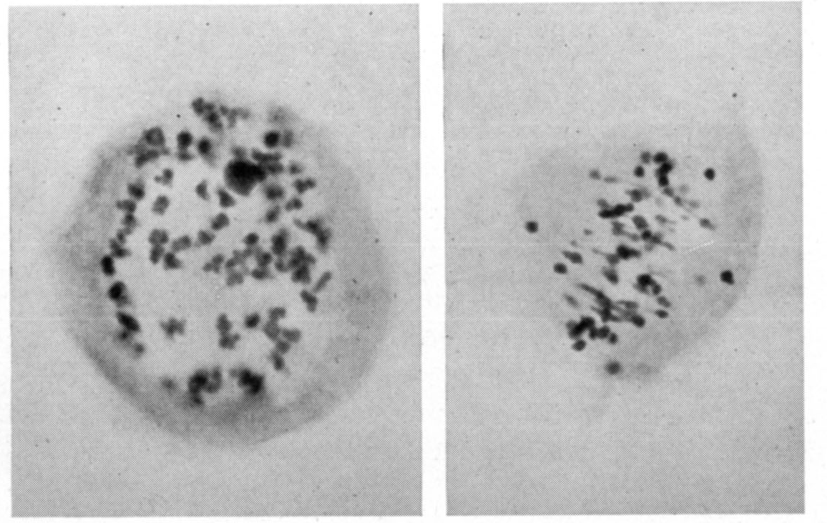
chromosome squashes for Pellaea
Alice Tryon’s chromosome squashes for Pellaea glabella var. simplex
x=29, 116 pairs
Manton’s chromosome squashes for Pellaea atropurpurea
x = 29, 87 pairs

Slide 8
On Apomixis …
Original Discovery
Our Vermont apomictic species:
Pellaea atropurpurea and Pellaea glabella var. glabella
Mechanics of the Döpp-Manton scheme
Altered Sporophyte Production: Farlow and Alice Tryon
Altered Spore Production: Manton on Cyrtomium
Gastony on the origins of Pellaea glabella var. glabella
Amanda Grusz on Apomixis, the Braithwaite scheme
Two Case Histories
Grusz on apomixis and polyploidy in Cheilanthes
Origin of apomixis – an example from Japan.
Notes:
acrostichoides

Slide 9
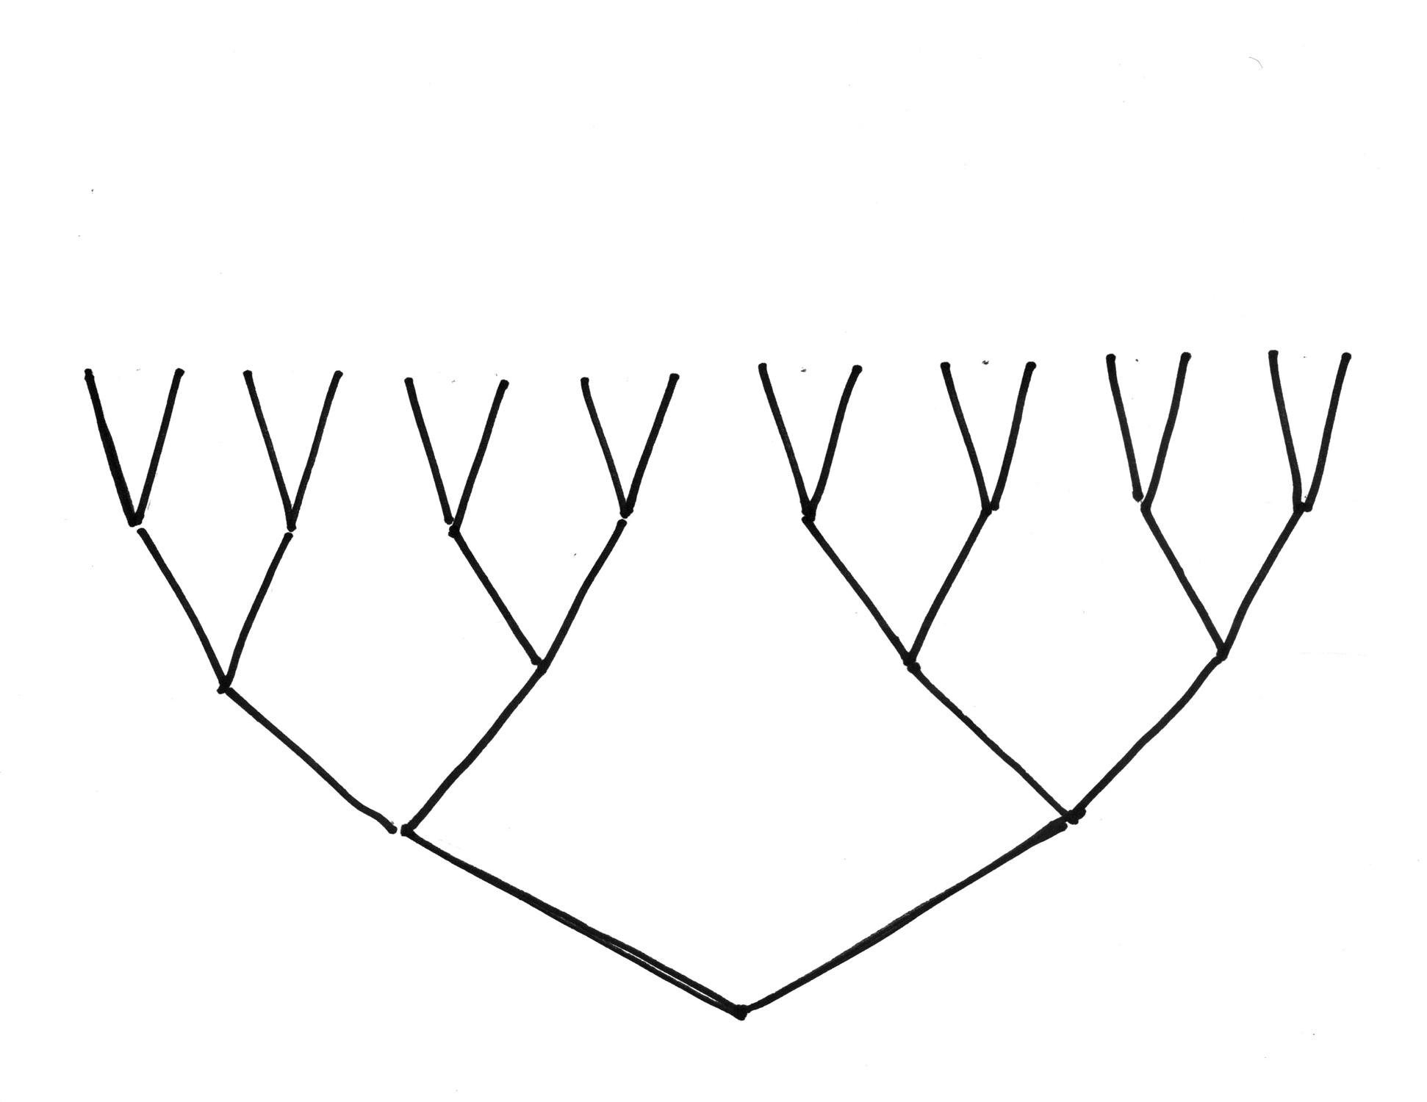
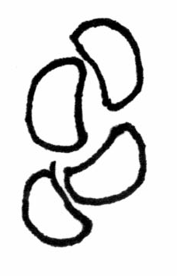
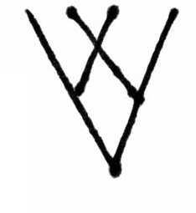
Sporogenesis in ferns with a typical sexual life cycle.
64 VIABLE SPORES
MEIOSIS
4 MITOTIC DIVISIONS
ARCHESPORIAL CELL

Slide 10
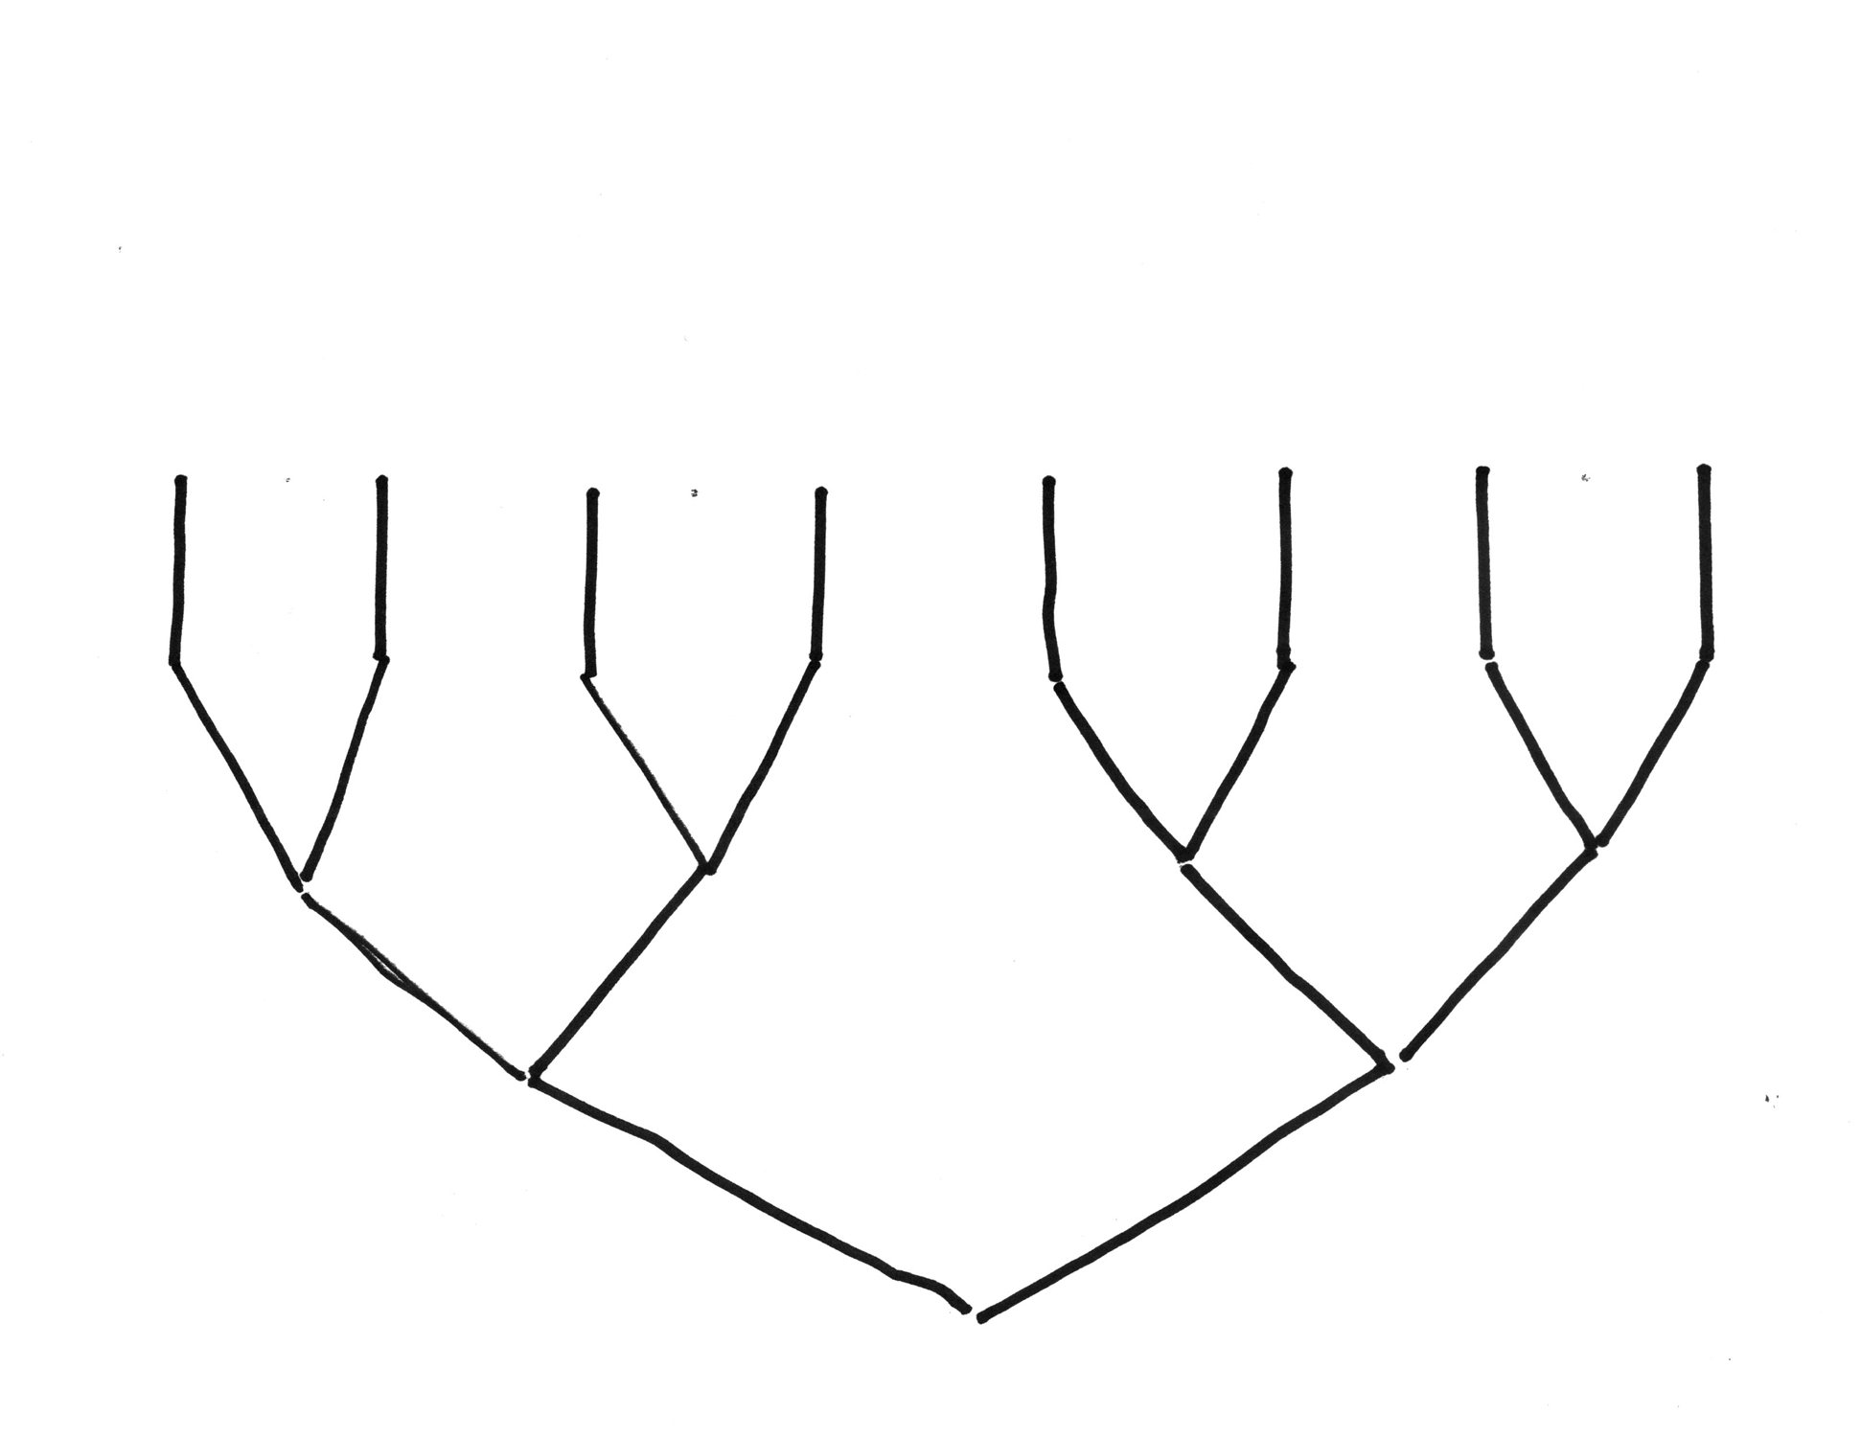
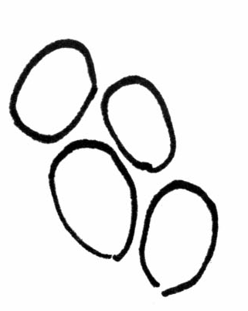
Sporogenesis in apomictic ferns: pathway 1 shows normal pairing of doubled chromosomes, yields viable spores.
32 VIABLE SPORES
MEIOSIS
NON-DISJUNCTION
3 MITOTIC DIVISIONS
ARCHESPORIAL CELL

Slide 11
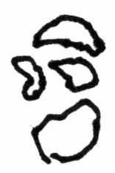
Sporogenesis in apogamous ferns: pathway 2 reveals chromosome homology, yields abortive spores
64 ABORTIVE SPORES
MEIOSIS
4 MITOTIC DIVISIONS
ARCHESPORIAL CELL

Slide 12
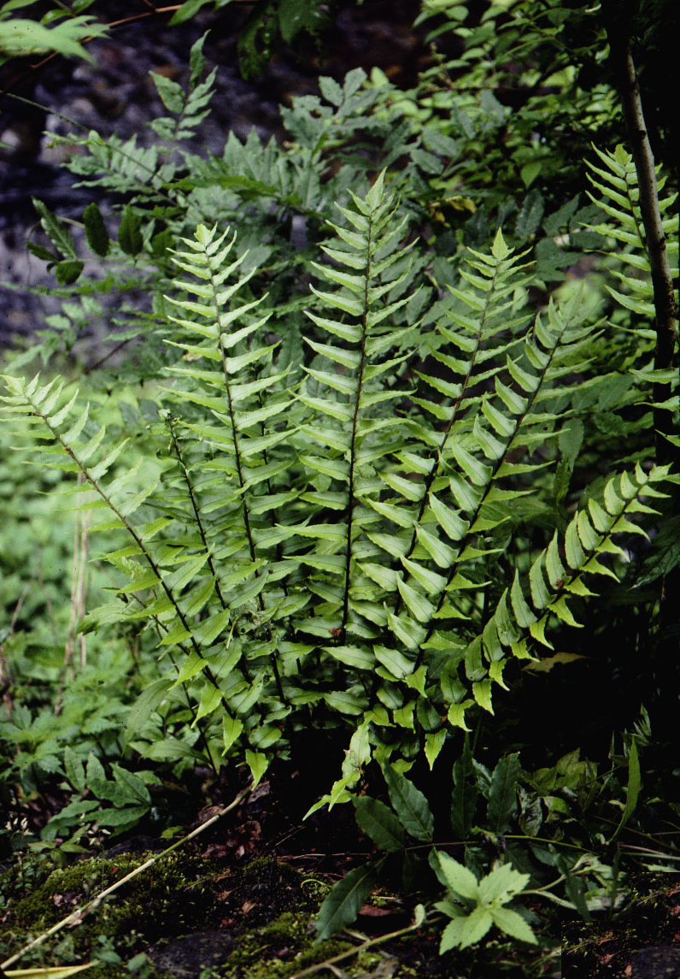
Cyrtomium
53

Slide 13
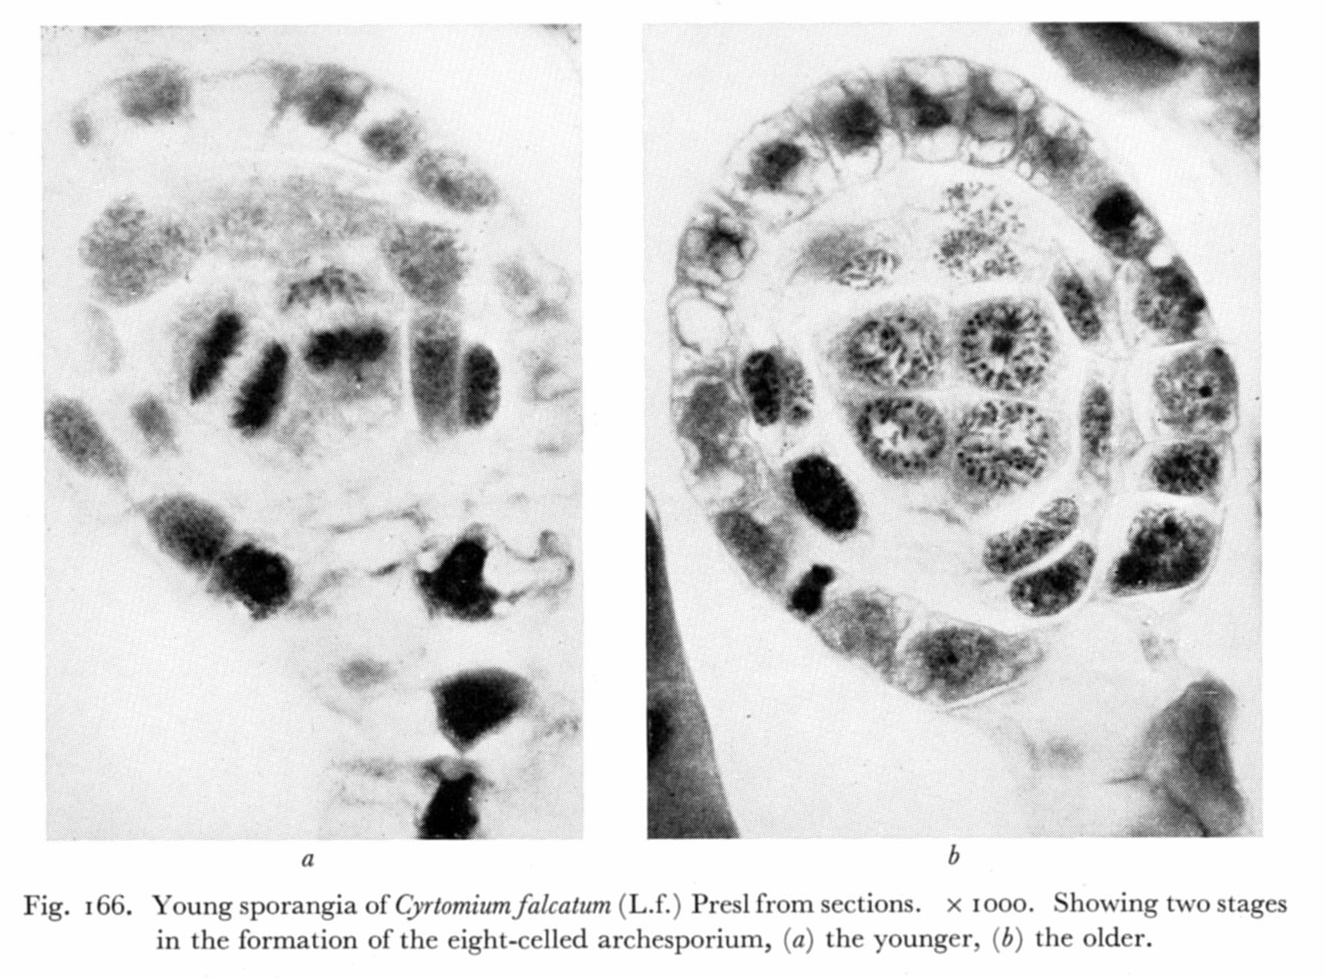
Döpp-Manton Mechanism: early sporogenesis (4 to 8 cells)

Slide 14
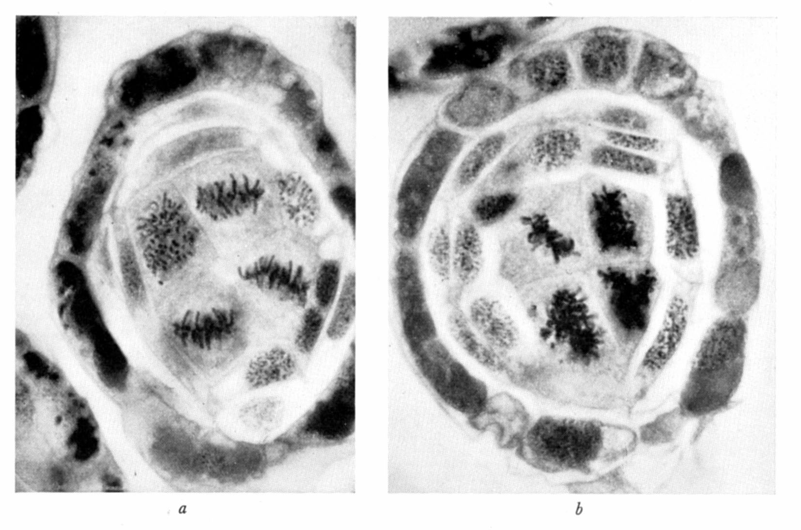
Döpp-Manton Mechanism: fourth premeiotic division

Slide 15
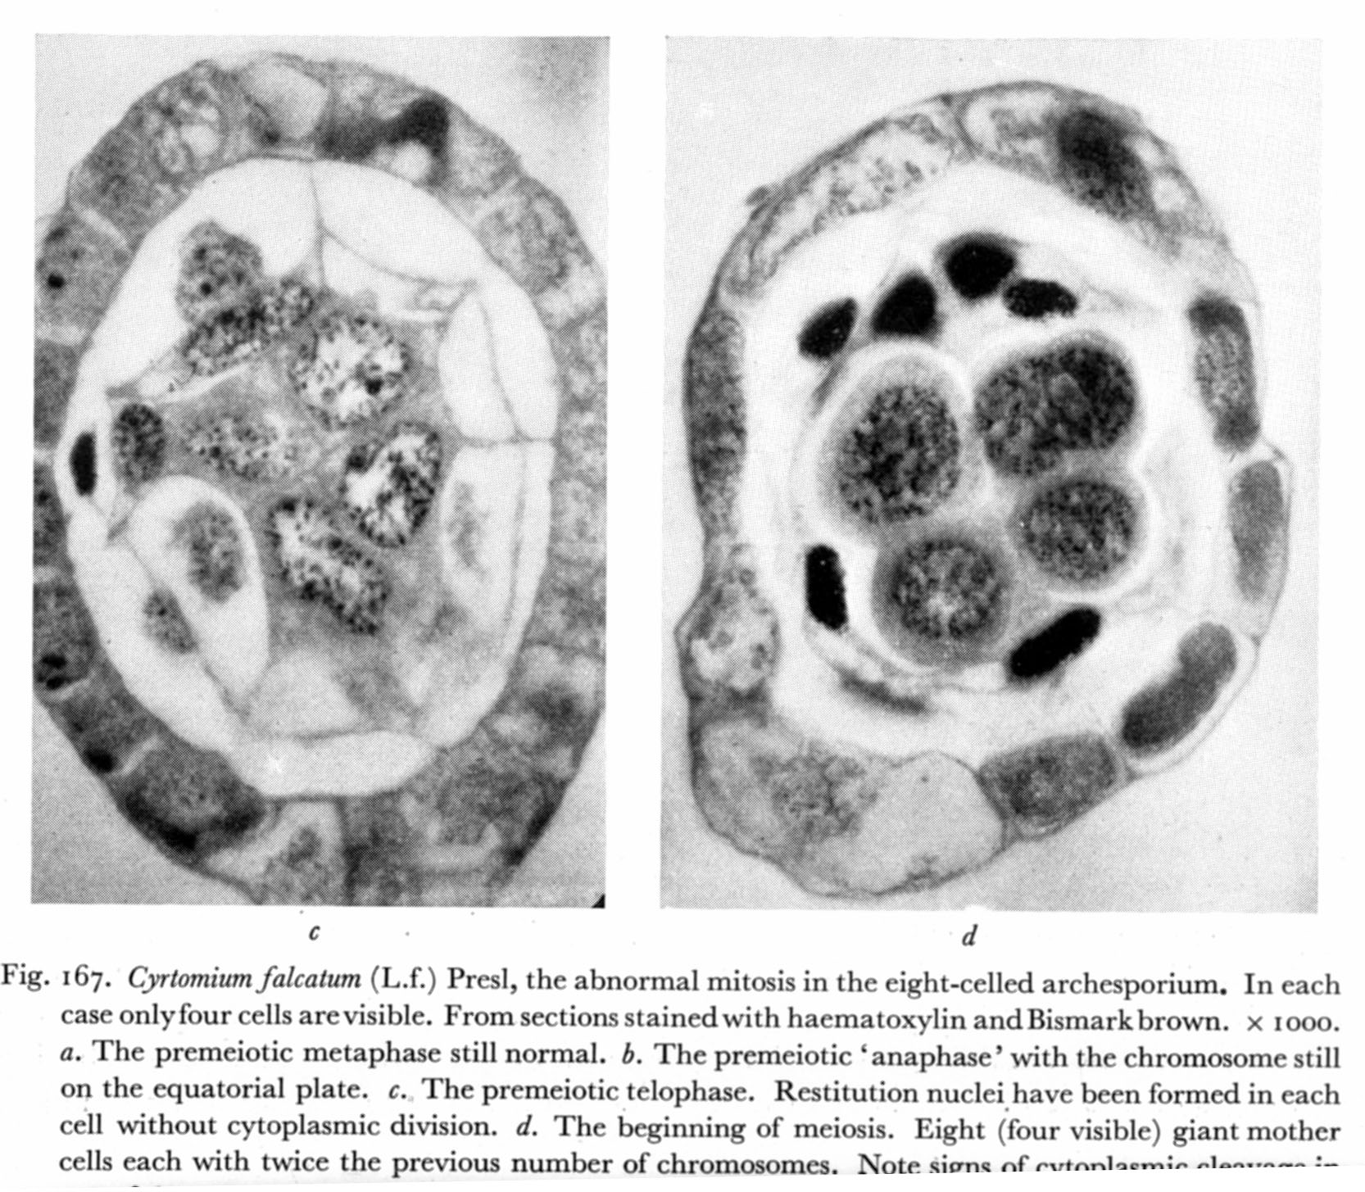
Döpp-Manton Mechanism: fourth (failed)
premeiotic division

Slide 16
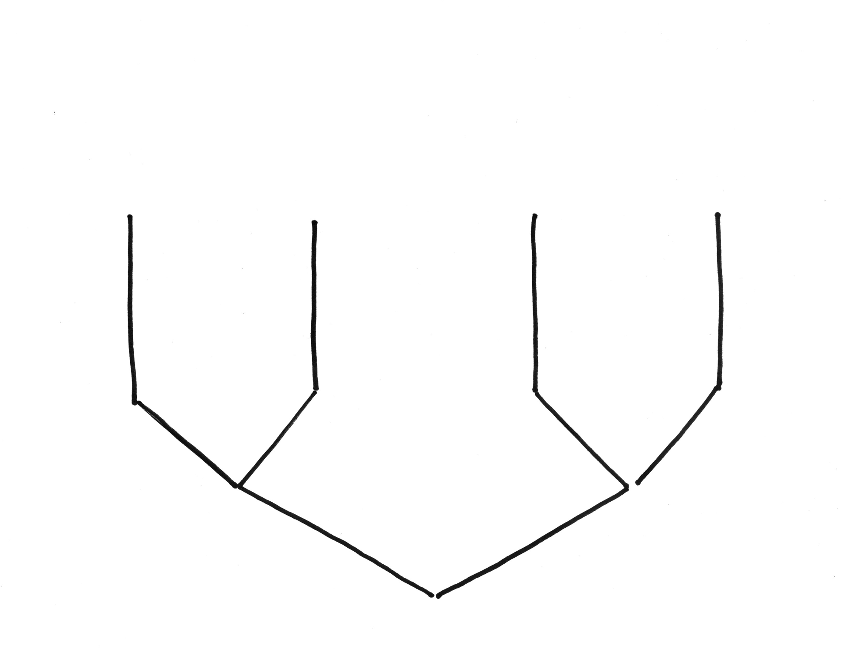
Sporogenesis in apogamous ferns: pathway 3 yields giant spores.
16 SPORES
MEIOSIS
2 NON-DISJUNCTIONS
2 MITOTIC DIVISIONS
ARCHESPORIAL CELL

Slide 17
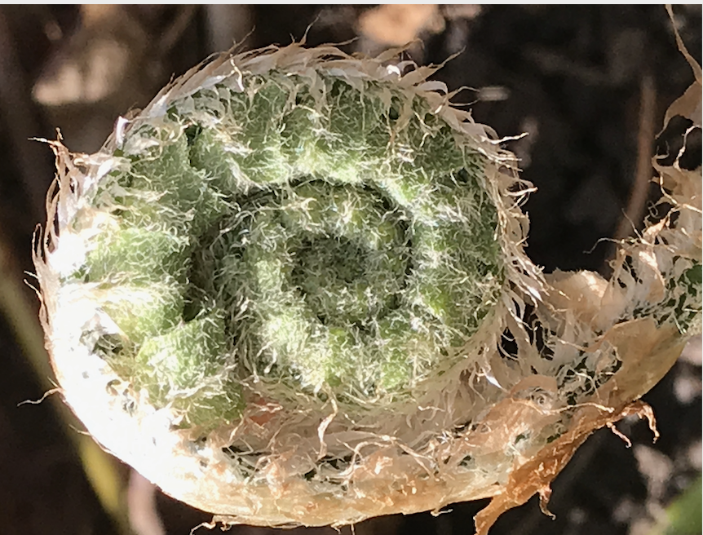
End of Feb. 21 Lecture

Slide 18
On Apomixis …
Original Discovery
Our Vermont apomictic species:
Pellaea atropurpurea and Pellaea glabella var. glabella
Mechanics of the Döpp-Manton scheme
Altered Sporophyte Production: Farlow and Alice Tryon
Altered Spore Production: Manton on Cyrtomium
Gastony on the origins of Pellaea glabella var. glabella
Amanda Grusz on Apomixis, the Braithwaite scheme
Two Case Histories
Grusz on apomixis and polyploidy in Cheilanthes
Origin of apomixis – an example from Japan.
Notes:
acrostichoides

Slide 19
Pellaea glabella var. glabella

Slide 20
Pellaea atropurpurea

Slide 21
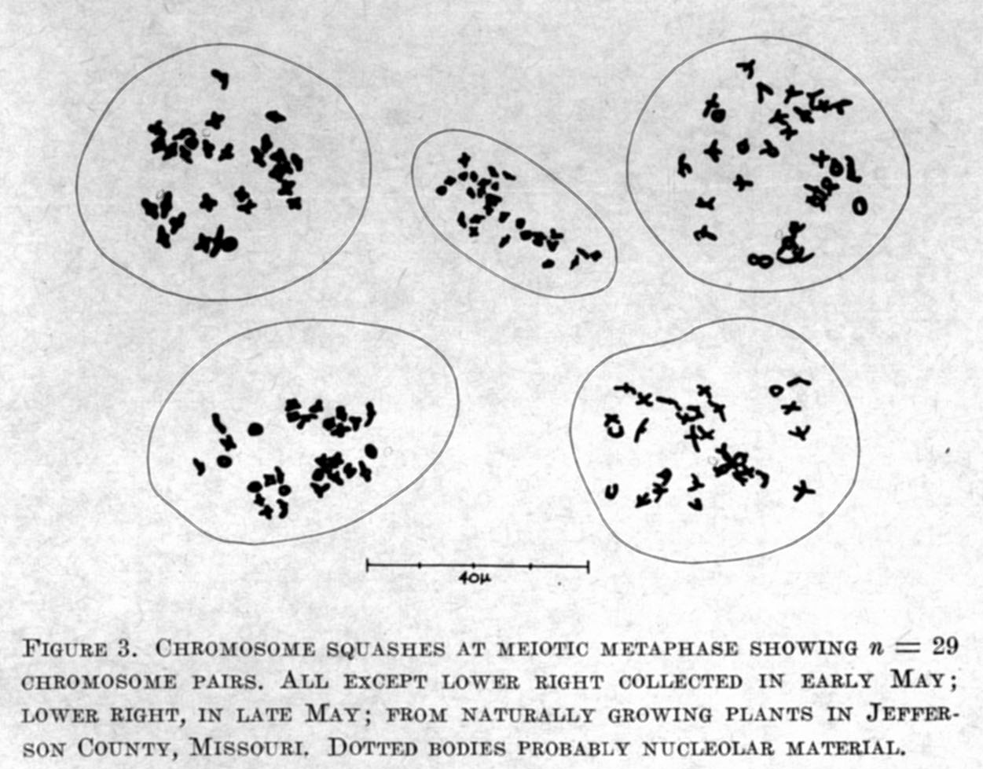
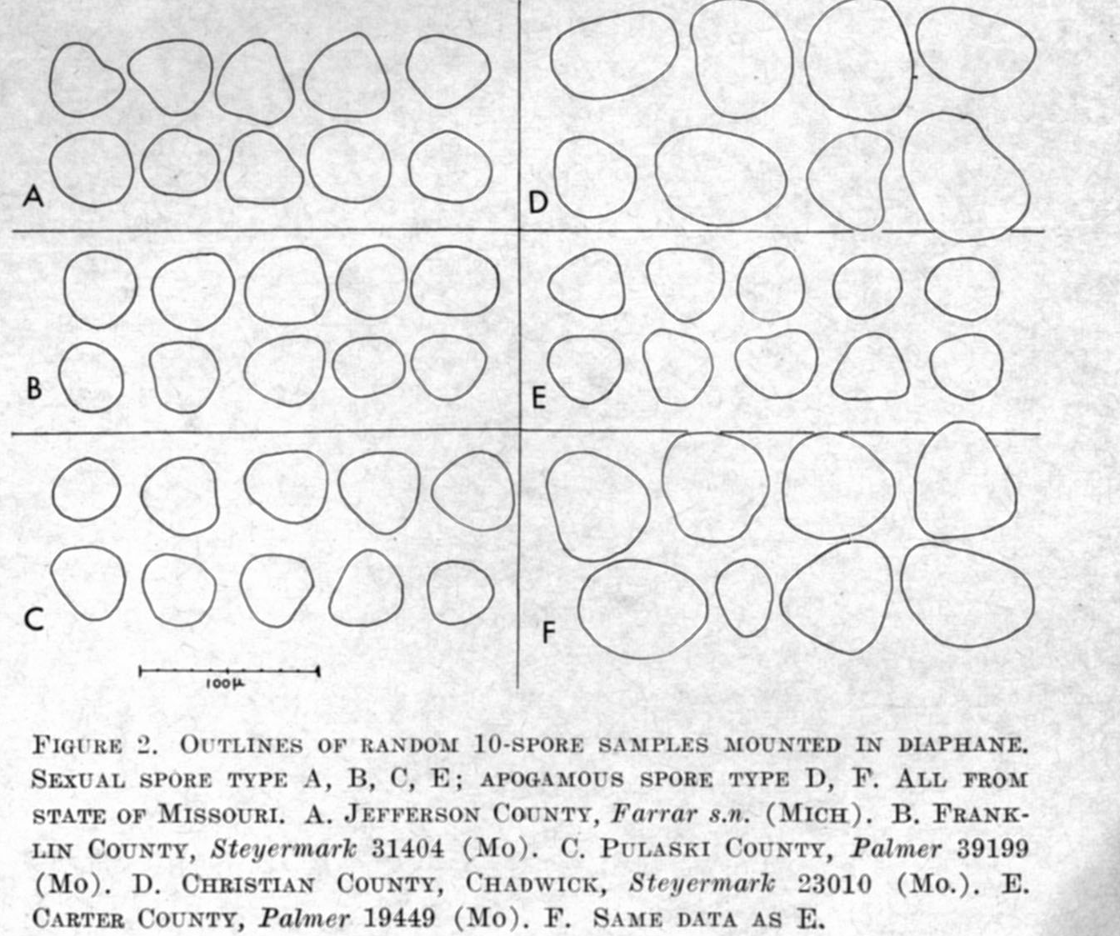
2x 29 IIs
Wagner, Farrar, and Chen discover a sexual diploid race of Pellaea glabella var. glabella, 1965
2x
4x
2x
2x
4x: 118 IIs
2x
4x

Slide 22
atropurpurpea
A

Slide 23
S
O
G
M

Slide 24
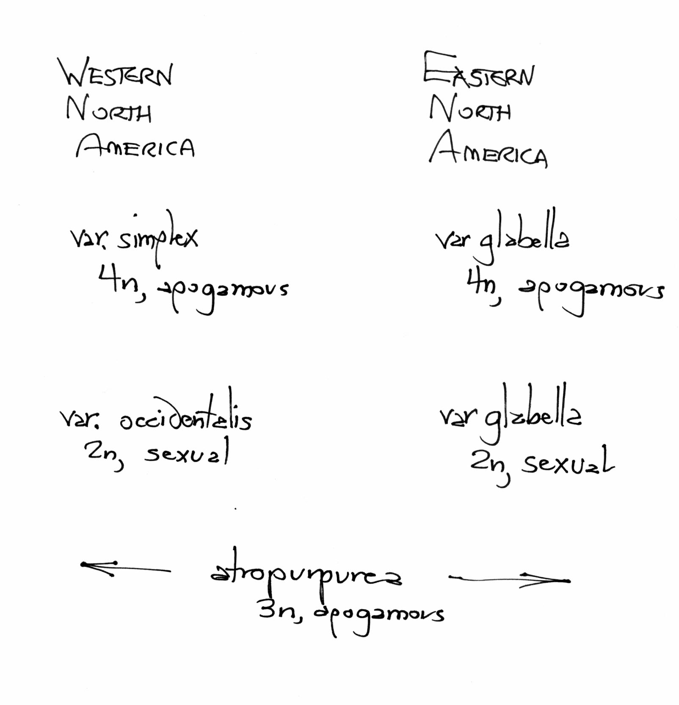
The players in the Pellaea story…
S
G
O
M
A

Slide 25
Gastony’s hypotheses for the ancestry of the tetraploid apogamous varieties of Pellaea glabella
S
G
autopolyploidy
O
M
A
Gastony, 1988. The Pellaea glabella complex. Amer. Fern J. 78:44-67.

Slide 26
Gastony’s hypotheses for the ancestry of the tetraploid apogamous varieties of Pellaea glabella
S
G
allopolyploidy
O
M
A

Slide 27
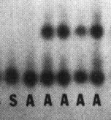
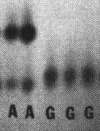
Gastony’s hypotheses for the ancestry of the tetraploid apogamous varieties of Pellaea glabella
S
G
SKDH
autopolyploidy
O
M
A
Gastony, 1988. The Pellaea glabella complex. Amer. Fern J. 78:44-67.

Slide 28
On Apomixis …
Original Discovery
Our Vermont apomictic species:
Pellaea atropurpurea and Pellaea glabella var. glabella
Mechanics of the Döpp-Manton scheme
Altered Sporophyte Production: Farlow and Alice Tryon
Altered Spore Production: Manton on Cyrtomium
Gastony on the origins of Pellaea glabella var. glabella
Amanda Grusz on Apomixis, the Braithwaite scheme
Two Case Histories
Grusz on apomixis and polyploidy in Cheilanthes
Origin of apomixis – an example from Japan.
Notes:
acrostichoides

Slide 29
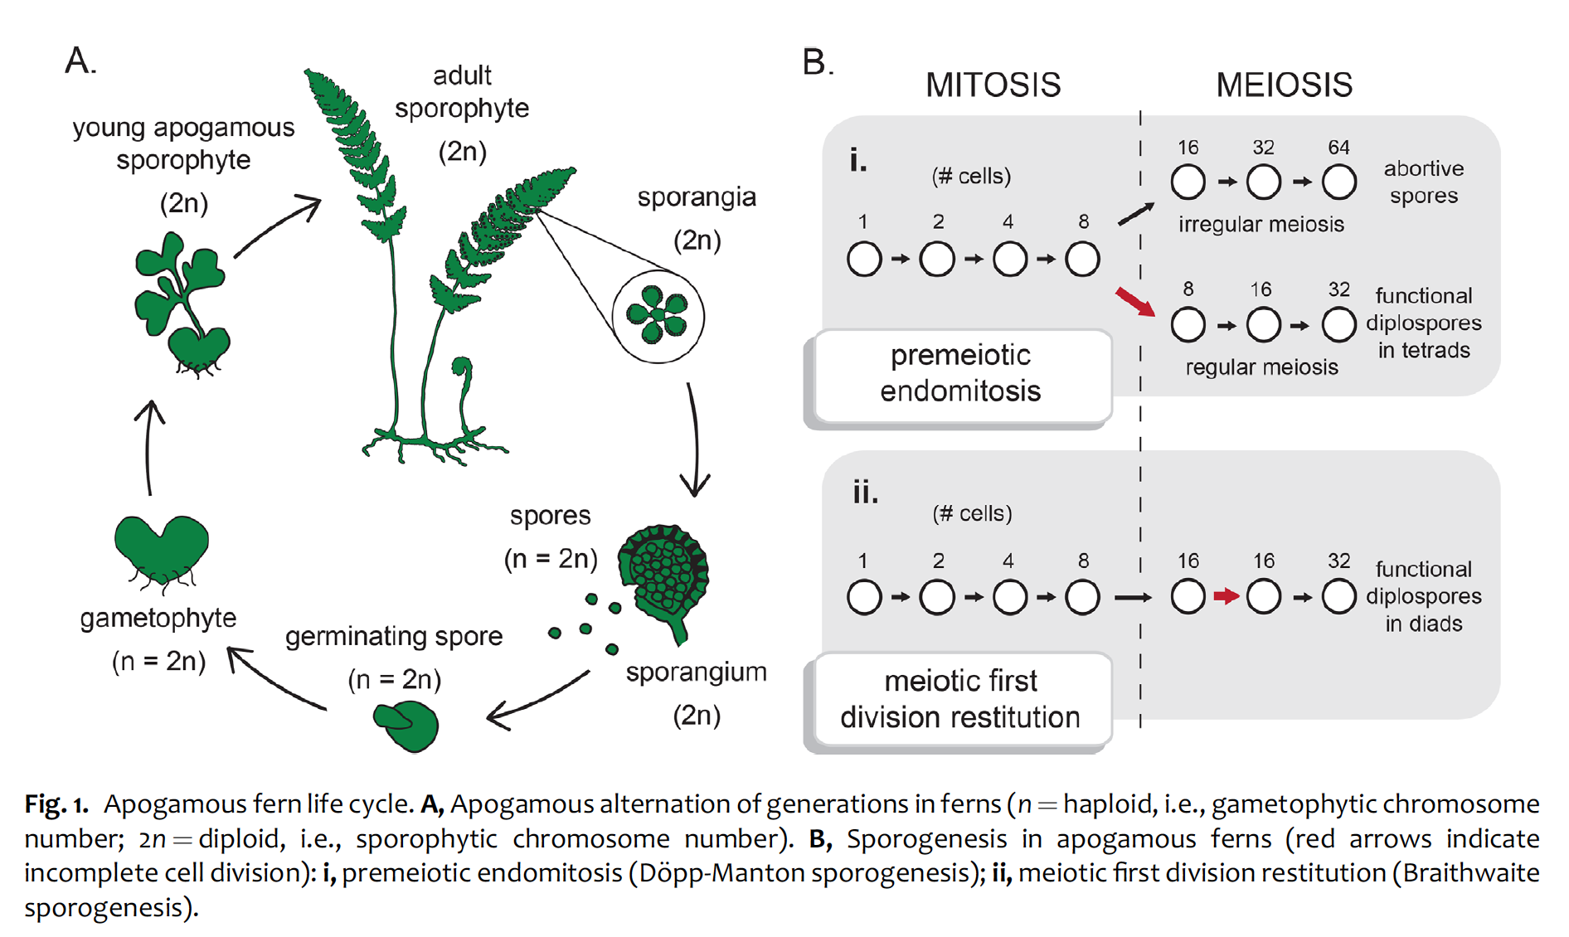

Slide 30
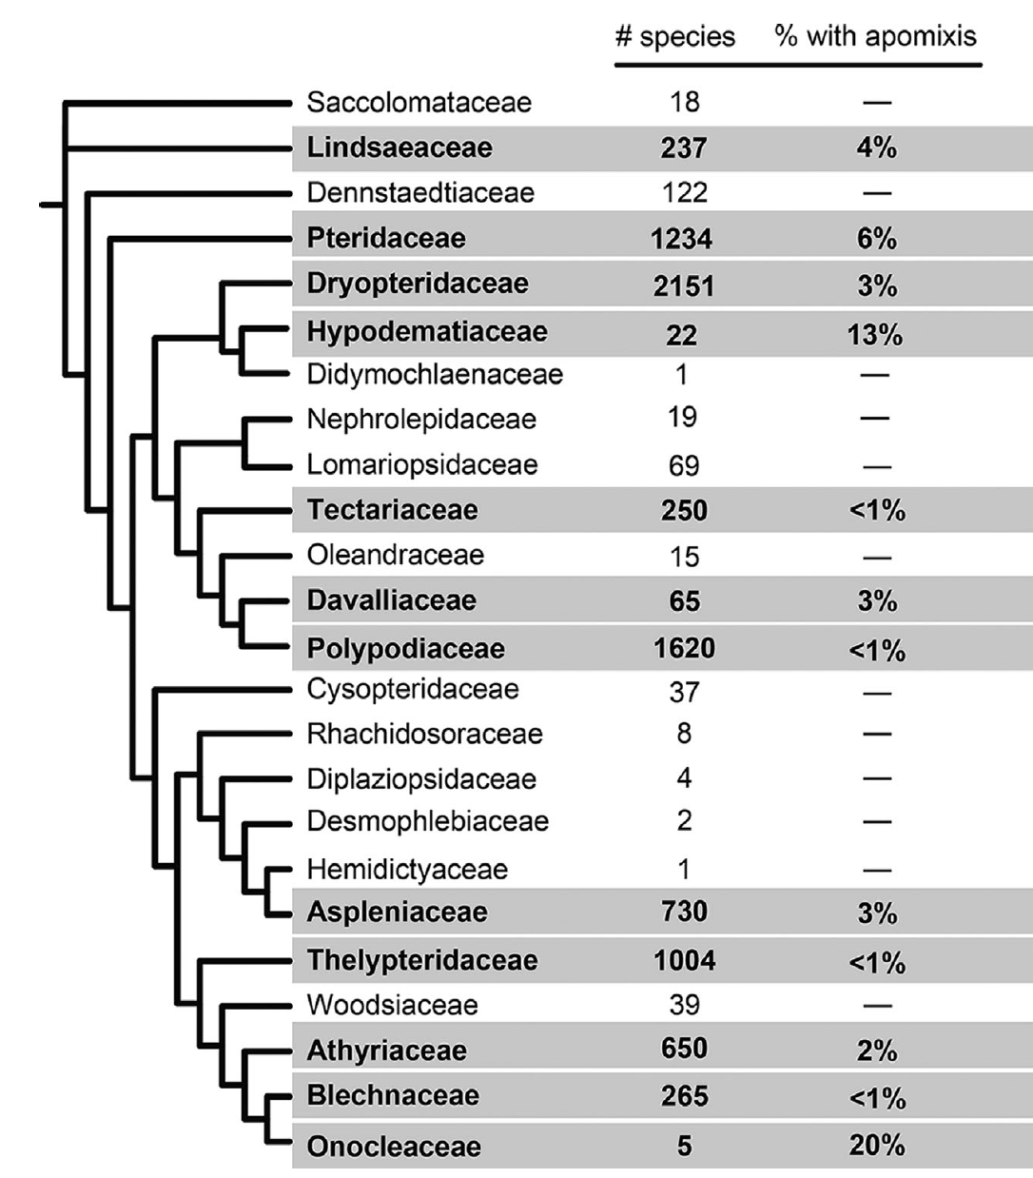

Slide 31
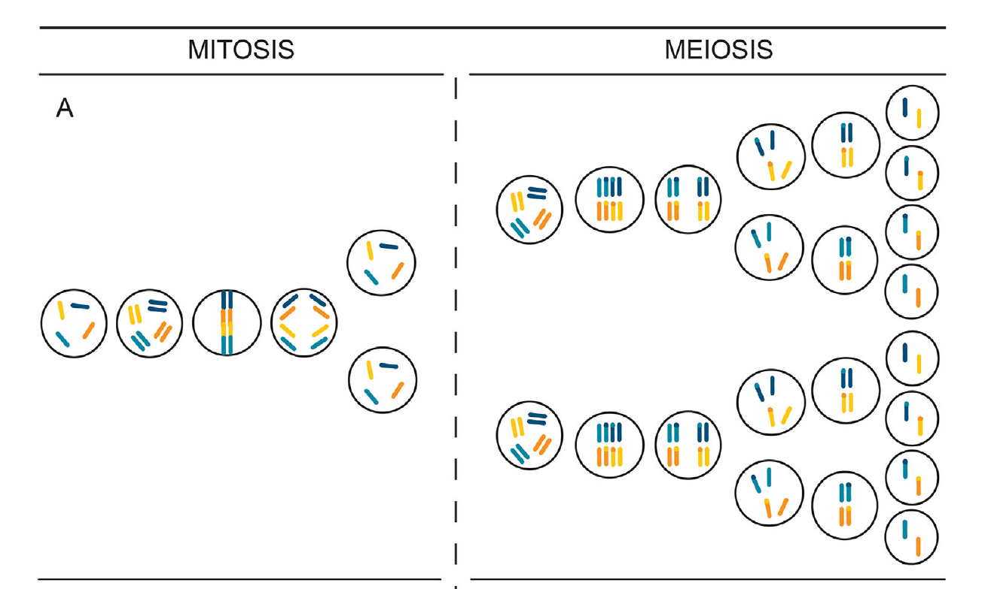
Sexual (not apomictic) life cycle)

Slide 32
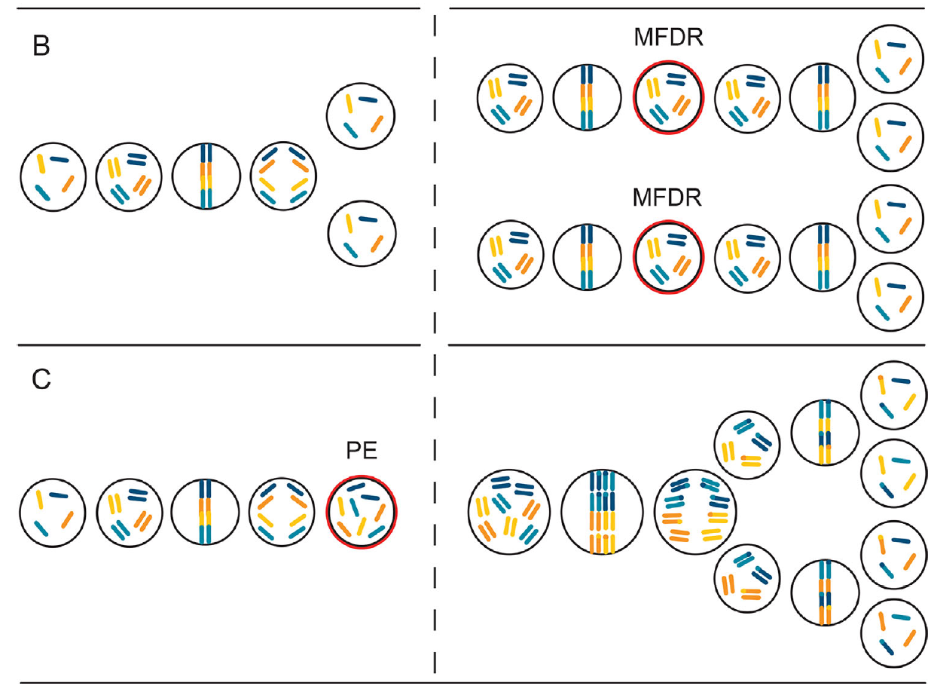
Braithwaite
Döpp-Manton

Slide 33
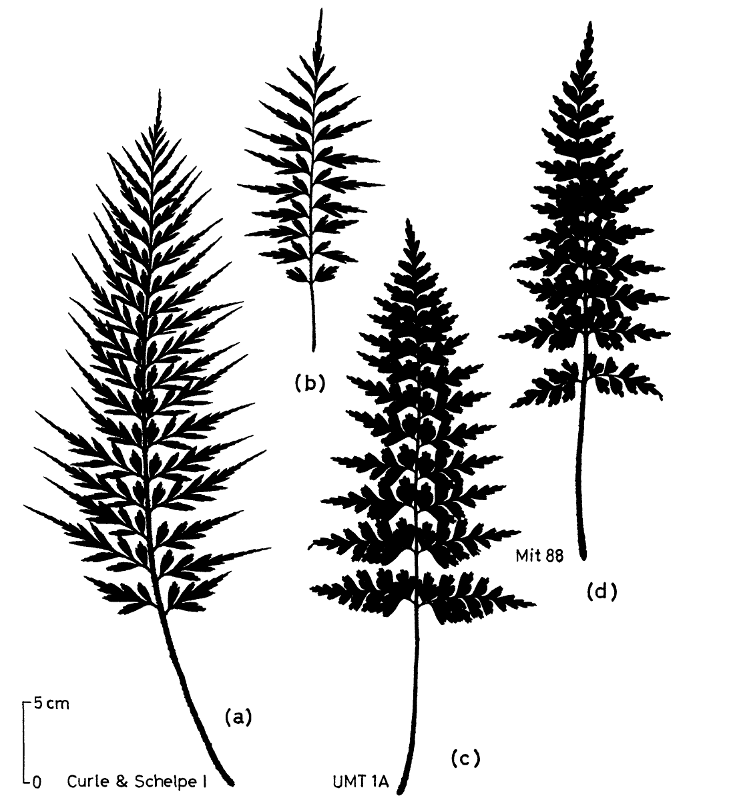
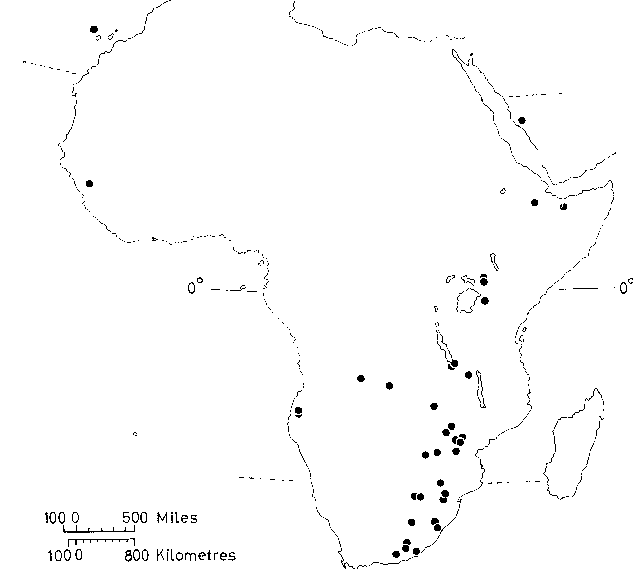
Braithwaite’s 1964 paper – the Braithwaite scheme:

Slide 34
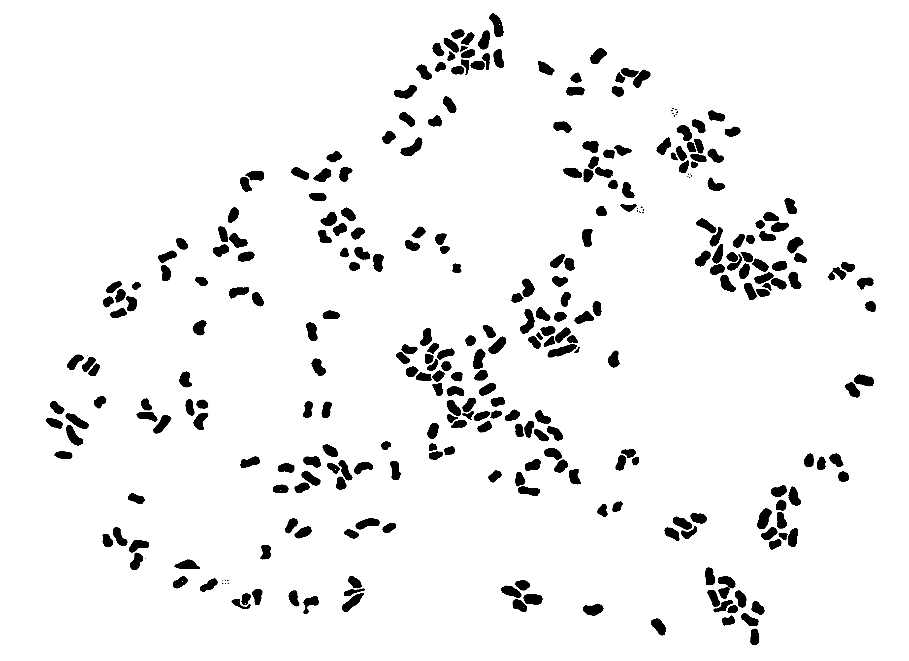
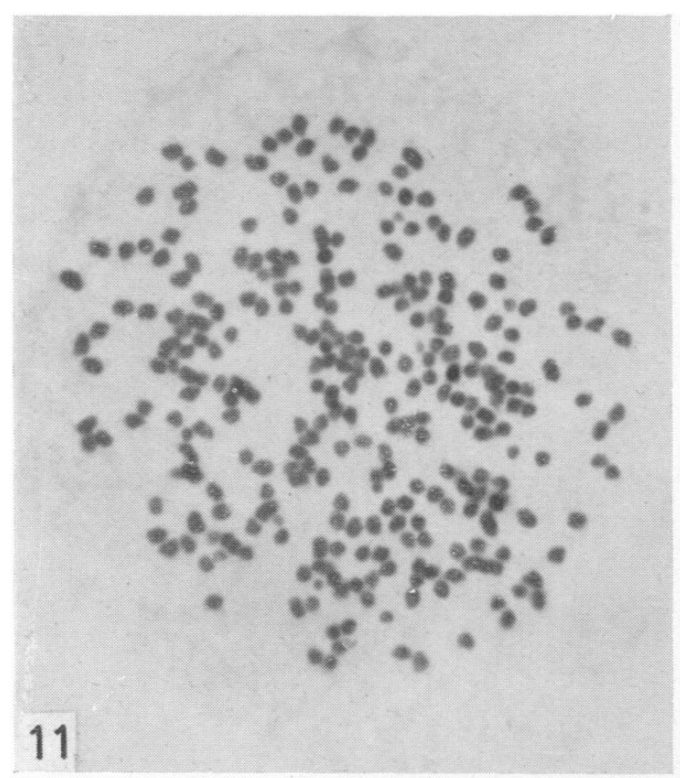
Meiosis 1 in Braithwaite’s apomictic Asplenium:
No pairing
(octoploid, 232 Is)

Slide 35
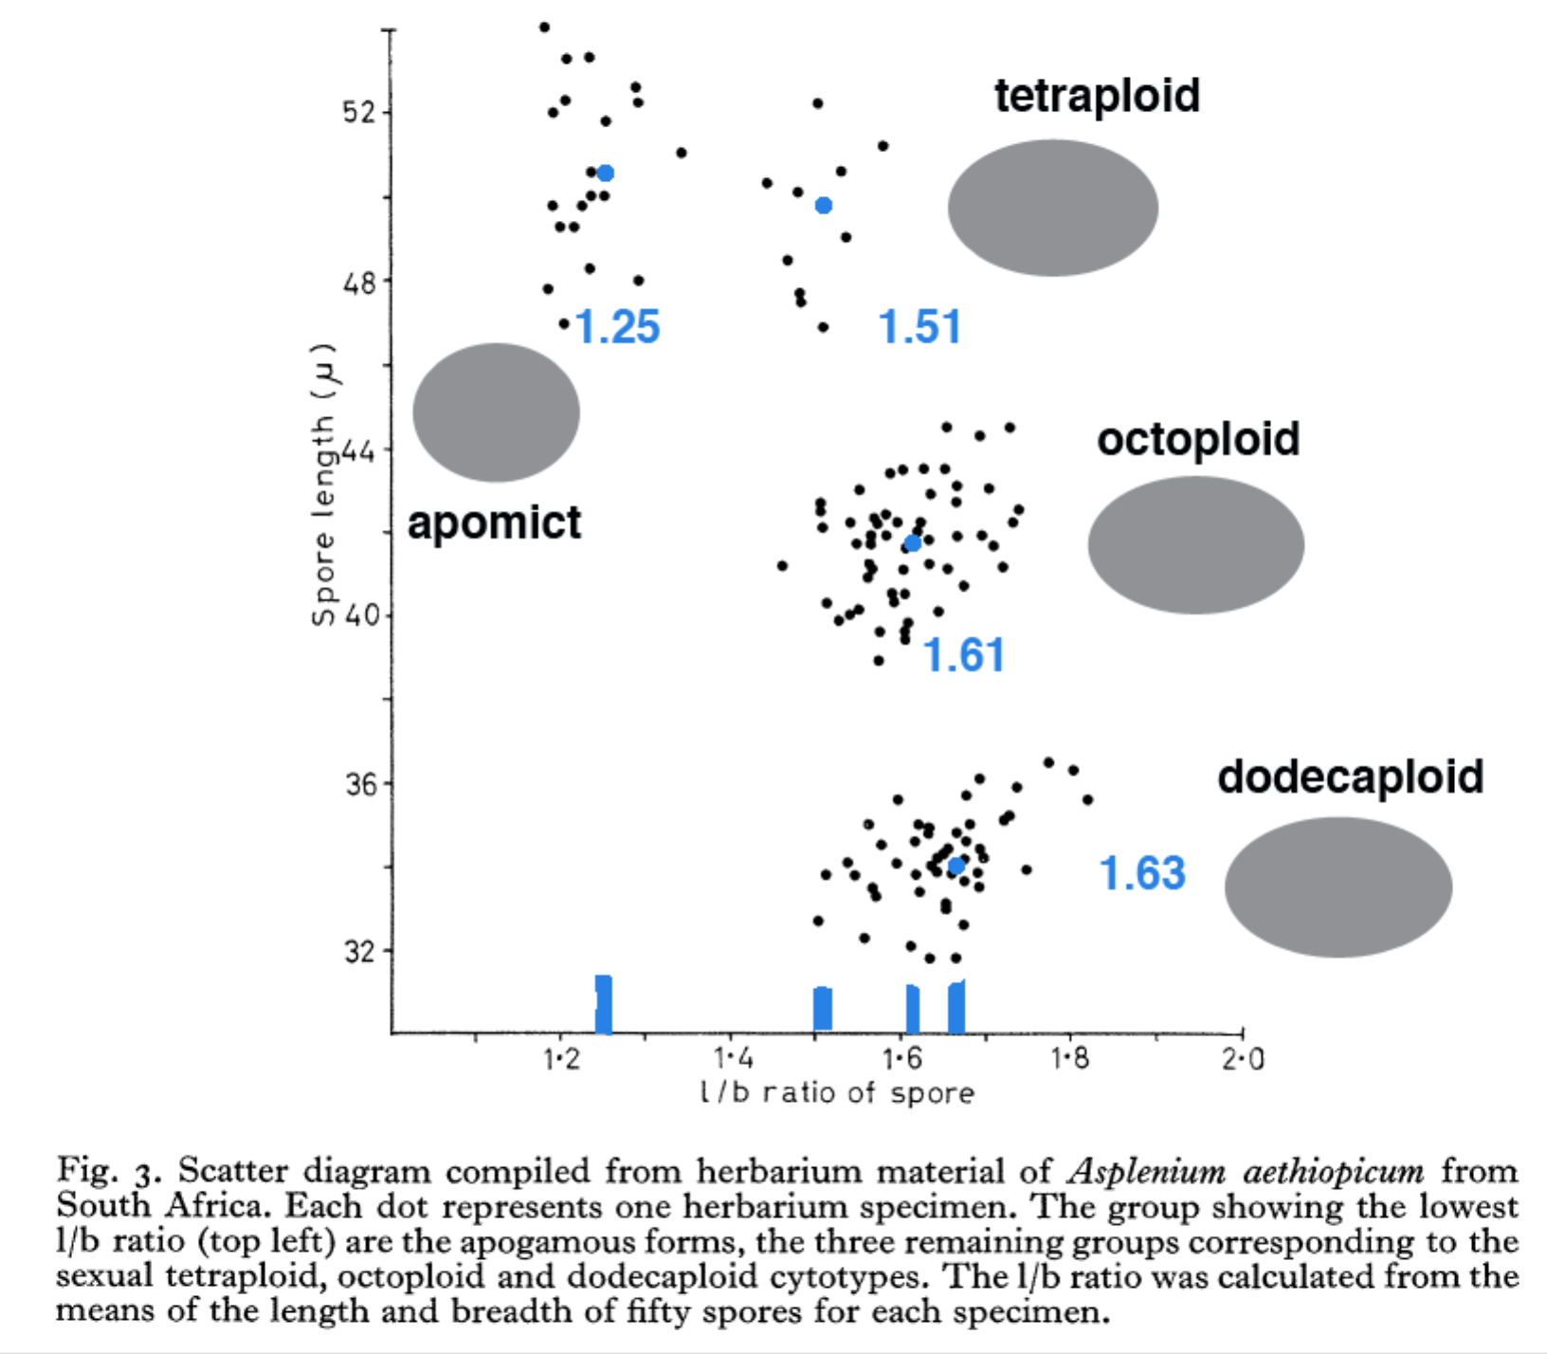
dodecaploid
(octoploid)
tetraploid

Slide 36
On Apomixis …
Original Discovery
Our Vermont apomictic species:
Pellaea atropurpurea and Pellaea glabella var. glabella
Mechanics of the Döpp-Manton scheme
Altered Sporophyte Production: Farlow and Alice Tryon
Altered Spore Production: Manton on Cyrtomium
Gastony on the origins of Pellaea glabella var. glabella
Amanda Grusz on Apomixis, the Braithwaite scheme
Two Case Histories
Grusz on apomixis and polyploidy in Cheilanthes
Origin of apomixis – an example from Japan.
Notes:
acrostichoides

Slide 37
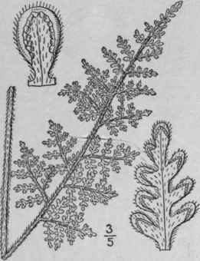
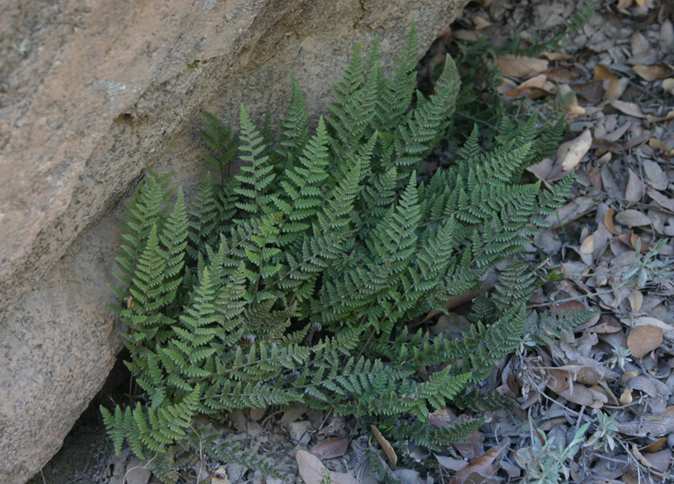
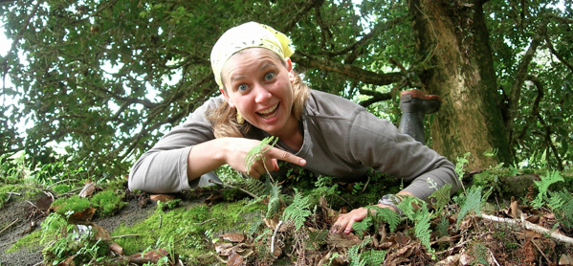
Apomixis and polyploidy in Cheilanthes (now Myriopteris) yavapensis and allies
Amanda Grusz

Slide 38
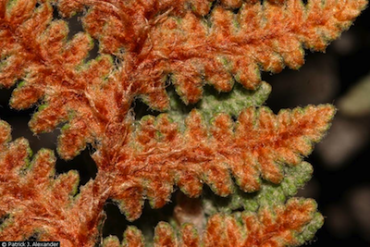
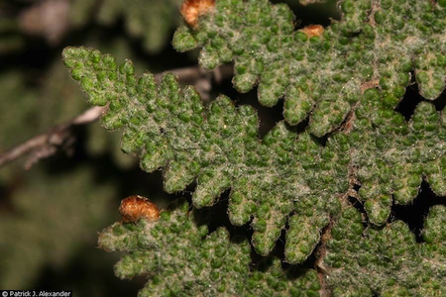
The diploids
Cheilanthes lindheimeri

Slide 39
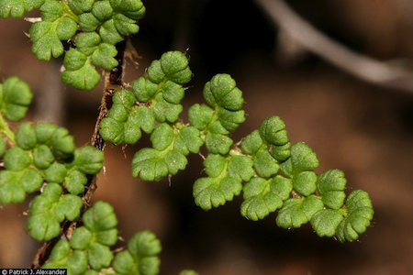
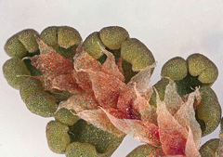
The diploids
Cheilanthes fendleri

Slide 40
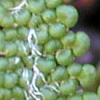
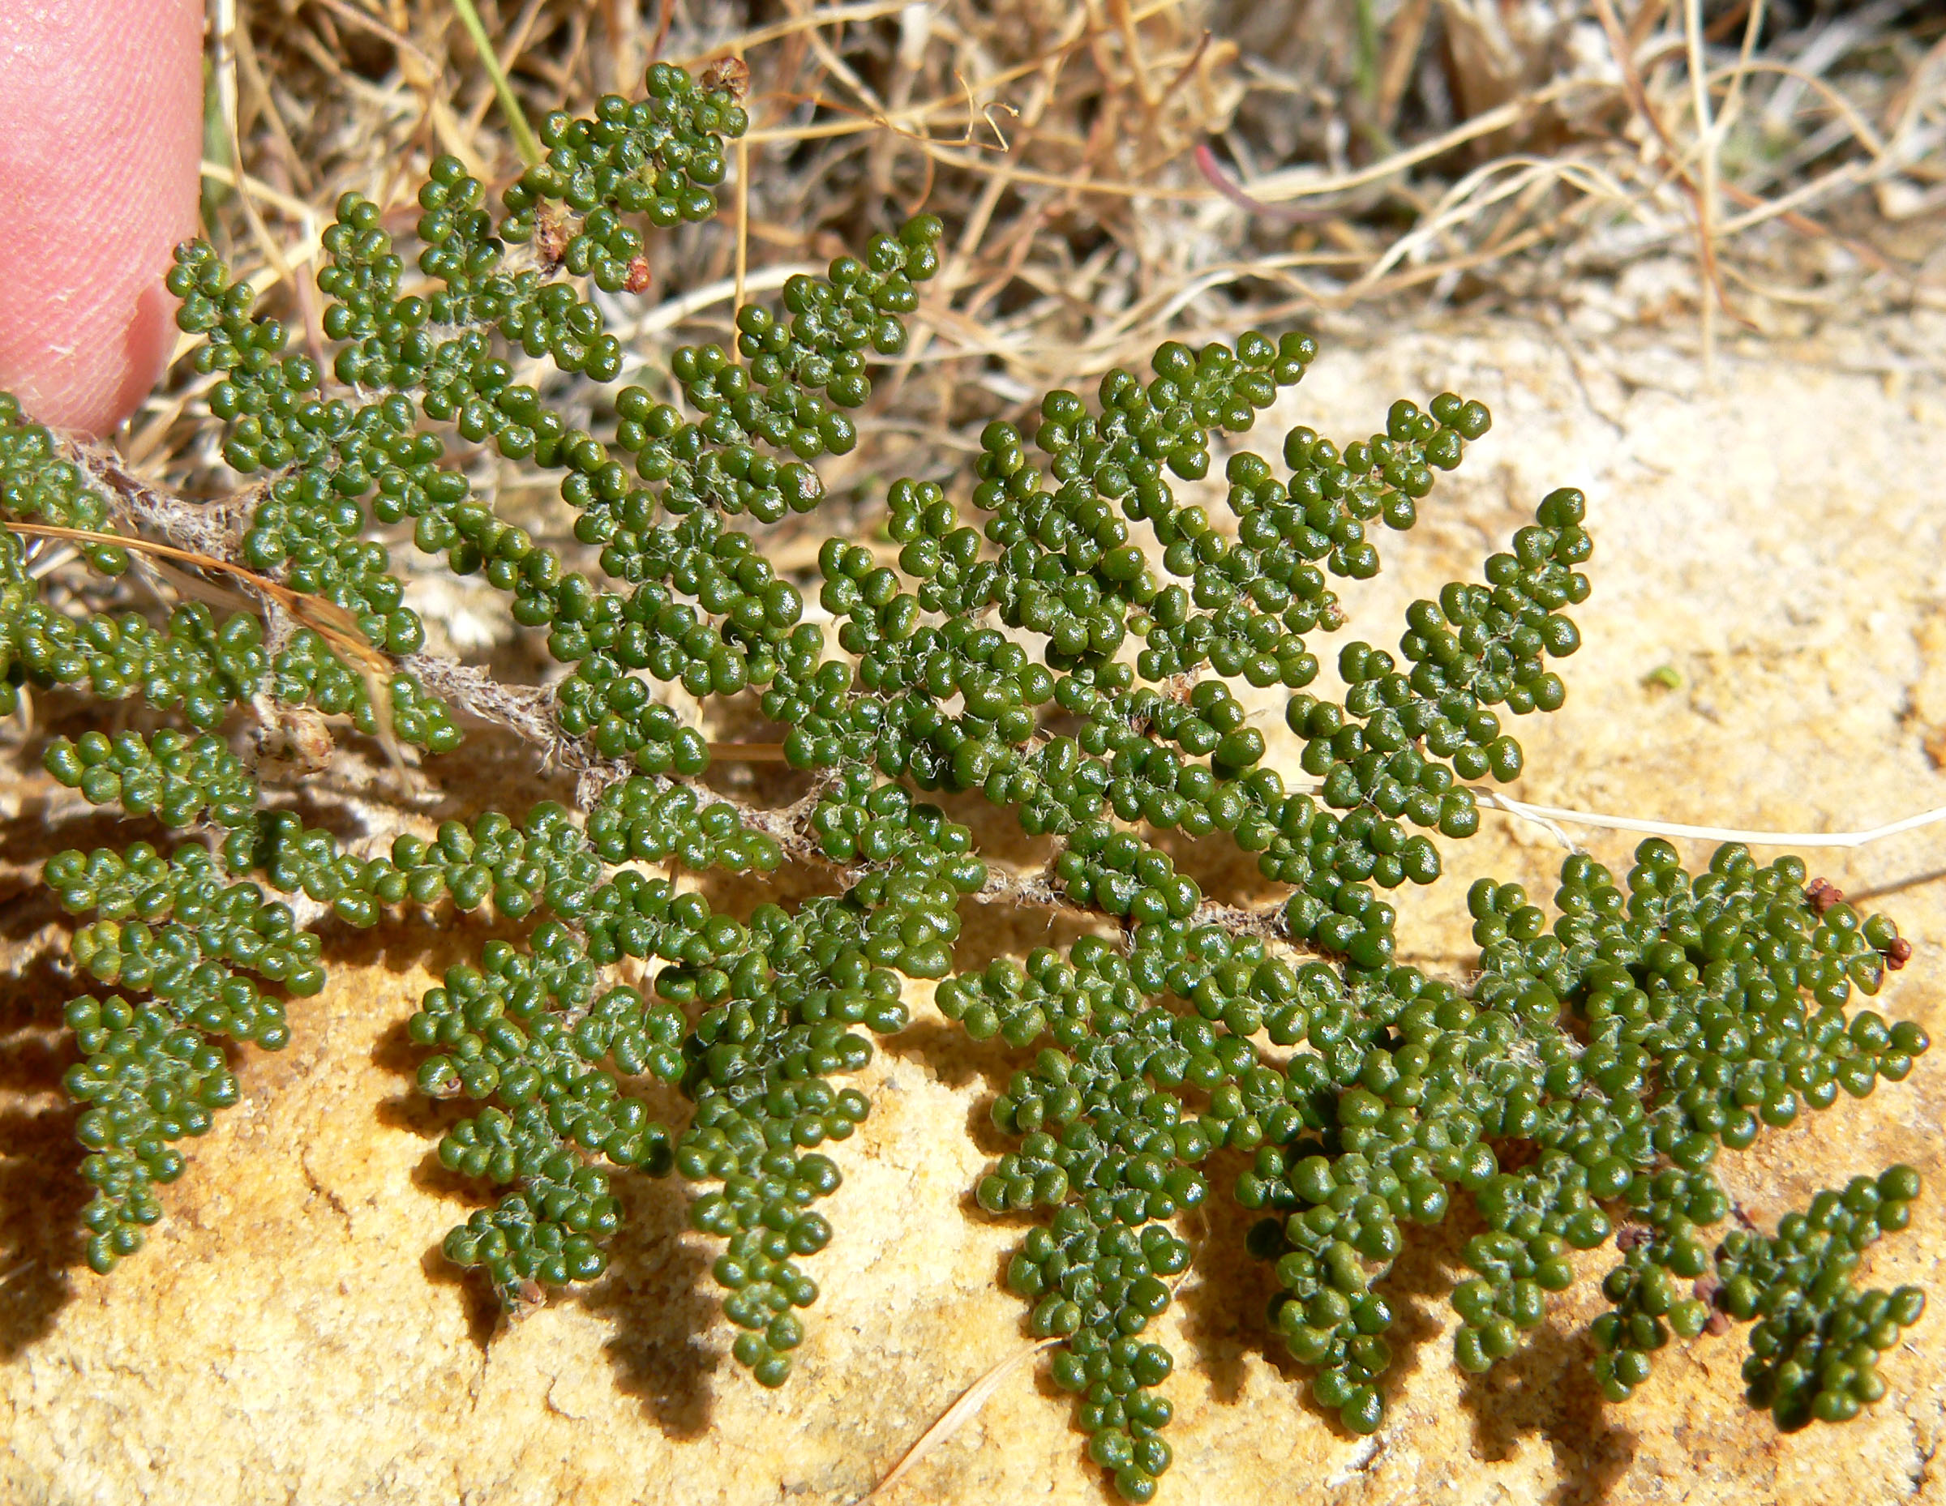
The diploids
Cheilanthes covillei

Slide 41
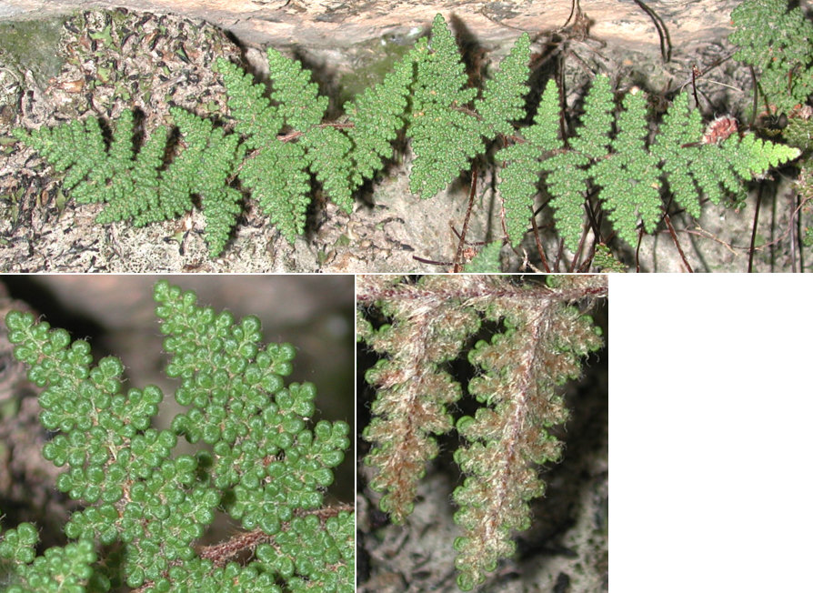
The central player: Cheilanthes yavapensis

Slide 42
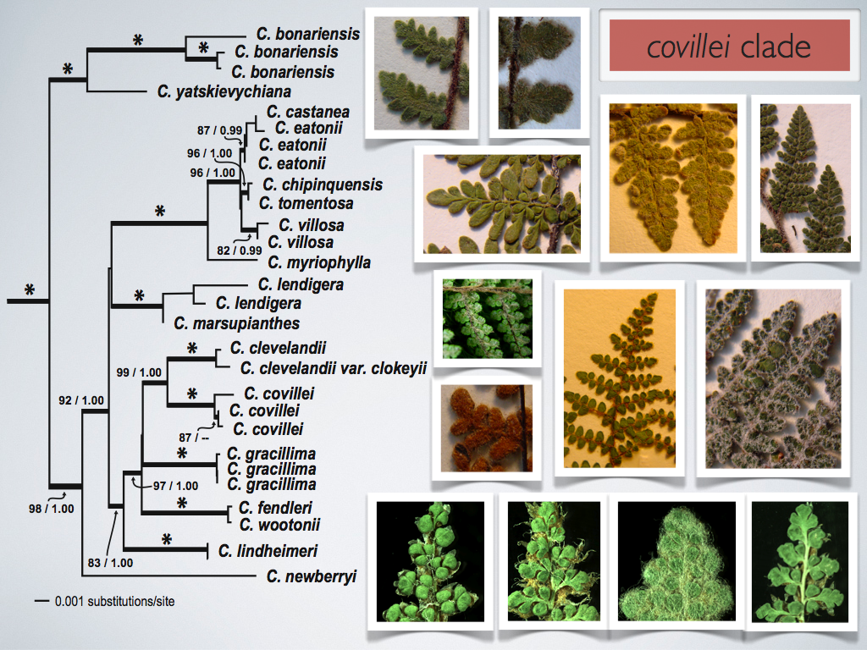
CC
FF
LL

Slide 43
Experimental Strategy
1. Plastid DNA sequencing
reveals egg parents of polyploids,
provides alternate test of conclusions about lineages.
2. Spore studies (number and size) imply ploidy and reproductive biology—reveal diploid lindheimeri.
3. Nuclear DNA sequencing
-- reveals the diploids involved in each polyploid.
4. Enzyme electrophoretic evidence provides information on copy number of each ancestral genome in the allopolyploids.

Slide 44
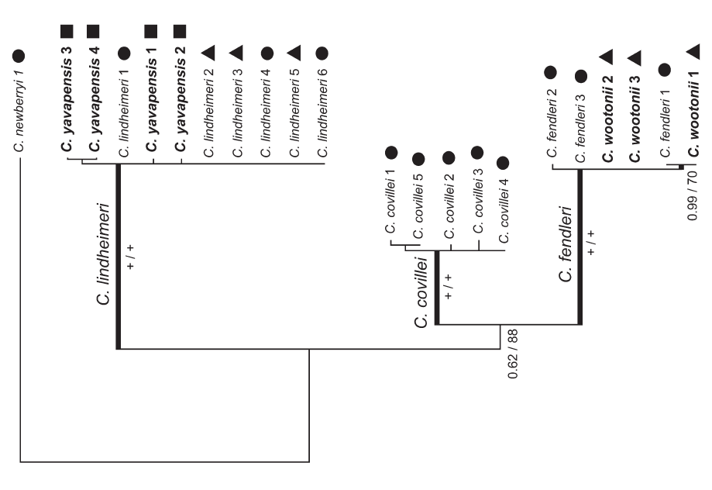
Phylogeny based on chloroplast DNA sequences
diploid
triploid
tetraploid
Notes:
The C. covillei clade included only accessions of diploid C. covillei (PP = 1.0, BS = 100%),
HENCE: C. covillei is not an egg parent.
2. The C. fendleri clade (PP = 1.0, BS = 100%) included all samples of diploid C. fendleri plus all accessions of the apomictic triploid C. wootoni
HENCE C fendleri is the egg parent of all C. wootonii .
3. The C. lindheimeri clade (PP = 1.0, BS = 100%) included all samples of that species (regardless of ploidy level), plus all accessions of C. yavapensis .
HENCE C. lindheimeri is the egg parent of all C. yavapensis.
4. Sexual diploid and apomictic triploid samples of C. lindheimeri have identical plastid sequences, suggesting that genetic divergence between the cytotypes is minimal.
HENCE: apogamous C. lindheimeri is an autopolyploid.

Slide 45
Inferences from the chloroplast DNA
1.The C. covillei clade included only accessions of diploid C. covillei
1.HENCE: C. covillei is not an egg parent.
2. The C. fendleri clade included all samples of diploid C. fendleri plus all accessions of the apomictic triploid C. wootoni
2.HENCE C. fendleri is the egg parent of all C. wootonii
3. The C. lindheimeri clade included all samples of lindheimeri (diploid and triploid), plus all accessions of C. yavapensis .
3.HENCE C. lindheimeri is the egg parent of all C. yavapensis.
4. Sexual diploid and apomictic triploid samples of C. lindheimeri have identical plastid sequences, suggesting that genetic divergence between the cytotypes is minimal.
4.HENCE: apogamous C. lindheimeri is an autopolyploid.

Slide 46
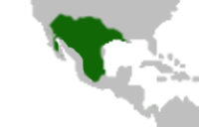




Herbaria: discovering diploid LL
Fertile herbarium specimens provided spores
LLL
LL
3 Populations located
Spore number: 32
Spore diameter: 61-64um
Spore number: 64
Spore diameter: 45-53um
Photo: J. Metzgar
Notes:
46

Slide 47
Experimental Strategy
1. Plastid DNA sequencing
-- reveals egg parents of polyploids,
-- provides alternate test of conclusions about lineages.
2. Spore studies (number and size) imply ploidy and reproductive biology—reveal diploid lindheimeri.
3. Nuclear DNA sequencing
-- reveals the diploids involved in each polyploid.
4. Enzyme electrophoretic evidence provides information on number of each ancestral genome in the allopolyploids.

Slide 48

Phylogeny based on nuclear DNA sequences
lindheimeri covillei fendleri
C

Slide 49
Phylogeny based on nuclear DNA sequences
lindheimeri covillei fendleri
C
yavapensis includes all three diploids.
wootonii includes lindheimeri and fendleri.
Apogamous lindheimeri is autopolyploid.
Both wootonii and yavapensis are polyphyletic.

Slide 50


Nuclear GAPcP Phylogeny
FF
100
C. yavapensis
To determine allelic dosage Amanda used isozymes…
C. wootonii
91
CC
100
100
C. yavapensis
LL
99
C. yavapensis
C. wootonii
C. newberryi
Photo: J. Metzgar
Notes:
50

Slide 51
Experimental Strategy
1. Plastid DNA sequencing
-- reveals egg parents of polyploids,
-- provides alternate test of conclusions about lineages.
2. Spore studies (number and size) imply ploidy and reproductive biology—reveal diploid lindheimeri.
3. Nuclear DNA sequencing
-- reveals the diploids involved in each polyploid.
4. Enzyme electrophoretic evidence provides information on copy number of each ancestral genome in the allopolyploids.

Slide 52


Slide 53

Isozymes: allelic dosage in C. yavapensis
TPI
Plastid locus
FF allele
CC allele
Nuclear locus
LL allele
CC
covillei
CFLL
FFL
wootonii
C. yavapensis
Notes:
53

Slide 54

The widespread apomictic triploid, Cheilanthes lindheimeri is an autopolyploid
derived from a rare, previously undetected sexual diploid.
The apomictic triploid Cheilanthes wootonii is shown to be an interspecific hybrid between C. fendleri and C. lindheimeri ,
The apomictic tetraploid C. yavapensis is comprised of two cryptic and geographically distinct lineages.

Slide 55

In sum…
Apomictic tetraploid
CCFL/CFLL
C. yavapensis
Apomictic triploids
CFL
FFL
LLL
C. wootonii
Sexual tetraploid
CCFF
Sexual diploids
CC
FF
LL
C. covillei
C. fendleri
C. lindheimeri
Father
Mother
Proposed
Notes:
55

Slide 56
End of Feb. 23 Lecture

Slide 57
On Apomixis …
Original Discovery
Our Vermont apomictic species:
Pellaea atropurpurea and Pellaea glabella var. glabella
Mechanics of the Döpp-Manton scheme
Altered Sporophyte Production: Farlow and Alice Tryon
Altered Spore Production: Manton on Cyrtomium
Gastony on the origins of Pellaea glabella var. glabella
Amanda Grusz on Apomixis, the Braithwaite scheme
Two Case Histories
Grusz on apomixis and polyploidy in Cheilanthes
Origin of apomixis – an example from Japan.
Notes:
acrostichoides

Slide 58

The interspecific triploid hybrid fern Cornopteris x christenseniana
4x
3x
2x
a, b C. x christenseniana;
c, d C. decurrentialata;
e, f C. crenulatoserrulata

Slide 59



The interspecific triploid hybrid fern Cornopteris x christenseniana
Cornopteris
crenatoserrula
80 chromosomes
Cornopteris
christenseniana
120 chromosomes
Cornopteris decurrentialata
160 chromosomes

Slide 60

3x
4x
2x

Slide 61

64- and 16-spore outcomes
a) 16 sporocytes
b) meiotic anaphase with bivalents separating and univalents scattered
c) 64 spores, all abortive spores, often forming tetrads
d) 64 spores, mostly abortive
e) 64 spores (16 tetrads); few abortive
f) 16 spores, mostly normal
None with 32 spores.
Park, C. H., & Kato, M. (2003). Apomixis in the interspecific triploid hybrid fern Cornopteris christenseniana
Notes:
Park, C. H., & Kato, M. (2003). Apomixis in the interspecific triploid hybrid fern Cornopteris christenseniana (Woodsiaceae). Journal of plant research, 116(2), 93-103.

Slide 62
On Apomixis …
Original Discovery
Our Vermont apomictic species:
Pellaea atropurpurea and Pellaea glabella var. glabella
Gastony on the origins of Pellaea glabella var. glabella
Mechanics of the Döpp-Manton scheme
Altered Sporophyte Production: Farlow and Alice Tryon
Altered Spore Production: Manton on Cyrtomium
Amanda Grusz on Apomixis, the Braithwaite scheme
Case Histories
Sigel on apomixis and farina evolution in Argyrochosma
Grusz on apomixis and polyploidy in Cheilanthes
Apomicts yielding apomicts. = Walker
Notes:
acrostichoides

Slide 63

Walker’s Pteris apomicts hybridizing-implying functional sperm.
multi-
aurita
quadri-
aurita
diploid,
sexual
confusa
diploid,
apomictic
triploid,
apomictic

Slide 64
On Apomixis …
Original Discovery
Our Vermont apogamous species:
Pellaea atropurpurea and Pellaea glabella var. glabella
Mechanics of the Döpp-Manton scheme
Altered Sporophyte Production: Farlow and Alice Tryon
Altered Spore Production: Manton on Cyrtomium
Amanda Grusz on Apomixis
Case Histories
Driscoll on detecting apogamy in Phegopteris
Notes:
acrostichoides

Slide 65





Slide 66

Insights on the origin of an apogamous tetraploid beech fern (genus Phegopteris) in northeastern North America

Slide 67

Mulligan et al. (1972) hypothesized the hybrid origin of a previously undescribed apogamous tetraploid beech fern from southern Quebec Phegopteris hexagonoptera X P. connectilis  tetraploid apomict
Sexual breeding system
Apogamous breeding system
Phegopteris connectilis
3x=90
n=90
Phegopteris sp.
4x=120
n=120
Phegopteris hexagonoptera
2x=60
n=30

Slide 68





Chromosome counts and pairing behavior of Phegopteris taxa from Mulligan et al. (1972)
2x
3x
4x
30 II
90 II
120 II
meiosis I
2x=60
3x=90
4x=120
mitosis

Slide 69
Characters shared by P. hexagonoptera and the putative hybrid include: 1) size of fronds 2) position of lowest pair of pinnae 3) shape of lowest pair of pinnae
Summary of
morphology
from Mulligan
et al. (1972)
Characters shared by P. connectilis and the putative hybrid include: 1) wings of the rachis 2) scales on the lower leaf surface 3) hairs in notch between pinnules 4) surface ornamentaion of spores 5) shape of fronds

Slide 70
There was more genetic material contributed by P. connectilis than P. hexagonoptera
P. hexagonoptera
X
P. connectilis
putative hybrid
HH
CCC
haploid egg (H)
triploid sperm (CCC)
HCCC

Slide 71
On Apomixis … 2021
Farlow’s Original Discovery, 1872
Our Vermont apomictic species:
Pellaea atropurpurea and Pellaea glabella var. glabella
Mechanics of the Döpp-Manton scheme (premeiotic endomitosis)
Altered Sporophyte Production: Farlow and Alice Tryon
Altered Spore Production: Manton on Cyrtomium
Gastony on the origins of Pellaea glabella var. glabella
Apomixis in the Pteridaceae and Thelypteridaceae
Sigel on apomixis and farina evolution in Argyrochosma
Grusz on apomixis and polyploidy in Myriopteris
Origin of apomixis – an example from Japan.
The Braithwaite Scheme (Meiotic first division restitution)
Notes:
acrostichoides

Slide 72

A re-examination of the hybrid hypothesis of Mulligan by Driscoll, Barrington, and Gilman (2004) in Vermont: evidence from morphology and isozymes

Slide 73
MORPHOLOGICAL RESULTS
The tetraploids resemble connectilis closely
Resemblance to hexagonoptera is superficial
Four of five measures were “beyond connectilis”
Any criterion of intermediacy fails.

Slide 74
Isozyme data provide six independent tests of the hybrid hypothesis proposed by Mulligan et al. (1972).
A couple of examples:

Slide 75
SET ASIDE

Slide 76

atropurpurpea
A
Notes:
gastony1989.pdf
“Although Pellaea atropurpurea was not involved in the origin of either agamosporous tetraploid variety of P. glabella, ongoing studies indicate that much of the morphological variation observed in P. atropurpurea results from hybridization between these triploid plants and sympatric sexual taxa. Electrophoretic and chromosomal data reveal that the so-called "simple form" of P. atropurpurea (discussed and illustrated by Tryon, 1972) arose through hybridization between that species and the rare Mexican diploid, P. notabilis. The resultant agamosporous tetraploid is fully fertile and has spread throughout much of Mexico (Windham, unpubl. data).”

Slide 77
On Apomixis …
Original Discovery
Our Vermont apomictic species:
Pellaea atropurpurea and Pellaea glabella var. glabella
Mechanics of the Döpp-Manton scheme
Altered Sporophyte Production: Farlow and Alice Tryon
Altered Spore Production: Manton on Cyrtomium
Gastony on the origins of Pellaea glabella var. glabella
Amanda Grusz on Apomixis, the Braithwaite scheme
Case Histories
Sigel on apomixis and farina evolution in Argyrochosma
Grusz on apomixis and polyploidy in Cheilanthes
Origin of apomixis – an example from Japan.
Notes:
acrostichoides

Slide 78


Erin Sigel: Farina Evolution in the Cheilanthoid Fern Genus
Argyrochosma
Argyrochosma dealbata
Notes:
Image source: http://www.infojardin.com/foro/showthread.php?t=236933

Slide 79


A. limiteana spore – 65 um
Notes:
LEFT RED BOX: small-spored sexuals
RIGHT RED BOX 32-spored apomicts
Fig. 4 . Average spore lengths for specimens listed in Table 1 ; error bars indicate one standard deviation. Symbol shading depicts the number of spores
per sporangium (see box on figure). Lines beginning and ending in arrows indicate specimens observed to have two sporangia types, each with a different
number of spores per sporangium. Letters below each data point correspond to major clades indicated in Figs. 2 and 3 . Ploidy is indicated for documented
chromosome count vouchers listed in Table 1 .

Slide 80



Central and SW United States
Central Andes

Slide 81

Notes:
Fig. 2 . The best ML phylogram from the combined analysis of atpA , rbcL , and trnG-trnR sequence data for 51 specimens of Argyrochosma, representing
all currently recognized taxa ( Windham 1987 ; Ponce 1996 ). The tree is rooted with Paragymnopteris delavayi , P. marantae , and Pellaea breweri . ML and
MP bootstrap support values are given at nodes. Two groups and six major clades (A-F) are recognized in this study. Mode of reproduction is indicated
for each fertile specimen (black circle = sexual, open circle = apomict, partially filled circle = sexual but producing a subset of unreduced spores, ? = sterile
specimen; see Table 1 ). See Table 3 for tree statistics.

Slide 82


Slide 83


Slide 84

Notes:
Fig. 3 . Parsimony reconstruction of farina condition mapped on the best ML tree shown in Fig. 2 , but where branches with low support (MLBS < 75%)
were collapsed. Circled letters refer to Clades A-F in Fig. 2 . Character state for each included specimen was determined using 10 Å~ magnification. Branch
color indicates farina condition (see box on figure).

Slide 85
Notes:
Fig. 2 . The best ML phylogram from the combined analysis of atpA , rbcL , and trnG-trnR sequence data for 51 specimens of Argyrochosma, representing
all currently recognized taxa ( Windham 1987 ; Ponce 1996 ). The tree is rooted with Paragymnopteris delavayi , P. marantae , and Pellaea breweri . ML and
MP bootstrap support values are given at nodes. Two groups and six major clades (A-F) are recognized in this study. Mode of reproduction is indicated
for each fertile specimen (black circle = sexual, open circle = apomict, partially filled circle = sexual but producing a subset of unreduced spores, ? = sterile
specimen; see Table 1 ). See Table 3 for tree statistics.

Slide 86




Slide 87
Conclusions: 1) evidence from morphology and isozymes suggest that the sexual diploid P. hexagonoptera is not involved in the ancestry of the apogamous tetraploid Phegopteris from Vermont 2) apogamous triploid P. connectilis is likely connected to the history of the tetraploid
So what entity is involved in the origin of the tetraploid apomict?
Work in progress in our lab, using the approach of cloning nuclear genes, and including Japanese sexual diploid and apogamous lineages.

Slide 88

chromosome squashes for Pellaea
Alice Tryon’s chromosome squashes for Pellaea glabella var. simplex
x=29, 116 pairs
Manton’s chromosome squashes for Pellaea atropurpurea
x = 29, 87 pairs

