Slide 1
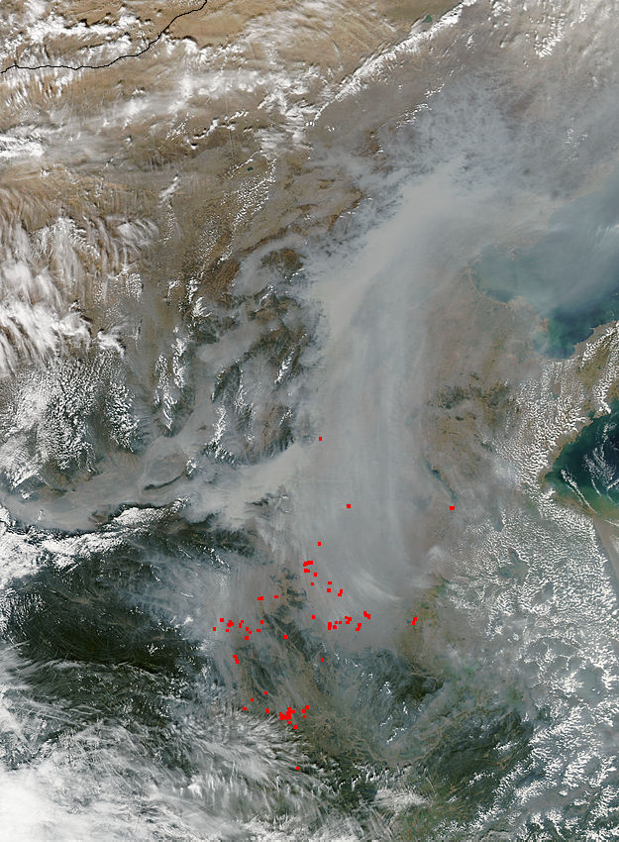
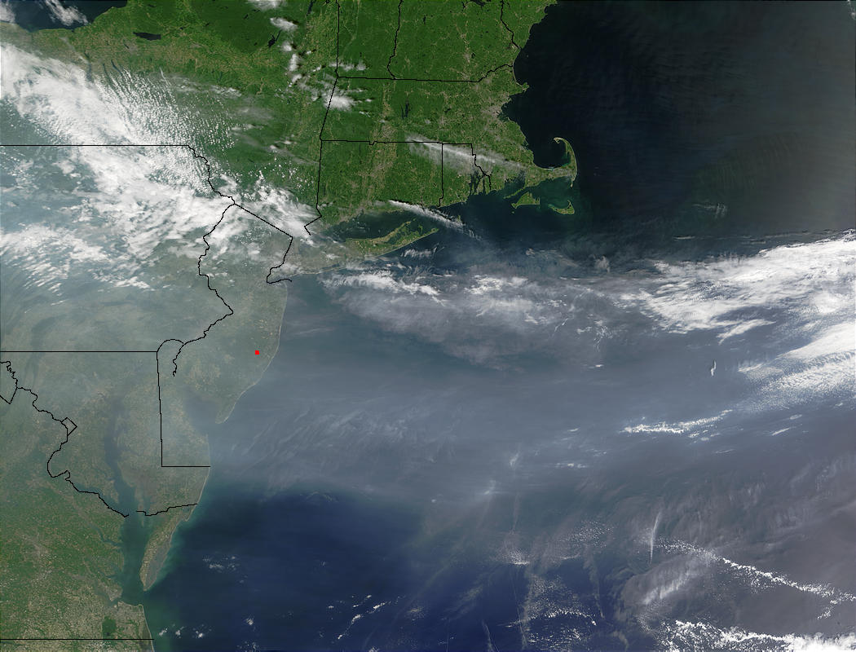




Satellites, Weather and Climate Module 8b:
Air Quality and Remote Sensing

Slide 2
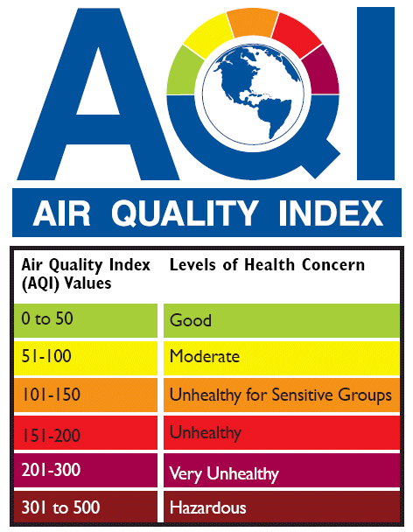
What is “Air Quality”?
The term “Air Quality” can have many different definitions:
“A measure of the condition of air relative to the requirements of one or more biotic species and or to any human need or purpose.”
“A measurement of pollutants in the air.”
“A description of the healthiness of the air.”
Descriptions of Air Quality can be both
quantitative and qualitative.
Air Quality is a term that is constantly changing over time.
All of the various definitions seek to link and describe the relationship between various concentrations of pollutants in the air with the health of human beings.
Notes:
All of these definitions share a common element – they all relate the air to the health of human beings

Slide 3
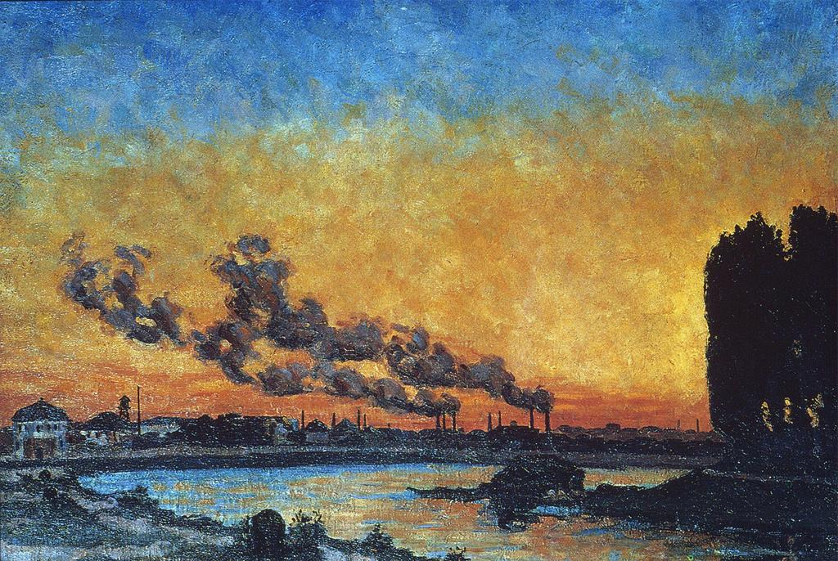
What is Air Pollution?
“Airborne particles and gases occurring in concentrations that endanger the health and well-being of organisms or disrupt the orderly functioning of the environment.” – Lutgens and Tarbuck
Air pollutants are broken down into two categories:
Primary Pollutants
Secondary Pollutants
“Setting Sun at Ivry” Jean Guillaumin 1869

Slide 4
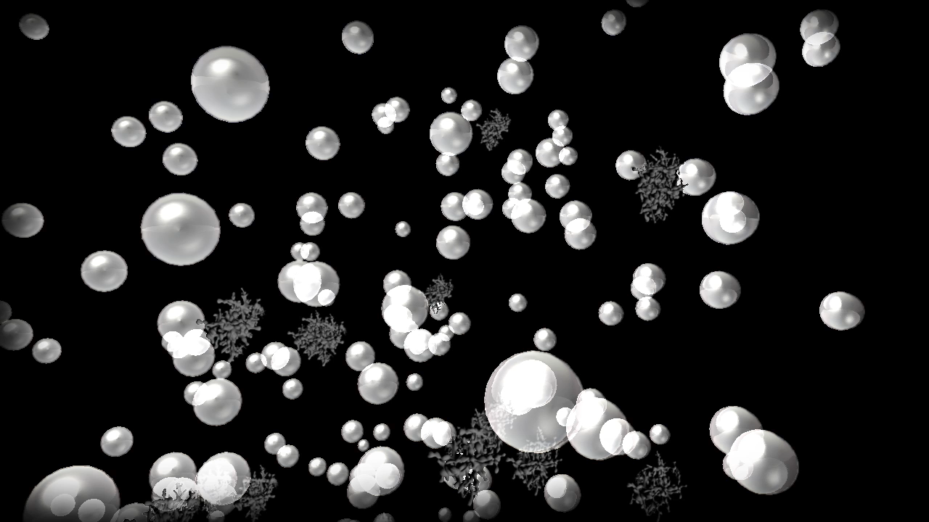
Primary Pollutants
Primary Pollutants are airborne particles that are emitted directly from identifiable sources. These tiny structures are known collectively as Particulate matter (PM). Once suspended in either air or water, the mixture of the two becomes known as an Aerosol.
Anthropogenic:
Combustion Processes
Chemical Processes
Nuclear or Atomic Processes
Roasting, Heating and Refining Processes
Mining, Quarrying and Farming Processes
Natural:
Volcanoes
Breaking Seas
Pollens and Terpenes
Fire
Blowing Dust
Bacteria and Viruses

Slide 5

Airborne Particles
The tiny structures being emitted by primary polluters are known collectively as Particulate Matter (PM). Once suspended in either air or water, the mixture of the two becomes known as an Aerosol.

Slide 6
Secondary Pollutants
Secondary Pollutants are not emitted directly into the air, but form in the atmosphere from reactions taking place between primary pollutants.
SMOG (Smoke + Fog)
VOG (Volcanic + Smog)
Ground Level Ozone

Slide 7

Smog

Slide 8
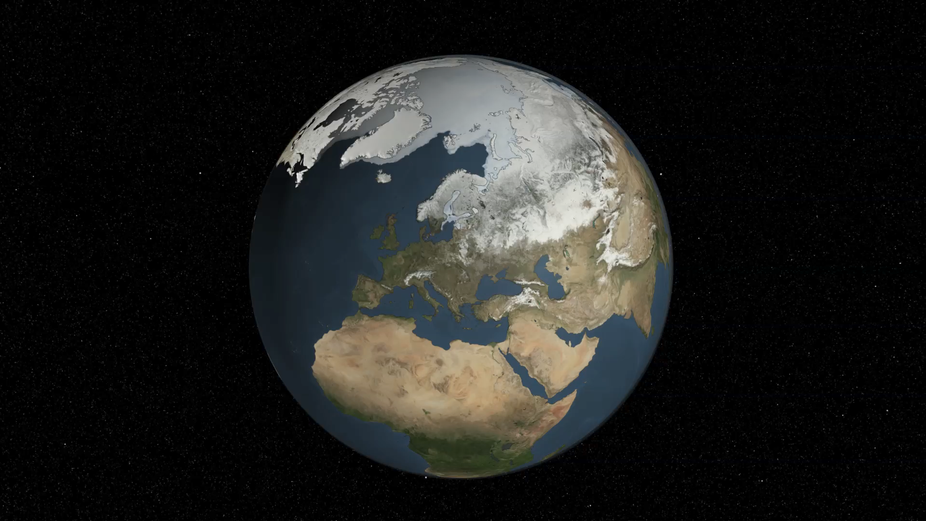
VOG
Volcanic Smog

Slide 9
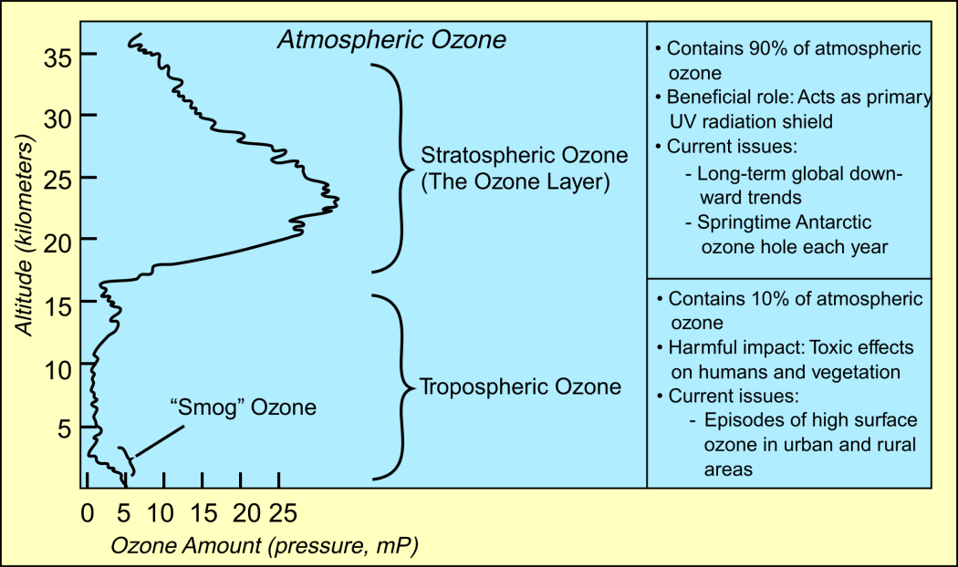
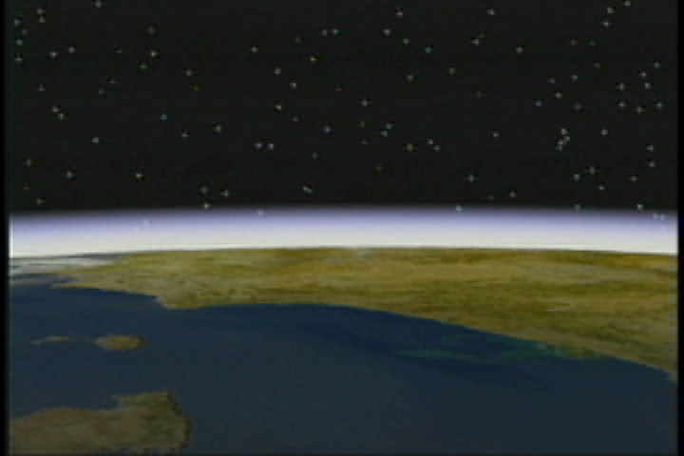
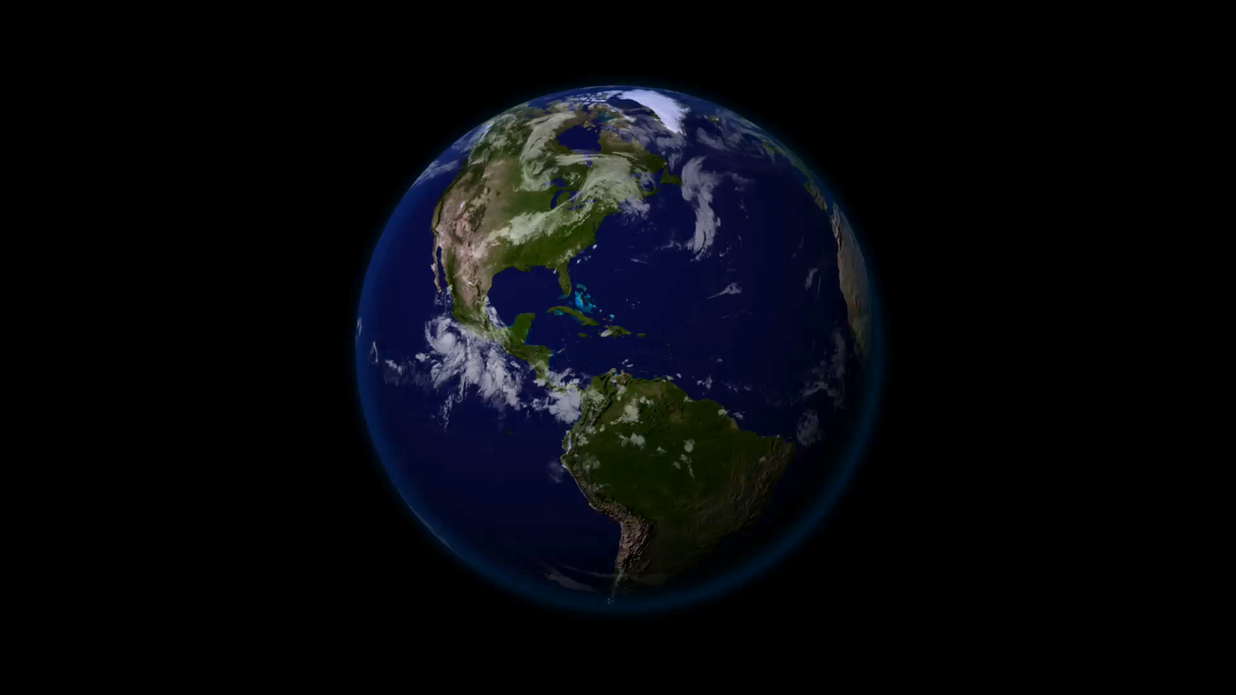
Ozone
Stratospheric Ozone: “GOOD” Ozone
Contains 90% of atmospheric ozone
Primary “Shield” for UV Radiation from Sun
Produced by UV rays interacting with Oxygen
Tropospheric Ozone: “Bad” Ozone
Other 10% of Atmospheric Ozone
Forms close to the ground when Hydrocarbons and Nitrogen Oxides react with sunlight.
Detrimental to human respiratory health
Slows and alters growth of many species of plants

Slide 10
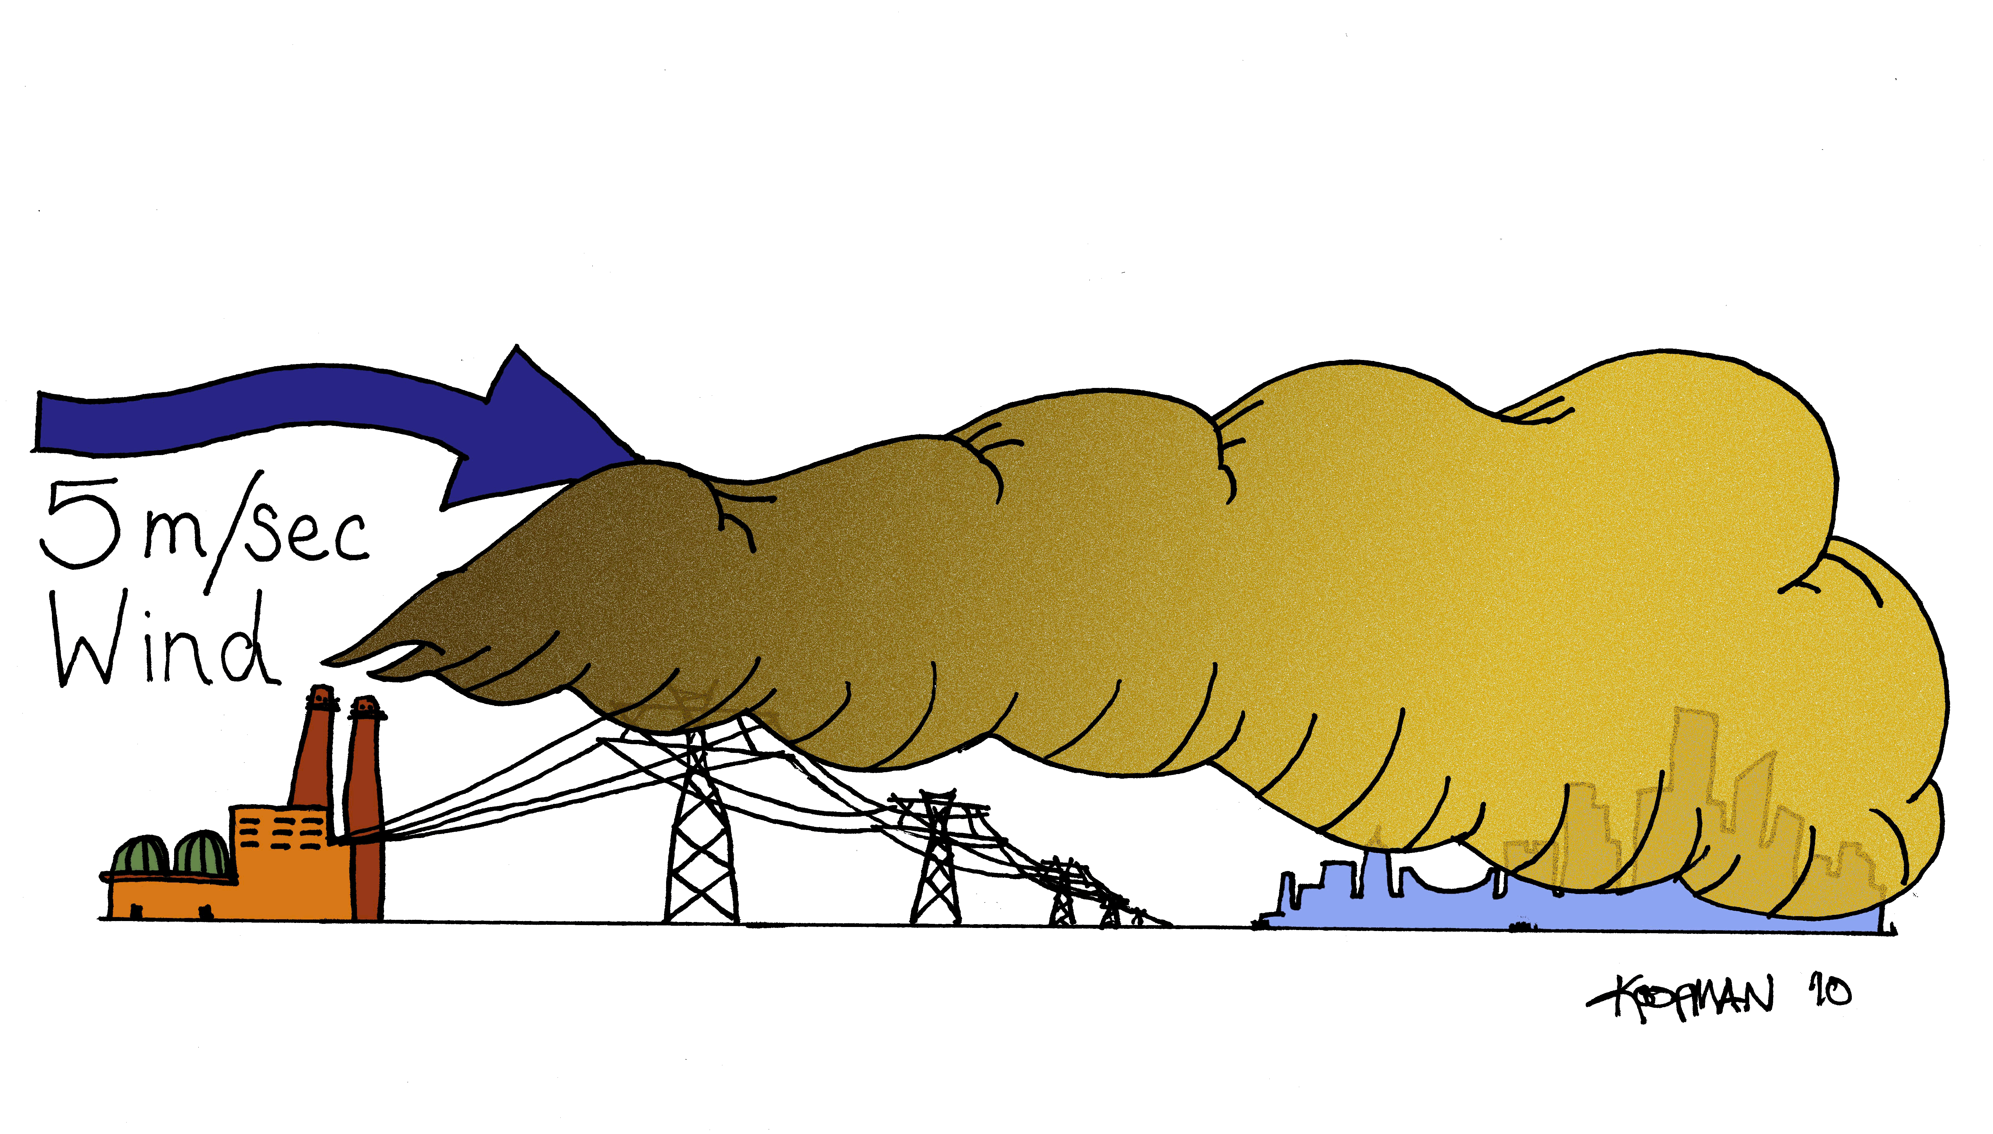
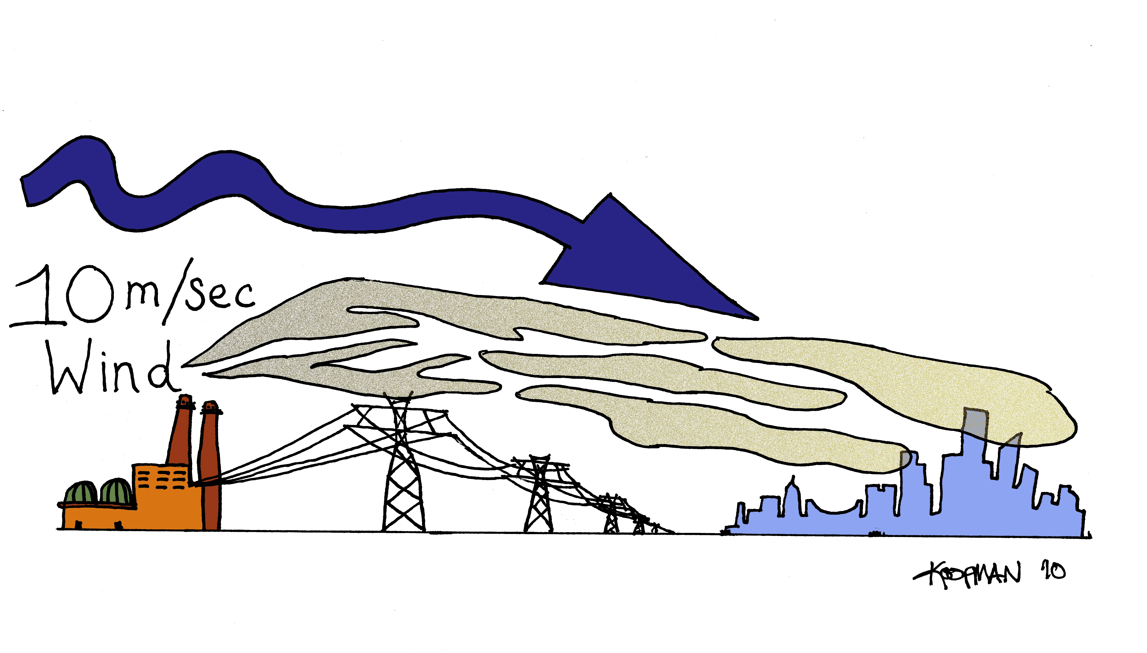
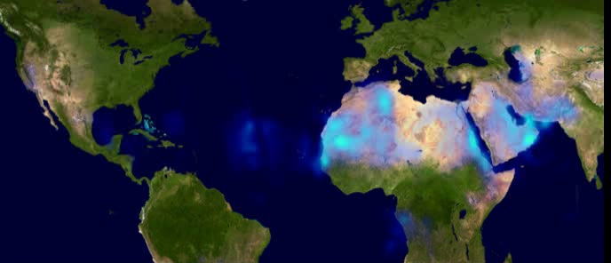
How are these pollutants spread?
Wind
“Dilution is the solution to pollution”
Wind causes bodies of polluted air to spread out across the Earth.
When winds are high, these bodies are spread out over larger areas, leading to a lower concentration of pollutants.
When winds are low, these bodies sit and stagnate over a smaller area leading to localized pockets of more concentrated pollution.

Slide 11
Mixing Depth/Height
The layer of air in between the surface of the Earth and the height at which convection begins to occur is called the “Mixing Depth” or “Mixing Height.”
Deeper Mixing Depths allow pollutants to be dispersed within a larger volume of air, leading to greater dilution of pollutants.
Shallower Mixing Depths “trap” pollutants in a small volume of air, which does not allow bodies of pollutants to disperse as quickly.
Hand Drawn illustration

Slide 12
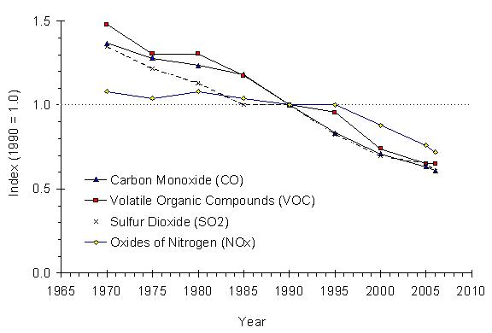
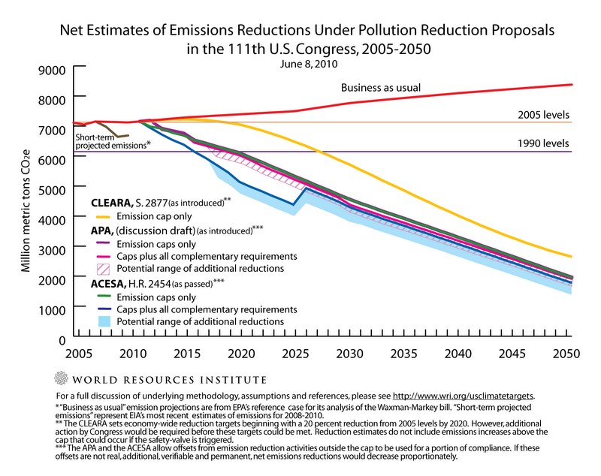
Quantity of Pollutants being emitted
EPA standards Timeline
Equation and group solving

Slide 13
Measuring Air Quality
Techniques
Monitoring Network Map (Google Earth?)

Slide 14
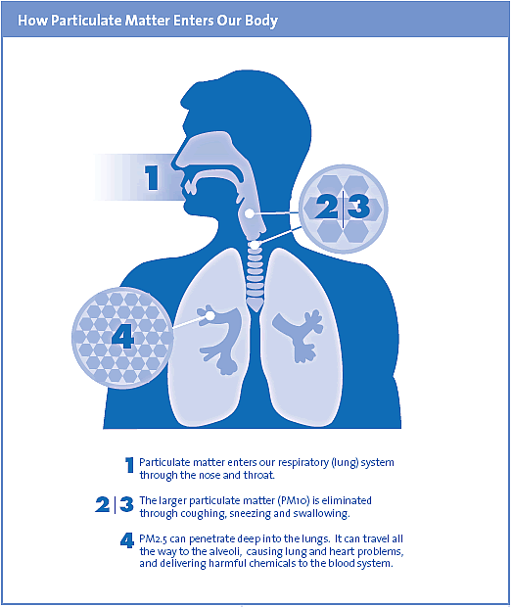
Health Impacts of Air Pollution

Slide 15
Air Pollution and Weather
Acid Rain
Condensation Nuclei

Slide 16
Climate Perspective
Historical Effects (Laki 1784, various volcanic events)
Global Dimming?
Future models

Slide 17
Remote Sensing of Air Pollutants
Spectrometry

Slide 18
Satellite RS of Pollutants
GOES
GOES-R Aerosol Mission
NASA Glory

Slide 19
Further information
Intermediate
Advanced
Vermont Ozone and PM2.5 maps: http://www.anr.state.vt.us/air/Monitoring/cfm/RealTimeMap.cfm Vermont Real Time Air Quality: http://www.anr.state.vt.us/air/Monitoring/cfm/RealTimeData.cfm Air Quality Index: http://www.anr.state.vt.us/air/Monitoring/cfm/AQICurrent.cfm North Atlantic Jet: http://virga.sfsu.edu/pub/jetstream/jetstream_atl/big/1005/ Pollution: http://apollo.lsc.vsc.edu/classes/met130/notes/chapter18/la_primary.html National Air Quality: http://www.weather.gov/aq/
NASA Glory Mission: http://glory.gsfc.nasa.gov/ NASA GOES-R Volcanic Ash: http://www.goes-r.gov/downloads/Factsheet-Volcanic%20Ash-11-16-09.pdf NASA Ozone Hole Watch: http://ozonewatch.gsfc.nasa.gov/

