Slide 1

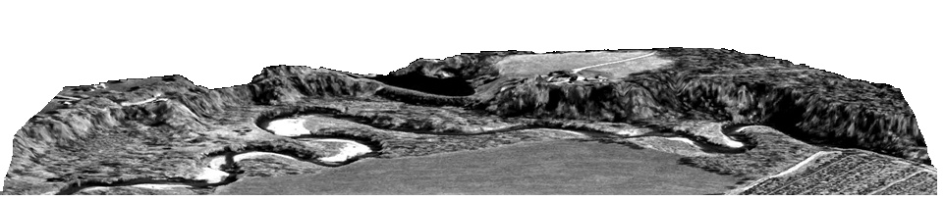



Stream Geomorphology
Leslie A. Morrissey UVM
July 25, 2012

Slide 2
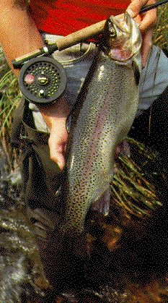
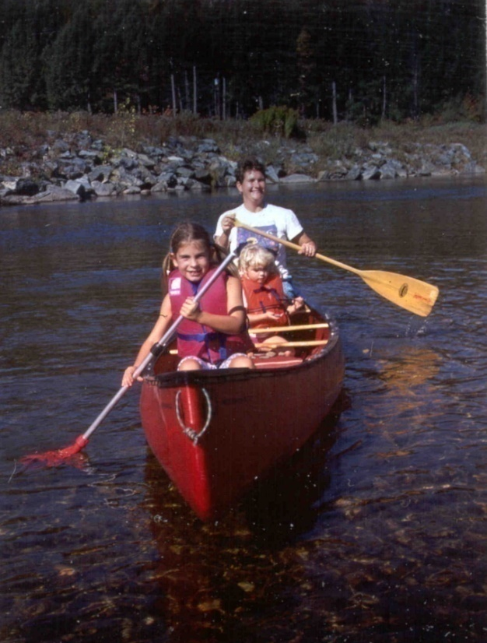
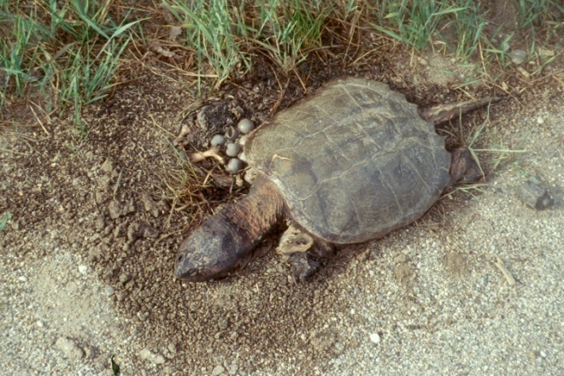
What Functions do Healthy Streams Provide?
Flood mitigation
Water supply
Water quality
Sediment storage and transport
Habitat
Recreation
Transportation
Aesthetic qualities

Slide 3
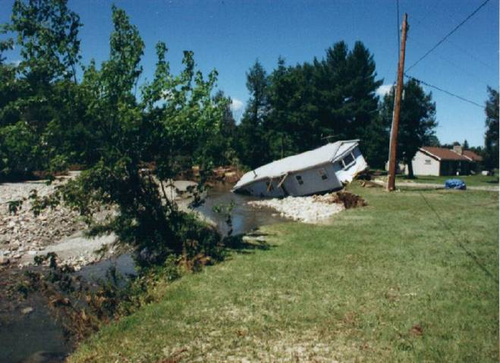
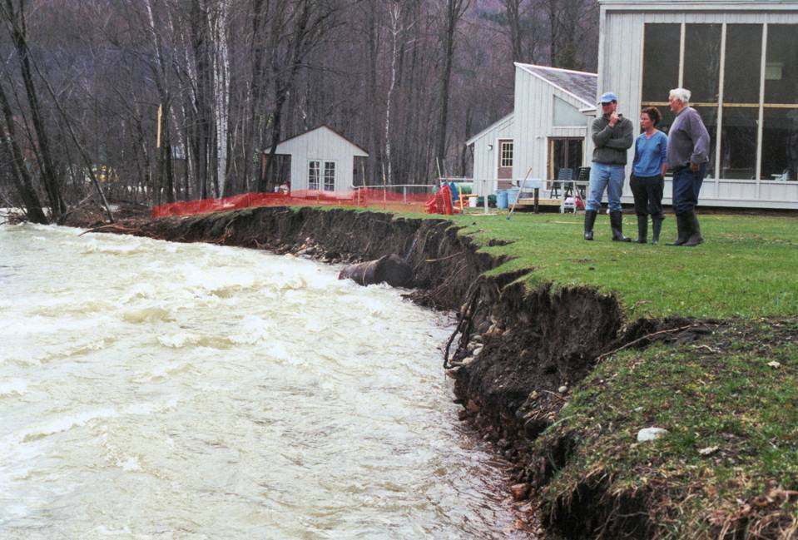
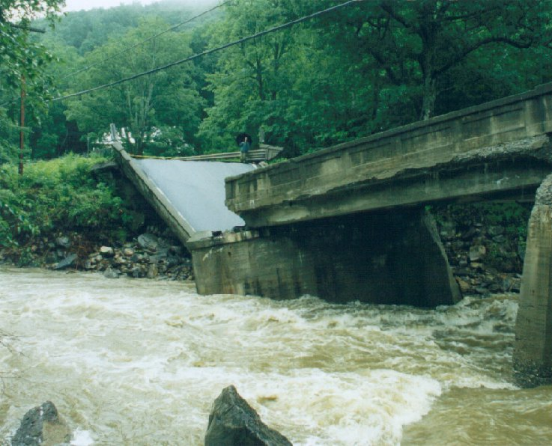
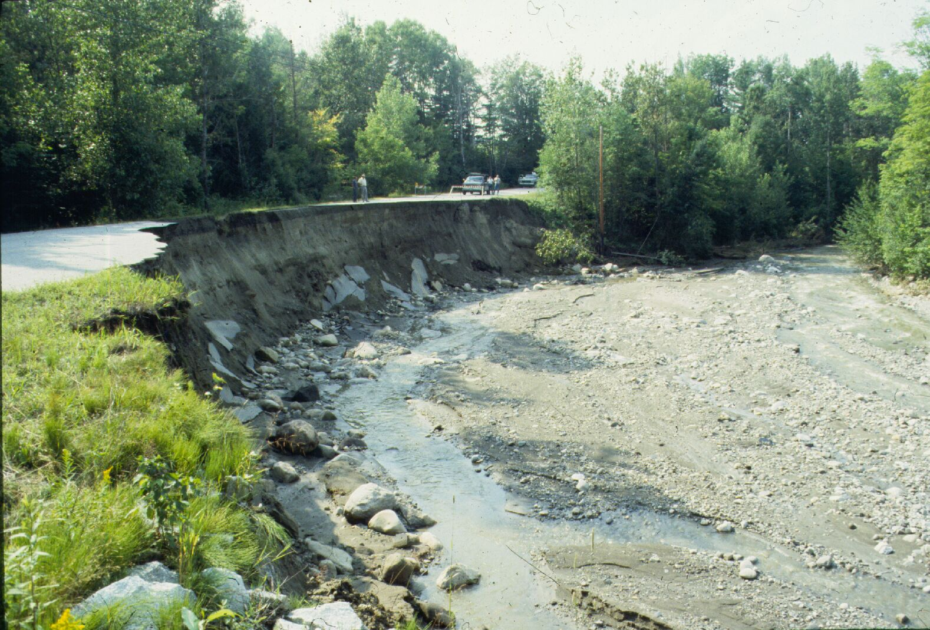
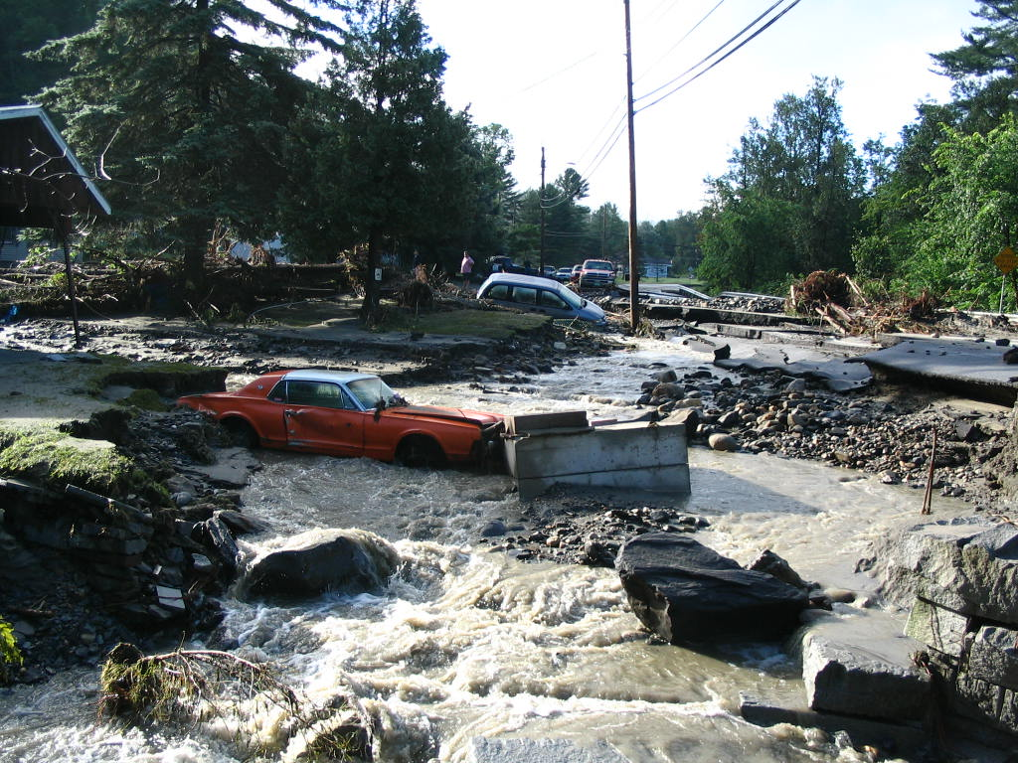
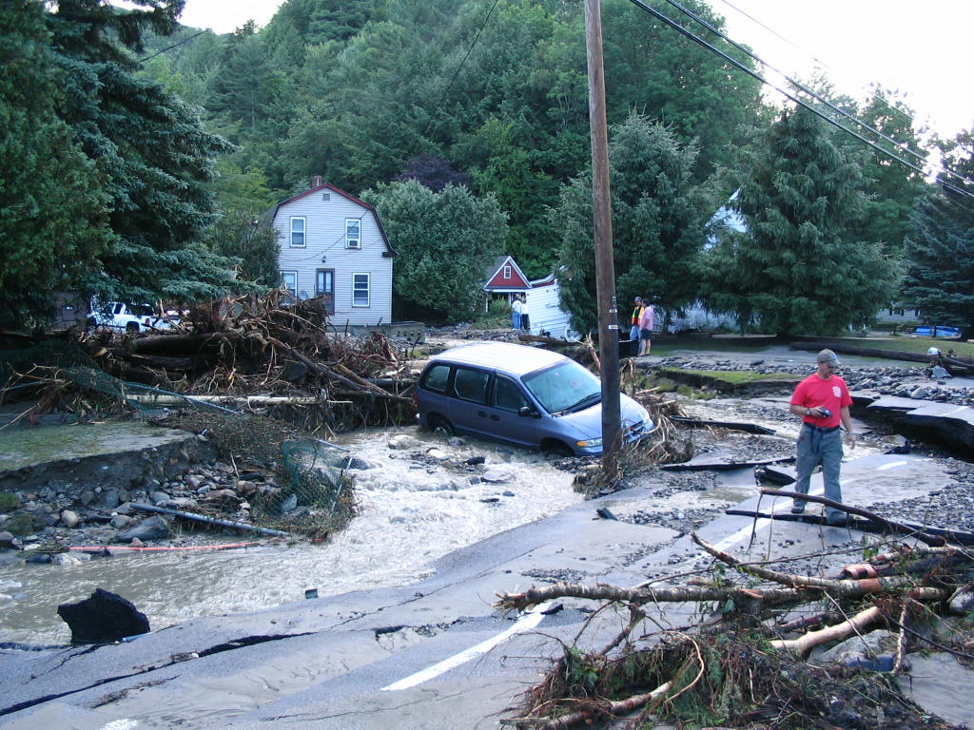
When streams go wild
In Vermont, most flood damage is caused by fluvial erosion
Notes:
Fluvial erosion is erosion caused by streams, rivers, creeks (water)
Estimated $20 billion in damages (US) due to Tropical Storm Irene
Cost of damage/recovery in VT - $700 million - $1billion

Slide 4
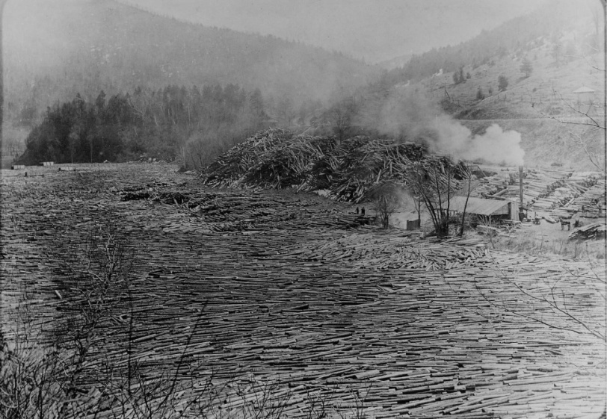
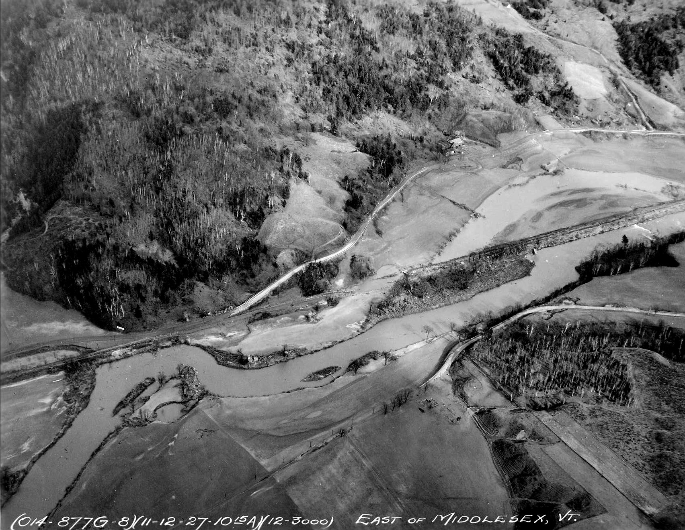
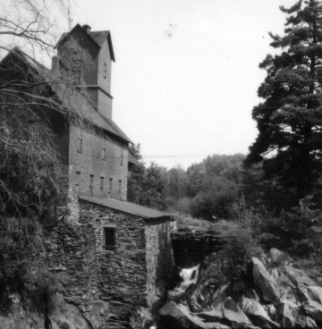
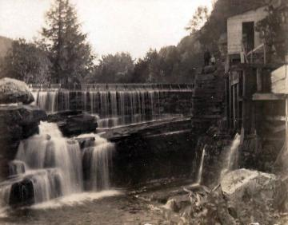
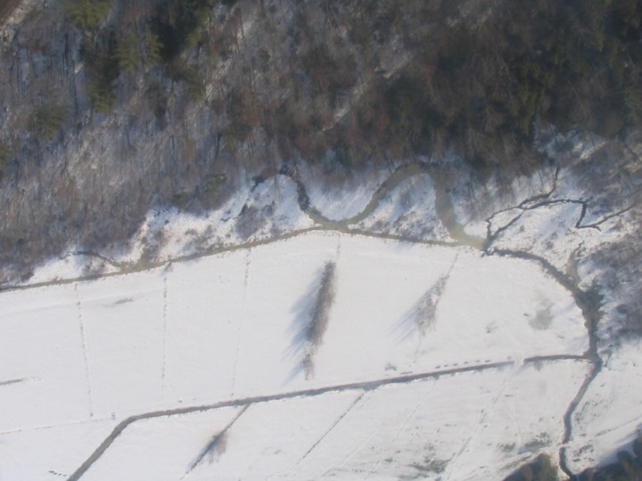
History of River Management
Transportation
Power
Agriculture
Notes:
Historically, river management focused on protecting infrastructure, increasing agricultural lands, and providing power through channel modification and draining.
Rivers were straightened and even moved to accommodate railroads and road networks. The photo (left) is of the Winooski, showing how the meander bends were cut off when the transportation infrastructure was built.
Agricultural ditches reroute runoff
Dams for water power for historic mills
Log drives - logs moving down river (top right)
Historic Red Mill on Browns River Jericho 1855

Slide 5
Notes:
“Crooked streams are a menace of life and crops”

Slide 6
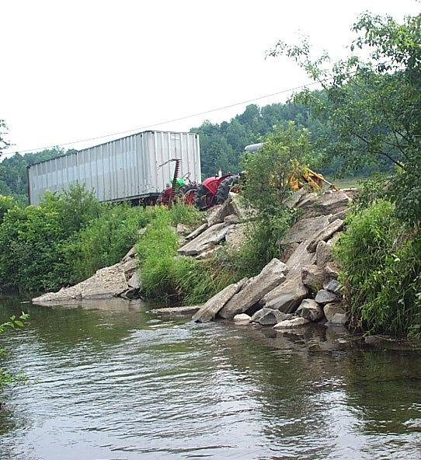
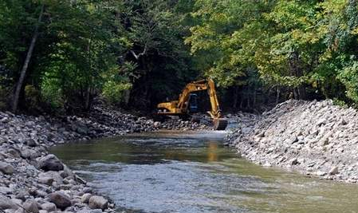
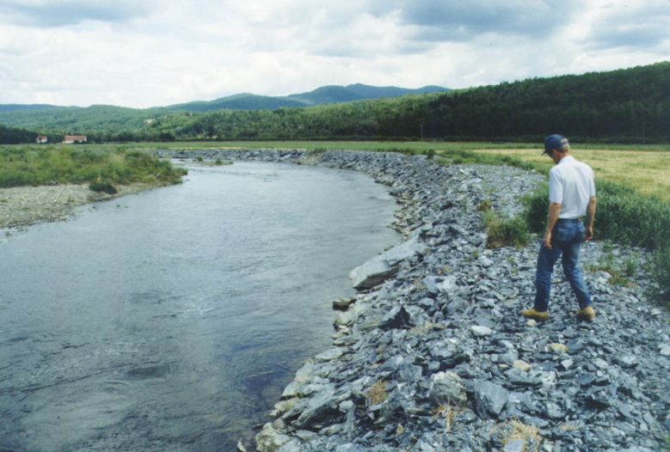
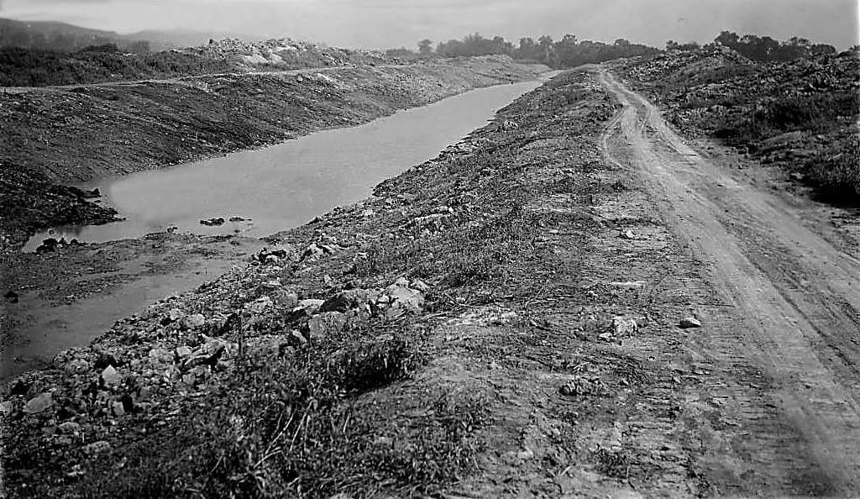
Traditional River Management
Goal - contain flow within straight channel
Stream channels were:
    dredged
    bermed
    armored
to withstand the increased stream power
Notes:
Engineering costs – high
Effectiveness - limited

Slide 7
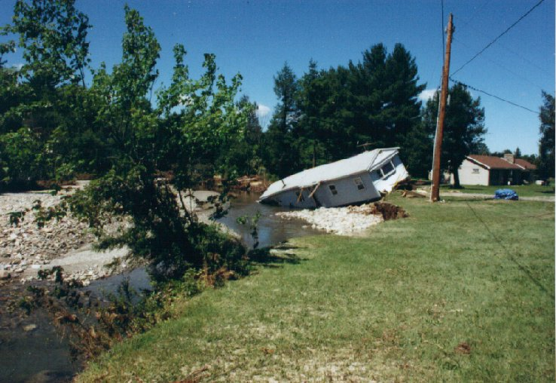

Disaster Can Result
Energy kept in the channel during flooding
can cause catastrophic damages downstream

Slide 8
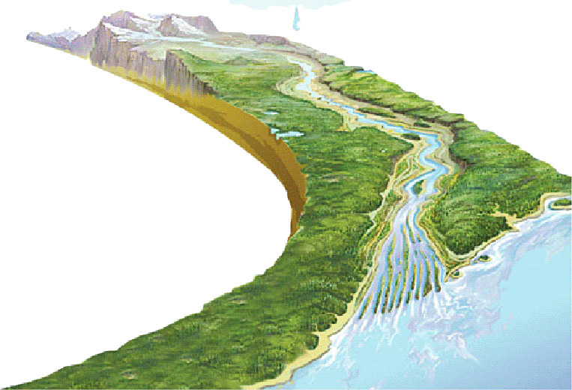
Streams are Indicative of Watershed Condition
Precipitation
Runoff
A change in the watershed will impact the stream network
Notes:
A change in the watershed will impact the stream network

Slide 9
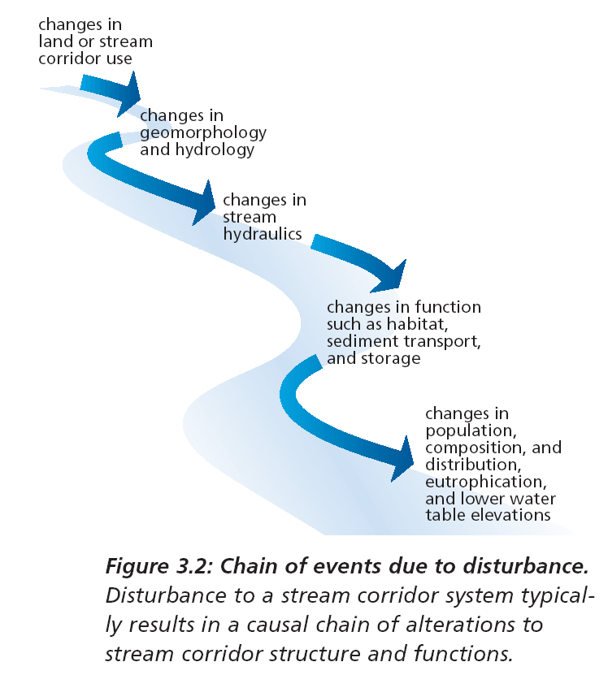
Disturbance-induced changes in stream structure and function
Notes:
Changes in land use and cover > changes in runoff and sediment inputs > changes in streams
Hydraulics – flow of water in channels (velocity, resistance to flow, sediment movement…all about the channel characteristics)

Slide 10
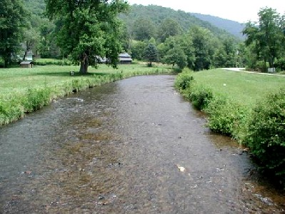
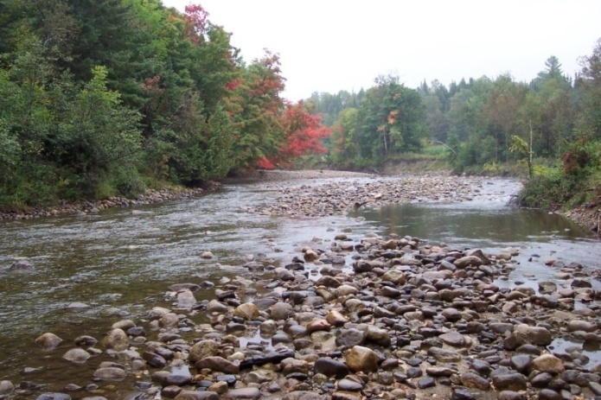
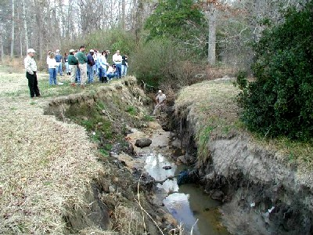
Fluvial Geomorphology
Channel characteristics (e.g., sinuosity, width, depth) are determined by stream discharge and sediment
Influenced by:
Watershed area
Land use and land cover
Soils and geology
Topography
Climate
Human impacts
Notes:
Fluvial geomorphology -the examination of the processes that operate in river systems that define their physical properties and the landforms which they create or have created

Slide 11
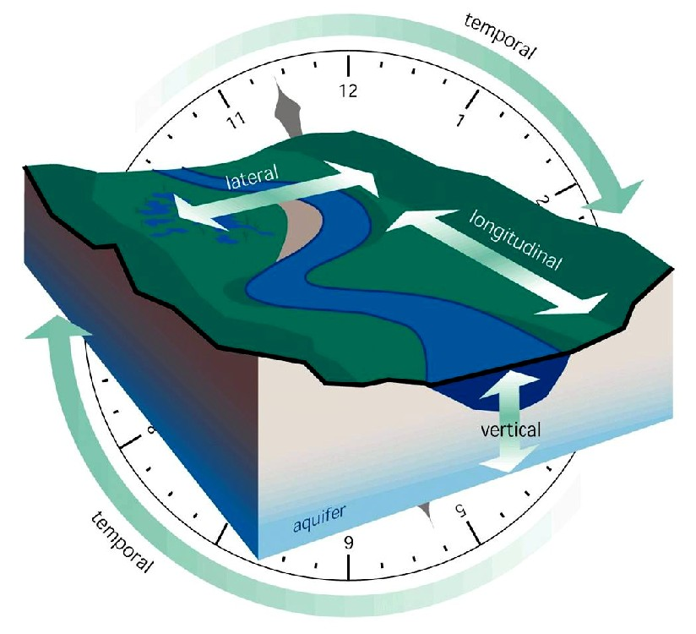
Streams Adjust to Changing Conditions
Lateral
Vertical
Longitudinal
Temporal
Stream Corridor Restoration: Principles, Processes, and Practices. 1998. Federal Interagency Stream Restoration Working Group.
Notes:
Streams are dynamic phenomena continually adjusting to changing watershed inputs.
This four-dimensional framework, found on page 1 of the noted SCR publication offers a good starting point for examining stream corridors….
• the physical structure of stream corridors is formed by the movement of water, materials, energy, and organisms within this multidimensional framework,
• lateral and vertical movements of water, materials, energy, and organisms also influence the character of stream corridors,
the longitudinal dimension or the stream as it flows from headwaters to mouth,
• time dimension because stream corridors are constantly changing over time (a single storm event, year, decade, centuries)

Slide 12
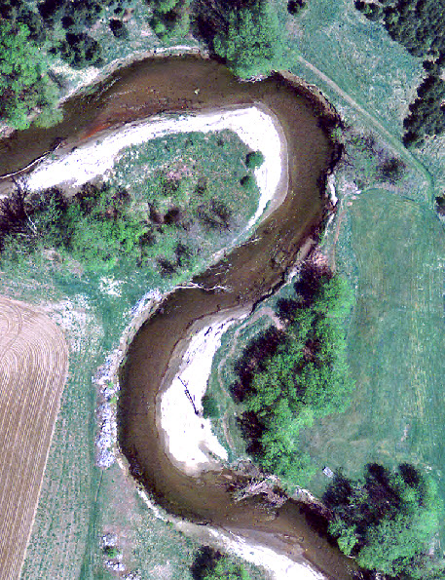
Lateral Channel Migration
Notes:
Erosion vs. deposition
Planform change (sinuosity, width, location)

Slide 13
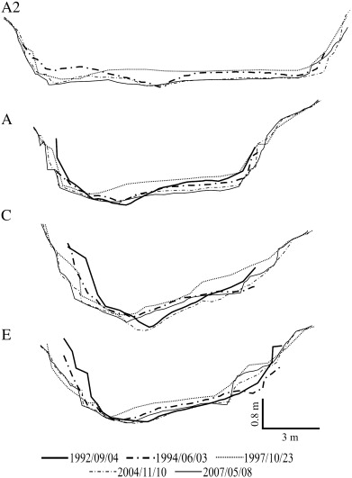
Vertical Movement of Stream Channel
1992 - 2007
Notes:
Leads to shallower or deeper channels. Varies by reach and over time.

Slide 14
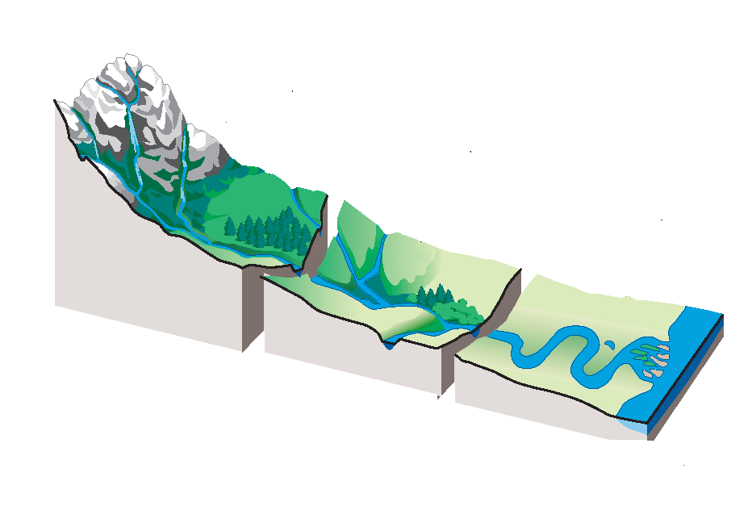
Stream Corridor Longitudinal Profile
(dominated by slope)
Headwaters
Transfer zone
Deposition zone
Miller, 1990
Notes:
“The overall longitudinal profile of most streams can be roughly divided into three zones
• zone 1, the headwaters, which has the steepest grade,
− sediment is eroded from the watershed and most of the finer particles are moved downstream,
• zone 2, the transfer zone, receives some of the eroded material,
− usually characterized by wide floodplains and meandering channel patterns,
• zone 3, the primary depositional zone, is where the stream begins to meander slowly across a broad, nearly flat valley near its mouth,
• it should be noted that these zones, while conceptual, are applicable to watersheds with relatively little relief from the headwaters to the mouth,
although erosion, transfer, and deposition occur in all zones, this zone concept focuses on the most dominant process.”

Slide 15
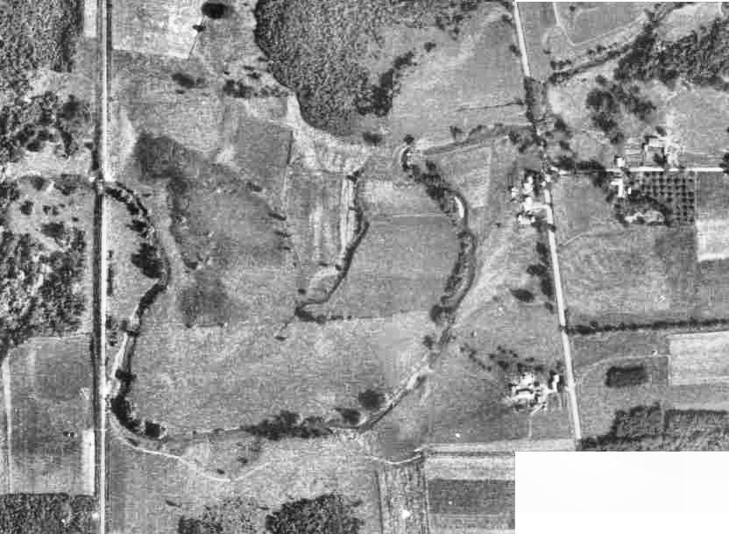
Temporal Changes in Stream Channel
Approximate location of 1900 channel
Lewis Creek
Channelized reach along toe of valley wall (today)

Slide 16
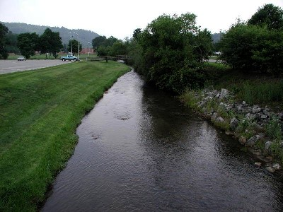
Terrace
Left Bank
Right Bank
Thalweg
Downstream
Notes:
The stream channel begins at the highest point of a bank or scarp and extends down to the deepest point in the stream or thalweg, across the stream bottom or streambed and up to the highest point on the opposite bank….
Bank orientation – imagine paddling down the stream with the left bank on your left and the right bank to your right.
Although streamflow is normally confined within the active channel, at high water, streams spill over their banks onto the surrounding floodplain.
A floodplain (or flood plain) is the nearly flat land adjacent a stream or river that stretches from the banks of the channel to the base of the enclosing valley walls and experiences flooding during periods of high discharge.
the dimensions of a stream channel cross section define the amount of water that can pass through without spilling over into the floodplain.

Slide 17
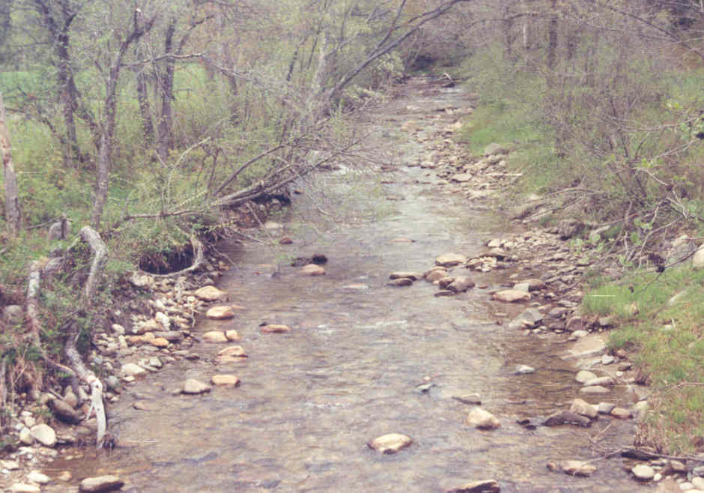
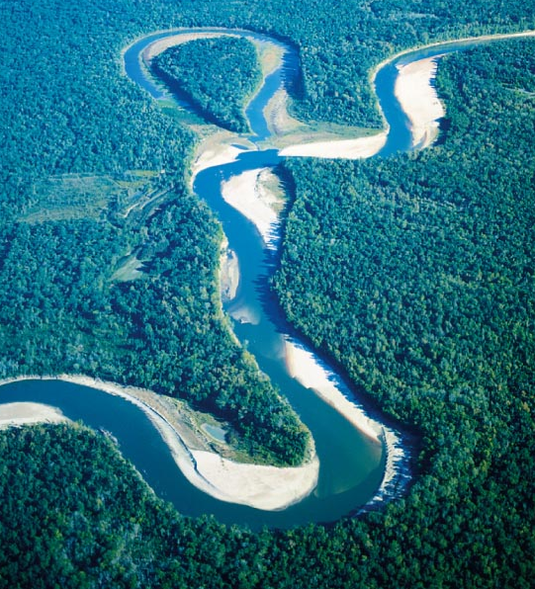
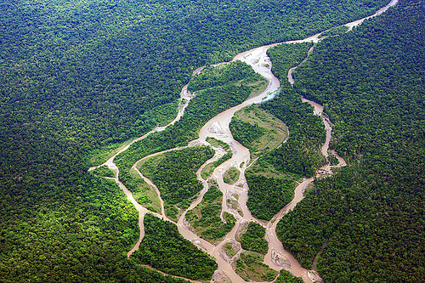
Stream Channel Patterns
  Straight channels →
    indicative of strong geologic structure (bedrock) or human control
  Braided streams ↘
    multiple interwoven channels
  Meandering channels ↓
    highly variable, sinuous
Notes:
These are the primary patterns in VT, although there are other patterns.
Straight channels are found in nature up near headwaters. Straight channels downstream are often the result of human disturbance (e.g. straightening, ditching, channelization)
Meandering streams are found downstream on flat broad floodplains – they are very efficient at moving water and sediment.
Braided streams often indicate high sediment loads – the stream is quite literally trying to push the alluvium sediments in the channel out of the way.

Slide 18
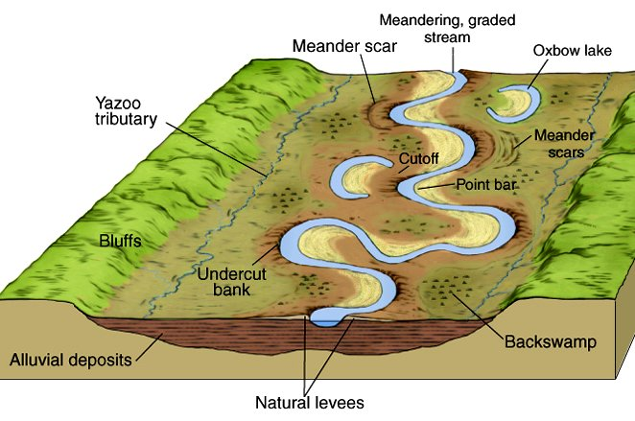
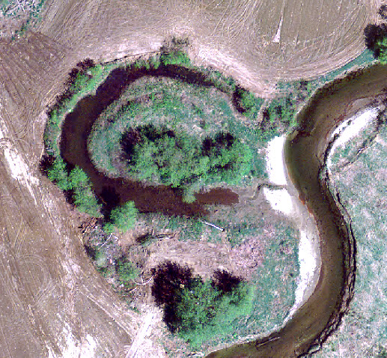
Meander Pattern
Tributary
Floodplain
Notes:
A floodplain (or flood plain) is the nearly flat land adjacent a stream or river that stretches from the banks of the channel to the base of the enclosing valley walls and experiences flooding during periods of high discharge.

Slide 19
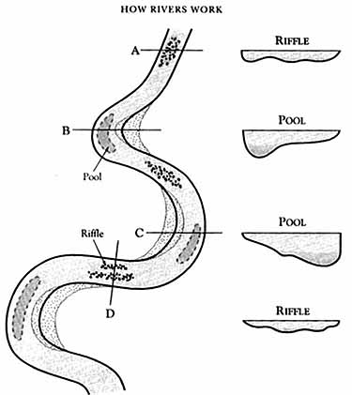
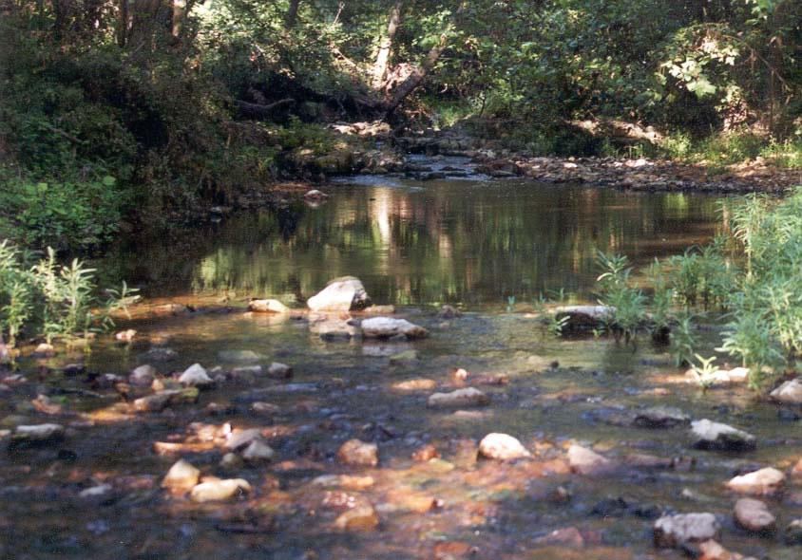
Pool and Riffle Sequence
Pool
Riffle
Notes:
Common pattern found near stream headwaters in VT
In a flowing stream, a riffle-pool sequence develops as a stream's hydrological flow structure alternates from areas of relatively shallow to deeper water. This sequence is present only in streams carrying gravel or coarser sediments. Riffles are formed in shallow areas by coarser materials such as gravel deposits over which water flows. Pools are deeper and calmer areas whose bed load (in general) is made up of finer material such as silt.
Riffles: sand and gravel beds, gravel bed rivers with gradients steeper than 2-3%
pools: fine grained bed material; low gradient & slow flow
Pool/step sequence variant: accumulations of woody debris, bedrock or interlocking cobbles & boulders; high gradient (>3-5%) & velocity
Provide different habitats and micro-ecosystems

Slide 20
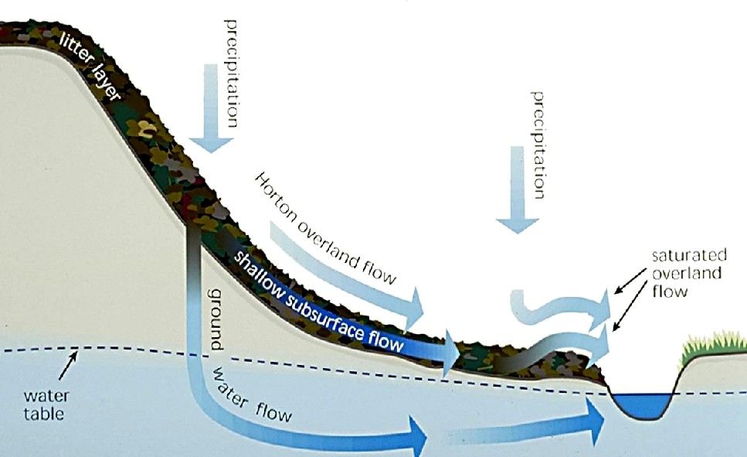


Water is the Driver
Runoff
Notes:
Water (how fast and how much) drives stream channel adjustments
“When the rate of rainfall or snowmelt exceeds the infiltration capacity of the soil, the excess water collects on the soil surface (pools) or travels downslope as runoff”.
“As illustrated, three basic types of runoff can occur individually or in combination.
• overland flow,
• shallow subsurface flow,
• subsurface flow”.

Slide 21
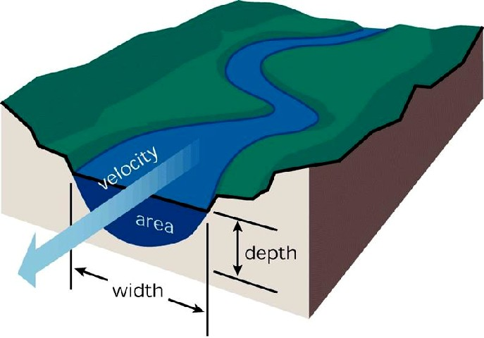
Velocity
vs.
Discharge
    Q = v x A = Discharge (cfs)
    v = Velocity (ft/s)
      A = Cross-Section Area (ft²)
Stream Corridor Restoration: Principles, Processes, and Practices. 1998. Federal Interagency Stream Restoration Working Group
Notes:
Velocity – describes how fast the water is moving, i.e. distance traveled per unit time
- typically expressed in feet per second (fps).
Velocity is typically related to erosion because the faster water moves, the more energy it has to pick up and carry sediment downstream.
v is related to slope, channel shape, and channel roughness.
Stream discharge - describes the volume of water moving down the channel per unit time; relates to how much and how fast the water is traveling
typically expressed in cubic feet per second (cfs)

Slide 22
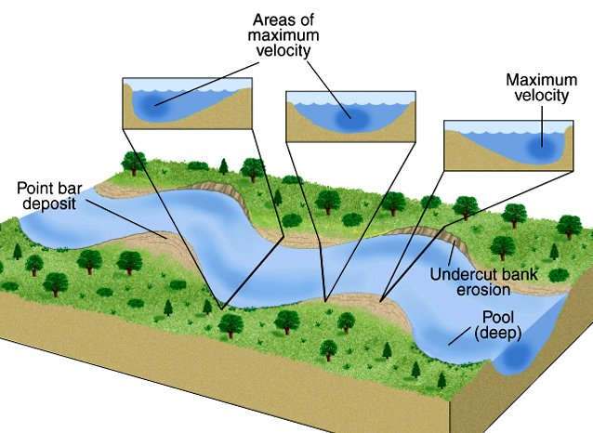
Velocity affects erosion and deposition
Faster flow -> erosion
Slower flow -> deposition
Notes:
High velocity on outside of a meander bend >> erosion (cut bank).
Low velocity on inside of bend >> deposition in the form of point bars.

Slide 23
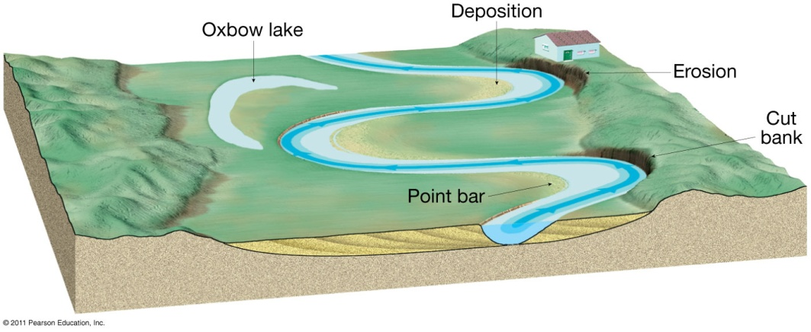
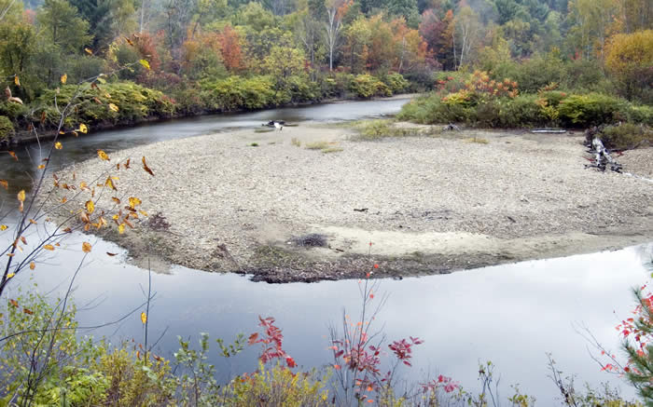
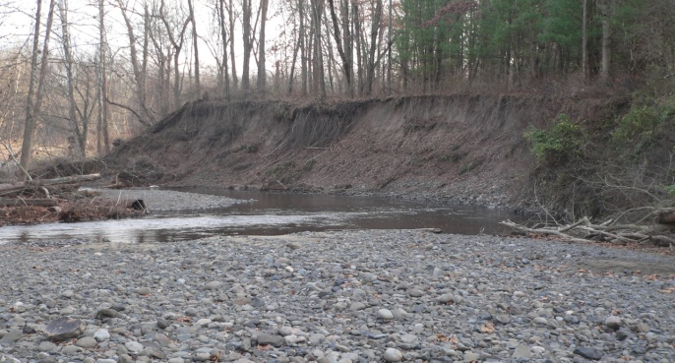
Shaping and Reshaping of Channels
  As gradient (slope) decreases, stream flow meanders -> lateral erosion
  Since flow is faster around the outside of a bend, meanders shift sideways by eroding their outer bank
  Since flow is slower on the inner bank, sediment is deposited

Slide 24
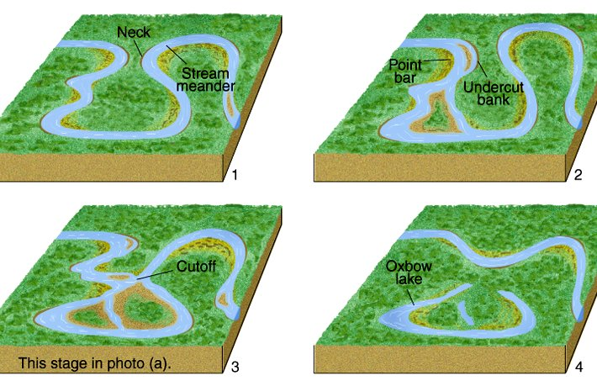
Channel Migration Process
(Planform Change)
Notes:
A variety of topographic features are formed on the floodplain by the lateral migration of the stream channel….
The shape or form of a stream as seen from above, as in a plan view.

Slide 25
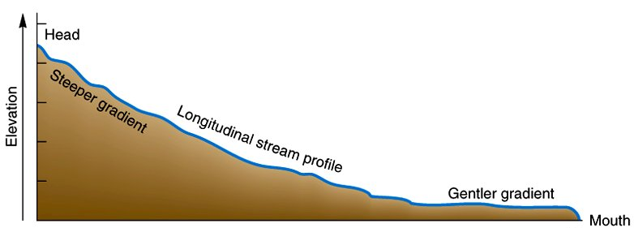
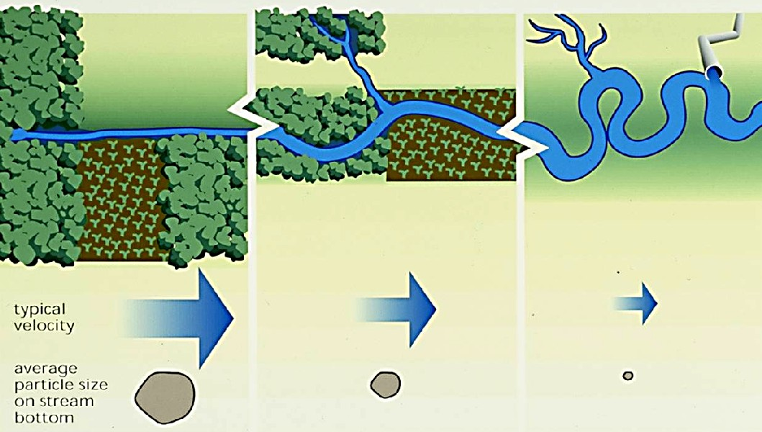
Water and Sediment
Connection
Flow
velocity
Particle size on stream bottom
Discharge
Notes:
Sediment load - the quantity of sediment that is carried past any cross section of a stream in a specified period of time, usually a day or a year. Typical unit for sediment load is metric tons.
Within a watershed, runoff varies both due to natural causes and land use practices……
these variations may change the size distribution of sediments delivered to the stream from the watershed by preferentially moving particular particle sizes into the stream”.
Near headwaters - straight fast channels move water quickly (although low volume, hence low discharge) along with larger particles (boulders, cobbles, gravel). Downstream as velocity decreases, particle size decreases to sands and clays.
Higher discharge downstream (but lower velocity) is due to additional water from tibutaries, culverts, ditches which leads to a higher volume (discharge)
Source - Stream Corridor Restoration: Principles, Processes, and Practices. 1998. Federal Interagency Stream Restoration Working Group

Slide 26
High elevation
Steep slopes
V-shaped valleys
Narrow channels
High velocity
Erosion (vertical)
Longitudinal Summary
Gentle slopes
Streams merge
Channels begin to meander
Floodplain broadens
Channels widen
Erosion and deposition
Headwaters
Transfer zone
Deposition zone
Flat, broad floodplain
Low slopes
Meandering channels
Lateral erosion
High discharge
Deposition dominates
Miller, 1990
Notes:
“The overall longitudinal profile of most streams can be roughly divided into three zones
• zone 1, the headwaters, which has the steepest grade,
− sediment is eroded from the watershed and most of the finer particles are moved downstream,
• zone 2, the transfer zone, receives some of the eroded material,
− usually characterized by wide floodplains and meandering channel patterns,
• zone 3, the primary depositional zone, is where the stream begins to meander slowly across a broad, nearly flat valley near its mouth,
• it should be noted that these zones, while conceptual, are applicable to watersheds with relatively little relief from the headwaters to the mouth,
• although erosion, transfer, and deposition occur in all zones, this zone concept focuses on the most dominant process.”

Slide 27
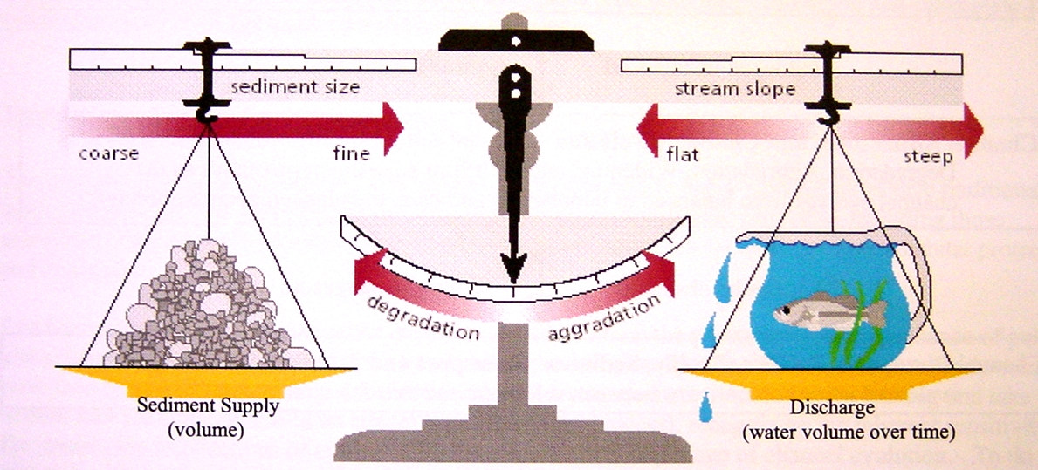
Dynamic Equilibrium
A stable stream transports the water and sediment produced by its watershed, such that over time it maintains its dimension, pattern, and profile, while neither degrading nor aggrading. However, if any factor changes, the other variables must change to reach a new equilibrium.
Sediment Load
Stream Power
In balance with
The amount of sediment and the size of the sediment particles that can be transported in a stream are directly related to the gradient (slope) of the stream channel and amount of water flowing in the stream channel at a particular time.
Lane (1955)
Notes:
Watershed inputs affecting channel equilibrium vary over time thus streams are constantly adjusting to reach a dynamic equilibrium where slope and flow balance the size and quantity of sediment the stream can carry. This Lane Diagram is useful to show how stable rivers are in balance with their watershed inputs (water and sediment).
Note: A stable river channel in equilibrium can erode and move within the landscape but retains the ability over time and in an unchanging climate to transport the flow, sediment, and debris of their watersheds such that they generally maintain their dimension (width and depth), pattern (meander length), and profile (slope) without aggrading (building up) or degrading (scouring down).
Erosion = degradation, deposition = aggradation
For example, the quantity and size of the sediment carried by a stream is proportional to the amount of water in the stream and the channel slope.
(1) If channel slope, for instance, is increased by straightening or channelization, the scale will tip with the arrow pointing toward streambed degradation and thus erosion will occur. Similarly if sediment load is increased by excessive erosion upstream, aggradation (deposition) will occur.
(2) If the if the slope decreases or if discharge decreases through the season, aggradation will occur, meaning the stream will drop its larger sediments. When the sediment size becomes fine enough, the scale will come back to equilibrium.
(3) Alternatively, if the slope increases between reaches or if discharge increases due to a storm event, degradation will occur, resulting in increased erosion.
(4) If runoff from a newly constructed road adds more sediment to the stream (but there is no change in slope or discharge), aggradation will occur and the sediment will drop out. Alternatively, building of a dam upstream typically reduces sediment supply. If discharge and slope remain the same, this will lead to increased erosion downstream.
STREAM POWER is defined as the product of discharge (Q) and slope (S).

Slide 28
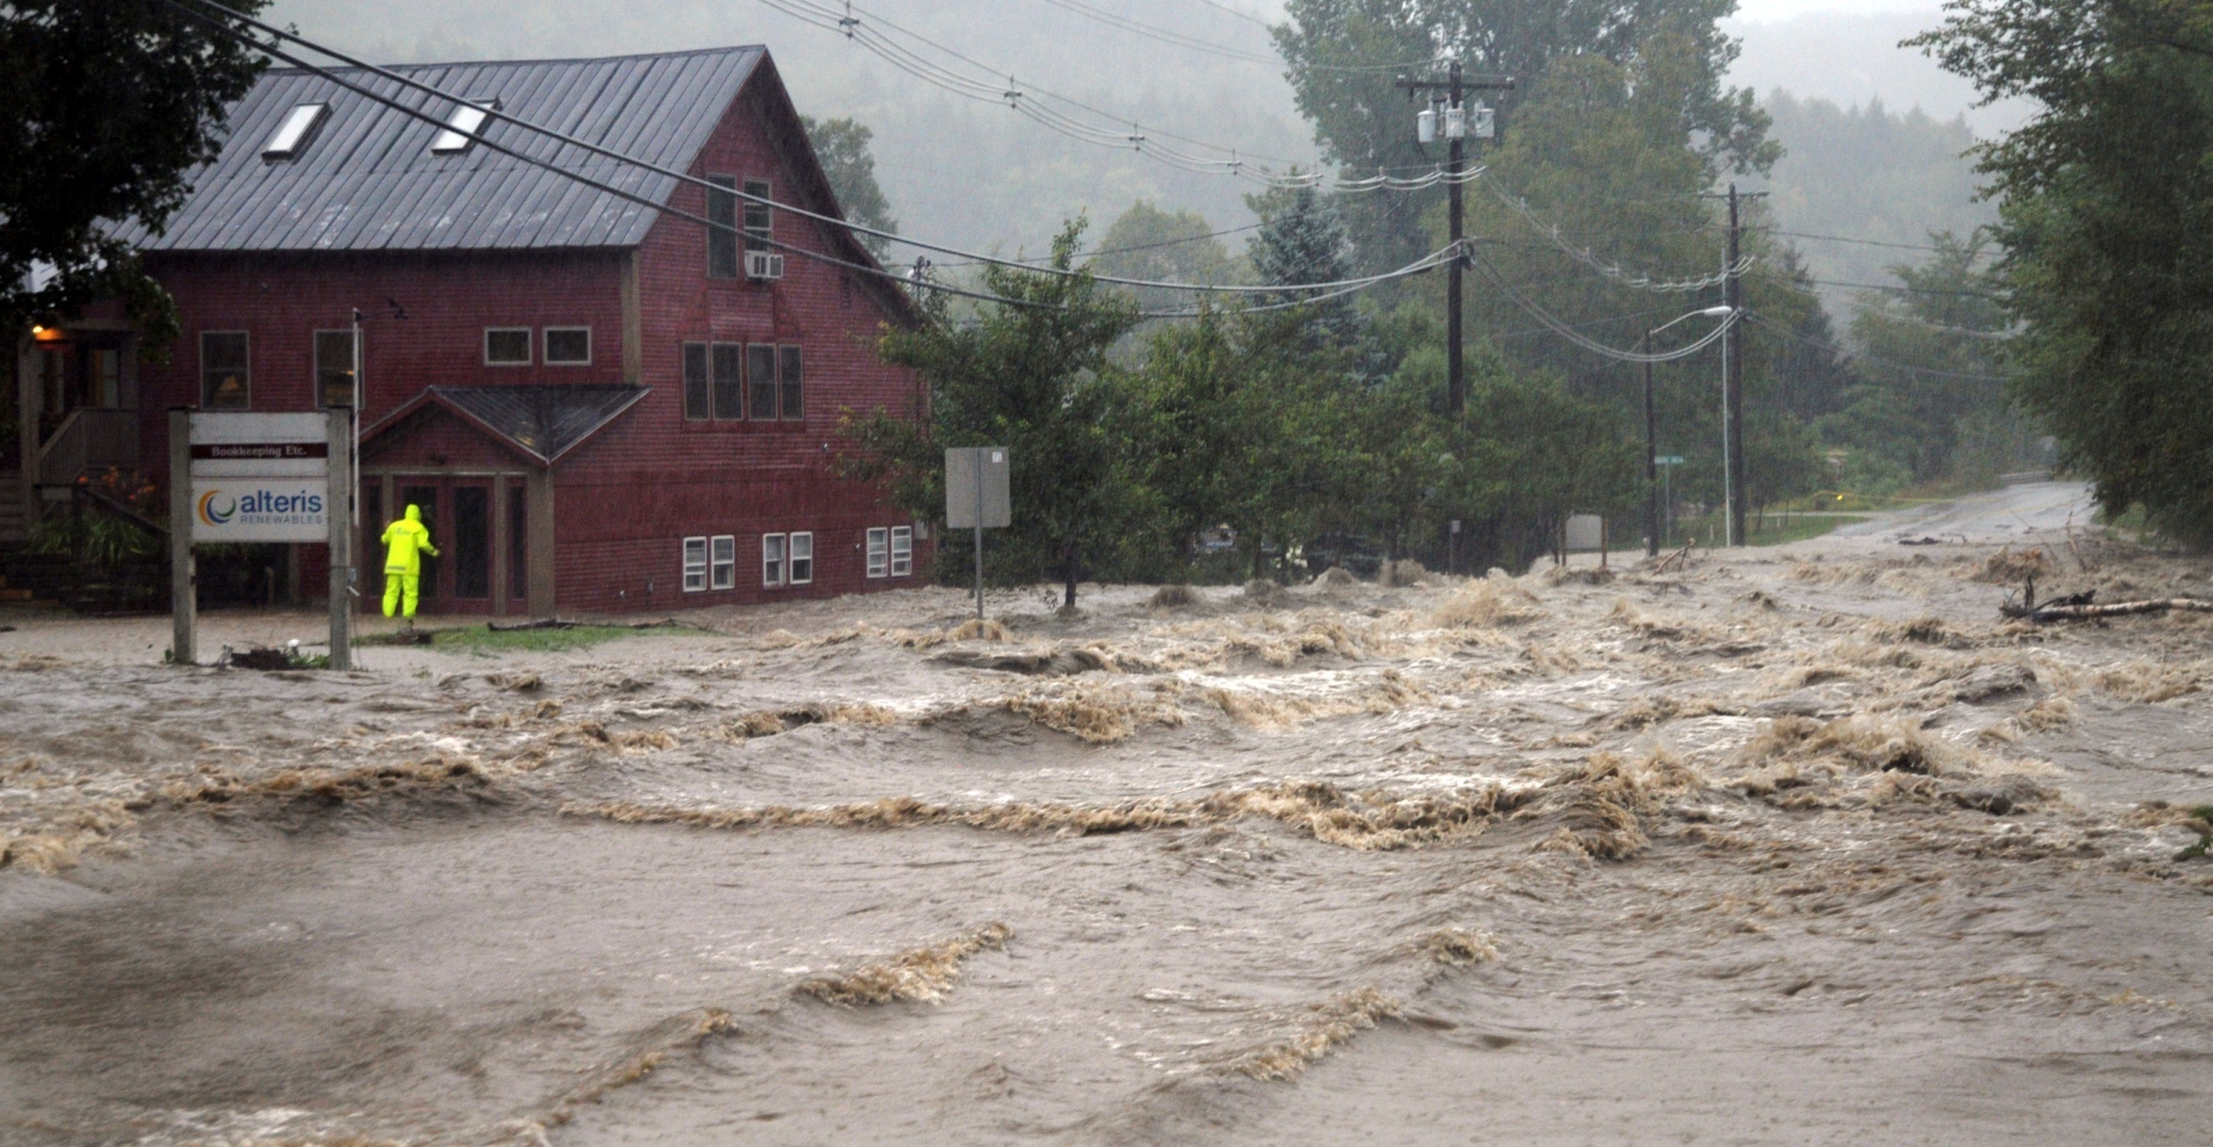
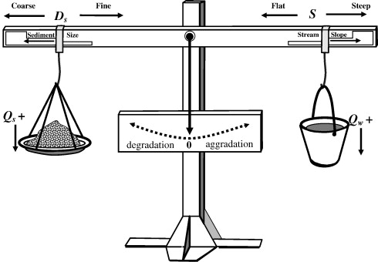
Storm > ↑ Discharge >>> Degradation
Sediment Load
Stream Power
Sediment Size
Coarse Fine
Stream Slope
Flat Steep
Degradation
Aggradation
Sediment Supply
(Volume)
Discharge
Notes:
The quantity and size of the sediment carried by a stream is proportional to the amount of water in the stream and the channel slope thus,
if discharge increases due to a storm event, degradation will occur, resulting in increased erosion.
STREAM POWER is defined as the product of discharge (Q) and slope (S).

Slide 29

Waterfall > ↑ Slope >>> Degradation
Sediment Load
Stream Power
Sediment Size
Coarse Fine
Stream Slope
Flat Steep
Degradation
Aggradation
Sediment Supply
(Volume)
Discharge
Notes:
Change in slope caused by a waterfall.
The quantity and size of the sediment carried by a stream is proportional to the amount of water in the stream and the channel slope thus,
if the slope increases (or stream power increases due to straightening or channelization), degradation will occur resulting in increased erosion.

Slide 30

Road construction > ↑ Sediment Supply >>> Aggradation
Road Construction
(assume no change in stream power)
Sediment Load
Stream Power
Sediment Size
Coarse Fine
Stream Slope
Flat Steep
Degradation
Aggradation
Sediment Supply
(Volume)
Discharge
Notes:
The quantity and size of the sediment carried by a stream is proportional to the amount of water in the stream and the channel slope thus,
if sediment load is increased by excessive erosion upstream or due to road/bridge construction (but there is no change in slope or discharge), aggradation (deposition) will occur and the sediment will drop out.

Slide 31

Upstream Dam > ↓ Sediment Supply >>> Degradation
Upstream Dam
Sediment Load
Stream Power
Sediment Size
Coarse Fine
Stream Slope
Flat Steep
Degradation
Aggradation
Sediment Supply
(Volume)
Discharge
Notes:
The quantity and size of the sediment carried by a stream is proportional to the amount of water in the stream and the channel slope thus,
building of a dam upstream typically reduces sediment supply. If discharge and slope remain the same, this will lead to increased erosion downstream. The stream becomes “hungry” for sediment.
Townsend lake and dam

Slide 32

Out of Balance
When a stream is unstable, i.e. out of balance, it is either aggrading (gaining sediment along its bed and banks) or it is degrading (deepening or widening due to the removal of sediment)
Unvegetated Point Bars
(aggradation)
Cut banks
(degradation)
Notes:
A stream's sediment load is typically deposited, eroded, and redeposited many times in a stream channel, especially during flooding events or climatic variations. Sediments are deposited throughout the length of the stream as bars or floodplain deposits. At the mouth of the stream, the sediments are usually deposited in alluvial fans or deltas,

Slide 33
What Can Change Streamflow?
(Dynamic equilibrium)
  Vegetative Clearing
  Channelization
  Streambank armoring
  Development
  Bare soil
  Irrigation or drainage
  Overgrazing
  Roads and railroads
  Dams
  Water withdrawal
Storms
Notes:
Human induced changes in streamflow and therefore dynamic equilibrium.

Slide 34




Examples
Culverts
Agricultural ditches
Channel straightening
Rerouting
Notes:
Channel modifications leading to instability

Slide 35





Constrictions
Stream crossings
  roads
  railroads
  bridges
Road culverts
Channelization
Dams
Bedrock
Notes:
More impacts to streamflow

Slide 36



What’s going on here?
< Bedrock control
Elevation (m)
< Alluvium
Notes:
Alluvium is loose, unconsolidated soil or sediments, which has been eroded, reshaped by water in some form, and redeposited in a stream channel.[
Change in slope from bedrock substrate to alluvium sediments
A drastic change in slope and widening of the stream corridor is defined as a reach boundary by VT ANR River Management Program (RMP) Fluvial Geomorphic Assessment

Slide 37


Storm events can trigger catastrophic floods
Climate change implications?
Baseflow - sustained amount of flow in a stream when no precipitation event has occurred
Peak discharge - stream flow attributed to a precipitation event
Notes:
Now that you are tipping the balance, storms provide stream power that results in catastrophic erosion (and later deposition downsteam).
Climate change predicts an increase in extreme events (e.g., storms depositing 1” or more of precipitation)

Slide 38



Greater runoff and higher in-stream velocities
contribute to streambank erosion
  Causes of bank erosion
  Lack of riparian buffers
  Channelization
  Dams
  Overgrazing
  Commercial dredging
  Piped discharge
    (culverts, ditches)
  Development
    Impervious surfaces
Notes:
Up to 90% of sediment is due to streambank erosion!

Slide 39



Sediment in Streams and Rivers
Leading non-point source of pollution
Largest source of impairment to streams and rivers worldwide (EPA)
Decreased water quality
Negatively impacts habitat health
Colchester Point
Tropical storm Irene
(02 September 2011)

Slide 40



Bank Protection
rock rip-rap (armoring)
cedar trees
Notes:
Engineering solutions are expensive and effectiveness is mixed.

Slide 41

Armoring moves the problem downstream…
Notes:
This is an example of mixed effectiveness

Slide 42

Development increases runoff
↑ Impervious surfaces
↓ Riparian buffers
↑ Stormwater inputs
↑ Peak discharge (flooding)
↑ Sediment loading
Post development
Pre development
Notes:
Development leads to increased impervious surfaces which do not absorb precipitation and often to a decrease in riparian buffers. This typically leads to increased stormwater inputs and peak discharge (flooding). These factors in turn increase both the volume and rate of surface runoff and thus erosion.
What are impervious surfaces? Surfaces that prevent infiltration of water into ground (Roofs, buildings, roads, parking lots, sidewalks).

Slide 43
Google Earth Activity
1. Photointerpret stream features along Browns River
  Stream features
    erosion
    deposition
  Channel modifications
    straightening, armoring, ditches, dams
  Channel adjustments
Notes:
Advances in remote sensing in recent years has revolutionized fluvial geomorphology…. high spatial resolution imagery and accurate airborne elevation data. We’ll assess fluvial features using imagery available on Google Earth.

