Slide 1
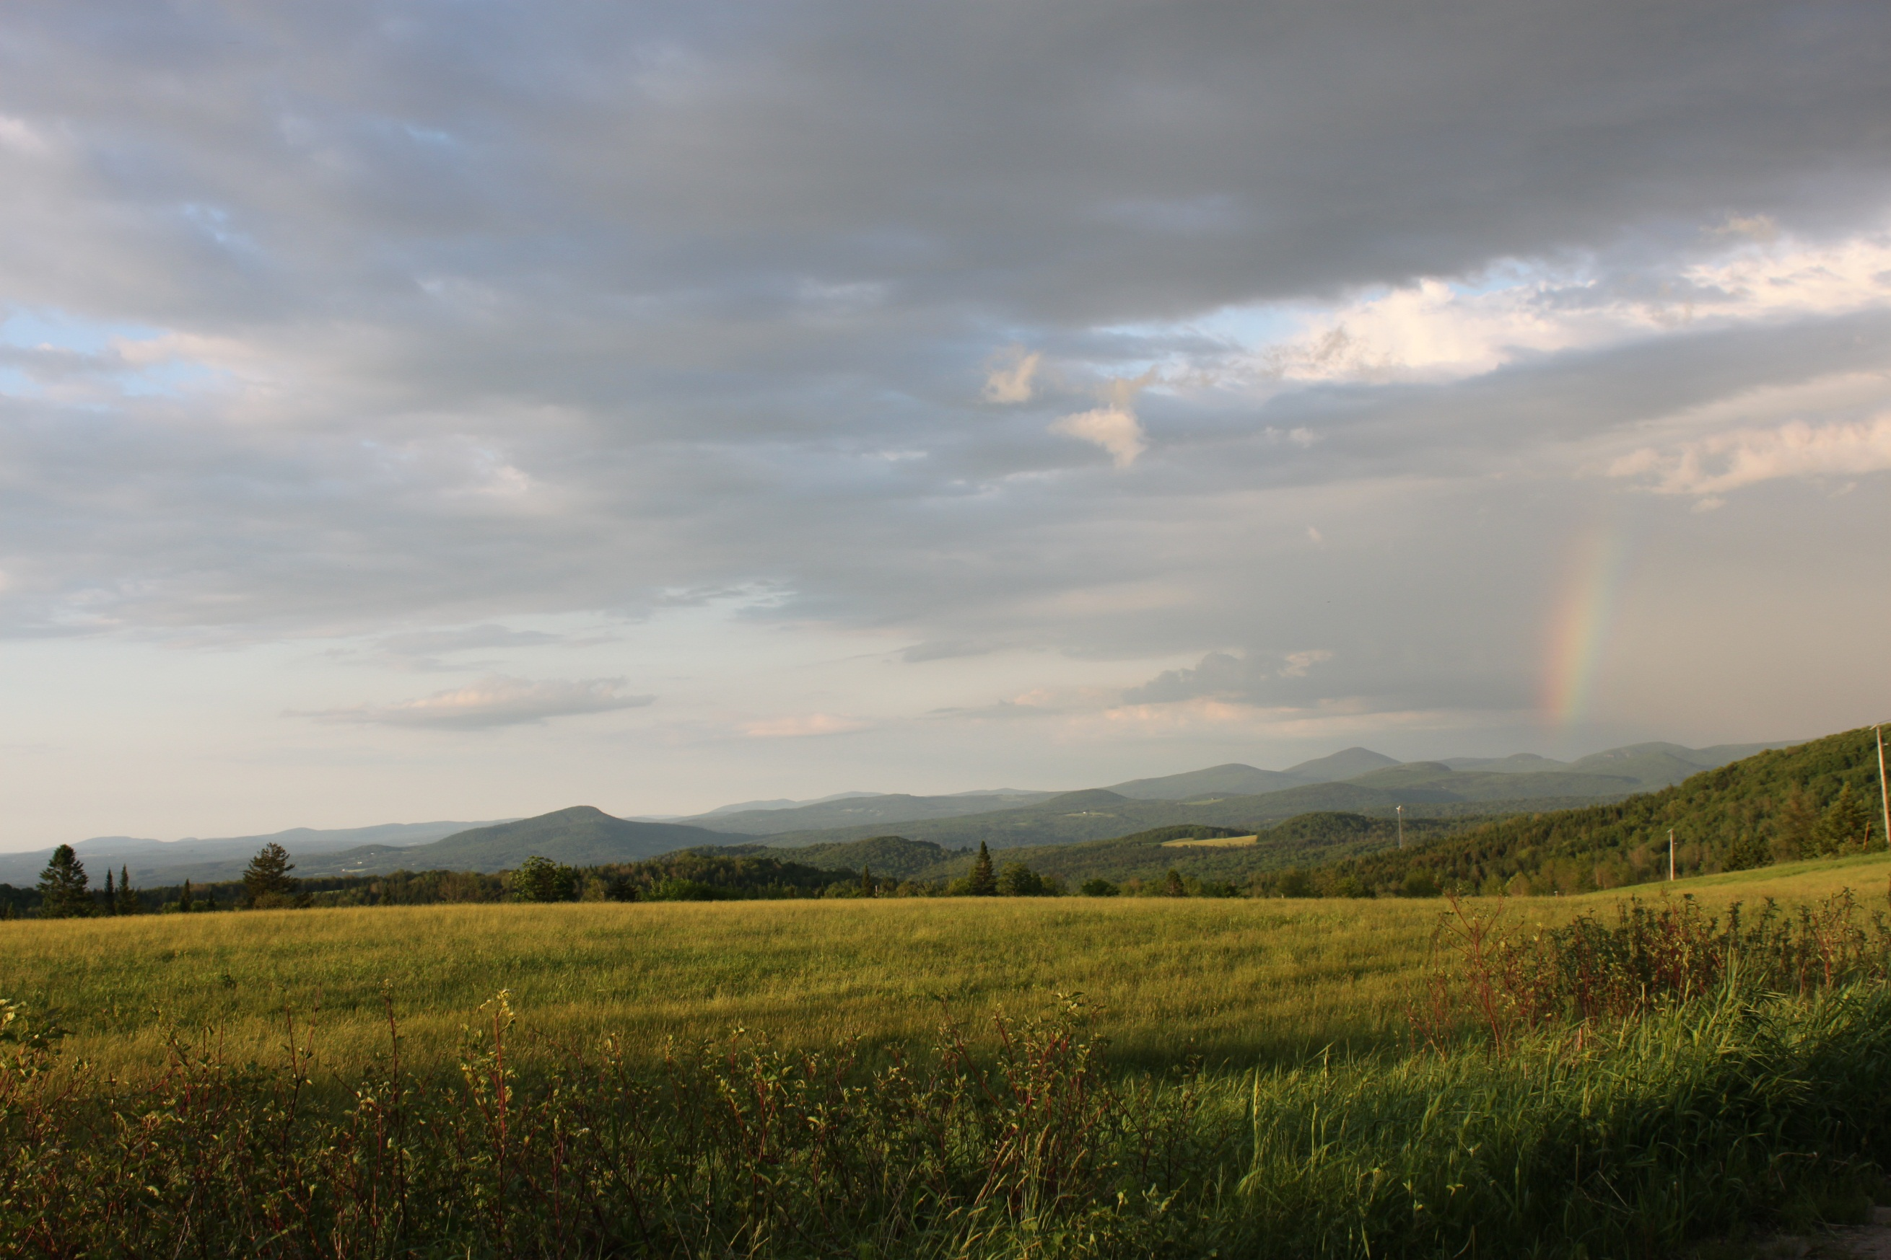
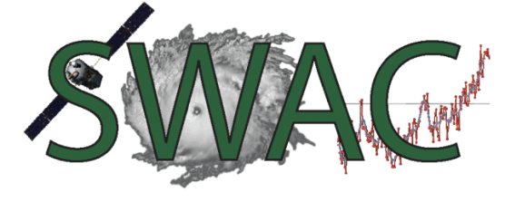
Modern Weather Prediction
Satellites, Weather, and Climate Module 23:
Dr. Jay Shafer
July 23 & 24, 2012
Lyndon State College
Jason.Shafer@lyndonstate.edu

Slide 2
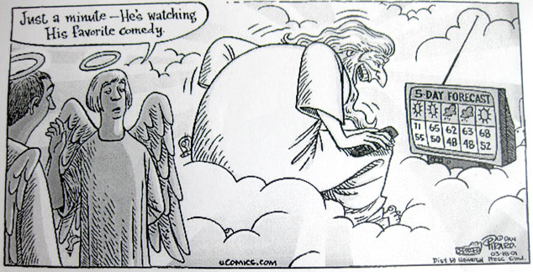

Slide 4
Verified at St. Johnsbury, VT
If the 5-day forecast was always within
5 degrees, would this be skillful?
Notes:
No trend in precipitation error – it’s hard to forecast event short term. Temperature errors trend up over time – at and beyond day 4, the forecast skill with the high and low temperature change sign, suggesting that both are becoming increasingly difficult to forecast. Note that, on average, air temperatures are within about 5 deg F, which is skillful through 5 days. The most challenging prediction problem is still precipitation in the short term (0-5 days).

Slide 5
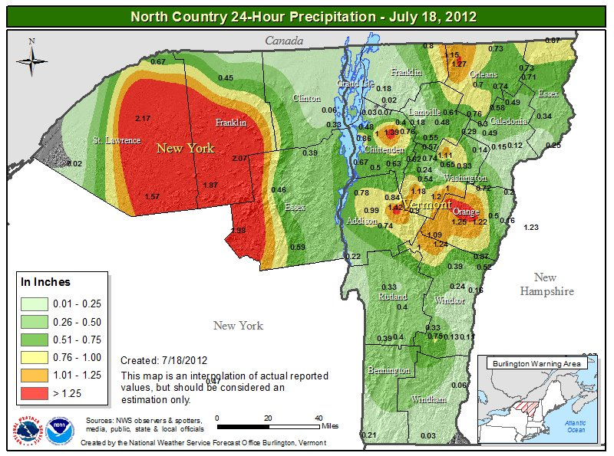
Precipitation…a trickier beast to accurately forecast…

Slide 6
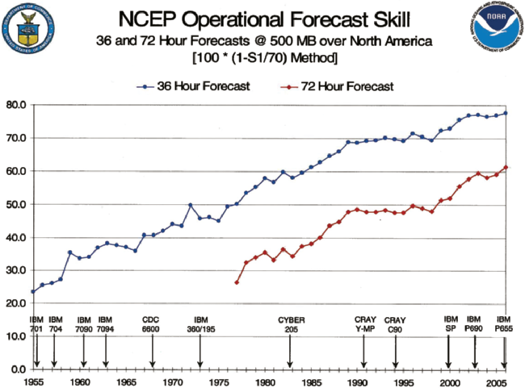
Skillful forecasts extend
out to at least 3 days
Computer power and time vs model accuracy as defined by the S1 score of 36- and 72-h NCEP 500-mb forecasts.

Slide 7
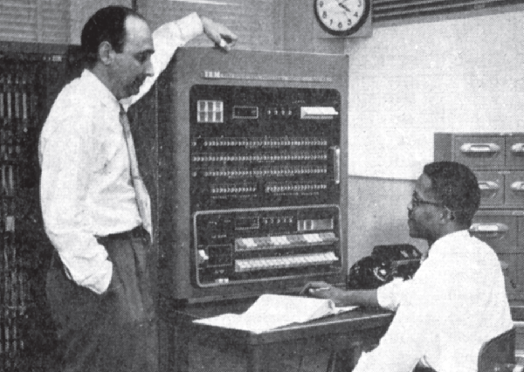
Did you want that coffee with sugar?
No thanks, but you might want to get me a book while this model runs…
Fred Shuman (left) and Otha Fuller circa 1955 at the IBM 701. The 701 was the first computer used by the JNWPU to produce operational numerical weather prediction.
Harper et al. 2007: 50th Anniversary of Operational NWP
http://journals.ametsoc.org/doi/pdf/10.1175/BAMS-88-5-639
http://www.ncep.noaa.gov/nwp50/

Slide 8
July 17 Severe Storms: Forecasts and Verification

Slide 9
Cold Frontal Position and Severe Reports

Slide 10
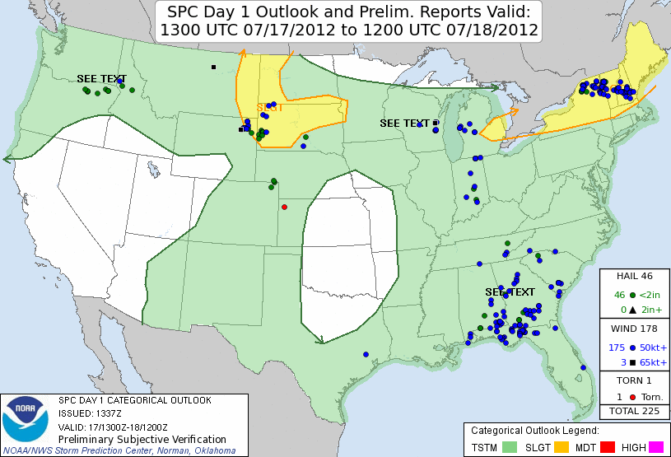
Storm Prediction Center Outlook and Verified Reports

Slide 11
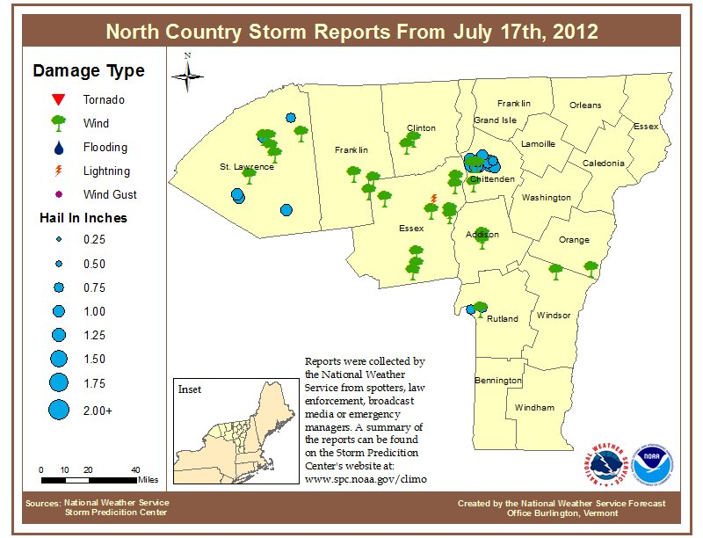

Slide 12
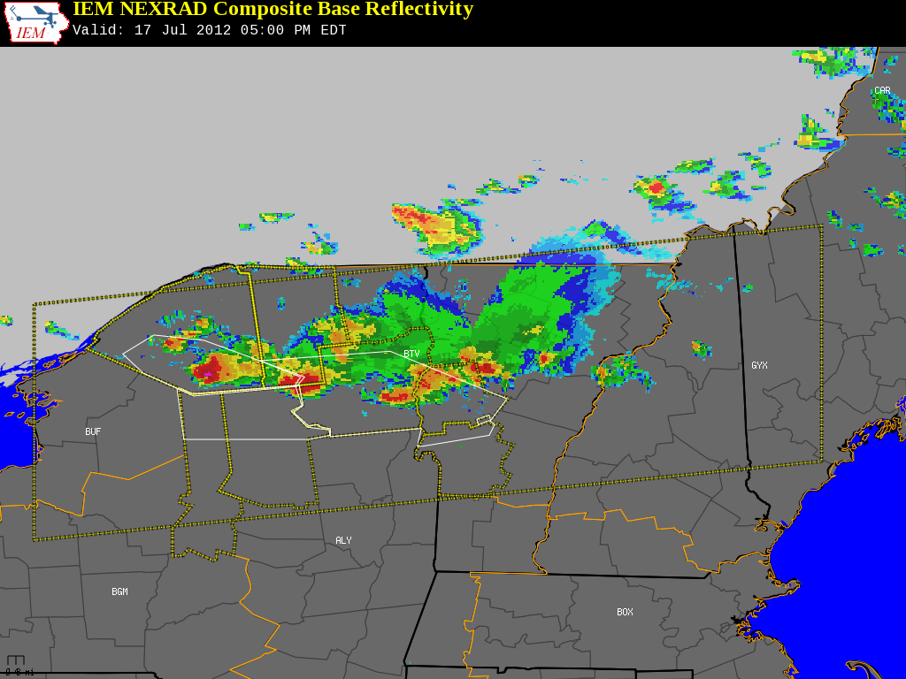
http://mesonet.agron.iastate.edu/GIS/apps/rview/warnings.phtml

Slide 14
SREF Model Forecasts
The SREF is the Short-Range Ensemble Forecast system; contains 20 members, each of which perturbs the initial state and/or model physics to run a suite of different solutions; statistical computations can then be done with solutions to enhance predictability.

Slide 15
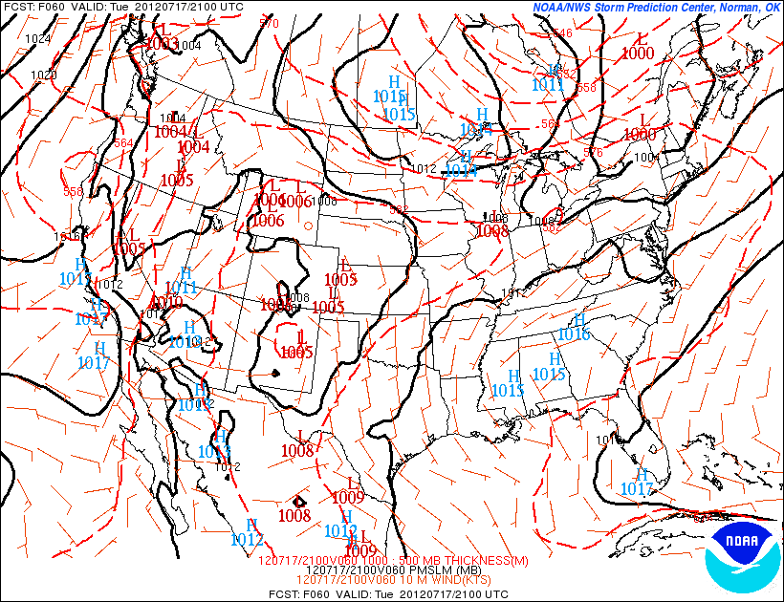
60 Hour Forecast Valid 5:00PM Tuesday July 21, 2012
Blue line denotes predicted position of cold front:
Mean sea-Level Pressure (Solid black lines, and surface wind barbs)

Slide 16
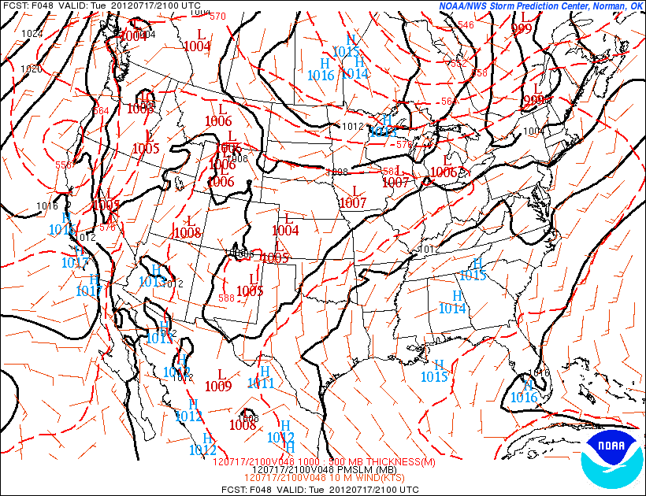
48 Hour Forecast Valid 5:00PM Tuesday July 21, 2012

Slide 17
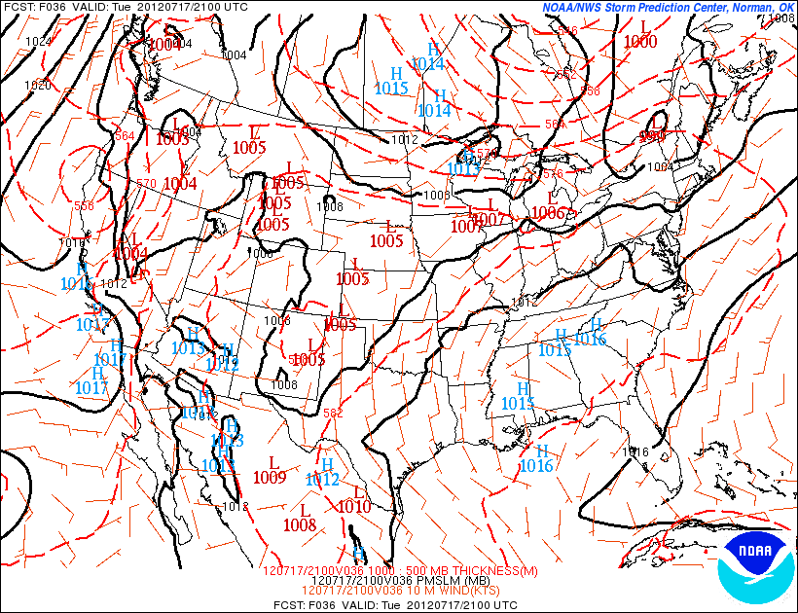
36 Hour Forecast Valid 5:00PM Tuesday July 21, 2012

Slide 18
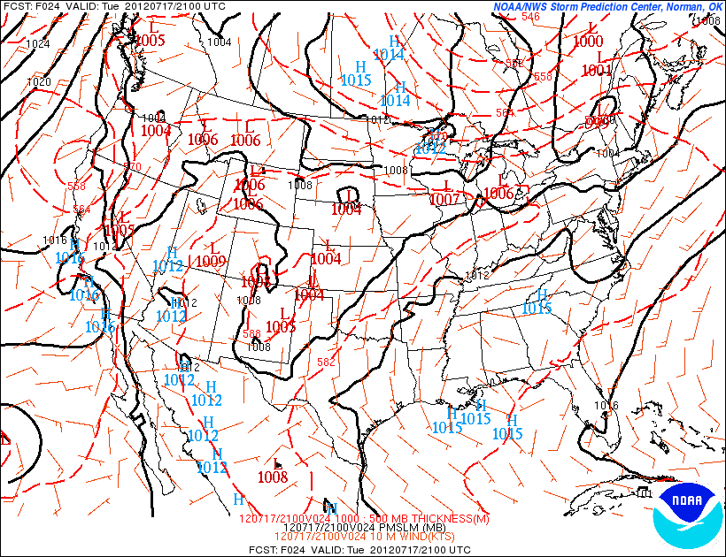
24 Hour Forecast Valid 5:00PM Tuesday July 21, 2012

Slide 19
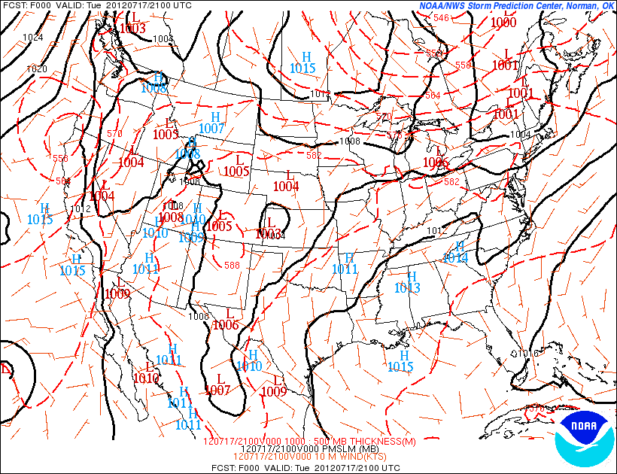
Verification at 5:00PM Tuesday July 21, 2012

Slide 20
Overlay of cold frontal predicted positions (blue)
and observed (red)
Note that the cold front position falls within
the large-scale pressure trough; a minimum in
sea-level pressure.

Slide 21
Precipitation

Slide 22
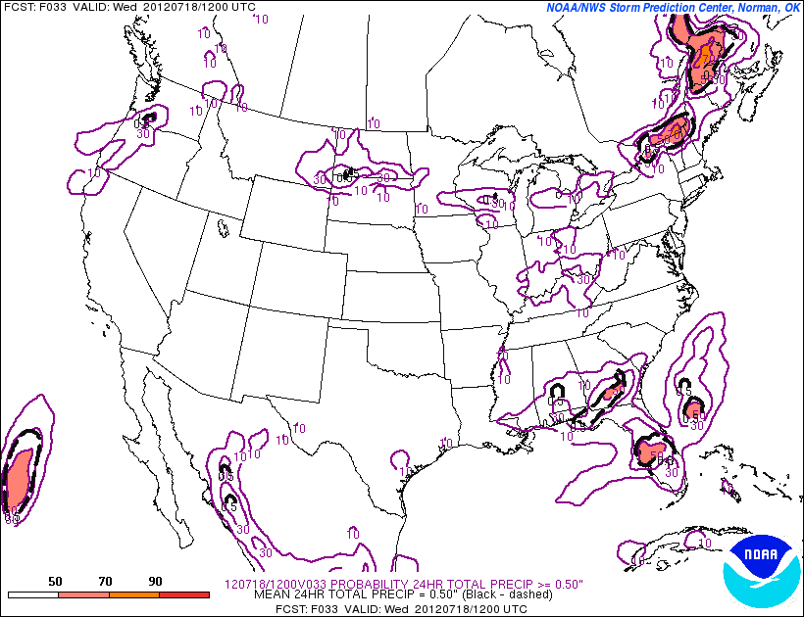
33 Hour Precipitation Probability Forecast >= 0.50”
Observed Precipitation
In many areas over 1”, there was less than
10% chance at a short lead time.
Fail! – Storms moved through faster and produced heavier rainfall
in the Adirondacks and central VT.

Slide 23
Temperature

Slide 24
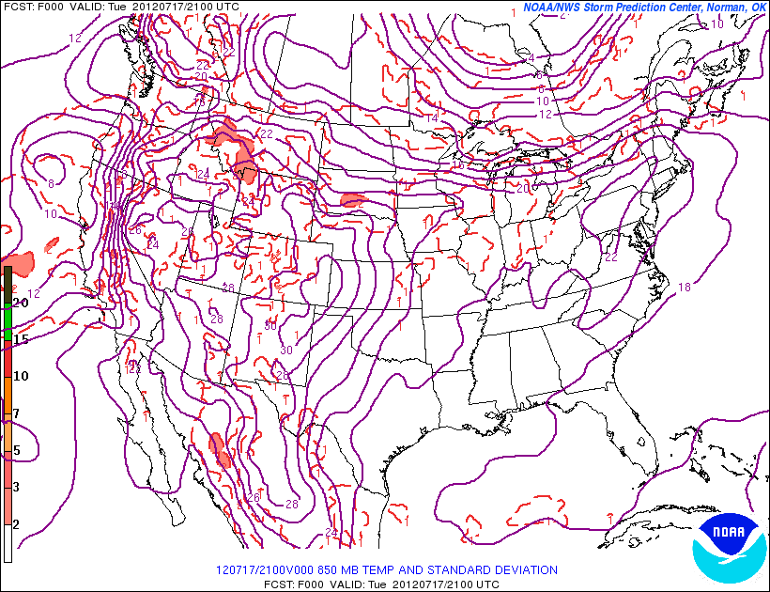
Observed 850mb Air Temperature (deg C)
850mb is approximately 5,000’ above sea-level
+20 deg C isotherm

Slide 25
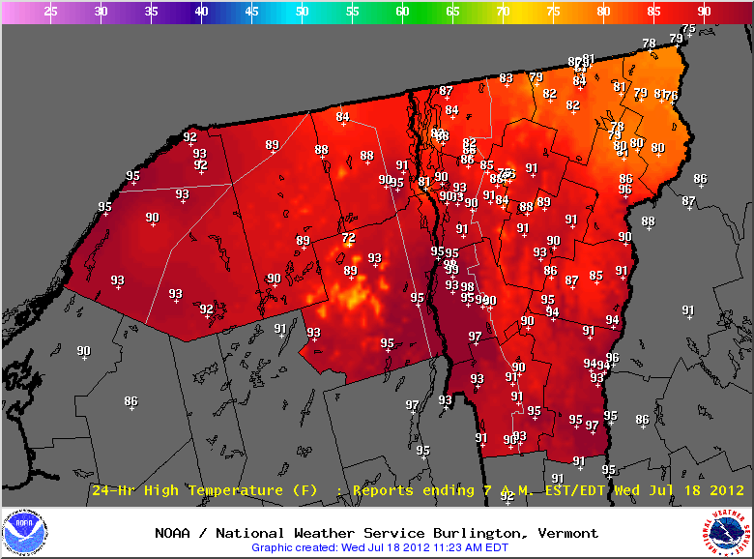
High Temperatures Tuesday July 17, 2012
+20 deg C isotherm
+20 deg C (68 F) isotherm at 850mb

Slide 26
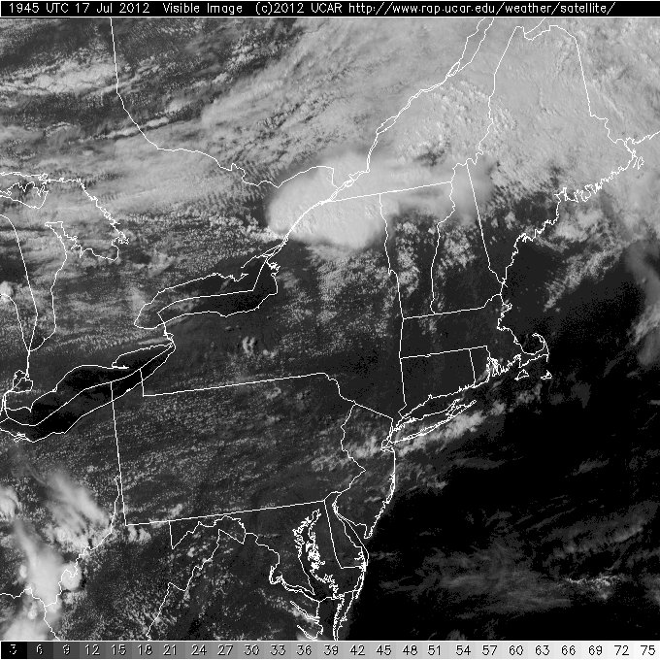
Warmer south due to sunnier conditions
http://weather.rap.ucar.edu/satellite/

Slide 27
Activity
Analyze sea-level pressure, and produce your own temperature and precipitation forecasts…

Slide 28
Analysis
Produce a hand analysis of current sea-level pressure over the northeast U.S.
Contour isobars (lines of constant sea-level pressure) every 2 mb
998, 1000, 1002, 1004, 1006, 1008, 1010, 1012, 1014, 1016, 1018, 1020, 1022, 1024…
Think about the large scale isobar pattern and where the cold front is located and the implications for the forecast
Make your own surface map: http://vortex.plymouth.edu/sfcwx-u.html

Slide 29
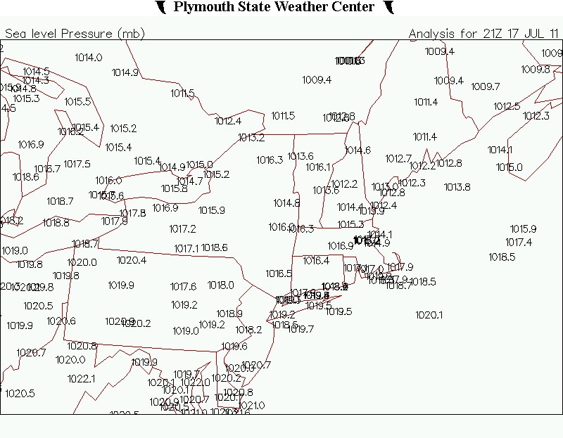
1014
1012
1012
1014
Make your own surface map: http://vortex.plymouth.edu/sfcwx-u.html
Courtesy Plymouth State University

Slide 30
Forecasting Words of advice
Atmosphere tends to stay in a similar state from one day to next more often than not, especially in summer -> implications are that a persistence forecast should be incorporated into the forecast
Persistence forecast: today’s weather will repeat tomorrow : current observations: http://meteorology.lyndonstate.edu/content/weather/data_localweather.php
Climatology method: First guess if you have no other information should be the climatology, or average high/low temperature….which is:
80 deg F: High Temperature
59 deg F: Low Temperature
Precipitation forecasting is tricky – best done probabilistically, climatology is not a good tool, recognizing the large scale pattern and understanding fundamentals that go into creating precipitation events is key….in this case we’ll try to leverage what happened on July 17
Comparing the current forecast scenario to prior events is known as an “analog” approach, which can be quite powerful if used correctly

Slide 31
Temperature Forecasting
Produce an air temperature forecast for:
Highest air temperature at Lyndon State today (deg F)
Lowest air temperature at Lyndon State tonight and Tuesday AM (deg F)
Use only the information provided herein – please don’t use your smartphone or the web

Slide 32
Temperature Forecasting
Summer Rules of thumb (assuming little change in air mass through day):
High Temperature at Lyndon State:
Clear skies: Add 12 to 16 deg C (21 to 29 deg F) to 850mb temperature
Cloudy (opaque) skies: Add 5 to 8 deg C (9 to 15 deg F) to 850mb temperature
Widespread soaking rainfall: Similar to air temperature at 850mb
Showery rainfall/mixed cloud cover: Add 6 to 10 deg C (10 to 18 deg F) to 850mb temperature
Low Temperature:
Principal control is degree of outgoing longwave radiation, which is affected principally by the amount of water (liquid and/or vapor) in the atmosphere
Clear skies: will generally be within a few degrees of the prior evening’s dewpoint temperature; you can find the current dewpoint temperature and prior 24 hrs at: http://meteorology.lyndonstate.edu/content/weather/data_localweather.php
Cloudy skies: may only drop 5-10 degrees from the daytime high temperature

Slide 33
Avg Hi SD: 8.4
Avg Lo SD: 8.7
Aug 3: 5.2
Greater variability with
low temperature annually.
Aug 16: 5.1
Jan 2: 14.2
Average High: Red
Average Low: Blue
One sigma from Means: Orange, Purple
Jan 1: 15.1

Slide 34
850mb Temperature forecast: 5:00PM July 23, 2012
+18 deg C
+15 deg C
+18 deg C
+15 deg C
NAM Model Forecast
GFS Model Forecast
Images courtesy NOAA: http://mag.ncep.noaa.gov/NCOMAGWEB/appcontroller

Slide 35
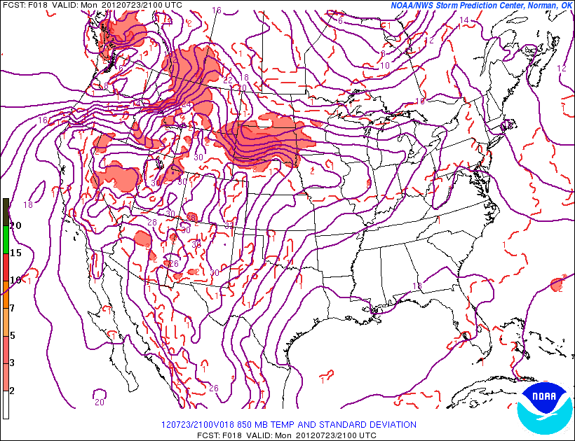
850mb Temperature forecast: 5:00PM July 23, 2012
+16 deg C
http://www.spc.noaa.gov/exper/sref/
SREF Model Forecast: Mean 850mb Temperature
http://www.spc.noaa.gov/exper/sref/

Slide 36
Precipitation Forecasting
Produce a precipitation forecast at Lyndon for:
Probability (from 0 to 100%) of measurable precipitation through 2:00PM Tuesday
Amount of precipitation (hundredths of an inch) of precipitation now through 2:00PM Tuesday

Slide 37
Precipitation Forecasting
Rules of thumb:
Ingredients-based approach is best, thinking about:
Moisture availability (Has it been dry or wet?)
Lift (Is there a large-scale weather system approaching?)
Instability – How much potential or instability is present for deep updrafts/storms?
Summer rainfall tends to be scattered and showery, and not widespread, implication -> go lower on probabilities

Slide 38
Average Annual Precipitation and Terrain
Jay Peak 63”
Newport 41”
East Albany 52”
Island Pond 43”
Mt. Mansfield 79”
Burlington 36”
St. Johnsbury 39”
Montpelier 40”
Mt. Washington 102”

Slide 39
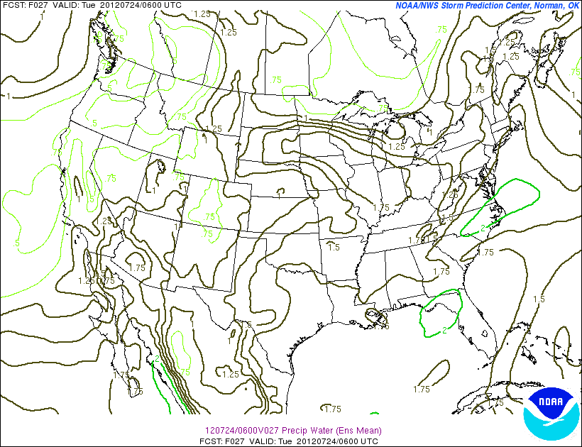
SREF Moisture: Precipitable Water: 2AM Tues July 24
Moisture Plume or
Atmospheric River: 1.5 to 1.75”
http://www.spc.noaa.gov/exper/sref/

Slide 40
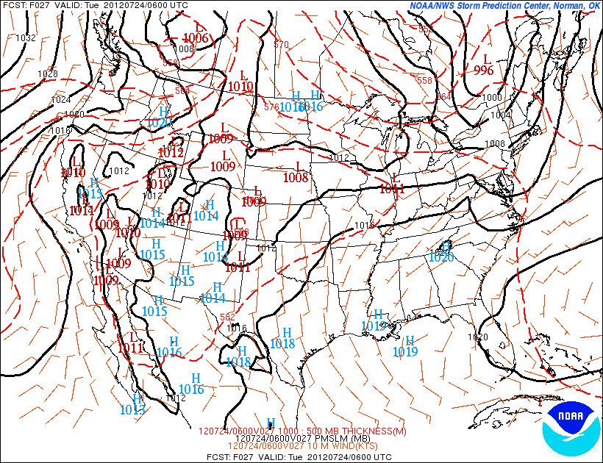
Lift: SREF Sea-Level Pressure forecast: 2AM Tuesday July 24
Trough axis with cold front: can expect decent lift
along and ahead of this feature.
http://www.spc.noaa.gov/exper/sref/

Slide 41
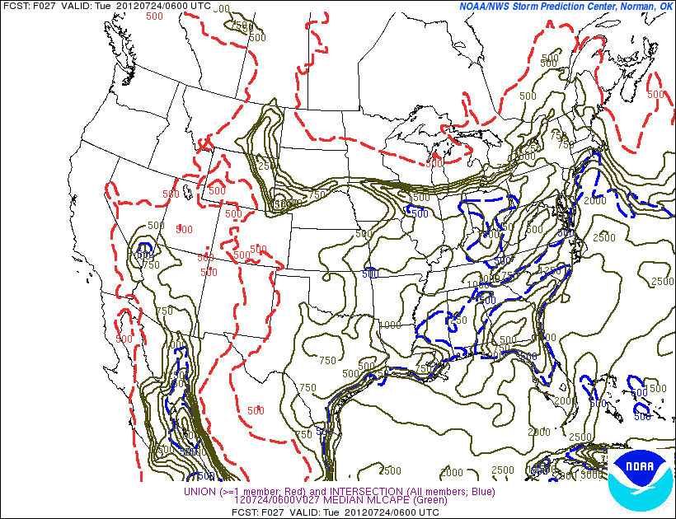
Instability: SREF CAPE 2AM July 24
CAPE 500 to 1000 J/Kg, a moderate
amount for overnight…
http://www.spc.noaa.gov/exper/sref/

Slide 42
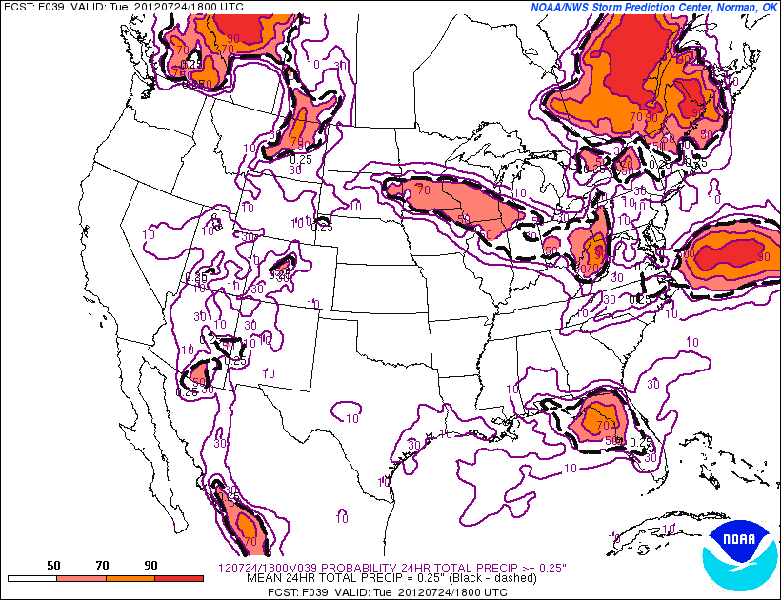
SREF Precip Probability of 24-hr precip >= 0.25” ending 2PM Tues July 24
http://www.spc.noaa.gov/exper/sref/

Slide 43
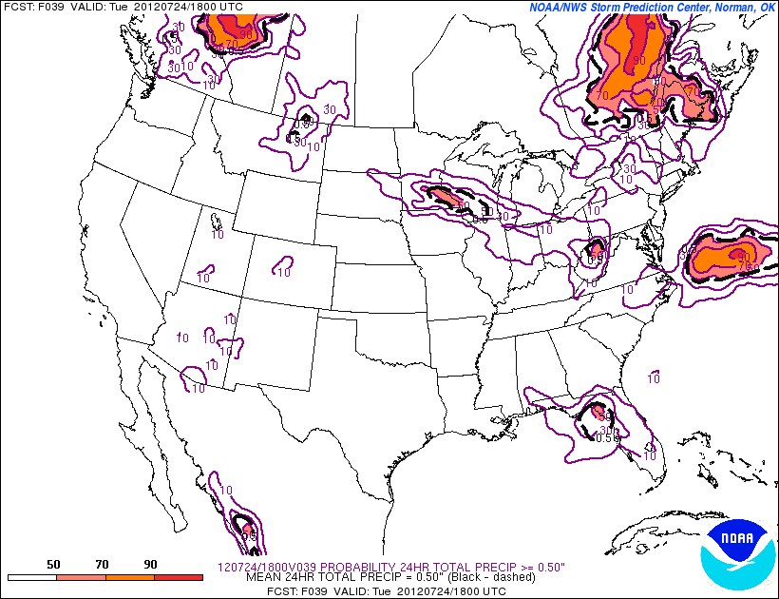
SREF Precip Probability of 24-hr precip >= 0.25” ending 2PM Tues July 24
http://www.spc.noaa.gov/exper/sref/

Slide 44
“Modern Weather Prediction, Part I” Yes, it's true...when meteorologists err, they still keep their job. Forecast errors, however, have declined notably with advances in technology and our increased understanding of the atmosphere. In fact, some predictive techniques show skill two to three weeks ahead. This module will present information on how modern meteorologists interpret weather forecasting models and observations to construct weather forecasts. Participants will make their own short-term (1 day) forecasts in a forecast contest framework, after producing their own analysis by hand, and interpreting weather forecast models. How one may implement a weather forecast contest and its scientific process into the classroom will be discussed.

