Slide 1
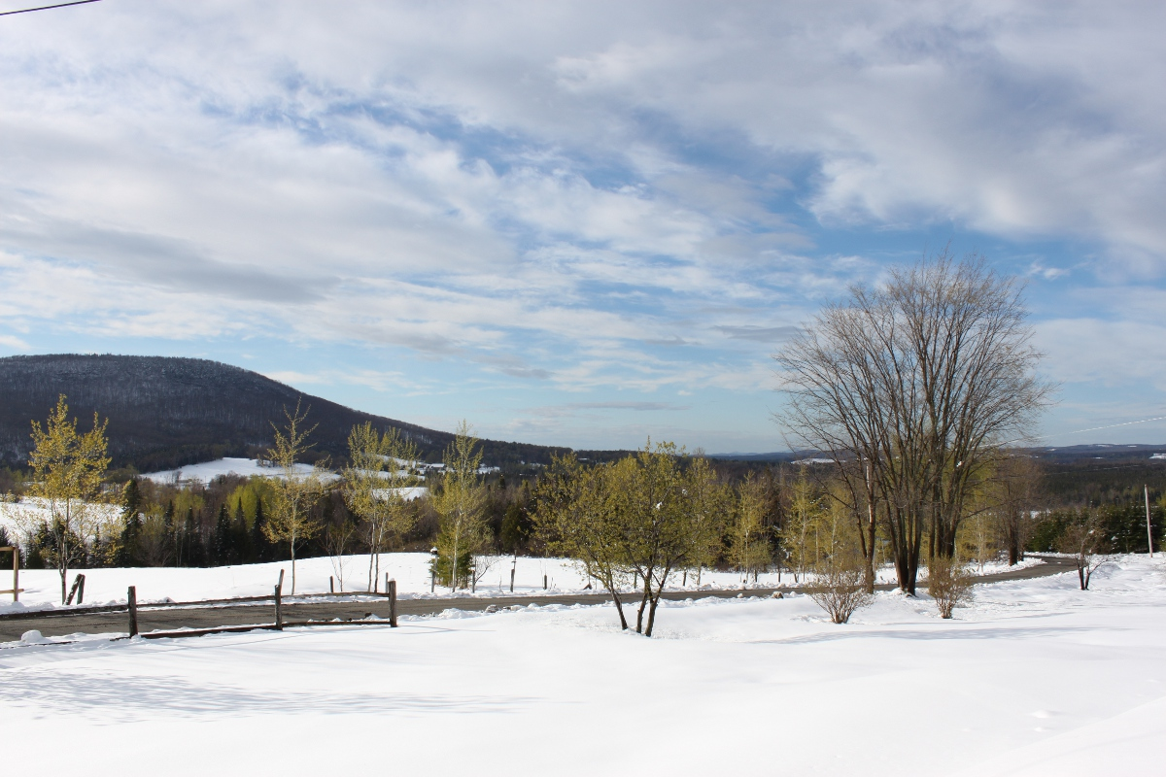
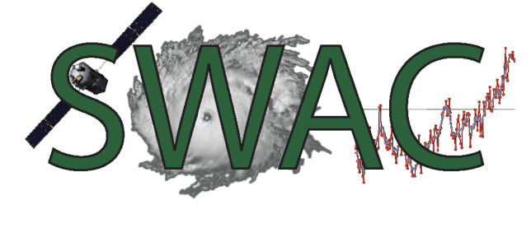



Where’s Winter?
Explaining Seasonal Weather Variability
Satellites, Weather, and Climate Module 20:
Dr. Jay Shafer
Mar 15, 2012
Lyndon State College

Slide 2
Outline
Winter 2012 Rankings
Possible Culprits
  AO (Arctic Oscillation)
  ENSO (El Nino Southern Oscillation)
Climate Change Considerations

Slide 3
Winter 2011-2012 Stats

Slide 4
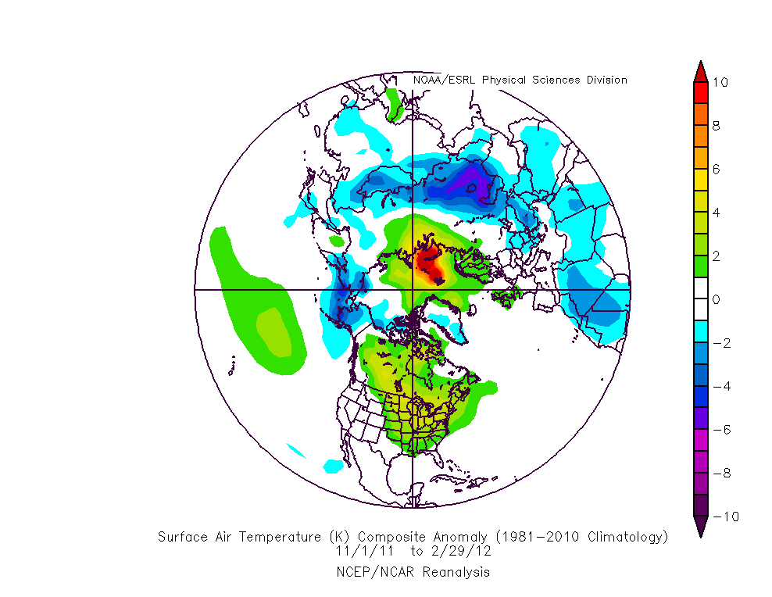
Temperature Anomaly: November to February 2012
Persistent warm over critical
cold air source regions
Units: Degrees Celsius

Slide 5
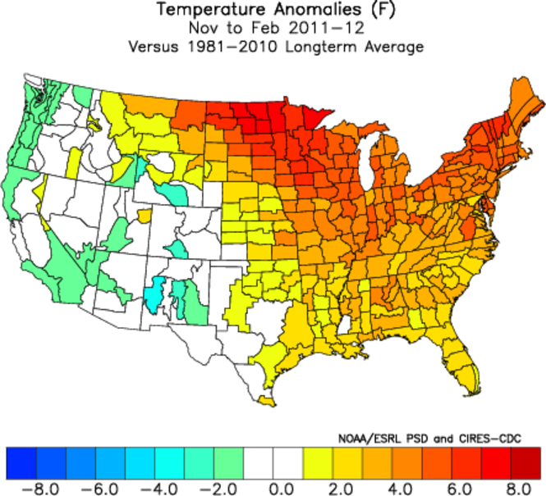

Slide 6
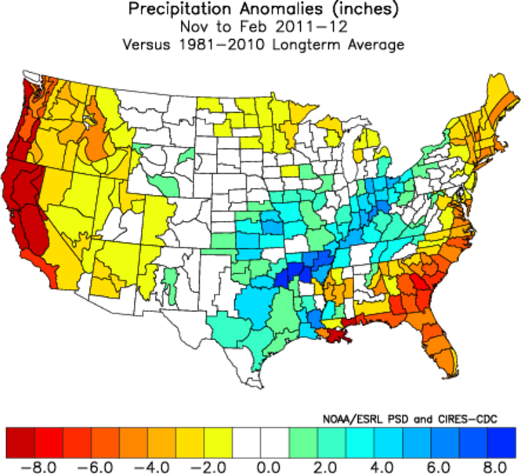
Relatively dry

Slide 7
Snowfall Ranks
Mt. Mansfield Oct 1 – Mar 12 Snowfall
Burlington Oct 1 – Mar 12 Snowfall
1 | 99.4 | 1964-1965
2 | 105.5 | 1958-1959
3 | 108.9 | 1955-1956
4 | 111.4 | 1982-1983
5 | 115.3 | 1956-1957
6 | 118.4 | 1961-1962
7 | 118.6 | 2011-2012
8 | 122.1 | 1960-1961
9 | 128.4 | 1986-1987
10 | 128.7 | 1979-1980
1 | 28.4 | 1979-1980
2 | 30.5 | 1988-1989
3 | 37.7 | 2011-2012
4 | 40.1 | 1990-1991
5 | 40.4 | 1948-1949
6 | 40.7 | 1960-1961
7 | 41.3 | 1964-1965
8 | 42.4 | 2001-2002
9 | 42.9 | 1950-1951
10 | 47.6 | 1944-1945
Records back to 1954
Records back to 1943

Slide 8
Temperature Ranks:
Average Mean Temperature Nov 1- Mar 12
Montpelier
Burlington
St. Johnsbury
1 | 29.2 | 2001-2002
2 | 28.4 | 2011-2012
3 | 28.1 | 1948-1949
4 | 27.9 | 2009-2010
5 | 27.4 | 1982-1983
6 | 27.0 | 1974-1975
7 | 26.9 | 1973-1974
8 | 26.6 | 2005-2006
9 | 26.6 | 1994-1995
10 | 26.3 | 1953-1954
1 | 32.4 | 2001-2002
2 | 31.9 | 2011-2012
3 | 30.1 | 1948-1949
4 | 29.9 | 1982-1983
5 | 29.4 | 2009-2010
6 | 29.0 | 2005-2006
7 | 28.9 | 1994-1995
8 | 28.9 | 1990-1991
9 | 28.5 | 1953-1954
10 | 28.5 | 1952-1953
1 | 30.6 | 2001-2002
2 | 29.9 | 1948-1949
3 | 29.2 | 1982-1983
4 | 28.4 | 1931-1932
5 | 28.3 | 2009-2010
6 | 28.2 | 1950-1951
7 | 27.7 | 2011-2012
8 | 27.7 | 1932-1933
9 | 27.6 | 1997-1998
10 | 27.6 | 2005-2006
Records back to 1948
Records back to 1940
Records back to 1894

Slide 9
Seasonal Variability
Largest one year
difference
Burlington, VT, Seasonal Snowfall Nov 1– Mar 14
How can one explain year-to-year variations?

Slide 10
Arctic Oscillation

Slide 11
Arctic Oscillation
Describes high latitude pressure pattern oscillations (atmospheric oscillation)
Derived from principal pattern of variability in low tropospheric (low level) atmospheric pressure patterns
Most influential during winter season
Can help to lock in long-lived (weeks to months) patterns that influence seasonal conditions
Predictable one to two weeks ahead

Slide 12
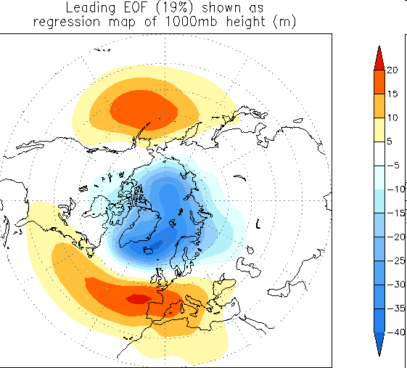
Anomaly pattern associated with Arctic Oscillation (AO)
Positive Arctic Oscillation State
Lower heights and
colder temperatures
Higher heights and
warmer temperature
Source: http://www.cpc.ncep.noaa.gov/products/precip/CWlink/daily_ao_index/loading.html

Slide 13
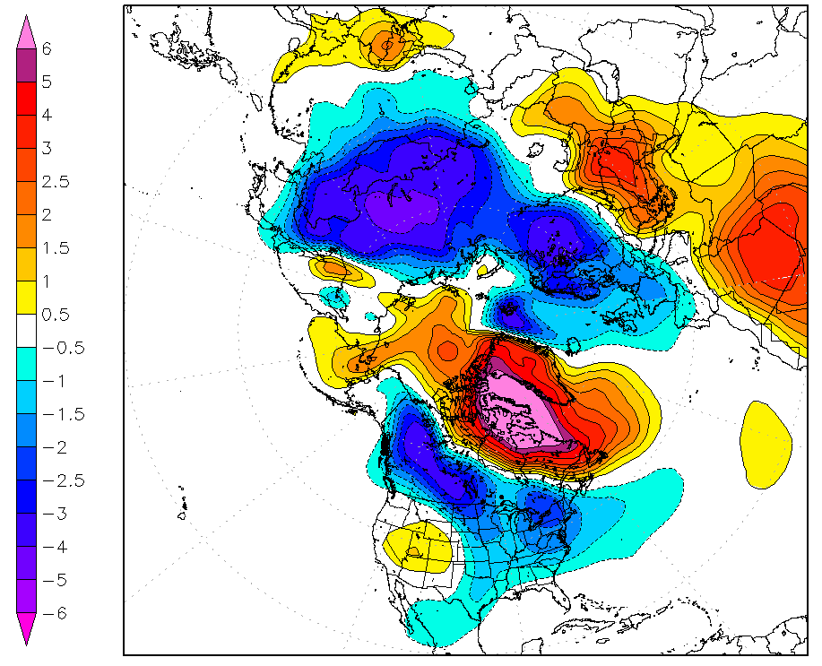
Surface Temperature Anomaly (Deg C)
+5 to +10 days after (–) AO transitions
Increased cold risk
Notes:
Eastern side of Rockies... Eastern U.S.

Slide 14
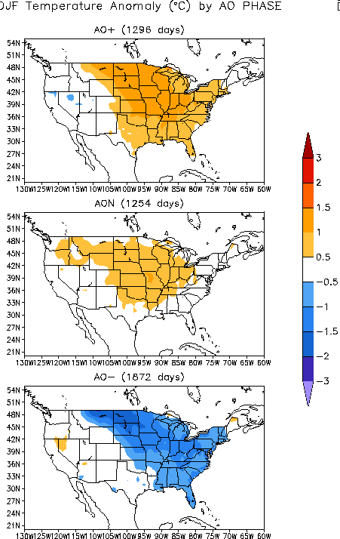
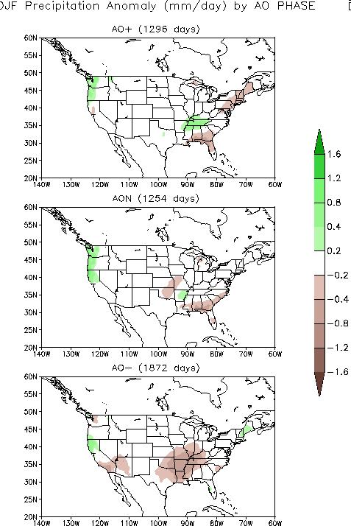
AO Negative Phase Conditions
Colder temperatures
Slightly wetter
Source: http://www.cpc.noaa.gov/research_papers/ncep_cpc_atlas/8/table_ao.html

Slide 15
AO Positive Phase Conditions
Warmer temperatures
Drier
Source: http://www.cpc.noaa.gov/research_papers/ncep_cpc_atlas/8/table_ao.html

Slide 16
AO Year-to-Year Variability
Blue: Winter 2011-12
Red: Winter 2010-11

Slide 17
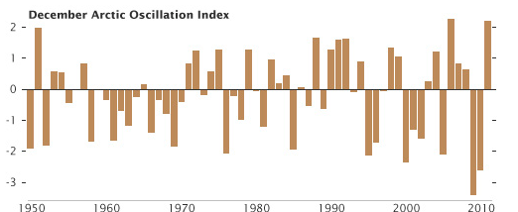
What causes the AO to be positive one December and negative another?
We don’t fully understand – it’s very complex!
NASA: http://earthobservatory.nasa.gov/IOTD/view.php?id=77076&src=eoa-iotd

Slide 18
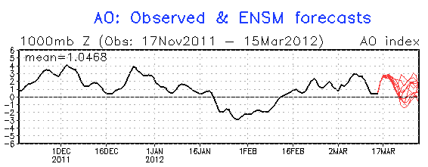
Observed AO (solid line) and Forecasts (Red lines)
http://www.cpc.ncep.noaa.gov/products/precip/CWlink/daily_ao_index/ao_index_ensm.shtml

Slide 19
ENSO

Slide 20
EL Nino – Southern Oscillation
Oceanic oscillation of equatorial sea surface temperatures (SST) in Pacific Ocean
Southern Oscillation: refers to atmospheric response to oceanic fluxes of heat and moisture (oceans lead the atmosphere)
Largest and most significant oscillation of SSTs in the world
Has significant impacts on global circulation

Slide 21
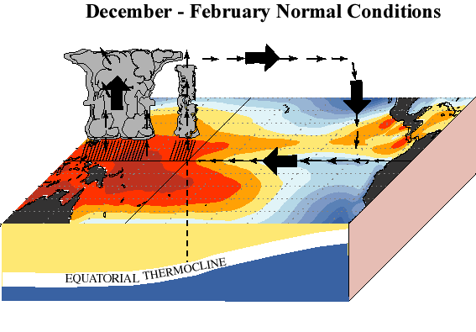
Source: http://www.cpc.ncep.noaa.gov/products/analysis_monitoring/ensocycle/enso_cycle.shtml

Slide 22
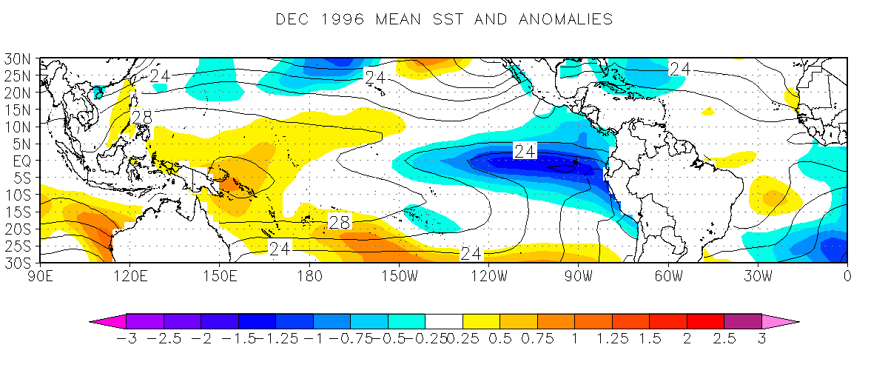
Example La Nina (cold phase) Conditions
Nino 3 Region
Nino 4 Region
Nino 1.2 Region
Temperature Anomaly (Degrees Celsius)

Slide 23
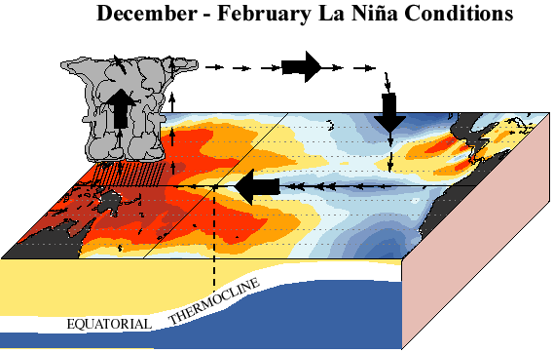
Source: http://www.cpc.ncep.noaa.gov/products/analysis_monitoring/ensocycle/enso_cycle.shtml

Slide 24
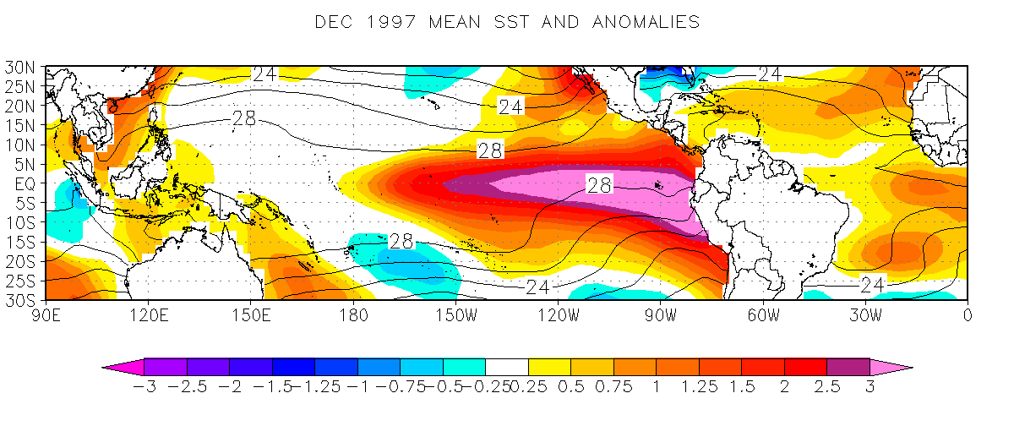
Example El Nino (warm phase) Conditions
Temperature Anomaly (Degrees Celsius)

Slide 25
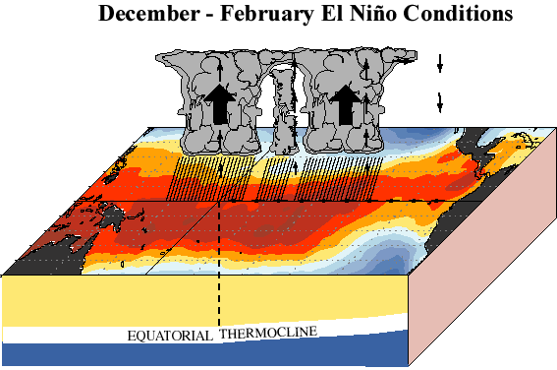
Source: http://www.cpc.ncep.noaa.gov/products/analysis_monitoring/ensocycle/enso_cycle.shtml

Slide 26
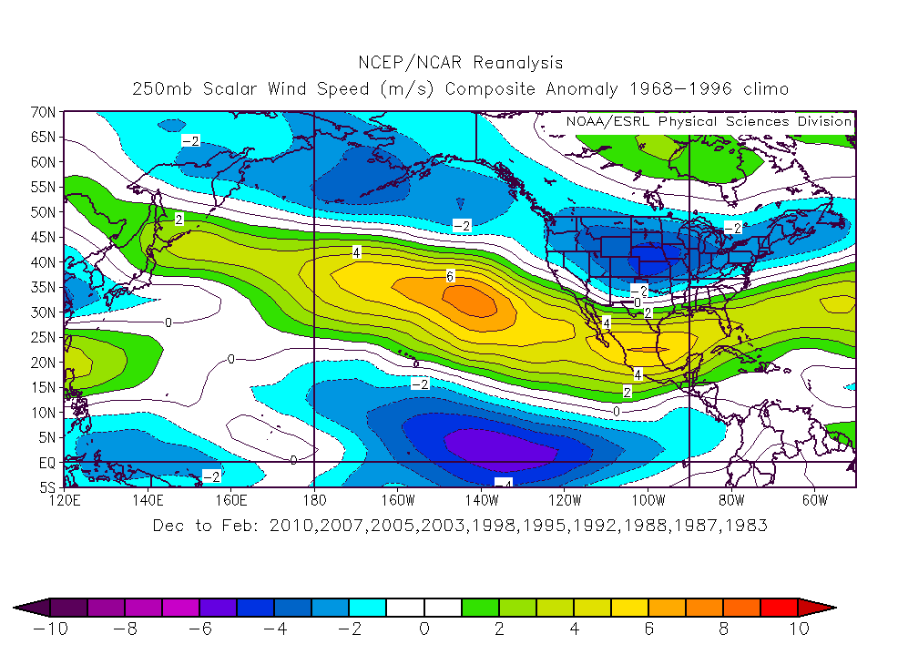
El Nino Winter Jet Stream Wind Anomaly
Top 10 El Niños since 1973
Stronger Jet
Weaker Jet
Units: m s⁻¹

Slide 27
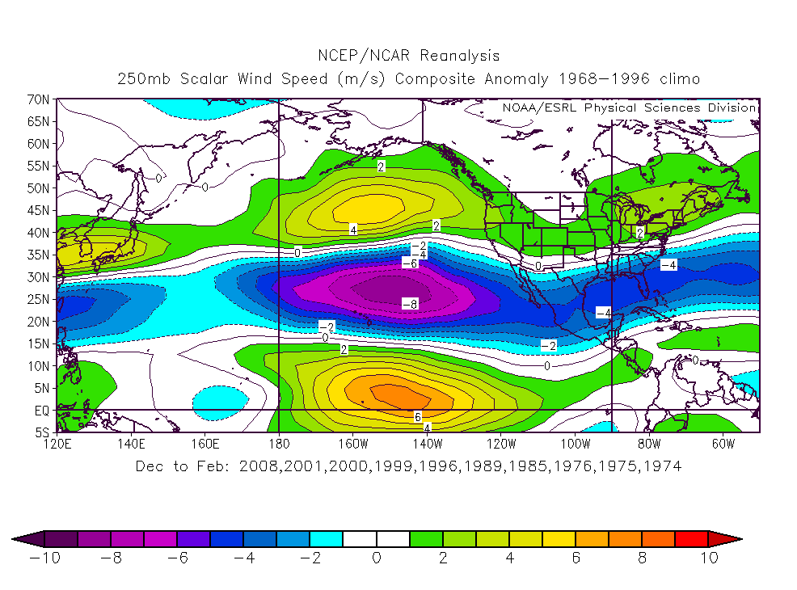
La Nina Winter Jet Stream Wind Anomaly
Top 10 La Niñas since 1970-2010
Weaker Jet
Stronger Jet
Units: m s⁻¹

Slide 28
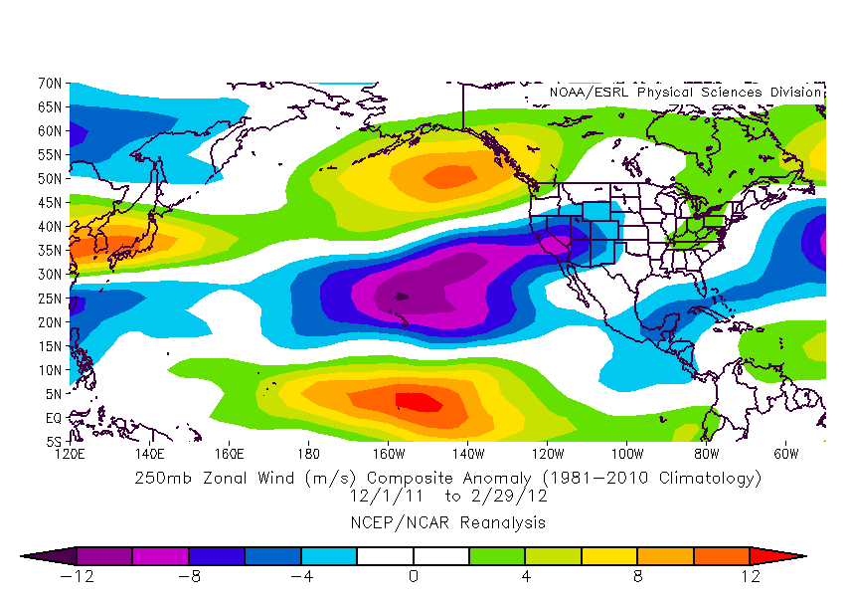
Winter 2011-12 Jet Stream Speed Anomaly
Typical La Nina pattern, but note strong jet in Pac NW
Units: m s⁻¹

Slide 29
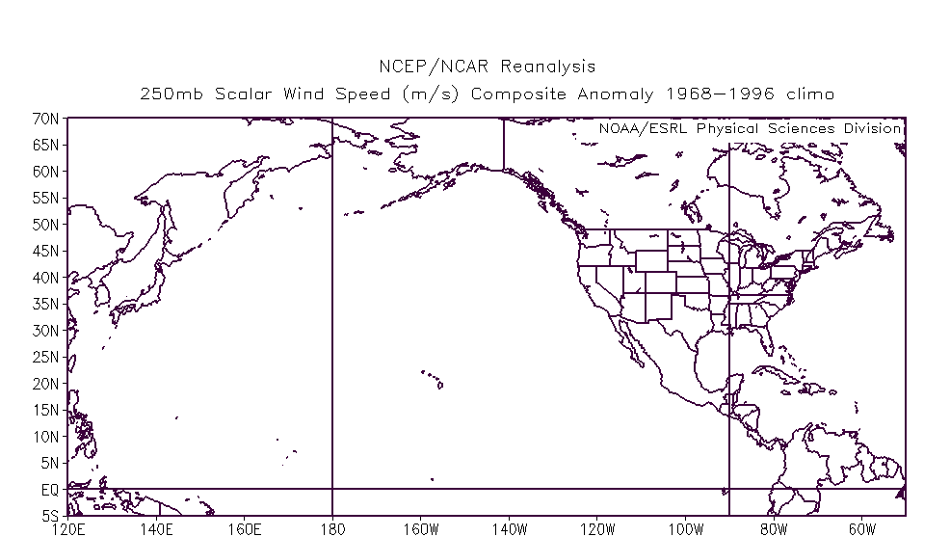
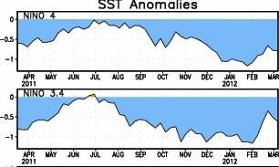
Winter Mean Jet Stream Positions
Red: Strong El Nino: Blue Strong La Nina
Green: Winter 2011-12
La Nina this winter.

Slide 30
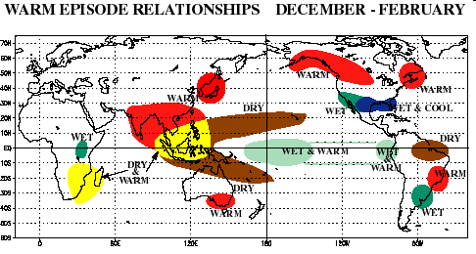
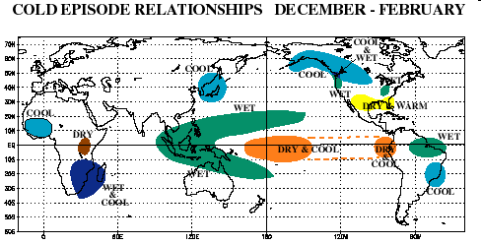
El Nino:
La Nina:
Source: NOAA - http://www.cpc.noaa.gov/products/analysis_monitoring/ensostuff/ensofaq.shtml#GLOBALimpacts

Slide 31
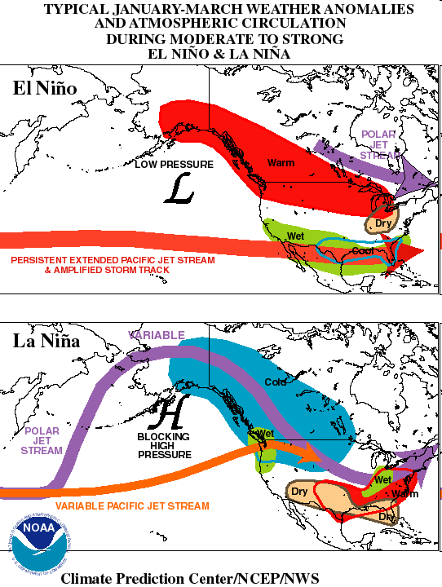

Slide 32
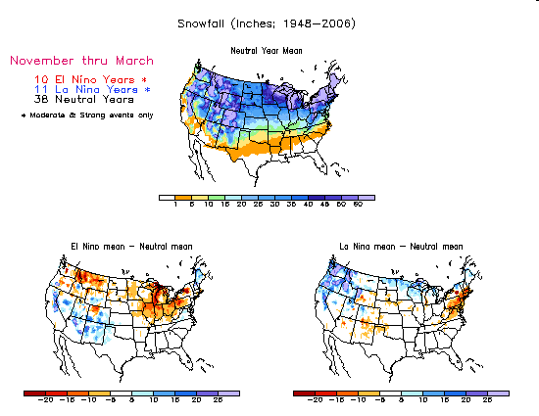
Winter Snowfall Anomalies: La Nina Conditions
Above average
Below average
NOAA: http://www.cpc.noaa.gov/products/analysis_monitoring/lanina/us_impacts/ustp_impacts.shtml#NVC

Slide 33
Winter Snowfall Anomalies: El Nino Conditions
Below average
Above average
NOAA: http://www.cpc.noaa.gov/products/analysis_monitoring/lanina/us_impacts/ustp_impacts.shtml#NVC

Slide 34
Climate Change Signals

Slide 35
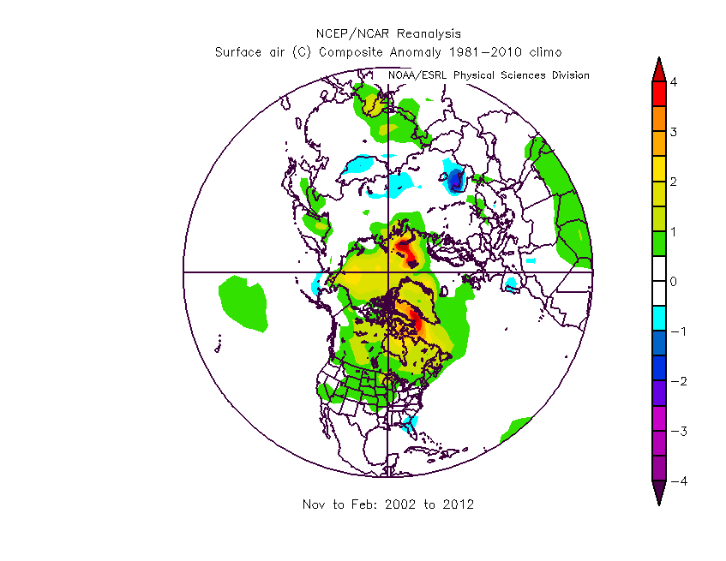
Winter Air Temperature Anomalies Last 10 Years
Warming is occurring rapidly at
high latitudes.

Slide 36
St. Johnsbury, VT, Average Temperature Nov 1 – Mar 14

Slide 37
Burlington, VT, Average Temperature Nov 1– Mar 14

Slide 38
Mt. Mansfield, VT, Seasonal Snowfall Nov 1– Mar 14

Slide 39
Burlington, VT, Seasonal Snowfall Nov 1– Mar 14

Slide 40
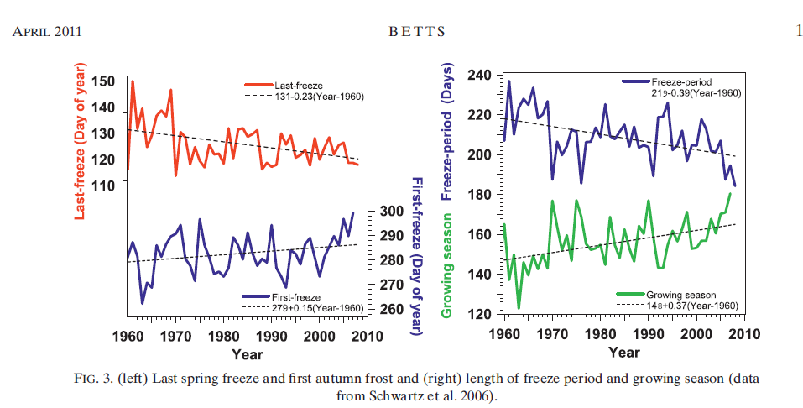
Betts 2011
http://journals.ametsoc.org/doi/full/10.1175/2011WCAS1096.1?prevSearch=[Contrib%3A+alan+betts]&searchHistoryKey=

Slide 41
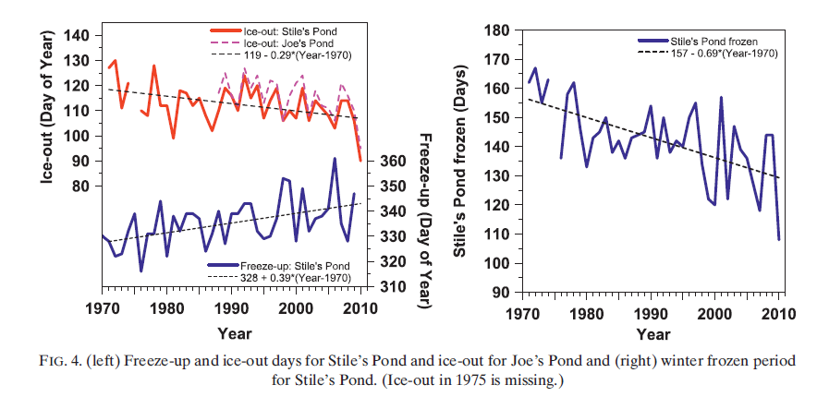
Betts 2011

Slide 42
Activity

Slide 43
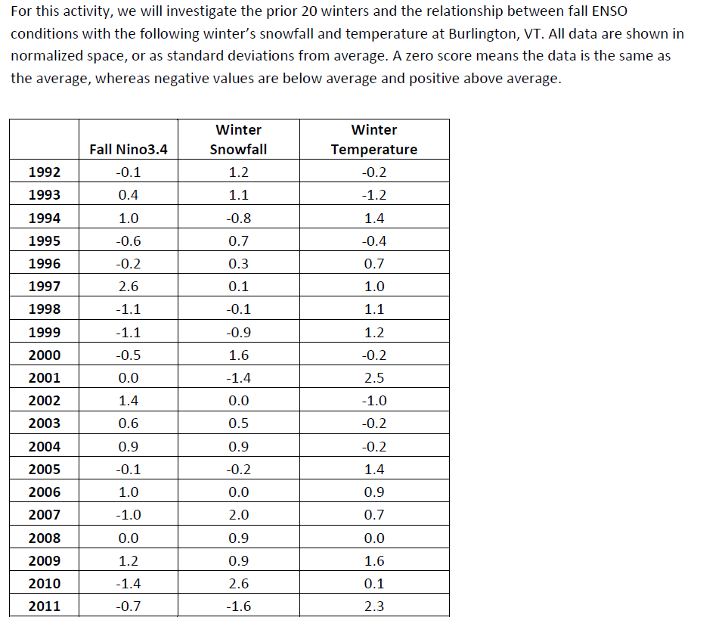

Slide 44
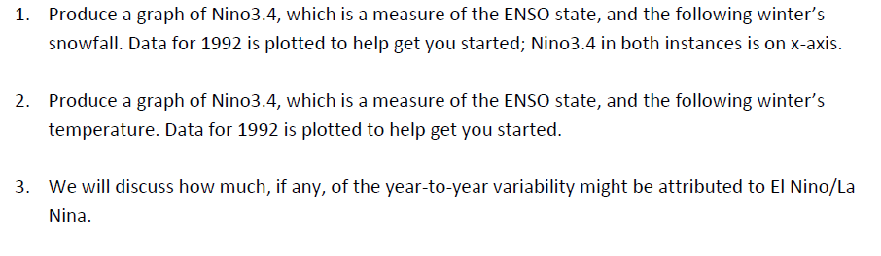
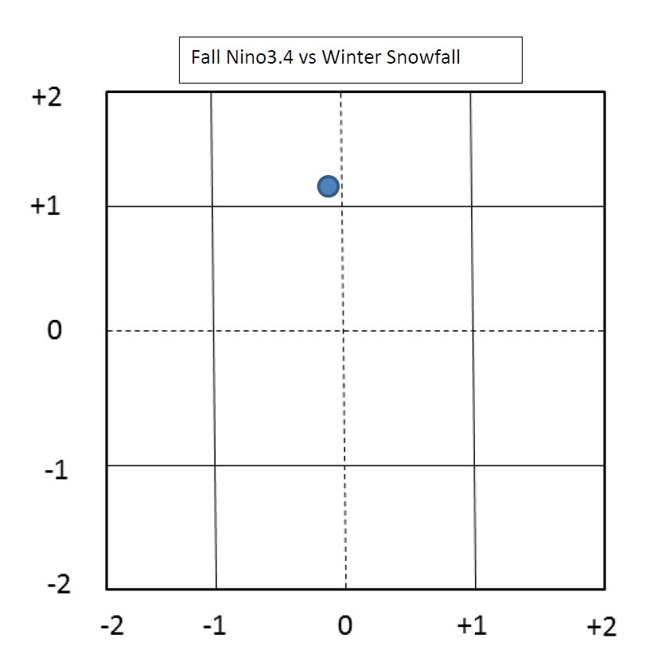

Slide 45
Nino3.4 vs Burlington Winter Snowfall
La Ninas
El Ninos
4: Above
2: Below
3: Above
1: Below

Slide 46
Nino3.4 vs Burlington Winter Snowfall
La Nina
+ Snow
N=6
El Nino
+ Snow
N=6
La Nina
- Snow
N=5
El Nino
- Snow
N=3

Slide 47
Nino3.4 vs. Burlington Winter Temperatures
La Ninas
El Ninos
4: Above
3: Below
5: Above
2: Below

Slide 48
Nino3.4 vs. Burlington Winter Temperatures
La Nina
Warm
N=7
El Nino
Warm
N=6
La Nina
Cold
N=3
El Nino
Cold
N=4

Slide 49
ENSO Conclusions
A lot of spread, ENSO does not explain much of the variability
Other factors must be at play, complex interactions of tropics and high latitudes
Slight tendency for snowier winters to be associated with La Ninas (top 3 winters were La Nina winters), however this year is an exception

Slide 50
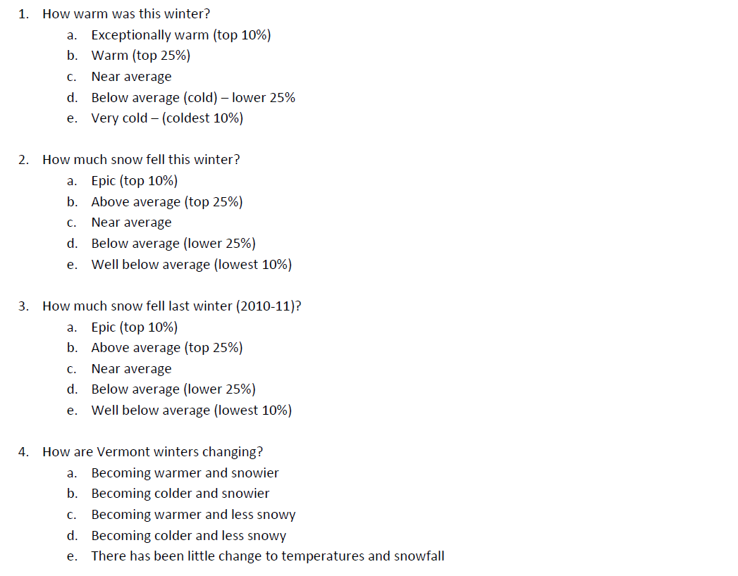
Post Assessment Questions

Slide 51
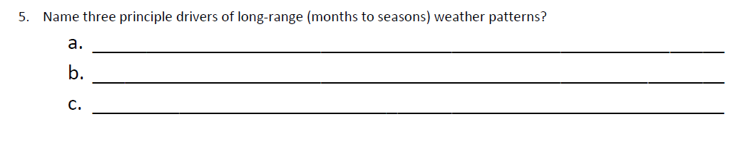
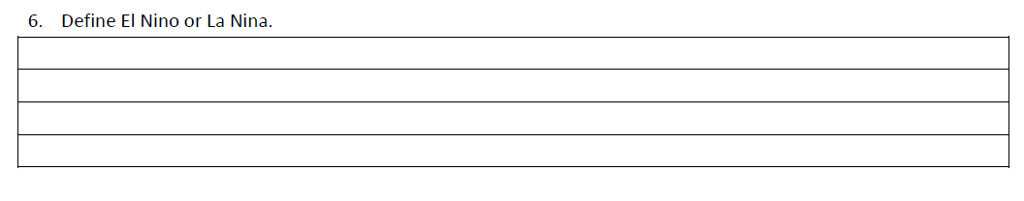
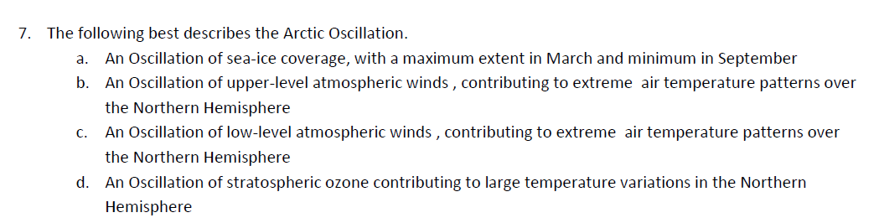
Arctic Oscillation
Pacific Jet Stream Patterns
ENSO
El Nino: Warm or positive phase of ENSO featuring well above average sea-surface
temperatures in the equatorial central and eastern Pacific Ocean.
La Nina: Cold or negative phase of ENSO featuring well below average sea-surface
temperatures in the equatorial central and eastern Pacific Ocean.

