Slide 1
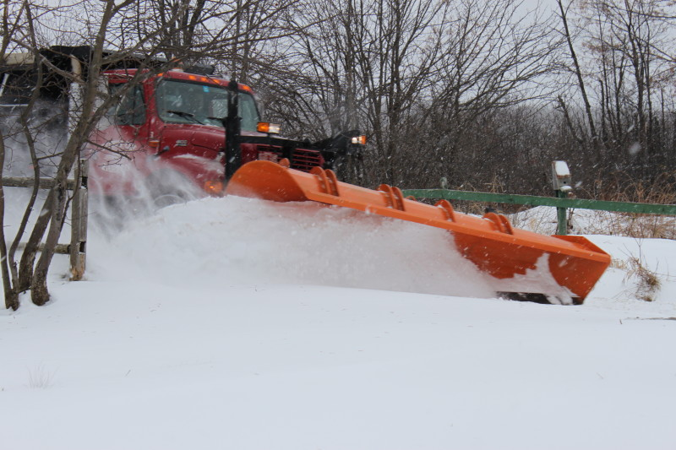




Characteristics of
Northeast Winter Snow Storms
Satellites, Weather, and Climate Module 19:
Dr. Jay Shafer
Dec 8, 2011
Lyndon State College
Jason.Shafer@lyndonstate.edu

Slide 2
Outline
Large scale structure of Northeast Snow Storms
  Surface pressure patterns
  Moisture patterns
  Frontal patterns
Forecasting storms: tools meteorologists used to predict today’s snow storm

Slide 3
Learning Outcomes
Improve understanding of the typical lifecycle of mid-latitude cyclones
Improve understanding of the structure of Nor’easters and how they produce heavy snowfall
Develop a basic understanding of how weather forecast models can be used to predict these events

Slide 4
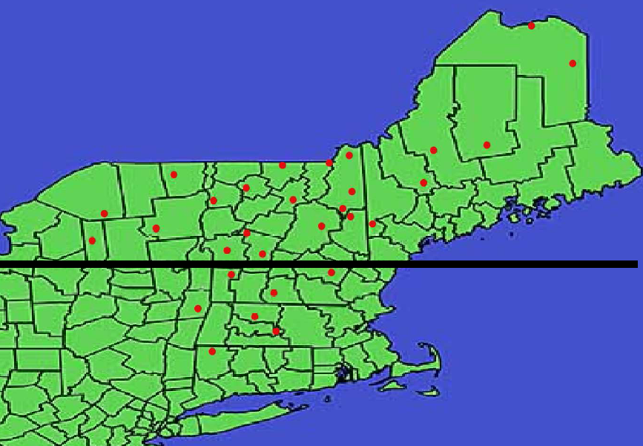
Northeast Snow Storm Project
Identified top 30 snow storms 1977-2007 using
area-averaged weighing of daily snow amounts
30 Stations used in our study
Results available online: http://apollo.lsc.vsc.edu/projects/snowstorm/

Slide 5
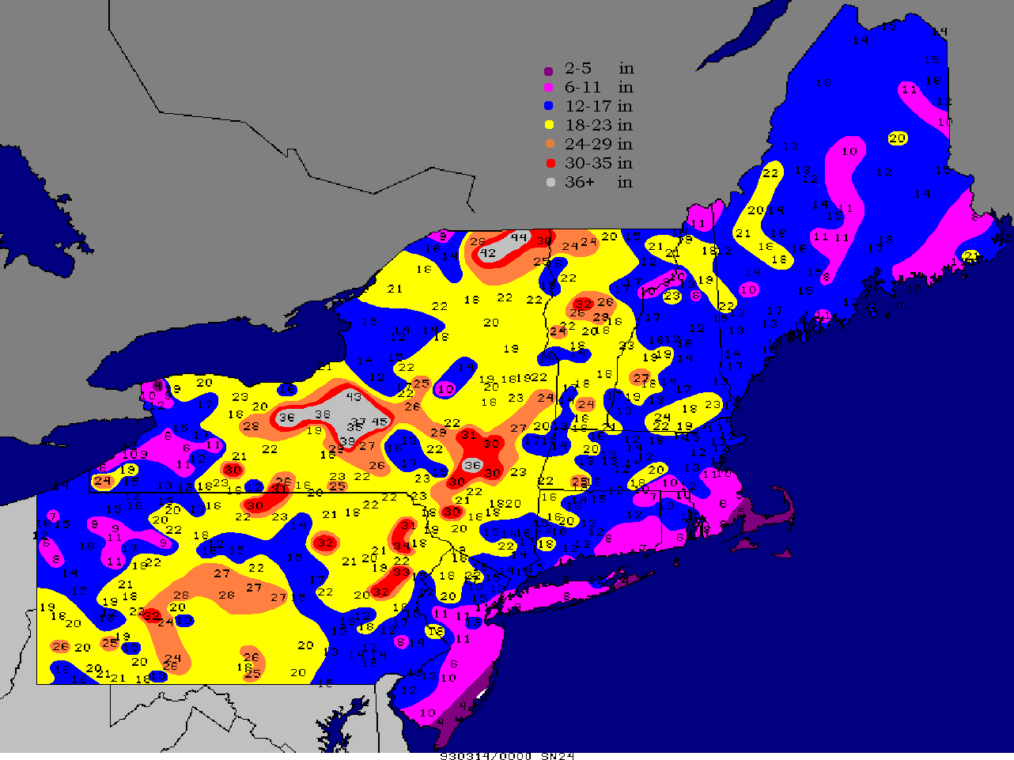
Mar 13-14, 1993: Snow Totals

Slide 6
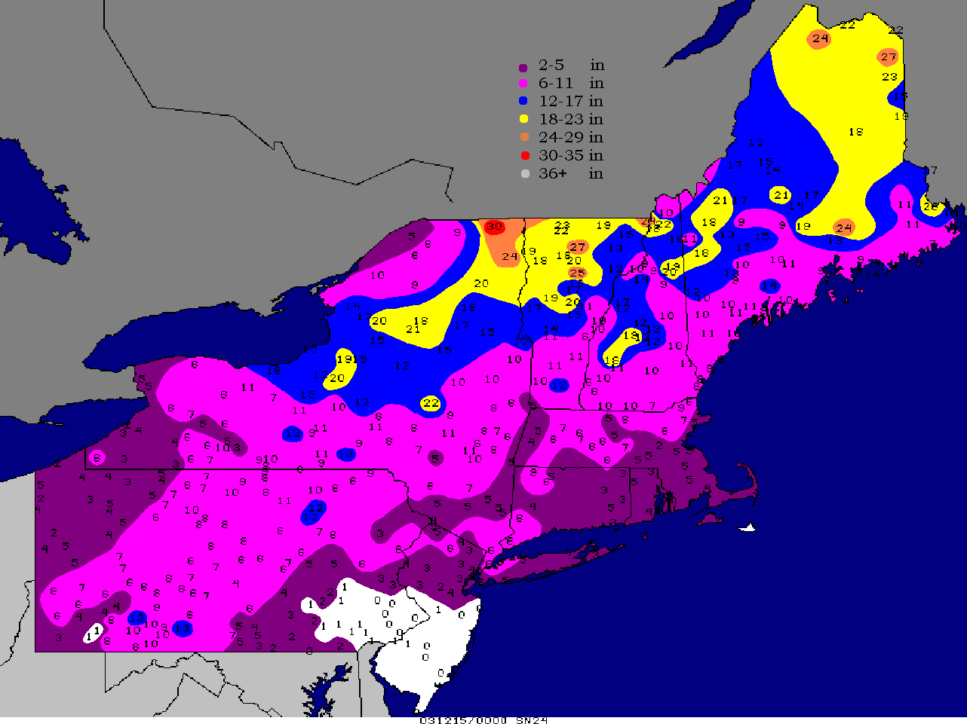
Dec 14-15, 2003: Snow Totals

Slide 7
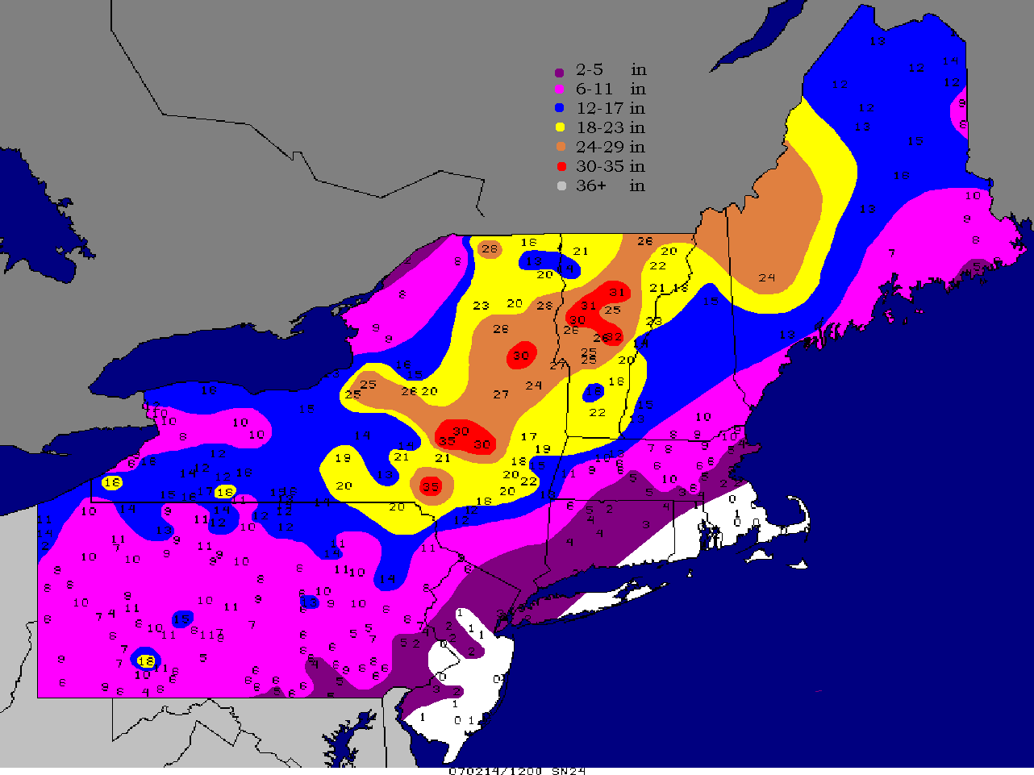
Feb 14-15 2007: Snow Totals

Slide 8
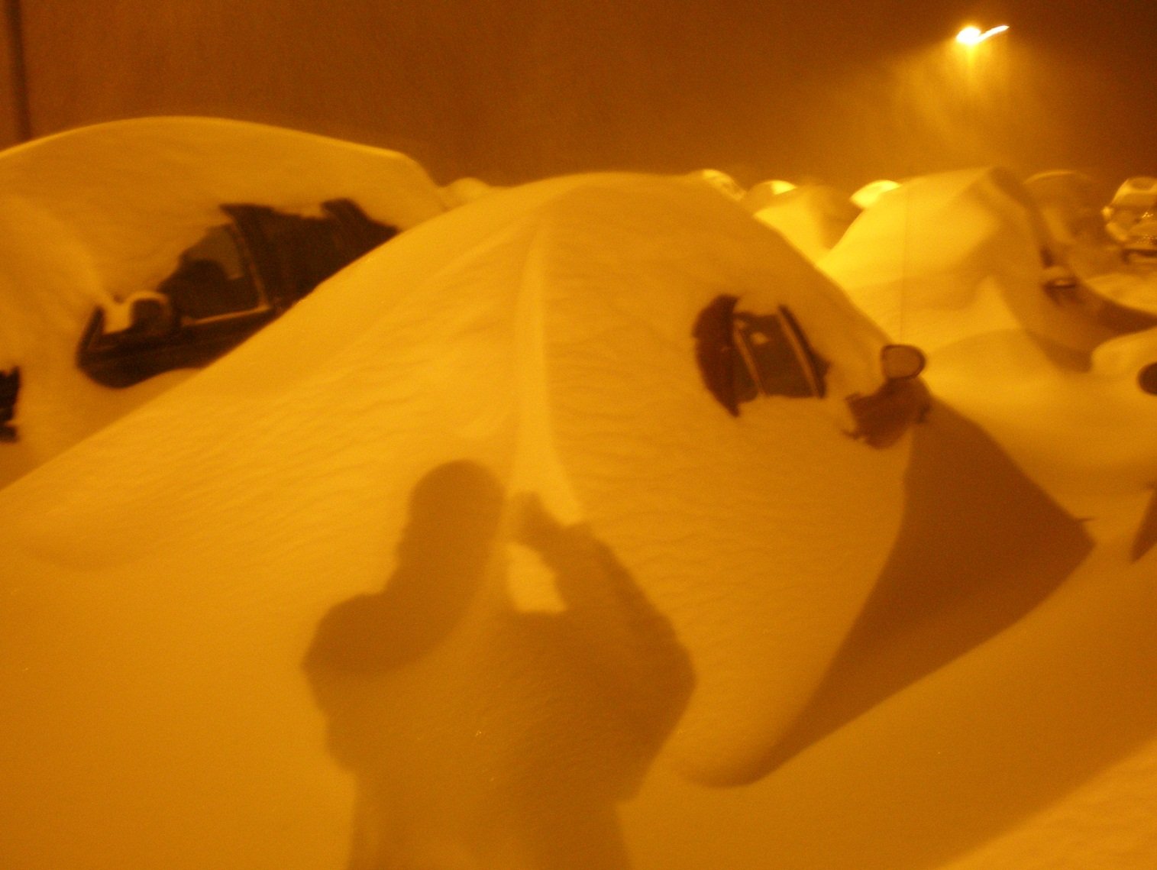
Surface Pressure Patterns
Valentine’s Day Blizzard, February 14 2007
Photo credit: Alexander Jacques

Slide 9
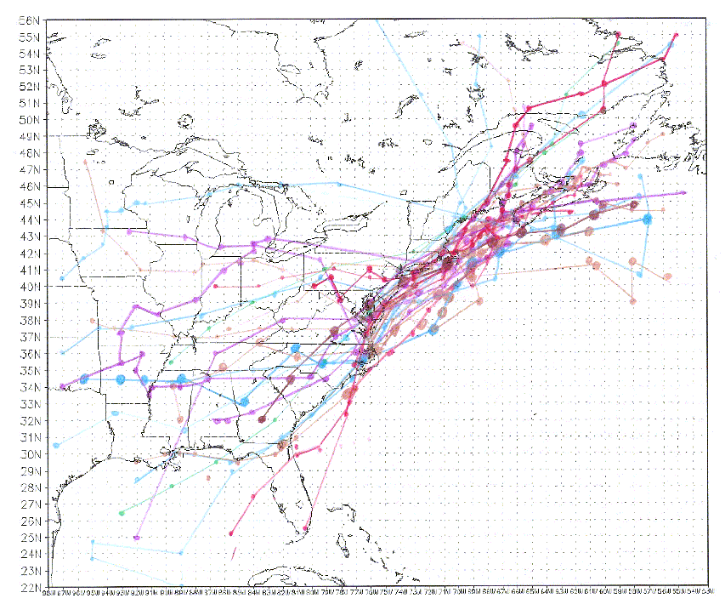
Surface low pressure tracks for major NE Snow Storms
Low Pressure
End Areas
Low Pressure
Origin Areas
Storm centers usually track from southwest to northeast,
and they have a diverse origin location, but there is confluence
in tracks in the Northeast. Note that all storms, except one,
have tracks near the coast or at the coast, and not inland.

Slide 10
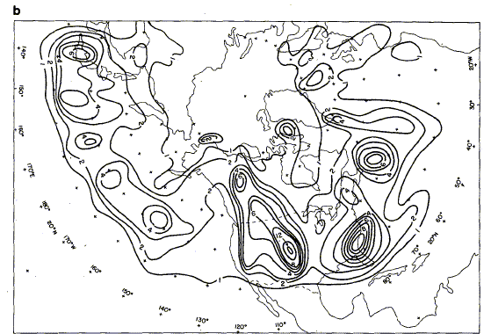
Storm Development “Cyclogenesis” Climatology
Cyclones, or areas of low pressure, are favored to form along the east coast,
and downstream, or to the lee of the major mountain barriers.
Roebber 1984, MWR

Slide 11
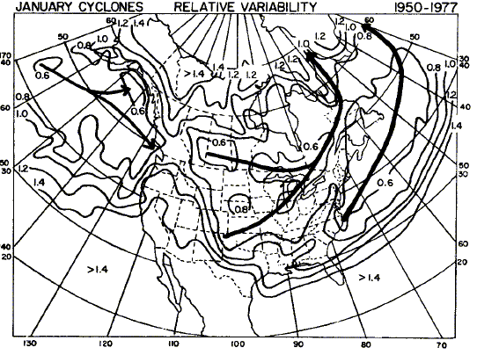
Principle January Cyclone Tracks
Track A
Track B
Track C
Three principle mean tracks; two downstream of the Rocky Mountains, and one coastal corridor track.
Note that, on average, most east coast winter cyclones move out to sea before they have high impacts on the northeast US.
Zishka and Smith, 1980, MWR

Slide 12
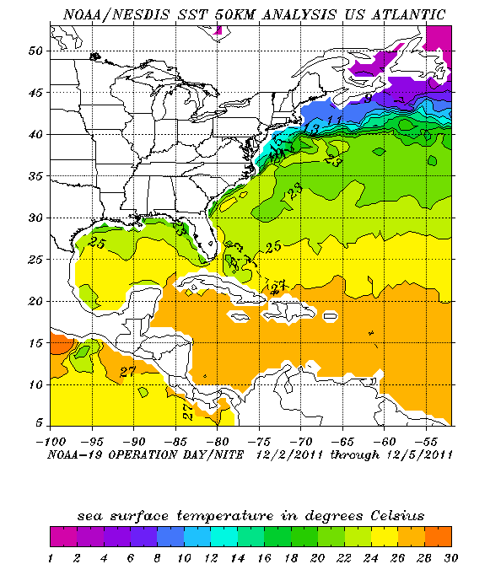
Why is the east coast favored for cyclone or low pressure formation?
Cold Continental
Air Masses
Juxtaposition of cold air masses
and warm temperatures related to
Ocean temperatures creates a strong
temperature gradient or “frontal zone”
Gulf Stream Current
This creates baroclinic instability, which
is an instability resulting from a strong
temperature gradient; Mother Nature does
not like strong temperature gradients, so
a midlatitude cyclone develops to even out
this gradient and bring warm air north and
cold air south.

Slide 13
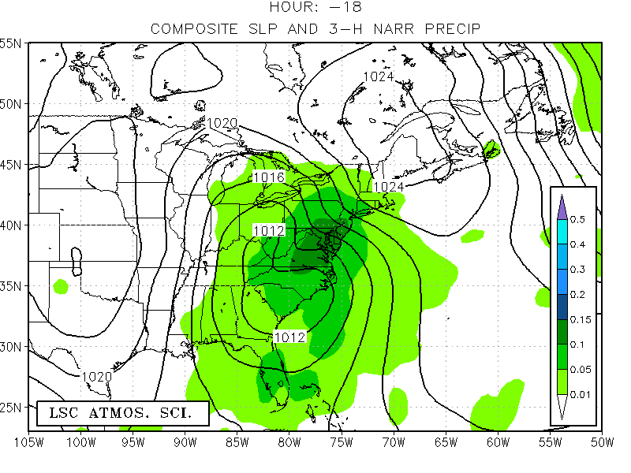
Average Pressure and Observed 3-HR Precipitation: Hour -18
Note the presence of a strong area of high pressure in place
ahead of the storm; this provides cold air, increases moisture flux
into the storm, and intensifies fronts.
H
L
Most major interior NE snow storms begin as a coastal track “C” and then intensify as they move up the coast, but
a good number have a pre-existing area of low pressure over the Ohio Valley and then reform off the coast.
Precipitation, shaded (inches)

Slide 14
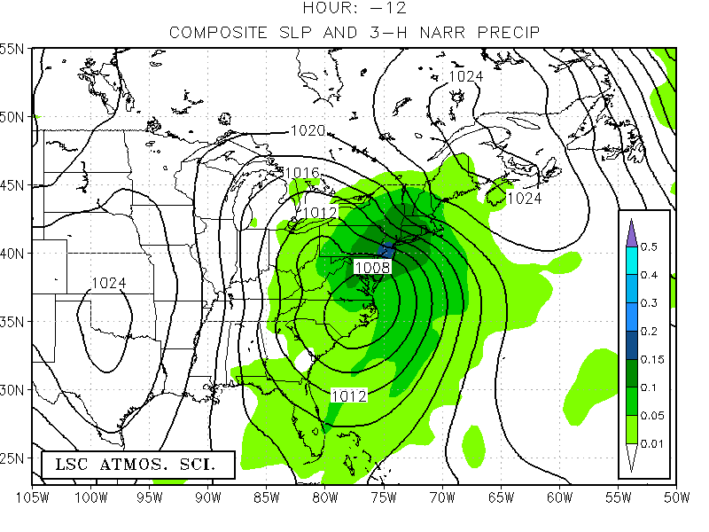
Average Pressure and Observed 3-HR Precipitation: Hour -12
Low consolidates as it approaches the coast, and precipitation
is falling well to the northeast of the low center.
H
L

Slide 15
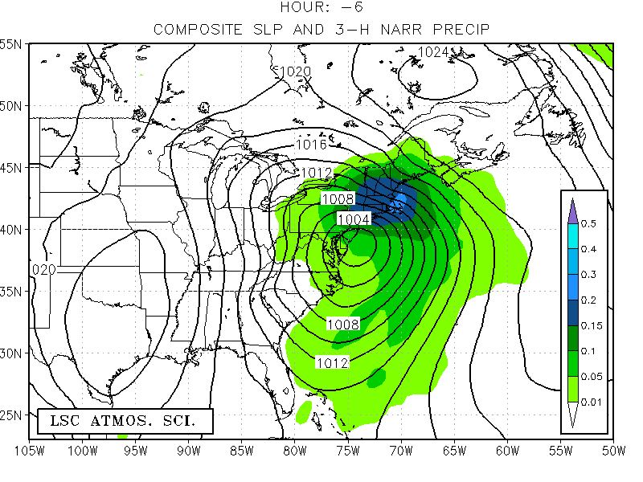
Average Pressure and Observed 3-HR Precipitation: Hour -06
Low is intensifying, or undergoing cyclogenesis, with a composite
value of ~1000mb; note that flow is strongly easterly at the sfc
H
L

Slide 16
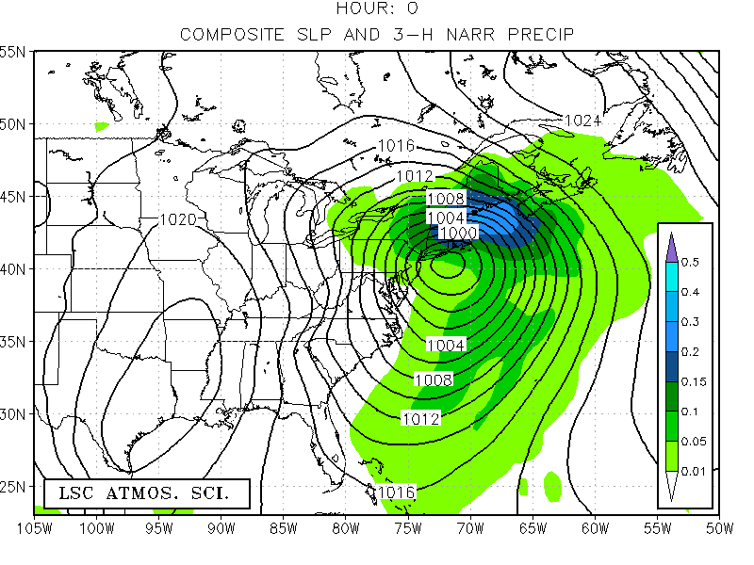
Average Pressure and Observed 3-HR Precipitation: Hour 0
H
L

Slide 17
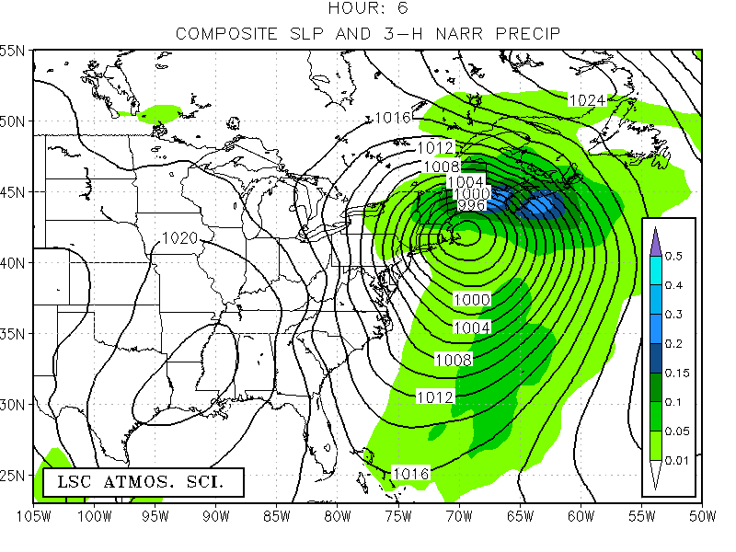
Average Pressure and Observed 3-HR Precipitation: Hour +06
H
Composite low is now ~992mb and wind has shifted more
Northeasterly -> this is why such storms are called, “Nor’easters”
L
Airflow is spinning counterclockwise or “cyclonically” around
The low pressure, as it always does in the Northern Hemisphere.
H

Slide 18
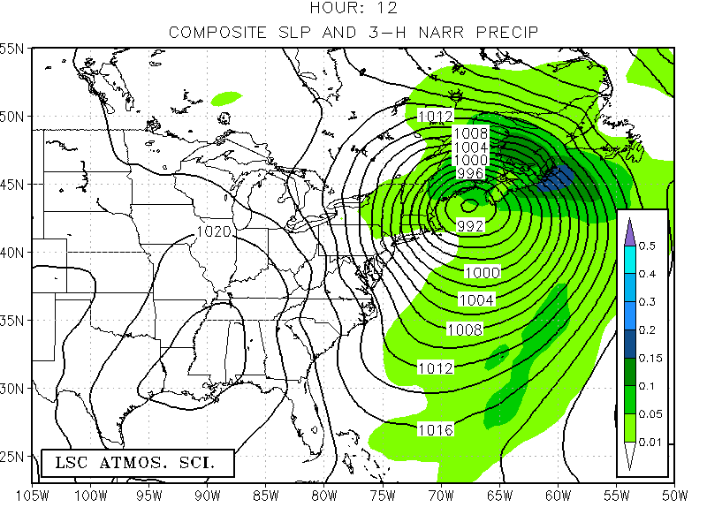
Average Pressure and Observed 3-HR Precipitation: Hour +12
Storm is still intensifying as it moves away from region;
The most vigorous storms are in their early stages to middle age,
but not “old” and winding down.
L
H

Slide 19
Moisture Source and Evolution

Slide 20
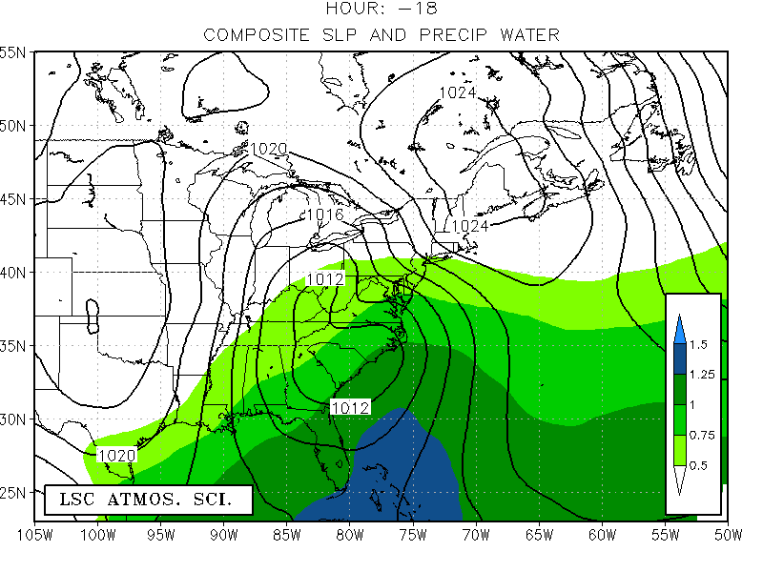
Average Pressure and Precipitable Water (Inches) Hour: -18
H
Moisture Plume or
Atmospheric River
Deep moisture plume ahead of the low pressure is present;
this acts to enhance available moisture into the storm system,
creating more precipitation and greater intensification via latent
heat release. Up to half of the intensification of these storms
can be attributed to heating of the column via latent heating,
which is release when water vapor condenses into clouds.
L
Precipitable water, shaded (inches)

Slide 21
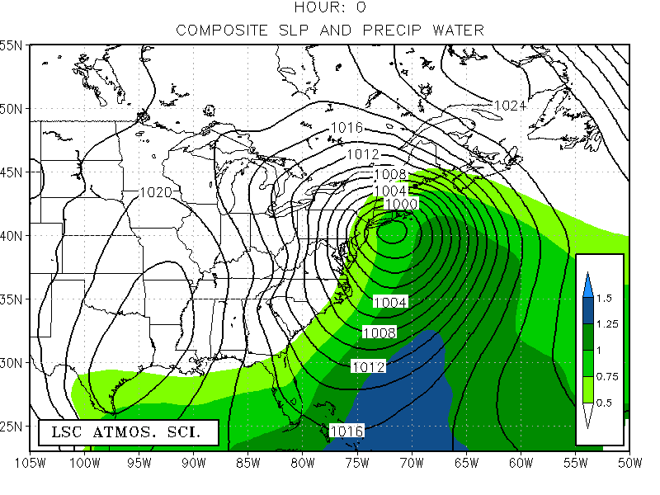
Average Pressure and Precipitable Water (Inches) Hour: 0
H
Moisture Plume or
Atmospheric River
L
Warm Moist Conveyor Belt

Slide 22
Temperature Pattern

Slide 23
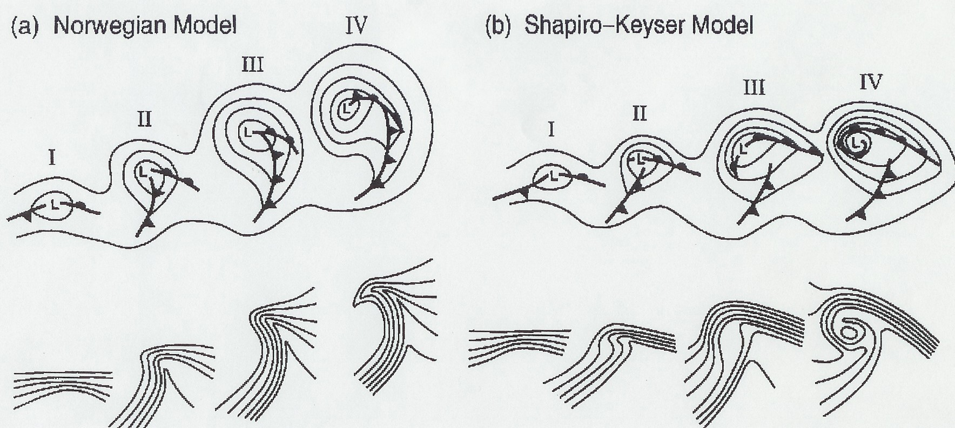
Mid Latitude Cyclone Lifecycle
Mid-latitude cyclones evolve through different phases:
Phase I: East-west stationary frontal zone with warm air south and cold air north
strong temperature gradient is present
Phase II: A kink develops on the isotherms (lines of constant temperature) as warm
and cold fronts develop and move.
Phase III: Wave on the isotherms amplifies and cold front advances faster than
warm front; cyclone is nearing maturity
Phase IV: Occlusion develops as cold front catches up with warm front; this process
does not always occur with every cyclone; ridge of warm temperatures
extends back toward the low center; storm is weakening
L
cold
cold
cold
warm
warm
sector
warm
warm
Isotherms: Lines of Constant Temperature

Slide 24
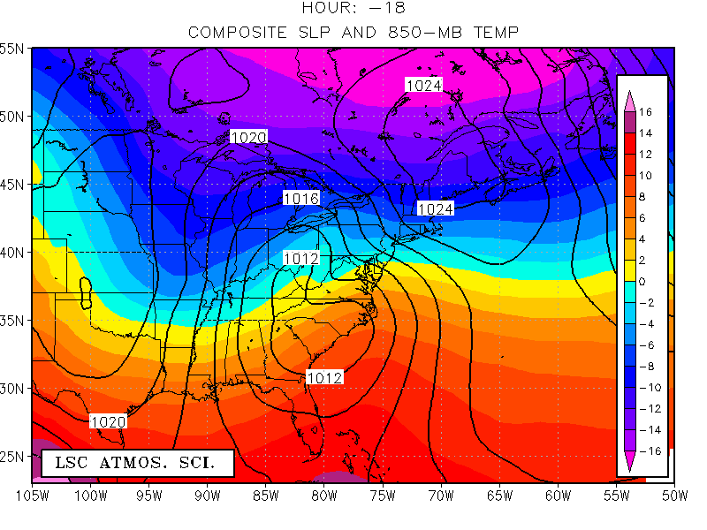
Average Pressure and 850-MB Temperature Hour: -18
H
cold
cold
L
Note the wave shape of the isotherms, and
position of the surface low near its inflection.
warm
850mb Temp (deg C), shaded

Slide 25
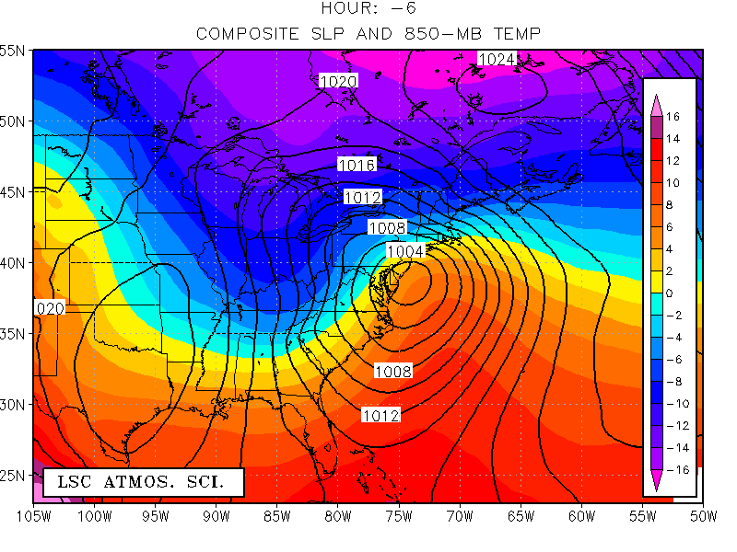
Average Pressure and 850-MB Temperature Hour: -06
H
L
Warm front
Cold front
Similarities to Phase II mid-latitude cyclone as
warm and cold fronts develop more curvature

Slide 26
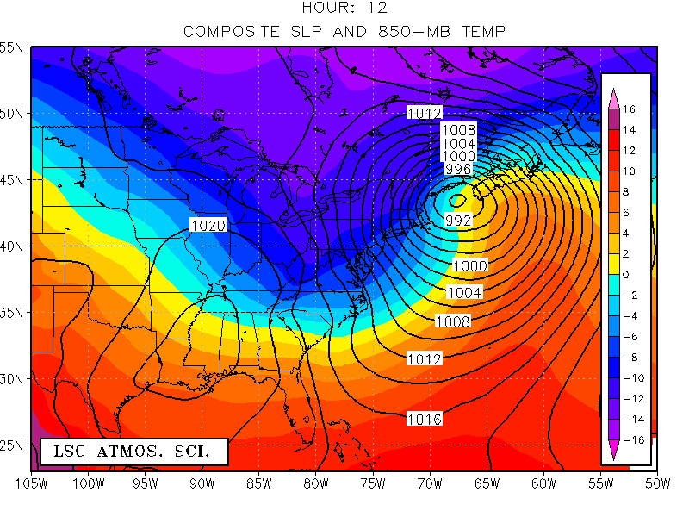
Average Pressure and 850-MB Temperature Hour: +12
Warm
front
L
cold
sector
warm
sector
Cold front
Similarities to Phase III mid-latitude cyclone as
temperature wave amplifies further

Slide 27
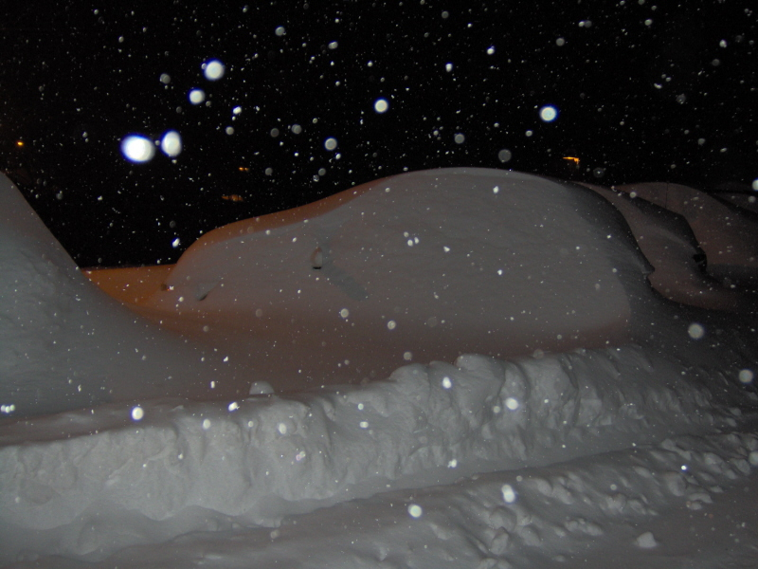
Upper-level Evolution:
Major Interior Northeast Snow Storms

Slide 28
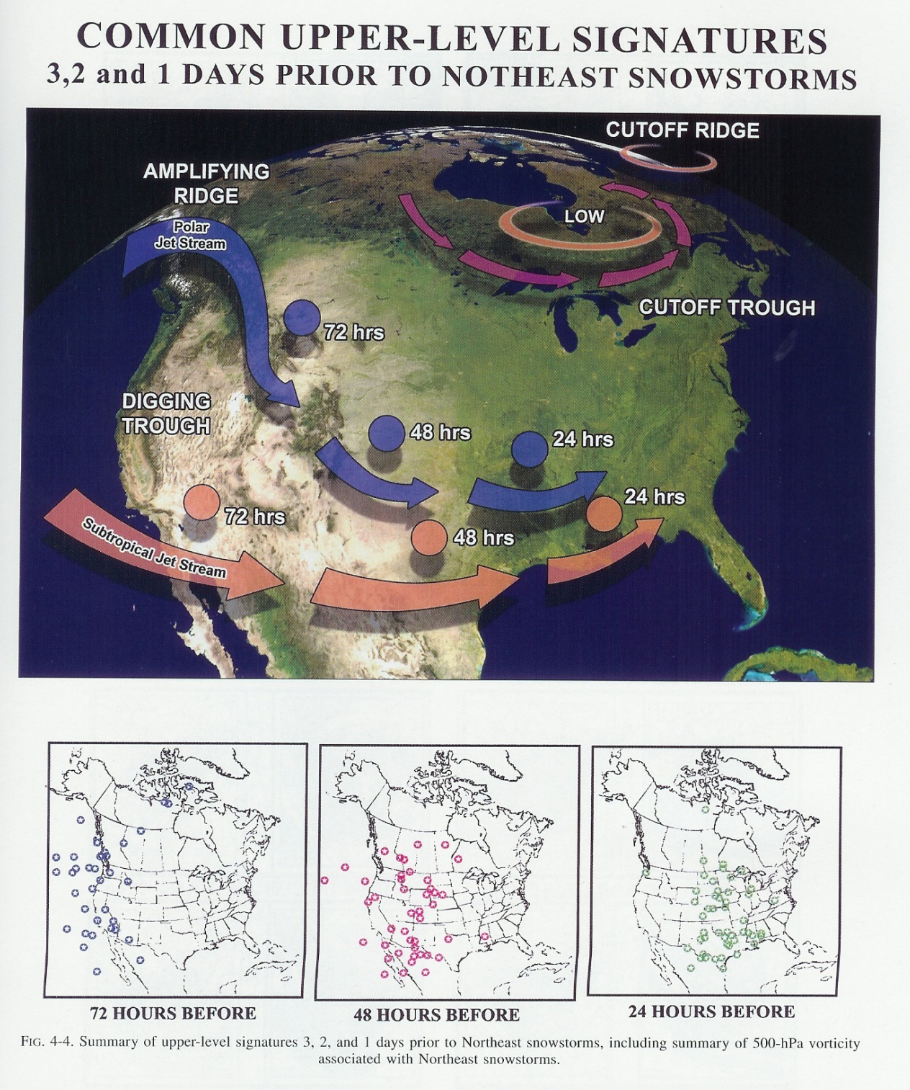
An upper-level disturbance is needed to perturb the
Low-level temperature gradient to produce a cyclone;
these are usually coherent features traceable days upstream
You can think of the jet stream as producing these features.
Kocin and Uccellini 2004

Slide 29
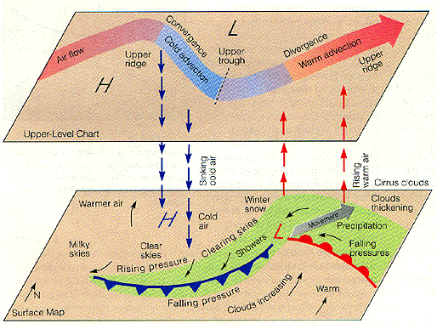
Vertical Structure
Ahrens 2006

Slide 30
Forecasting East Coast
Snow Storms

Slide 31
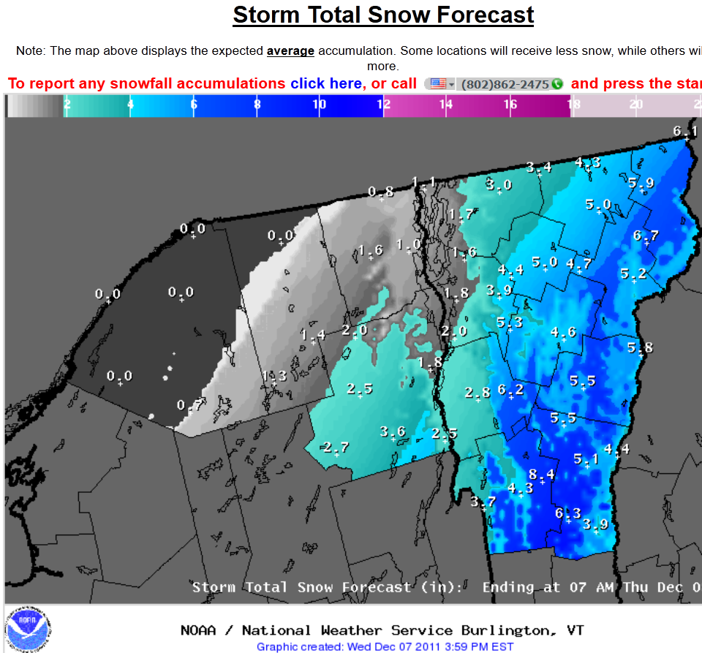

Slide 32
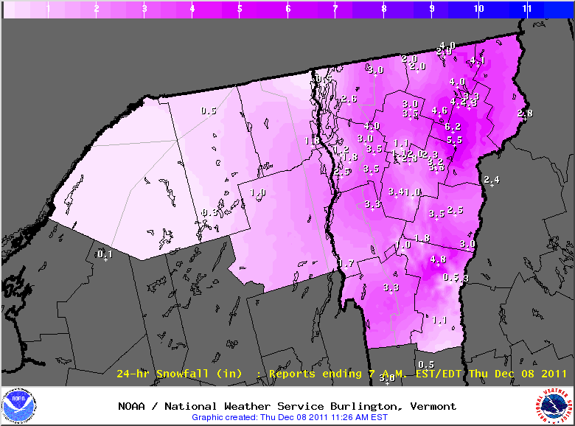
Snowfall Verification

Slide 33
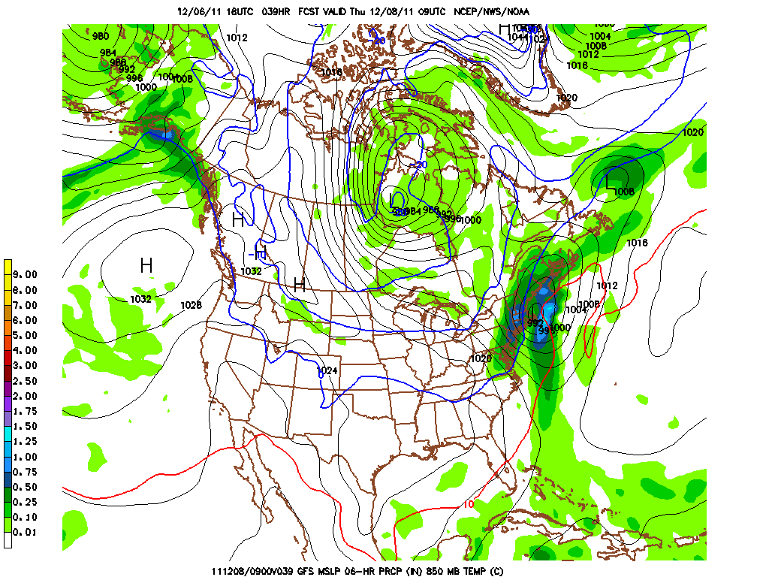
GFS Model Forecast: 39 Hour Forecast Valid 4:00AM Thursday
L
Isobars (solid lines), 6-Hour Precipitation Shaded

Slide 34
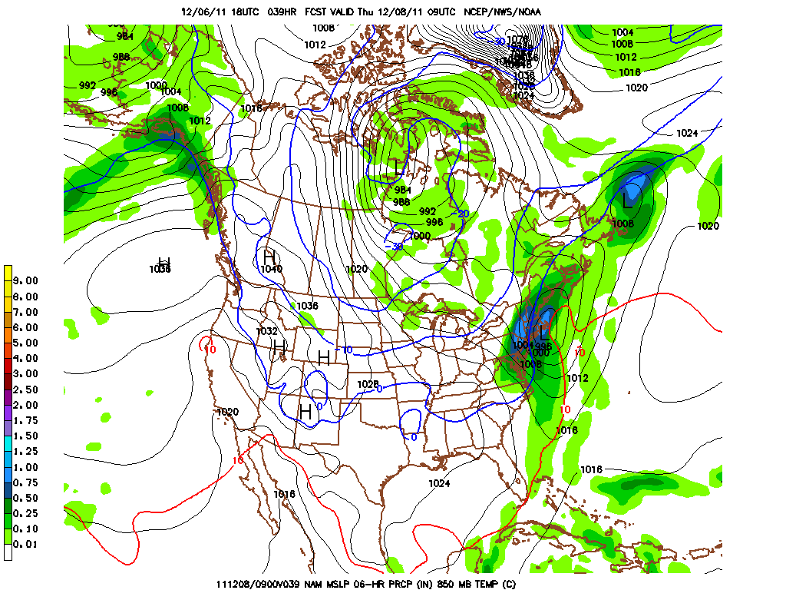
NAM Model Forecast: 39 Hour Forecast Valid 4:00AM Thursday
L
Both models are similar in their position of the low, but the NAM
Is a little slower in the progress on the surface low position.
Isobars (solid lines), 6-Hour Precipitation Shaded

Slide 35
Assessing Forecast Uncertainty

Slide 36
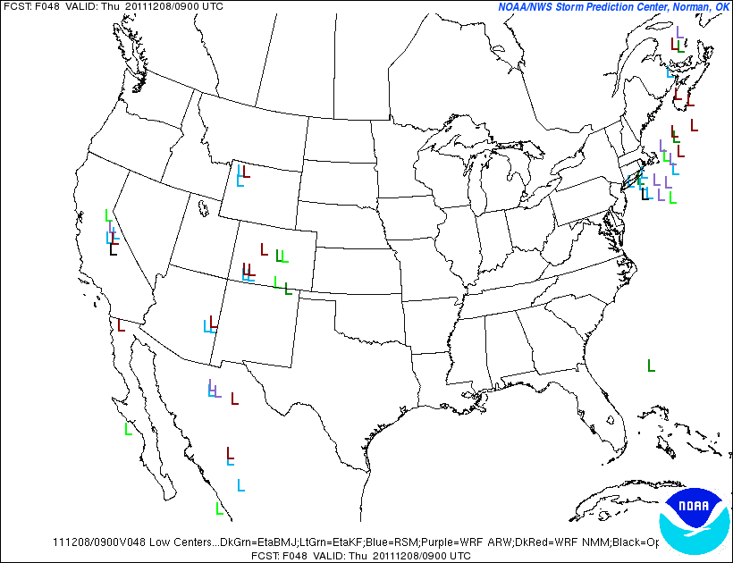
There was a lot of spread in the position/timing of the surface
low, even with a 2-day forecast.
This plot shows a position of the surface low pressure position
for the different model versions.

Slide 37
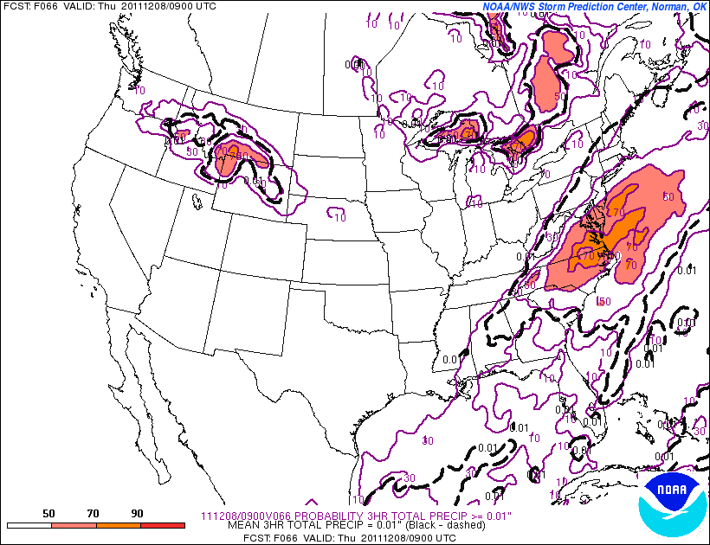
Models trended more inland with the storm track leading up to the event
The next four slides show the probability of accumulating
precipitation valid at the SAME forecast time on 4:00 AM Thursday
Probabilities in %

Slide 38
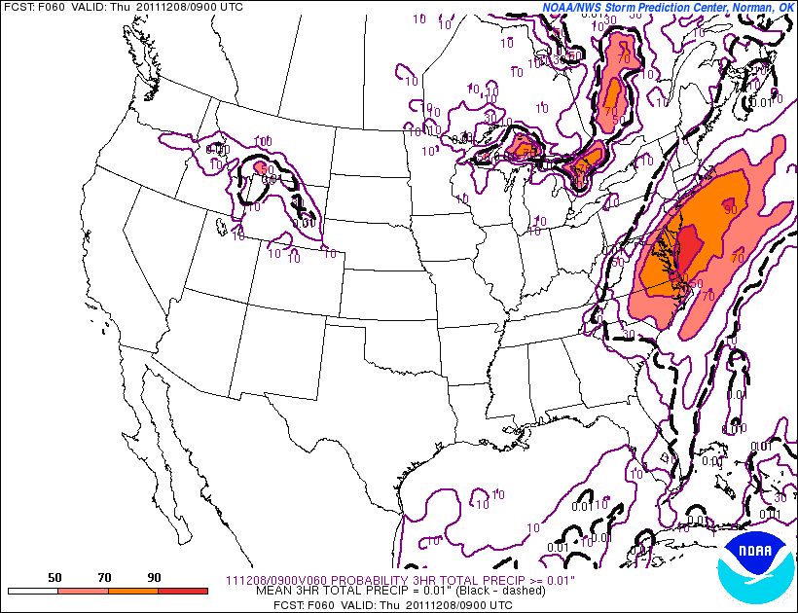
60 Hour Forecast
Probabilities in %

Slide 39
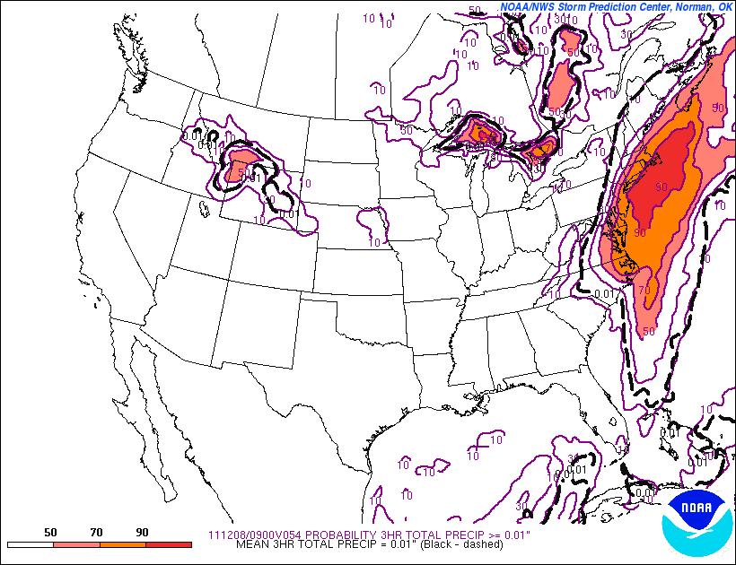
54 Hour Forecast
Probabilities in %

Slide 40
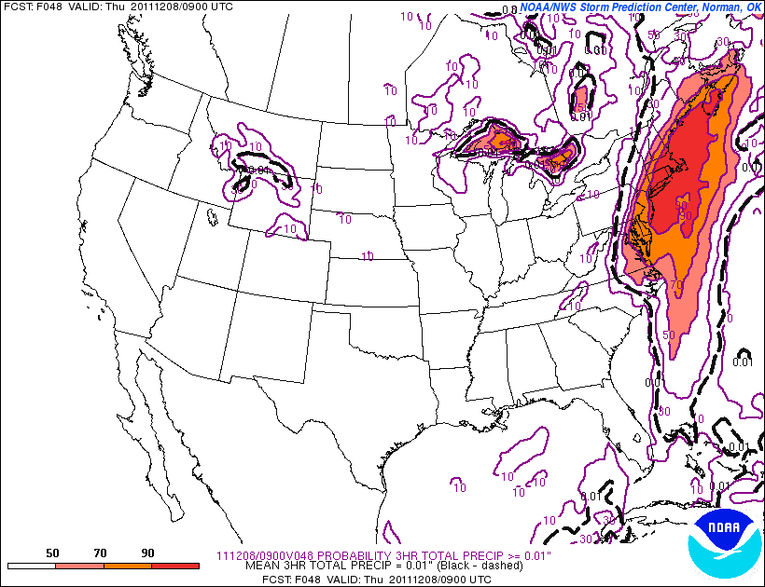
48 Hour Forecast
Probabilities in %

Slide 41
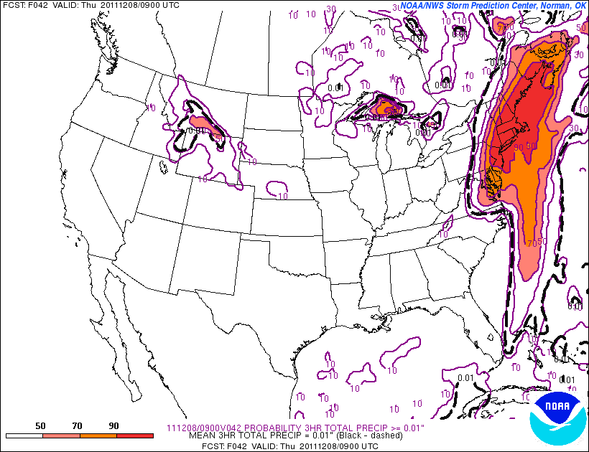
42 Hour Forecast
Note inland shift in probabilities. The trend is your friend.
Probabilities in %

Slide 42
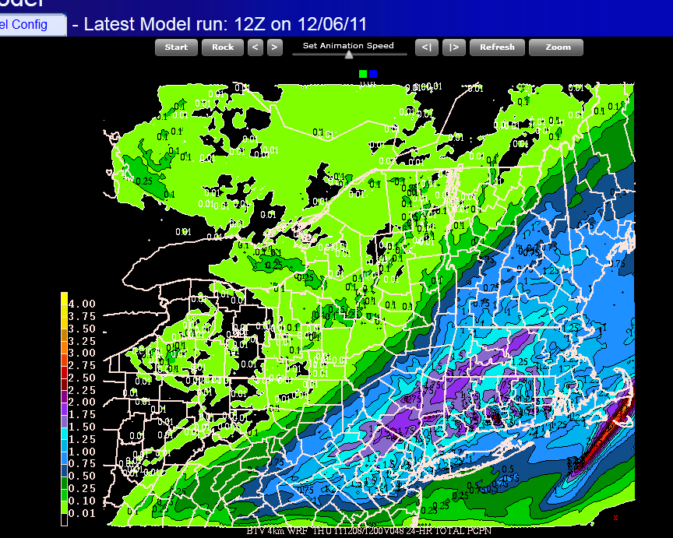
Gradient in precipitation amount looked pretty tight.

Slide 43
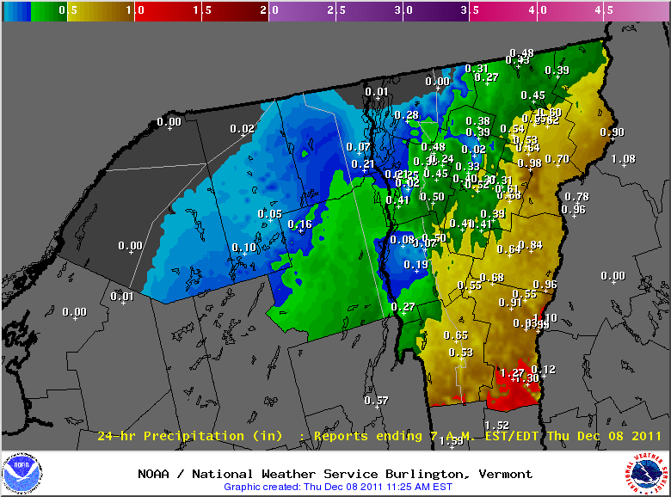
Precipitation Verification

Slide 44
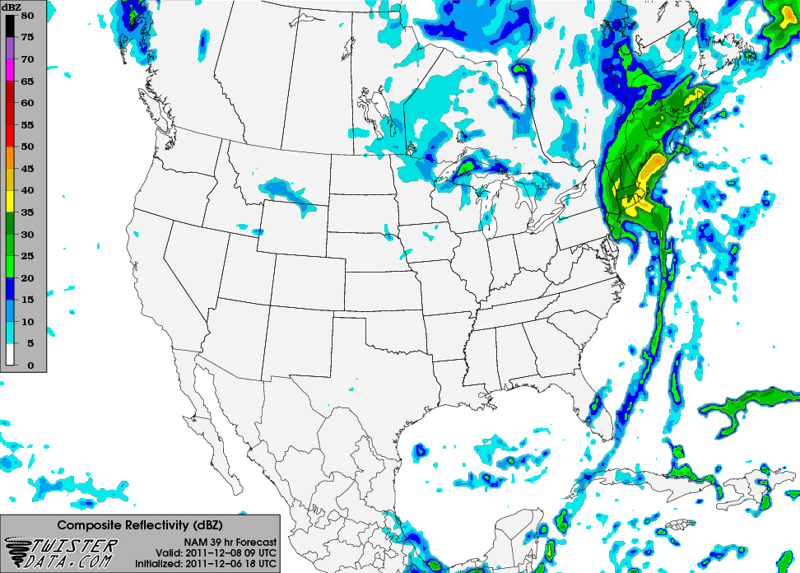
NAM Model Forecast Simulated Radar Imagery Valid 4:00AM Thursday

Slide 45
Activity
Plot the surface low position every 3 hrs over the last day for today’s storm
  How did the track of the storm compare to other snow storms?
Annotate the surface low strength in (mb) to each low position
  Was the surface low intensifying, decaying, or remaining the same strength as it passed the Northeast?
Compare frontal development to the typical midlatitude cyclone model
  What stage or stages did today’s snow storm evolve through?

Slide 46
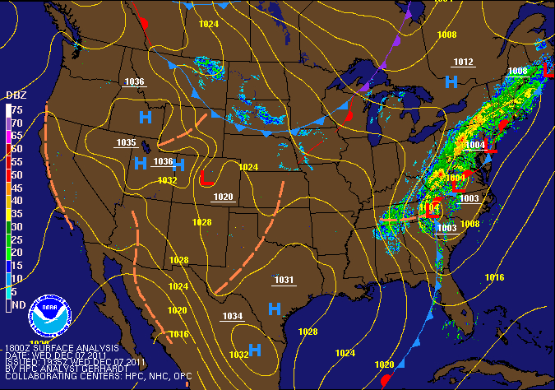
1:00PM Wednesday

Slide 47
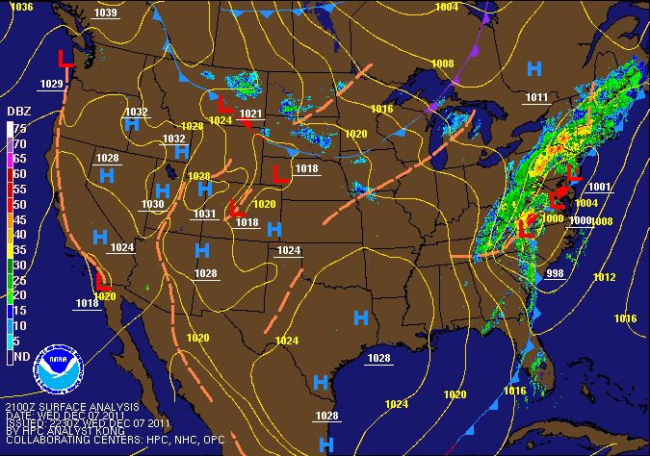
4:00PM Wednesday

Slide 48
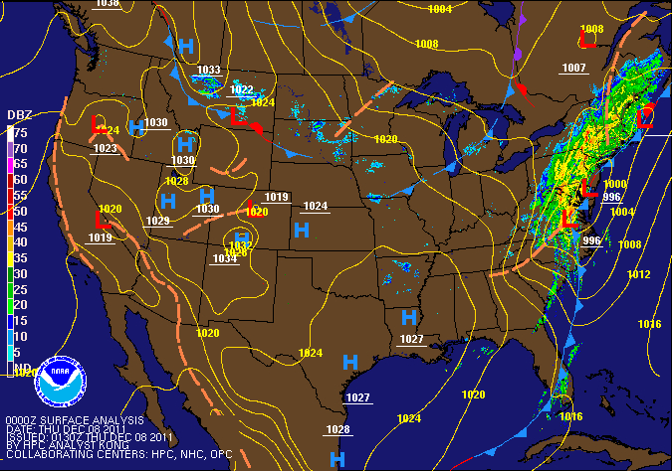
7:00PM Wednesday

Slide 49
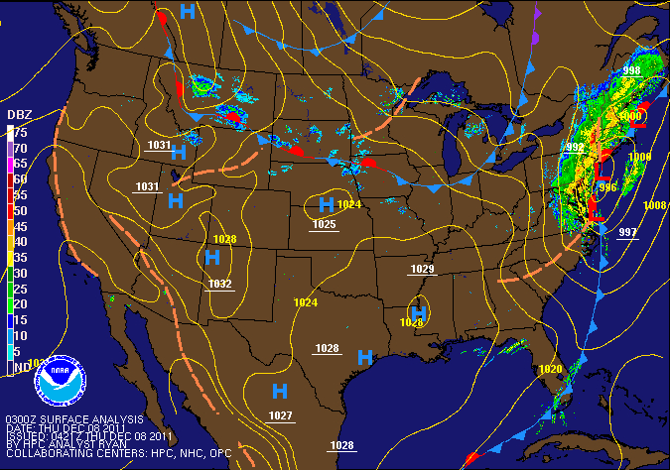
10:00PM Wednesday

Slide 50
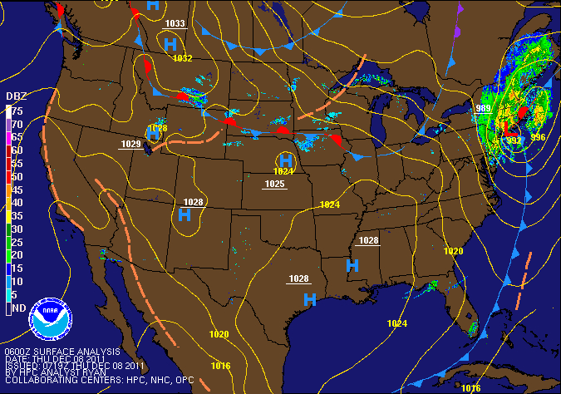
1:00AM Thursday

Slide 51
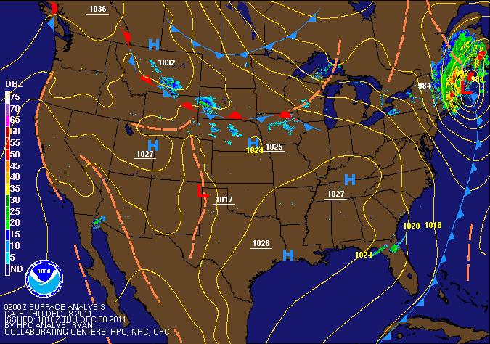
4:00AM Thursday

Slide 52
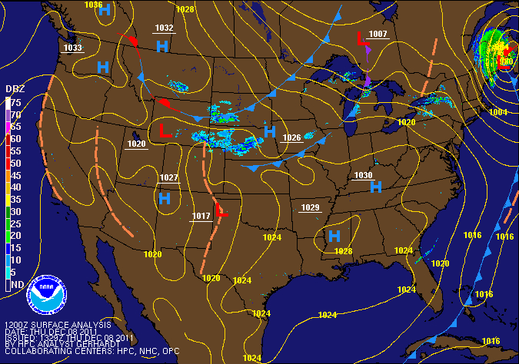
7:00AM Thursday

Slide 53
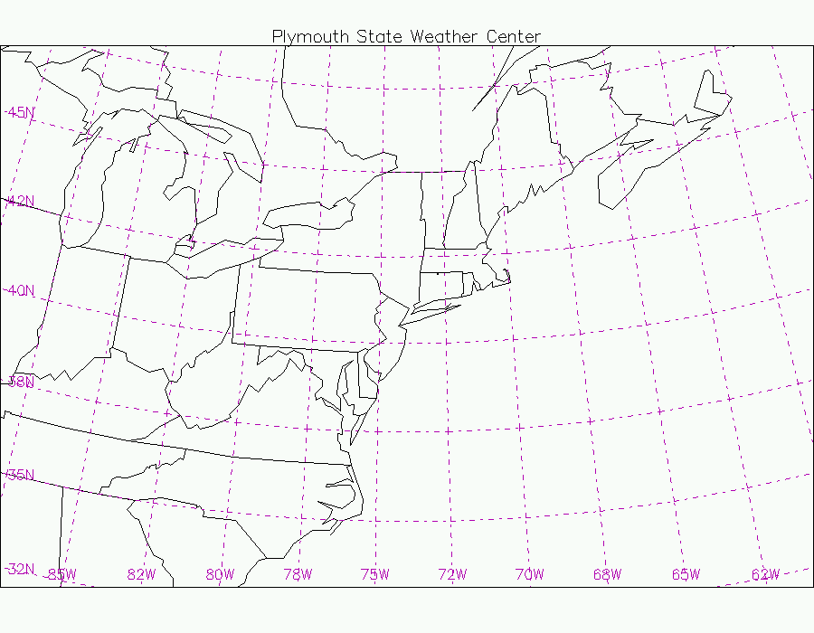
L
980
L
L
984
L
989
992
L
L
L
996
998
1003mb

Slide 55
1:00AM Thursday

Slide 56
Resources
Lyndon Snow Storm Project: http://apollo.lsc.vsc.edu/projects/snowstorm/
NOAA Weather Forecast Models: http://mag.ncep.noaa.gov/NCOMAGWEB/appcontroller?prevpage=index&MainPage=index&cat=MODEL+GUIDANCE&page=MODEL+GUIDANCE
Burlington Weather.com: http://www.burlington-weather.com/models.php
NWS Burlington: http://www.erh.noaa.gov/er/btv/
Daily Observed Temperatures and Precipitation via NWS: http://www.erh.noaa.gov/btv/html/climatemaps/
Contact: jason.shafer@lyndonstate.edu

