Slide 1
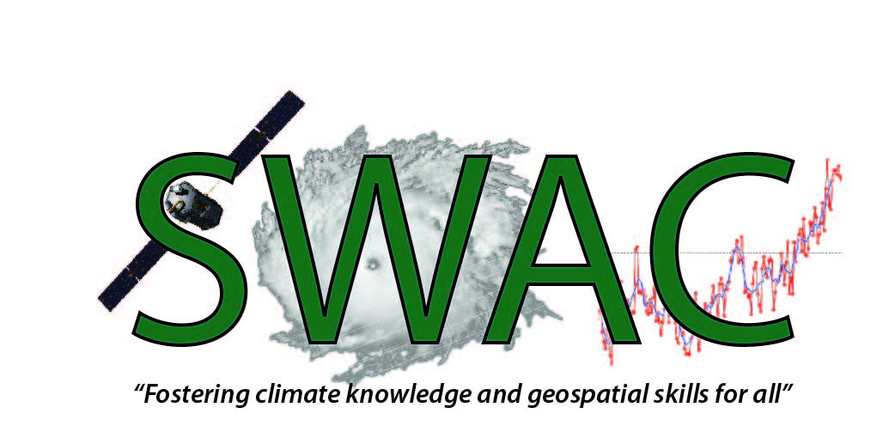

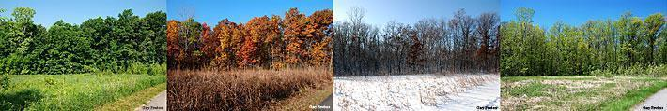
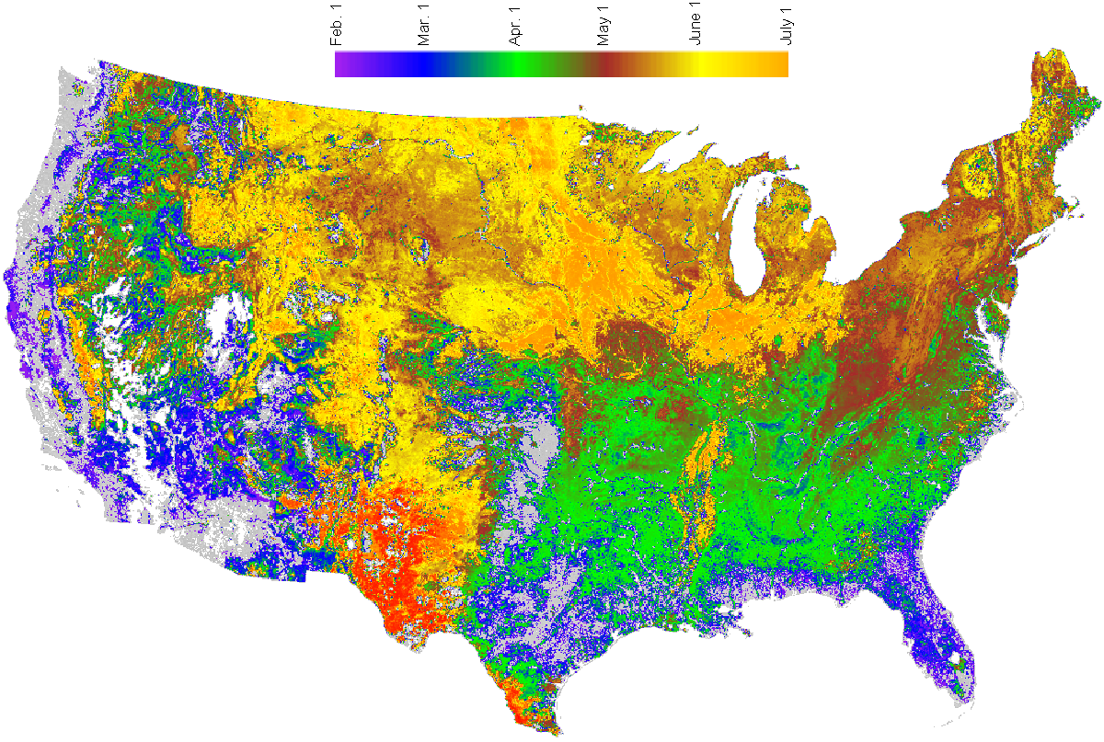
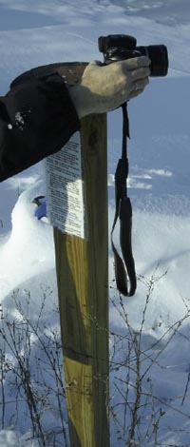
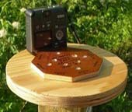
Climate Change and Vegetation Phenology

Slide 2
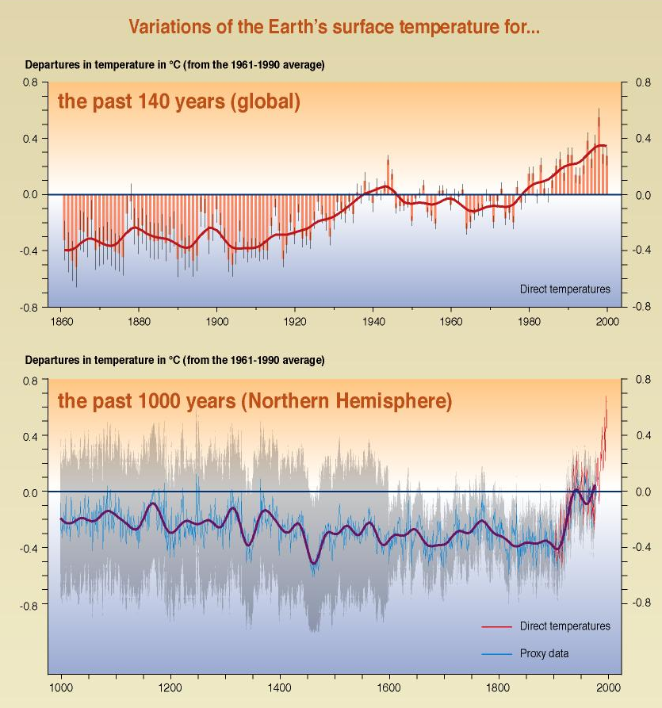
Climate Change
  In the Northeastern US mean annual temperature increased 0.7°C over 30 years (0.26° C per decade)
  Expected another 2-6°C over next century
  (Ollinger, S.V. “Potenail effects of climate change and rising CO2 on ecosystem process in northeastern U.S. forests)

Slide 3
Why does it matter?
  Impacts on plant productivity
  Competition between plant species
  Interaction with other organisms
  Food production
  Shifts in agricultural
  Pest and disease control
  Pollen forecasts
  Carbon balance of terrestrial ecosystems
  Feedback into atmosphere
  Water, energy exchange
  Timing of migrations and breeding
  other ideas?
Notes:
CARBON flux exchange, however its complicated by water availability, soil respiration. Quantify what is happening to then investigate what it means for all these other things care about.

Slide 4
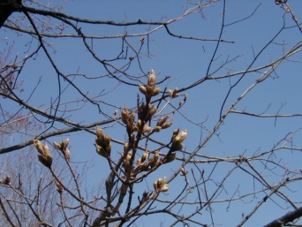
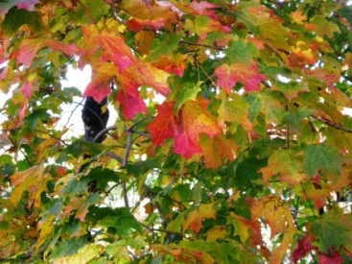
Phenology is the science that measures the timing of life cycle events in all organisms
Plants tell a story about climate……
Listening to the story they tell year after year can tell us about climate change
Earlier Springs
Later Falls

Slide 5

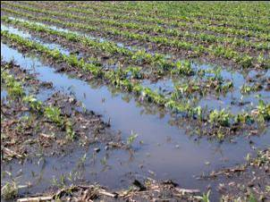
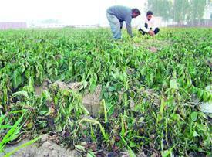
Plants provide an excellent context to understand changes in the environment
They are extremely sensitive to:
temperature change
precipitation change
growing degree days
Notes:
Plant Phenology and Climate Change
We know that plants can tell a story about climate change. Changes in the timing of phases of the plant life cycle, known as phenophases, are directly affected by temperature, rainfall, and day length. While these environmental factors change throughout the year in places where there are distinct seasons, the first two, temperature and rainfall – are also changing in many regions because of changing climates. Scientists have found that the timing of phenological events of many plant species has changed recently as a result of changing temperatures and rainfall patterns. Learn more about what these changes mean and how Project BudBurst participants can help.

Slide 6
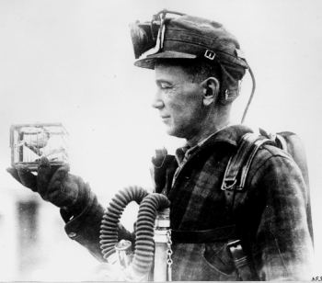
Phenology: A glimpse of ecosystem Impacts
Some potential effects:
  Wildlife populations
  Vegetation health
  Species composition and ranges
  Water availability
  Nutrient cycling and decomposition
  Carbon storage

Slide 7
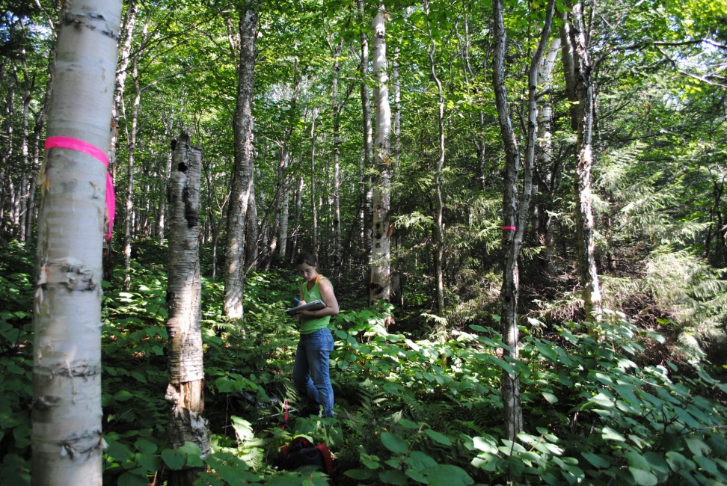
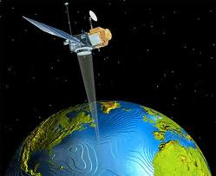
Measuring Phenology
Field Observations Satellite Remote Sensing
Notes:
Scientists started tracking vegetation phenology at permanent research plots they could visit on a regular basis and track changes. This would include visual estimates of the condition of buds, flowers and leaves.
But how vegetation responds across the landscape is more informative than what is happening at a small scattering of research plots. This is where remote sensing comes in. Scientists could use the spectral reflectance from the surface of the earth to quantify how “green” each pixel (location on the ground) was.

Slide 8
How do scientists monitor vegetation phenology?
Tier 1
Intensive
Sites
AmeriFlux
Field Based
NWS Coop
NPS Inv. & Mon.
State Ag. Exp. Sta.
Tier 2
Spatially Extensive
Science Networks
Increasing Process Knowledge Data Quality
# of Measurements
Decreasing Spatial Coverage
Tier 3
Nature
Preserves,
Campuses
Spatially Extensive
Volunteer & Education Networks
Satellite Based
Tier 4
NASA
USGS
NOAA
Remote Sensing and
Synoptic (wall-to-wall) Data
George R. Kish U.S. Geological Survey

Slide 9

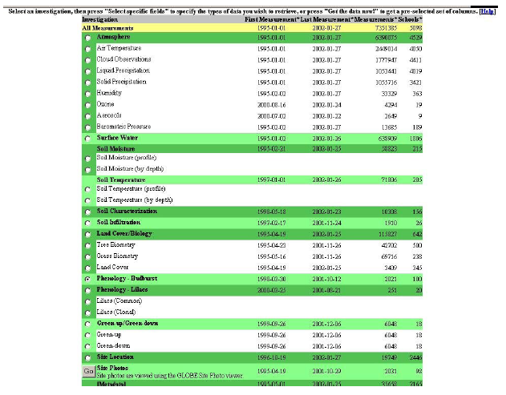
Measuring Phenology on the ground
Field Observations
Notes:
Scientists started tracking vegetation phenology at permanent research plots they could visit on a regular basis and track changes. This would include visual estimates of the condition of buds, flowers and leaves.
But how vegetation responds across the landscape is more informative than what is happening at a small scattering of research plots. This is where remote sensing comes in. Scientists could use the spectral reflectance from the surface of the earth to quantify how “green” each pixel (location on the ground) was.

Slide 10
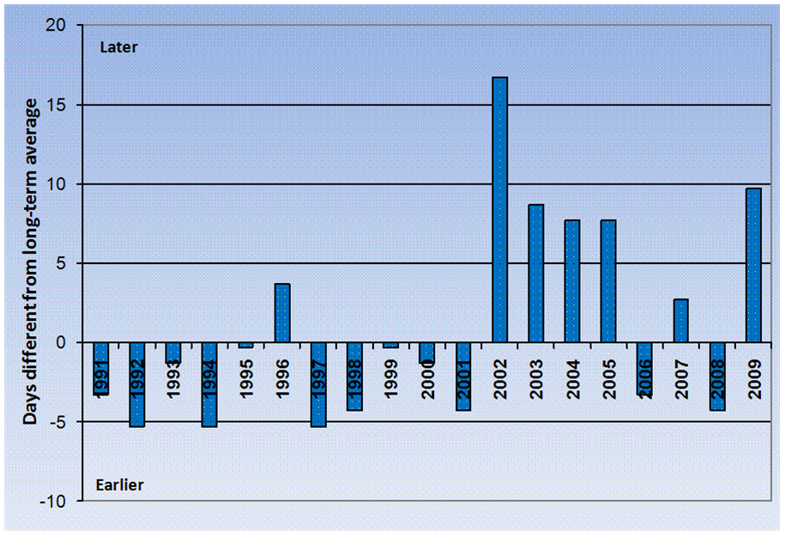

Timing of sugar maple leaf drop
Monitored at Proctor Maple Research Center
Sandra Wilmot Tom Simmons

Slide 11
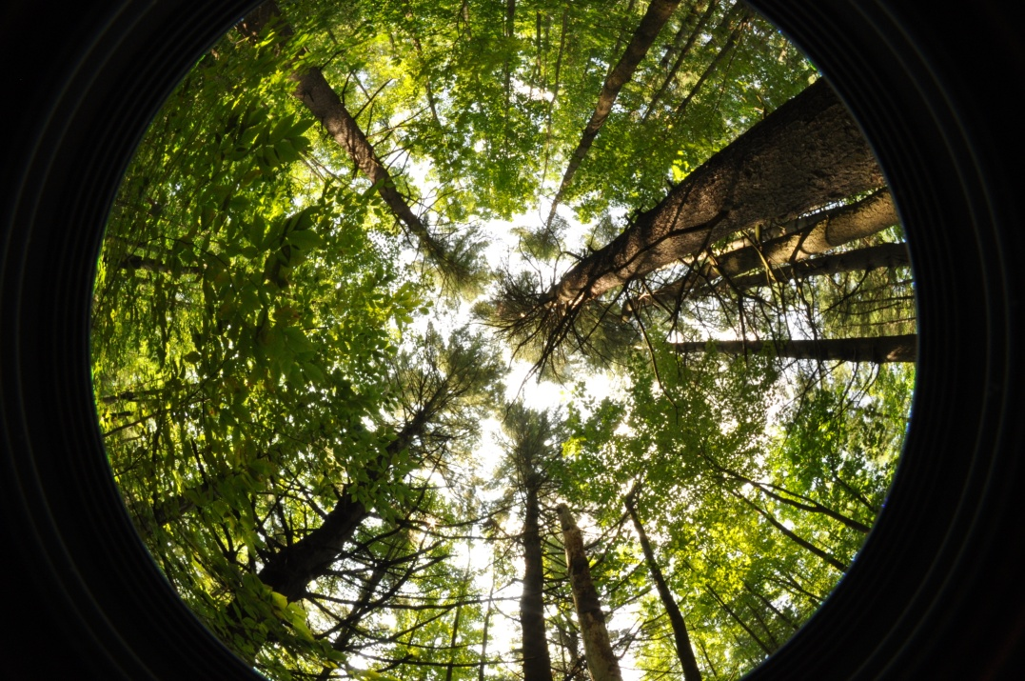
Hemispherical Photography
Helps us “see” the canopy as a satellite might see it
Notes:
Satellites see large areas of the ground. Therefore our ground measurements should try to include data from a similarly sized area.
Hemispherical cameras help us “see” the canopy as a satellite might see it.
We can then calculate indices like NDVI to approximate “greenness” and compare that with our visual observations on the ground.
This will help us to identify how to link satellite derived NDVI values to the start and end of the growing season.

Slide 12
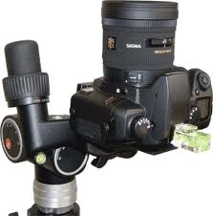

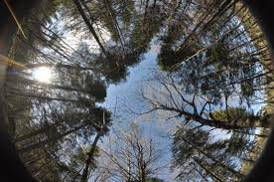
Hemispherical Imagery
Scientists spend big bucks to purchase the equipment and software necessary to link ground measurements with satellite imagery.
Calculate canopy closure, transparency, leaf area index, vegetation indices, gap fraction, etc.

Slide 13
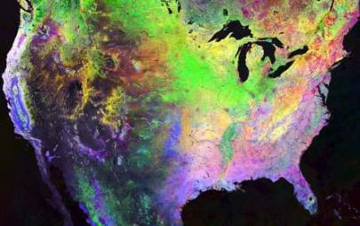
Measuring Phenology
Satellite Remote Sensing
Land surface phenologies in 2000 revealed by three AVHRR biweekly composites.” From USA National Phenology Network (USANPN)
Notes:
Scientists started tracking vegetation phenology at permanent research plots they could visit on a regular basis and track changes. This would include visual estimates of the condition of buds, flowers and leaves.
But how vegetation responds across the landscape is more informative than what is happening at a small scattering of research plots. This is where remote sensing comes in. Scientists could use the spectral reflectance from the surface of the earth to quantify how “green” each pixel (location on the ground) was.

Slide 14
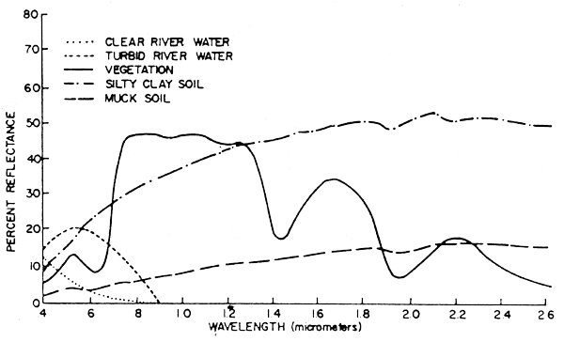

How do you see phenology from space?
Chlorophyll, strongly absorbs visible light for photosynthesis.
Leaf cell structure reflects near-infrared light.
NDVI exploits these characteristics of vegetation reflectance to quantify how much, how dense and how productive vegetation is.
http://www.fao.org/docrep/003/T0446E/T0446E04.htm
Notes:
Plants appear green to us because of the blue and red wavelengths absorbed for photosynthesis leave only green wavelengths in the visible spectrum for us to see.
But plants have another common reflectance signature in the near infrared portion of the electromagnetic spectrum. How high this plateau is, compared to how low the trough is at the chlorophyll absorption well in the red wavelengths can give you a measure of how “green” a pixel is.
The most common formula to summarize these key spectral values is called the Normalized Difference Vegetation Index.
The NDVI is calculated from these individual measurements as follows:
where VIS and NIR stand for the spectral reflectance measurements acquired in the visible (red) and near-infrared regions, respectively (http://earthobservatory.nasa.gov/Features/MeasuringVegetation/measuring_vegetation_2.php).
These spectral reflectances are themselves ratios of the reflected over the incoming radiation in each spectral band individually, hence they take on values between 0.0 and 1.0. By design, the NDVI itself thus varies between -1.0 and +1.0.

Slide 15
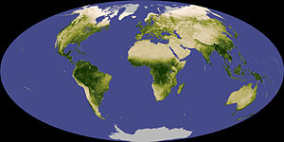
Normalized Difference Vegetation Index
NDVI
Negative values of NDVI correspond to water.
Values close to zero correspond to barren areas of rock, sand, or snow.
low, positive values represent shrub and grassland
high values indicate temperate and tropical rainforests.
Notes:
It can be seen from its mathematical definition that the NDVI of an area containing a dense vegetation canopy will tend to positive values (say 0.3 to 0.8) while clouds and snow fields will be characterized by negative values of this index. Other targets on Earth visible from space include
free standing water (e.g., oceans, seas, lakes and rivers) which have a rather low reflectance in both spectral bands (at least away from shores) and thus result in very low positive or even slightly negative NDVI values,
soils which generally exhibit a near-infrared spectral reflectance somewhat larger than the red, and thus tend to also generate rather small positive NDVI values (say 0.1 to 0.2).

Slide 16
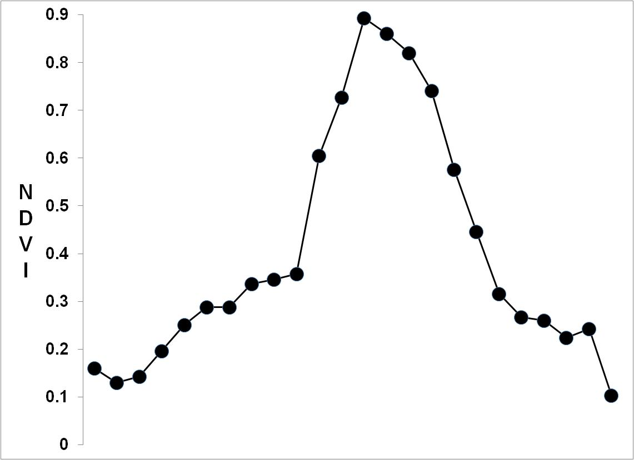
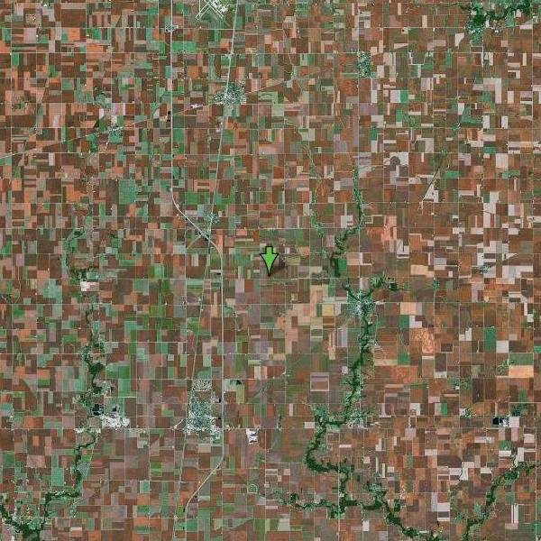
Corn/Soy belt Central Illinois
Kirsten M. de Beurs, Ph.D.
Virginia Tech University
Notes:
Knowing what you now know about NDVI, what does this curve tell you about the seasonal use of this land?
Barren in winter, spring and fall (NDVI values near 0.2), then rapid crop growth (likely due to fertilization and irrigation (NDVI values approaching 0.9).

Slide 17
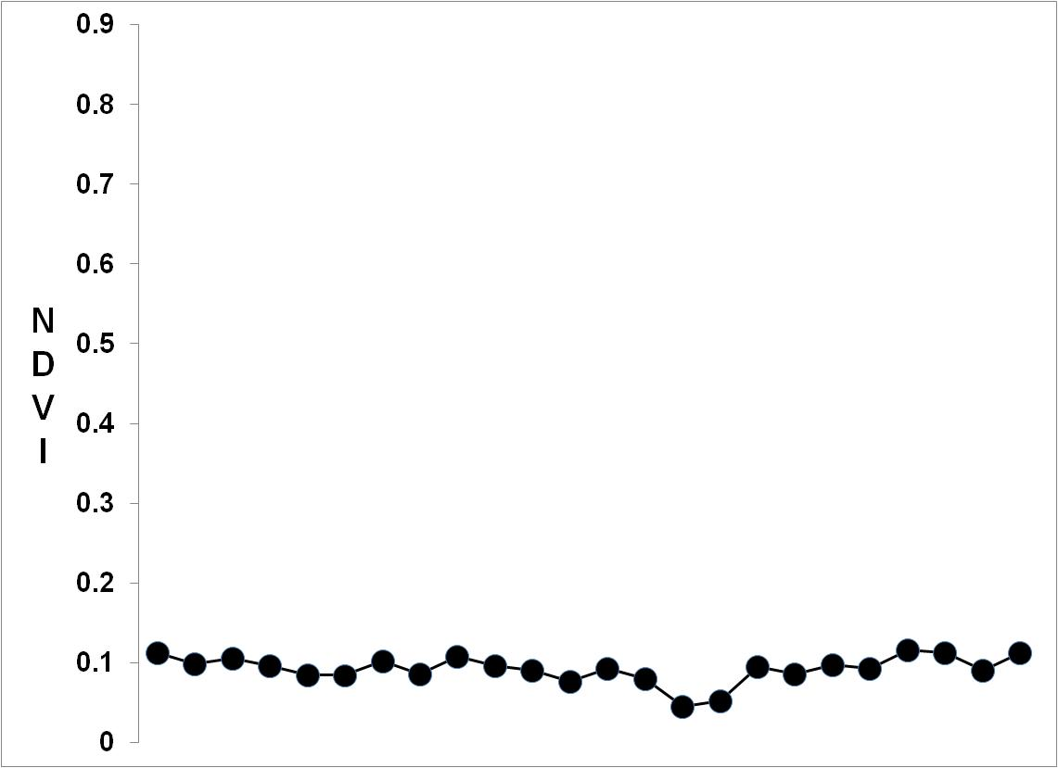
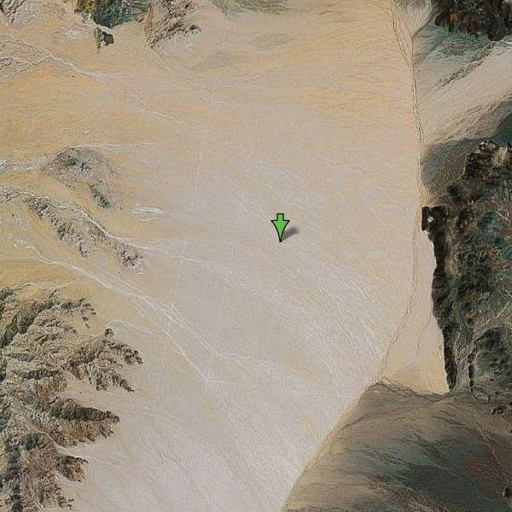
Death Valley
What would this NDVI curve look like?
Kirsten M. de Beurs, Ph.D.
Virginia Tech University
Notes:
Knowing what you now know about NDVI, what does this curve tell you about the seasonal use of this land?
NDVI values around 0.1 year round indicate a near complete absensce of vegetation ……. Desert in fact, with no obvious wet season.

Slide 18
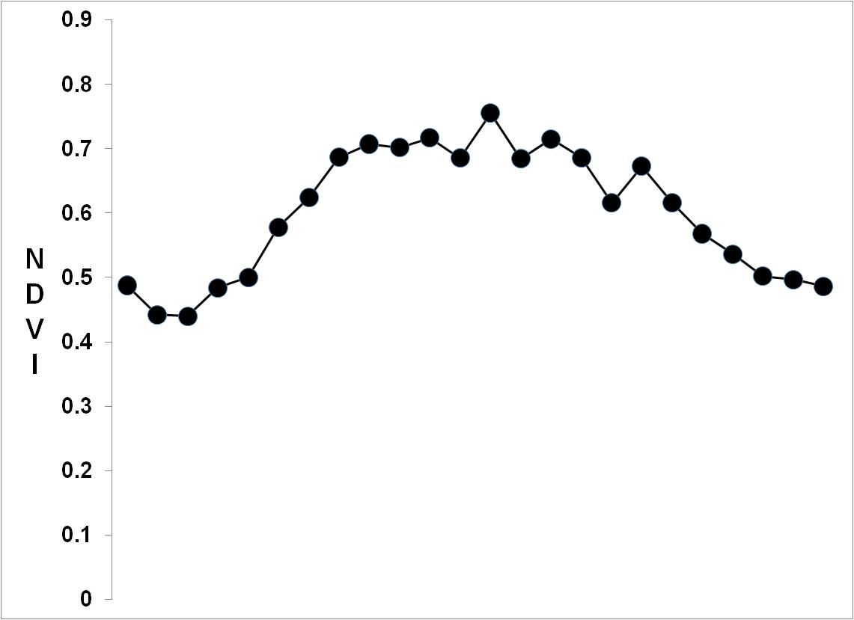
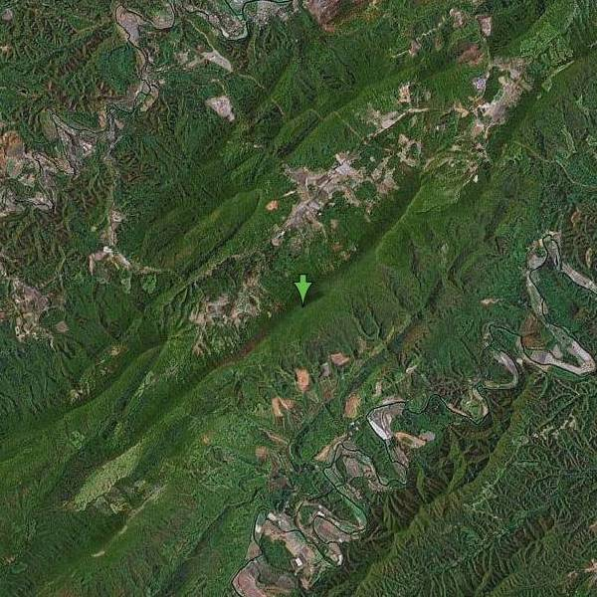
Forest
Southwest Virginia
What would this NDVI curve look like?
Kirsten M. de Beurs, Ph.D.
Virginia Tech University
Notes:
Knowing what you now know about NDVI, what does this curve tell you about the seasonal use of this land?
NDVI values peak in the summer around 0.7 indicating a moderately dense forest canopy. But because winters are mild and precipitation is year round, NDVI remains relatively high across the long growing season and never drops below 0.4.

Slide 19
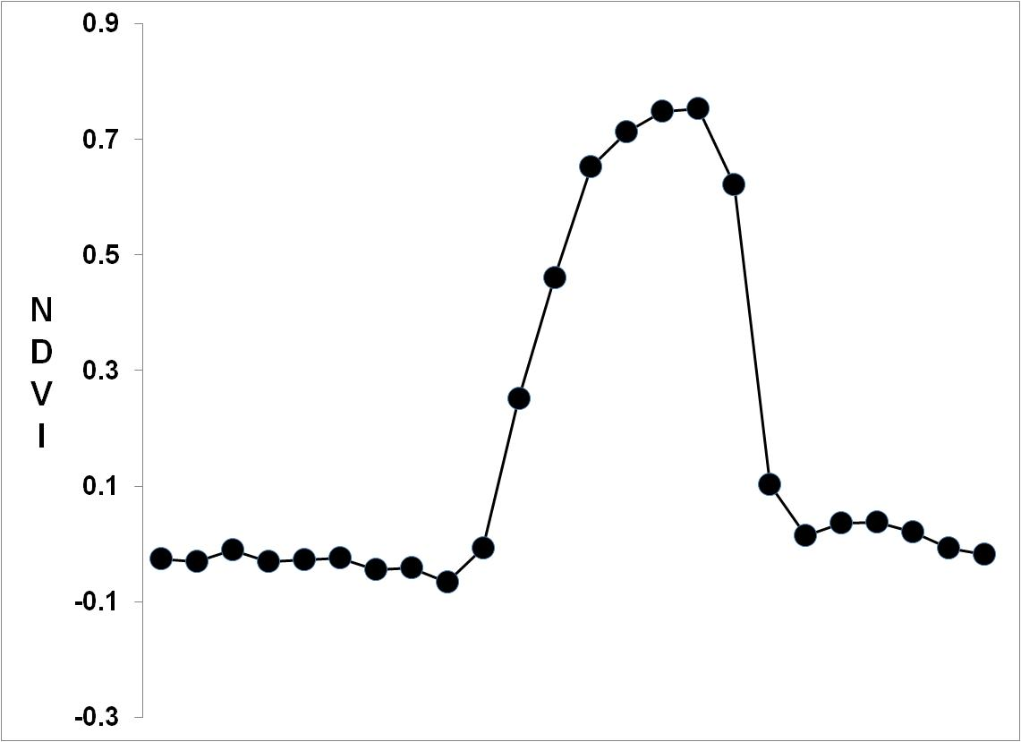
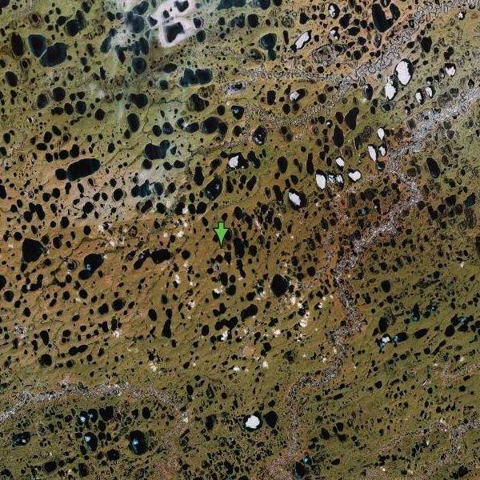
Tundra Northern Alaska
What would this NDVI curve look like?
Kirsten M. de Beurs, Ph.D.
Virginia Tech University
Notes:
Knowing what you now know about NDVI, what does this curve tell you about the seasonal use of this land?
Huge range between the min NDVI (ranging to near negative values indicating snow) and max NDVI (0.7) over a very short growing season, indicate a brief arctic summer with dense growth of grasses.

Slide 20
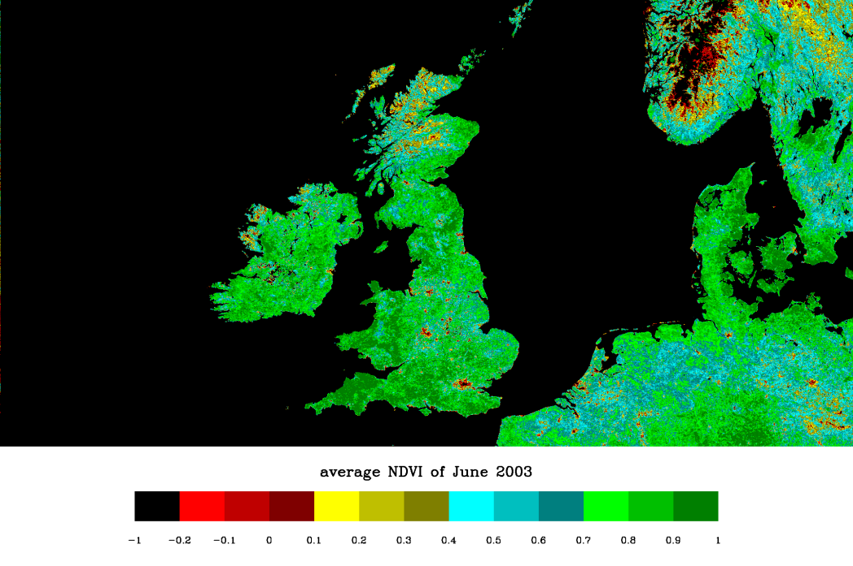
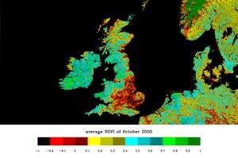
NDVI for Phenological Dates
comparison of NDVI values for different dates
http://www.seiswaves.com/cappelluti/docs/anims/leicester/

Slide 21
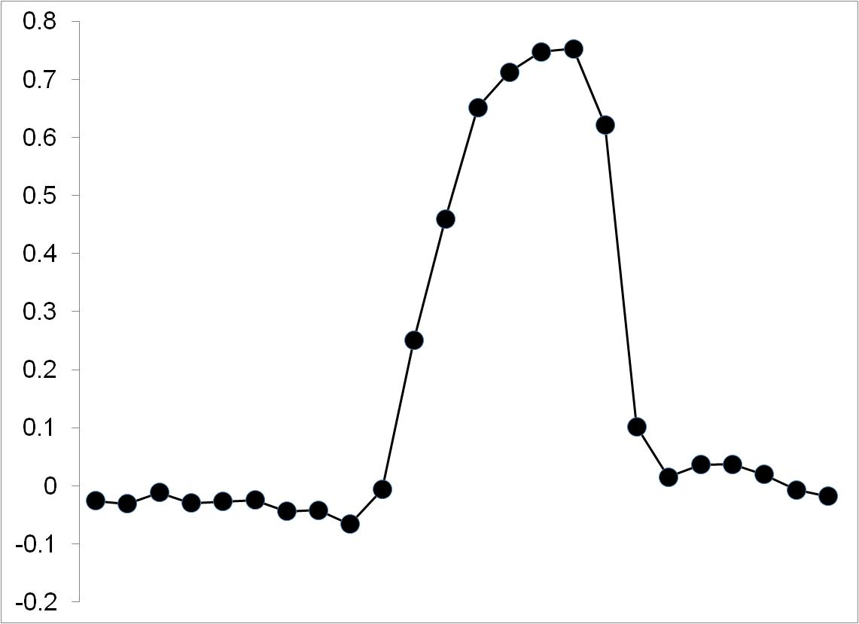
Plotting NDVI
Use of NDVI to identify key phenological dates
Maximum NDVI
Rate of Senescence
Rate of Greenup
Time Integrated NDVI
End of Season
Start of Season
Duration of Season
SOS
Notes:
In general, if there is much more reflected radiation in near-infrared wavelengths than in visible wavelengths, then the vegetation in that pixel is likely to be dense and may contain some type of forest. Subsequent work has shown that the NDVI is directly related to the photosynthetic capacity and hence energy absorption of plant canopies.^{[5][6]}

Slide 22
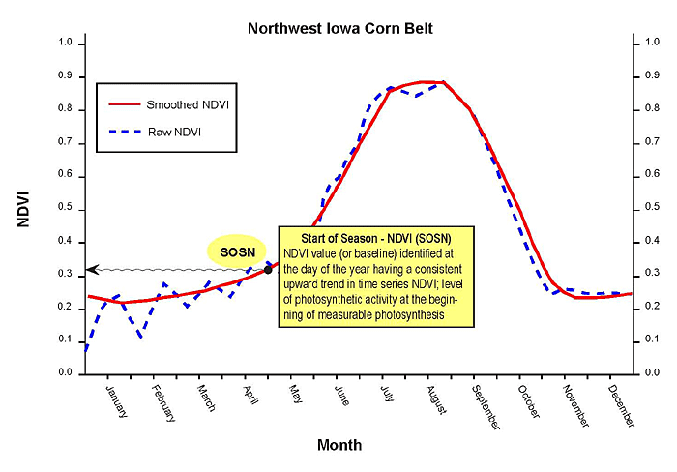
How do you determine dates?
Use of NDVI thresholds to identify key phenological dates
Start of the Season
http://phenology.cr.usgs.gov/methods_metrics.php
Notes:
But even the best remote sensing data isn’t perfect. Note the difference between the dotted raw NDVI and the solid (red) smoothed NDVI (smoothing by moving average).
Why do you think they do this?.....to minimize error encountered between dates of imagery (perhaps atmospheric conditions were different, illumination angle, location of the pixel, non-phenological changes on the ground etc).

Slide 23
Common Thresholds
0.5 of the Max:Min NDVI ratio to approximate the start and end of the season
EOS
Kirsten M. de Beurs, Ph.D. Virginia Tech University
Notes:
NDVI Thresholds
Measure is easy to apply.
However, across the conterminous US, NDVI threshold can vary from 0.08 to 0.40.
Thus, it is inconsistent when applied towards large areas.
Some believe that rapid growth is more important than first leaf occurrence or bud burst.
Lower likelihood of soil – vegetation confusion than at lower thresholds.

Slide 24
50% Threshold (Seasonal Mid-point)
(White et al., mean day = 124, May 4th)

Slide 25
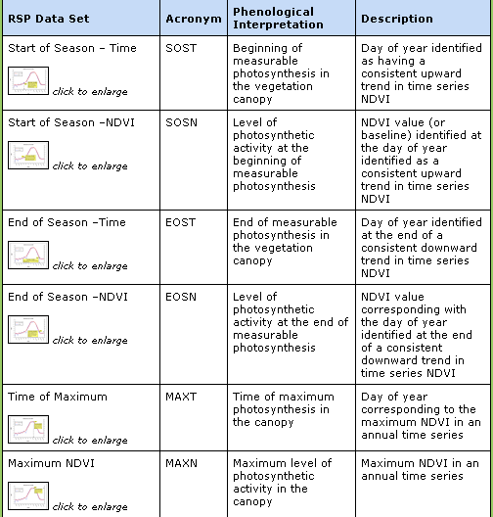
Other key phenological dates
http://phenology.cr.usgs.gov/methods_metrics.php
Notes:
Plotting time-series NDVI data produces a temporal curve that summarizes the various stages that green vegetation undergoes during a complete growing season. Such curves can be analyzed to extract key phenological variables, or metrics, about a particular season, such as the start of the growing season (SOS), peak of the season (POS), and end of the season (EOS). These characteristics may not necessarily correspond directly to conventional, ground-based phenological events, but do provide indications of ecosystem dynamics.
A complete list of the phenological metrics we extract from smoothed, time-series NDVI data is shown in Table 2. Calculated for each year or growing season, these metrics are the basis for diverse research and monitoring applications, including climate change studies.

