Slide 1
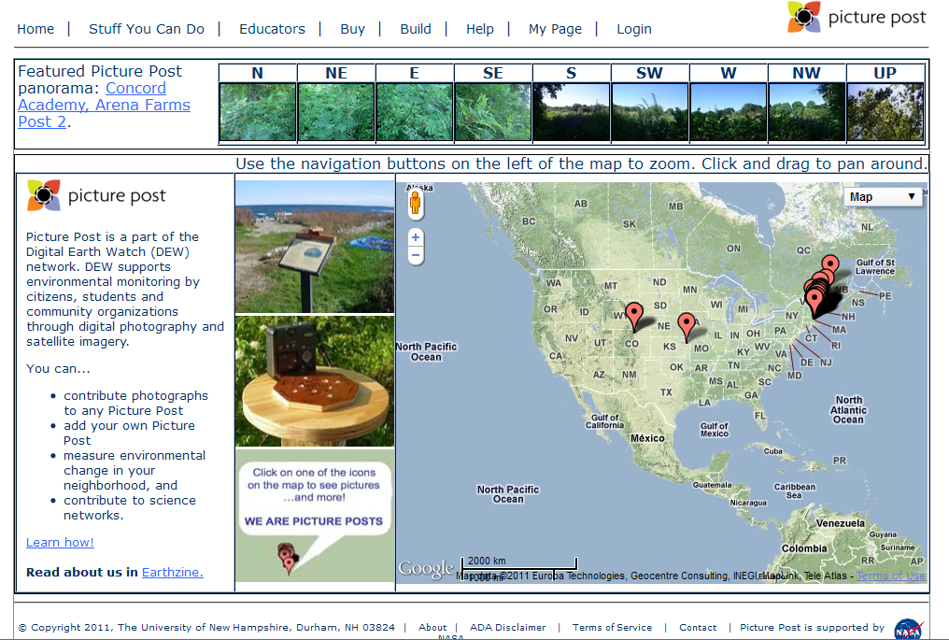
Picture Post
http://picturepost.unh.edu/
Notes:
Picture Post is a part of the Digital Earth Watch (DEW) network. DEW supports environmental monitoring by citizens, students and community organizations through digital photography and satellite imagery.
There are many ways of gathering environmental data. Digital Earth Watch has developed an innovative way of obtaining that data through the use of PicturePosts. A PicturePost is comparable to a tripod on which digital photographs can be taken of the environment in a 360° series over time.
Modern technologies let us monitor plant health using the proportions of light reflected from leaves. Combining this data with our understanding and observations of plant behavior and physiology helps us to quickly assess the quality of the local environment. DEW brings together biology, physics, chemistry, technology, art, engineering, and math in a project that predominantly supports field studies in middle to high school and self-guided education in environmental science. Many tools such as free software and ideas for activities and student challenge questions are provided on this website.

Slide 2
What is a Picturepost
A stable permanent platform
in an ecological important location
where you take
photographs
over time
Notes:
WHAT IS A PICTUREPOST? There are many ways of gathering environmental data. Digital Earth Watch has developed an innovative way of obtaining that data through the use of PicturePosts. A PicturePost is a wooden or plastic post used to hold a camera in order to take photographs of an area in a 360° series.
The PicturePost photographs should be taken about once a week, and are used to monitor changes in the environment over time. One can observe changes in plant health over time, as well as view the drastic changes of spring “green-up” and “green-down.” One can also observe changes in canopy cover, water levels of ponds and lakes, and air conditions.
Photographs are uploaded onto the PicturePost website, where they are shared with other participants and researchers. The PicturePost photograph database is online at http://picturepost.smugmug.com/.
what is expected of PicturePost users. They are expected to choose a PicturePost location, purchase and install their own PicturePost, as well as take and upload photographs once a week.

Slide 3
What you can do with Picturepost
Contribute photographs to the scientific network
Track changes in your site over time
Link your findings to satellite imagery of your area
Notes:
You can...
contribute photographs to any Picture Post
add your own Picture Post
measure environmental change in your neighborhood, and
contribute to science networks.

Slide 4
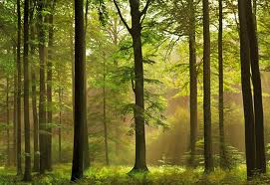
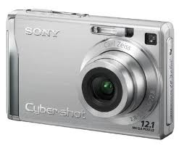
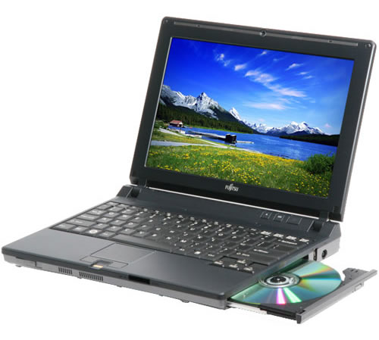
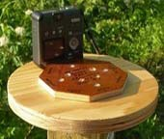
What you need
A permanent plot to visit
Digital Camera
Camera Mounting Block and post
Compass
Computer (for image upload)
Downloaded freeware
A group committed to taking regular photos of their site
Notes:
Any digital camera will do
Any computer or laptop will do, as long as you can download the software.
DEW software supported by both MAC and PC platforms
The mounting block can be made from scratch or purchased through the picture post program.

Slide 5
The Picture Post Process
Select a Location
Install a permanent PicturePost
Take pictures once a week
Upload pictures to the DEW website
Analyze Characteristics of your pictures
Contribute to the scientific Network
Track changes over seasons
Track changes over years
ID and track key phenology stages
Notes:
“THE PICTUREPOST PROCESS” As a PicturePost participant, you will be responsible for the five steps of the “PicturePost process.” These steps are obtaining the PicturePost, selecting a location, installing the PicturePost, taking photographs, and uploading the photograph to the Digital Earth Watch online database.
what is expected of PicturePost users. They are expected to choose a PicturePost location, purchase and install their own PicturePost, as well as take and upload photographs once a week.

Slide 6
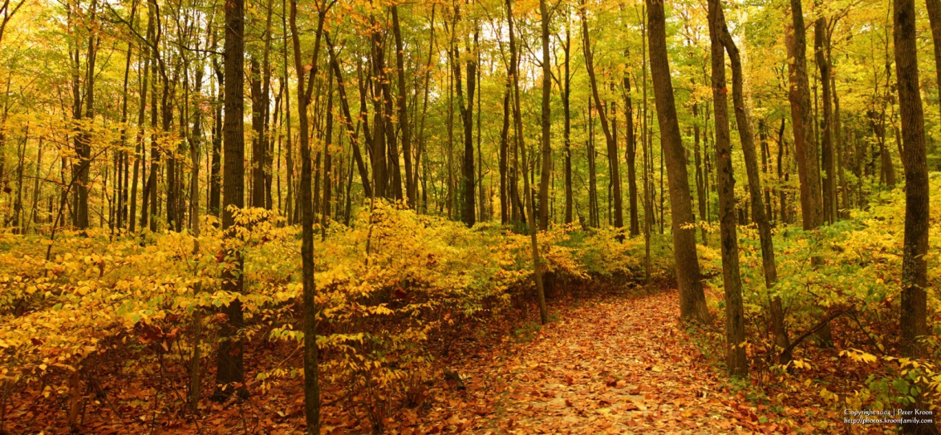
The Picture Post Process
Select a Location
Choose an easily accessible location
Include vegetation in each canopy level
Include a landmark feature for reference
Notes:
Choosing a location for your PicturePost is an important step of the process. The type and quality of data will directly depend on your location choice. Your organization may have a specific goal or site already in mind, but we have provided some general guidelines for choosing a PicturePost location below.
The PicturePost should be placed in a greenspace. This means that it should be surrounded by vegetation in order to make observation of plant life efficient and the data useful.
It is beneficial to the PicturePost project to include as many environmental features within view of the PicturePost as possible. These features could be lakes, ponds, hills, rocks, and a variety of vegetation.
It is a good idea to include at least one “landmark feature” within view of the PicturePost. This feature will serve as a reference point for comparing data from that location.
Try to choose a location that can capture vegetation in each of the herbaceous (ground-level), shrub (mid-level) and canopy (tree-level) “layers” of the environment. You will be able to compare the different level of impact by environmental influences on these different layers. You will also see the stunning changes of these layers during spring green-up and autumn green-down.
The PicturePost should also be accessible by the public, but located in area with low risk for vandalism.

Slide 7
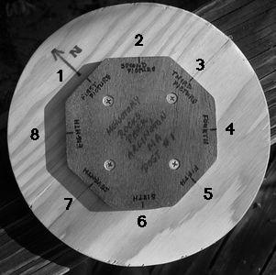
The Picture Post Process
Install a permanent PicturePost
Notes:
There are two ways to obtain a PicturePost. You can build your own or buy one. Building a PicturePost out of wood requires only about $25 of materials. A wooden PicturePost can be placed anywhere, but is susceptible to warping and rotting. Those PicturePosts must be replaced often. The exact replacement time depends on the conditions of the area in which it is placed.
INSTALLING YOUR PICTUREPOST The instructions for installing a PicturePost that are described here refer to the installation of a plastic PicturePost. If you choose to build your own wooden PicturePost, see Appendix A for instructions. All of the instructions can be found online at http://mvh.sr.unh.edu/mvhtools/build_picturepost.htm.
Instructions:
1. Dig a hole at least 3 feet deep and wide enough for the 4x4 PicturePost. (The PicturePost must be installed below frost depth. In the Boston area, that is about 3 feet. For the frost depth of your area, consult local builders.)
2. Use a level to keep the post level, while back filling the hole with dirt. Make sure to check the level in all directions and to stamp the dirt until it is firm and the post is stable.
3. Find true north for your area online at: http://www.thecompassstore.com/decvar.html. For the Boston area in early 2008, magnetic north is 15 degrees west of true north. See the picture at the right. Notice that the compass is held so that the white tip of the compass, which points north, points 15 degrees west of north.
4. Align the post cap so that the north directions points to true north. Double check alignments and drill four holes through the post head into the post. Secure with the drywall screws.
5. Using permanent marker or paint, label the post head with location information and attach basic instructions.
6. Now, PHOTOGRAPH AWAY!!!

Slide 8
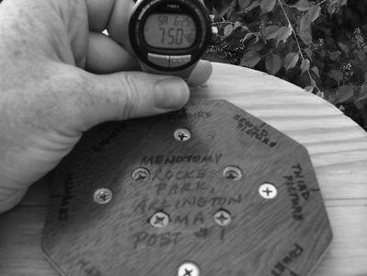
The Picture Post Process
Take pictures once a week
During a most of the year, take photographs once a week.
To study the seasonal cycles, take photographs once a day during spring “green up” and autumn “green down.”
Record the time and date of your photos
Take 8 photos of the landscape (clockwise starting N) and one of the sky
Notes:
TAKING PICTUREPOST PHOTOGRAPHS
Taking PicturePost photographs is as simple as using a tripod. We suggest using a digital camera, so that pictures can be uploaded to the PicturePost database. In order to simplify the naming process before uploading, you should take your photographs in a specific manner described below. These instructions are also available online at: http://mvh.sr.unh.edu/mvhtools/taking_photos.htm.
Instructions:
1. Record the date, time, and location of your photographs. We suggest taking a photograph of a watch and the PicturePost cap for this purpose. (See picture at the right.)
2. Take 8 photographs of the landscape and 1 of the sky.
Make sure that the zoom lens is set to the widest angle.
Take the first photograph with the back of the camera against the north side of
the octagon.
Take photographs in a clockwise manner (north, northeast, east, southeast, etc.)
Take a photograph with the camera on its back and the bottom edge of the camera aligned with the north side of the octagon to record sky or canopy conditions.
How often should you take photographs?
During a most of the year, take photographs once a week.
To study the seasonal plant cycles, take photographs at least once a day during spring “green up” and during autumn “green down.”
Coordinate with a group of photographers during the busy weeks

Slide 9
The Picture Post Process
Take pictures once a week
Notes:
TAKING PICTUREPOST PHOTOGRAPHS
Taking PicturePost photographs is as simple as using a tripod. We suggest using a digital camera, so that pictures can be uploaded to the PicturePost database. In order to simplify the naming process before uploading, you should take your photographs in a specific manner described below. These instructions are also available online at: http://mvh.sr.unh.edu/mvhtools/taking_photos.htm.
Instructions:
1. Record the date, time, and location of your photographs. We suggest taking a photograph of a watch and the PicturePost cap for this purpose. (See picture at the right.)
2. Take 8 photographs of the landscape and 1 of the sky.
Make sure that the zoom lens is set to the widest angle.
Take the first photograph with the back of the camera against the north side of
the octagon.
Take photographs in a clockwise manner (north, northeast, east, southeast, etc.)
Take a photograph with the camera on its back and the bottom edge of the camera aligned with the north side of the octagon to record sky or canopy conditions.
How often should you take photographs?
During a most of the year, take photographs once a week.
To study the seasonal plant cycles, take photographs at least once a day during spring “green up” and during autumn “green down.”
Coordinate with a group of photographers during the busy weeks

Slide 10
The Picture Post Process
Register and Log in to the site
Create your Picture Post location within the database http://picturepost.unh.edu/help_addpost.jsp
Upload pictures to the DEW website
Contribute to the scientific Network
Notes:
Pictures can be taken by anyone and can be posted on the DEW SmugMug website. 7
There, the information can be viewed, downloaded, and analyzed (Measuring Vegetation Health, 2006d). Digital Earth Watch developed the database for PicturePost images in order to begin to collect information about the changing environment.
Adding your post to the network:
Register on the Picture post site and follow these directions to add a post. http://picturepost.unh.edu/help_addpost.jsp
You will also need the latitude and longitude of your post (see installation instructions). The date that you installed your post. A photograph of your post. A set of 9 reference photographs (you can take these photographs when you install the post). A name for your post (include this in your post signage). A brief description of your post (include this in your post signage). The time zone that your post is in (if you don't know your time zone, you can find it here.)
UPLOADING PHOTOGRAPHS
It is very important to upload your PicturePost photographs to the correct folder in the PicturePost database, so that the database has consistent data that will be useful in analysis. The instructions below will help you through the uploading process. These instructions can also be found online at: http://mvh.sr.unh.edu/mvhtools/uploading_photos.htm. Because the PicturePost website is meant to serve as a database for environmental data, we have guidelines for photographs that are acceptable for the uploading. Please read them in Appendix B.
Logging In
Go to http://picturepost.smugmug.com/.
Click on “login”
Use email: “picklejohnmr@gmail.com” and password: “postguest”
Setting up a folder for your PicturePost
Before you upload any photographs, you will have to create folders in the PicturePost database for you PicturePost. The instructions to do this are explained here:
At the PicturePost database home page (http://picturepost.smugmug.com/), click “add photos”
For “title” type in: “state abbreviation”-“three letter code for PicturePost and post number”-“compass direction”
Note: You will have to make up a three letter code for your PicturePost. Like the example, it should reflect the PicturePost’s location.
For example see below
For the “category” choose the state in which your PicturePost is located. If you do not see your state, select “Create a new category” and type in your state.
For the “subcategory” select “Create a new subcategory” and type in the park or school, city, and state abbreviation of your PicturePost. (In the example below, that is “Fresh Pond Reservation, Cambridge, MA.”)
Leave the “theme” and “quick settings” as default and click “Create Gallery.”
Repeat these steps for Northeast, East, Southeast, South, Southwest, West, Northwest, and Sky.
Renaming your photographs
A program designed to assist you in renaming your photographs is available online at http://mvh.sr.unh.edu/mvhtools/picturepost_intro.htm. The instructions below can also be used in place of that program. Once the photographs are uploaded to the PicturePost database, they cannot be renamed!!! Please follow these rules. SSPPP#CCYYMMDDHHmm.jpg
SS = State Abbreviation
PPP = 3-letter location name
CC – Direction Camera is pointing
o NN = North
o NE = Northeast
o EE = East
o SE = Southeast
o SS = South
o SW = Southwest
o WW = West
o NW = Northwest
o SKY = Camera pointing skyward
YY = Year
MM = Month
DD = Day of month
HH = Local hour (on the 24 hour clock)
mm = Minutes
Select an upload process
Standard provides the easiest procedure.
Browse your computer to find your photos
Double check location, post number, and direction
Click “Add Photos

Slide 11
The Picture Post Process
Upload your photos on your “My Page”
http://mvh.sr.unh.edu/mvhtools/uploading_photos.htm
Upload pictures to the DEW website
Contribute to the scientific Network
Notes:
Renaming your photographs
Please follow these rules. SSPPP#CCYYMMDDHHmm.jpg
SS = State Abbreviation
PPP = 3-letter location name
CC – Direction Camera is pointing
o NN = North
o NE = Northeast
o EE = East
o SE = Southeast
o SS = South
o SW = Southwest
o WW = West
o NW = Northwest
o SKY = Camera pointing skyward
YY = Year
MM = Month
DD = Day of month
HH = Local hour (on the 24 hour clock)
mm = Minutes
Select an upload process
Standard provides the easiest procedure.
Browse your computer to find your photos
Double check location, post number, and direction
Click “Add Photos

Slide 12
Download the Panorama Software
Visualize changes over time
Panarama Factory Software
http://www.foto-freeware.de/panoramafactory.php

Slide 13
Panorama Software
Visualize changes over time
Upload your photos into the Panorama Factory by clicking on the Camera Icon
Panarama Factory Software

Slide 14
Panorama Software
Visualize changes over time
Drag your newly imported photos into the correct order
Select them all with the CTRL button
Click on the Stich Icon
Panarama Factory Software

Slide 15
Panorama Software
Visualize changes over time
Panarama Factory Software
Select your new panorama
From the File Tab select Save View As
Now you can save your panorama as a jpg. Or .tif for later analysis or stacking.
Animate Your Images

Slide 16
More Visualization Tools
Visualize changes over time
Animate Your Images
Make your own Picture Story using Windows Movie Maker or Apple’s QuickTime Pro
Panarama Factory Software
Notes:
CREATE A TIME LAPSE MOVIE! By making a time lapse movie out of your photographs, you can observe changes in plant health and growth. To make a movie, you will need to take several pictures from one view of the PicturePost or download them from the PicturePost database. We suggest using Windows Movie Maker or Apple’s QuickTime Pro.

Slide 17
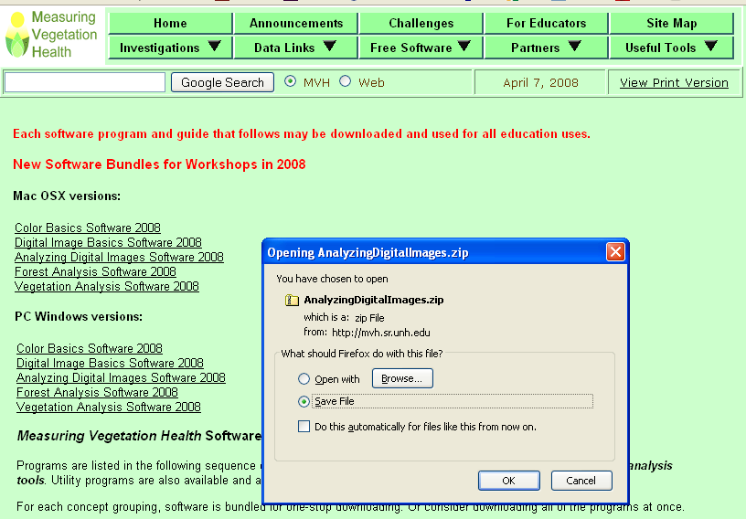
Download the ADI Software
Quantify Canopy Characteristics
Analyzing Digital Images Software
http://mvh.sr.unh.edu/software/software.htm
Notes:
Note that this is a zip file……you will need an unzip software pack to unzip the files to install.

Slide 18
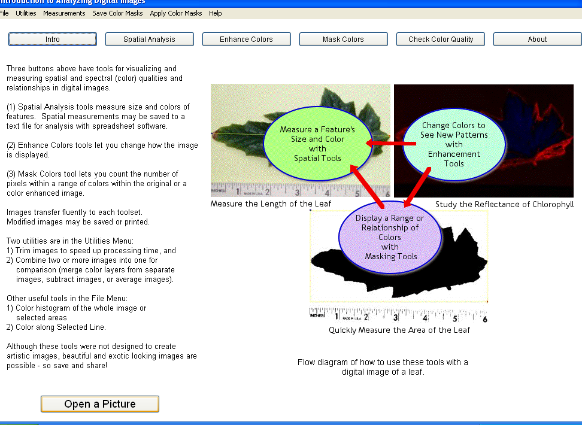
Analyzing your imagery
Open the Analyzing Digital Imagery Program
Click Open a Picture and browse to your image
Select NONE for the Calibration Method
Quantify Canopy Characteristics
Analyzing Digital Images Software

Slide 19
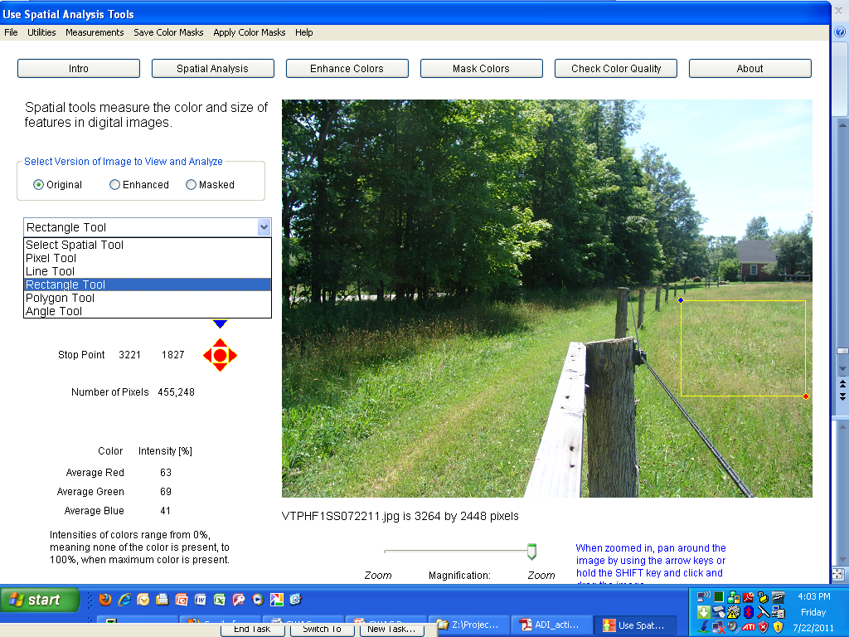
Analyzing your imagery
Select the Rectangle Tool to isolate an area of vegetation in your image
Quantify Canopy Characteristics
Analyzing Digital Images Software

Slide 20
Analyzing your imagery
Record your color intensities for the Red, Green and Blue Bands
Calculate your greenness Index as:
Quantify Canopy Characteristics
Analyzing Digital Images Software

Slide 21
Analyzing your imagery
Calculate your greenness Index as:
Quantify Canopy Characteristics
Analyzing Digital Images Software

Slide 22
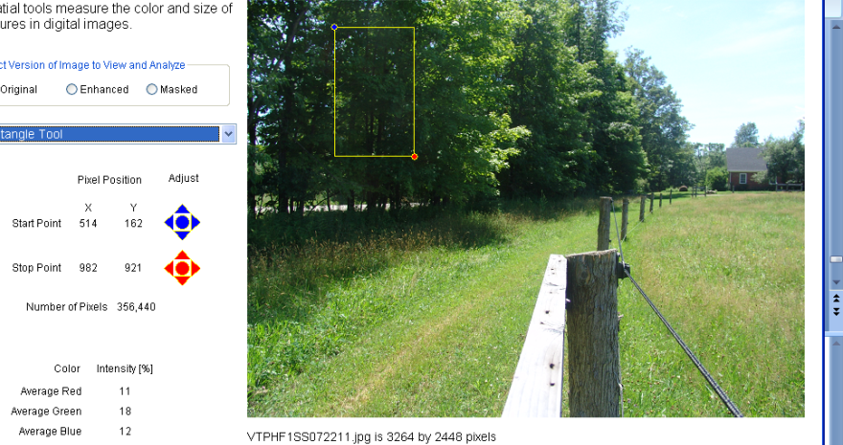
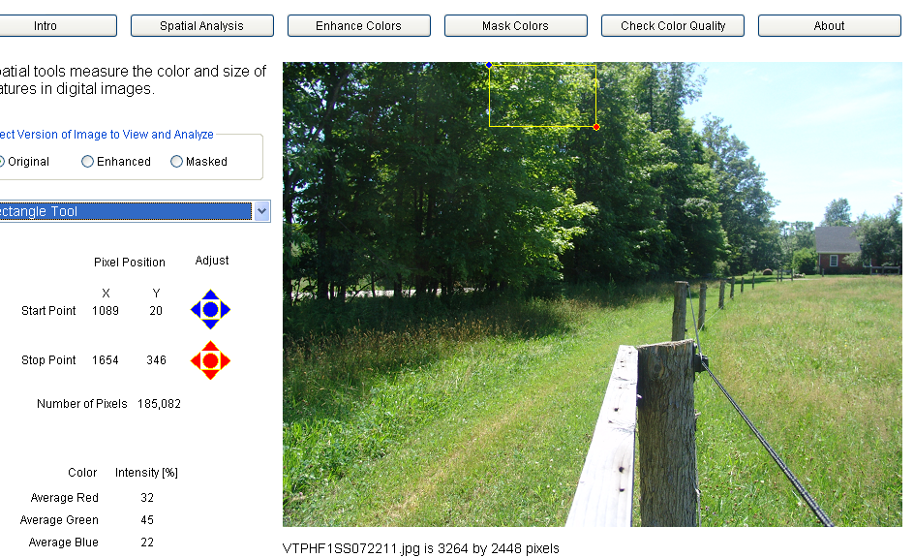
Analyzing your imagery
Investigate how grass compares to trees or how shadow compared to sunlit areas
Quantify Canopy Characteristics
Analyzing Digital Images Software

Slide 23
A wealth of information
Pulling it all together

