Slide 1
Detecting Temporal Trends In Species Assemblages With Randomization Procedures And Hierarchical Models
Nick Gotelli
University of Vermont USA

Slide 2


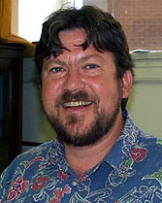
Collaborators!
Robert Dorazio
University of
Florida USA
Gary Grossman
University of
Georgia USA
Aaron Ellison
Harvard Forest USA

Slide 3
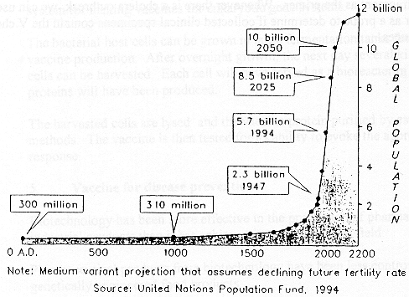
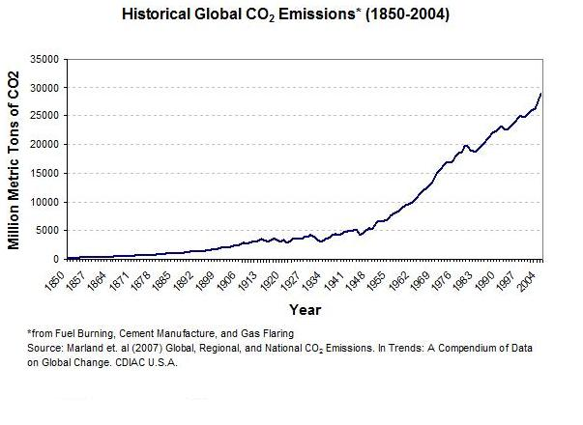
Causes of Temporal Change in Communities

Slide 4
Pathways of Temporal Change
Abiotic Change
Changes in abundance
Changes in abundance of competitors, predators, prey

Slide 5
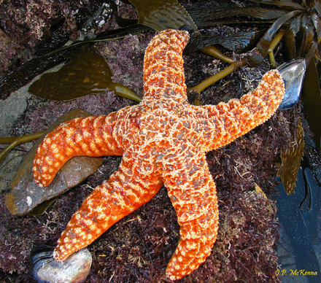
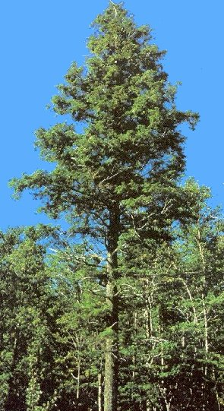

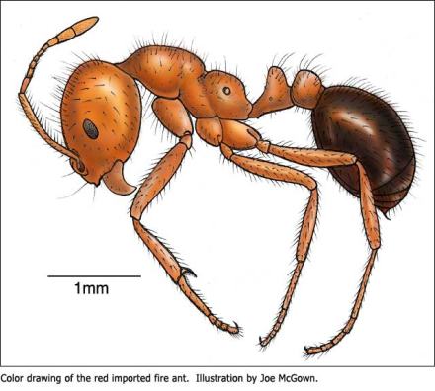
Conspicuous Drivers of Temporal Change
Keystone
Species
Foundation Species
Ecosystem Engineers
Invasive Species

Slide 6
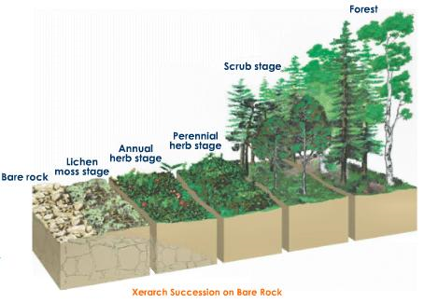
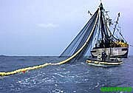


Subtle Drivers of Temporal Change
Habitat alteration, succession
Long-term
climate change
Hunting, overexploitation
“Shifting Baseline”

Slide 7

But not all apparent patterns of temporal change reflect “true” changes in population or community structure!

Slide 8
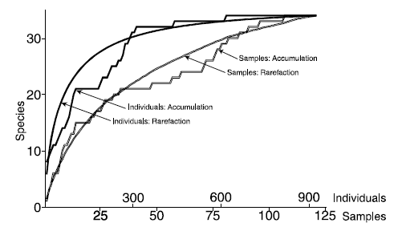
Most indices of species diversity and population size are sensitive to “sampling” effects

Slide 9

How can we account for sampling effects when assessing temporal changes in populations and communities?

Slide 10
Data Structure
 | Sample 1 | Sample 2 | Sample 3 | Sample 4 | Sample 5 | Sample 6
Species A | 515 | 320 | 501 | 550 | 570 | 902
Species B | 0 | 0 | 0 | 2 | 1 | 0
Species C | 2 | 4 | 5 | 9 | 27 | 60
Species D | 1 | 1 | 0 | 0 | 0 | 3
Species E | 0 | 0 | 0 | 0 | 34 | 0
i = 1 to S species
j = 1 to T consecutive temporal samples
y_{ij} = count of individuals of species i recorded in sample j

Slide 11
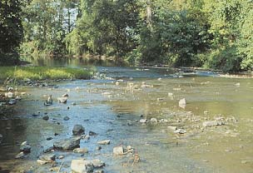
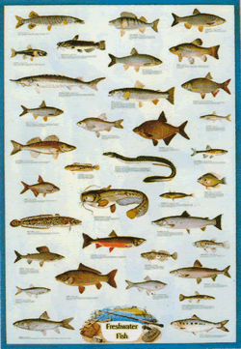
Freshwater fishes in a central U.S. stream
i= 1 to 55 species
j = 1 to 15 ~ annual samples (1963 – 1974)
N = 14,142 individuals sampled by seining
Grossman, G. D., Moyle, P. B., and J. R. Whitaker, Jr. 1982. Stochasticity in structural and functional characteristics of an Indiana stream fish assemblage: a test of community theory. Am. Nat. 120:423-454.

Slide 12
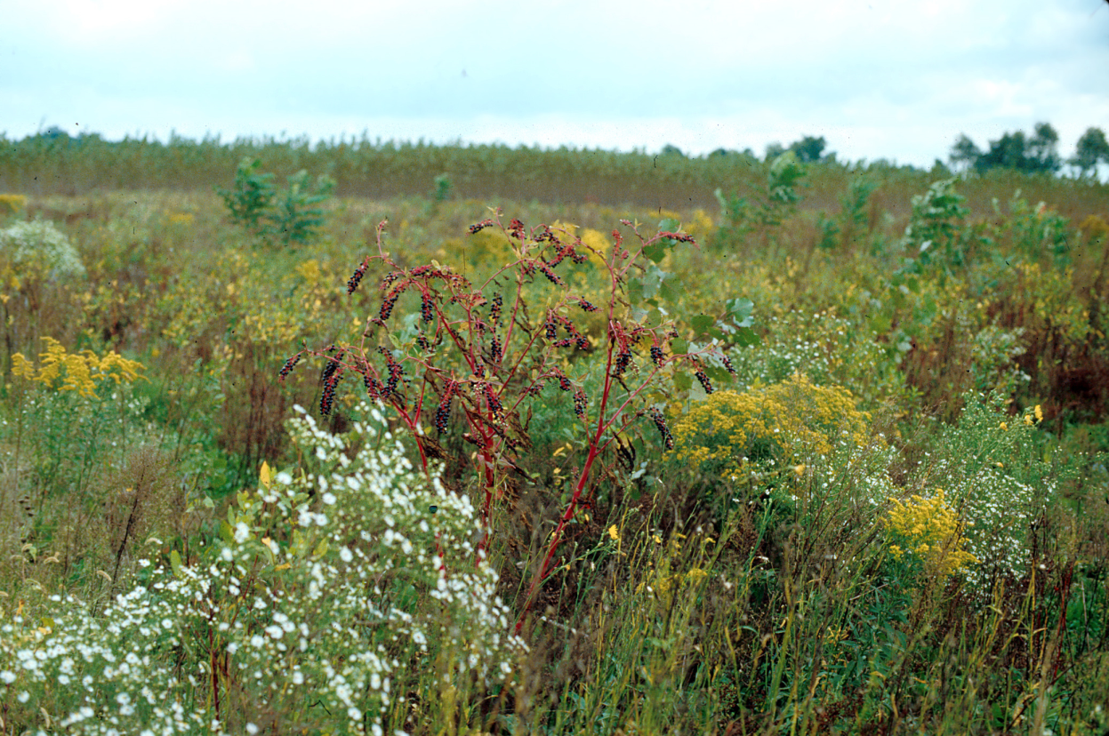
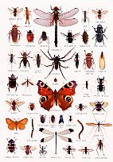
Insects in a central U.S. grassland (KBS)
i= 1 to 9 species common species (Chrysopidae, Lampyridae )
j = 1 to 14 annual samples (1989 – 2002)
N = 5614 individuals sampled by sticky traps
Isaacs, R., J. Tuell, A. Fiedler, M. Gardiner, and D. Landis. 2009. Maximizing arthropod-mediated ecosystem services in agricultural landscapes: The role of native plants. Frontiers in Ecology and the Environment 7: 196-203.

Slide 13
Null model test for temporal trends in community structure
Metric to summarize pattern of temporal change (TC)
Specify distribution of TC under sampling H₀

Slide 14
Abundance Trends For A Single Species

Slide 15
Abundance Trends For A Single Species

Slide 16
Abundance Trends For A Single Species

Slide 17
Community Trends in Abundance
Stationary
Non-Stationary
Null hypothesis for measurement of temporal trends at community level

Slide 18
Metric to summarize pattern of temporal change
TC is the sample variance of trend line slopes for all species in the assemblage

Slide 19
Community Trends in Abundance
Stationary
Non-Stationary

Slide 20
Specify distribution of TC under sampling H₀
Assign each of individuals N to different time periods based on t_{j}, the proportion of the total collection made at time j (good and bad sampling intervals)
Assign each of the N individuals to a different species based on p_{i}, the proportion of the total collection represented by species i (common and rare species)

Slide 21

Assumptions of Null Model
Multinomial sampling, conditional on total abundance (N)
Species differ in commonness and rarity
Time periods differ in suitability for detection
No species interactions

Slide 22
Incorporating Undetected Species
Observed S is a biased under-estimator of total S
Undetected species should be included in the null distribution
Estimate the number of missing species using non-parametric Chao2 estimator (Chao 1984)

Slide 23
Non-parametric Estimator for Undetected Species
T = number of censuses
Q₁ = number of “singletons” (species detected in exactly 1 census)
Q₂ = number of “doubletons” (species detected in exact;u 2 censuses)
Chao, A. 1984 Non-parametric estimation of the number of classes in a population. Scandinavian Journal of Statistics 11: 265-270.

Slide 24
Estimating Relative Abundance

Slide 25
Estimating Relative Abundance
Undetected Species

Slide 26
Estimating Relative Abundance
Assumption: Relative frequency of undetected species =
0.5 x relative frequency of rarest observed species
Undetected Species

Slide 27
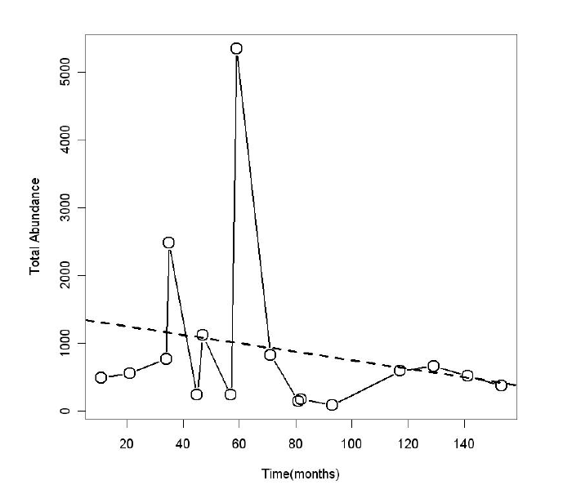
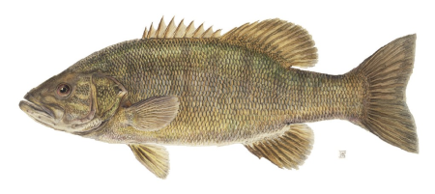
Temporal Trends of Stream Fishes
Total Abundance (1963-1974)

Slide 28
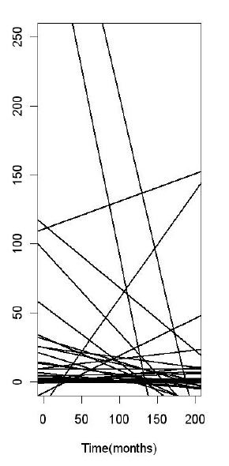
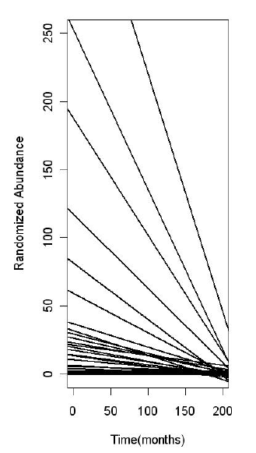
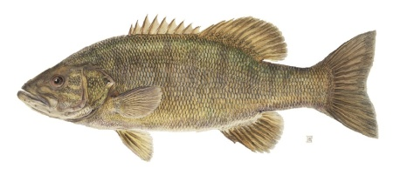
Temporal Trends of Stream Fishes
Individual Species (1963-1974)
Null Distribution

Slide 29
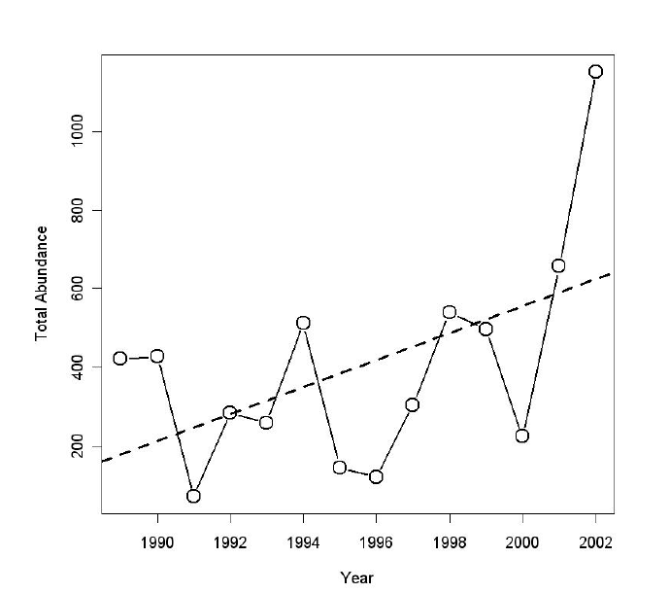
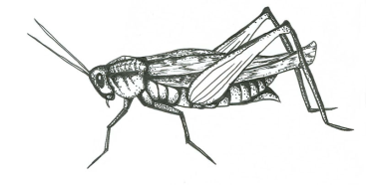
Temporal Trends of Grassland Insects Total Abundance (1989-2002)

Slide 30
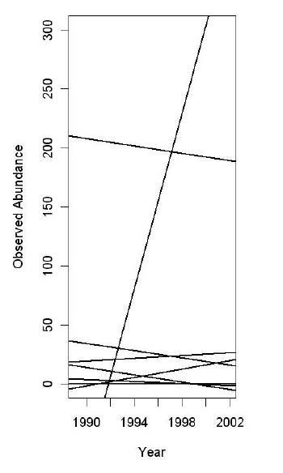
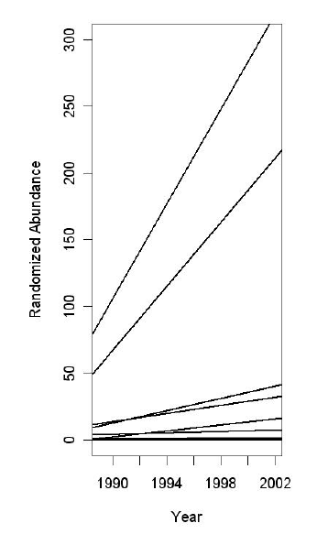
Temporal Trends of Grassland Insects
Individual Species (1989-2002)
Null Distribution

Slide 31
Estimating Temporal Trends For Individual Species
Assumes model of exponential growth
Poisson distribution for population size
Detection probabilities differ among species, but are constant across sampling dates
Growth rates for individual species estimated from common distribution
Model cannot be fit for species that are very rare (< 10 occurrences)

Slide 32
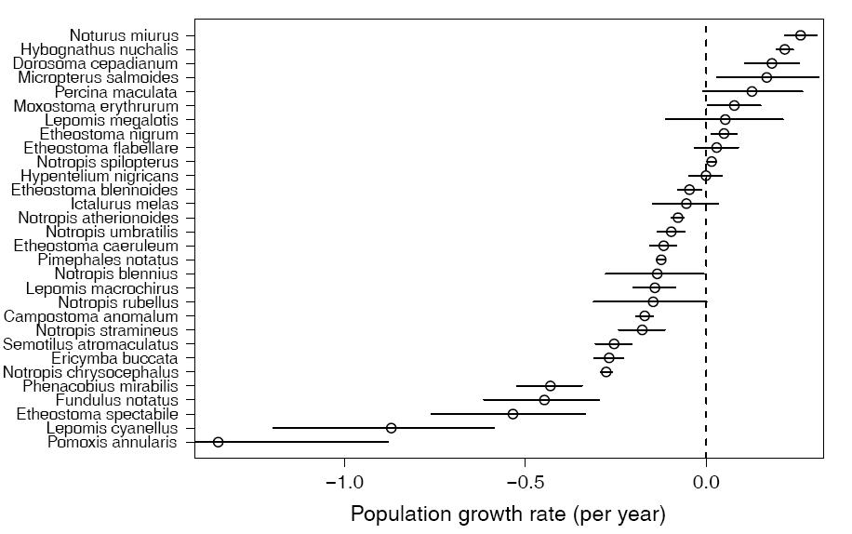
Estimated Growth Rates of Stream Fishes

Slide 33
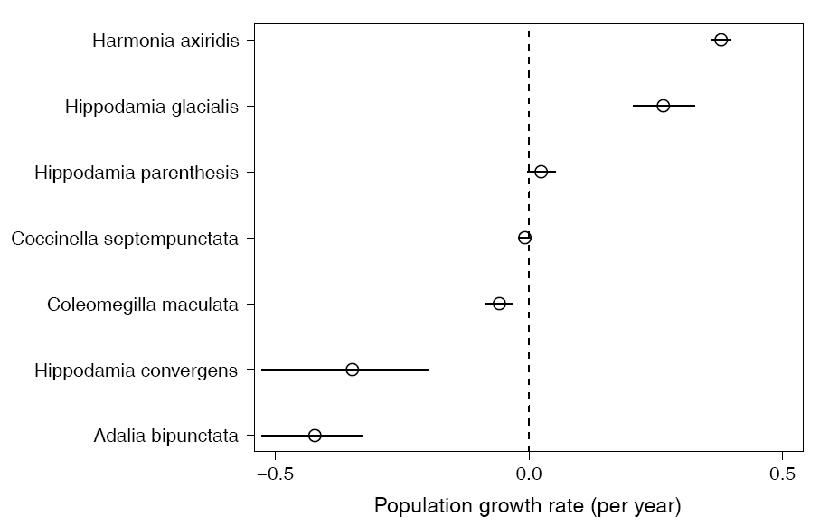
Estimated Growth Rates of Grassland Insects

Slide 34
Summary
Temporal changes in community structure generated by abiotic forces and species interactions
Multinomial sampling model as a null hypothesis for temporal trends
Heterogeneous patterns for
stream fishes and grassland insects
Hierarchical model to estimate
trends for individual species

