Slide 1
All materials provided in this training, including the contents of linked pages, are provided for general informational purposes only. While we seek to provide links to current and authoritative information, neither UVM nor this office guarantees the accuracy of information accessible online; therefore, this information must not be relied upon as substitute for legal advice from a qualified attorney. Please contact the UVM Office of the General Counsel attorney to obtain current legal advice specifically responsive to your questions.
UVM Medical Leave and FMLA/VPFLA/Military Leave

Slide 2
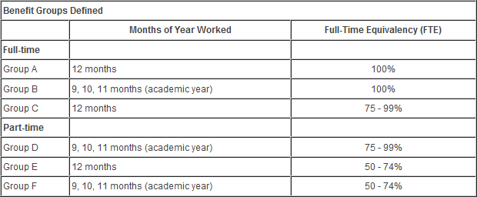
Benefits Groups
Notes:
To understand the amount of medical leave, also known as sick pay, that is available to you, you must identify to which benefits group you belong. Identify your group and press next to continue.
Employees in benefits group A earn the equivalent of one day per month or 12 days per year. If your standard hours are 7.5 per day, you will receive 90 hours per year. If your standard hours are 8 per day, you will receive 96 hours per year. Employees in benefits groups B through F are eligible for the same number of medical leave hours, but they are prorated based on the employees’ full time equivalent, or FTE. For example, an employee that works an 85% FTE of a 37.5 hour work week, receives 76.5 hours per year. An employee that works a 50% FTE of a 40 hour work week is entitled to 48 hours per year.
New employees automatically receive the equivalent of one year’s worth of medical leave on the day they are hired. These hours can be used immediately, however any probationary period that has been applied, can be extended by the amount of medical leave that is taken.
After one year of employment with UVM, new employees begin earning medical leave on a monthly basis.
Accrual of medical leave is unlimited, but unlike vacation time, unused hours are not paid out to the employee upon her or his leaving the University. Additionally, medical leave cannot be shared between employees.

Slide 3
When to Use UVM Medical Leave
During an illness
To attend medical/dental appointments
To actively care for a seriously ill immediate family member
  Spouse (or partner in a civil union)
  Child/Stepchild
  Parent/Stepparent
  Parent/Stepparent of your spouse (or partner)
For childbearing
Notes:
Medical leave, or sick pay, can be used in many different situations, including, but not limited to the following:

Slide 4

Family and Medical Leave Act (FMLA)
Notes:
The Family and Medical Leave Act, or FMLA, entitles eligible employees to take unpaid leave for specified family and medical reasons with a guarantee of continued health insurance coverage.

Slide 5
Family and Medical Leave Act (FMLA)
Twelve workweeks of leave in a 12-month period for:
  the birth of a child and to care for the newborn child within one year of birth;
  the placement with the employee of a child for adoption or foster care and to care for the newly placed child within one year of placement;
  to care for the employee’s spouse, child, or parent who has a serious health condition;
  a serious health condition that makes the employee unable to perform the essential functions of his or her job;
  any qualifying exigency arising out of the fact that the employee’s spouse, son, daughter, or parent is a covered military member on “covered active duty
Notes:
Under Federal Family Medical Leave Act, eligible employees are entitled to the following:

Slide 6
Family and Medical Leave Act (FMLA)
OR
  Twenty-six workweeks of leave during a single 12-month period to care for a covered service member with a serious injury or illness who is the spouse, son, daughter, parent, or next of kin to the employee (military caregiver leave).

Slide 7
Vermont Parental and Family Leave (VPFLA)
Notes:
In addition to the Federal FMLA law, the State of Vermont has enacted the Vermont Parental and Family Leave Act or VPFLA. The law requires many employers, including UVM, to allow full-time employees to take up to 12 weeks per year of unpaid leave for pregnancy, birth, adoption or serious illness of themselves or close family members. Employers may not retaliate against employees who exercise their rights under the law and normally must reinstate employees in their jobs on return from leave.

Slide 8
Vermont Parental and Family Leave (VPFLA)
The parental leave section of the act applies to employers with 10 or more employees.
The medical leave section of the act applies to employers with 15 or more employees.
To qualify under the act employees must be continuously employed by the same employer for a period of one year for an average of at least 30 hours per week.
Notes:
VPFLA stipulations state the following:

Slide 9
Vermont Parental and Family Leave (VPFLA)
Vermont law also allows many employees to take up to 24 hours per year (4 hours per month) of short-term unpaid leave for routine medical and dental care, children’s academic needs, medical emergencies, and the like.

Slide 10
Differences between FMLA and VPFLA
FMLA
vs.
VPFLA
Notes:
There are significant differences between the Vermont Parental and Family Leave Act and the federal Family and Medical Leave Act (FMLA). In general, whichever of the two statutes provides greater protection for employees is the one that will apply.

Slide 11
Differences between FMLA and VPFLA
 | Federal Law | VT Law
Number of employees required for coverage | 50 or more employees (within 75 miles) | 10 or more employees (parental leave) or 15 or more employees (family & short term leave) – location of employees is irrelevant
How long must employee work to be eligible? | 12 months (minimum of 1250 hours) | 12 months (average of 30 hours per week)
Weeks of leave annually | 12 | 12
What is family leave? | Leave for birth or adoption of a child or placement of a child for foster care and in order to care for that child. | Leave for serious illness of employee or family member.

Slide 12
Differences between FMLA and VPFLA
 | Federal Law | VT Law
What is parental leave? | Not applicable – see above | Leave for pregnancy, birth or adoption of a child under age 16
What is parental leave? | Not applicable – see “what is family leave” above | Leave for pregnancy, birth or adoption of a child under age 16
What is medical leave? | Leave for serious health condition of employee, which prevents him/her from performing job duties or to care for family member with serious health condition | Not Applicable – see “what is family leave” above

Slide 13
Differences between FMLA and VPFLA
 | Federal Law | VT Law
What is a “serious health condition” or a “serious illness?” | A serious health condition is defined as one requiring inpatient care or continuing treatment by a health care provider. DOL regs. define this to include pregnancy or an incapacitating illness of more than 3 calendar days length. | A serious illness is defined as one requiring inpatient care or continuing treatment by a health care provider. There are not interpretive regulations, but DOL’s federal guidelines are persuasive because the statutory definitions are so similar.
For what family member can leave be taken? | Medical leave can be taken to care for the employee’s spouse, child or parent with a serious health condition. (Spouse probably does not include civil union partner). | Family leave can be taken for the serious illness of the employee’s child, stepchild or ward who lives with the employee, foster child, parent, spouse or parent of spouse. Spouse includes civil unions.

Slide 14
Differences between FMLA and VPFLA
 | Federal Law | VT Law
Can spouses working for the same employer each take leave based on the same condition/event? | Spouses working for the same employer may be limited to a total of 12 weeks of leave for the birth and care of a child, or the placement of a child for adoption of foster care or to care for such a child. | Yes. Each spouse is entitled to 12 weeks of leave annually.
Do benefits continue during leave? | Health insurance only | All benefits continue
Who pays for benefits during leave? | Employee/employer each pay the proportion toward health insurance that they did during regular work time. | Employee/employer each pay the proportion of all benefits that they did during regular work time.

Slide 15
Differences between FMLA and VPFLA
 | Federal Law | VT Law
Can employee use vacation, sick or other paid leave during leave? | No limitation on amount of such leave employee may use – Employer can require employee to use up such time. | May use up to 6 weeks (at employee’s option only) of accrued paid leave time during leave.
Reinstatement of employee required when leave ends? | Yes – unless employer can show that employee was terminated or denied reinstatement for reasons unrelated to the leave. | Yes – and employer has burden to prove by clear & convincing evidence that employee was terminated/not reinstated for permitted reasons.

Slide 16
Differences between FMLA and VPFLA
 | Federal Law | VT Law
Short term leave available? | No. | Yes, for a broad range of school, medical and professional activities for self, children and other relatives, up to 4 hours per 30 days, up to 24 hours per 12 months, in increments of 2 hours. (7 days’ notice required except in case of emergency).

Slide 17
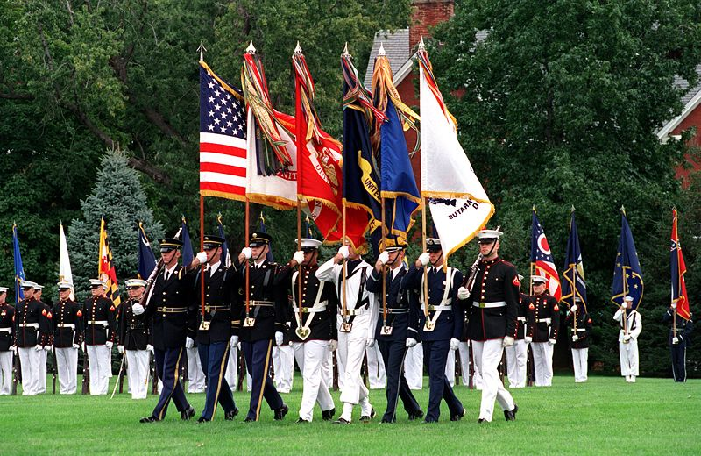
The Uniformed Services Employment and Reemployment Rights Act (USERRA)
Notes:
The Uniformed Services Employment and Reemployment Rights Act, or USERRA, provides employees who are called up to perform military service with reemployment rights.

Slide 18
The Uniformed Services Employment and Reemployment Rights Act (USERRA)
Protects employees who are gone from work for up to five years.
Existing health plans must be offered to the employee for 18 months.
If leave is 90 days or less, the employer must promptly return the employee to the same job. Employees continue to accrue seniority during leave.
If leave is more than 90 days, the employer may substitute a different job with the same pay, status and seniority.
If leave lasts more than 30 days, the law provides job protection for returning employees for six to 12 months. During that time, the employee may only terminated for cause.

Slide 19

Vermont Military Service and Leave
Notes:
A member or applicant for membership in the National Guard shall not be denied initial employment, reemployment, retention of employment, promotion or any benefit of employment on the basis of service, application to service or obligation to serve.

Slide 20
Vermont Military Service and Leave
Any absence for military training or state active duty shall not affect the employee’s right to receive normal vacation, sick leave, bonus, advancement, and other advantages of employment normally anticipated in the employee’s position.
Notes:
Vermont Military Service and Leave

Slide 21
Staff Leave Requests Scenarios
Do I say yes?
What type of leave do I grant?
Should documentation be required?
Notes:
As a manager, there are three questions you should ask yourself when you receive a staff leave request. Do I say yes? What type of leave do I grant? Should documentation be required?

Slide 22

Staff Leave Requests Quiz #1
Jane calls you at the beginning of her work day. Her car won’t start. She wants the day off.
Notes:
***Please provide answers to each situation. Thank you.***

Slide 23
Staff Leave Requests Quiz #2
Li’s husband passes away and she needs bereavement leave. How much time is she allowed?
Notes:
***Please provide answers to each situation. Thank you.***

Slide 24
Staff Leave Requests Quiz #3
Sharon serves in the Vermont Guard
  She asks for two weeks of paid leave to attend military summer camp. This will be in addition to the two week summer vacation that you have already approved for Sharon
  Shortly after her vacation, Sharon’s cousin is injured in Iraq and she requests an additional 15 weeks of paid leave to care for her cousin while he is recovering from his wounds. What are your options?
Notes:
***Please provide answers to each situation. Thank you.***

Slide 25

Staff Leave Requests Quiz #4
Andrew needs 10 weeks of leave because he is adopting a child.
Notes:
***Please provide answers to each situation. Thank you.***

Slide 26

Staff Leave Requests Quiz #5
Senad requests 10 hours of leave over a six month period to attend teacher conferences and school functions for his two children.
Notes:
***Please provide answers to each situation. Thank you.***

Slide 27

Staff Leave Requests Quiz #6
Terri needs 12 weeks of leave to care for the father (who lives in Oregon) of her same sex partner.
Notes:
***Please provide answers to each situation. Thank you.***

Slide 28
Staff Leave Requests Quiz #7
Percy believes he is about to receive a disciplinary warning for a performance issue and discloses that he is depressed and need time off.
Notes:
***Please provide answers to each situation. Thank you.***

Slide 29
Staff Leave Requests Quiz #8
Matasi wants to take March 19, 20 and 21 as his cultural holidays.
Notes:
***Please provide answers to each situation. Thank you.***

Slide 30

Staff Leave Requests Quiz #9
Marty’s daycare center is closing for two weeks because the provider is recovering from surgery. Marty asks for leave to care for his child during this time. He wants to use his accrued medical leave to cover the time out.
Notes:
***Please provide answers to each situation. Thank you.***

Slide 31
Staff Leave Requests Quiz #10
Nitesh works in Student Financial Services. He wants to become a yoga master and asks for three months of educational leave to become certified. Would your answer be different if Nitesh wanted three months of educational leave to take a study course for the CPA exam?
Notes:
***Please provide answers to each situation. Thank you.***

Slide 32
VPFLA Resources
http://www.atg.state.vt.us/issues/employment-law/leave.php
Notes:
For more information regarding VPFLA, click on this link.

Slide 33
FMLA Resources
http://www.dol.gov/whd/fmla/
http://www.dol.gov/whd/fmla/finalrule/MilitaryFAQs.pdf
http://www.dol.gov/whd/fmla/finalrule/NonMilitaryFAQs.pdf
Notes:
For more information regarding FMLA, click on these links.

