Slide 1
What is Digital History?
Hope Greenberg, Center for Teaching and Learning, University of Vermont

Slide 2
Web Revelations
https://web.archive.org/web/20020830141821/http://www.loc.gov/exhibits/vatican/toc.html
Notes:
Computing historians: early 1960s – the cliometrics revolution and disaster
1980s: the PC and the format wars – how can historians/humanists share? Text Encoding Initiative
1990s: The Web: is it any good for history? Yes: Rome Reborn, one of the first major exhibits to show historic documents, in color, viewed on the new GUI web browser, Mosaic. The web companion exhibit to the physical exhibit at the Library of Congress.

Slide 3
Digitizing the Archives
http://memory.loc.gov/ammem/index.html
https://www.archives.gov/
Notes:
Early (and continuing) collection of digitized documents.

Slide 4
Focused Collections
https://www.cliohistory.org/
https://www.cliohistory.org/click/
Notes:
Digitized documents used to build focused exhibits, including many images.

Slide 5
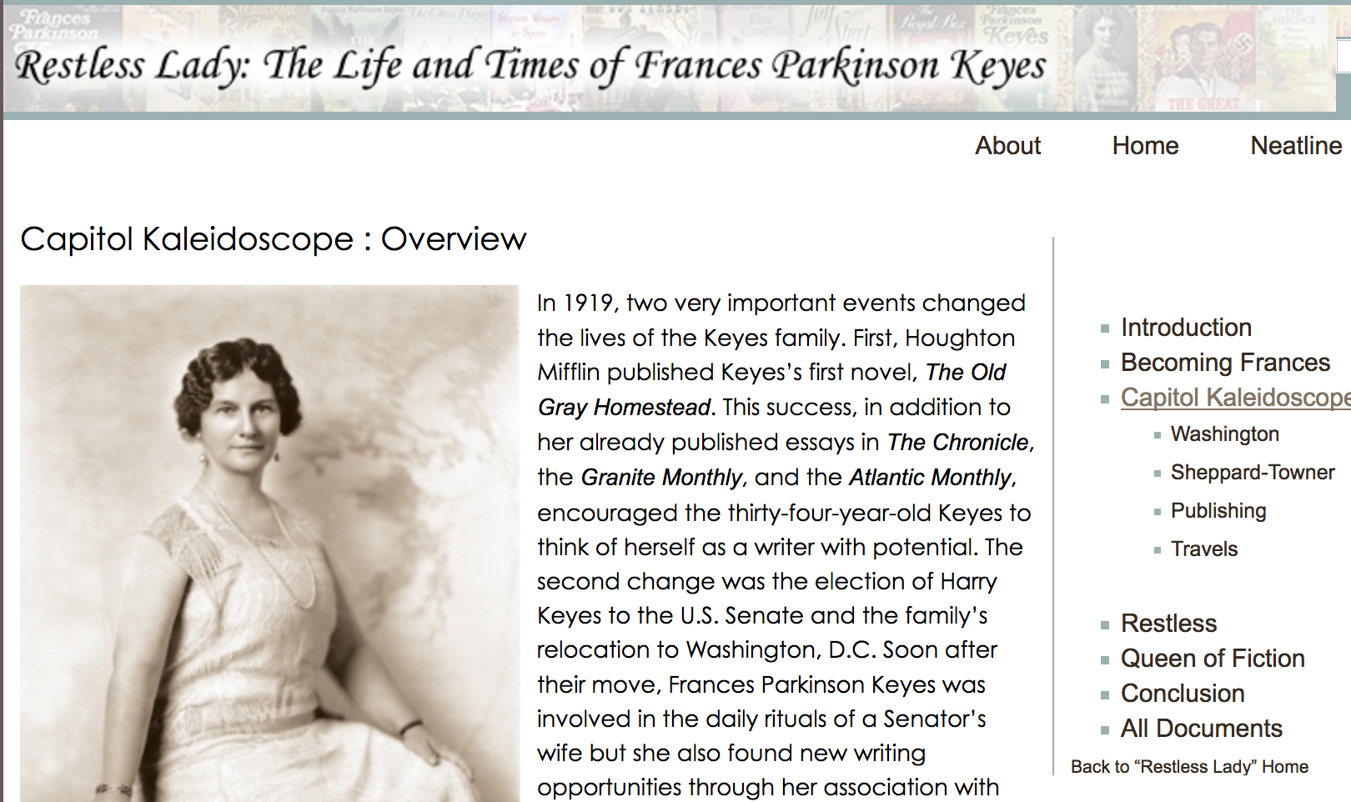
Focus + Archive
http://valley.lib.virginia.edu/
http://badger.uvm.edu/omeka
Notes:
Illustrated books have limits on the number of illustrations. The web has no such limits. Thus, an online exhibit can contain many images (digitized documents), can make them keyword searchable through transcription, can add metadata to help with searches, and can contain, in addition to the images used for the exhibit, many more images. The Valley of the Shadow was one of, if not the, earliest collection that included a narrative with supporting documents as well as thousands of documents, newspapers, and photographs that could be searched and mined by historians and the public. In other words, visitors and researchers were encouraged to weave their own narratives from the material.
The exhibit on Frances Parkinson Keyes provides the same approach: it builds on previous work, expands that work, and provides access to over 400 documents.

Slide 6
Spatial Narratives
http://www.texasslaveryproject.org/about/
http://gildedage.unl.edu/
Notes:
Roy Rosensweig, founding father of so many digital history projects and acknowledged leader of digital history, argued that digital scholarship had to move from experimentation with tools and methods to something more permanent, more ingrained in the discipline of history. These projects are from two grad students who created them not as end products, although they work well that way, but as a way of exploring and developing the ideas that would lead to their dissertations.

Slide 7
Supporting the Model
http://spatialhistory.stanford.edu
Notes:
Lone historians, especially historians who are the first and only digital historians in their departments, need infrastructure and collegial support to hone their work. Stanford’s Spatial History Project provides that space and support. Building on similar earlier models like that of UVA: IATH (Institute for Advanced Technology in the Humanities) the SHP provides support for historians interested in exploring spatial history.

Slide 8
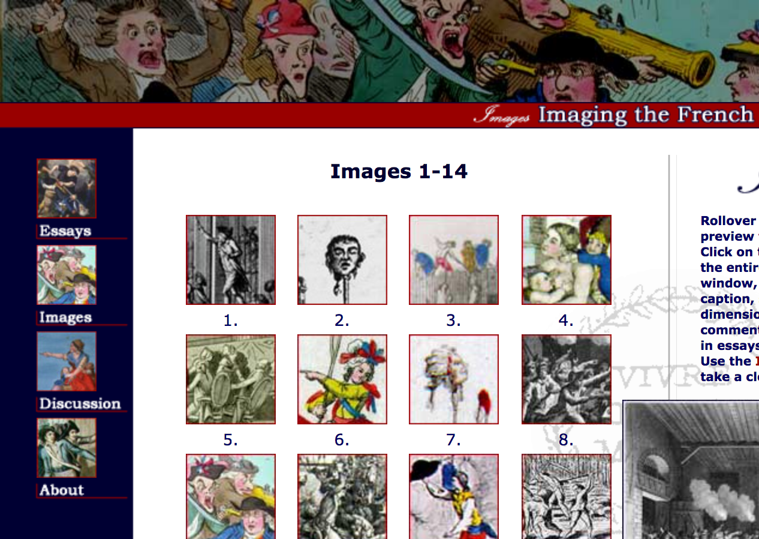
A Culture of Collaboration
http://web.stanford.edu/group/spatialhistory/cgi-bin/site/index.php
http://chnm.gmu.edu/revolution/imaging/home.html
Notes:
They also encourage colleagues to share methods and ideas. A similar example is that of the French Revolutionary Images project that brings together scholars to study a small topic, create the web site, discuss their work with each other, and contribute collaboratively.

Slide 9
Expanding Models
http://kindred.stanford.edu/#
Notes:
While geospatial history is a quickly growing field, many scholars are questioning whether maps, especially modern maps like Google, are the only way, or even the best way, to model history. Kindred Britain creates a different kind of “map”, a network map of relationships between people to explore how those connections impact history.

Slide 10
Doing Digital History
https://www.historians.org/teaching-and-learning/digital-history-resources/resources-for-getting-started-in-digital-history
Notes:
Supporting digital historians means providing venues for them to share their work, to discuss their methods and strategies, to learn about new scholarship in the field, and to learn about what tools are being developed. The AHA has begun to gather and provide these types of resources to further the development of DH.

Slide 11
Questions?
Hope Greenberg
hope.greenberg@uvm.edu

