Slide 1

UVM
Student Research Conference
2012
Presentations and Posters Workshop

Slide 2


Our plan for this session:
Presentations and Posters Workshop
Notes:
Introduce ourselves, then briefly outline the plan. We’ll look at the SRC web site first and talk about the schedule while pointing out student information area. Next we will spend the bulk of the session on how to create presentations or posters, focusing on content, design, and performance. Last we’ll cover a bit of the tech stuff – you use ppt for posters and save as pdf.

Slide 3
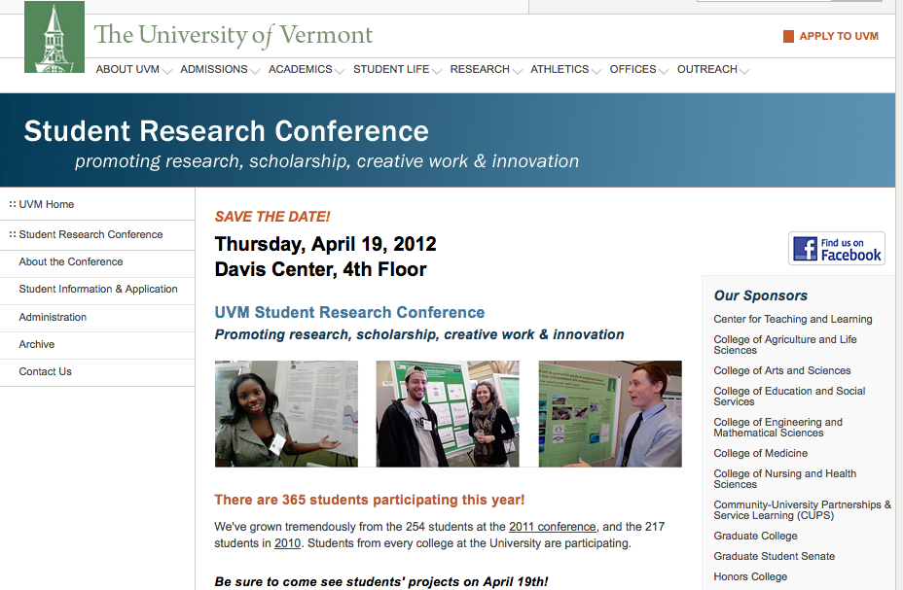
For information: http://www.uvm.edu/~uvmsrc
http://www.uvm.edu/~uvmsrc/
Presentations and Posters Workshop
Notes:
Point out that there is a student information area, then go to website. Look at calendar, deal with any questions. Go to student information area, point out resources. Repeat that this is SRC central - keep an eye on it for updates.
Mention and describe GSS practice session!!

Slide 4
(Presenters: come to Davis Center Wednesday afternoon to load presentations)
The Day
A.M.
Presentations
Posters
P.M.
Presentations
Posters
Speakers
Presentations and Posters Workshop
Notes:
Don’t forget: GSS session
Wednesday preloading and dress rehearsal.
Mac/Windows, they can send files to Hope if they can’t make it but no guarantees! Describe the Day, poster setup, make sure to recruit them to stay for noon talks. Snacks all day. Bring friends!! But ask to stay for full hour.

Slide 5

Your
Presentation or
Poster
Presentations and Posters Workshop
Notes:
Your presentation, even poster, is made up of three things. We’ll take a look at each area.

Slide 6
Some Powerpoint Approaches
Traditional
Assertion-Evidence
Pecha kucha (peh-chah’-k-chuh)
Interactive
Dialog (dancing with Powerpoint)
Presentations and Posters Workshop
Notes:
As we think about these steps to creating our presentation I’d also like to show you several different approaches based on powerpoint/pdf to consider before you build your own. I’ll show some samples of these at appropriate points during this presentation but wanted to mention them first:
The most common approach is the traditional “bullet point slides” model. Many people decry this one but it can be effective if you follow some simple rules.
Assertion-evidence doesn’t use bullet points,instead it uses full sentences that make an assertion, then images or graphs as evidence to support or describe that assertion.
Pecha kucha is a model that comes from the design world. The impetus for this model was to force slide shows to be short. The formal model is to use 20 slides/20 seconds per slide, which works out to about 6 minutes, but variations can be fun.
Interactive slides are built on the fly, with help from the participants.
Dialog, or what I like to call “dancing with Powerpoint” can be defined in several ways: I’ll show you one of my favorite master practitioners of this method.

Slide 7
Your
Presentation or
Poster
Presentations and Posters Workshop
Notes:
Your presentation is made up of three things.
Content: what is your topic? What will you be presenting on? What actual information goes into your presentation?
Design: how will you organize that information? Will you use words, images or both? In what order will you present your information?
Performance: What delivery strategies will resonate with your audience? What will make your presentation interesting? What will detract from it?
These are all interwoven but we’ll look at each area. But first let’s consider some approaches.

Slide 8

How much?
Organized how?
Optimum stickiness?
Presentations and Posters Workshop
Notes:
One of the most difficult tasks when creating a presentation is to decide how much, and what, information to include. Much of that decision will be determined by why and where you are presenting: is this a 10 minute talk on a topic to an audience that knows little about that topic? Is this a one hour workshop? Are you hoping your audience will take away a few major points or are you attempting to teach them something in detail?
Is the way you organize your material going to help determine what you will include? Is that organization going to help achieve your purpose?
So, if your purpose is to have them take away the major points, how do you work to ensure that will happen?

Slide 9
If you want to sound like an expert you should make sure that you have included everything.
Put in complex charts graphs, and images too, so they can really appreciate and understand just how much work you have done.
The information should be written in detail and text should always fill the slide.
Read it to the audience so you know they are getting it and won’t miss anything.
Prove that you remember all the details by including any bits and pieces you can squeeze into your allotted time.
Make sure all of your thoughts and ideas are there, and it will be a fine presentation.
Presentations and Posters Workshop
Notes:
Introduce with: here is a typical ppt slide
Give them a moment to start reading themselves, then jump in and read part of it over them – really annoying!

Slide 10
If you want to sound like an expert you should make sure that you have included everything.
Put in complex charts, graphs and images, too, so they can really appreciate and understand just how much work you have done.
The information should be written in detail and text should always fill the slide.
Read it to the audience so you know they are getting it and won’t miss anything.
Prove that you remember all the details by including any bits and pieces you can squeeze into your allotted time.
Make sure all of your thoughts and ideas are there, and it will be a fine presentation.
Presentations and Posters Workshop
Notes:
How much is enough? This is the time to talk about “Pick 3-4 main ideas you want them to remember.”
As you create your presentation or poster, look at each slide or area of the poster critically and ask: is this helping the audience understand what I am saying?
Does it add to or detract from the point I am trying to make?
Don’t try to teach the audience – do try to fix the highlights in their minds.

Slide 11

Traditional, or, “Darth Vader Method”
Presentations and Posters Workshop
Notes:
Can you imagine if Darth Vader had said: Luke, I want to teach you about the Dark Side. Let me show you a Powerpoint…

Slide 12
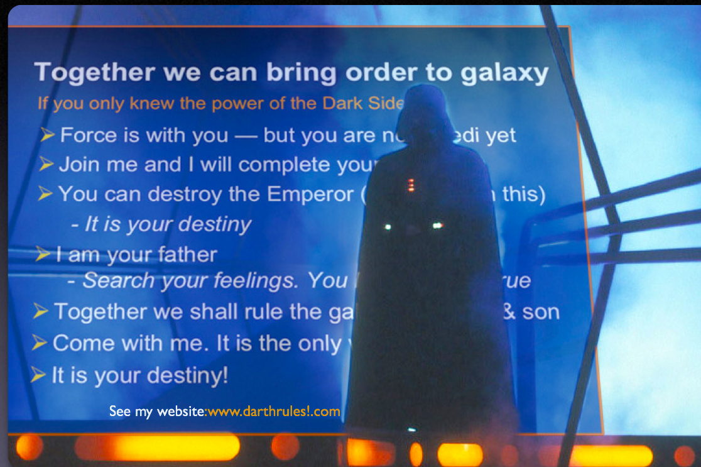
Presentations and Posters Workshop

Slide 13
“Less is more.”
Presentations and Posters Workshop
Notes:
How do you choose what to include? How do you present your information? How much is too much?
“Pick 2-3 main ideas you want them to remember.”
As you create your presentation, look at each slide critically and ask: is this helping the audience understand what I am saying?
Does it add to or detract from the point I am trying to make?
Don’t try to teach the audience – you are not there to teach them everything you know about your topic – but do try to fix the highlights in their minds.
What else helps you do that?.....

Slide 14
“Good research presentations and posters tell a story.”
Presentations and Posters Workshop
Notes:
This is your story about what you have done. Take the credit with your voice. Passive voice: the research was conducted to determine…the final result was obtained…
Active voice: I decided to research xyz topic because…I tried this and it worked…I tried this and it didn’t give me the expected results so I decided to try this…
Stories have an arc, esp. mystery stories: the setup (why?), the exposition (what action?), the reaction (what happened?), the conclusion (what did it all mean?)
A beginning, middle and end

Slide 15
Introduction
Methods
Results
Conclusions
or
Introduction
Key Points
Conclusions
Presentations and Posters Workshop
Notes:
Research presentations or poster follow the same kind of arc:
Doesn’t have to be exactly like this, but it provides a good foundation.
Let’s look at each step individually

Slide 16
Introduction
Statement of problem
Research question
Your motivation
What’s interesting?
Presentations and Posters Workshop
Notes:
Introduce your topic: what are you talking about? Why did you research this? What about this topic interested you?
Why do scholars study this/what do they conclude?
Briefly state the main points
Remember: you are not here to teach everyone all about your topic. You are here to highlight some specific points of your topic.

Slide 17
Methods
Your approach
Adjustments
Active voice, not passive
Presentations and Posters Workshop
Notes:
Again: active voice – “I did this, then I tried that, it worked as expected or it didn’t so then I did this”

Slide 18
Results
Main points
(if they want details they will ask)
Expected? Or not?
Presentations and Posters Workshop
Notes:
This is a point where you can start to focus or repeat your main points

Slide 19
Conclusions
Brief recap
Reiterate main themes
Implications or next steps
Connect to introduction
Presentations and Posters Workshop
Notes:
So what was you problem/research question again?
What are YOUR next steps
Main points – no more than 3-4
Next steps could also be what questions were not answered or would you pursue next?
If you haven’t used bullet before, this is a good place for them

Slide 20
“Tell ’em what you’ll tell ’em,
tell ’em,
tell ’em what you told ’em.”
Presentations and Posters Workshop

Slide 21
Assertion-Evidence Model
Michael Alley, Penn State
Presentations and Posters Workshop
Notes:
assertion-evidence structure:a sentence headline states the main assertion of the slide. That headline assertion is then supported not by a bullet list, but by visual evidence: photos, drawings, diagrams, graphs, films, or equations.

Slide 22
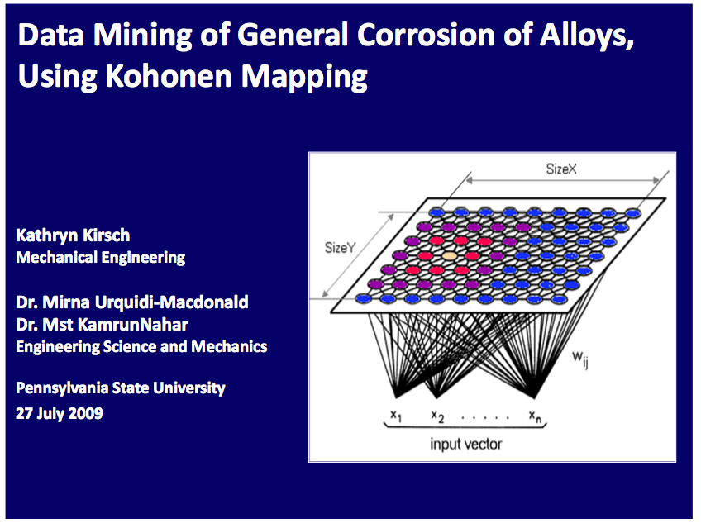
Notes:
Portions only!

Slide 23

Notes:
Portions only!

Slide 24
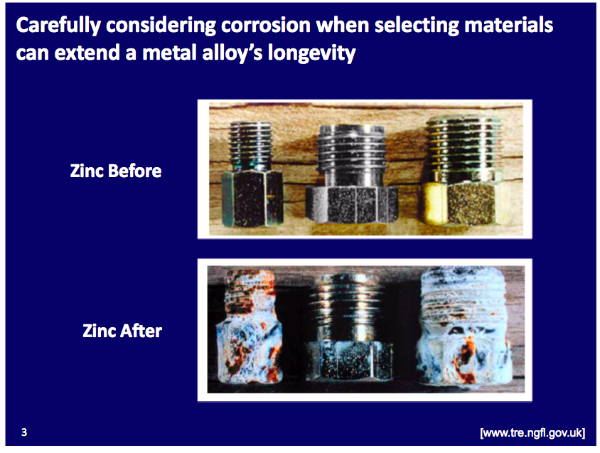
Notes:
Portions only!

Slide 25
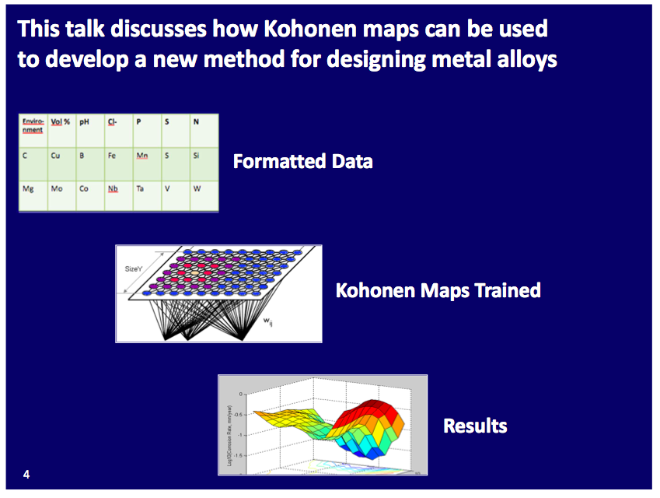
Notes:
Portions only!

Slide 26
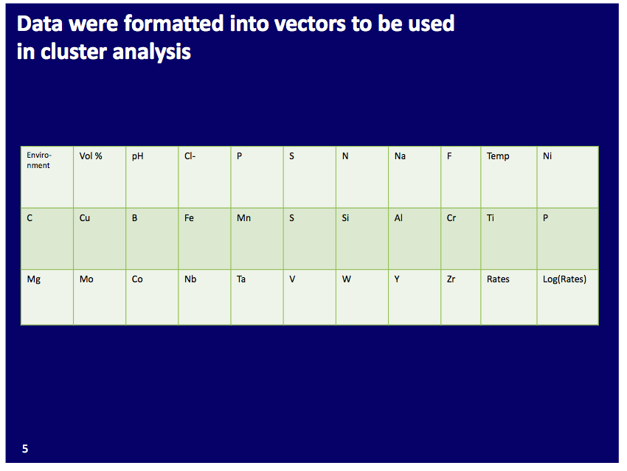
Notes:
Portions only!

Slide 27
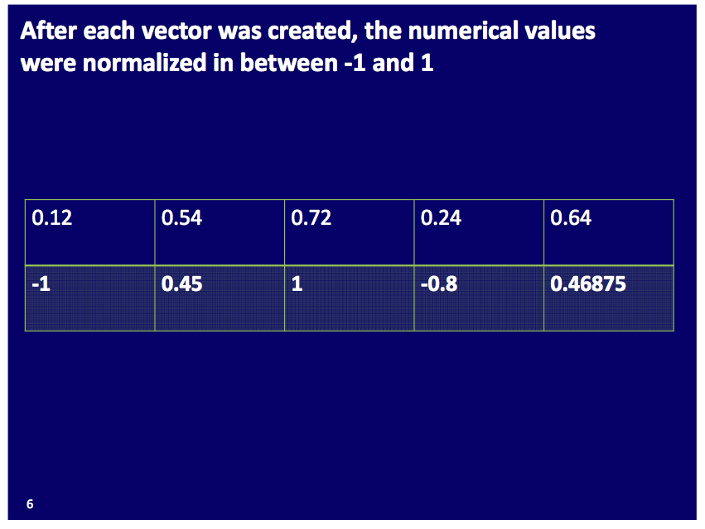
Notes:
Portions only!

Slide 28
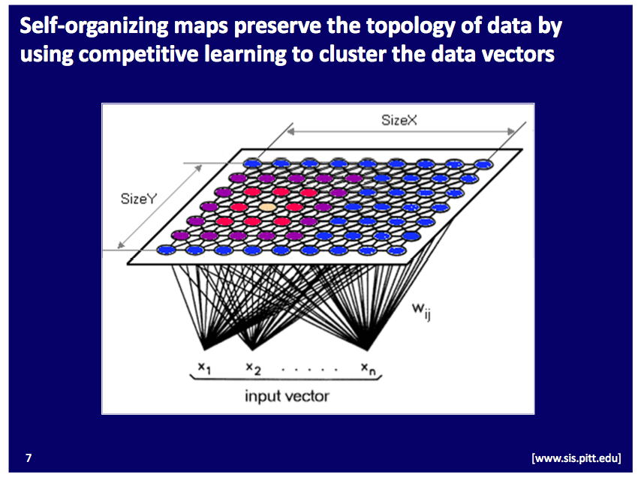
Notes:
Portions only!

Slide 29
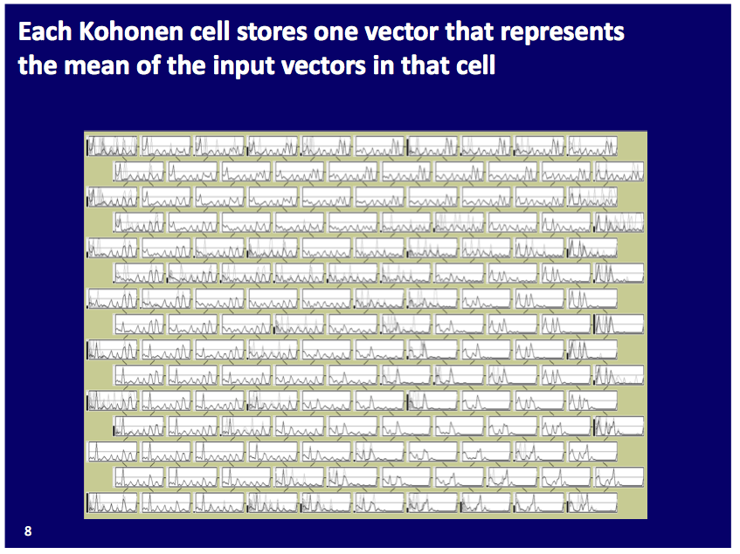
Notes:
Portions only!

Slide 30
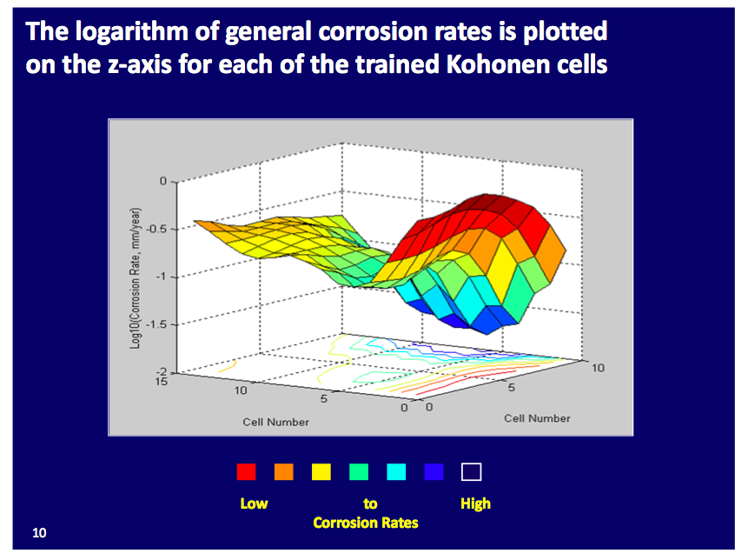
Notes:
Portions only!

Slide 31
…and the slides conclude with…
Notes:
Portions only!

Slide 32
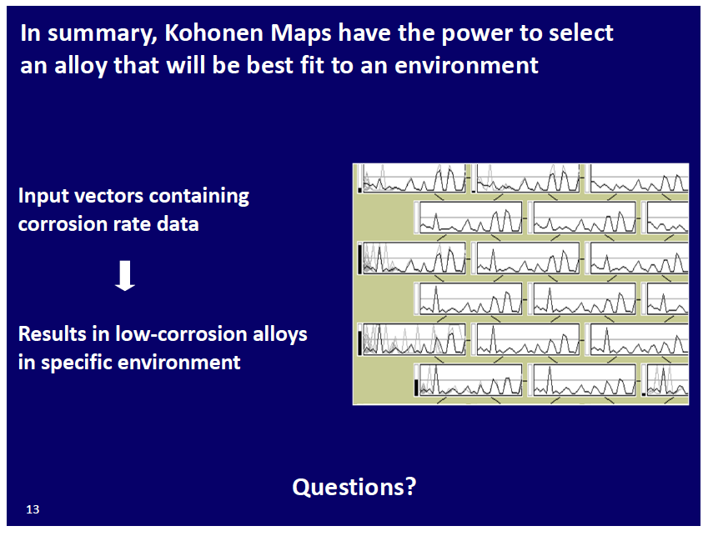
Notes:
Portions only!
Here’s my summary, and here are the key points that led to that conclusion.

Slide 33
Pecha Kucha
…even fewer words
Presentations and Posters Workshop
Notes:
If appropriate, you might a presentation composed of images. But be careful…it is tricky to stay on track…
Here’s our second example of a powerpoint approach, pecha kucha.
This example is designed to act as an introduction to a unit on Vermont history

Slide 34
Vermont Split Towns
Notes:
I’d like to tell you a story. This presentation is intended to act as an introduction to a unit on Vermont history that explores factors that changed VT landscape in the 19th century.

Slide 35
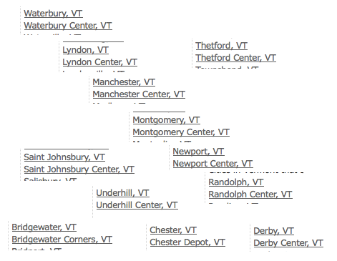
Notes:
If we look at a list of today’s Vermont town names an interesting pattern emerges. . Some towns have names like North Bennington, South Burlington, which makes sense—they are indeed north or south of the towns of the same name. But there are a number of towns that appear to be split into two sections not related to obvious geography. Most of these include the name “center.”

Slide 36
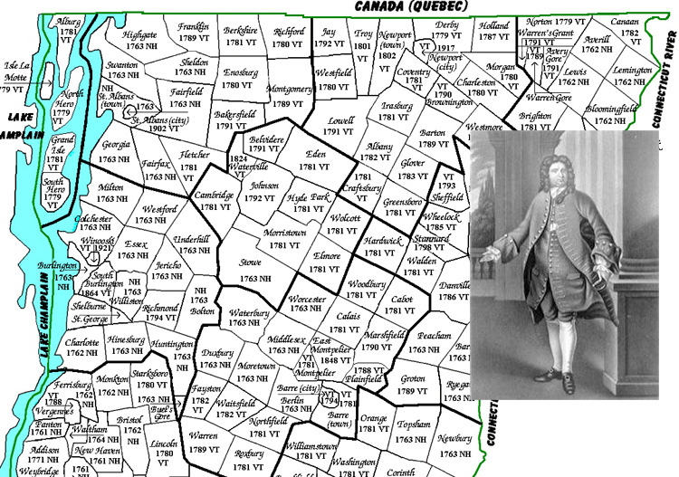
Notes:
The original names were determined when Benning Wentworth, governor of New Hampshire, creatively interpreted the described boundaries of New Hampshire to include all the land we now know as Vermont. He broke this area into grants, each about 6 miles square, and made a tidy profit for the crown (and no doubt for himself) selling them to speculators and settlers. Some of these areas had already been surveyed but some had not, as the unfortunate owners of the town of Mansfield discovered when they found that half of their town lay on the east flank of Mt. Mansfield with the other half on the west flank.

Slide 37
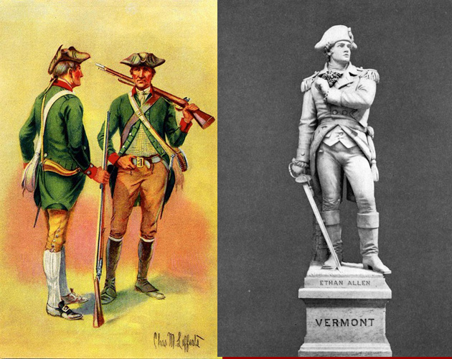
Notes:
New York laid claim to the same land, petitioned the king to stop Wentworth, and in 1770, declared all the Wentworth grants invalid. They also declared that the current residents must repurchase from NY the land they had already paid New Hampshire for. This infuriated residents of the area, including those master speculators, Ira and Ethan Allen and his Green Mountain Boys, ultimately leading to the establishment of the self-declared Vermont Republic and general rebellion against the New York government.

Slide 38
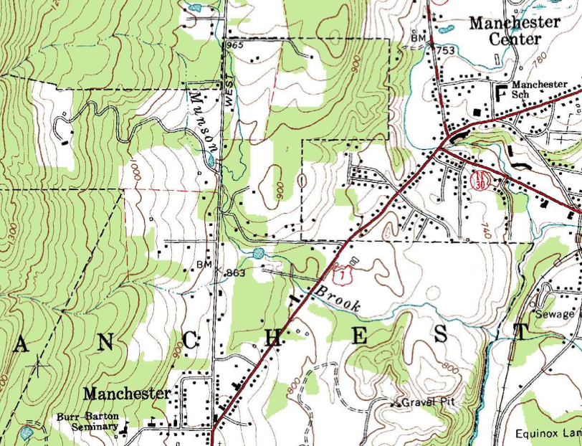
Notes:
Let’s start with where town centers were situated. People are usually surprised to learn that many Vt towns were established on top of hills. If we look at a topographical map of Manchester, for example, we see that the original town was on a hill several hundred feet higher than the later Manchester Center. Why would people, walking, riding or driving wagons, settle on top of a hill?

Slide 39
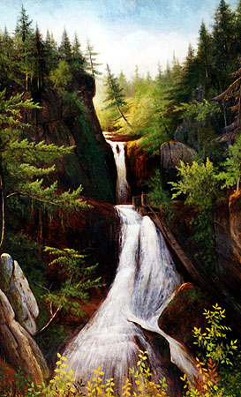
Notes:
When settlers arrived they found the valleys to be inhospitable places, choked with brush and fallen trees, all of which would have to be cleared before planting. The tops of hills, by contrast, were often found to have fewer trees and many meadows with hay all ready for cattle to graze on. Why?

Slide 40

Notes:
Yes, beavers had already done much of the work. A cleared field trumps a little hill climbing any day!

Slide 41
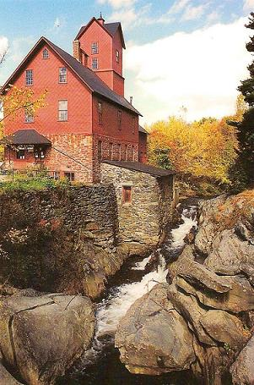
Notes:
As towns became established the lower areas could eventually be cleared, and this became increasingly important as all those rapid running streams and rivers found at the bottom of hills became a good source of power to run mills. So we see the first movement of town centers from hills down to valleys.

Slide 42
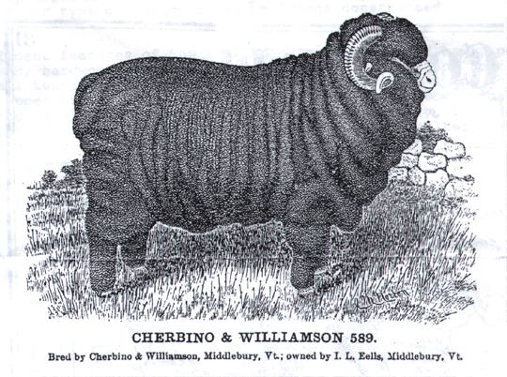
Notes:
But there were still plenty of reasons for people to live on hillsides. Sheep do better on hills where they are less prone to the foot diseases that come with lowland conditions. In the great sheep boom of the early 19th century, sheep dominated the hillsides and town centers continued to thrive on hilltops as well.

Slide 43
…and so on.
Presentations and Posters Workshop
Notes:
Pecha kucha is very good for a narrative-type presentation.
Mention Prezi

Slide 44
How much? “Less is more.”
Organized how? “Tell a story.”
Stickiness? Reiterate. “Tell ’em….”
Presentations and Posters Workshop
Notes:
Recap Content:
don’t make them read your slides, shoot for 3 main points (if the audience attends 10 sessions during the day, ouch!)
Have a definite storyline with a beginning, middle, and end
Revisit your key points at various times throughout your presentation

Slide 45
Introduction
Methods
Results
Conclusions
Presentations and Posters Workshop
Notes:
The same kinds of categories can be applied to a poster, except that you do not need to repeat your main points so much

Slide 46
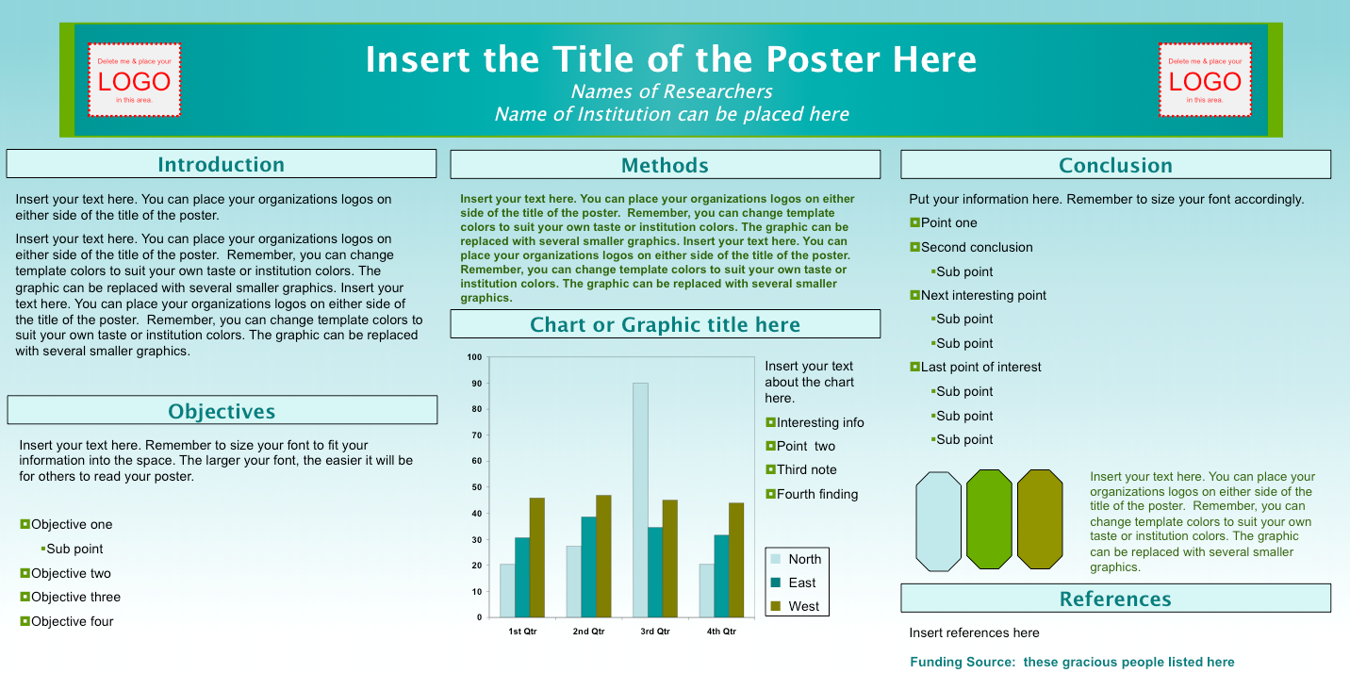
Presentations and Posters Workshop
Notes:
Posters follow the same kind of arc
Also note the LOGOs

Slide 47
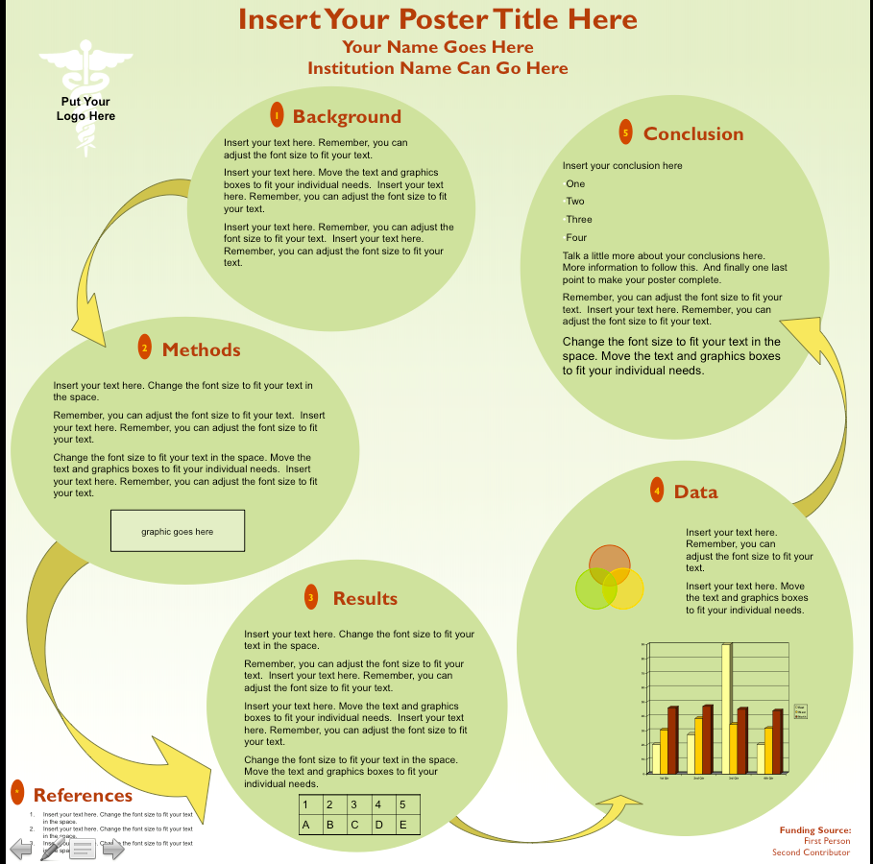
Presentations and Posters Workshop
Notes:
Word count: 442

Slide 48
Your
Presentation or
Poster
Presentations and Posters Workshop
Notes:
Once you have your content, consider your design: how will you organize that information? Will you use words, images or both? In what order will you present your information?

Slide 49
Design
Color, balance, elements
Simplicity works
Choose images/graphs wisely
Presentations and Posters Workshop
Notes:
Color; good contrast, balance empty areas and filled; graphical images like the tower logo provide a bit of polish
Simplicity: in color, in fonts, in design. Light color background easier in badly lit room. Color blindness, colors on computer screens/projectors.
Graphs…see next slide…

Slide 50
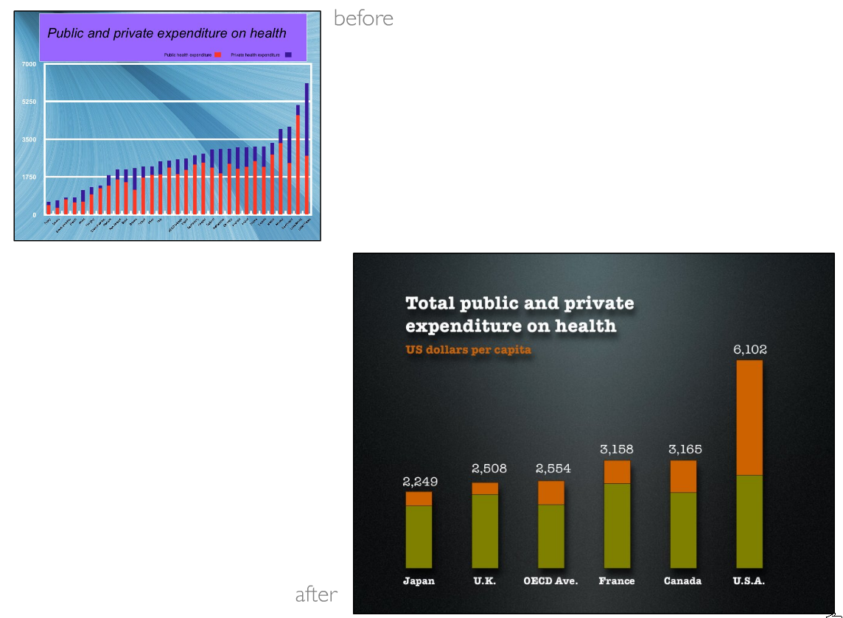
Presentations and Posters Workshop
Notes:
Here are two slides – without even trying to figure out what each represents which one is easier to read?
From how far back can you understand each graph?

Slide 51
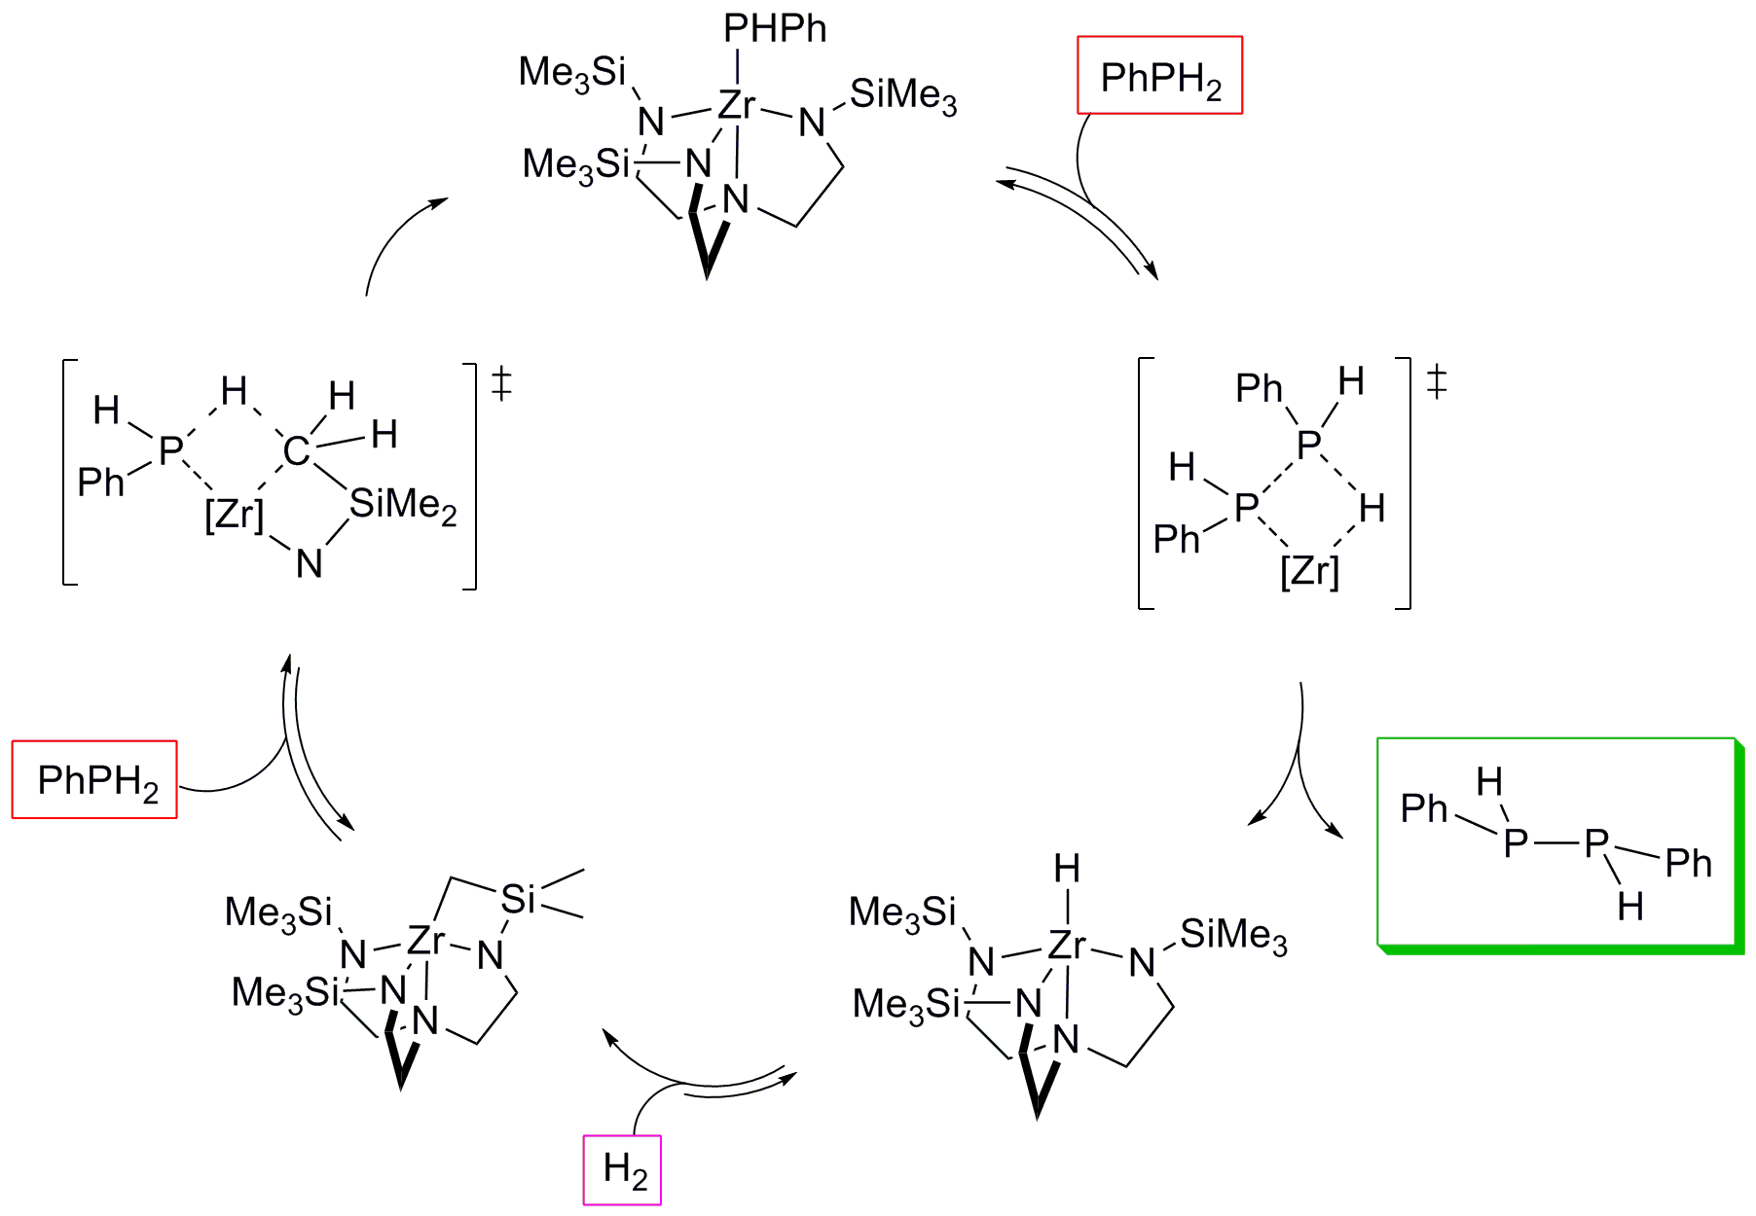
Mechanism of Dehydrocoupling
Waterman, R. Organometallics, 2007, 26, 2492.
Presentations and Posters Workshop
Notes:
Interactive: take a look at this slide, jot down what you notice
What is this slide about (obvious)
Which way does the process go? Are there things of note happening along the way?
citation

Slide 52
Presentations and Posters Workshop
Notes:
Word count: 442
Design applies to posters

Slide 53

What about the posters in this room?
Presentations and Posters Workshop
Notes:
How does someone visit your poster? (Do it.)
Let’s take a few minutes to get up and look at the posters around the room. Jot down what you like, what you think works well, what could be better. Note the balance of color, the images, the size of the font, the flow of the content: does it tell a story.

Slide 54
Your
Presentation or
Poster
Presentations and Posters Workshop
Notes:
Our last category is Performance. This is one where you probably, as a group, already have a font of knowledge about what works and what doesn’t, so I’m going to use our third example of a powerpoint approach, to address this one.
We had Darth Vader before, so we’ll call this one….

Slide 55
Interactive, or, “Yoda Method”
Presentations and Posters Workshop
Notes:
This type of presentation or slide works best in a workshop setting or any setting where you want to collect information or opinions from your audience.

Slide 56

“Luke, write your own destiny you must.”
Presentations and Posters Workshop
Notes:
“Luke, write your own destiny you must.”

Slide 57

What are your favorite tips?
Presentations and Posters Workshop
Notes:
Get suggestions and write on the board. Make sure to include: hands out of pockets, memorize first sentence or two, speak up, the audience is on your side, use the space you have (stand here for exposition, there for main points, etc.), two hand a laser pointer, watch out for the projector light, practice to friends and to mirror, outloud (muscle memory for your mouth), elevator speech

Slide 58
Dialog, or, “dancing with ppt”
Presentations and Posters Workshop
Notes:
Get suggestions and write on the board. Make sure to include: hands out of pockets, memorize first sentence or two, speak up, the audience is on your side, use the space you have (stand here for exposition, there for main points, etc.), two hand a laser pointer, watch out for the projector light, practice to friends and to mirror, outloud (muscle memory for your mouth), elevator speech

Slide 59
As we watch this performance pay particular attention to these questions:
When does the speaker read or repeat the exact words on the slide?
If not reading, what is the speaker saying when a new slide appears?
How are bullet points used in this example?
Is there a pattern to his presentation? (Introduction, reiterative explication, etc.)
Presentations and Posters Workshop

Slide 60
“Your slides or poster
are not your presentation;
you
are your presentation.”
Presentations and Posters Workshop

Slide 61
Tech
Stuff
Presentations and Posters Workshop

Slide 62
To make a poster, use PowerPoint and set the dimensions. When done, save as pdf.
Embed graphics and images, don’t insert them as Objects.
Text? 72 points = 1 inch printed. Smaller than 30 is hard to read.
Presentations and Posters Workshop

Slide 63
Questions?
hope.greenberg@uvm.edu
http://www.uvm.edu/~uvmsrc
And thanks go to:
Rory Waterman, UVM, for the original talk, and the chemistry slide.
Garr Reynolds for images and inspiration.
Presentations and Posters Workshop

