Slide 1
Object-Based Learning: The Apps
Hope Greenberg, Center for Teaching and Learning

Slide 2
Research: Gather and Winnow
I would like students to cast a wide net and collect x number of images that represent a common theme or idea. Then:
provide a basic description of each
draft a short statement about how it represents their idea
select the top 3 (4, 5, etc.) to write about in more detail.

Slide 3
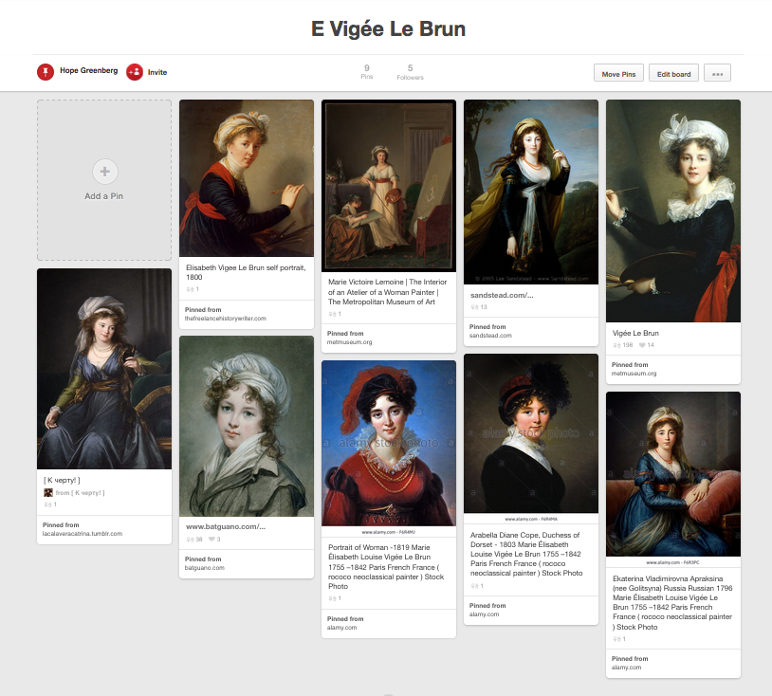
Pinterest
Image “bookmarks” (links with a thumbnail)
Reorganizing is manual
Sample: Godey Zouave Jackets

Slide 4
Close-looking + describing
I would like students to
observe an object,
focus on details,
pinpoint and describe/interpret those details,
link those details to other objects.

Slide 5
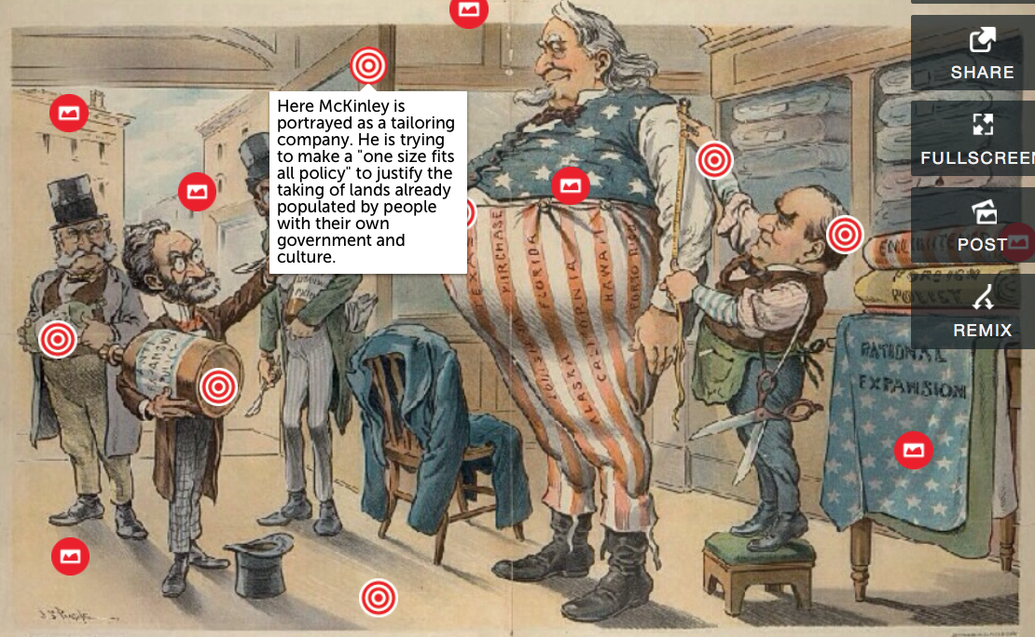
ThingLink
Base image + pins
Pins can contain text, links, images.
Good for: identifying linking close “reading”
More examples

Slide 6
Critical thinking + writing
I would like students to
Construct an argument based on their observations of an object
Write a substantial piece about that argument
Include multiple images of the object

Slide 7
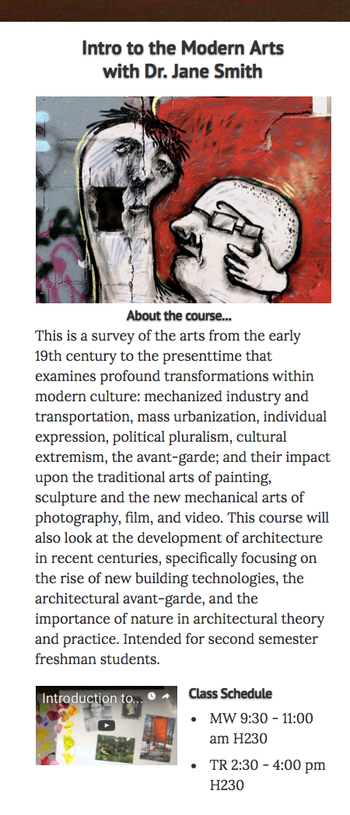
Populr.me
Create a single web page by choosing a theme and pasting in your text and images.
Good for: multimedia essays syllabus resume
Can also collaborate
Sample
A similar program, Strikingly, creates single public page with sliding images.

Slide 8
Close-looking
I would like students to
Make a short video of a 3-D object
Focus on specific aspects of the object
Describe, pose questions, or comment on those aspects at the point they appear in the video
+ Collaboration
Invite other students to comment
(Also a useful tool for recording presentations then asking for peer review.)

Slide 9
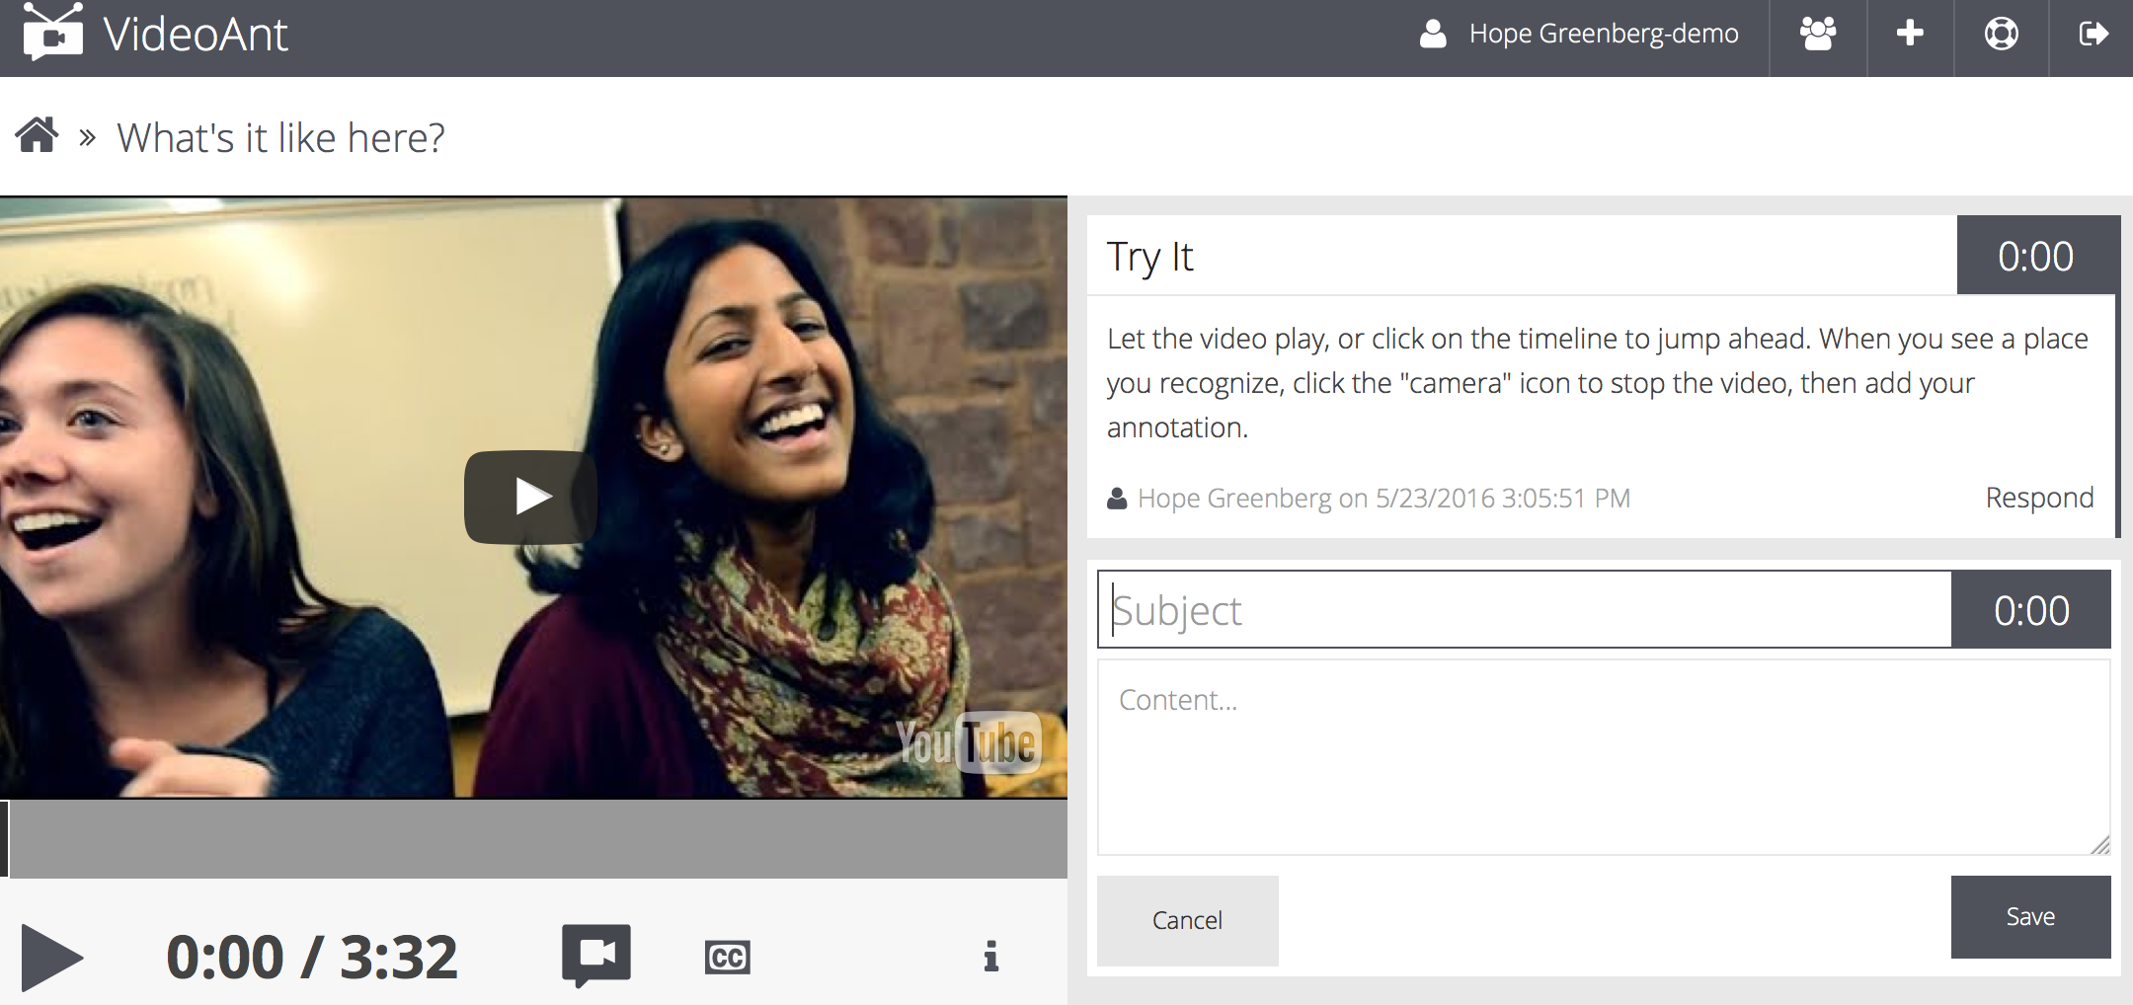
VideoAnt
Add text annotations next to a video at specific time points in that video. Comments appear to the right.
Sample
Notes:
For a similar product that adds on-screen annotations, Vidzor. http://watch.vidzor.com/y2hR4h3wbe_?t=201704062021

Slide 10
Critical thinking + writing + time
I would like students to
Construct an argument based on their observations of objects in time
Write a substantial piece about that argument
Include multiple images of the objects
Display the objects and writing on a timeline

Slide 11
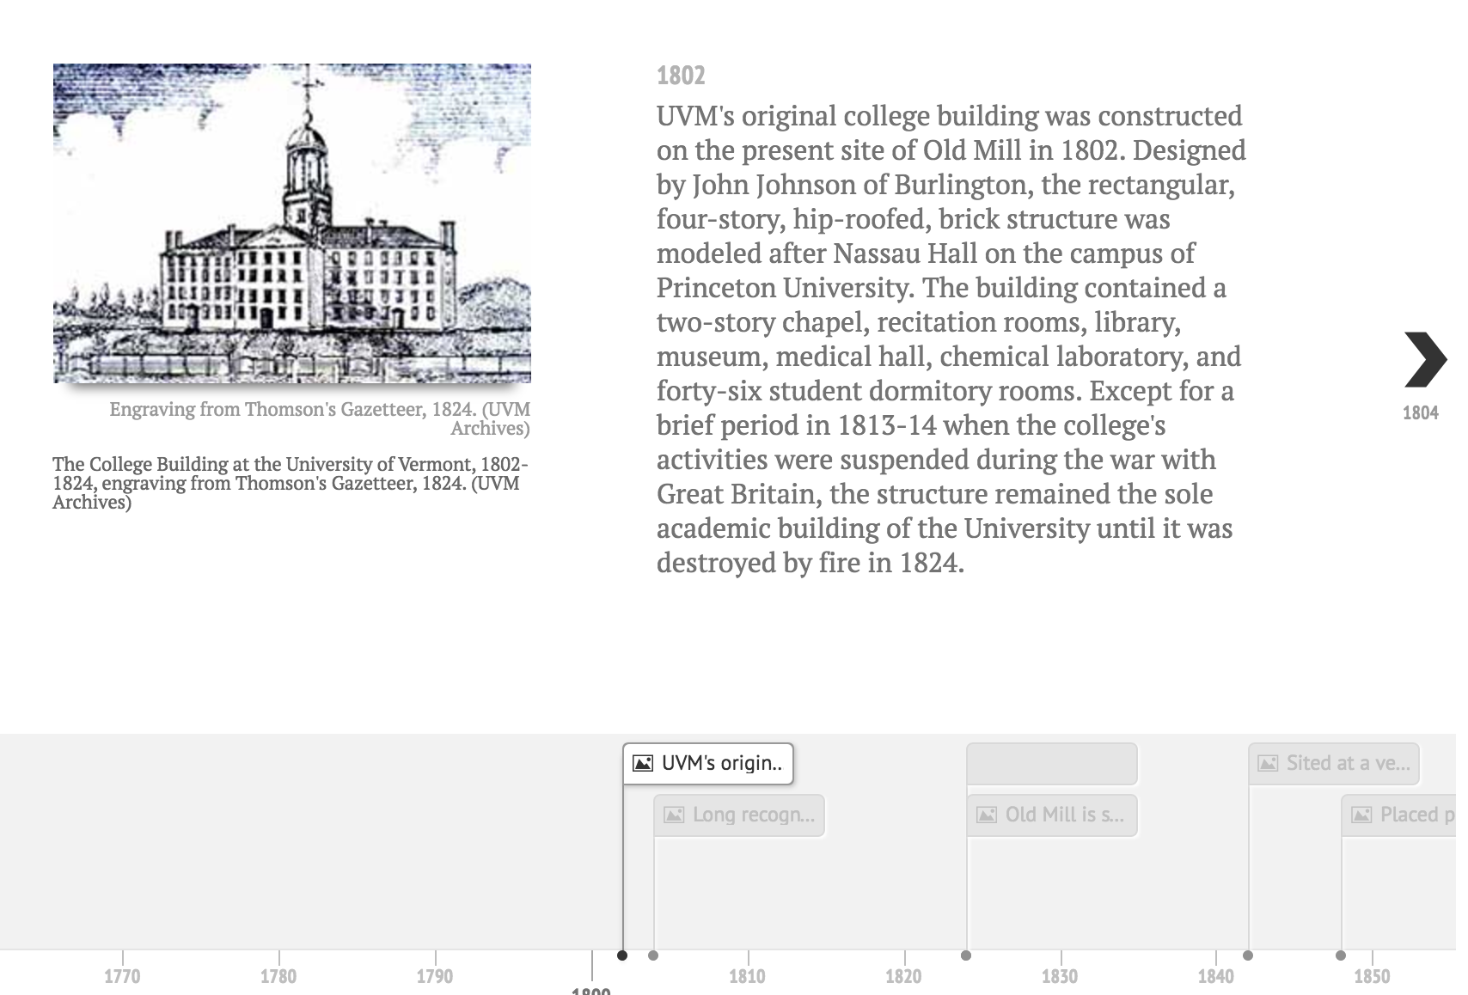
TimelineJS
Create a Google spreadsheet with dates, events, descriptions or stories, and links to images.
Pull it altogether and TimelineJS will build the timeline.
Samples

Slide 12
Critical thinking + writing + space
I would like students to
Construct an argument based on their observations of objects and space
Write a substantial piece about that argument
Include multiple images of the objects
Connect that writing to geographical waypoints

Slide 13
StoryMapJS
Mark way points on a map and tell your story
If you would rather simply have a map with pins that contain text, images, or link, try Google MyMaps.
Utagawa Hiroshige Sample
US Manifest Destiny sample

Slide 14
Critical thinking + writing + collaboration
I would like students, as a class or in groups, to
Explore multiple aspects of an object
Write a multi-section piece that includes themes or topic categories
Include multiple images of the objects
Present their work as a cohesive whole

Slide 15
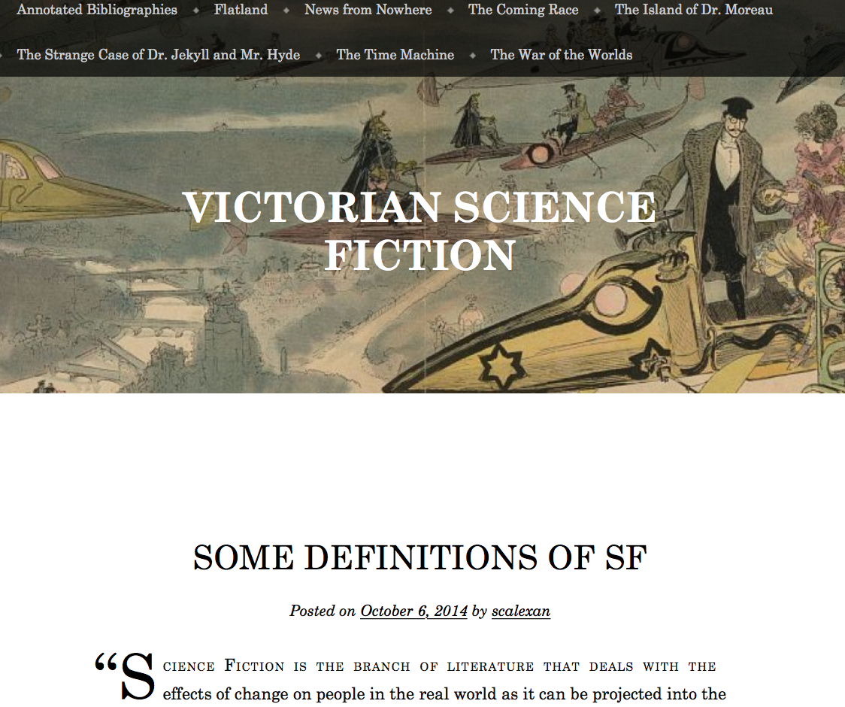
WordPress (using Pages)
Blogs contain chrono-logical posts or static pages.
You can invite multiple people to contribute to the blog.
Good for: writing stories multimedia essays group project research notes gathering resources
Page blog: Victorian Science Fiction

Slide 16
All categories
I would like students, as a class or in groups, to
Explore, collect, and curate objects/documents
Research and describe the objects using current metadata standards
Develop a written argument or framing narrative
Group the objects/documents into an exhibit that supports the argument
Present the work as a cohesive whole

Slide 17
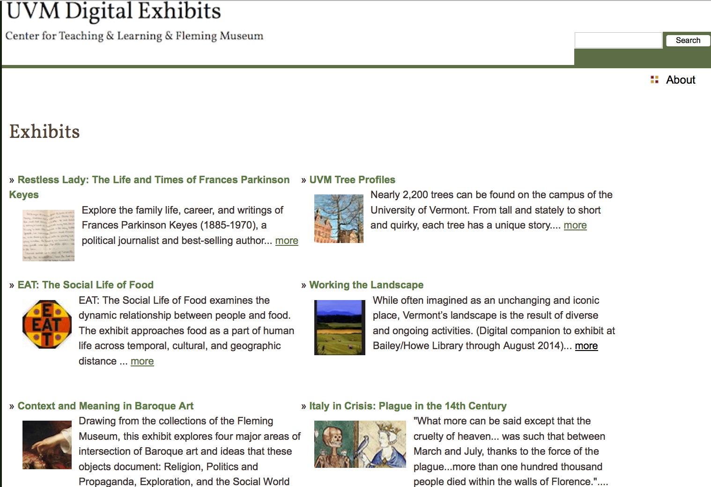
Omeka
Searchable image database with ability to create an exhibit
3 options:
UVM hosted badger.uvm.edu/omeka
omeka.net
host your own
Good for:
scholarly curated collections with robust metadata rich exhibits built around the collection
Notes:
Group projects

Slide 18
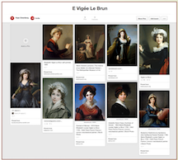
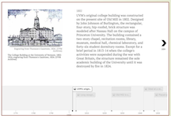
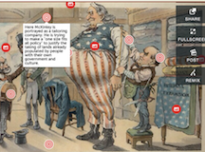
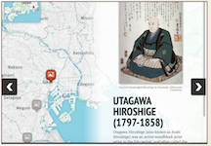
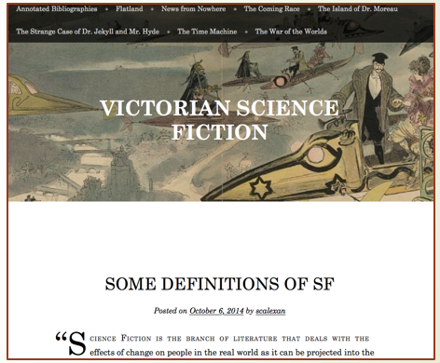
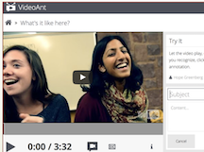
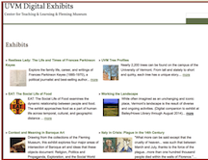
Pinterest
TimelineJS
ThingLink
StoryMapJS
Populr
WordPress
VideoAnt
Omeka

