Slide 1
Digital Humanities at the University of Vermont
Hope Greenberg
Academic Computing Services
Center for Teaching and Learning
Learning Resources Group
Notes:
My talk today is going to be about how digital humanities projects have evolved at UVM, a historical tale, or perhaps…

Slide 2
Digital Humanities at UVM:
A History of Failure
Notes:
A cautionary tale. Unless we define failure as
Edison did…

Slide 3
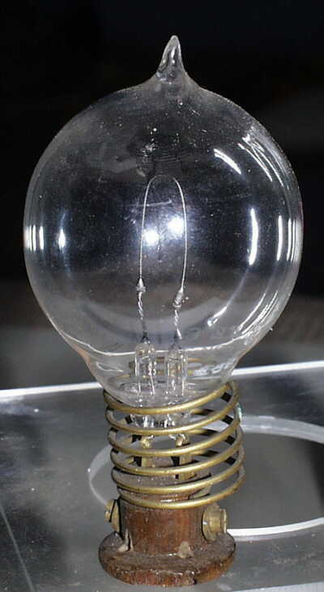
“I have not failed.
I've just found 10,000 ways that haven't worked.”
- Thomas Alva Edison

Slide 4
IT Support, serving 12,000 students,
3,000+ faculty and staff:
Enterprise Technical Services
Departmental IT Groups
and then there is us:
Learning Resources Group
Center for Teaching and Learning (CTL)
Academic Computing Services (ACS)
Center for Media Development (CMD)
Notes:
The University of Vermont (http://www.uvm.edu) is a mid-size university of approximately 12,000 undergraduate, graduate and medical students, across 7 colleges and over 100 programs.
The core IT organization is Enterprise Technical Services, but many colleges and departments have IT groups of their own. Generally, at present the central IT organization and the satellite IT groups support things like administrative systems, the network, the computer store, the helpline, etc. In other words, faculty, staff, and student computing needs from the hardware level up through the application level.
I am ¼ of Academic Computing Services which was recently moved out of the main IT department and combined with the Center for Teaching and Learning and Media Development to form the Learning Resources Group. In our case, our mission, our credo if you will, has not changed…

Slide 5
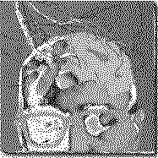
Academic Computing Services
“We will explore
we will recommend
we will encourage you
we will teach you how to do it
but we can’t do it for you.”
Notes:
Although not always possible or desirable we try to stick to this credo. Partly because our size makes any other option impossible, but mostly because we feel that the best way to understand ITs impact on scholarship is to experience it. But what does this mean in actuality?

Slide 6
We support PEOPLE
WebCT ➔ Blackboard
MySQL
wikis
video
CSS
podcasts
SPSS
ContentDM
blogs
EndNote
web
Word
workshops
xml
php
GIS
dSpace
PowerPoint
PhotoShop
Notes:
Yes we teach and support applications, but these are always changing. So when faculty come to us with questions, ideas, or pedagogical problems that IT might solve, we work with them to find a solution. And sometimes we work to find a solution to a problem that has not yet been expressed.

Slide 7
But what about digital humanities?
Notes:
And that’s where the digital humanities story starts. In the early1990s, about the same time we were installing our first web servers, I discovered the Text Encoding Initiative. Wonderful. It seemed obvious that this was something with true scholarly potential. That deep involvement with texts through markup combined with the delivery potential of the web, would add a fascinating dimension to humanities scholarship. So…

Slide 8
The Idea
We can build and support an infrastructure for humanities faculty and students to create the digital resources they need to advance their teaching, learning, and scholarship goals.

Slide 9
Experiment 1:
R&D
Marketing
Notes:
So, our first experiments began with some research: what were emerging standards, what technologies, what applications, etc. and some marketing. I found that a colleague in Special Collections was also interested in the application of SGML to humanities texts.

Slide 10
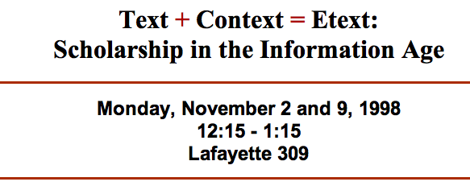
Notes:
Together we planned a series of lectures and small events to inform and to gauge interest. Attendance was…..disappointing.

Slide 11
Experiment 2:
Inspire with exemplars
Notes:
For our second experiment we decided to build some model collections. I’ll show you a couple of those.

Slide 12
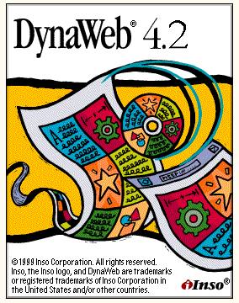

Notes:
Library Special Collections and Academic Computing, received a grant from Inso Corporation to install 2 DynaWeb servers to house electronic text collections. DynaWeb was an SGML-based corporate document publishing system.

Slide 13
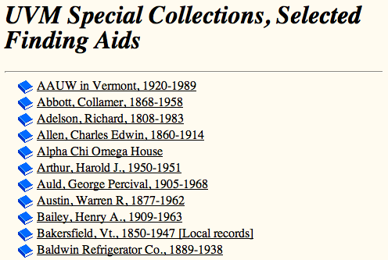
Notes:
The library proceeded to digitize and publish their Finding Aids using the Encoded Archival Decsription DTD.

Slide 14
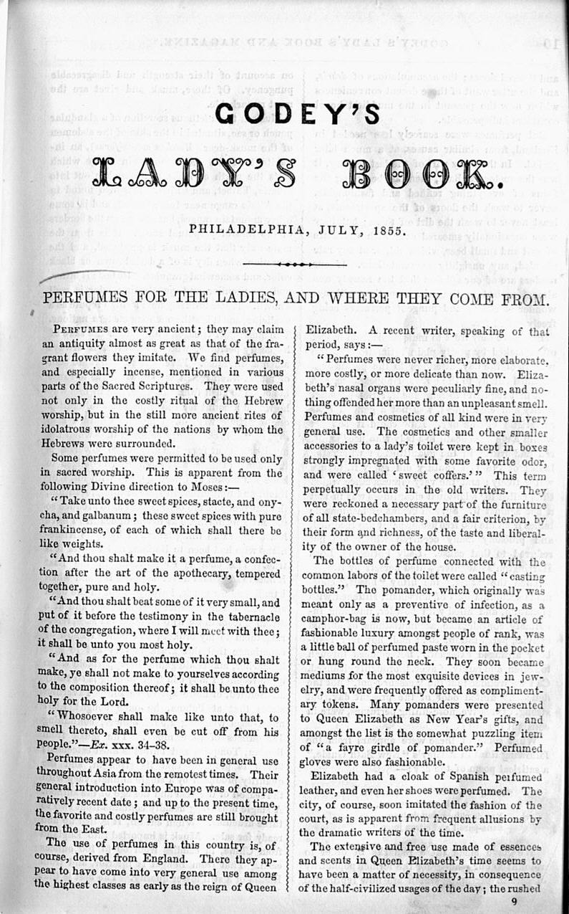
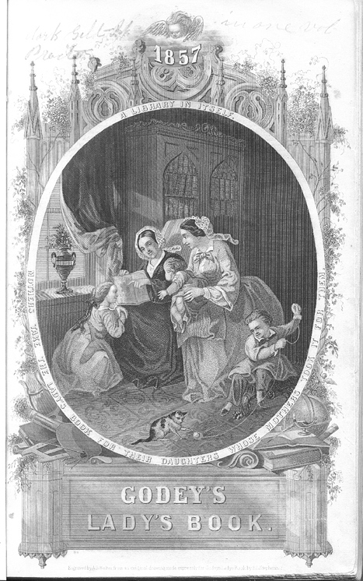
<HEAD TYPE="article">PERFUMES FOR THE LADIES, AND WHERE THEY COME FROM.</HEAD><DIV2 TYPE="images”>
<p>Perfumes appear to have been in general use throughout Asia from the remotest times. Their ~eneral introduction into Europe was of comparatively recent date; and up to the present time, tl~e favorite and costly perfumes are still brought from the EasL</p></DIV2>
Notes:
For my sample project I chose to digitize several issues of Godey’s Lady’s Book, one of mid- 19th century America’s most popular magazines. It is a frequently used primary resource for History, Literature or any scholars interested in the culture of this time period. So, great resource. Each page was scanned and OCRd, with the resulting text being marked up according to the Text Encoding Initiatives guidelines. The quality of the OCRd text was too poor to be displayed as a transcription, but it was just good enough to provide reasonable search results, upon which time we would display the actual page image. This model, fondly known as “dirty OCR,” was used by several humanities computing projects. This project gave us a sense of how much time would be involved in creating this type of resource.

Slide 15
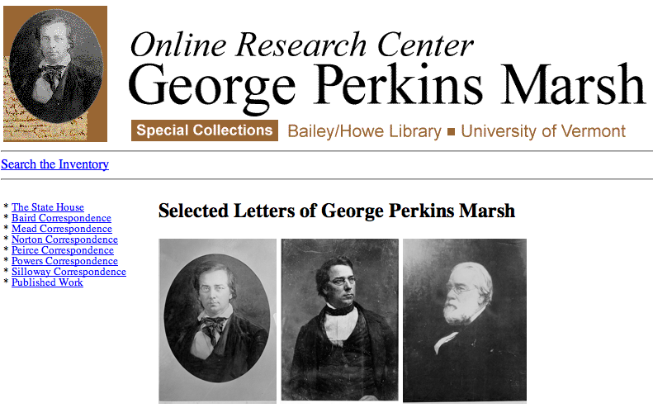
Notes:
Meanwhile. The library had received a grant from the Woodstock Foundation to digitize correspondence from its George Perkins Marsh collection. author of Man and Nature, published in 1864, was one of the first to recognize and describe in detail the significance of human action in transforming the natural world.” He has been called the father of the environmental movement. This project also used the Text Encoding Initiative DTD but, as the TEI was built to be extensible, they used a customized version specific to letters/ correspondence. In terms of our experiments, we learned the importance of help. This project hired student workers and also received many hours of help from some dedicated volunteers, including a professor emeritus who was interested in Marsh.

Slide 16
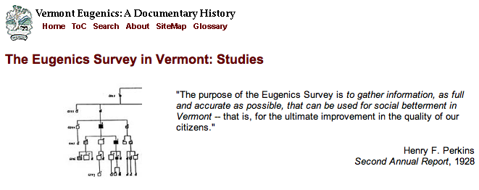
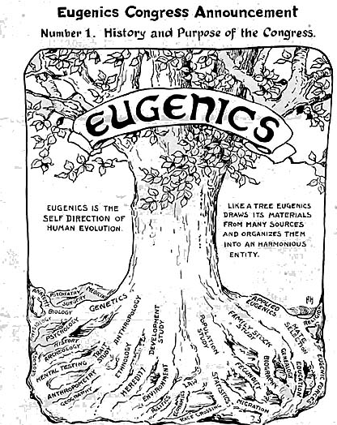
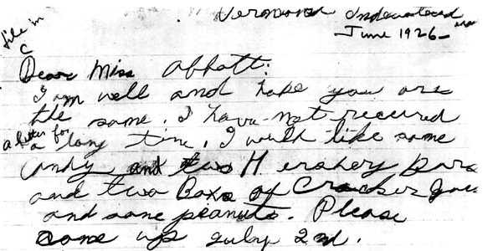
Notes:
Our 4th project came from Nancy Gallagher, a woman who had just completed an MA in History at UVM and had published her book “Breeding Better Vermonters; The Eugenics Project in the Green Mountain State.” As part of the research for that book she had scanned hundreds of documents from repositories across the state. She had received a grant to develop this topic into an interdisciplinary educational resource to facilitate use of primary historical sources. But there was enough interest in the community for something broader than that. Most of the grant went to student help, which was an excellent investment.

Slide 17
Experiment 3:
“Grow” student expertise
Notes:
The response to our model projects was wonderful. Many users, many inquiries. At least from people outside the university. Our faculty… well. So we planned the next experiment. We had had such good results with student help. We thought that if we could develop a cadre of experienced students, we could then match to faculty projects, either pay them or give them credit. I also wanted an opportunity to teach about digital humanities. Neither History nor English were interested in such a course at that time, but the Computer Science department allowed me to offer CS005: Introduction to Applied Humanities Computing, as an undergraduate course. The course was a combination of the theoretical and the practical. We studied topics in humanities computing and also the practical aspects of digitization, scanning, OCR, etc. I taught them xml in the form of the TEI, and xslt to transform our marked up text for web publication.

Slide 18
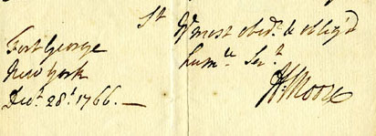
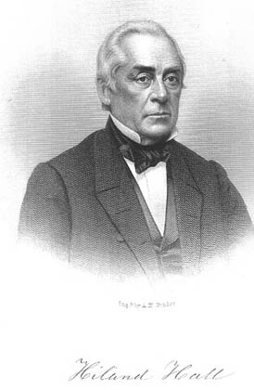
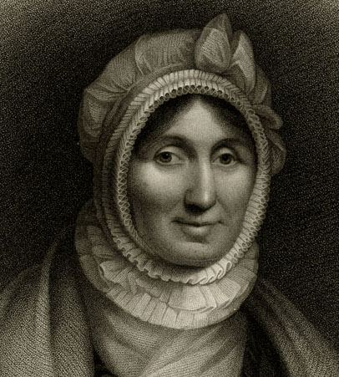
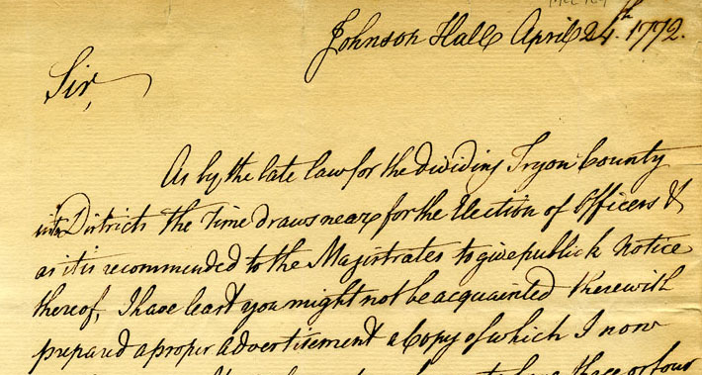
Notes:
The text that published was from Special Collections. It was an unbound edition of Hiland Hall’s “History of Vermont” published in 1868. It had been unbound and then each page had been remounted on individual pages. This had been done at the behest of Hall’s great-grandson. Hall had been a collector of autographs and documents related to Vermont History. His great-grandson continued to acquire documents, and envisioned including one such document for each page of the History. What he was creating was a sort of paper hypertext. At any rate the students loved working with real historical documents and building something that could be used by others. There was just one little problem. Because the course could not be used by lower level students to fulfill History or English requirements, most of the students who took it were seniors. Our cadre of experienced students… graduated.

Slide 19
Experiment 4:
Combine forces
Notes:
UVM tends to be a highly distributed environment. Ideas and projects tend to happen in isolation, or to use an icon of the Vermont landscape…

Slide 20
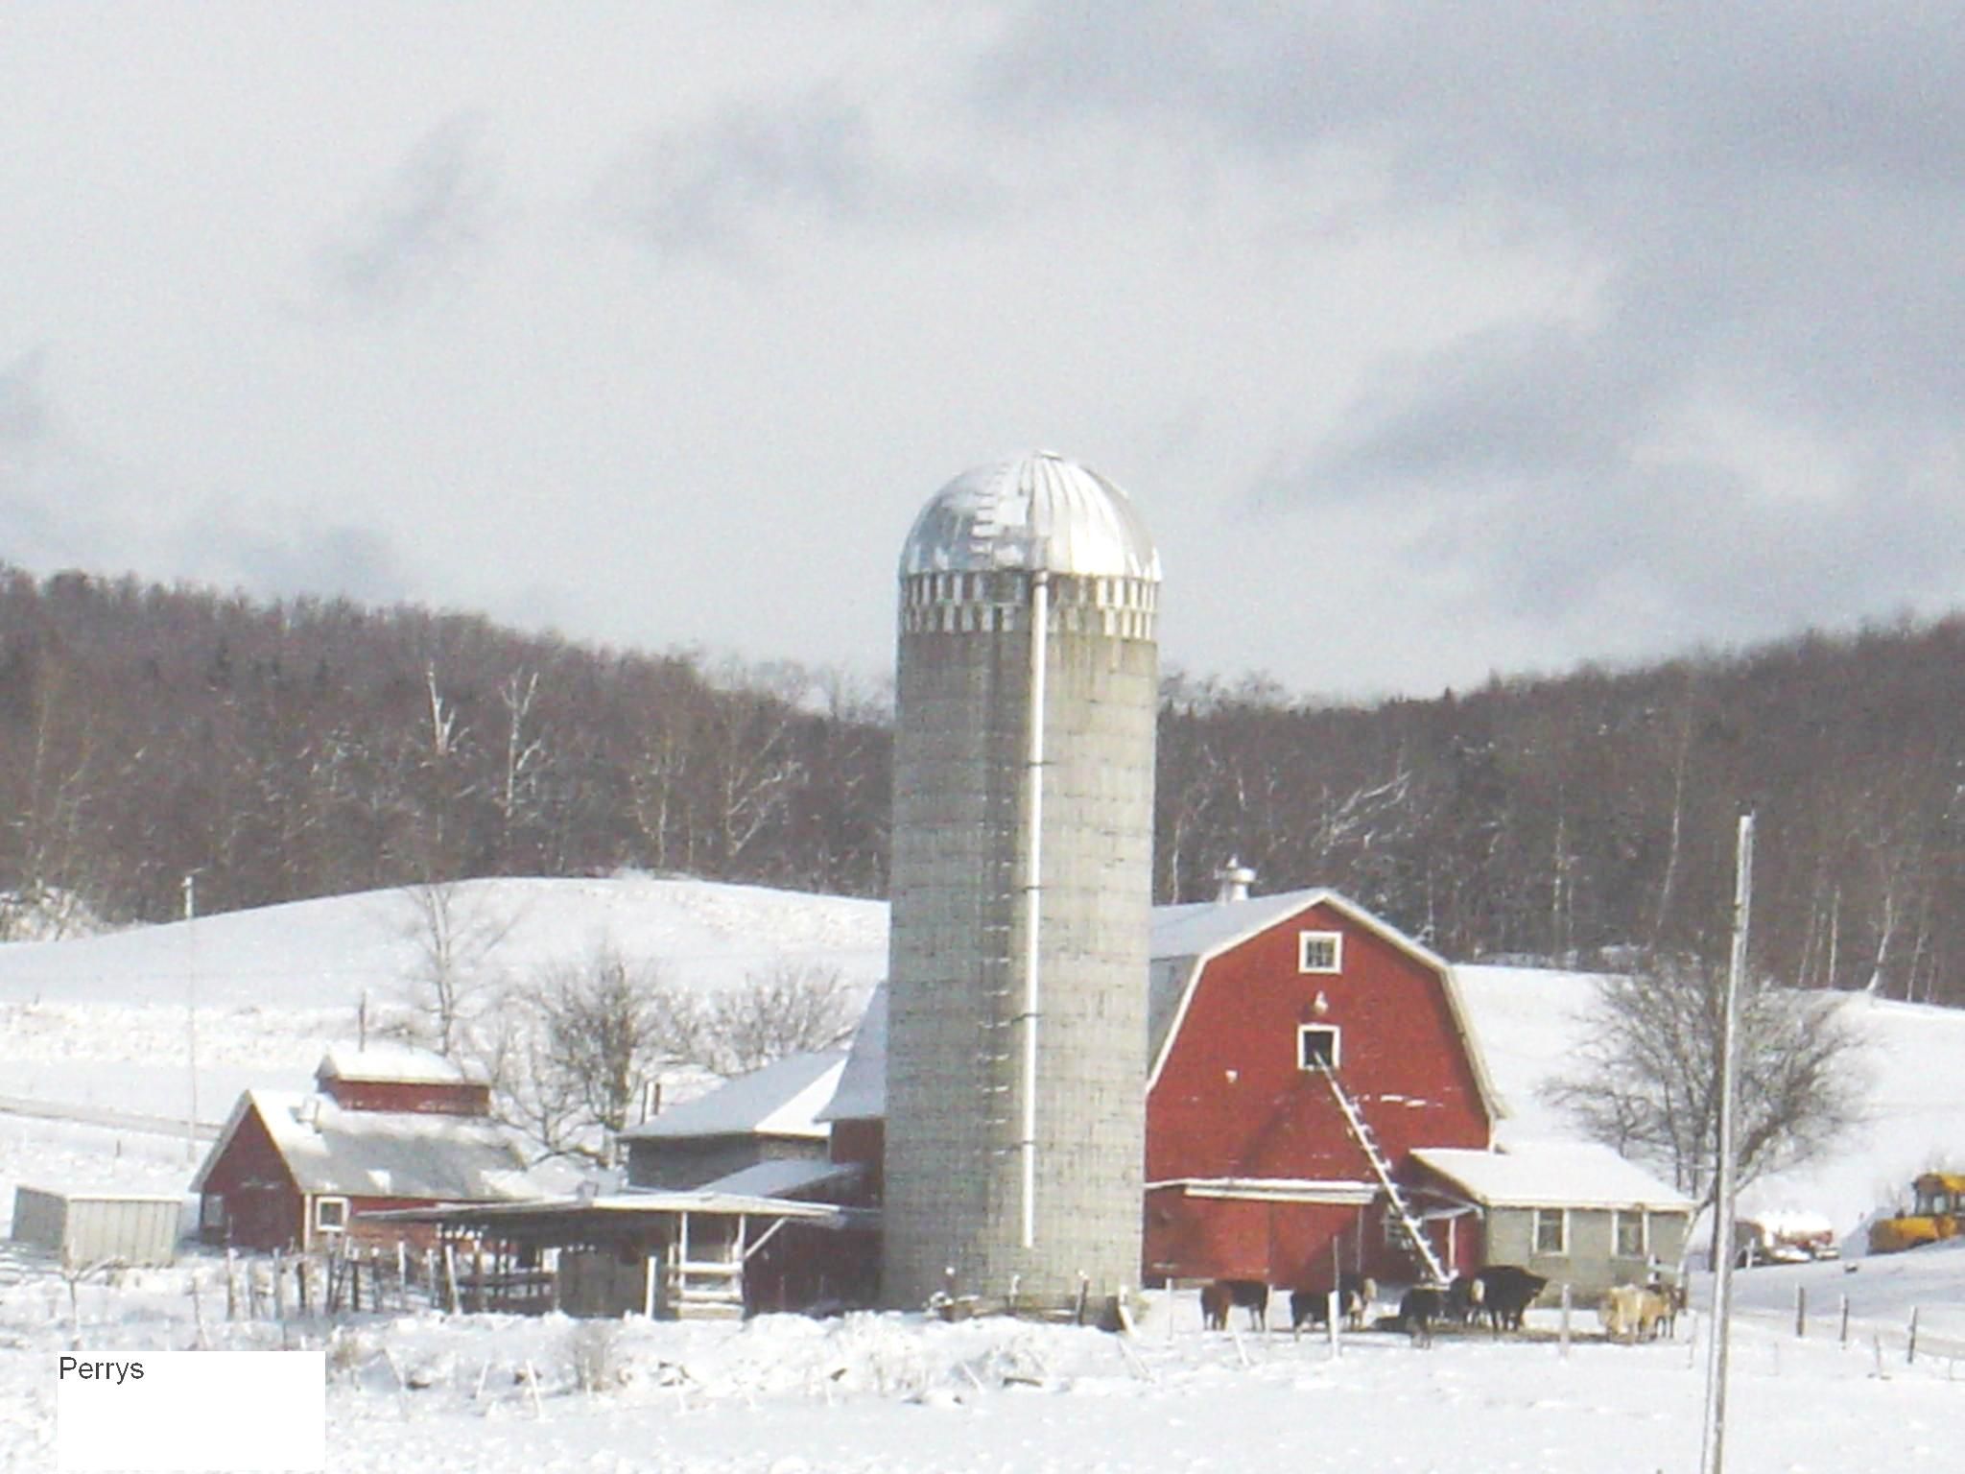
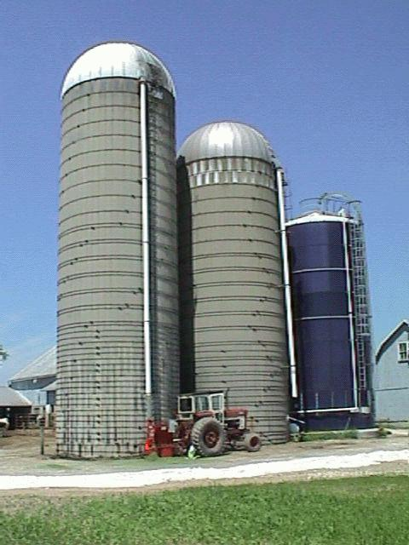
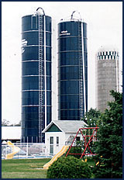
Notes:
Silos. Projects and resources developed in one area don’t necessarily connect to similar resources developed in others. This isn’t necessarily a bad thing, except, of course

Slide 21
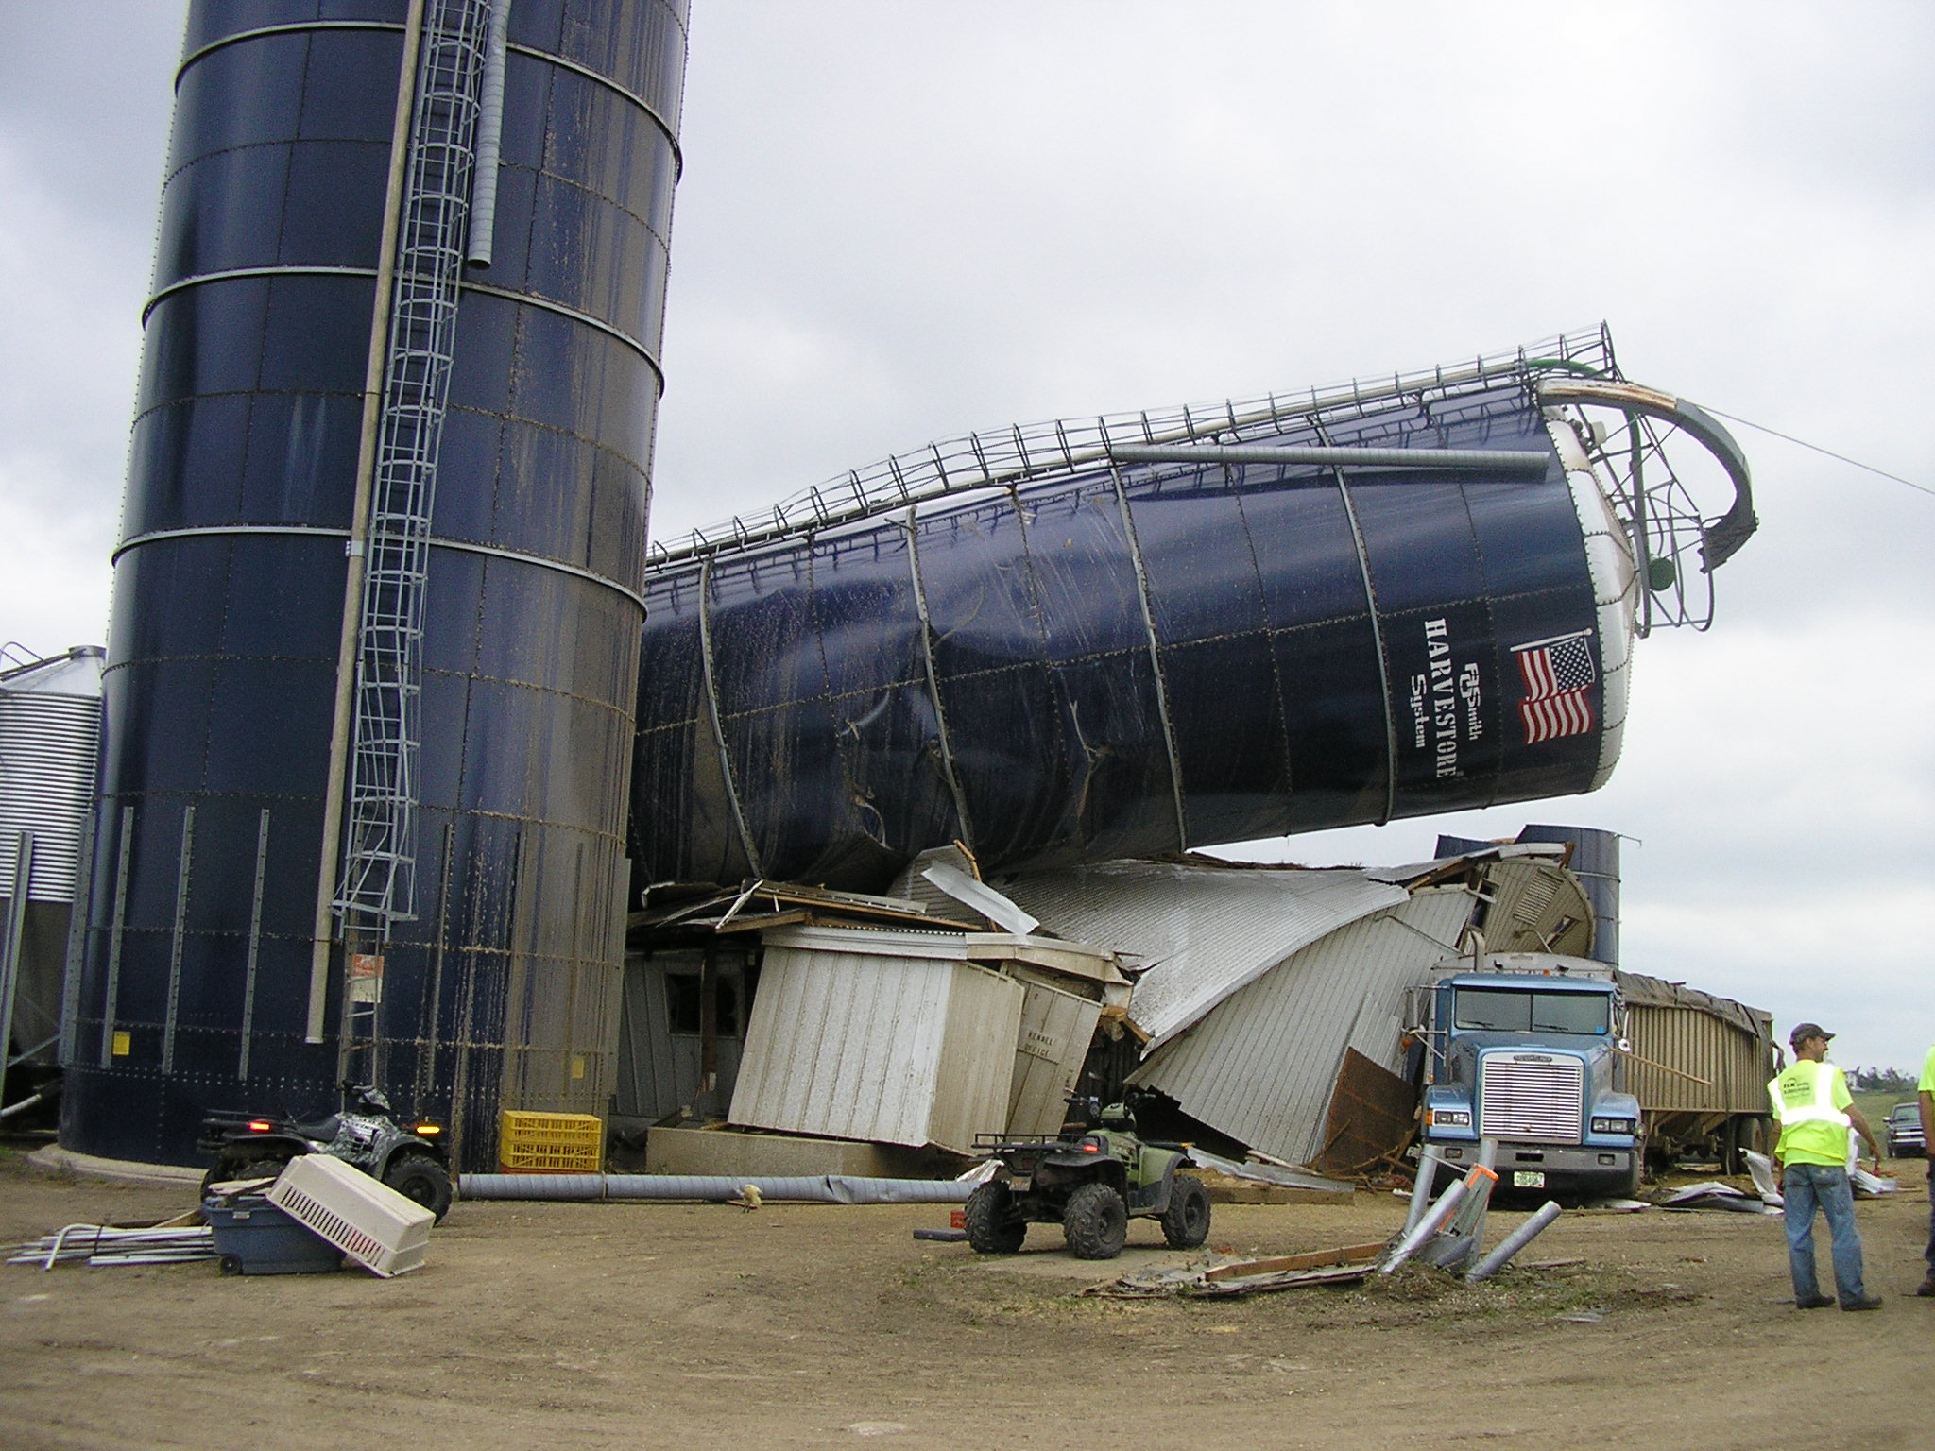
Notes:
it makes project longevity a more precarious proposition
Interest in online collections was growing, so we decided to bring together the various groups and people on campus who wanted to further efforts in this area.

Slide 22
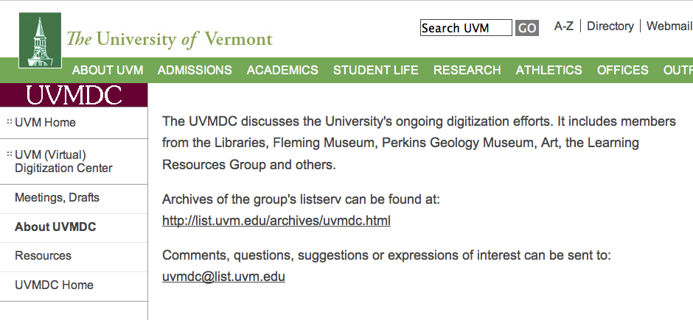
Notes:
We made several discoveries: our several constituencies really did have differing needs. In fact, though we had been thinking in terms of “humanities computing” several of the projects were not actually in the humanities. The types of needs fell, roughly, into:
- image collections for use among several faculty in conjunction with courses, whether in classroom or for assignments. Challenges: need for secure access due to copyright restrictions
- exhibitions which combined searchable image collections with narrative frameworks, for class use, but also for the larger community.
- electronic texts, both for display and for study.

Slide 23
Experiment 5:
Image Collections
Notes:
Most members of our group were looking for ways to build image collections, so we started there. We had already installed dSpace for experiments with an Institutional Repository but it also provided an easy interface for our faculty to build image collections. We added ContentDM for its image handling capabilities and easy interface, then began to compare the two. BTW we are a mixed Mac/Windows environment, and ContentDM was and is a Windows-only product, which was why we did not go completely in that direction, although we later wrote some scripts to batch upload jobs from Excel so that Mac-using Art faculty could use the product.

Slide 24
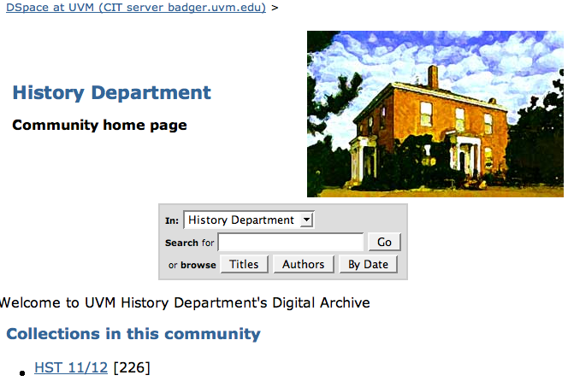
Notes:
The six to seven faculty who rotate through teaching the several sections of Intro to American History built the History 11/12 collective where each member could add the images they needed for their sections.

Slide 25
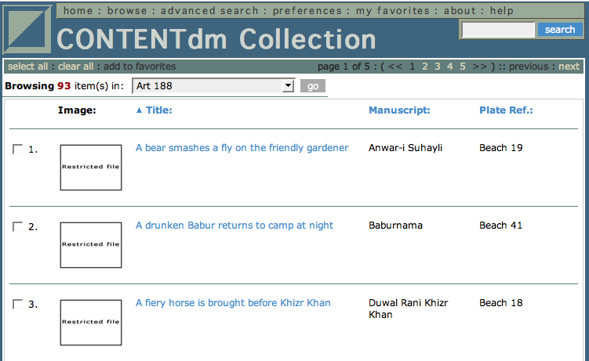
Notes:
Several Art History courses built a similar collection of art images. Many of their images were under copyright restriction which necessitated a secure environment which ContentDM handled easily.

Slide 26
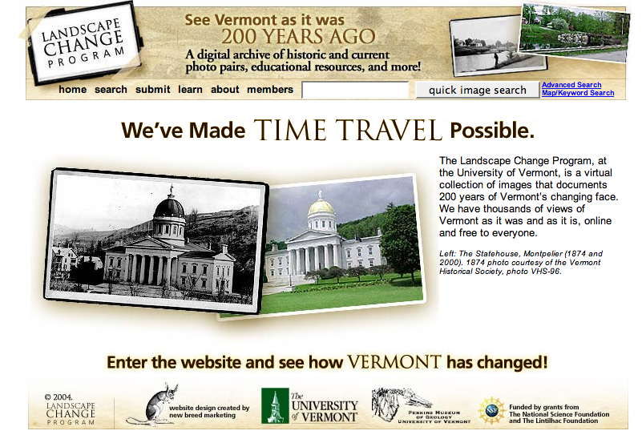
Notes:
The Landscape Change Program was funded externally and was built from the ground up. The project itself compares historical images of Vermont with contemporary images. In many cases the contemporary images are taken by students in the related course but the project also accepts mages taken by community members. You can search by town, etc.

Slide 27
Experiment 6:
A more formal approach…
Notes:
These experiments led us to conclude that there was indeed room for digitization efforts at UVM, and that broader institutional support might now be possible. We needed a more formal approach

Slide 28
i.e., get more $$

Slide 29
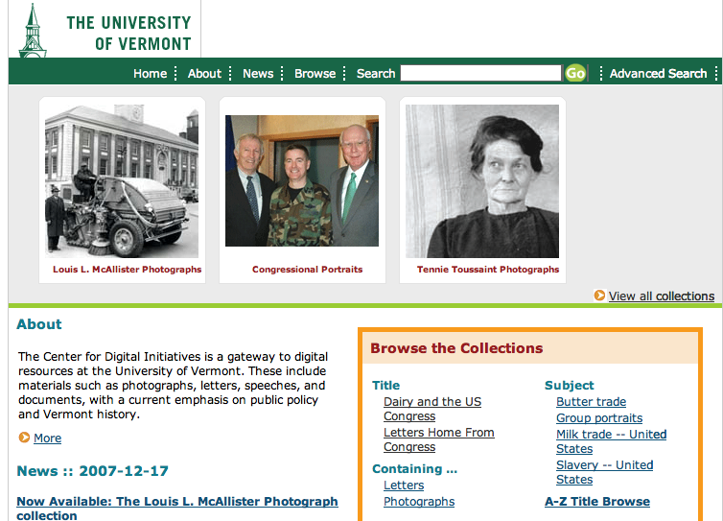
Notes:
So, after successful application and granting of earmark funds, we hired our first Digital Initiaitves Librarian, Winona Salesky, in 2006. The current emphasis (based on the main source of funding) is on the congressional papers of Senators Jeffords and Leahy. Another large project is to digitize the thousands of photographs of Vermont in the McAllister collection. BTW this system is built using eXist, the XML database. Winona has also created a system using xForms whereby library cataloguers can handle the creation and application of the metadata for these items so that task is not left up to the students who are scanning and transcribing.

Slide 30
We have learned…
Notes:
ideas/vision: good
Institutional buy-in (support or money) is necessary
We will continue to build collaborations and are mindful that many faculty are quite IT-skilled, while many IT people have a deep interest in the content that is being created.
One size need not fit all: we do not have to build one major system that will do it all. Working with multiple systems is still a viable approach, not quite the support nightmare one might envision.

Slide 31
Looking Ahead…
Notes:
In terms of Academic Computing and faculty projects, the CDI relies on a Collections Development Committee, so the initial faculty-built collections will likely use materials drawn from Special Collections. However, we will probably run a parallel server based on the systems Winona is developing, for faculty-built collections that are drawn from elsewhere, especially those that may not have the metadata needs of the “official” projects (for example, faculty photograph collections used for classes).
We still need to work on getting more faculty to think like producers of digital projects instead of just consumers
We will continue to experiment, to find new methodologies for adaptation, to encourage and react to our faculty needs. We will continue to do research…
And of course, our definition of research has been and may continue to be…
History methods class

Slide 32
“If we knew what we were doing it wouldn’t be called research.”

Slide 33
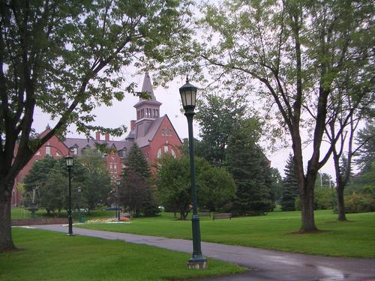
University of Vermont Center for Digital Initiatives:
http://cdi.uvm.edu
Questions:
hope.greenberg@uvm.edu
Winona Salesky’s blog on the process of building the CDI:
http://thedil.wordpress.com/

