Slide 1
Blackboard 9.0 to 9.1
What’s New for UVM?
Notes:
We will soon be upgrading our current version of Blackboard 9.0 to the new version, 9.1. In this slide show we’ll take a look at some of the changes.

Slide 2
Bb 9.0 to 9.1: Differences
Bug fixes
Enhanced features
New features
Notes:
The changes from 9.0 to 9.1 fall into 3 categories. Many of the bugs in 9.0 are fixed in this version. Several of the familiar features have been enhanced, and there are a few, but only a few, totally new features.

Slide 3
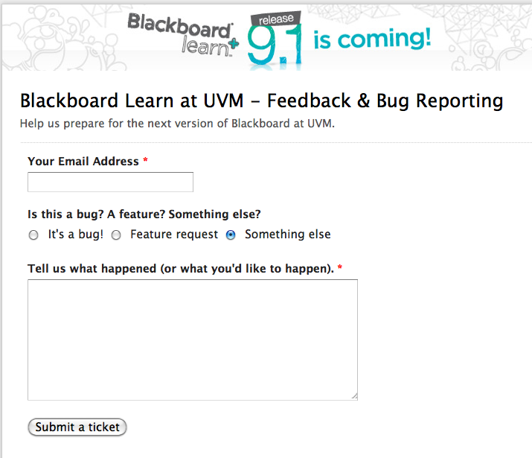
Bug fixes
Help us catch them!
Notes:
Of course, it wouldn’t be new software without bugs. We hope you will help us identify them. At the top of every 9.1 screen you will see a little link to the bug report page. As you can see, reporting a bug is easy, so I hope you will help us with this. And if you think of a feature that you would like to see added to Blackboard, let us know that as well. We make no promises but Blackboard does pay attention to requests.

Slide 4
Enhanced features
Grade Center:
Color codes
Smart views
Tests:
Random questions/question sets
Copy
Statistics
Grade by question
Adding images
Learning Module navigation
Priority Announcements
Notes:
Here are a few items in our second category, enhanced features. [give them a moment to read]. As you can see, quite a lot of work has been done to the Test function and the Grade Center. There are more options for building sets of questions and for randomizing questions so that students do not see the same exact test. It’s now easy to copy an entire test to another test so you can make changes or update portions of the test without having to recreate an entirely new test. More statistics about tests are available and one feature that many people requested has been added. In 9.0 you would view each students test, one at a time. If you wanted to see how all student did on a particular question, you would have to open each students test and find their answer to that question. The Grade by Question feature lets you see how all students answered a particular question. There have also been some enhancements to a few other features: it’s easier to add images, there is improved navigation in the Learning Module feature and you can now make an Announcement stay at the top of the Announcements page while additional announcements are listed in their usual reverse chronological order.

Slide 5
9.0
9.1
Notes:
Here are some changes in the that you will see when building your course content.. In the top half are the familiar Blackboard 9.0 buttons. In this case we’re looking at the content area named “Course Materials” with editing turned on.
In the bottom half are the new Bb9.1 buttons. Some thing, like create and build, have been combined under one button and the buttons have been renamed

Slide 6
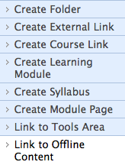
9.0
Notes:
Here are the choices from 9.0 [pause] It’s already a long list and Blackboard has added a few more options, so now instead of a drop-down list, when you click on the Build button you will see…

Slide 7
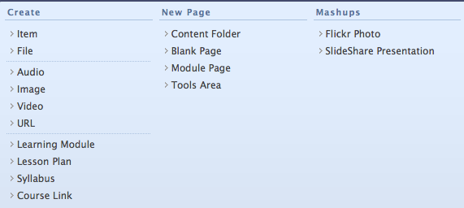
9.1
Notes:
The new arrangement. Some of these are familiar. Item is still there as is Folder, though it’s now called Content Folder. There are some new addition. On the far right you’ll now see that there are options to add links to photos frpom the Flickr website as well as to slide shows from SLideShare. We’ll take a closer look at the rest in a moment

Slide 8
9.0
9.1
Notes:
The next button in the old version is the Evaluate button. In the new version this is titled “Create Assessment.” but as you can see, you have the same choices.

Slide 9
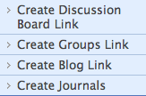
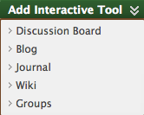
9.0
9.1
Notes:
And for collaborate, almost the same, with one new feature. Blackboard 9.1 now has its own built-in wiki.

Slide 10
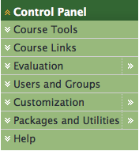
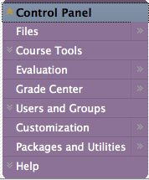
9.0
9.1
Notes:
The Control Panel is still found on the left side of the Blackboard screen, but you can see there have been a couple of minor changes. The Grade Center now has its own area because we have a couple new features.

Slide 11
New
features
Wikis
Rubrics
Lesson Plans
“mashups”
Smart Views: Favorites
Notes:
Let’s take a look at some of the new features that have been added to 9.1. As I mentioned, there’s a new wiki. We also have a new Rubric feature. This let’s you create grading or assessment rubrics for student work which you can share with the students. The Lesson Plan feature lets you add objectives to each section, module, or assignment you create in Blackboard. The mashups are what Blackboard calls those links to Flickr and Slideshare that I mentioned earlier. Smart Views are in the Grade Center.

Slide 12
New
features
Smart views: favorites
Notes:
The Grade Center link in the Control Panel can now take you to the Full Grade Center, as usual, or it can show you only those items that need grading. For a large class, this should be a good time saver. Notice the “Top of class” item. This links to a Smart View that I created in the Grade Center. The new Grade Center allows me to choose grades based on criteria that I set. I can have these highlighted in colors and I can gather them into a Smart View so that I merely click on the name to see those grades. For example, I could choose to see all students who have received top marks for a particular assignment, or choose to see students who are currently at risk of failing.

Slide 13
New
features
Wikis
Rubrics
Lesson Plans
Smart Views: Favorites
“mashups”
…and…(drum roll please)…
Notes:
So, those are the main new features. But there is one more. Think for a moment how you handle content in Blackboard now: you create content areas then you add folders and create items in those folders, then you type information into those items, or upload and attach files to those items. In other words, you have to create the area where the content will be attached, and then you can add things one at a time. If you want to use those files in another area of the same course, you have to upload them all over again. So what’s new?

Slide 14
9.1
Notes:
Files. The new version of Blackboard now has a centralized place in your course where you can store all the course files. You can upload them individually or in batches. You can upload files at any time and then choose to use them at a later date. You can even organize those files into your own folders. It looks like this…

Slide 15
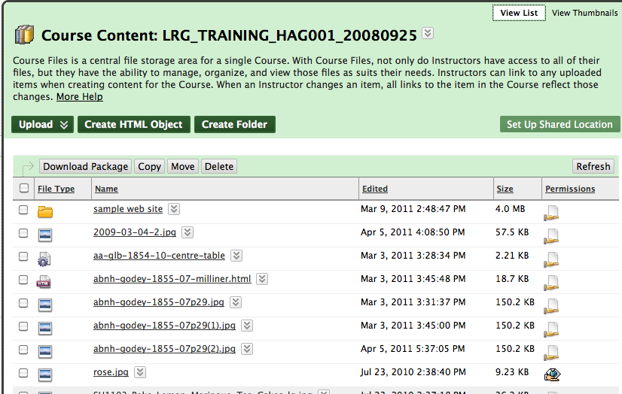
Notes:
These are all the files that I will be needing for this class.

Slide 16
Learn more at:
ctl.uvm.edu
Notes:
To learn more about the Blackboard upgrade, or to find details on how to use the new features, visit us at

