Slide 1
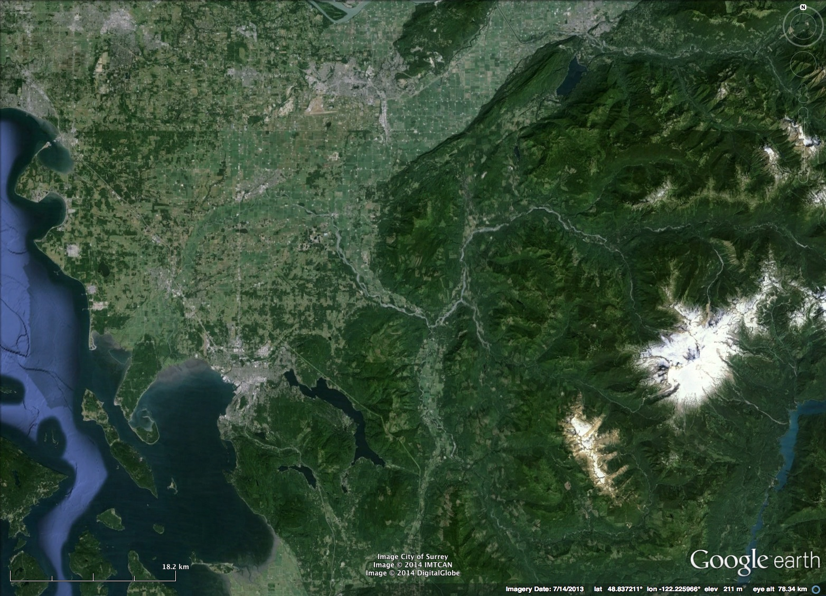
Hint: You want to be sure that the text on your poster will be visible to your viewers. To see how your text will look in “real life” (i.e. when printed), go to the “View” menu, click “Zoom”, click “Zoom” again, and choose “100%”.
For titles, we suggest using a font size of ~40-50
For captions, we suggest using a font size of ~25-40
TYPE THE TITLE OF YOUR PROJECT; PLEASE DON’T CHANGE THE SIZE/POSITION/COLOR OF THE TITLE
Names of both partners
Mid-Semester Project for GEOL151, Fall 2018
Arrows, boxes, etc, will help you organize your thoughts, connect images to captions, and provide flow through your ideas.
A note about COLOR. Color can be very helpful in a poster… but try to use it thoughtfully since it can be distracting if overdone. You might think about using a single color for each different category of thought (for example, differentiate hillslopes from fluvial by having the image borders different colors). You probably want all of your text to be black for readibility.
Remember that you can enclose your text in a box if you’d like. Just insert a text box, right click, and select “Format Shape”.
Hint: You can adjust the width of your text box by dragging the edges. You do NOT need to press “Enter” after each line of text… that will make things very messy to edit! Just adjust the box so that it is the width you want. This will change the size of the box rather than the size of the font. Note that you can also choose whether to have your font centered or left-aligned.
Think about how you can use font formatting to your advantage. For example, you can put key words in bold to make them jump out.
Leave this outer 1’’ border to ensure all of your content will print

