Slide 1
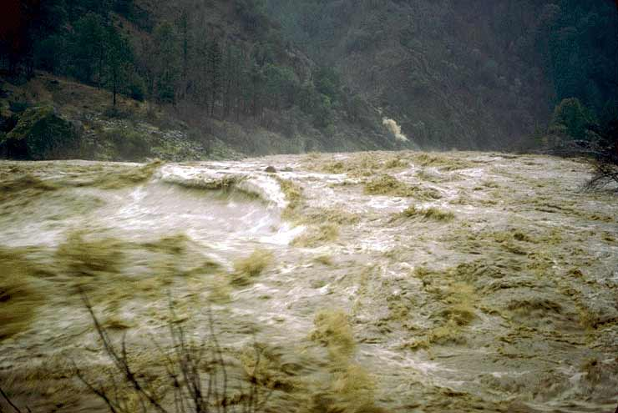
Week 4: Rivers as Conveyors
(Fluxes of water, sediment, and elements)
The Water:
Measuring and Monitoring Discharge (Q):
  Besides apples, how do we accurately measure Q?
  Long-term monitoring of Q.
  Channel Roughness and Manning’s Equation.
  Bankfull discharge - identification and prediction.
The Stuff in the Water:
Sediment and element loading:
  It goes where the water goes.
  How do we measure how much is in the water?
  Erosion and sediment loads

Slide 2
Start with the water:
Discharge (Q) m³/sec

Slide 3
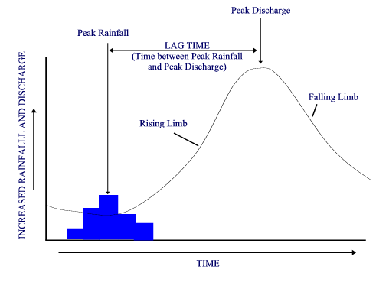
Stream Gauging:
Discharge has been recorded since the Egyptians:
(flooding along the Nile)
How are precipitation and river level related?
River Discharge
Response
Precipitation
Event
(hyetograph)
These relationships are specific to each individual basin

Slide 4
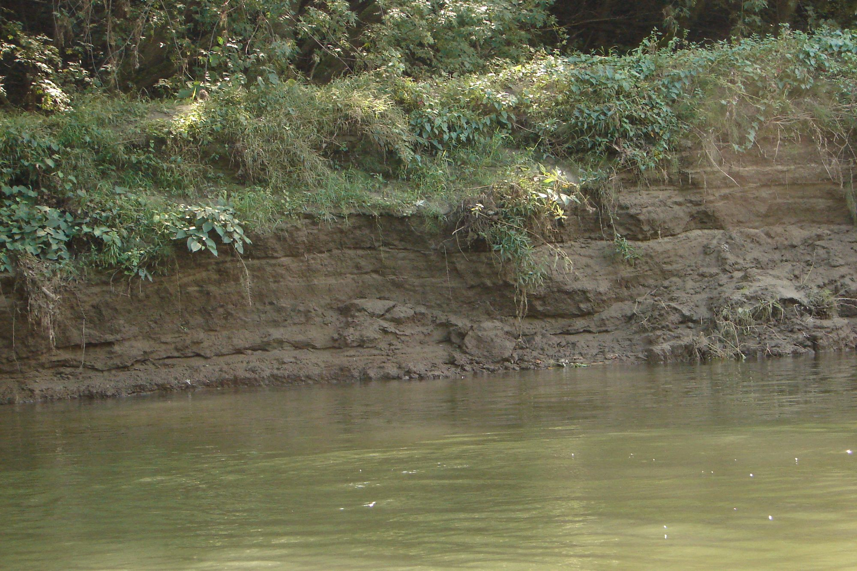
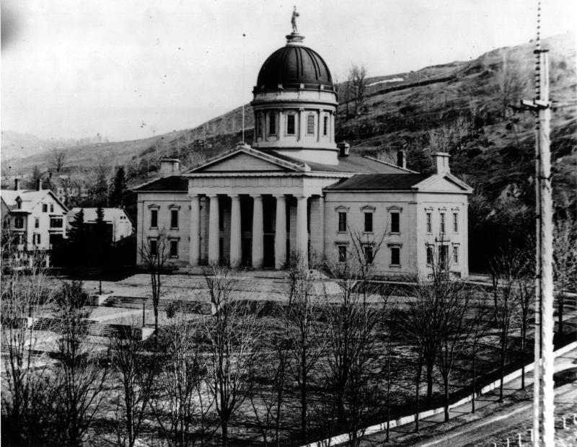

Q (Discharge)
Base flow
Time
1870
2007
LS00878 and LS11203_001 from the Landscape Change Program

Slide 5
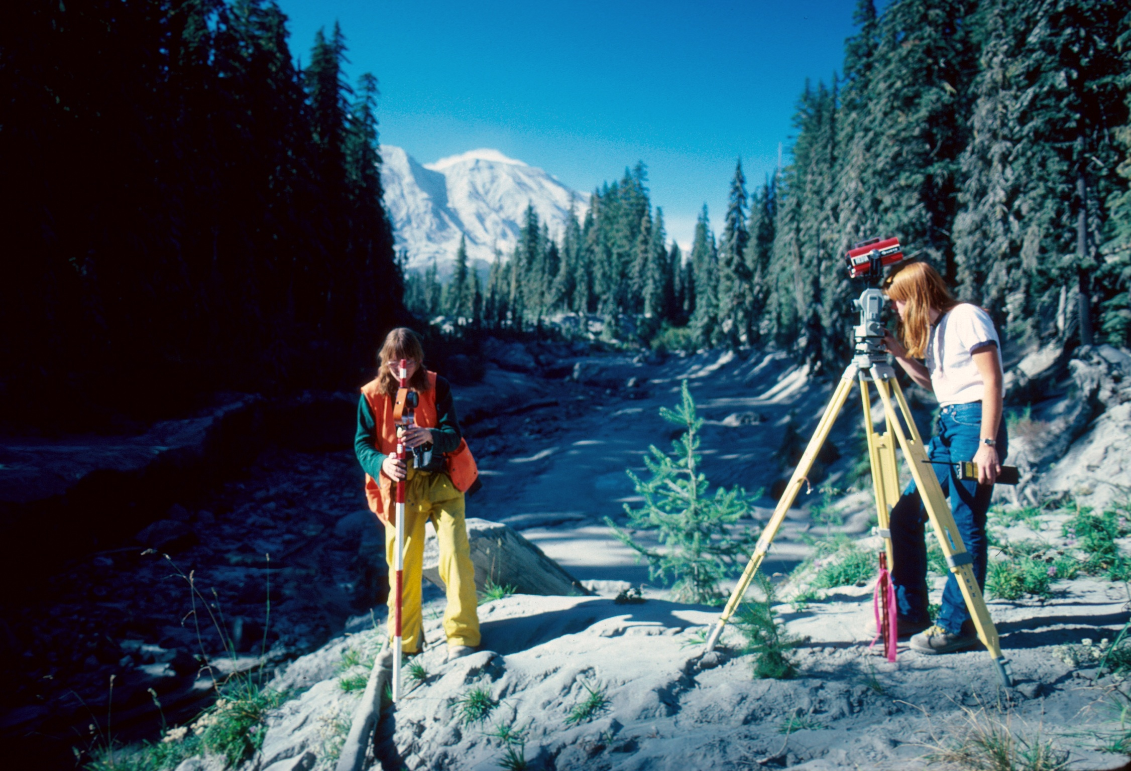
Flow Gauging:
Things we want to figure out:
How much water is flowing through a river cross-section
At a particular instant in time?
2. At a certain discharge, how deep will the water be?
Q = A x V
What we need to answer these:
Detailed cross-section of channel Geometry
AND Velocity across that cross-section
2. Multiple paired Q-d measurements

Slide 6
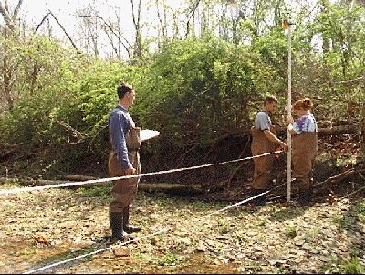
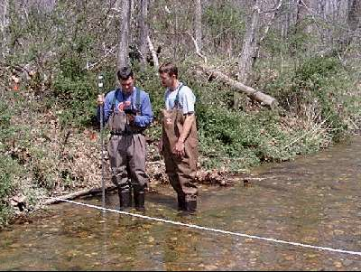
1
Surveying River Cross-Sections:
Width
Water Depth
Velocity

Slide 7
Surveying River Cross-Sections:
Depth (m)
Water level
Q
Q
Distance (m)
Width x Ave Depth x Velocity = Cruddy Q

Slide 8
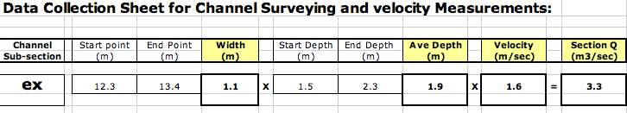
Need Much More Detail: Divide into Sections
Velocity Measured
At 0.6 depth at mid-point
Depth (m)
Water level
1
2
3
4
5
6
7
Distance (m)
When you are done, you add up all the sections to get the
Total Discharge for the entire channel
3
Width
Average Depth

Slide 9
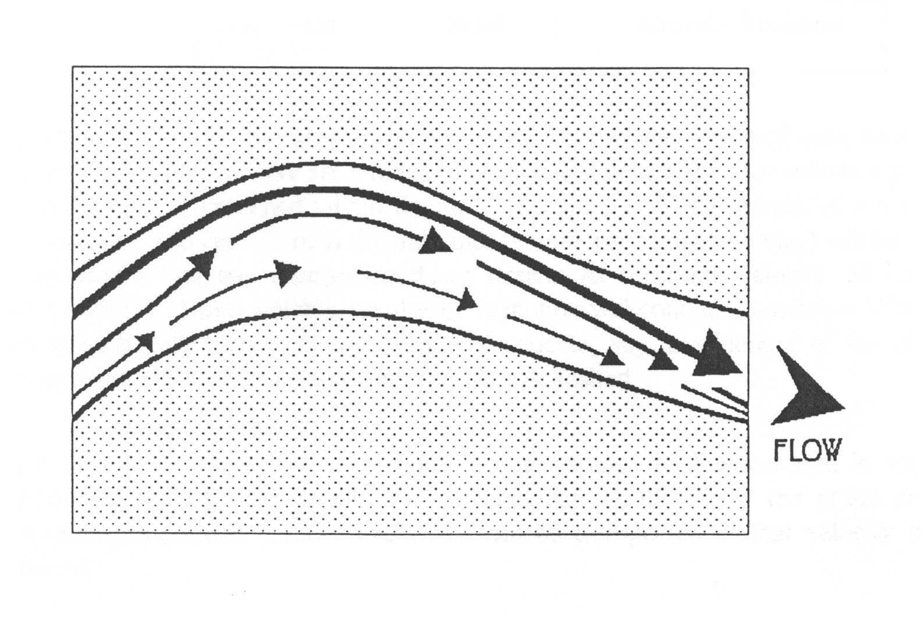
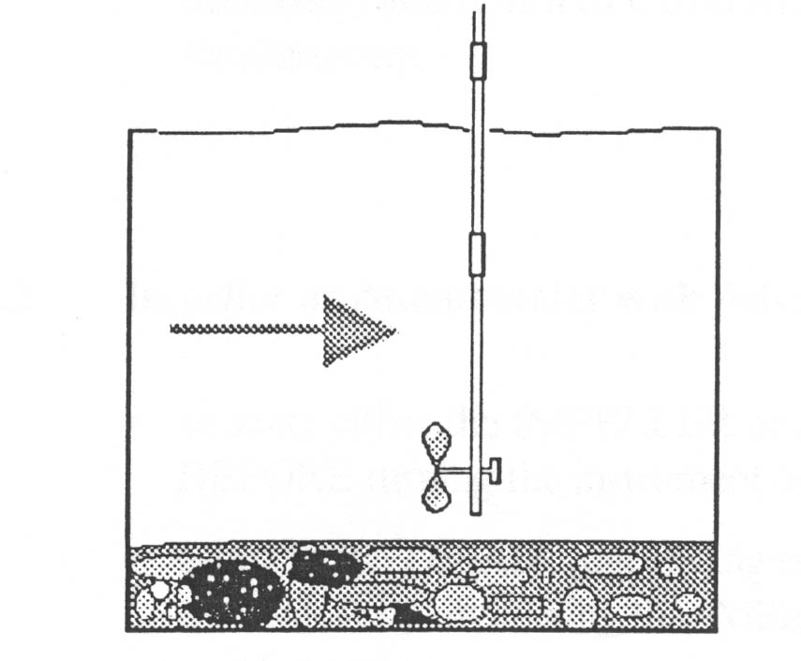
1
Flow meter for measuring water speed
.6d

Slide 10
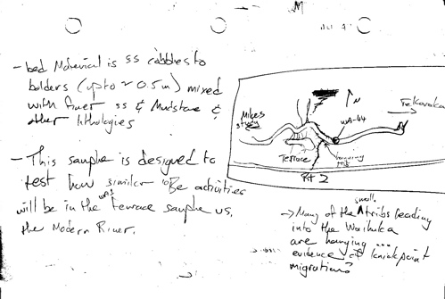
Critical to make a sketch of your cross-
Section as you go.
This is where you catch all your mistakes

Slide 11
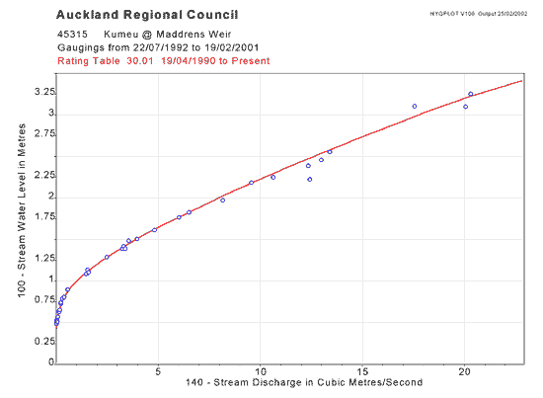
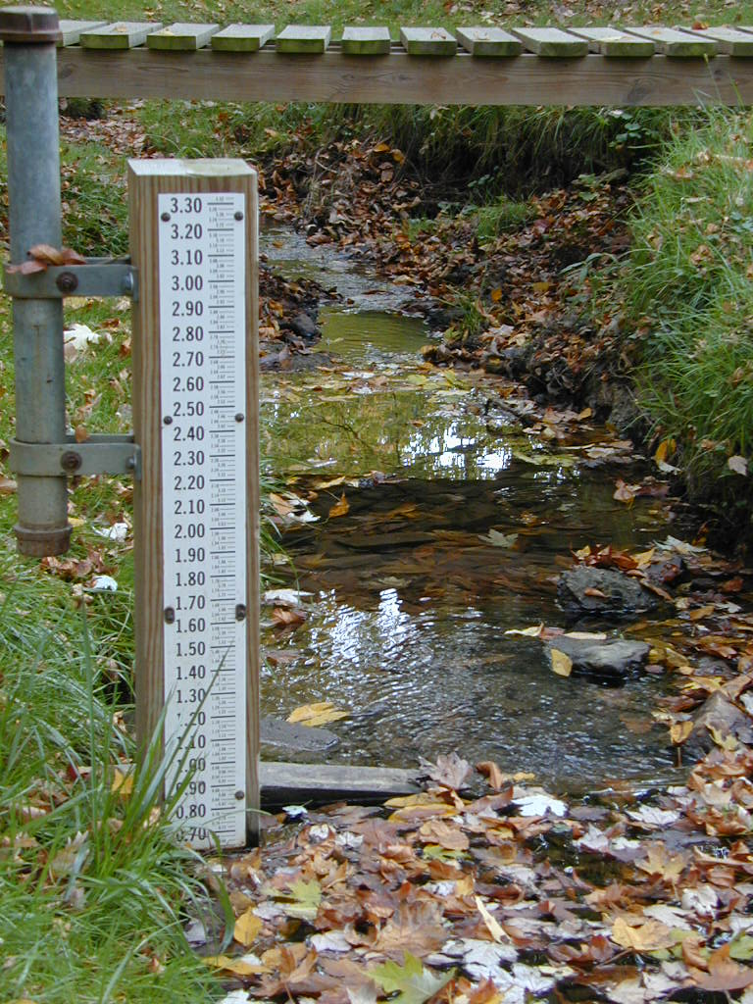
Do enough of these, and you can make a
Stage Height Discharge Rating Curve
1
Water Height
Predict River
Stage for any Q.
Good for flood
prediction
Q

Slide 12
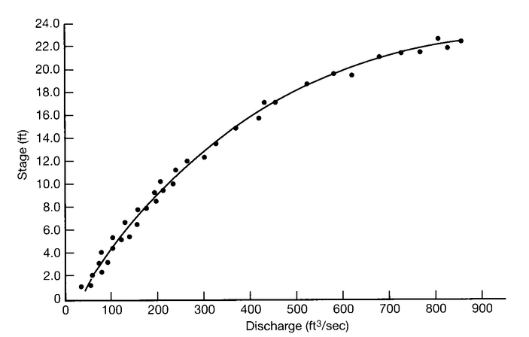
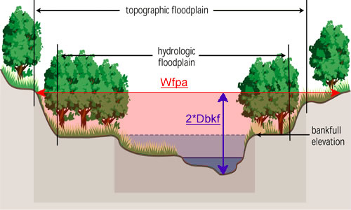
Why does the curve “Roll” over?

Slide 13
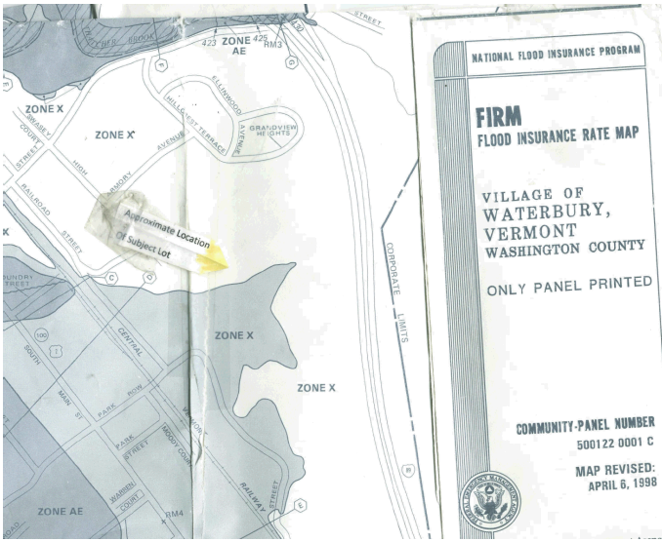
Hydro + geomorph = flood zone mapping
Notes:
Geomorphologists informing society

Slide 14
Channel Roughness
Manning Equation:

Slide 15
Manning Equation:
represents the roughness or friction applied to the flow by the channel
Watch
Units
Q and n inversely related…one goes up, the other must go down. LWD?
A = cross-sectional area (m²)
R = Hydraulic Radius (a/WP) (m²/m)
S = Slope (m/m)
N = Manning n (roughness coefficient)
Bigger the n, the rougher the channel is
Notes:
Irish engineer Robert Manning 1889 assumes uniform flow

Slide 16
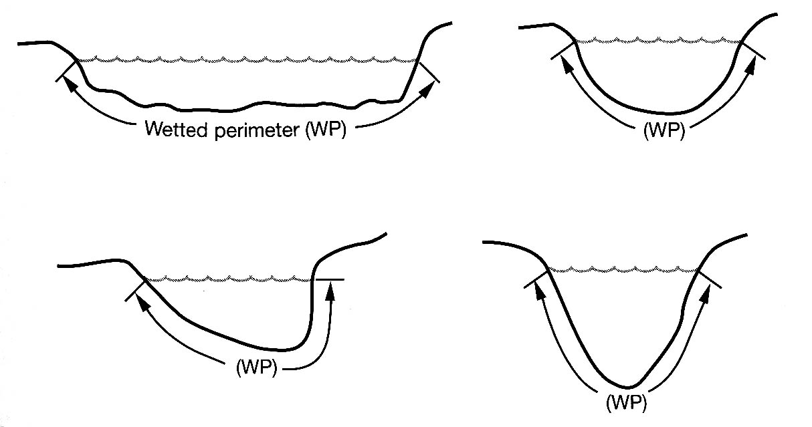
R - Hydraulic Radius
R = Hydraulic Radius (a/WP) (m²/m)
Cross-sectional Area of river channel / Wetted Perimeter
(the data you will collect) (WP ~ width + 2depth)
(square meters) (meters)

Slide 17
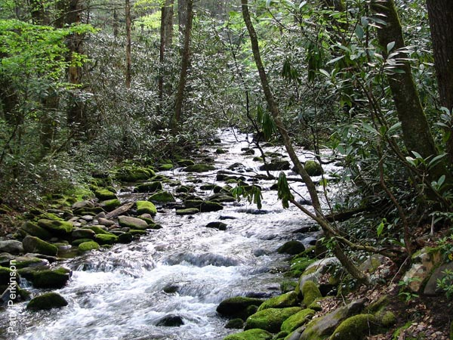
S - Slope of WATER SURFACE
Slope = change in elevation / distance downstream
(rise) (run)
Run
Rise

Slide 18
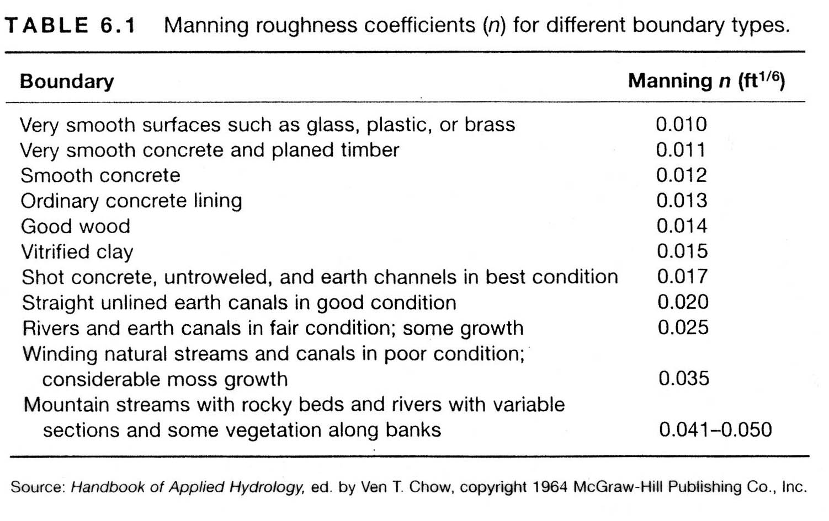
2
Manning n values:

Slide 19
http://wwwrcamnl.wr.usgs.gov/sws/fieldmethods/Indirects/nvalues/
2
Clark Fork at Missoula, Montana
n = 0.030
Boundary Ck at Porthill, Idaho
n = 0.073

Slide 20
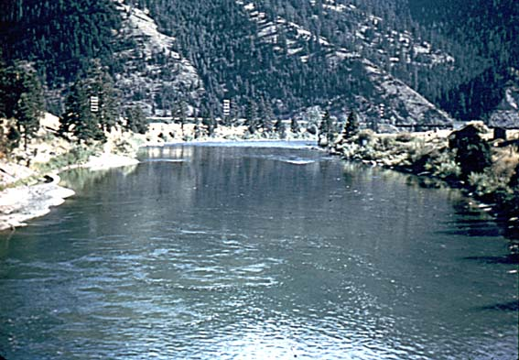
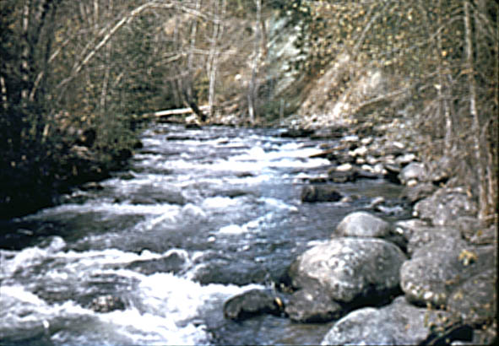
Why would anyone care how rough or smooth
A river channel is?
“smooth channel”
“rough channel”
Same Q
Same Q
Water level
Water level
Higher Stage
Relative velocity?

Slide 21
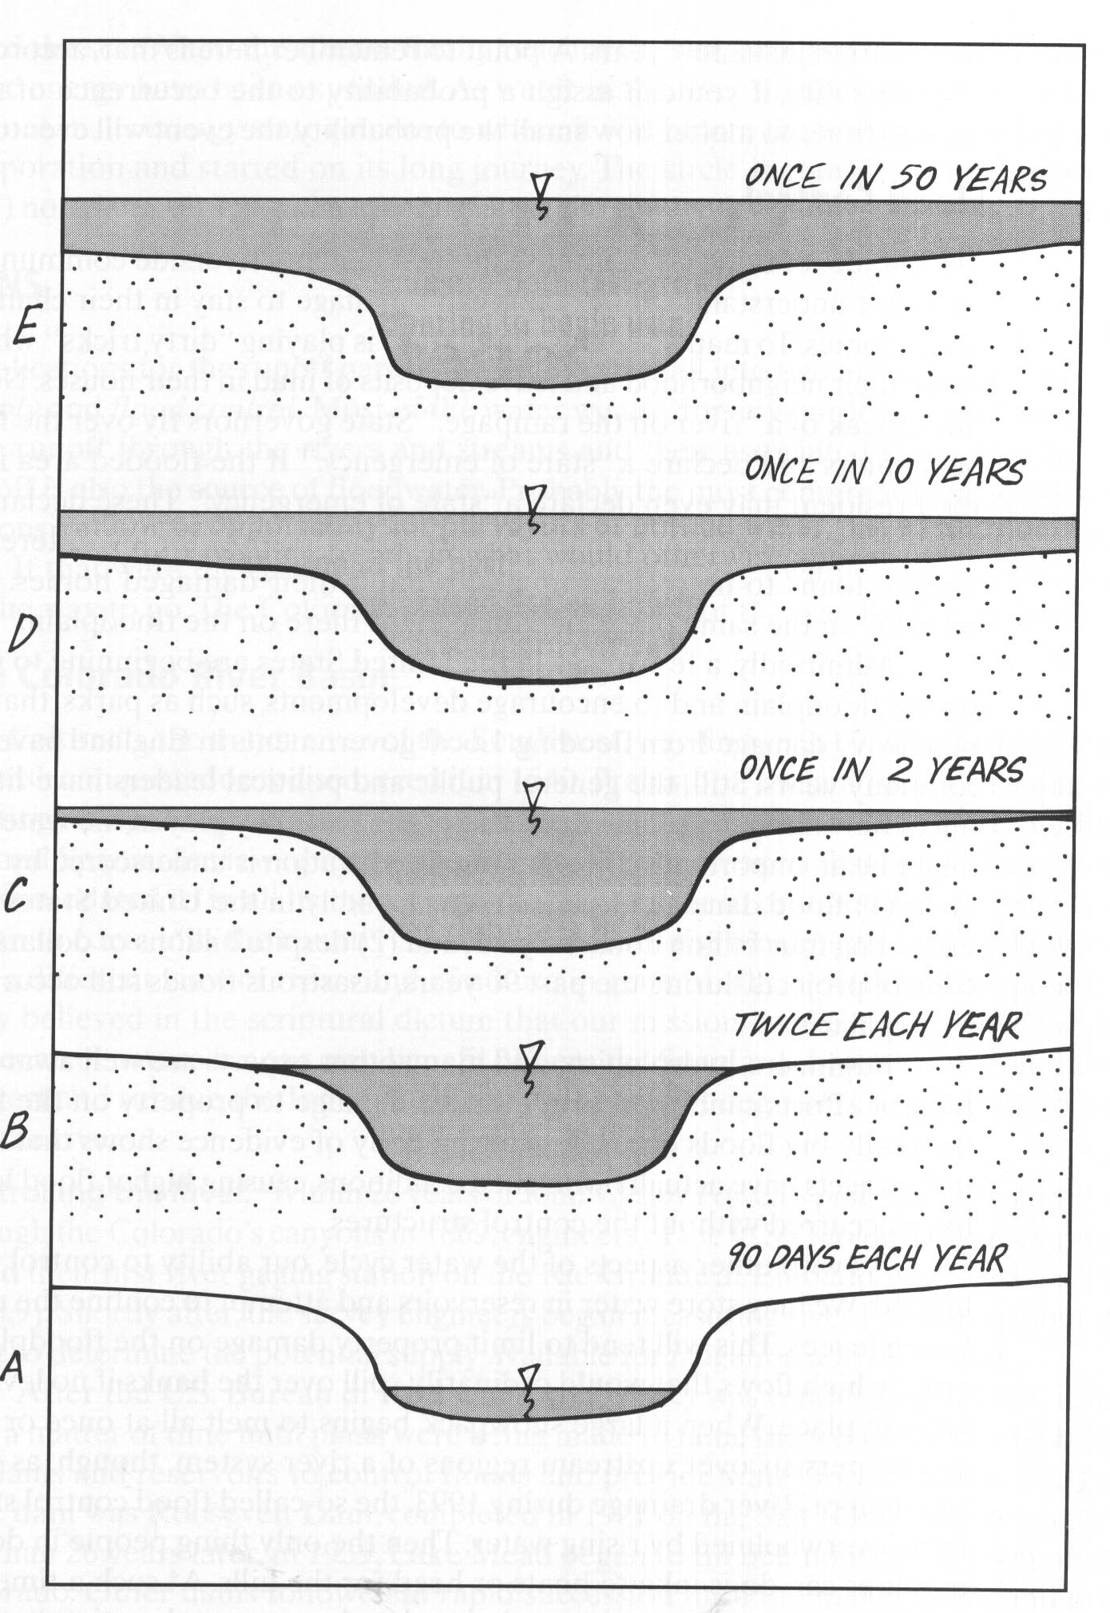
3
Flow Levels
“Channel-forming flow”?
Bank full flow about
Once every 1-2 years
Try to define in field using
observations
This is for alluvial channels

Slide 22
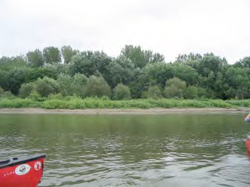
Identifying Bankfull in the Field
(Here’s where it gets interesting)
Bankfull!
Break in slope
Inset bench or small terrace
Vegetation change
*Combine with Mannings n to predict Q

Slide 23
The Stuff in the water:
Sediment mass loading in rivers:
Sediment load: The mass of sediment carried in
The water column at a particular discharge and at a particular
Point along a river channel (mass / volume)
Sediment Yield: The total mass of sediment yielded per unit
Area per time (e.g. Tons / km² / yr).
Changes downstream
Changes with discharge

Slide 24
4
Sediment Transport Through Rivers
Bedload -- material moving along the bed, shear forces exerted by water sufficient to move clasts -- rarely measured (at % level)
Suspended Load -- material kept in the water column by turbulence and lift forces (easy to measure in grab samples)
Dissolved Load -- material in solution (easy to measure in grab samples)
Bedload usually <<< than suspended load and ignored
Dissolved load varies, usually < than suspended load

Slide 25
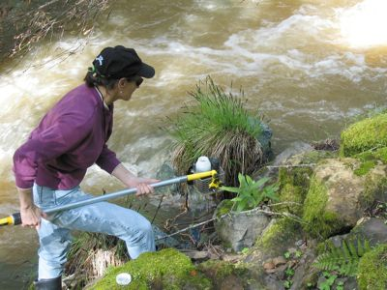
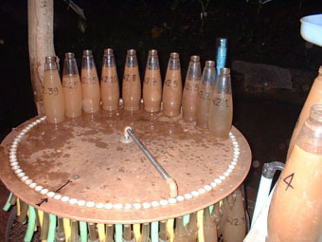
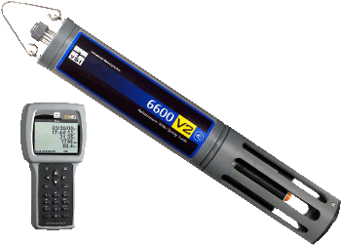
4
Sampling for Suspended Load……
Optical Sensors

Slide 26
Getting from daily sediment yields
To total mass loading and erosion rates
Typically, measured kg of sediment each day, added together over
An entire year.
Integrate suspended load over all flows (mass/time)
+
Integrate bedload load over all flows (mass/time)
+
Integrate dissolved load over all flows (mass/time)
=
TOTAL MASS LOSS (mass/time)
Divide by density and can express as Height change/time m/My…..cm/ky

Slide 27
Load varies over time and discharge

Slide 28
Integration over all flows is a non trivial problem!
Need Rating Curves (suspended, dissolved, bedload)
4
Suspended Load - Similar to Discharge Curves
Can predict
Concentration
At any given
Discharge
Discharge
Suspended Sediment concentration

Slide 29
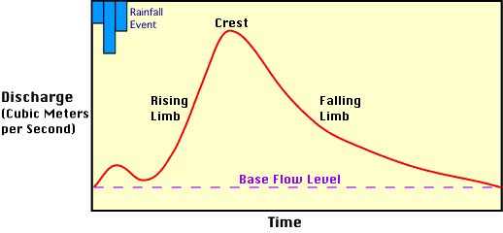
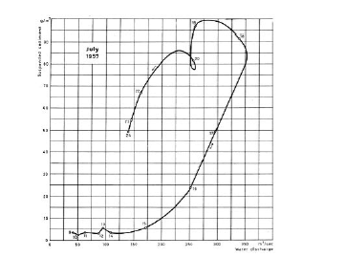
Integration over all flows is a non trivial problem!
What happens when you track through the hydrograph
4
Hydrograph
Hysteresis loop:
Sediment concentration
Different at the same
Discharge.
Make predicting
Concentration based
On discharge difficult
Discharge
Suspended Sediment concentration

Slide 30
SEDIMENT YIELD
- What comes out
SEDIMENT GENERATION
- Material generated by
weathering and erosion
= or ≠
Timescale
Steady state
Human impact
Episodic disturbance

Slide 31
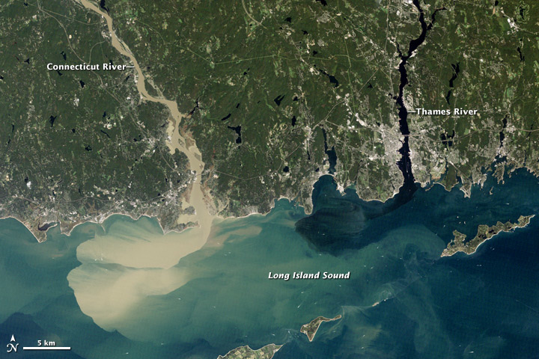
Where Did Irene Dump our Real Estate?

Slide 32
River Lab Logistics
On Huntington, in water
Measure discharge - river surveying and velocity measurements
Compare pools and riffles - Discharge and Roughness.
Field estimate of bankfull stage - Need channel geometry and slope
Suspended and dissolved load on Wednesday.
Bring: Raingear, warm clothes, pencils and waterproof paper
OLD TENNIS SHOES! Teva/toenail story

Slide 33
http://www.youtube.com/watch?v=4LxMHmw3Z-U&feature=related

