Slide 1
Petroleum Geology

Slide 3
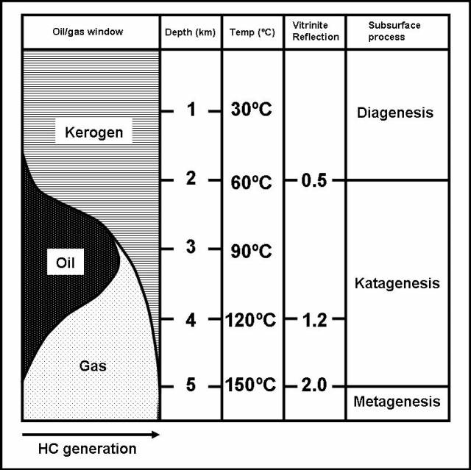
Origin of oil
70% of world oil formed in the Mesozoic era
Tropical climate (warmer), with less oxygen…

Slide 9
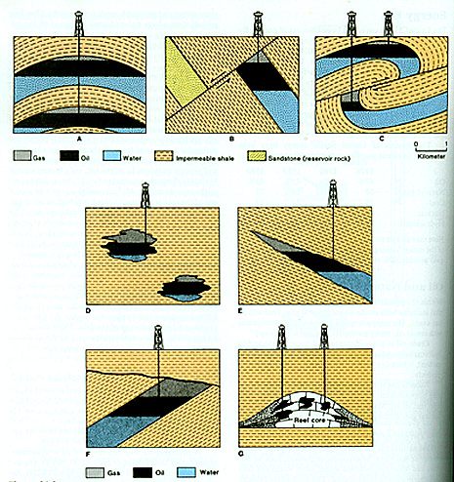
Traps

Slide 11
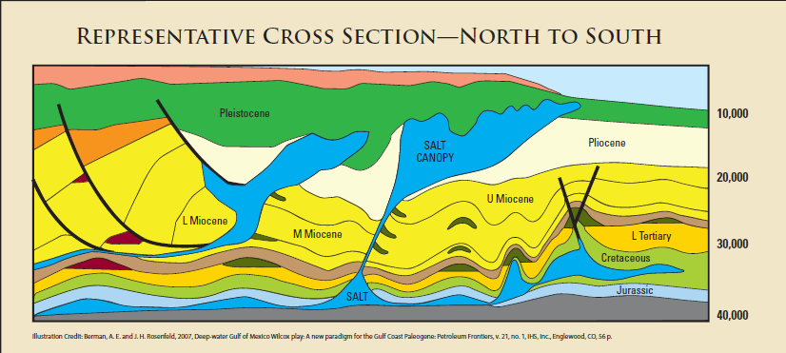
Gulf of Mexico rocks

Slide 12
references
http://www.geo.wvu.edu/~jtoro/Petroleum/01_intro.pdf
www.ndoil.org/image/cache/Petroleum_Geology.pdf

