Slide 1
Delivery
Week Three 9/11-9/15

Slide 2
Check in with the Syllabus
Week Beginning | Lecture Topic | Lab Topic/Activities | Readings (Complete before next lecture/lab meeting)
Aug 28th | Introductions, Office Hours, Dramatic Reading | Check Roster Speeches of Introduction Prepare for Dramatic Reading | READ THE SYLLABUS! KNOW THE SYLLABUS! And Michael J. Gelb, “Let your Body Talk,” in Present Yourself!
Sept 4th | NO CLASS LABOR DAY WEEK | NO LAB LABOR DAY WEEK | Steve Schwarze, “Public Speaking and the Public Sphere” in Speaking in the Public Sphere.
Sept 11th | Delivery | Begin Dramatic Readings
Sept 17th | Arrangement | Dramatic Readings
Sept 25th | Reading/Lecture Quiz Audience/Adaptation | Dramatic Readings | Gerard Hauser, “Rhetorical Opportunities” in Introduction to Rhetorical Theory

Slide 3
Delivery
Most requested!
Where to begin??????

Slide 4
It is more than just speaking voice.

Slide 5
Start with the situation
Prepon, Appropriateness, Rightness of fit

Slide 6
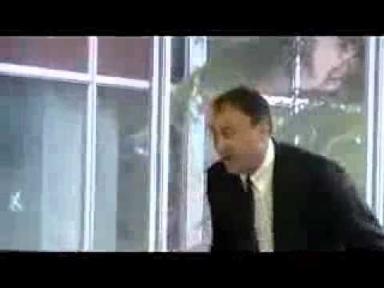
“wrong”ness of fit

Slide 7

Situations as seasons

Slide 8
Just as seasons determine what you wear, do, etc. The situation of public speaking establishes the standards for what counts a “good” delivery.

Slide 9
In other words, the standard for a “good” speech is contingent on the situation.

Slide 10
Choosing a type of delivery
Impromptu (https://www.youtube.com/watch?v=JCjXuXDamNEhttps://www.youtube.com/watch?v=JCjXuXDamNE)
Extemporaneous
Manuscript
Memorized

Slide 11
In this class
Impromptu
Extemporaneous
Manuscript
Memorized

Slide 12
Why Extemporaneous style
It allows the speaker to develop a living human relationship with their audience.
It allows speakers to adapt to the audience and the particularities of the situation

Slide 13
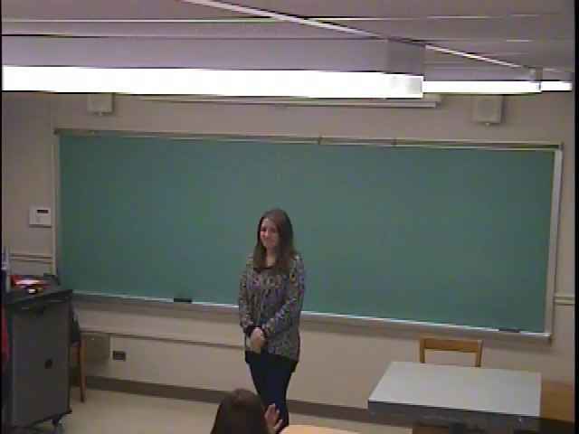
Example

Slide 14
Extemporaneous style and the signpost technique
a.k.a “Keyword’

Slide 15
How do I get to the Library?

Slide 16
Extemporaneous style
We use landmarks to keep track of where we are, where we have been, and where we are going.

Slide 17
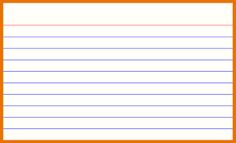
Bad note cards
Too often, when preparing for extemporaneous speeches, students will have the urge to write out a full manuscript. As a result, the student becomes cut off from the audience resulting in a less engaging presentation. Writing out complete sentences or paragraphs invites the speaker to simply read what has been written, eliminating the benefits of extemporaneous speaking

Slide 18
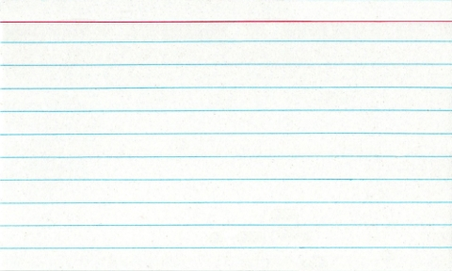
Good Note Cards
Define the Problem
Too Many Notes
Why is it a problem
Less engaging
Limits adaptation

Slide 19
No sentences! (with some exceptions)
You note cards are meant to be a map, helping guide you through the speech.
They are not meant to be read aloud (other than quotations)
Getting used to extemporaneous speaking can be very difficult because it is not as safe as a script.

Slide 20
….but mastering extemporaneous style is a highly valuable skillset

Slide 21
Expectations……
Improvement not perfection
Getting more comfortable speaking from notes.

Slide 22
My three favorite…..
Introduction
  Preview
Thing 1
  Awesome
Thing 2
  Unique
Thing 3
  Inspiring
Conclusion
  Why should you check these things out.

Slide 23
Tips
When preparing note cards, ideas should be represented with the bare minimum number of words. Abbreviations, symbols, arrows can be useful tools.
Leave space on notecards, so that you must fill them in.
Notes should be flexible, but a safety net in case you get lost so that you may get back on track
Practice speaking from minimal notes. Varying the words you use is a good thing.

Slide 24
…speaking of variation
Copia exercise (What are one of your favorite things)
I like burritos.
  Of all things that bring joy in this world, burritos are without comparison.
  While eating a burrito, all the world’s problems disappear.
  Burritos are dope.

Slide 25
Questions about physical delivery?

Slide 26
The Mumble Game
Global warming and rising sea levels
Why you should come to UVM.
Burritos are dope.
Marvel vs DC

