Slide 1
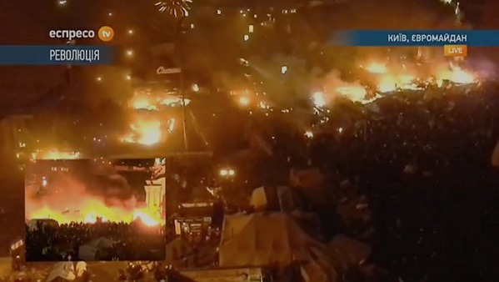
Framing the Euromaidan revolution & its aftermath Adrian Ivakhiv
Democratic Fascist
Russian New Cold
Geopolitical
Revolution? Coup? Invasion? War?
Crisis?

Slide 2
It’s about… Europe (vs. Russia)?

Slide 3
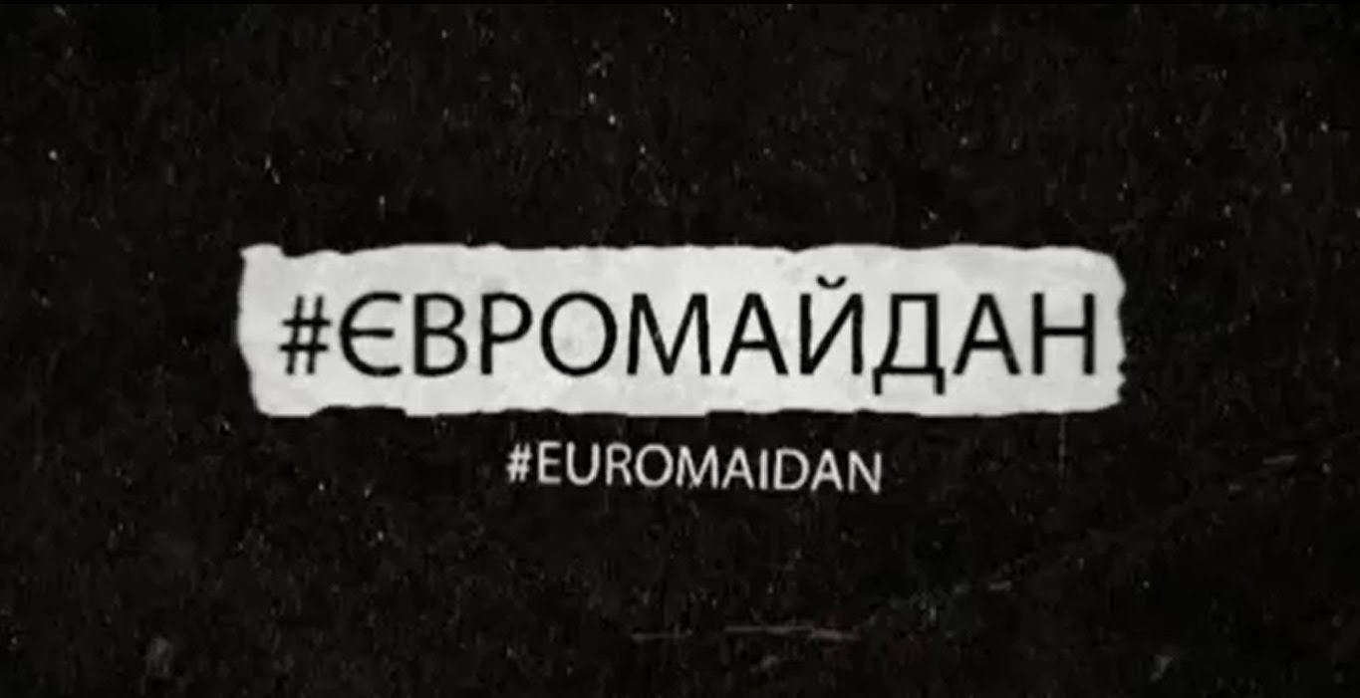
It’s about… Europe (vs. Russia)?
Notes:
Mustafa Nayyem – social media call (“Euromaidan” to distinguish it from previous “Maidan”)

Slide 4
It’s about… East vs. West?
Notes:
2004 elections…

Slide 5
It’s about… East vs. West?
Notes:
… and some other examples of maps disseminated widely in the western media
(more on linguistic differences in a moment)

Slide 6
It’s about… East vs. West?
Notes:
More nuance here, but what’s this identification of “Russian” and “Ukrainian”?

Slide 7
Maximum # of protestors at single event http://upload.wikimedia.org/wikipedia/commons/2/2e/Euromaidan_Protests.png
It’s about… East vs. West?
Notes:
Maidan support…

Slide 8
It’s about… Russians (speakers) vs. Ukrainians (speakers)?
Notes:
ETHNIC Russians…

Slide 9
It’s about… Russians (speakers) vs. Ukrainians (speakers)?
Notes:
Russian speakers… but in fact most Ukrainians speak BOTH Russian and Ukrainian, or a mix of the two (“surzhy”)
Note my experience following social media: Ukrainian and Russian often used interchangeably in same conversation without any problems

Slide 10
It’s about… Russians (speakers) vs. Ukrainians (speakers)?
Notes:
…same data, different picture…

Slide 11
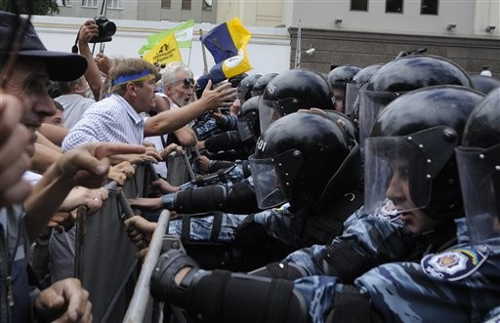
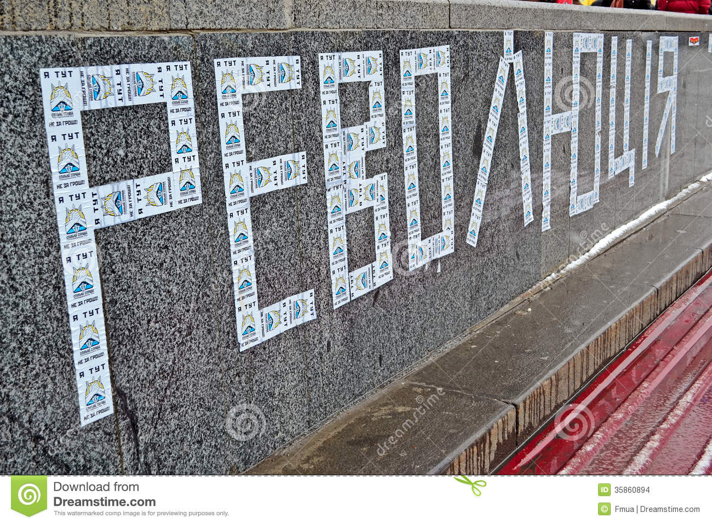
It’s about… Democracy vs. authoritarianism?
Notes:
For the activists, this was the main narrative: democracy, transparency, ANTI-CORRUPTION…

Slide 12
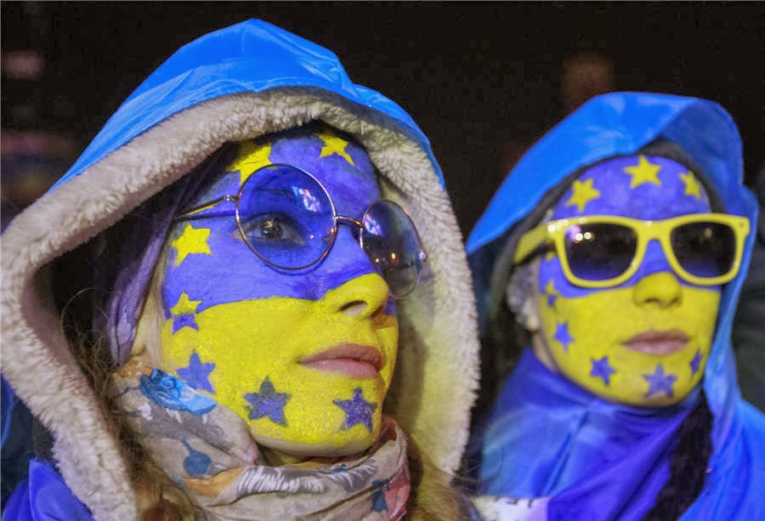
“The bearer of sovereignty and sole source of power in Ukraine shall be the people.” – Ukr. Constitution
It’s about… Democracy vs. authoritarianism?

Slide 13
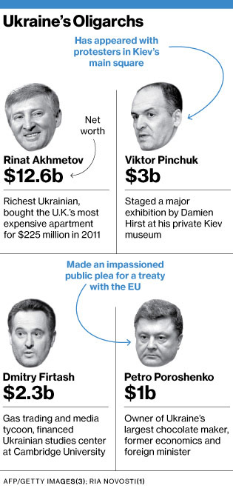
It’s about… Oligarchs vs. oligarchs
Notes:
Oligarchs on both sides…
One change since 2004 is the existence of alternative views in the media (but more in central and western Ukraine), some of them owned by oligarchs supportive of Maidan.

Slide 14
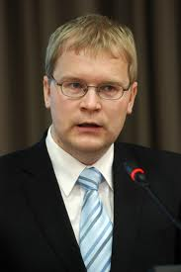
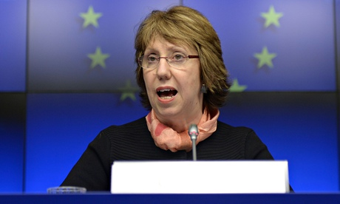
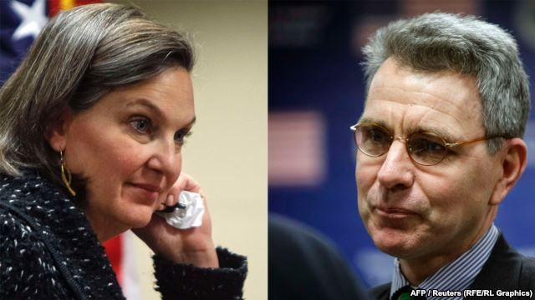
It’s about… US/EU (vs. Russian) interests?
Notes:
Theories about US covert involvement (compare the video above with Venezuela video).
Leaked phone calls (Nuland-Pyatt, Paet-Ashton): are these the 2 best calls they managed to find?

Slide 15
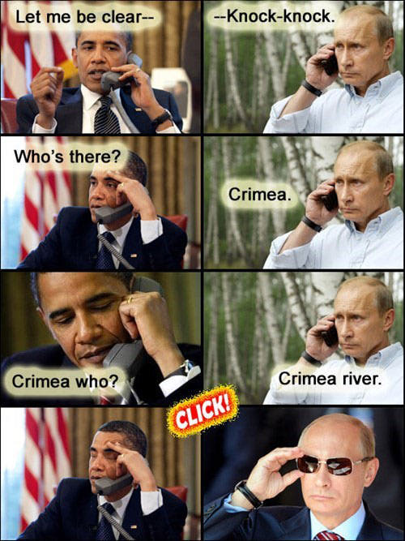
It’s about… US/EU (vs. Russian) interests?

Slide 16
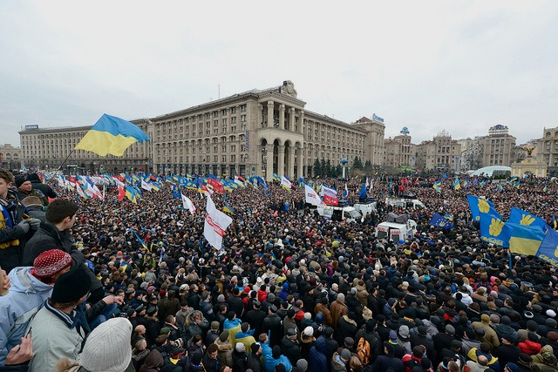
It’s about… Right (“fascism”) vs. left?

Slide 17
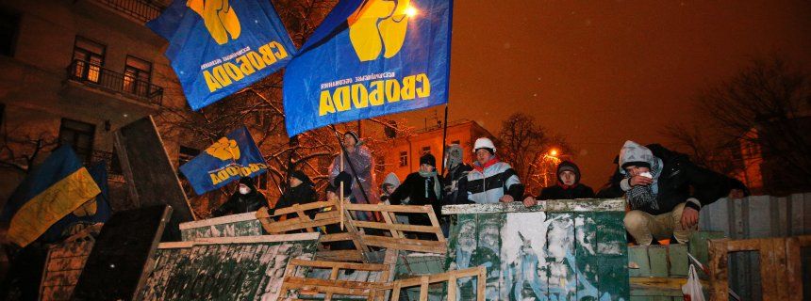
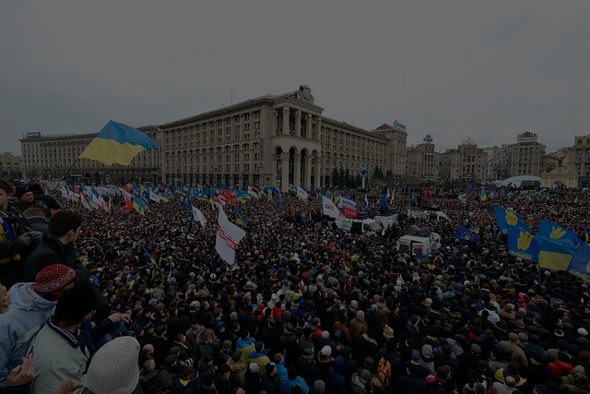
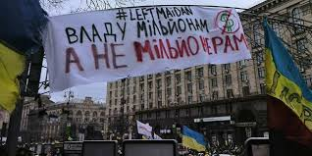
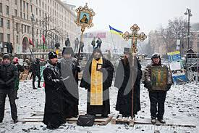
It’s about… Right (“fascism”) vs. left?
Opposition parties:
Fatherland
UDAR
Freedom
Democratic Alliance
Student groups, Afghan war vets, Ultras (football fans)
Church groups: Orthodox KP, Greek-Catholic, Orth. Autoceph.
Crimean Mejlis, other ethnic minority groups
Extra-parliamentary groups: Vidsich (Rebuff civic movement), Right Sector (far right coalition), Common Cause, Leftmaidan, et al.
“Maidan” Association (Vseukr. Obiedn. “Maidan”), Civic Council of Maidan
Civic Sector, Ne Zlyi Maidan, Euromaidan SOS, Maidan Open University, the Hospital Guard, et al.
Civic Committee for Investigating Human Rights Abuses in Ukraine, MaidanPost Media Guard
Maidan Self-Defence units
Auto-Maidan
Pop personalities, private citizens
Notes:
(Images: Autonomous Workers Union, Leftmaidan, Svoboda, churches)
Broad spectrum of political, religious, cultural affiliations represented in Maidan. But left parties don’t really exist in Ukraine (Communists not really left; Socialist Party collapsed). Differences between established parties are more “cultural” (pro-west vs. pro-Russia orientation, democratization vs. authoritarian style, language issue, nationalism) than economic (ambiguous centrism is popular: lean left before elections, turn right after elections). Nationalists - including the far right, but more broadly civic nationalists - gained through the revolution. Far right took advantage to gain exposure & support. Independent left split over participation in Maidan; participation grew after government violence esp. Jan. 16 anti-protest legislation. Main difference within Maidan was between grassroots (anti-corruption) and established parties – still being worked out…

Slide 18
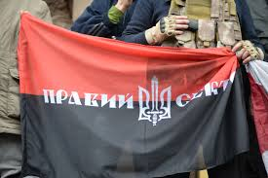
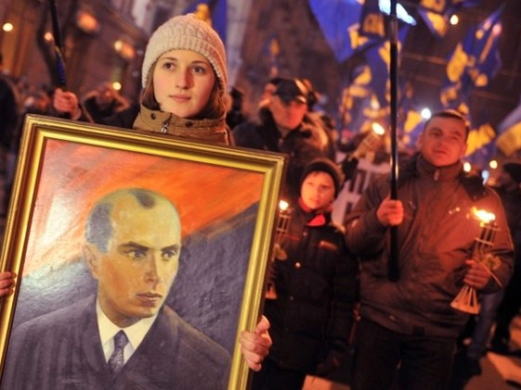
It’s about… Right (“fascism”) vs. left?
Notes:
Bandera as divisive figure (“fascist” for easterners, “anti-Soviet hero” for westerners)

Slide 19
×
×
Notes:
See left-wing analysis of the current government: http://www.labournetaustria.at/tord-bjork-14-3-2014-the-new-neoliberal-fascist-government-in-ukraine-re-the-propaganda-war-%C2%AD-an-interesting-article/
My comments on this diagram: see http://blog.uvm.edu/aivakhiv-ukrtaz/2014/03/28/update-on-recent-ukraine-developments/ (scroll down)

Slide 20
It’s about… all of the above?
Europe vs Russia:
sort of (at first), more anti-Putin than anti-Russia
East vs West:
partly (but also younger-older, educated-less so, etc.)
Russians (speakers) vs Ukrainians (speakers):
not so much
Democracy/transparency vs authoritarianism & corruption:
for activists, YES!! - for others, it depends
Oligarchs vs oligarchs:
not primarily, but inevitably connected
US/European vs Russian interests (geopolitics):
Russian: yes, US/European: only somewhat (less than in 2004)
Right vs left:
not at its core, but as a by-product

Slide 21
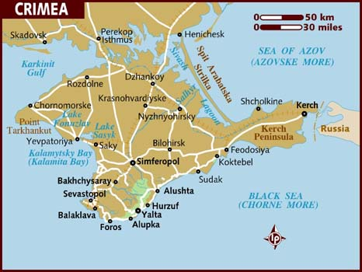
What about Crimea?
Legitimate vs. illegitimate intervention?
Russia taking back “what belongs to it”?
Armed invasion? New cold war?

Slide 22
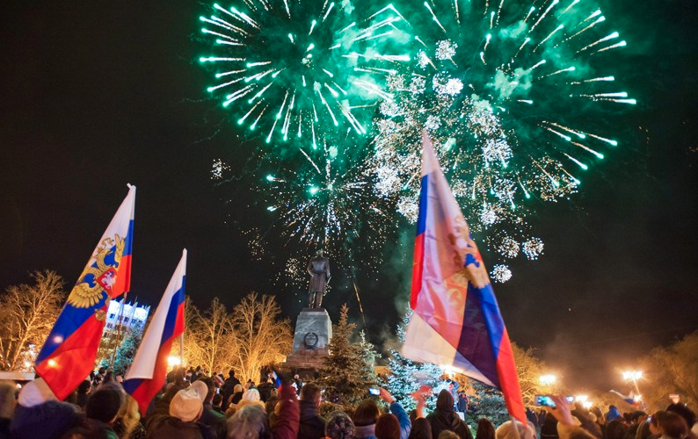
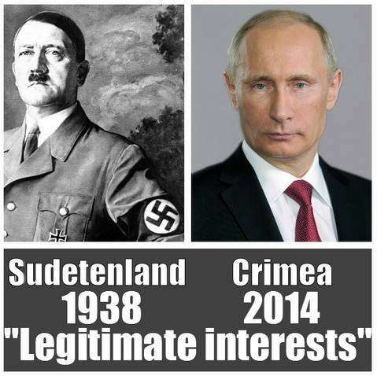
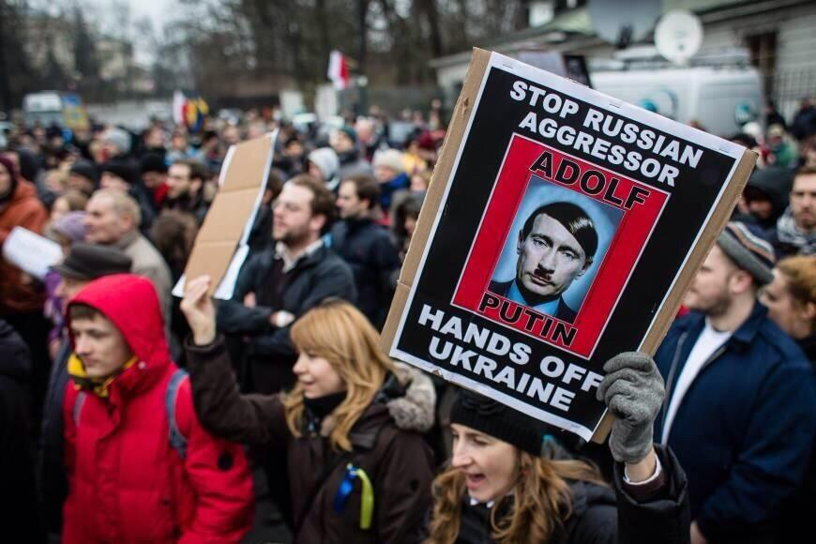
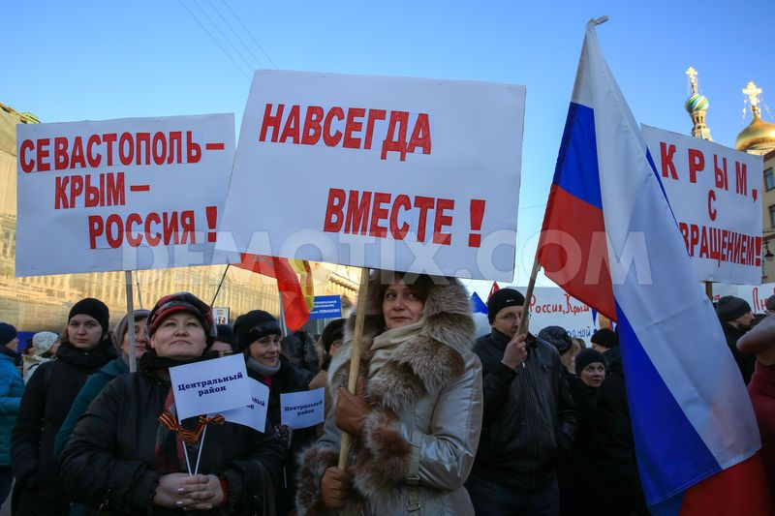
What about Crimea?
Legitimate vs. illegitimate intervention?
Russia taking back “what belongs to it”?
Armed invasion? New cold war?

Slide 23
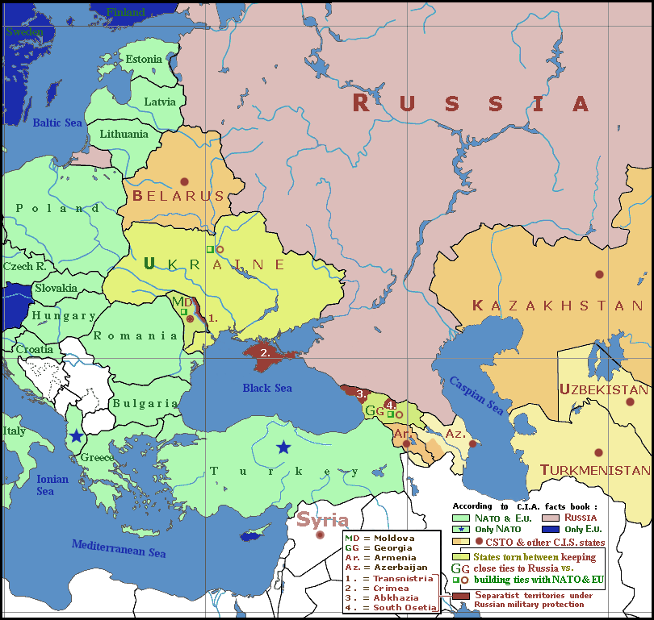
What about Crimea?
Legitimate vs. illegitimate intervention?
Russia taking back “what belongs to it”?
Armed invasion? New cold war?

Slide 24
For more…
http://blog.uvm.edu/aivakhiv-ukrtaz/

