Slide 1
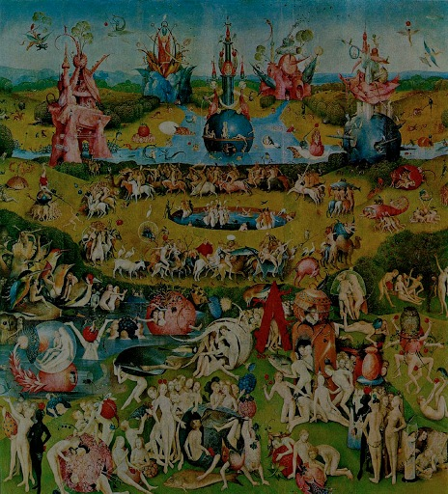
Querying Natural Religion:
Immanence, Gaia, & the Parliament of Lively Things
American Academy of Religion, Baltimore Convention Center, 2013
Presider: Sarah M. Pike, California State University, Chico
Panelists: Adrian Ivakhiv, University of Vermont Daniel Deudney, Johns Hopkins University Timothy Morton, Rice University William Connolly, Johns Hopkins University
Bron Taylor, University of Florida
Notes:
A few words of introduction to Bruno Latour and his Gifford Lectures, which serve as the occasion for this panel of comments and responses.

Slide 2
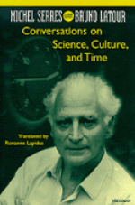
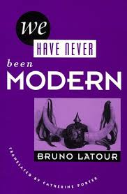
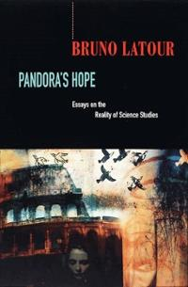
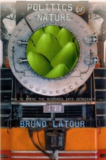
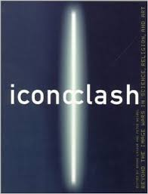
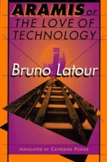
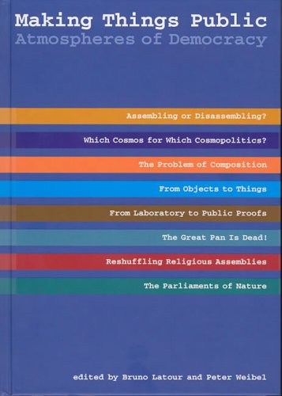
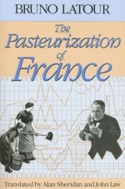
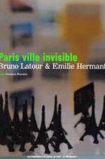
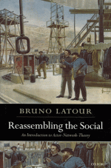
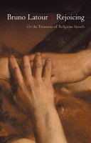
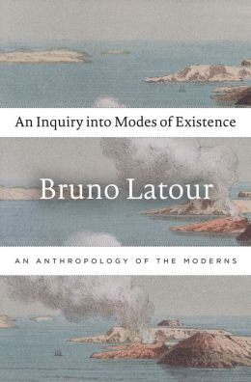
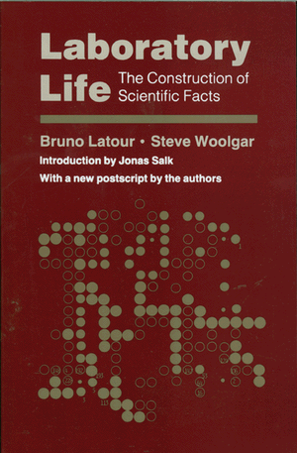
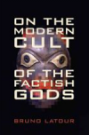
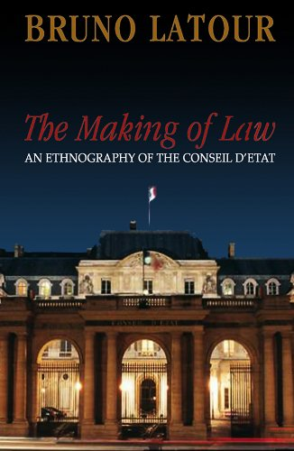
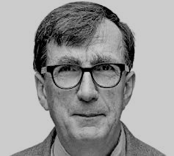
Notes:
Latour is best known for his work in science studies (or STS), in works like Laboratory Life and Science in Action, and for developing the research program known as ‘actor-network theory’ (ANT)

Slide 3
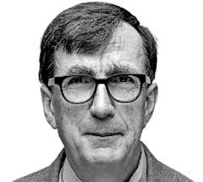
Notes:
For some, he is better known for having played a role in the so-called Science Wars of the 1990s – conflicts pitting ‘scientific realists’ like Alan Sokal, Paul Gross, Norman Levitt, and Jean Bricmont, against a series of enemies they variously identified as ‘social constructivists,’ ‘postmodern relativists’, and the ‘academic Left.’
The deep irony, for Latour, was that he has been so adamant in recognizing the power of science, and had long been criticized by many of his STS peers for ‘leaning over backwards’ to welcome ‘nature’ back into the social.
The key point here is that what Latour recognizes is not the power of Science to access ‘Reality’ or ‘Nature’ directly – through objective reason, or the scientific method, or something else pure and mysterious –
but rather its power to forge the kinds of mediations and translations that build powerfully robust and durable networks of relationality between humans and the nonhuman world.

Slide 4
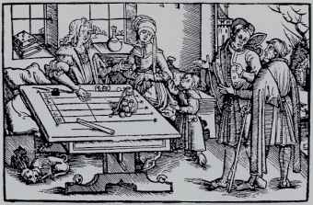
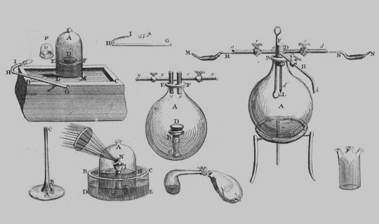
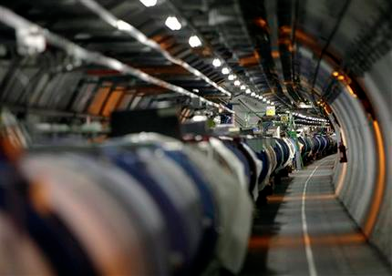
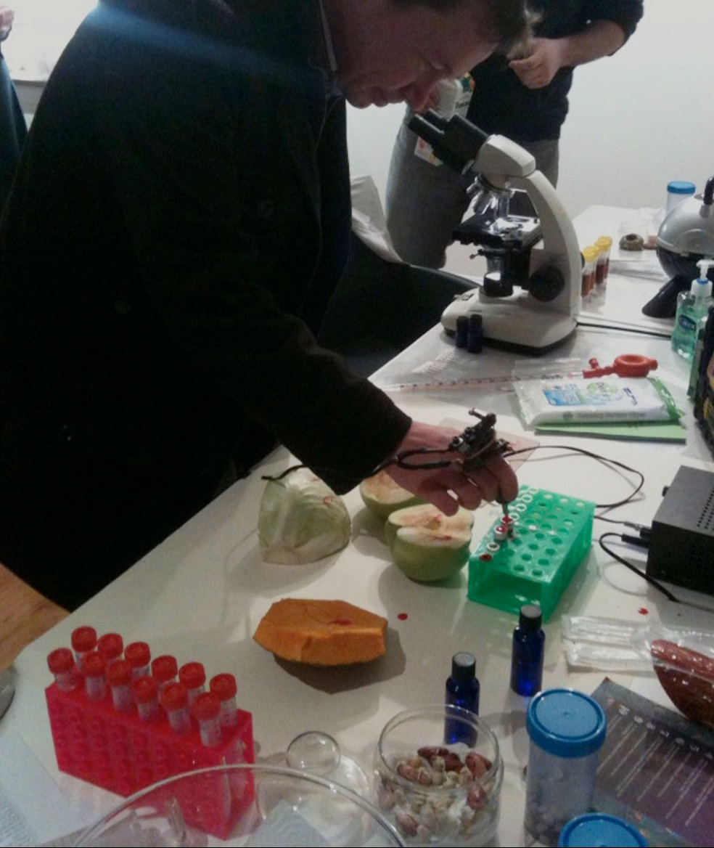
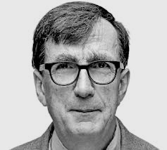
Notes:
It is this that, for Latour, constitutes the real distinctiveness of science: Through its many interventions and its complex practices, science enrolls the world in so many ways so that that world can respond to it. It is this that gives us, its beneficiaries, an access to reality that other modes of existence have rarely provided. And it is precisely those mediations –what science does – that count, not its claims about Reason, Objectivity, or anything else.

Slide 5
Is it real, or is it a construction?
Notes:
The correct question to ask, for Latour, is not: “Is it real, or is it a construction?” but

Slide 6
✗
Is it real, or is it a construction?
How, and through what mediators, is it constructed?
How does the construction change all the actors (actants) involved?
How well is it constructed?
Notes:
“How, and through what mediators, is it constructed? How does the construction change each of the actors involved? And how well is it constructed?”
Though he prefers to call himself an anthropologist of not only science, but of Modernity, or a mysterious people he calls ‘the moderns,’ there’s a case to be made that Latour has latterly become something of a poet and rhapsodist of science – or at least of ecology, and certainly of Gaia.

Slide 7
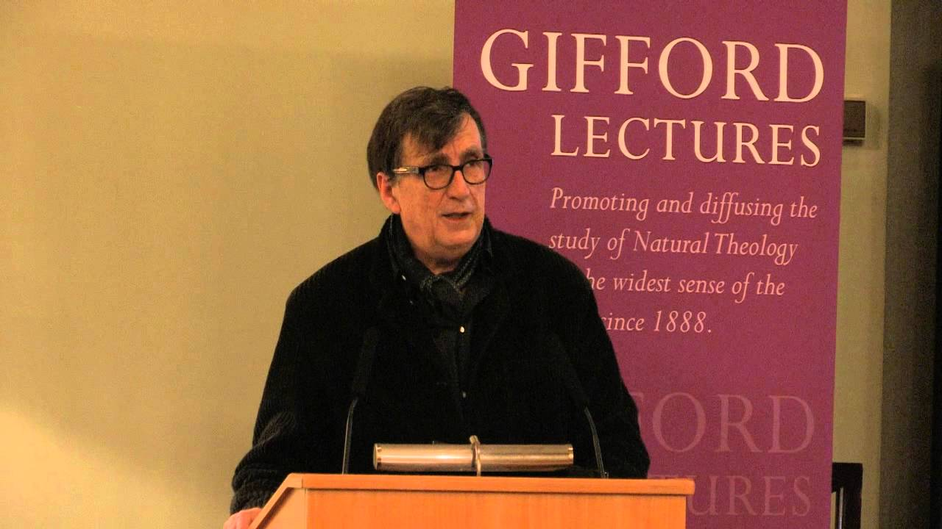
“Facing Gaia: Six Lectures on the Political Theology of Nature”
Notes:
This brings us to the Gifford Lectures, which took place last February in Edinburgh under the provocative title “Facing Gaia: Six Lectures on the Political Theology of Nature.”
To understand these lectures, one needs a grasp of the project Latour has been pursuing for the last quarter-century or so, which he has more recently called an “Inquiry into Modes of Existence.”

Slide 8
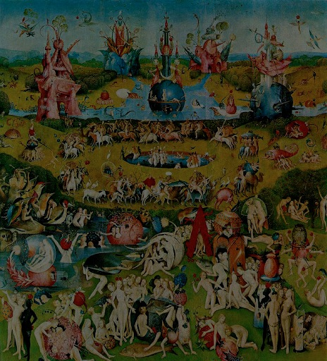
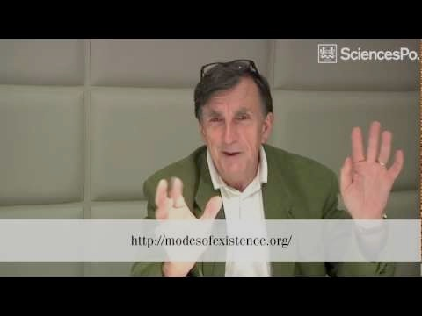
Notes:
This European Union supported project – now a 500-page book as well as an labyrinthine and interactive web site, full of digressive elaborations, comments, secret passageways and buried chambers – attempts to create an anthropology of an entity Latour cryptically calls ‘the Moderns.’
This is a ‘comparative anthropology’ would in fact relativize – and here is where Latour is an ontological relativist – the set of ideas that have shaped western modernity’s understanding of itself.
In place of the binaries that have done this work up to now – mind and matter, subject and object, nature and society, science and politics, reason and faith (or reason and emotion), facts and values, truth and perception, and so on – Latour proposes a philosophical anthropology that pays attention not to what is claimed by any ‘regime of truth’ (in Foucault’s terms) or ‘mode of existence’ (in Etienne Souriaut’s and now Latour’s), but to what is done by it, with it, and through it.
Latour reveals himself to be dedicated to undoing the ‘bifurcation of nature’ that A. N. Whitehead criticized over a hundred years ago: the bifurcation between the ‘primary qualities’ that science takes as the essence and reality of a thing, and the ‘secondary qualities’ that are epiphenomena introduced by perception, experiential oddities that clutter the landscape of reality with their messiness and undecideability.
If we are to overcome this bifurcation, for Latour and his colleague Isabelle Stengers, it is through a comparative anthropology of the different natural-cultural ‘collectives’ the universe has been assembling for at least as long as ‘we’ have been here (whoever ‘we’ take ourselves to be).
Such a comparative anthropology would begin by asking a whole set of different questions about the world, or worlds, that have been constructed all around us . . .

Slide 9
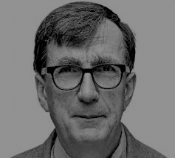
What sort of people are they?
What are the entities under which they assemble?
How do they distribute the agencies making up their cosmos?
Notes:
Questions such as:
“What sort of people are they?” (People, after all, are products of formations in which personhood, subjecthood, of one kind or another, is recognized.)
“What are the entities under which they assemble?” To what do they ascribe their assembly as such?
“And how do they distribute the agencies making up their cosmos?” (Gifford 58)

Slide 10
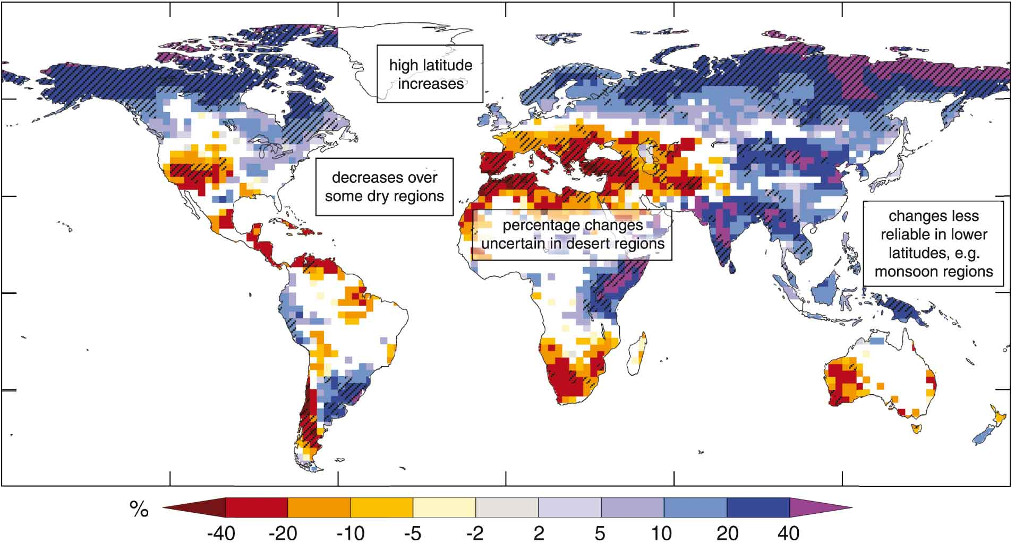
Notes:
Latour’s approach to this challenge takes as a precondition that we live in perilous times: times when scientists evoke a looming climate catastrophe, while others ask them “But why should we trust you any more than anyone else?”
His inquiry is intended to answer this question in the only way that is admissible once the starting points are shifted toward a neutral ground outside the parameters of the sciences themselves.
The answer is always: look to what they do. Look to how they make their world, and how we make ours. Compare on the basis of what is made, and what we might make together – through the mediations we might come up with in the diplomatic, or “cosmopolitical,” project that lies ahead of us all.

Slide 11
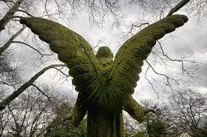
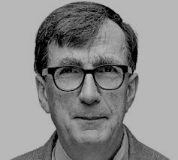
Notes:
Gaia, for Latour, is not a readymade superorganism, nor anything unified, universal, indisputable and indefeasible (74). She is not a “sovereign power lording it over us.” Gaia is not Nature itself, which Latour argues is as profoundly religious a concept as any, despite (or because of) its use as a foundational term by science. Nor is she “the environment”—as if there were a subject (humanity) that pre-existed its insertion into this “natural” something that envelops and environs us.
There is no “harmony” to be found with Gaia.
Instead, Gaia is a project to be composed, carefully, by the agencies that might allow for its composition or might simply resist it.
We, if we are a “we,” might be among those agencies. In the era increasingly known as the Anthropocene, humanity is certainly one—and many—of these agents, fully entangled with so many others, even if we humans have never ourselves been unified, let alone modern.

Slide 12
demogenesis
Notes:
Latour refers in the Gifford Lectures to the cosmopolitical project as an experiment in “demogenesis”: an attempt at creating a “people” and a “body politic” out of the many who confront each other in the wake of the Anthropocene.
These people might include the human as well as the animate, the organic, the technological, the fantastic, and so many others—all of those agents formerly called “objects” alongside all those formerly called “subjects.”
The great challenge for this project is this:
How does one conduct diplomacy with things that don’t speak, at least not in a language known to the parliaments of the Moderns or of the never-been-moderns?
How can we envision a diplomacy – a messy and rambunctious parliament – that would translate the languages spoken by all the entities of Gaia?
Latour’s responses here have been suggestive rather than comprehensive. They would surely include the tools and practices of scientists—the monitoring instruments, observation stations, expeditions, databases, graphs, models, standards, formats and formulas, disputation procedures, and so on. “Science,” he writes, “is the new aesthetics able to render us sensible to where we are standing” (130).

Slide 13
Notes:
But he suggests a role for artists as well – and here I should mention the play that Latour has written about Gaia (which you can read online) and the Gaia Global Circus Project, which is being produced in Paris as we speak,
And he suggests a role for activities that clearly resemble religion, and that include the rituals and ceremonies that could establish “a new people and an earth to come” (Deleuze & Guattari).

Slide 14
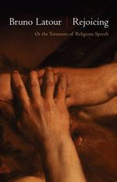
Notes:
“The rituals to be imagined,” he writes, “might not fill the churches, but they will shake the scientific disciplines quite a lot and extract from ethnography a rich lore of practices” (136).
Religion figures in this project profoundly because it is about not information or belief, but transformation and metamorphosis. At least that is Latour’s argument.
What sorts of transformations are we in need of, if this collective venture of a Earthbound collectivity is to proceed forward?

Slide 15
Notes:
What sorts of transformations are we in need of, if this collective venture of a Earthbound collectivity is to proceed forward?

Slide 16
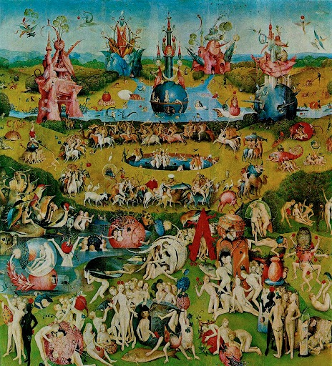
Notes:
What kinds of agents are to be appealed to, under whose jurisdiction we might gather? What sorts of rites, rituals, and cultic practices would guarantee the lines of communication and translation that could make this collectivity robust and peaceable?
There are those critics who worry about what would happen if we opened our democratic arms to those trillions of others—the nonhumans, the objects (or those formerly known as objects), the things themselves.
Democracy, they suggest, is to be hoarded for those who alone deserve it. Democracy, others cry, is just too painfully slow—with humans, let alone with others.
I look to the panelists to shed light on whether we should, and how we might, answer these questions.

