Slide 1
Advancing an Integrated Approach to Environmental Policy in VT
Jamey Fidel – General Counsel/
Forest & Wildlife Program Director
Vermont Natural Resources Council

Slide 2

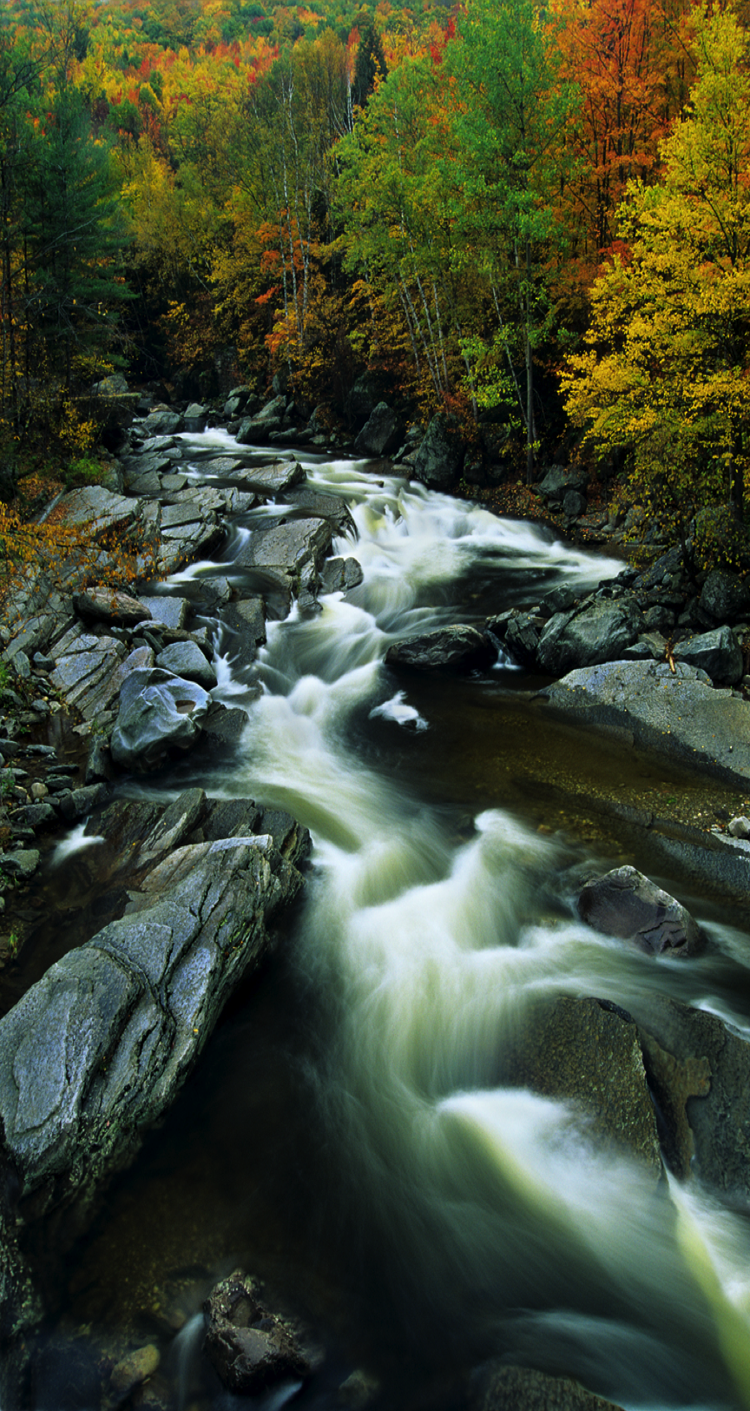
With the support of our 4,000 members and advocates, VNRC works across four program areas from the grassroots to the Legislature to promote policies and practices that:
Support vibrant communities, healthy downtowns and the rural working landscape
Keep Vermont’s water pure, public and plentiful
Protect Vermont’s natural areas, forests, and wildlife
Promote a clean, green and efficient energy future

Slide 3

VNRC was founded in 1963 by farmers, foresters, sportsmen, and conservationists.
Expertise in:
Research
Science and Policy
Legislative Advocacy
Education and Communication
Technical Assistance
Grassroots organizing
Legal Advocacy

Slide 4
Sustainable Communities Program – Recent Successes
Promoting Growth Centers by creating incentives to direct development to places where infrastructure already exists.
Secured the passage of H.823 (Act 147), which updated Act 250, Vermont’s land use development law, to better address strip development. This is one of the biggest changes to Act 250 in a long time.
Played a role in the adoption of a genuine progress indicator by the legislature, a measurement system that takes into account environmental, economic, and social well-being.
Helped support the creation of a Working Lands Enterprise Board and the investment of $1 million into Vermont agricultural and forest based enterprises.

Slide 5
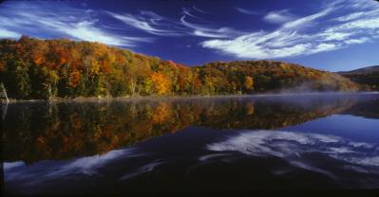
Water Program – Recent Successes
Passed legislation protecting groundwater as a public trust resource and establishing a permitting program for large groundwater withdrawals like water bottling.
Successfully fought for new protections for wetlands, essentially ensuring that any wetland that appears on the ground is protected under state law.
Advocated for Vermont’s shoreland protection law that requires setbacks for any new development on lakes, and the minimization of expandion on existing lots.
Advocated for aggressive clean up plans for impaired waters at ski resorts in Vermont due, in part, to off-mountain development.

Slide 6
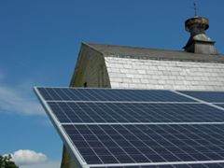
Energy and Climate Change Program– Recent Successes
Helped lead the expansion of net metering to promote more residential solar.
Oversaw coordination of the Vermont Energy and Climate Action Network —over 100 grassroots energy groups working to help their communities and neighbors save energy, transition to renewables and address climate change through adaptation and mitigation solutions.
Helped shape the Total Energy Study to identify the most promising policy and technology pathways to reach Vermont’s energy and greenhouse gas goals.

Slide 7
Forest and Wildlife Program – Integrating Diverse Strategies
Collaboration with Diverse Partners
Research
Technical Assistance
Legislation
Legal
Action Planning

Slide 8
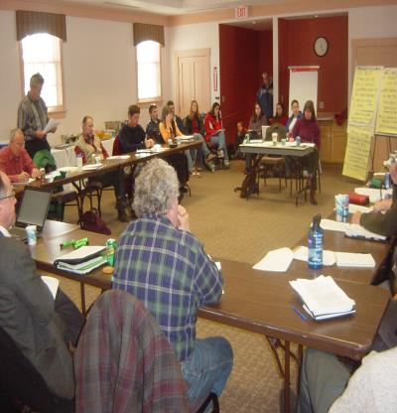
Forest Roundtable
An ongoing policy discussion on the issues of parcelization and forest fragmentation.
Bringing diverse interests together to work on a common issue of concern (over 170 participants).
Information sharing and networking.
Developing recommendations to reduce the causes and impacts of parcelization and forest fragmentation.
Educating legislators and the public.

Slide 9
Forest Roundtable

Slide 10
Forest Roundtable
Final Report with twenty-seven recommendations on policies to address parcelization and fragmentation.
Tax Policy
Conservation Planning
Valuation of Ecosystem Services
Long-term Sustainability of the Forest Products Industry
Rec. # 4: Conduct an independent legislative study of the UVA Program.
Examine the statutory goals of the program and assesses the program’s effectiveness with respect to the original goals.
For example, is the goal of conserving natural ecological systems adequately addressed?
This study should also assess ways to expand landowner enrollment in the program, and assess the effectiveness of the land use change tax.

Slide 11
Example: Research to Policy Making
Act 65 of 2007 provides for an Independent Study of the Use Value Appraisal Program.
Legislative Council hires a consultant to review and analyze the Use Value Appraisal Program.
A 17 Member Task Force reviews report, holds hearings and issues a final legislative report with proposed legislation.
Consultant issue a report with data and statistics on Program.
Act 205 of 2008 streamlines Program and improves enrollment or ecologically significant resources (old forests, riparian buffers, natural communities of statewide significance, rare, threatened, and endangered species, vernal pools, and forested wetlands).
Notes:
Add importance of understanding scientific value of ecologically significant resources that can be managed for non-timber values.

Slide 12
Forest Roundtable
Rec. # 9: Track annual rates of parcelization in Vermont.
Rec. #10: Utilize existing data and develop maps to identify and prioritize forest blocks for conservation.
Rec. #11: Track and analyze rates and degree of forest fragmentation in Vermont.
Rec. #12: Integrate existing planning efforts at the local, regional and state level to better address fragmentation.
Rec. #13: Identify and correct gaps in Act 250 and other land use regulations to attenuate the rate of parcelization and forest fragmentation in Vermont.

Slide 13
Example: Research to Policy Making
Track annual rates of parcelization in Vermont.
VNRC secures funding through Northeastern States Research Cooperative to create state database to track parcelization rates.
VNRC begins to share results of findings.
Notes:
Add importance of understanding scientific value of ecologically significant resources that can be managed for non-timber values.

Slide 14
Number of Parcels by Size

Slide 15
Trends
Land with Dwellings
Use Value Appraisal
The amount parcels with dwellings on them increased by 126,000 acres during the study period.
Between 2003 and 2009, about 300,000 more acres were enrolled in the Use Value Appraisal Program, bringing the total to 2.2 million acres.
Loss of Large Parcels
Between 2003 and 2009, due to subdivisions, the amount of land in parcels larger than 50 acres declined by about 42,000 acres, or roughly 7,000 acres per year.
Notes:
According to assessment records, the value of land in parcels 50 acres or larger appreciated significantly during the study period, from an average of $930 per acre in 2003 to $1615 in 2009.
Tease subdivision stats and Act 250 for afternoon.

Slide 16
Example: Research to Policy Making
Utilize existing data and develop maps to identify and prioritize forest blocks for conservation.
Track and analyze rates and degree of forest fragmentation in Vermont
VT Fish and Wildlife Department utilizes steering committee to create GIS maps of forest blocks to prioritize the significance of contiguous blocks for their biological and conservation values and to assess potential threat to them from future habitat fragmentation.
Notes:
Add importance of understanding scientific value of ecologically significant resources that can be managed for non-timber values.

Slide 17
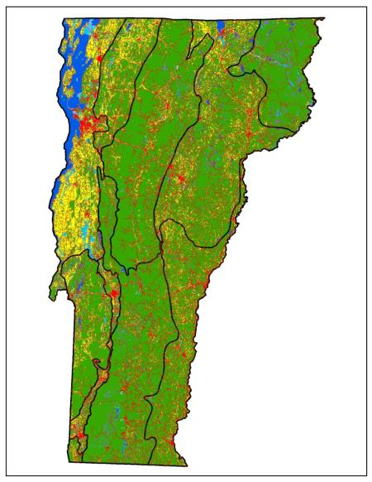
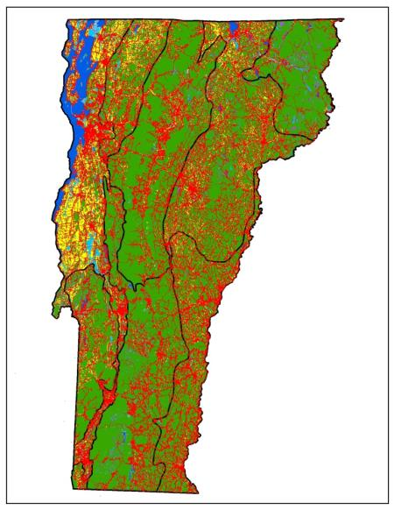
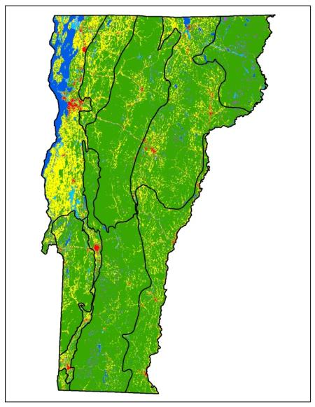
Prioritize Blocks and Track Fragmentation
Notes:
Satellite imagery and both the E911 roads and E911 buildings all shown. The first map that is just the satellite imagery with forest as green, agriculture as yellow, urban areas as red, and blues/purples as water and wetlands. If you advance the slide (right arrow key) you should get the E911 roads layer superimposed on top. And the next advance should put the E911 buildings on top of that.

Slide 18
Policy Making
Identify and correct gaps in Act 250 and other land use regulations to attenuate the rate of parcelization and forest fragmentation in Vermont.
Senate Natural Resources and Energy Committee passes S.100 out of commiitee. The goal of the bill is to expand the jurisdiction of Act 250 to address forest fragmentation.
The bill passes as Act 118 and calls on the Commissioner of the Dept. of Forests, Parks, and Recreation to submit a legislative report by Jan. 15, 2015 assessing the current and projected effects of fragmentation, and providing recommendations for how best to protect the integrity of Vermont’s forestlands and preserve large blocks of contiguous forestland.
Notes:
Add importance of understanding scientific value of ecologically significant resources that can be managed for non-timber values.

Slide 19
Policy Making
Integrate existing planning efforts at the local, regional and state level to better address fragmentation.
VNRC convenes statewide summit with regional planning commissions, professional planners and state agencies to develop statewide land use action plan to address fragmentation.
VNRC holds regional workshops with local planning commissions and conservation commissions to provide feedback on strategies.
Notes:
Add importance of understanding scientific value of ecologically significant resources that can be managed for non-timber values.

Slide 20
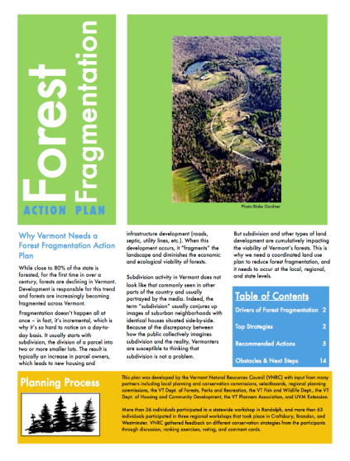
Action Plan
Forest Fragmentation
Action Plan
A roadmap for implementing nine priority strategies for reducing forest fragmentation and parcelization.
Outlines concrete action steps for planning and zoning, conservation, education and advocacy strategies at the local, regional and state level.

Slide 21
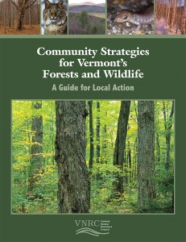
Policy Development - Technical Assistance
Provides 15 individual chapters on regulatory and non-regulatory strategies to sustain forests and wildlife at the local and regional level.
Includes case studies, examples of definitions and regulatory standards to conserve forest resources, and illustrations for effective site design.
Was distributed to every local planning and conservation commission and regional planning commission in VT.

Slide 22
An Integrated Approach
Forest Roundtable – Diverse stakeholders agree on shared values and recommend key policies.
Necessary research is conducted. Science and data are used to create state databases, GIS maps, and justification for action.
Action Plan is developed. Technical assistance throughout the state.
Testimony and ultimately legislation or other policy implementation.
Advocacy helps tell the story.

Slide 23
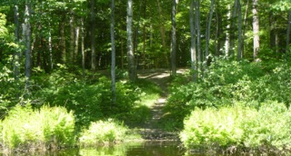
Another Example of
Science to Policy:
Shorelands Protection

Slide 24
An Integrated Approach
Policy is identified by legislature and ANR – need for greater shoreland protection in Vermont.
Research had been conducted by ANR comparing developed and undeveloped shorelands. Research shows higher biota in undeveloped habitat.
Coalition is formed.
Hearings around the state.
Grassroots advocacy

Slide 25
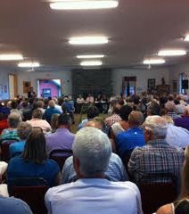
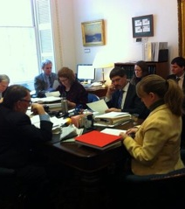
Shorelands Protection

Slide 26
An Integrated Approach
Testimony in committees.
After two years of legislative attention, The Shoreland Protection Act is passed in 2014 establishing a state regulation for guiding development within 250 feet of the mean water level on all lakes greater than 10 acres in size.
Notes:
Vermont Natural Resource Council
Federation of Vermont Lakes and Ponds
Lake Champlain Committee
Conservation Law Foundation
Sierra Club (who hired Necrason to help in the statehouse)
Individual volunteers who came to public hearings, public meetings, testified at the statehouse etc

Slide 27
Reflections on an Integrated Approach
Science to policy action requires a multi-pronged approach.
Scientific justification for action usually begins the conversation.
Collaboration among stakeholders is key.
Advocacy is a necessary component.
Grassroots organizing.
Legislation may be the ultimate result, but action comes in many different forms (agency policy, legal advocacy, conservation planning, land conservation, land management decisions, local and regional land use planning, citizen awareness, more informed research, etc.)
How to bridge collaboration between scientific community and advocacy community is a very important topic.
Notes:
LONE WOLF (VNRC ALONE) WILL NOT LEAD TO COMPREHENSIVE LEGISLATION
Advocacy is the countless hours building grassroots support, lobbying, working the media, building a movement, etc.
Roundtable, water caucus as model – here scientific updates, have policy makers in the room, discuss, strategize, and move ideas to action.
Caucus is comprised of many stakeholders, open to all who have an interest in water policy. It is not a consensus group but it works to get everyone on the same page with where the discussion is going.
Meets quarterly, topics include upcoming rules, water quality standards, lake champlain policy, legislation.
Attendees: watershed groups, state ANR and Ag staff, legislators, RPCs, academia, citzens, etc.

