Slide 1
Groundwater as a Phosphorus Source
George Pinder
Samuel Marano
Mathew Trueheart

Slide 2
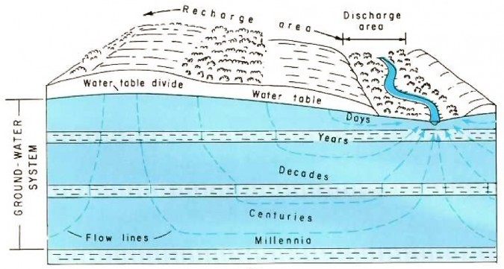
Regional Groundwater Flow
lake
lake sediment

Slide 3
Phosphorus Concentration in Groundwater Discharge to the Lake
lake concentration

Slide 4
Average Mass Flux of Phosphorus
Notes:
Integrate Q*[P] over time: 16 mg/m2/year
Limited dataset to compute mass flux for entire lake,
16 +/- 8 kg/year (~~<5% of total load, based on 1982-84 study)

Slide 5
Questions Raised by Research
is the phosphorus found in the groundwater collected by the seepage meter carried by regional flow or is it phosphorus mobilized by the groundwater due to the low oxygen content of the groundwater?
what research can be conducted to answer this question?
given each scenario, what, if anything, can be done to reduce the groundwater contribution to the lake?

