Slide 1
Health Services Research
Benjamin Littenberg, MD
UVM Legislative Summit
November 16, 2016

Slide 2
Agenda
Why is some research better than others?
Case example about behavioral health
Role of patients in research
When is science good enough to inform policy?

Slide 3
Clinical trials are the gold standard for comparing therapies
Essential characteristics of a robust clinical trial:
A pre-established protocol
A meaningful control group
Random assignment of subjects to treatment or control
Blinded assessment of outcomes

Slide 4
Why write a protocol?
If the data are not working out the way you hoped, it is tempting to change the plan to find some way to make it look better.
Change the outcome variable
Change the study subjects
Change the analytic methods
When this happens, the results are much less likely to be reproducible and generalizable to other populations.

Slide 5
Why have a control group?
People get better on their own without therapy.
We need to know “what if we hadn’t used the new treatment?”

Slide 6
Why randomize which subjects get which treatment?
If the only difference between the active and control groups at baseline is which treatment they get, we can conclude that any differences in outcomes are due to treatment.
Doctors are smart - they select treatments for (sometimes) very good reasons.
Randomization takes treatment assignment out of the hands of the doctors .
Randomization means the active and control groups are probably similar before treatment.

Slide 7
Why blinding?
The people who measure the outcomes and do the analysis can’t see which group the subjects are in.
We scientists like to think of ourselves as impartial and unbiased.
However, deep down, we usually favor one group or the other.
Subconscious preferences can come out during measurement and analysis.
Blinding reduces the chances of bias.

Slide 8
Case example: Behavioral Health
Common Mental Health issues
Anxiety, Depression, etc.
Common Substance Abuse issues
Alcohol, Tobacco, Drugs
Common Lifestyle issues
Diet, Exercise, Medications, Sleep, etc.
Stress
Huge prevalence, impact & costs

Slide 9
3 Models of Behavioral Health in Primary Care
Most Behavioral Health (BH) issues present to Primary Care (PC).
How can we get services to needy patients?
Refer to outside BH clinician (MD, MS, PhD, etc.)
Co-location (BH at the same address)
Integrated BH and PC

Slide 10
Integrated Behavioral Health
Shared space
Shared records
Evidence-based BH services
Automatic systems for managing BH patients:
Screening
Scheduling
Monitoring
Follow-up
Frequent communication among providers
Stable reimbursement for BH services

Slide 11
Current research at UVM
Integrating Behavioral Health and Primary Care for Comorbid Behavioral and Medical Problems (IBH-PC)
Funded by The Patient-Centered Outcomes Research Institute (PCORI)
$18.5M over 5½ years
Executive Committee
Rodger Kessler, PhD
Connie van Eeghen, DrPH
Jennifer Lavoie
Many, many others at UVM and across the country

Slide 12
The IBH-PC Intervention
Online Skills training for BH providers, PCPs and staff
A Toolkit of suggested tactics for integration
Protocolized Process for facilitated redesign of Primary Care practices
12 hour intensive team exercise to plan changes
Toyota Production System LEAN method

Slide 13
Aims
Aim 1: Determine if increased integration results in better patient-centered outcomes.
Aim 2: Determine if protocolized process techniques are effective in increasing BH integration.
Aim 3: Explore how contextual factors affect the implementation and patient-centeredness of integrated BH care.

Slide 14
Design: Randomized Trial
40 PC practices with co-located BH
Randomized to stay in co-location or become integrated
Recruit a random sample of 75 patients per practice
Assess patients (and practices) at baseline and every 12 months
Unit of randomization is the practice (n=40)
Unit of analysis is the patient (n=3,000)

Slide 15
Study Design
Integration
40
Practices
Randomize
Baseline Measures
Baseline Measures
Usual Care
Follow-up Measures
Practice Redesign Process
Follow-up Measures
Co-location
18 Months

Slide 16
40 Primary Care Practices
Family Practice or General Internal Medicine
Commitment to having BH clinician onsite
Willing to engage in integration efforts
Electronic medical records
Private practices, Federally Qualified Health Centers, Academic clinics, etc.

Slide 17
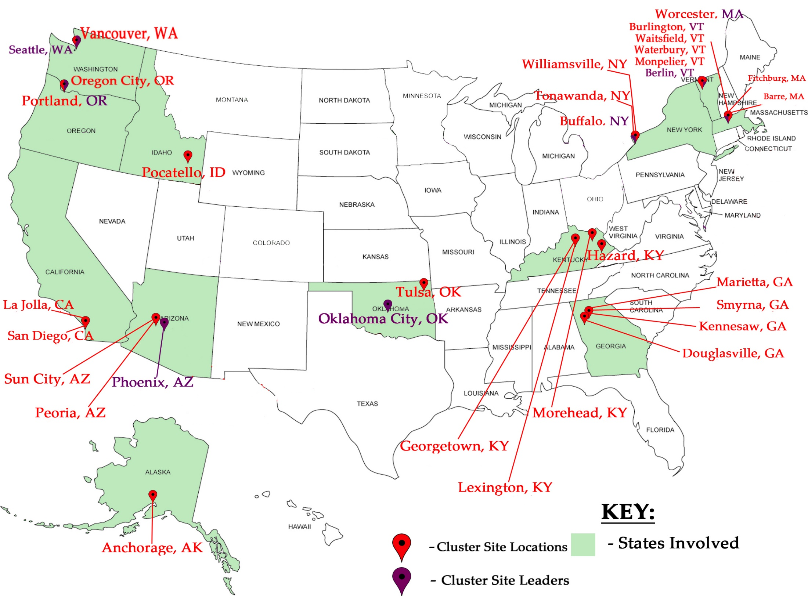

Slide 18
3,000 patients
At least one chronic medical problem:
Arthritis
Asthma/COPD
Diabetes
Heart Failure/Hypertension
At least one Behavioral Health problem:
Anxiety/Depression
Chronic pain/Headache/Fibromyalgia
Insomnia
Irritable Bowel Syndrome
Alcohol or Substance use disorder

Slide 19
Outcomes
Primary: Symptoms & Functional Status
Secondary:
Communication
Empathy
Self-management
Adherence
Time lost to disability
Emergency Room and hospital visits
Disease specific outcomes (blood sugar control, blood pressure)
Did the practices change?

Slide 20
“Patient Centered” means collaboration
The study team includes patients (and caregivers) at every step:
Framing the question
Which conditions?
Outcome measures
Recruitment strategies
Consent process
Analysis
Dissemination of results
Patient partners serve on:
Co-investigator teams (% effort salary)
Strategic Advisory Group (honoraria and expenses)
Practice redesign teams (honoraria and expenses)

Slide 21
Why is IBH-PC “robust”?
It has a published protocol.
No changing the rules after the game has started
It randomizes assignment to treatment vs. control.
No hand-picking “most likely to succeed”
The control is a viable alternative.
No “straw-man” comparisons that are easily bested
It has pre-specified outcomes.
No cherry picking
Measures are blinded.
The outcomes are not measured by someone with an interest in the study results
The research sites are real-world clinics from all over.
Not just special research clinics with unusual characteristics

Slide 22
Why do robust designs matter?
They are much less likely to be biased
The results are much more likely to apply in other settings
Most published “science” is either
Preliminary
Over-interpreted
Biased
Not generalizable, or
Fraudulent

Slide 23
Making policy?
Ignore press releases and brochures
Discount “science” that is produced by commercial interests
Insist on, at the least, peer review
Look for Randomized Trials
Ask for help – you have a whole University eager to help you!

Slide 24
Acknowledgements
Research reported in this presentation was funded through a Patient-Centered Outcomes Research Institute (PCORI) Award (PCS-1409-24372).
The views, statements, and opinions presented in this meeting are solely the responsibility of the author(s) and do not necessarily represent the views of PCORI, its Board of Governors or Methodology Committee.
PCORI is an independent, nonprofit organization authorized by Congress in 2010. Its mission is to fund research that will provide patients, their caregivers, and clinicians with the evidence-based information needed to make better-informed healthcare decisions. PCORI is committed to continually seeking input from a broad range of stakeholders to guide its work.

Slide 25
Thanks!
Benjamin Littenberg, MD
Henry and Carleen Tufo Professor of Medicine
Professor of Nursing
www.IBHPC.blogspot.com

