Slide 1
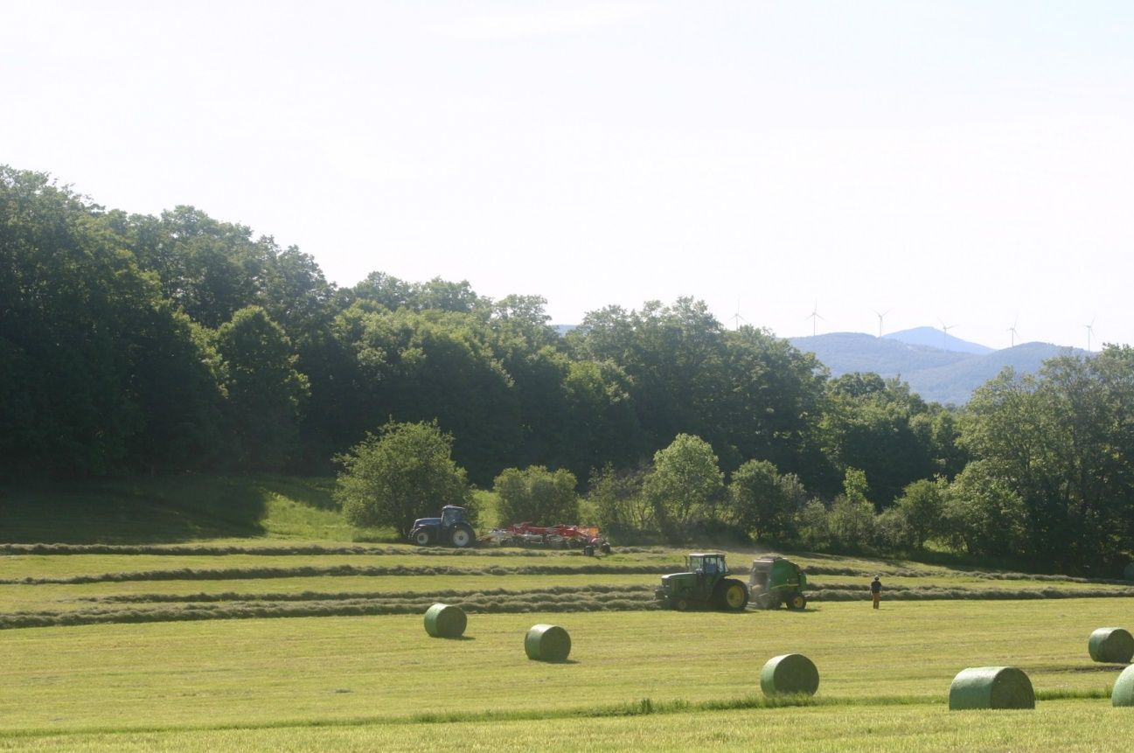
Leaving, Staying, and Coming Home: Insights from Vermont Migration Research for Policy-Makers
Cheryl Morse
Geography Department
University of Vermont
Vermont Legislators’ Summit 2017

Slide 2
2014-2017
vtrootsmigration.org

Slide 3
Vermont’s Population Age-Sex Profile
2016 American Community Survey Estimates
Male
Female

Slide 5
VT Roots Research Branches
Vermont Roots Migration Survey – 2014 (n=3,692)
VT Roots Follow-Up Survey for Leavers—2014 (n=38)
Global Returnees Survey—2016 (n=35)
Global Returnees Group Interviews—2016 (n=11)
Meaning of Maple Survey for Leavers and Returnees—2017 (n=28)

Slide 6
The Importance of Landscape, Family Ties, and Culture
More than forty percent of all Returnees reported they moved back because:
I enjoy Vermont’s landscape (43%)
I missed Vermont’s culture and community (42%)
I missed my family (56%)
12% said they moved back to Vermont for a new job opportunity

Slide 7
The Importance of Landscape, Family Ties, and Culture
More than half of all Stayers reported they stayed in Vermont because:
I enjoy Vermont’s landscape (66%)
I stayed to live near family (62%)
I appreciate Vermont’s culture and community (50%)
32% said they stayed because their work is in Vermont

Slide 8
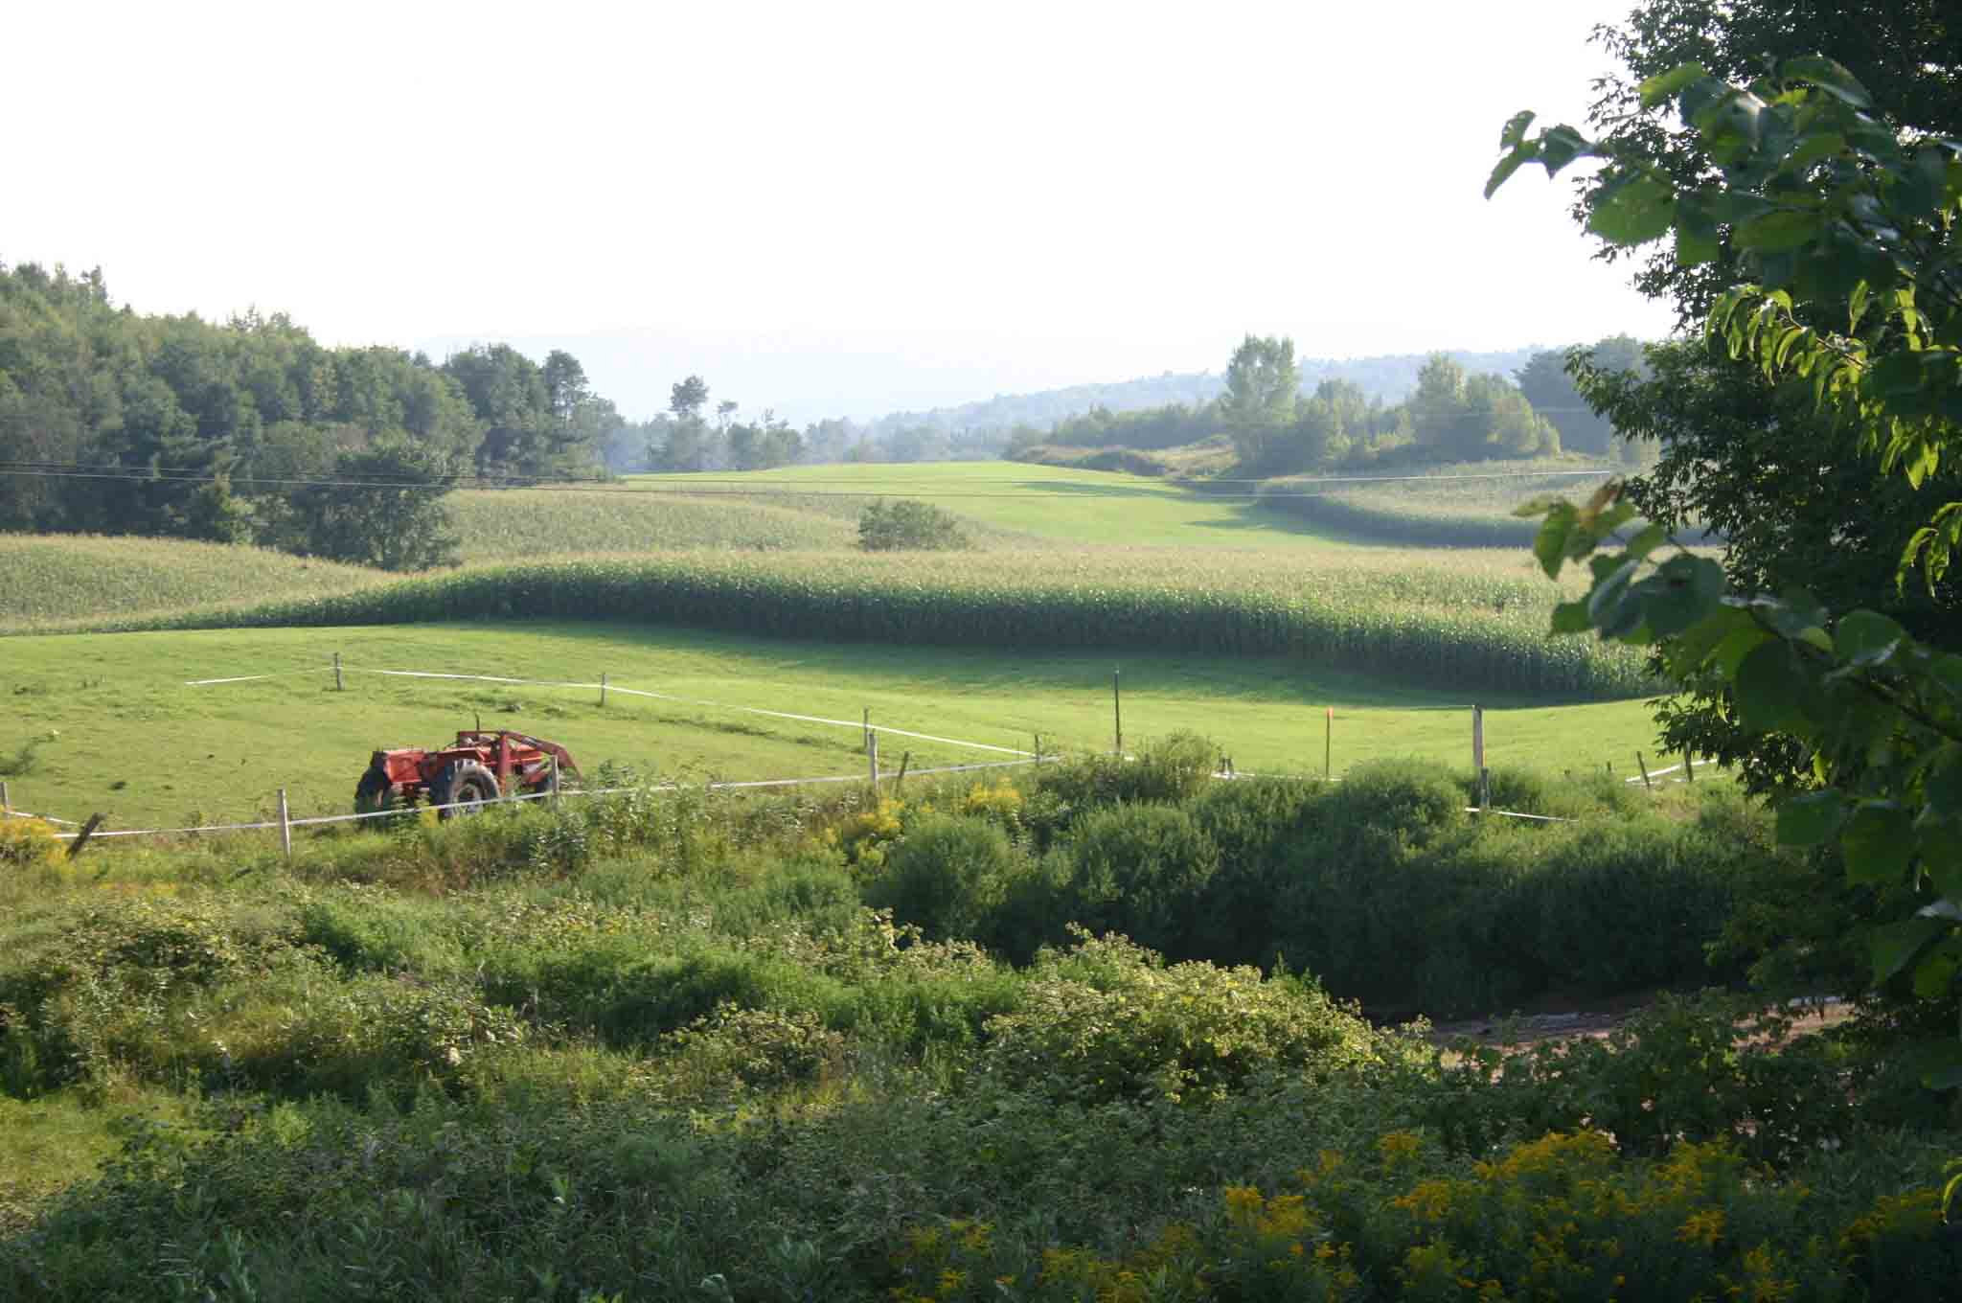
The Importance of Landscape, Family Ties, and Culture
Most Leavers feel homesickness for Vermont (82%)
They miss:
Landscape
Family
Vermont’s community and culture

Slide 9
Jobs, the Cost of Living, a Cold Climate and a Lack of Diversity
No reason for leaving dominates the leavers’ responses.
They express multiple and diverse reasons for leaving:
I can earn more money outside VT (35%)
My work is outside VT (30%)
VT’s cost of living is too high (24%)
VT’s cold weather is intolerable (21%)
I prefer to live in an area with greater cultural diversity (20%)

Slide 10
Gender and Educational Attainment Matter
Examples:
Among leavers, men are far more likely to say they believe they can make more money outside of VT
Leavers with lower educational attainment are far more likely to say Vermont’s cost of living is too high, and …
That Vermont’s cold weather is intolerable
Among stayers, women are far more likely than men to say they stayed to live near family

Slide 11
Key Questions
What can be done to make Vermont a more livable place for people with lower educational attainment?
How do encourage cultural diversity?
How might focusing on livable communities, inviting landscapes, and small size attract new residents who will stay?
What can we learn from in-migrants to Vermont?
How do we acknowledge the contributions of Vermonters who stay?

Slide 12
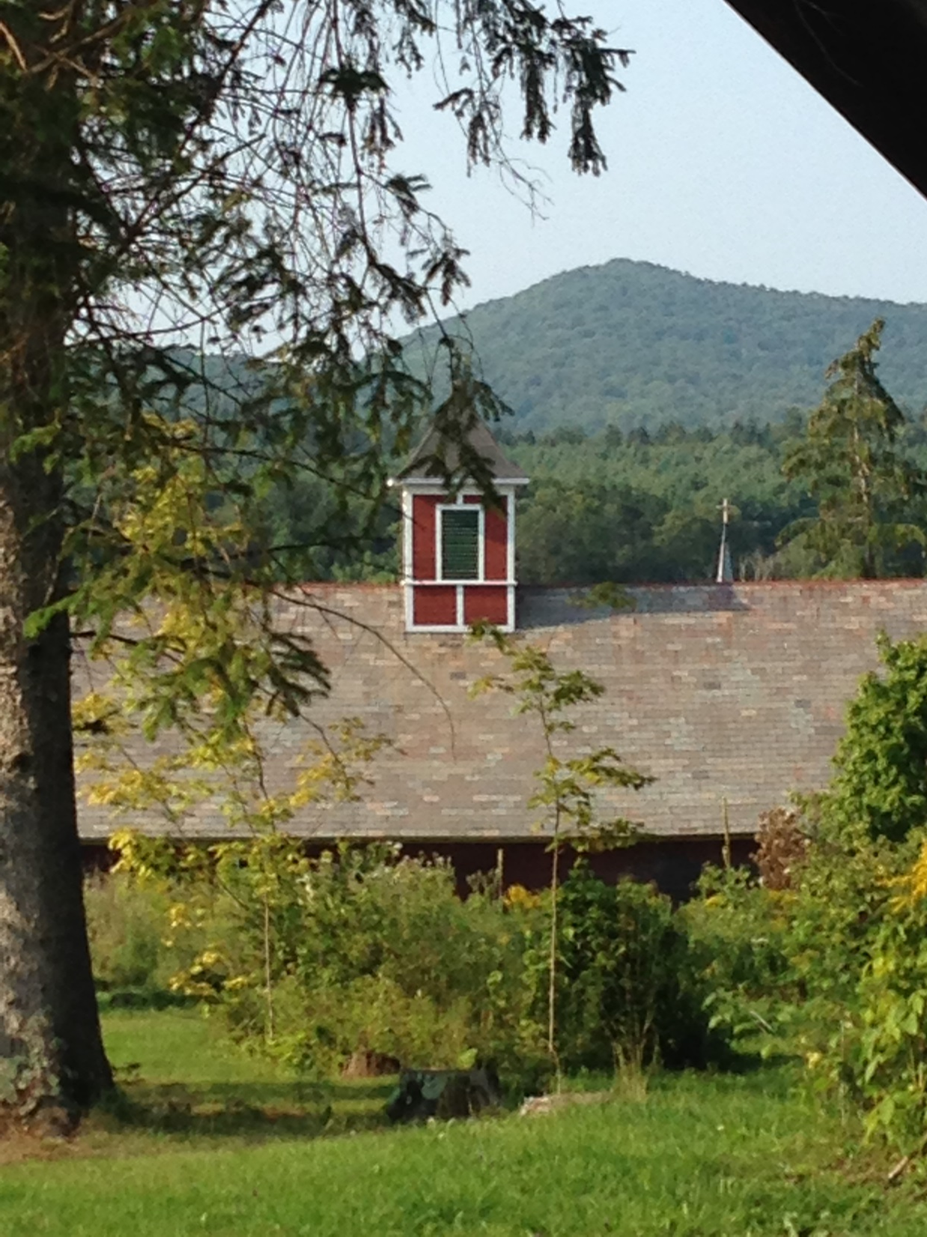
Cheryl Morse
cheryl.morse@uvm.edu

