Slide 1


Becoming Involved in Disaster Preparedness and Response in Your Community
Adapted from Natural Rural Behavioral Health Center (NRBHC)
In Production with University of Florida
Issued in furtherance of Cooperative Extension work, Acts of May 8 and June 30, 1914, in cooperation with the United States Department of Agriculture. University of Vermont Extension, Burlington, Vermont. University of Vermont Extension and U.S. Department of Agriculture, cooperating, offer education and employment to everyone without regard to race, color, national origin, gender, religion, age, disability, political beliefs, sexual orientation, and marital or familial status. August 2011.
Notes:
The UVM Extension Building Capacity project is designed around building leadership skills for Vermont’s nonprofit sector in the hopes of enhancing community development. In the aftermath of the May 2011 floods and Tropical Storm Irene, the Building Capacity team thought it was important to address community development opportunities for nonprofits, local businesses, volunteers, local relief committees etc. trying to recover from devastation. The following information will focus on the special concerns of rural communities in the face of disaster and how to manage when important needs, like feasible resources are limited. This information is adapted from Natural Rural Behavioral Health Center in production with the University of Florida. Also check out ‘Becoming Involved in Disaster Preparedness and Response in your Community’ for more community development resources for when disaster hits.

Slide 2
Before You Get Started
Find out about existing preparedness efforts in your community so you do not have to reinvent the wheel.
Irene Relief Aid and Resources:
http://www.efficiencyvermont.com/about_us/efficiency_vermont_news/Irene/general_info/irene_recovery.aspx
FEMA Recovery information for VT residents:
http://www.uvm.edu/extension/?Page=emergency_fema.html
Notes:
Need Links

Slide 3
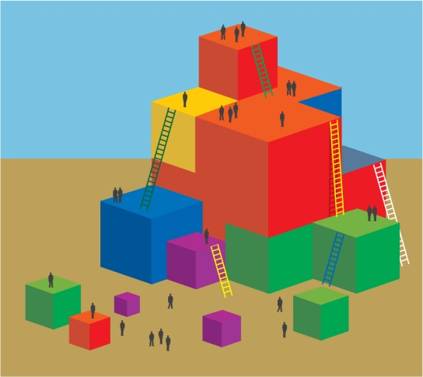
Before You Get Started
Determine how you can become involved in existing efforts and define your role in these efforts.
UVM Leadership & Civic Engagement:
http://www.uvm.edu/~vfwf/?Page=instructions/criteria.html&SM=instructions/sub-menu.html
American Red Cross (VT & NH)
http://www.redcrossvtnhuv.org/general.asp?SN=8084&OP=8098&IDCapitulo=44W8UXGL8L

Slide 4
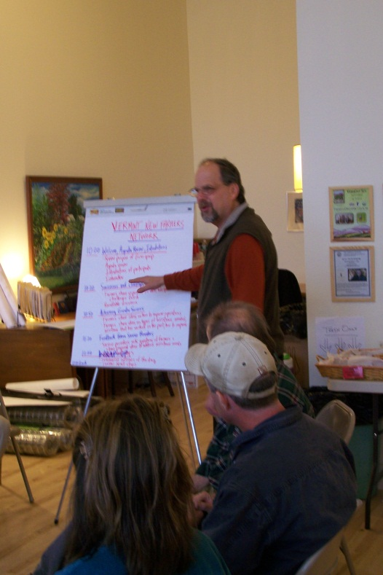
Roles for Community Professionals
Participate in emergency planning
Providing individual support to those
affected by a disaster
How to help support VT communities
affected by ‘Irene’
http://www.uvm.edu/extension/?Page=emergency.html#how_to_help
Notes:
links

Slide 5
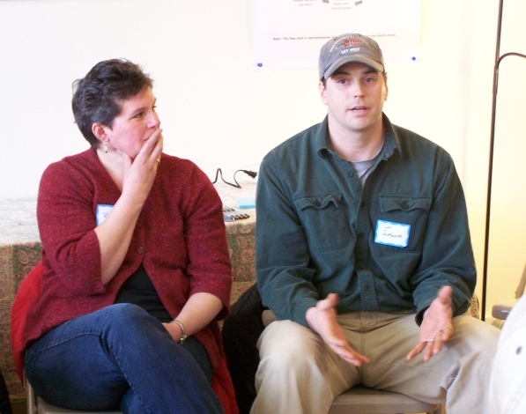
Training Your Community
Inform the community about the effects of disaster, warning signs for post-disaster stress, how to provide emotional support and stress management strategies.
Dealing with Disasters:
http://www.extension.iastate.edu/topic/recovering-disasters
Irene Recovery Effort website:
http://www.uvm.edu/~lce/

Slide 6
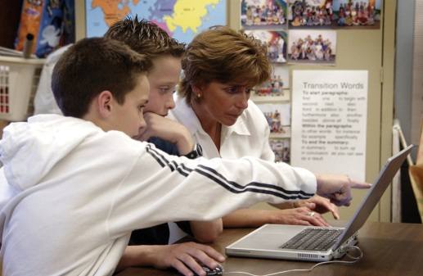
Educate Community Members
  Develop web-based and written educational materials
  Provide schools, work and faith based educational programs
  Develop media contacts
  Resources for Educators:
  http://www.uvm.edu/extension/?Page=emergency.html#schools
Notes:
links

Slide 7

Build Collaboration For Long-Term Recovery Services in the Community
  Rumor control
  Mental health services
  Economic supports
  Vermont Department of Health:
  http://healthvermont.gov/
  Vermont Response Blog:
  http://vtresponse.wordpress.com/

Slide 8
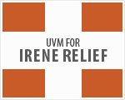
Participate in Emergency Planning
Contact community planners and found out how to become involved
Determine what knowledge and resources you have to lend after a disaster event
University of Vermont Emergency Management
http://www.uvm.edu/~emergncy/
Vermont 2-1-1
http://www.vermont211.org/
Notes:
Links: extension, red cross, united way

Slide 9


Participate in Emergency Planning
Build partnerships with local (Extension and CAP Agencies) and regional (Red Cross) helpers
UVM Extension Service:
www.uvm.edu/extension
American Red Cross (VT & NH)
http://www.redcrossvtnhuv.org/index.asp?IDCapitulo=44W8UXGL8L

Slide 10
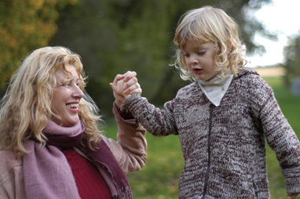
Provide Individual Support
Encourage use of healthy coping strategies and stress management techniques
Distributing information on the mental health effects of disaster and services available
Coping with Disaster:
http://www.mentalhealthamerica.net/go/information/get-info/coping-with-disaster
Notes:
Links: local mental health agencies

Slide 11

Provide Individual Support
Providing referrals to local mental health resources
VocRehab:
http://www.uvm.edu/~farmfam/
VT Department of Mental Health:
http://mentalhealth.vermont.gov/
Resources for parents and teachers:
http://www.ready.gov/kids/index.html
Notes:
Links to resources for trainings…

Slide 12

Contact Building Capacity: capacity@uvm.edu
For more information about UVM Extension’s Building Capacity programs, visit our website:
http://www.uvm.edu/extension/community/buildingcapacity/

