Slide 1
THE NCC Credential and the national counselor examination
Becoming a National Certified Counselor

Slide 2
What is the NCC?
A PORTABLE credential
A demonstration of QUALITY
An affirmation of commitment to the counseling profession

Slide 3
The NCC Credential is NOT…
The same as state licensure
“Just a test”

Slide 4
What are the main requirements for the NCC?
A completed master’s degree in counseling (with a minimum of 48 semester hours)
A passing score on the National Counselor Exam (NCE)
Submission of an sealed official transcript

Slide 5
Why do I want the NCE?
It’s a resume booster (the NCC is a lucrative credential, especially when held early on in your career)
You may find it useful to have while waiting to meet state licensure
You could get paid more. Some states award salary supplements to NCC holders

Slide 6
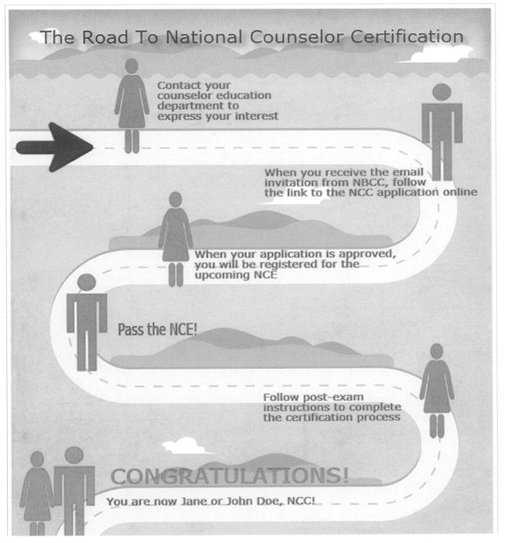
Overview of NCC Application Process

Slide 7
What will happen after I sign up to take the NCE?
You will receive an “invitational e-mail” from the NBCC that will guide you through the application process.
  *NOTE you must apply to take the NCE online, simply signing up with the counseling program will not register you to take the test.
The following slides will show you what to expect when you complete the online application process

Slide 8
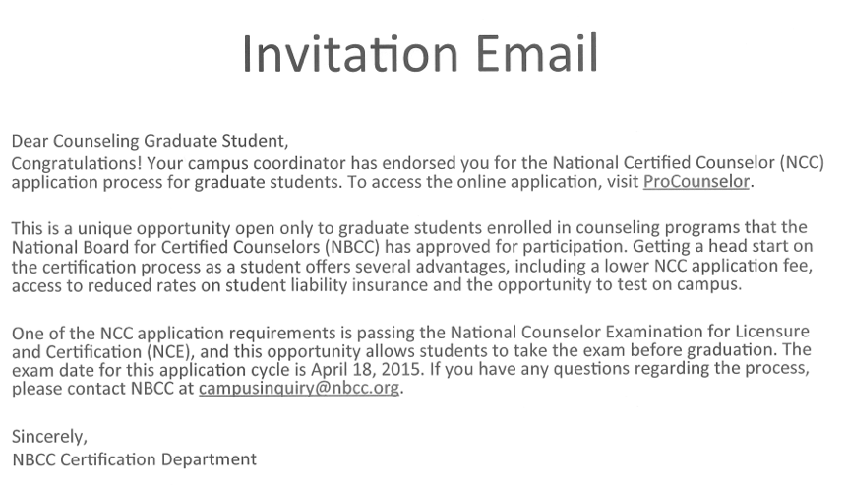
The Initial E-mail
Notes:
Once you register to take the NCE with the Graduate Counseling Program, we will send your name to the National Board of Certified Counselors. The National Board of Certified Counselors will then send you an e-mail (see above)

Slide 9
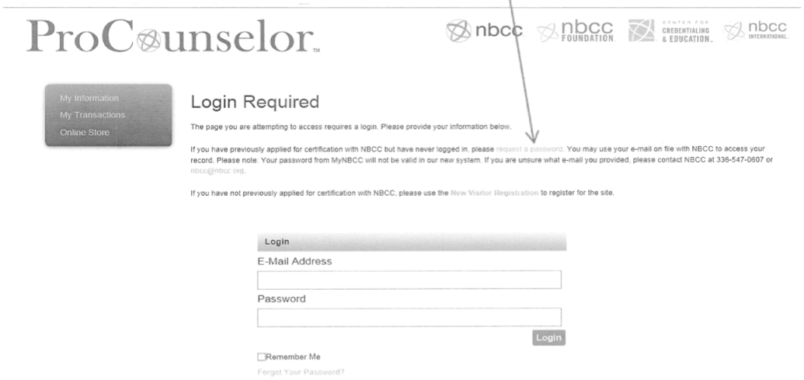
Getting Started
Notes:
The e-mail from the NBCC will contain a link with instructions for you to REGISTER ONLINE to take the NCE. Merely signing the roster with the counseling program will not allow you to take the NCE, you must also register with the NBCC through the link that will be sent to you.

Slide 10
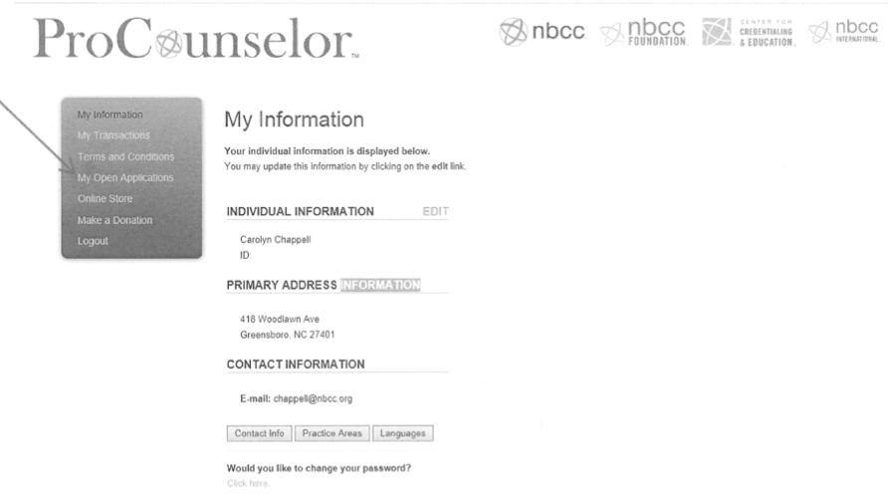
Once You Log In

Slide 11
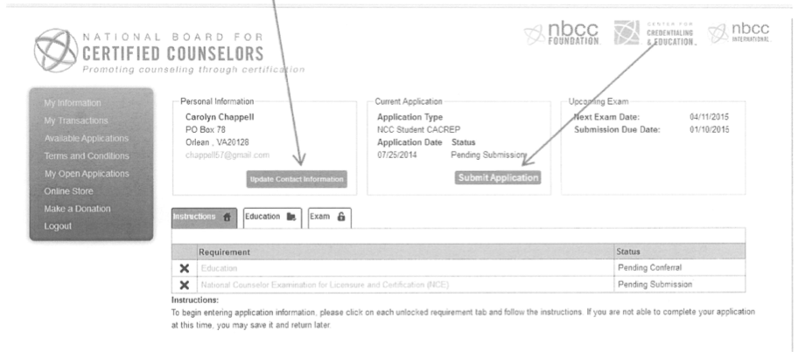
The Application Process

Slide 12
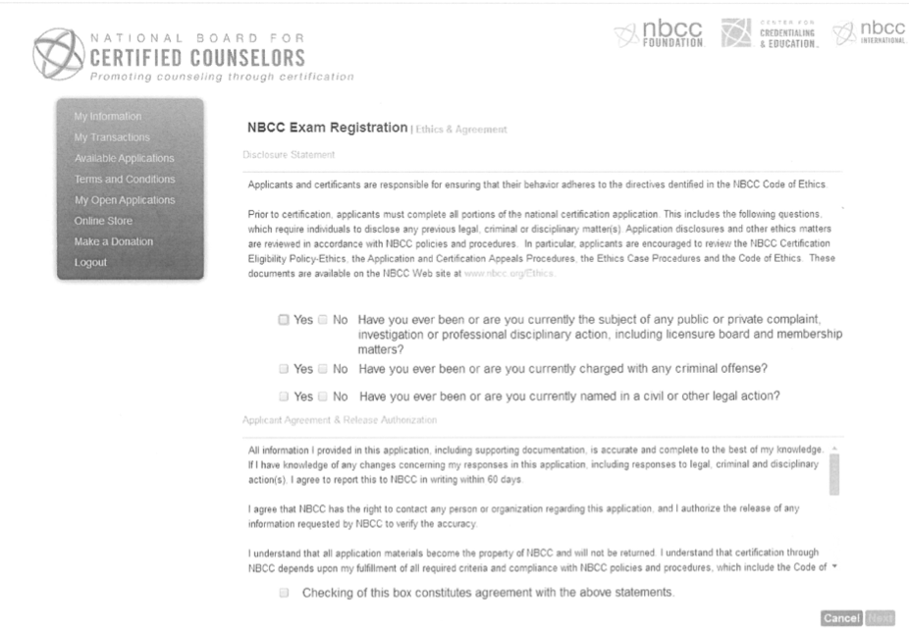
Ethics Disclosure & Application Agreement
Notes:
In the event that you need to answer “Yes” to one of the above questions, you should contact the NBCC with a letter explaining the reason for your response. The NBCC can inform you to whom to direct your letter.

Slide 13
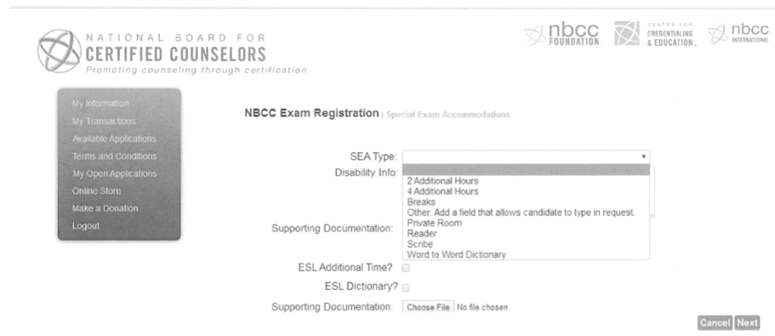
Special Exam Accommodation Requests (SEAs)
Notes:
Special accommodations for the exam can be provided for those who require them

Slide 14
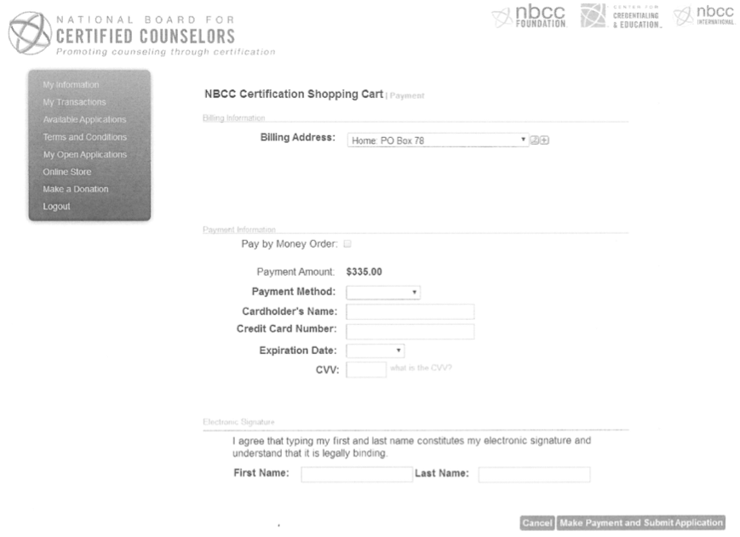
Payment
Notes:
The current cost of the NCE will be indicated on the on-line application. The cost tends to go up every few years.

Slide 15
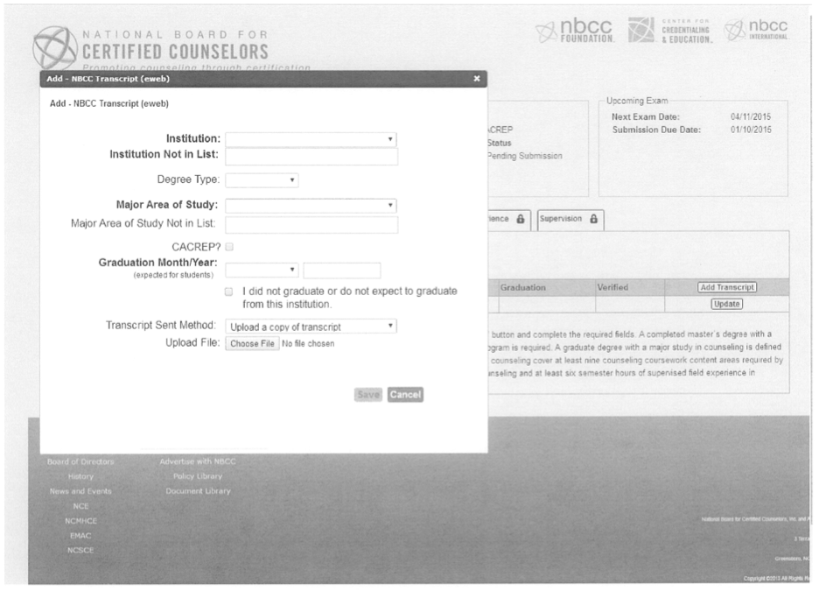
Completing the Process

Slide 16
After Submitting the Application
You will receive a pre-exam E-newsletter from NBCC and an examination admission letter with NBCC ID # and information on where the exam is given.
Take the National Counselor Exam
Depending on whether you pass or fail, NBCC will provide instructions on how to proceed.

Slide 17
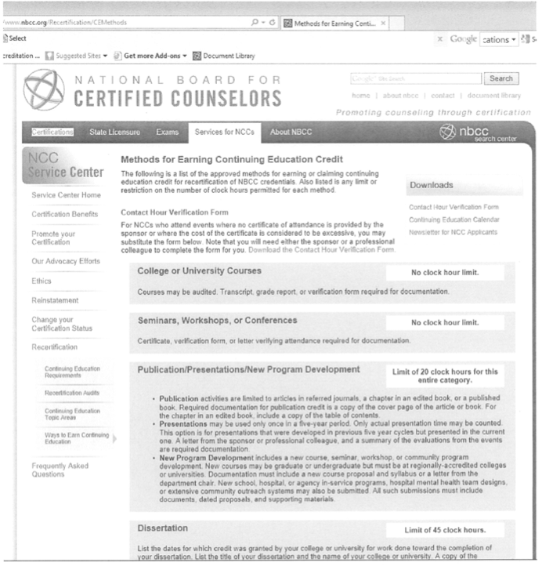
Maintaining Your Certification
Notes:
Note: $75.00 annually to maintain good standing.

